Slide 1
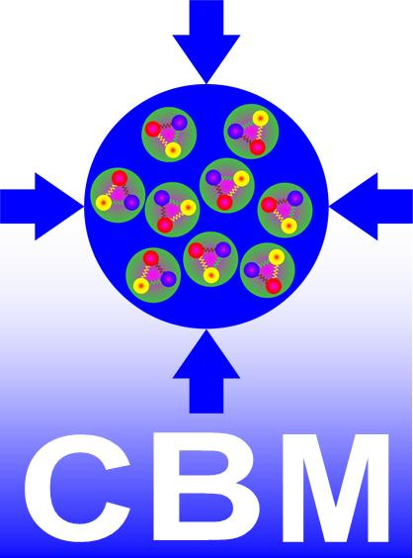


The CBM experiment at FAIR
− Overview of detector and technologies −
Johann M. Heuser, GSI, Darmstadt
J-PARC Heavy-Ion Seminar – November 10, 2022
Facility for Antiproton and Ion Research
Compressed Baryonic Matter Experiment

Slide 2
Outline
very brief reminder of the physics aim of CBM
out of which the proposed experiment structure follows
and the chosen detectors and technologies
before we then overview those, a brief look at the status of
FAIR and the site construction
finally, a short selected look at the demonstrator setup
mCBM is made
… all sticking to a personal selection and depth of the matter,
as the topics are quite extensive …

Slide 3
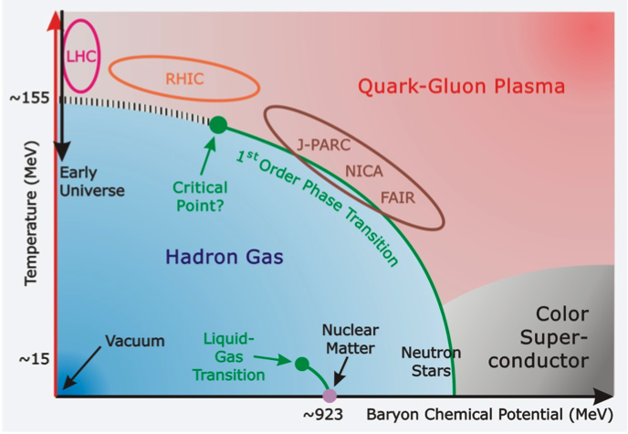
Physics aim
Systematic exploration of QCD matter at large baryon densities, with high accuracy and (rare) probes.
Equation-of-state, phases
Hadron yields, collective flow, correlations, fluctuations
(Multi-)strange hyperons (K, Λ, Σ, Ξ, Ω)
production at (sub)threshold energies
Chiral symmetry
In-medium modifications of light vector mesons
ρ, ω, φ → e⁺+e⁻ (μ⁺+μ⁻) via dilepton measurements
Hypernuclei
Charm production
Excitation function in p+A collisions (J/ψ, D⁰, D±)
Charmonium suppression in cold nuclear matter

Slide 4
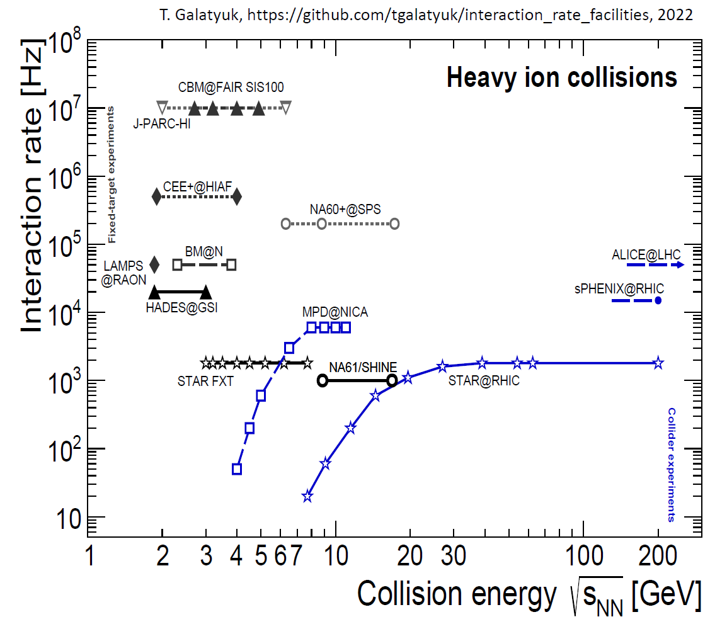
Physics aim
Systematic exploration of QCD matter at large baryon densities, with high accuracy and (rare) probes.

Slide 5
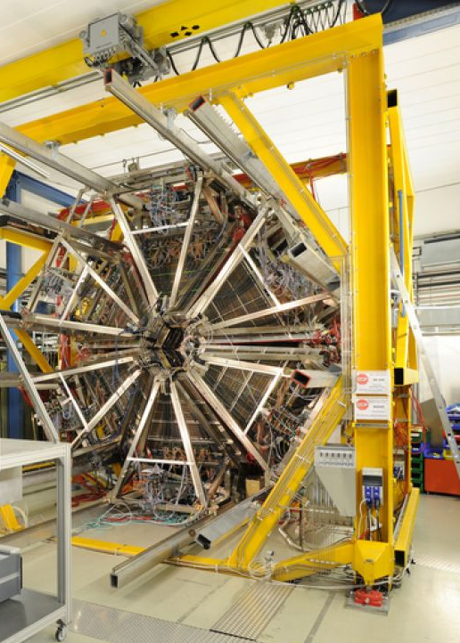
CBM and HADES experiments at SIS100
CBM
forward spectrometer
polar angular acceptance 2.5° < Θ < 25 °
full azimuthal coverage
configurations:
Hadron-Electron
Hadron-only
Muon
core functionality in all:
silicon tracking
in dipole magnetic field
components laid out for
heavy systems (like Au+Au)
full event reconstruction
up to (peak) interaction rate 10⁷/s
HADES SIS18 → SIS100
CBM-HADES
sharing of same beamline
different target positions
different running times (HADES beam dump between CBM and HADES)

Slide 6
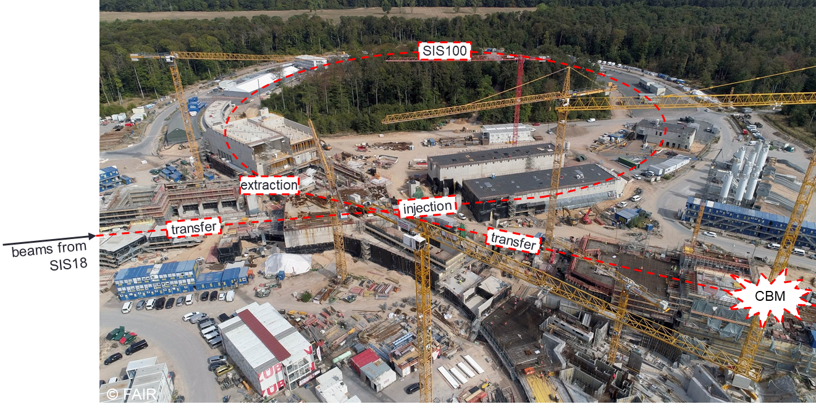
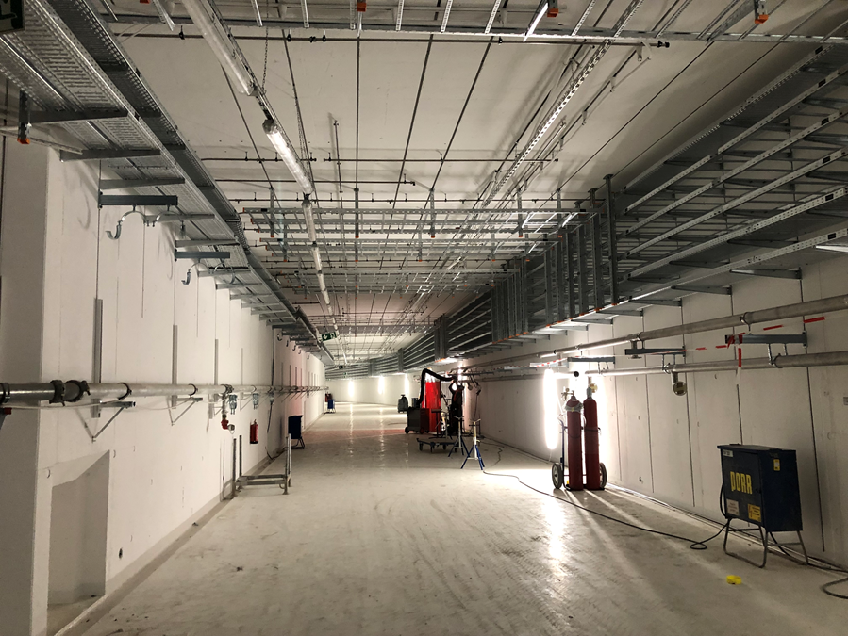
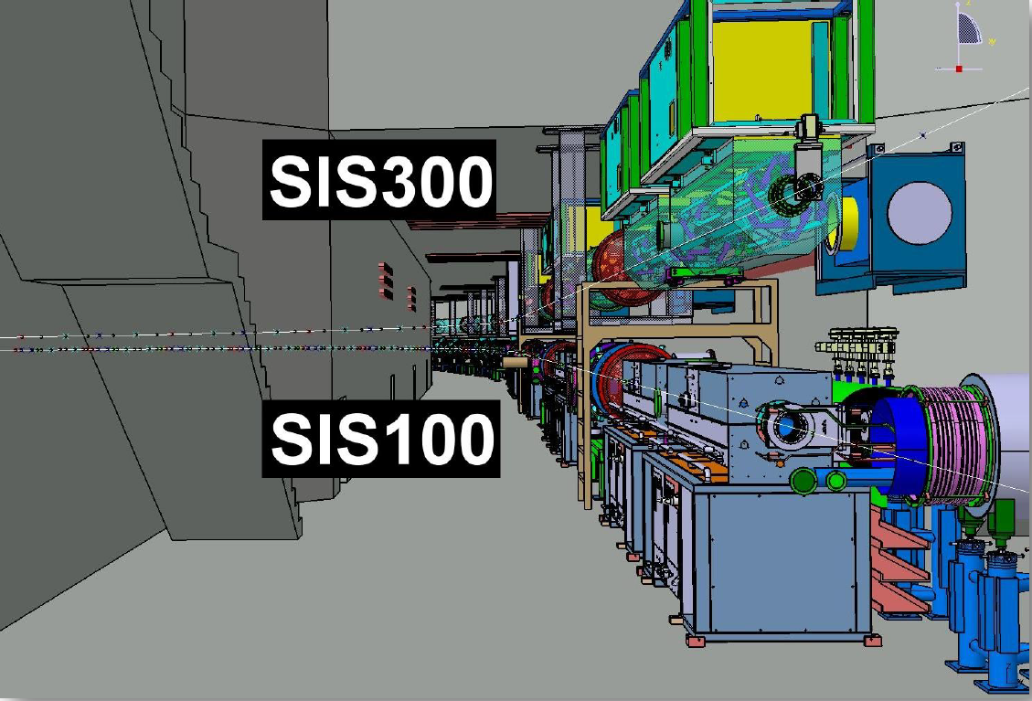
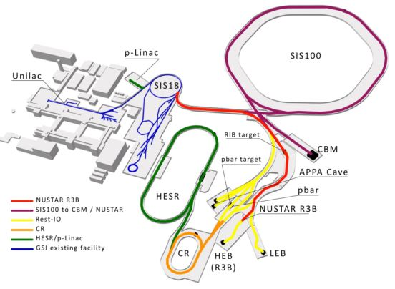
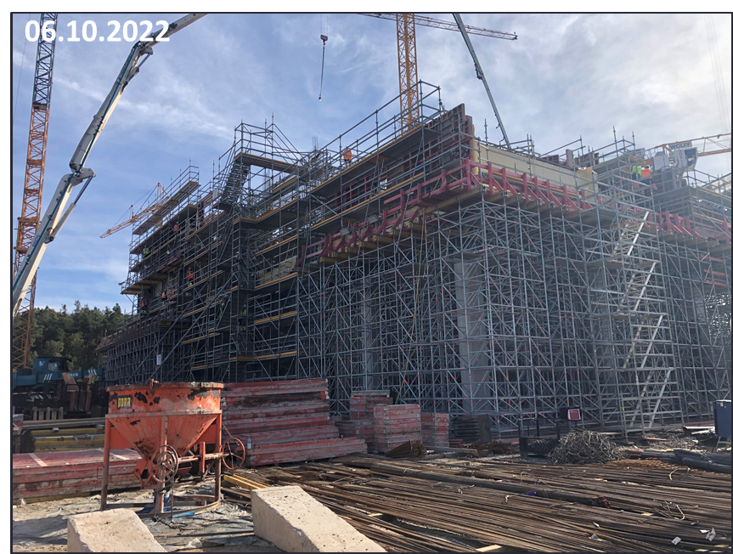
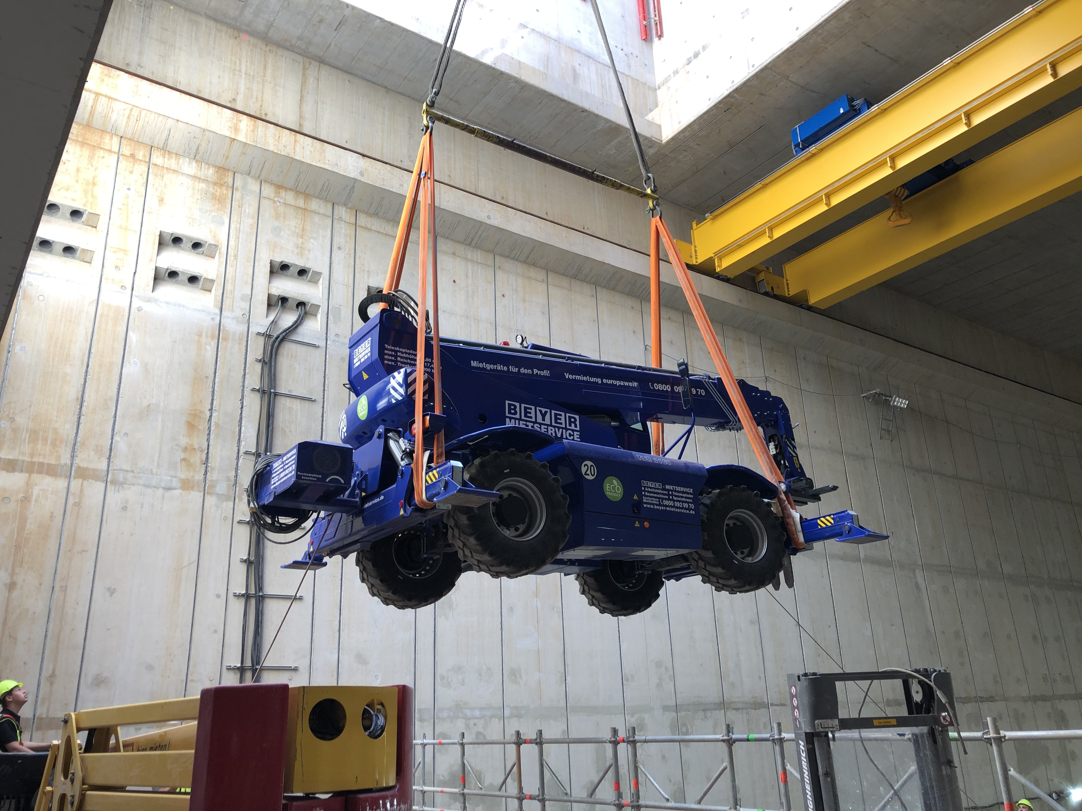
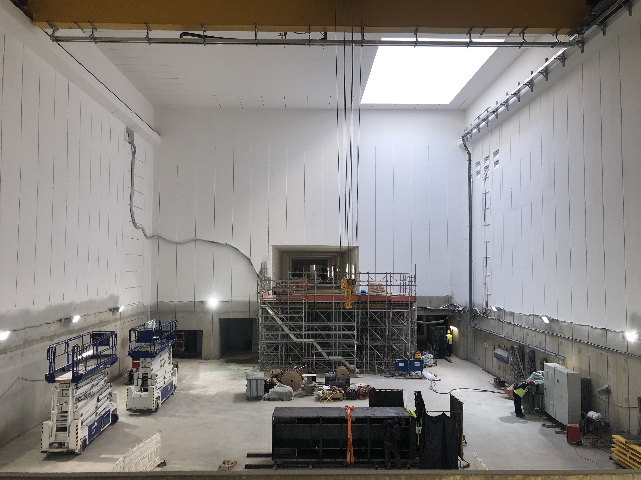
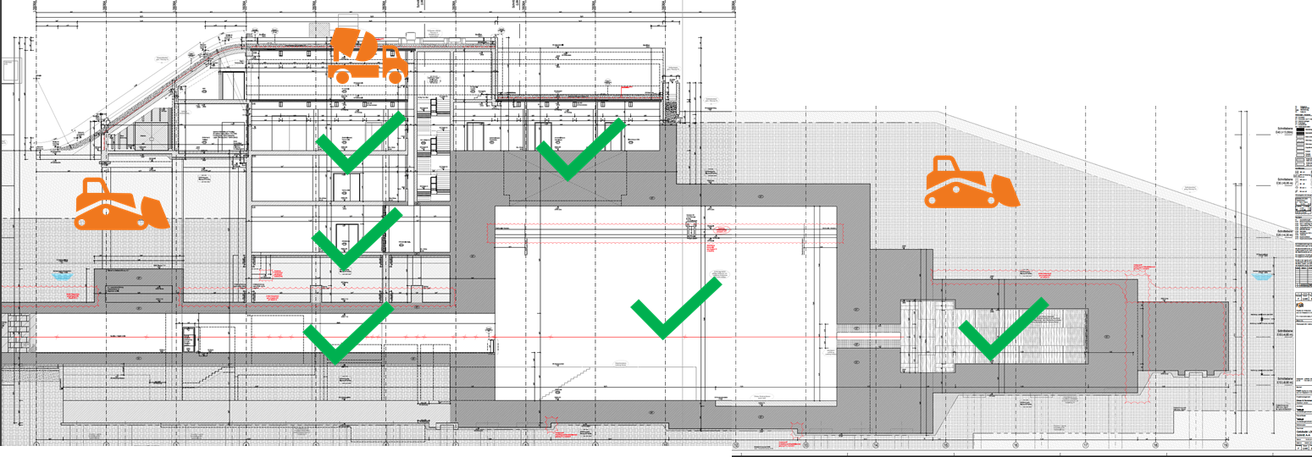
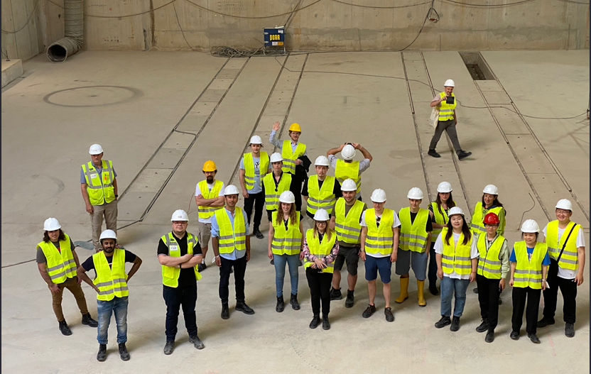
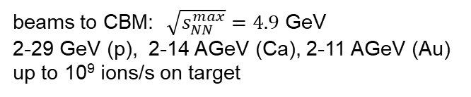
FAIR and CBM sites under construction
Fall 2022
SIS100 tunnel
CBM building
CBM cave
beams to CBM: $\sqrt{s_{NN}^{max}}=4.9$ GeV
2-29 GeV (p), 2-14 AGeV (Ca), 2-11 AGeV (Au)
up to 10⁹ ions/s on target

Slide 7
FAIR and CBM sites under construction
Fall 2022
SIS100 tunnel
Civil construction proceeds well:
SIS 100 tunnel completed
transfer building
CBM building
NUSTAR sites …
further installations open
Accelerator components:
many available (SIS100 dipole magnets)
others (quadrupoles, …) impacted by sanctions due to
Russia’s war on Ukraine
News, next steps: Scientific Review report, FAIR Council 12/2022
CBM building
CBM cave
beams to CBM: $\sqrt{s_{NN}^{max}}=4.9$ GeV
2-29 GeV (p), 2-14 AGeV (Ca), 2-11 AGeV (Au)
up to 10⁹ ions/s on target

Slide 8
A walk through the detector systems
MUCH
(park position)
SC Dipole Magnet
configurations:
Hadron-Electron
MVD, STS, RICH, TRD, TOF, PSD
Hadron-only
Muon
beam dump
HADES
Micro Vertex Detector (MVD)
Silicon Tracking Systen (STS)
Ring Imaging Cerenkov Counter (RICH)
Transistion Radiation Detector (TRD)
Muon Chambers (MUCH)
Time-of-Flight system (TOF)
Projectile Spectator Detector (PSD)
Data Acquisition System (DAQ)
PSD
TOF
TRD
RICH
STS
MVD
target
DAQ
~ 20 m

Slide 9
A walk through the detector systems
MUCH
(park position)
SC Dipole Magnet
configurations:
Hadron-Electron
Hadron-only
STS, RICH, TRD, TOF
Muon
beam dump
HADES
Micro Vertex Detector (MVD)
Silicon Tracking Systen (STS)
Ring Imaging Cerenkov Counter (RICH)
Transistion Radiation Detector (TRD)
Muon Chambers (MUCH)
Time-of-Flight system (TOF)
Projectile Spectator Detector (PSD)
Data Acquisition System (DAQ)
PSD
TOF
TRD
RICH
STS
MVD
target
DAQ
~ 20 m

Slide 10
A walk through the detector systems
SC Dipole Magnet
RICH
(park position)
configurations:
Hadron-Electron
Hadron-only
Muon
STS, MUCH, TRD, TOF, PSD
beam dump
HADES
Micro Vertex Detector (MVD)
Silicon Tracking Systen (STS)
Ring Imaging Cerenkov Counter (RICH)
Transistion Radiation Detector (TRD)
Muon Chambers (MUCH)
Time-of-Flight system (TOF)
Projectile Spectator Detector (PSD)
Data Acquisition System (DAQ)
PSD
TOF
TRD
MUCH
STS
MVD
target
DAQ
~ 20 m

Slide 11
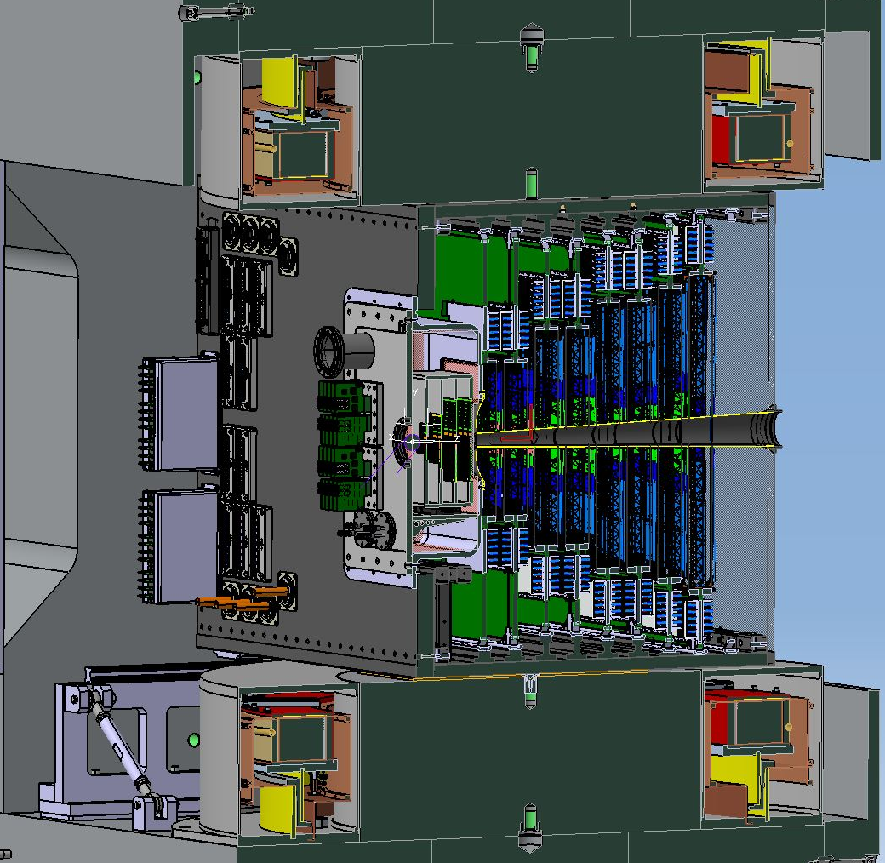
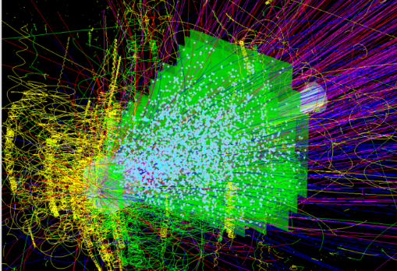
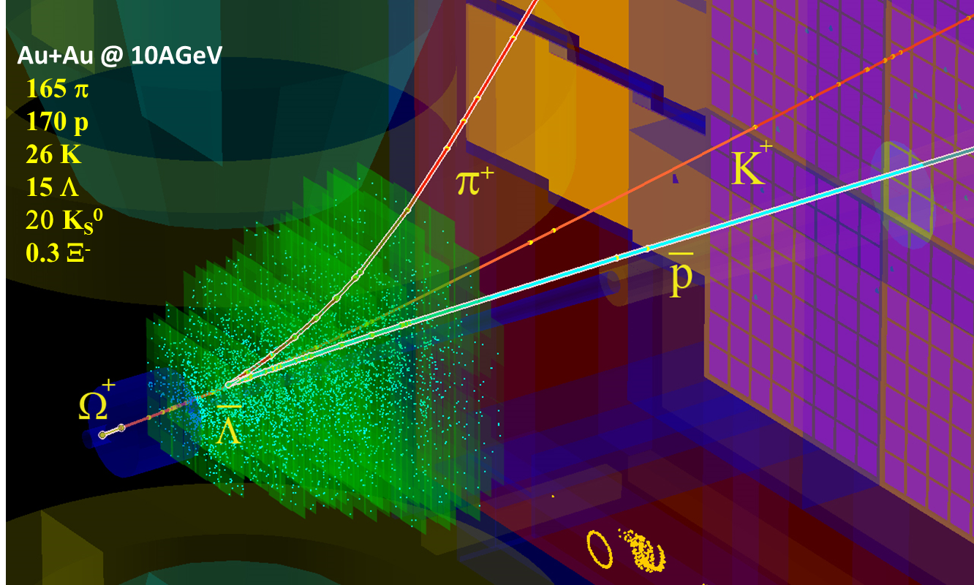
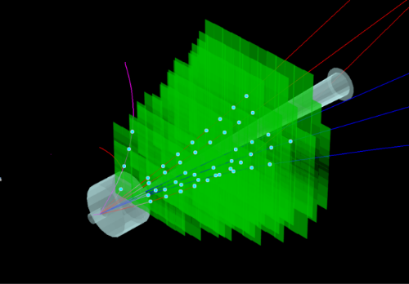
Silicon Tracking System
UrQMD + GEANT + CbmRoot
Main CBM detector for charged particle measurement incl. momentum determination.
track point measurement in high-rate collision environment:
10⁵ − 10⁷/s (A+A), up to 10⁹/s (p+A)
physics aperture, position in dipole magnet:
  ≈ 2.5° ≤ Θ ≤ 25°, 0.2 m ≤ Δz ≤ 1.1 m
  first four stations wider for better low-momentum particle detection (e.g. di-lepton program)
8 tracking stations
  radiation hard for several years of operation
  double-sided silicon microstrip sensors
  hit spatial resolution ≈ (x) 15 µm, (y) 110 µm
self-triggering front-end electronics
  time-stamp resolution ≈ 5 ns
material budget: ≈ 0.3% – 1.5% X₀ per station
  Δp/p < 2% (p > 1 GeV/c, 1 Tm field integral)
STS
target
central Au+Au, 8 AGeV
MVD
beam
pipe
2.5°
25°
in-STS decay, Au+Au, 10 AGeV
Dipole magnet: H-shape, 320 t, warm iron yoke/poles, cylindrical super-conducting coils in two separate cryostats with LHe cooling
opening: 144 cm (H), 300 cm (W), ≈ 120 cm (L)
coils: Nb-Ti filaments in copper matrix; 1749 turns
operating current 686 A, max. magnetic field in coils 3.25 T
p+C, 29 GeV

Slide 12
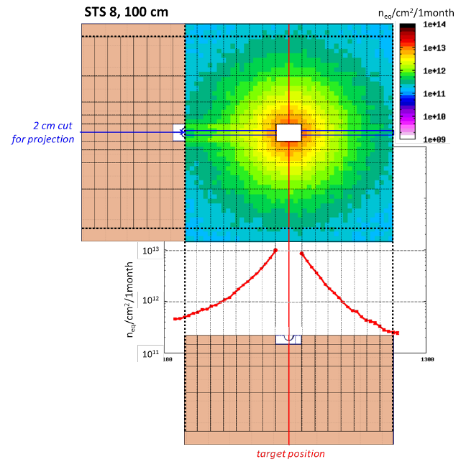
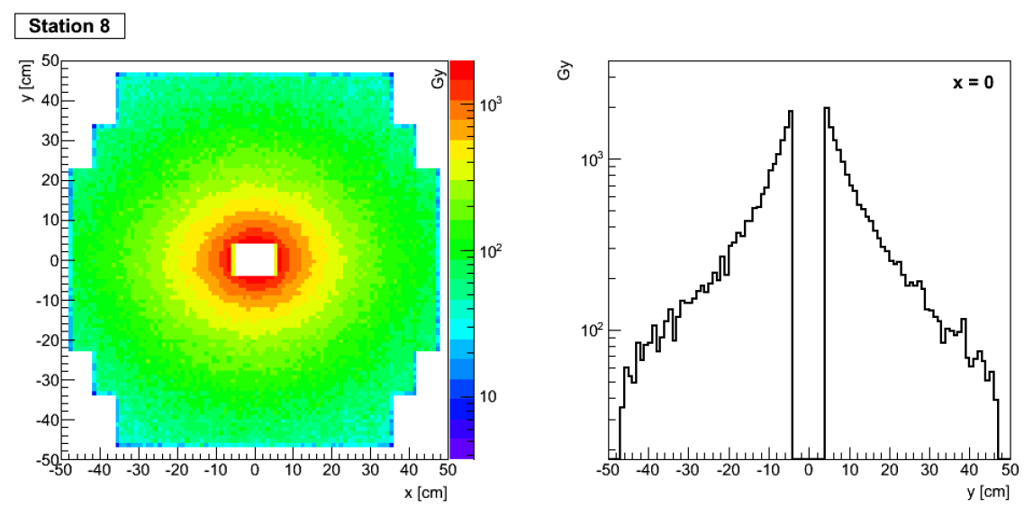
Environmental conditions for STS
Non-ionizing dose (FLUKA)
Total ionizing dose (UrQMD/CBMRoot/GEANT3)
25 GeV/u Au+Au collisions;
SIS300, CBM experiment in muon configuration.
1 month of “standard” running
corresponds to 10⁹ Au ions/s
on a 250 µm Au target yielding 2.6 x 10¹³ interactions
in its 1% nuclear interaction length.
25 GeV/u Au+Au collisions;
SIS300, CBM experiment in muon configuration.
5 x 10¹³ interactions;
Delta electrons produced at
the target not included.
Sensors:
< 10¹⁴ 1 MeV n_{eq}
over lifetime
→ cooling to -10 °C
Electronics:
< 1 Mrad over lifetime
→ locate at detector
periphery

Slide 13
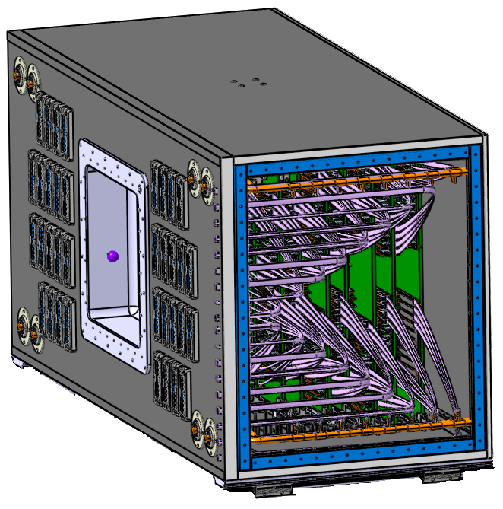
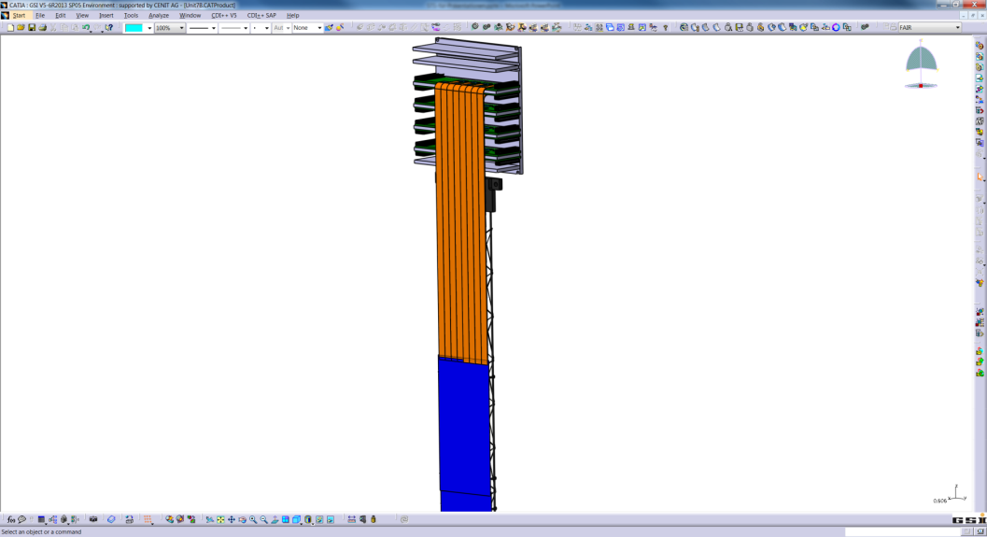
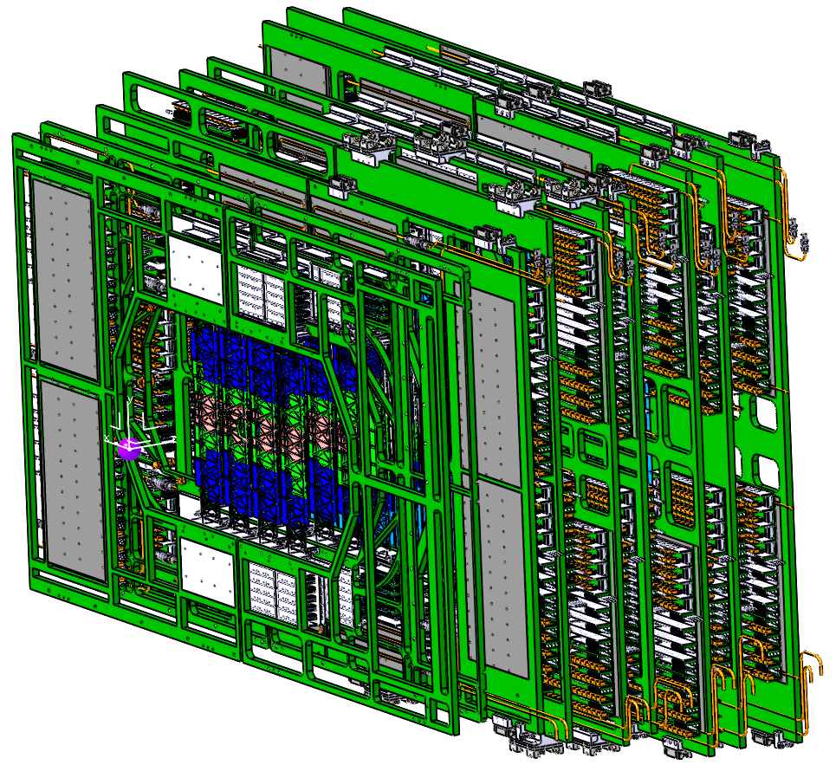
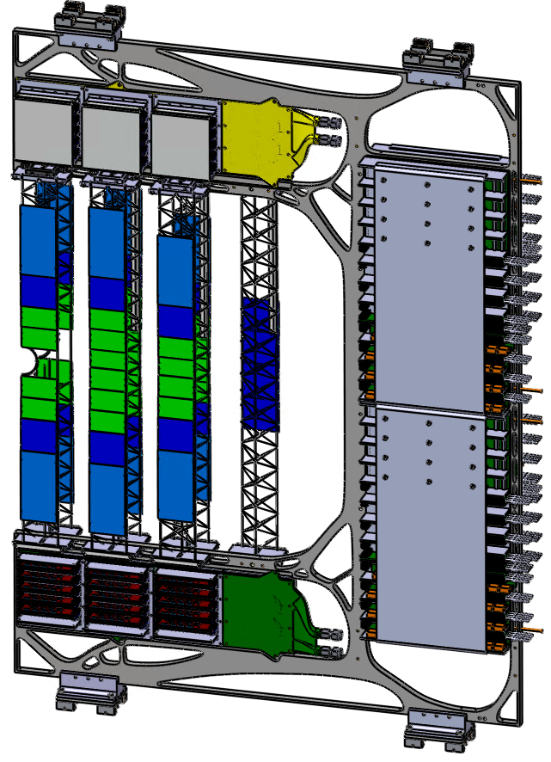
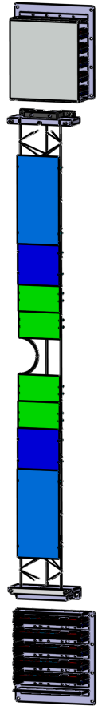
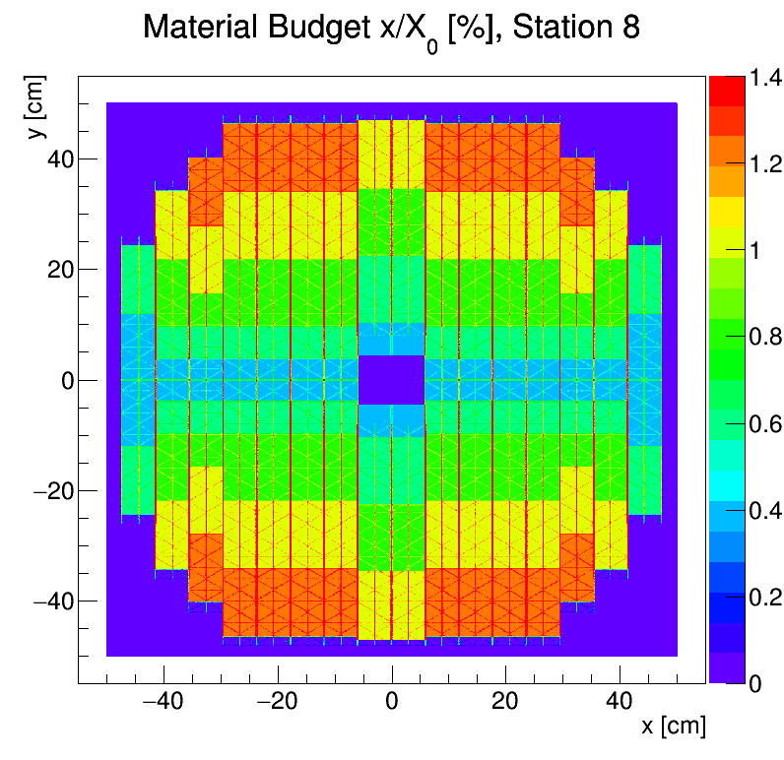
STS breakdown
system integrated in
thermal enclosure
sensors at T ~-10 °C (gas cooling)
electronics cooling through thermal interfaces (liquid NOVEC,
T > -40 °C)
services/ massive materials located at the periphery
includes target box, beam pipe
front-end electronics board
in cooling shelves
876 modules
in 132 variants
1.4 m
    module:
    2 x FEBs à 8 r/o ASICs/128 ch.
    2 x 8 ultra-thin read-out cable stacks
    double-sided silicon micro-strip sensor, 1024 strips per side
    system:
    ~ 1.8 million read-out channels
    ~ 14 000 r/o ASICs “STS-XYTER”
    ~ 40 kW power dissipation incl. all
    r/o + power electronics
sensor
ultra-thin
r/o cables (“micro cables”)
many components of unique design, precisely matching their specific location
2.3 m
1.0 m
front-end electronics
C-frame
material budget/station [%X₀]
FEE
read-out + power electronics
8/10 modules on CF support
8 tracking stations
18 mechanical half-units
106 ladders in 41 variants

Slide 14
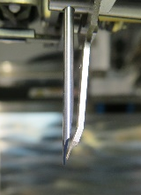
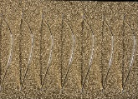
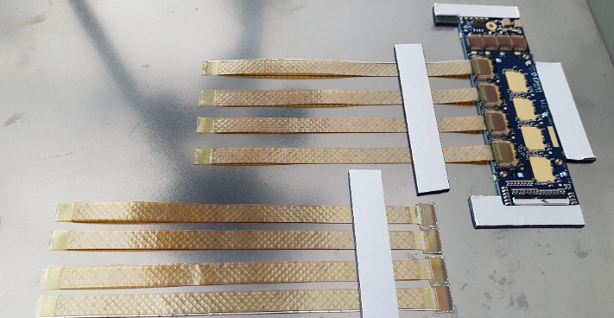
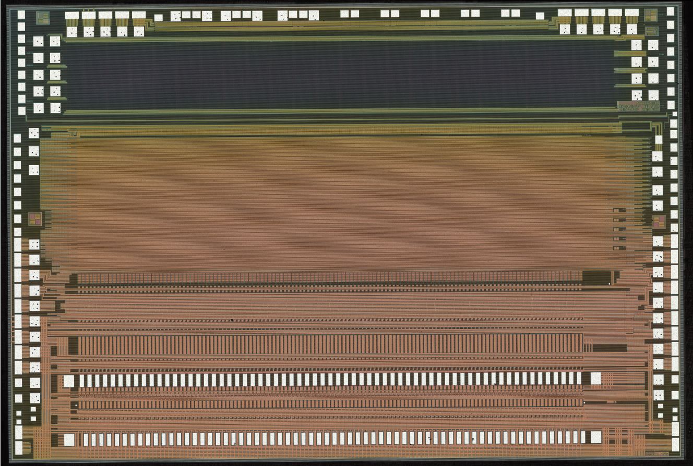
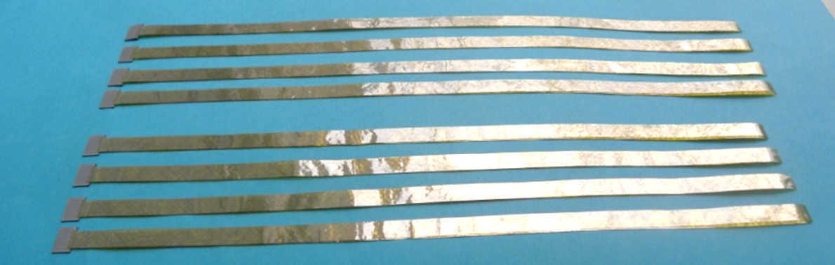
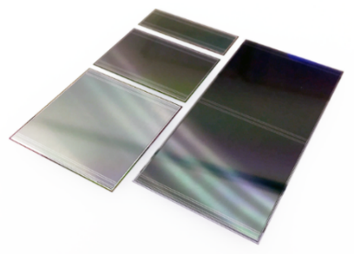
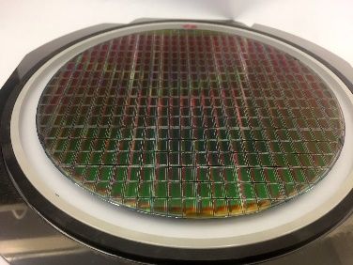
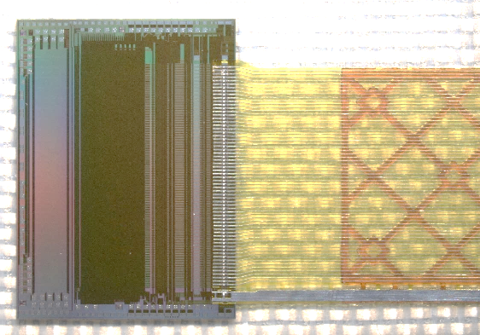
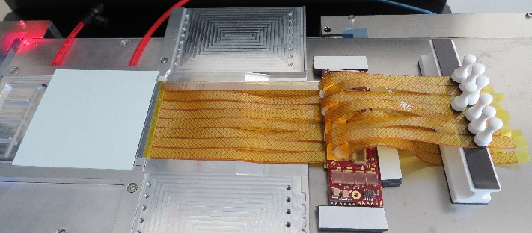
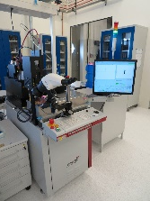
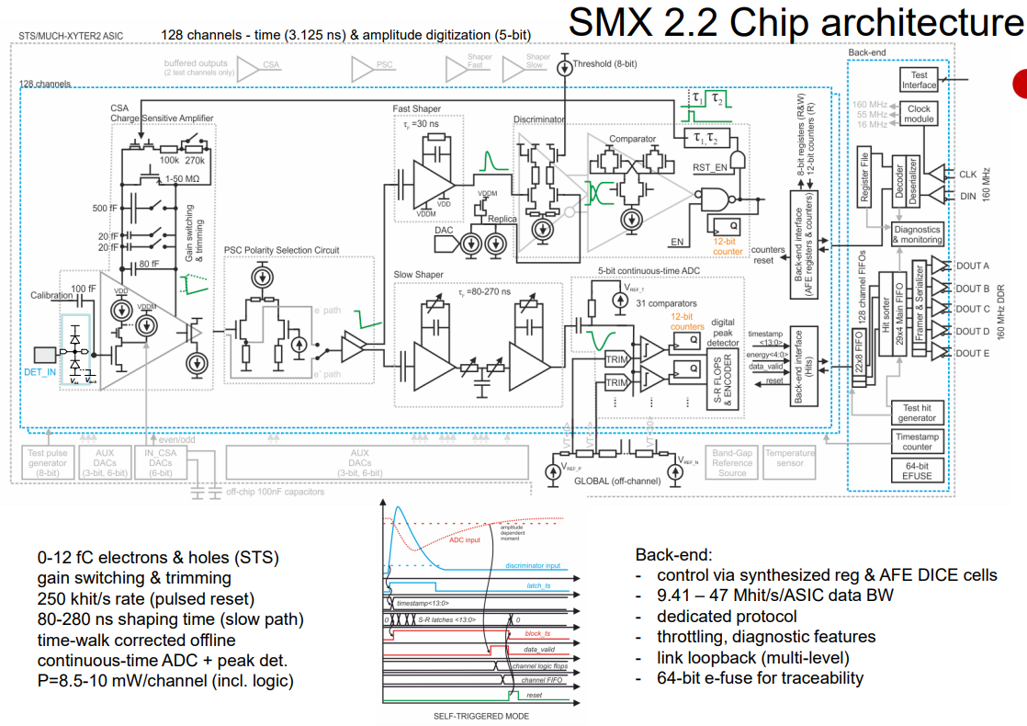
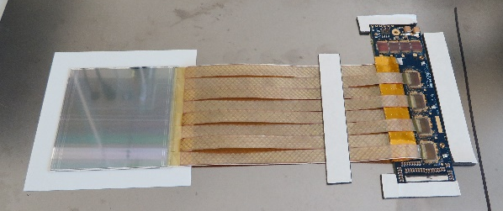
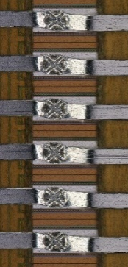
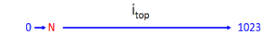
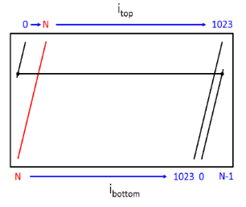
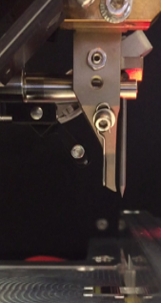
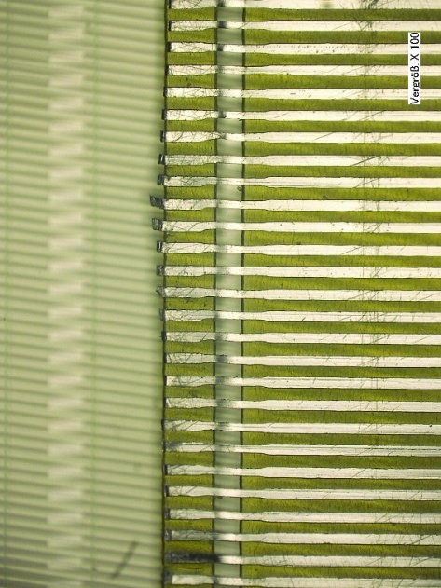
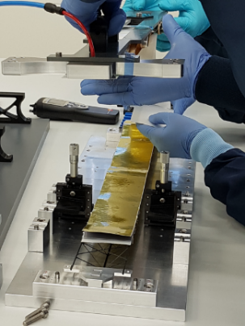
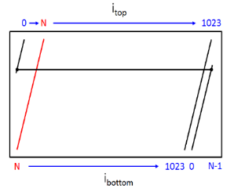
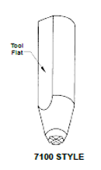
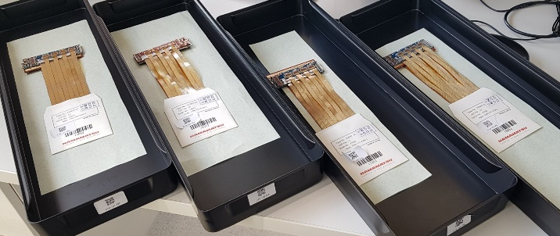
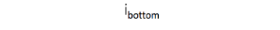
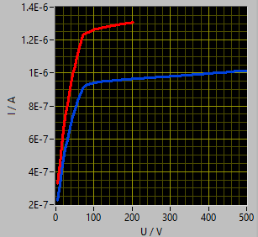
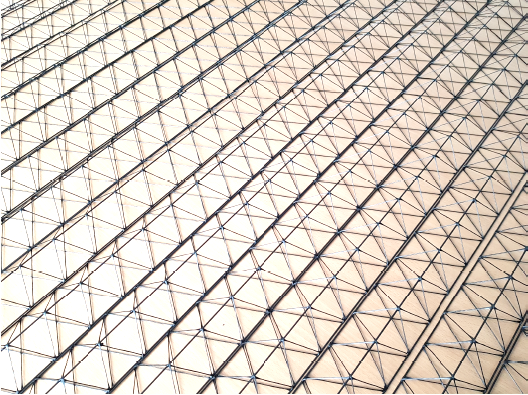

Sensor, FEE, microcables, assembly
Al wire (typ. 25 µm ∅ )
FEB
wedge tool
arXiv:1506.05168
wire bonding
microcables + chip
microcables: Al-polyimide, 2× 14+10 µm thick
Hamamatsu
  type n, 320 ± 15 µm
  resistivity < 8 kOhm·cm
  double-sided, 0/7.5° strip angle
  p-side with 2nd metal routing
  1024 channels/side , 6 cm wide
  strip pitch 58 µm; AC read-out
  strip lengths: 2/4/6/12 cm
UMC 180 nm
ASIC
SMX2.2, a 128 Channel, Event-Driven Tracking Chip for Silicon and Gaseous Detectors
Delvotec G5
TAB bonding
module, pre-series assembly
ladder
vendor (~25 C)
GSI (~22 C)
tab tool
Al traces
20 µm wide, at 166 µm pitch
fast path: timing 3.125 ns
slow path: amplitude measurement 0-12 fC, 8bit ADC
P=8.5-10 mW/channel (incl. logic)
data rate: 9.41 – 47 Mhit/s/ASIC
radiation hardness
sensor

Slide 15






STS – performance simulations
primary-track efficiency
momentum resolution
STS top view – MC hits
> 97%
target
Au+Au, 12 AGeV/c, 1 T
Au+Au, 12 AGeV/c, 1 T
p_{T} – y coverage
Bx,y [T]
position in magnetic field
GEANT model with active and passive materials (v21e)
-40
-20
0
20
40
60
80
z [cm]

Slide 16








Micro Vertex Detector
Material budget:
  O(0.5 %) (x/X0) /station
  First station in VX:
  O(0.3 %) (x/X0)
MIMOSIS 1: full-scale prototype
state-of-the-art MAPS technology
Monolithic Active Pixel Sensors
operating in target box vacuum ∼ 10⁻⁴ mbar
~300 CMOS sensor chips
extends momentum reconstruction for charged particles down to about 300 MeV/c
enables secondary vertex reconstruction for weak decays of charmed hadrons,
precision significantly better than 100 μm
for decay products with p_{lab} > 1 GeV/c, benchmarked by the D mesons (lab) life time.
from standard MAPS
to modified with gap
≈ 5 µm spat. resol.
→ ~ 10⁵coll./s
≈ 150 W total
Radiation hardness > 7 × 10¹³ n/cm², > 1 Mrad
(back/top biasing)
Operation temperature -10 C → liquid NOVEC cooling
CVD diamond / TPG carrier for heat evacuation to heat sink

Slide 17






Ring Imaging Cherenkov Detector
CBM MAPMTs in HADES RICH
Cherenkov Radiation: Charged particle travelling faster
than speed of light in the respective medium radiates
light at Cos(Θ) = 1/(n β) = v_{l}/v_{p} → threshold Cherenkov
emitted light may be focussed onto a circle with r_{circ}~ Cos(Θ) ~ 1/v_{p}
RICH signature + momentum reveals particle type
→ di-electron + hadron programs
CO₂ radiator gas, vessel volume
2.2 × 6 × 5.06 m³ (l × w × h) = 67 m³
  p-threshold 4.65 GeV/c, n=1.00045, UV cutoff 180 nm
13 m² segmented glass mirrors
with reflective Al and protective MgF₂ coating
80 tiles, 6 mm thick, R=3m, focal length 1.5m
photo detector planes:
  MAPMT (H12700) readout (1000 pcs), 64k ch,
  DIRICH readout chain: quasi free-streaming FPGA-TDC readout, leading trailing + edge time measurement
special challenge: B-shield down to 2-3 mT
hadron suppression
~ 10⁴
DIRICH readout modules

Slide 18










Transition Radiation Detector
Sudden change of ratio:
⇒ emission of e.m. radiation ⇒ change of n: TR
counting gas mixture:
Xe/CO2 (85/15)
(optionally Ar/CO2 (80/20)
high absorption cross section for photons in the TR spectral range
electrons: dE/dx + TR
rest (pions): dE/dx
(short)
electron identification at high momenta (p ≳ 6 GeV/c)
where RICH alone is not longer effective
→ pion suppression factor of 10 − 20 (SIS100)
→ RICH + TRD (+ TOF): > O(10⁴)
identification of fragments (e.g. d ⟷ ⁴He)
via specific energy loss measurement (dE/dx)
→ resolution ~30 %
four-layer TRD adds tracking capability:
  Tracking between STS and TOF detectors
  → good space point resolution of ~ 300 μm
  Works at high interaction rates (up to 10 MHz)
  → r/o ASIC SPADIC (Self-triggered Pulse Amplification and Digitization ASIC)
PE foam/ fibers/ foils
cathode pad plane
pads read-out by independent channels
TRD2D variant demonstrated: triangular pad read-out and
paired signal amplification
entrance window
mTRD demonstrator
25 µm Kapton + 50 nm Al
– Al coating is drift cathode, also moisture barrier
– TR absorption trough Al, 5 keV in 50 nm Al: 99,7% transmission

Slide 19













Muon Chambers
instrumented hadron absorber
muon: heavy lepton, mass 106 MeV
  little multiple scattering + Bremsstrahlung
  very long absorption length in matter
separate muons from hadronic (strongly interacting) background
energy dependence → energy filter for Muons
Each station with three tracking layers.
Trigger RPCs
MUCH 3 and 4
GEM detector technology
Ar+CO₂ 70:30
MUCH-XYTER based readout
robust
low-cost
fast
~ 1 ns single-gap
~50 ps for multi-gap
Silicon Tracking System (STS)
Muon Absorber and Chamber System (MUCH)
Transition Radiation Detector (TRD)
Time of Flight Detector (TOF)
track, vertex and momentum reconstruction
muon identification
global tracking
particle identification via time measurement

Slide 20














Time-of-Flight
Charged particle flux at L = 8 m from target
FLUKA Au+Au at E_{kin} = 11A GeV, 10⁷/s
Multi-gap Resistive Plate Chambers
Inner wall: MSMGRPCs
highest counting rate
highest granularity
~15 m² active area (up to Θ≈ 11°)
modular architecture
  12 modules, 4 types
Y [cm]
charged hadron identification through
Time-of-Flight measurement
flux [Hz/cm²]
t_{ToF} = t_{sp} – t_{st} – offset(s)
σ_{T}^{RPC} ≈ 40ps
(CBM: L = 6 m)
various variants for CBM:
# gaps, glass type + thickness, strip lengths + pitch, outer dimensions, impedance
p
X [cm]
Detectors with different rate capabilities and granularities needed as function of polar angle.
K
π
Symmetric structure: 5 gaps × 2 stacks
Gas gap thickness: 200 μm
Active area 60/100/200 mm × 300 mm
Resistive electrodes:
~10¹⁰ Ωcm, 0.7 mm Chinese glass
Strip structure for Readout & HV electrodes
Differential
readout
T0 (t_{start)} concepts
in beam:
  diamond counter
  σ ≈ 30 – 40 ps , 100 kHz rate limit
  LGADs alternative for light systems
software solution
  fast particles
  in (semi) central collisions
fragment counter
surrounding beam pipe
cosmics test stand
eTOF @ STAR
Inner
ToF Requirements
wall
Full system time resolution σ_{T} ~ 80 ps
Efficiency > 95%
Rate capability ≤ 50 kHz/cm²
Polar angular range 2.5° – 25°
Active area of 120 m²
Occupancy < 5%
Low power electronics (~120.000 chs)
Free streaming data acquisition
Outer wall
σ_{T} = 67 ps
90%C₂H₂F₄ + 5%SF₆ + 5%iso­C₄H₁₀
NINO FEE (ALICE Coll.) + CAEN TDCs

Slide 21





Projectile Spectator Detector
PSD as proposed in TDR
determination of centrality and even plane of the collisions
Wanted: "reaction plane"
defined by vectors of beam direction and impact parameter
no direct measurement possible.
compensating sampling calorimeter
sandwich Pb/Scint ratio 4:1
44 modules, aperture 0.21° < Θ < 5.7°
6.5 l, good energy resolution ~55%/√E
light readout from a section through
WLS fibers by photodiodes
20 × 20cm beam hole in the center,
reducing radiation damage
total 22 tons of weight on a platform movable in 3 dimensions
CBM hadron setup with PSD replaced by a FWALL?
^{N}spec ^{= A}proj ^{+A}targ ^{−N}part
N produced particles ~ N_{part} "wounded nucleon"
scintillators BC408 + SIPMs
Instead: “event plane”
determination with a “Forward Wall Detector”
Many physics variables are highly dependent on the centrality: kinetic freeze-out temperature, multiplicity of produced particles, flow...

Slide 22



mCBM @ SIS18
CBM full-system test-setup,
a slice in Φ of CBM detector systems, Θ = 2.5° – 25°
set up from 2017/18 at HTD detector test area of SIS18
commission and optimize the complex interplay of the different detector systems with the trigger-less streaming data acquisition and the fast online event reconstruction and selection.
test detector and electronics components developed for CBM, as well as the corresponding online/offline software
under realistic experiment conditions up to the top
CBM interaction rates of 10 MHz.
beam on target

Slide 23




mCBM @ SIS18
mSTS demonstrator (2021)
a look at few of the many results
O+Ni at 2 AGeV, 10¹⁰ ions per spill, ~ 500 kHz int. rate
2 tracking stations
4 mechanical units
11 modules
(various prototype component versions, 2017 – 2021)
mounted on 5 detector ladders
with carbon-fiber support frames
time correlation and stability
of subsystems (2020)
²⁰⁸Pb+Au at 1MHz
offsets corrected
high-rate tests with TOF – RPCs (2021)
2 AGeV ¹⁶O beam, 10 s spills
4 mm Ni target
10⁸ – 10¹⁰ beam particles/s
[ps]

Slide 24










mSTS performance (2021)
Operational!
Just few r/o ASICs not read-out,
few individual channels missing/masked
3D hits maps,
projections onto tracking layers
Charge calibration: MIPs clearly in range
Correlations of hit pairs STS1:STS2 (hit time resolution 5 ns)
XX
YY
σ_{YY0} = 0.0655 cm
σ_{YY1} = 0.1099 cm
fits with simulation
σ = 0.028 cm
inside time window (-100, +100) ns
Fraction of correlated hits
as function of r/o threshold
Target extrapolation STS1:STS2
with simplified alignment
Correlation
mSTS0:TOF
first performance results match expectation
much more to come … analysis of mCBM campaign 2022

Slide 25
Summary
CBM requires detectors, as well as data transport, processing and analysis, capable of
registering the imprints of high-rate nuclear collisions beyond example in heavy-ion physics.
Suitable state-of-the art techniques have been chosen in CBM-specific adaptations.
Prototypes detectors have been developed, performance tests made, showing the
CBM requirements reached / in reach soon.
Construction of many systems is to start shortly, the site infrastructure is far advanced.
For deeper insight, refer to e.g. the Technical Design Reports as pointed to in the References.
Due to sanctions in response to Russia’s war on Ukraine, several components from Russia
have become unavailable to the CBM project, entire teams are suspended from the Collaboration.
E.g. the superconducting dipole magnet - efforts on replacement are being made.
Acknowledgements
Much input and material used from my CBM colleagues, without explicit mentioning.
It’s a great pleasure, and trust in CBM, that STS modules from the pre-series production, and read-out components, will be used in the ongoing upgrade of J-PARC E16.

Slide 26


CBM-STSモジュールを楽しみにしています 2023年春のJ-PARC E16実験で

Slide 27
References
CBM Collaboration: https://www.cbm.gsi.de
Status and Perspectives of the CBM experiment at FAIR
N. Herrmann, Proc. SQM 2021
EPJ Web of Conferences 259, 09001 (2022)
https://doi.org/10.1051/epjconf/202225909001
CBM Progress Report 2021: https://repository.gsi.de/record/246663
CBM Technical Design Reports: https://www.cbm.gsi.de/documents

