Slide 1
Monte Carlo Transport Simulation
Panda Computing Week 2012, Torino

Slide 2
What is a Monte-Carlo simulation?
The expression "Monte Carlo method" is actually very general. Monte Carlo (MC) methods are stochastic techniques, meaning they are based on the use of random numbers and probability statistics to investigate a problem
A Monte Carlo method is a technique that involves using random numbers and probability to solve problems. The term Monte Carlo Method was coined by S. Ulam and Nicholas Metropolis in reference to games of chance, a popular attraction in Monte Carlo, Monaco

Slide 3
What is a MC transport simulation?
A Monte Carlo transport simulation is a program which simulates the passage of elementary particles through matter. [Geant3 User’s Guide]
In consists of the following parts:
Geometry package
Transport package
Visualization package
Detector response package
User Code

Slide 4
How does a MC simulation work?
Initialization
Create geometry
Define materials and media
Create the geometrical setup of the experiment
Define active sensitive volumes in the setup
Define/Create particles and their physics properties
Event processing
Read one event from event generator
Transport one event through the setup
Cleanup to be ready for the next event
Final Cleanup
Write data to file

Slide 5
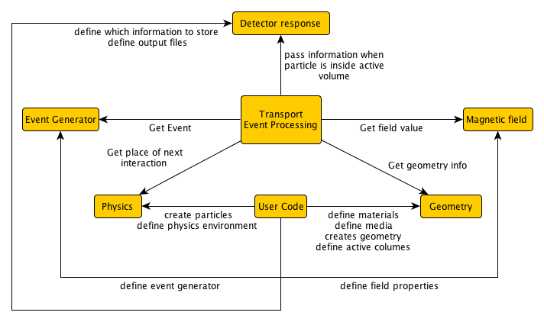
How does a MC simulation work?
Quite complex dependencies
User code implemented “inside” the MC framework
Complete rewrite needed for new MC framework

Slide 6
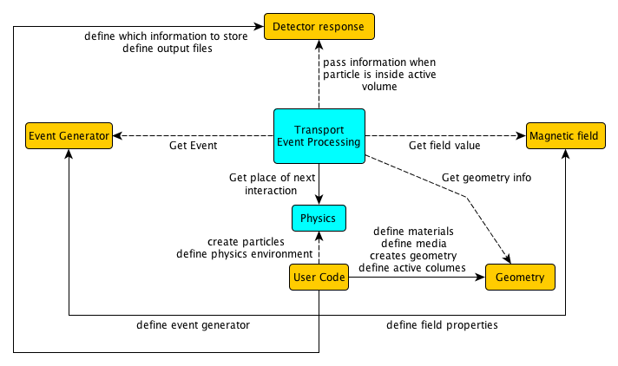
How does VMC work?
Use interfaces which decouple the user code and
the concrete Monte Carlo
Use different Monte Carlo’s with same user code

Slide 7
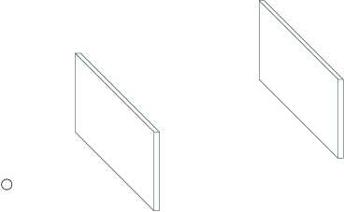
MC transport in detail (1)
Silicon detector
Initialization done
Transport package read event kinematics
One particle at position (x, y, z) with momentum (Px, Py, Pz)
Transport package get from geometry package the distance to the next boundary in direction of particle track
Transport package get from physics package the distance where the next interaction in the medium happens
Depending on the medium, the particle and the physical settings there are several physical processes to be taken into account
Gold Target
Particle

Slide 8
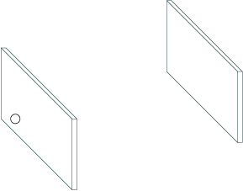
MC transport in detail (2)
Silicon detector
Assume particle is in vacuum, so no interaction
Transport moves particle on the next boundary to be crossed
Gold Target

Slide 9
MC transport in detail (3)
Silicon detector
Assume particle is in vacuum, so no interaction
Transport moves particle on the next boundary to be crossed
If one looks much closer, one can see that the particle is moved slightly inside the new volume
Now the transport again checks for distance to next boundary and physical interaction
Particle has an interaction inside the target (scattering) so the kinematic properties of the particle are updated
Particle leave target without any further interaction.
Gold Target
Boundary
Medium 1
Medium 2
ε

Slide 10
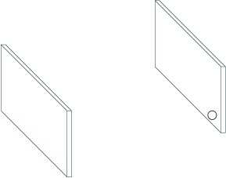
MC transport in detail (4)
Silicon detector
Since particle is in vacuum again, it is moved across the next boundary
This time we are in a detector (active medium)
Detector response function is called for every step inside the detector which has access to the following information
Position
Momentum
Energy loss
PID
Track length
Time of flight
Gold Target

Slide 11
MC transport in detail (5)
Tracks are transported sequentially
Two possible ways
Put particle 1 on stack
Put particle 2 on stack
Handled differently by different MC
In CbmRoot
Save info when particle is entering a sensitive volume
Sum up energy loss while inside sensitive volume
Write complete MCPoint to output when particle leave sensitive volume
➔ Only one MCPoint
Second case handled wrong
Sensitive Volume
2
1
Geant 3
1: entering
1: exiting
2: entering
2: exiting
Geant4/Fluka
1: entering
1: disappeared
2: entering
2: exiting
1: entering
1:exiting
2 MC points 3 MC points

