Slide 1
HEDM-related research of UPM at FAIR
J.J. Honrubia
ETSI Aerospace Engineering, UPM, Madrid, Spain
Workshop on High Energy Density Physics Opportunities at FAIR
November 18th, Madrid, Spain

Slide 2
Research areas of our group
Simulation group with a broad experience in plasma simulation.
Main research topic: Alternative ignition schemes, shock ignition and fast ignition.
Our research related to HEDM:
Ion stopping model.
Intense ion beam propagation in resistive materials.
Ion acceleration in cones.

Slide 3
Ion stopping power

Slide 4
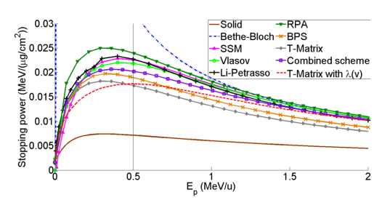
Ion stopping experiments
Ion beam-plasma modeling is important for fundamental studies on warm dense matter, fast ignition and others.
Experiments have shown evidences of substantial discrepancies of the stopping power models, specially near the Brag’s peak [W. Cayzak et al., Nat. Com. 8, 15693 (2017)].
other theories
carbon
plasma
T-Matrix & BPS
N ions
0.59 MeV/u
Classical Li&Petrasso model and other models systematically overestimate the energy loss by 20 – 25%, while the T-Matrix and BPS models fit well the experimental results.
TM
BPS

Slide 5
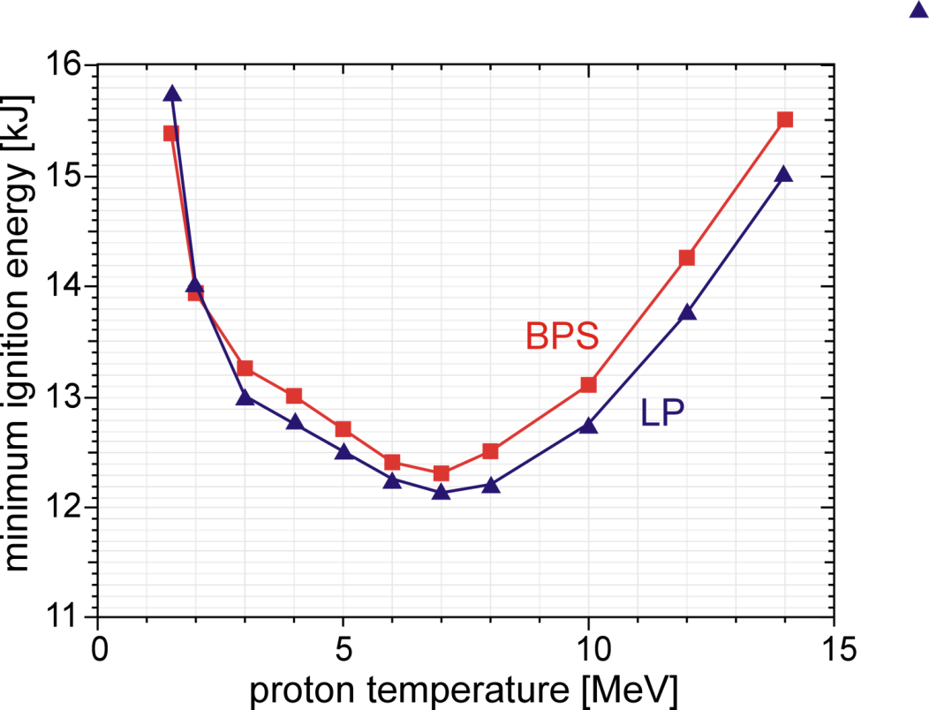
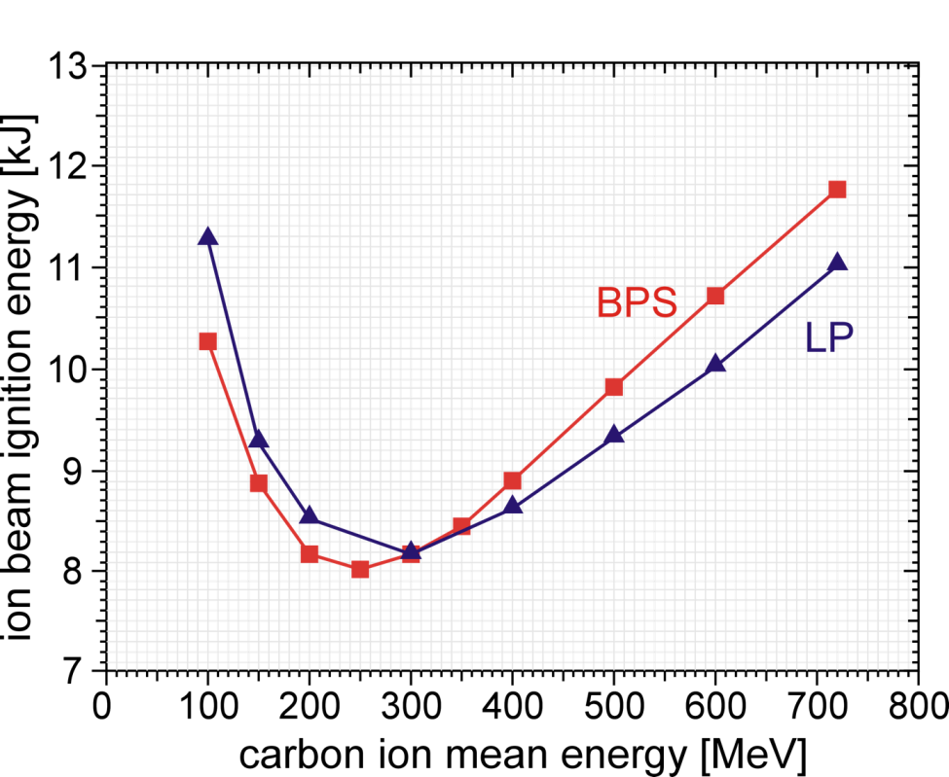
Sensitivity of the ignition energies
to the stopping model
Ignition energies are weakly sensitive to the stopping power model for Maxwellian protons, showing a slight increase of about 0.5 kJ or lower.
For quasi-monoenergetic ions, the optimal mean kinetic energy is shifted towards lower energies due to the higher proton range of the BPS model.
Maxwellian protons
Quasi-monoenergetic carbon ions
carbon ions
BPS = Brown, Preston & Singleton model
LP = Classical (Li&Petrasso) model
δE/E=0.125

Slide 6
Ion beam transport in
resistive materials

Slide 7
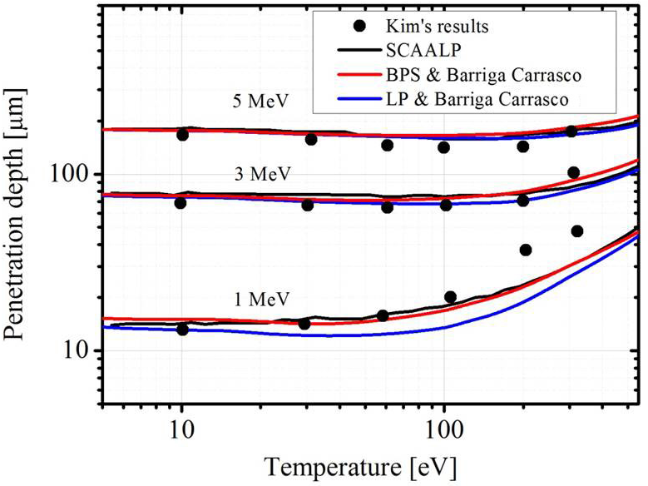
Ion beam transport in resistive materials
Very intense ion beams passing through a resistive material may generate resistive fields that affect its propagation.
The ohmic heating of the plasma can be non-negligible.
Our stopping model: Barriga-Carrasco for bound electrons [LPB 23, 211 (2005)] + BPS for free electrons [Phys. Rep. 410, 237 (2005)].
Good agreement with SCAALP [G. Faussurier et al., PoP 17, 052707 (2010); M. Gauthier et al., HEDP 9, 488 (2013)].
BPS & Barriga-Carrasco
SCAALP
LP & Barriga-Carrasco

Slide 8
B-field generation in solid Aluminum
Perfectly collimated proton beam of 5 MeV impinging on a solid Al target at room temperature. Flattop pulse with a 3 ps duration. [J .Kim et al., Phys. Plasmas 23, 043104 (2016)].
20 ps simulation time.

Slide 9
Beam compression due to resistive fields

Slide 10
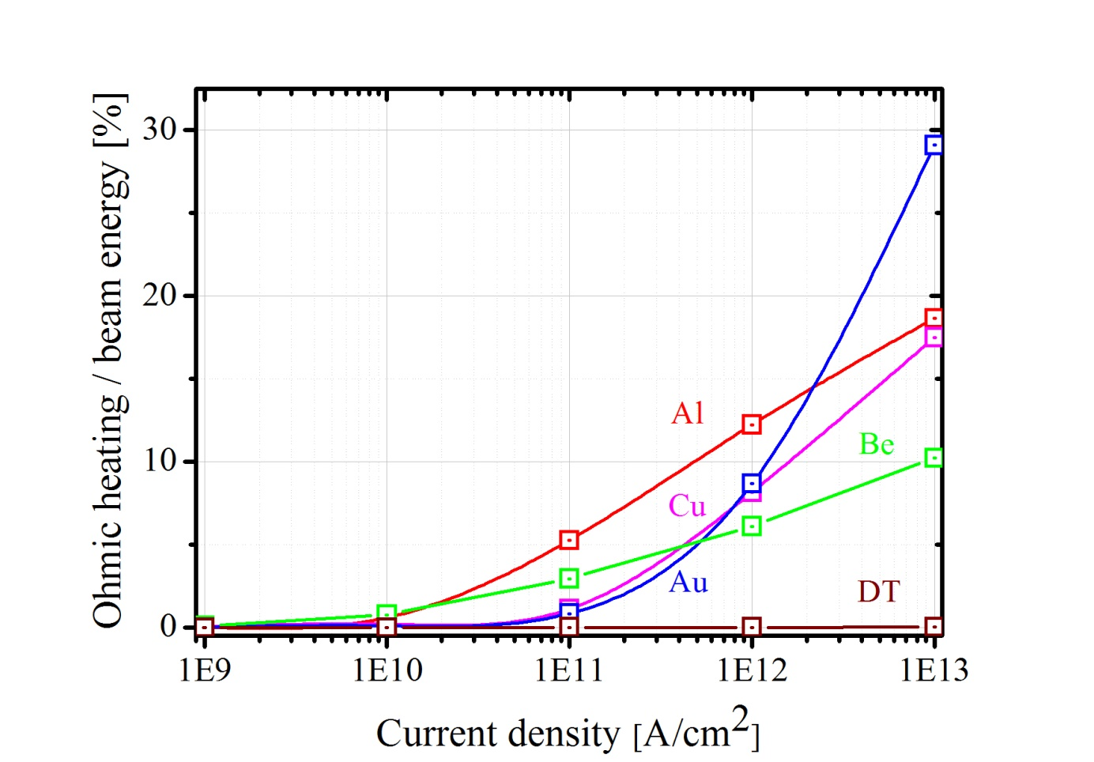
Importance of Ohmic heating on ion beam energy deposition
Ohmic heating is important for high current densities and heavy materials, but negligible for ion fast ignition applications.
Fractions of the pulse energy as high as 30% (Au, 10¹³ A.cm⁻²) can be deposited in the plasma by Ohmic heating.
Monoenergetic 5 MeV protons in solid Be, Al, Cu and Au.
DT at 300 g/cm³

Slide 11
3-D effects caused by resistive fields
5 MeV protons with an energy spread of 10% impinging on a solid Al target.
Current density j = 10¹¹ A.cm⁻², no thermal conduction, normal incidence.

Slide 12
Ion acceleration in cones

Slide 13
PIC simulation data
Open PIC code EPOCH-2D [Arber et al., PPCF 57, 113001 (2015)].
Target [
Length (x) = 130 μm.
Width (y) = 90 μm.
Pre-plasma: exponential profile with a scale-length = 2 μm.
Grid: 4550 x 3150 cells (35 cells per laser wavelength).
Honrubia, Morace and Murakami, MRE 2, 28-36 (2017)].
n_{e} (cm⁻³)
10¹⁸
1.1×10²³
n_{e} =100 n_{c}
DT
Laser
Wavelength λ = 1.06 μm.
Peak intensity I₀ = 10²⁰ W/cm².
Spatial profile: Super-Gaussian, FWHM = 55 μm.
Temporal profile: Gaussian, FWHM = 1 ps.
Boundary conditions for particles and fields
x : laser and thermal
y : periodic
10 n_{c}
Au
H
14 μm
C

Slide 14
Proton beam divergence due to self-generated B-fields
B-field generation at the cone wall by a surface current [Zou et al., Phys. Plasmas 22, 063103 (2015)].
B-field is dragged by the quasi-neutral plasma of protons + co-moving electrons, which are trapped by the B-field at the cone tip.
B-field is compressed at the cone tip reaching values of 10’s of kT [Honrubia, Morace and Murakami, MRE 2, 28-36 (2017)].
The polarity of the B-field at the cone tip is such that protons are scattered, hollowing or even breaking the proton beam.
Experimental evidence in Morace et al., Scientific Reports 12, 6876 (2022).

Slide 15
Summary
Experimentally validated stopping power models such as BPS should be used in ion-plasma interaction simulations. Experimental studies of ion stopping are essential.
The role of resistive fields for intense ion beams should be investigated experimentally. However, the current densities required may be beyond the FAIR capabilities.
Systematic studies of proton acceleration in cones are important to generate high energy density states in the laboratory with applications to proton fast ignition.
Carrying out experiments at the GSI facilities is an excellent opportunity to advance in the fields of WDM and HEDM physics.

