Slide 1
The FAIR phase-0 program at GSI/HHT (2021-2025)
Paul Neumayer, GSI
Workshop on High Energy Density Physics Opportunities at FAIR
ETSIAE, UPM, Madrid, Spain
November 18, 2022

Slide 2
Summary
Within FAIR Phase-0 the HED@FAIR collaboration has exciting opportunities for HED-science experiments
Experiments with intense ion pulses at the HHT-cave
  Heavy-ion heating for generation of extreme matter states
  New laser beamline from PHELIX enables x-ray probing schemes
  IPD-measurements on HI-driven samples planned as day-1 experiment
  PRIOR: a unique high-energy proton microscope for dynamic experiments
Intense laser-matter experiments at PHELIX
  Development of high-flux sources (x-ray, protons, neutrons, gamma) for applications (x-ray backlighting, neutron-imaging, nuclear reactions)

Slide 3
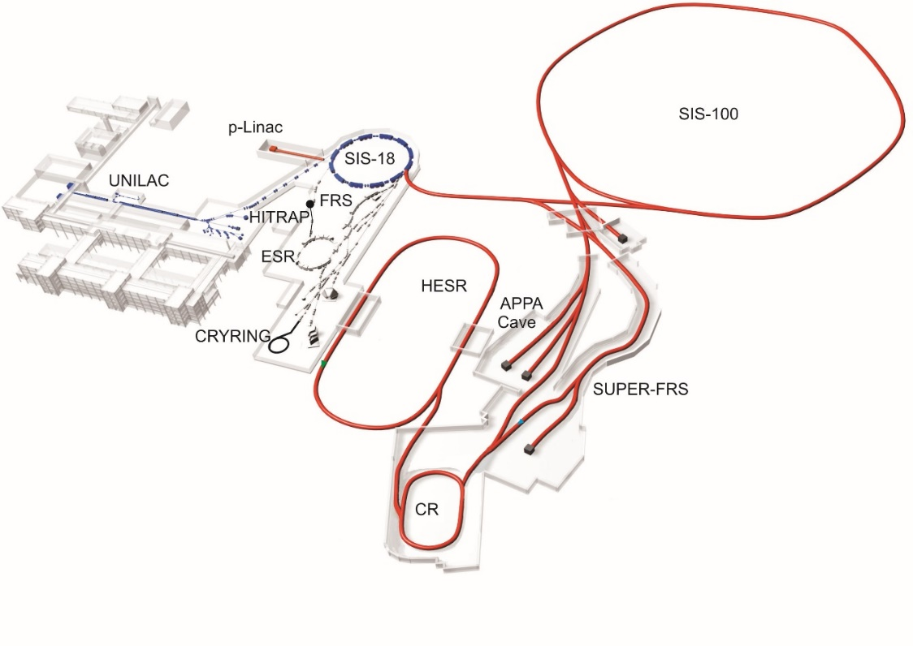
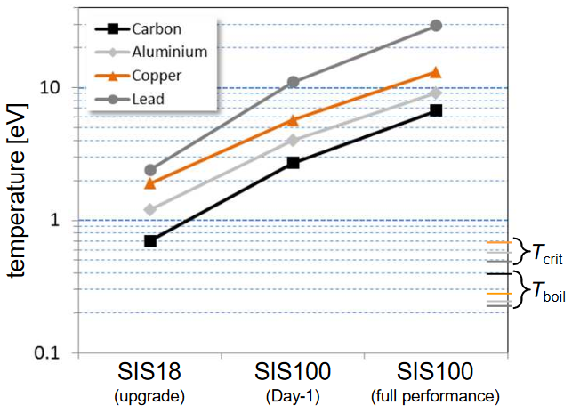
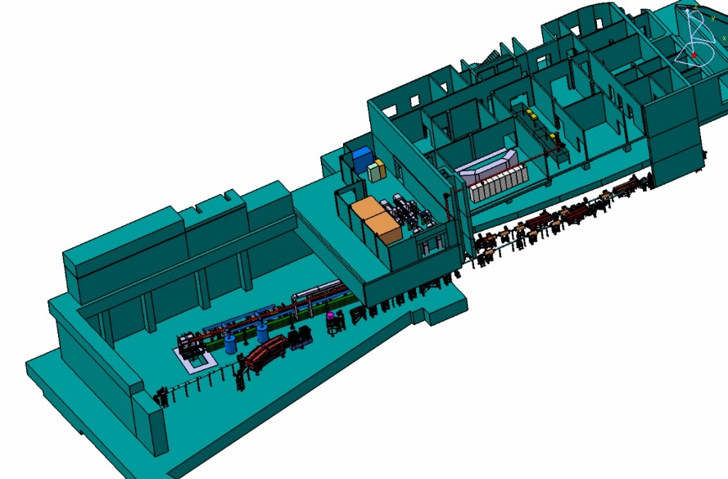

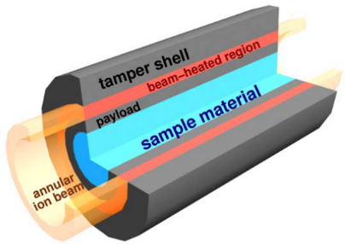
FAIR will offer exciting new possibilities for research in high-energy density matter science
Generation of
HED conditions!
Ion beam driven plasmas:
large mm-size samples
homogenous energy deposition
equilibrium conditions
5x10¹¹U-ions
mm spot-size
100ns pulses
prep-lab
Heating + expansion
Isentropic compression
HP-Laser
ion beam
Control room
Wobbler or external driver setup
sample
Vacuum
target chamber
Large-aperture, high-gradient superconducting quadruplet
(strong focusing or imaging)
window

Slide 4

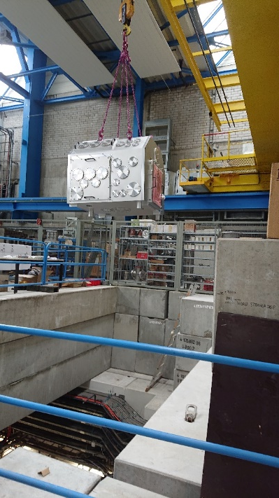
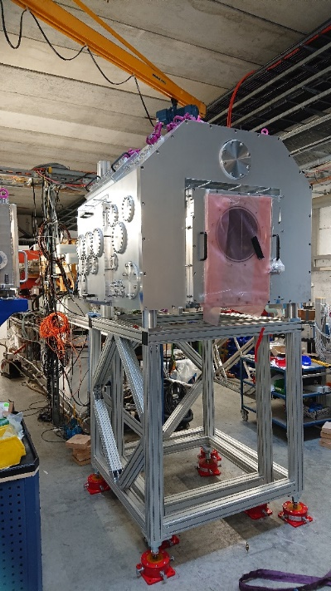
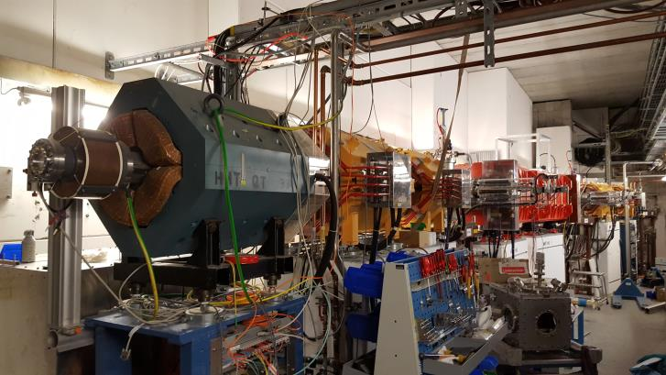
Early experiments in FAIR Phase-0 at HHT
FAIR „Phase-0“:
Research activitites related to or relevant for FAIR, before start of FAIR operation in 2025.
APPA target chamber installation in the HHT experimental area
Z6
HHT
PHELIX
Focusing quadrupoles @HHT

Slide 5
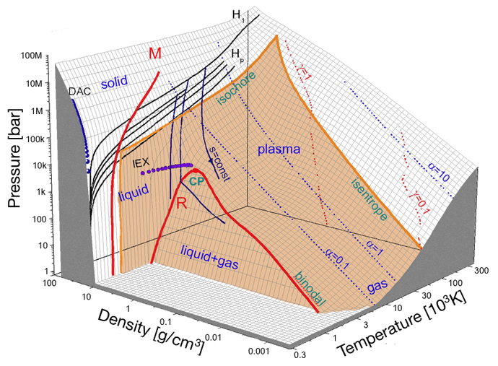
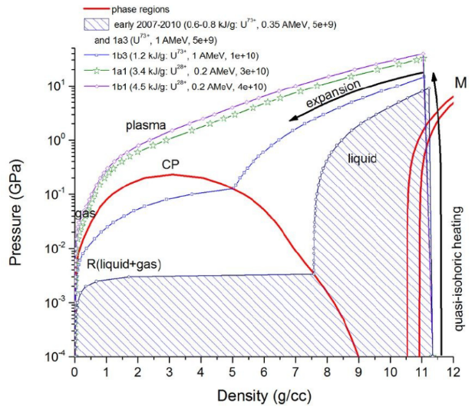
HIHEX: Heavy Ion Heating and EXpansion
For most metals in the periodic system the locations of the critical points are still unknown!
Theoretical estimates of the critical point location differ by up to 100–200% in T and P
HIHEX:
Heating by heavy ion pulses
Subsequent expansion
Lead (Pb) phase diagram
Simulations of parameter evolution
Full FAIR
ion beam
„early“ beams
(SIS-18)
sample
window
Courtesy:
IPCP, Chernogolovka
“Early” HIHEX can access region around critical points of various materials

Slide 6
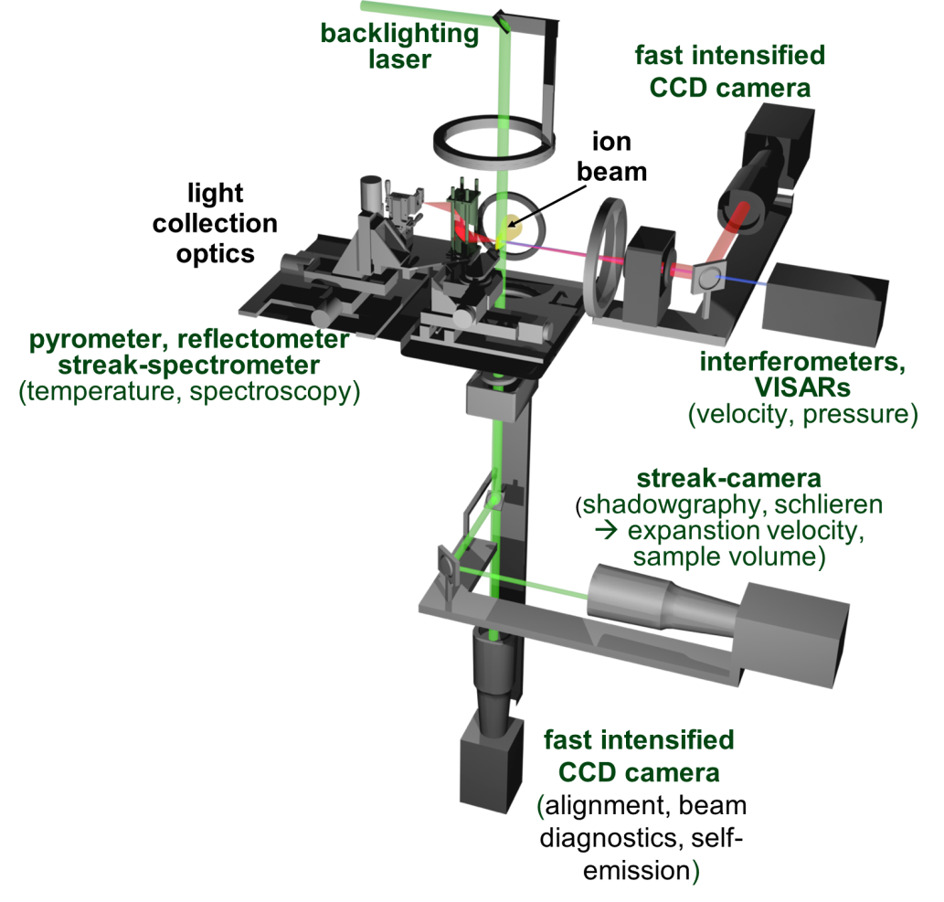
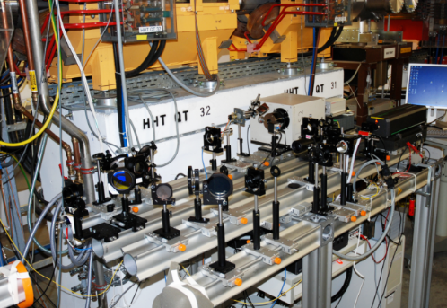
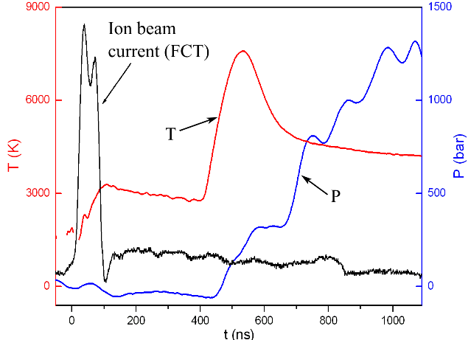
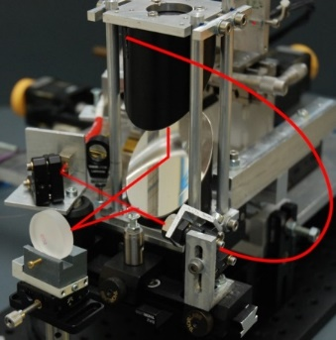
Proof-of-principle HIHEX-experiments at GSI
laser interferometer
U⁷³⁺, 350 AMeV, 3∙10⁹ / 100 ns
fast pyrometer/reflectometer
Pb target

Slide 7
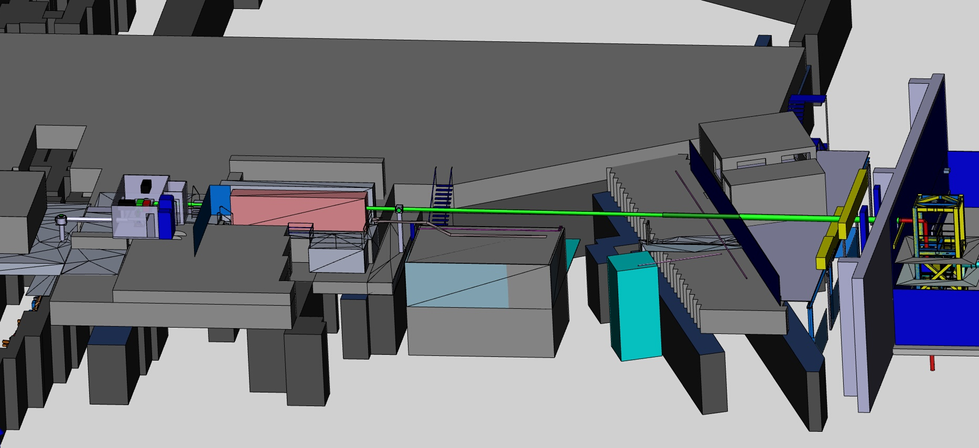
HHT-beamline: transport of high-energy laser pulses from PHELIX to the HHT-cave
ESR hall
HHT
high energy, high temperature experimental cave
FRS
fragment separator
HITRAP
deceleration facility
Optics lab
Laser-beam parameters
in HHT:
PHELIX
laser facility
  200 J
  527 nm
  1 ns up to ~10 ns
  15 cm beam-∅
∼ 65 m

Slide 8
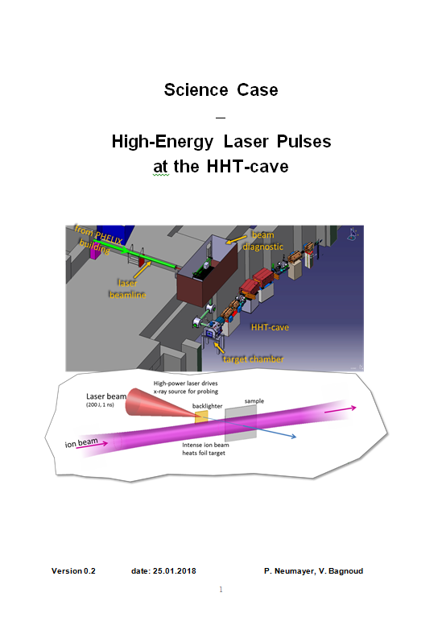
New capabilities enabled by high-energy laser pulses at the HHT-cave
200J/ns laser pulses, focused to 10¹²-10¹⁵W/cm² can drive:
Intense He-α line-radiation sources (<10keV) from mid-Z plasmas, few keV quasi-continuous radiation from high-Z plasmas
⇒ Diagnostic capabilities enabled by laser-driven x-rays:
Radiography
  low-Z targets: (isentropic) expansion/compression, ablation/fracture/spallation/explosion
  high-Z targets: expansion into low-Z tamper
X-ray diffraction
  lattice constant + strength, structural phase transitions (e.g. diamond-graphite), melting
X-ray scattering
  liquid structure (ion-ion distance, coupling strength, ion temperature, compressibility)
Absorption spectroscopy
  XANES (electron temperature), VUV-opacity (e.g. Bi, Pb), continuum lowering
few Mbar shocks into solids
Shock-induced ablation/spallation
Laser-accelerated flyer plates
→ Proton microscopy with PRIOR
International panel discussion (HED@FAIR2017 workshop):
The unique combination of the intense heavy ion beams at HHT with a high-energy laser pulse significantly enhances the experimental possibilities and has a large scientific discovery potential
Notes:
panel discussion,... , now also officially endorsed by Collaboration Board

Slide 9
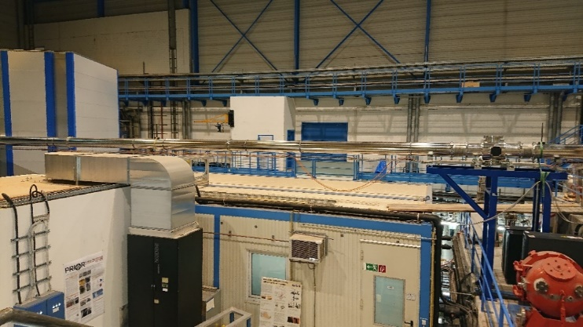
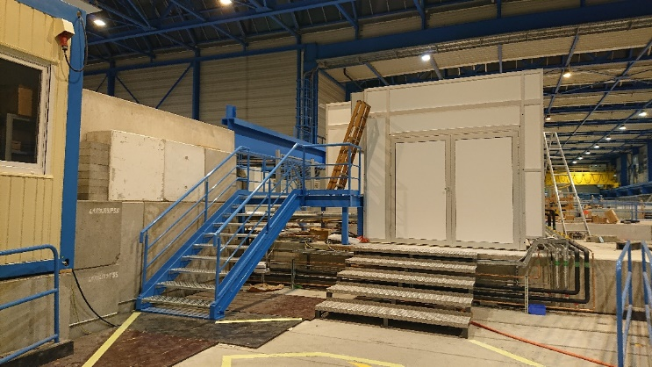
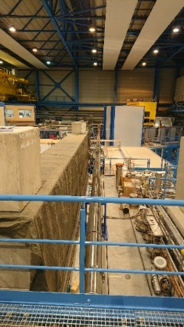
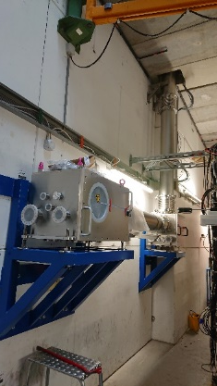
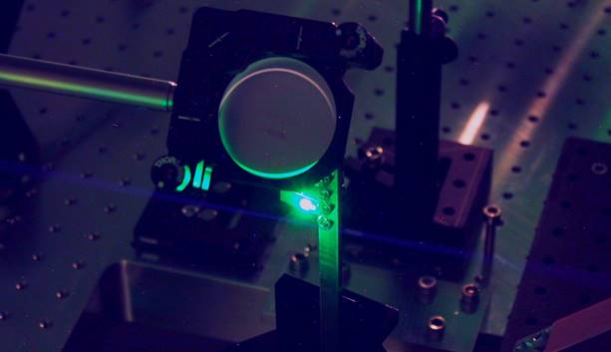
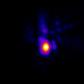
HHT-beamline: transport of high-energy laser pulses from PHELIX to the HHT-cave
HHT cave
Optics lab
PHELIX
← PHELIX
HHT →
HHT
↓
Beamline complete, vacuum system operational
First light in HHT cave (May 2021)
Simultaneous ion + laser pulses in new target chamber, synchronization <10ns
up to 200J at 2ω (2ns pulse duration)
focal spot-∅ 20 μm (~90% in 60µm)
pointing fluctuations ±2x focal spot
laser plasma
Focus image
SIS-18 ion beam
PHELIX laser

Slide 10



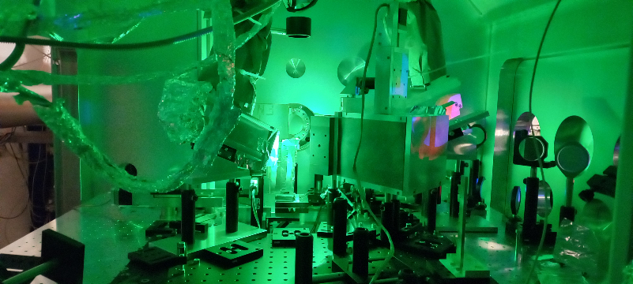
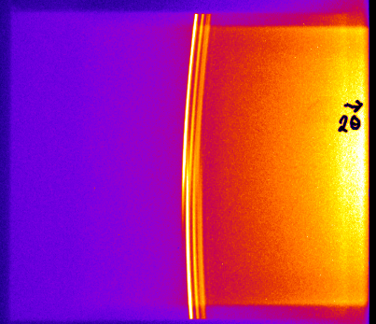
First combined laser-ion experiments at SIS18
May 2022: First beamtime combining intense heavy-ion beams with high-energy laser pulses
APPA day-1 target chamber used in first experiment at HHT-cave
High-energy laser beamline at full specs! (200J at 527nm)
>4e9 Pb-ions/pulse, focusing down to 0.6x0.9mm (FWHM) !
Variety of ion beam, optical + x-ray diagnostics fielded
Demonstrated laser-driven x-ray probing of HI-heated targets
Strong participation by several university groups from within HED@FAIR
Setup in target chamber
X-spec
X-Ray Diffraction
→ graphitization, melting
XRTS
BIF
X-Ray Thomson Scattering → ionic vibrations (T_{i})
focus diag
Ti-He_{α} (4.75keV)
PHELIX
pyro
(img.)
Source
XRD
pyro
(point)
heated region
Scattering
energy
ions
X-ray probing reveals microscopic
properties of HED samples

Slide 11
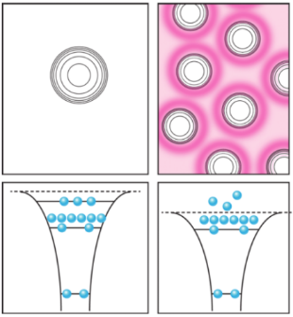
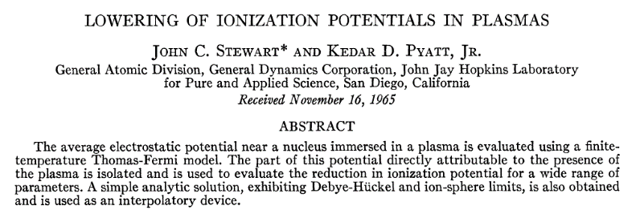
Ionization Potential Depression (IPD)
Ionization determines:
Equation-of-State P(ρ, ε)
Transport (radiation, electrical, heat)
Microscopic structure
...
Important when modeling ICF, planets and stars, plasma diagnostics
In a plasma the field around an ion is perturbed by the neighboring charged particles (e+i).
This leads to a shift of energy levels & reduction of the boundary between bound and unbound states (continuum)
→ Effective ionization energy is reduced
(“IPD“, Ionization Potential Depression)
S&P-model: „smooth interpolation between IS and DH limits“
*weak coupling, non-degenerate electrons
Used in many modern codes: CRETIN, FLYCHK, LASNEX-DCA, ...
Astrophysical Journal (1966)

Slide 12
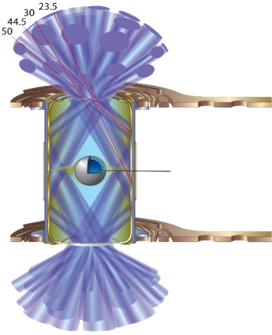
Recent experiments test IPD models in dense plasmas
LCLS
Orion
NIF
X-ray Scattering
CH
(10μm)
Al-target
Al
(0.15μm)
CH-target
XFEL
2x 200J
0.5ns
(351nm)
100J
0.5ps
(532nm)
backlighter
(@9keV)
spectrometer
spectrometer
Heating: X-FEL
Probing: K-shell emission (from photo-ioniz.)
Heating: ps (PW) laser
Compression: ns-laser
Probing: Resonance line emission (impact excitation)
Heating + compression: Hohlraum drive
Probing: X-ray scattering
T=70...180eV
ρ =ρ₀ (isochoric)
highly transient, non-eq.
T=500...700eV
ρ =0.5...4xρ₀
T ≈110eV
ρ ≈7xρ₀
Ciricosta et al., PRL (2012)
Hoarty et al., PRL (2013)
Kraus et al., PRE (2016)

Slide 13
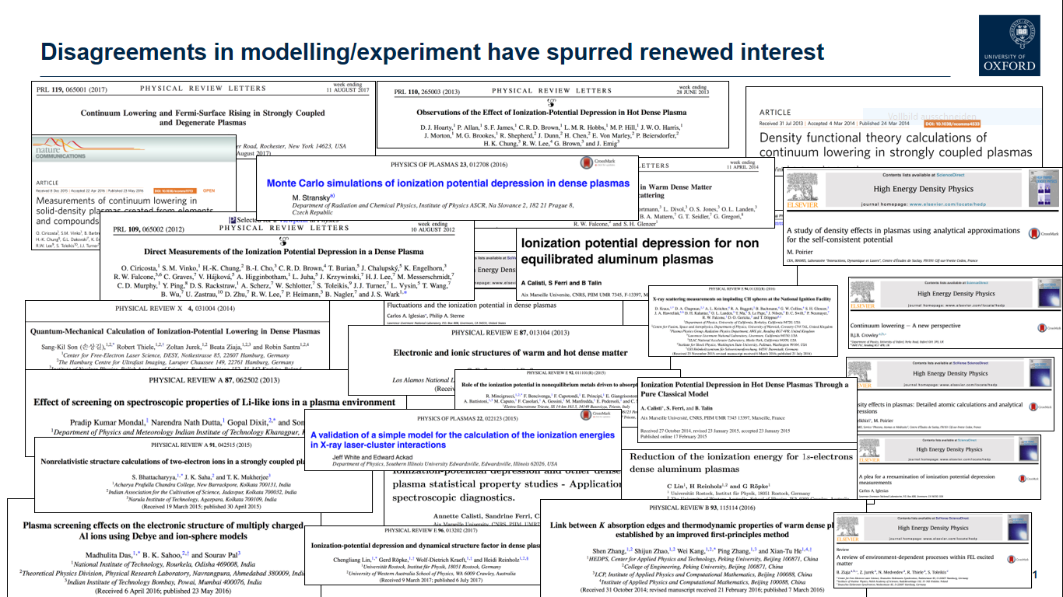

Recent experiments test IPD models in dense plasmas
LCLS
Orion
NIF
X-ray Scattering
CH
(10μm)
Al-target
Al
(0.15μm)
CH-target
Vast majority of this work is theoretical!
Experimental data remains scarce, especially for different density conditions!
XFEL
2x 200J
0.5ns
(351nm)
100J
0.5ps
(532nm)
backlighter
(@9keV)
spectrometer
spectrometer
Heating: X-FEL
Probing: K-shell emission (from photo-ioniz.)
Heating: ps (PW) laser
Compression: ns-laser
Probing: Resonance line emission (impact excitation)
Heating + compression: Hohlraum drive
Probing: X-ray scattering
T=70...180eV
ρ =ρ₀ (isochoric)
highly transient, non-eq.
T=500...700eV
ρ =0.5...4xρ₀
T ≈110eV
ρ ≈7xρ₀
Ciricosta et al., PRL (2012)
Hoarty et al., PRL (2013)
Kraus et al., PRE (2016)
Slide courtesy of S. Vinko, U Oxford
UC Berkeley, June 2021

Slide 14
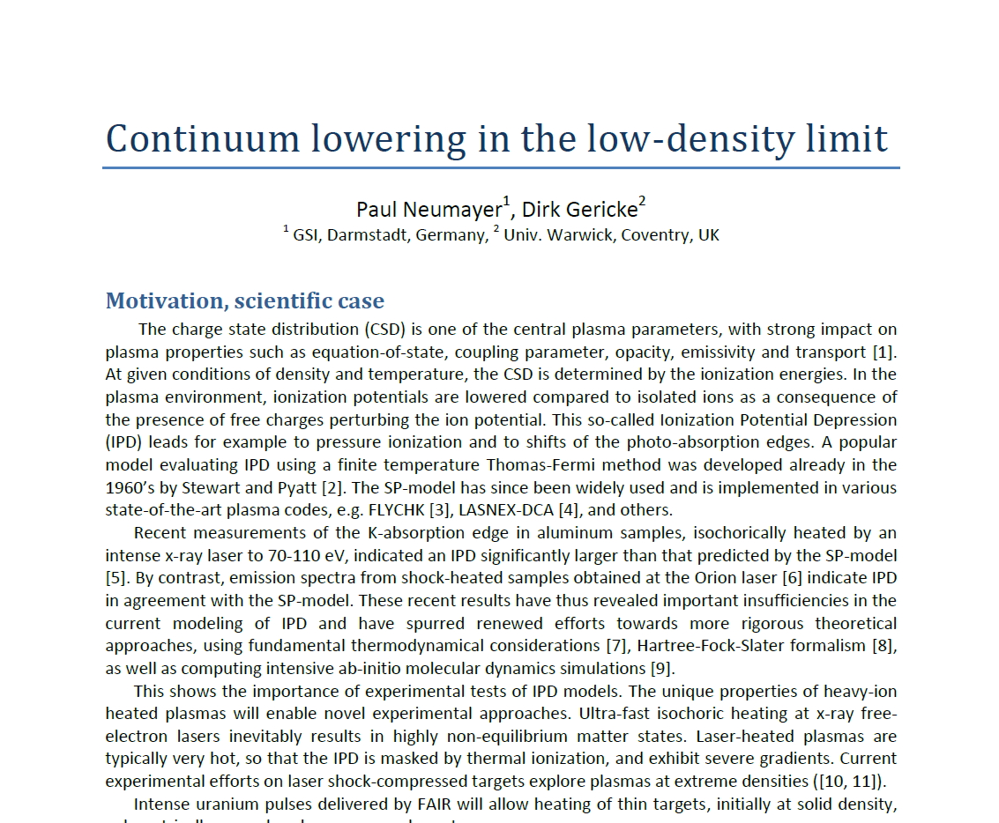
Recent experiments test IPD models in dense plasmas
LCLS
Orion
NIF
X-ray Scattering
CH
(10μm)
Al-target
Al
(0.15μm)
CH-target
XFEL
2x 200J
0.5ns
(351nm)
100J
0.5ps
(532nm)
backlighter
(@9keV)
spectrometer
spectrometer
Heating: X-FEL
Probing: K-shell emission (from photo-ioniz.)
Heating: ps (PW) laser
Compression: ns-laser
Probing: Resonance line emission (impact excitation)
Heating + compression: Hohlraum drive
Probing: X-ray scattering
Proposal for day-1 experiment:
Measure Ionization Potential Depression in strongly-coupled Al-plasma
T=70...180eV
ρ =ρ₀ (isochoric)
highly transient, non-eq.
T=500...700eV
ρ =0.5...4xρ₀
T ≈110eV
ρ ≈7xρ₀
Heating + expansion by heavy ion pulse
→ create large, homogenous, well-defined sample of strongly-coupled plasma
Probing: X-ray absorption spectroscopy
Ciricosta et al., PRL (2012)
Hoarty et al., PRL (2013)
Kraus et al., PRE (2016)

Slide 15
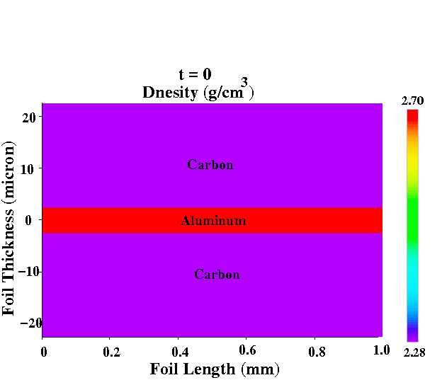
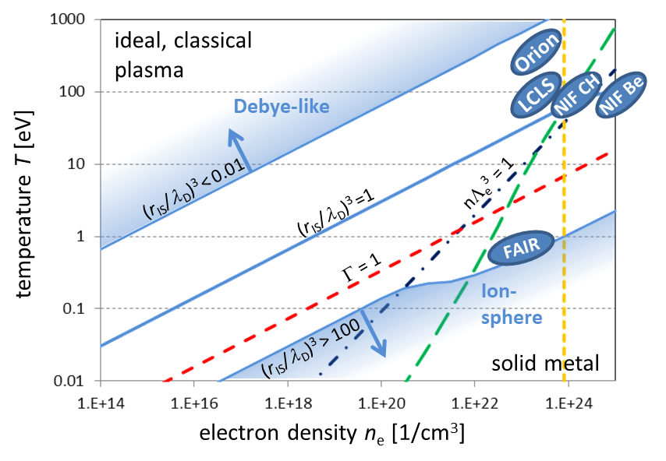
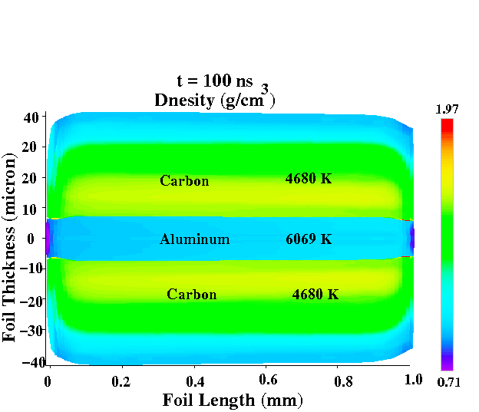
Hydrodynamic simulations show heavy-ion heating and quasi-1D expansion
t = 0 ns
ρ [g/c]
Ion beam parameters:
5e10 U-ions
1.25 mm FWHM focal spot
100 ns pulse duration
Target:
Al-foil (5 μm)
C-tamper (2x20 μm)
foil thickness [micron]
foil length [mm]
t = 100 ns
ρ [g/c]
foil thickness [micron]
Heavy-ion heating will yield:
large, homogenous, near-LTE samples
strongly-coupled, highly degenerate state (i.e. WDM)
foil length [mm]
homogenous over >0.5mm !

Slide 16
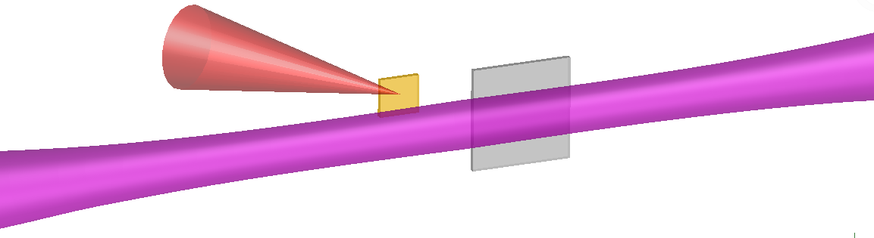
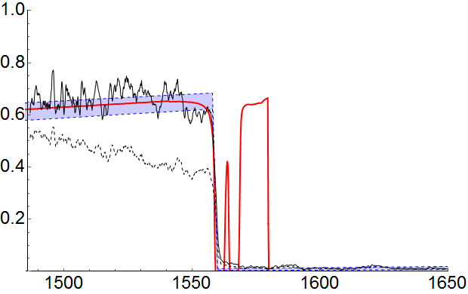
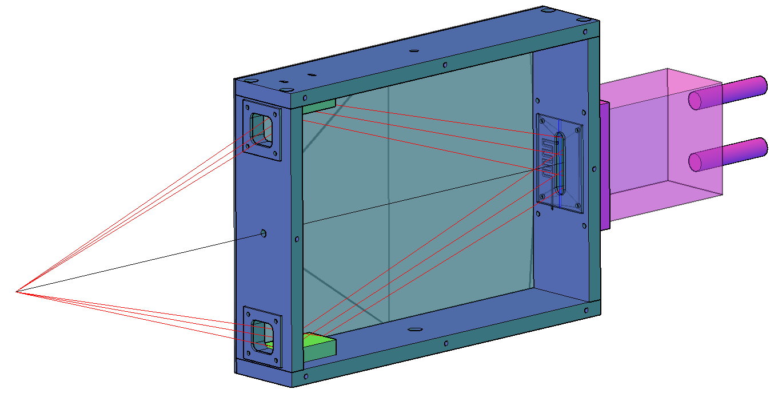
Probing by x-ray absorption spectroscopy
High-power laser drives x-ray source for probing
Laser beam
(100J, 0.5ns)
Al-foil
(5μm)
Au-foil
ion beam
Absorption spectra
Intense ion beam heats foil target
Exp (corr.)
Exp (uncorr)
CXRO (4...5μm Al)
FLYCHK (0.1 ρ_{solid})
Spectrometer development
High-resolution dual-channel x-ray spectrometer (C. Spielmann, Univ. Jena)
Gated x-ray imager (R. Cheng, IMP/Lanzhou)
transmission
K-edge shift
M-shell rebinding
also: XANES/EXAFS
Resolution:
<2eV spectral
200μm spatial
energy [eV]
transmission
2x KAP
(conical)
in-vacuum
x-ray CCD
Experiment will access transition
from metal to dense atomic gas
reference

Slide 17
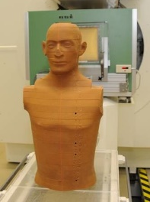
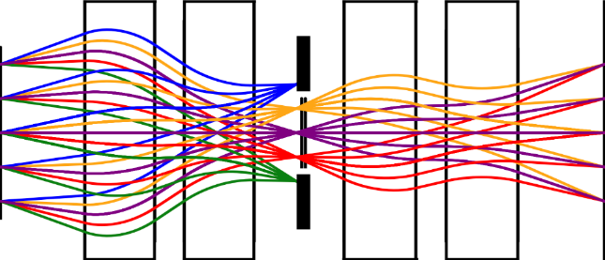
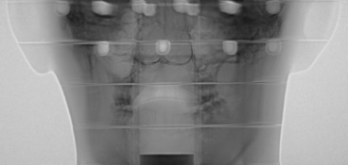
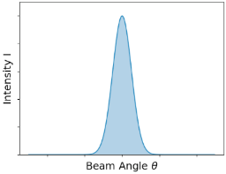
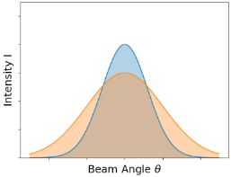
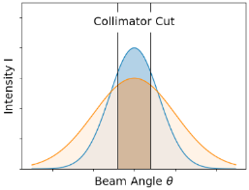
Proton Microscopy at FAIR (PRIOR): imaging dense samples generated with secondary drivers
GeV Protons
Object
Detector
good range in matter
low amount of scattering
low dose deposition
F
D
F
D
Design goal:
Spatial resolution 10 µm
Temporal resolution 10 ns
Density resolution 1%
Secondary drivers:
Laser shocks
Gas gun
(Under-water) electric wire explosions
High-explosives
…
position
incident beam
after object
after collimator
on
detector
transmission (intensity)
provides information about
the object density
D. Varentsov et al.,
Rev. Scient. Instrum. 87, 023303 (2016)

Slide 18
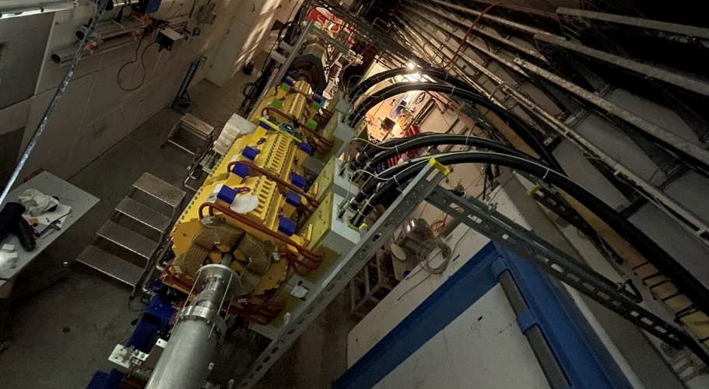
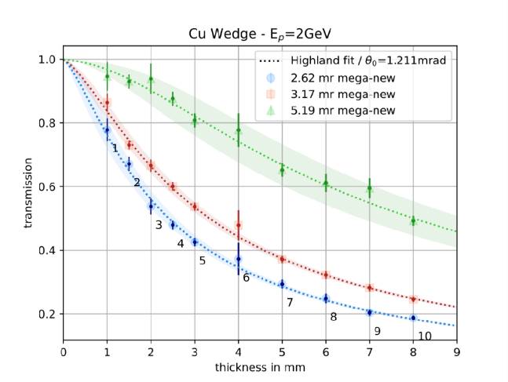
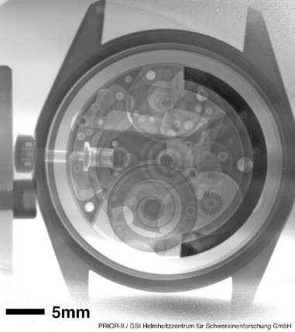
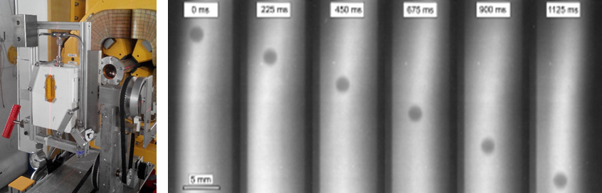
The proton microscope PRIOR has been successfully commissioned in Phase 0 experiments in 2021 & 2022
Experimental setup at HHT
Static imaging (watch)
Excellent density resolution
Experiment: “Understanding liquid-liquid phase transformations by temperature-dependent viscosity measurements at high pressures using high energy proton microscopy”
High pressure heated Titanium-vessel
Steel ball „falling“ in liquid Sulfur

Slide 19
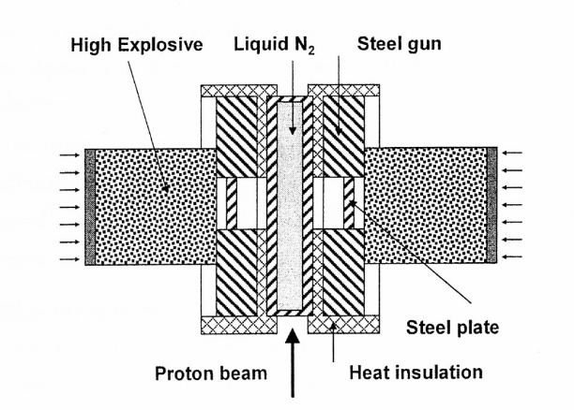
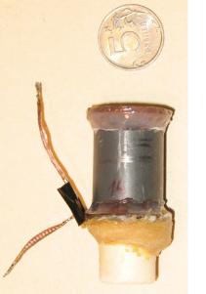

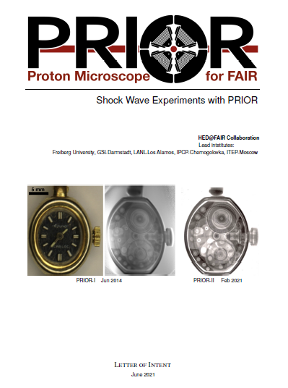
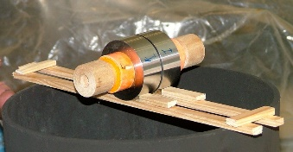
Compact HE generators can be used to create
shocked samples to be studied with PRIOR
Example 1: Shock-Compressed Non-Ideal Plasmas of Rare Gases
Example 2: Phase Transitions in Molecular Liquids at High Pressures
∅ 22 mm
Gas inlet system
Xe gas 2.5 bar
35 mm
20 mm
HE charges
MHE ~ 30 g
p ~ 10 kbar
T ~ 3 eV
Ignitor
MHE ~ 60 g
p ~ 600 kbar
uS ~ 3 km/s
PRIOR will offer unique possibilities to diagnose explosively-driven shock wave experiments
A letter-of-intent for explosively driven experiments has been submitted to FAIR for evaluation
Once the science case is approved by FAIR, preparations (technical, applying for needed permits) will start

Slide 20
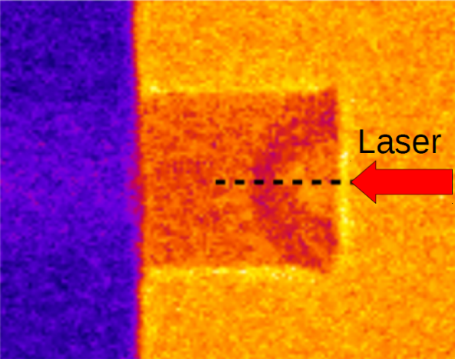
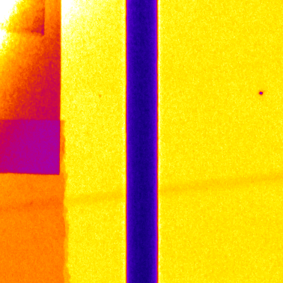


PHELIX: Laser-driven x-ray sources for high-resolution x-ray radiography
Spherical shock propagation in polystyrol-cylinder
300μm
10¹⁴W/cm²
L. Antonelli et al., EPL 125, 3 (2019)
Δt = 0
Δt = 1.2 ns
Δt = 2.4 ns
Hydro-evolution of „isochorically heated“ wires
Laser
10¹⁸W/cm²
Ti-wire
50μm

Slide 21







Laser-driven x-ray radiography as density diagnostic in HIHEX experiments
Simulated radiographs
HIHEX + laser-driven radiography
Liquid
T≈3400...6000K, ρ =ρ₀
Critical point region
T≈5600K, ρ ≈4g/cm³
Strongly coupled plasma
T≈4000K, ρ ≈2g/cm³ → Γ ≈ 4
detector
2 mm
≈
heavy-ion
beam
-1
0
1
-1
0
1
-1
0
1
radius [mm]
radius [mm]
radius [mm]
Pb
∅600μm
≈10mm
Demonstration at PHELIX
thickness [μm]
0
125
250
550
1050
1550
backlighter
foil
Laser parameters:
E_{L}=120 J
τ_{p} = 0.6 ps
1mm
high-intensity
laser pulse
≈ 5% density
sensitivity
Target:
relat. signal
Au-foil
(5.3μm)

Slide 22



Performance of
Using ultrafast optical parametric amplifier (uOPA) temporal contrast of 10⁶ to 10¹¹ can be applied
Improvement of beam transport, implementation of a deformable mirror and focussing by a glass parabola; max. proton energy increased from 80 MeV to 93 MeV

Slide 23

Demonstration of laser-driven neutron resonance spectroscopy (NRS) with PHELIX
PHELIX accelerates protons and deuterons to create intense neutron bursts in a converter (>10¹⁰ per shot)
Neutrons are moderated for application in neutron resonance absorption spectroscopy (~4x10⁷ n_{th}/sr/shot)
Identified 3 W-isotopes
+ Ta-impurity (~1%)

Slide 24

Laser-driven thermal neutron radiography

Slide 25




Fission of ^{nat}U with laser-driven protons at PHELIX
PHELIX generates high proton fluxes (10¹² p⁺/pulse above 15 MeV ≈ 10²² p⁺/sec.)
Laser-induced nuclear physics
  Fission in HED Environment
  relevant for Nuclear Astrophysics
Successful demonstration of a gas-transport-based detection method
Identified short-lived nuclides:
¹³⁴I, ¹³⁶I, ¹³⁷Xe, ¹³⁸Xe, ¹³⁹Xe and ¹⁴⁰Cs (half-lives shorter than 40 s)
PHELIX parameters
Energy: 200 J
Duration: 400 fs
Gamma spectrum
time-resolved spectra facilitate nuclide identification
P. Boller et al., Scientific reports, 8, 2020
Notes:
Experiment description: the laser comes from the left. It is focused on a thin (1um) thick gold foil and generates a proton bunch. The uranium foils are located in a container located only 4 cm away from the laser-plasma interaction point and catches about 10% of the produces protons. The fission products leave the foil due to their recoil and are stopped in a gas before they are transported to a detector. The created isotopes reach the detector only a few seconds after their generation.

Slide 26


Strongly enhanced generation of directed MeV electrons in low-density polymer aerogels
Direct laser acceleration in near-critical density plasma
Intense sources of protons, gamma-rays and neutrons
foam + convertor
gammas
positrons, neutrons
foam + thin foil
protons
neutrons
M. M. Günther, O.N. Rosmej et al., Nat. Commun. 13, 170 (2022)

Slide 27
Summary
Within FAIR Phase-0 the HED@FAIR collaboration has exciting opportunities for HED-science experiments
Experiments with intense ion pulses at the HHT-cave
  Heavy-ion heating for generation of extreme matter states
  New laser beamline from PHELIX enables x-ray probing schemes
  IPD-measurements on HI-driven samples planned as day-1 experiment
  PRIOR: a unique high-energy proton microscope for dynamic experiments
Intense laser-matter experiments at PHELIX
  Development of high-flux sources (x-ray, protons, neutrons, gamma) for applications (x-ray backlighting, neutron-imaging, nuclear reactions)
Thanks for your attention!

