Slide 1
Workshop on High Energy Density Physics Opportunities at FAIR
V. Bagnoud for the HED@FAIR collaboration

Slide 2
Outlook
summary
Introduction – plan for the day
Overview of FAIR
  Status of the construction
  FAIR scientific organization: the 4 FAIR pillars
  Spanish participation in FAIR
HEDP at GSI and FAIR
  Combined laser and ion experiments
  PHELIX
Consequences of the international situation
List of missing components for the APPA cave

Slide 3
Introduction – plan for the day - goals of the workshop
Session 1: chair J. Honrubia
10:00 – 10:30 | V. Bagnoud | 20’ + 10’ | Status of the FAIR project and GSI HED facilities
10:30 – 11:00 | P. Neumayer | 25’ + 5’ | The FAIR phase-0 program at GSI/HHT (2021-2025)
11:00 – 11:15 | S. Neff | 12’ + 3’ | HEDP Infrastructure at the APPA cave
11:15 – 11:30 | A. Blazevic | 12’ + 3’ | The LIGHT beamline at GSI
Coffee Break – 30’
Session 2: chair A. Bret
12:00 – 12:30 | L. Volpe | 20’ + 10’ | Ion Stopping Power in extreme states of matter @ FAIR
12:30 – 12:50 | A. Alejo | 15’ + 5’ | Overview of activities at the Laser Laboratory for Acceleration and Applications (L2A2)
12:50 - 13:10 | R. Florido | 15’ + 5’ | Flexible Non-LTE atomic-kinetics and detailed Stark-broadened lines profiles for spectroscopic characterization of high-energy-density plasmas
13:10 – 13:30 | R. Piriz | 15’ + 5’ | High energy density physics research at the UCLM
Lunch Break – 1h 30’
Session 3: chair P. Neumayer
15:00 – 15:20 | C. Huete | 15’ + 5’ | Shock waves dynamics for arbitrary equations of state. A theoretical description
15:20 – 15:40 | J. Honrubia | 15’ + 5’ | HEDM-related research of UPM at FAIR
15:40 – 16:00 | M. Ehret | 15’ + 5’ | Standardization of metrology for laser plasma experiments and laser based secondary sources
Coffee break
Session 4: chair V. Bagnoud
16:15 – 17:00 | General discussion – where to go from here?
Survey the field (topics and participants)
  start new actions (common applications for money and experiments, staff exchanges, …)
Define the next steps
  decision on writing a white paper
Get organized!
  lobbying (or not)
  define contact persons

Slide 4
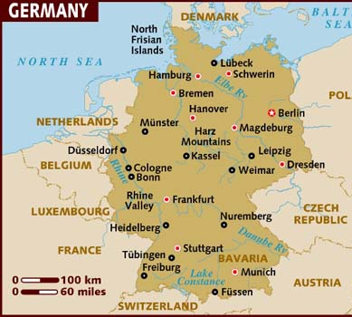
Introduction GSI and FAIR
GSI was founded in 1969 in Darmstadt
GSI is known for:
  research on heavy nuclei (Darmstadtium, Hassium, Röntgenium)
  Hadron therapy of hard-to-cure forms of cancer
GSI is part of the Helmholtz association
  operation of large research infrastructure, and
  own integrated research programs
Start of the plasma physics program: late 1970’s
Since 2008, combined laser-ion experiments with PHELIX
Darmstadt

Slide 5
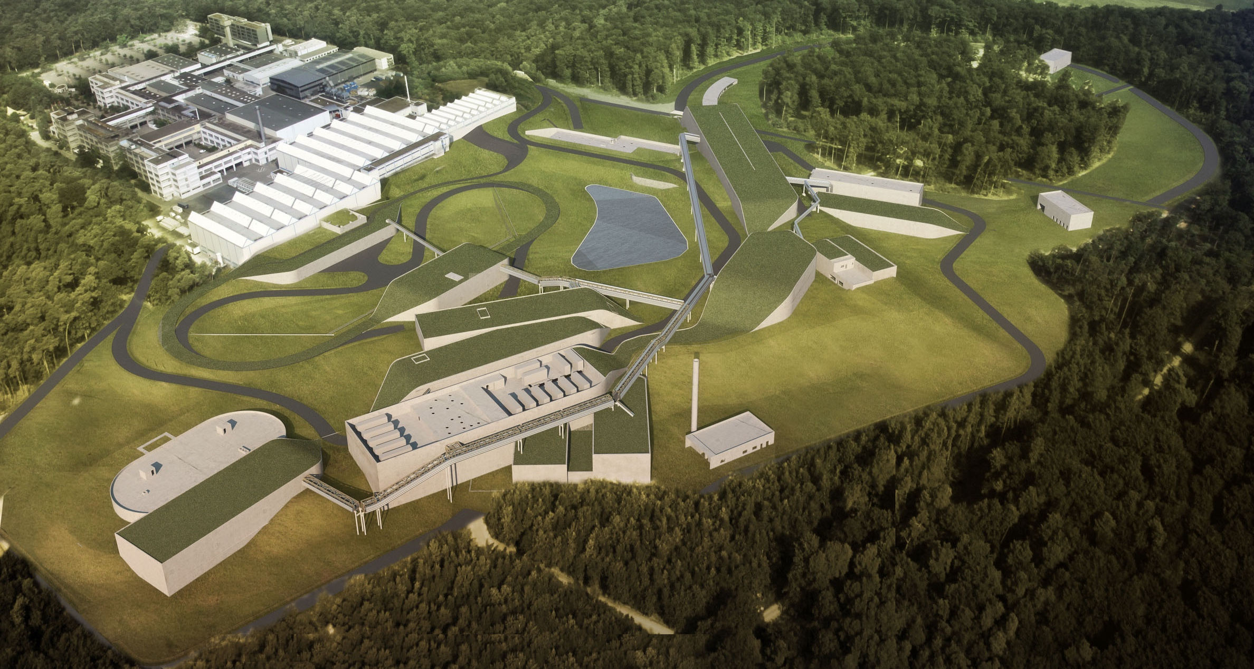
FAIR: Facility for Antiproton and Ion Research
ESFRI Landmark
Top priority for European
Nuclear Physics Community
Driver for Innovation in Science and Technology

Slide 6
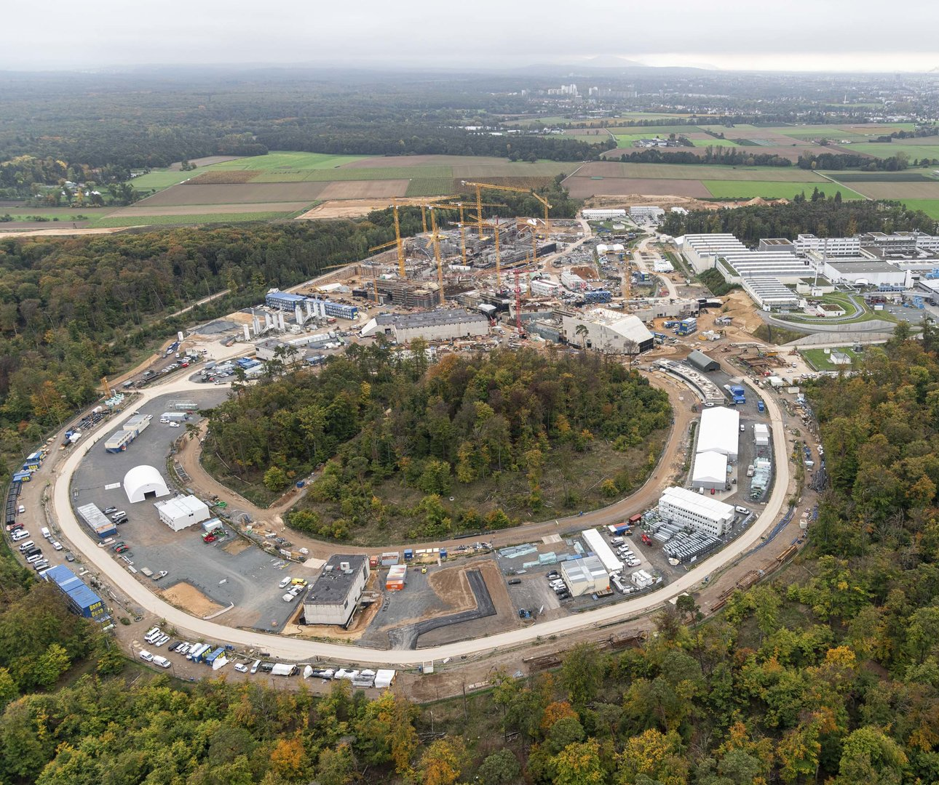
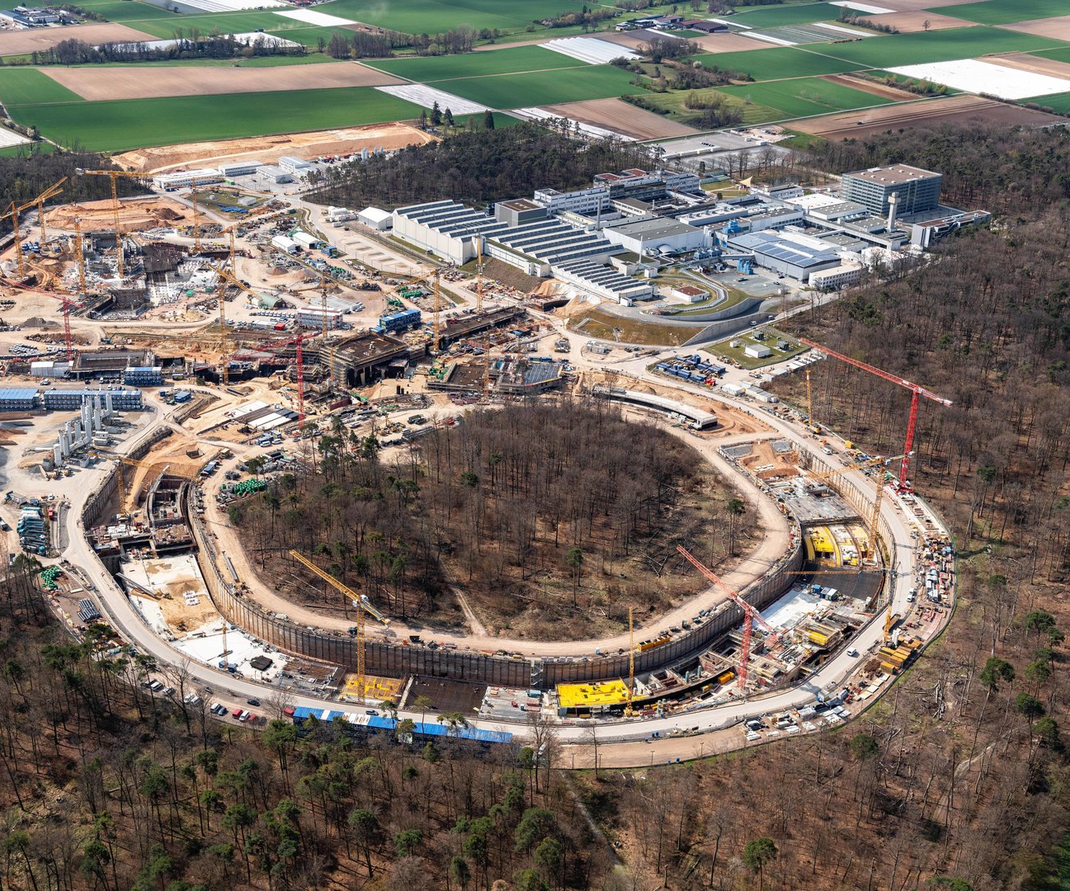
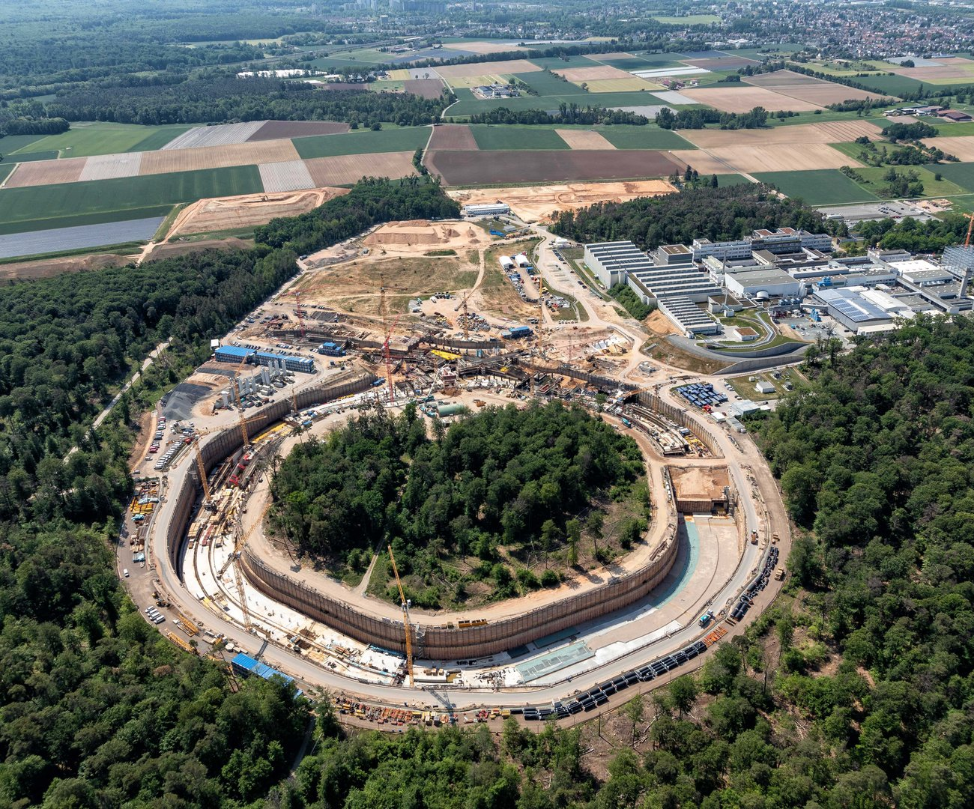
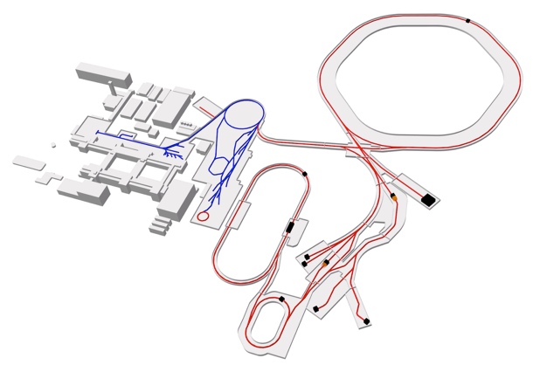
FAIR: a huge construction site
FAIR construction started in 2018
Ring Accelerators
Linear Accelerator
UNILAC
SIS100
SIS18
100 m
APPA
cave
Existing facilities
FAIR beamlines
Experiment stations
APPA stations
May 2020
April 2021
Oct. 2022
Storage
Rings

Slide 7
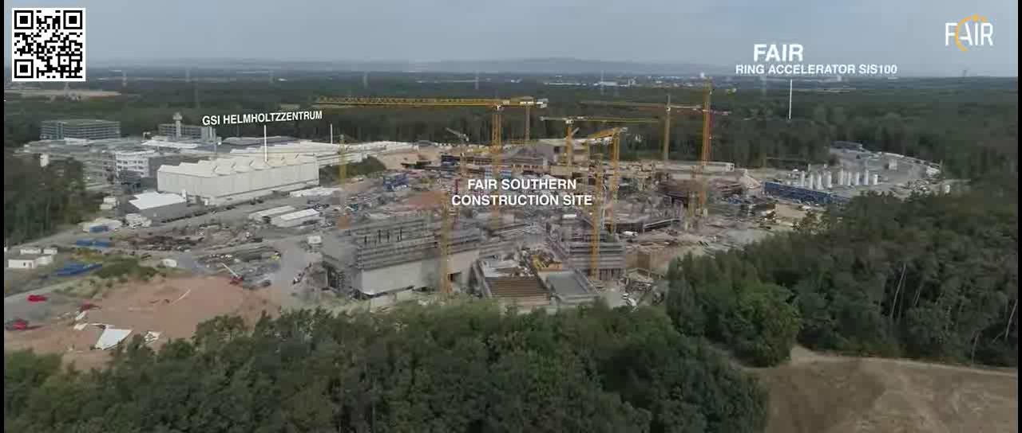
FAIR video…

Slide 8
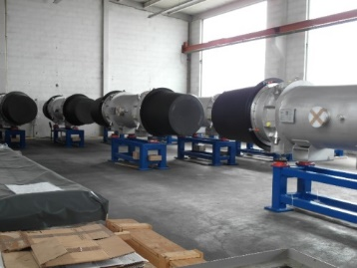
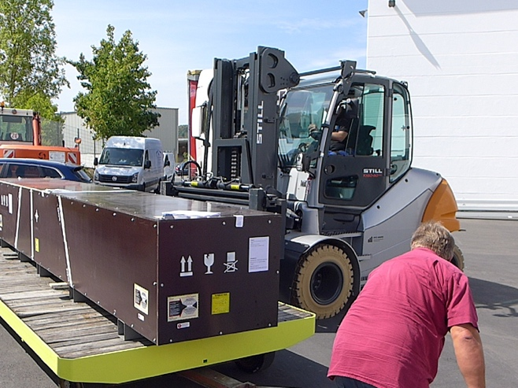
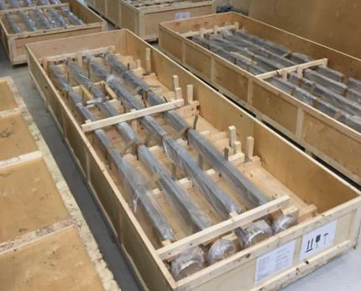
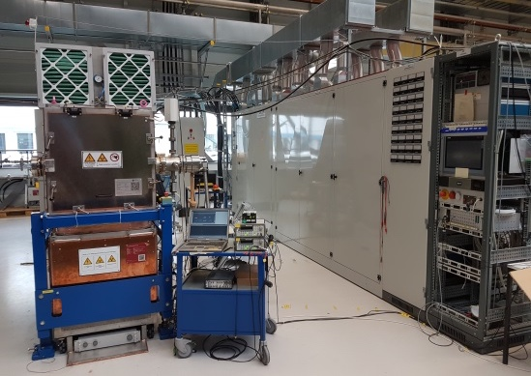
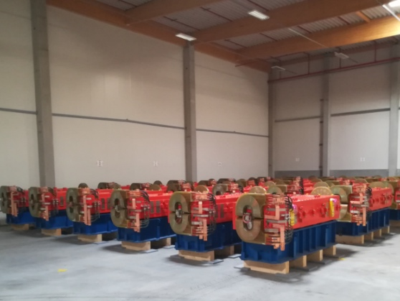
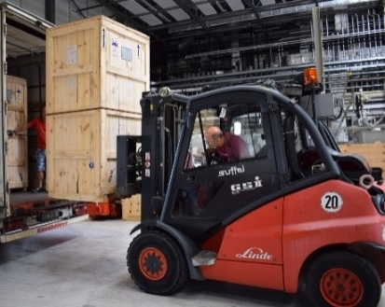
Status of FAIR: Accelerators: construction / procurement progress
~ 60 sc dipole SIS100 modules manufactured at BNG and 55 shipped to GSI and tested
SIS100 quadrupole units shipped from JINR to BNG for integration into FOS module
All 51 HEBT vacuum chambers of batch 1 delivered (BINP, Russia)
The series production of RF – debunchers
All HESR Dipoles are produced, in Jülich and 65% are delivered to FAIR
Delivery of 1st 6 series Power Converter from India, (ECIL, India)

Slide 9
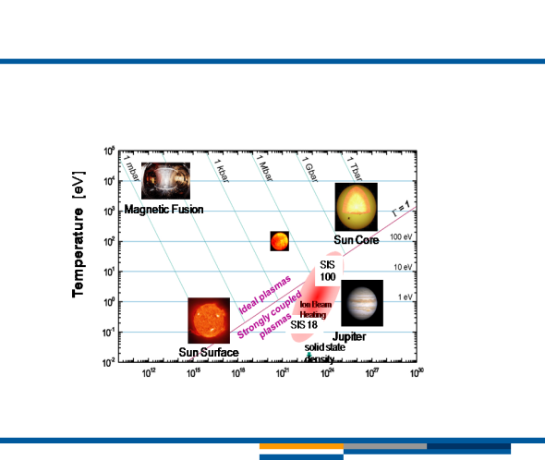
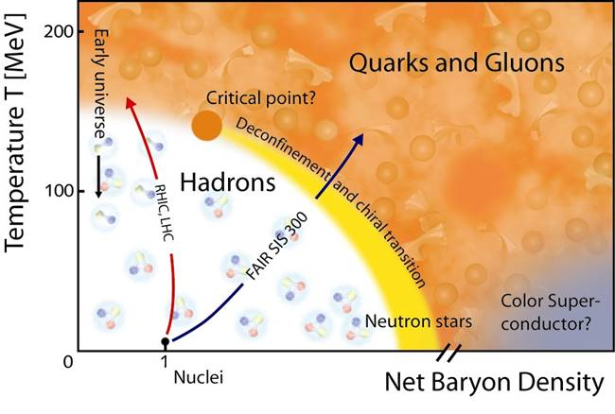
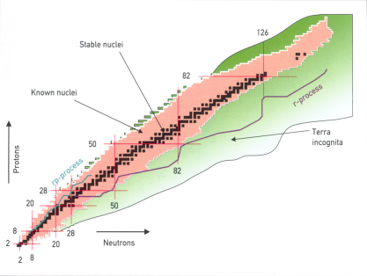
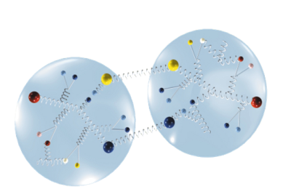
The FAIR science: the four pillars
atomic physics, biophysics, plasma physics, material research, other applications
APPA
CBM
nuclear- and quark-matter
nuclear structure and
nuclear astrophysics
NuSTAR
hadron structure and dynamics
PANDA

Slide 10
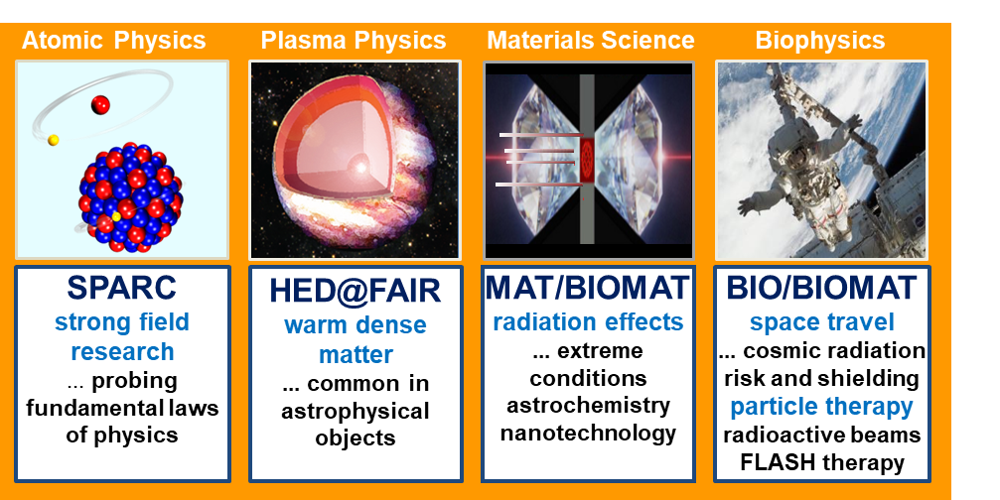
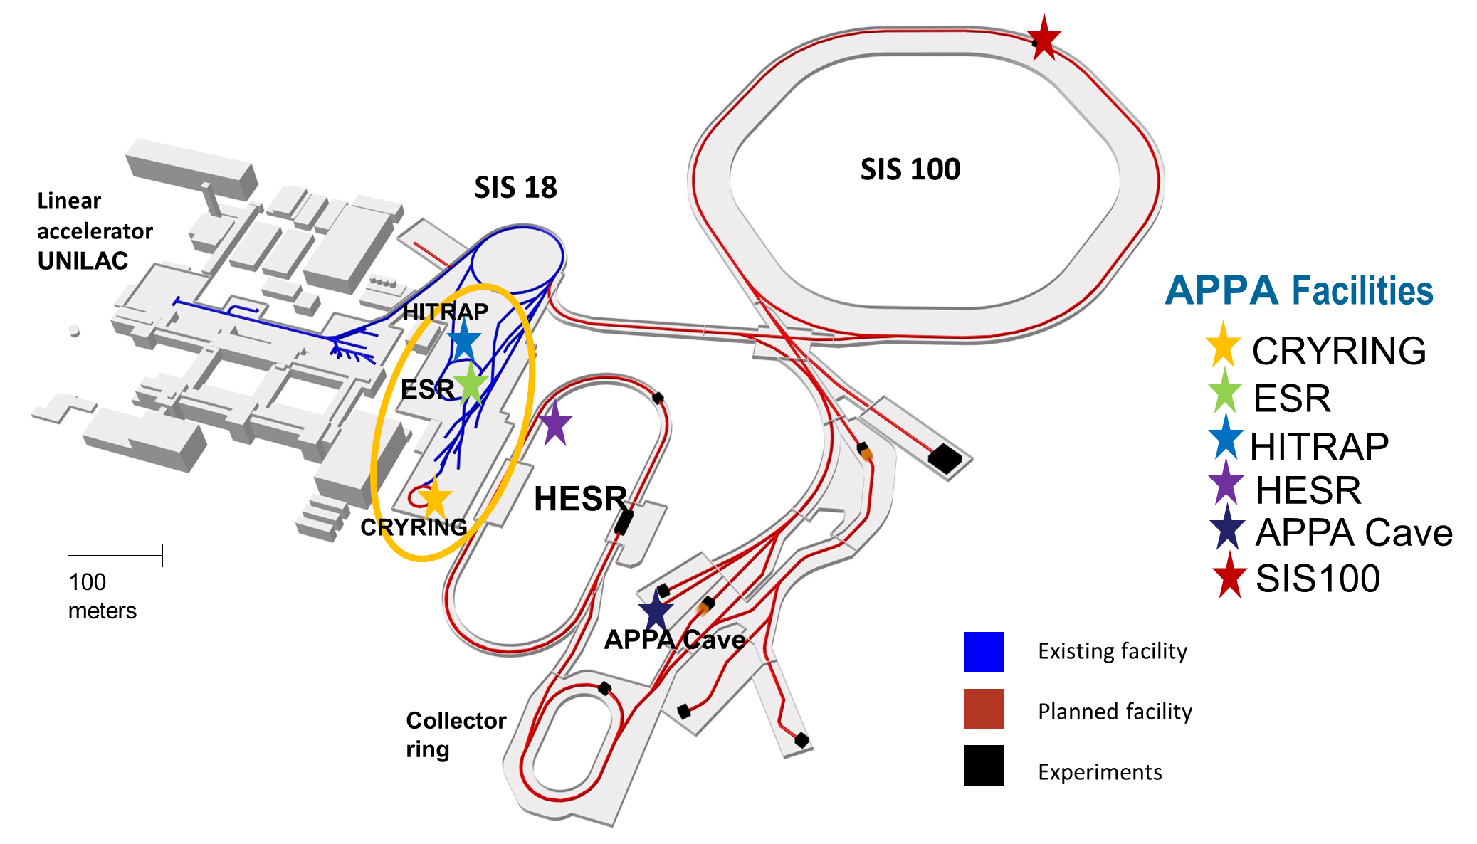
Facilities of APPA at FAIR
(Atomic and Plasma Physics and Applied sciences)
APPA science program aims at exploiting the full parameter range of FAIR beams at different experimental areas.
APPA has been formed to jointly coordinate common experimental installations such as the APPA cave and to use synergies in selected research projects.

Slide 11
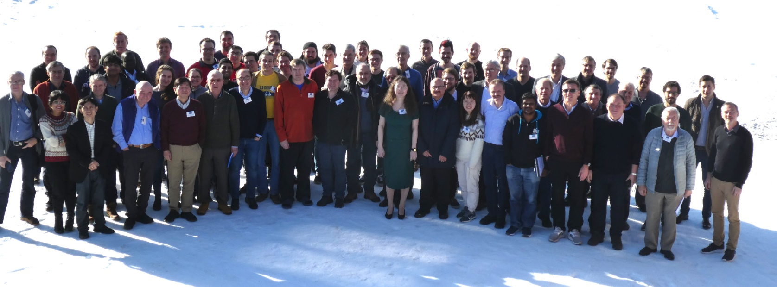
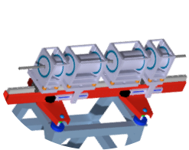
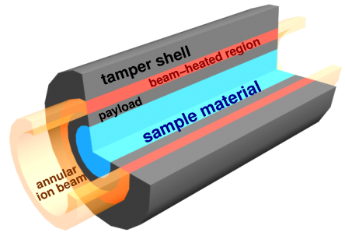
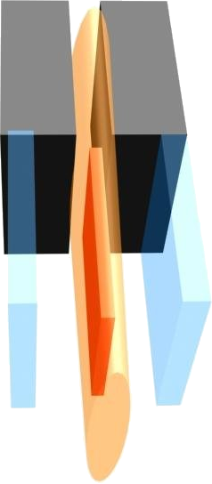
HED@FAIR collaboration
HED@FAIR
Spokesperson | Kurt Schoenberg (LANL)
Chair Collaboration Board | Vincent Bagnoud (GSI & TU Darmstadt)
Technical Coordinator | Abel Blazevic (GSI)
Resource Coordinator | Stephan Neff (FAIR)
meeting of the HED community in Hirschegg (2019)
187 members/
11 countries
PRIOR
HIHEX
LAPLAS
three experimental schemes

Slide 12
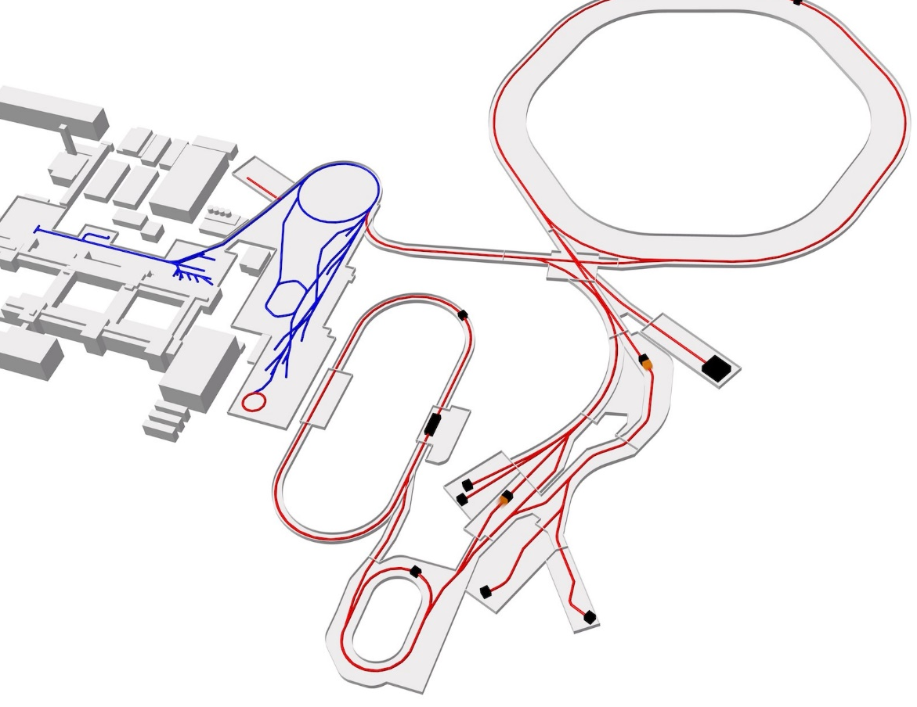
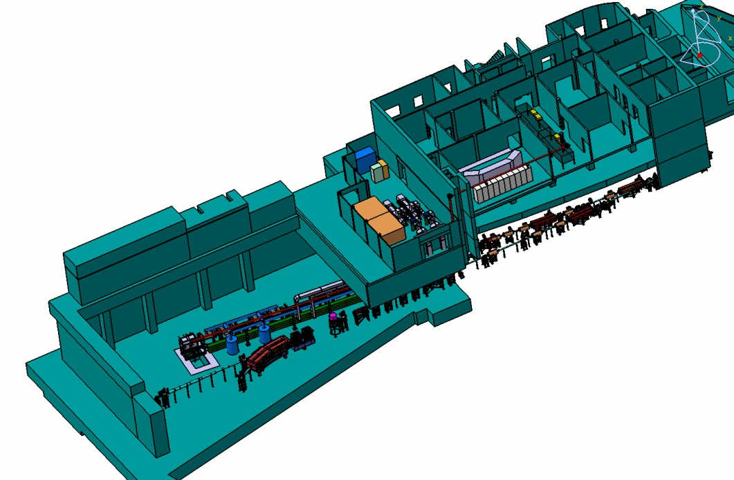
Experiments in the APPA cave
At APPA-cave: 900 m²
protons (10 GeV): 2 x 10¹³ p/bunch
U²⁸⁺ (2 GeV/u): 5 × 10¹¹ ions/bunch
Bunched operation: ≈100ns
SIS100
PHELIX
SIS18
Z6
HHT
HESR
APPA
Cave
Flexible detector settings
Flexible beam shaping
External drivers (HE-laser, pulsed power, gas gun, ...)

Slide 13
Participation of Spain to FAIR
FAIR is an international company under German law. Countries are shareholders.
Collaborations are responsible for organizing access to experimental areas.
  Rules of access (either quotas or merit) are not defined yet.
A participation of Spain as shareholder has been discussed since the first day and is prepared in the FAIR consortium agreement.
  Today, Spain is only represented in NUSTAR (ca. 50 members) as individual participants
Contribution for being official member: 1% of the total costs, right now about 30 M€. Up to 57 M€ appear in discussions.
  In the discussion plays the participation of Germany to IFMIF-DONES (Granada) a symmetric role.

Slide 14
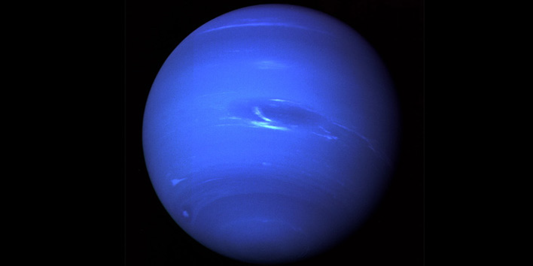
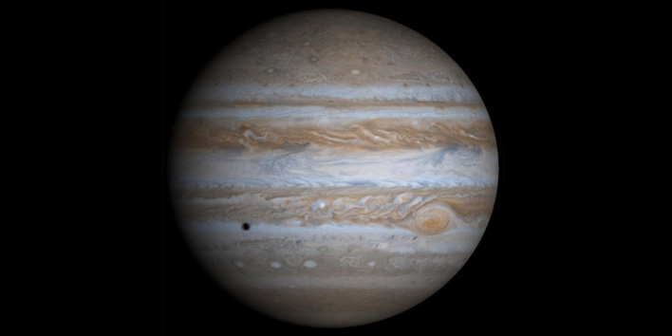
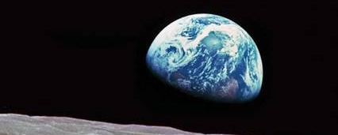
Planetary science questions can be addressed by plasma physics at FAIR
Are there diamond layers in Uranus and Neptune? – Ross et al., Nature 292 435 (1981)
Does high density metallic state of water contribute to sustaining magnetic field in Uranus and Neptune? (Stevenson et al., Rep. Prog. Phys. 46, 555, 1983)
What is equation of state of H across range of conditions for Jupiter, how does it separate from He? (Netelman et al., Astrophys. J 683 1217, 2008)
What is exact melting curve of iron? (Anzellini et al., Science 340, 2013 – N. Tahir et al., The Astrophysical Journal Supplement Series 232 (2017) No. 1 )

Slide 15
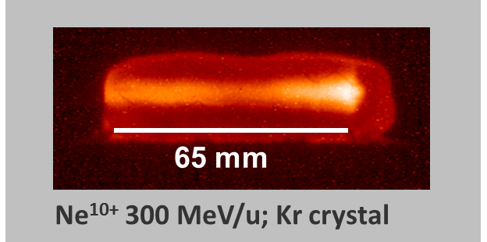
FAIR: extreme states of matter at the mesoscale
HED@FAIR Physics case:
FAIR is an ideal driver for generating warm dense matter (WDM) at near equilibrium conditions
From the time scale (microseconds) and size (mm³), FAIR-generated WDM is highly relevant to planetary science
Projected HED states achievable at FAIR
10⁵
1 Gbar
HED
10⁴
ICF
Laser plasma
1 Mbar
sun core
10³
10²
temperature [eV]
FAIR
Γ = 1
WDM
10¹
Jupiter core
10⁰
earth-like cores
isochoric heating
Solid state density
10⁻¹
compression
10⁻²
10²⁰
10²¹
10²²
10²³
10²⁴
10²⁵
10²⁶
density [ion/cm³]

Slide 16
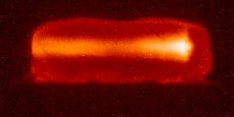
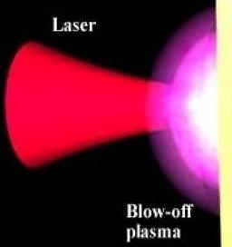
The FAIR facility is complementary to other drivers
Intense, energetic beams of
heavy ions (GSI & FAIR)
High-brilliance XUV photon sources (XFEL & DESY)
65 mm
Ne¹⁰⁺ 300 MeV/u; Kr crystal
large sample volume (mm³)
uniform physical conditions
any target material
long time scales (50 ns)
small sample volume (100 μm³)
high gradients
low-Z target material
short time scales (100 fs)
Advantages of FAIR-generated plasma:
  large samples : mesoscale
  local thermodynamical equilibrium
  uniform samples

Slide 17
Predicted transition of graphite to diamond in FAIR compressed targets [3]
Uranus
ice layer [1]
Earth Geotherm [2]
100
diamond
10
diamond +
metastable graphite
liquid
1
graphite +
metastable diamond
LAPLAS target with a weakly focused ion beam
Pressure (Gpa)
Conditions naturally meet planet interior conditions
Exploration of the diamond phase > 1 μs, uniform volume ~1 mm³
Unique experimental possibility
0.1
graphite
vapor
0.01
area covered by FAIR
heating path
0.001
0
2000
4000
6000
8000
10000
[1] M. Ross et al., Nature 292, 435 (1981)
[2] data from https://www.geo.arizona.edu/xtal/geos306/geotherm.htm
[3] N. Tahir et al., submitted to scientific report
Temperature (K)

Slide 18
FAIR is ideal to study iron using the LAPLAS scheme [5]
Melting curve of Iron
DAC measurements¹
earth core
conditions
1000K uncertainty
10000
DFT² (theory)
Diffusion Monte Carlo³ (theory)
MD⁴ (theory)
8000
20% ions on axis
4
3
6000
2
Temperature (K)
LAPLAS*
4000
1
ions on axis
LAPLAS
2.5 x intensity
2000
no ion on axis
high-Z material compression with annular ion beam
0
0
0.5
1
1.5
2
2.5
3
3.5
4
4.5
5
S. Anzellini et al., Science 340, 466 (2013)
D. Alfè et al., Phys. Rev. B 79, 060101 (2009)
E. Sola et al., Phys. Rev. Lett. 103 , 078501 (2009)
A. B. Belonoshko et al., Phys. Rev. Lett. 84, 3638 (2000)
Pressure (Mbar)
[5] N. Tahir et al., The Astrophysical Journal Supplement Series 232 (2017) No. 1

Slide 19
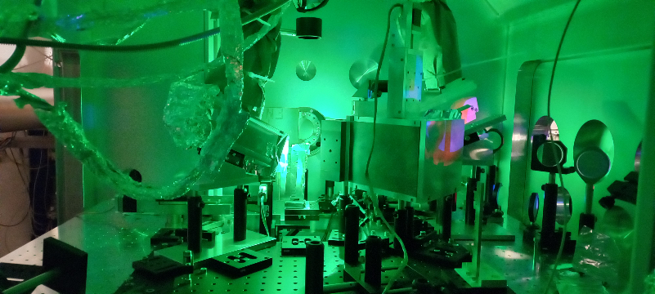
Lasers as backlighters for HEDP
Laser-driven secondary sources are highly penetrant and undergo a fast-tracked evolution
AT GSI/HHT a test stand for backlighting with nanosecond-laser-based incoherent x-rays is in operation since 2021
  x-ray transmission and imaging provide density measurements
  x-ray spectroscopy gives access to temperature measurements
At FAIR, more effective backlighter technologies must be employed
  high flux of hard x-rays (20-100 keV), semi-coherent x-ray sources (betatron) and particle sources (neutrons, ions, electrons) will bring complementary information.
A backlighter laser for FAIR must be a short-pulse high-energy laser matching the repetition rate of FAIR
GSI/HHT experimental platform
HIHEX at HHT
PHELIX
ions

Slide 20
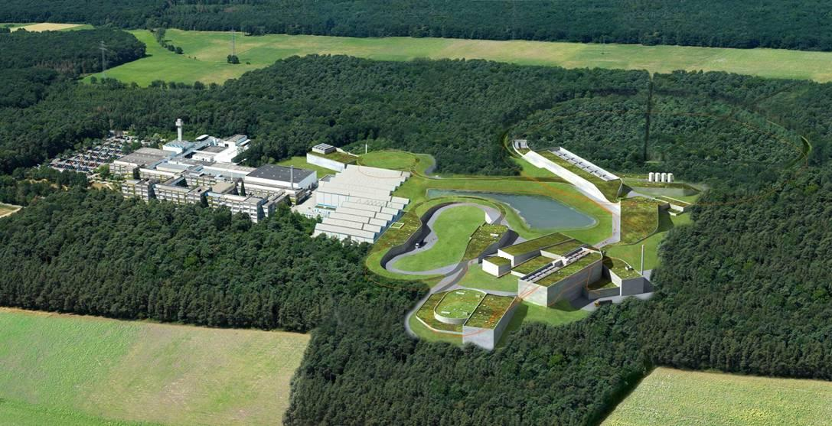
The Helmholtz Beamline at FAIR
Helmholtz-Beamline
Scope:
Building a kilojoule high-repetition-rate laser
Use:
Advanced diagnostics for HED targets at the high-energy cave (backlighting with X-rays, ions, neutrons, electrons)

Slide 21
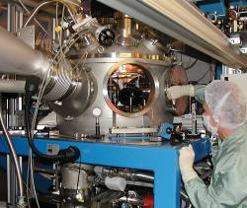
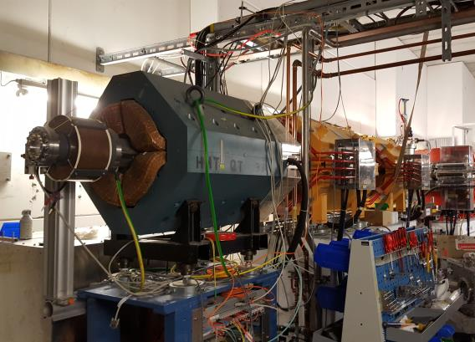
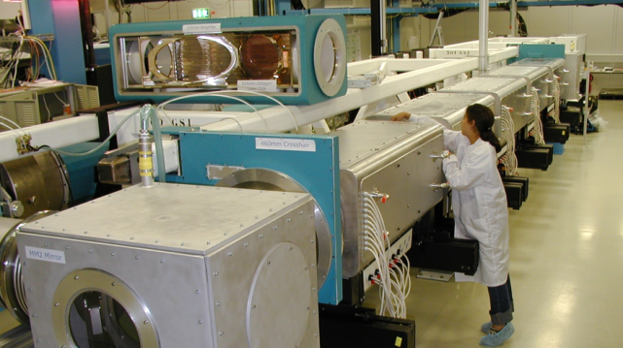
Experimental sites at GSI for Plasma Physics until 2028
Target station Z6 at UNILAC
Target station HHT at SIS18
Ions
energy: 3 - 12 MeV/u
intensity: ~1 pmA
Ions
energy: 400 MeV/u
up to 10¹⁰ ion/pulse
Laser (2020)
200 J, 2ω, 0.3- 10 ns
SIS
Laser
200 J @ 1 – 10 ns, 2ω
30 J @ 0.3 – 2 ps (100 TW)
Z6
HHT
PHELIX
High Energy / High Intensity Laser
PHELIX
UNILAC
stand alone experiments
0.5 PW, 200 J @ 400 fs
high temporal contrast
double-beam option

Slide 22
PHELIX is the work horse of plasma physics at GSI
Injection box
Faraday
Isolator
Main Amplifier
Sensor
Target
Chamber
diagnostics
Petawatt
Compressor
100 m

Slide 23
Consequences of the international situation
Because of Brexit + increase in material costs: construction prices in the Frankfurt area have skyrocketed
Because of the war in Ukraine:
  all contracts with Russian companies & Institutes have been cancelled (exception of Jina)
  all scientific collaborations with Russian institutes have been frozen
The situation creates a bottleneck in the construction of the accelerator
  lots of components missing for SIS-100 and the high-energy beam transport
A new plan is in preparation with the priority on:
  early science for NUSTAR (R3B) in 2025-2026
  completion of SIS-100 until 2028
Consequence: >5 year delay in the APPA cave (and PANDA and rest of NUSTAR)

Slide 24
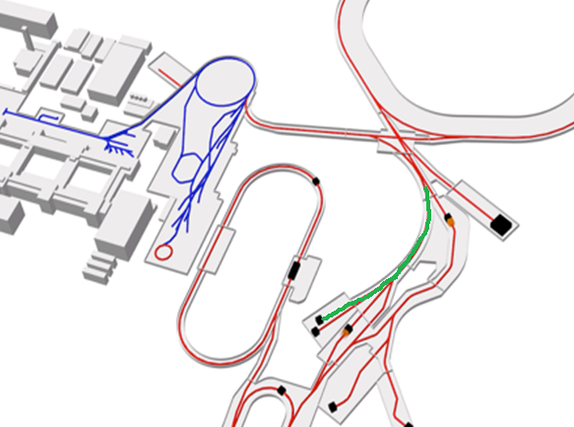
List of missing components for the HED@FAIR beamline
Components from the APPA beamline will be reassigned to the FRS beamline as a consequence of the missing Russian contribution
Cost for re-procurements
  Vacuum (vessels + tubes + valves): 1,144 k€
  Beamline magnets: 7,400 k€
  Supra-conducting magnet: 4,460 k€
  total : 13,004 k€
Compared to the amount of a possible Spanish contribution (57 M€) – we would like to see ~ 25% for HEDP
SIS100
APPA
cave
Storage
Rings

Slide 25
FAIR is on its way
summary
At FAIR, most of the raw construction will be finished next year (except HESR and CR)
But HED@FAIR is most impacted by the consequences of the international situation
  we look for 21 M€ to avoid strong delays for the APPA cave
    ~5 M€ are necessary to finish the building infrastructure (electro, services,…)
    ~13 M€ are necessary to procure the components for the beamline (magnets + vacuum)
    3 M€ are necessary to equip the target area (controls, detectors, backlighter laser)

Slide 26
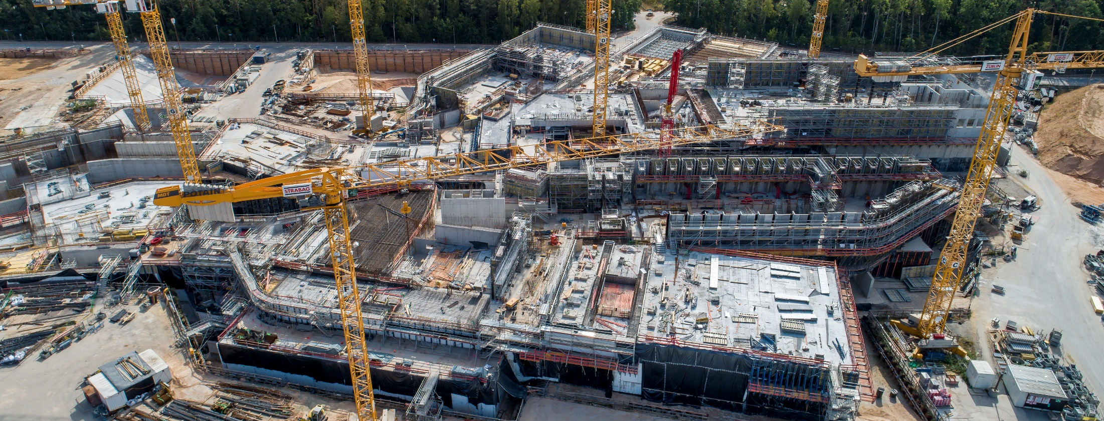
Thank you
air view of the FAIR southern buildings (NUSTAR & APPA Caves)

