Slide 1
GLAD status, upgrade & maintenance
R3B Collaboration Meeting
20221115 GSI Darmstadt
H. Simon ●
GSI Darmstadt

Slide 2
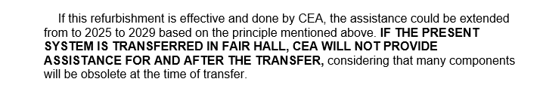
Remaining issues: 20220607
Improved field maps → Based on Valeriis field maps inconsistencies with tracker have been found (M . Heil / A Kelic-Heil )
➔ Dedicated mapping foreseen (3t mapping table to be installed after exp. campaign, Measurements until 20220626).
In-kind accepted (France/Germany)
In-kind contracts closed
Maintenance contract closed preventive maintenance and hot-line support (10k€/y)
Documentation received 05/2022 / approval by QA pending
Common funds via NUSTAR → ECE/ECSG (193k€@2005)

Slide 3
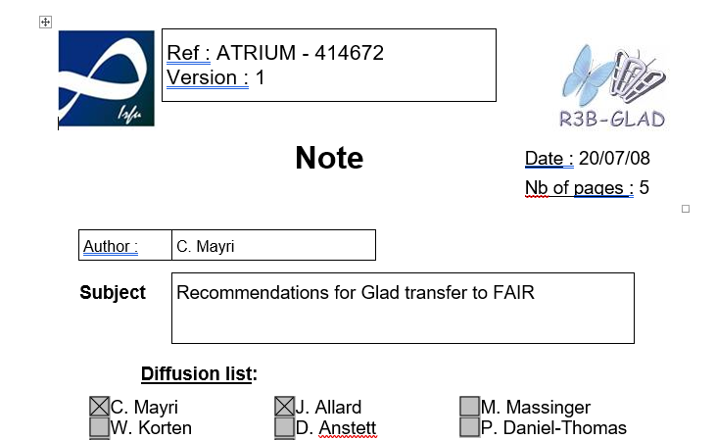
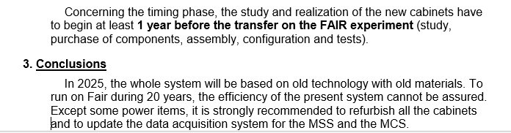
Scope:
Cabling, Magnet Control, Magnet Safety System, Software
Price tag: roughly 200k€ ➔ refined estimate 11/2021.

Slide 4
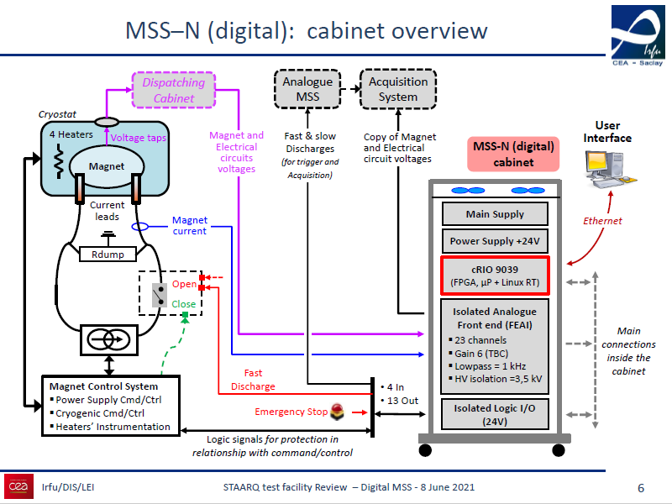
CERN HL-LHC project

Slide 5
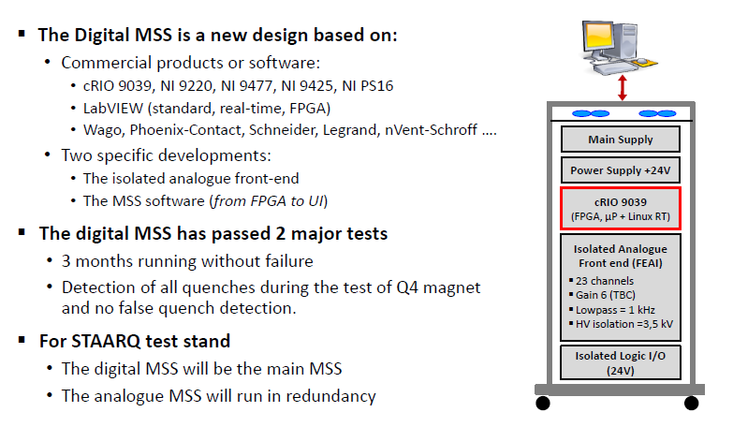
Proposed CEA Design for refurbishment

Slide 6
MCS refurbisment
Some components cannot be maintained after 2025. That includes the PLC and the Muscade software.
The CABTR are operational but cannot be replaced. It is strongly recommended to replace them by CABTF.
The helium box and the ProfiBus could be replaced by more recent and industrial components : LM510 box and ProfiNet. The helium gauges will be replaced.
Other spare components like Sipart, heaters, cabinet equipment may be purchased without replacing the installed ones.
There is a big incertitude on the cable replacement if they are not compatible with Fair safety standards or if they are too short.
Put on hold, can be replaced as part of preventive maintenance (2025-)

Slide 7
Glad CS refurbishment CEA Saclay 2021/11/04

Slide 8
Context
The assistance contract is valid until 2025. It should be extend to 2029 if the magnet control system is refurbished,
The MCS design is dated from 2014 and its building from 2015. Some components are already obsolete.
The MSS design is second generation architecture. We are shifting on numerical safety system (5th generation).

Slide 9
Proposals
CEA-Irfu made a proposal in 2020 for a whole refurbishment of the systems (except the heater cabinets). The estimated cost was 300 k€ of hardware and 300 k€ of manpower (the proposal text indicates 100 k€ by mistake). (internal !)
We studied other scenarios reusing a part of the present cabinets. In this case, it is recommended to purchase some spares. In case of failure, there is a risk to quench the magnet and to loose many experimental days.

Slide 10
MCS refurbisment
Some components cannot be maintained after 2025. That includes the PLC and the Muscade software.
The CABTR are operational but cannot be replaced. It is strongly recommended to replace them by CABTF.
The helium box and the ProfiBus could be replaced by more recent and industrial components : LM510 box and ProfiNet. The helium gauges will be replaced.
Other spare components like Sipart, heaters, cabinet equipment may be purchased without replacing the installed ones.
There is a big incertitude on the cable replacement if they are not compatible with Fair safety standards or if they are too short.
Put on hold, can be replaced as part of preventive maintenance (2025-)

Slide 11
MCS cost
Priority | 1 | 2 | 3 | 4
Hardware | 13 k€ | 35 k€ | 6 k€ | 6 k€
Manpower | 45 Tech.days | 5 Tech.days | 5 Tech.days
There is also all the manpower for the design, the test, the cabinet unwiring and rewiring, and the new system commissioning on Fair.
This work needs 30 days of engineer and 110 days of technician.
We recommend to perform the priority 1 and 2 and to provide the spares (priority 4) for a cost (2021) of :
- hardware 54 k€
- manpower 100 k€
The cable replacement cost is about 40 k€ and 10 k€ of manpower

Slide 12
MSS refurbisment
The present MSS cannot be transferred on Fair and has to be updated in numerical version. Without replacement, the magnet should be damaged in case of main failure.
The As-net (V1) should be maintained by purchasing some spare components. It should be updated in version 2 as soon as it will be operational. The cabinet equipment may be purchased without replacing the installed ones.
There is a big incertitude on the cable replacement if they are not compatible with Fair safety standards or if they are too short.

Slide 13
MSS cost
Priority | 1 | 2
Hardware | 89 k€ | 35 k€
Manpower | 105 Eng.days 90 Tech.days | 5 Tech.days
There is all the manpower for the design, the test, the cabinet unwiring and rewiring, and the new system commissioning on Fair.
This work needs 80 days of engineer and 50 days of technician.
We recommend to perform the priority 1 and the spare procurement for a cost (2021) of :
- hardware 100 k€
- manpower 210 k€
The cable replacement cost is about 30 k€ and 10 k€ of manpower

Slide 14
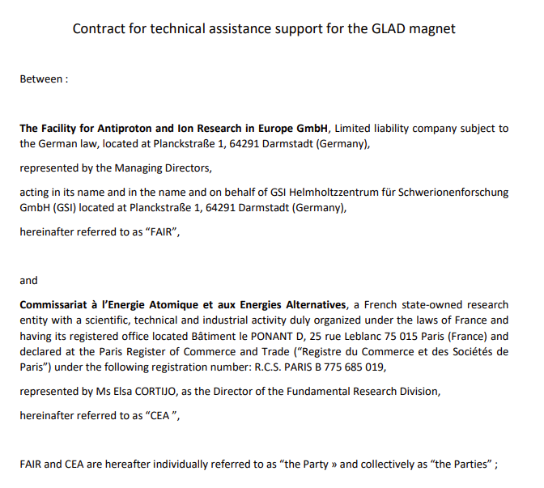
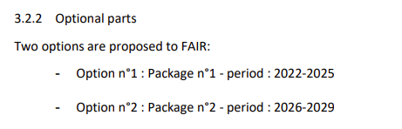
Update on funding stuation
NUSTAR common fund 300k€ meanwhile in allocation via FAIR directorate (still this year).
Ongoing: formal order for „option 1“ – maintenance and associated payment 10k€/a.
Next step: „option 2“ - start setting up acquisition system already in 2023 - run and commission in parallel to tests, field mapping (`23)
Documentation now in EDMS and approved by QA

Slide 15
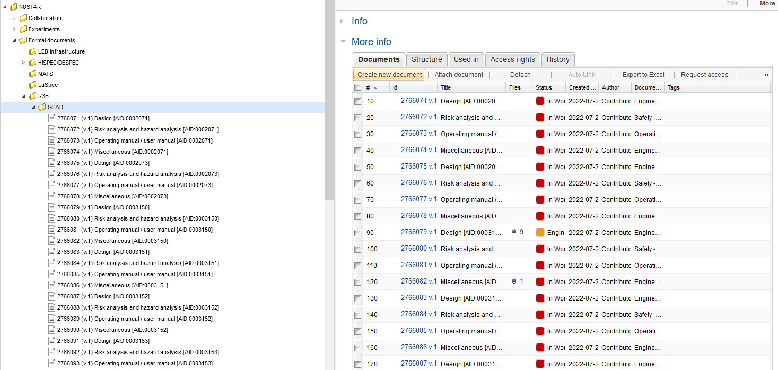
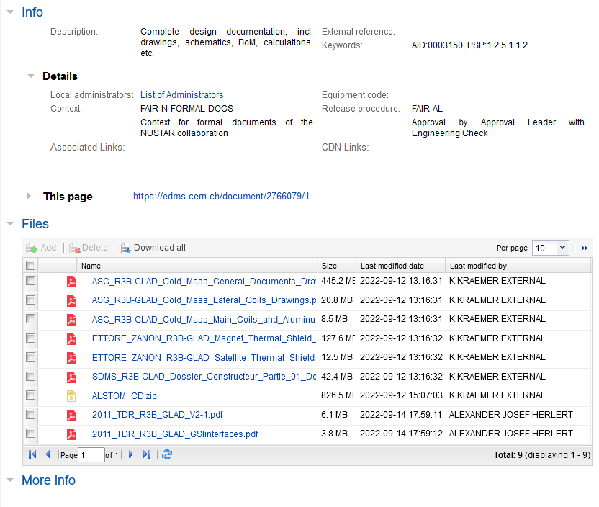
Documents scanned and final payment released
GSI-CEA final delivery contract curing increased project cost
- non conformity: „documentation“ now ok

Slide 16
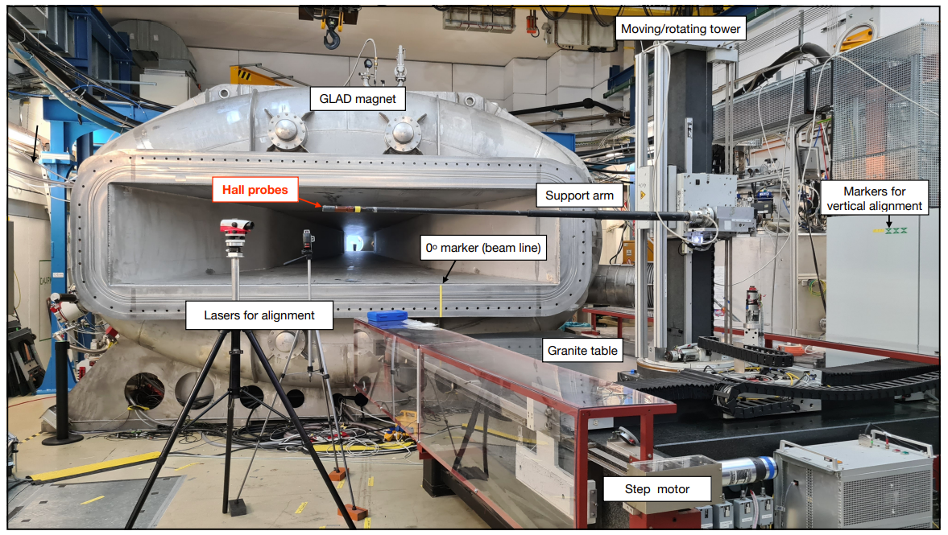
Field measurements (Draft report/analysis by V. Panin)

Slide 17
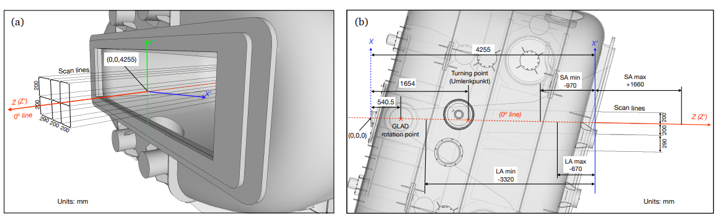
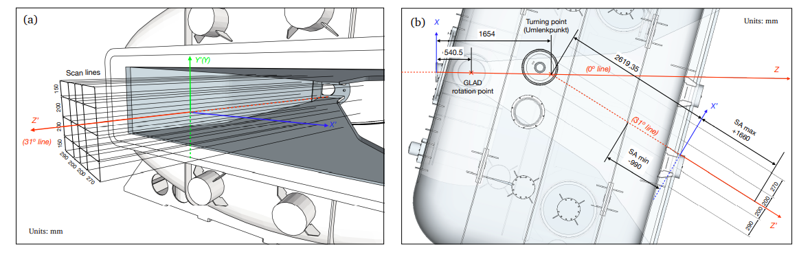
Field measurements from exit flange, 0° and 31°

Slide 18
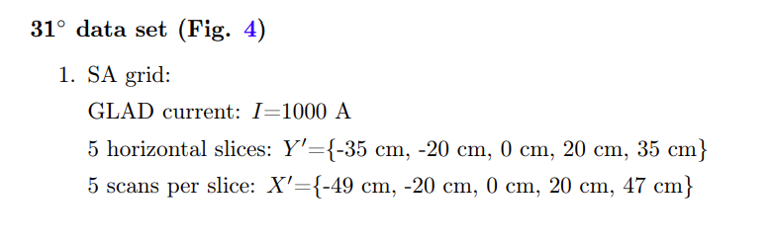
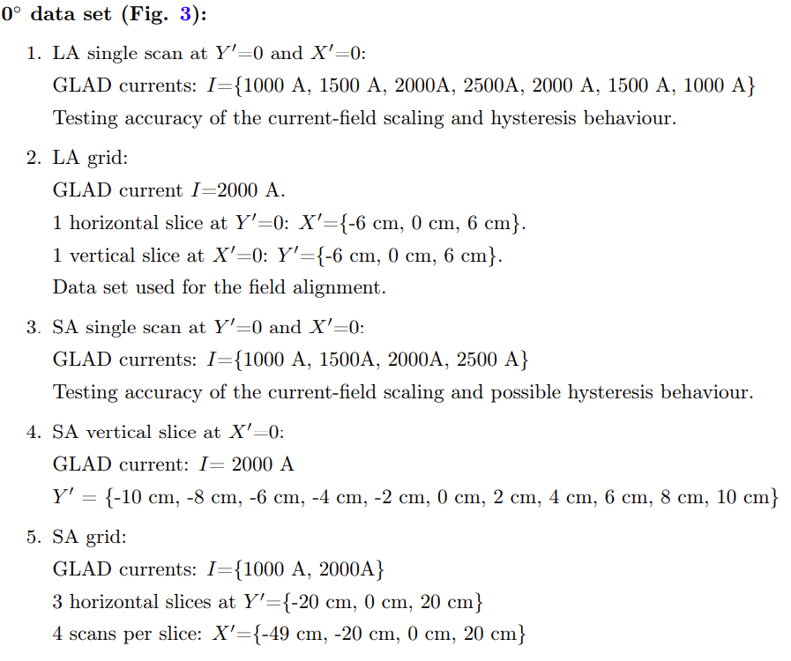
Field measurements from exit flange, 0° and 31°
Long arm and short arm measurement, restricted range

Slide 19
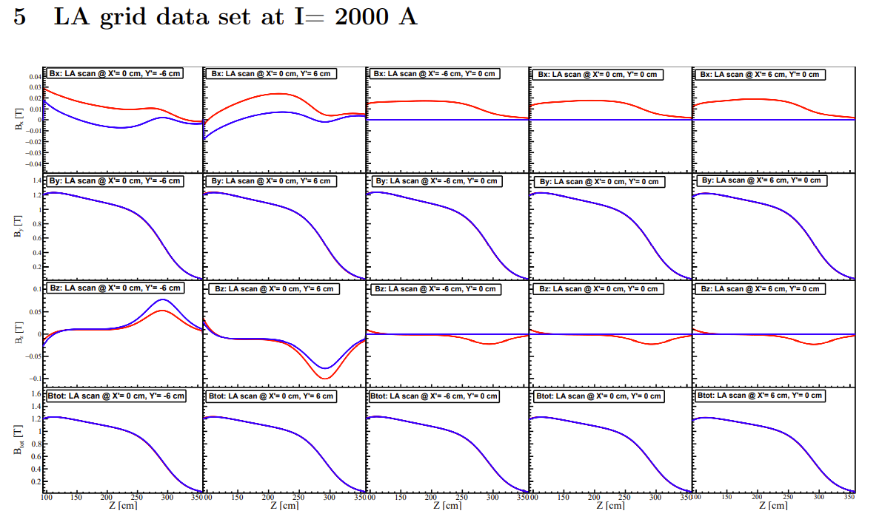
Alignment of field using fit to 0° Data
before alignment
calculated field map
B_{x}
B_{y}
B_{z}
B_{tot}

Slide 20
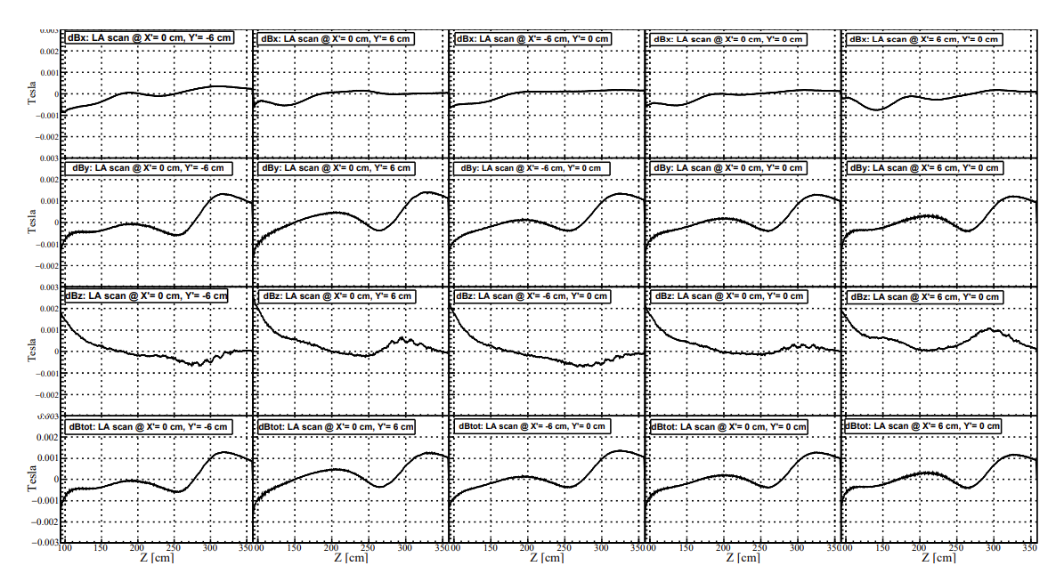
Alignment of field using fit to 0° Data
Residual after alignment about 1mT

Slide 21
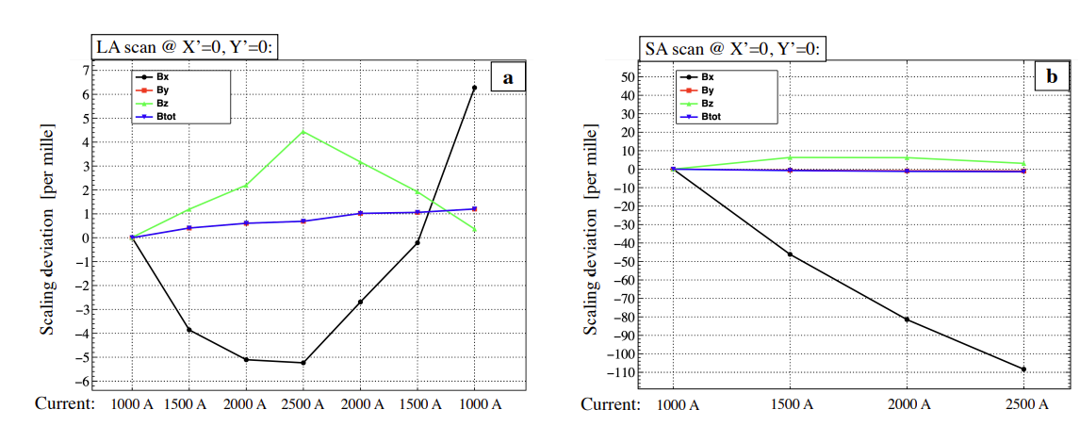
B_{y}, B_{tot}
B_{x}, B_{z}
Integral field, relative deviation of different components to calc., deviations several permille for B_{x} shortarm close to flange!
Hysteresis effect observed!
not yet sufficient information for high precision tracking
Δp/p~10⁻³ (M. Heil, A. Kelic-Heil S454 data)

Slide 22
TODOs
understanding of 31° data
μ_{r} measurement of welds and stainless steel housing
new measurement programme with MSS commisioning 2023
2 weeks measurement time seem achievable
→ optimized program necessary

Slide 23
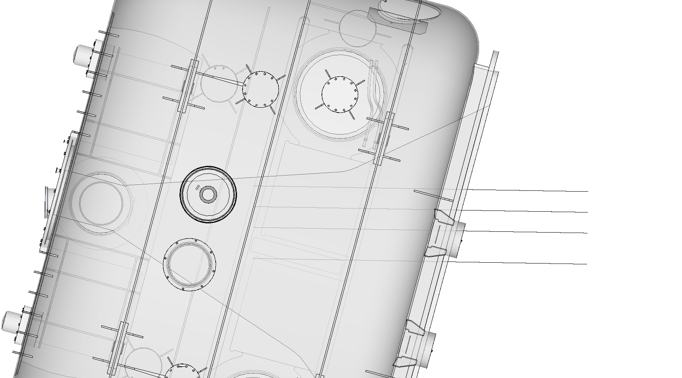
Map measurements with small step ~ 10-20 mm
different currents ?
(b)
X
X’
4255
Turning point
(Umlenkpunkt)
SA min
-970
SA max
+1660
1654
540.5
Scan lines
╳
╳
(0º line)
200
Z (Z’)
GLAD
rotation point
200
(0,0,0)
290
LA max
-670
LA min
-3320
Units: mm

Slide 24
Hysteresis studies, effect of the walls of the chamber and entrance flange
different currents, X,Y +-10cm
(b)
X
X’
4255
Turning point
(Umlenkpunkt)
SA min
-970
SA max
+1660
1654
540.5
Scan lines
╳
╳
(0º line)
200
Z (Z’)
GLAD
rotation point
200
(0,0,0)
290
LA max
-670
LA min
-3320
Units: mm

