Slide 1


Alpide beam test at CERN
By Luke Rose
16/11/2022

Slide 2
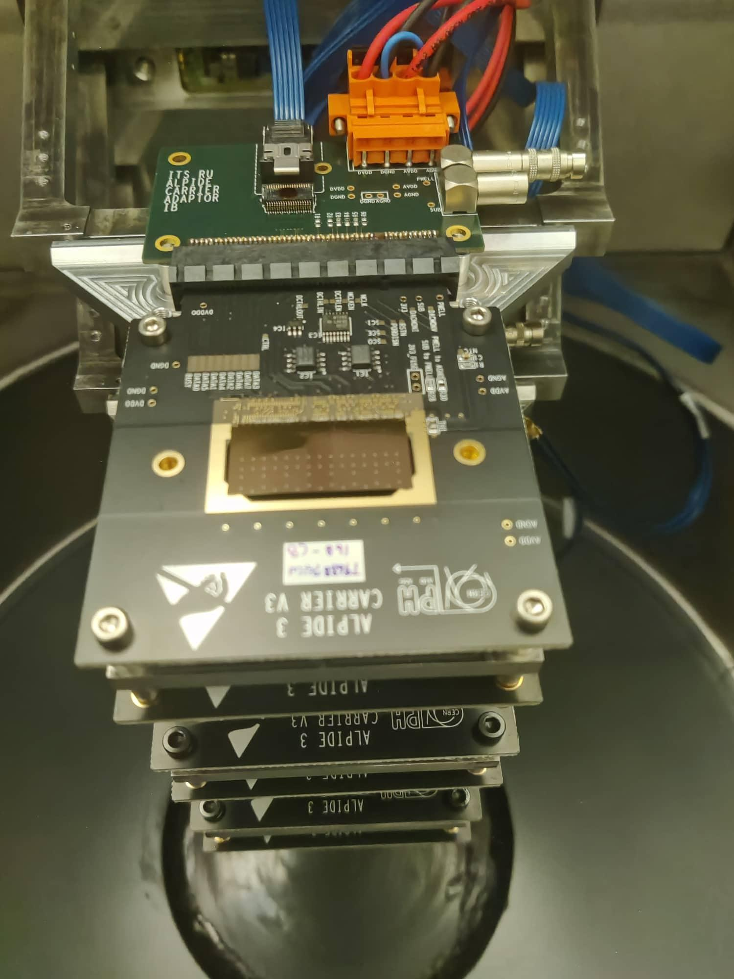
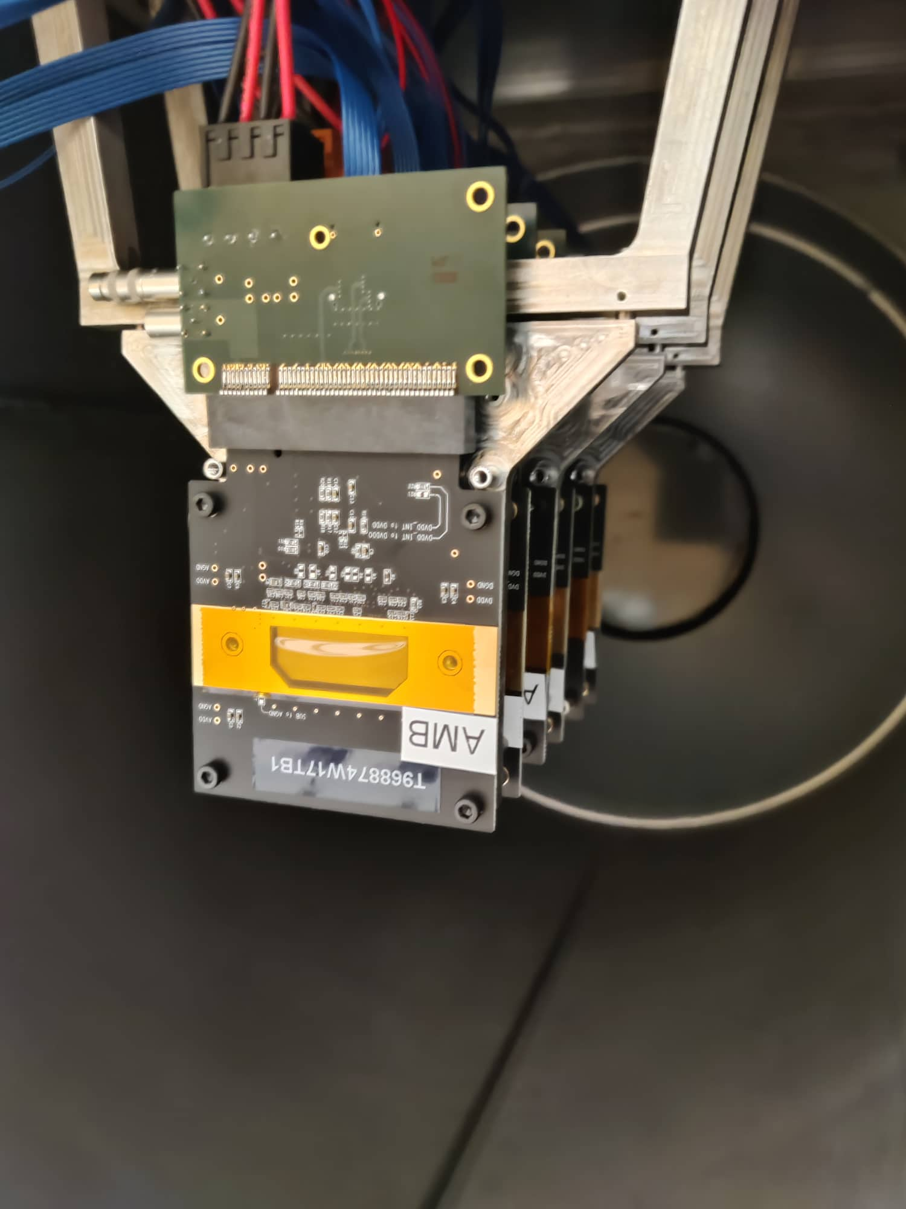
6 Alpides to 6 mosaics

Slide 3
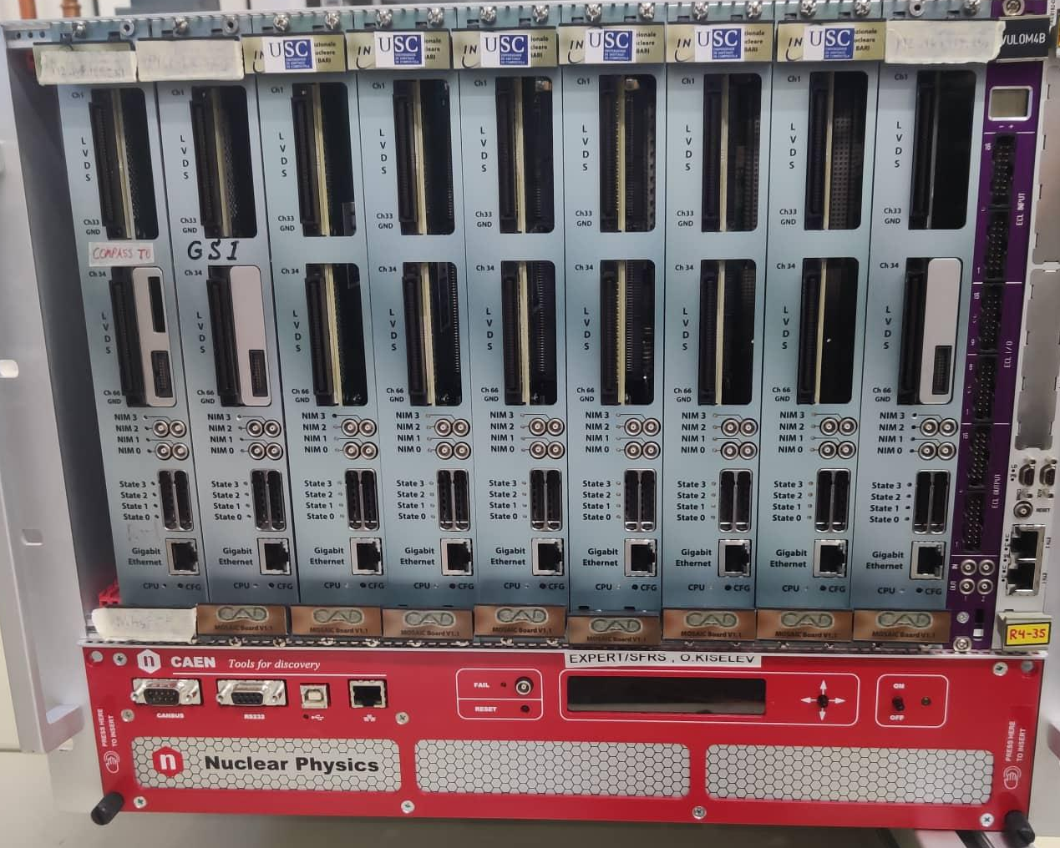
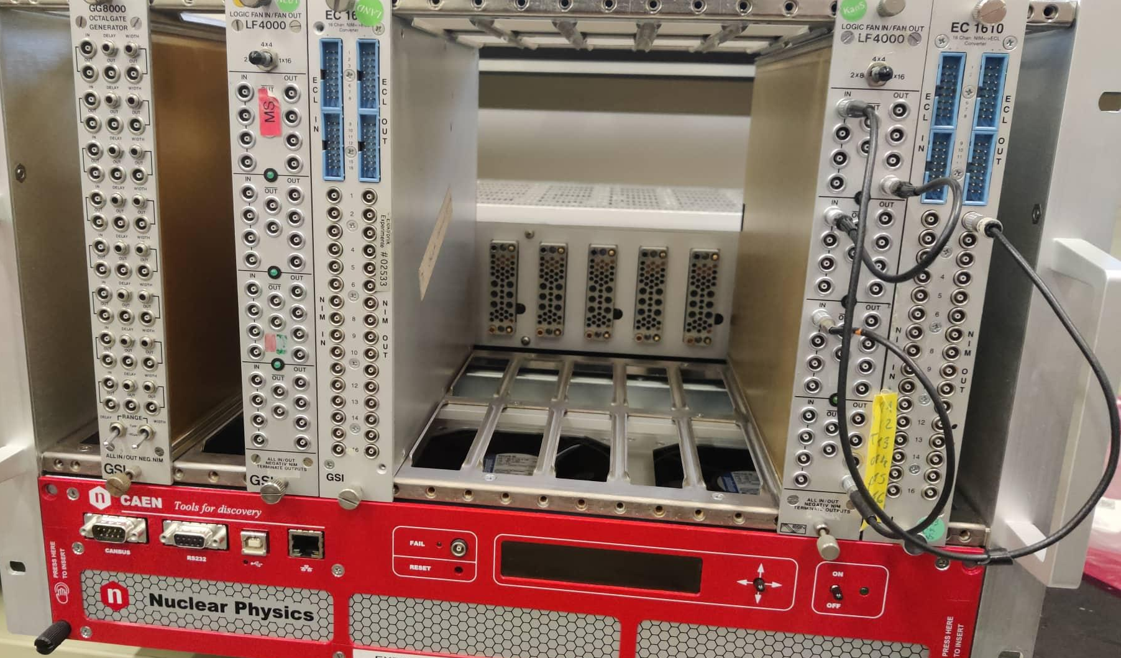
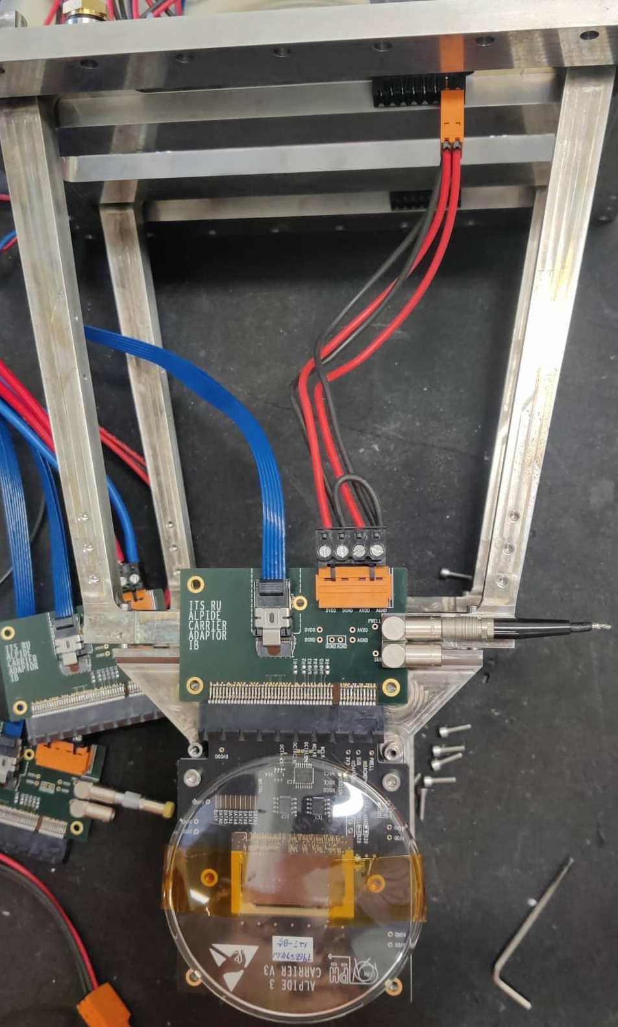
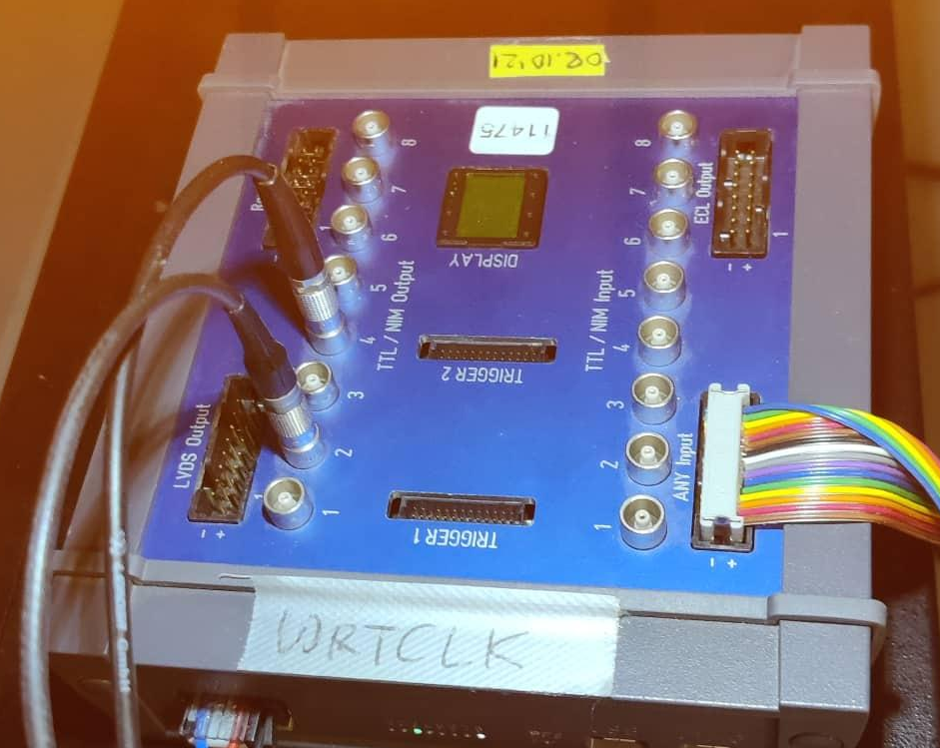
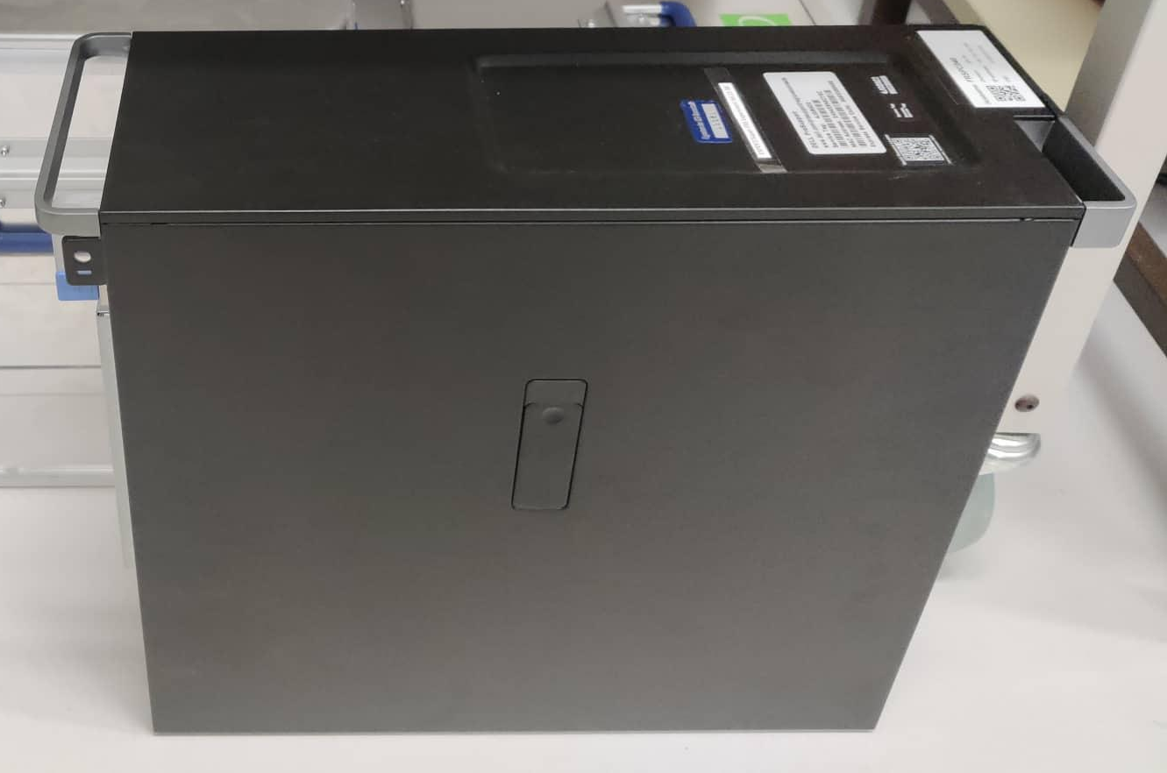
Initial Daq Setup
Pulsar
Data
Trg
Trg
Rio4 ->VME controller configers pulser.
VULOMB 4B->Generate Pulse trigger signal.
EXPLODER->Timestamping WR.
ECL to NIM convertor
FiFo->Distributes trigger and TS to mosaics.
Clock
Data
Data
Data

Slide 4
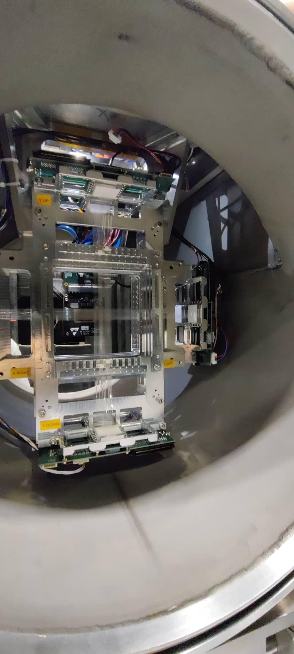
Goals
Use 160 GeV/c Muon beam (MIPs) to create tracks and reconstruction of alpide hit map to verify position resolution (R3B)
To verify the daq functionality with COMPASS random/poisson trigger (R3B & AMBER)
To see if ALPIDE+SiFi detectors are feasible working together (AMBER)
Cluster analysis of “hadronic” beam at varying energies (bonus due to parasitic running).

Slide 5
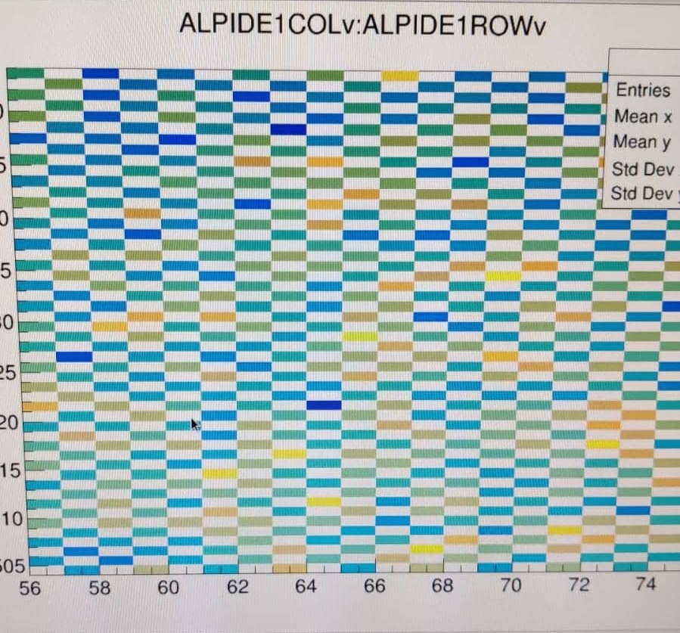
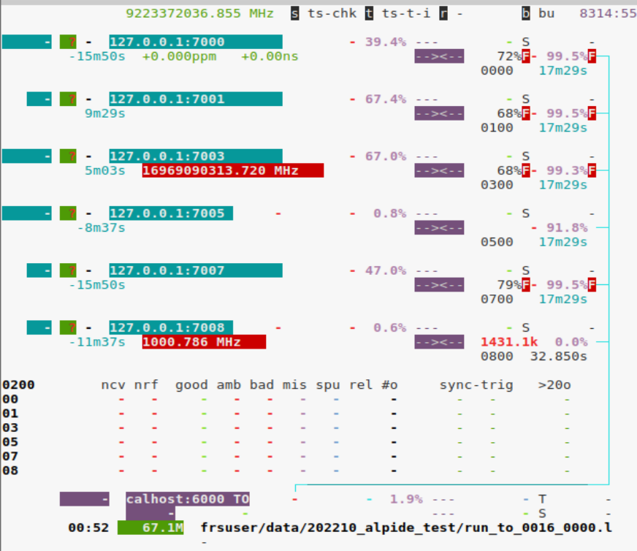
1st hurdle
2nd hurdle
Time sync borked (frequency ratio of the CPU clock vs the received timestamps = 18Phz at max)
Mapping borked

Slide 6
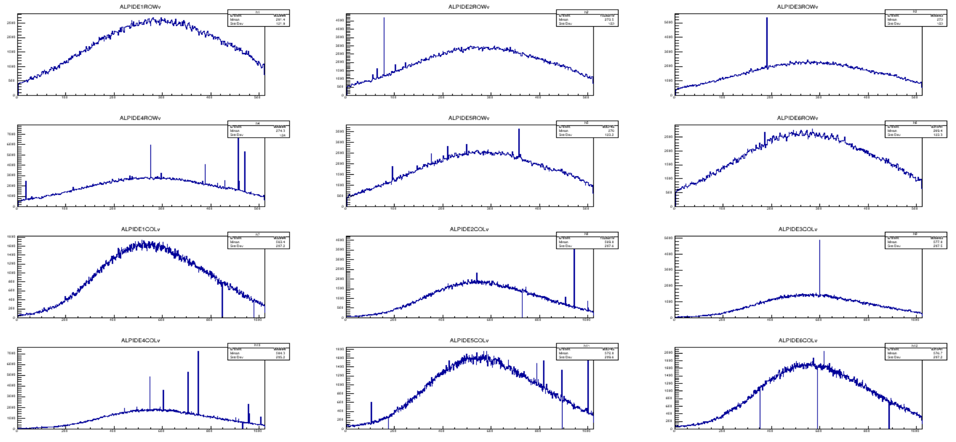
Beam profile -> Noisy channels then suppressed.

Slide 7
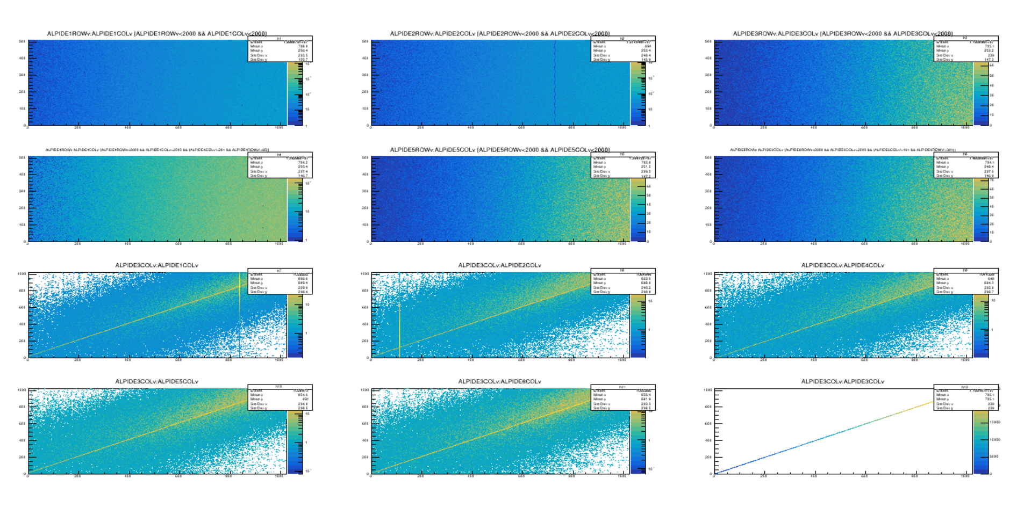
Internal trigger 2000hz ->2MHz beam off center of detector beam 160GeV/c muons

Slide 8
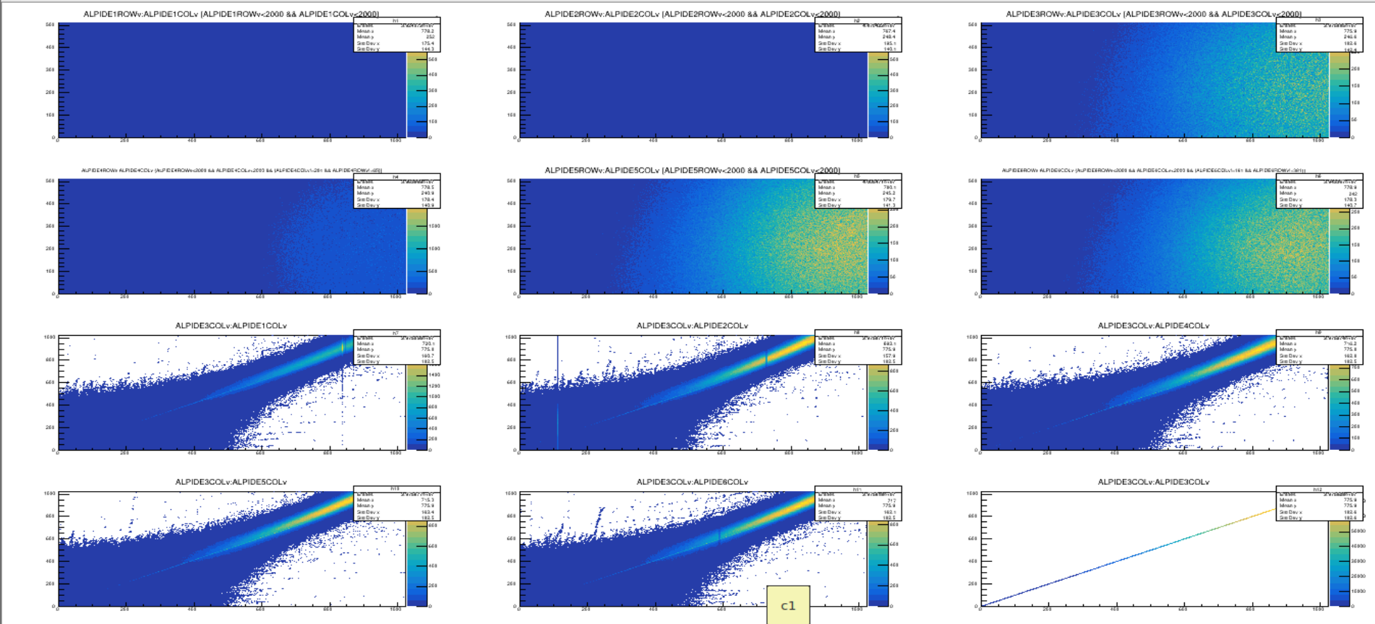
External trigger 3000hz ->2MHz beam off center of detector beam 160GeV/c muons with no clustering applied start to see nice correlation

Slide 9
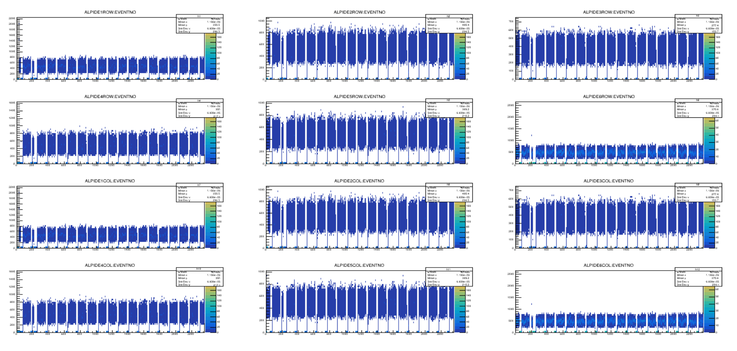
Looking at number of pixels fired per event binned with event number/Timestamp with internal trigger configuration can see beam structure and can confirm the detectors respond the same to beam (Threshold).

Slide 10
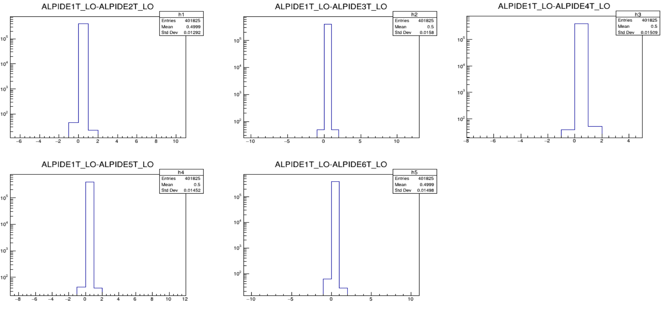
Then using ALPIDE1 as time reference for sync can check timestamp deviation of stitched events, –time-stitch=wr,100 so 100ns of time for dviation here very little deviation so time sync is good !

Slide 11
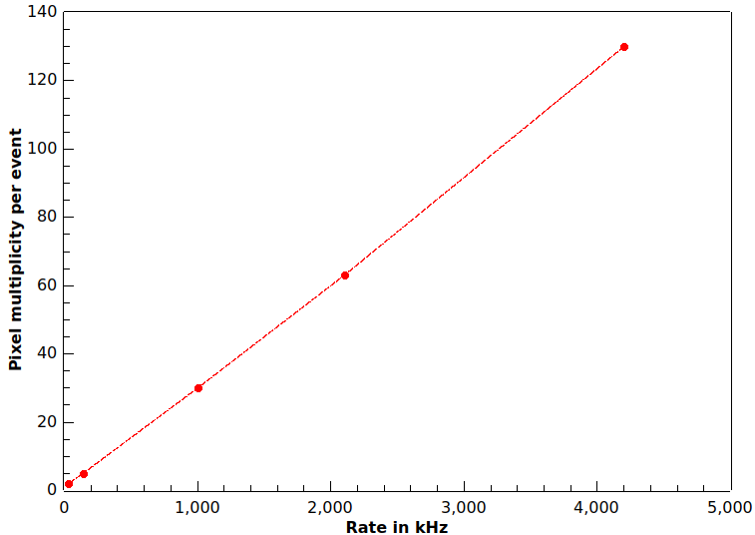
Use of downscaled poisson compass trigger ->maxing around 13kHz
X is beam rate and
y is hits per event

Slide 12
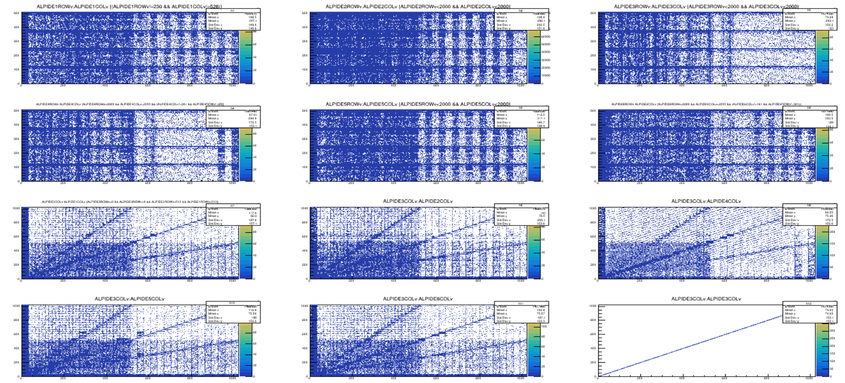
Problems - Mosaic fast link speed failed…Why??

Slide 13
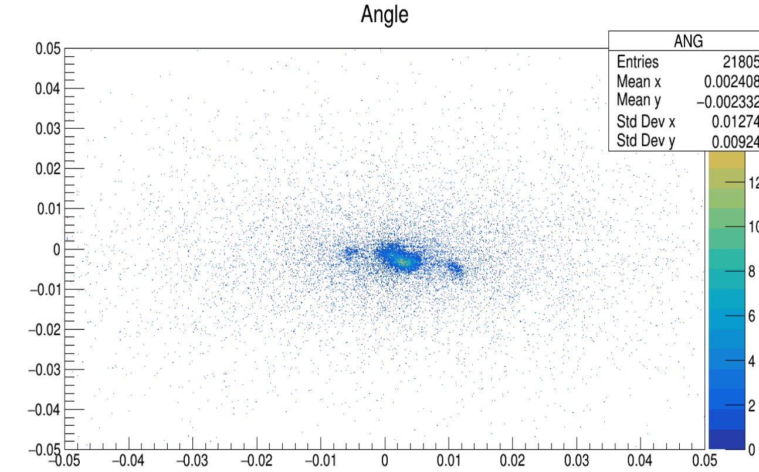
VERY preliminary result
YZ [deg]
XZ [deg]
Crude macro for angle of beam dispersion for single cluster strange artifacts not quantified and not seen in other runs. But (0.01/180)*pi=0.00017rad -> 170μrad over 14cm

