Slide 1
Update on Host Lab computing resources and DAQ WG issues
Bastian Löher, March 2022 – Haik Simon, November 2022

Slide 2
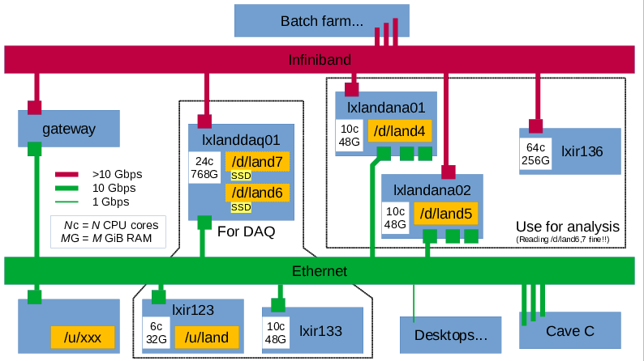
R3B DAQ / Analysis hardware 2022
For DAQ
Online
analysis
Time
sorter
Event
builder
Slide by H. Johansson

Slide 3
R3B Data flow as proposed (NVMe buffer)
Analysis
Nearline data immediately
HDD
80TB
DAQ nodes
(VME/x86)
2nd copy
data is safe
DAQ nodes
(VME/x86)
nfs
DAQ nodes
(VME/x86)
rsync
…
DAQ
Event builder
lxir133
Ethernet
NVMe storage
> 1 GByte/s
possible
Infiniband
DAQ nodes
(VME/x86)
DAQ
DAQ nodes
(VME/x86)
DAQ
DAQ nodes
(VME/x86)
DAQ / rsync
>10TB
1st
copy
Time sorter
lxlanddaq01
1-100 MByte/s
(until 2022)
10TB
LTSM
N * rsync
< 100 MByte/s
(until 2022)
Lustre
🖭
Time sorter / flash storage should be same hardware
TSM

Slide 4
R3B Data flow as proposed (NVMe buffer)
Analysis
Nearline data immediately
HDD
80TB
DAQ nodes
(VME/x86)
2nd copy
data is safe
DAQ nodes
(VME/x86)
DAQ nodes
(VME/x86)
DAQ
nfs
…
Event builder
lxir133
rsync
Ethernet
Infiniband
DAQ nodes
(VME/x86)
DAQ
🖭
DAQ nodes
(VME/x86)
DAQ
DAQ nodes
(VME/x86)
Time sorter
with NVMe
1-100 MByte/s
(until 2022)
LTSM
>10TB
< 100 MByte/s
(until 2022)
TSM
1st
copy
> 1 GByte/s
possible
N * rsync
Lustre

Slide 5
Available System solutions
(20221017 Thorsten Kollegger, Muhammad Al-Turany, Bastiiii, Stephane, Haik)
lxi(r) machines: Rackmount server with interactive login (and local storage /local)
/u available, no lustre mounts
  DAQ controls (screen)
  Event builders
  Time sorter (with disk bandwidth limitations)
  provide nearline storage
  interactive online & nearline-analysis
  interactive offline (with local copy of data) analysis
lxb machines: Rackmount batchfarm nodes only access via queue system
/u not available, direct generic fast luster mounts, load balancing, slices can be reserverd to assure priority
  non-interactive offline analysis
NFS considered harmful
luster cross mounts have safety issues
backup from luster can be done, backup form /local to be found out

Slide 6
R3B Data flow as proposed (NVMe buffer) - ONLINE interactive and batch farm processing - OFFLINE
OFFLINE interactive
NEARLINE
OFFLINE batch
Event builder
lxir133
Analysis
Event builder
lxir133
Event builder
lxir133
lxir
Analysis nodes
lxfsq
* N
DAQ nodes
(VME/x86)
/local
DAQ nodes
(VME/x86)
DAQ nodes
(VME/x86)
3rd .. N^{th} copy
data is safe
DAQ
80TB
🖭
…
Event builder
lxir
„HA“ buffer
fire & forget
Ethernet
Infiniband
lxfsq
DAQ nodes
(VME/x86)
DAQ
rsync
DAQ nodes
(VME/x86)
burst, r&w
DAQ
DAQ nodes
(VME/x86)
Time sorter
with NVMe
TSM
1-100 MByte/s
(until 2022)
>10TB
1st
copy
rsync
UCESB
Lustre
ONLINE (lxir)
Analysis
< 100 MByte/s
(until 2022)
- segmented lustre 2023ff
- last MDS rebuild ?
> 1 GByte/s
possible
Nearline data immediately
/local
80TB
HADES: max latency DAQ to tape 6000s
DAQ->FSQ 50MByte/s * 8 -> 350MByte/s
2nd copy
data is safe

Slide 7
Comments are needed
Analysis work flow needs to be analysed and understood further
  Batch farm use ?!
Potentially we need to maintain 1(+1 spare) solution for the special Time sorter
  NVME DISKS, with SSD RAIDS no issue
Only lxb, lxi(r) machines are supported by IT
/local disk-space has to be provided at collaboration expense – more overall
backup scheme needs to be implemented
  from lustre with large files
  from /local working directories - differential? how long?
Standard solutions have been identified wherever possible …
  drawbacks and compromises to be mitigated !
Viable scheme serves not only R³B but also other NUSTAR experiments, equipment can be shared (as currently being done with the FRS group).

Slide 8
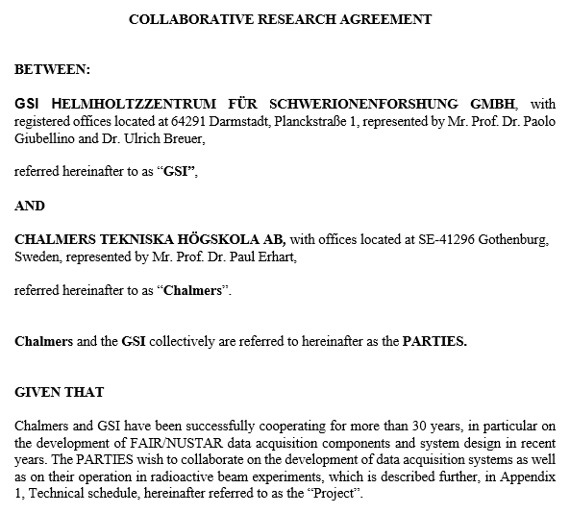
Further steps …
- Renew collaboration
on DAQ issues.
- CTH will be installed as
„friend“ university to the
facility
- Intended Starting:
02/2023
- Collaboration contribution
~30%
- TUDA contribution
~70%

