Slide 1



Califa Simulations for s467 experiment
Luke Rose
17/11/2022

Slide 2
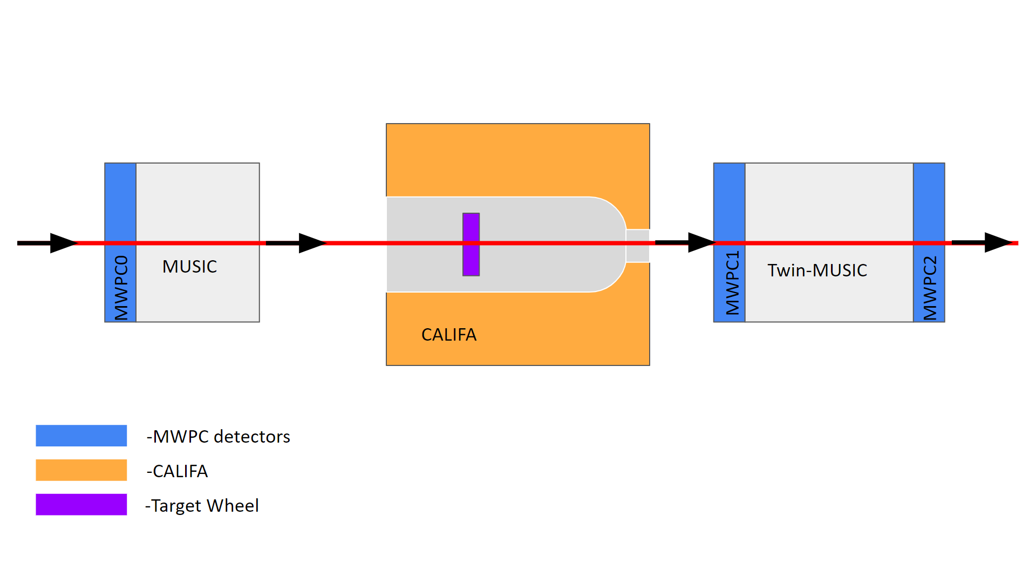
Setup Before Glad(s467)

Slide 3
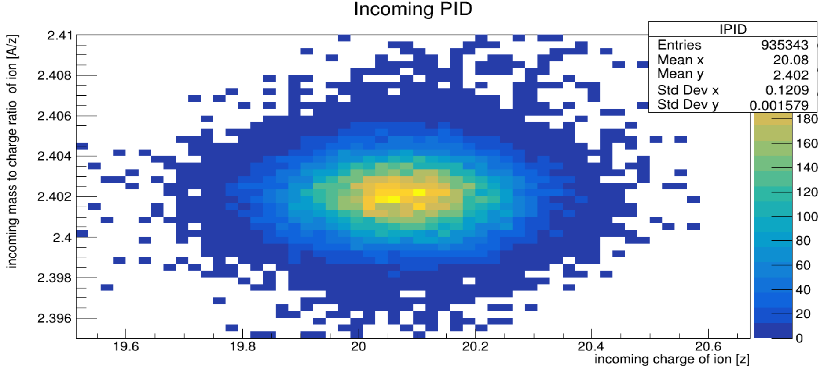
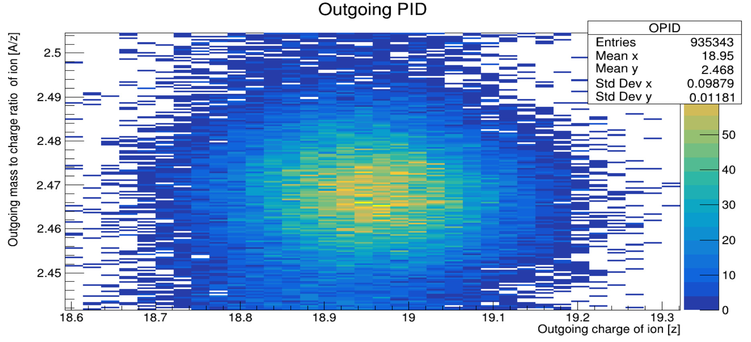
PID Gating for specific reaction Channel
Possibility to also use TPATS to see if that can help with analysis and gating on channels
48Ca
(p,2p)
47K
TPAT-Trigger PATern:
0: SofStart # Min bias
1:CalifaOR # Reaction
2:NeuLAND # Neutron
3:0 S2L # p+n
(Can then Gate on incoming and fragment PID for individual channels)

Slide 4
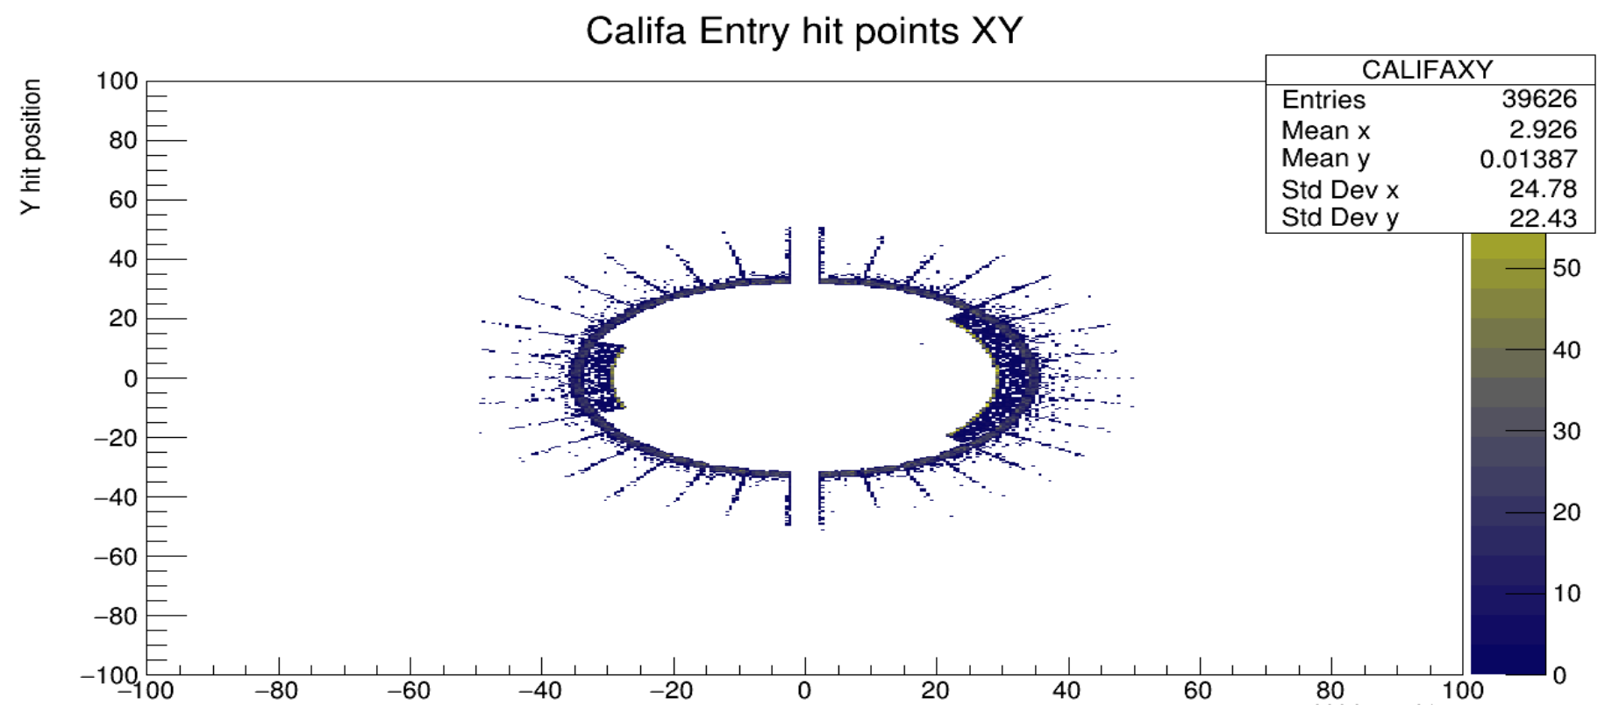
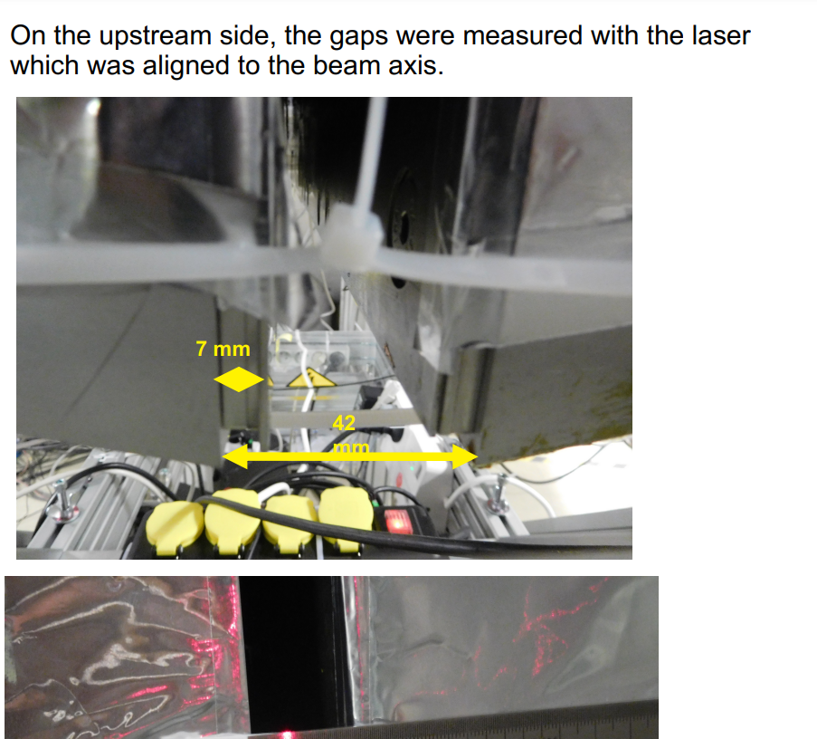
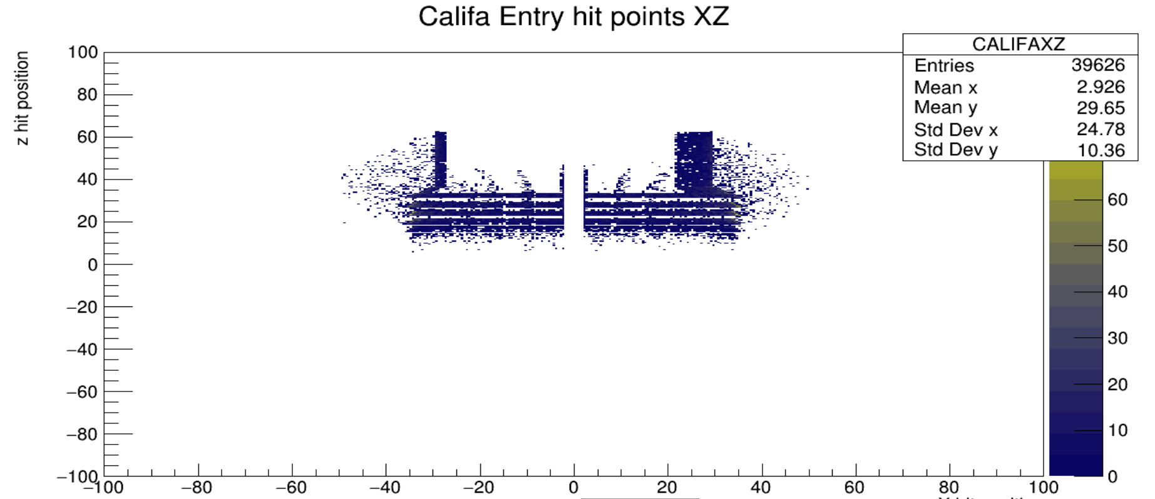
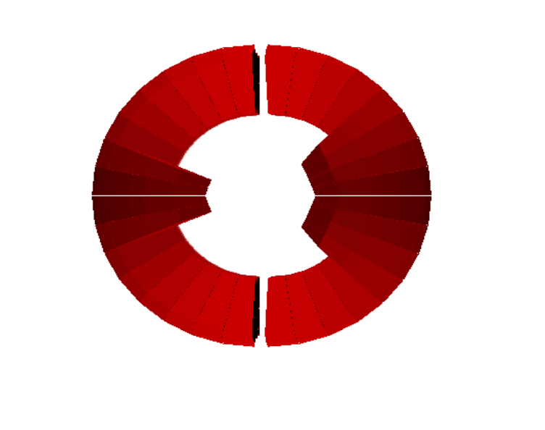
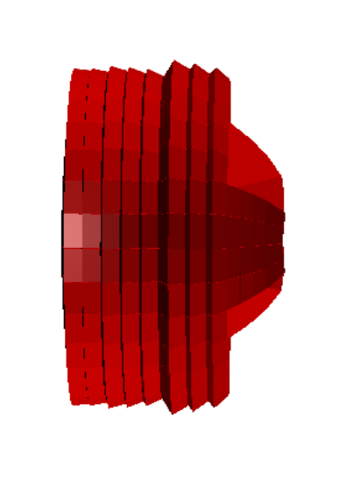
Simulation
Simulated 100k
Events into califa+CH2 target.
First level of data gives hits on detector creating outline of geometry.

Slide 5
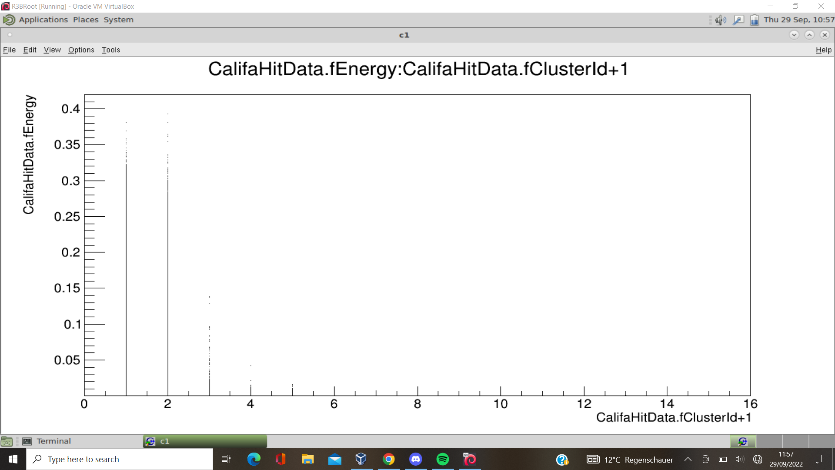
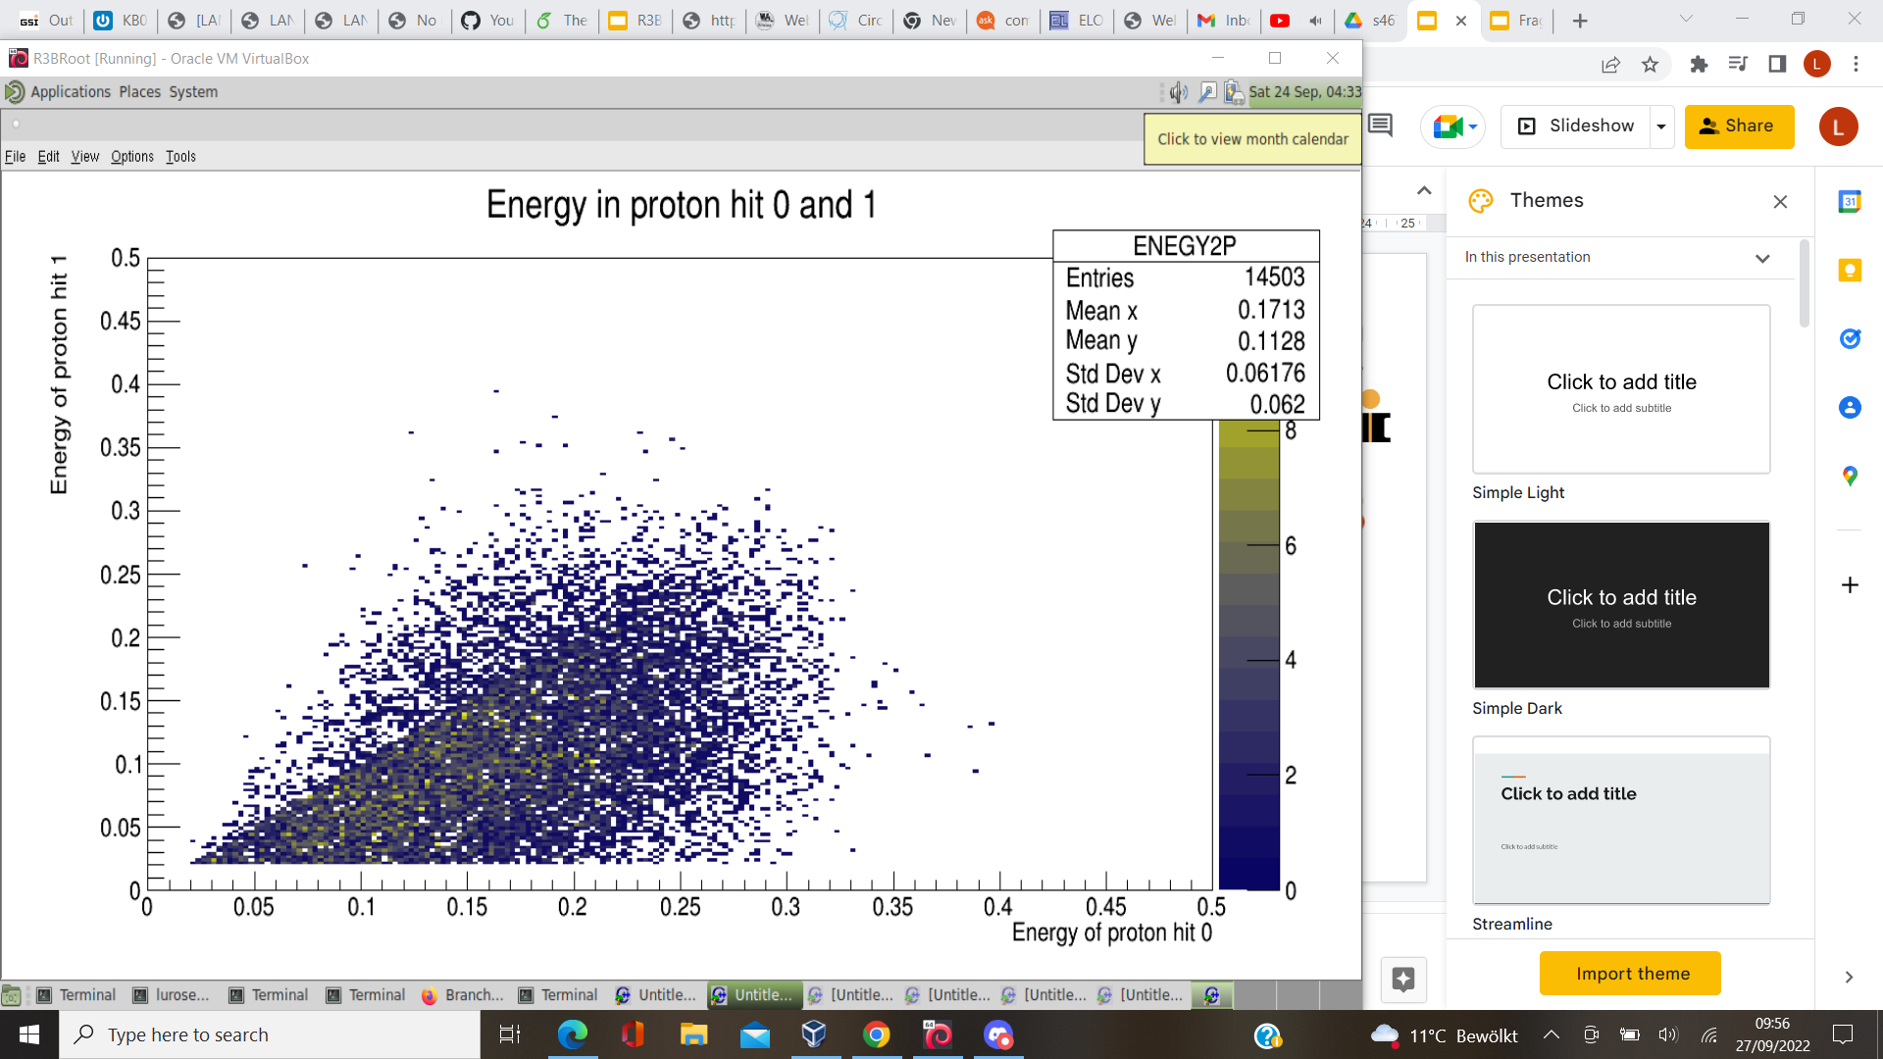
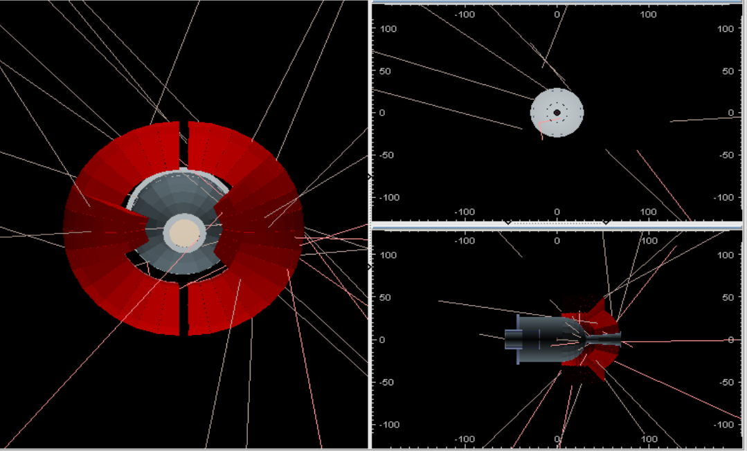
Simulation
Also saw that cluster>2 had sufficient energy
Saw that taking care with the clustering algorithm this effect was minimised
Cut on Energy>20 MeV for proton cluster.

Slide 6
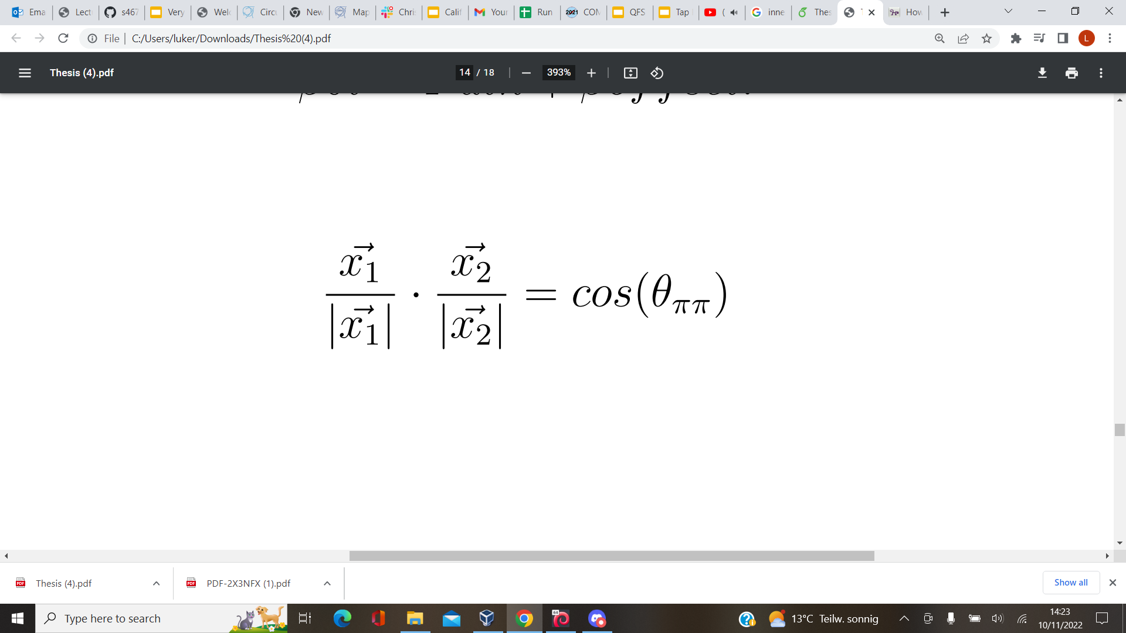
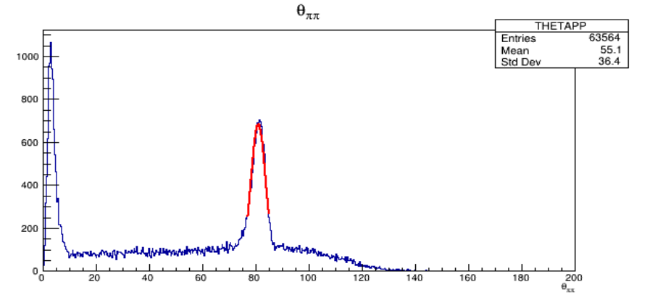
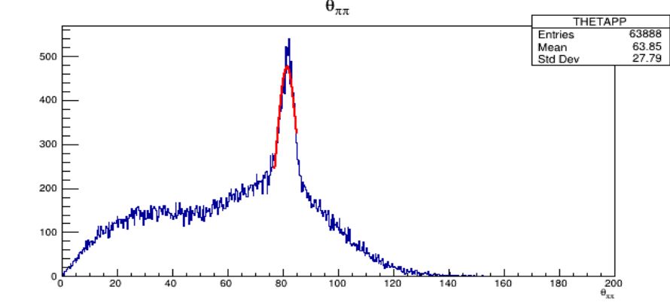
Opening Angle
p1
Opening angle for simulation of Ca40 @ 460 AMeV on CH2 target using Califa2020 with modified separation
p2
No clustering -> Square Window(0,0)
Silly clustering -> Square Window(3,3)

Slide 7
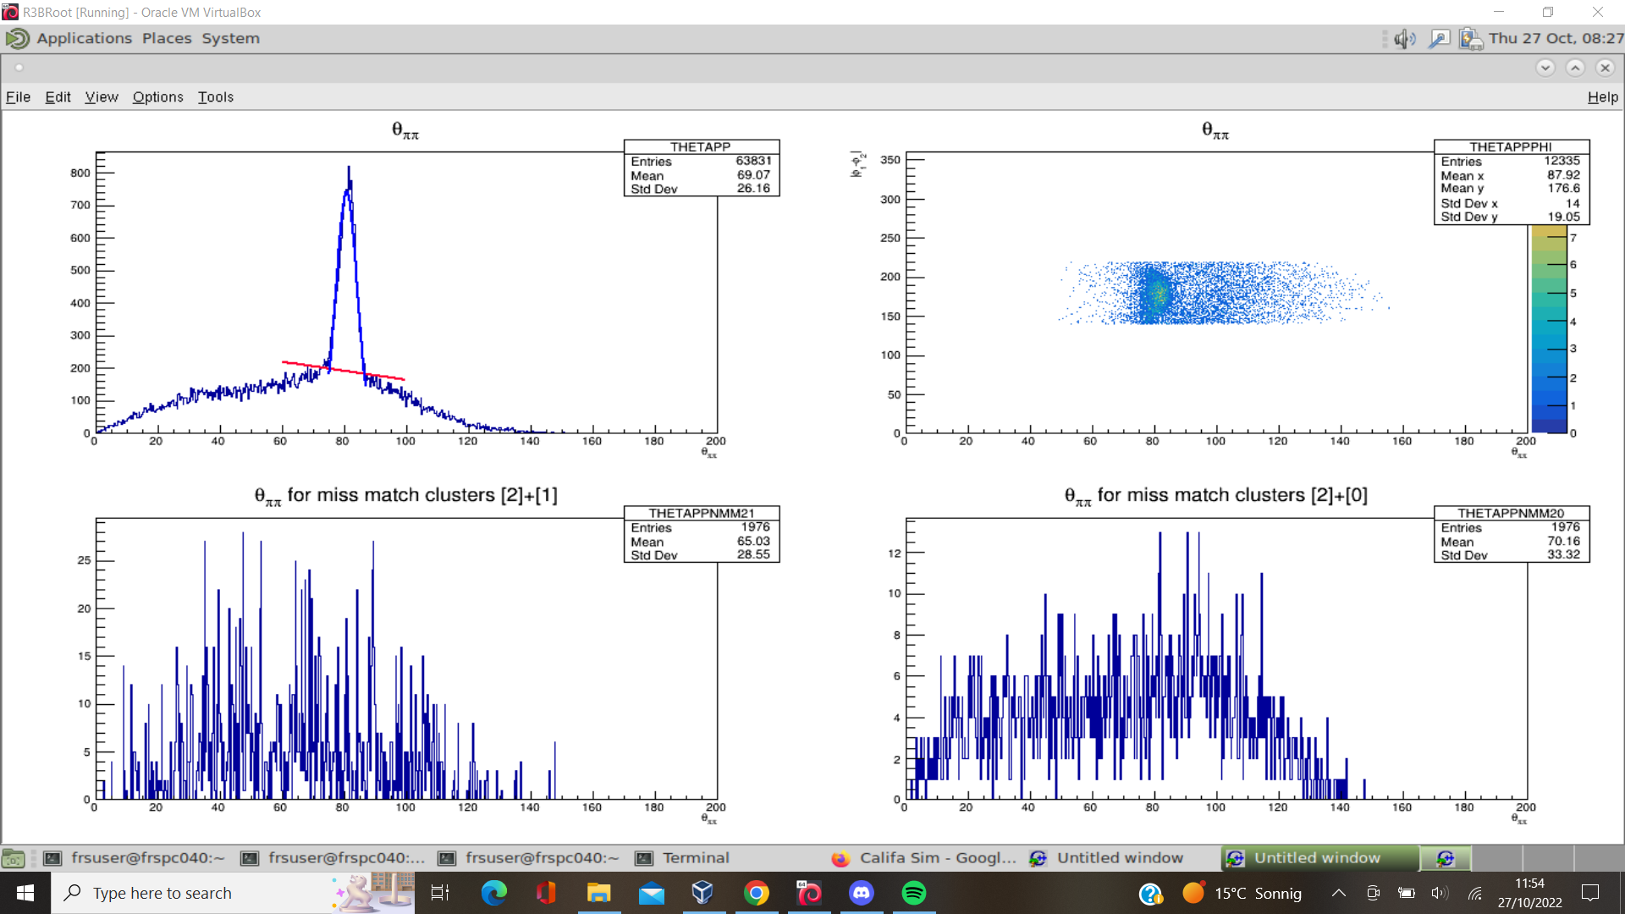
Opening Angle
p1
Opening angle for simulation of Ca40 @ 460 AMeV on CH2 target using Califa2020 with modified separation
So Signal to background 5.5% at optimal setting and 2.7% at worst silly setting.
p2
Normal Clustering + background subtraction

Slide 8
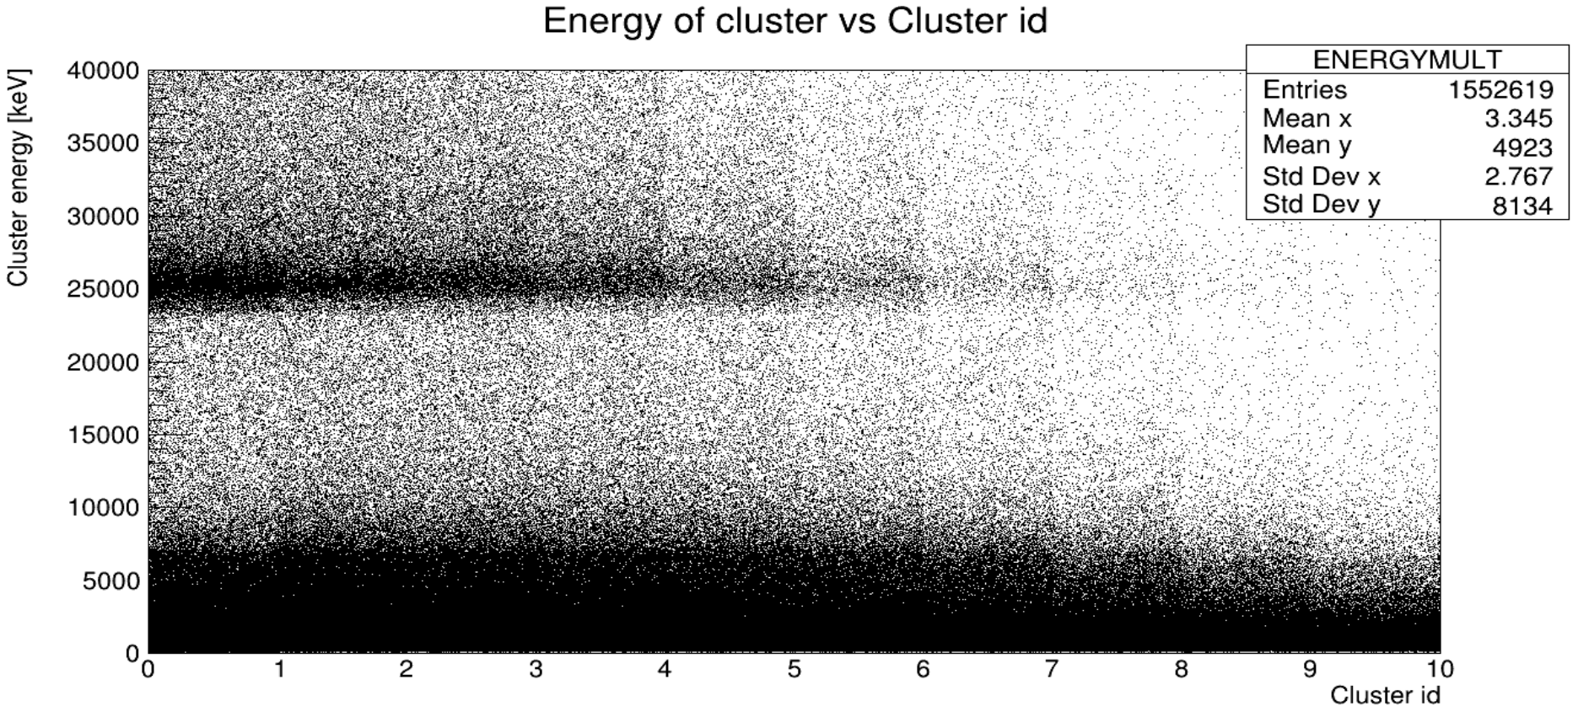
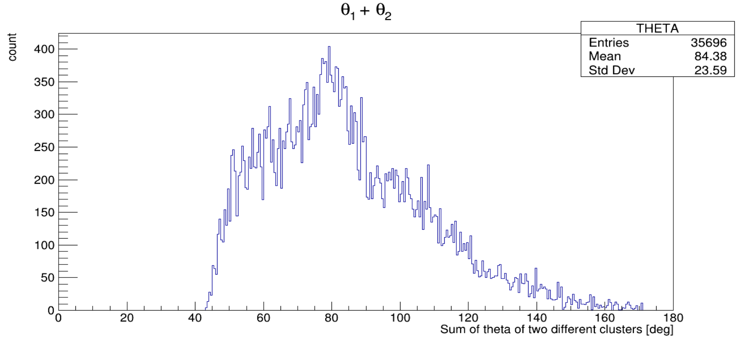
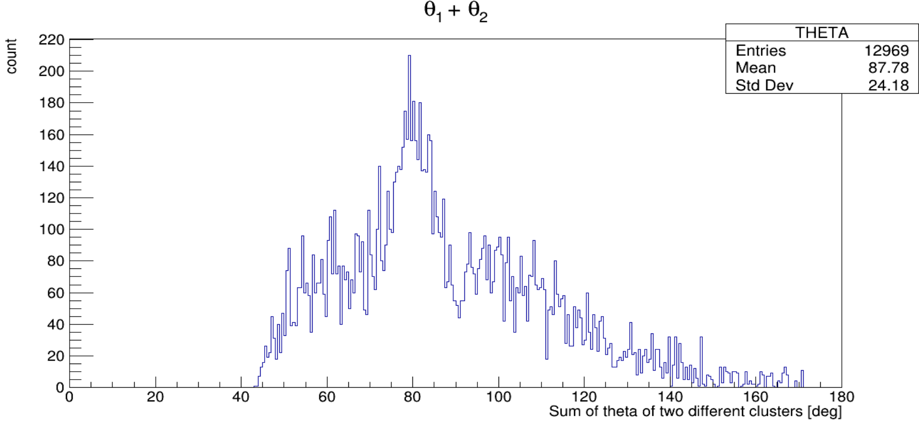
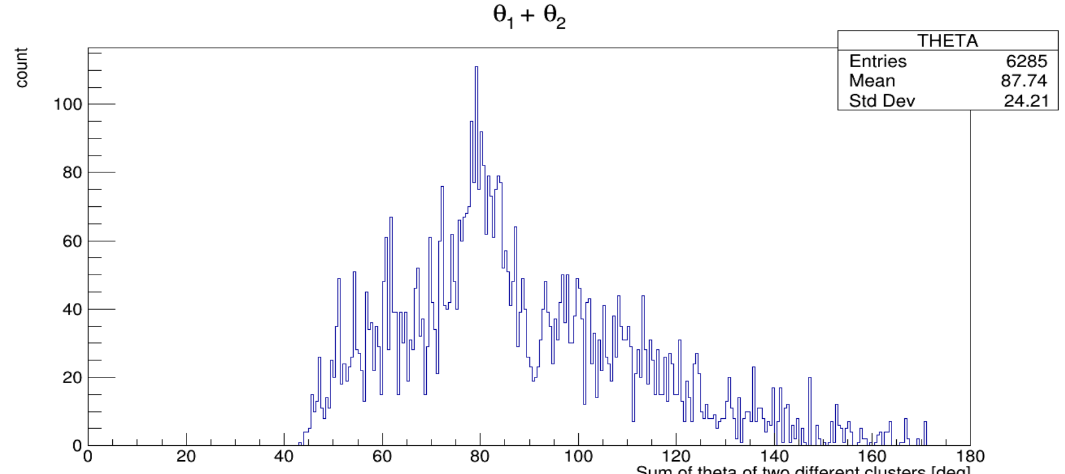
Experiment Observation - Ca50 Beam Setting on CH2
CE[j] = cluster “j” energy
ETHR = 20 MeV
CE[0]>ETHR && CE[1]>ETHR
CE[0]>ETHR && CE[1]>ETHR && CE[2]<ETHR
Now Gating using tracking information that (p,2p) has occurred (inZ-outZ)=1

Slide 9
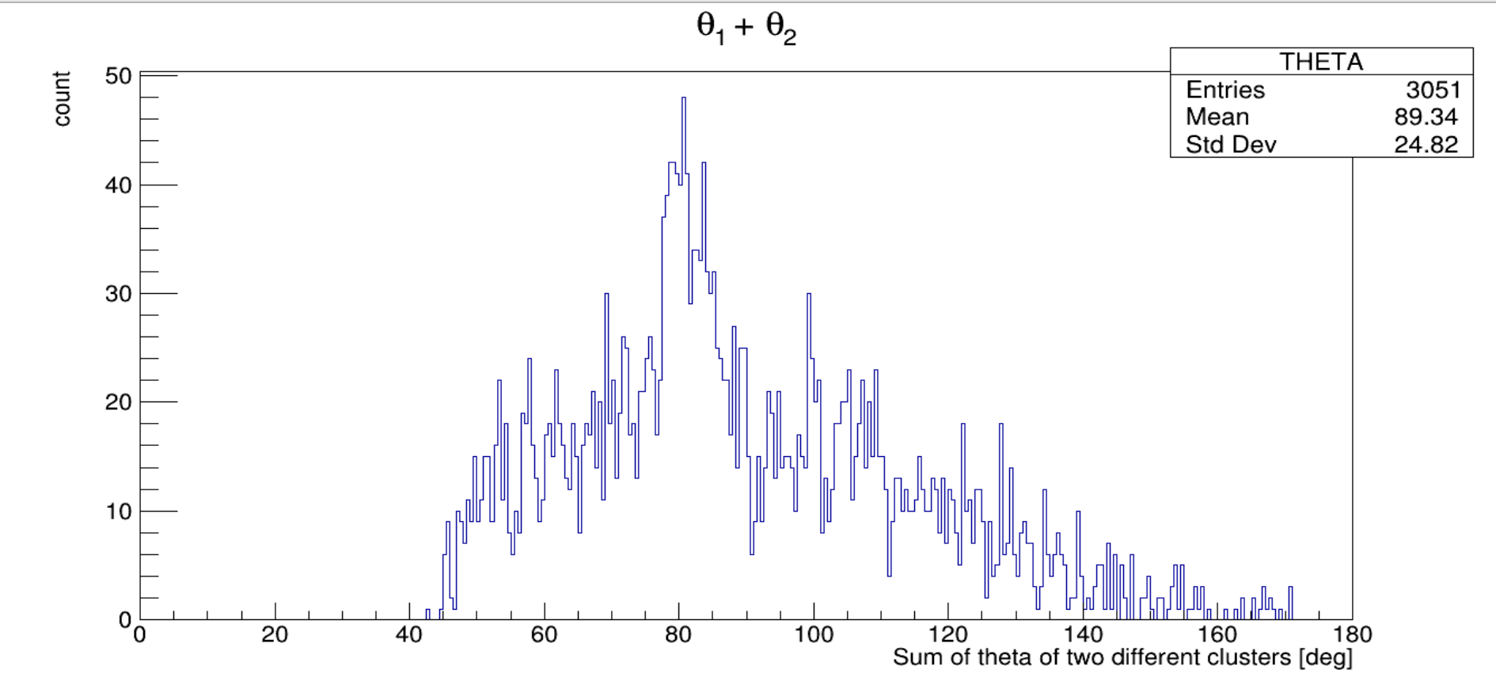
Now gating solely on Ca isotopes chain
Statistics getting very low details need double checking and verifying too see why this happens.

Slide 10
Questions?

