Slide 1



Status of RPC System for S522/S509
November 16th, 2022
R³B Collaboration Meeting
Manuel Xarepe
PhD in Engineering Physics FCUL

Slide 2
Overview
Introduction
RPC detector
RPC integration in R³B environment
Story so far
RPC calibration
Beam time performance
Summary and Outlook

Slide 3
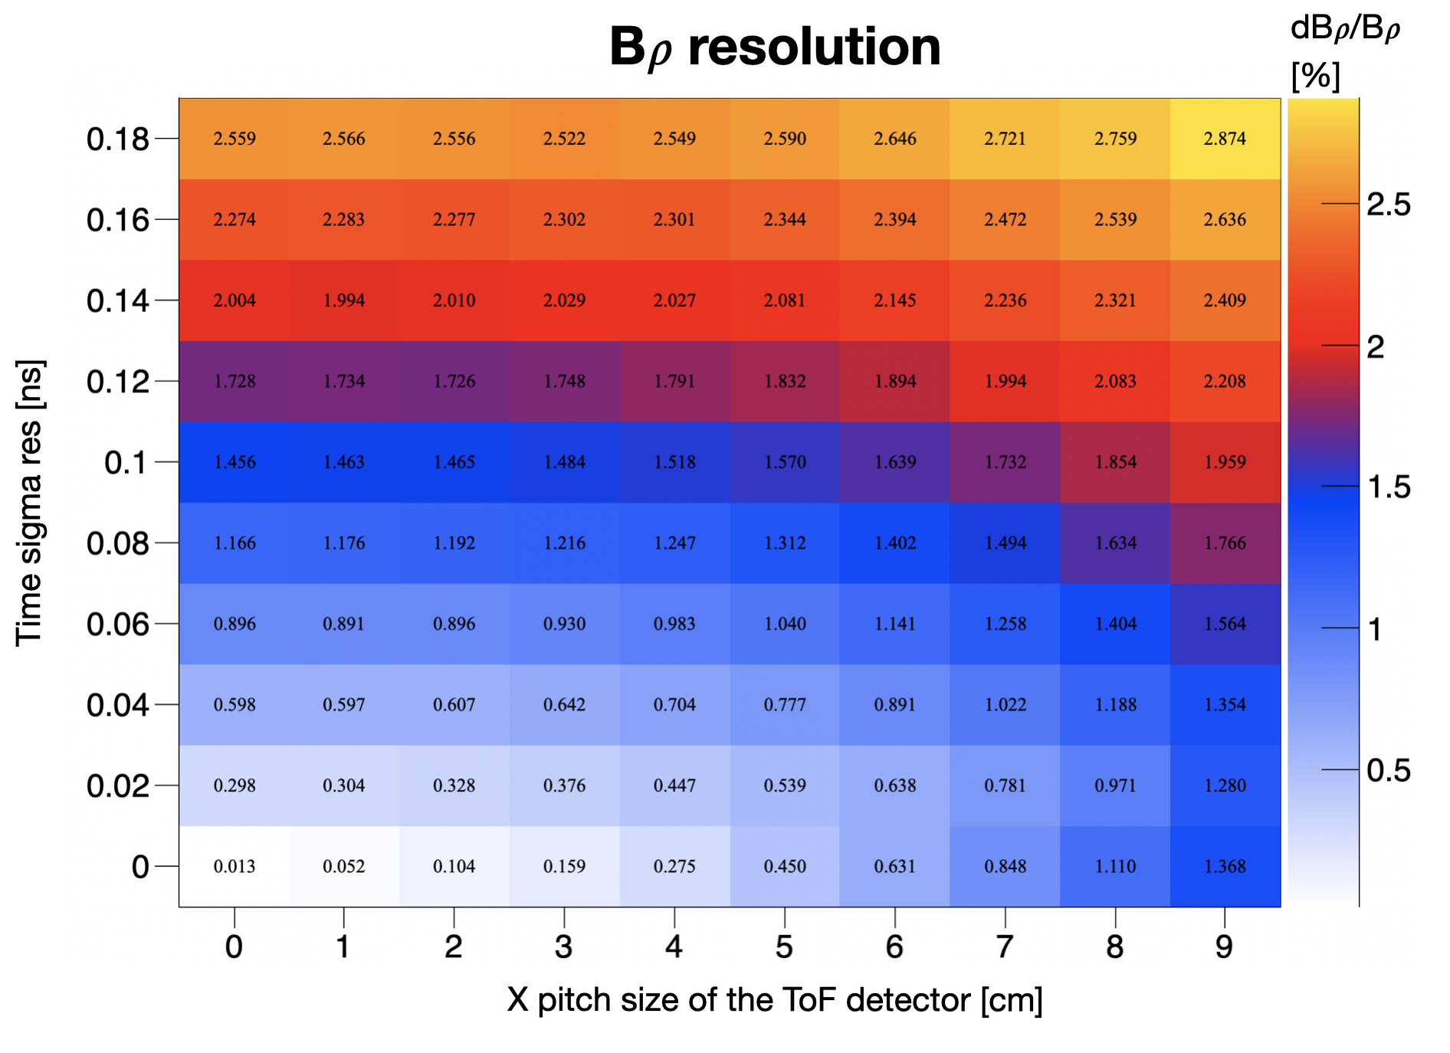
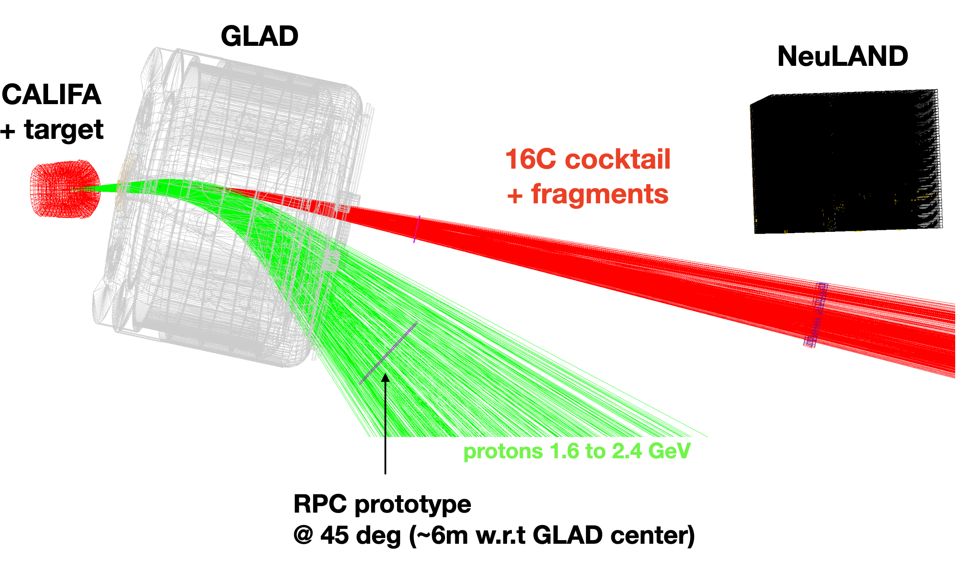
S522 Experiment and why an RPC?
First characterization of Short-Range Correlations in exotic nuclei at R³B - Spokesperson: Anna Corsi and Or Hen
For the RPC detector Δσ ≈ 50 ps and ΔX ≈ 1cm
Courtesy of Valerii Panin

Slide 4
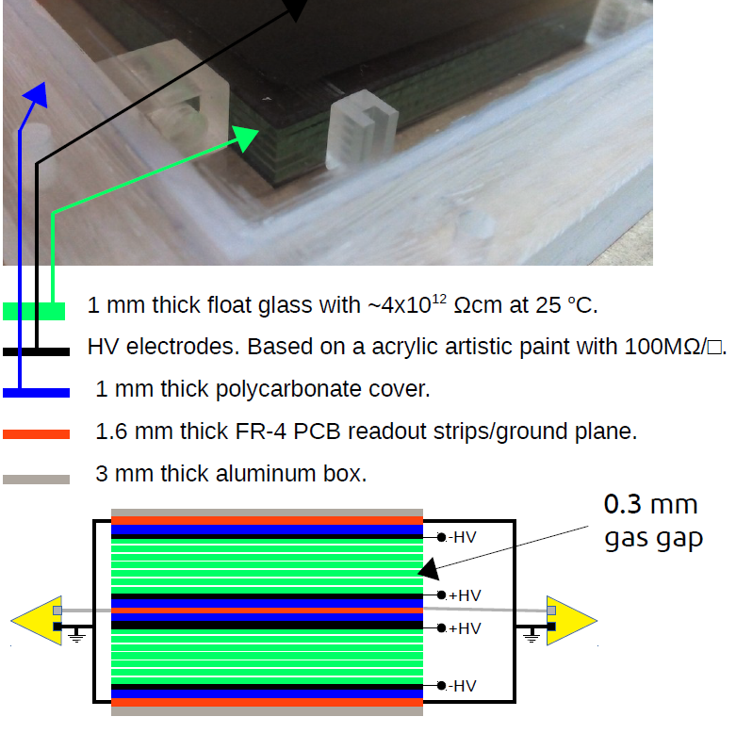
(RPC) Resistive Plate Chamber Detector
Active area of 1500x1200 mm² = 1,8 m²
Two modules composed of 6 gaps RPC glass stacks
Gas mixture of C₂H₂F₄ (98%) and SF₆ (2%)
Readout strips 3 cm width (placed in the middle of the two modules)
Readout in both sides of the strips
The SHiP timing detector based on MRPC - A. Blanco et al.

Slide 5
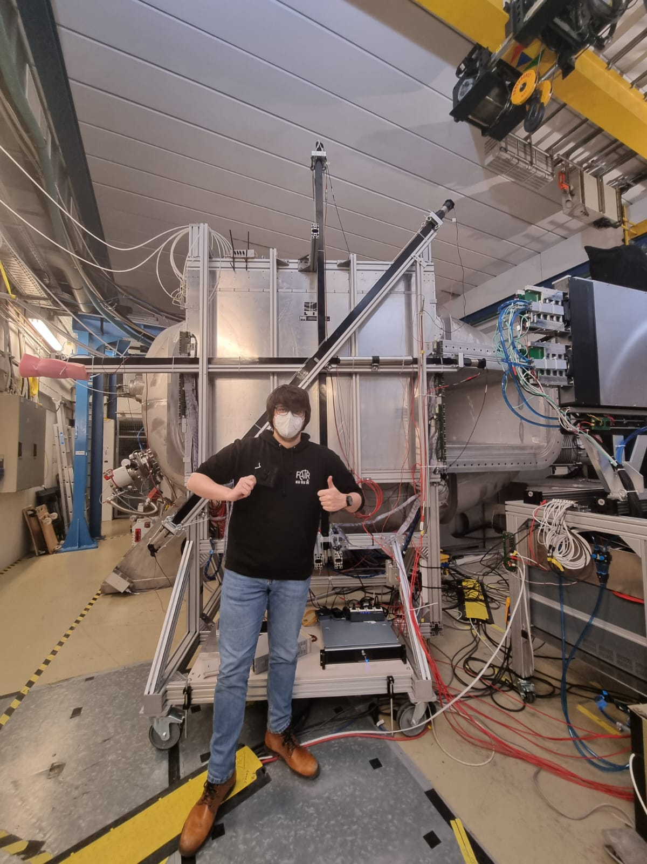

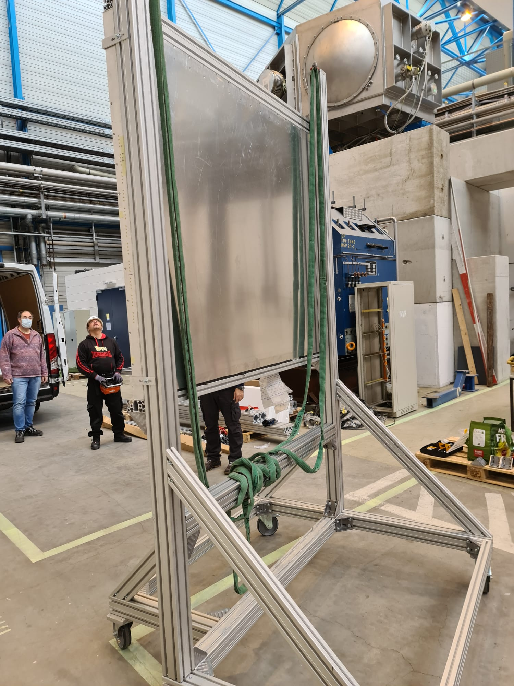
R³B integration
The RPC arrived on the 29/11/2021
Positioning the Detector inside Cave C
Integrating the Detector into the R³B DAQ
Implementing R³B analysis tools (online and offline)

Slide 6
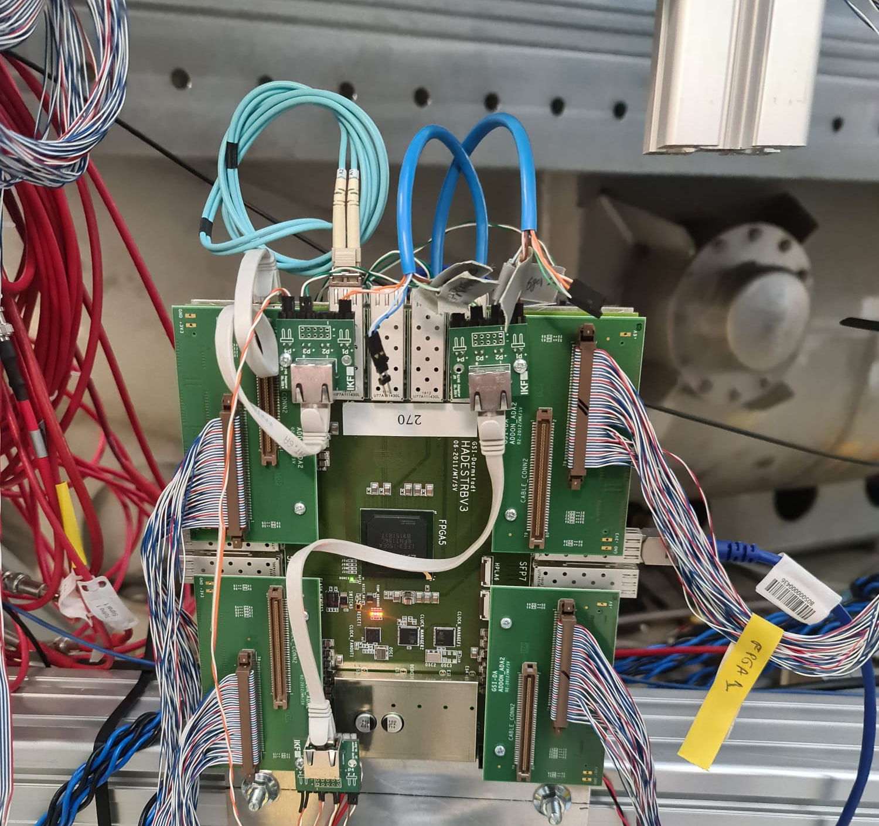
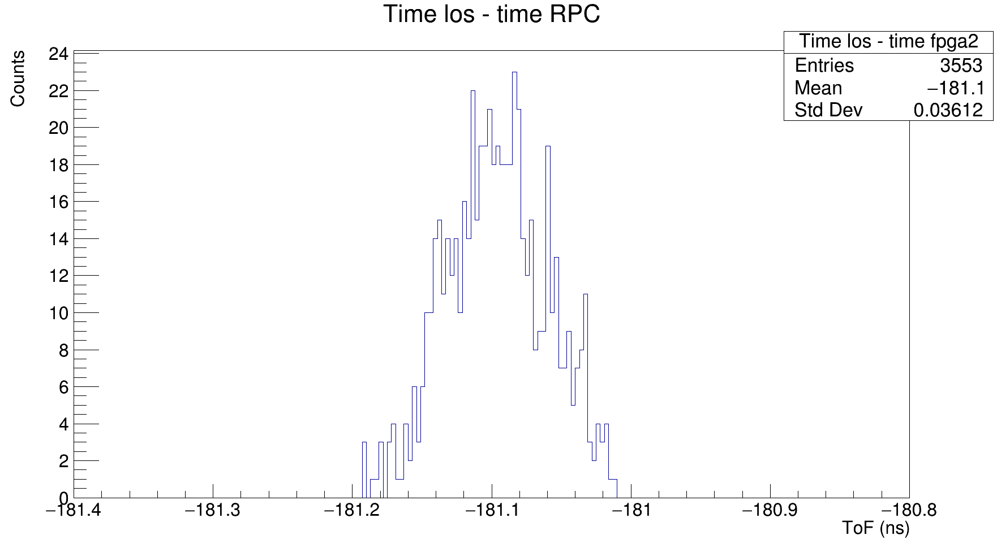
DAQ integration
Small TRB system including:
128 multihit TDCs
Central trigger system with quite some logic inside.
Receive R³B trigger
Send any RPC local trigger.
System is running its own eventBuilder DABC from HADES
Synchronization with R³B DAQ
TRB system incorporates white rabbit time stamp from r3b.
Data is exported through MBS transport protocol, the entire RPC event is packaged into one LMD subevent.
Drasi (time sorter) runs into this subevent transparently
sigma ~ 36 ps

Slide 7
RPC readout and data structure
lateral View
top View
TR
From the readout we can obtain:
#Strip
Time Leading and trailing
Side (L, R)
From this we can calculate:
Y position from #Strip
X position from (TR-TL)/2
Time over Threshold (ToT) values that will be used to select the hit
y
TL
TL
x
TL
gap Cu
+HV
+HV
+HV
-HV
- HV
+HV
-HV
-HV
z
z

Slide 8
Calibrating the RPC
Several calibration need to be implemented:
Time over threshold alignment (ToT) - > Using derivative to find offset;
Very important for Hit selection
Position alignment of the Strips -> Uses the integrated histogram of the hits;
Very good alignment
Time Calibration
Calibrate time intra/inter-strip
Final objective, a isochron surface placed in the R3B environment
Position the RPC into the R³B environment
Measurements with laser and radioactive source
Sweep Run with ⁴⁰Ar at 300 MeV/u

Slide 9
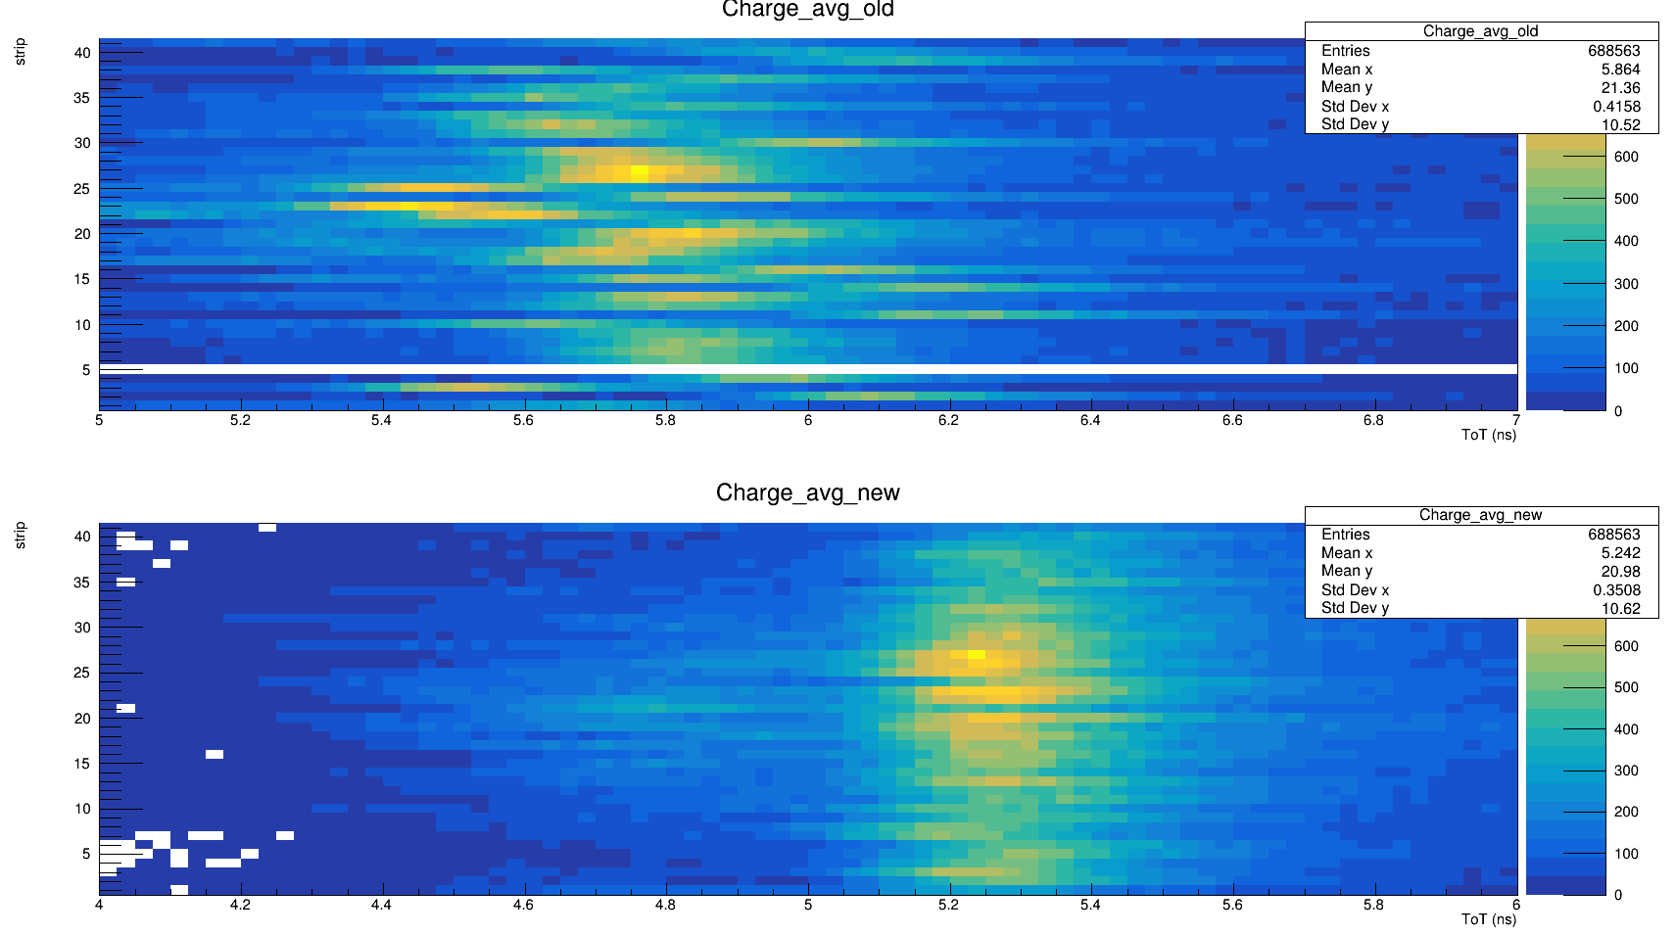
ToT alignment
10% of events mismatched events
2% of events mismatched events

Slide 10

Calibration
Several calibration need to be implemented:
Time over threshold alignment (ToT) - > Using derivative to find offset;
Very important for Hit selection
Position alignment of the Strips -> Uses the integrated histogram of the hits;
Very good alignment
Time Calibration
Calibrate time intra/inter-strip
Final objective, a isochron surface placed in the R3B environment
Position the RPC into the R³B environment
Measurements with laser and radioactive source
Sweep Run with ⁴⁰Ar at 300 MeV/u

Slide 11
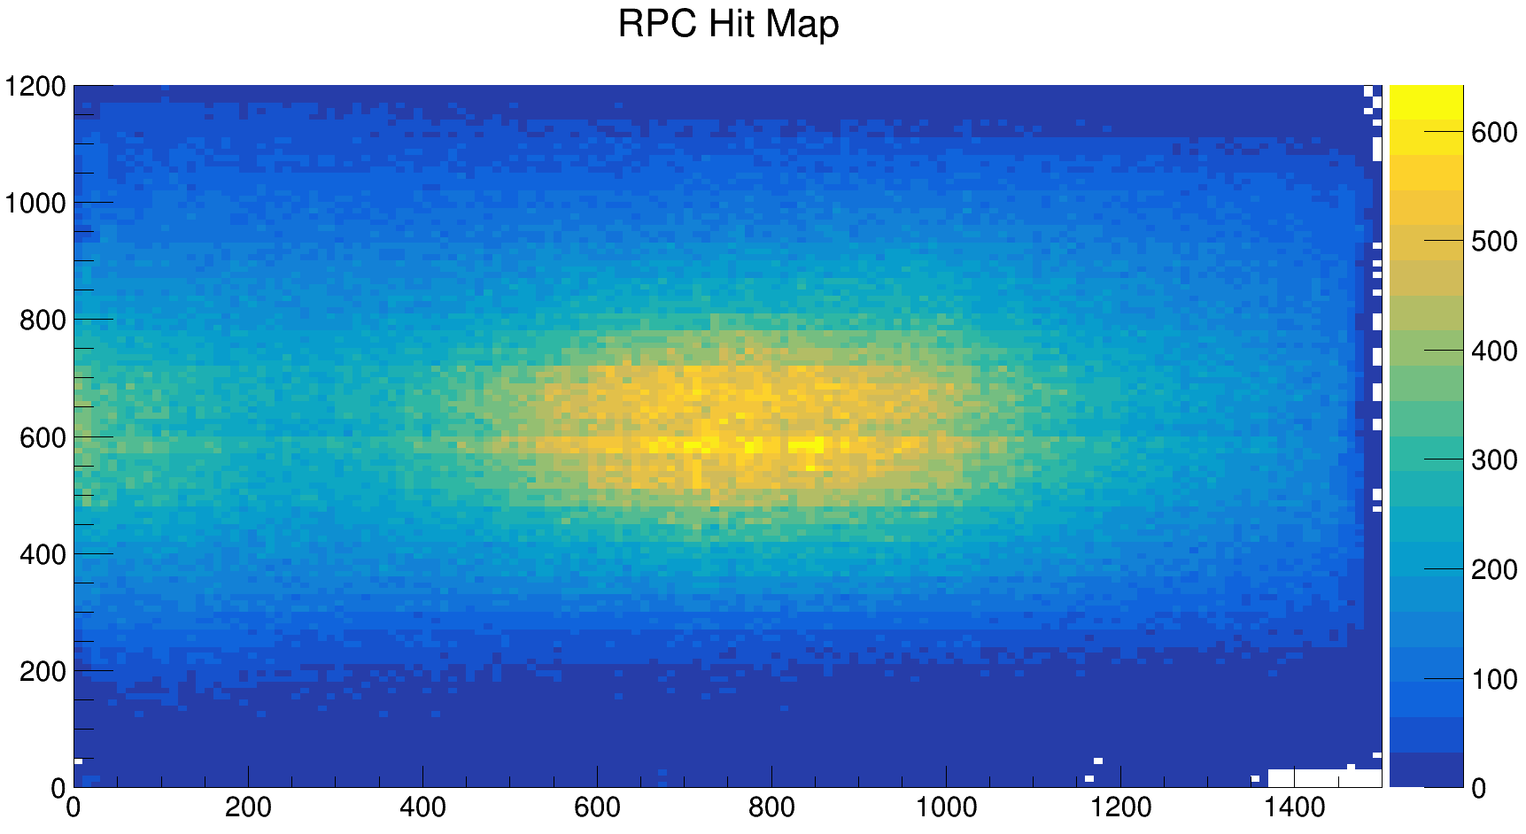
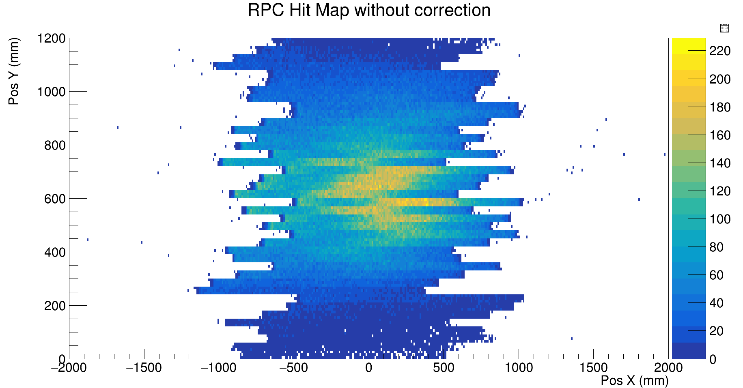
RPC Hit Map alignment
Pos x [mm]
Pos x [mm]

Slide 12
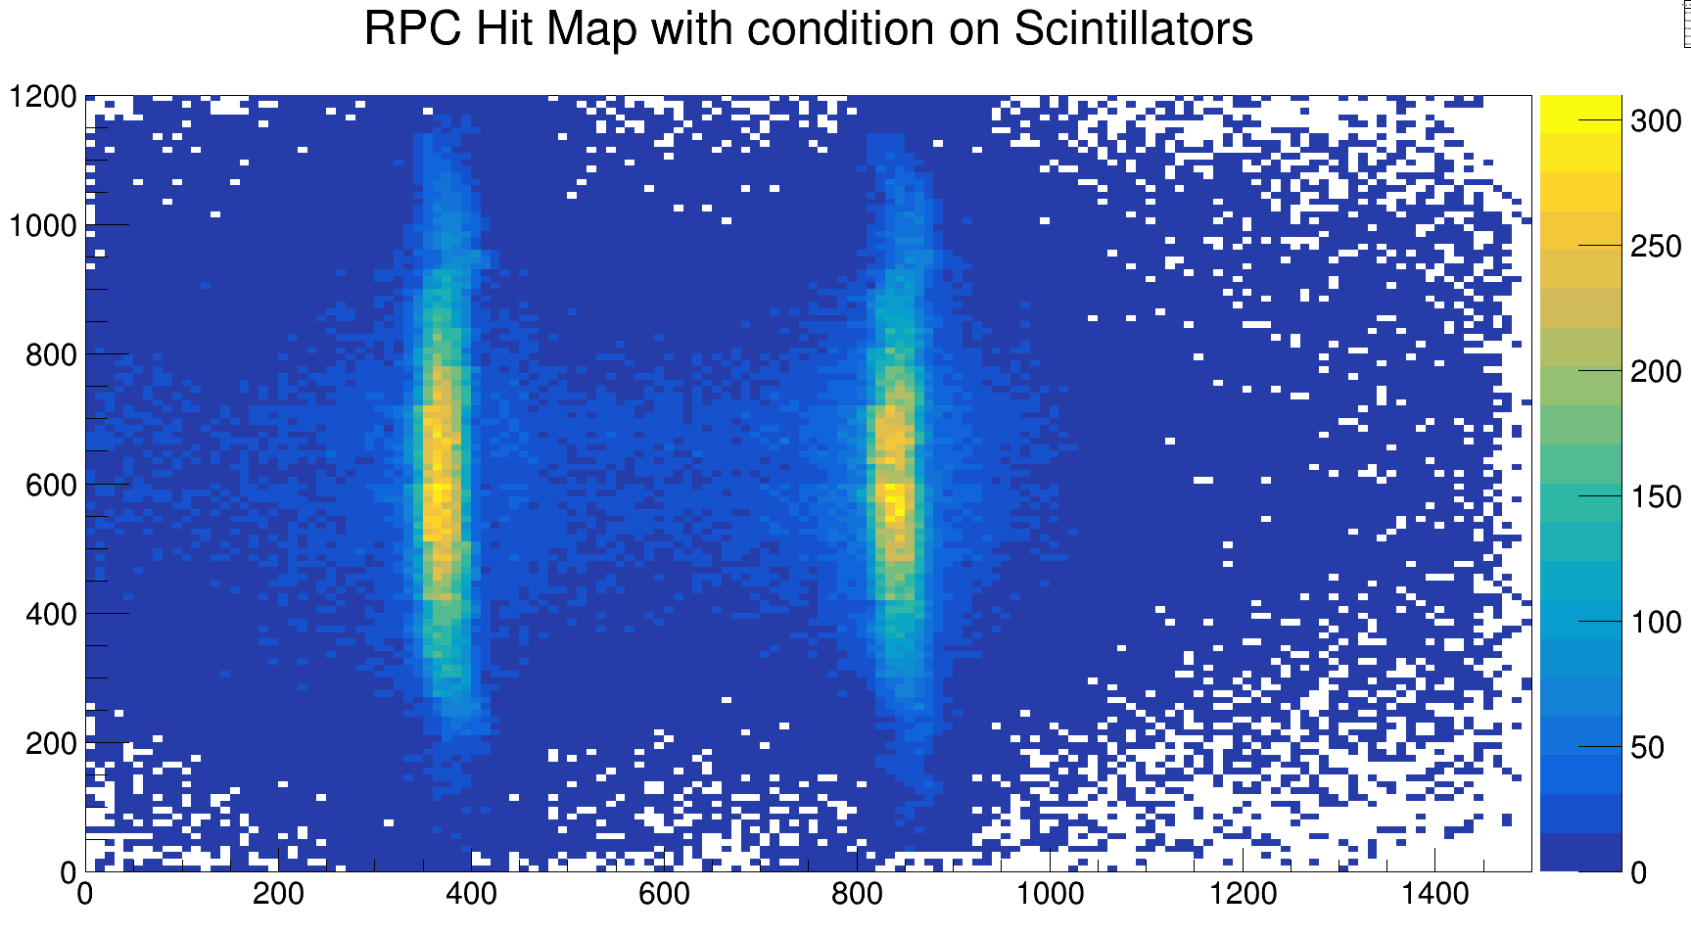
RPC Hit Map alignment
Pos Y [mm]
Pos x [mm]

Slide 13
Calibration
Several calibration need to be implemented:
Time over threshold alignment (ToT) - > Using derivative to find offset;
Very important for Hit selection
Position alignment of the Strips -> Uses the integrated histogram of the hits;
Very good alignment
improve with Scintillator
Time Calibration
Calibrate time intra/inter-strip
Final objective, a isochron surface placed in the R3B environment
Position the RPC into the R³B environment
Measurements with laser and radioactive source
Sweep Run with ⁴⁰Ar at 300 MeV/u

Slide 14
RPC Time Calibration
Side View
There are 2 approaches:
Using cosmic coincidences
Using protons from the reaction
Crucial for the analysis as the RPC needs to be an isochron surface.
Work in progress!
Neuland Bar

Slide 15
Experimental Setup
View From Behind
Side View
Vertical NB 1
Vertical NB 2
Neuland Bar
Horizontal NB

Slide 16
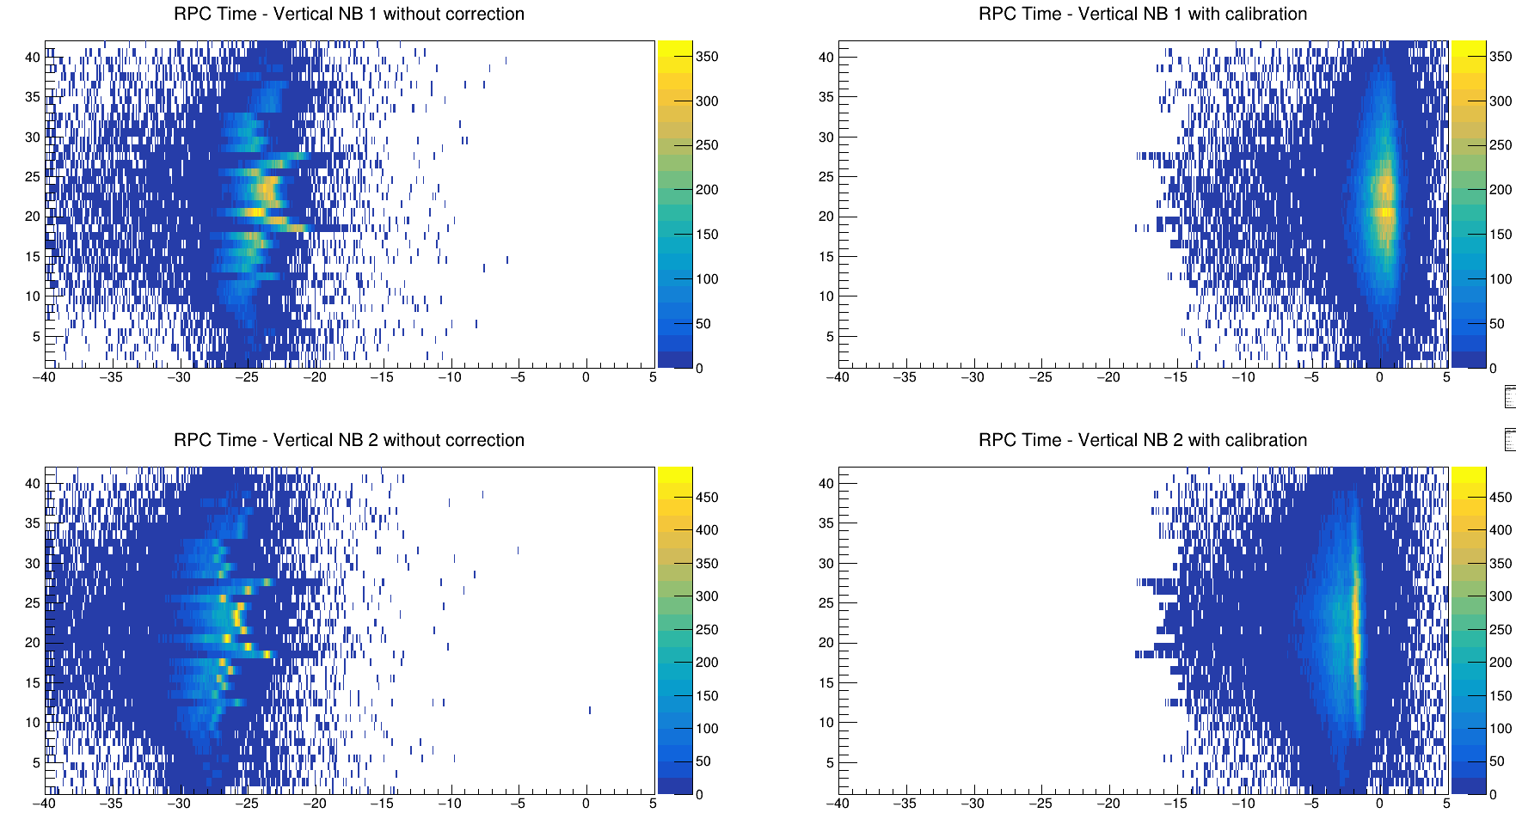
Alignment using Protons
Strip #
time diff [ns]

Slide 17
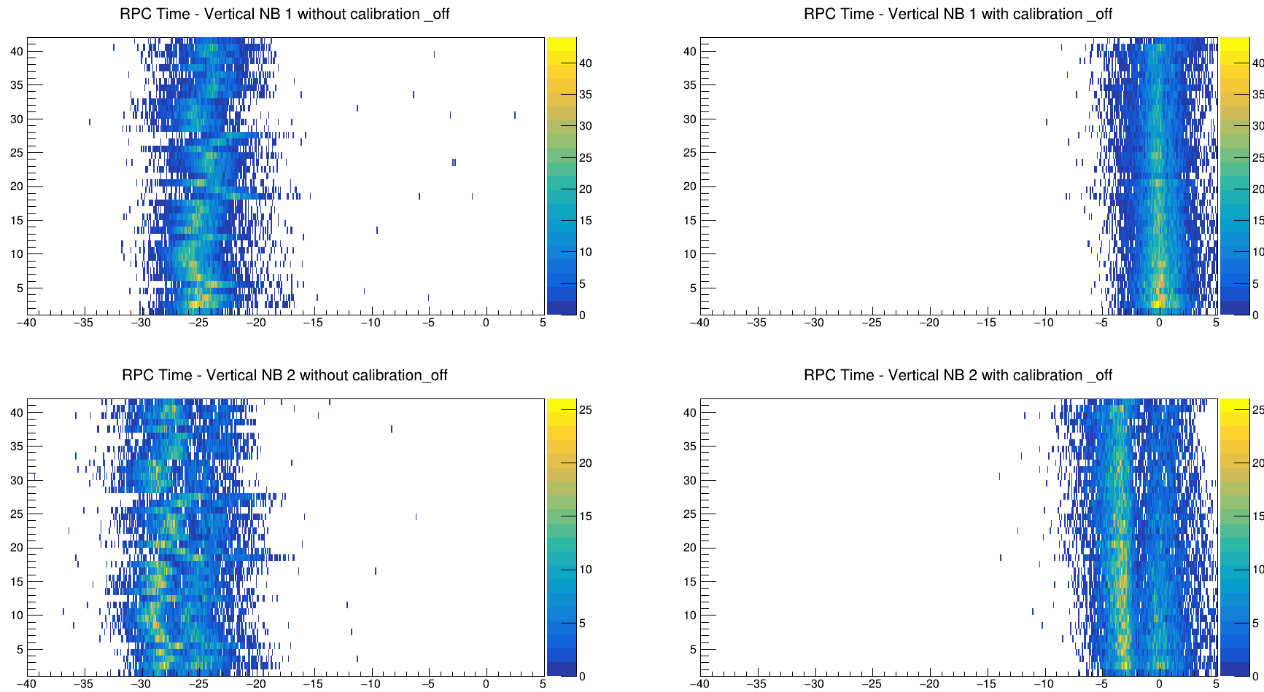
Alignment using Protons - OffSpill
Strip #
time diff [ns]

Slide 18
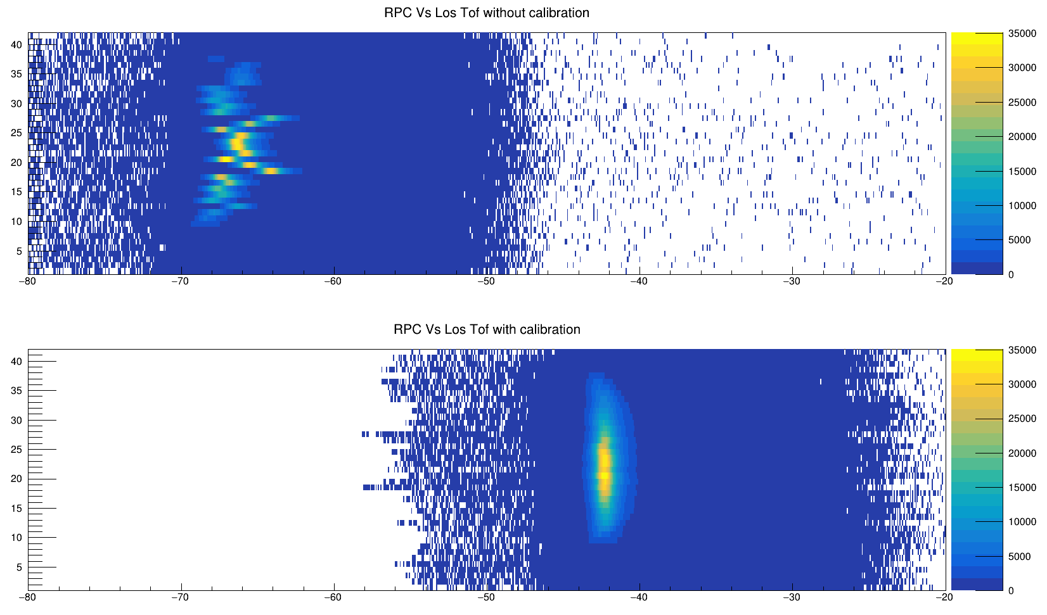
Aligned ToF with Los
Strip #
time diff [ns]

Slide 19
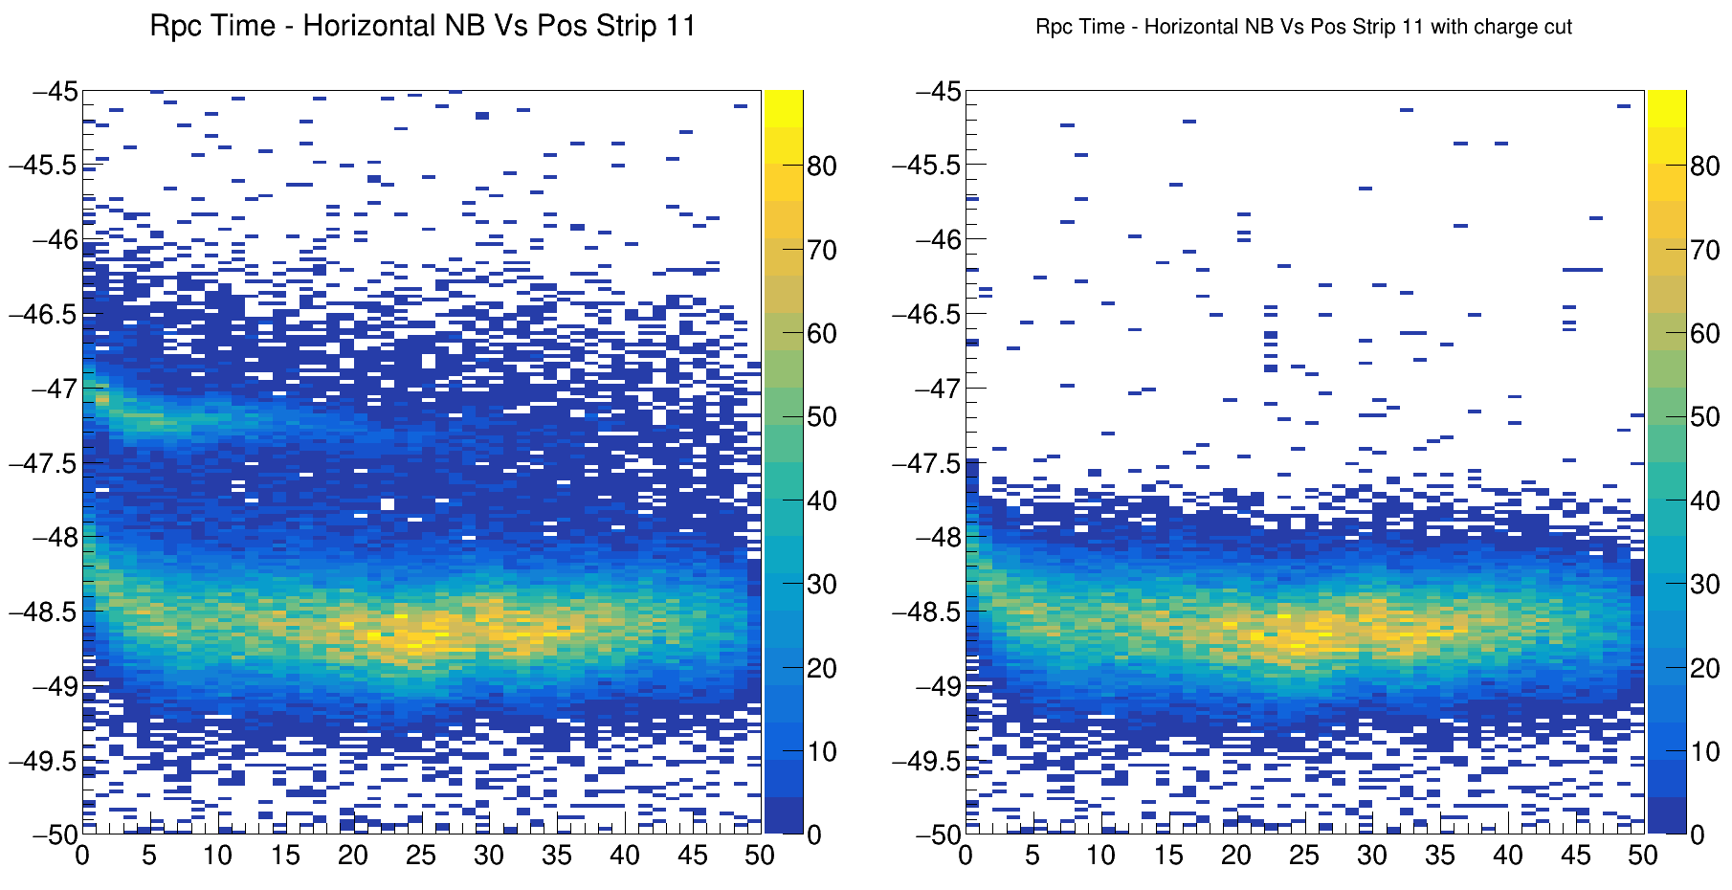

Horizontal Time Distribution
time diff [ns]
# Interval in Pos

Slide 20
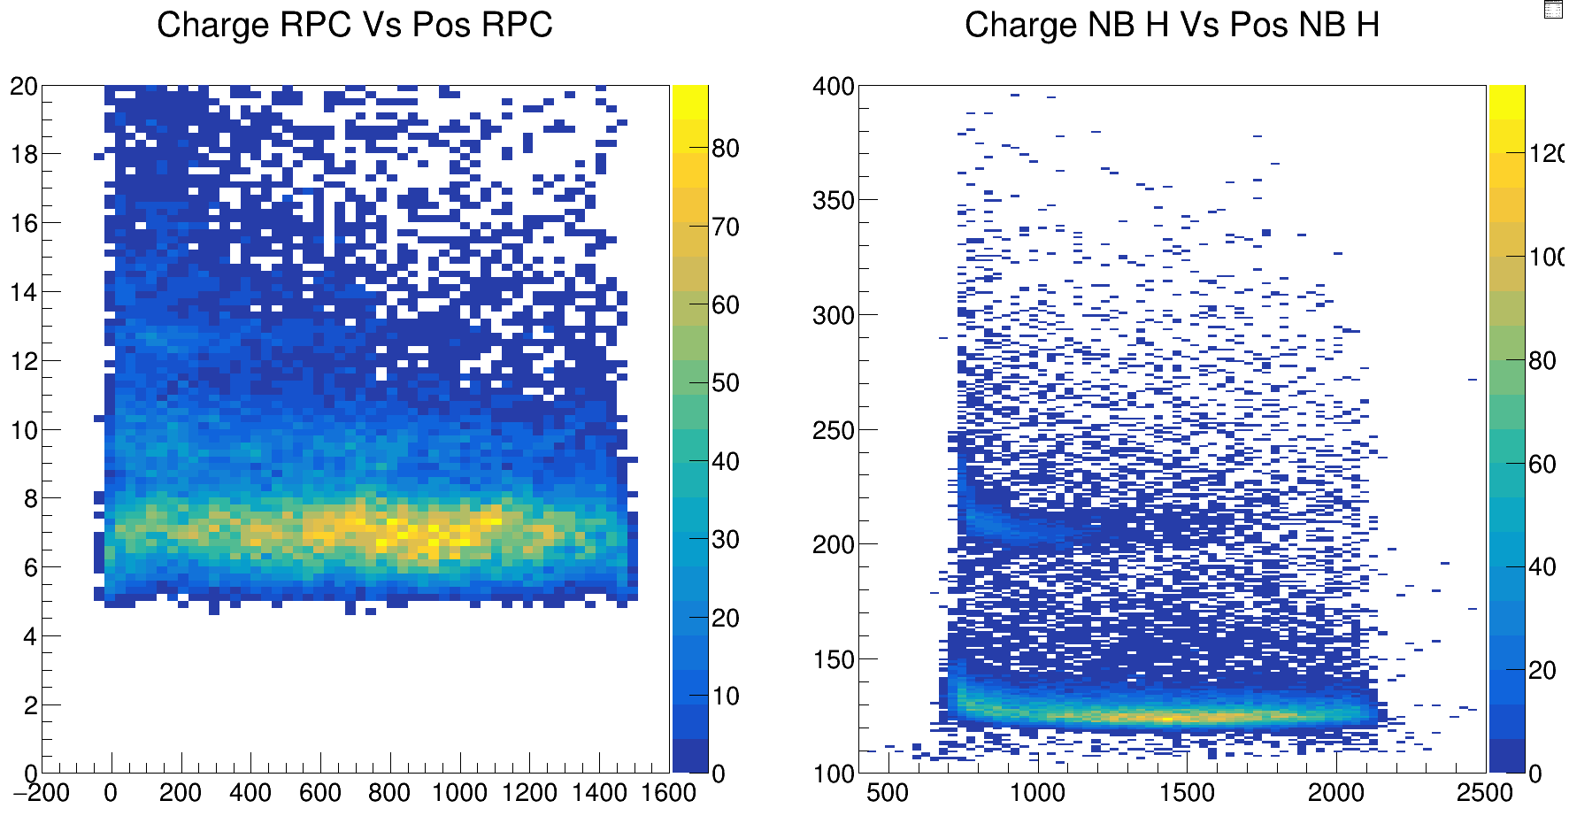
Charge spectrums
Time over Threshold [ns]

Slide 21
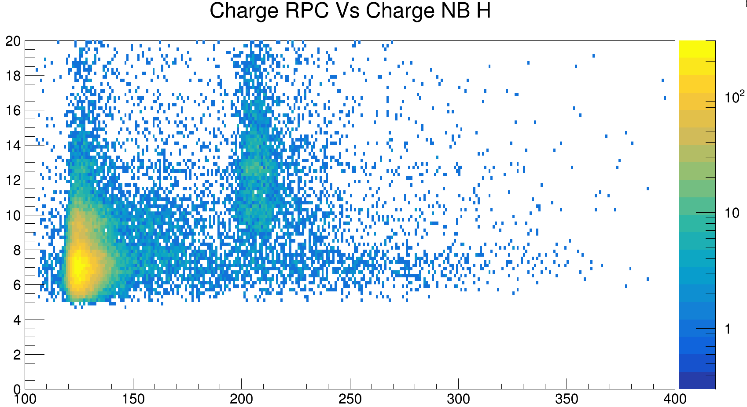
Charge spectrums
Time over Threshold [ns]
Time over Threshold [ns]

Slide 22
Horizontal Time Distribution
time diff [ns]
# Interval in Pos

Slide 23
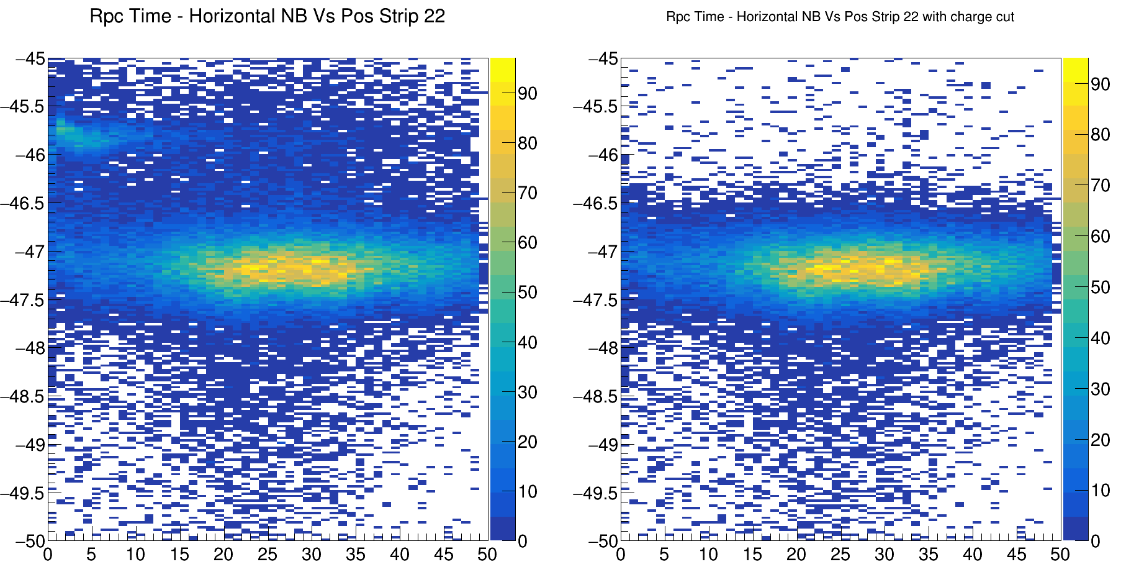
Horizontal Time Distribution
time diff [ns]
# Interval in Pos

Slide 24

Calibration
Several calibration need to be implemented:
Time over threshold alignment (ToT) - > Using derivative to find offset;
Very important for Hit selection
Position alignment of the Strips -> Uses the integrated histogram of the hits;
Very good alignment
improve with Scintillator
Time Calibration
Calibrate time intra/inter-strip
Final objective, a isochron surface placed in the R3B environment
Position the RPC into the R³B environment
Measurements with laser and radioactive source
Sweep Run with ⁴⁰Ar at 300 MeV/u

Slide 25
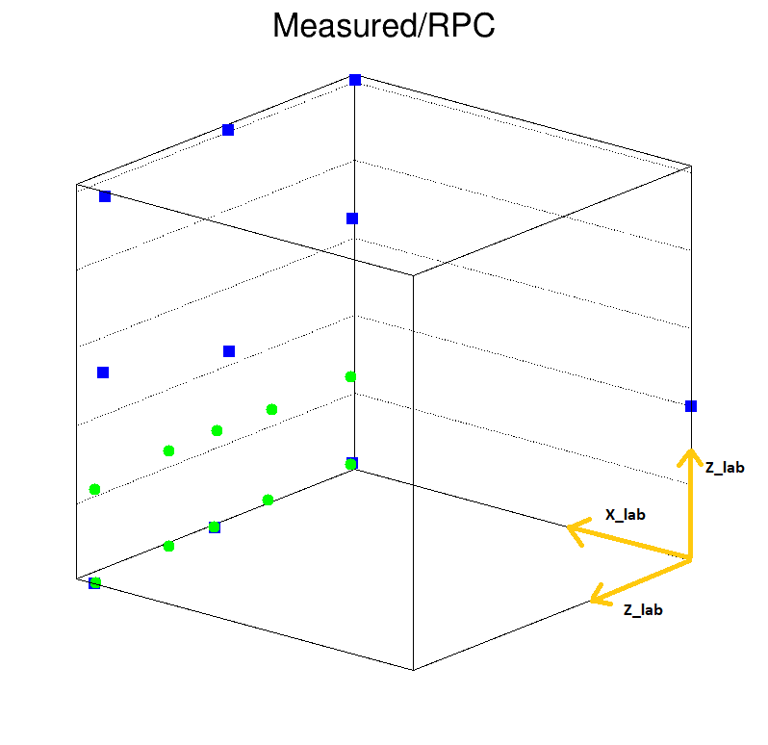
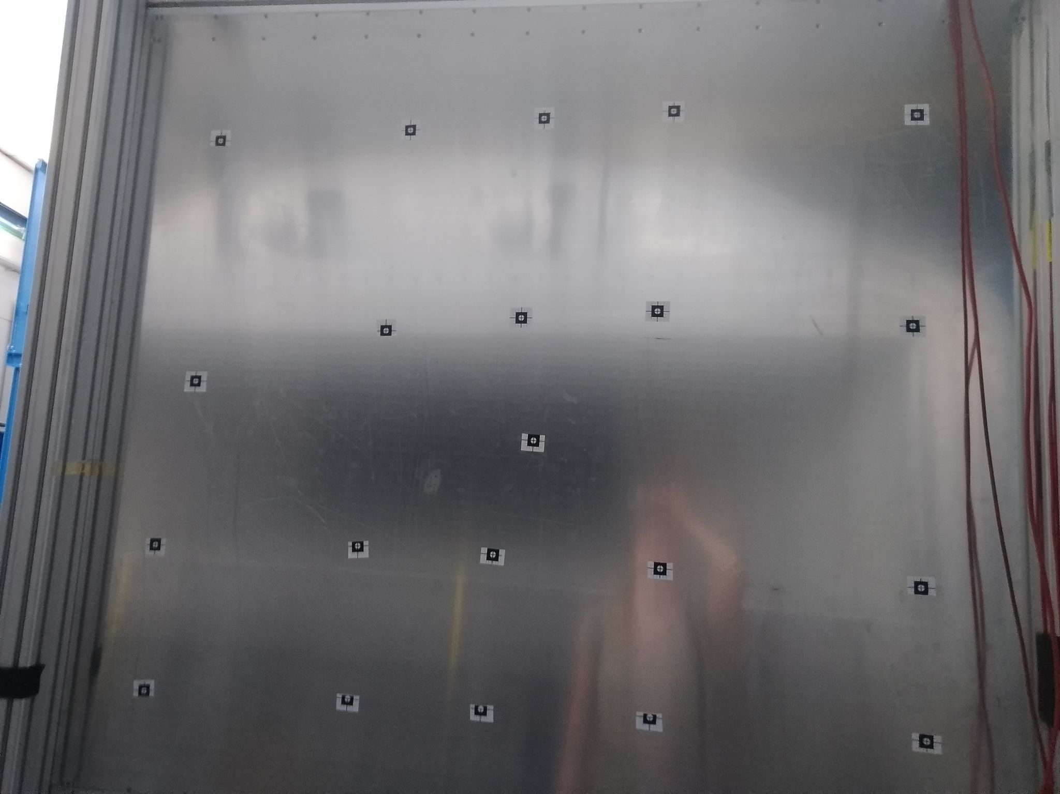
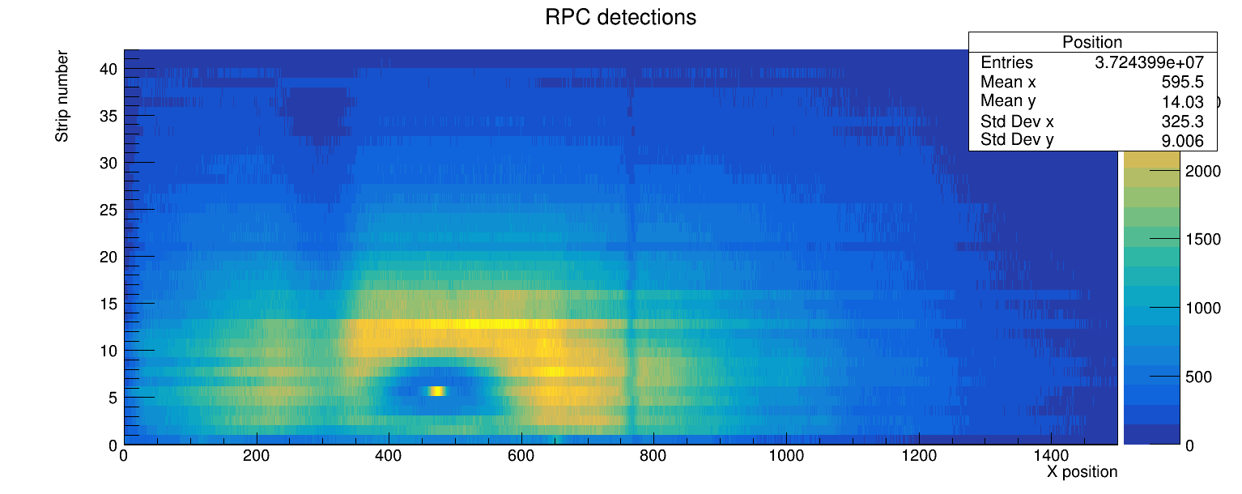
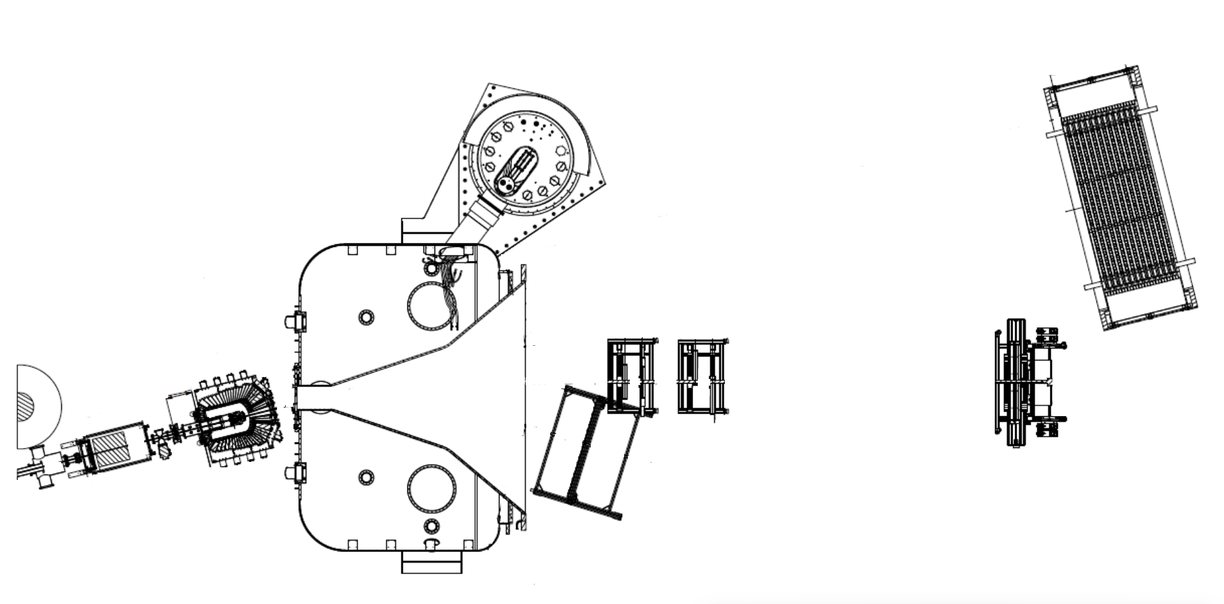
Correlate Strip Position with RPC box
Bending Point

Slide 26
Sweep run with ⁴⁰Ar
Calibrate the RPC Position:
300 MeV/u 40Ar beam sent through GLAD;
Sweep the RPC by changing the Magnetic field of GLAD;
Compare the results with simulation;

Slide 27
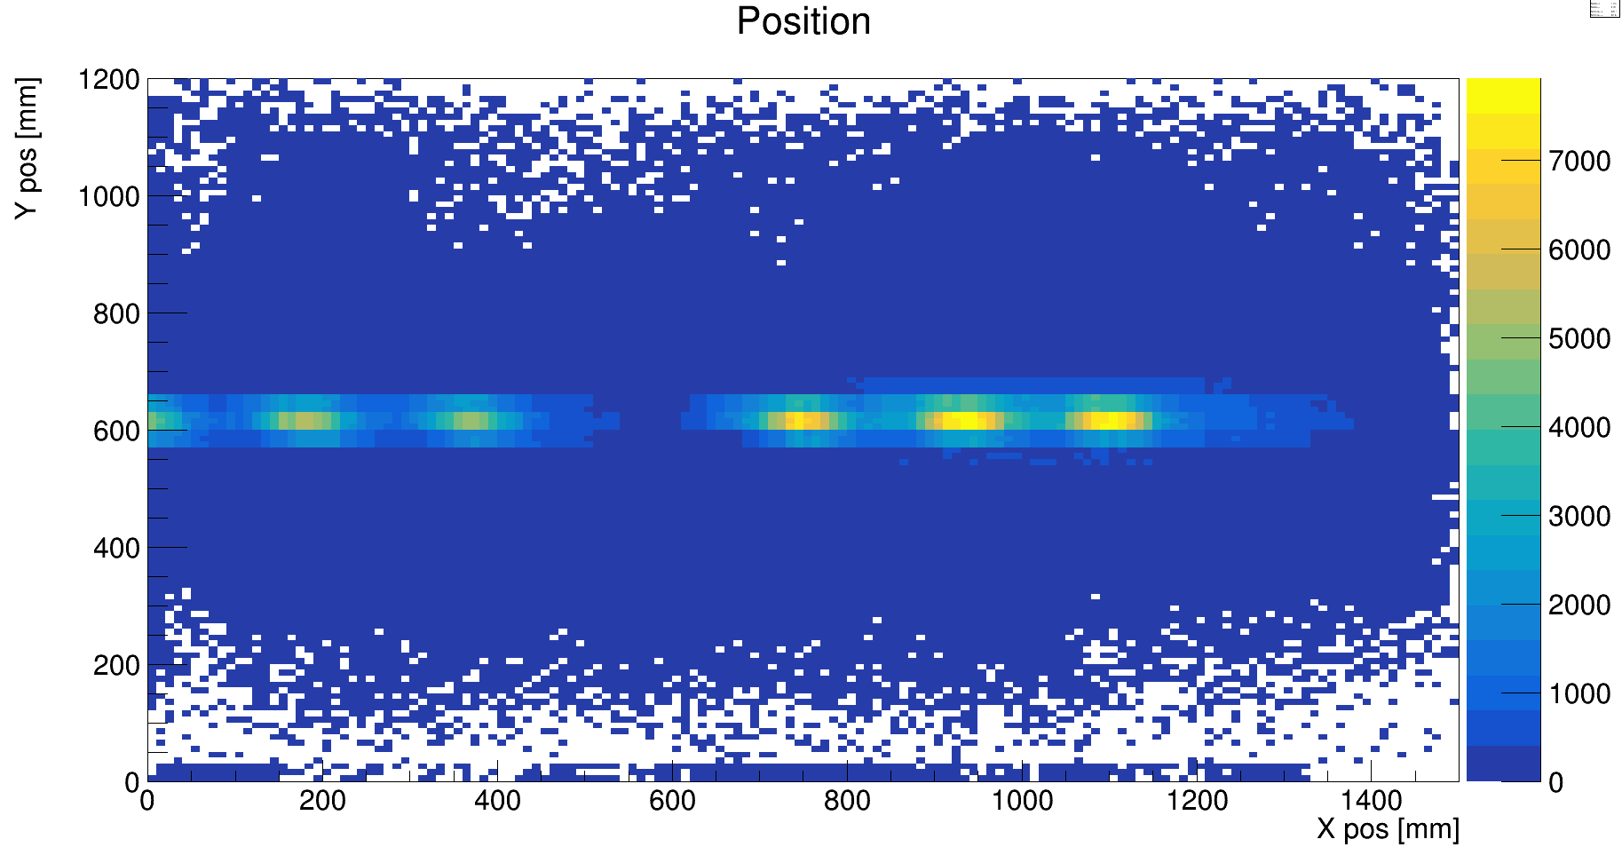
Sweep run with ⁴⁰Ar

Slide 28
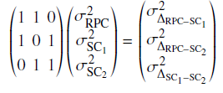
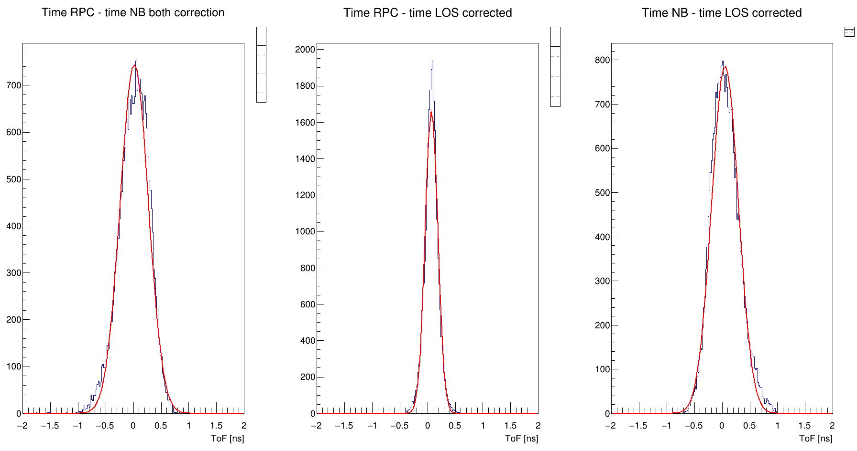
RPC Resolution for ⁴⁰Ar
where:
Sc1 is Start detector
Sc2 is Scint Bar
σ_{RPC} = 0.098 ns
σ_{Sc1} = 0.059 ns
σ_{Sc2} = 0.235 ns
This results are for the ⁴⁰Ar beam!

Slide 29
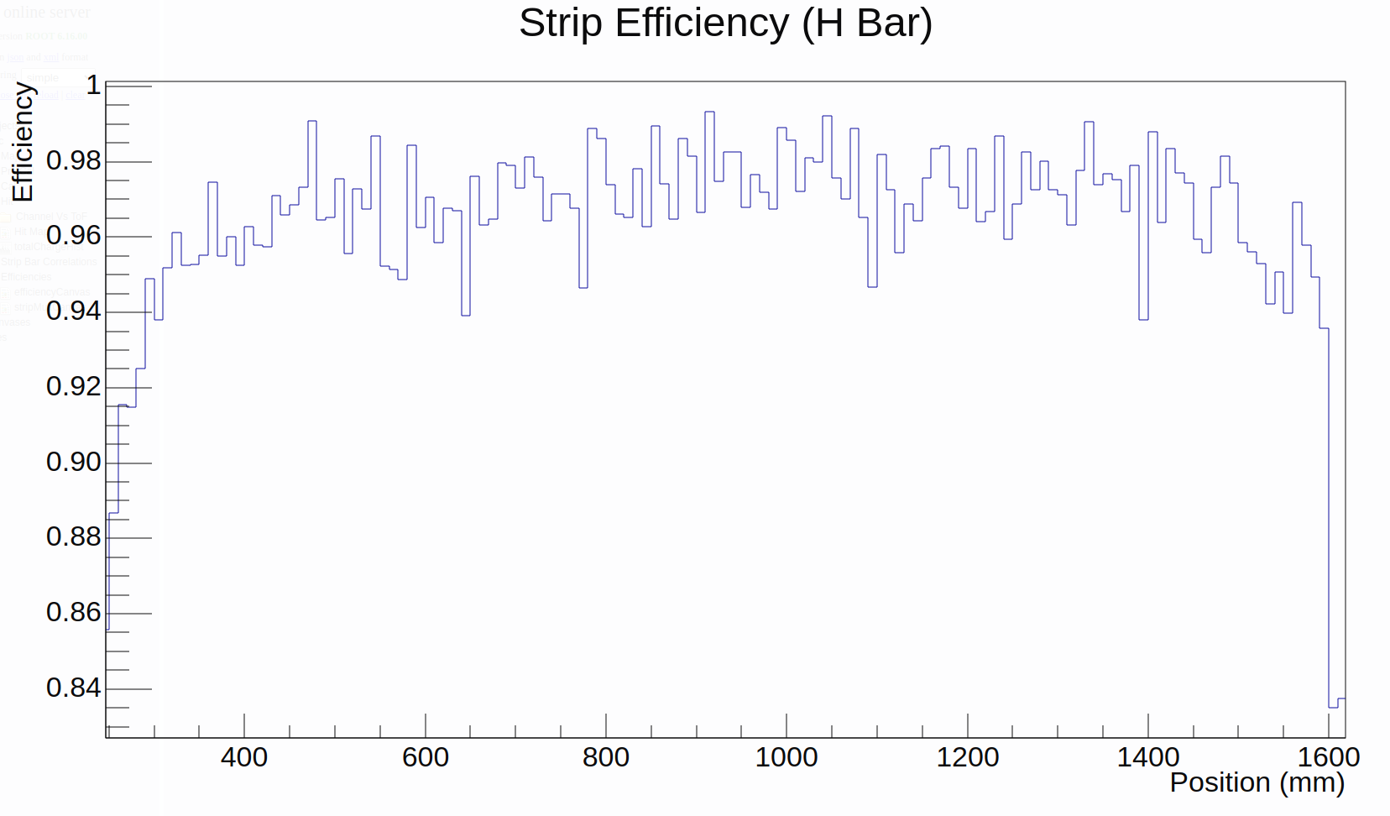
Beam time performance
First Beam time at R³B:
RPC efficiency higher than 95%;
Good synchrony between RPC and the other detectors
Detector and DAQ were stable during the two weeks of beam time

Slide 30
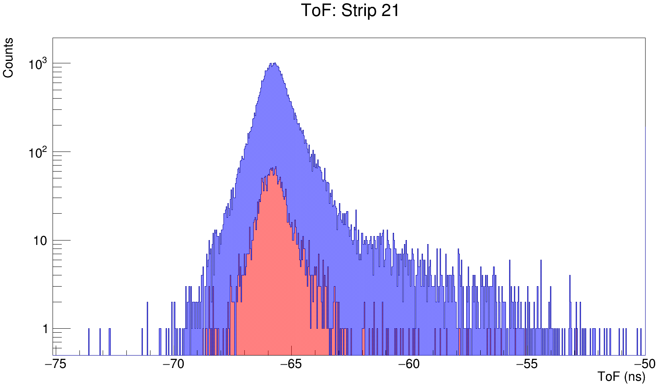
Beam time performance
ToF between RPC and LOS for ¹⁶C Beam at 1.25 GeV:
reaction of interest ¹⁶C(p,2pp)¹⁴Be
All events
Selection of charge 4 (¹⁴Be)
¹⁴Be
p
Around 1% of all data

Slide 31
Summary and Outlook
RPC detector fully implemented into R³B environment
Daq integration of a completely new system
Maybe change to the R³B standard
Software for calibration was developed
Pull Request Required
Calibration still in development:
Good ToT calibration
Good alignment of the strip position
Use scintillator bars to better the calibration
Time calibration
Understand some of the structures the we see

Slide 32
Summary and Outlook
Simulation of RPC in R3BRoot
RPCPoint developed;
Started working on the Digitizer
Complete the analysis of the ⁴⁰Ar run;
Include the Inbeam Foot into the analysis
Look at MultiDimensional Fit (MDF) to verify the positioning of RPC
Data analysis!

Slide 33
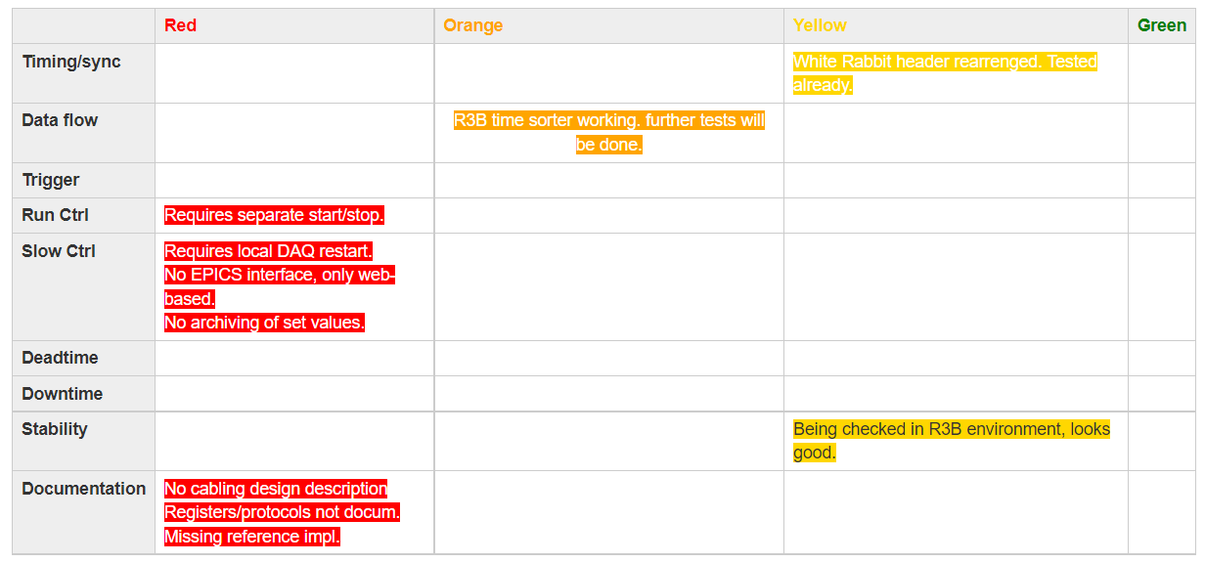
Summary and Outlook

Slide 34
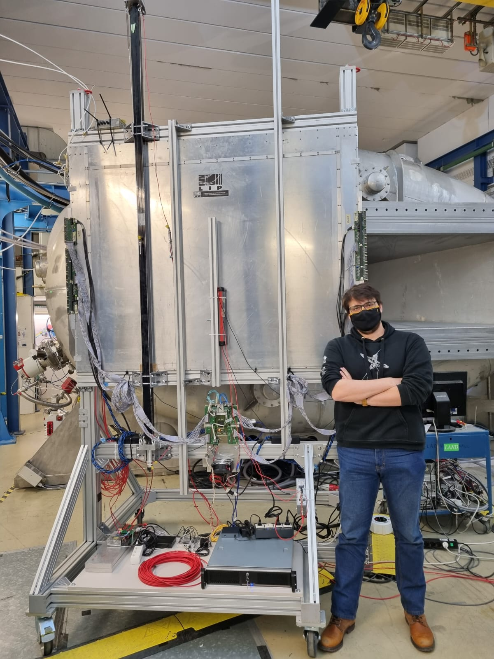


Thank you for your attention!
Supported by Portuguese FCT, Project Refs: 2021.05736.BD and EXPL/FIS-NUC/0364/2021

Slide 35
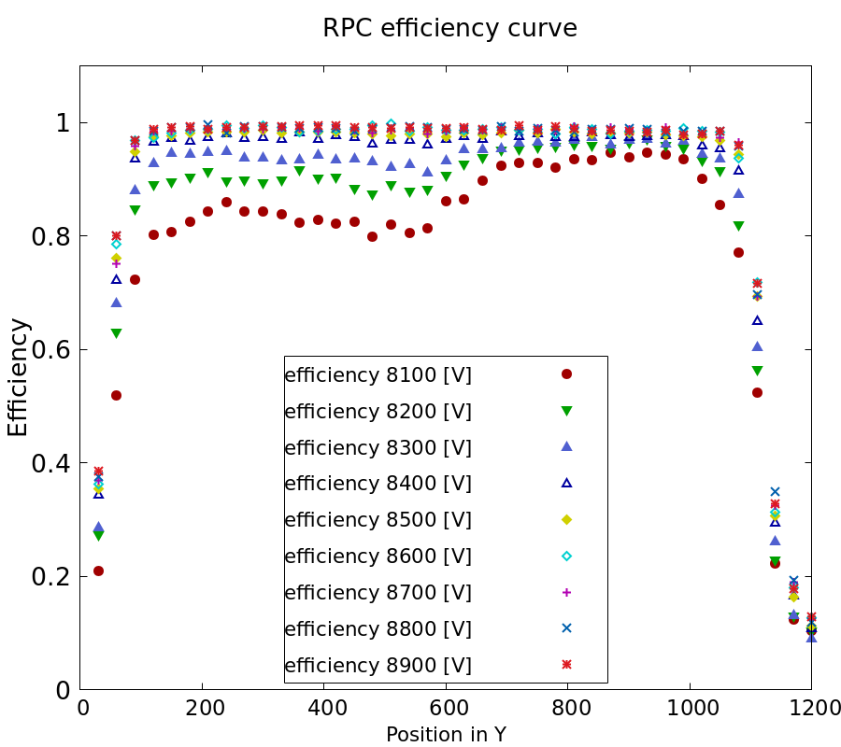
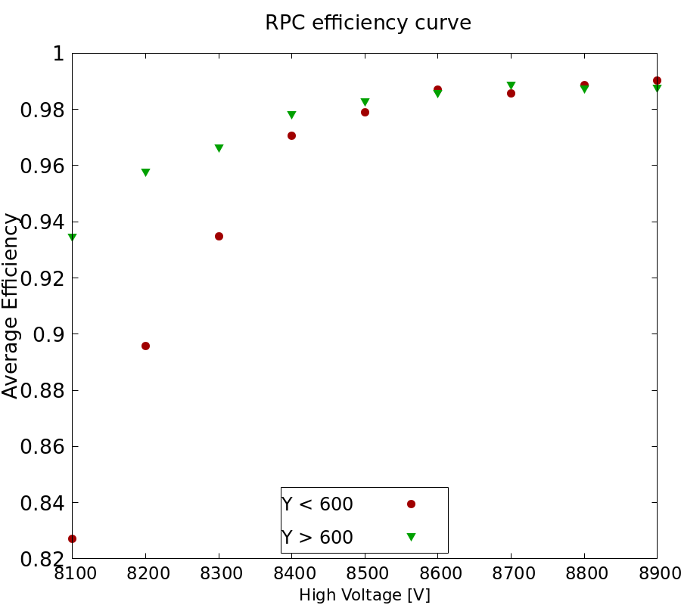
Finding HV working point at R³B

Slide 36
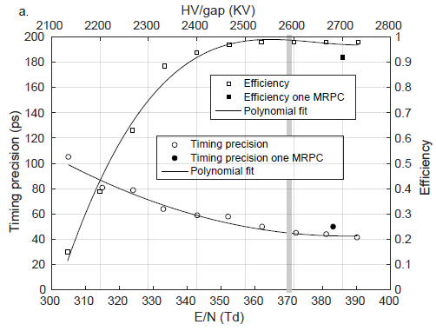
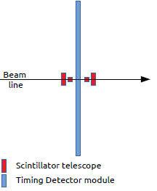
Characterization at CERN
RPC characterized at CERN with a beam of negative pions with and energy of 8 GeV/c
The SHiP timing detector based on MRPC - A. Blanco et al.

Slide 37
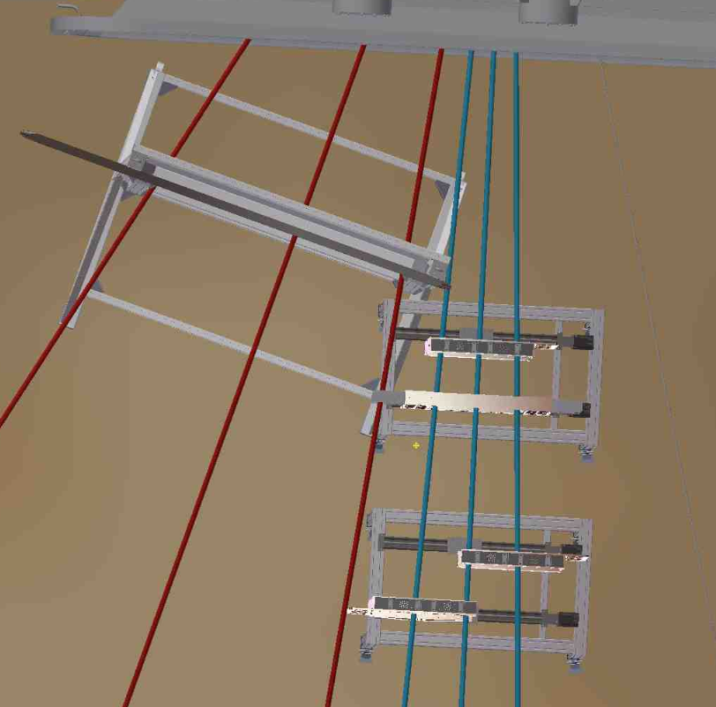
RPC Position in the cave
The RPC center will be position at 3.70 m from the bending point of GLAD.
It will cover the forward emitted proton from:
21º-44º for the ¹²C beam;
27º-51º for the ¹⁶C beam;
Angles with respect to the bending point of GLAD;
Daniel Koerper CAD design

Slide 38
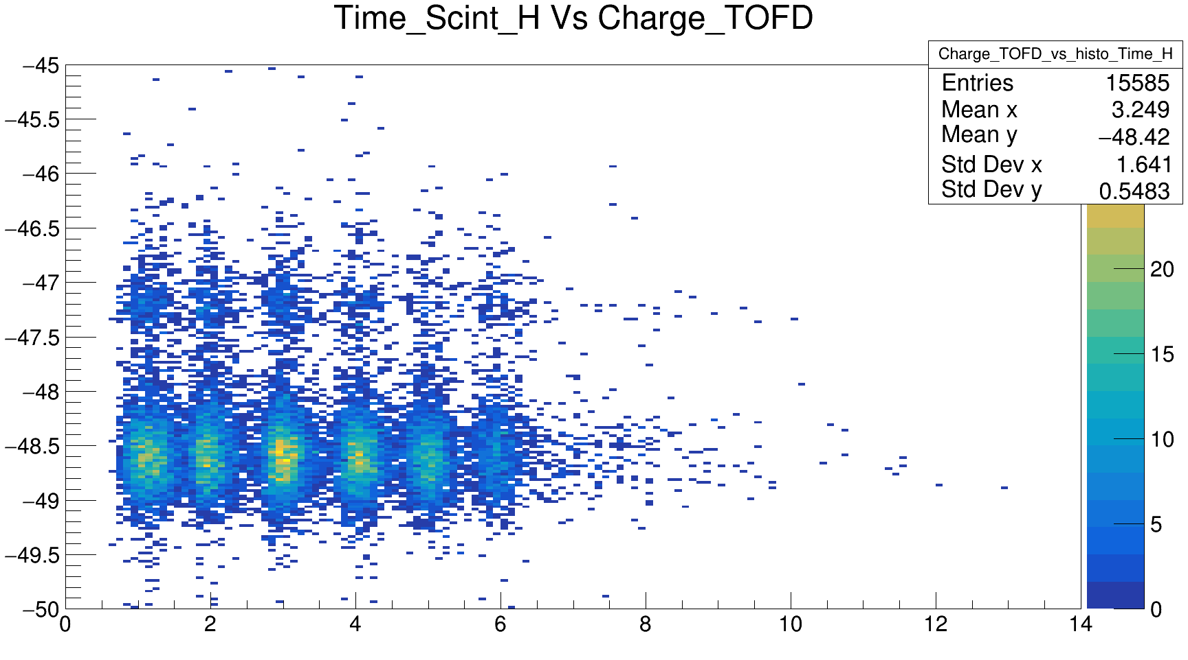
Correlation with TOFD

Slide 39
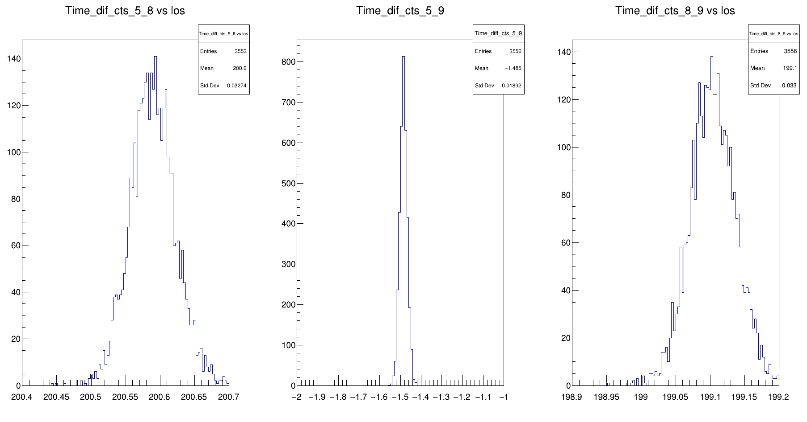
Pulser Test

Slide 40
