Slide 1
PANDA collaboration Meeting 22/3
10-14 October 2022
GSI, Darmstadt, Germany
MDC Development status
Michele Caselle, Vladimir Sidorenko, Daniela Calvo, Andreas Kopmann, Kai Lukas Unger, Olena Manzhura, Tobias Stockmanns and Jürgen Becker

Slide 2
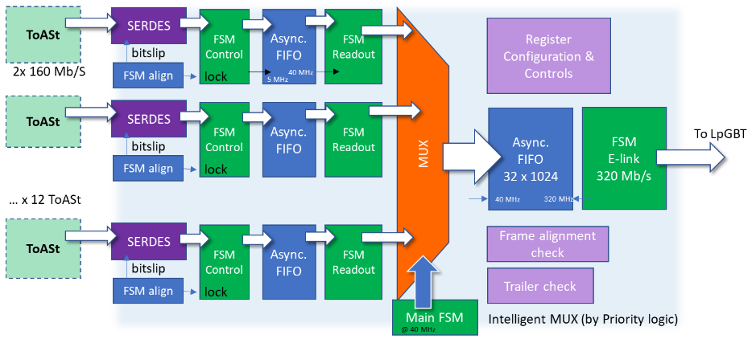
Module Data Concentrator ASIC
Radiation-tolerant ASIC local controller of the microstrip detector modules
MDC ASICs will be develop in UMC 110 nm CMOS, same CMOS technology of the ToASt ASICs, both the ToASt and MDC will be manufactured in the same engineering runs
Features:
Designed to readout up to 8 links
Dynamic configuration of the number of ToASt asics and high-speed links (including spares)
No-active links are kept in low-power mode
Intelligent multiplexing logic to balance the data occupancy
Status of MDC architecture (Panda CM 22/2)
… X 7 ToASt

Slide 3
Module Data Concentrator ASIC
Radiation-tolerant ASIC local controller of the microstrip detector modules
MDC architecture (Panda CM 22/2)
… X 7 ToASt

Slide 4
Module Data Concentrator ASIC
Radiation-tolerant ASIC local controller of the microstrip detector modules
Current MDC architecture (Panda CM 22/3)
CfgRx
CfgTx
From LpGBT (output eLinks)
ToAST Configuration module
… X 7 ToASt

Slide 5
MVD Detector
Readout architecture
Counting room
(Real-time)
Active volume
Outside active volume
3.
On-line
Double-sided strip modules
ToASt
2.
MDC
(Module data Concentrator)
FPGA
Compute
Node
ToASt
…
ToASt
e-links
Downlink (controls & timing)
MMB
(MVD Multiplexer Board)
Strip Detector
LpGBT
ToASt
MDC
(Module data Concentrator)
e-links
LpGBT
optical link
Uplink (data)
ToASt
…
Copper
ToASt
1.
Long distance
SODANET
ToASt configuration strategy:
Configuration from SODANET is stored in a “user space register” implemented in the FPGA The User space register contains an update copy of the MVD configuration
The configuration is sent to LpGBT by optical downlink
MDC will provide the local configuration of the ToASt
Notes:
The User space register contains an updated copy of the MVD configuration, so that, in case of detector configuration, all updated configuration data are retrieved from FPGA and not from SODANET

Slide 6
MVD Detector
Readout architecture
Counting room
(Real-time)
Active volume
Bit error on cmd and/or chip_ID
Outside active volume
3.
On-line
Double-sided strip modules
ToASt
2.
MDC
(Module data Concentrator)
FPGA
Compute
Node
ToASt
…
ToASt
e-links
Downlink (controls & timing)
MMB
(MVD Multiplexer Board)
Strip Detector
LpGBT
ToASt
MDC
(Module data Concentrator)
e-links
LpGBT
optical link
Uplink (data)
ToASt
…
Copper
ToASt
1.
Long distance
SODANET
ToASt configuration strategy:
Configuration from SODANET is stored in a “user space register” implemented in the FPGA The User space register contains an update copy of the MVD configuration
The configuration is sent to LpGBT by optical downlink
MDC will provide the local configuration of the ToASt
Notes:
The User space register contains an updated copy of the MVD configuration, so that, in case of detector configuration, all updated configuration data are retrieved from FPGA and not from SODANET

Slide 7
ToASt configuration codes
Configuration procedure implemented in the front-end (ToASt)
The MDC configuration module validates the 0/1 fixed bit and the sequence of the commands received
Developed by Gianni
Command

Slide 8
MDC ToASt configuration module
ToAst configuration and “error protection” architecture
MDC conf FIFO
ToASt
FSM_TX_CFG
LpGBT interface
Downlink from LpGBT (output elinks)
ToASt
…
ToASt
Chip Select
Register select (ch/glob)
Register write (conf data)
….
Register select (ch/glob)
Register write (conf data)
….
Chip Deselect
-----
Register read (conf data)
No operation (idle)
FSM_CFG_check
FSM_RX_CFG
Uplink transmit data from the lpGBT to the counting room
MDC
Implemented on ToASt (Gianni)

Slide 9
MDC ToASt configuration module
ToAst configuration and “error protection” architecture
MDC conf FIFO
ToASt
FSM_TX_CFG
LpGBT interface
Downlink from LpGBT (output elinks)
ToASt
Chip Select
Register select (ch/glob)
Register write (conf data)
….
Register select (ch/glob)
Register write (conf data)
….
Chip Deselect
…
ToASt
Chip Select
Register select (ch/glob)
Register write (conf data)
….
Register select (ch/glob)
Register write (conf data)
….
Chip Deselect
-----
Register read (conf data)
No operation (idle)
FSM_CFG_check
FSM_RX_CFG
Uplink transmit data from the lpGBT to the counting room
MDC
Implemented on ToASt (Gianni)

Slide 10
MDC ToASt configuration module
ToAst configuration and “error protection” architecture
MDC conf FIFO
ToASt
FSM_TX_CFG
LpGBT interface
Downlink from LpGBT (output elinks)
ToASt
Chip Select
Register select (ch/glob)
Register write (conf data)
….
Register select (ch/glob)
Register write (conf data)
….
Chip Deselect
…
ToASt
Chip Select
Register select (ch/glob)
Register write (conf data)
….
Register select (ch/glob)
Register write (conf data)
….
Chip Deselect
-----
Register read (conf data)
No operation (idle)
FSM_CFG_check
FSM_RX_CFG
Uplink transmit data from the lpGBT to the counting room
MDC
Implemented on ToASt (Gianni)

Slide 11
MDC ToASt configuration module
ToAst configuration and “error protection” architecture
MDC conf FIFO
ToASt
FSM_TX_CFG
LpGBT interface
Downlink from LpGBT (output elinks)
ToASt
Chip Select
Register select (ch/glob)
Register write (conf data)
….
Register select (ch/glob)
Register write (conf data)
….
Chip Deselect
…
ToASt
Sequence VALID
Chip Select
Register select (ch/glob)
Register write (conf data)
….
Register select (ch/glob)
Register write (conf data)
….
Chip Deselect
-----
Register read (conf data)
No operation (idle)
FSM_CFG_check
FSM_RX_CFG
Sequence NOT VALID
Uplink transmit data from the lpGBT to the counting room
MDC
Implemented on ToASt (Gianni)

Slide 12
MDC ToASt configuration module
ToAst configuration and “error protection” architecture
MDC conf FIFO
ToASt
FSM_TX_CFG
LpGBT interface
Downlink from LpGBT (output elinks)
ToASt
Chip Select
Register select (ch/glob)
Register write (conf data)
….
Register select (ch/glob)
Register write (conf data)
….
Chip Deselect
…
ToASt
MMB-FPGA
( counting room)
cfg_sequence will be sent again
Chip Select
Register select (ch/glob)
Register write (conf data)
….
Register select (ch/glob)
Register write (conf data)
….
Chip Deselect
-----
Register read (conf data)
No operation (idle)
FSM_CFG_check
FSM_RX_CFG
Sequence NOT VALID
Uplink transmit data from the lpGBT to the counting room
MDC
Implemented on ToASt (Gianni)

Slide 13
MDC ToASt configuration module
ToAst configuration and “error protection” architecture
MDC conf FIFO
ToASt
CfgTx
FSM_TX_CFG
LpGBT interface
Chip Select
Register select (ch/glob)
Register write (conf data)
….
Register select (ch/glob)
Register write (conf data)
….
Chip Deselect
Downlink from LpGBT (output elinks)
ToASt
…
ToASt
Sequence VALID
Chip Select
Register select (ch/glob)
Register write (conf data)
….
Register select (ch/glob)
Register write (conf data)
….
Chip Deselect
-----
Register read (conf data)
No operation (idle)
FSM_CFG_check
FSM_RX_CFG
Uplink transmit data from the lpGBT to the counting room
MDC
Implemented on ToASt (Gianni)

Slide 14
MDC ToASt configuration module
ToAst configuration and “error protection” architecture
MDC conf FIFO
ToASt
CfgRx
FSM_TX_CFG
LpGBT interface
Chip Select
Register select (ch/glob)
Register write (conf data)
….
Register select (ch/glob)
Register write (conf data)
….
Chip Deselect
Downlink from LpGBT (output elinks)
ToASt
…
ToASt
Chip Select
Register select (ch/glob)
Register write (conf data)
….
Register select (ch/glob)
Register write (conf data)
Register read (conf data)
COMPARE
….
Chip Deselect
COMPARE
FSM_CFG_check
FSM_RX_CFG
Uplink transmit data from the lpGBT to the counting room
MDC
Every write operation is completed by a readback
Implemented on ToASt (Gianni)

Slide 15
MDC ToASt configuration module
ToAst configuration and “error protection” architecture
MDC conf FIFO
ToASt
FSM_TX_CFG
LpGBT interface
Downlink from LpGBT (output elinks)
ToASt
Chip Select
Register select (ch/glob)
Register write (conf data)
….
Register select (ch/glob)
Register write (conf data)
….
Chip Deselect
…
ToASt
Chip Select
Register select (ch/glob)
Register write (conf data)
….
Register select (ch/glob)
Register write (conf data)
….
Chip Deselect
-----
Register read (conf data)
No operation (idle)
COMPARE
FSM_CFG_check
Configuration
OK
FSM_RX_CFG
True
Uplink transmit data from the lpGBT to the counting room
MDC
Every write operation is completed by a readback
Implemented on ToASt (Gianni)

Slide 16
MDC ToASt configuration module
ToAst configuration and “error protection” architecture
MDC conf FIFO
ToASt
CfgTx
FSM_TX_CFG
LpGBT interface
Chip Select
Register select (ch/glob)
Register write (conf data)
….
Register select (ch/glob)
Register write (conf data)
….
Chip Deselect
Downlink from LpGBT (output elinks)
ToASt
…
ToASt
CfgRx
False
Chip Select
Register select (ch/glob)
Register write (conf data)
….
Register select (ch/glob)
Register write (conf data)
….
Chip Deselect
-----
Register read (conf data)
No operation (idle)
Compare
FSM_CFG_check
Errors in programming
number of rewrites
up to for 6 times
FSM_RX_CFG
Uplink transmit data from the lpGBT to the counting room
MDC
Every write operation is completed by a readback
Implemented on ToASt (Gianni)

Slide 17
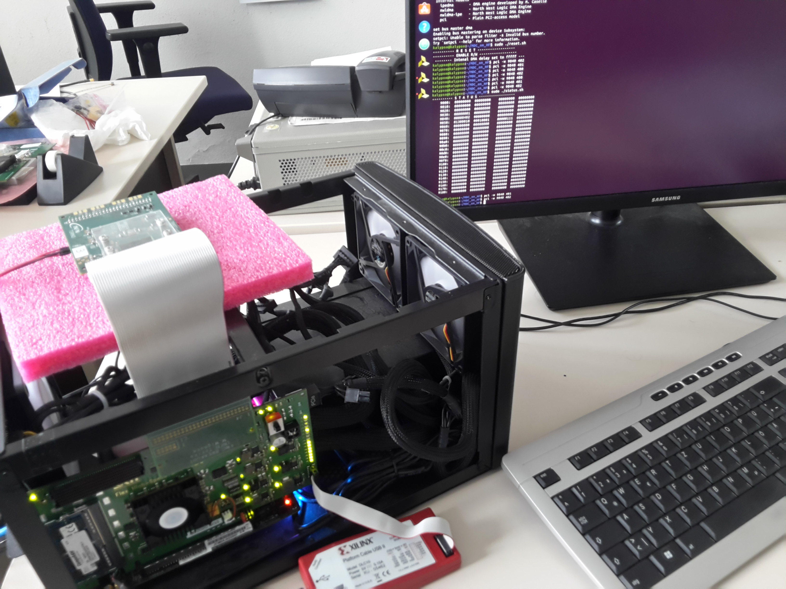
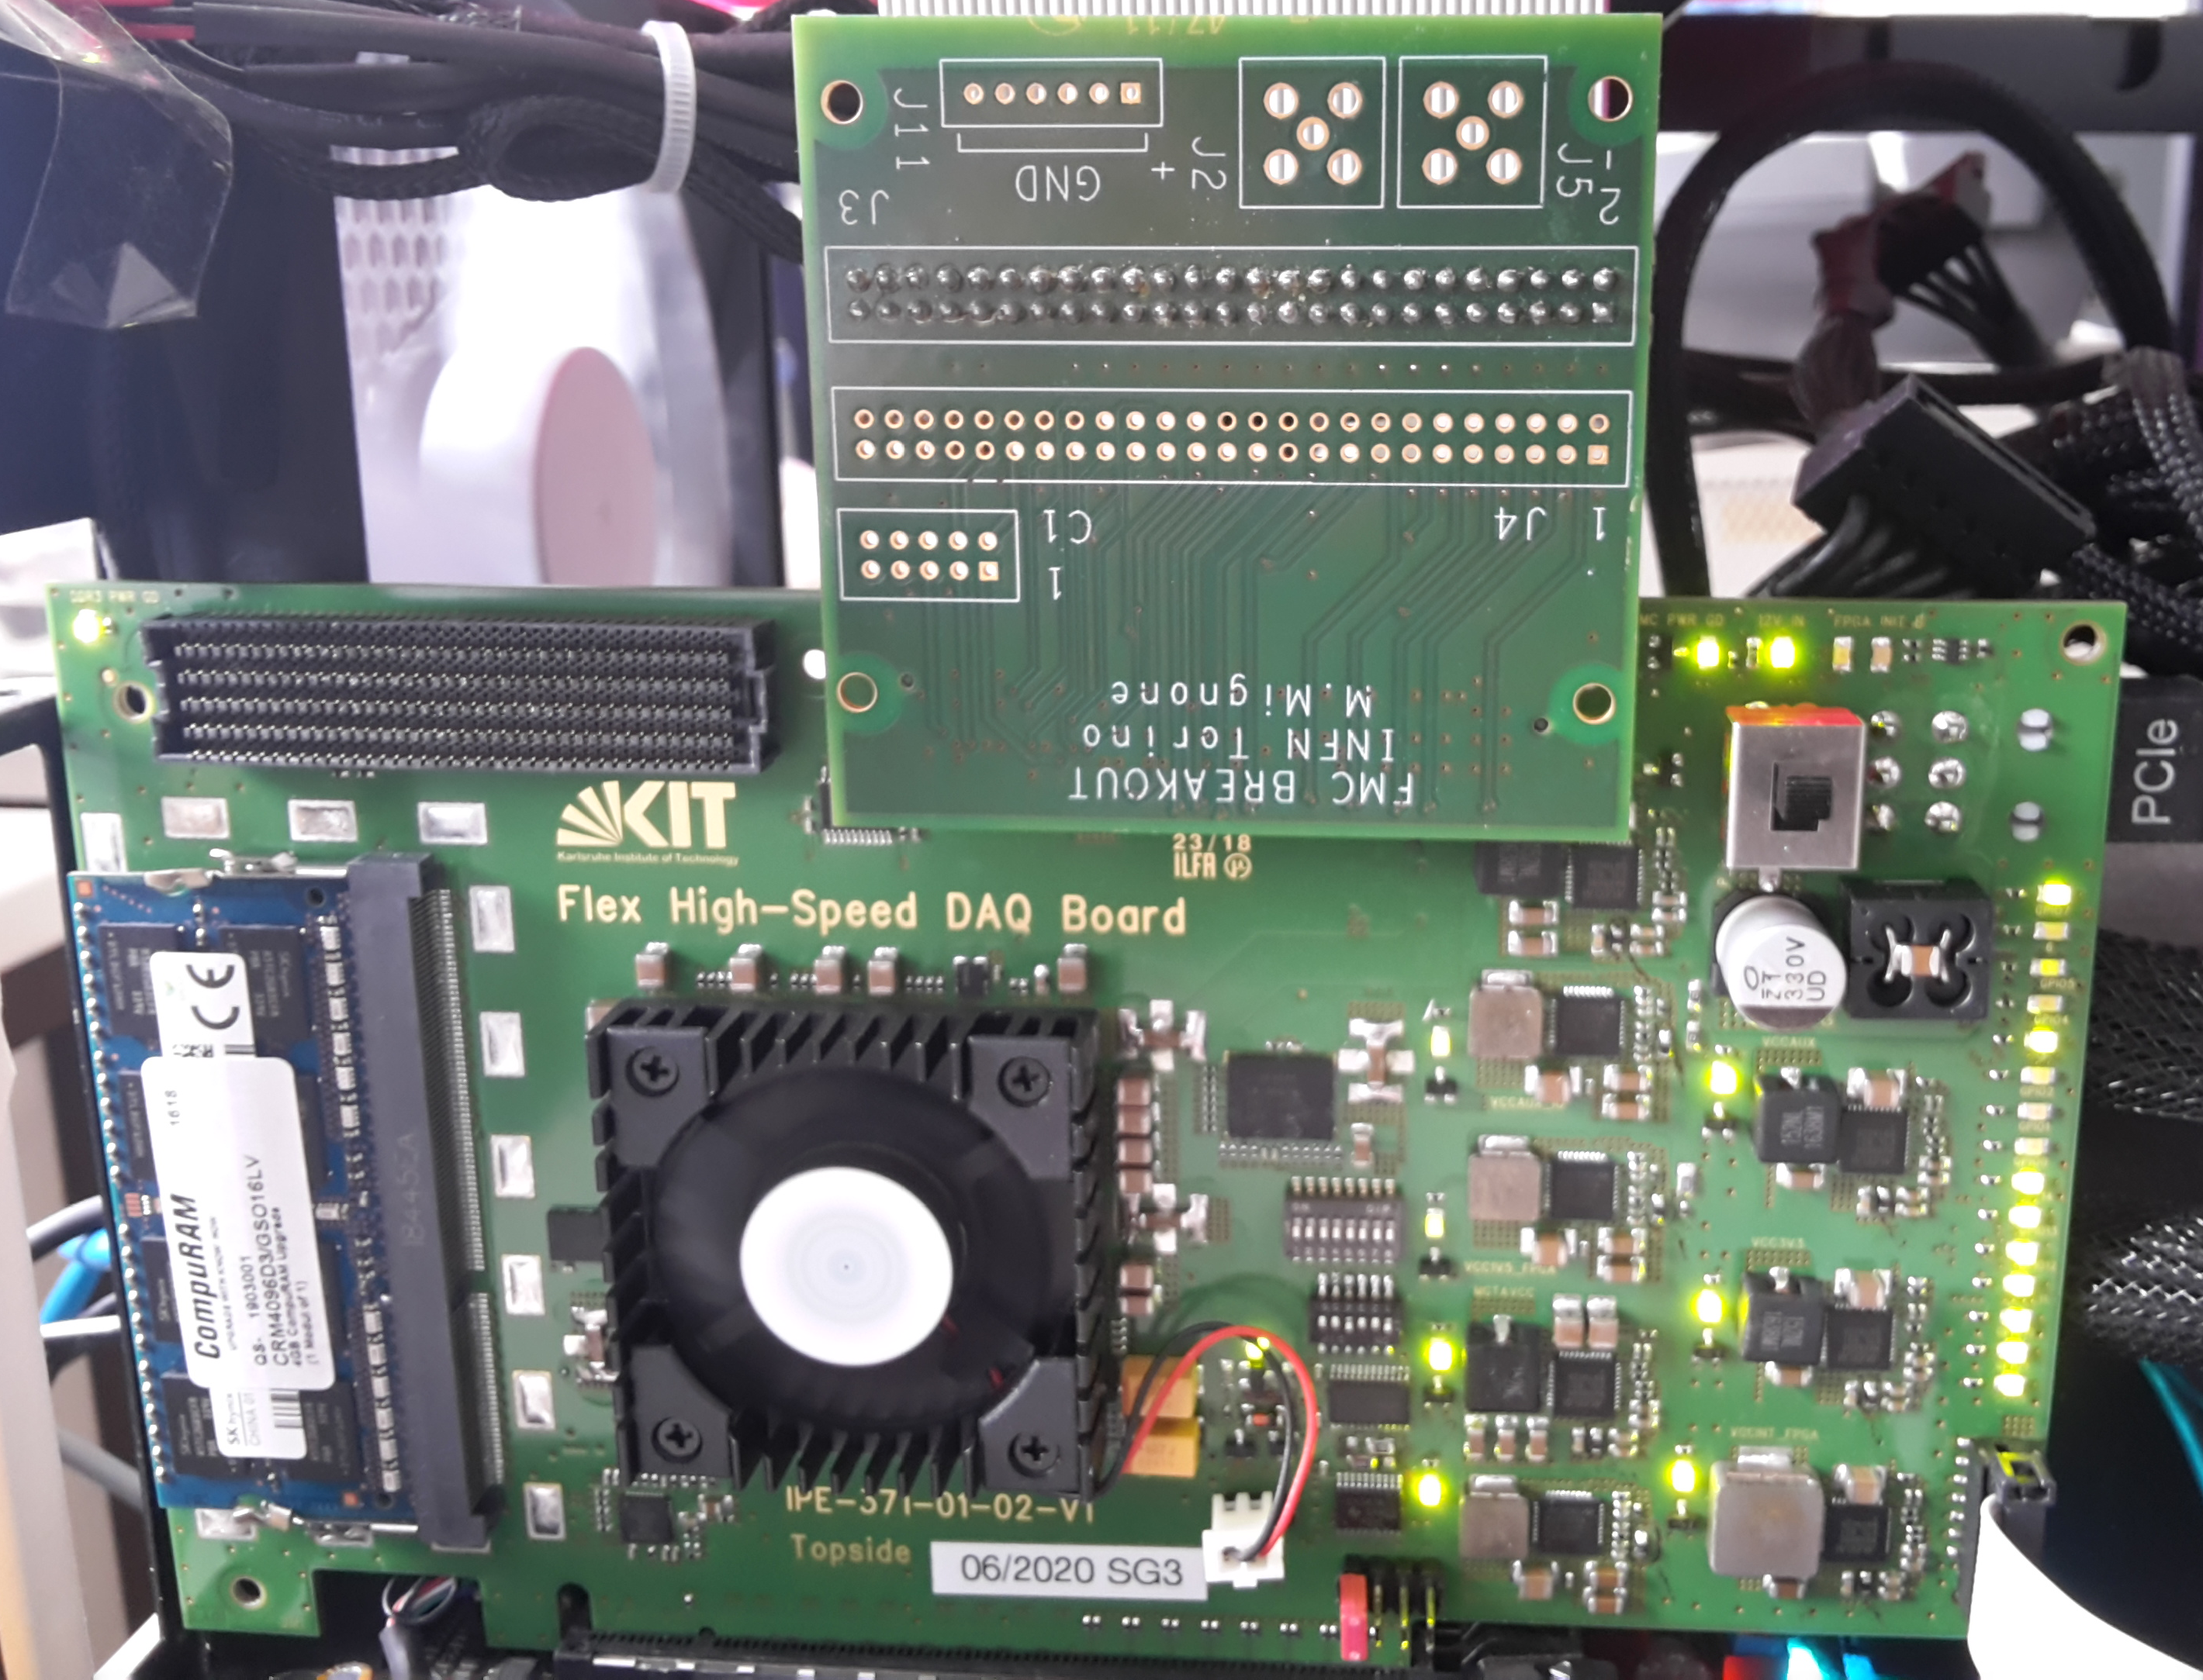
MDC on FPGA and integration test
FPGA integration of the MDC with the KIT-DAQ infrastructure
ToAST testBoard (To)
System reply to Linux cmd
Mini-PC
HighFlex PCIe card

Slide 18
MDC integrated on KIT framework
GPU-Direct technology, GPU-direct over InfiniBand/ETH
Setup for “lab tests” and “beam tests”
Several options are available:
Detector data (ToASt) → processed by local GPU (GPU-Direct technology)
Detector data → send to a remote PC/HPC by GPU-Direct over InfiniBand /ETH
Detector data → locally stored on Disks (SDD)
Detector control
Locally by standard PC
Remotely by EPICS or ETH commands
PCIe data throughput of 120 Gb/s continuous readout mode

Slide 19
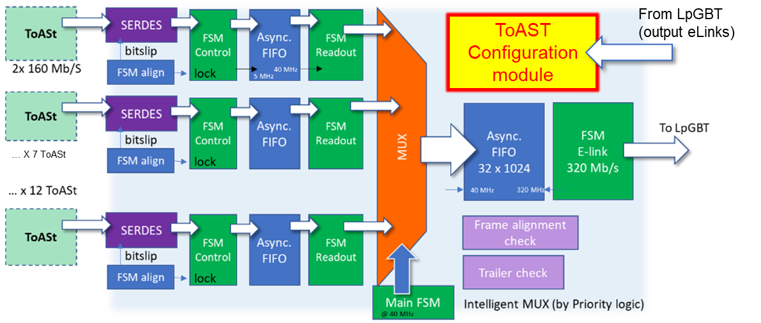
MDC on FPGA
FPGA integration of the MDC with the KIT-DAQ infrastructure
PCIe Base Address Register (BAR)
MDC architecture
PCIe Programmed IO (PIO)
PC
GPU-Direct KIT-DMA
FIFO
FIFO
Data
FPGA implementation
Ext. memory DDR3 (4 GB)
19

Slide 20
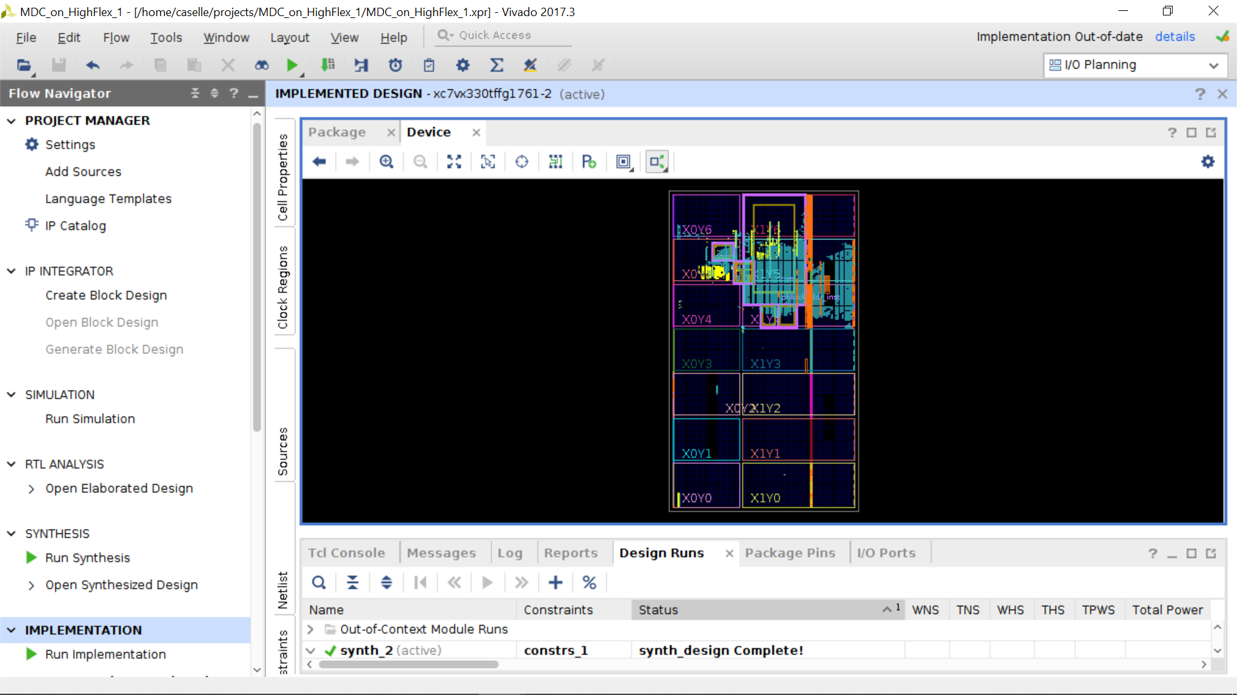

Slide 21
Conclusion & What’s next
Test integration between MDC and ToASt → will continue
All ToASt signals are present
TxOut0 and TxOut1 data links → locked by MDC (on FPGA)
ToASt configuration → working
Next steps:
To learn how to use the configuration files provide by Gianni
To readout the data from ToASt (internal test pulse)
Thanks for your attention

Slide 22
Back-up

Slide 23
Module Data Concentrator (Data Format)
MDC data format and real-time data consistency check
32 bits
CRC
ToASt
(data format)
Header
SYNC
SYNC
Data
SYNC
Data
…
Trailer
128 packets
ToASt frame (25.6 µs)
SYNC packets → to check the communication between TX_ch channel (ToASt) and MDC
Only HEADER, DATA and TRAILER transmitted
MDC
(channel)
Header
Data
Data
…
Trailer
CRC
CRC
CRC
MDC
(Data format)
…
…
…
Header MDC
Header
Data
Data
Trailer
Header
Data
Data
Trailer
Trailer MDC
ToASt 0
ToASt 11
To DAQ
Frame number alignment → performed on MDC and packed in the MDC Header
CRC data check and correction → performed on the FPGA/ZYNQ (off-detector electronics)
MDC Header and Trailer (32 bits) free to any further metadata to be sent to off-detector acquisition

