Slide 1


Progress of the Hyperatom setup
Marcell Steinen, Patrick Achenbach, Michael Bölting, Jürgen Gerl, Philipp Hermann, Ivan Kojouharov, Josef Pochodzalla, Héctor Sanchis Perez, Falk Schupp
Helmholtz-Institut Mainz
Panda Meeting 22-3

Slide 2
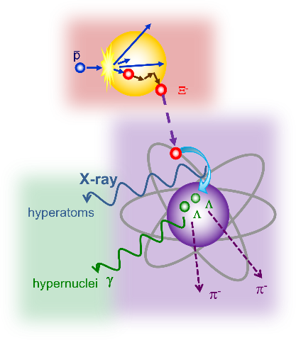
Outline
Y
Y
Y
(Anti)hyperon propagation
Ξ⁻ Hyperatoms
ΛΛ Hypernuclei
GiBUU
Target system
PandaRoot
PANGEA
Falk‘s talk(s)

Slide 3
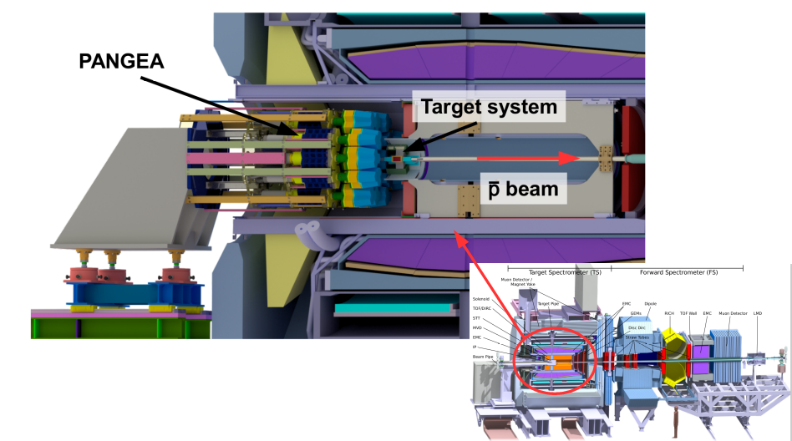
Hyperatom/hypernuclei setup
Dedicated target system
PANGEA

Slide 4
Outline
Target system
  Mechanical design
  3D printed Vacuum chamber
  Z Motor positioning
PANGEA
  Holding structure
  Detector manufacturing

Slide 5
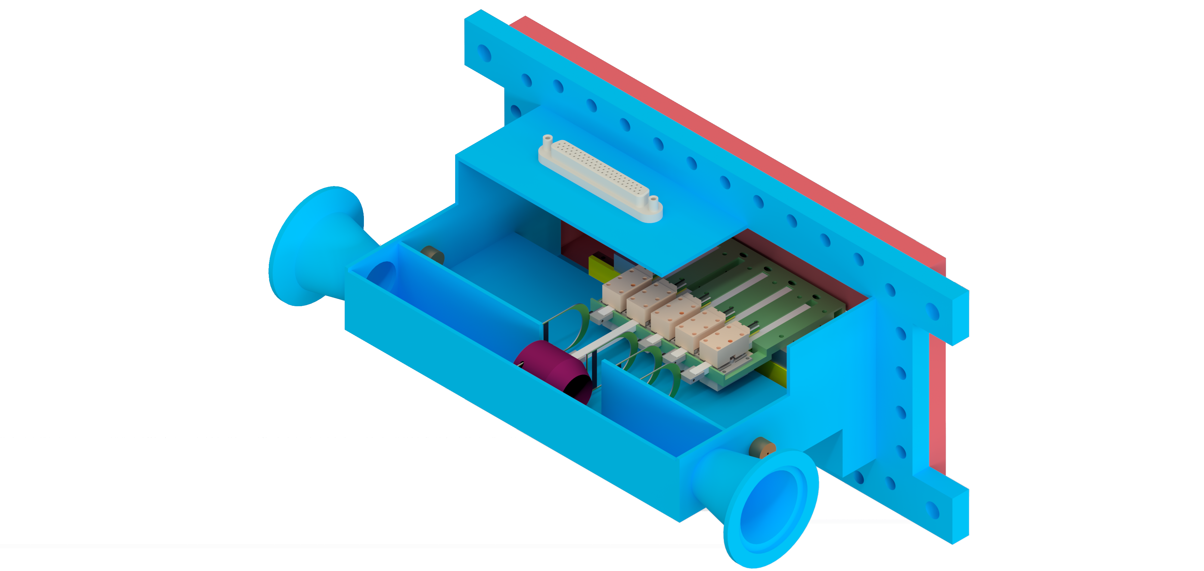
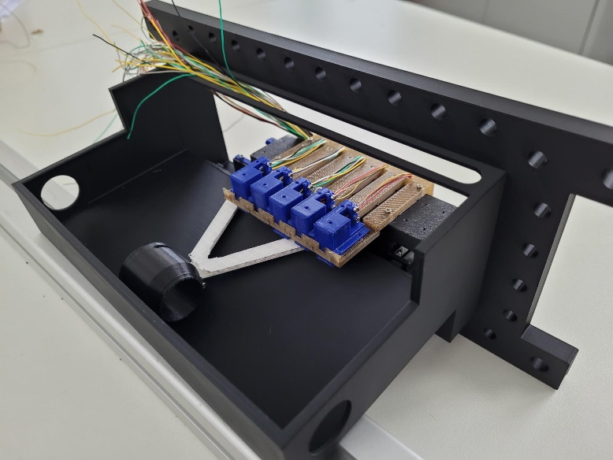
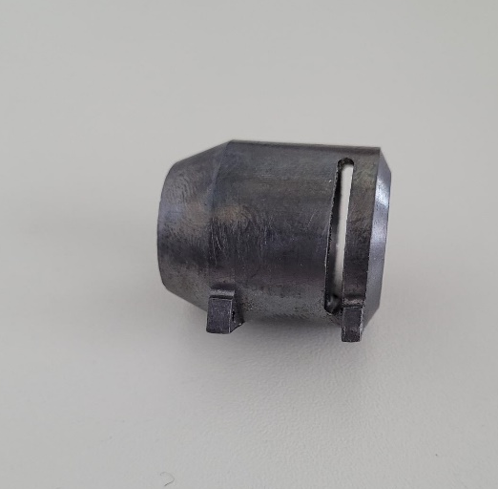
Target system – Design
p
3D printed model:
Handling
Cabling
2 cm
Lead secondary target
Notes:
Two staged target system
Movable and exchangable primary target
Secondary target differ for both experiments
Embedded or outside of the beam pipe
Ti foil for hyperatom target
Right now we focus on the hyperatom target

Slide 6
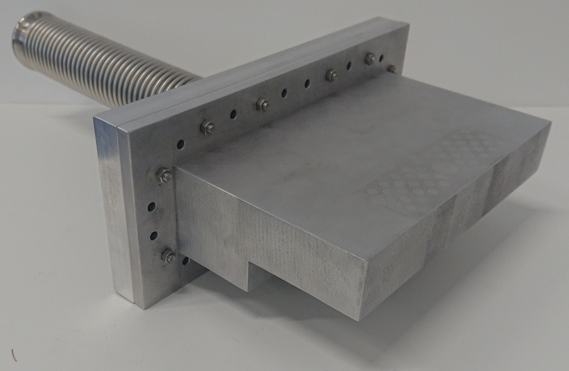
Target system - 3D printed chamber
Small chamber with comlex design
Hard to mill/weld -> Al 3D print
Vacuum capabilities? Mechanical stability?
Upside down view
Massive 8 mm walls!

Slide 7
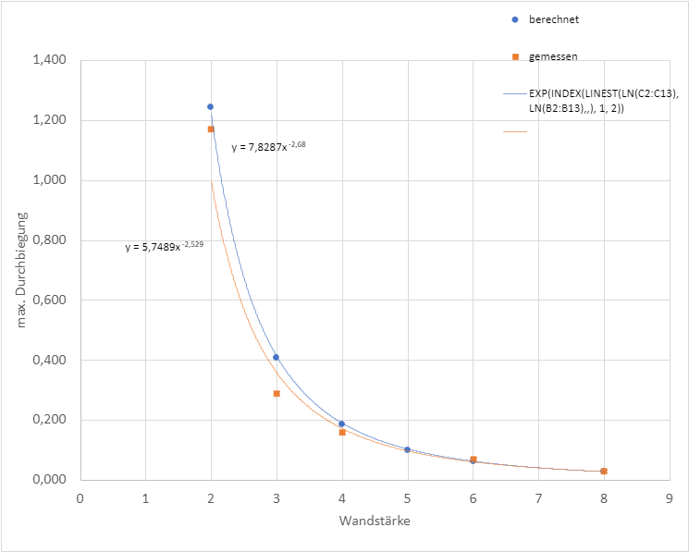
Target system - 3D printed chamber (2)
Simulated
Measured
γ absorbed in chamber material must be reduced
Deformation measured after evacuation
Measurements better than FEM simulations
Deformations for 2 mm walls too high
Max. deformation [mm]
Wall thickness [mm]

Slide 8
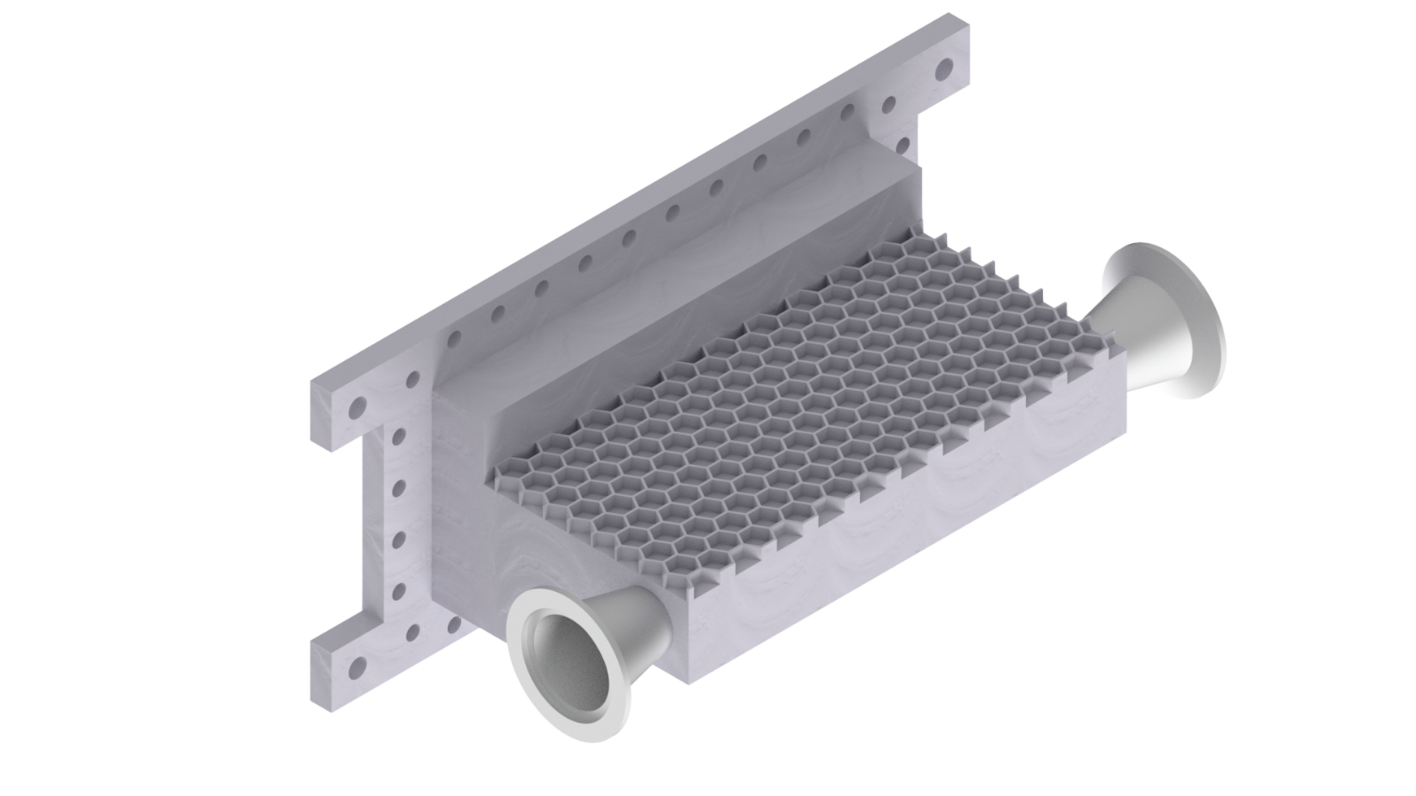
Target system - 3D printed chamber (3)
Upside down view
Honeycomb structure to improve stability
Minor vacuum issues with this model
-> Post processing of 3D printed model by heat/pressure
treatment for next version
CAD drawing

Slide 9
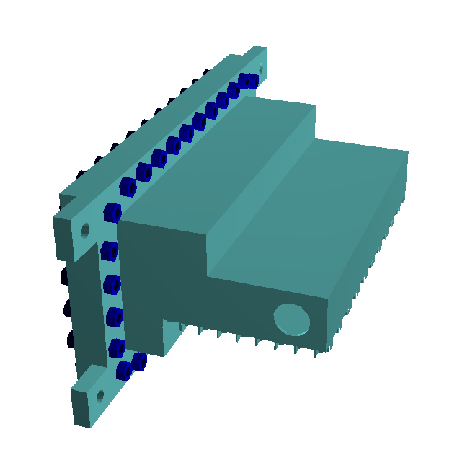
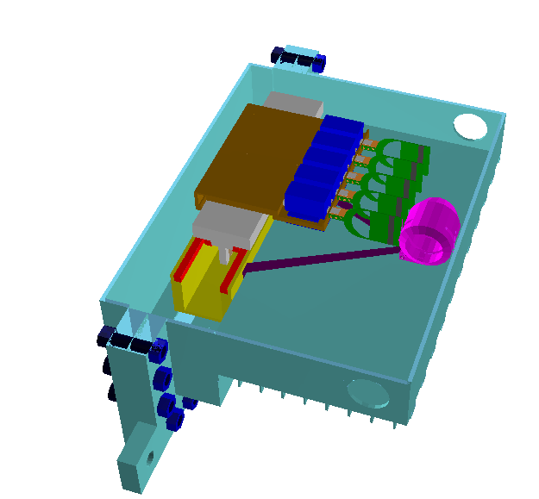
Target system - simulations
Detailed model in PandaRoot

Slide 10
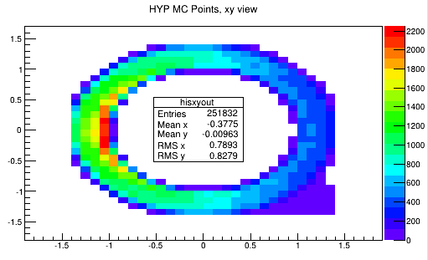
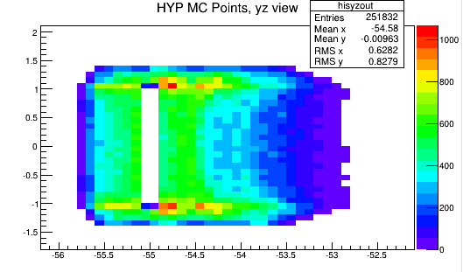
Target system - simulations (2)
Ξ⁻ stopping:
  Sligthly below previous designs (0.49 % vs. 0.57)
  Mainly caused by slit in target (required!!)

Slide 11
Target system - simulations (2)
γ efficiency:
  Compared some variations of the target chamber
 | γ eff @ 559 keV
No chamber | 5.49 %
2 mm, no honeycomb | 4.84 %
2 mm | 4.76 %

Slide 12
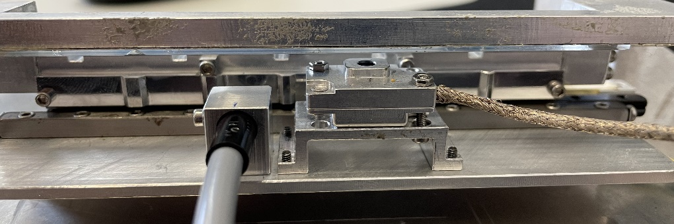
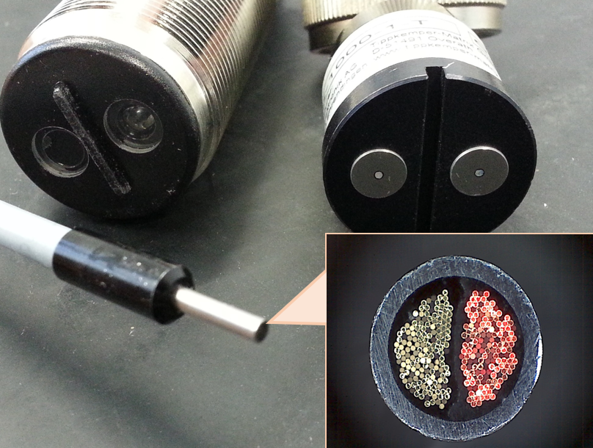
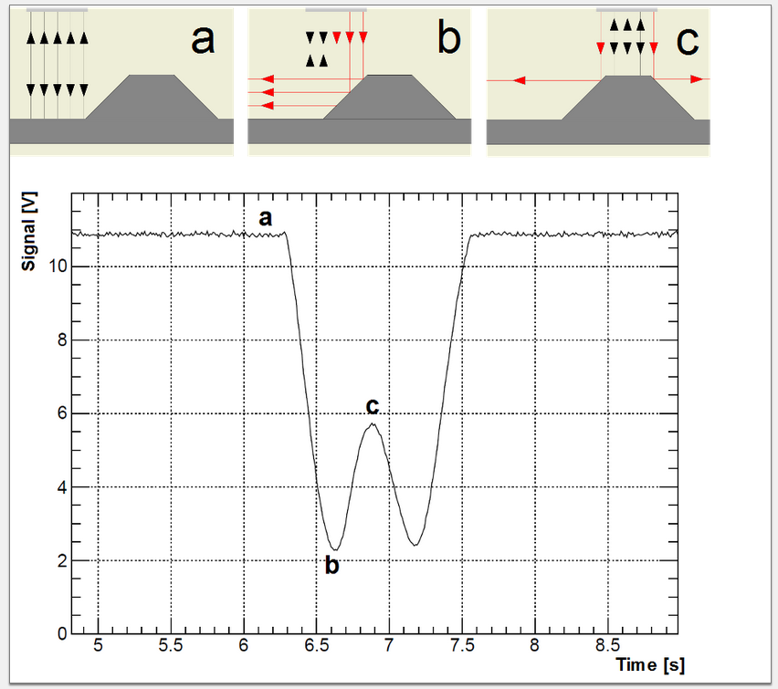
Target system – position system
Crucial to hit the slit in the absorber when changing target
  Z positioning (beam axis): better than 100 µm
Radiation hard position system based on IR reflection

Slide 13
Target system – position system (2)
Target moving full range
  FWHM: (18.71 +- 0.38) μm
  Max deviation: 30µm
Paper in preparation (Falk)

Slide 14
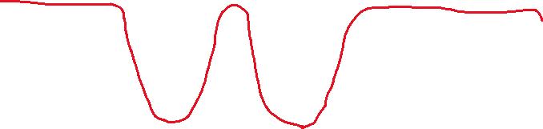
Target system – position system (3)
Algorithm required to steer the system to a specific position
Precision? Repeatabity?
Summer student: Héctor Sanchis Perez

Slide 15
Target system – position system (4)
Avg std. dev.: 8 µm
Avg interval: 48 µm
Max. interval: 75 µm
Outliers:
  Improvement of the readout electronics
  in progress
Summer student: Héctor Sanchis Perez

Slide 16
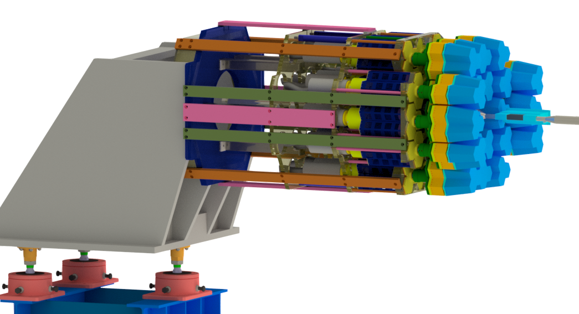
PANGEA
Picture still with old coolers

Slide 17
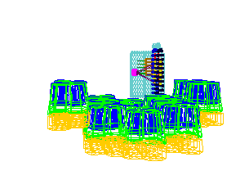
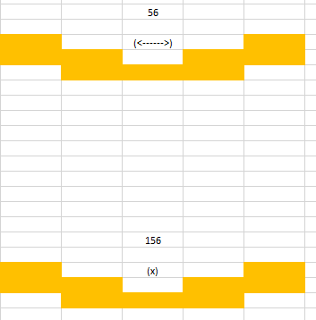
PANGEA - Orientation
Absorbed γ in the target system
  Orientation of PANGEA?
No improvement!
  No need for 90° rotation
  with more complex frame
 | γ eff @ 559 keV
Horizontal PANGEA (56) | 4.76 %
Vertical PANGEA (156) | 4,75 %

Slide 18
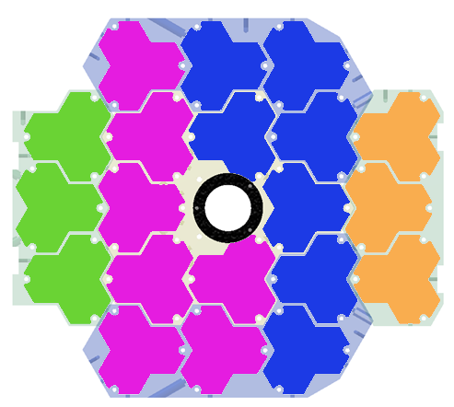
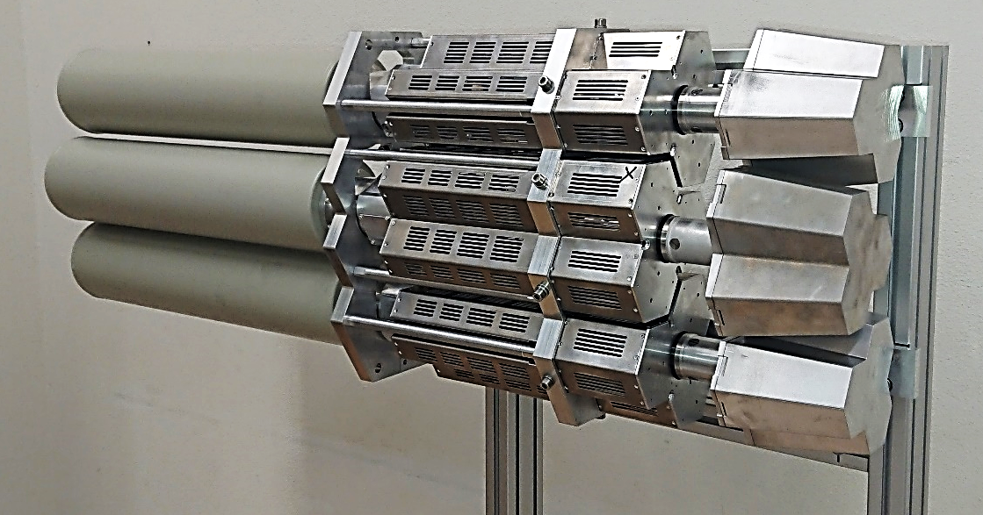
PANGEA – Holding structure
4 submodules
Splitting in half for installation and maintenance
First submodule fully designed, produced and tested

Slide 19
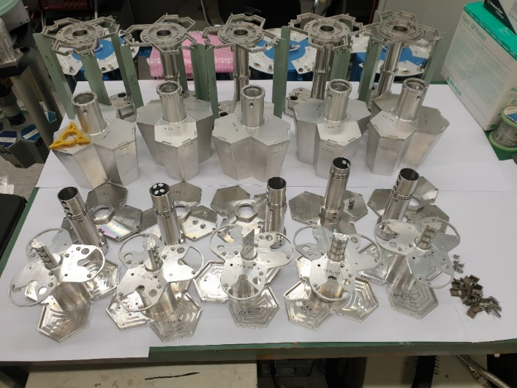
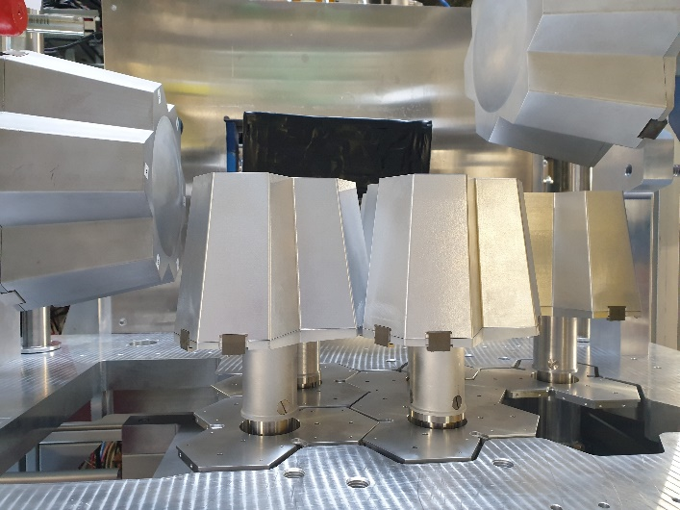
PANGEA – manufacturing
Components fully available:
  25 detectors (PANGEA: 20)
fully assembled (prel. Electronics):
  8 detectors
Partly assembled
  8 detectors
  Staged assembly,
  small noise issues must be fixed
Further assembly in progress
More components ordered
Components delivered by TIFR-Mumbai.
8 detectors used in DESPEC S450 at FSR(GSI) (May 22)

Slide 20

Summary
Target system (hyperatom):
  Redesign in progress (components now available)
  Successful tests of stability and vacuum capability of 3D printed
  vacuum chamber
  Precision of the position system better than required and very stable repeatability
PANGEA
  Orientation of columns is irrelevant for the performance
  First submodule of the holding frame successfully tested
  Manufacturing of PANGEA is ongoing
  8 detectors successfully used in DESPEC experiment
Thank you for
your attention

