Slide 1


CERN-GSI Collaboration on
Beam Instrumentation
CERN-GSI Collaboration
Steering Board Meeting
17th November 2022
For peace
and freedom
Solidarity
with Ukraine

Slide 2
Outline of the Talk
Fields of Collaboration between BI departments at CERN and GSI
  Collaborative support for development of Cryogenic Current Comparators
  GSI Support to CERN e-lens BGC monitor and its commissioning
  Software and data analysis for Ionization Profile Monitor
  Common developments on FESA integration of diagnostic devices
  incl. control integration of Bunch Shape Monitor
  5. SEM-Grid developments for high-intensity beams
  6. BPM design and measurements with low energy, low intensity beams
  Summary and Next Steps

Slide 3
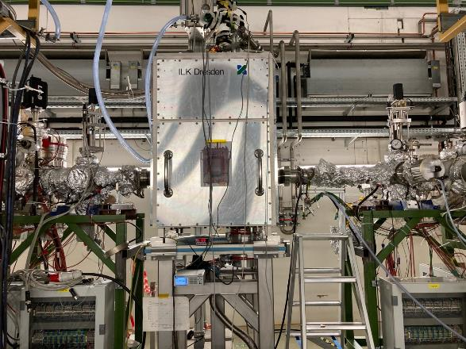
WP1: Cryogenic Current Comparator
Goal: Low, nA current measurement
Large collaboration: GSI, CERN,
University & institutes Jena,
TU-Darmstadt
(funded by German Science Ministry)
CERN AD: operational standard device
Five CCCs required for FAIR:
for storage rings and
transfer lines for slow extraction
CCC potentially for ELENA &
slow extraction from PS & SPS
Common developments e.g.
cost-effective magnetic shielding,
methods of noise reduction
CCC developed by U Jena, GSI CERN installed in CERN-AD
Successfully accomplished:
GSI + Verbundforschung-Partner:
improvement of CCC detector
simulation, flux concentrator
SQUID and readout electronics
laboratory tests of ‚axial‘ CCC
CERN:
development, installation and commissioning of CCC for AD
CCC installed in Cryring
Involved persons
CERN: T. Koettig, T. Lefevre, M. McLean, J. Tan, M. Wendt
GSI: L. Crescimbeni, D. Haider, M.Schwickert, T. Sieber
+ U Jena, Helmholtz Institute Jena,
IPHT Jena & TU Darmstadt
Support by German BMBF

Slide 4
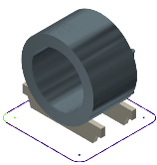
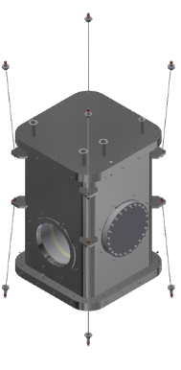
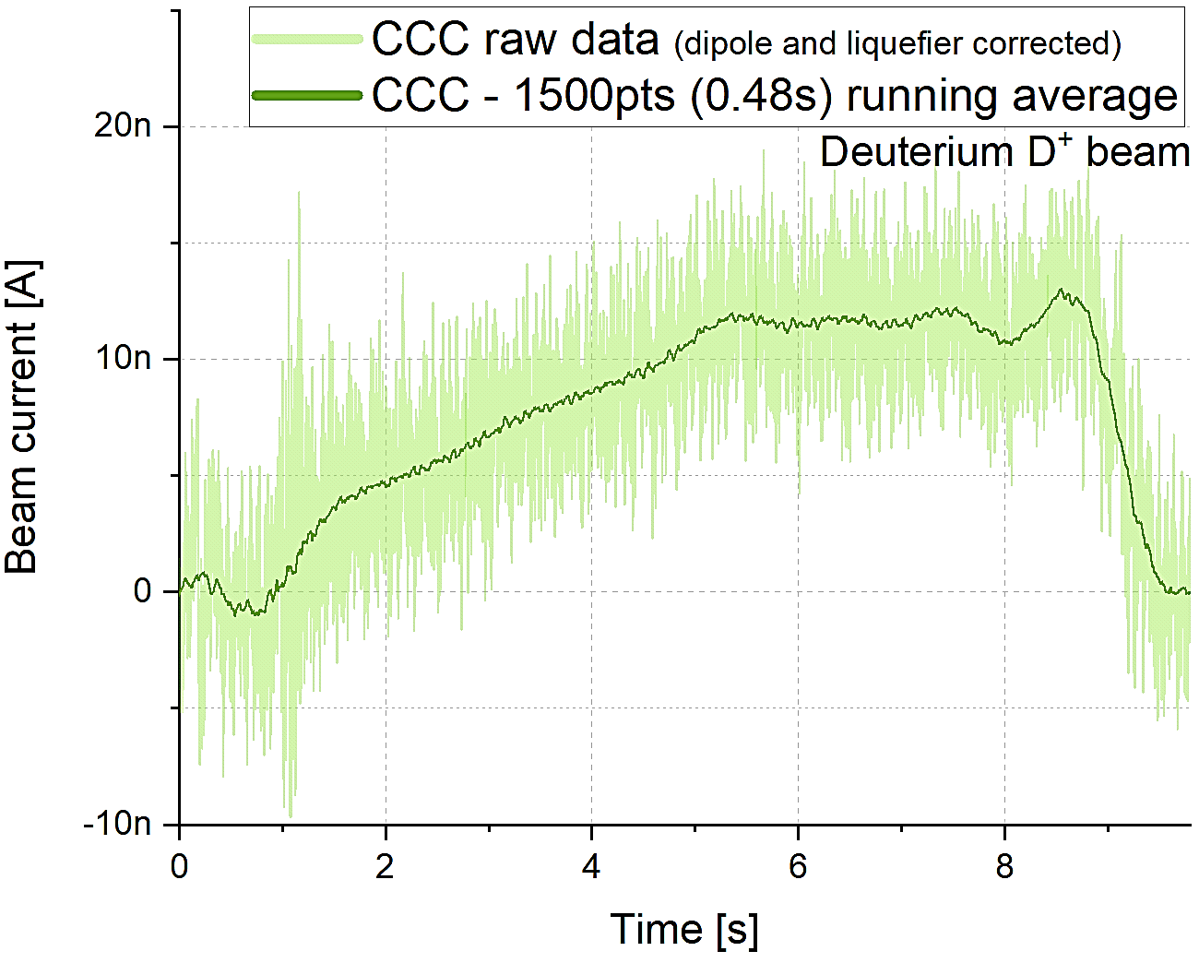
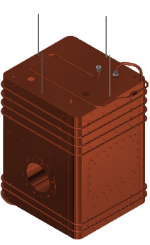
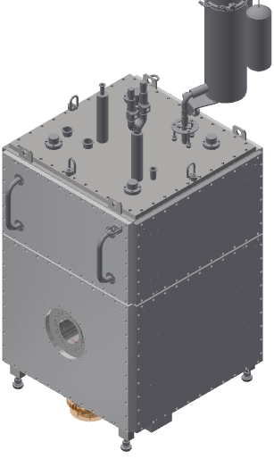
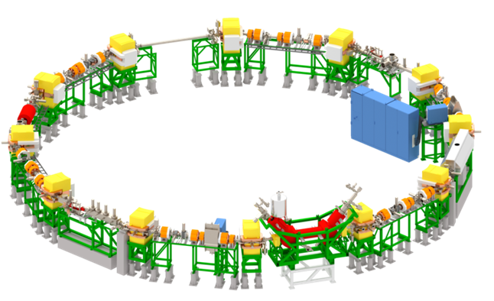
WP1: CCC at GSI: Cryring as prototype for FAIR
CCC Detector
Future topics at rings & transfer-lines:
CERN: - participate in CCC series production,
e.g. for slow extraction from PS & SPS
GSI: - optimization of CCC ring-type
- manufacture of 5 FAIR transfer-line CCCs
(German In-Kind), incl. FESA class
Example: Low current measure
Achievement: Resolution ≈ 3 nA_{rms}
incl. reliable corrections
Liquid He
Container
20
10
Beam Current [nA]
Thermal
Shielding
CCC installed in Cryring
0
10 s Cryring cycle
-10
Comparable
results at AD
Vacuum
Vessel
CCC
Cryring
Support by German BMBF

Slide 5
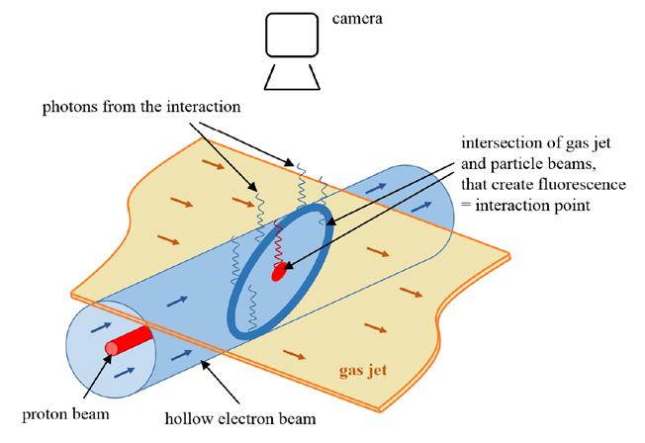
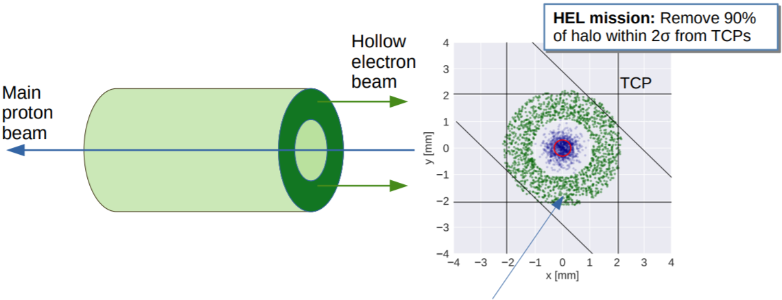
WP2: Collaboration CERN e-lens Diagnsotics
Goal: Hollow electron lenses (e-lens) for halo cleaning, base-line HL-LHC
Requirement: precise alignment of proton ↔ electron beam
Beam Induced Fluorescence BIF detector
with intersecting gas sheet (‘Beam Gas Curtain BGC’):
Realized within collaboration of CERN, Cockcroft Institute and GSI
Tasks of GSI within the collaboration:
GSI continually delivers support with expert know-how on fluorescence techniques
Involved persons:
CERN: Large BGC collaboration, headed by R. Veness
Cockcroft Institute: C. Welsch, H. Zhang et al.
GSI: P. Forck, S. Udrea

Slide 6
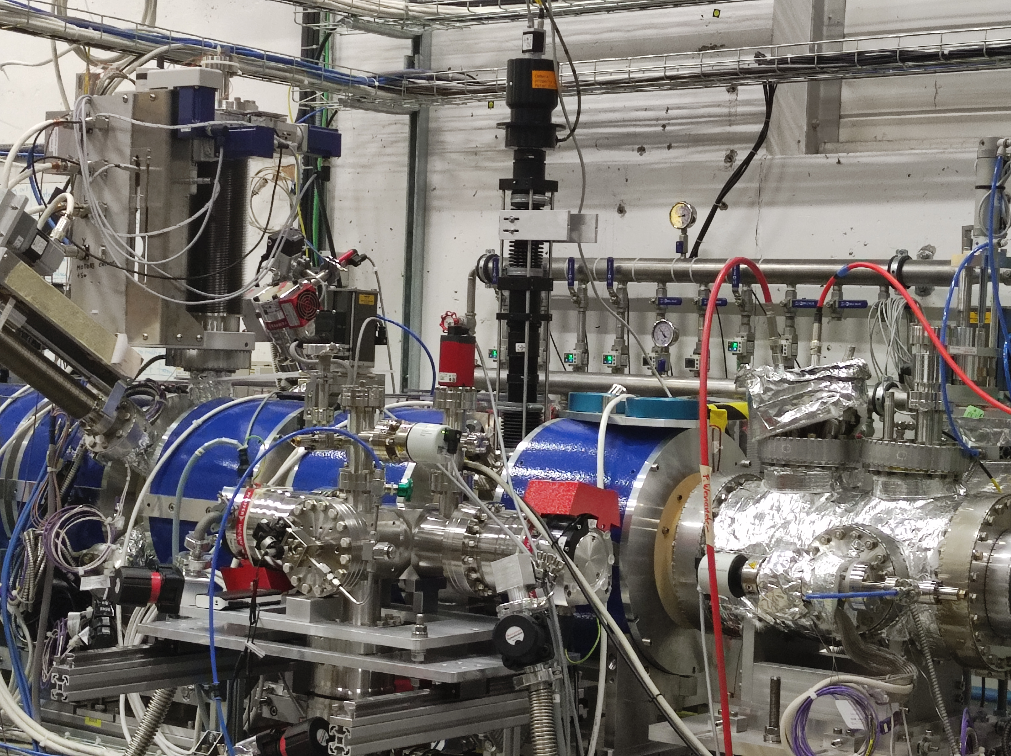
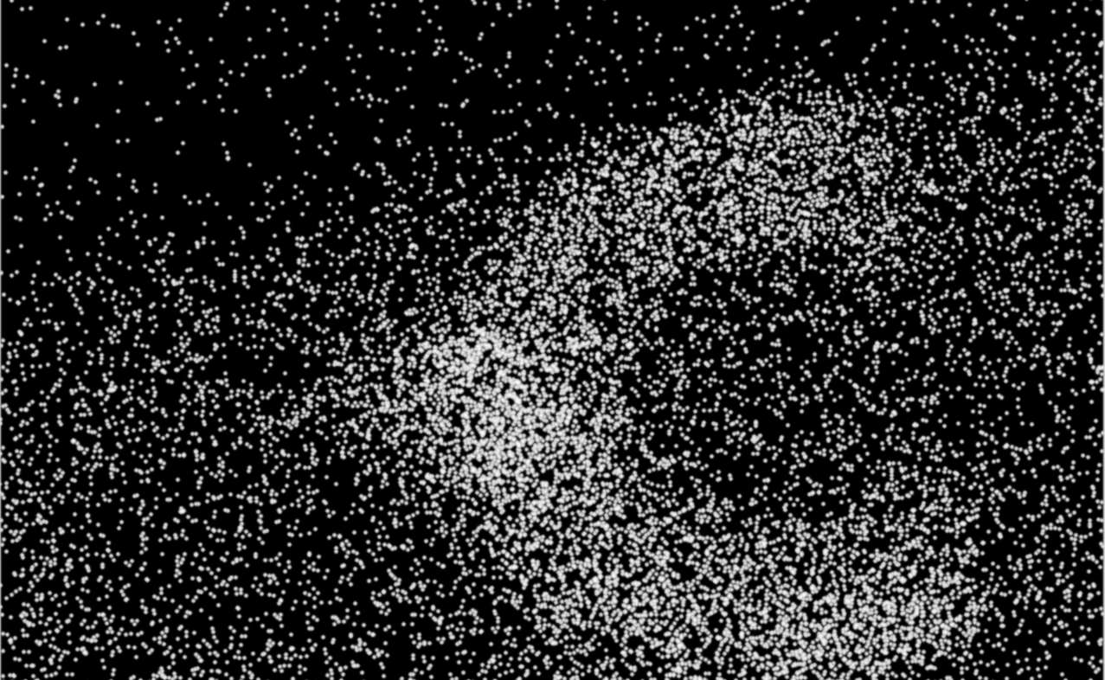
WP2: Collaboration CERN e-lens: HEL-Test Bench
Installation of full monitor at HEL Test Bench
HEL-Test: Straight beam, short pulse operation
Full BGC monitor installation
First test on 10th Nov. 2022 (last week)
⇒ Functionality proven!
⇒ Correct design and theoretical calculations
HEL Test Bench
BIF camera
Optics
Gas jet
First image of hollow electron beam
10th Nov. 2022
e⁻-beam
Parameter e-lens: 7KeV, 0.4 A, 25 µs at 10Hz
Exposure time: 600 s
Corresponding to 150 ms for cw operation

Slide 7
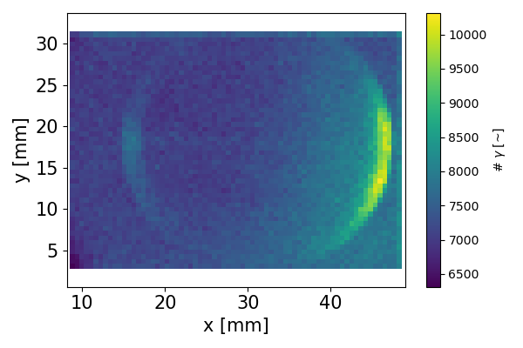
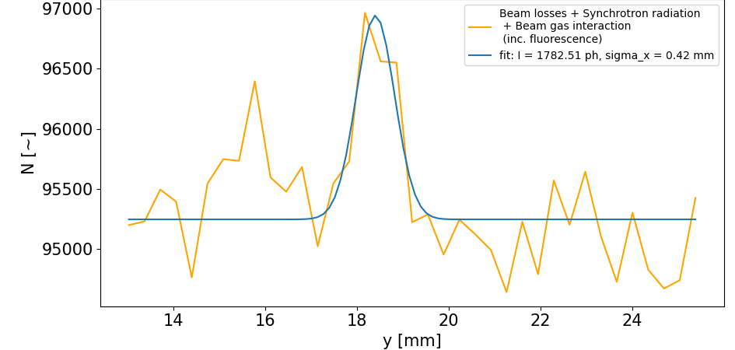
WP2: Collaboration CERN e-lens: LHC Installation
Installation at LHC:
No gas jet, but pressure bump
Several tests in 2022
Using Neon as working gas
Signal strength as expected
(previous data only up to few MeV beam energy)
⇒ Functionality proven!
⇒ Correct design and theoretical calculations
⇒ Stronger signal with gas jet
beam
Y projection (sum across x)
Beam [#bun] | Beam [#p] | Energy [TeV] | Gas [mbar] | Int .time [s]
2100 | ~1.4 ᐧ 10¹⁴ | 6.8 | ~2 ᐧ 10⁻⁸ | 430
Preliminary!!!
7

Slide 8
WP2: Collaboration CERN e-lens: Role of GSI
Expertise of GSI concerning BIF = BGC monitors
Actions during design and realization phase:
  Atomic physics basis for various gases (detailed evaluation for Ne, Ar & N₂)
  Technical design of optics & image intensifier system
  Data analysis and interpretation for various experimental conditions
  Actual topics in 2022:
  Participation at HEL test-stand investigations
  Challenges: high e⁻ beam current, strong magnetic field, limited insertion space
  Investigations: Fluorescence levels, trapping of ion and electrons, space charge influence
  Participation at LHC proton beam measurements
  Challenges: signal strength, background mitigation
  Future: Consultancy for BGC installation and operation at HEL@LHC within HL-LHC upgrade
  Involved persons:
  CERN: Large collaboration incl. Cockcroft Inst., headed by Ray Veness; GSI: P. Forck, S. Udrea
8

Slide 9
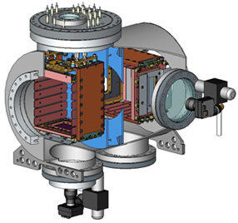
WP3: Ionization Profile Monitor
Various realizations of IPMs exist both, at CERN and GSI
In the past: Mutual technical exchange based comparable designs
Important challenge is code development for image reconstruction
caused by the beam’s space charge broadening
⇒ Development of the “Virtual IPM” software (see next slides)
GSI proposes to enhance the existing technical exchange on:
  Common code developments and long-term code maintenance
  previously by D. Vilsmeier (GSI PhD student)
  Detailed validation procedures
  Advanced machine learning image reconstruction techniques
IPM at GSI SIS18

Slide 10
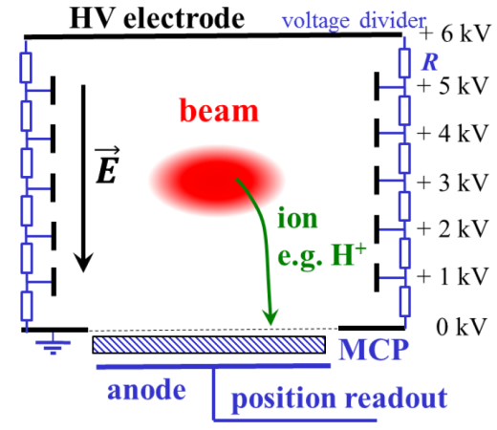
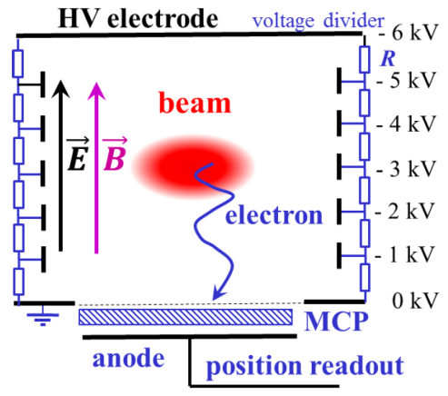

WP3: Ionization Profile Monitor: Performance
Ion detection mode:
Electron detection mode:
Virtual-IPM Simulation code:
Developed by Kenichirou Sato (leave from J-PARC), Mariusz Sapinski, Dominik Vilsmeier at CERN & GSI
Performant simulation includes:
beam-gas ionisation; electron & ion trajectories;
effect of beam space charge &
guiding field non-uniformities, etc.
Usage at GSI, CERN, CEA/Saclay, Cockcroft Institute, BNL … (plus other, undocumented users)
Available at https://gitlab.com/IPMsim/Virtual-IPM
VirtualIPM simulation of LHC IPM with varying B-field strengths
James Storey CERN
CERN: H. Sandberg, J. Storey
GSI: P. Forck, R. Singh, D. Vilsmeier, S. Udrea (?)

Slide 11
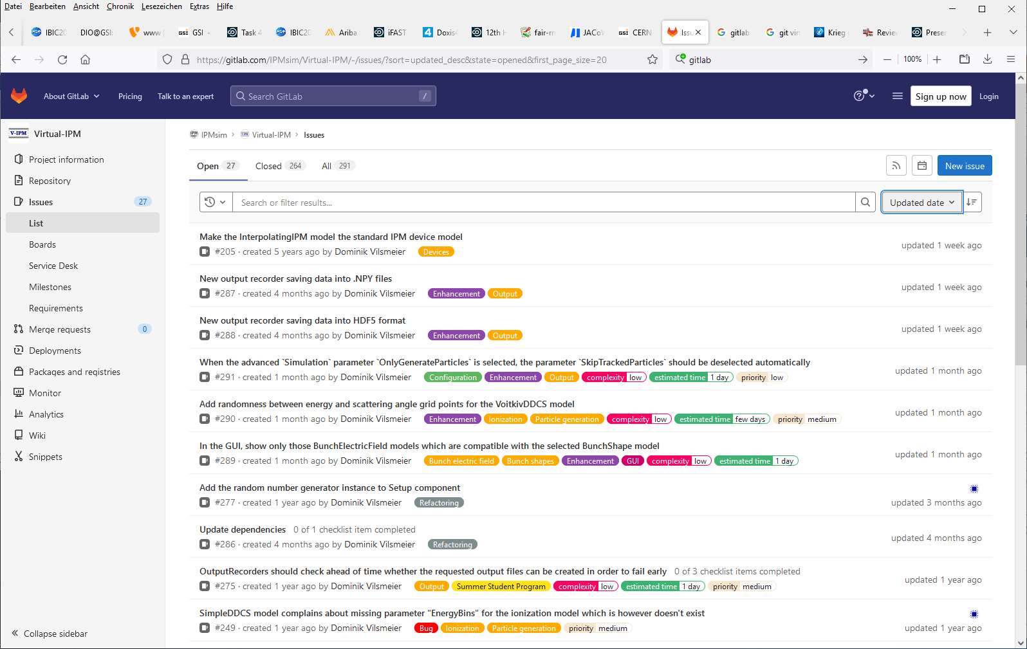

WP3: Ionization Profile Monitor: Status & Future
Virtual-IPM status:
Public available software in Python
Most advanced simulation tool for IPMs, BIF etc.
Based on significant contributions by the community
Bunch of users (for IPM, e-lens, BIF, image smearing…)
Ongoing development, e.g. last update 2nd Nov. 22
Graphical User Interface
Personal status:
Started by Mariusz Sapinski (CERN→GSI→CERN→PSI)
Development & maintenance by Dominik Vilsmeier
(PhD student at GSI)
However, Dominik Vilsmeier will soon finish his PhD
GitLab: List of Issues
Future:
Proposal: collaboration between CERN BI & GSI
GSI: S. Udrea (?), D. Vilsmeier as postdoc (?)
Alternative: ask PSI for involvement of M. Sapinski

Slide 12
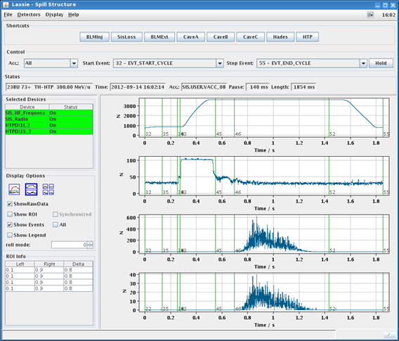
WP4: FESA Integration of Beam Diagnostics
FESA software for beam diagnostic data acquisition
Instruments with common hardware calls common FESA developments
→ Strong interest of GSI to collaborate with CERN BI
Examples:
FESA integration of the Cryogenic Current Comparator
→ ongoing, discussed above
FESA integration and Graphical User Interface & Data Analysis
of Bunch Structure Monitor (Feschenko-type)
→ to be started
CERN: S. Jackson, F. Roncarolo, J. Tan
GSI: P. Forck, T. Hoffmann , M. Schwickert, T. Sieber for general hardware, particular CCC & BSM,
S. Lauber for longitudinal phase-space reconstruction

Slide 13
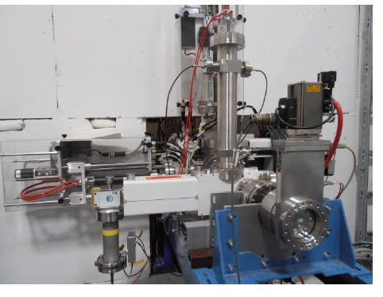
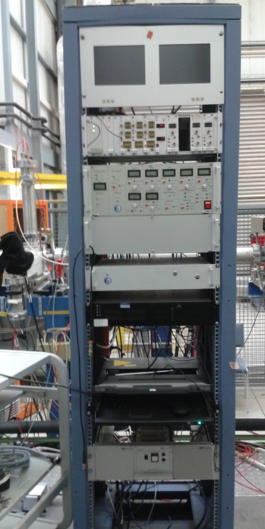
WP4: FESA Integration: Bunch Shape Monitor
Bunch Shape Monitor features:
Turn-key system purchased from
Russian Institute for Nuclear Research (INR)
Functionality of the system well proven
at CERN, GSI, SNS, FRIB
Replacement of complex device control
from LabVIEW to FESA plus performant GUI

Slide 14
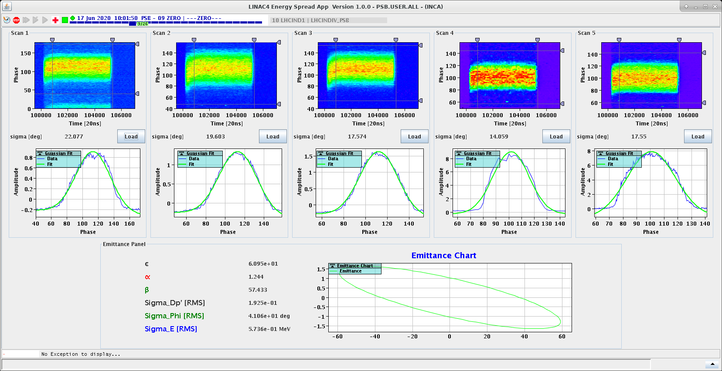
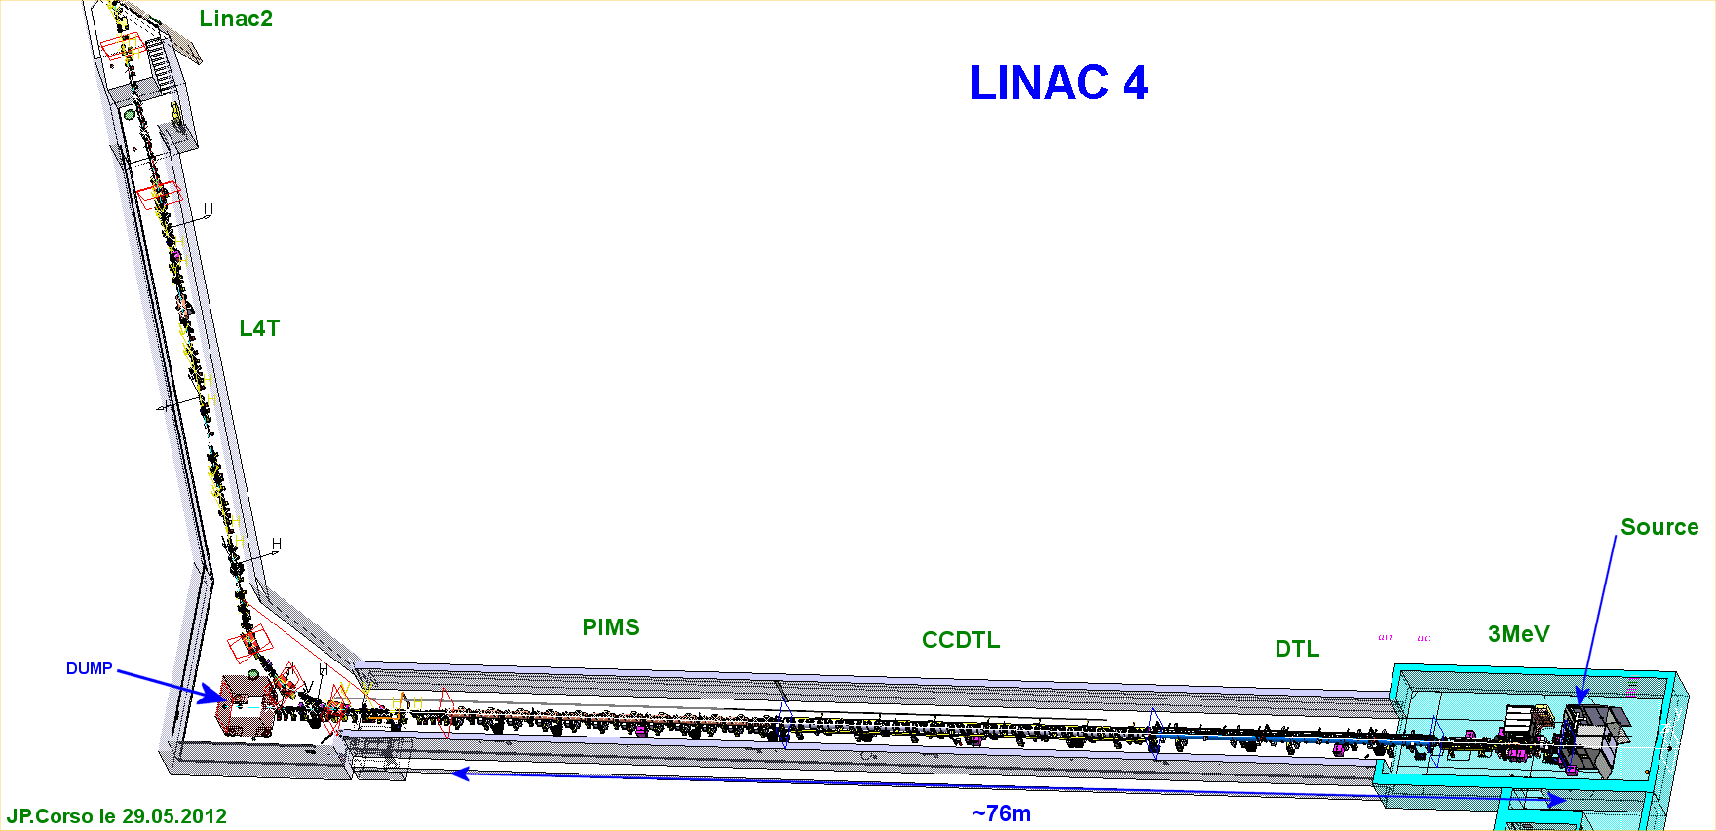
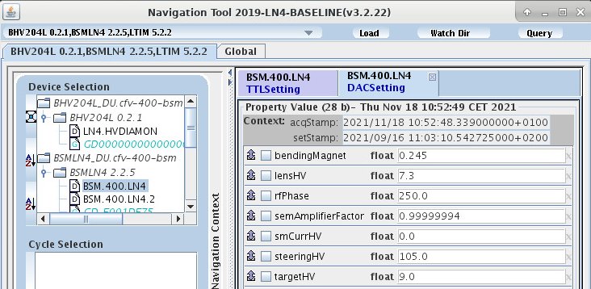
WP4: FESA Integration: Bunch Shape Monitor
CERN LINAC4
BSM2 : Longitudinal emittance reconstruction
Bunch Shape Monitor features:
Turn-key system purchased from
Russian Institute for Nuclear Research (INR)
Functionality of the system well proven
at CERN, GSI, SNS, FRIB
Replacement of complex device control
from LabVIEW to FESA plus performant GUI
FESA & GUI in operation at CERN
GSI’s interest adaptation of CERN FESA & GUI
to FAIR control system.
BSM2
174 ps
154 ps
138 ps
111 ps
138 ps
BSM1
Reconstruction of the longitudinal phase space:
Performed using different methods, exchange about performance
GSI: Technical Integration Committee advised to upgrade TK with BSM
FESA Class
CERN: S. Jackson, F. Roncarolo, J. Tan
GSI: P. Forck, T. Hoffmann T. Sieber; S. Lauber (phase-space reconstruction)

Slide 15
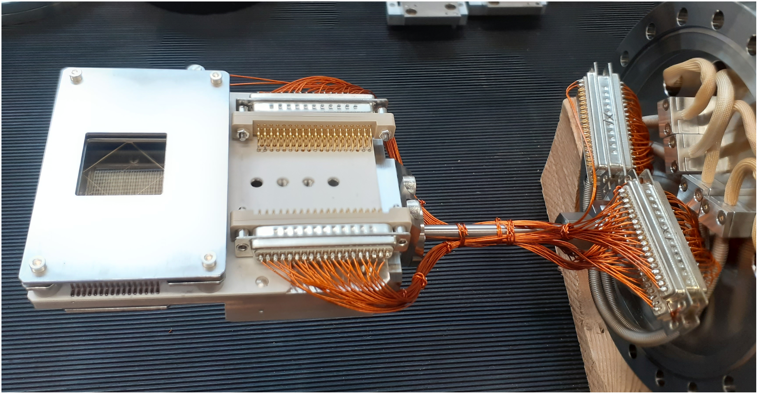
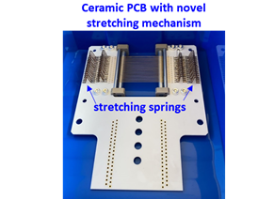
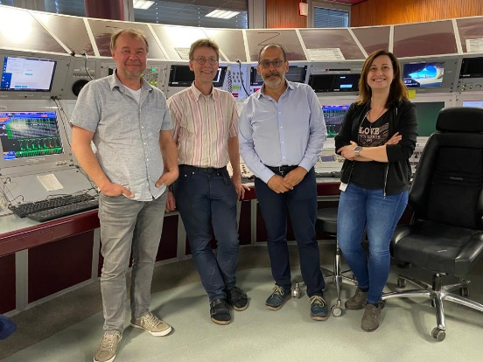
WP5: SEM-Grid Monitors for high Intensities: Hardware
SEM-Grid: Standard tool for profile and emittance measurement
SEM-Grids for pLINACs:
Wire distance 0.5 mm (smaller beam size than at UNILAC.
In the past: Informal knowledge exchange
between CERN and GSI
Compare CERN & GSI standard SEM-grids
for possible destruction,
including thermal simulations
Participation at beam times CERN ↔ GSI
SEM-Grid (Harp) for vertical profile
64 wires
32 mm
produced by company Proactive
CERN: F. Roncarolo, (A. Navarro)
GSI: P. Forck, T. Sieber
Possibly PSI: M. Sapinski
Team during GSI beam time

Slide 16

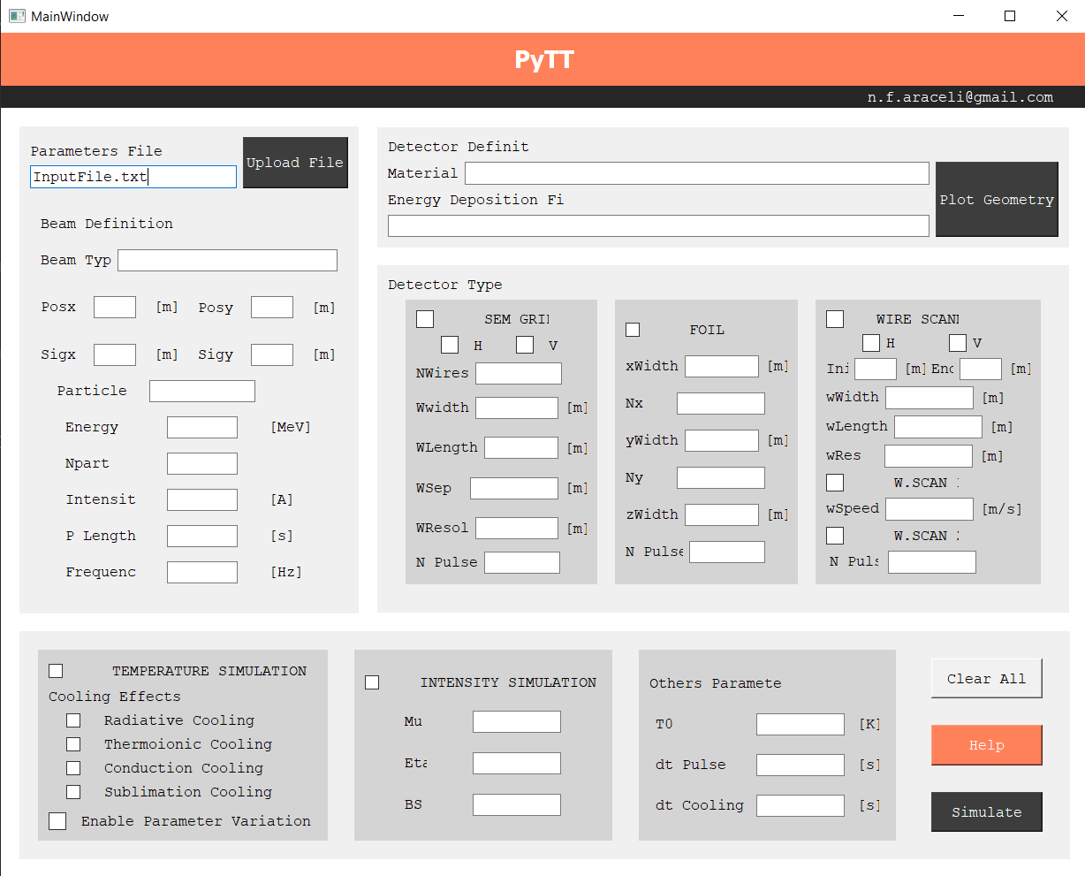
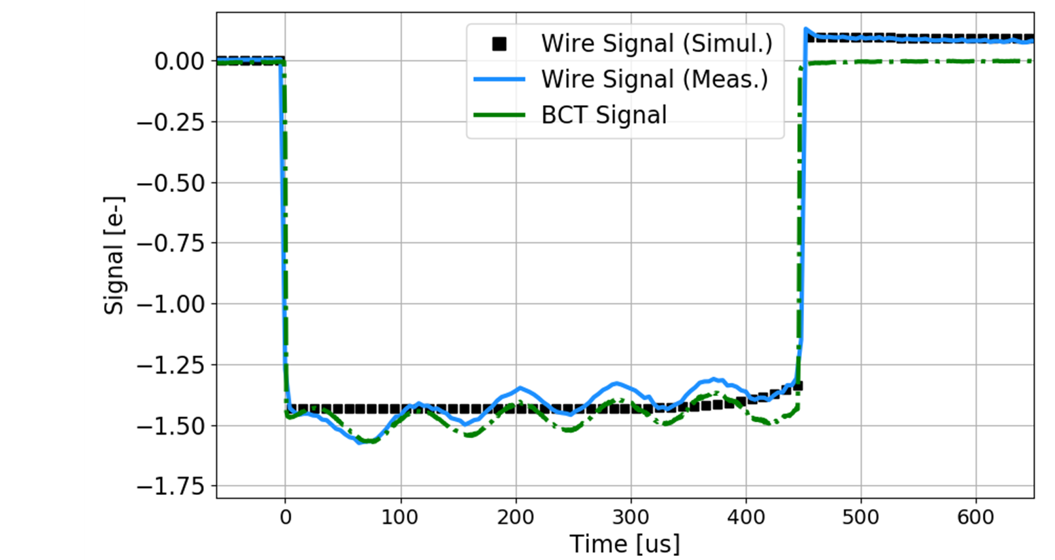
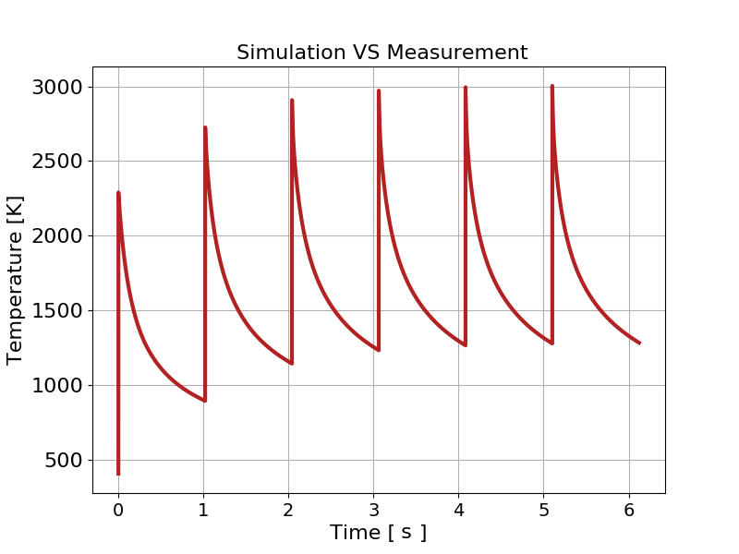
WP5: SEM-Grid Monitors for high Intensities: Simulation
CERN: Development of thermal simulation code
Based on former work by M. Sapinski
Python code PyTT by A. Navarro et al.
Available at https://github.com/navarrof/PyTT
Example of simulation and measurements at LINAC4 160 MeV
CERN’s thermal simulation code PyTT
Comparison: Simulated and measured
signal from a wire at the beam core
Wire temperature from simulation
A. Navarro PhD thesis
CERN: F. Roncarolo, (A. Navarro)
GSI: P. Forck, T. Sieber
Poteintially PSI: M. Sapinski
Goal:
Experimental tests of simulation results & code improvement
Improvement & durable availability of PyTT code

Slide 17
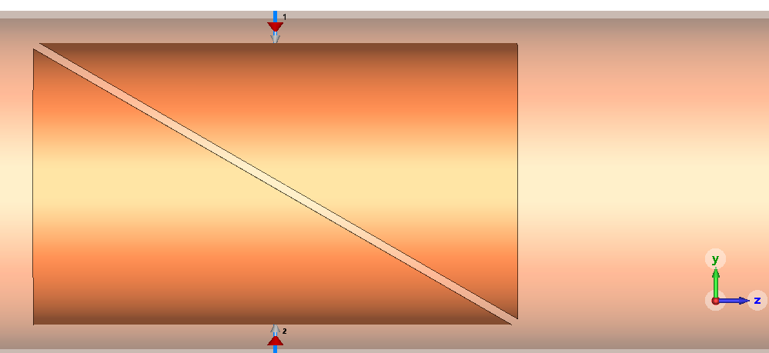
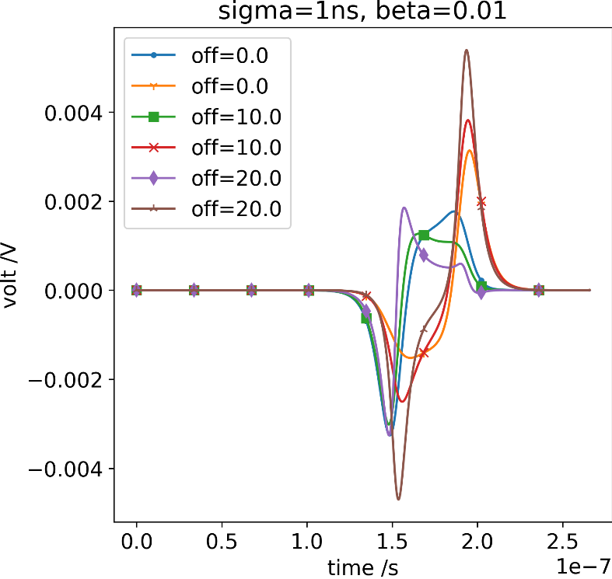
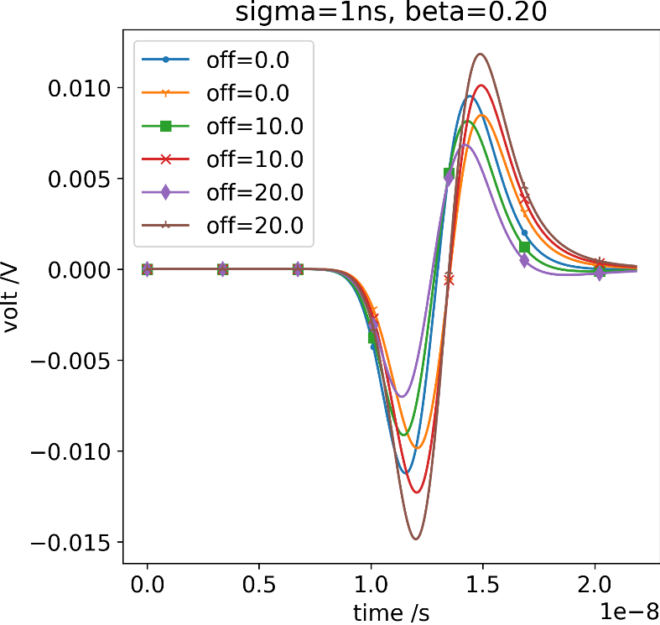
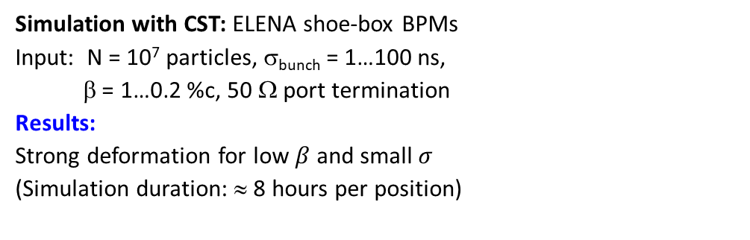
WP6: BPM Hardware, Simulation and Analysis Methods
Beam Position Monitors used at all accelerators
One common topic: Low intensity measurements
⇔ High accuracy and, low detection threshold
Actual example: Anti-proton ring ELENA BPMs
Common efforts: Simulation and pre-amplifier
120 mm
66 mm
Simulation with CST: ELENA shoe-box BPMs
Input: N = 10⁷ particles, σ_{bunch} = 1…100 ns,
β = 1…0.2 %c, 50 Ω port termination
Results:
Strong deformation for low $β$ and small $σ$
(Simulation duration: ≈ 8 hours per position)
Support by German BMBF

Slide 18
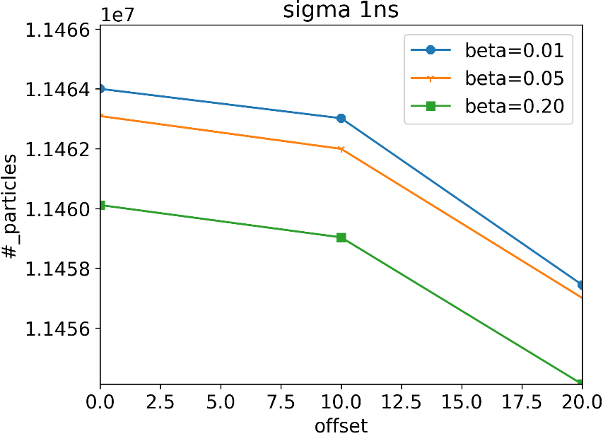
WP6: BPM Hardware, Simulation and Analysis Methods
Beam Position Monitors used at all accelerators
One common topic: Low intensity measurements
⇔ High accuracy and, low detection threshold
Actual example: Anti-proton ring ELENA BPMs
Common efforts: Simulation and pre-amplifier
Pre-amplifier: Novel design to achieve sensitivity,
based on charge integration
Results:
Promising achievements at ELENA
Common discussion on improvements
ELENA cycle
bunched
coasting
CERN: D. Alves, O. Marqversen, M. Wendt ( and A. Boccardi, M. Gasior…)
GSI: O. Chorniy, P. Forck, W. Kaufmann, S. Klaproth, P. Kowina, C. Krüger, A. Reiter, R. Singh

Slide 19
Summary and next Steps 1/2
  1. Collaborative support for development of Cryogenic Current Comparators → established collaboration
  GSI: PhD funding available for CCC optimization for FAIR, series production
  CERN: Possible participate in CCC series for slow extraction → Participation in workshops
  2. GSI Support to CERN e-lens BIF monitor → very well established collaboration
  GSI: Provides expert support, long-term benefit for BIF monitors → Participation at HEL and LHC tests
  CERN: Leading institute for HEL installation and operation
  3. Software and data analysis for Ionization Profile Monitor → clarification of code maintenance required
  GSI: Software Virtual-IPM produced → personnel for long-term maintenance required
  CERN: Usage for simulation, contribution to development
  4. Common developments on FESA integration of diagnostic devices → action from GSI expected
  GSI: Must define schedule for BSM monitor FESA & GUI adaption, reconstruction techniques → personnel required
  CERN: Definition of common interest (e.g. hardware types, reconstruction techniques)
  5. SEM-Grid developments for high-intensity beams → clarification of code maintenance required
  GSI: Beam tests of SEM-Grid
  CERN: Beam tests of SEM-Grid, bench measurement and performant simulation code

Slide 20

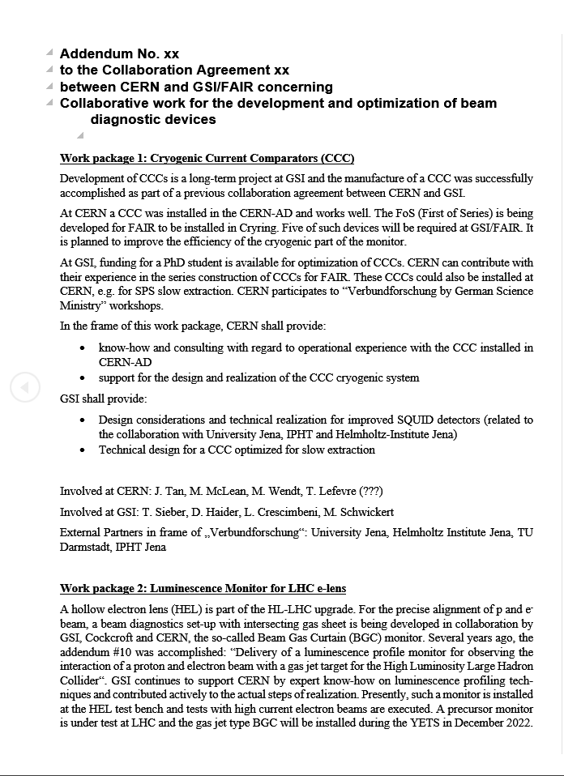
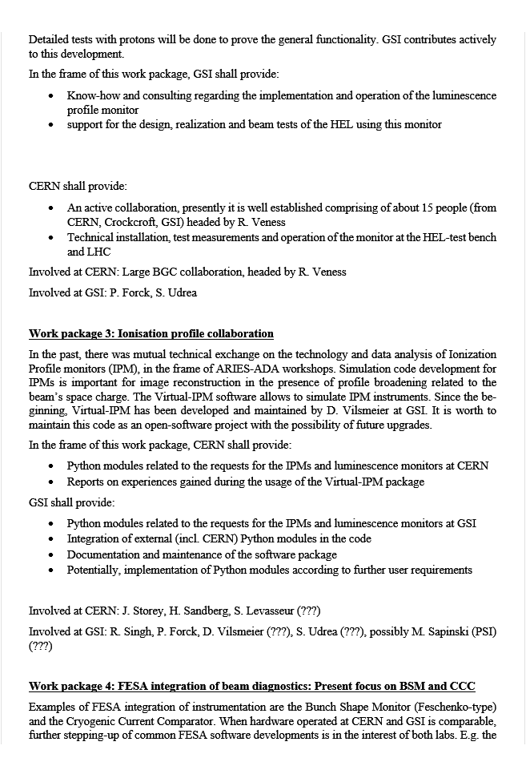

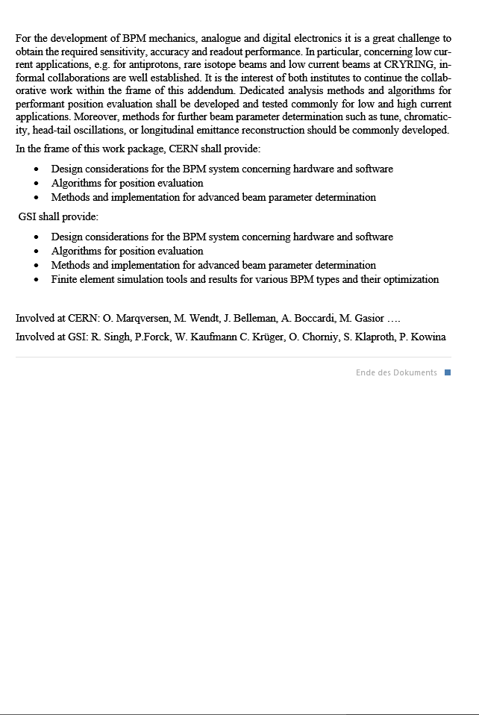
Summary and next Steps 2/2
  6. Actual BPM developments (presently low intensity) → Informal, established cooperation on actual topics
  GSI: Advanced design considerations, experience in CST simulation, advanced analysis methods
  CERN: Advanced design considerations, analog and digital electronics, advanced methods
  → Work-package 3 & 4 (IPM simulation, BSM software): Additional personnel required at GSI
  Further on:
  Intense collaboration within the EU-Project IFAST concerning slow extraction ‘micro-structure’
  → Beam dynamics studies, power supplier stabilization, fast counting detector development
  → Could/should be included as WP7 concerning detector development (?)
  Actions:
  Continuation of established collaboration (CCC, e-lens BGC)
  Agreement of simulation software support (IPM)
  Kick-off for common development (FESA, BSM)
  Promotion of collaboration for actual topics (SEM-Grid, BPM & further topics)
  Actualization of addenda, draft version in discussion with CERN

Slide 21
Action Items Beam Diagnostics
CERN-GSI Steering Board Meeting
ACTION 6: A draft of an amendment for topics related to beam instrumentation should be prepared within three months (M.Schwickert and T.Levefre).
collaboration on all beam instrumentation topics (5 WPs) is in progress
description of topics and tasks was elaborated and summarized by GSI
draft text version of amendment was prepared by GSI and sent to CERN
currently, the draft amendment is reviewed and supplemented by CERN
Technical Integration Team (thematically linked to WP4 of the collaboration)
ACTION 85-1: Clarify priorities for the activities on monitoring the injector beam parameters (TI team). -> Bunch profiles
monitoring the beam parameters during SIS18 injection addressed and prioritized by TI team
BI team prepared list of existing devices and possible upgrades to monitor injected beam
repair and commissioning work on Bunch Shape Monitor (BSM) started, but only Prio2 in ACC matrix
recent beam studies have shown large variations along the macropulse
  Thank you for your attention!

