Slide 1

Synchrotron
Collaborations CERN – GSI/FAIR
P. Spiller
17.11.2022

Slide 2
SIS100 KO Exciter/ TFS System
Transverse-Feedback System (TFS) for SIS100: The appointment of a GSI Work Package Leader for the TFS/KO System has been expected until Q2/2022, but still nobody has been found. Collaboration activities for the engineering design can only start when someone at GSI or FZJ has been nominated for this task.
Focus: Transverse KO extraction is the reference slow extraction method for SIS100. KO system is day-1 „device“ of SIS100.
Physical requirements and technology of KO Exciter system are similar to the SIS100 TFS system and the LHC ADT transverse damper system.
Considering an electrostatic kicker versus strip line exciter and Tetrode versus solid state amplifier systems.
New WPL (B. Breitkreuz) from FZJ has been identified in the frame of the „TransFAIR“ process.
General (physical) Specification of TFS System completed by V. Kornilov and on KO Exciter by D. Ondreka.
Collaboration for establishing the technical specification with CERN (W. Hofle) considering the LHC damper system may be launched on short term.

Slide 3
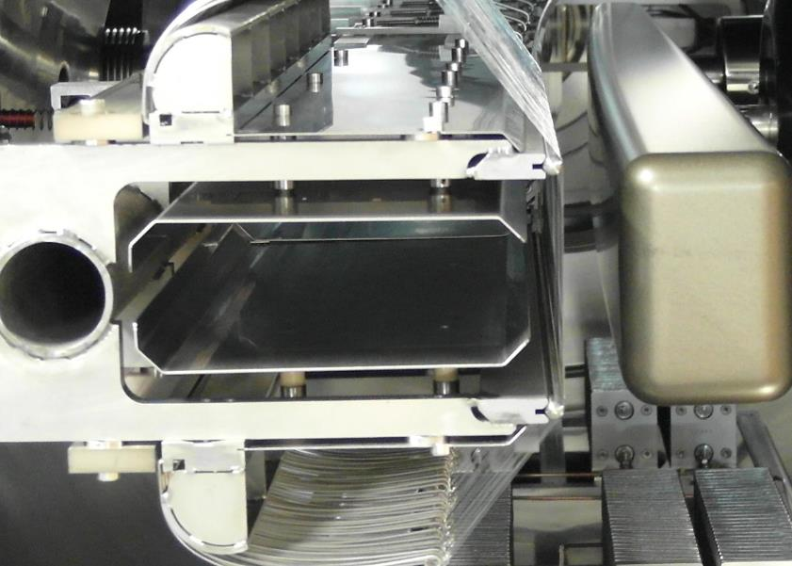
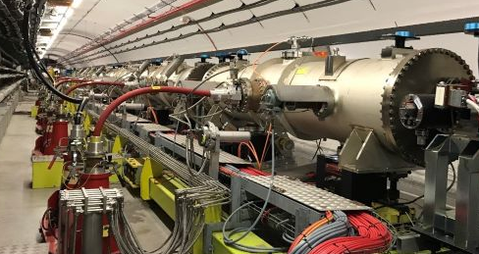
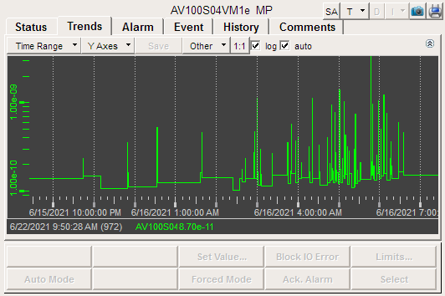
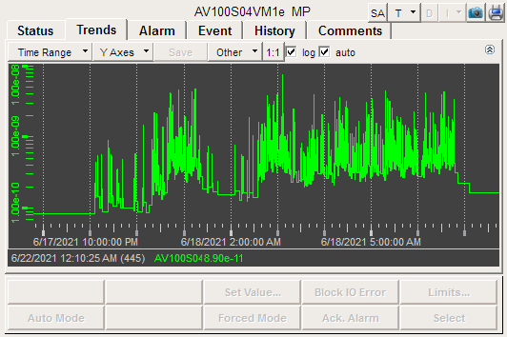
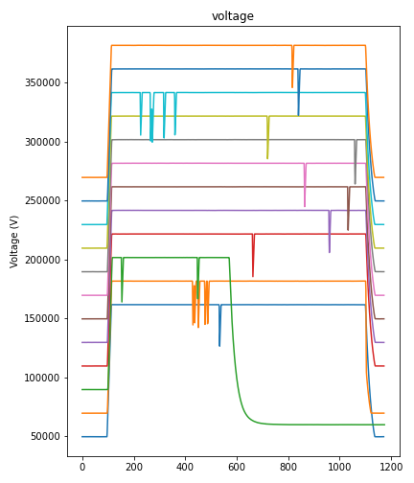
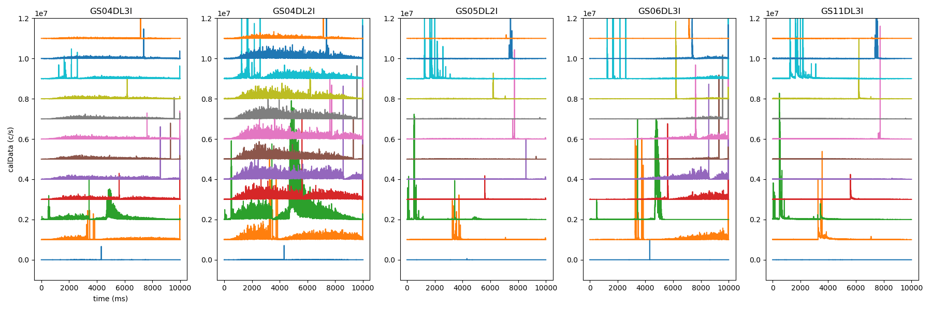
Electrostatic Septa
Essential devices for slow extraction
  HV systems operated at physical limits
  Intensity limited by losses on wires
Issues for high-intensity beams
  High-energy protons (e.g. SPS)
    Activation due to production of secondaries in wires
  Heavy ions (e.g. SIS100)
    Temperature increase in wires due high dE/dx
    Prevention of sparking at high fields (~100kV/cm)
Collaboration interests
  R & D topics
    Thin low-Z wires for loss reduction
    Cathode materials to suppress sparking
    Systems for monitoring wire temperature
    Understanding influence of dE/dx on sparking rate
  Exchange on methods and concepts
    Stability of anode support under heating
    Instrumentation of septa for spark detection
    X-ray measurements for detecting hot spots
    Methods for analyzing spark cause
    Methods for verifying wire alignment
CERN contact: J. Borburgh (Head SY-ABT-SE)
SIS18 injection ES
ES section in SPS
Courtesy RHV (GSI)
Source: https://sy-dep-abt.web.cern.ch/se
Hot spot detection at SIS18 using TLDs
SIS18 ES vacuum vs. dE/dx
Ar¹⁸⁺ 1.0 GeV/u
Bi²⁶⁺ 0.2 GeV/u
Beam loss patterns during sparking events at SIS18
Courtesy B. Gålnander (GSI)

Slide 4
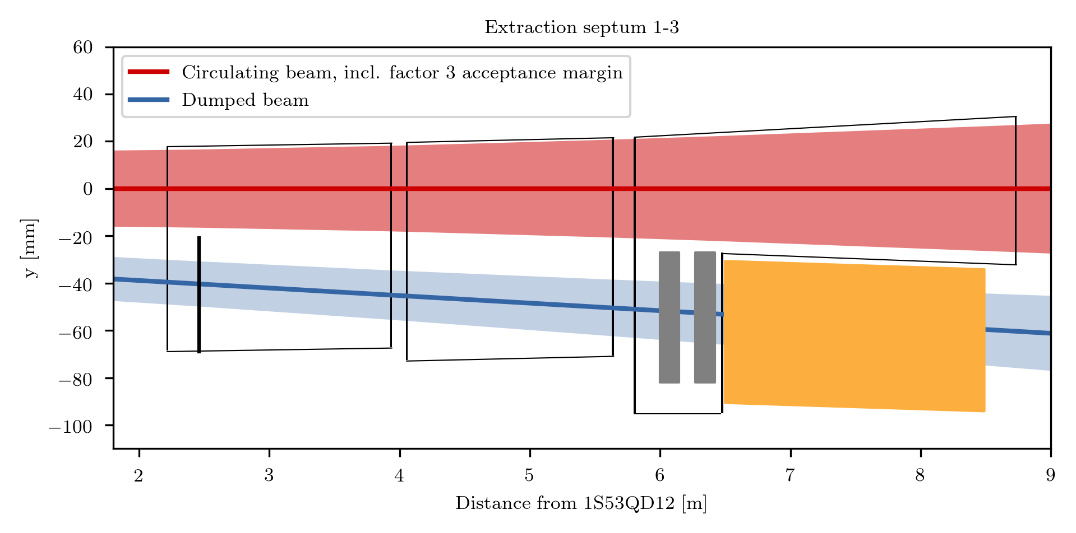
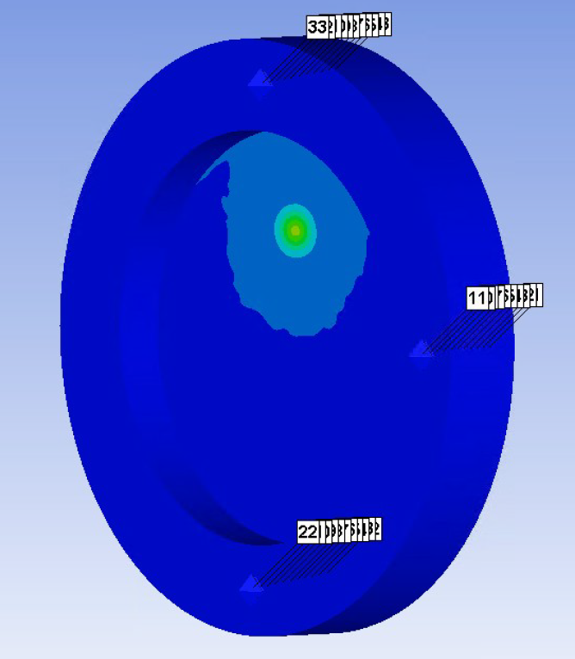
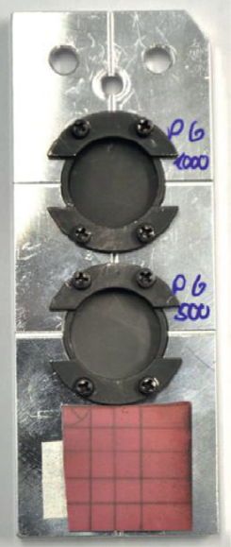
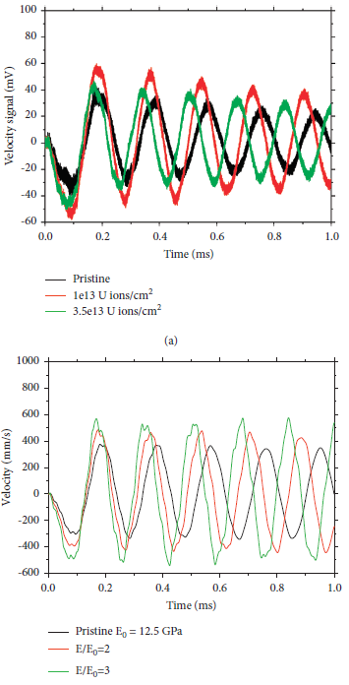
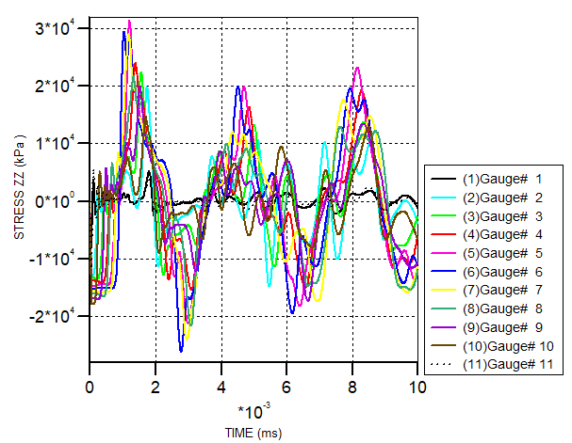
Materials for High Intensity Beams
Materials for beam-intercepting devices
  Collimators, degraders and diffusors
  Beam dumps and exit windows
  Wires for septa and instrumentation
Collaboration interests
  R & D topics
    Carbon materials for collimators and dumps
    (e.g. CFC, high density graphite, flexible graphite)
    Materials for beam exit windows
    (e.g. glassy carbon, high-entropy alloys (HEA))
    Beam diffusors for E-septum protection
    Materials for septum and instrumentation wires
  Exchange of methods and data
    Simulation tools and strategies for dump design
    Estimation of damage thresholds from simulations
    Material properties of known materials for use
    in thermo-mechanical simulations
    Radiation damage effects
    XHV properties and handling of materials
Successful collaborations in various
EU projects: EuCARD, ARIES, I.FAST
CERN contacts
  M. Calviani (Head SY-ABT-SE)
  A. Bertarelli (Head EN-MME)
Geometry of SIS100 beam dump section
Degrader
Low-Z
High-Z
Courtesy R. Martin (GSI)
SIS100 beam exit window
Response of graphite discs
to 100µs U-beam at UNILAC
Simulation of
pressure waves
using Ti-6Al-4V
Courtesy Ph. Drechsel (GSI)
M. Tomut et. al, Shock and Vibration, Vol. 2021

Slide 5
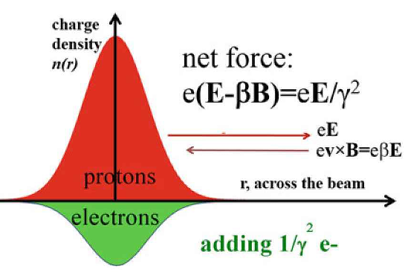
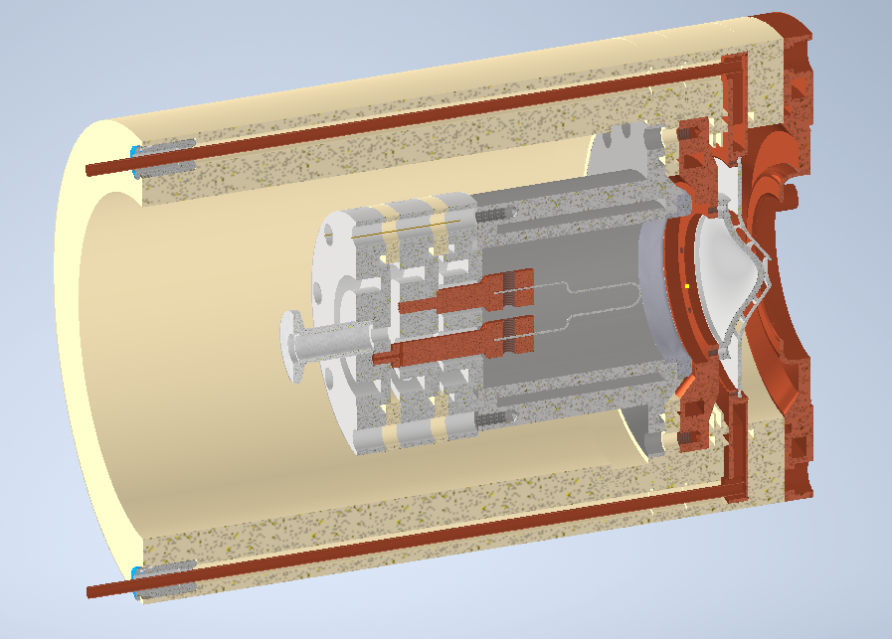
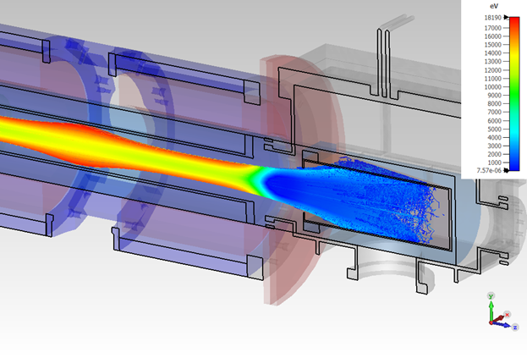
Electron Beam Devices
E Lens for Space Charge Compensation
ARIES workpackage on electron gun developments has been finished. Modified deliveries have been reached.
GSI continues developing the e lens as a whole and especially the development of an Rf modulated electron gun. New collaboration contract signed with IAP, Frankfurt.
Further mutual interest in exchange of R&D results, technolgies (e.g. diagnostics) and experiences.
Bunch structure in SIS18 cycle
Modulation to match bunch
Injection
Bunching
Accele-ration
t
GSI E Lens Development:
Motivation: Increase of heavy ion intensities beyond the space charge limit
  Light ions are space charge limited in SIS18 today
  Ion source and injector upgrades will push the limits
  Electron lenses allow to increase intensities by (partial) compensation of space charge
Roadmap: SC compensation lens for SIS18
  Requirements on lens
    Compensation of ΔQ_{sc} = 0.2 for A/Q ≤ 4
    3 Lenses with L = 3.3 m lead to 10 A peak current
    RF modulation to follow bunch structure (0.4 – 1 MHz)
    Matching by means of flat transverse profile
  GSI R&D towards the design and manufacturing of prototype lens
    Required for benchmarking and optimization
3D model of SCC electron lens
E gun test stand at IAP, Frankfurt
CERN contact: Adriana Rossi
Gun and collector design

Slide 6
Field Measurement in S.C. Magnets

Slide 7
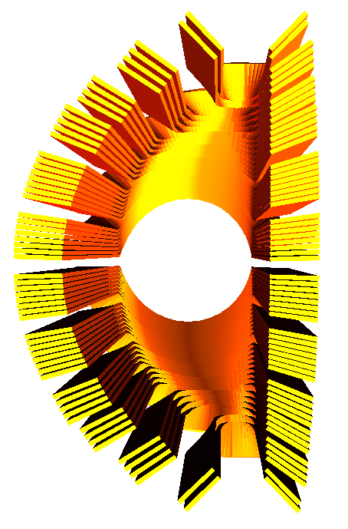
S.C. Magnet R&D
proposed
purpose/benefit
Superconducting cosine-theta septa might be used at future accelerators (e.g. FCC, SIS400, medical, …). For feasibility studies the concept must be transferred to an engineering design.
S.c. fast ramped magnets might be beneficial for future fast ramped s.c. synchrontrons in an FCC or LHV injector system.
S.c. energy saving magnets might reduce the energy consumption and increase sustainability of large accelerator systems.
Cosine-theta septa coil
Fast ramped (1 T/s) high field prototype magnet
collaborations
FCC |  | IFAST
S.c. septa concepts expertise (comparison Nuclotron – Rutherford) |  | Development of a new HTS based Nuclotron cable for fast ramped s.c. magnets
GSI has signed the MoU for the FCC feasibility study and joins the governing board
GSI has special expertise in fast ramped s.c. magnets (SIS100, SIS300)
Benefit from complementary expertise
CERN contacts: Jan Borburgh, Lucca Bottura
7

