Slide 1
GSI: Super-FRS Magnet Testing
Haik Simon
CERN, November 17th, 2022

Slide 2
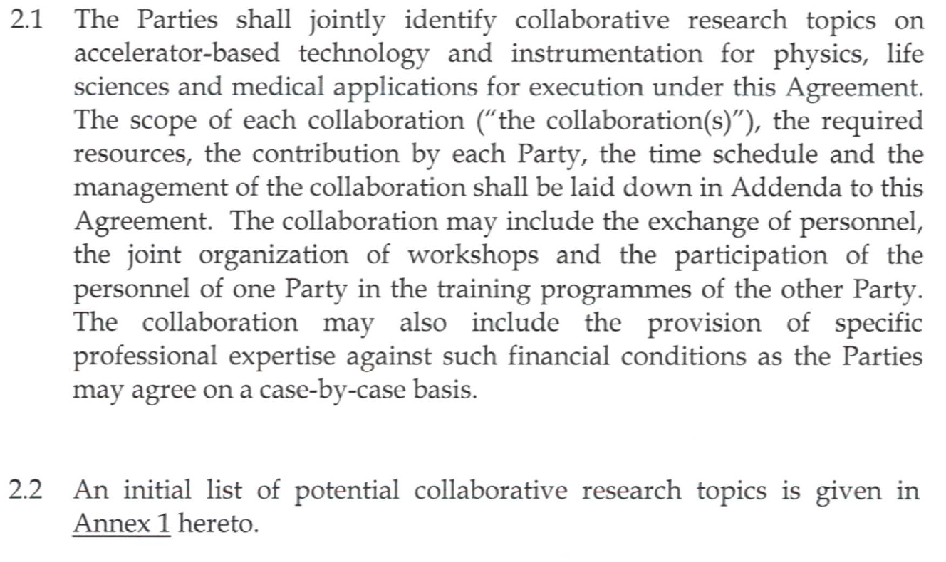
Current collaboration contracts
CERN-GSI/FAIR collaborations: superconducting magnets
all collaborations in the framework of the 2010 agreement K1727/DG
TITLE/SCOPE | Machine | Status | Addendum | Date
Cryogenic testing of the superconducting magnets for the Super-FRS | Super-FRS | active | #2 #4 #5 #12, KR3912 | 2012 2014 2016 2018
31/10/2023
collaborative effort
free exchange of information apart from sensitive contract relevant issues
e.g. NC negotiations with suppliers
Collaborative research topics !

Slide 3
Team@CERN (2022)
Ressource management
Budget, harmonize CERN&GSI
schedule
Collaboration matters
Daily coordination
Daily: dashboards
Coordination on site
+ M. Michels
collaboration
Test schedule sequence is defined by GSI/FAIR Test Manager in accordance with supplier info

Slide 4
Roles and responsibilities
GSI executes the
testing
deploys 5 FTEs to work on site
further personnel if necessary
defines tests plan and procedures
gives support for operation, upgrade and maintenance of the interfaces
pays operation costs
CERN prepares and maintains the facility available
guarantees the functionally of the facility
contributes 1 FTE (test facility coordinator) + 0.4 FTEs
Coordinates Field Support Units (FSU paid by GSI)
supports GSI activities and training
offers standard offices and IT network
covers energy cost

Slide 5
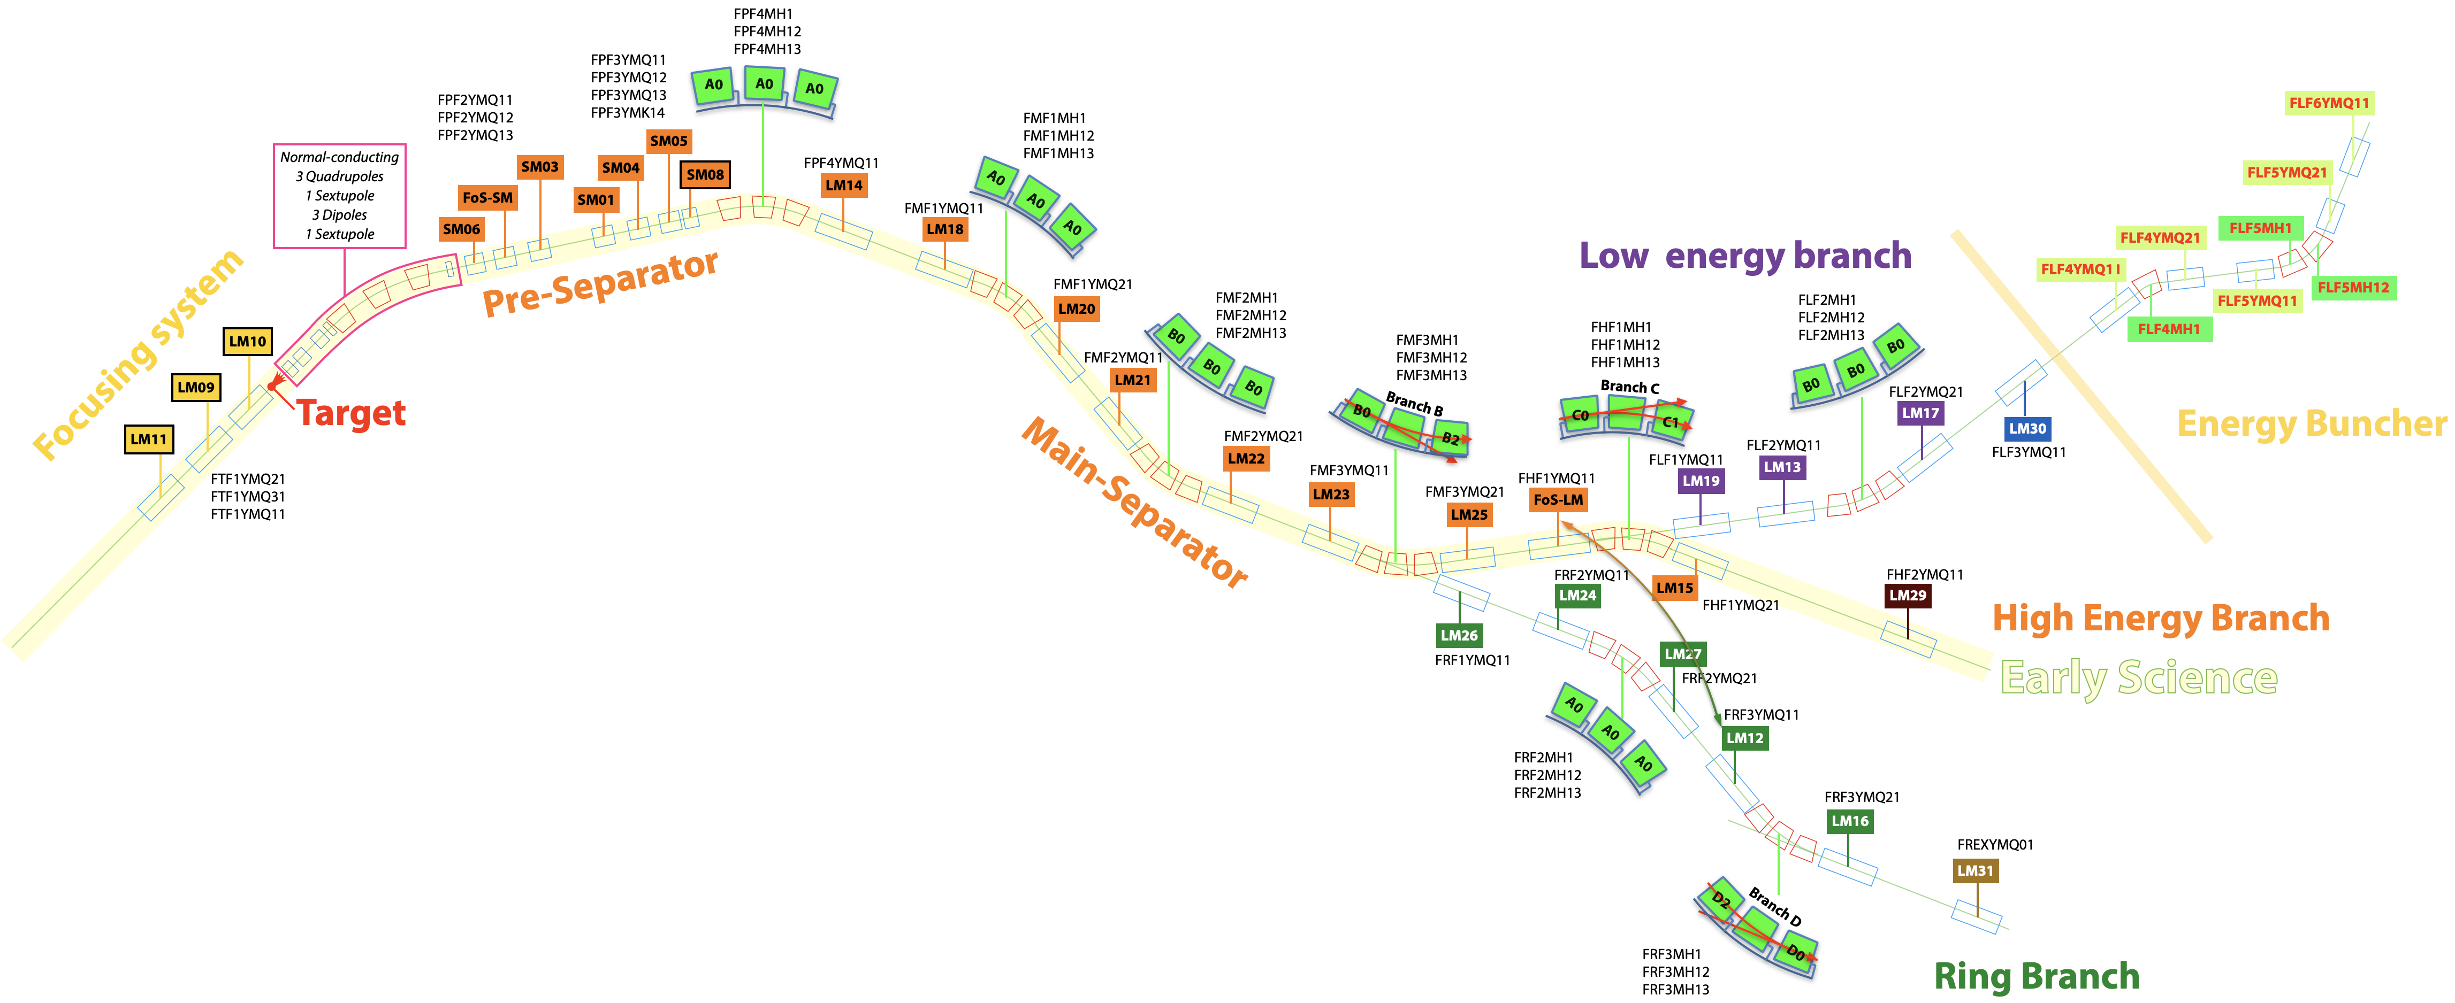
Potential update in scope
to be tested for Early Science:
7 short multiplets
13 long multiplets
15 dipoles including 2 branched dipoles
Include staging scenario (tbd) in addendum

Slide 6
Summary/Open issues
Very successful collaboration!
Many Milestones achieved – - Site functional for series (G. Riddone, M. Charrondiere + team)
- Series testing in ramp up phase (A. Chiuchiolo + team)
Collaboration:
Office space (Bat. 30) / integration with CERN collaborators
Contracts:
Prepare new Addendum from 31/10/2023
Adapt to Early science (First Science) scope
Organisation:
Implement final testing scheme for series
Finalize preparations on site for series testing
(e.g. additional storage buffer, goods reception process with suppliers,
remaining commissioning of benches)

Slide 7
Thank you for your attention

Slide 8
Appendix: Production Status Early science
All SM multiplets FAT (7/7)
LM multiplets (4/14) (13 + 1FoS →RB)
5th to come CW47
Dipoles 1/15 FoS FAT
2nd,3rd to come Q1/2023

