Slide 1
CERN-GSI Collaboration Steering Board Meeting SFRS Magnet Testing CERN: Status at the test facility
CERN-GSI Collaboration Steering Board Meeting (17 November 2022) · GSI Indico (Indico)
17 November 2022
G. Riddone, CERN
Contributions from M. Charrondiere and T. Dupont

Slide 2
Content
KR3912/TE – Short reminder
Status of the systems
Few highlights
Cooldown issues and actions
Preparation area
On-site coordination
Magnet workflow and sequencer tool
Conclusions

Slide 3
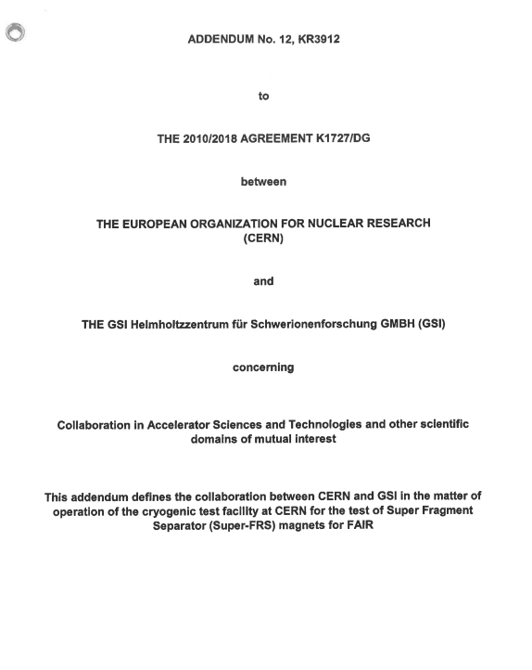
Collaboration agreement KR3912/TE
Test facility at CERN for the tests of Super Fragment Separator (Super-FRS) magnets for FAIR
GSI is leading the activity, and contributes to it with:
4 FTE: operation team (2 eng. and 2 technical eng.) (now 5 FTE)
CERN is contributing with:
0.4 FTE: support with best –effort service from its equipment groups (cryogenics, survey, power converters, energy extraction, quench protection, data acquisition an control)
1 FTE: on-site technical engineer - support and coordination with internal services and CERN contractors
Industrial support from other groups which is charged to GSI on cost-recovery basis: the total cost estimated at 5.4 MCHF for the two phases now until Q4/2026 (originally until Q1/2024).
Total FTE for 2022: 0.8
1 FTE from Jan 2022
1 FSU (industrial support) full time from May 2022
Second FSU full time from Oct 2022
Logistics and storekeeper; 0.2

Slide 4
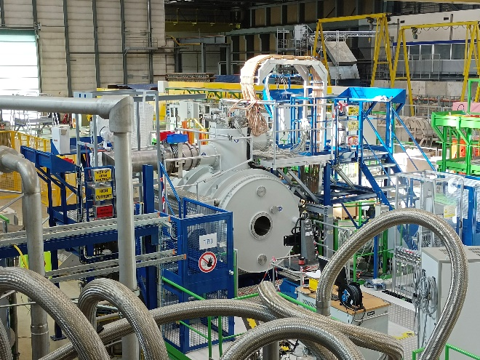
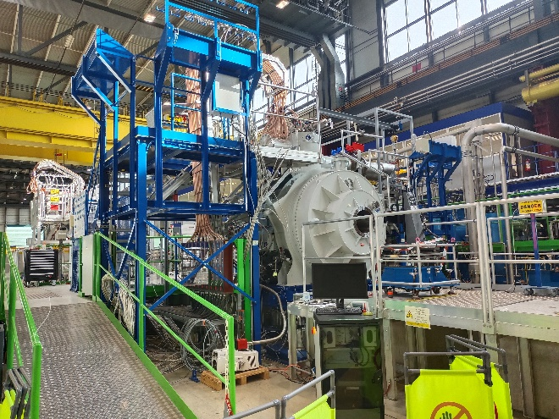
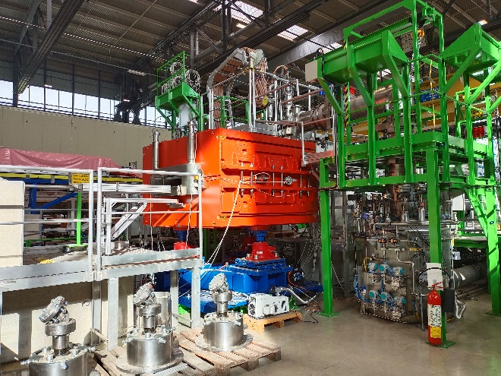
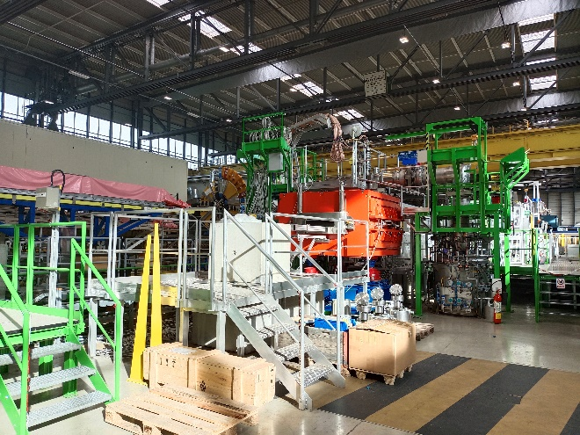
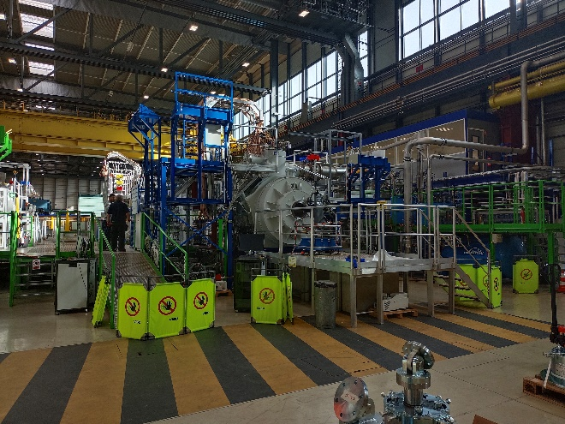
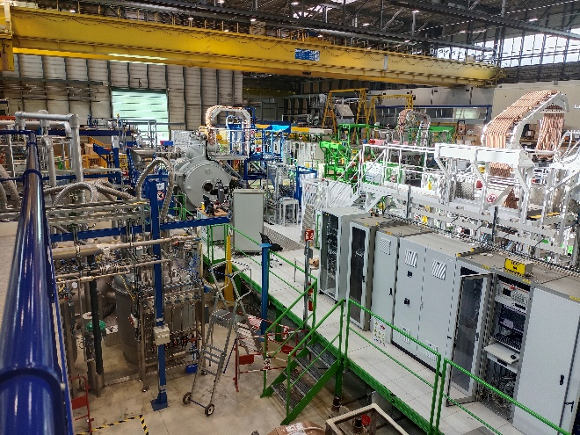
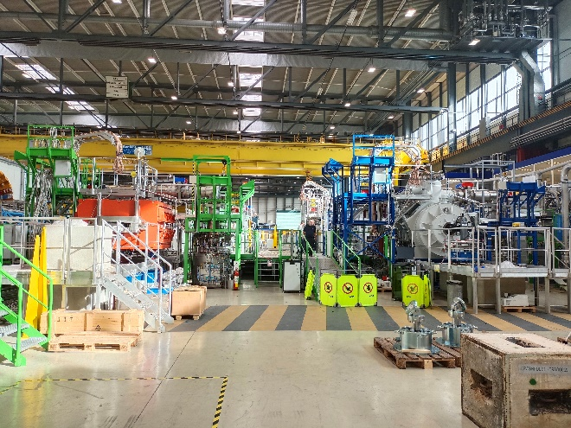
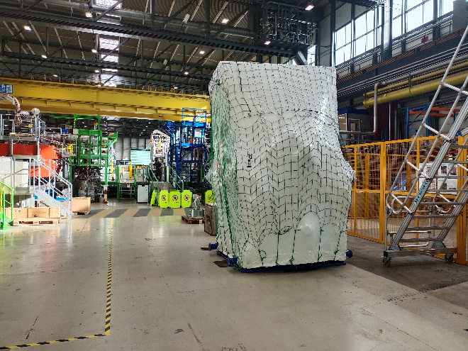
Test Facility in B180 TB1-TB2 and preparation area
TB1-SM01
TB1-SM01
TB2-D2
TB2-D2
Test facility
Test facility
Preparation area
Preparation area

Slide 5
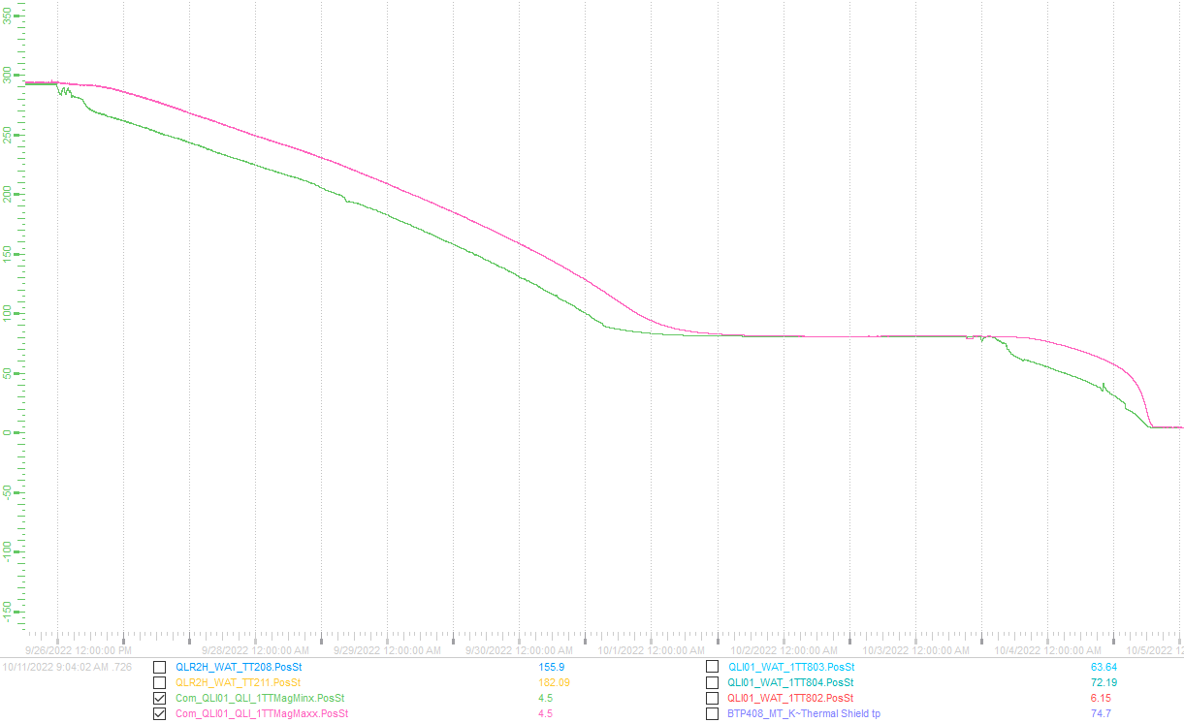
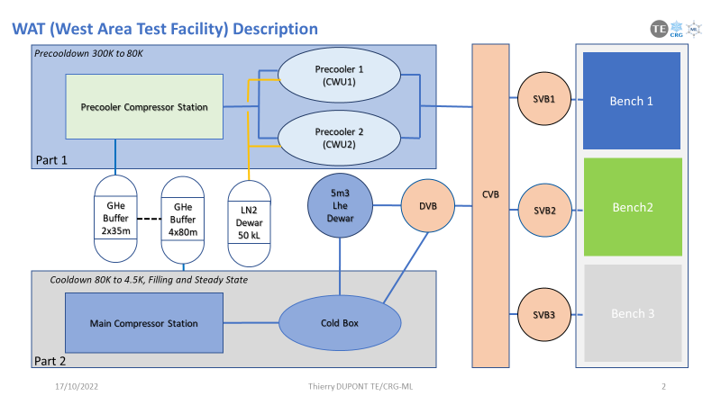
Status Overview (1)
Cryogenic system (TE-CRG)
Main equipment commissioned: remains the validation of the CWU2 (cooldown warmup unit) following new process modification
Several actions undertaken to solve clogging issues, cleanliness issues and to limit perturbations during parallel tests
EDMS: summary of CD and WU
Phase 1 (300K to 80K) ~ 4.5 d
Stand by 80K
Phase 2 ~ 1.5 d
CWU1 parameters:
HP: 12bars
Flow: 22g/s
SM01 Cooldown on bench 1 with CWU1

Slide 6
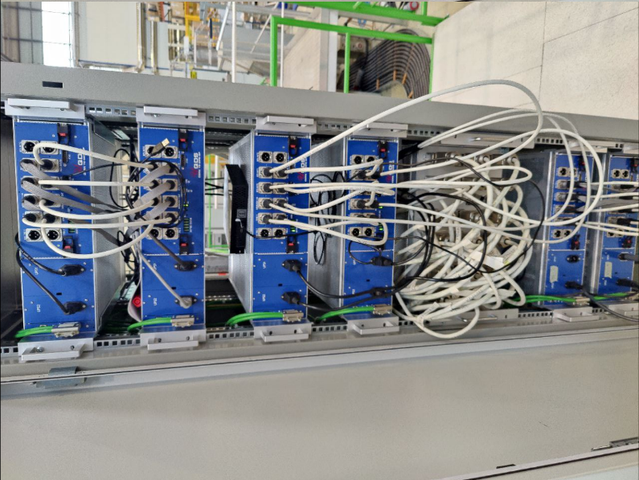
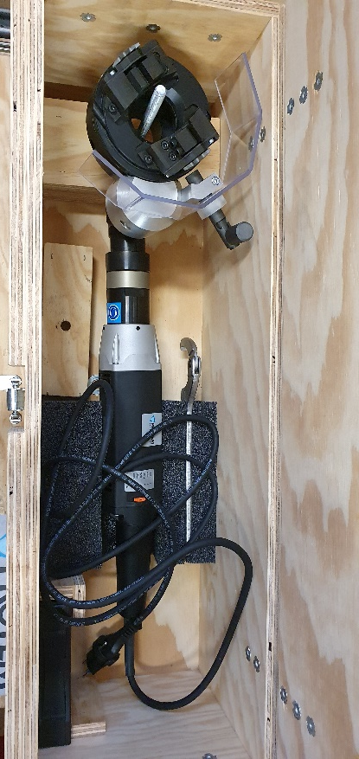
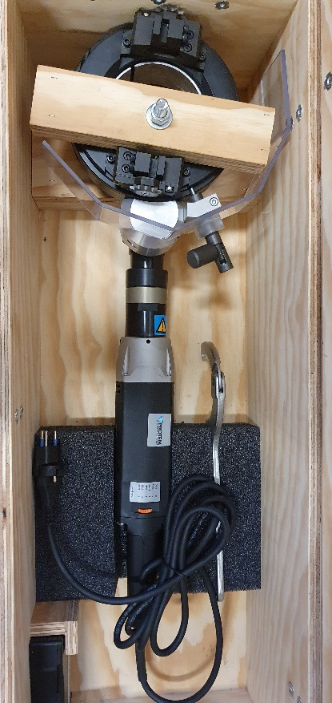
Status Overview (2)
Jumper connection (EN-MME)
Two new PROTEM machines delivered in Summer 2022 (big and small heads for different pipe diameters)
Quench Protection and Energy Extraction systems (TE-MPE)
TB1 : 6 UQDS units installed, 4 commissioned
TB2 : 2 UQDS units installed, 2 commissioned (this config. covers 3 magnets, to be completed in the next weeks))
TB3 : 6 UQDS units installed, 2 commissioned

Slide 7
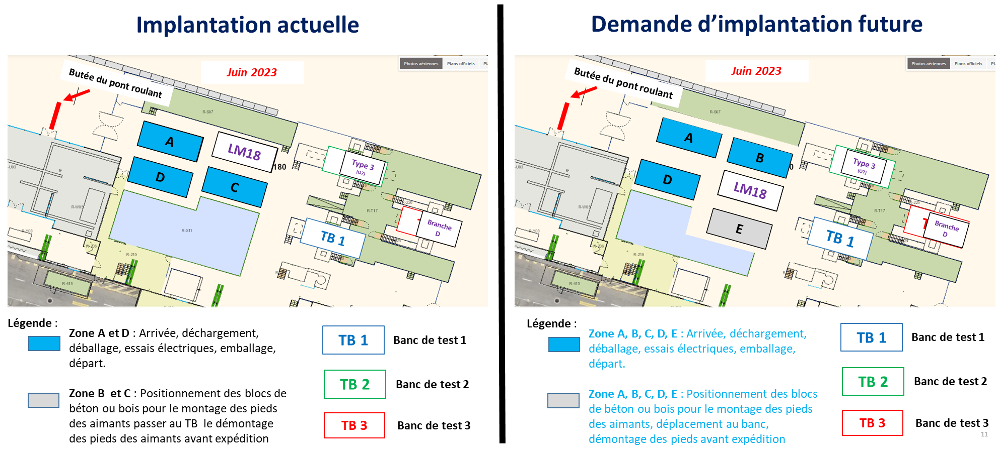
Status Overview (3)
Preparation area
Detailed integration study carried out to cope with series production needs and possible non-conformities
Space increased by 60 m² – woks completed in Jan 2023
Main procedures
Safety: measures to be put in place during the operation of the Test Benches (link)
Inspection visits with CERN safety representative for the different activities, such as handling, welding and leak test
Access and custom formalities (link)
Transport: over-sized (link) and standard transport
Leak tightness test procedure (link)
Welding (link)
Action from 2021
Steering Meeting
MSC
MSC

Slide 8
On-site coordination
On-site technical engineer
Weekly meetings with GSI and CERN teams
GSI testing team
Leak tests AL4030
Handling-Transport EN-HE
Cryo system TE-CRG
Survey BE-GM
Welding/Cutting EN-MME
Powering SY-EPC
Quench Protection TE-MPE
Mechanics FSUs
Logistic and coordination TE-RAS
Tuning schedule on weekly basis keeping flexibility
Detailed planning updated weekly
Follow-up with SEQUENCER TOOL
- Input: magnet workflow and activity duration

Slide 9
Magnet test workflow
Alignment
Transport rods removal
Mounting safety valve
Jumper alignment and connection
Leak tests
Vacuum vessel closure
Electrical tests at warm
Insulation vacuum pumping
Insulation vacuum leak test
Cryogenic conditioning
Cooldown & heat load tests
Current leads cooldown
Electrical test at cold
Commissioning/Powering
Magnetic measurements
Magnetic axis fiducialisation
(Heat load tests)
Warmup
Insulation vacuum breakage
Jumper Disconnection
Dismount safety valve
Mount transport rods
Transport to preparation area
Prepare logistic for delivery
Magnet documentation check
Reception at CERN
Handling
Unpacking/unwrapping
Visual inspection
Electrical tests at warm
Installation on feet
Opening transfer lines
Transport to test bench
GSI
CERN
Common
Preparation area IN
Test benches
Preparation area OUT
Close transfer lines
Removal of feet
Purging
Electrical tests at warm
Nitrogen gas filling
Prepare logistic for shipment
Packing (ext.)
Handling
Check out

Slide 10
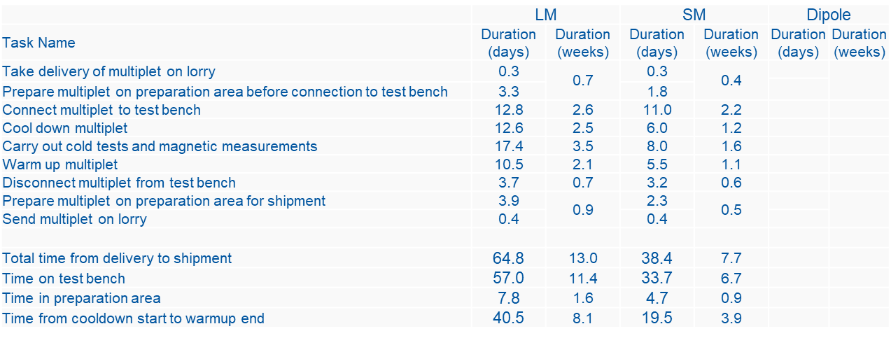
Magnet test – duration per cycle (in working days/weeks)
Typical example: multiplets
Experience from the FoS
Identification of overlaps and constraints in the overall planning

Slide 11
Sequencer tool (1)
Software (InforEAM) allowing for following the test steps and communicating the actions and progress among the different CERN and GSI teams
Based on validated workflow, activity duration per magnet type
Pilot version under testing
In progress: different statistics, dashboard to follow advancement, traceability
Features adapted to operational needs
Full sequence for LM and SM (from delivery to shipment) integrated
Basic features implemented (mailing, check-list and signatures, comments, documents)
Navigation through magnet sequence
Access to report showing statuses of different steps
Next version:
dipole + extra features (EDMS, EDH, bench location, administrative sequence) + new requests from feedbacks on pilot

Slide 12
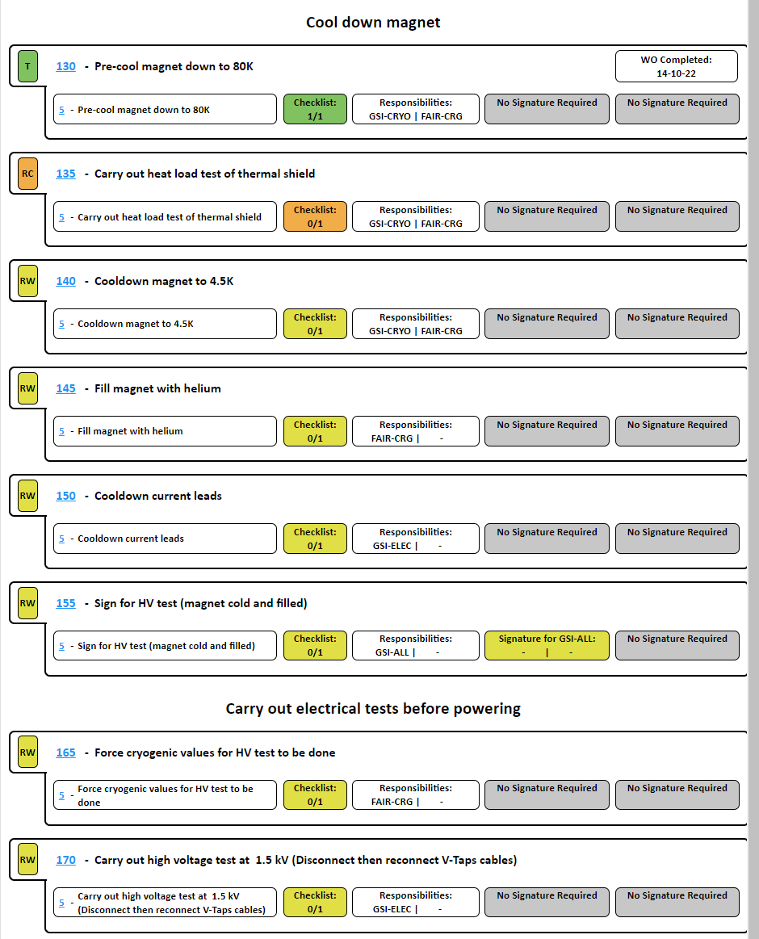
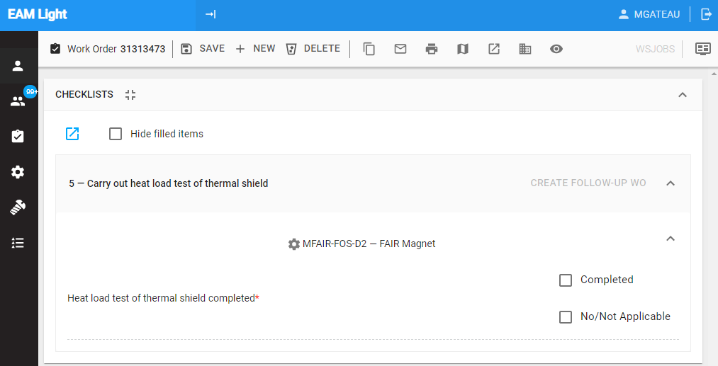
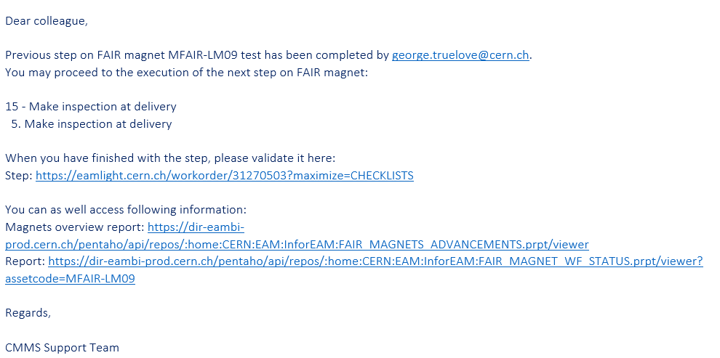
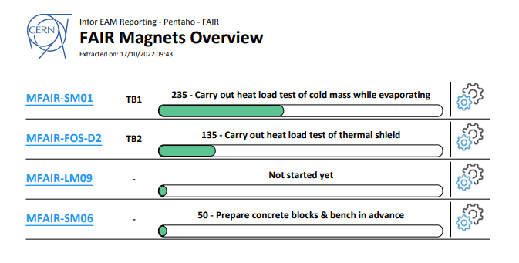
Sequencer tool (2)
4 – status per magnel
3- view on dedicated step
2 –change of step notified via email
1
EAM Light (cern.ch)

Slide 13
Conclusions
Delivery – Testing – Shipment: CERN systems commissioned and test facility ready to fulfill the planning dictated by the FAIR project
Transition phase towards series productions started in 2022 and will be completed in June 2023 (detailed coordination, sequencer tool, procedures implemented)
2022: CERN resources higher than expected
CERN and GSI flexibility to overcome non-conformities and delays
Planning
Received updated planning based on the experience of the First of Series (FoS) production (see Antonella presentation)
End of the tests Q4/2026
Amendment to the contract with be needed and CERN impact to be evaluated
Testing of the additional Energy Buncher magnets still to be confirmed

Slide 14
Thanks to GSI colleagues for the nice and fruitful collaborations
Thanks for your attention

