Slide 1
CERN Overview
Mike Lamont
CERN-GSI Collaboration Steering Board Meeting
17 November 2022

Slide 2
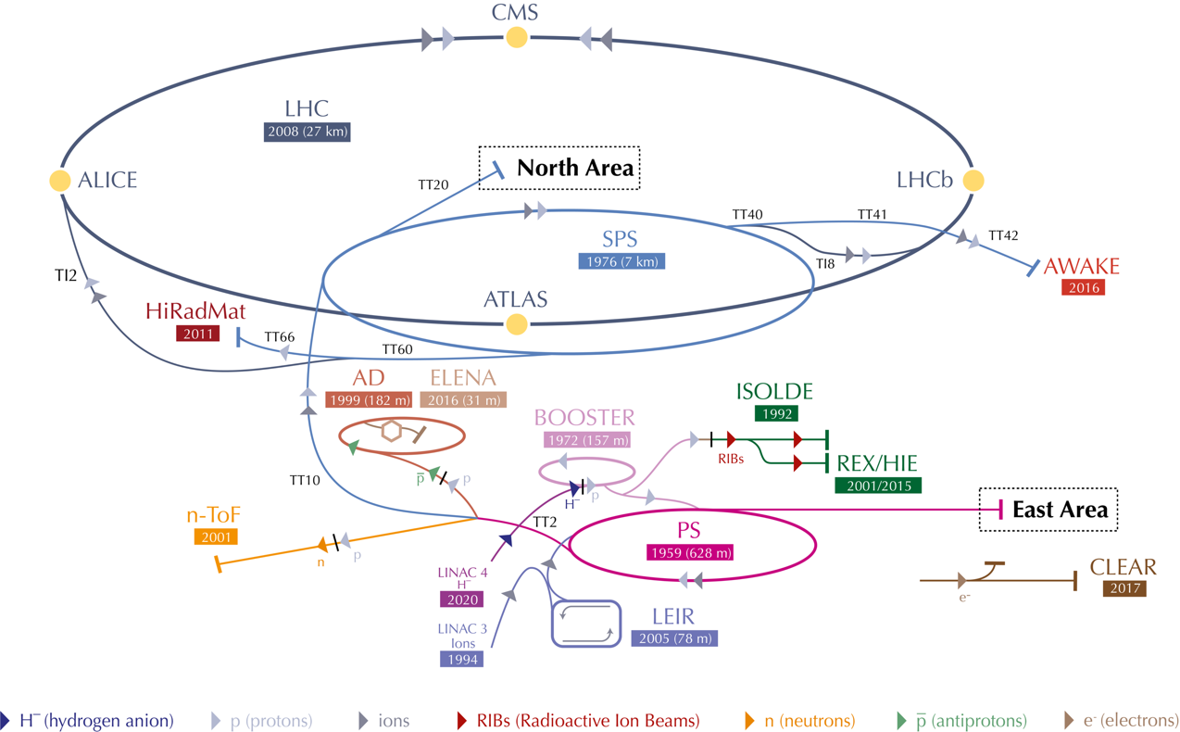
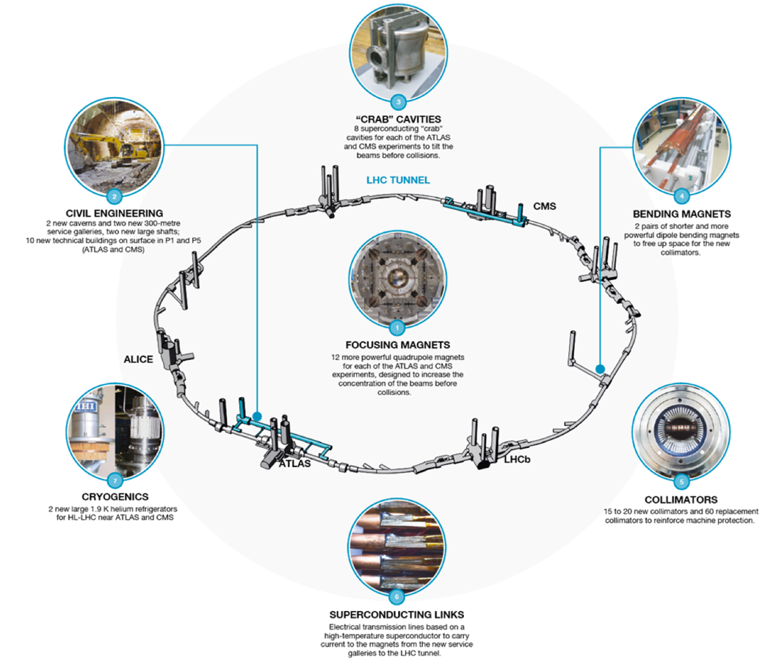
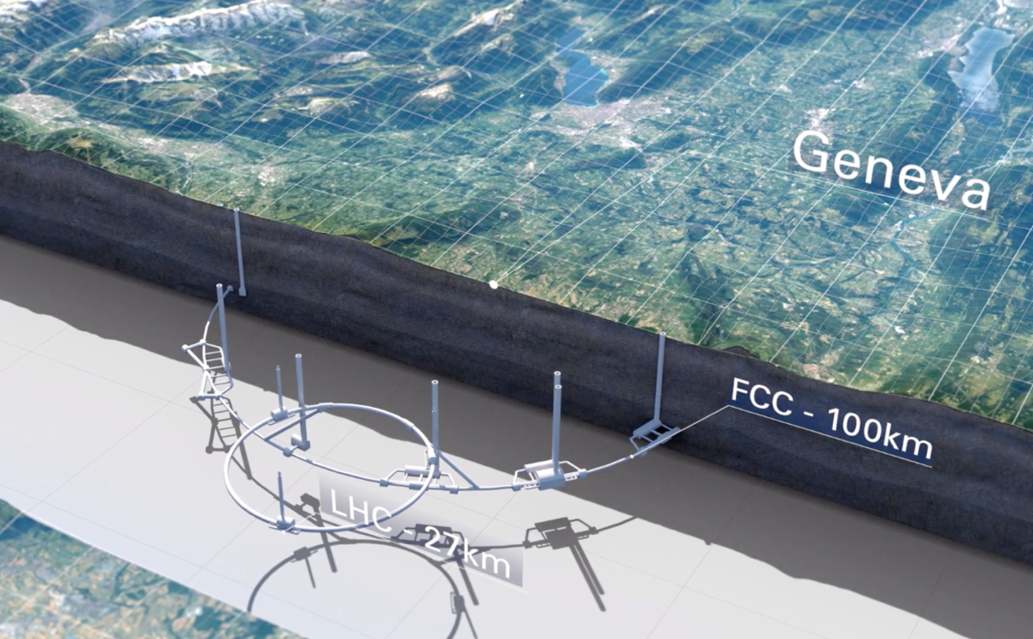
Run 3
HL-LHC
Future Options
Technology/R&D

Slide 3
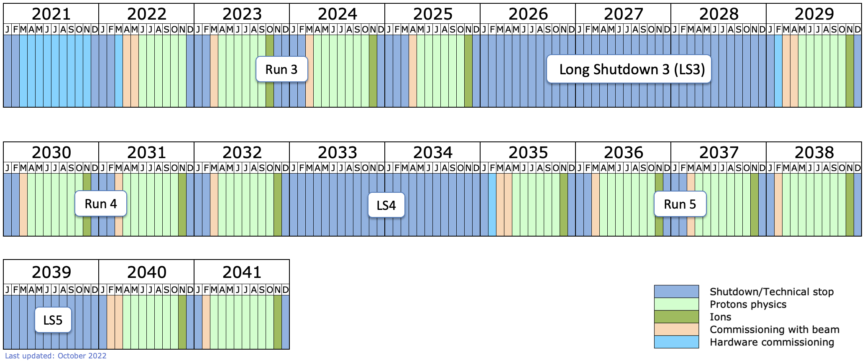
LHC/HL-LHC Timeline to 2041

Slide 4
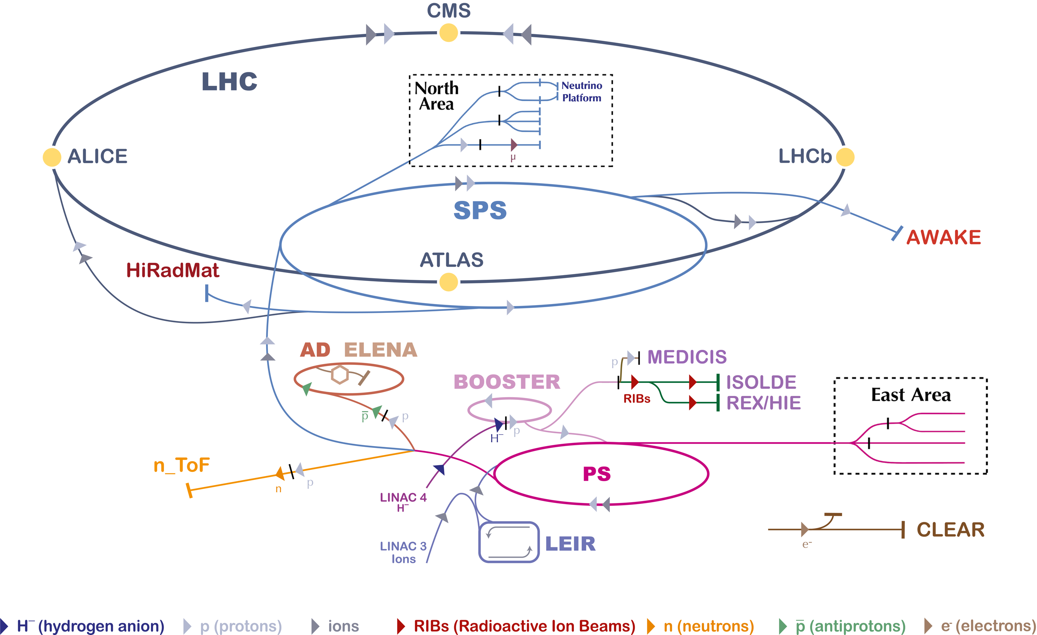

Slide 5
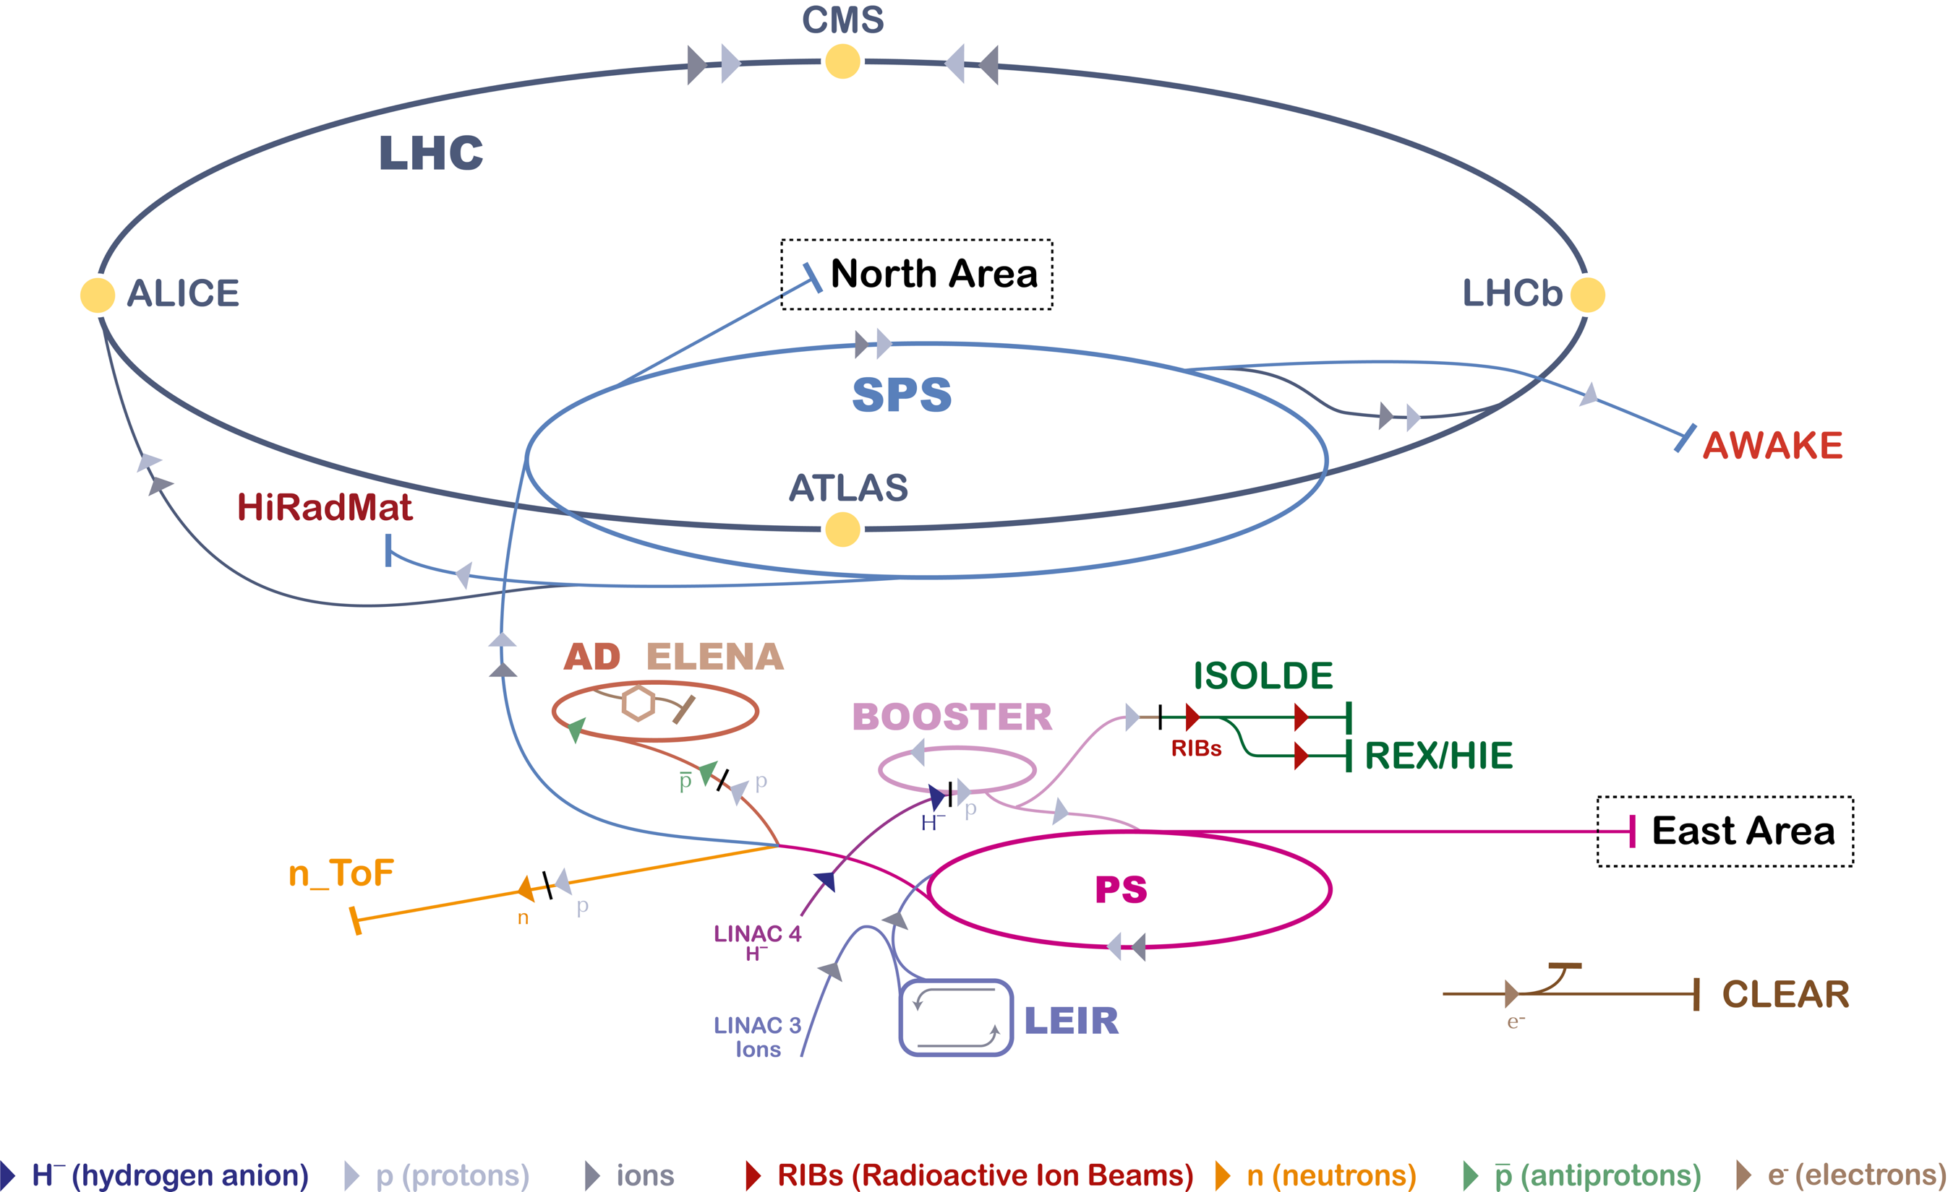
IONS

Slide 6
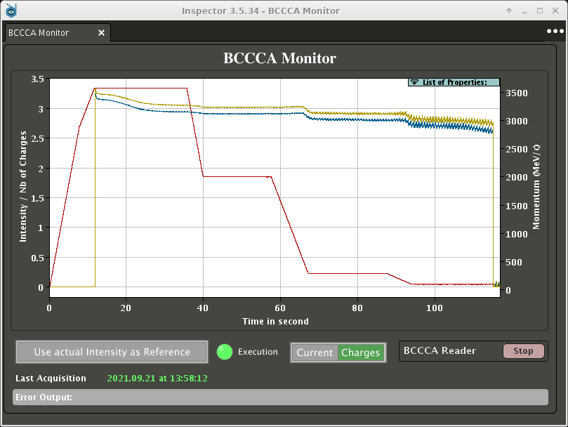
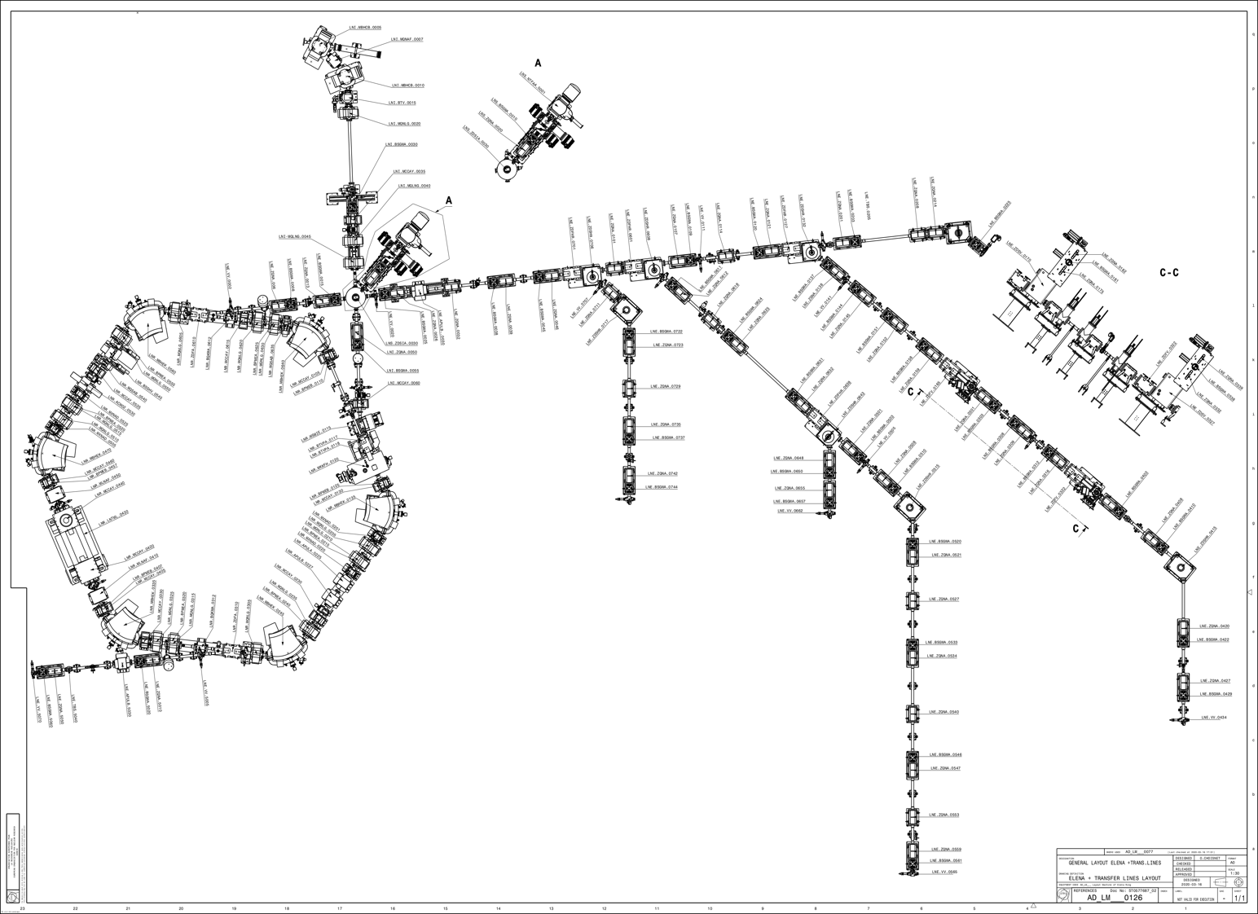
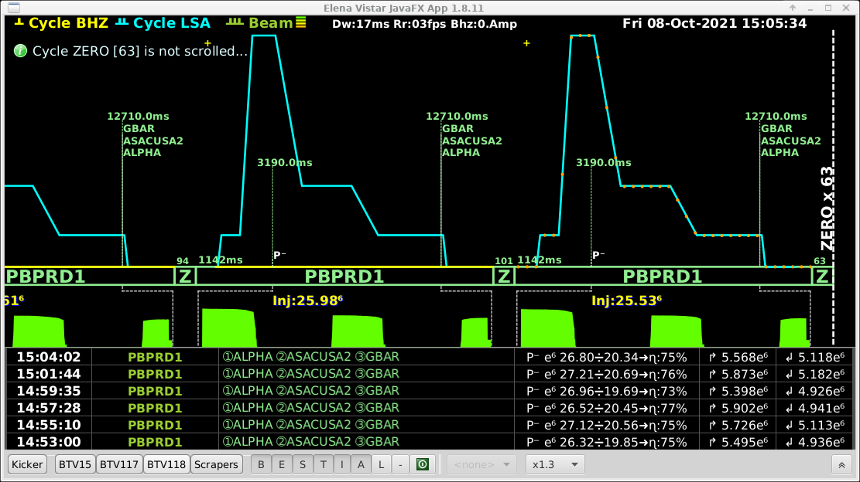

AD and ELENA
3.5 GeV/c
100 MeV/c (5.3 MeV)
AEGIS
ELENA
100 MeV/c
13.7 MeV/c (100 keV)
BASE
ASACUSA
ALPHA

Slide 7
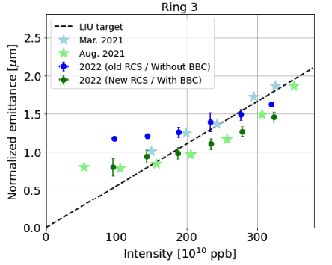
LHC Injector Upgrade completed in LS2

Slide 8
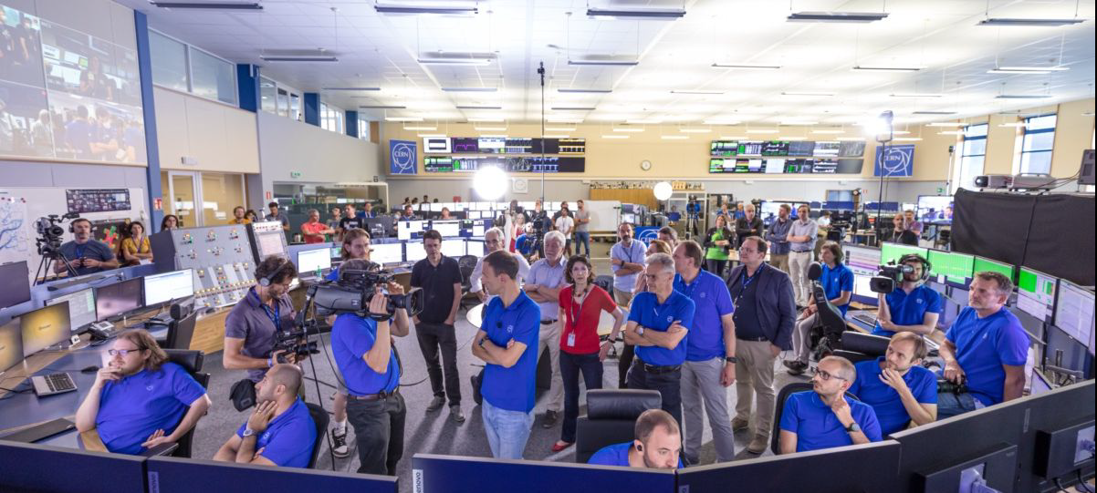
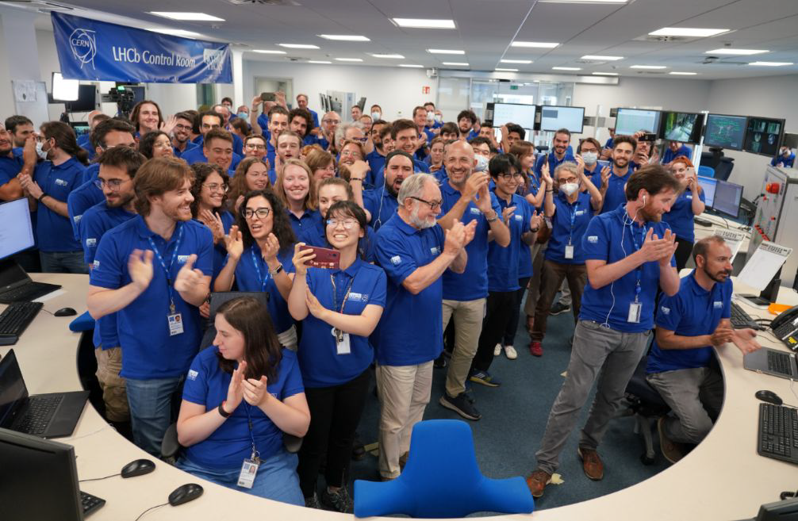
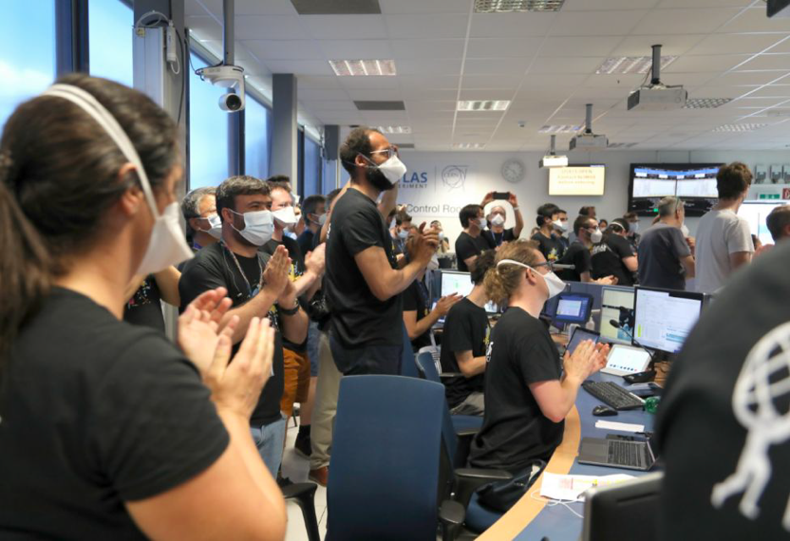
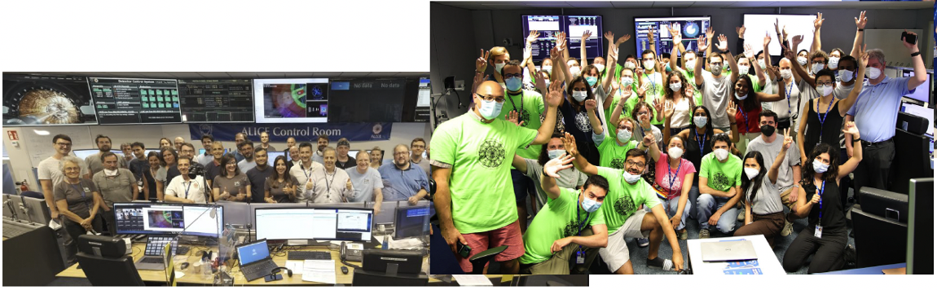
LHC highlights - 5th July
After ~ 11 weeks of commissioning
First Stable Beams energy record 13.6 TeV on 5th July
  Cryo managed to recover just in time from a rather heavy quench in the morning !!
Successful event as reported by the communication team

Slide 9
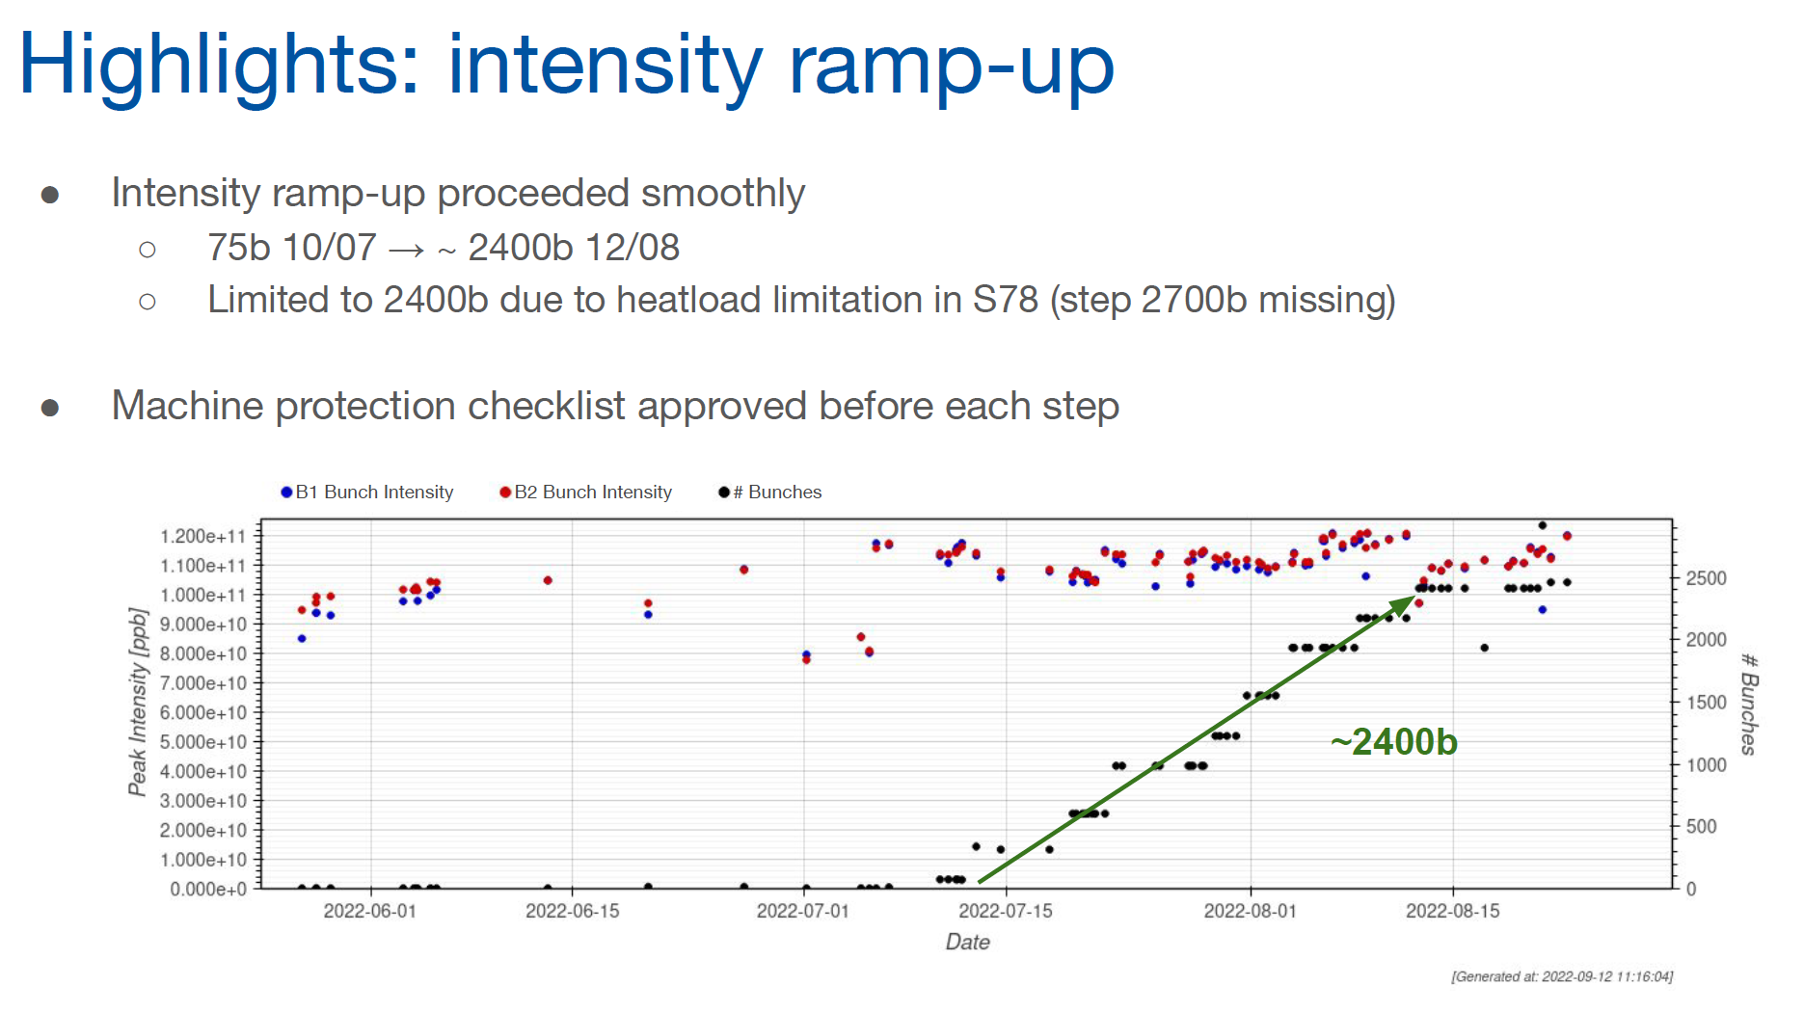
LHC – intensity ramp-up

Slide 10
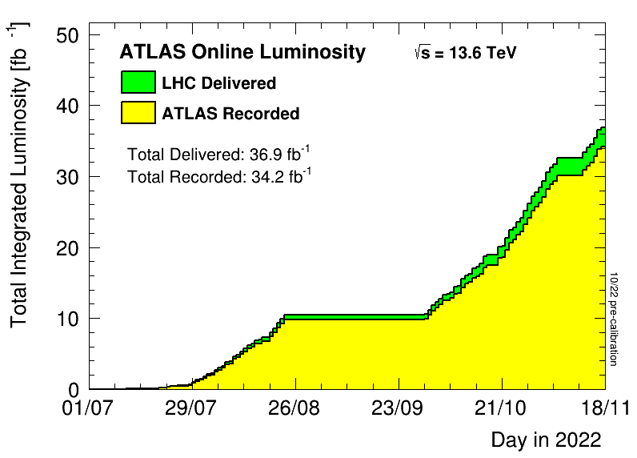
Luminosity production
Stunning performance!

Slide 11
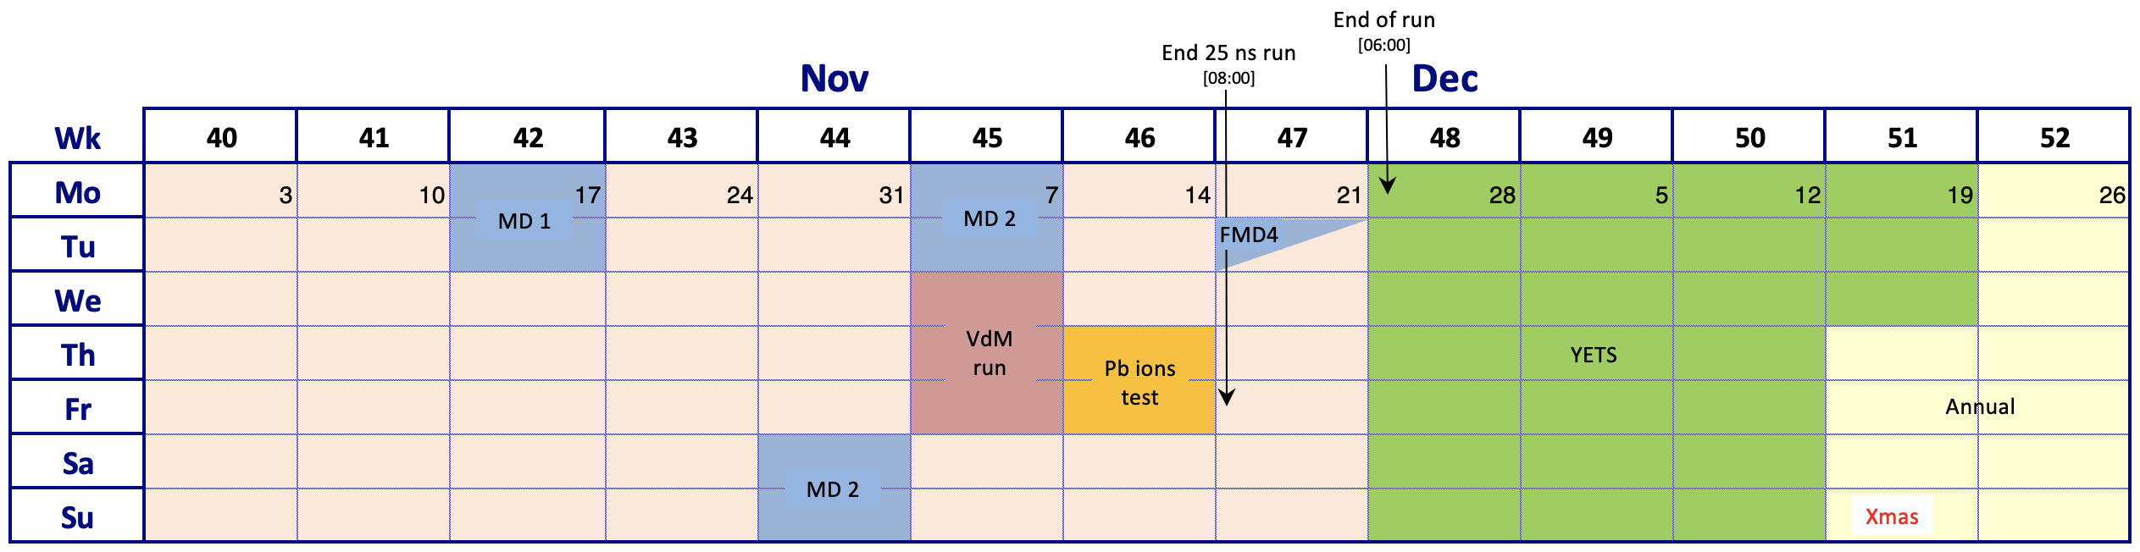
2022 – Q4 – updated LHC schedule
Start of YETS 2 weeks earlier than foreseen
Version 1.2.
Pb ion run 2022 run postponed
  Longer ion runs in the coming year(s) to compensate
  Short (2-day) Pb ion test run
End of 2022 run 06:00 28th November

Slide 12
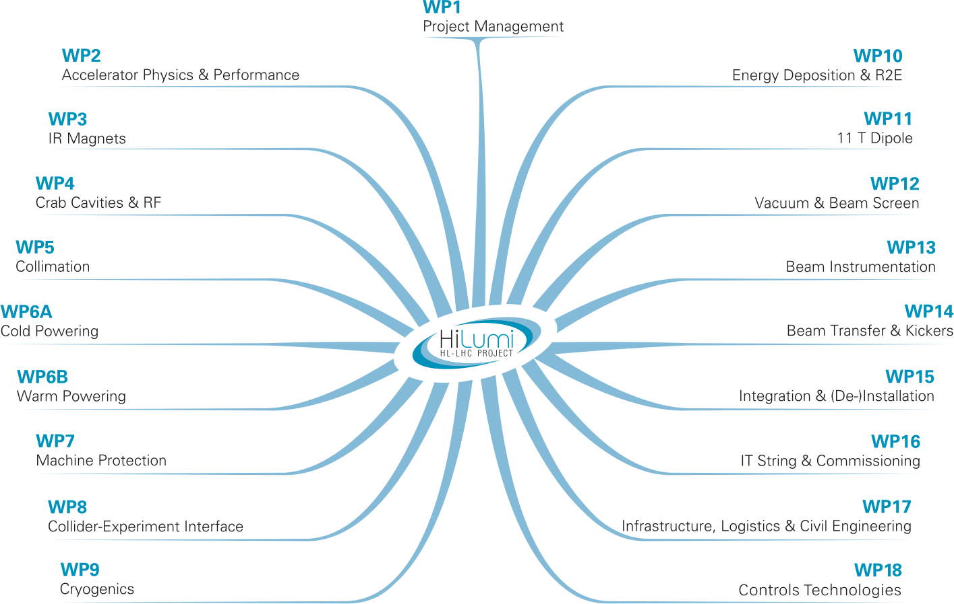
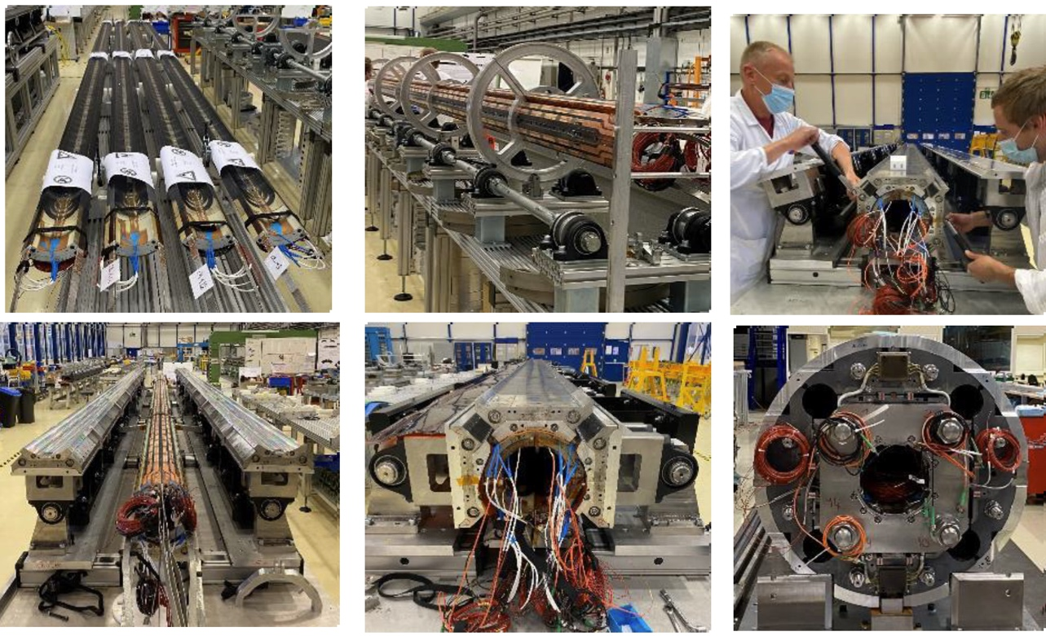
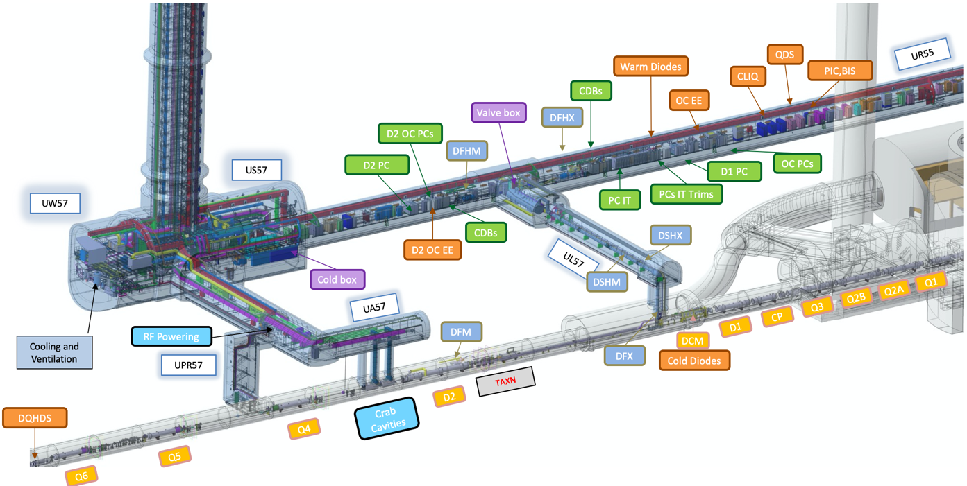
HL-LHC
Earned Value: ~60%
Still lots to do!
Novel technologies moving into production after intense R&D
Significant global in-kind contributions
Successful deployment in LS3 is vital

Slide 13
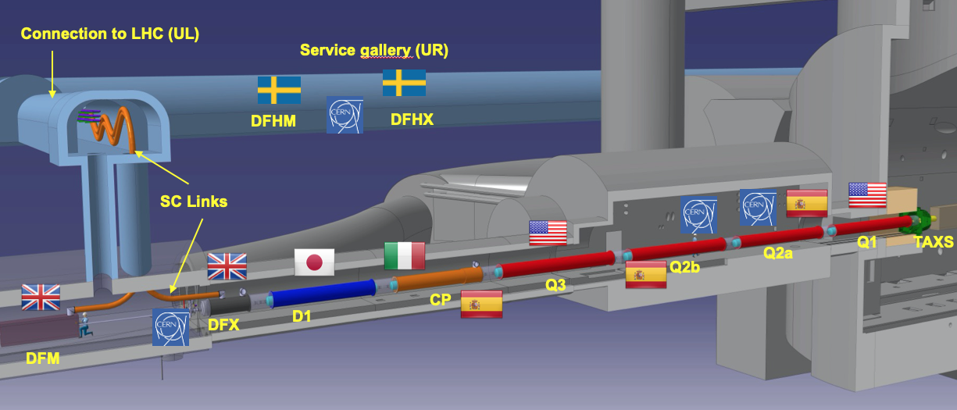
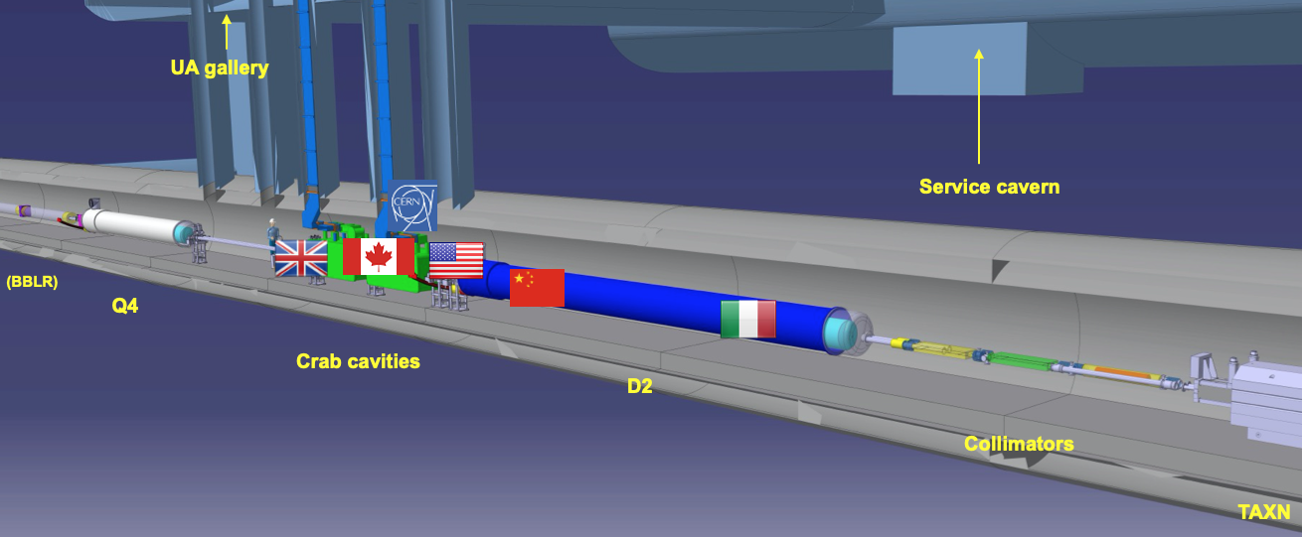
Truly international collaboration

Slide 14
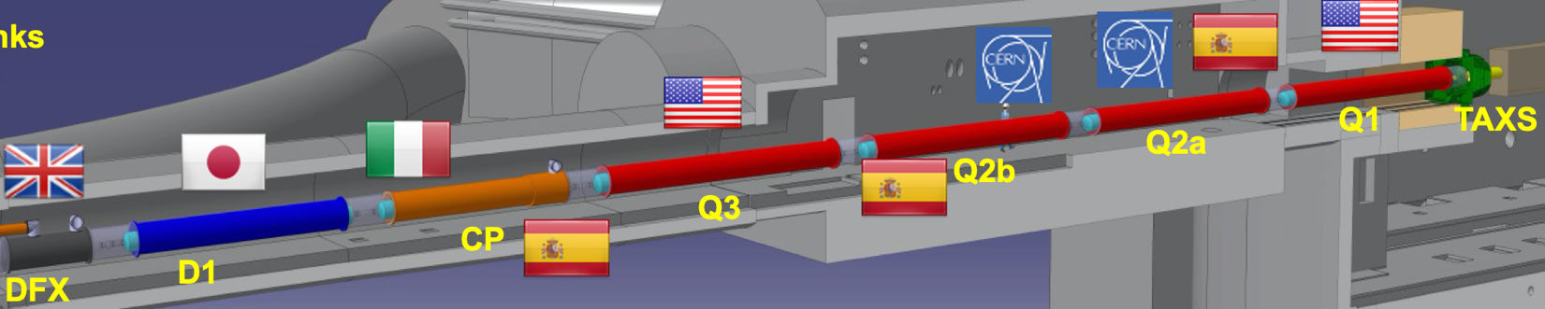
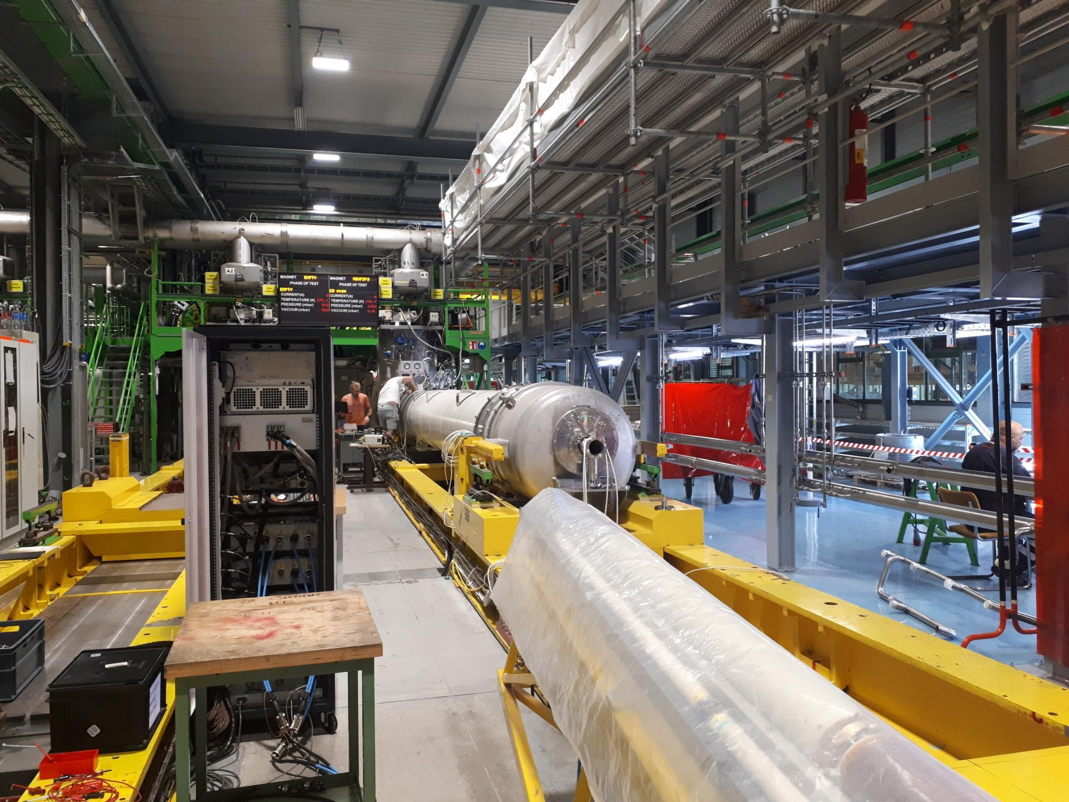
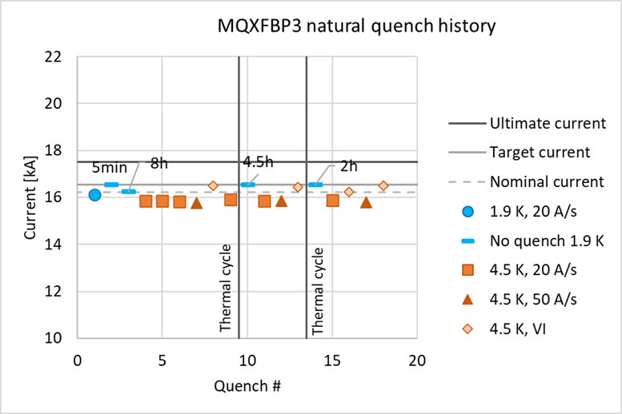
Inner Triplet Quadrupole Q2 - MQXFBP3
Latest prototype (P3) achieved nominal plus 300 A after one quench

Slide 15
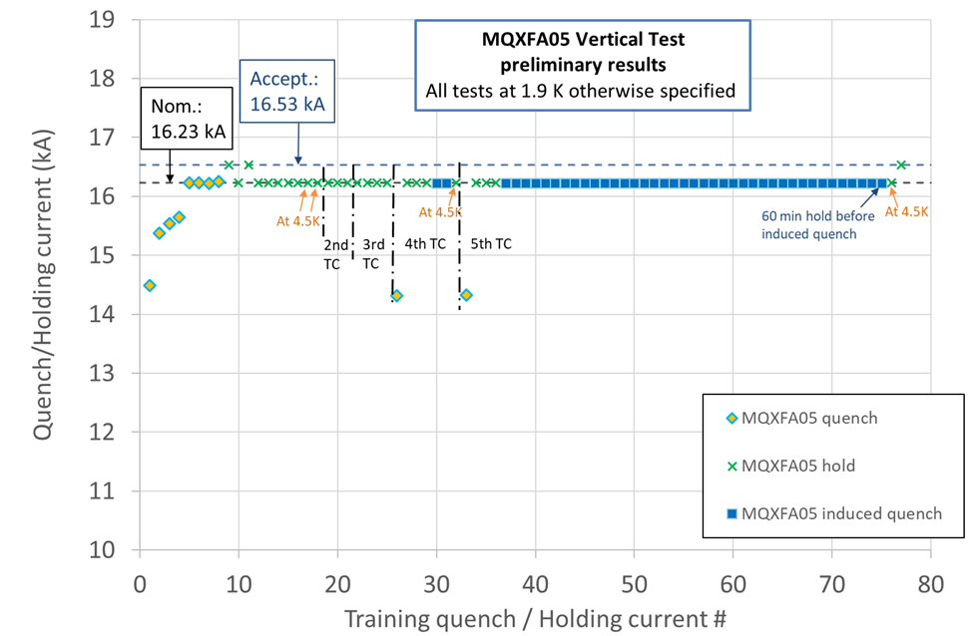
Inner Triplet Quadrupole Q1/3 – MQXFA – endurance test
Today (May 25) the BNL team completed the endurance test at 1.9-4.5 K for MQXFA05, demonstrating performance after more than 50 quenches…

Slide 16
ATLAS
Challenges for the ATLAS & CMS Phase II Upgrades:
Price increases and procurement issues
Contributions from institutes in Russia

Slide 17
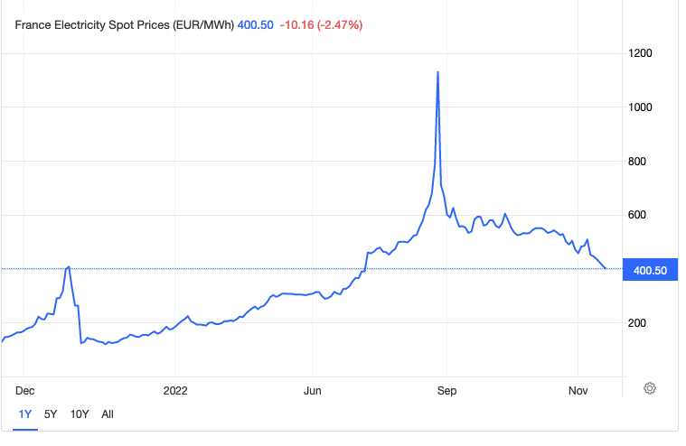
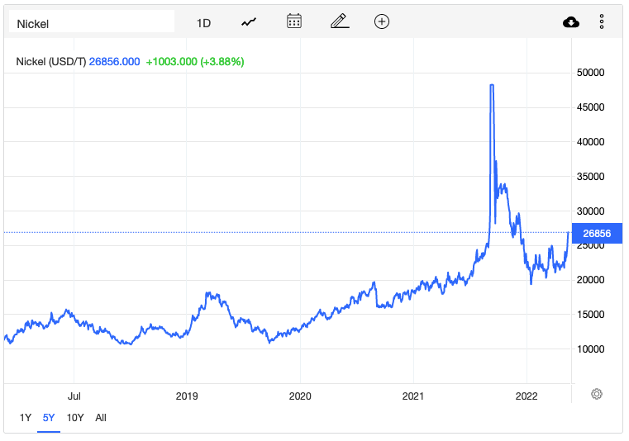
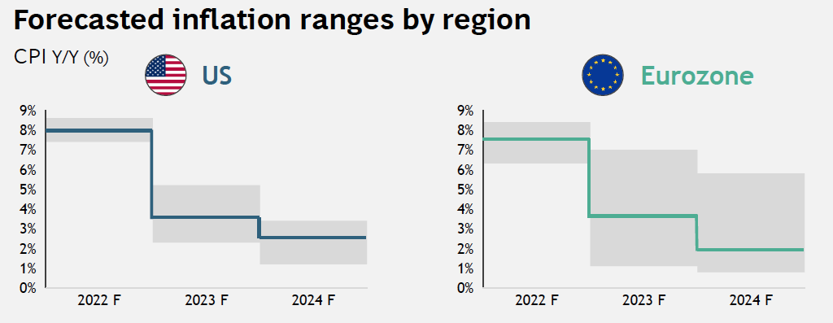
Difficult times
Post-COVID, Russian invasion of Ukraine
Leading to a challenging trifecta:
  Volatile market conditions
  High energy prices (direct and indirect impact on CERN)
  Inflation
Electricity
Nickel

Slide 18
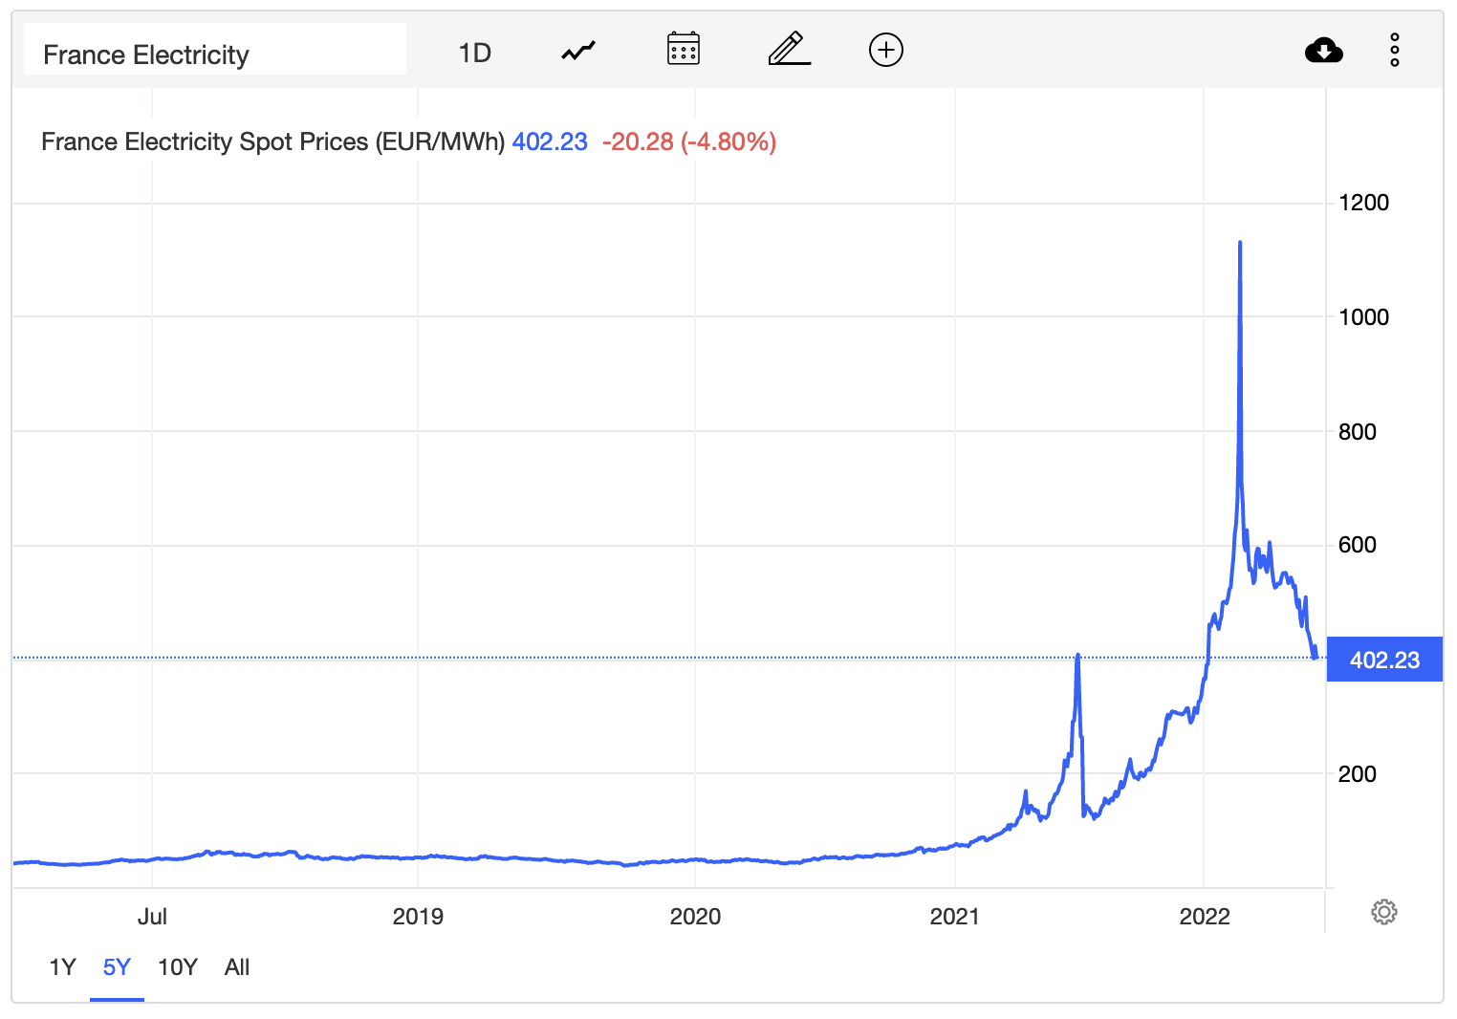
French Electricity Prices
France is contending with its worst nuclear outages in decades after EDF extended shutdowns of several key nuclear reactors.
Of a total of 56, ~28 reactors are shut down, some for issues related to stress corrosion issues and others for routine maintenance.
France, which was a power exporter, has become an importer…
5 years

Slide 19
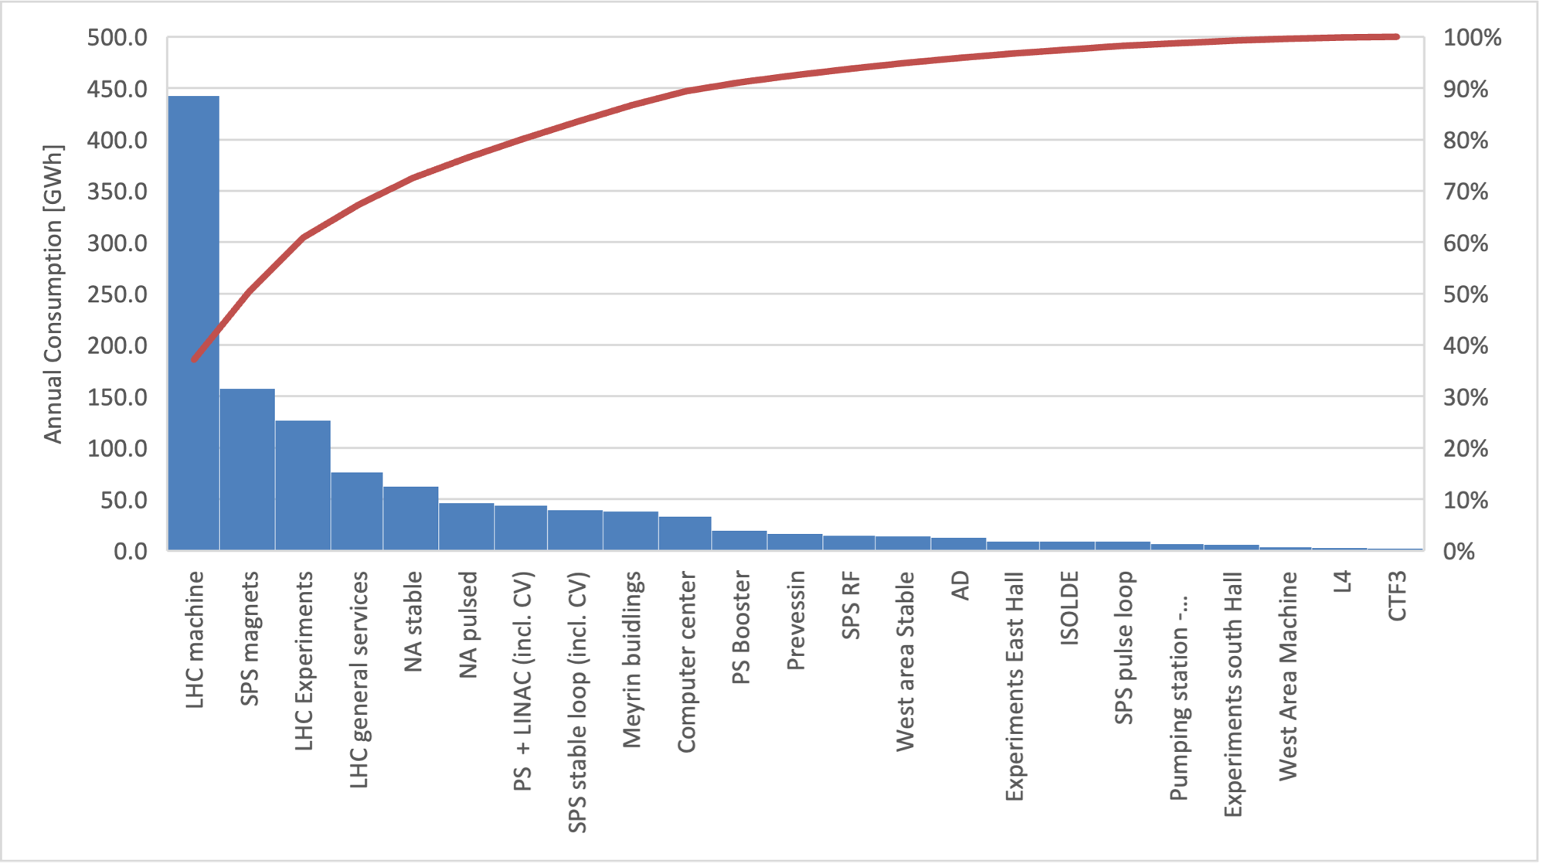
Annual Consumption during a Run
Annual total ~1.3 TWh
Average (17,18) [GWh]

Slide 20
Schedule Adjustments
2022: Complex starts year end technical stop (YETS) 2 weeks early
  Stop Monday 28th November instead of Monday 12th December
  Explicit request/offer from EDF (~10 MCHF plus savings from reduced consumption)
  Demonstration of CERN’s social responsibility in difficult times
2023/2024: 19 weeks YETS
  Explicitly included in Medium Term Plan
  Social responsibility and cost
Seriously considering long-term implications

Slide 21



FCC
Lots going on out there, deliverables for mid-term review presented to Council
Muon Collider
Successful Horizon INFRA-DEV bid for a Muon Collider design study
Energy for Sustainable Science
ESRF, Sep 29-30
ESRF, CERN, ESS, DESY, PSI, ERF++

Slide 22
Conclusions
Challenging times, good to see the full Complex fully up and running and the start of Run 3 for the LHC
Medium term
  Encouraging progress HL-LHC side, on track for series production of the many HL-LHC components
  Continued push of Accelerator R&D for present and future developments
  Looking to exploit our diversity potential – interesting opportunities
Options for future colliders being actively and enthusiastically pursued
Sustainability and energy management very much on the agenda

