Slide 1
CERN-FAIR-GSI Collaboration Meeting
17th November 2022
FAIR Project Status Report
Jörg Blaurock
Technical Managing Director FAIR GmbH & GSI GmbH

Slide 2
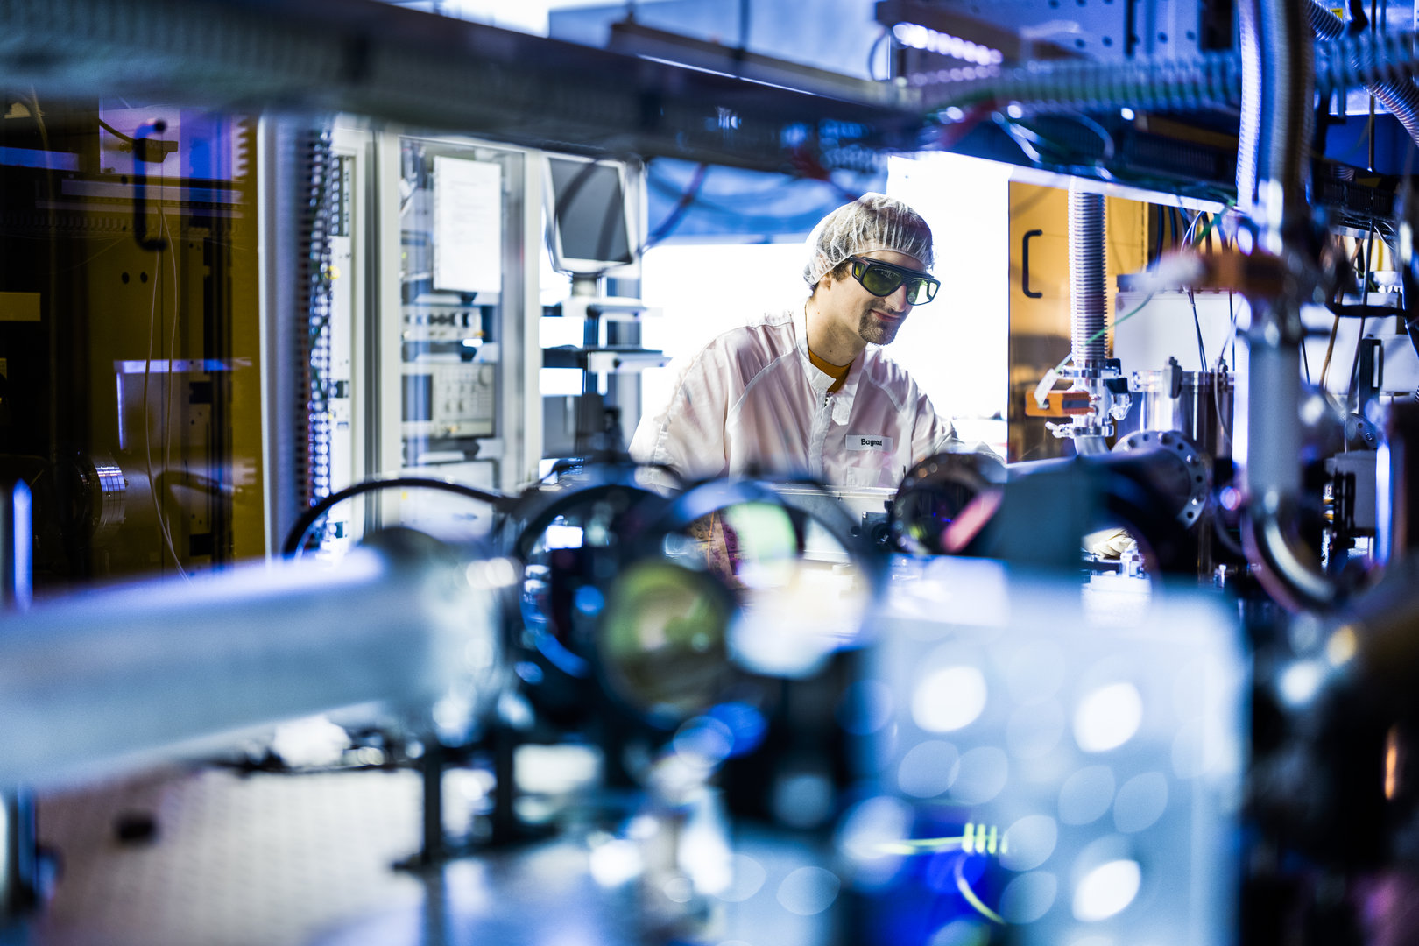
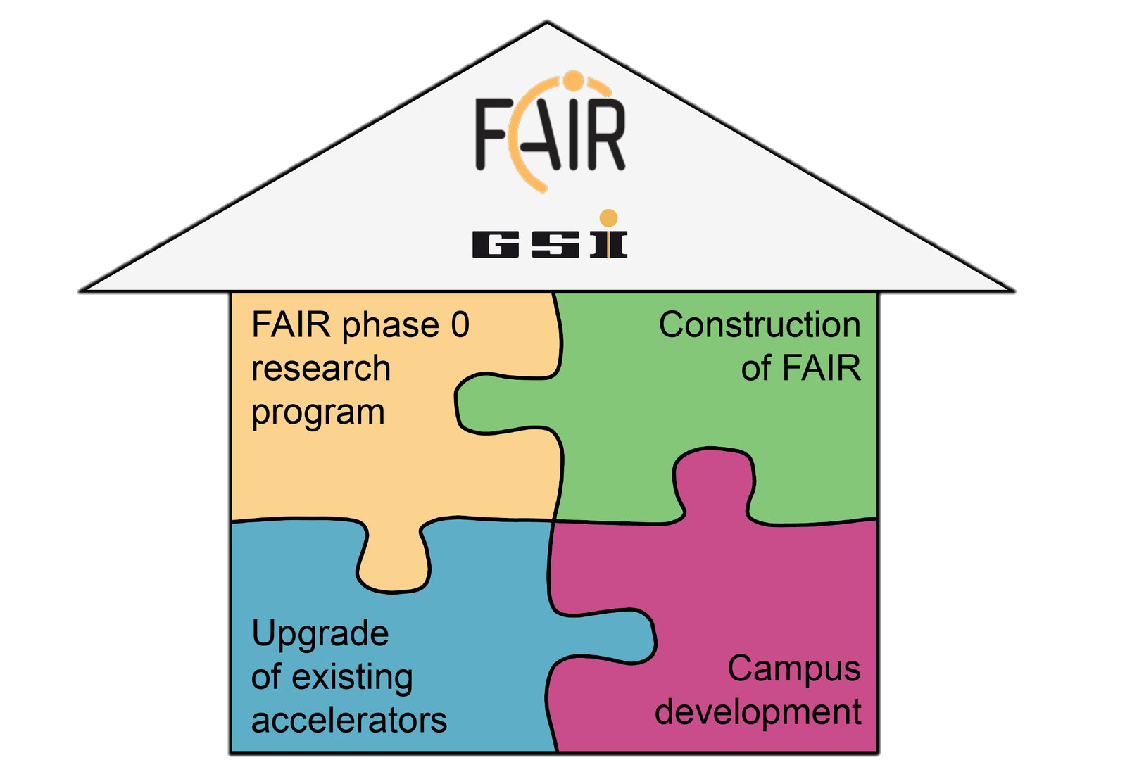
Agenda
FAIR Phase 0
Beamtime 2022
Upgrade of existing accelerators
Integrated Campus Schedule
Development on Campus
Campus Infrastructure
Construction of FAIR
Project Time schedule
Highlights

Slide 3
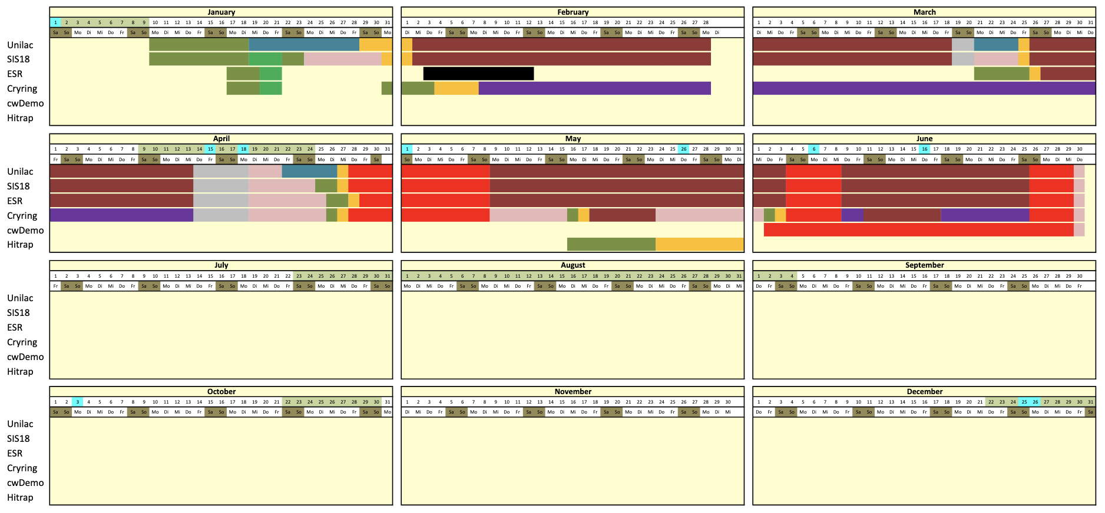
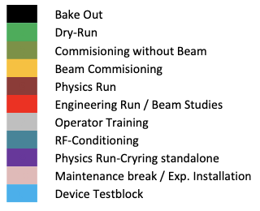
FAIR phase 0 beamtime 2022
15 weeks of user beamtime + HITRAP commissioning + cw Demonstrator Tests

Slide 4
FAIR phase 0 beamtime 2022
physics run started on February 2nd and ended on June 29th as planned
Available machines: UNILAC, SIS18, FRS, ESR & Cryring
total 2760 hours of user operation
integrated availability = 87%, parallel factor = 2.6 → ca. 6250 hours effective beam time
plus 3 weeks dedicated to machine studies
including 2 weeks for commissioning of HITRAP
the second run under pandemic conditions
All corresponding measures that had proved valuable in previous year were taken again
The beamtime was successfully completed
4

Slide 5
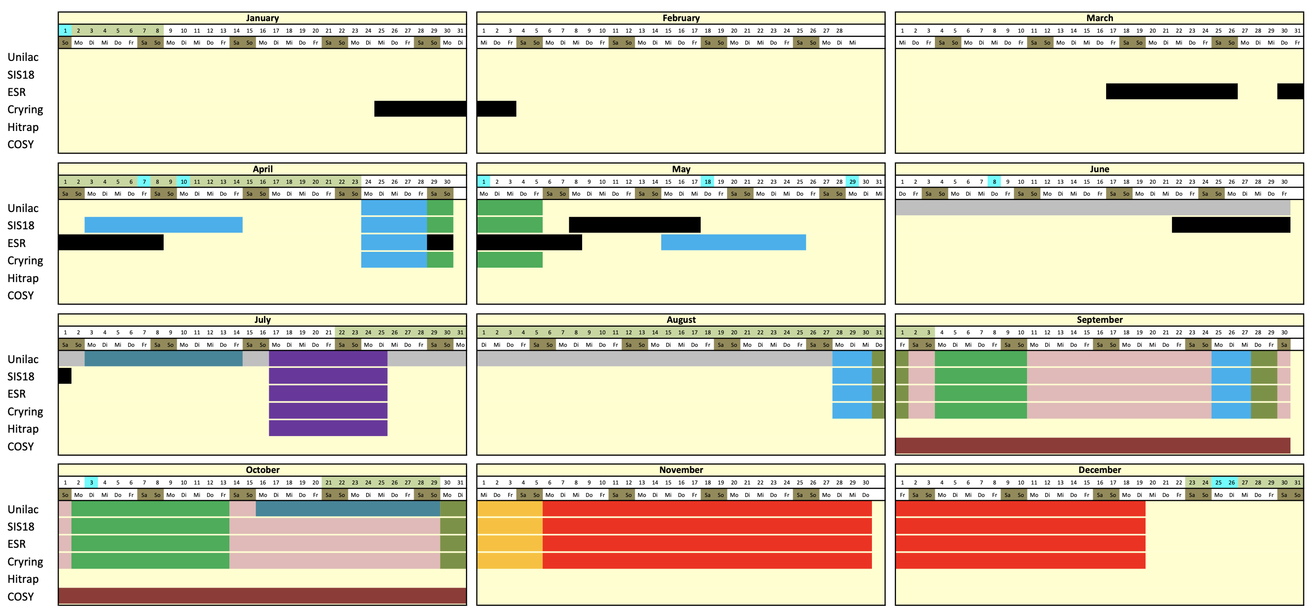
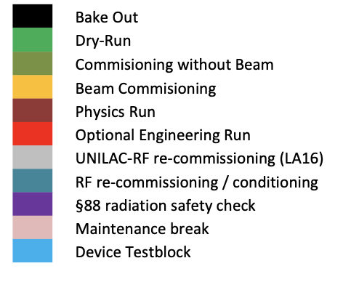
Long Shutdown & Engineering Run 2023

Slide 6
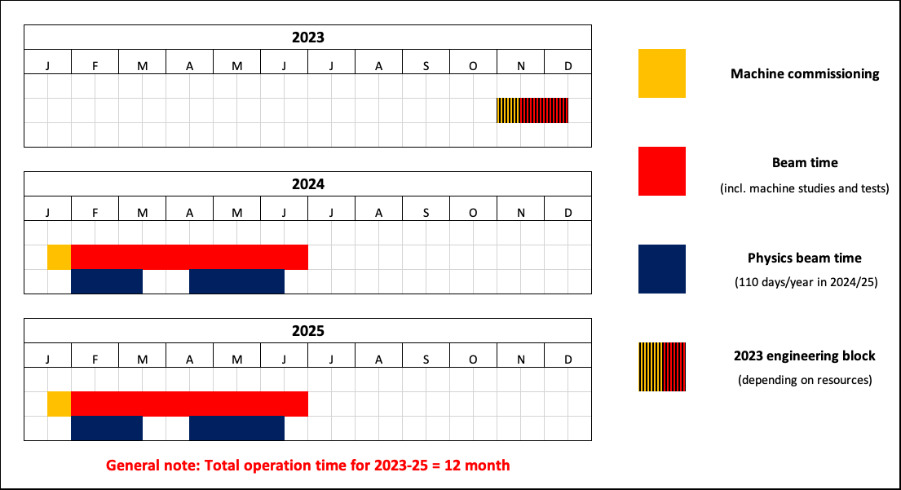
Beam time 2023/2024/2025

Slide 7
Agenda
FAIR Phase 0
Beamtime 2022
Upgrade of existing accelerators
Integrated Campus Schedule
Development on Campus
Campus Infrastructure
Construction of FAIR
Project Time schedule
Highlights

Slide 8
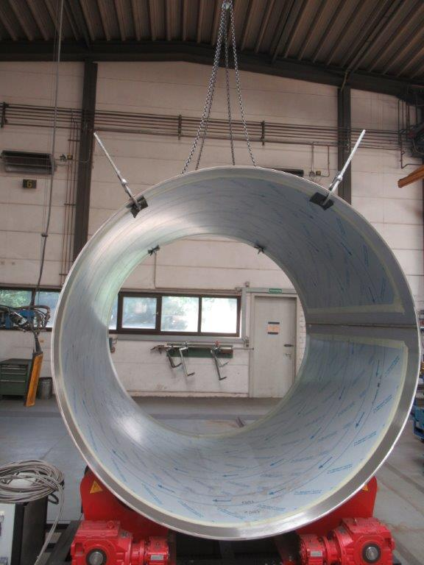
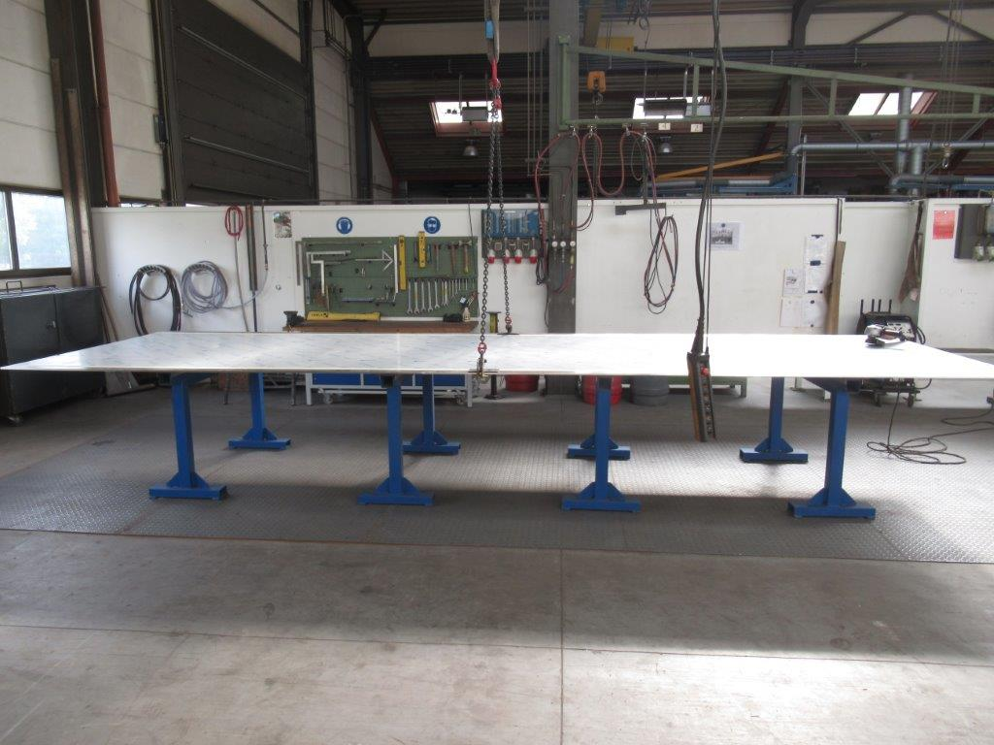
Highlights (part 1)
August 2022
The production of the first series tanks for the new Alvarez
has started in August 2022.

Slide 9
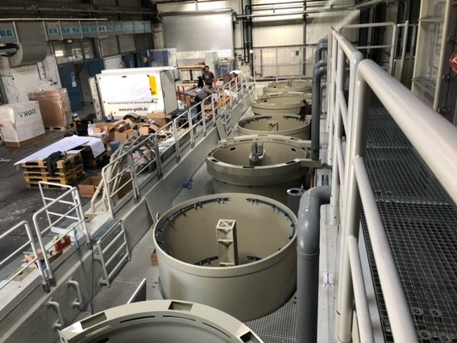
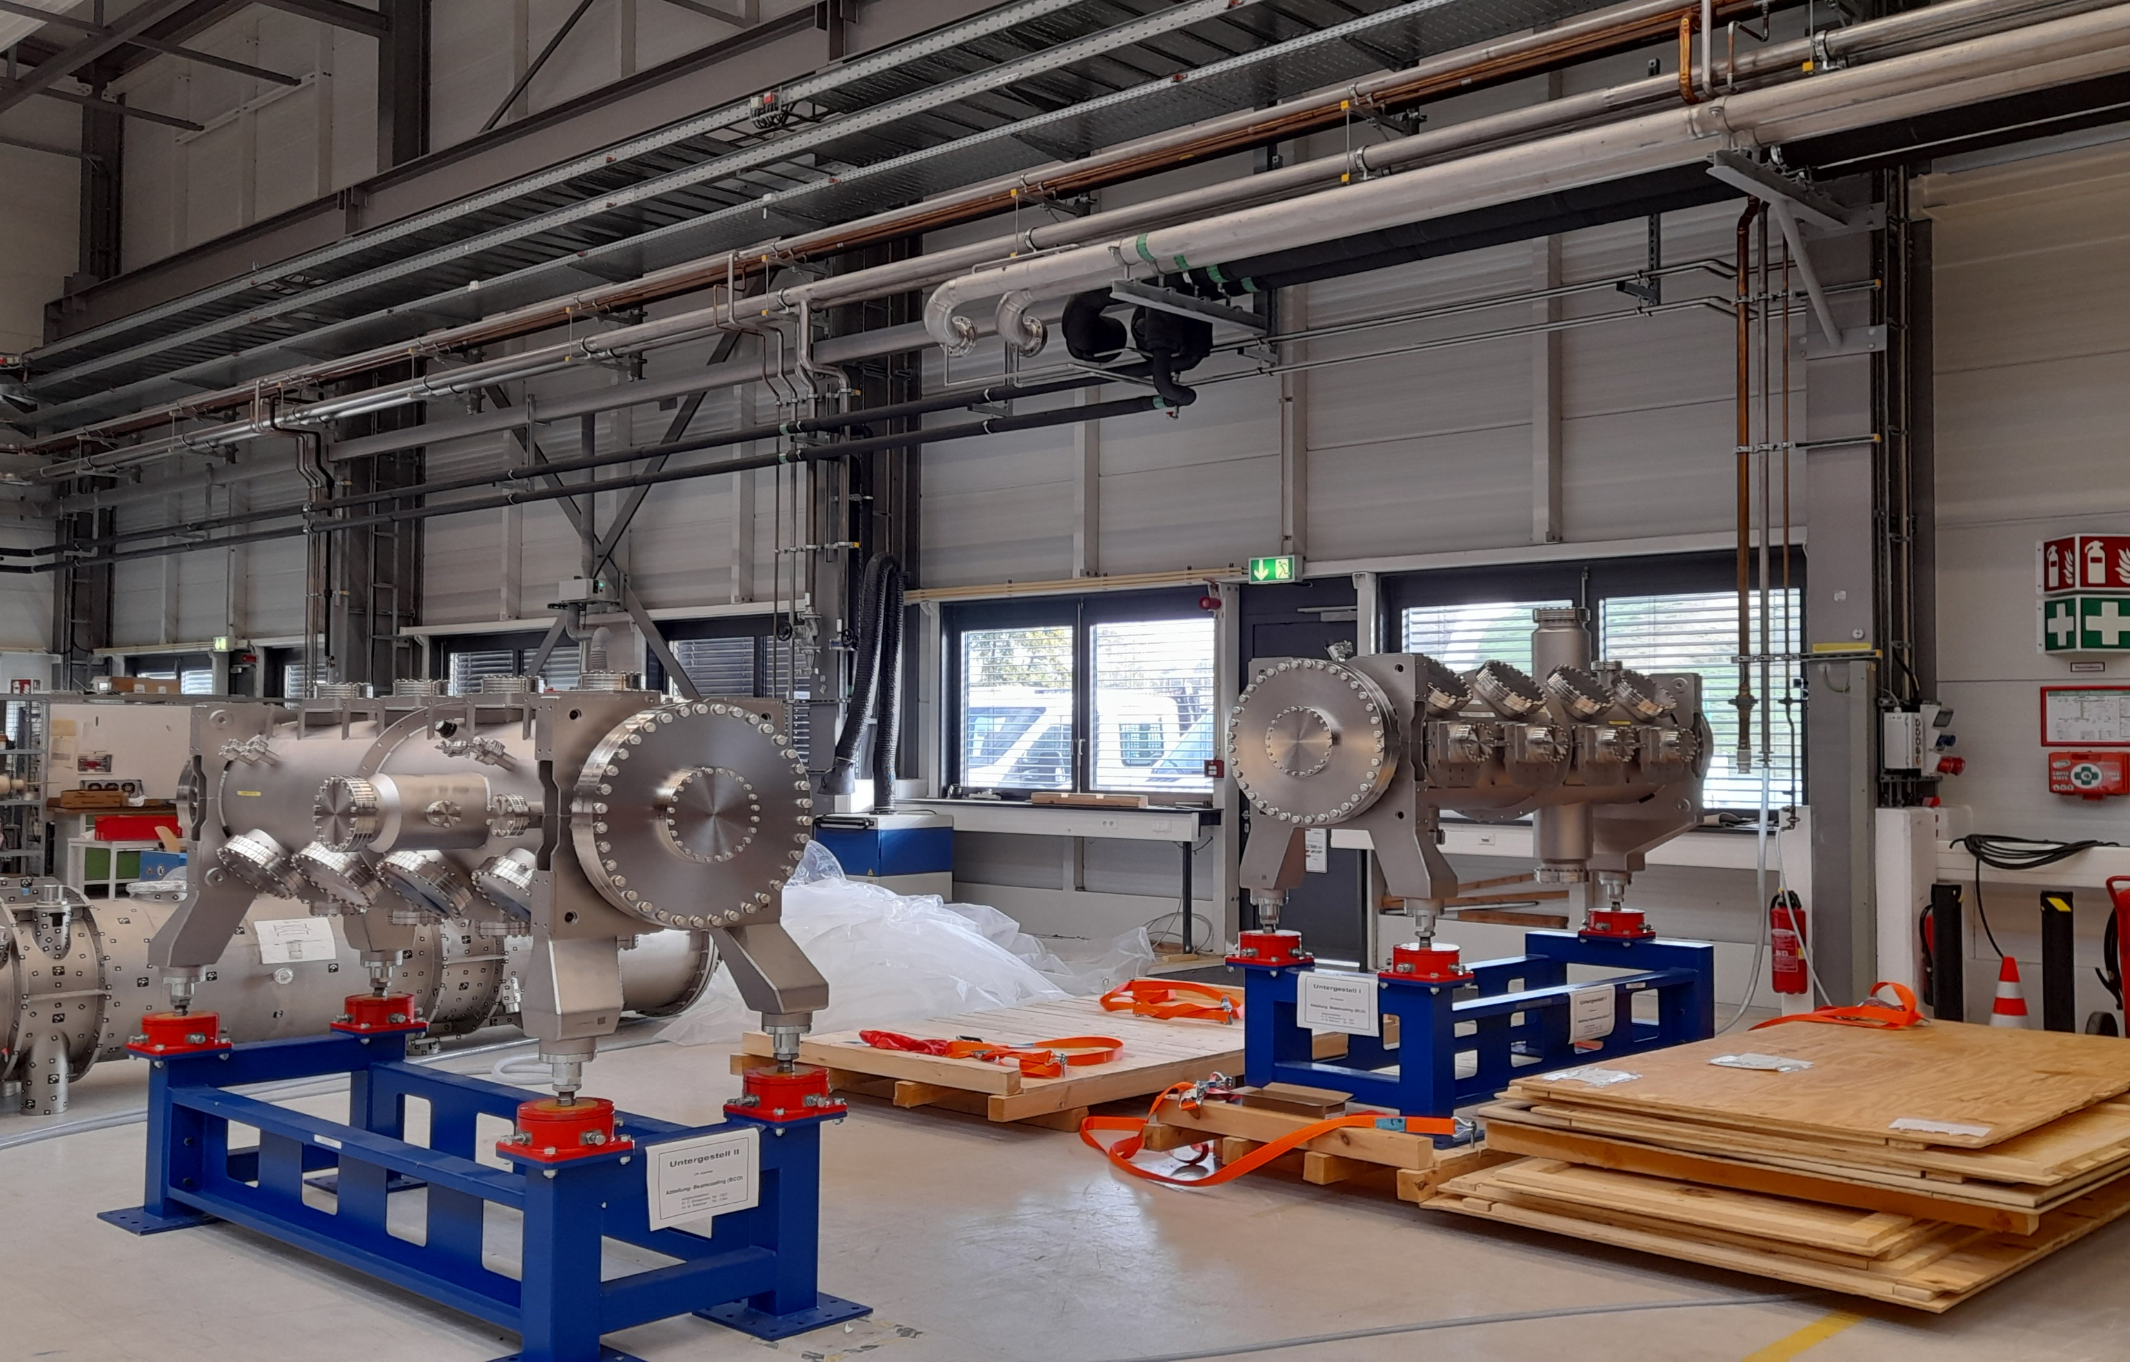
Highlights (part 2)
September 2022
TVH Retrofitting works are successfully ongoing. The first both electrolyte containers were positioned.
September 2022
2 Cryogenic Pick-Up Vacuum Tanks for Stochastic Cooling of Collector Ring delivered.

Slide 10
Agenda
FAIR Phase 0
Beamtime 2022
Upgrade of existing accelerators
Integrated Campus Schedule
Development on Campus
Campus Infrastructure
Construction of FAIR
Project Time schedule
Highlights

Slide 11
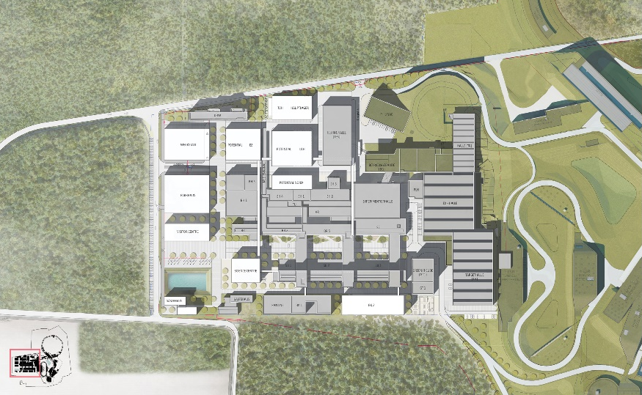
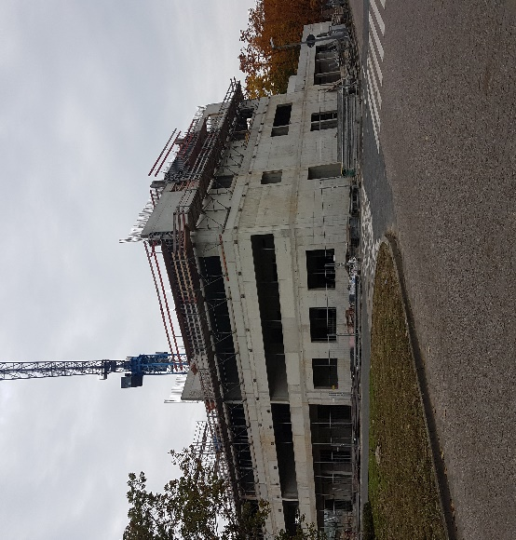
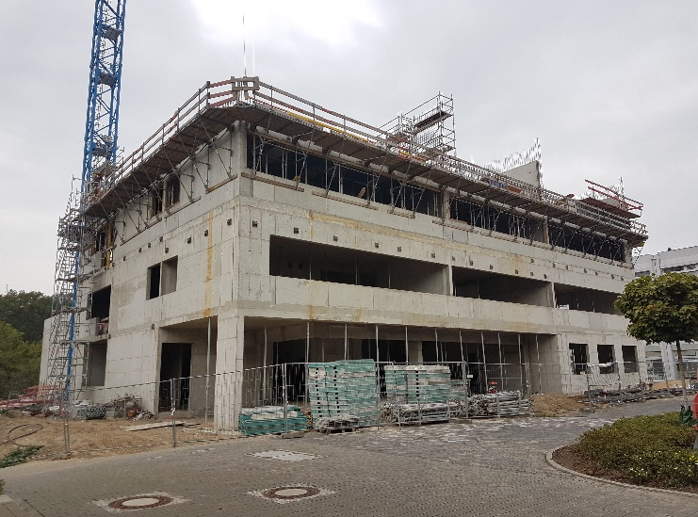
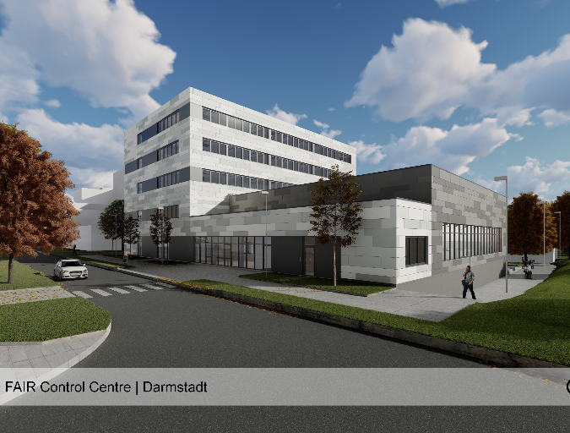
FAIR Highlights
FAIR Control Center (FCC)
Campus Masterplan
main control room
conference
office

Slide 12
Agenda
FAIR Phase 0
Beamtime 2022
Upgrade of existing accelerators
Integrated Campus Schedule
Development on Campus
Campus Infrastructure
Construction of FAIR
Highlights
FAIR Essential decisions required

Slide 13
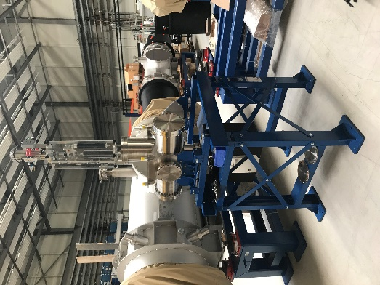
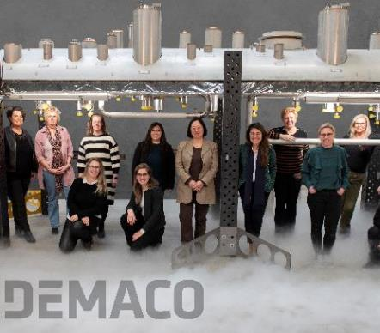
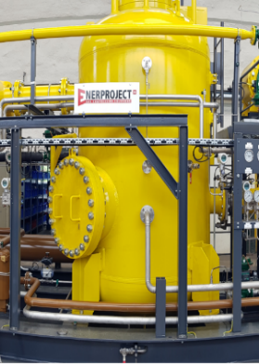
FAIR Highlights (Part 1)
July 2022
Installation of Cryogenics Projects such as SIS100 distribution system (Demaco), CRYO2, CWU and DB3 (LKT) started in Q3/2022 on FAIR construction Site.
July 2022
29 HEBT modular stands of batch 1 delivered. Test installation of 2 modular stands with diagnostic chambers and pumps performed.

Slide 14
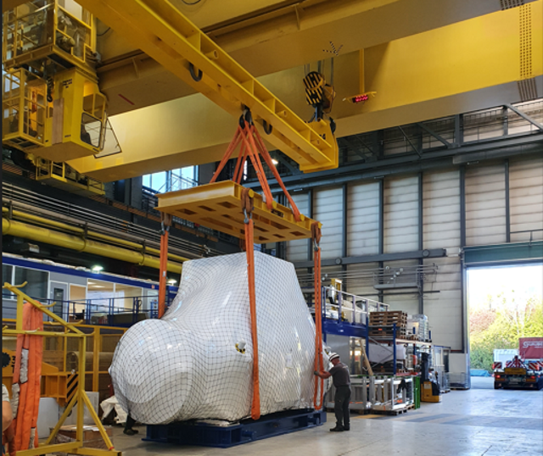
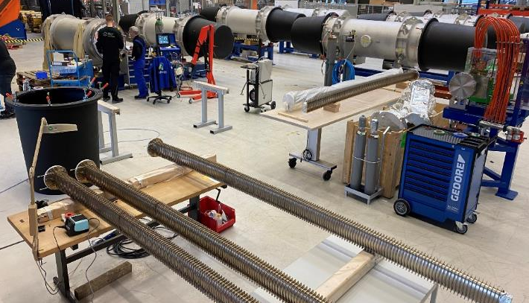
FAIR Highlights (Part 2)
September 2022
The SIS100 Series integration of dipole
chambers into dipole modules is
successfully completed
(110 pieces).
September 2022
First-of-series of the SuperFRS Super
Conducting Long Multiplet delivered
from CERN test- faciliy to GSI campus.

Slide 15
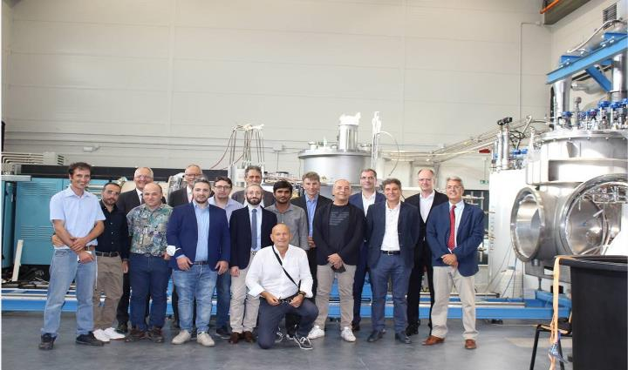
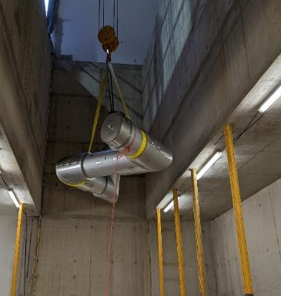
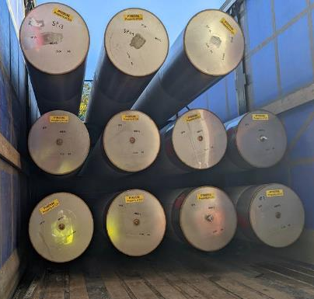
FAIR Highlights (Part 3)
September 2022
On 05th & 06th of September a Management and Commissioning
meeting took place @ INFN Institute in Salerno (Italy).
September 2022
On 28th September the first 14 Spools were successfully delivered by
company DEMACO and brought into the SIS100 tunnel.

Slide 16
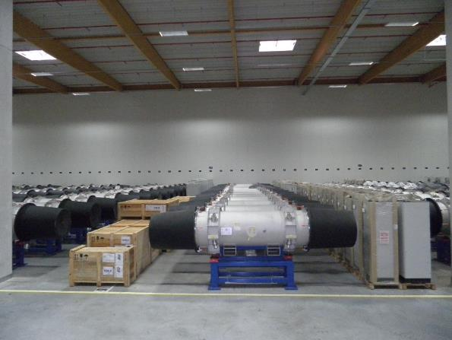
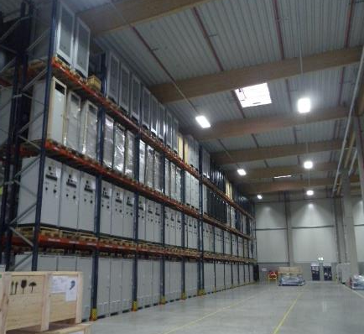
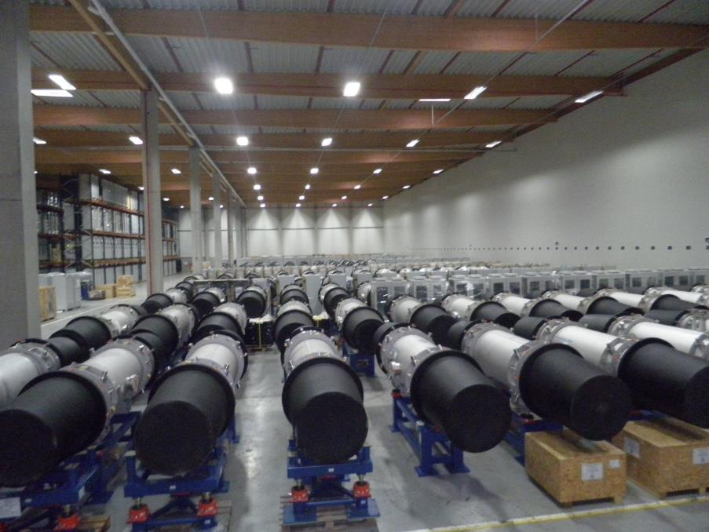
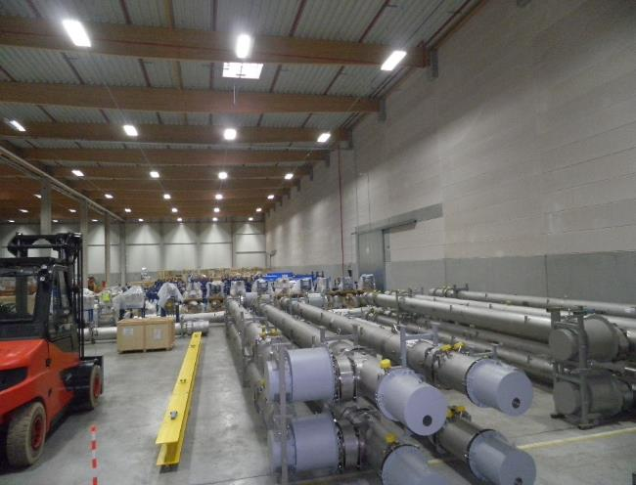
FAIR Highlights (Part 4)
Completed and delivered high-tech components for accelerator & experiments
Storage area: approx. 9.900 m²
4.195 objects (Components, assemblies, boxes, etc.)
50% of SIS100 components stored
90% of HESR components stored

Slide 17
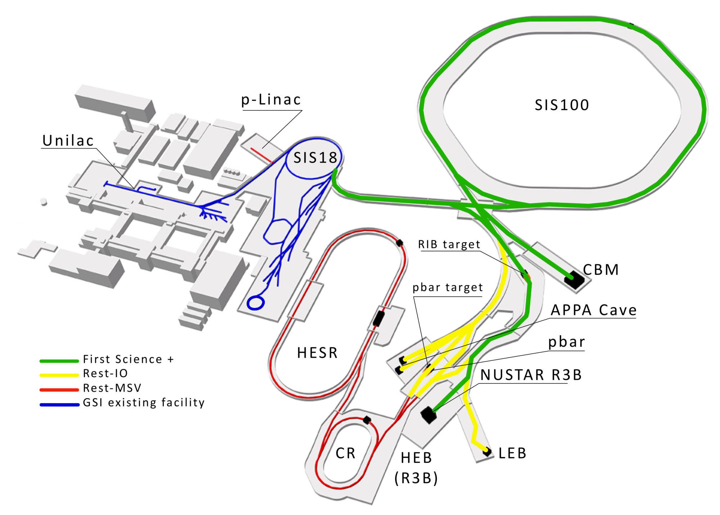
FAIR Essential decisions required
Results of the “First Science and Staging Review of the FAIR Project” were presented to the FAIR Council on 25th of October 2022 with the following main conclusions of the FAIR Council:
The Scientific Review panel recommends that the scenario FS+ (SIS100, Super-FRS-HEB and CBM) would be the most appropriate starting scenario to achieve world leading science.
Next Steps:
FAIR Council to decide on the implementation of scenario FS+ (SIS100, Super-FRS-HEB and CBM) in December 2022 and to provide the corresponding financing
A preliminary budget increase is needed at the end of 2022 in order to ensure the project execution continuity from beginning of 2023 onwards

Slide 18
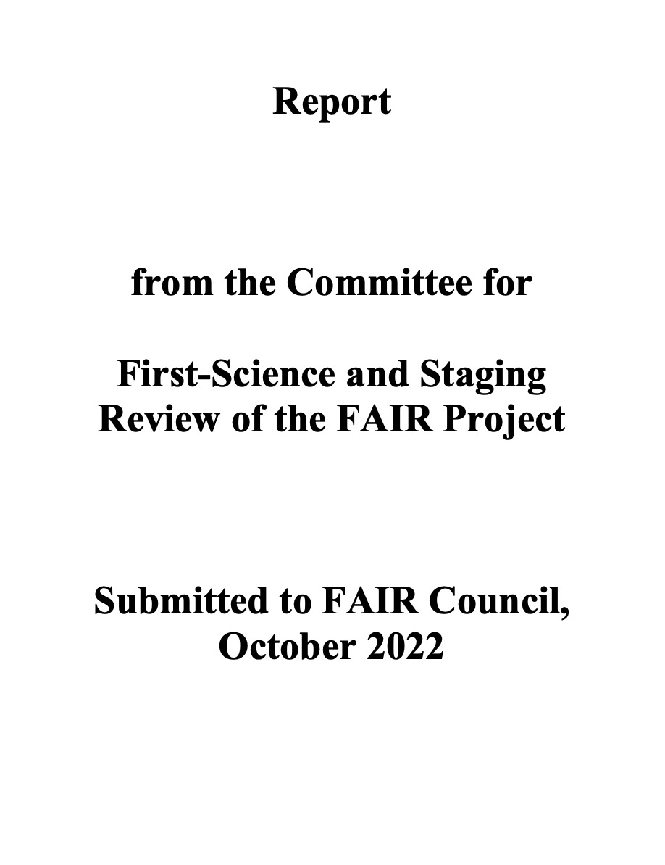
The First Science and Staging Review
The international review panel has issued its report, which is publicly available in full on our website
The scientific program of all four FAIR pillars is indicated as outstanding and in many cases world leading
The competition by other facilities is strong, but FAIR has an hedge if built in a timely manner
Given the financial constraints, a start configuration including SIS100, SFRS with the High Energy cave and CBM is recommended

Slide 19
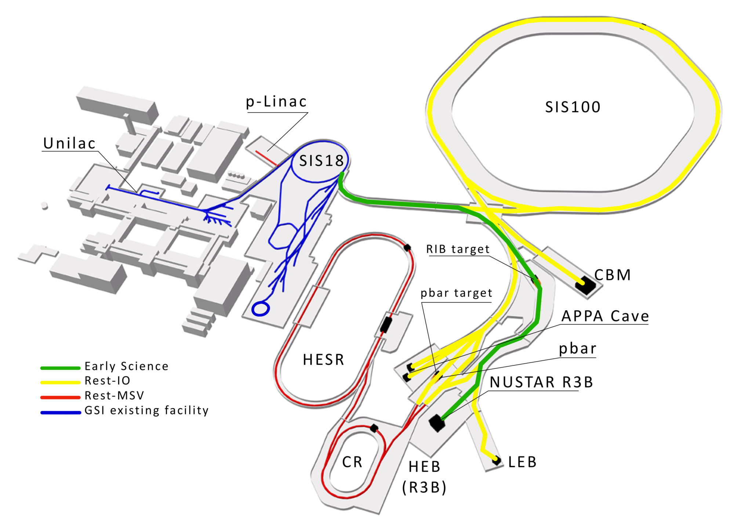
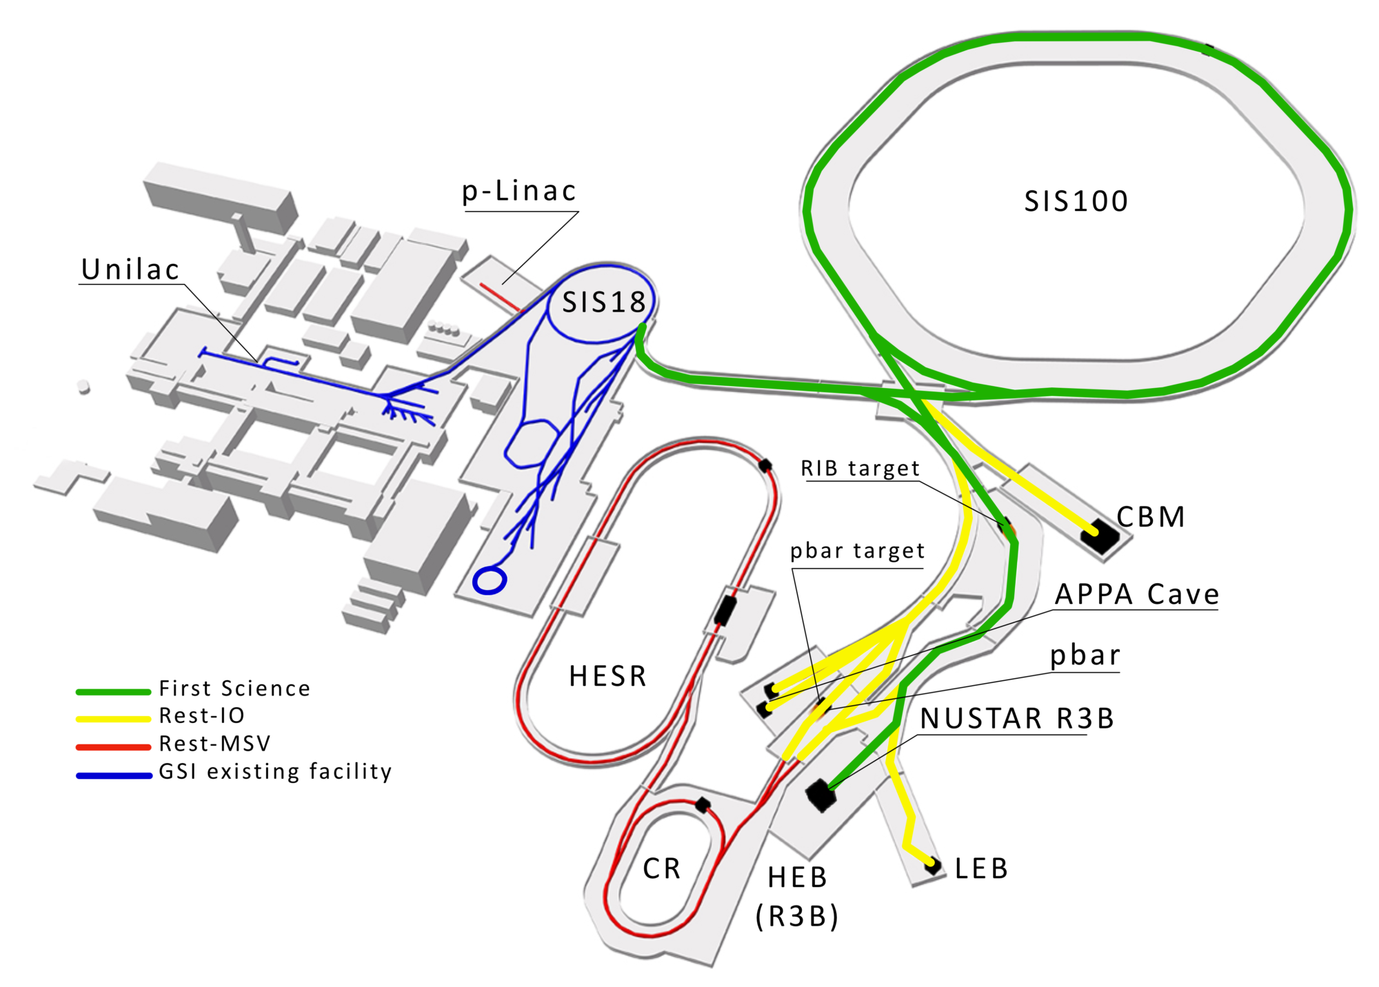
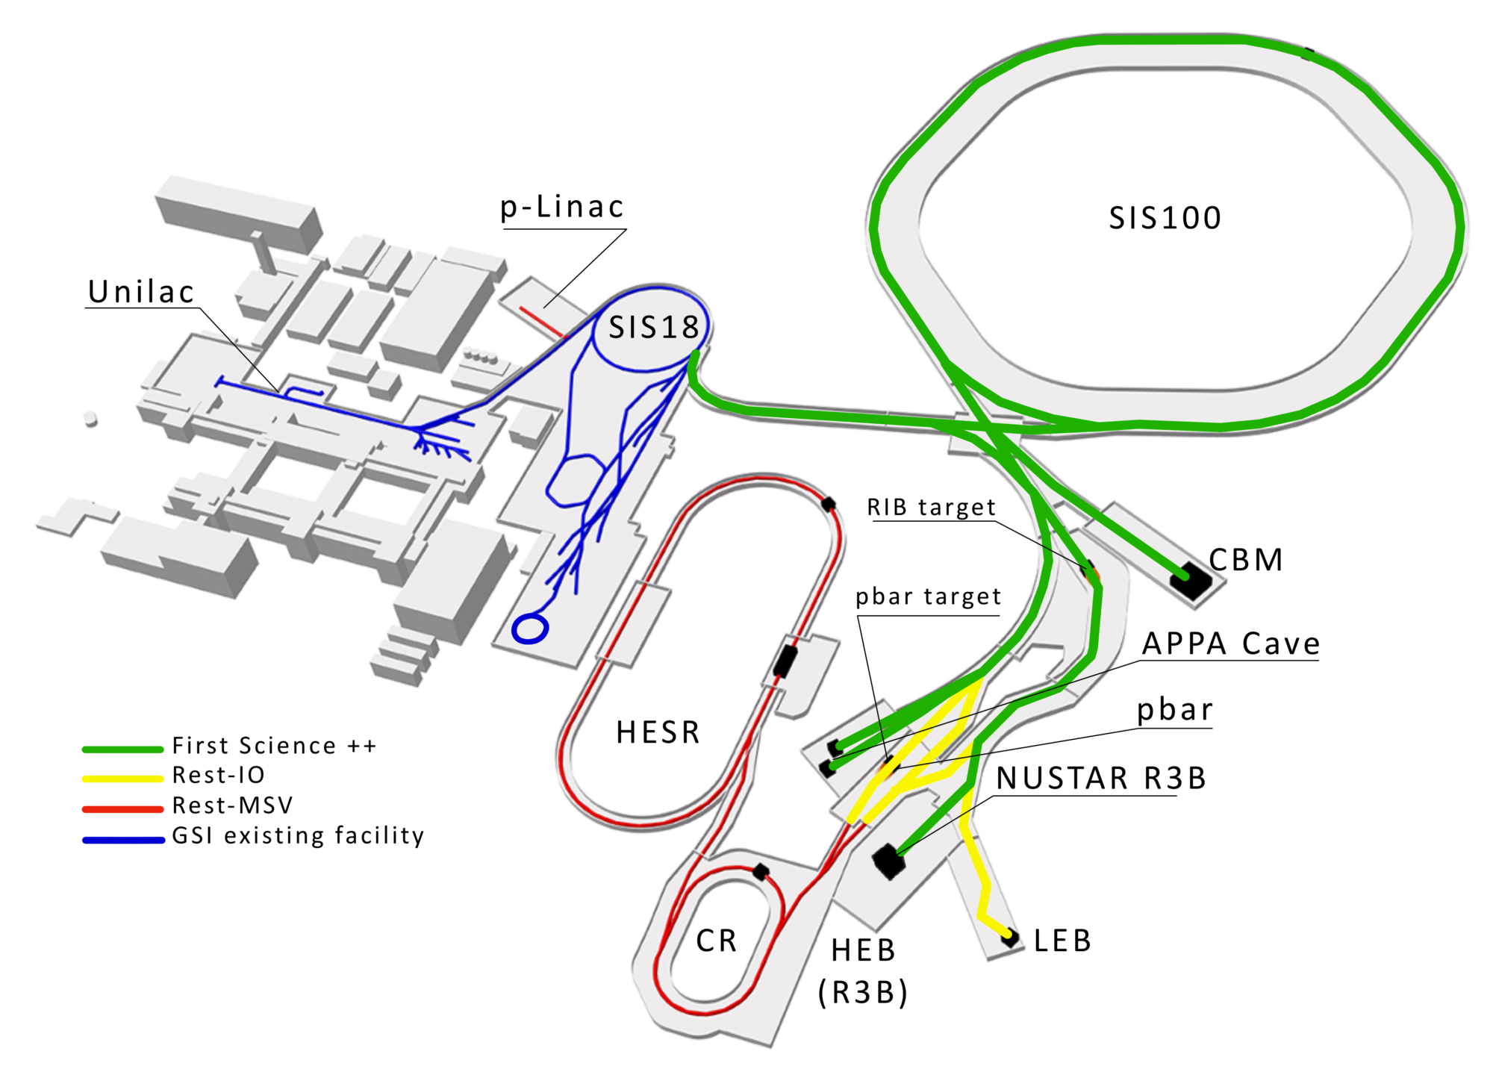
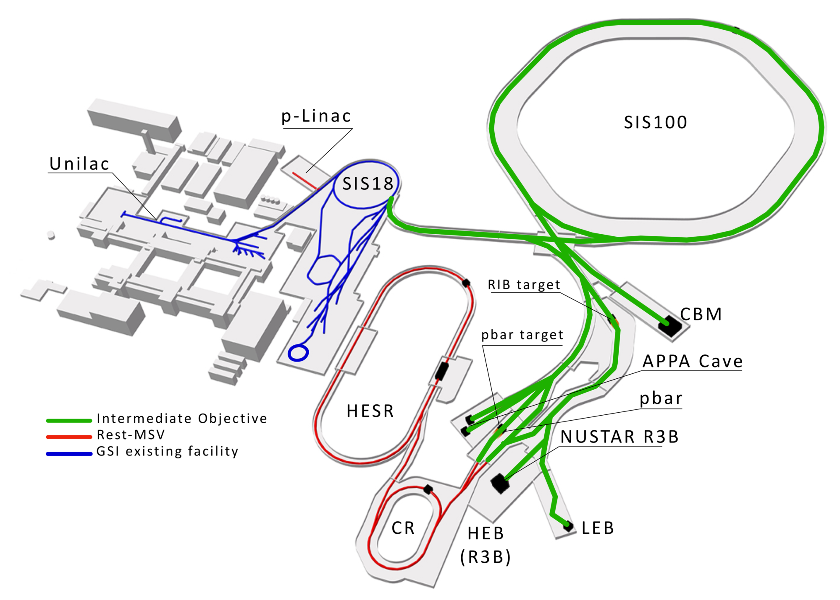
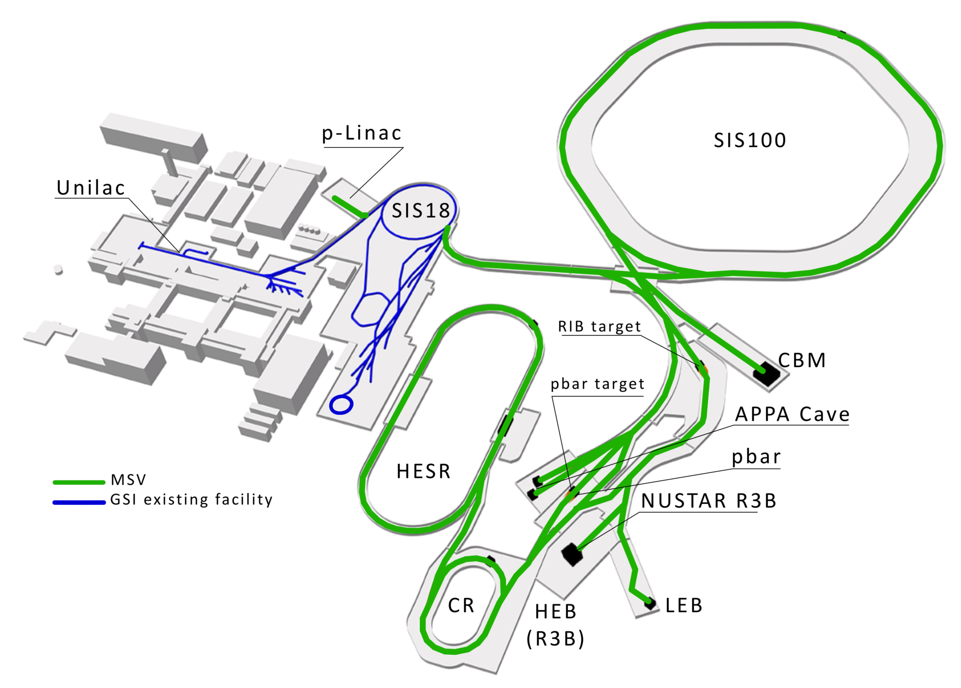
FAIR stepwise approach towards IO and MSV
Early Science
First Science
First Science +
First Science ++
Intermediate Objective
Modulare Startversion

Slide 20
Situation with Russia
Decisions by FAIR Council in September 2022:
Decision 1:
Collaboration contracts (exception JINR contract) with Russia will be terminated or declared void as per EU sanctions latest by 10. Oct. 2022 following the legal assessment.
Decision 2:
JINR contract is not falling under the EU sanction regime as per the legal assessment. FAIR will apply for the related export permit to BAFA immediately.
In case of a positive statement by BAFA FAIR will contact JINR to reactivate contract execution.
FAIR will present a plan for alternative manufacturing possibilities as a risk mitigation in case the production with JINR will fail. This plan will be decided latest in the FAIR Council meeting December 2022.
Decision 3:
All assignments (contracted and not yet contracted) to Russia are revoked and are with FAIR.

Slide 21
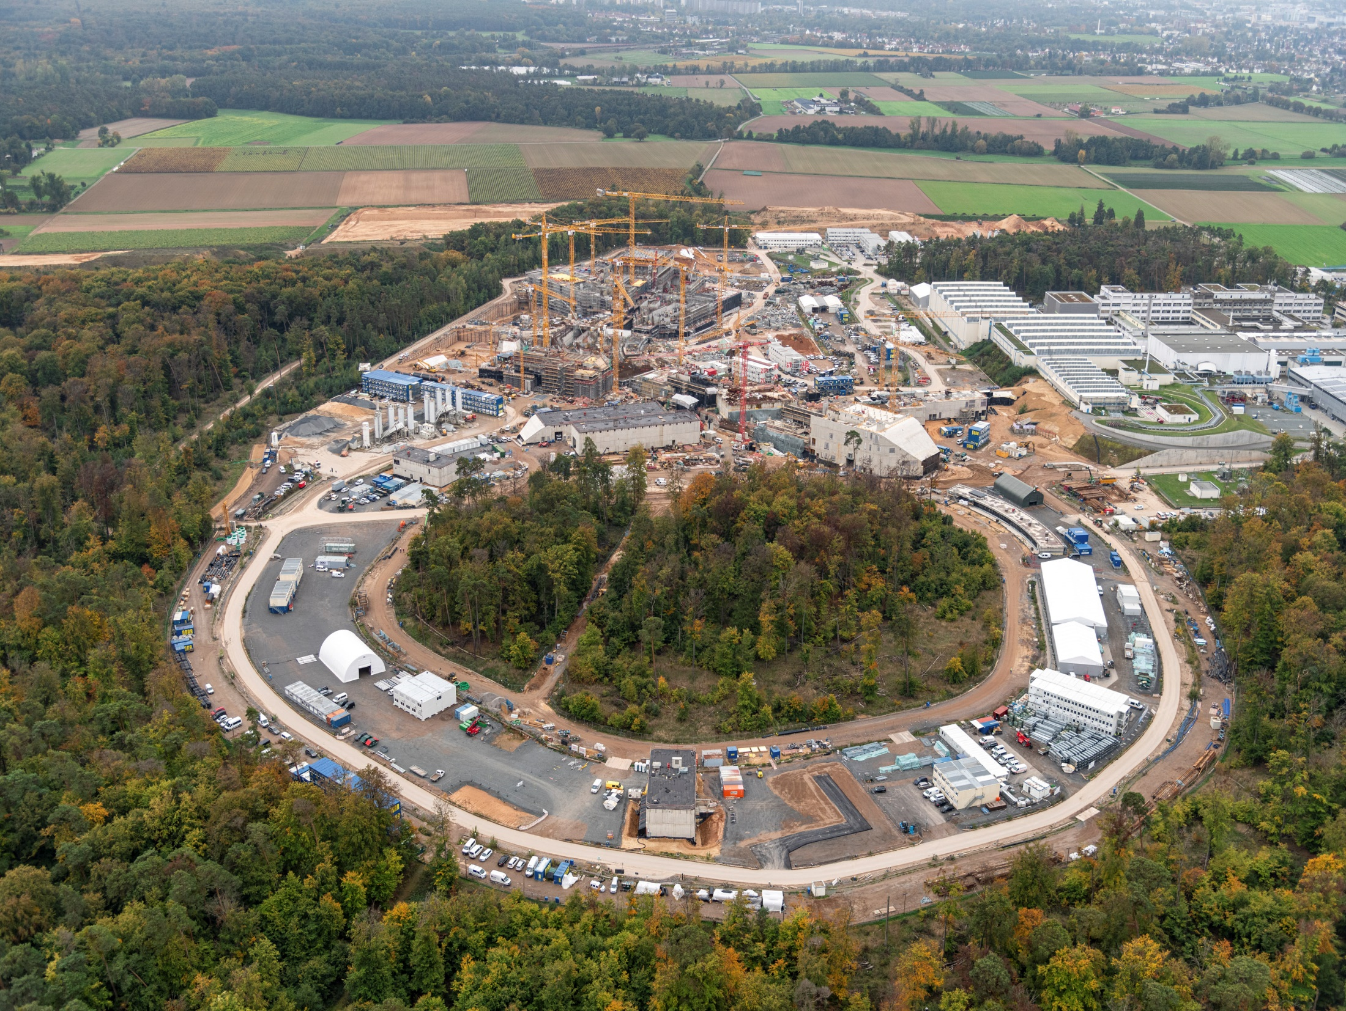
FAIR in construction
November 2022

Slide 22
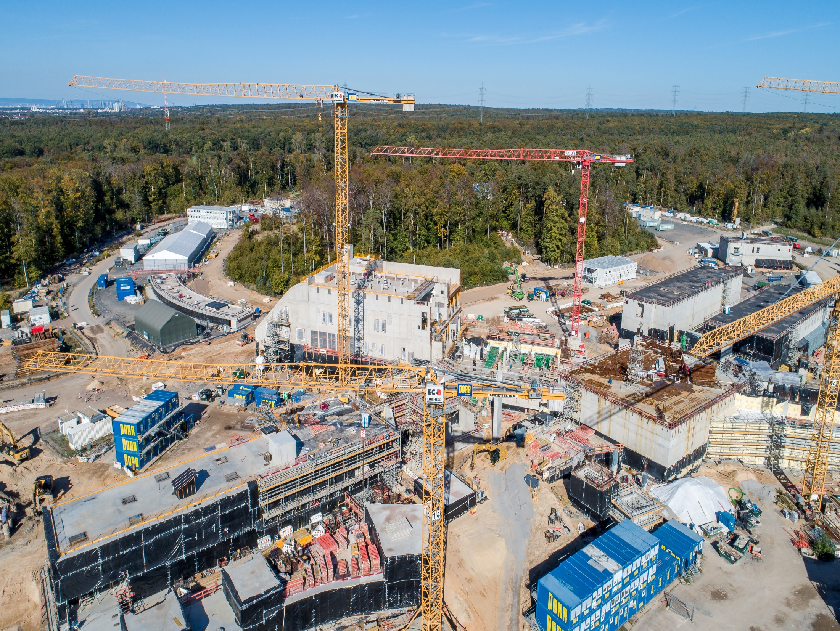
FAIR in construction
Area North – SIS100
November 2022

Slide 23
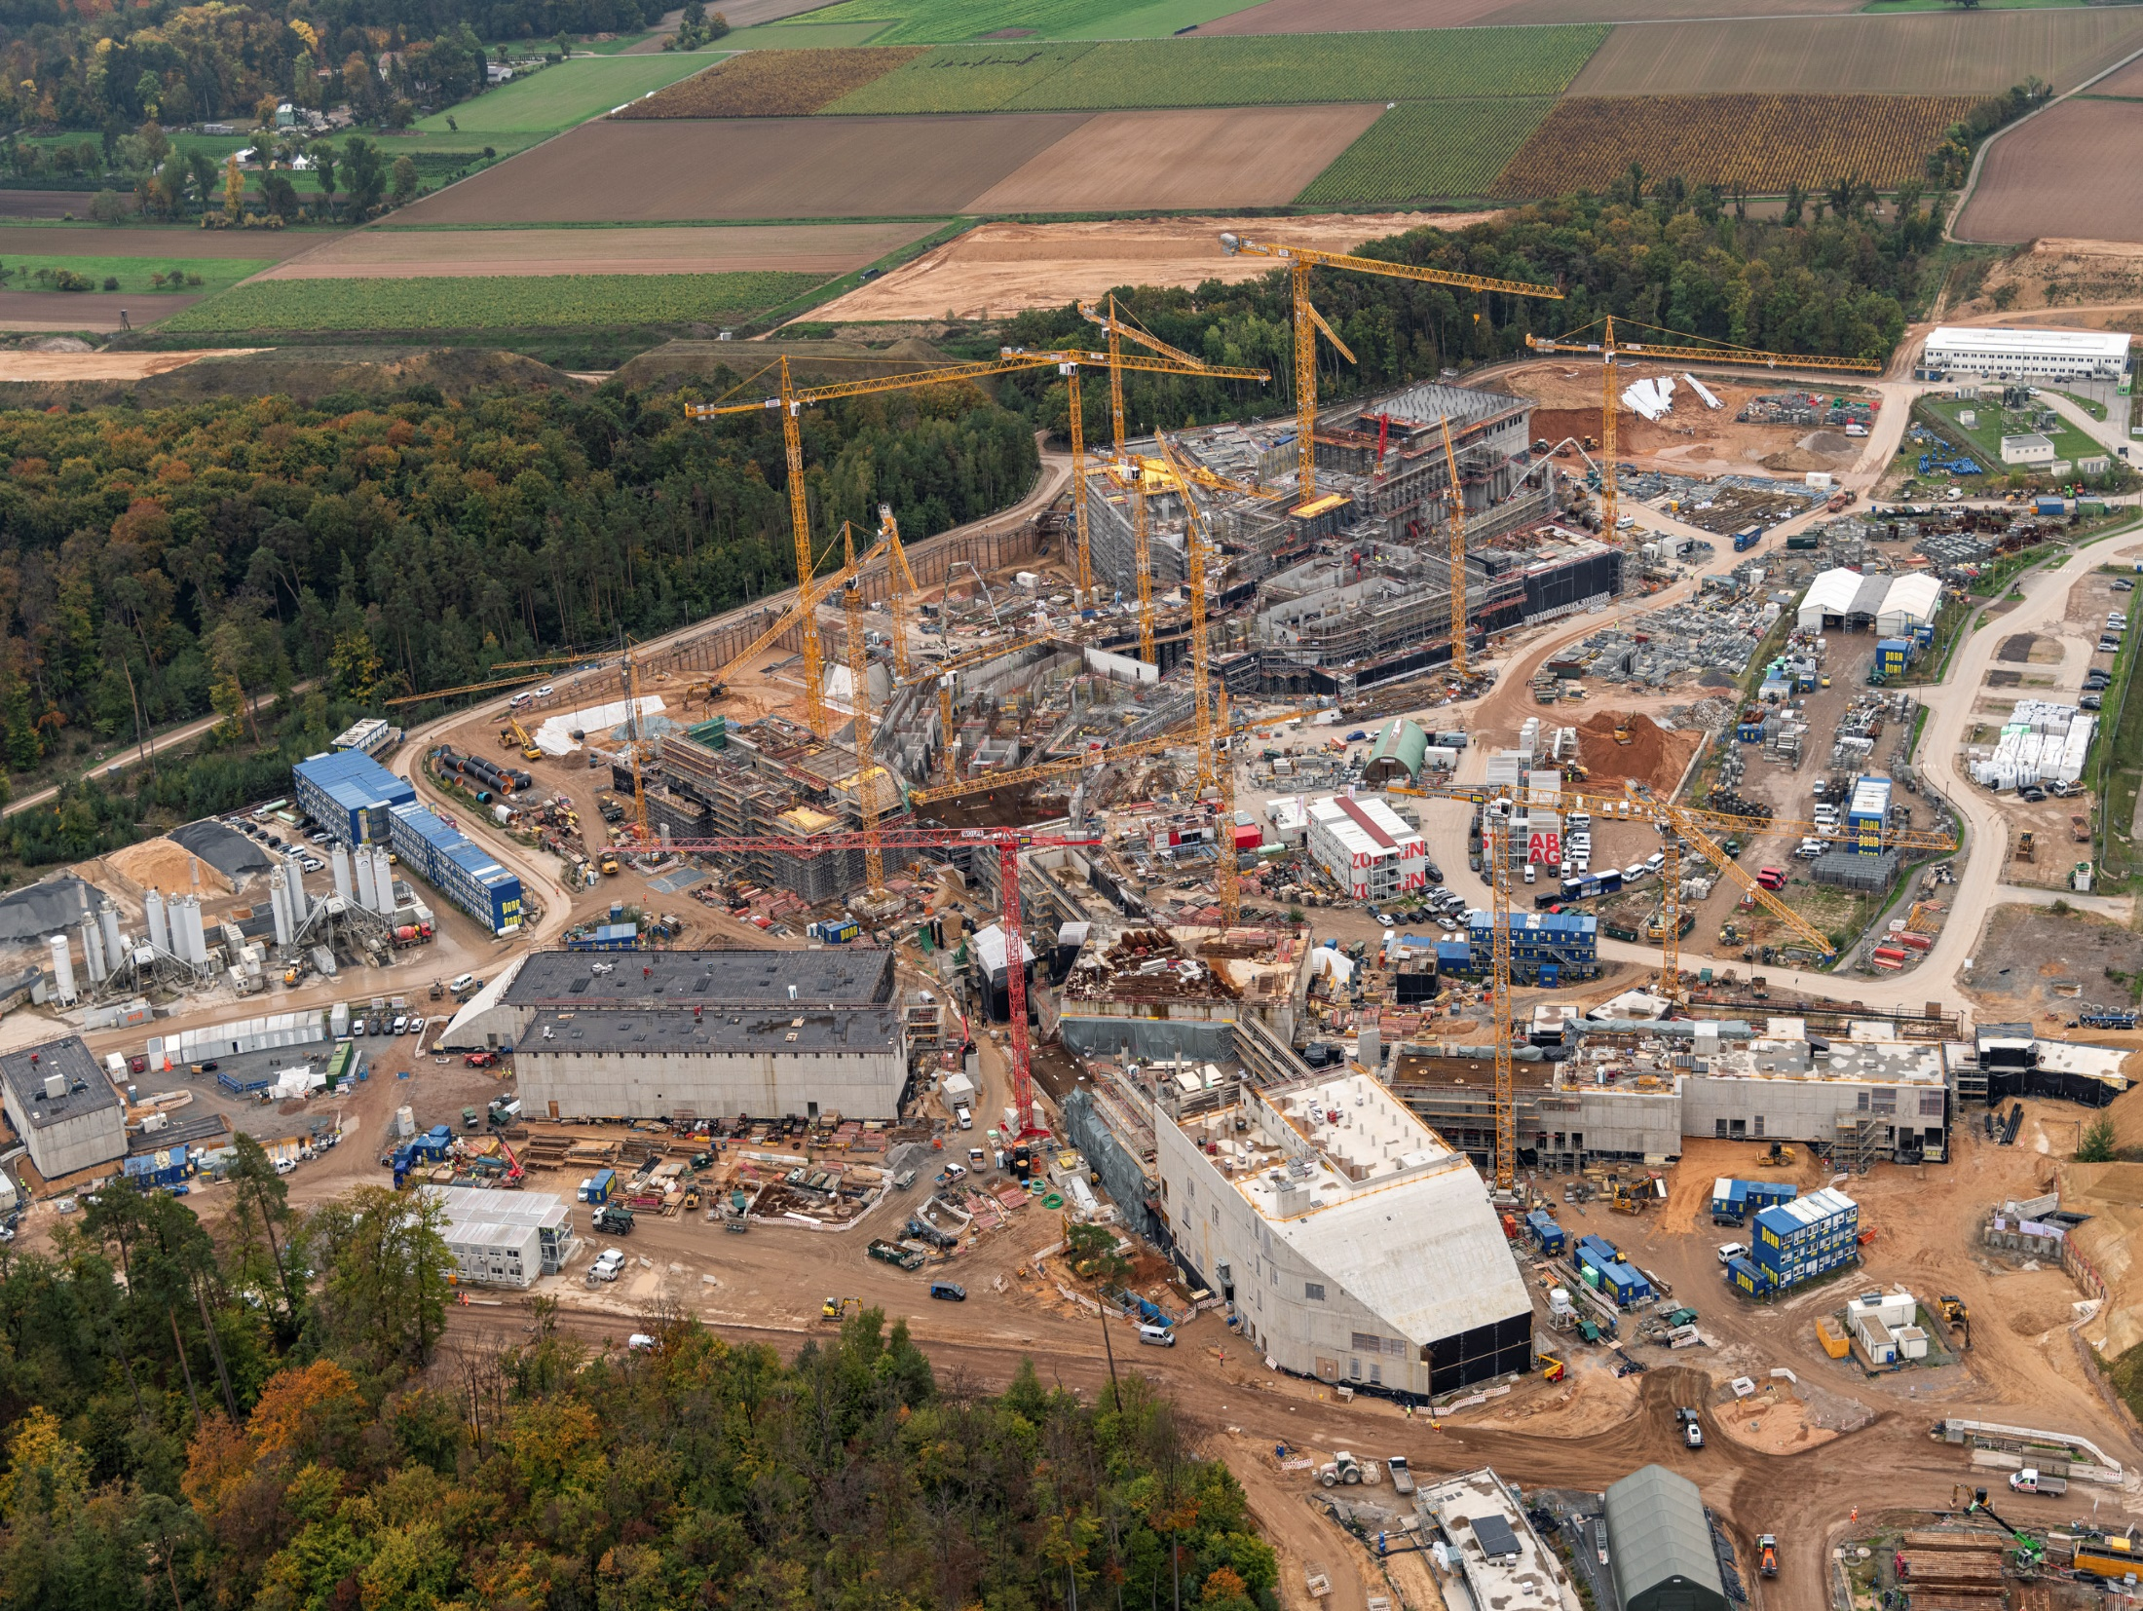
FAIR in construction
Experimental Buildings
November 2022

Slide 24
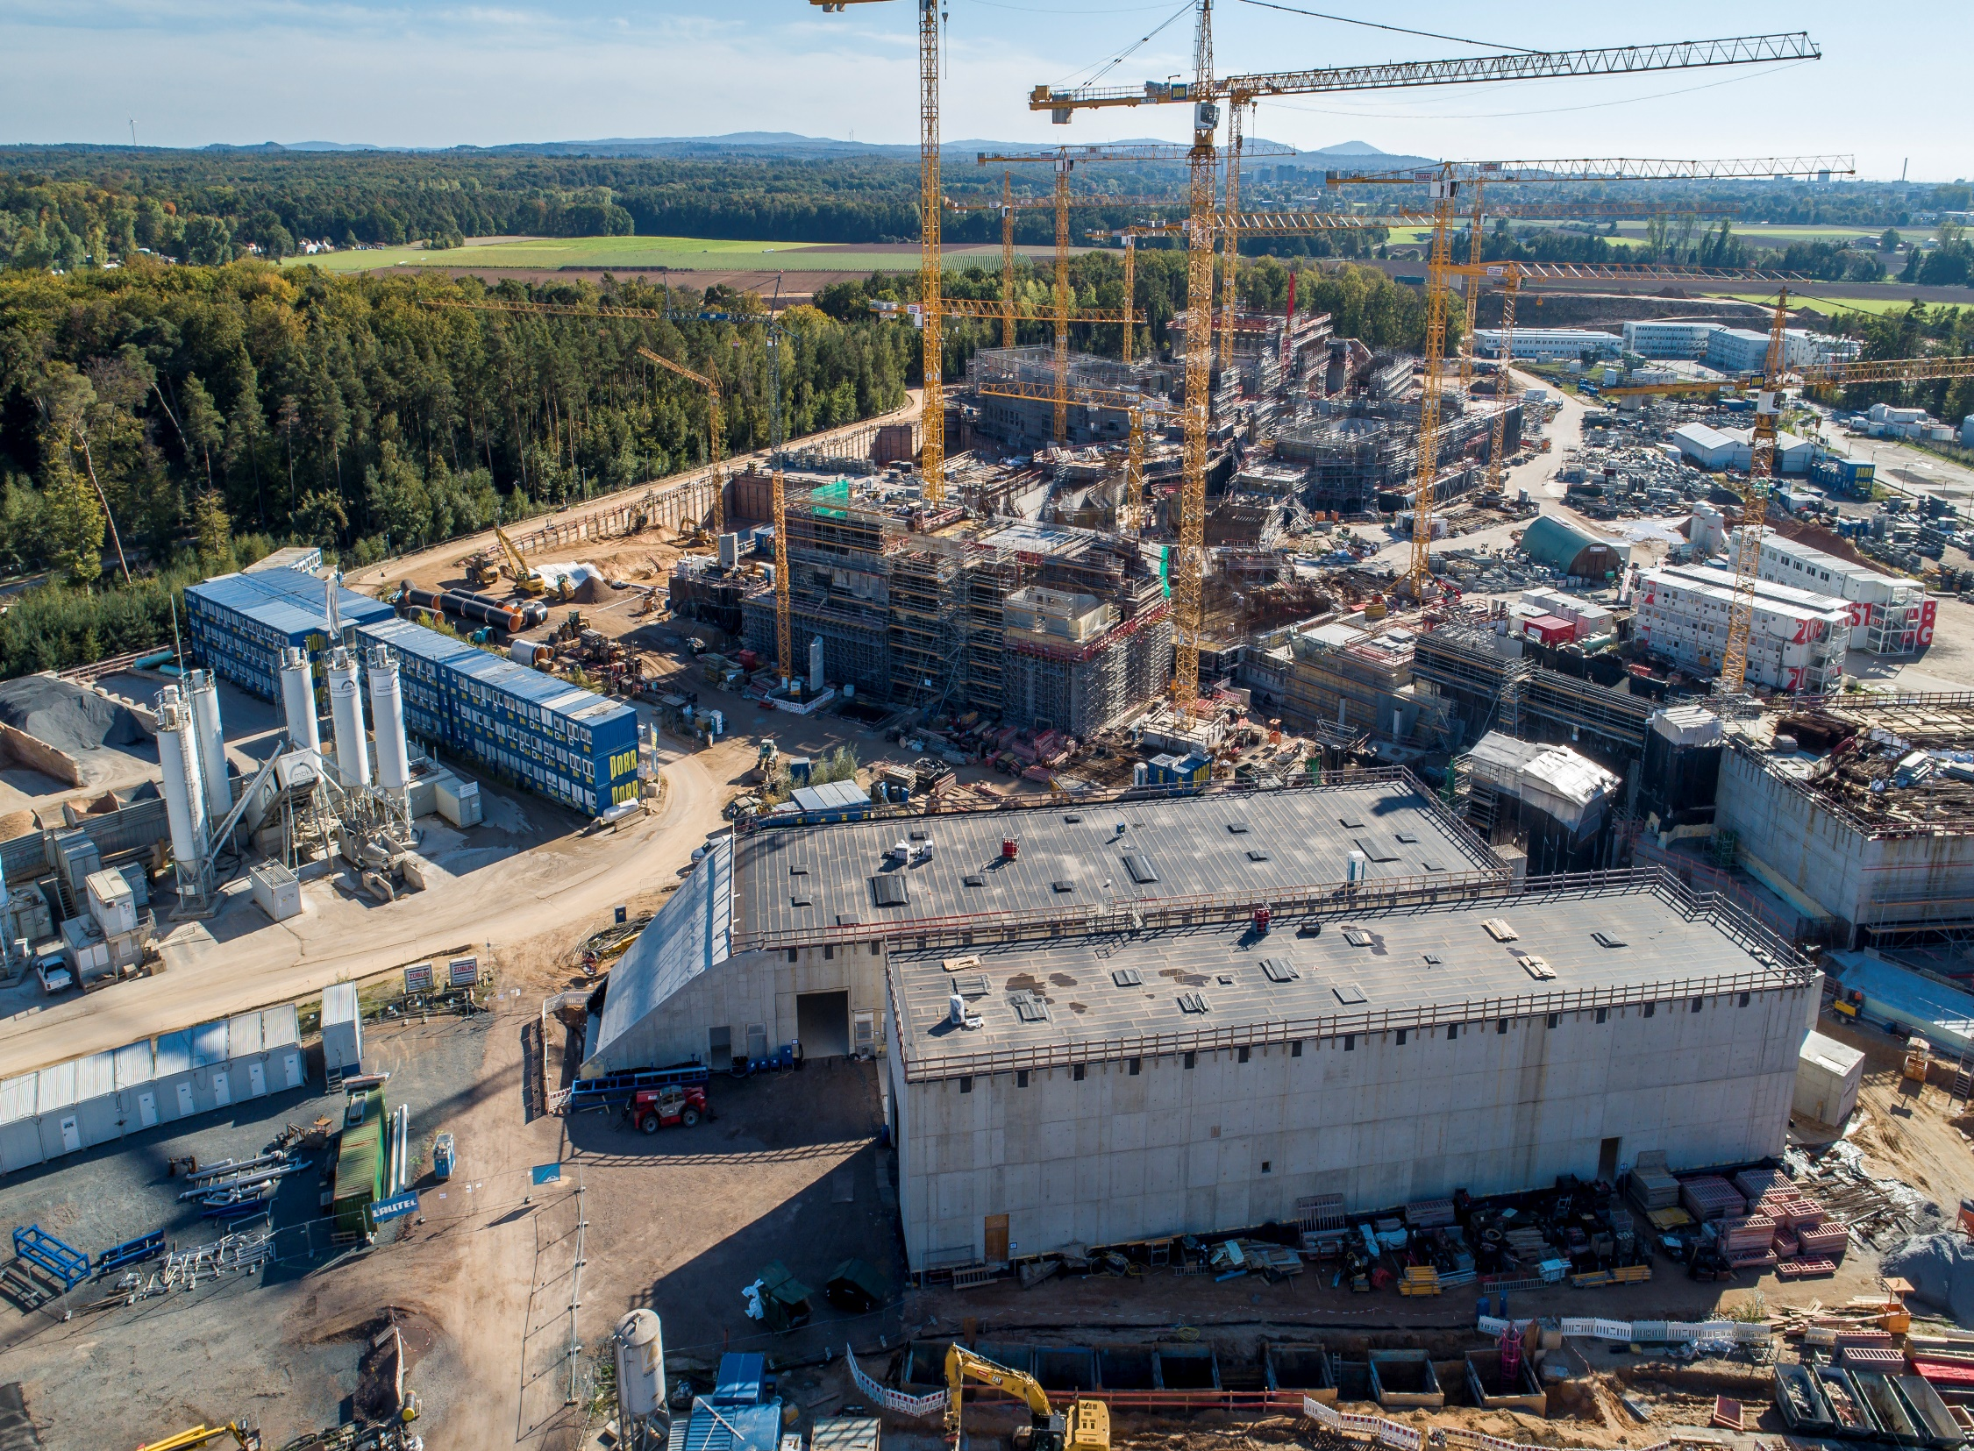
FAIR in construction
November 2022

Slide 25
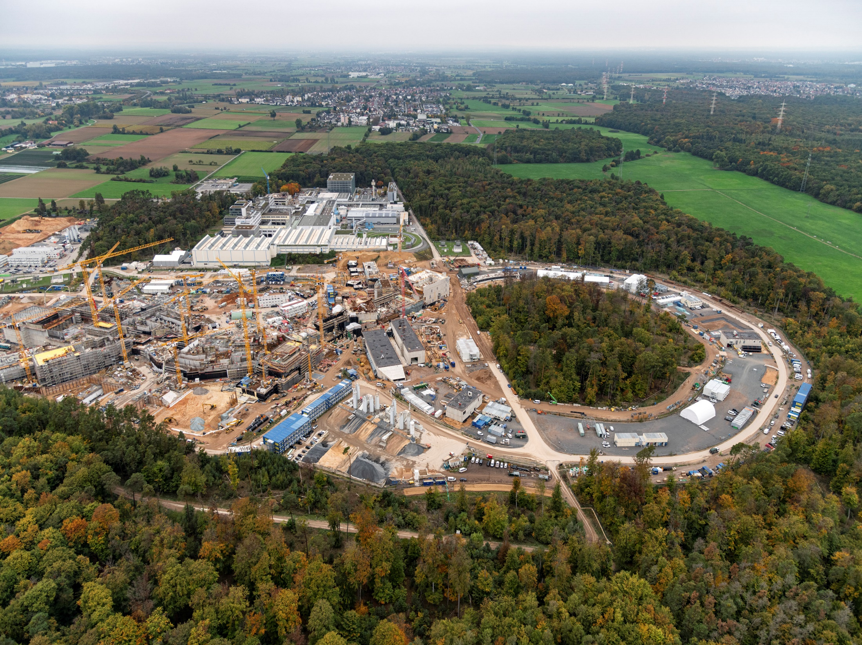
FAIR in construction
November 2022

Slide 26
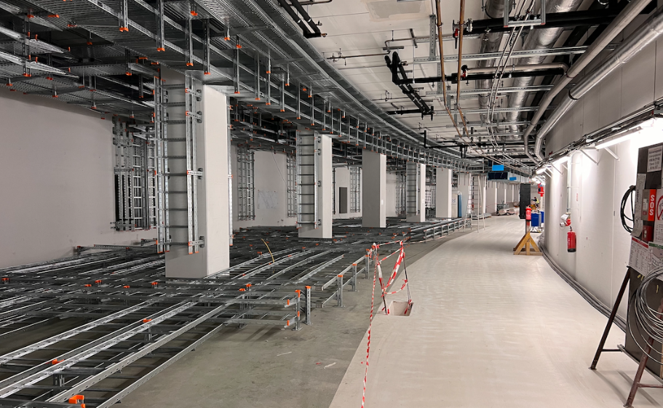
FAIR in construction
October 2022

Slide 27
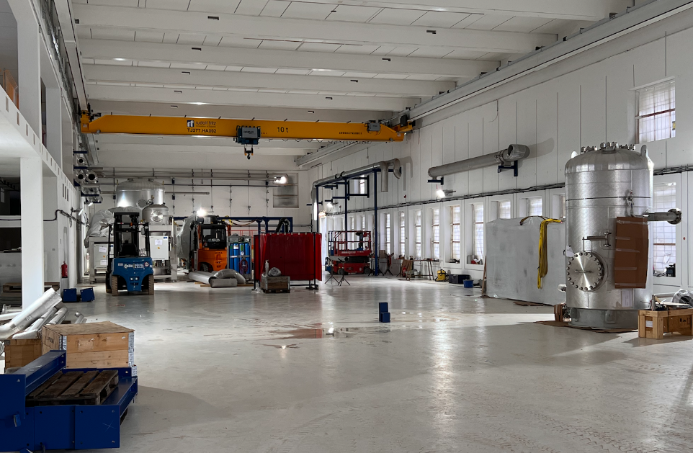
FAIR in construction
October 2022

Slide 28
Thank you for your attention !

