Slide 1
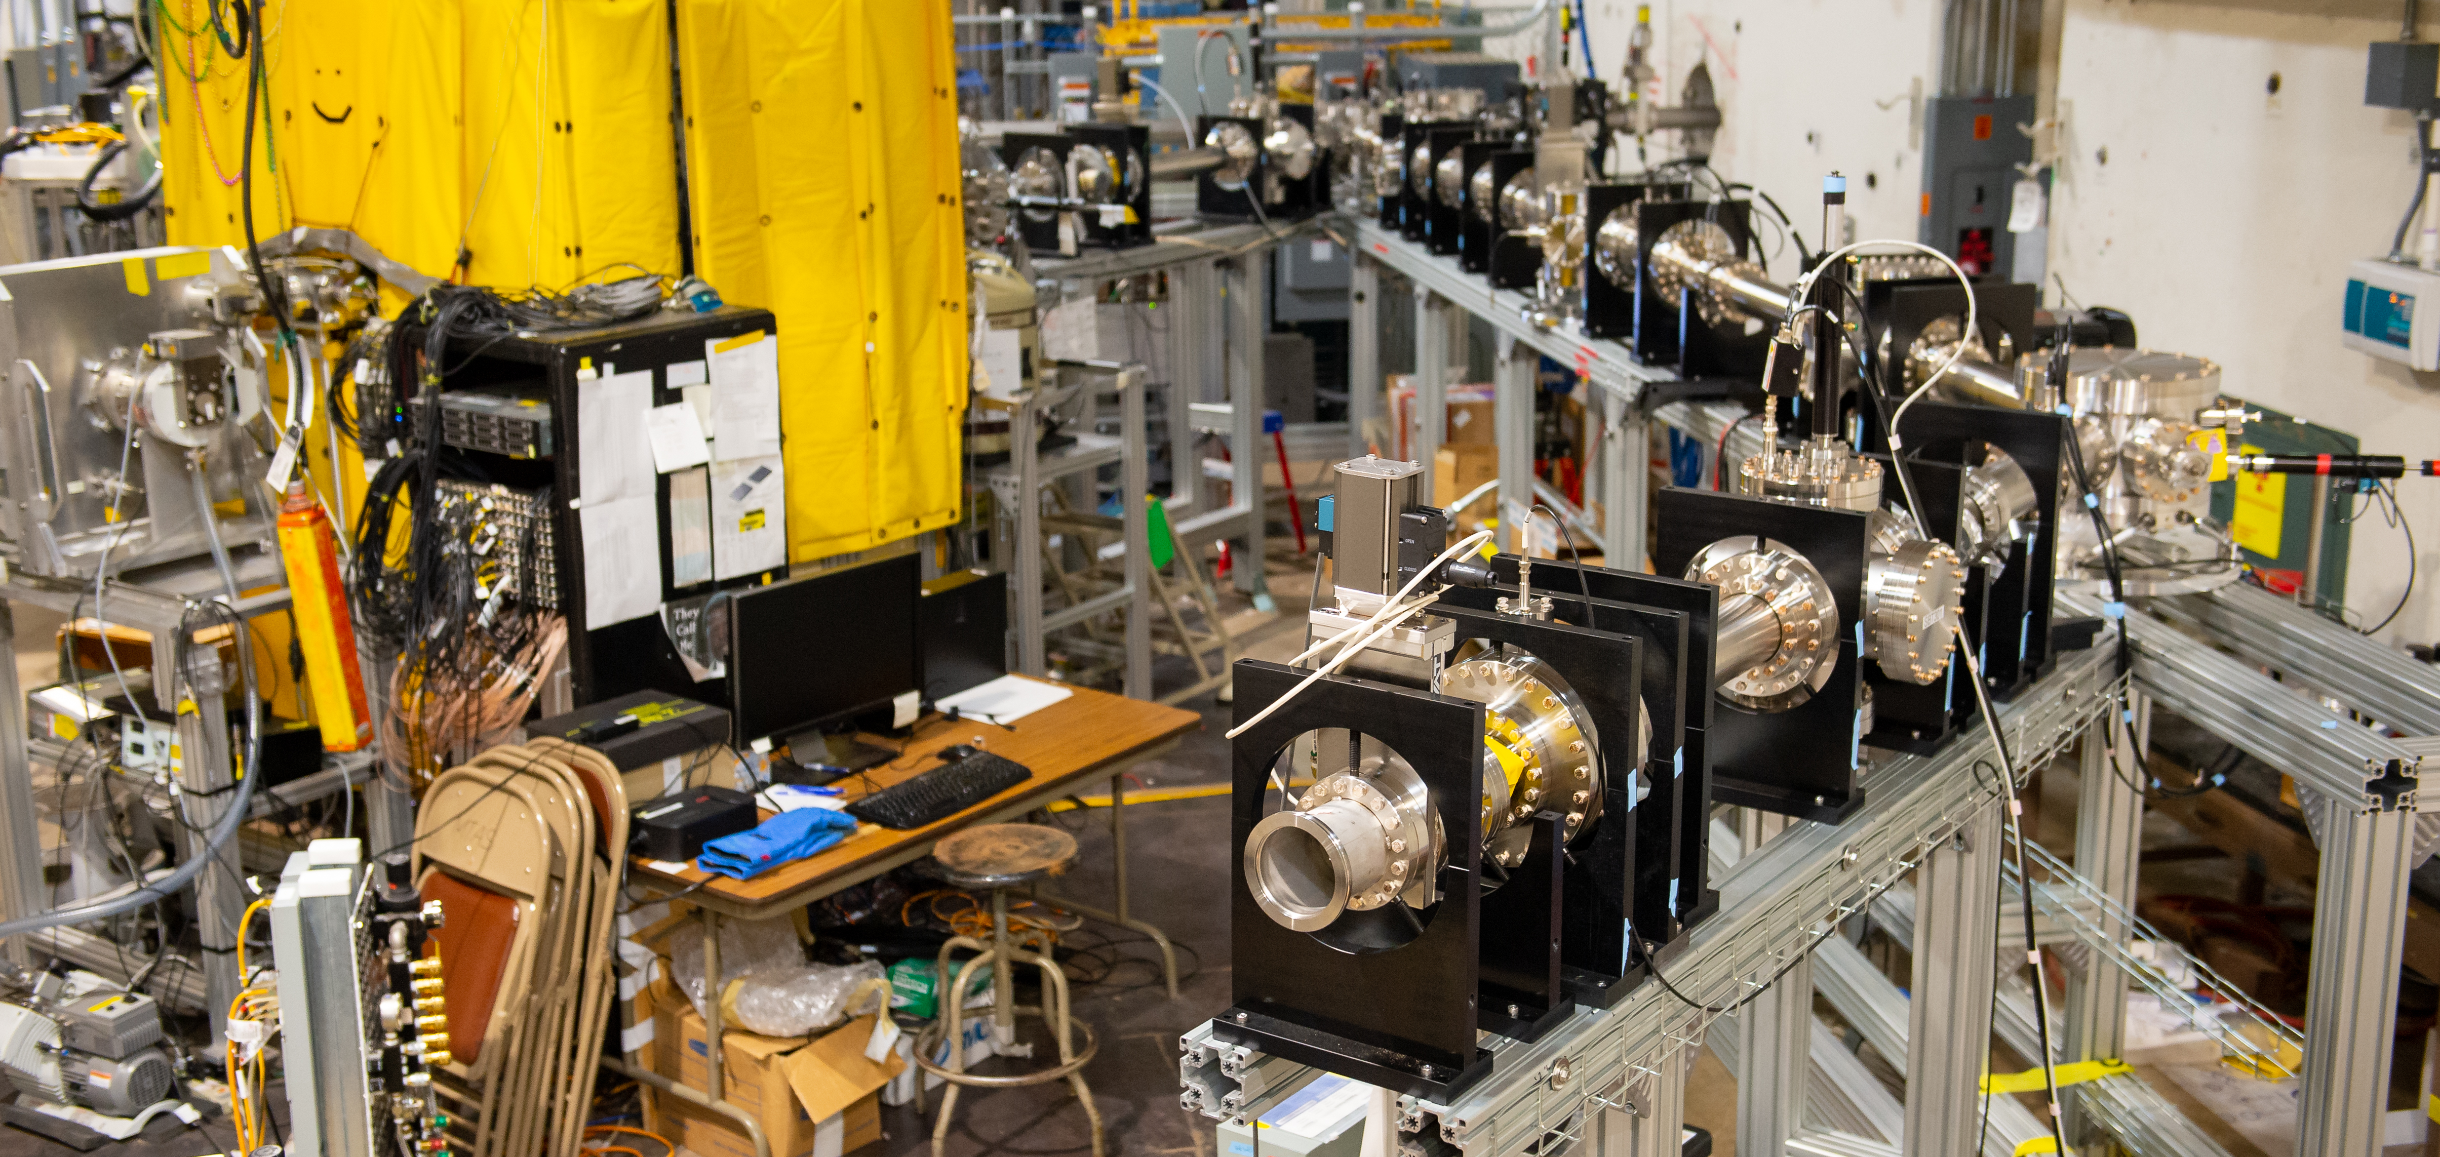
Past, present, and future of Argonne’s caribu facility
erhtjhtyhy
Jason Clark
Physics Division
Argonne National Laboratory
SMI-2023
May 8-11, 2023

Slide 2
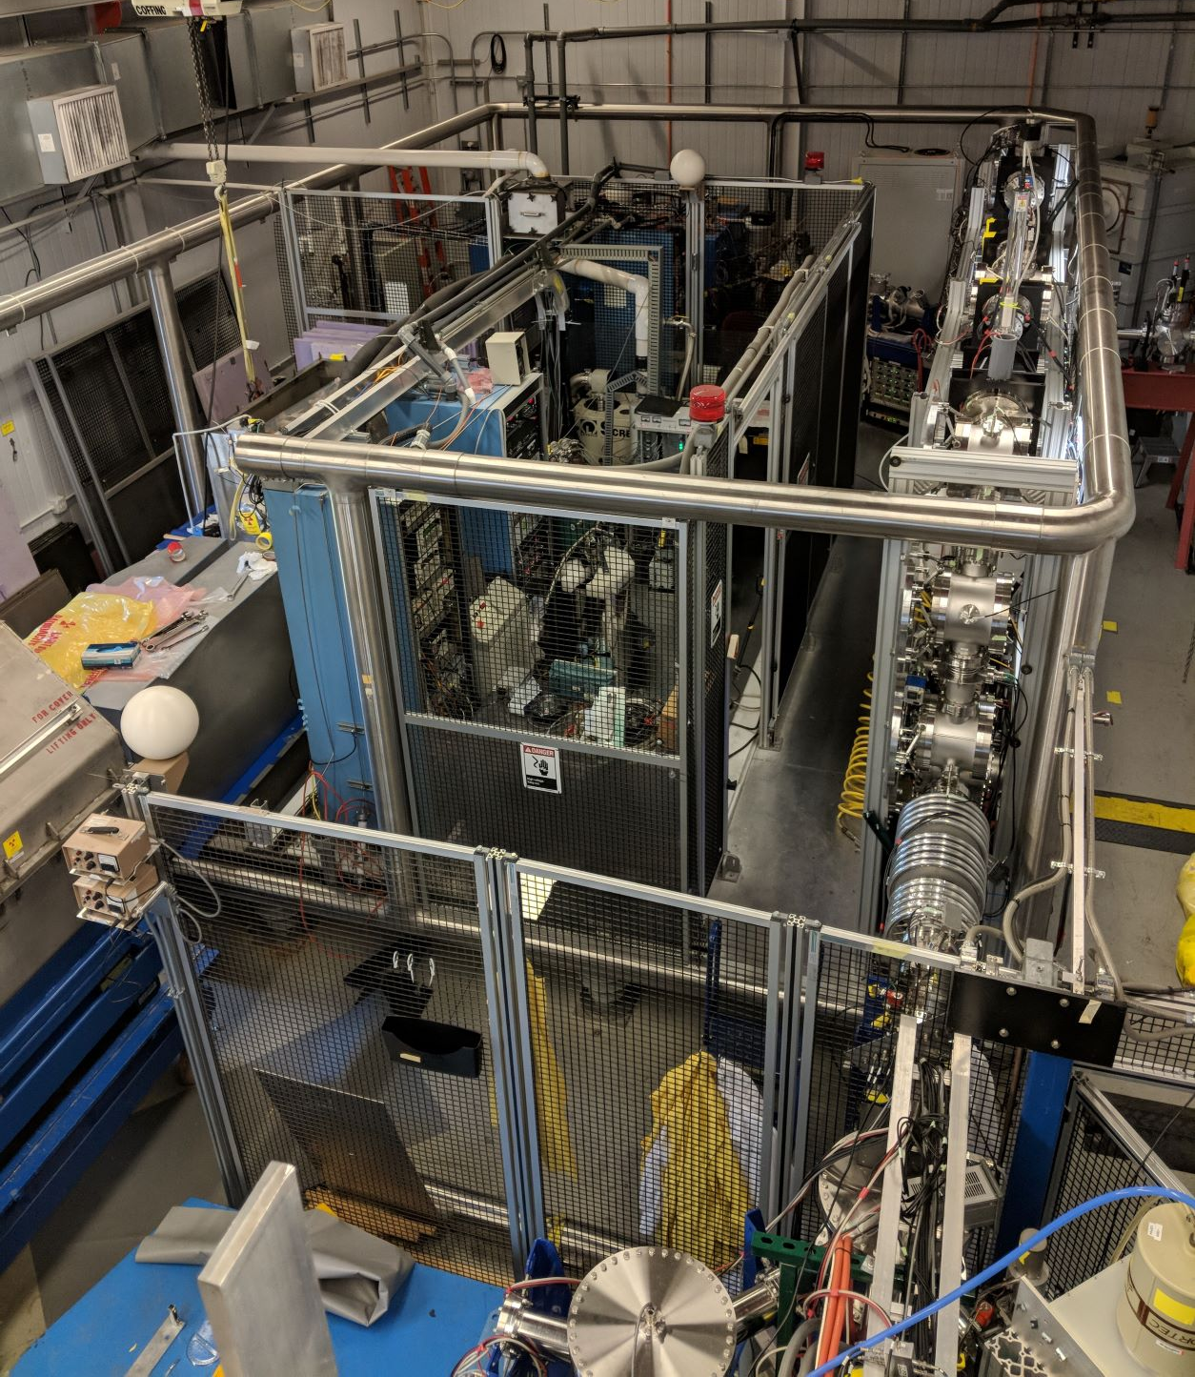
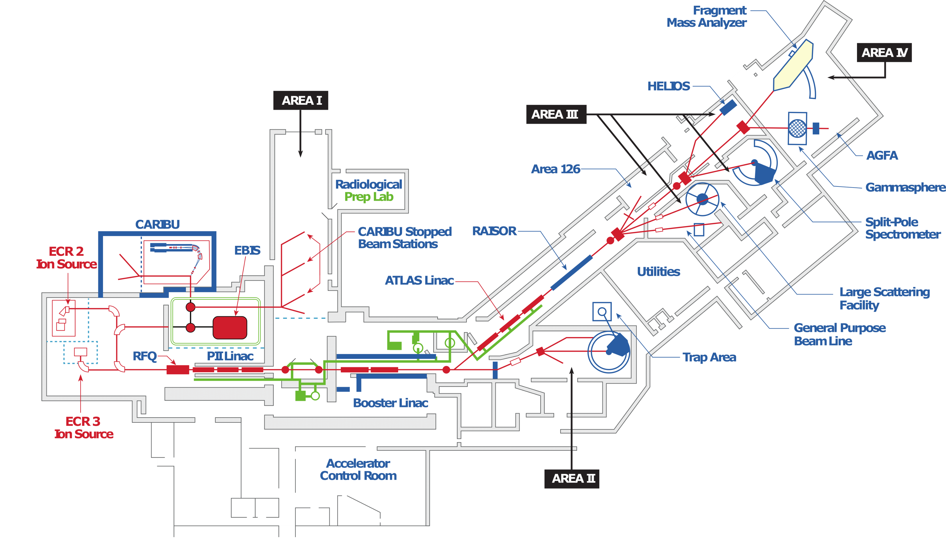
The caribu facility OF ATLAS at Argonne
CAlifornium (²⁵²Cf) Rare Isotope Breeder Upgrade (CARIBU) facility of ATLAS at Argonne National Laboratory
Provides unique neutron-rich beams using a ²⁵²Cf fission source
Delivering unique beams for 10+ years

Slide 3
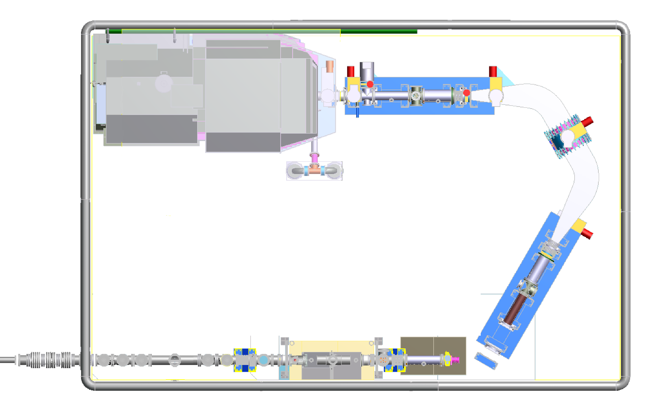
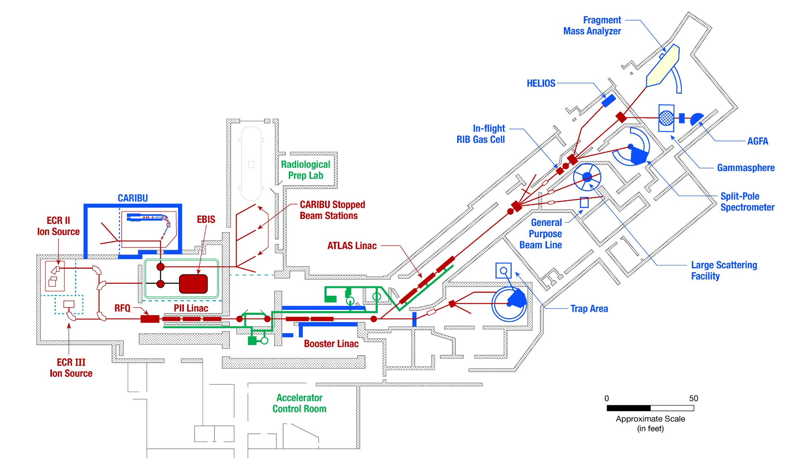
The CARIBU Facility of ATLAS at Argonne
Basic properties of fission fragments can be measured with instruments in ‘stopped’ beam area
Pure beams delivered to large experimental area with low background
Clean CARIBU beams can be accelerated through ATLAS to ~ 15 MeV/u
3

Slide 4
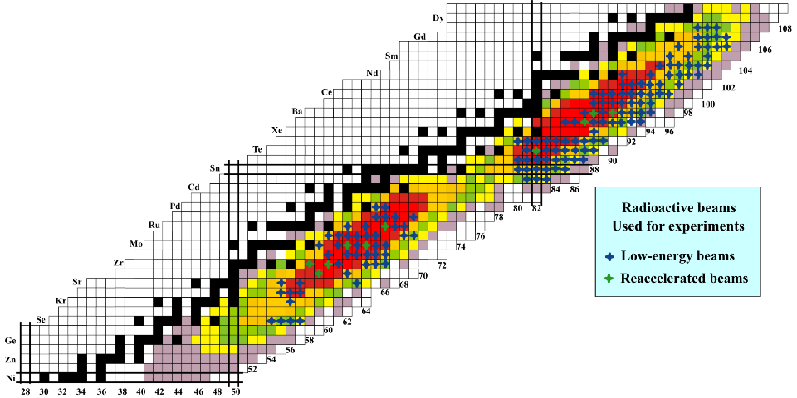
CARIBU beams delivered to experiments
Production of neutron-rich isotopes through fission (²⁵²Cf spontaneous fission source)
²⁵²Cf source properties:
  3% fission branch
  2.6 year half-life
  ~ 1 Ci (40 billions decays / s )

Slide 5
Layout of the caribu facility
Gas catcher (collect fission fragments)
Isobar separator (select specific fragment) R ~ 10,000
~1 Ci ²⁵²Cf source
MR-TOF (high-resolution mass separation) R ~ 100,000
Buncher (transforms continuous CARIBU beam into pulsed beam)
5

Slide 6
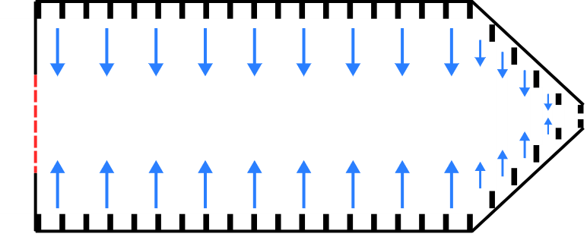
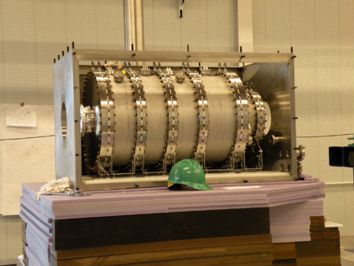
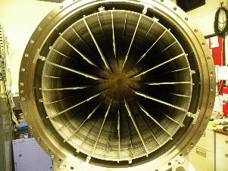
Gas catcher
+
-
+
-
rf electric fields
ultrapure He gas
DC voltage gradient
²⁵²Cf fission
fragments
~50 Torr He Gas
rf electric field
DC gradient and gas flow
gas flow
Thermalized fission fragments at q = 1+, 2+
6

Slide 7
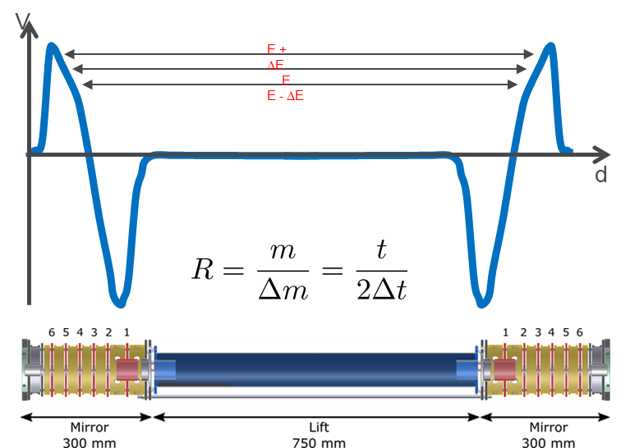
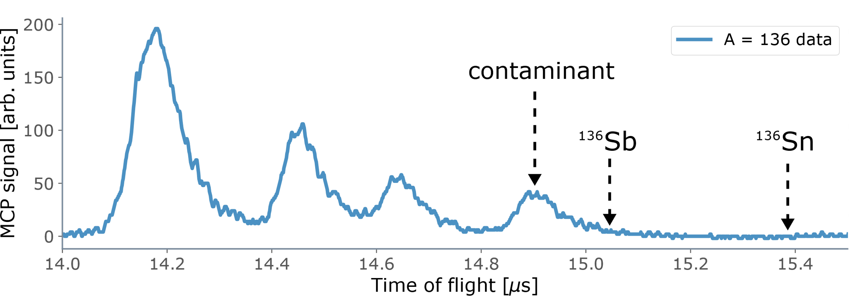
Multi-reflection time-of-flight (MR-TOF)
Ion bunches enter and bounce inside the potentials created by the two ion mirrors with a cycle time described by: 𝑡∝√(𝑚∕𝑞).
Fast (~10 ms), simple, high resolution (R ~ 100,000) isobar separator.
  Can be used for mass measurements or for isobaric suppression
¹³⁶Xe
10ms cycle, R~100,000
¹³⁶I
¹³⁶Te

Slide 8
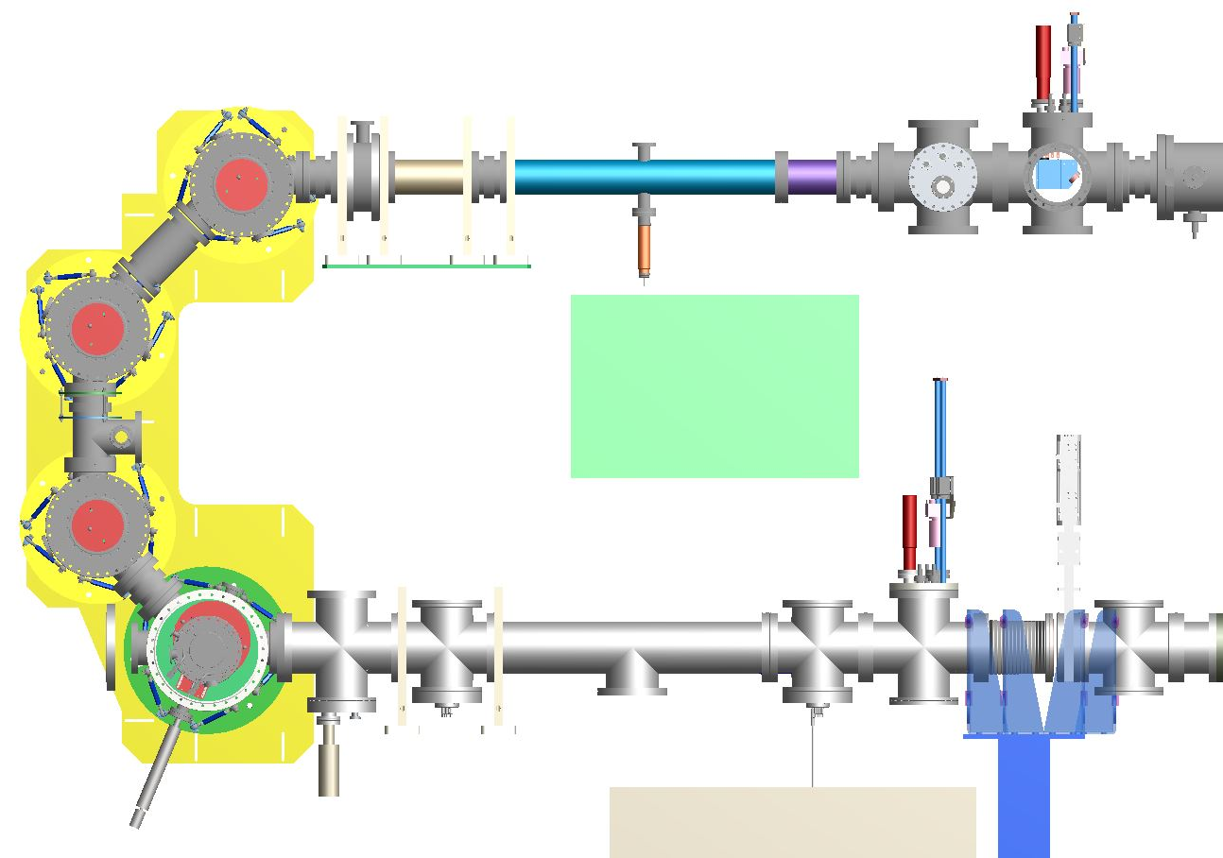
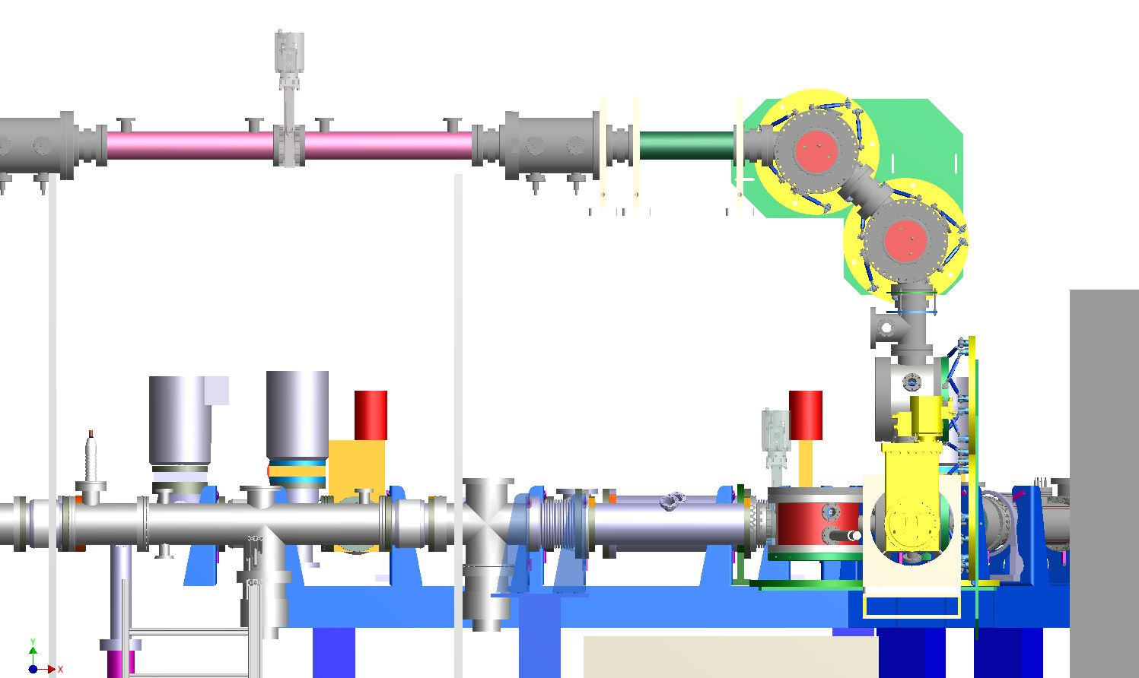
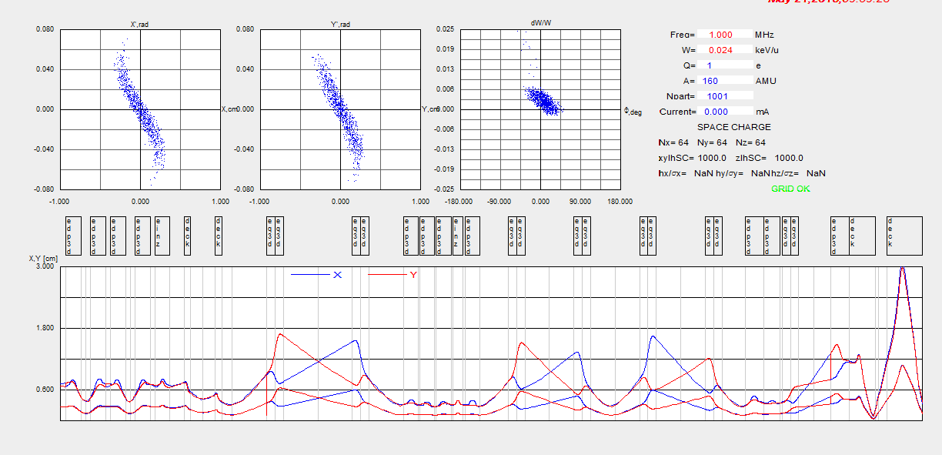
Delivery of caribu beams
2-step accelerator
Courtesy Al Barcikowski
To EBIS
From CARIBU
MR-TOF
Buncher
z
x
System must be efficient, fast, and provide clean, pulsed beams
When you run out of room in 2 dimensions …
All elements (diverters, lenses, steerers) are electrostatic and compact
Emittance growth is minimal
Courtesy Brahim Mustapha
8

Slide 9
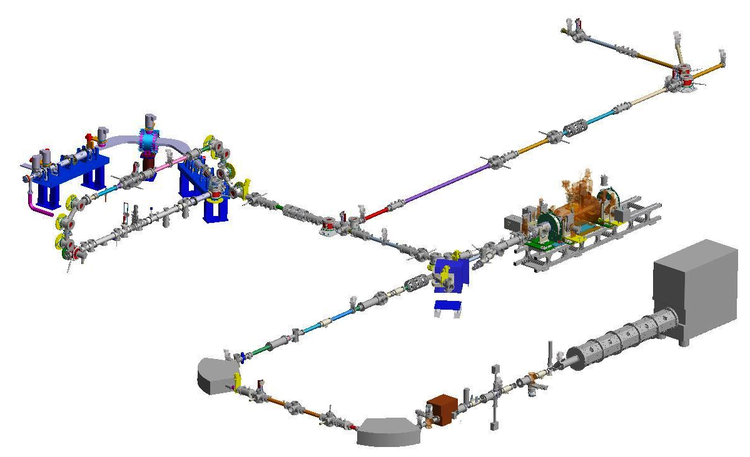
Area 1:
Caribu low-energy experimental hall
Low-energy experimental area
Low-energy experimental area takes advantage of more room and much less background (compared to experimental area in the CARIBU hall)
Beams transported to the new hall with E ~ 23keV
Isotopically pure radioactive beams provided with the MR-TOF
Experiments started moving in during 2019 and took advantage of the beams available
CARIBU isobar separator
EBIS
MR-TOF
ATLAS RFQ

Slide 10
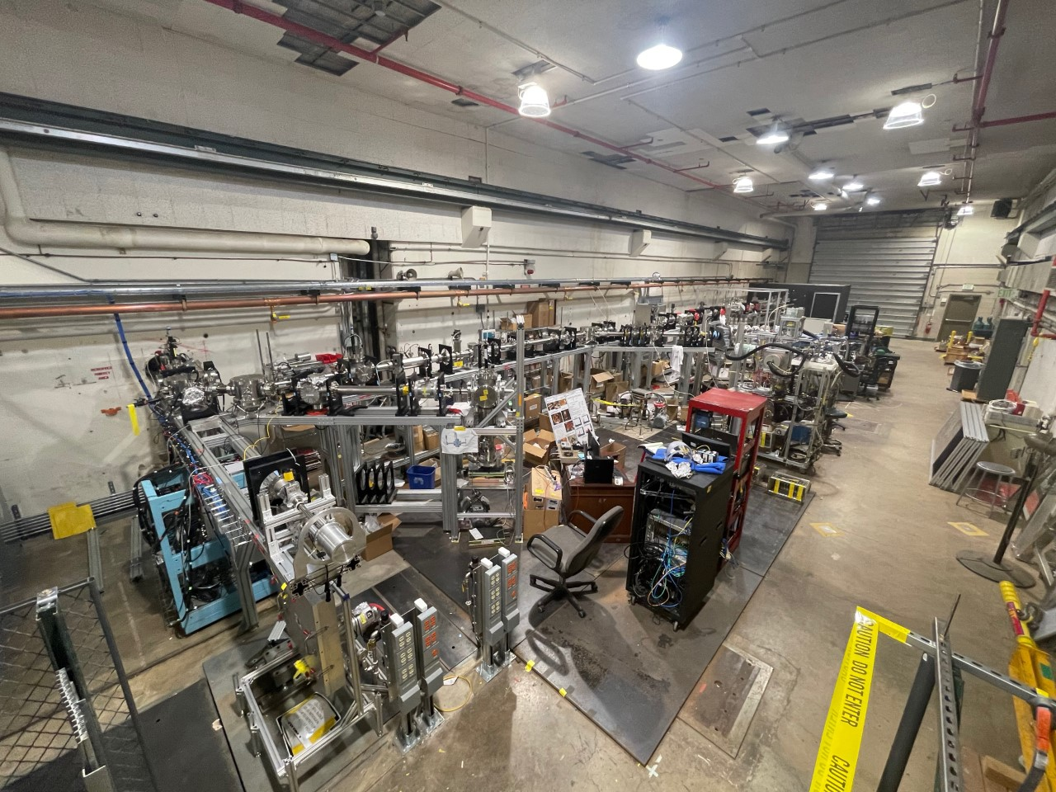
Caribu low-energy experimental hall
(‘stopped’ beam area)
Total of 8 beamlines available:
  6 pre-buncher
  2 post-buncher
Area is becoming popular, and we’re starting to run out of space already!
2019: X-array/SATURN/LACES
2020: MTAS, SuN
2022: Buncher installed, CLS
2023: BEARTRAP
2024: GAMMASPHERE

Slide 11
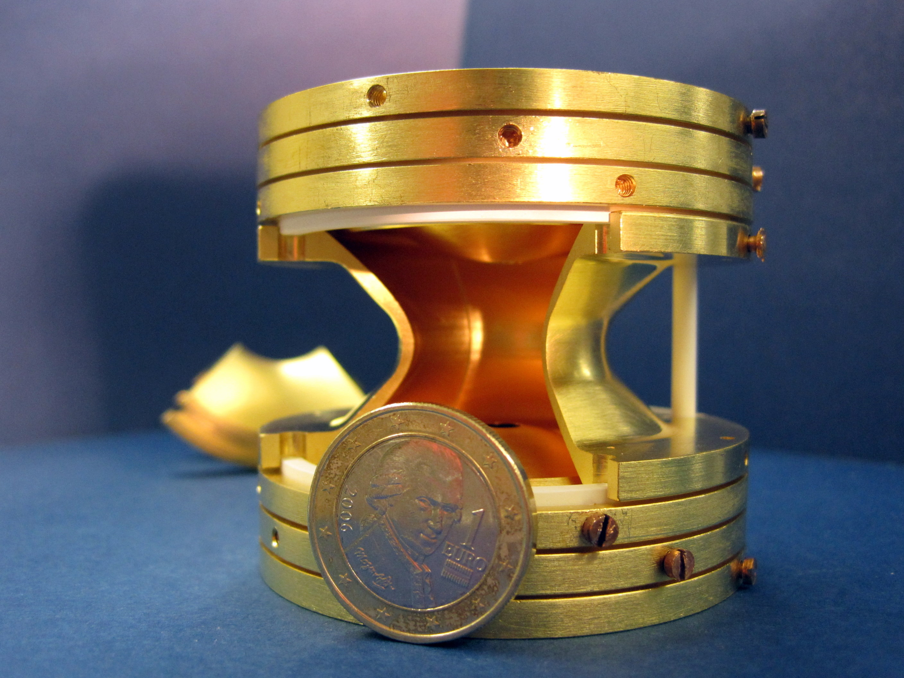
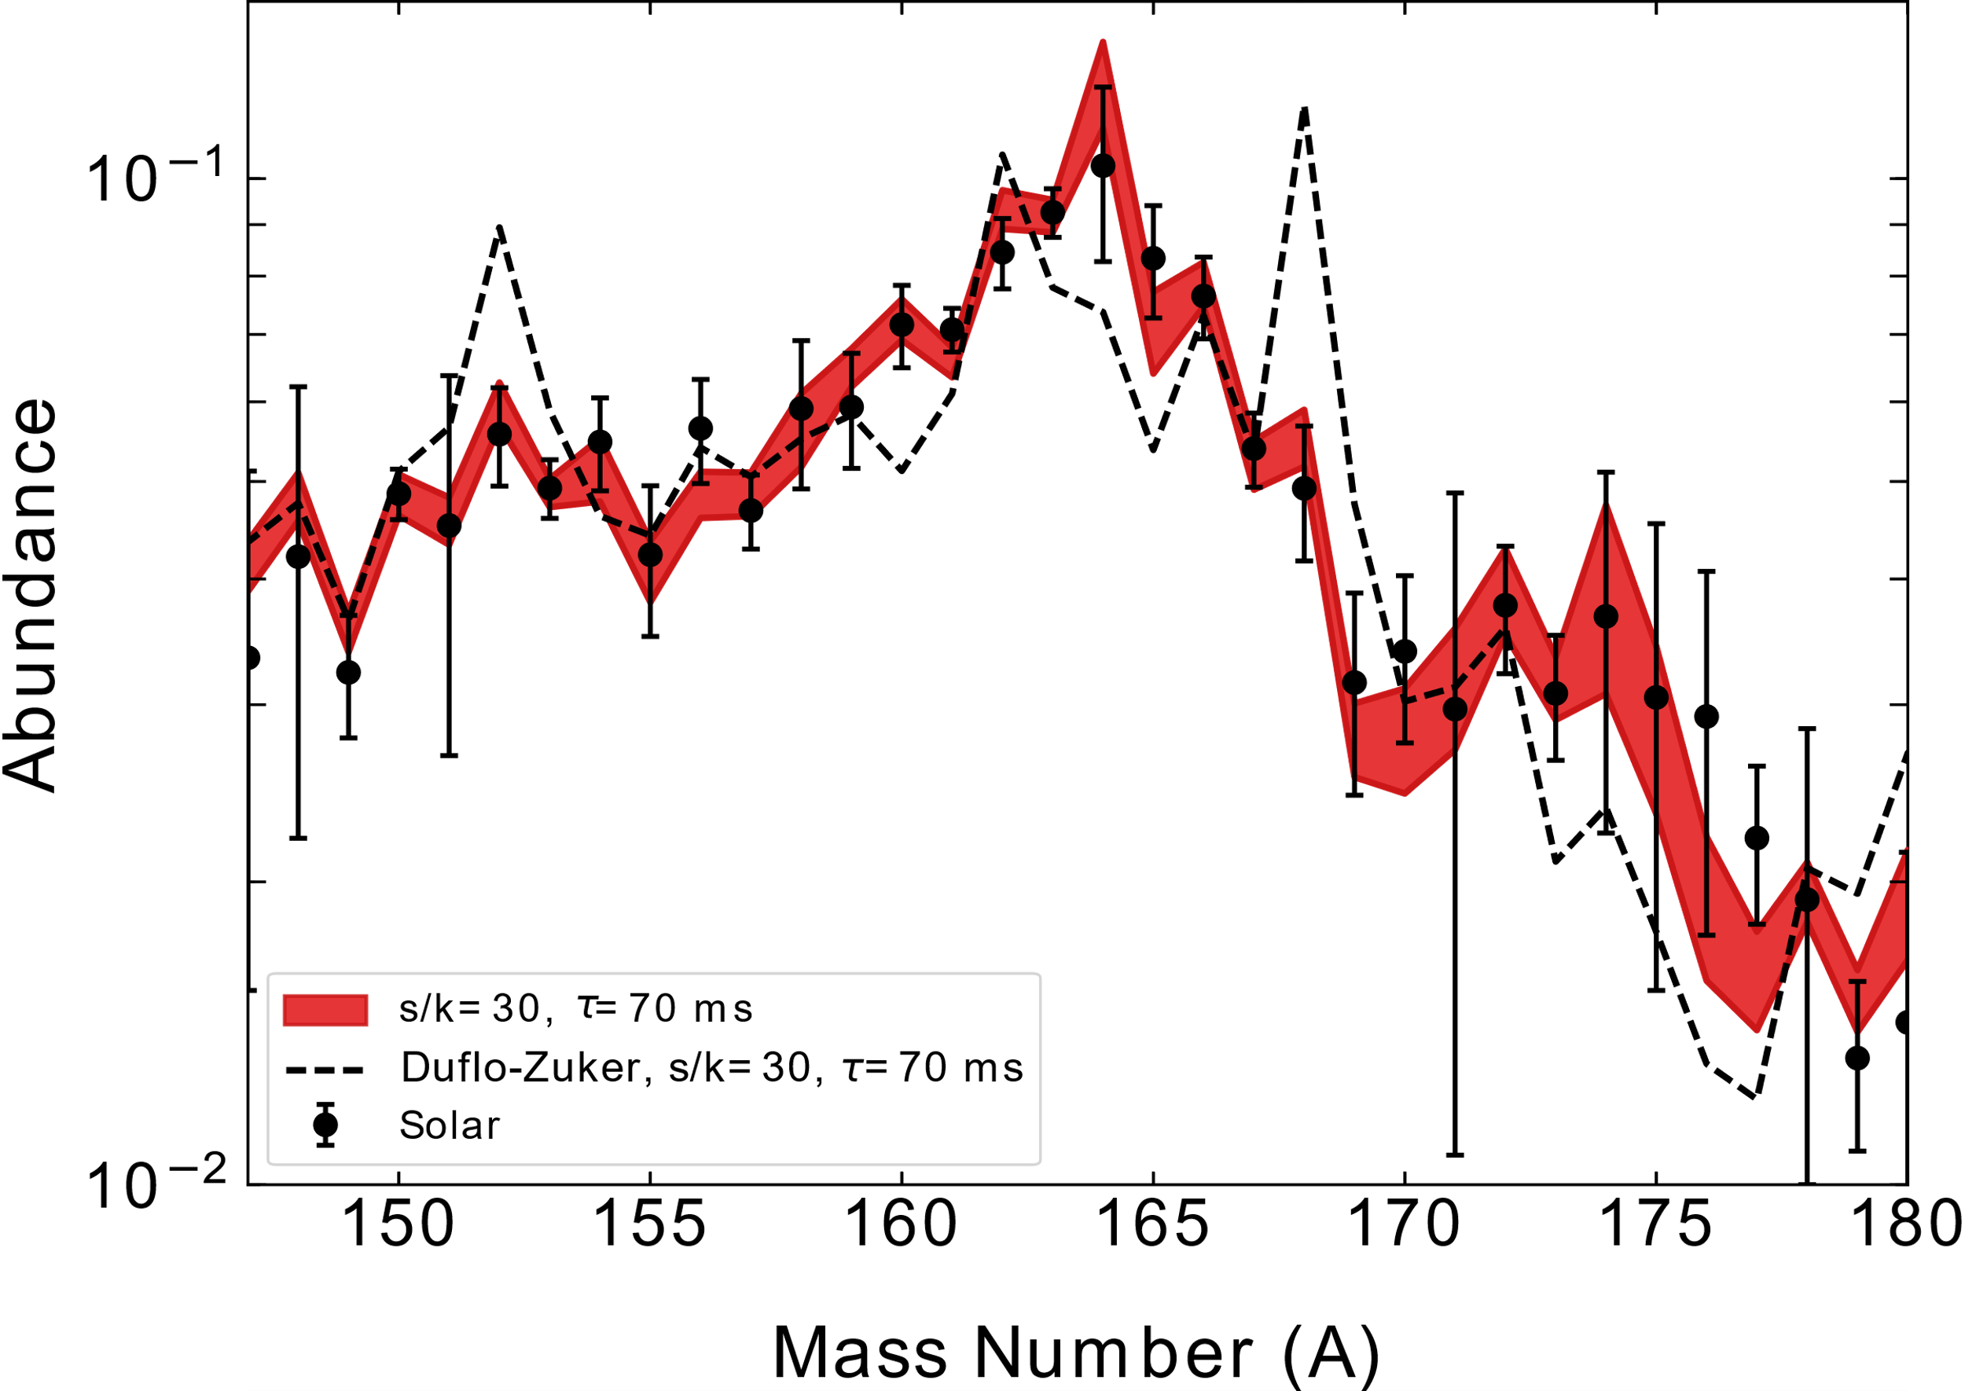
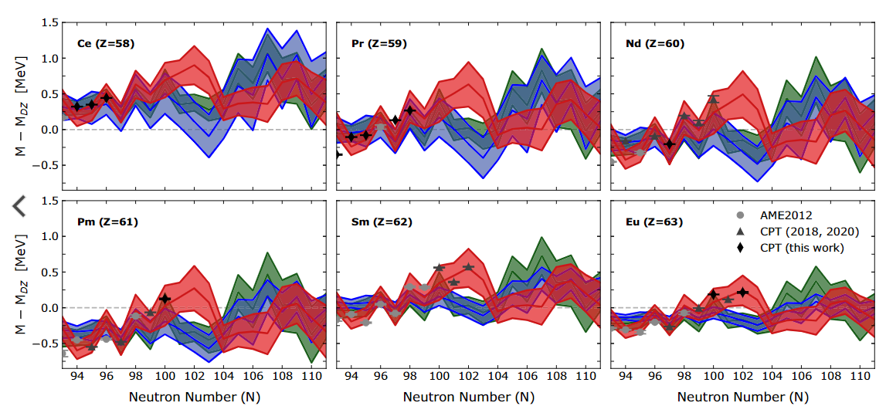
Measurements with the CPT at CARIBU
Rare-earth abundance peak
Bands: Theoretical predictions obtained from “reverse engineering” the mass surface that best reproduces the rare earth peak of the observed solar r-process abundance through Markov chain Monte Carlo (MCMC) technique.
Insufficient production: Fission yield drops quickly with N, ²⁵²Cf has a half life of 2.6 year
hot
cold
hot/cold
R. Orford, N. Vassh et al., Phys. Rev. C, 105, L052802 (2022).

Slide 12
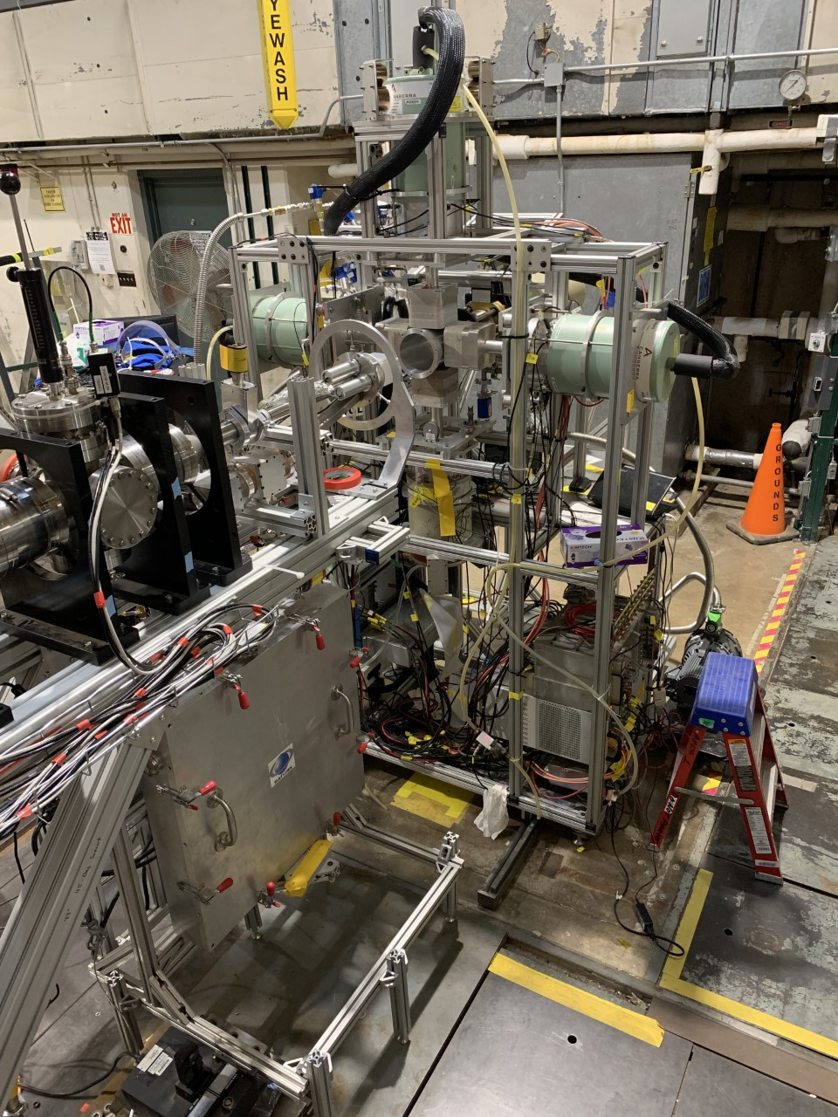
X-Array and saturn in area 1
High-Resolution βγ Decay Spectroscopy with Tape Station
Obtain Data on Half-lives, Isomers, β-Delayed Neutron Emission, Branching Ratios, β-Feeding Intensities to Discrete States
5 HPGe Clover Detectors for 5% Absolute Efficiency at 1 MeV
2 Scintillator Configurations Surround Implant Site: 10 cm Cylinder or 3 Paddles
Supports Coupling Auxiliary Detector Systems (CLYC, LaBr, etc.)
Commissioned in Area 1 May, 2019 with Beams of ¹⁴²Cs and ¹⁴⁶Cs
X-Array
Recent Publications:
  A. J. Mitchell et al., NIM A 763, 232 (2014).
  A. J. Mitchell et al., Phys. Rev. C 93, 014306 (2016).
  D.J. Hartley et al., Phys. Rev. Lett. 120, 182502 (2018).
  K. Siegl et al., Phys. Rev. C 98, 054307 (2018).
  F.G. Kondev et al., EPJ Conf. 223, 01028 (2019).
  D.J. Hartley et al., Phys. Rev. C 101, 044301 (2020).
  A. J. Mitchell et al., Phys. Rev. C 103, 024323 (2021).
SATURN

Slide 13
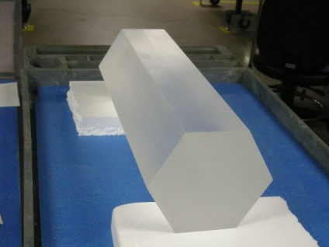
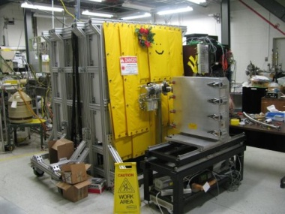
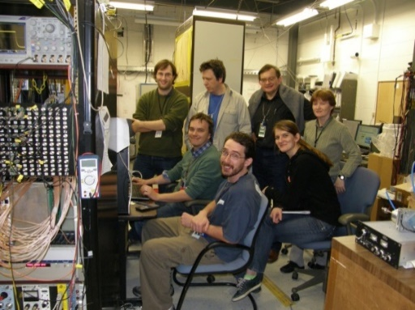
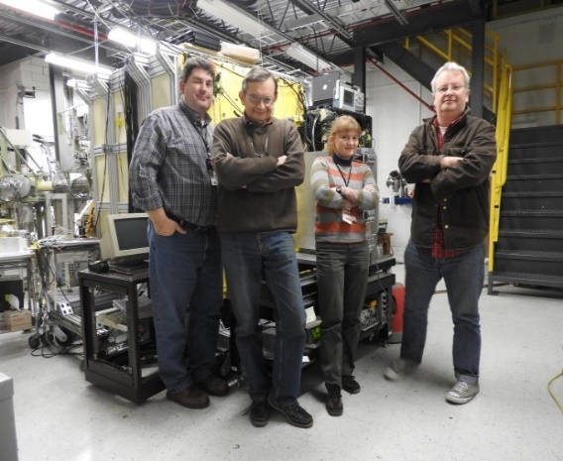
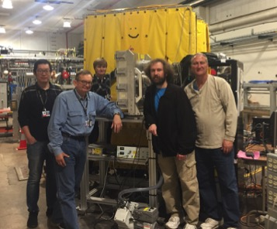
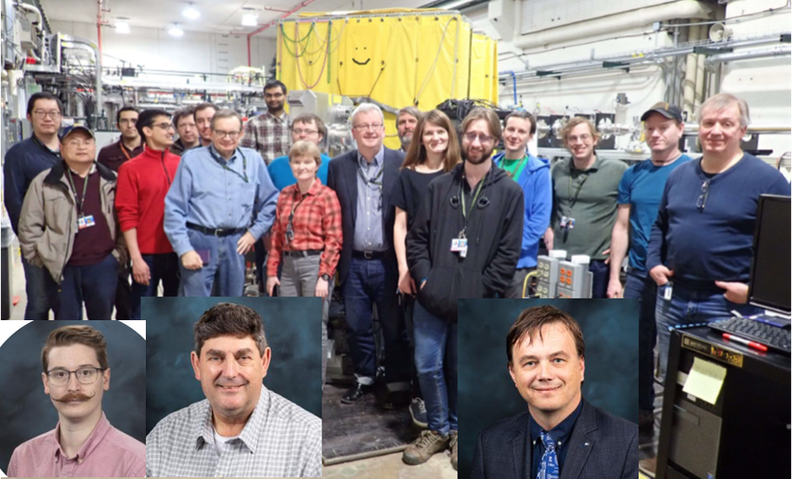

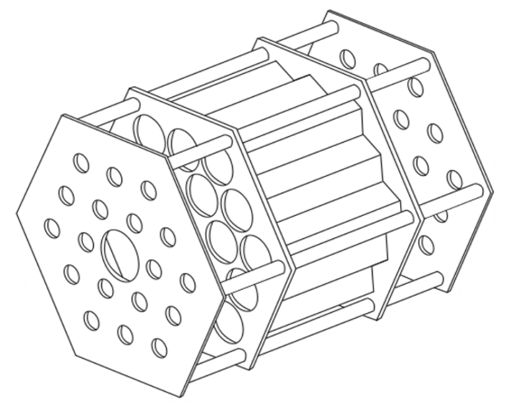
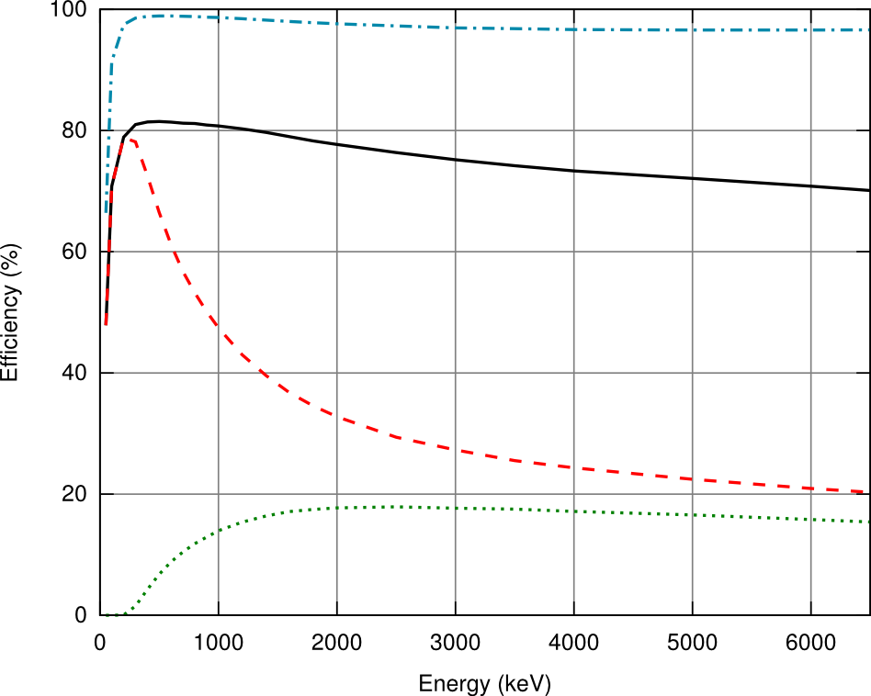
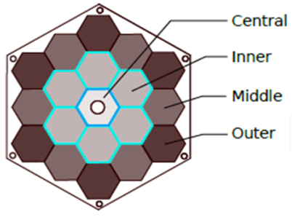
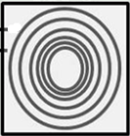


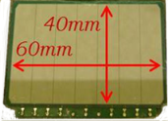
Mtas in area 1
St. Gobain (OH)
ORNL HRIBF
ANL CARIBU
2020-2021
2010
2011
2012
2016
2019
MTC
Part of γ-ray energy detected
Full energy absorption
for a single γ-ray in MTAS
Central - full energy
beam
Segmented structure
19 modules
1-ton of NaI(Tl)
Ge
Inner – full energy
2 Si dets
Auxiliary detectors, Moving Tape Collector, and 6-tons of shielding
Impressive efficiency, plotted here up to 6 MeV
total 99%-98%, single γ-line 80%-70%
Rasco et al., PRC 2018
Wolińska-Cichocka et al., NDS 2014
13
Karny et al., NIM 2016

Slide 14
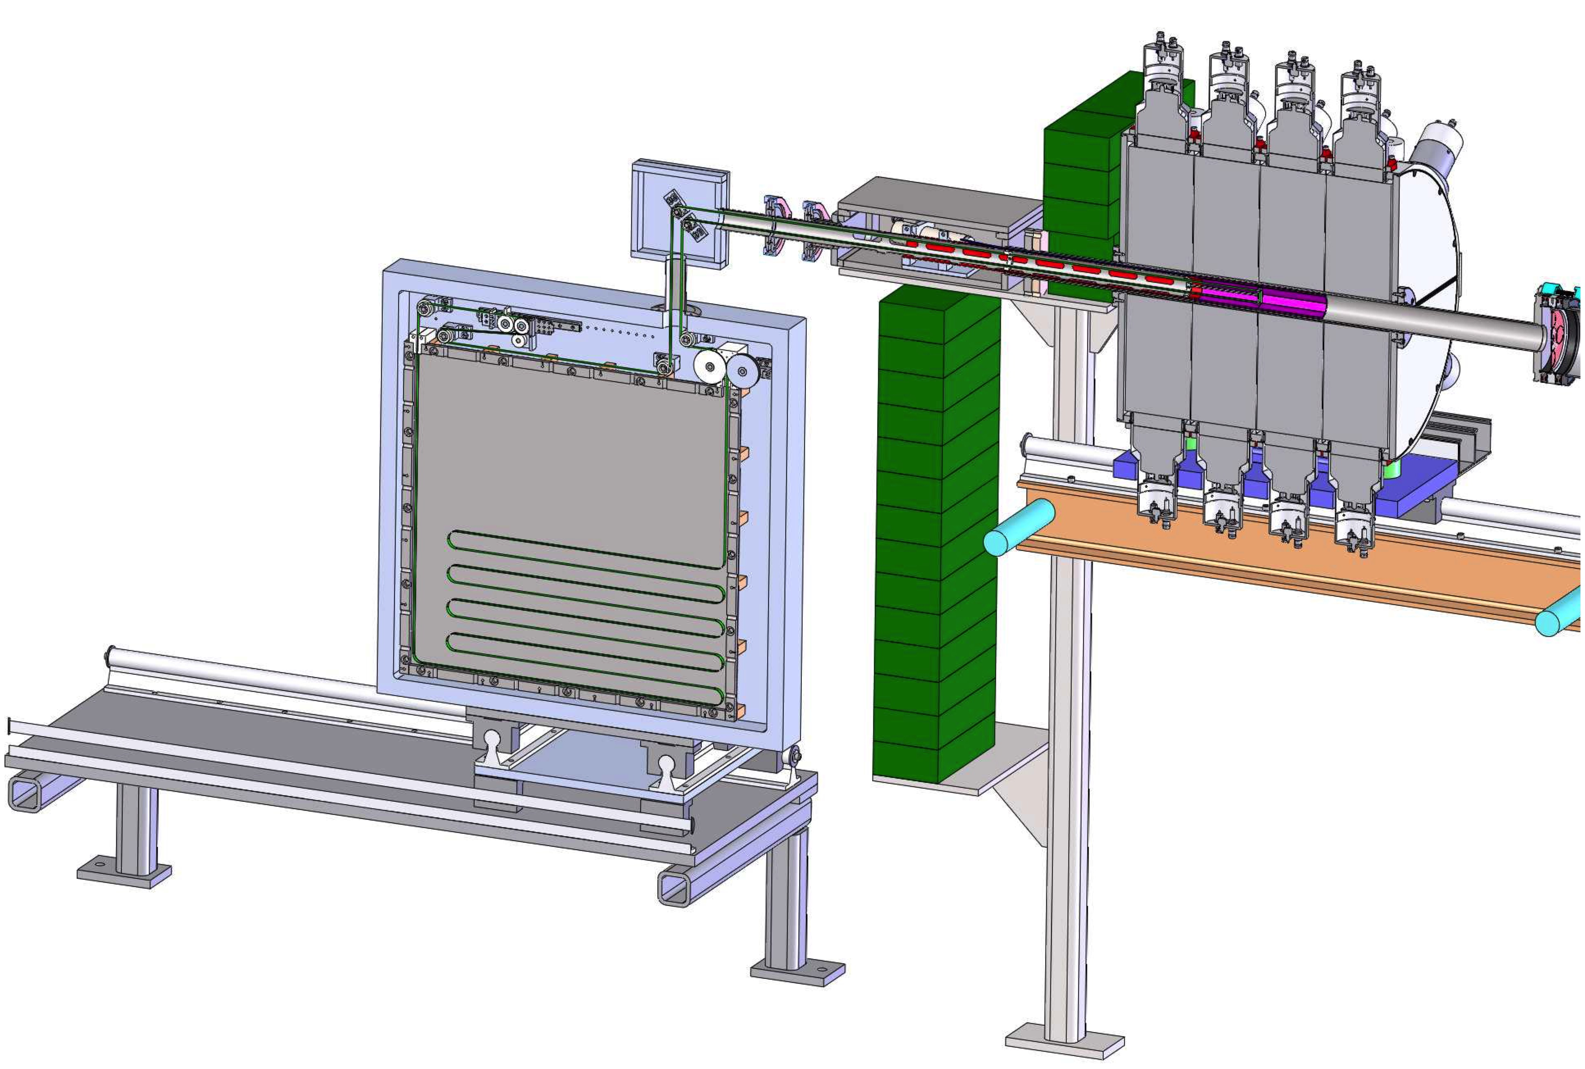
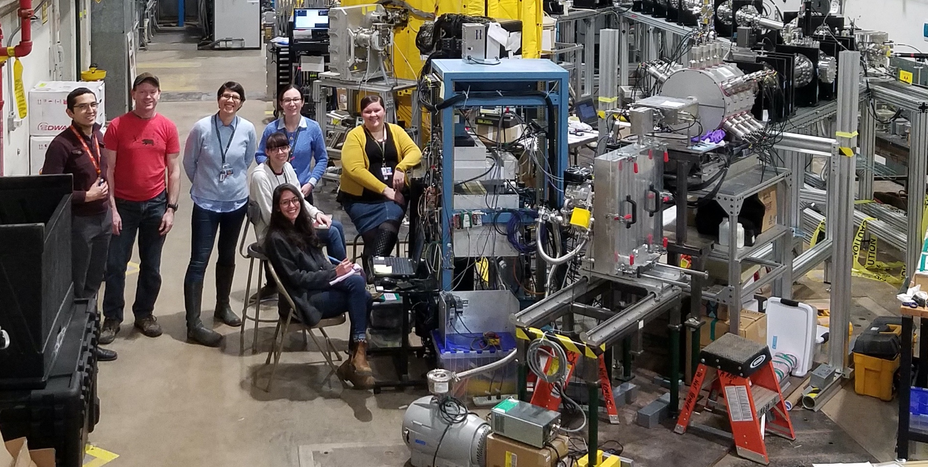
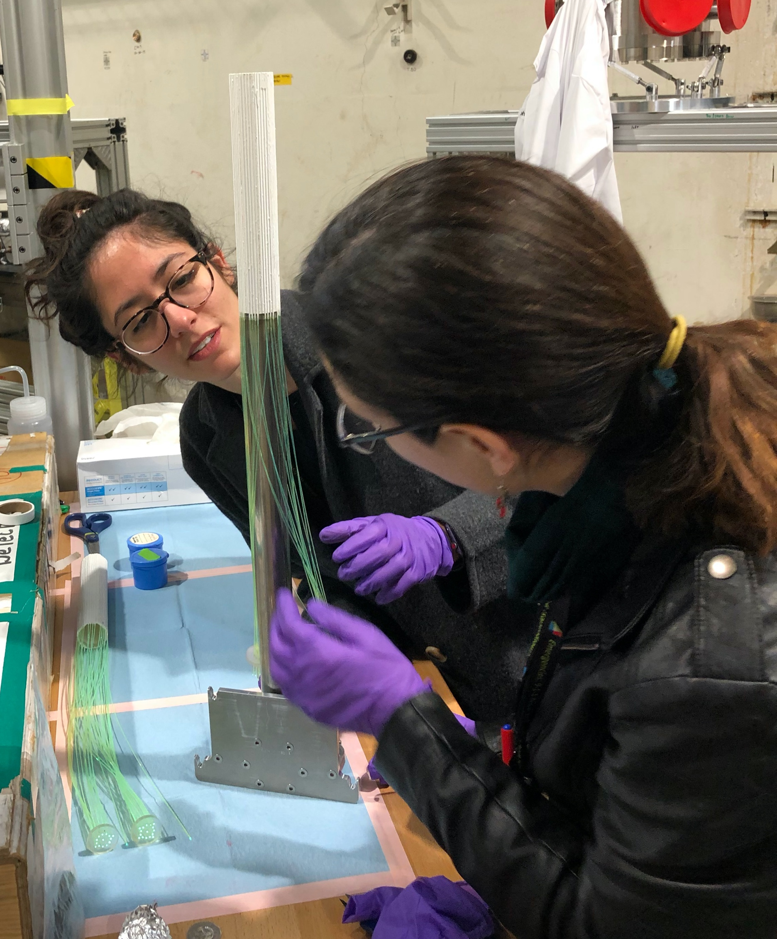
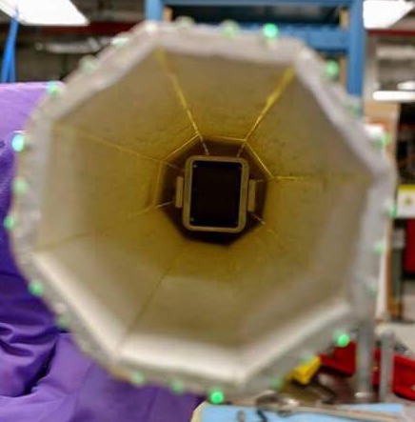
SuN in area 1
SuNTAN
Tape Transport System
beam
SuN
SuNTAN
Design by LSU and ANL
Fiber Detector
β-detection
Hope College
Completed experiments
#1742: Study of ¹³⁵I(n,γ)¹³⁶Ι for i process (Spyrou, MSU)
#1799: ⁸⁷⁻⁸⁹Kr(n,γ)⁸⁸⁻⁹⁰Kr for i process (Lyons, PNNL)
#1795: n-capture around A=140 (Spyrou, MSU)
#1807: γ-strength and level density in Zr (Smith, MSU)
#1812: n-capture at A=93 (Sweet, LLNL)
#1755: β-decay of neutron-rich Sn and Sb (Liddick, MSU)
(2 more experiments planned for the Fall 2022 period)
Result status
One publication submitted (#1799)
Muecher et al, PRC Lett. 2022
One publication in preparation (#1795) Spyrou et al.
Remaining experiments under analysis
14

Slide 15
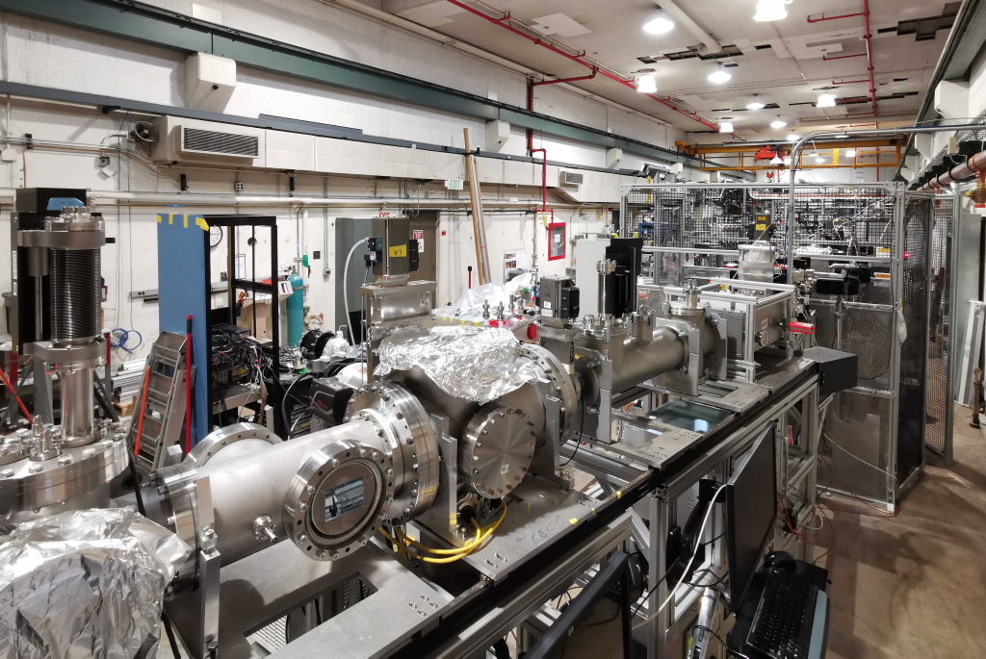
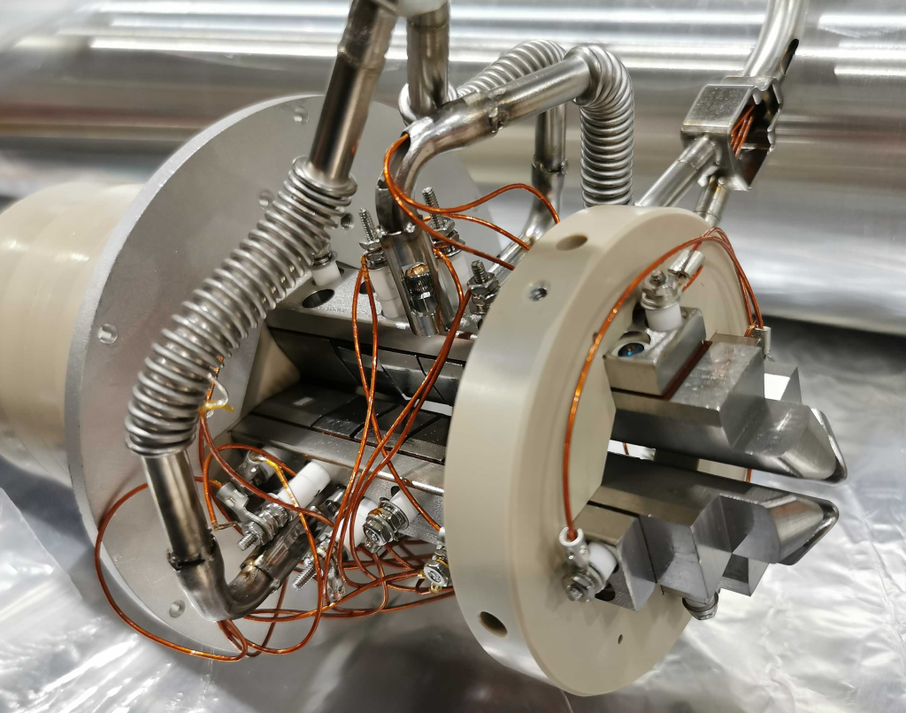
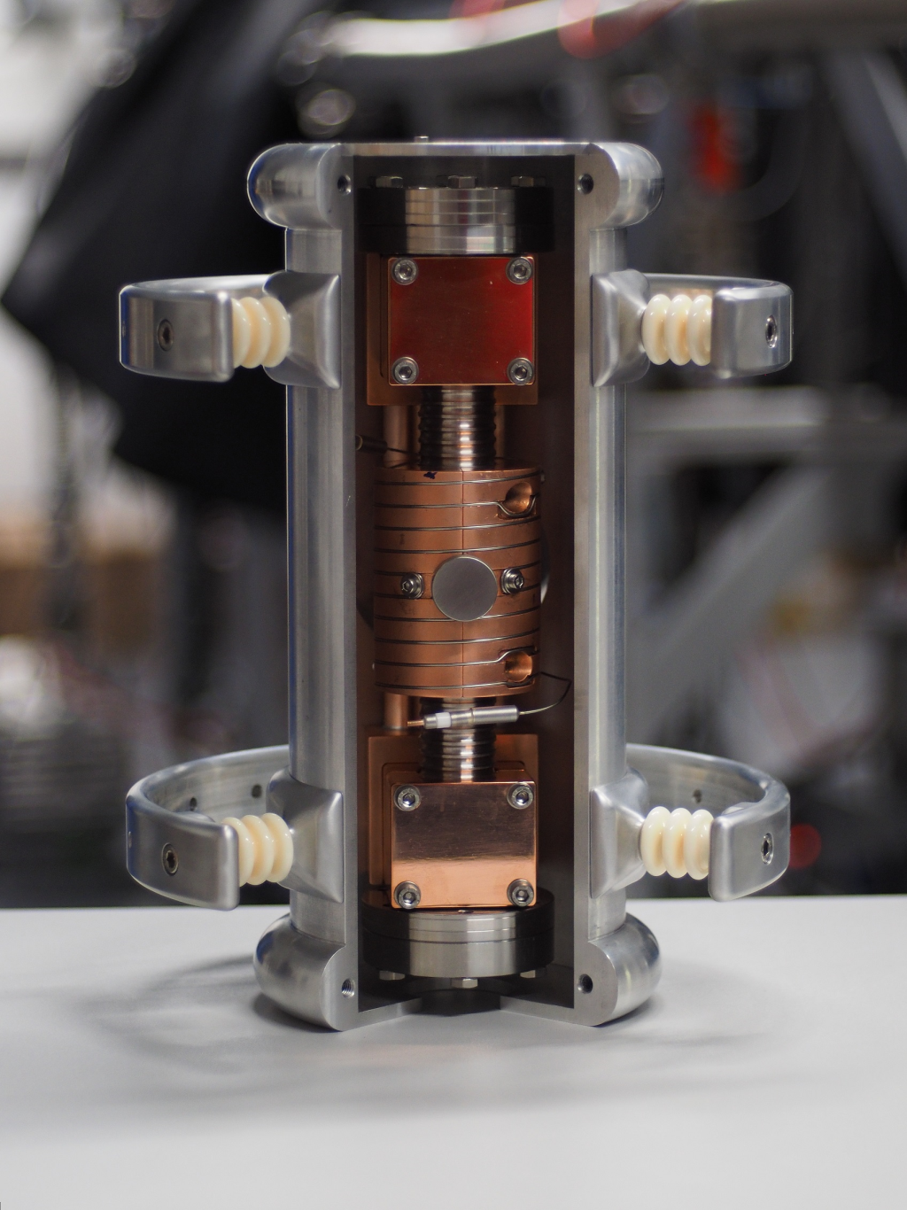
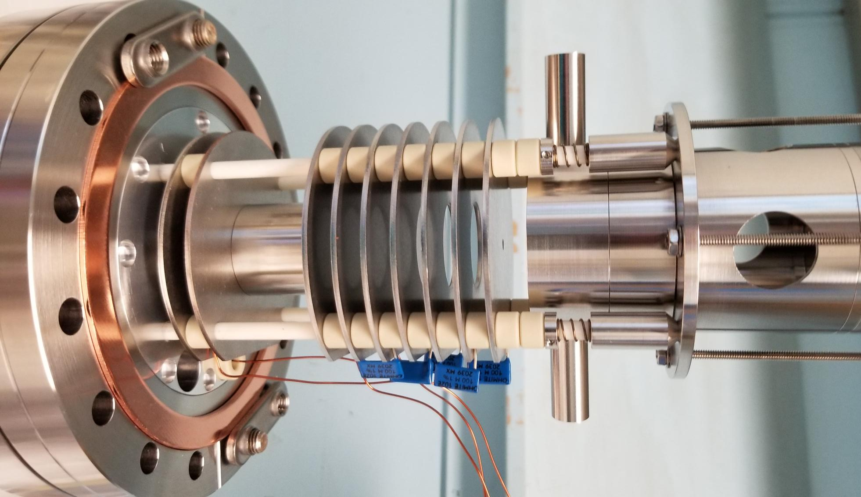
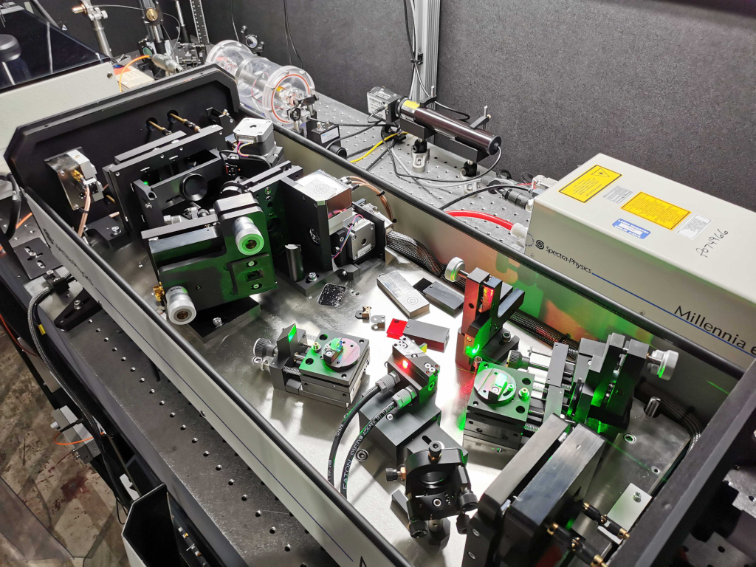
THE CLS SETUP in area 1
The collinear beamline in the CARIBU low-energy area
Laser ablation source
  Tested, working with Ti, Pd
Cooler / Buncher
  Commissioned in Fall, 2022
Laser system
  Running at 340-370nm
CLS beamline
  CEC: Temperature, Mg tests successful
Cooler/buncher
CARIBU Laser Lab (Matisse Ti:Sa + Wavetrain 2f)
New charge exchange cell for operation with Mg (~600°C / 1100°F)
Laser Ablation Offline Source

Slide 16
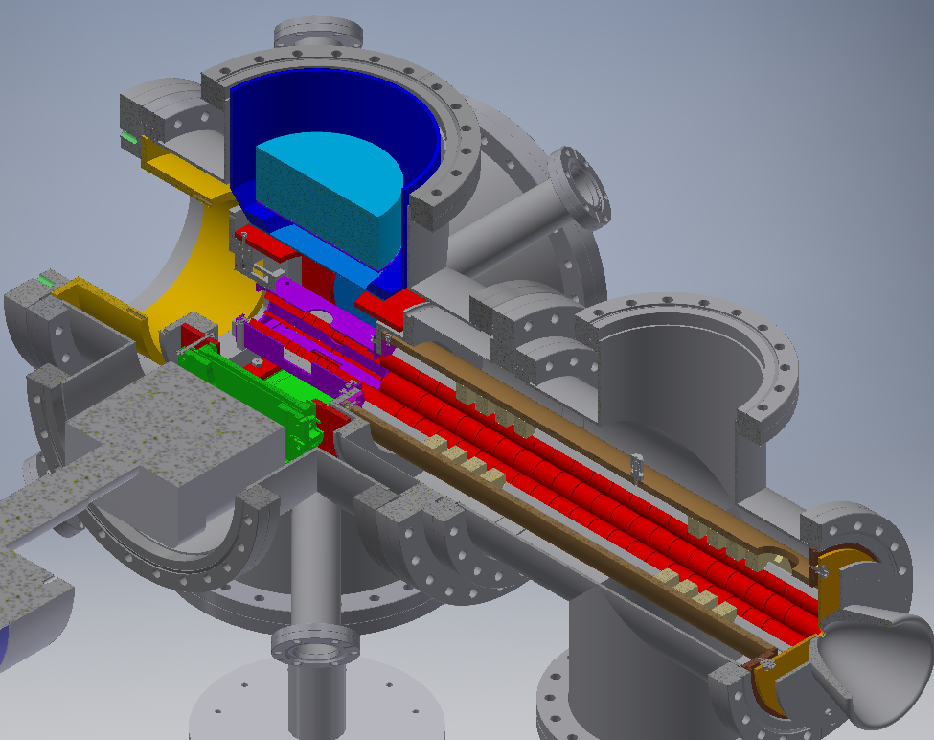
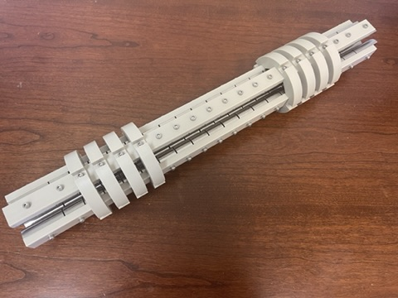
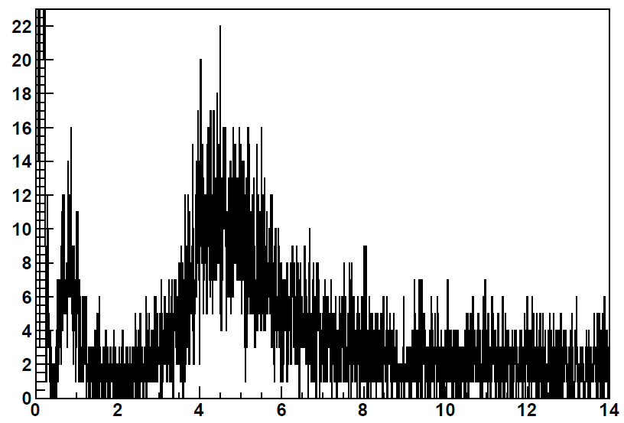



Beartrap in area 1
N.D. Scielzo et al., Nucl. Instrum. Meth. A 681, 94 (2012).
$Δ$E-E scintillator
Open-geometry trap structure accommodates radiation detectors (large solid-angle coverage)
Let ion decay (ex: ¹³⁷I⁺) from rest at center of ion trap (Paul trap)
Surround ion trap (Paul trap) with plastic scintillators (to detect β’s) and MCPs (to detect decay recoils)
Beta-delayed neutron decay produces recoil detected by TOF with MCP
Measurement trap
Preparation trap
MCP assembly
HPGe crystal
HPGe
136Xe ions following β-delayed neutron emission
MCP
Recoil ion
137Xe ions following β decay
(+ γ emission)
$$γ$$
Counts/6.5 ns
$$β$$
Trap electrodes
$$n$$
Plastic ΔE-E
$$ν$$
Time of flight (μs)

Slide 17

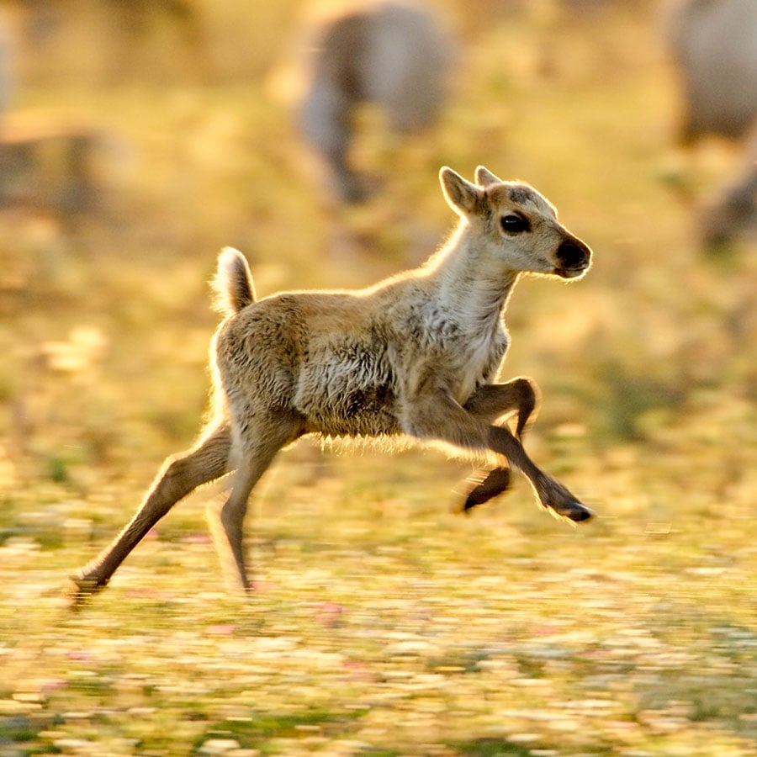
CARIBU nuCARIBU
CARIBU:
  Need to change source roughly every 3 years
  Yield limited by how thin an intense ²⁵²Cf source could be made
  Sources received were not consistently thin
nuCARIBU:
  Replace ²⁵²Cf source by neutron-induced fission on actinide foils
  More reliable source of fission products
  Operationally easier to maintain and operate
  Gain an order of magnitude in overall fission rate … i.e. ~ 10⁹ fission/sec vs current few 10⁷ fission/sec
  Higher fission yield feeding in the ¹³²Sn region or above ⁷⁸Ni region

Slide 18
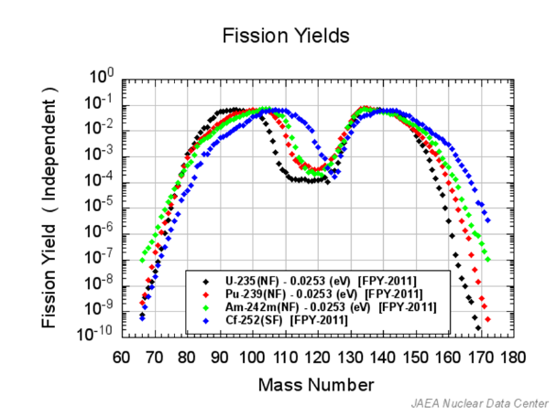
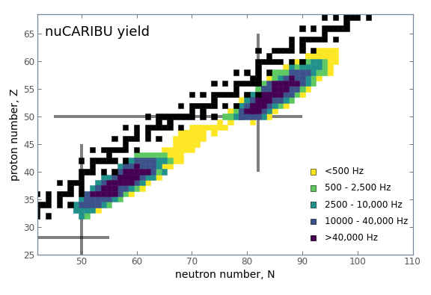
Changes in fission distribution
Significant gain
Significant gain in the Sn and Br regions
Significant loss in the Ru and Ce regions
Significant loss

Slide 19
Optimize yield by choice of foil
²³⁵U available at 93% purity has been identified and is available as a metal for rolling. Will be used first.
²³⁹Pu, ^{242m}Am and other fissionable isotopes are also available but more difficult to handle
Different fissioning isotopes allow to optimize yield to particular region
Significant gains over ²⁵²Cf in some region from relative yield, enhanced further by higher fission rate, but losses in heaviest region

Slide 20
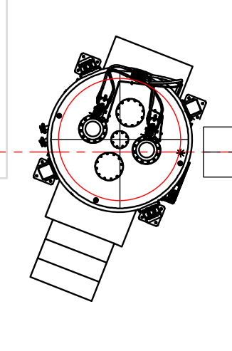

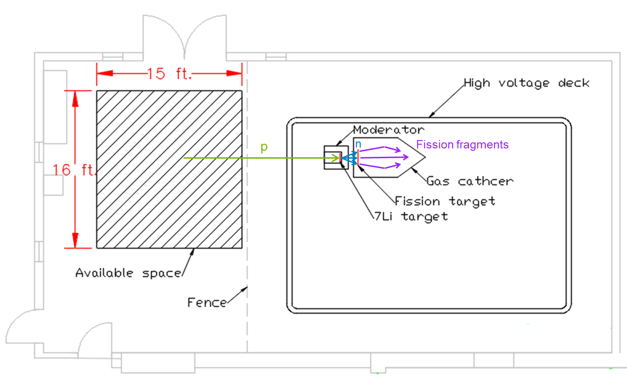
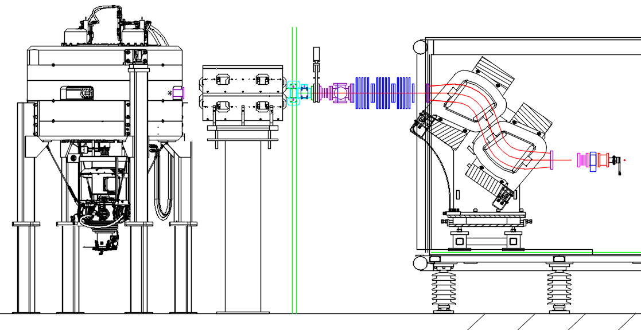
nuCARIBU overview
Compact accelerator from BEST CYCLOTRON SYSTEMS
Neutron producing target, moderator and shielding assembly
Proton accelerator
  6 MeV, 0.5 mA compact proton cyclotron
Transport system
⁷Li n-production target
Moderator
Actinide target

Slide 21
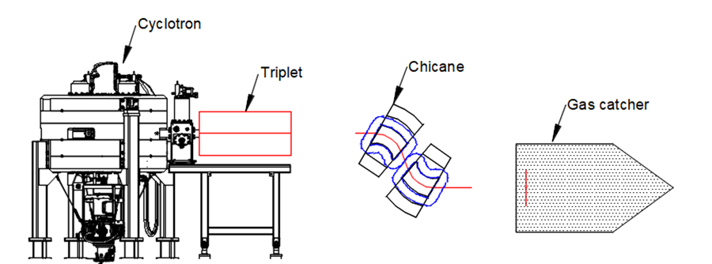



nuCARIBU status
Beam transport system design completed
Delivered Nov 2022
Cyclotron passed factory acceptance test
Has been delivered to Argonne on Jan 31 2022
Concept developed for high power heat removal
Prototype built and being tested

Slide 22
summary
CARIBU has provided a wealth of neutron-rich nuclides for study
Mass measurements with the CPT has helped to constrain the sites of the astrophysical r-process
New experimental hall (Area 1) has hosted X-array / SATURN / LACES, MTAS, SuN with a series of successful experiments
Expanding capabilities in Area 1 with cooler/buncher now providing beams to CLS and soon to BEARTRAP
Preparations underway for upgraded Gammasphere to move to Area 1
nuCARIBU to replace CARIBU in the coming year
  ²⁵²Cf spontaneous-fission source being replaced by induced-fission (p+⁷Li) of foils
  Expect x10 increase in yield as compared to CARIBU

Slide 23
Questions?

