Slide 1
Development of a
Hot Cavity Catcher Laser Ion Source
Docent Mikael Reponen – SMI, Gießen, Germany , 2023

Slide 2
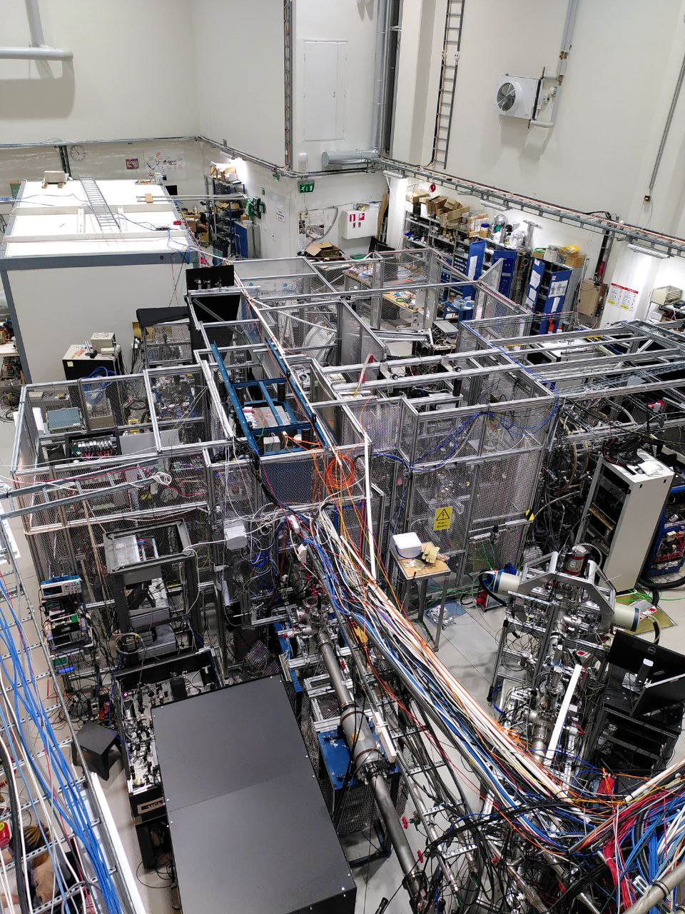
Outline
JYFL-ACCLAB
  IGISOL
    The IGISOL method
Laser setups and laser spectroscopy
Motivation
History
Recent results
Outlook

Slide 3

University of Jyväskylä Accelerator Laboratory

Slide 4
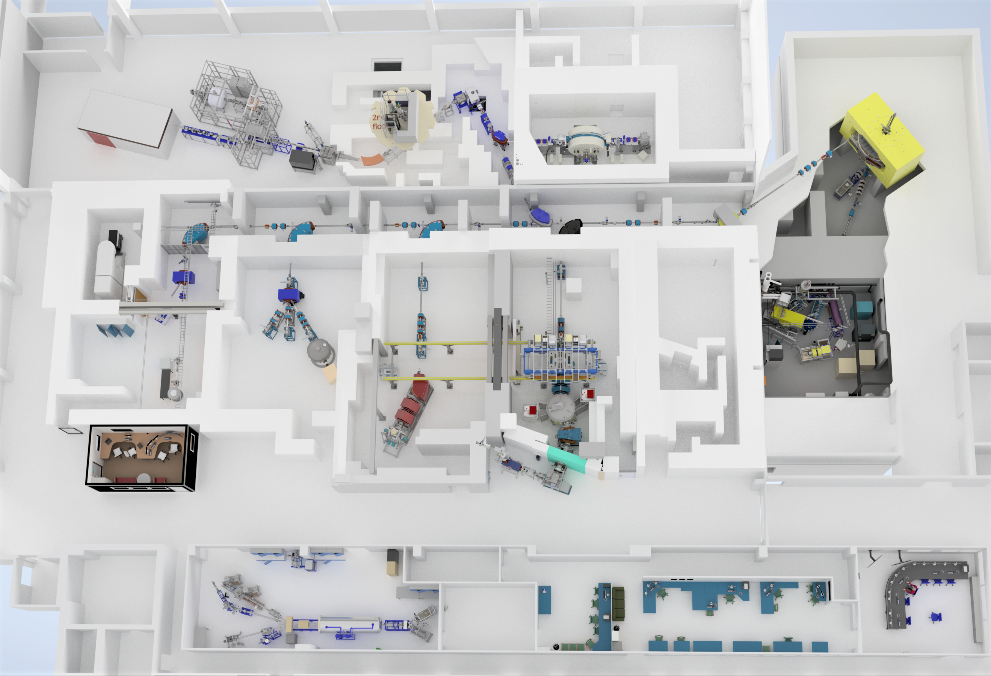
JYFL-ACCLAB
C-Linac
MCC30
Emax=30 MeV
K130:
Emax= 130 (q²/A ) MeV
Beams from p to Au
Annual use: 6500-7000 h/year
IGISOL
Optical spectroscopy
Atomic masses
Decay spectroscopy
Ion sources
ECR: (6.5 GHz, 14 GHz, 18 GHz )
Multicusp: (H-,D-)
RITU/MARA/ MARA-LEB
Nuclear spectroscopy
(Optical spectroscopy)
RADEF
Radiation effects
Microfilters
LSC
Nuclear reactions
Pelletron
EMAX=1. 7 MeV
Accelerator based material physics
ToF-ERDA/RBS/PIXE
Ion source development (Lasers + Cs sputtering)

Slide 5
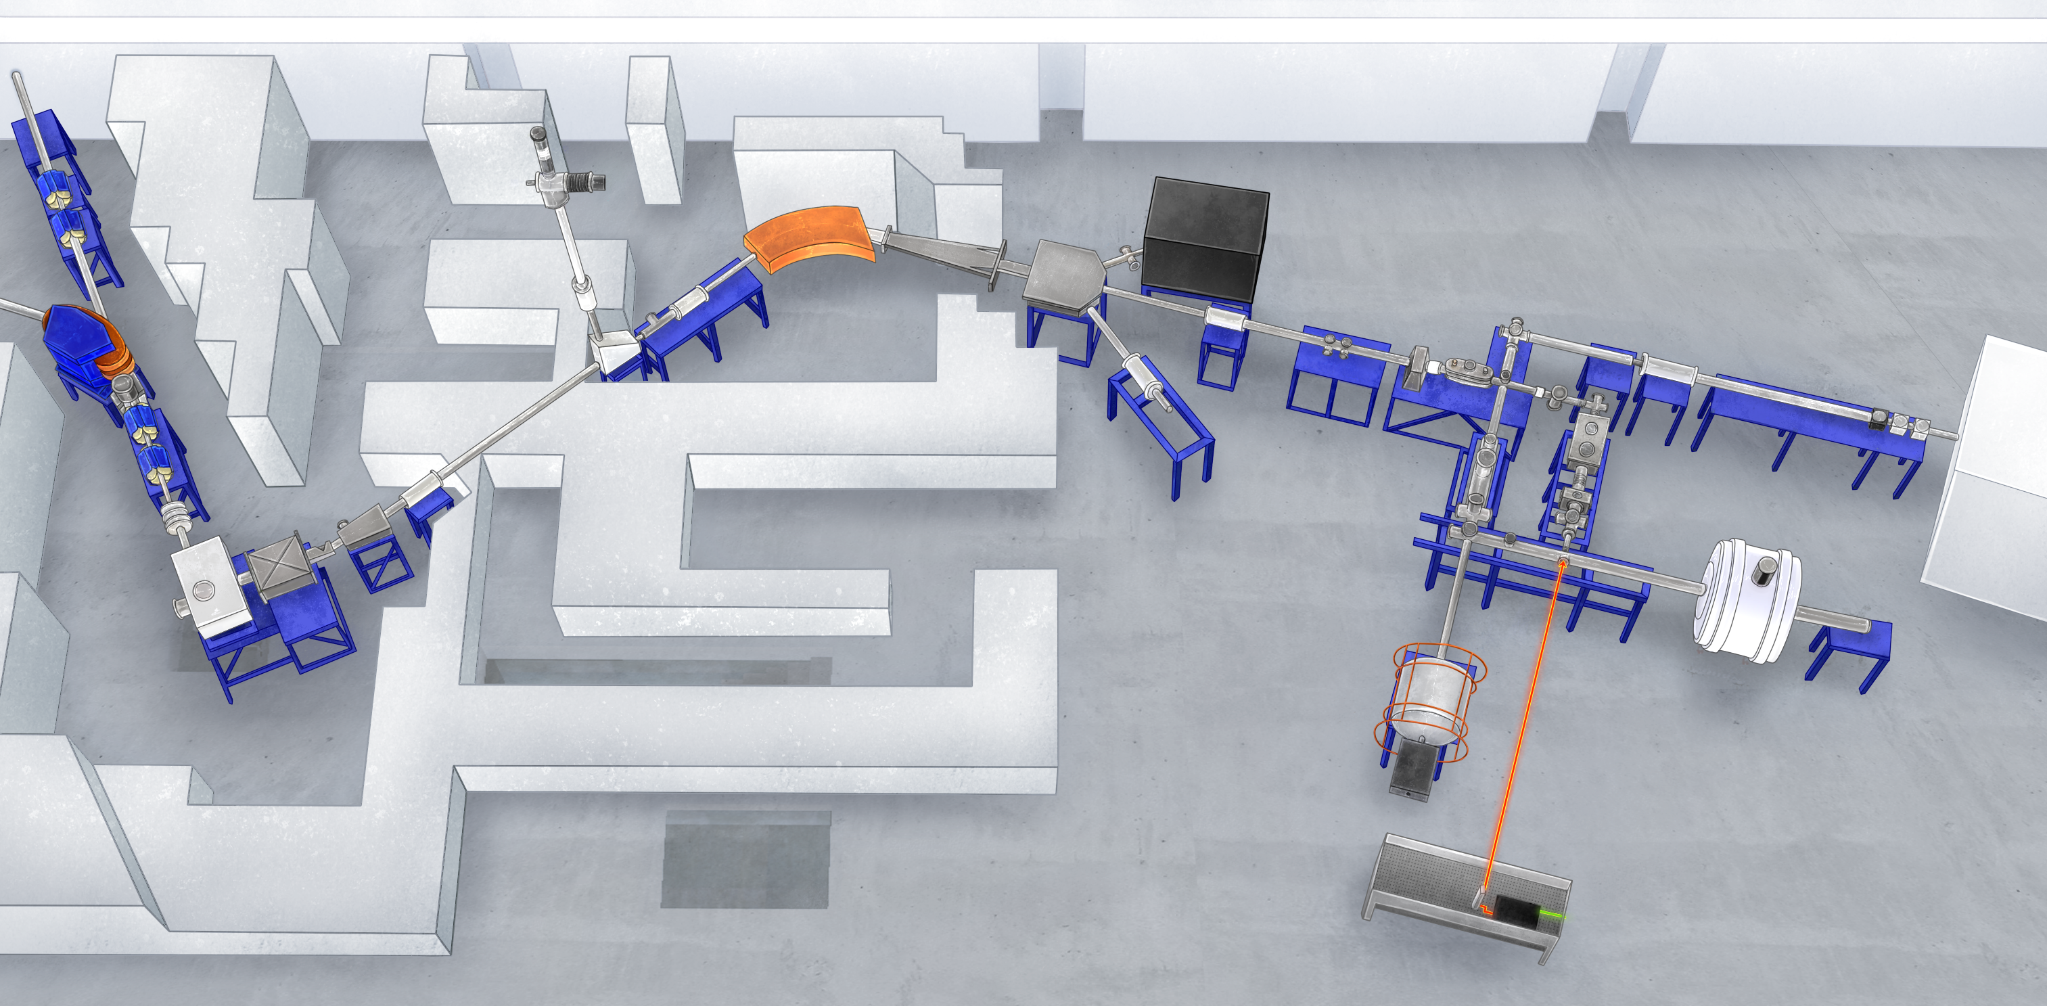



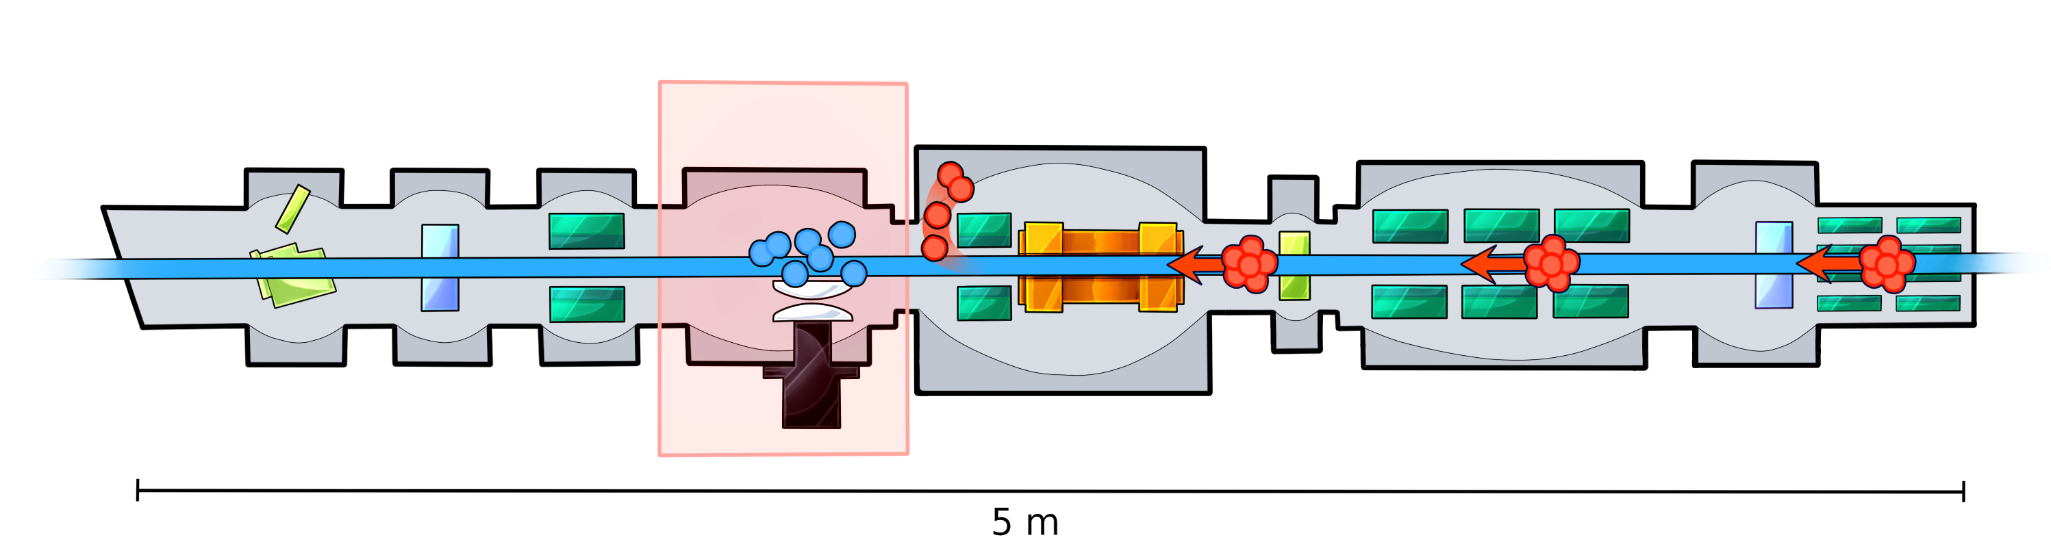
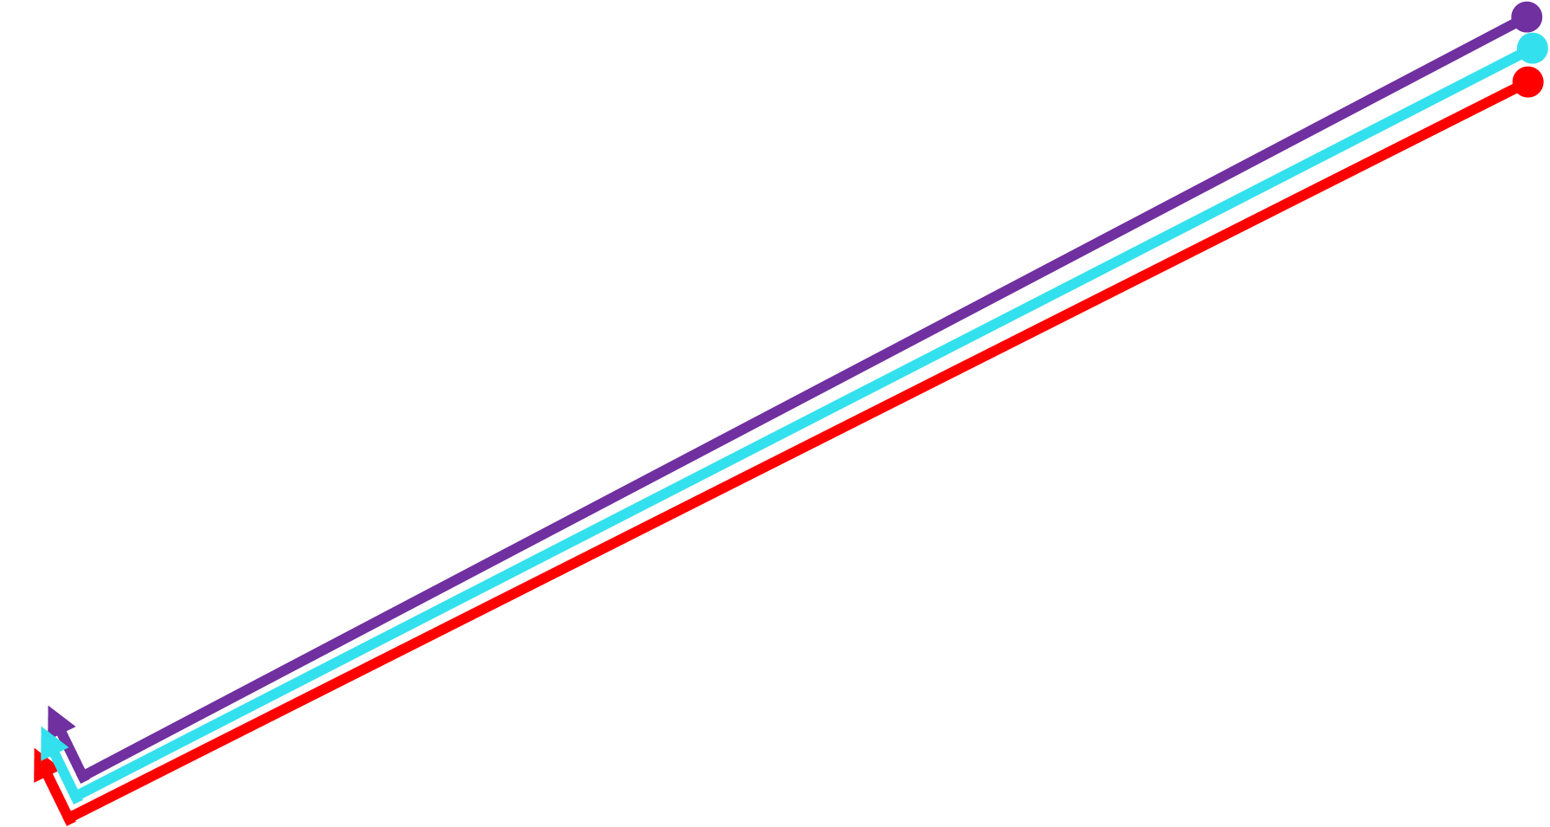


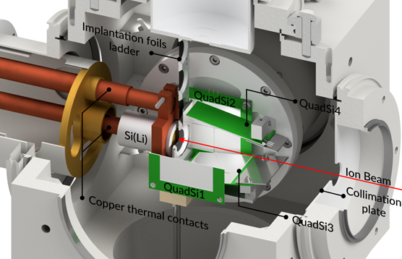

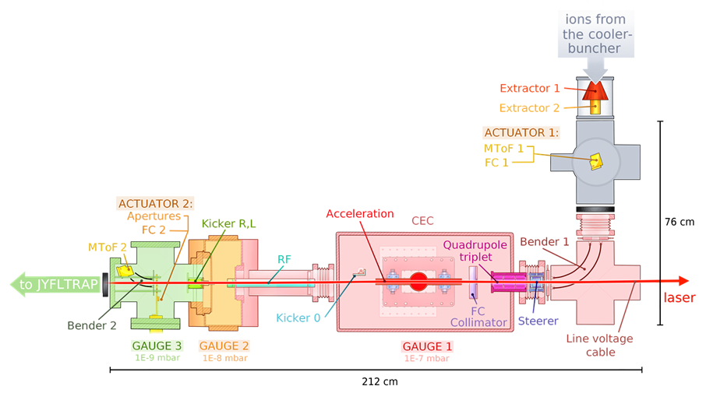
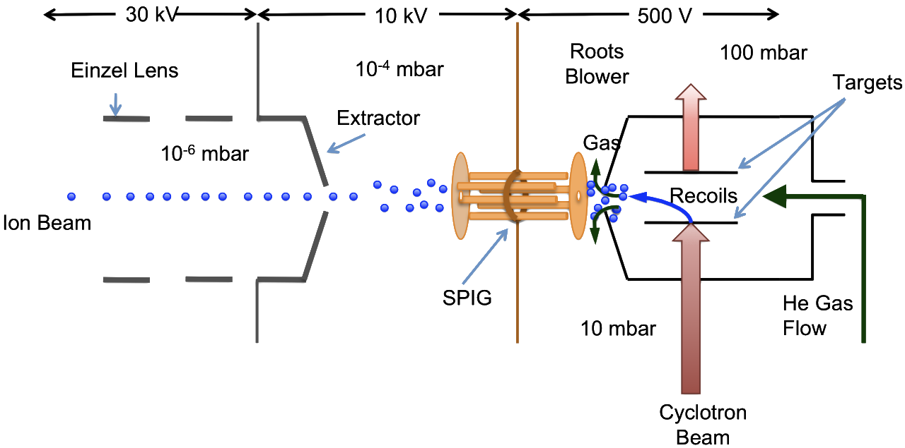
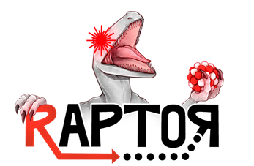


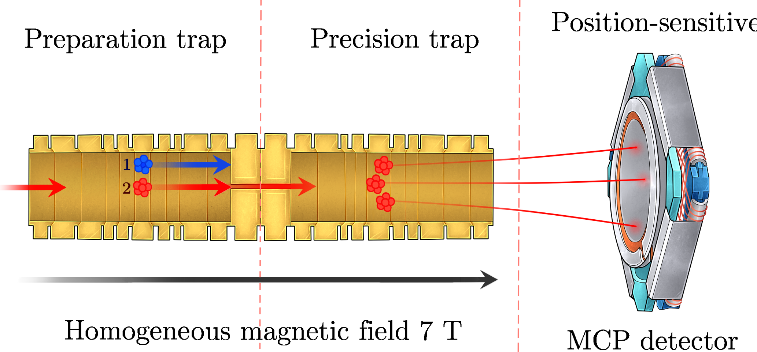
Offline ion source
Dipole magnet
RFQ Cooler-Buncher
Collinear laser spectroscopy
Atom Trap
Goal: Producing coherent gamma radiation via isomeric decay of ^{135m}Cs in a Bose-Einstein condensate.
MR-ToF
200 000 MRP so far
MORA
(Matter's Origin from the RadioActivity of trapped andoriented ions)
Looking for CP violation in nuclear beta-decay via D correlation measurement.
Spectroscopy beamline
Diagnostics
Nuclear decay spectroscopy
Instrument development
FURIOS
(The Fast Universal ResonantIOn Source)
A 10 kHz pulsed solid-state Titanium:sapphire laser system‌
Provides high-power laser beams for very sensitive resonance ionization spectroscopy (RIS).
RAPTOR
(Resonance ionization spectroscopy And Purification Traps for spectRoscopy)
IGISOL
Fast and chemically non-selective way to produce radioactive nuclei.
JYFLTRAP
(Penning trap mass spectrometer)

Slide 6
HCLIS motivation – ⁹⁴Ag
Measurement of ⁹²Rh, ⁹⁴Pd mass with JYFLTRAP at IGISOL
  ⁹⁴Ag mass
  1 proton and 2 proton separation energy
Two-proton separation energy
and two-proton decay data
[6] I. Muhka et al., Nature 439, 298 (2006)
[23] D. Kast et al., Z. Phys A 356, 363 (1997)
One-proton separation energy
and one-proton decay data
[24] G. Audi et al., Nucl. Phys A 729, 3 (2003)
AME 2003 Ex = 6500(2000)# keV (21⁺)
AME 2021 Ex = 6500(550)# keV (21⁺)
AME 2021 Ex = 1350(400)# keV (7⁺)
D. G. Jenkins, Phys. Rev. C 80 (2009) 054303
A. Kankainen et al., Phys. Rev. Lett. 101 (2008) 142503

Slide 7
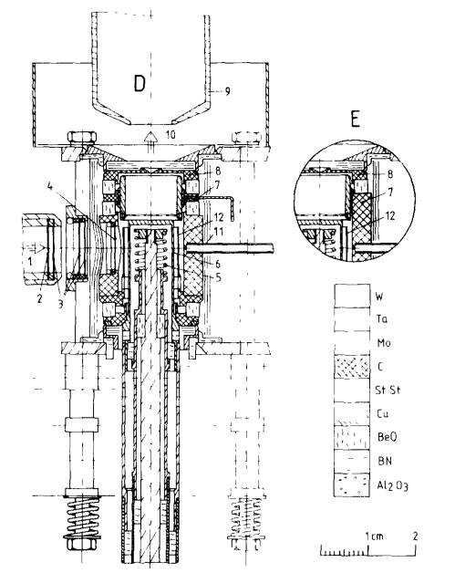
Hot cavity ion source origins
GSI Catcher-Ion-Source-System
  FEBIAD
  Surface ionization
Used to produce a lot of isotopes in the immediate region below tin-100
  Very efficient!
  Very fast
Some laser ion source work done already
¹⁰¹Sn: Z Janas et al 1995 Phys. Scr. 262 (1995)
¹⁰⁰In: W. Kurcewicz, Z. Phys. A - Atoms and Nuclei 308, 21-31 (1982)
⁹⁷Cd: K. Schmidt, Nuclear Physics A 624 185-209 (1997)
⁹⁴Ag: I. Mukha, Nature volume 439, 298–302 (2006)
⁹³Pd: K. Schmidt, Eur. Phys. J. A 8, 303–306 (2000)
R. Kirchner et al. Ion sources for the GSI on-line separator NIM 186, 1–2, (1981)
Notes:
Foreced electron beam arch discharge

Slide 8
Ionization method: Laser resonance ionization
e⁻
Autoionizing state
Each element have their unique atomic structure - “fingerprint”.
Multiple laser beams overlapped with atoms to stepwise excite and ionize
  Efficient! As high as >50%, typically a few %
A great method for sensitive laser spectroscopy
  Resolution highly environment dependent.
Continuum
~5-9 eV
Ionization potential
λ₃
Rydberg states
σ_{I}~ 10⁻¹⁷ cm²
2nd excited state
λ₂
1st excited state
σ_{R}~ 10⁻¹² cm²
λ₁
  We chose resonance ionization to gain a huge improvement in selectivity!
0 eV
Ground state

Slide 9
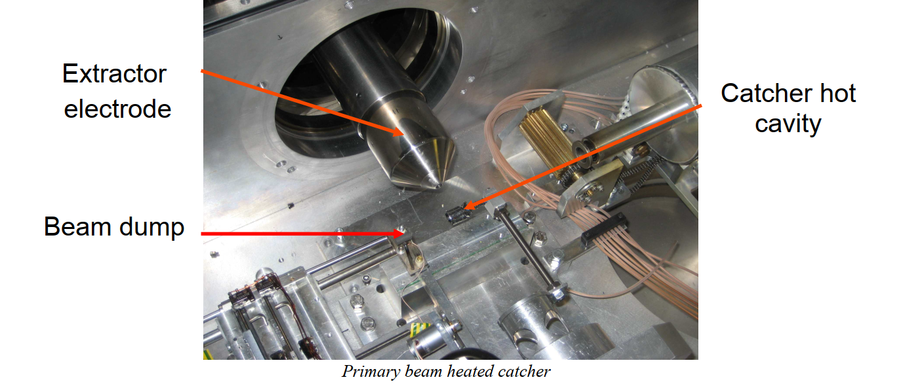
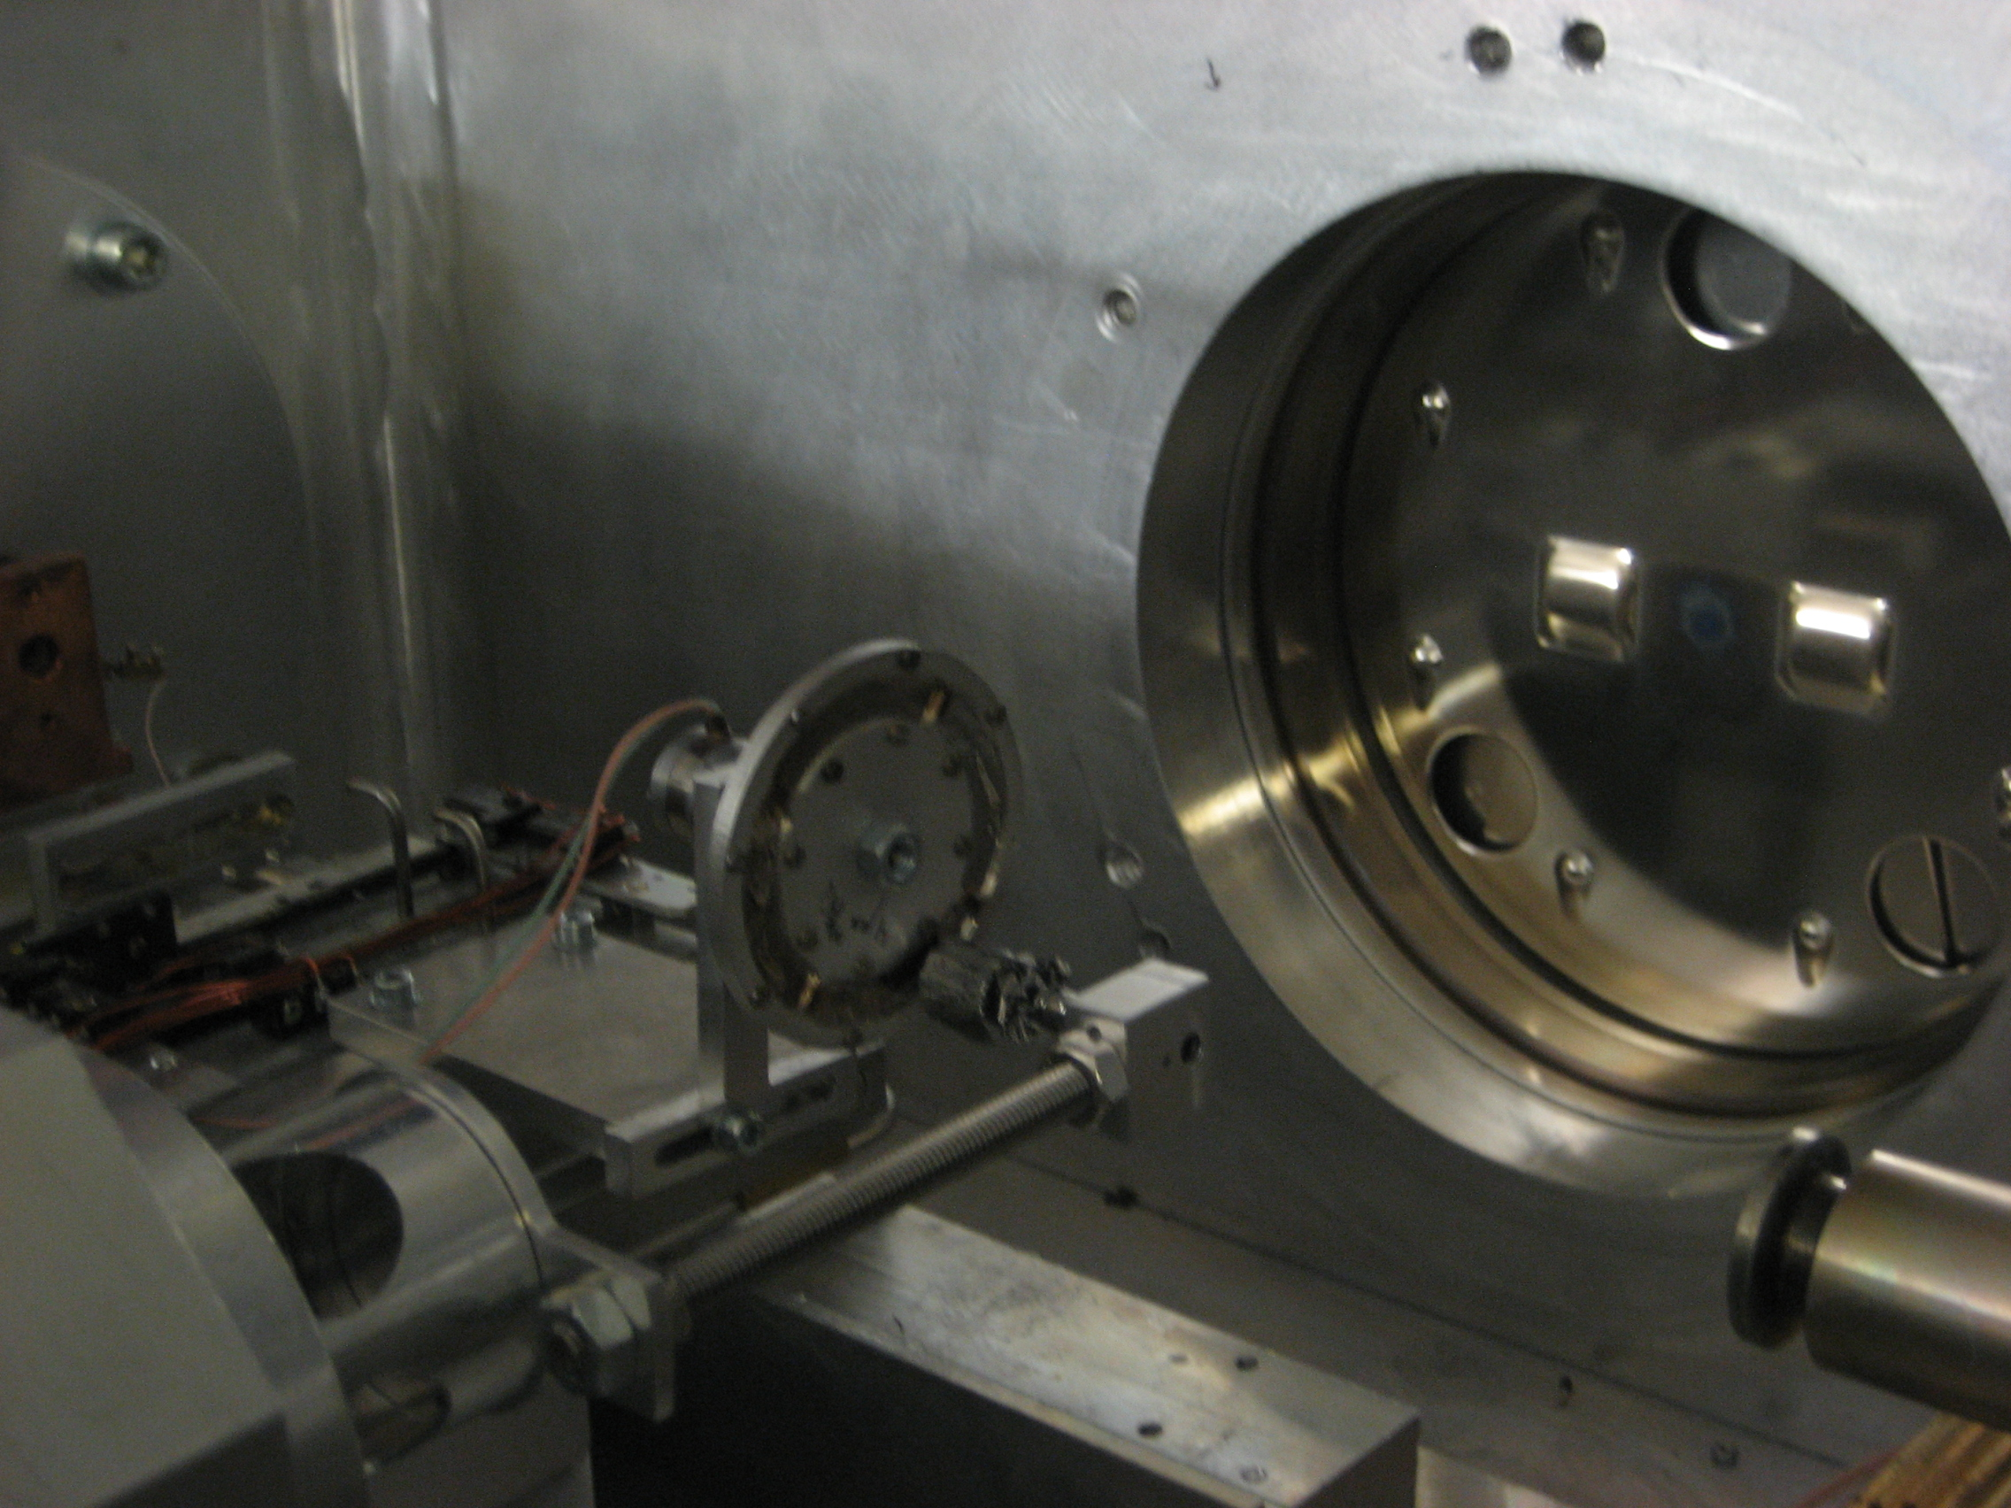
Hot Cavity Catcher at IGISOL ver 0.
The hot cavity project at IGISOL started in 2007.
  First iterations were primary-beam heated catchers
“PRIMARY BEAM HEATED CATCHER
The first tests of a hot cavity involved direct heating of a graphite catcher using a ⁴⁰Ca⁸⁺ primary beam. A beam intensity of 125 pnA provided a heating power of ~19 W on the catcher.
T. Kessler, I.D Moore

Slide 10
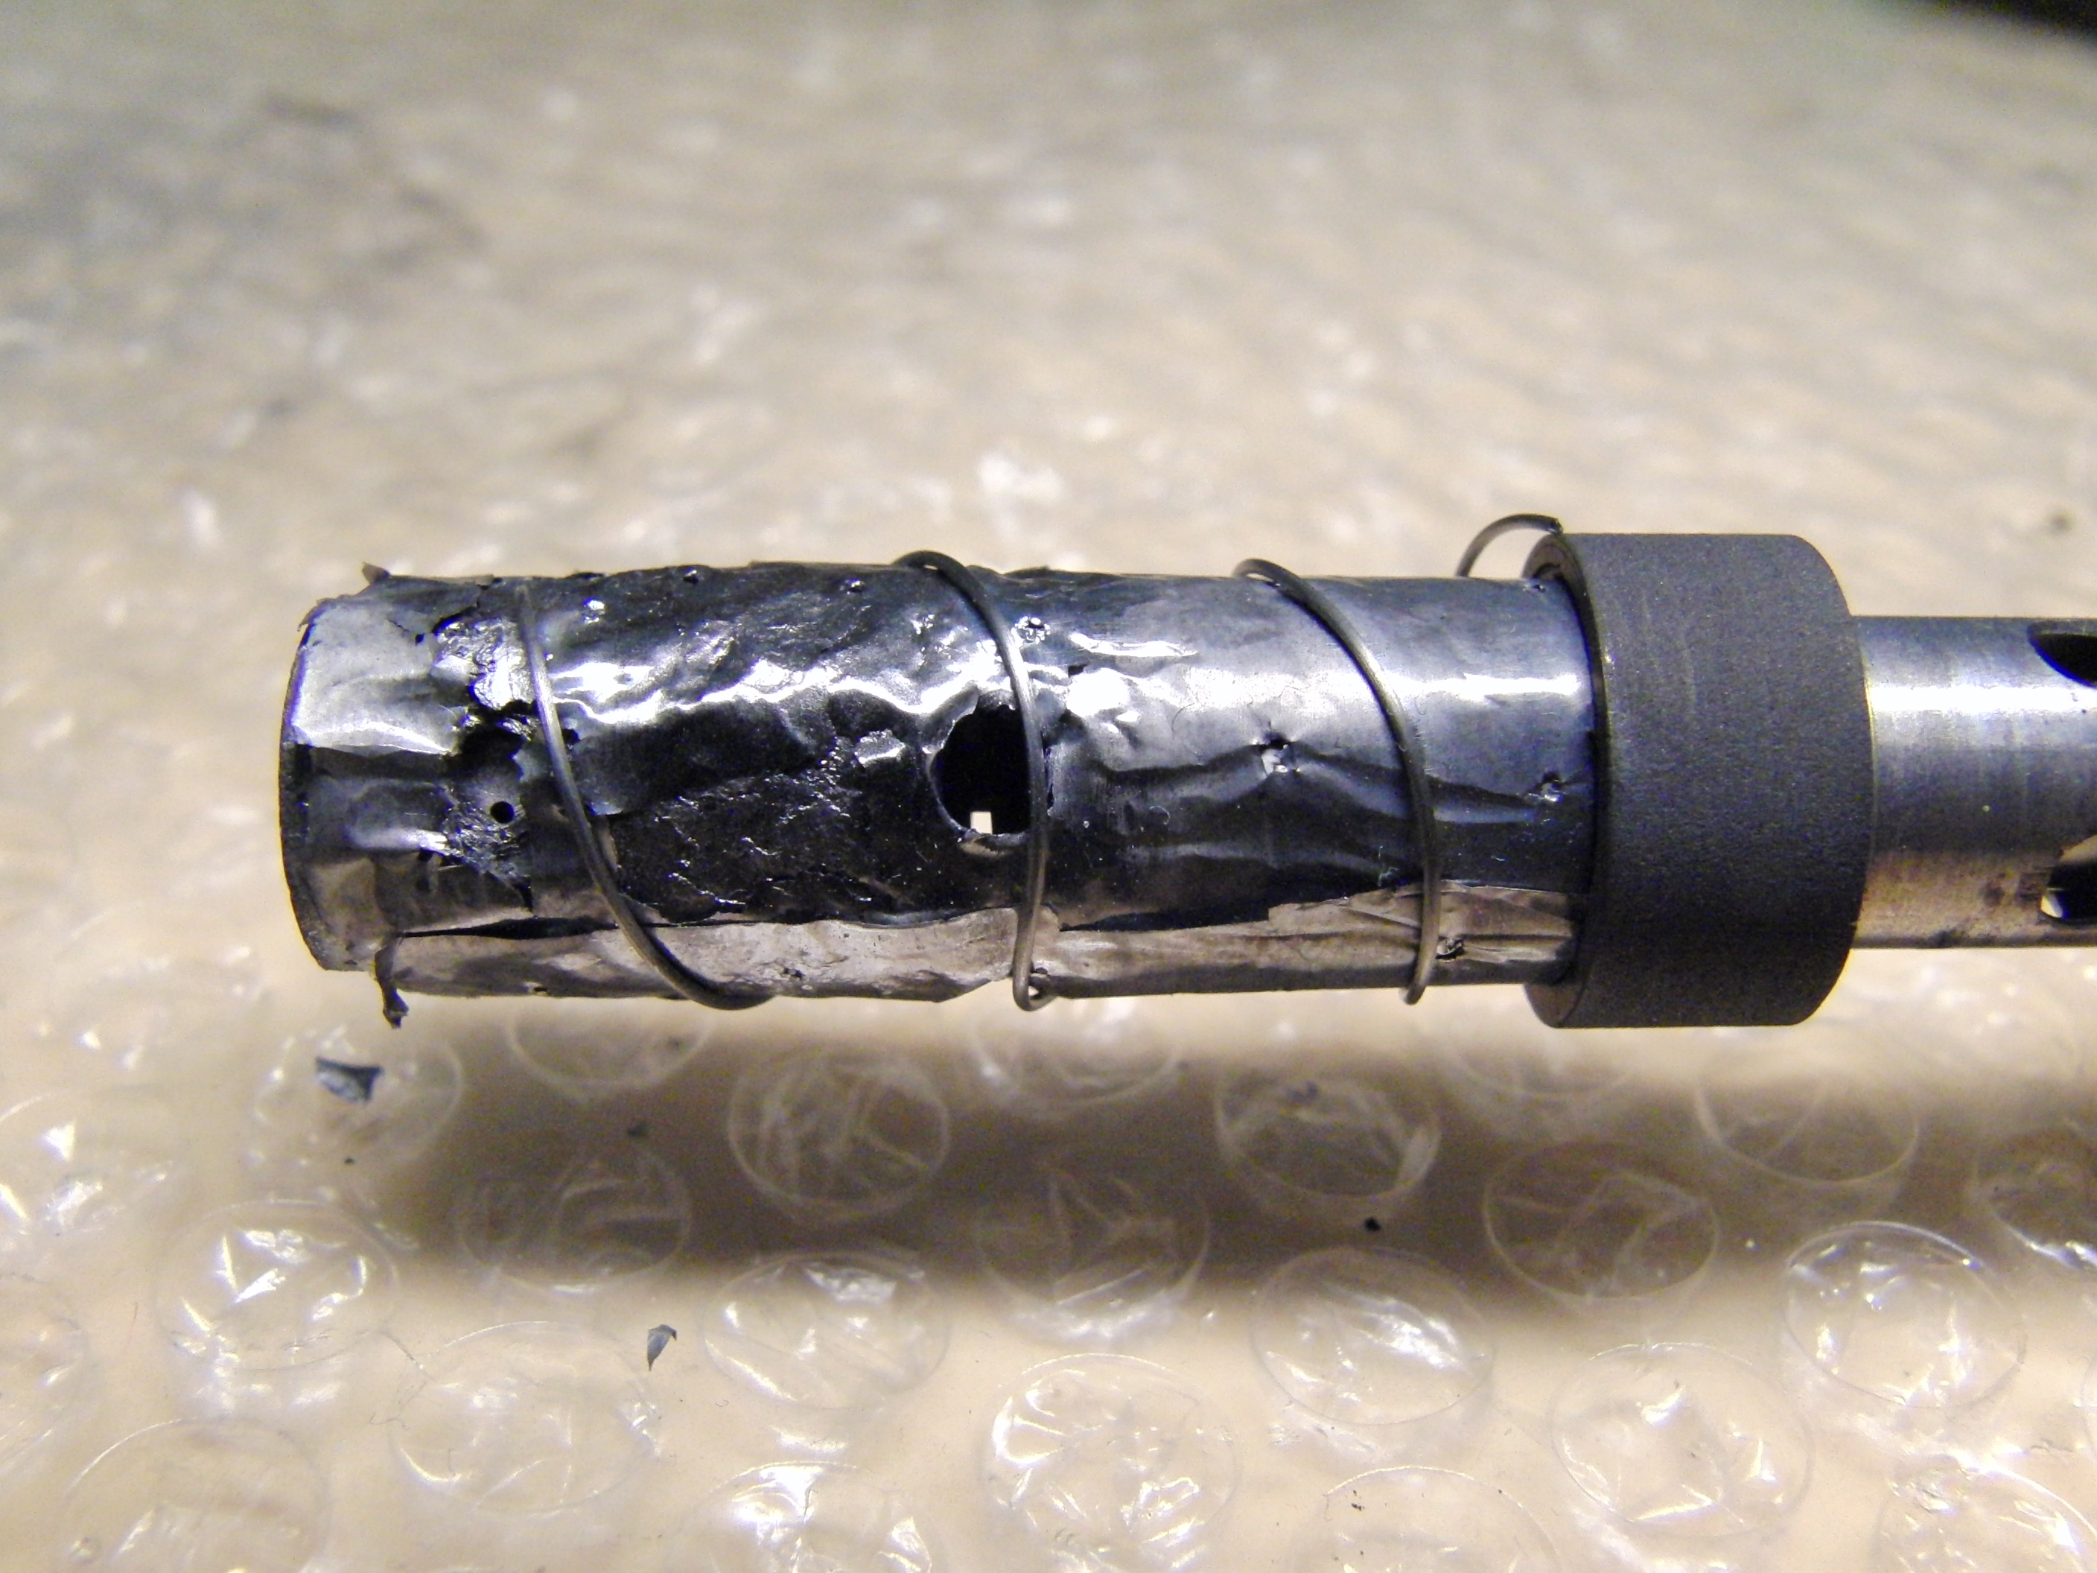
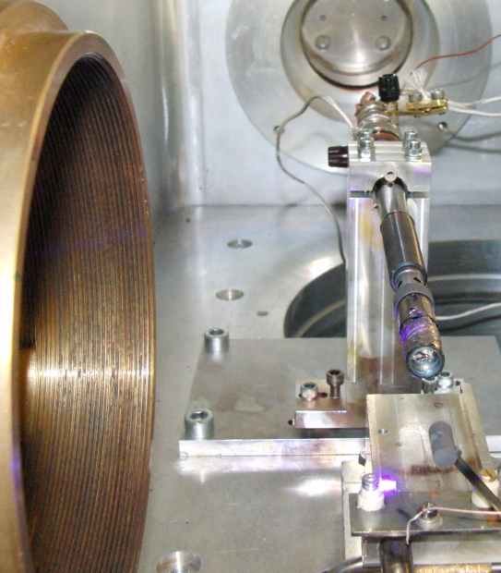
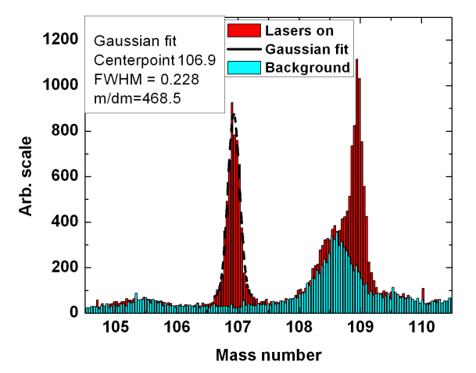
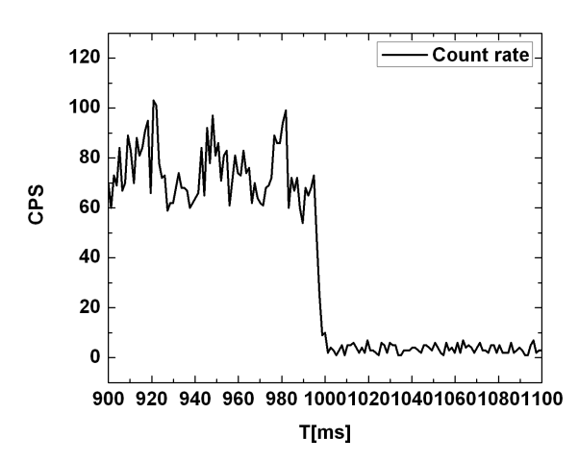
Hot Cavity Catcher at IGISOL ver 1.
Two FEBIAD ion sources acquired from GSI in 2008-2009
  We had difficulties in achieving a stable operation
  Multiple melted components!
  First offline RIS results
¹⁰⁷Ag first step wavelength
scan as function of oven temperature
Dipole mass scans over stable ^{107,109}Ag
Laser ionized ¹⁰⁷Ag signal in crossed-beam geometry
M. Reponen et al., Eur. Phys. J. A 42, 509–515 (2009)
Notes:
Promise to make 94Ag that

Slide 11
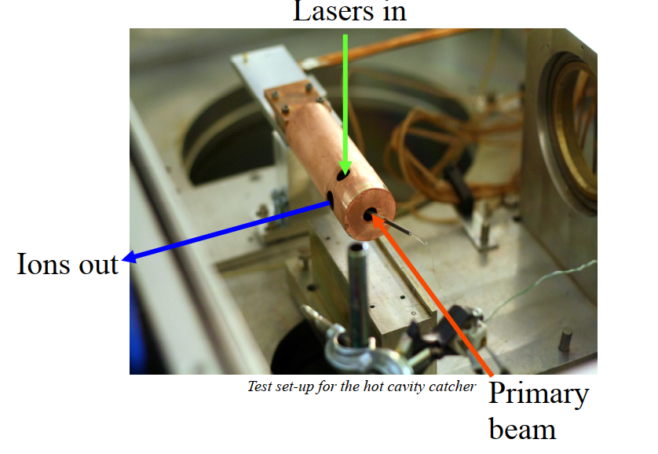
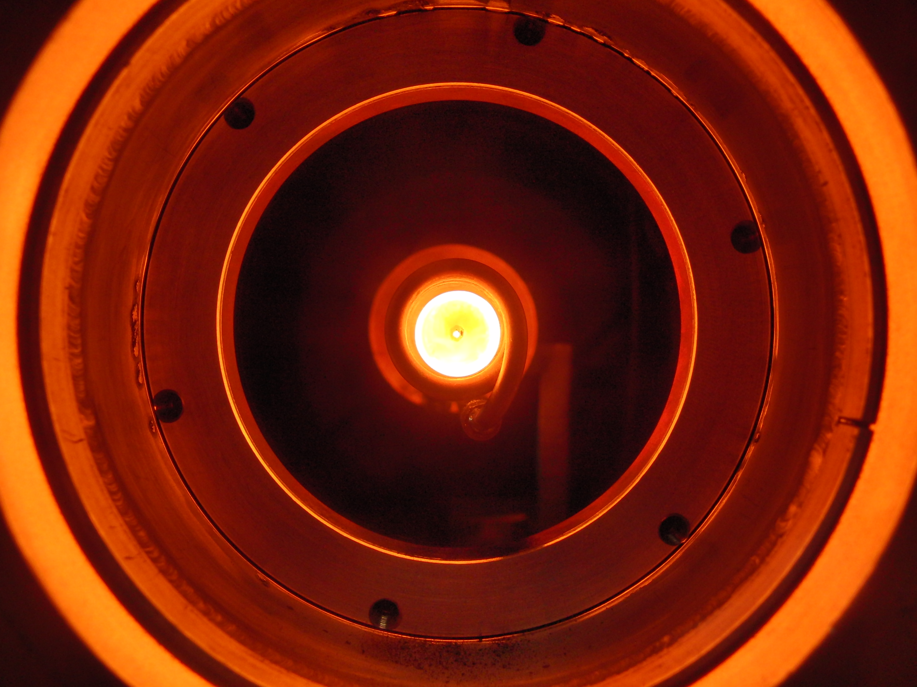
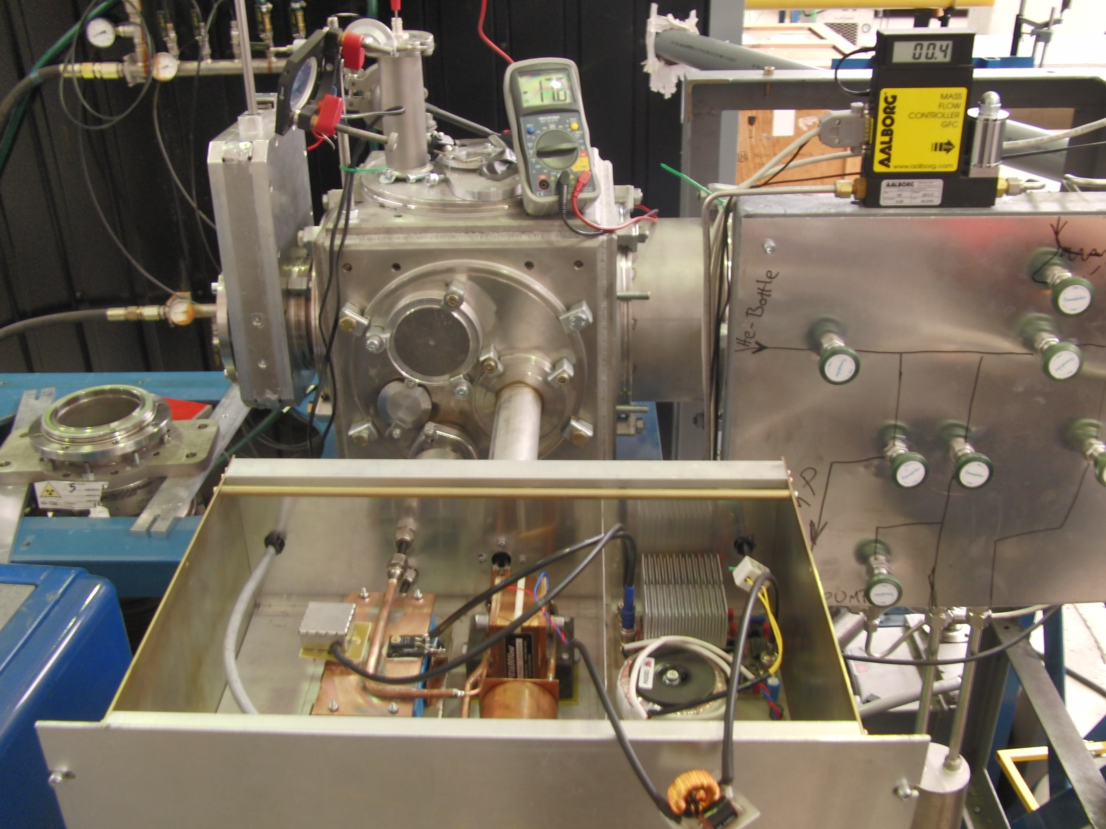
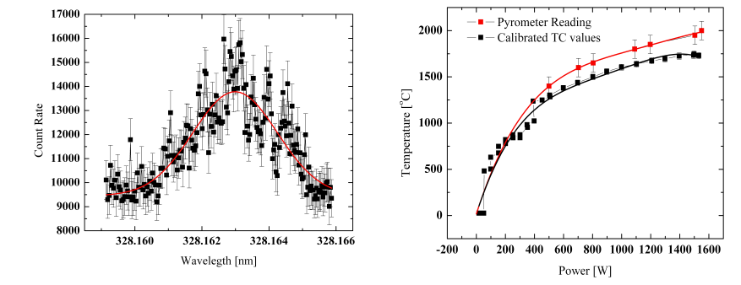
Inductively Heated Hot Cavity Cather Laser Ion Source
Ver. 3
Made in collaboration with JYFL ACCLAB ion source team
Focus was to address the stability issues of FEBIAD and provide a better laser ionization geometry.
  The first iteration was without a specific laser interaction region.
  Laser ionization between the coil caused huge energy spread
  Poor efficiency
  Laser scan over the first resonant step. The FWHM
  of the scan is 8.2 GHZ.
  Catcher temperature as a function of the power drawn by
  the RF supply.

Slide 12
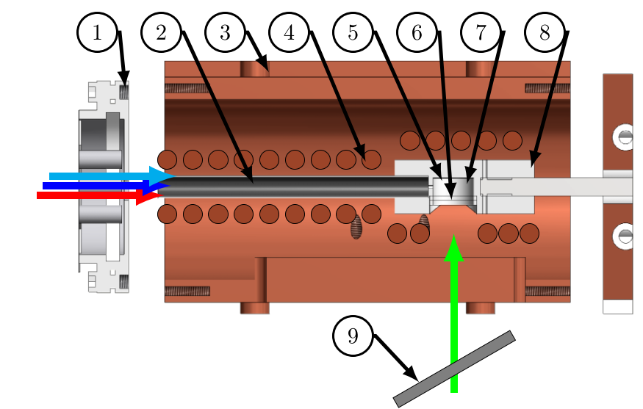
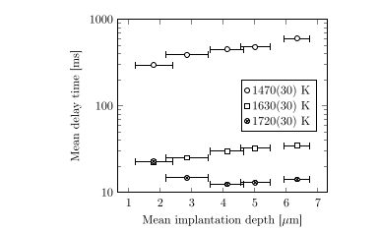
Inductively Heated Hot Cavity Cather Laser Ion Source
Ver. 4
Included a transfer tube for laser ionization
  Inductively heated
Demonstrated the fast extraction of silver
1. SPIG entrance, 2. Ta transfer tube,
3. Water-cooled heat shield, 4. Copper coil, 5. Graphite catcher, 6. Ta window, 7. Hot cavity, 8. Mo crucible, 9. Ni degrader foil.
The mean delay time τ acquired via a fit for different catcher temperatures (measured at the window) and implantation depths. The error bars indicate one standard deviation of the implantation depth distribution. Errors associated with the delay time are within the data points.
M. Reponen et al., Rev. Sci. Instrum. 86, 123501 (2015)

Slide 13
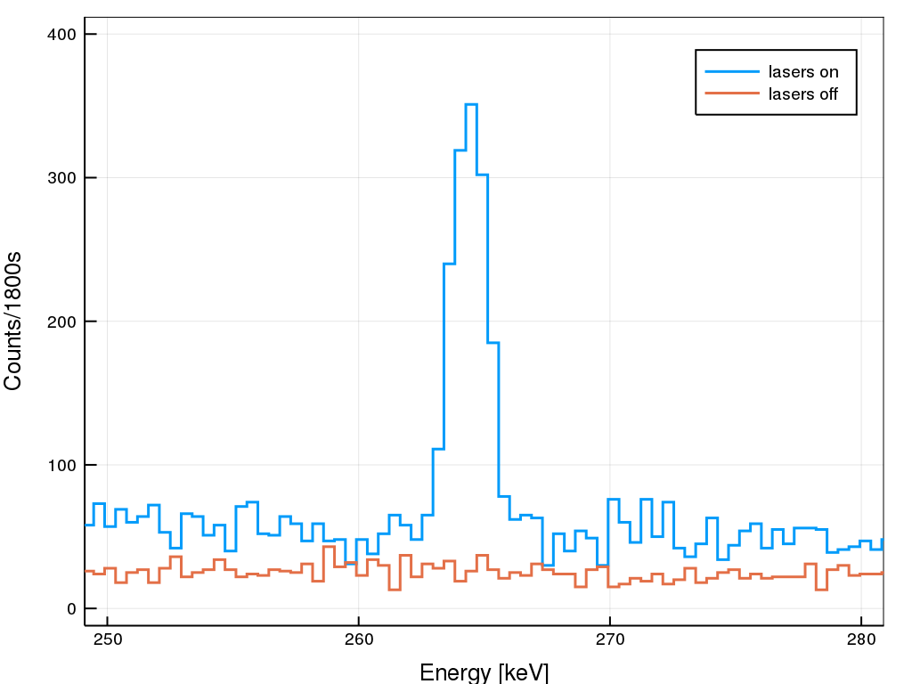
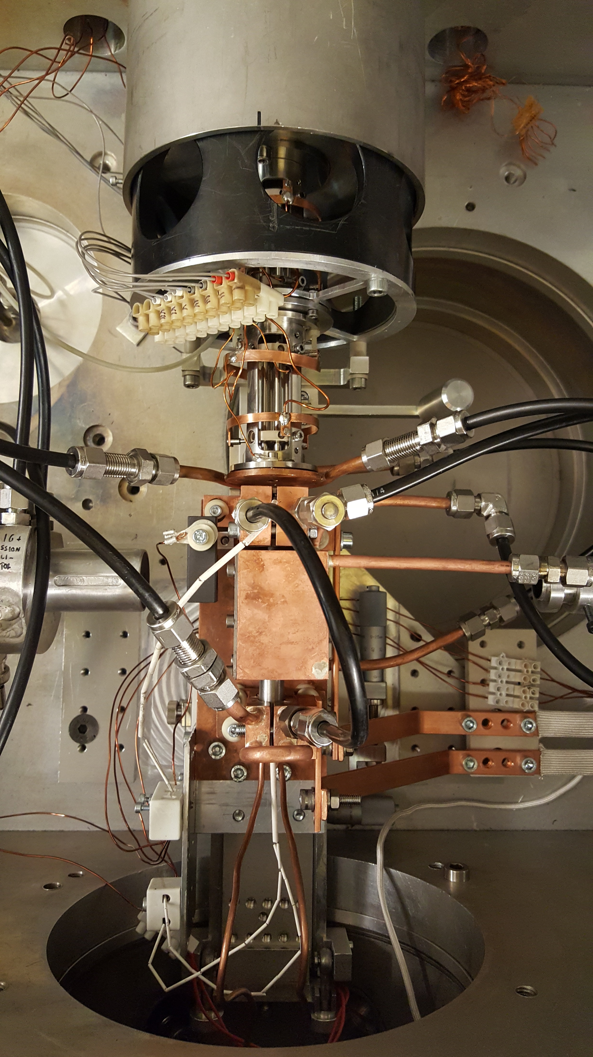
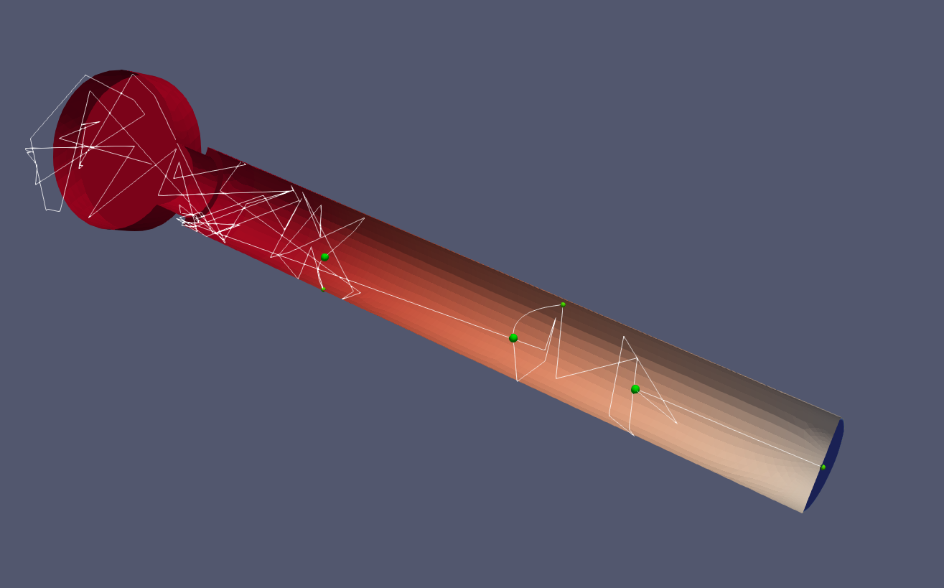
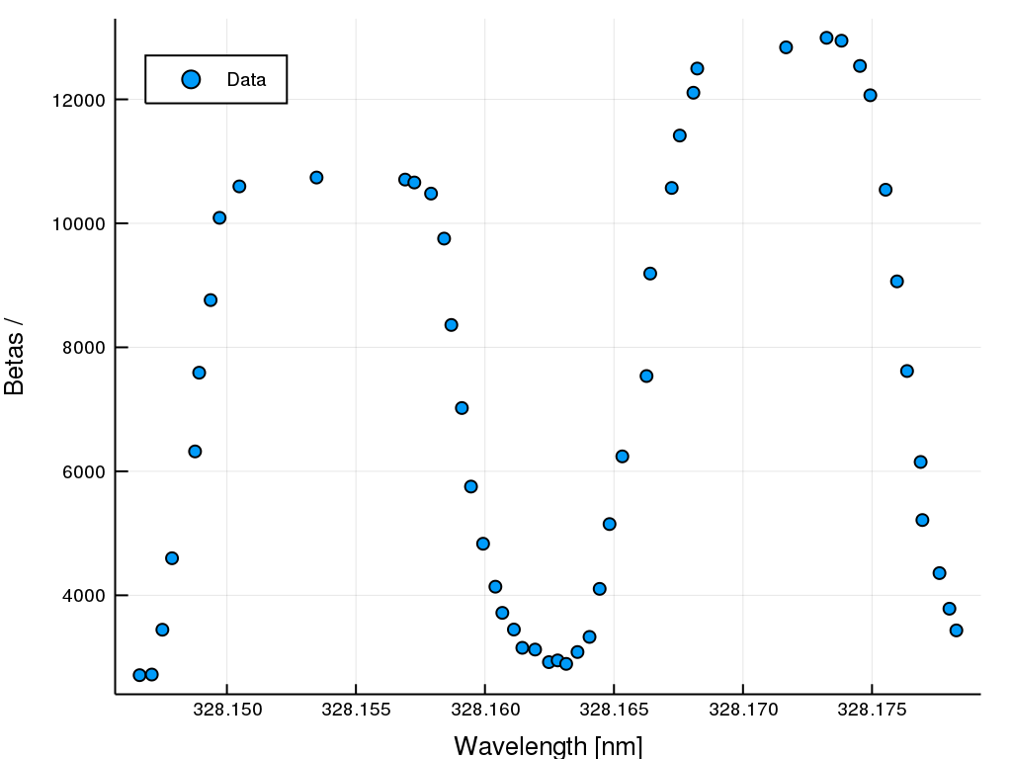
Inductively Heated Hot Cavity Cather Laser Ion Source ver 5.
Separate heating for catcher and the transfer tube
  Current flow through the whole crucible
  Full Mo crucibles hard to manufacture
    Deformation under heating an issues
First extraction of radioactive silver!
  ⁹⁹Ag observed
  Lasers scanning and ion detection arrangement was deemed poor.
⁹⁹Ag gamma
Beam out
Laser in
Primary beam
Catcher

Slide 14
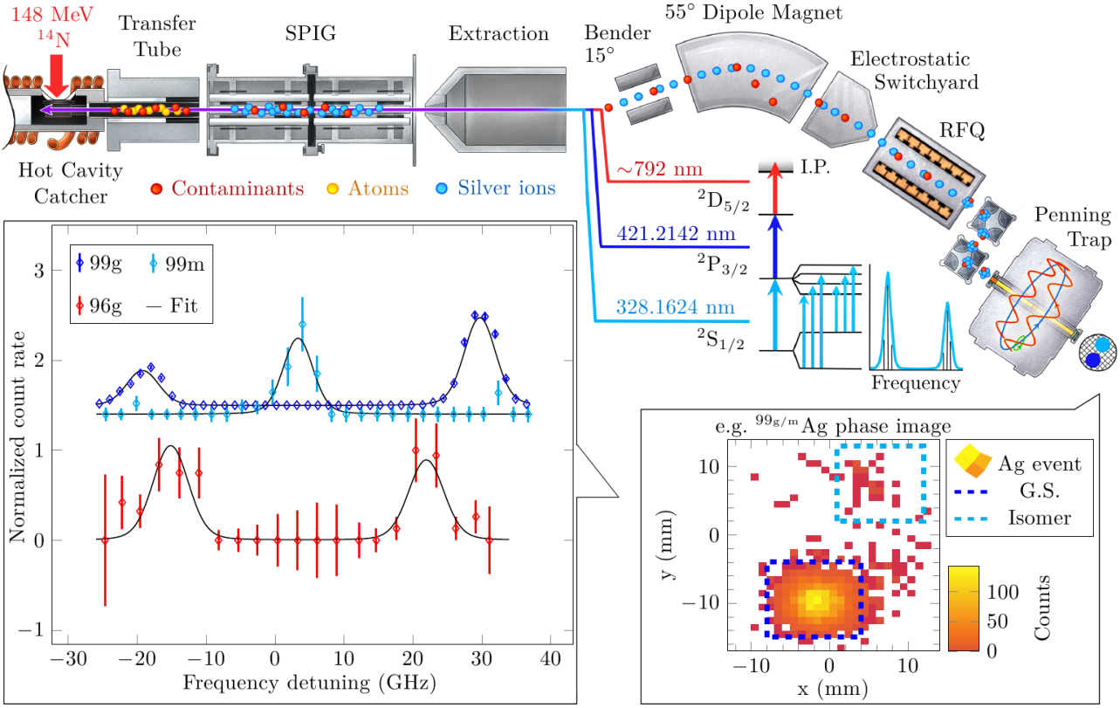
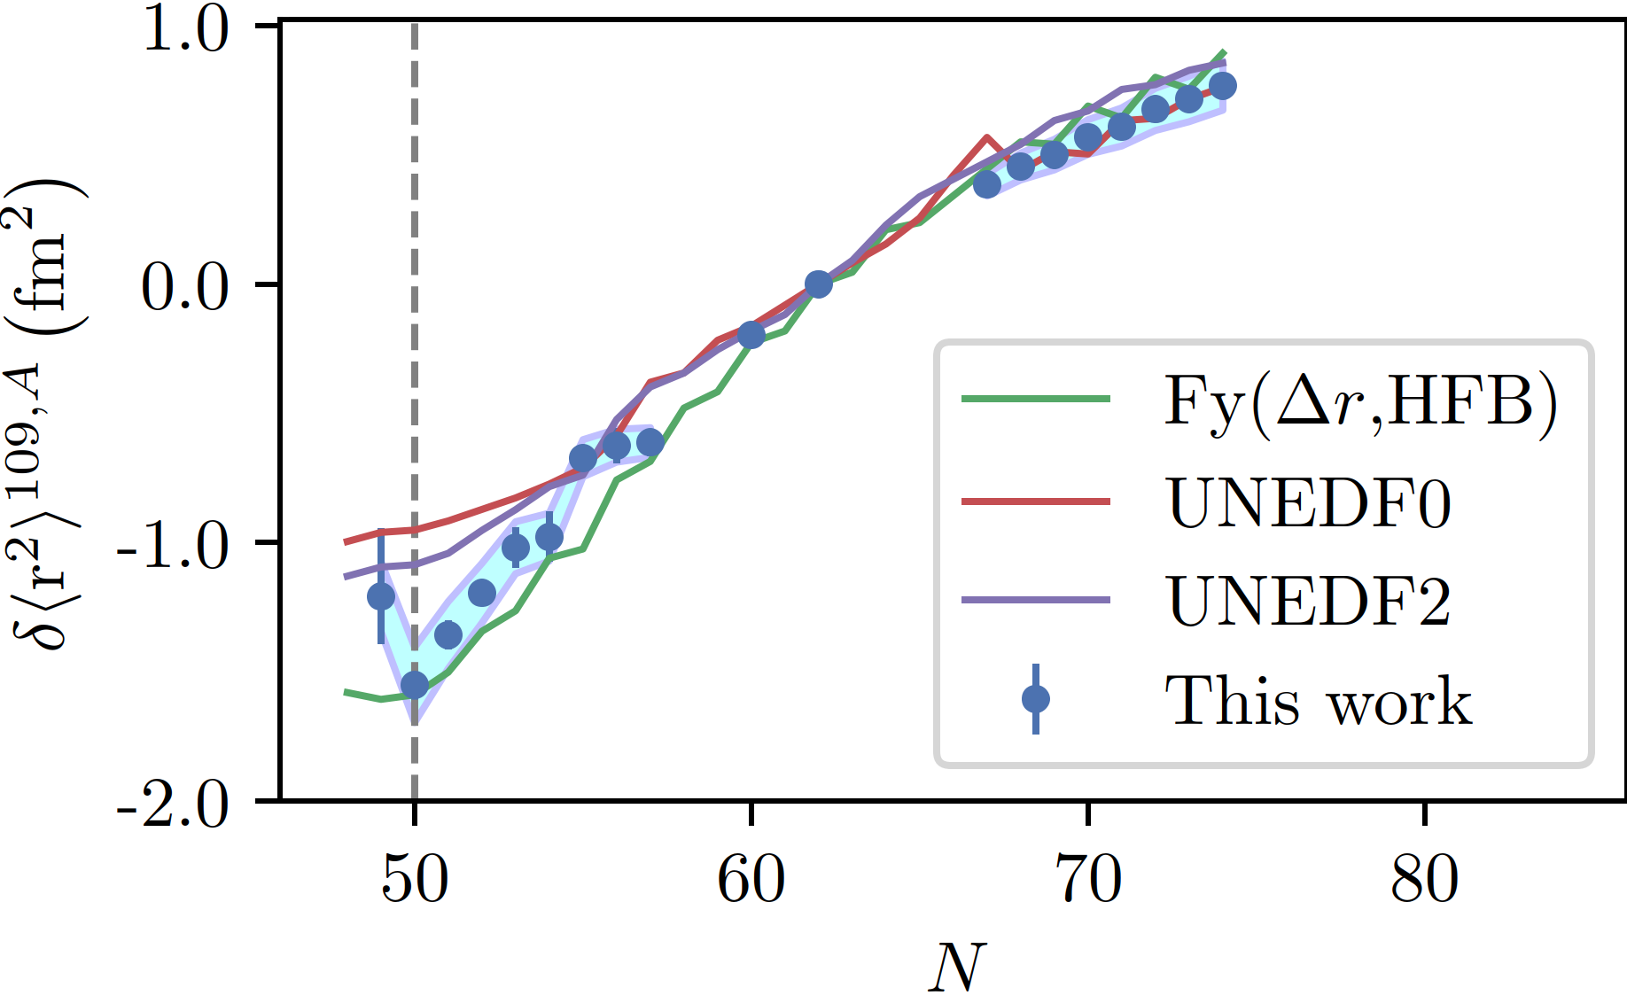
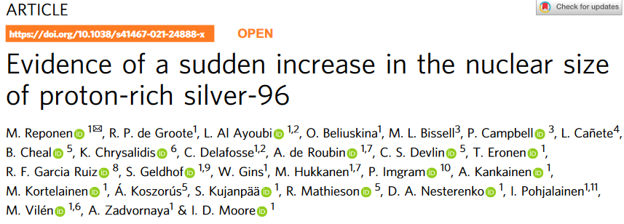
Inductively Heated Hot Cavity Cather Laser Ion Source ver 5. - Combined PI-ICR and Dual Etalon lasers
M. Reponen et al., Nat. Comm. 12 (2021)

Slide 15
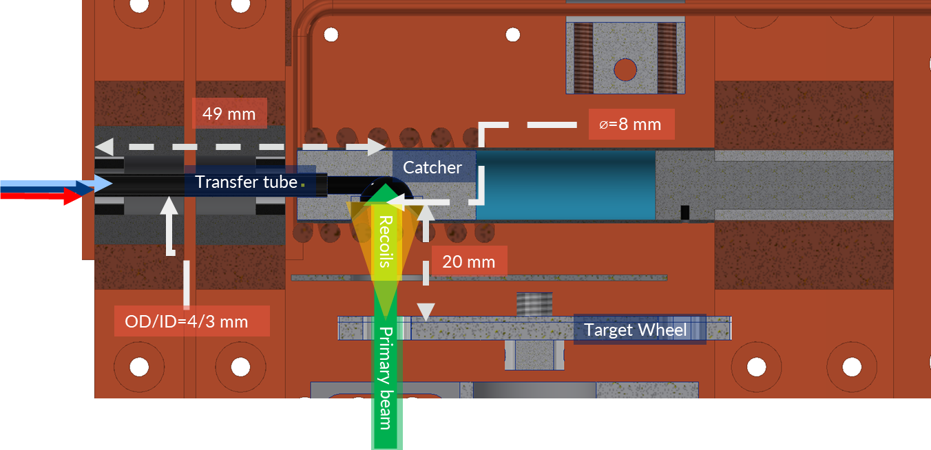
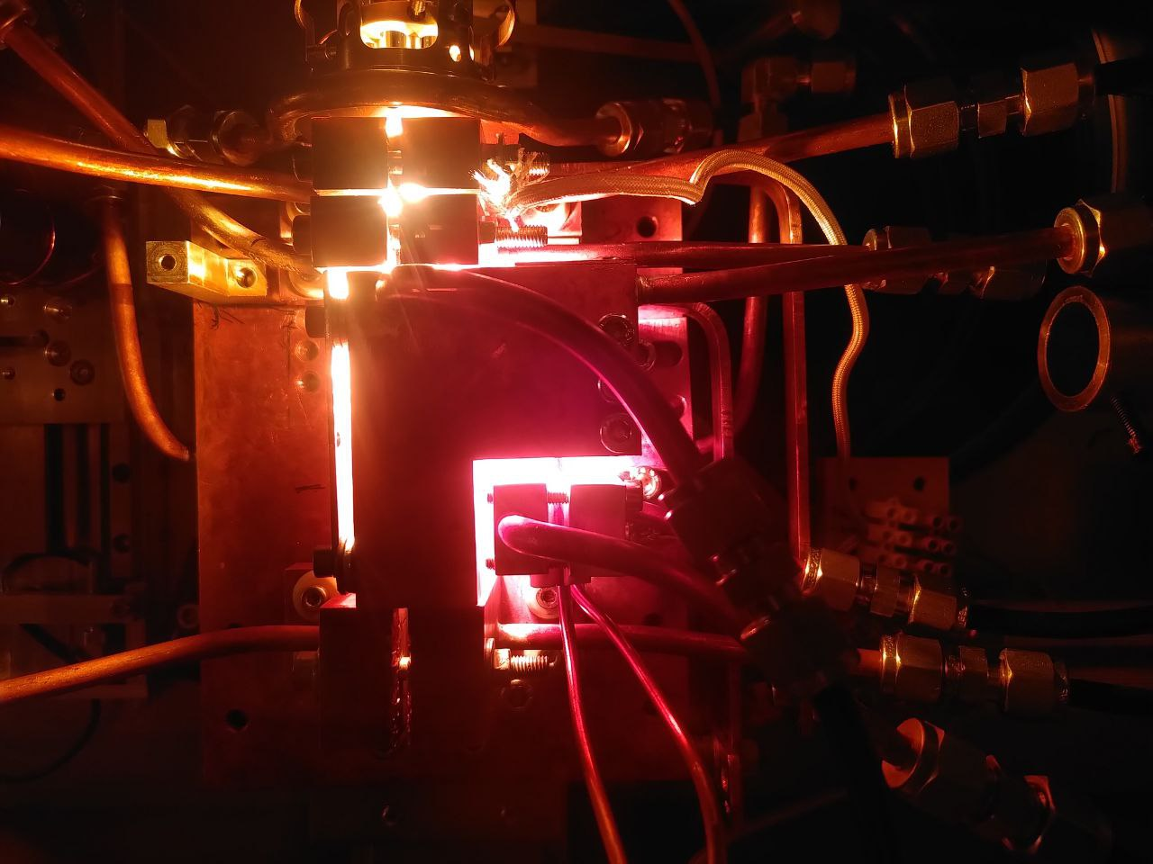
Inductively Heated Hot Cavity Cather Laser Ion Source ver 6.
A target ion source system for fusion-evaporation products
  Efficient: 1 % for Ag and Pd
  Fast: <20 ms for Ag, less than 90 ms for Pd
¹⁴N + ^{nat./92}Mo
⁴⁰Ca + ^{58/60}Ni
Notes:
The graphite transfer tube was replaced with sigradur.

Slide 16
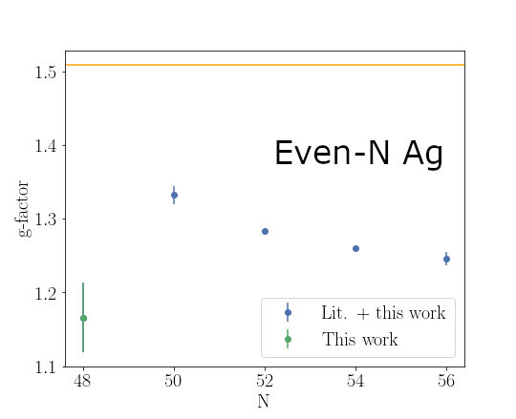
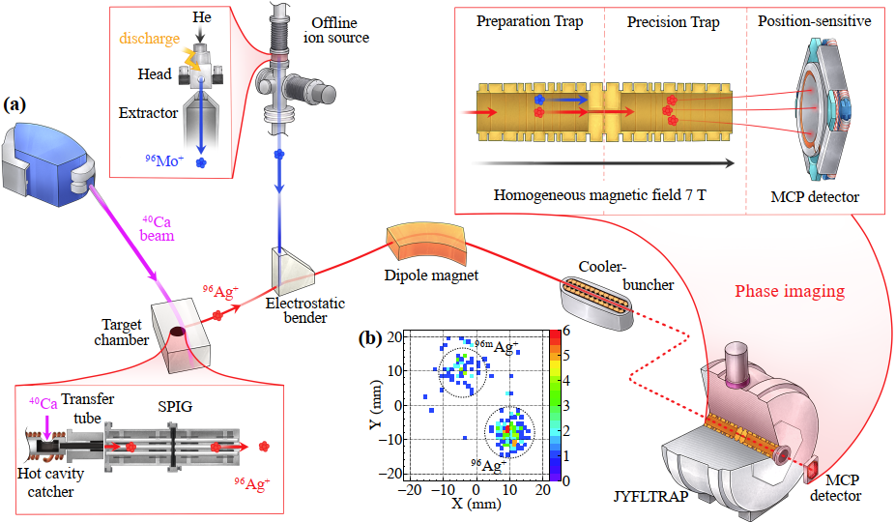
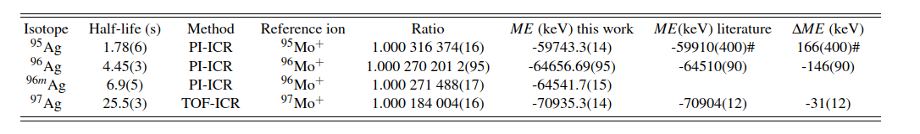
PI-ICR Assisted RIS and mass measurements beyond N=50
M. Reponen, in preparation
Preliminary!
Z. Ge, M. Reponen, in preparation

Slide 17
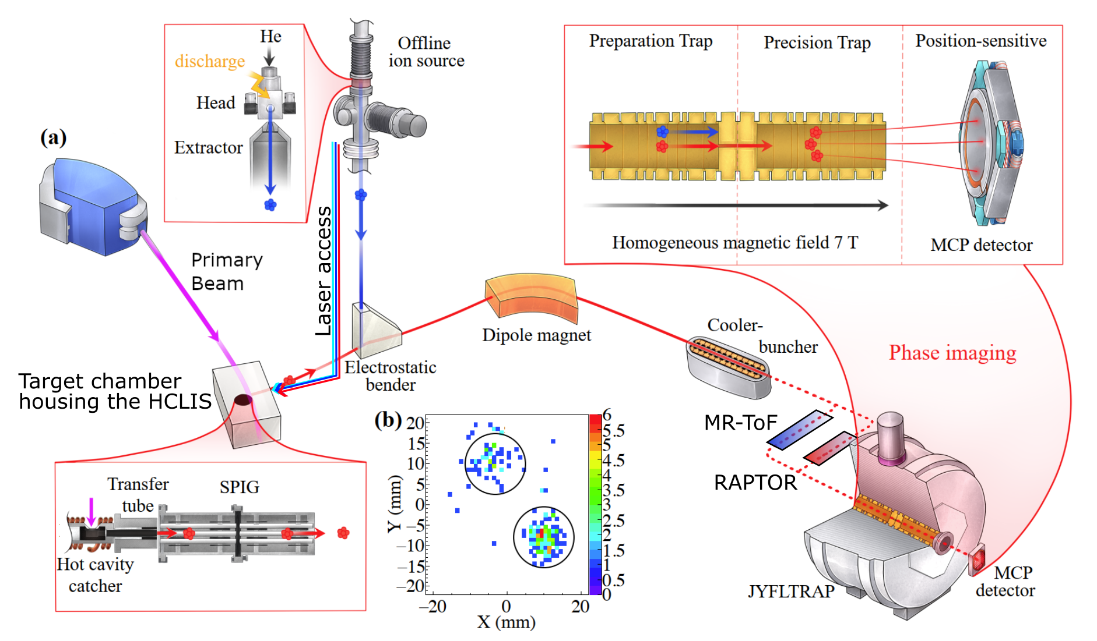

Slide 18
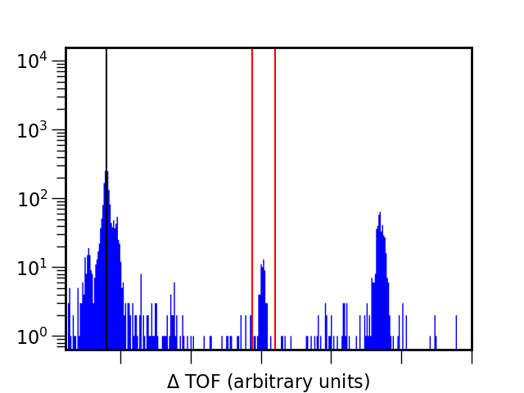
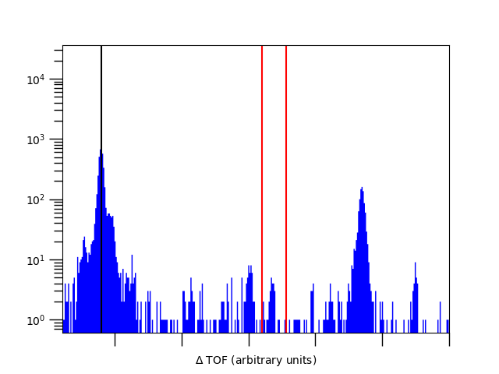
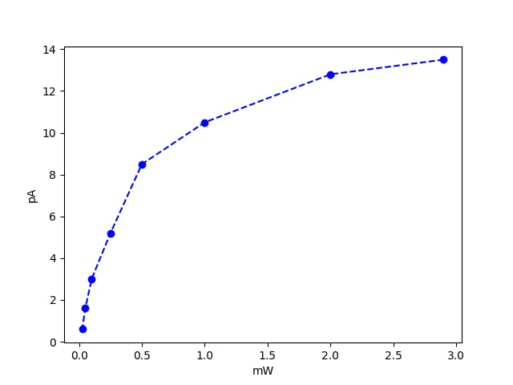
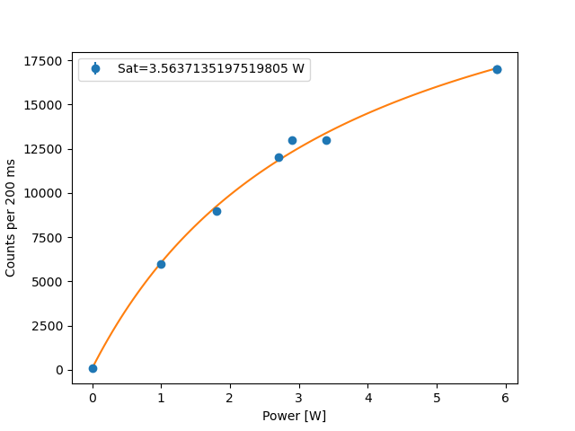
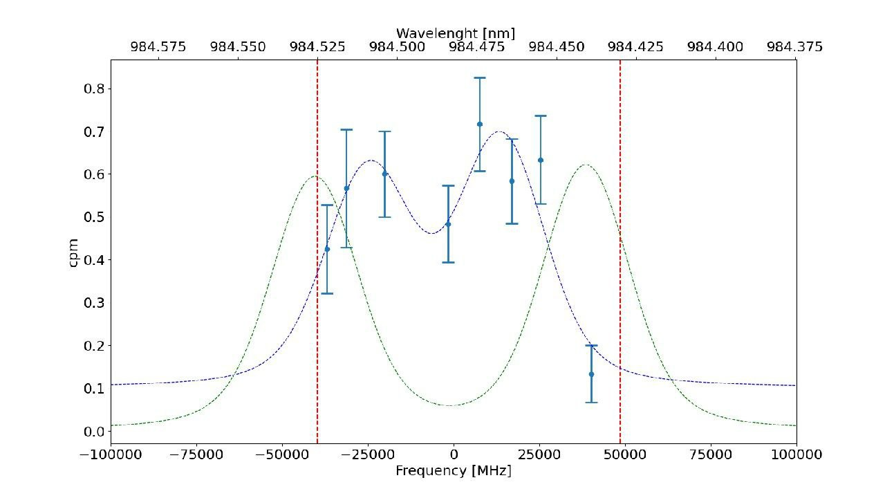
Latest results
Laser wavelength set to 984.494 nm (JUN45 based estimate for 7+!)
Preliminary!
Preliminary!
26.4-10.5 mass spectrometry of ⁹⁴Ag
  A 205 MeV ⁴⁰Ca
  2.2 mg/cm² ⁵⁸Ni rotating target
  1, 2, 3, 4 µm Mo degrader set
⁹⁵Ag clearly seen with MR-ToF
Two states clearly observed at mass 94
Laser wavelength set to 984.525 nm (JUN45 based estimate for 21+ !)
  Mass peaks responds to lasers on/off and delays and first step laser frequency.
1st step: 328 nm
Ionizing step: ~750-770 nm
Preliminary!
Notes:
Encouraged by recent successes on ^{96, 95}Ag in JYFLTRAP Penning trap.
21+: ~70 nbarn
50+: ~580 nbarn

Slide 19
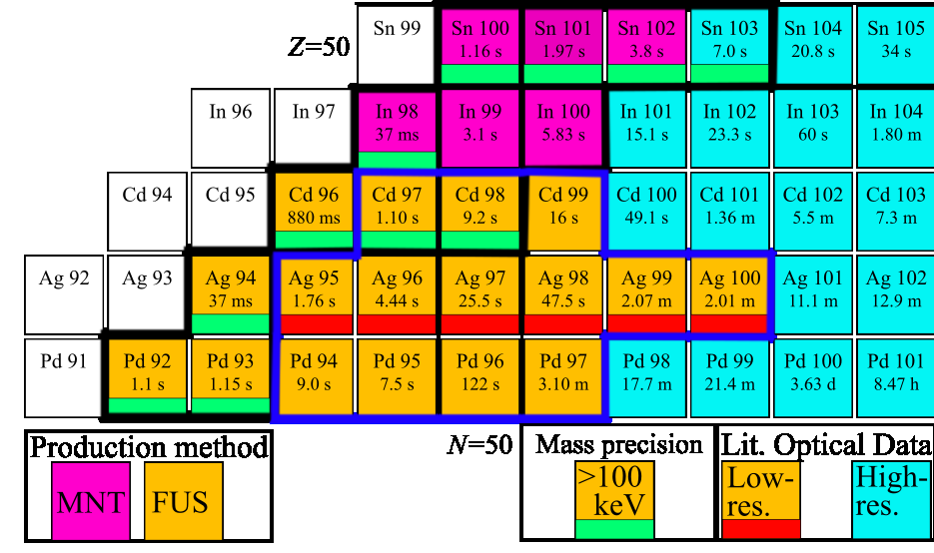
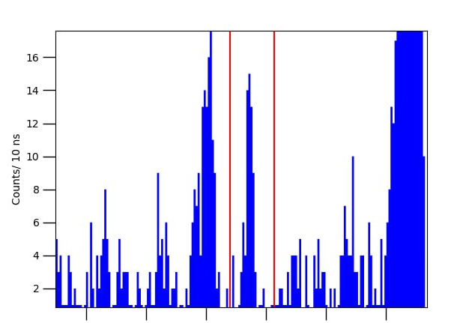
Summary and Outlook
Hot cavity + mass filters
  Access to N=Z line!
    ⁹⁴Ag produced via ⁴⁰Ca+⁵⁸Ni!
    MNT reactions possible pathway for Sn and In?
Research opportunities in the region below tin-100:
  Laser spectroscopy
    ⁹⁴Ag will be next
  Further mass measurements
    1 % HCLIS efficiency shown for Pd!
  Decay spectroscopy with pure isomeric beams?
Hot cavity future activities
  Characterize the latest catcher properly!
  Improve efficiency
    Now factor or 20-30 away from GSI
21+
Notes:
21+ cross section very similar to tin-100 cross-section. 70 nbarn vs 30 nbarn.

Slide 20
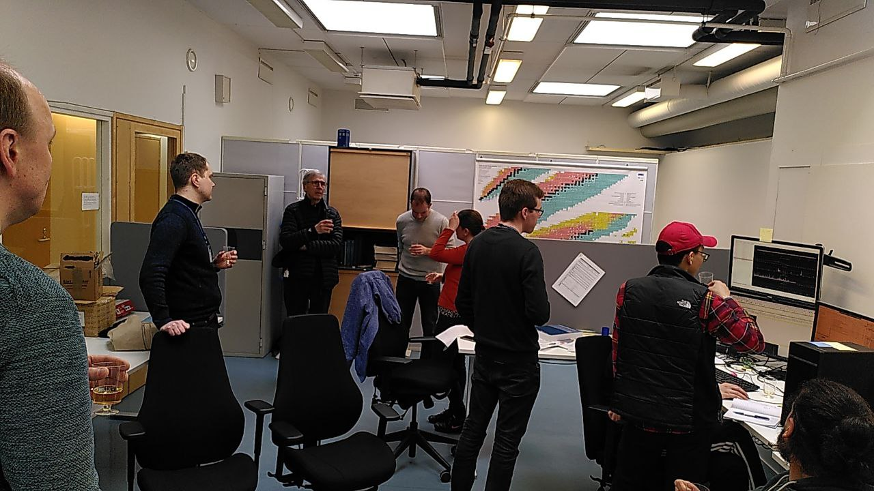
Thank you for listening!
JYFL-ACCLAB: T. Eronen, A. Jaries, A. Kankainen, S. Kujanpää I. D. Moore, S. Nikas, I. Pohjalainen, A. Raggio, J. Ruotsalainen, M. Stryjczyk, V. Virtanen,
and the IGISOL group!
KU Leuven: R. P. de Groote
GSI: Z. Ge
Giessen: G. Kripko-Koncz
GANIL: L. Caceres

