Slide 1
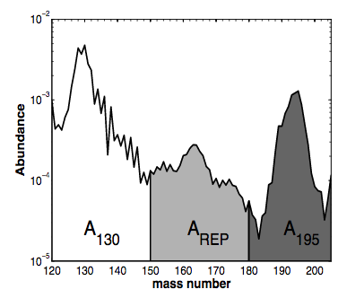
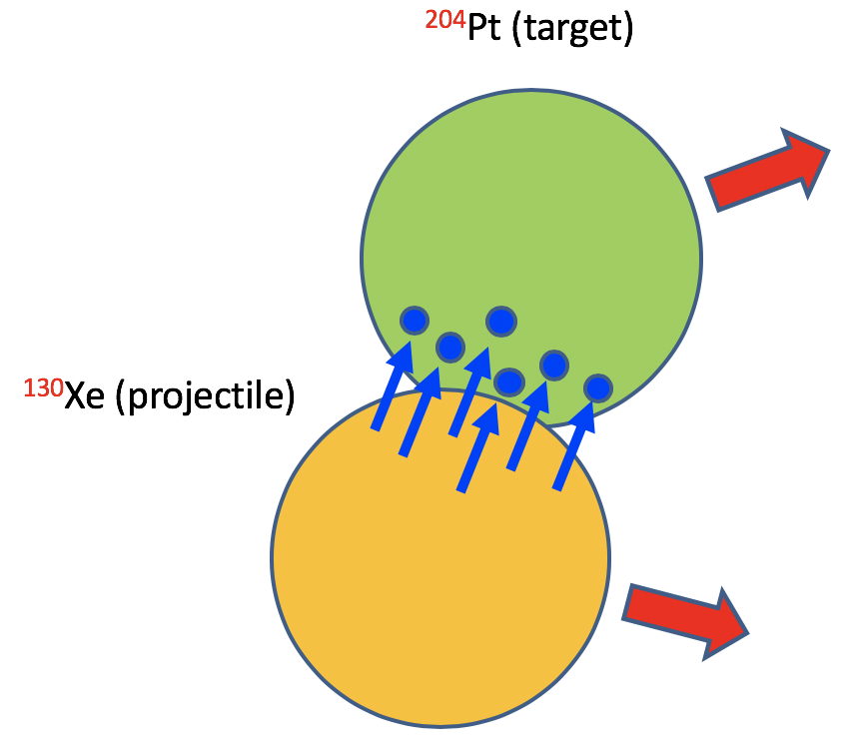
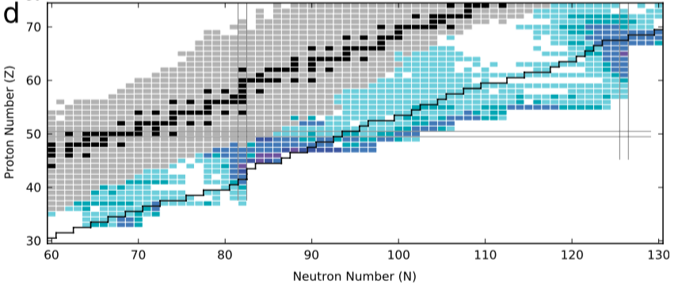
The N = 126 Factory
Maxime Brodeur
University of Notre Dame

Slide 2
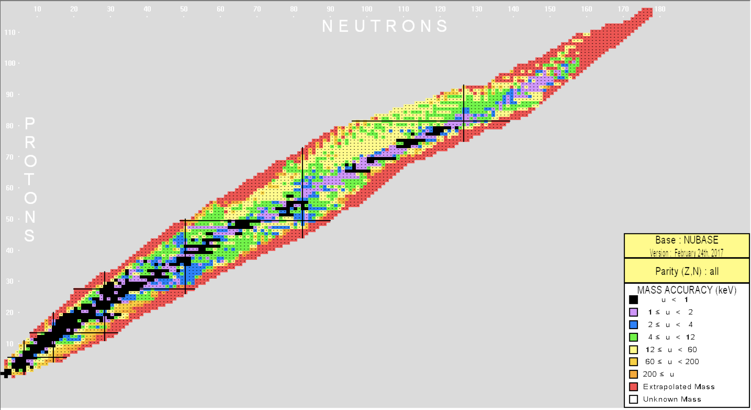
What is known?
²⁵²Cf
²³⁸U
Actanides
²⁰⁸Pb
Fission peaks
N = 126

Slide 3
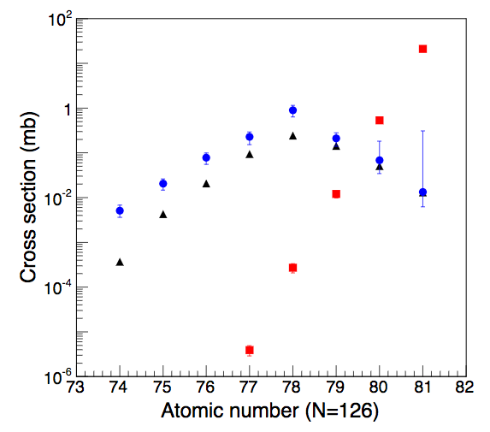
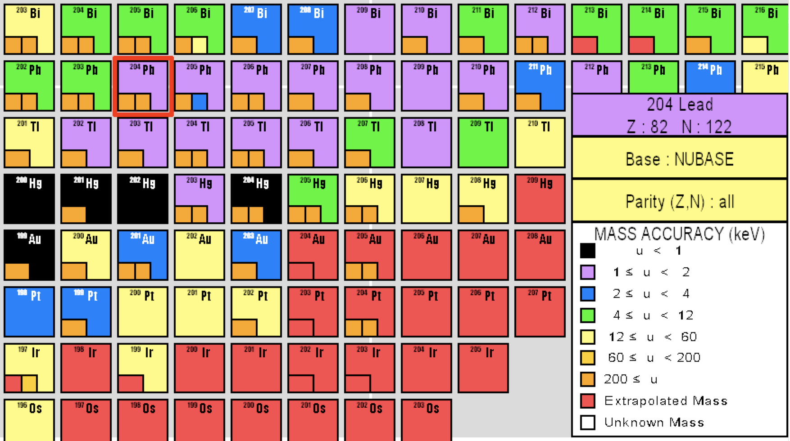
Cross-sections…
Fragmentation
²⁰⁸Pb + ⁹Be at 1 GeV/u
(fragmentation reaction with best cross-sections for N = 126)
Fragmentation
MNT reactions
(measurement)
MNT reactions
(calculation)
Hirayama et al., EPJ Web Conferences 109, 08001 (2016)
¹³⁶Xe + ¹⁹⁸Pt at 10 MeV/u
(best multi-nucleon transfer (MNT) reaction)

Slide 4
Production of N = 126 nuclei
Calculations by James Kelly done using:
http://nrv.jinr.ru/nrv/webnrv/grazing/

Slide 5
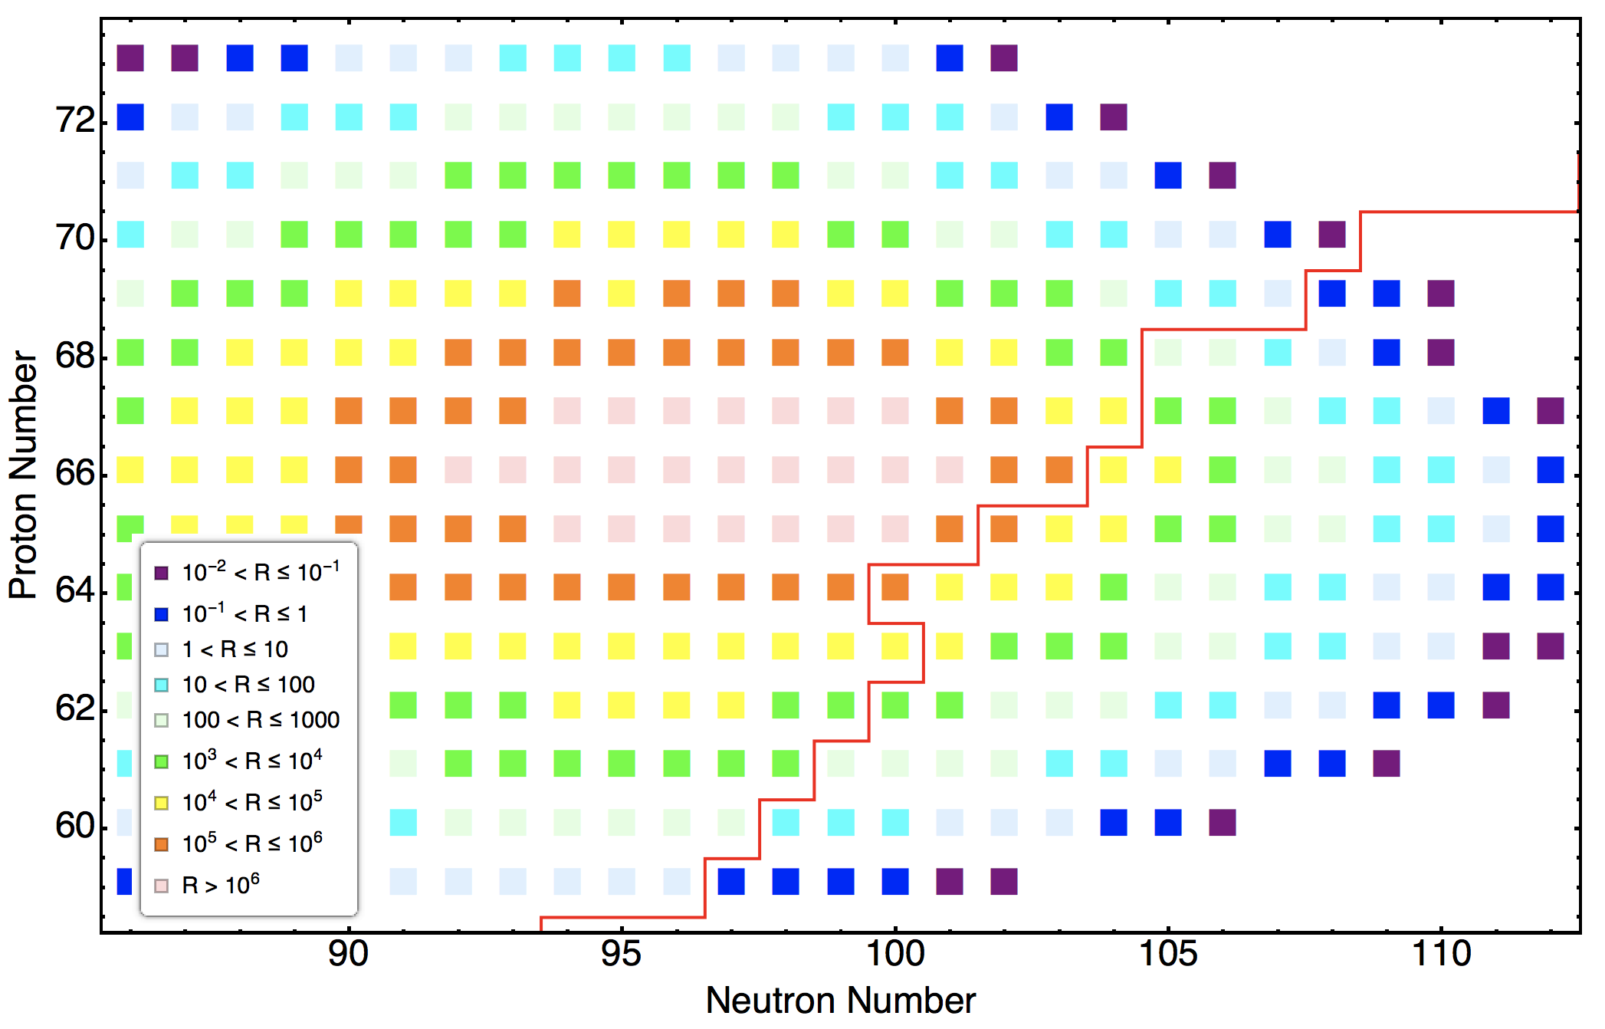
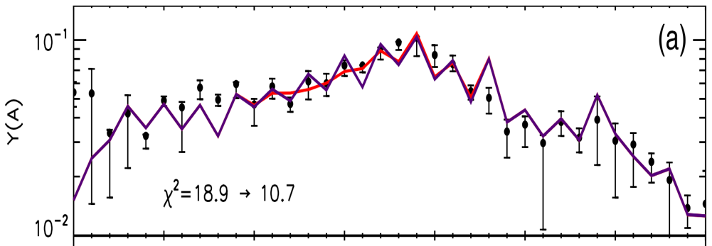
Near the heavy fission peak
¹³⁶Xe +¹⁶⁴Dy
Done at JYFLTRAP/CPT
AME16
Yb
Er
Dy
M. Vilen et al., PRL 120, 262701 (2018)
Gd
Sm
Nd
Calculations done using:
http://nrv.jinr.ru/nrv/webnrv/grazing/

Slide 6
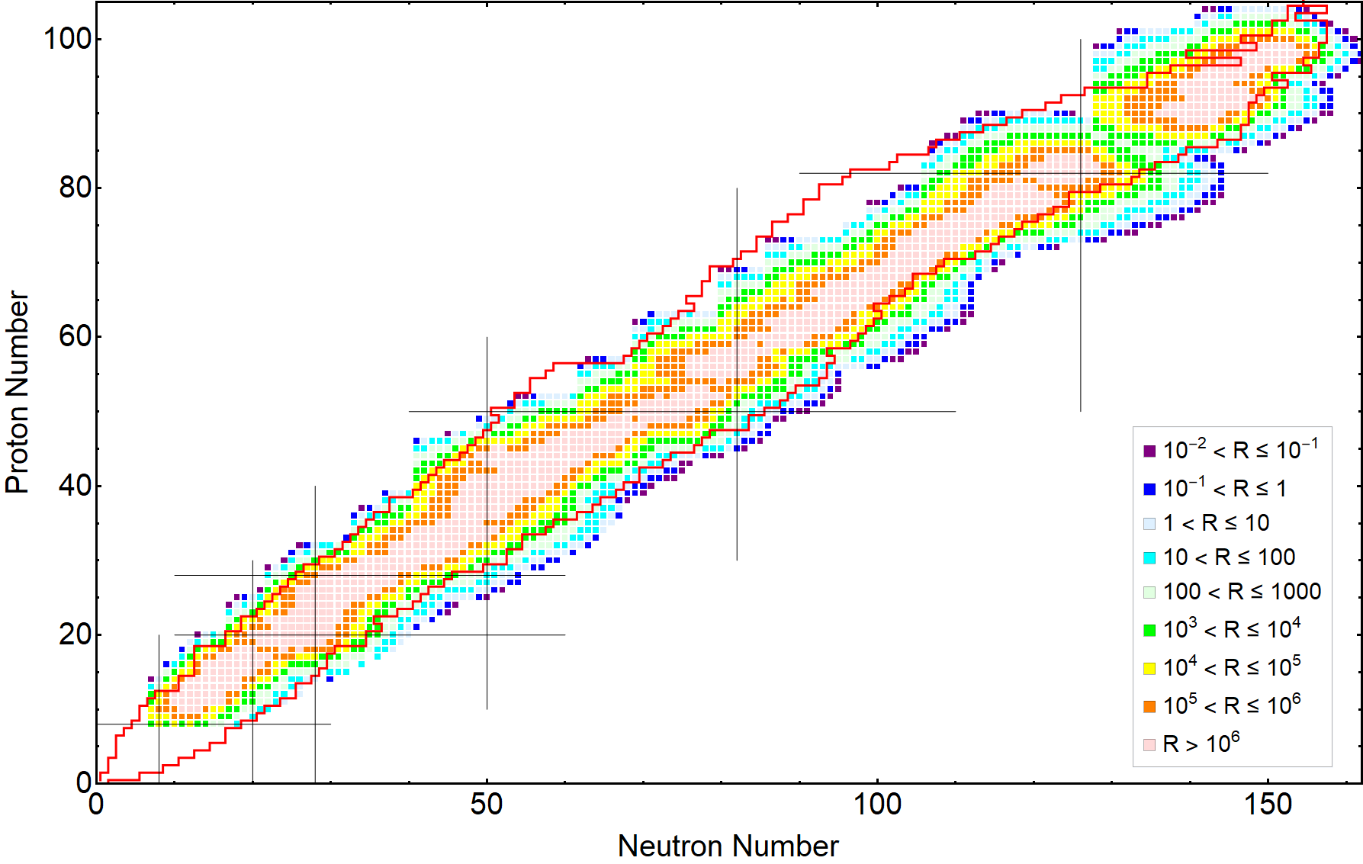
From Mg to Cf
5 pμA ¹³⁶Xe at 9 MeV/u on different targets (²⁶Mg to ²⁵²Cf)
Target thickness 10 mg/cm² or 50 mCi/cm² limit.
Red lines: AME20 known masses
Calculations by Biying Liu done using:
http://nrv.jinr.ru/nrv/webnrv/grazing/

Slide 7
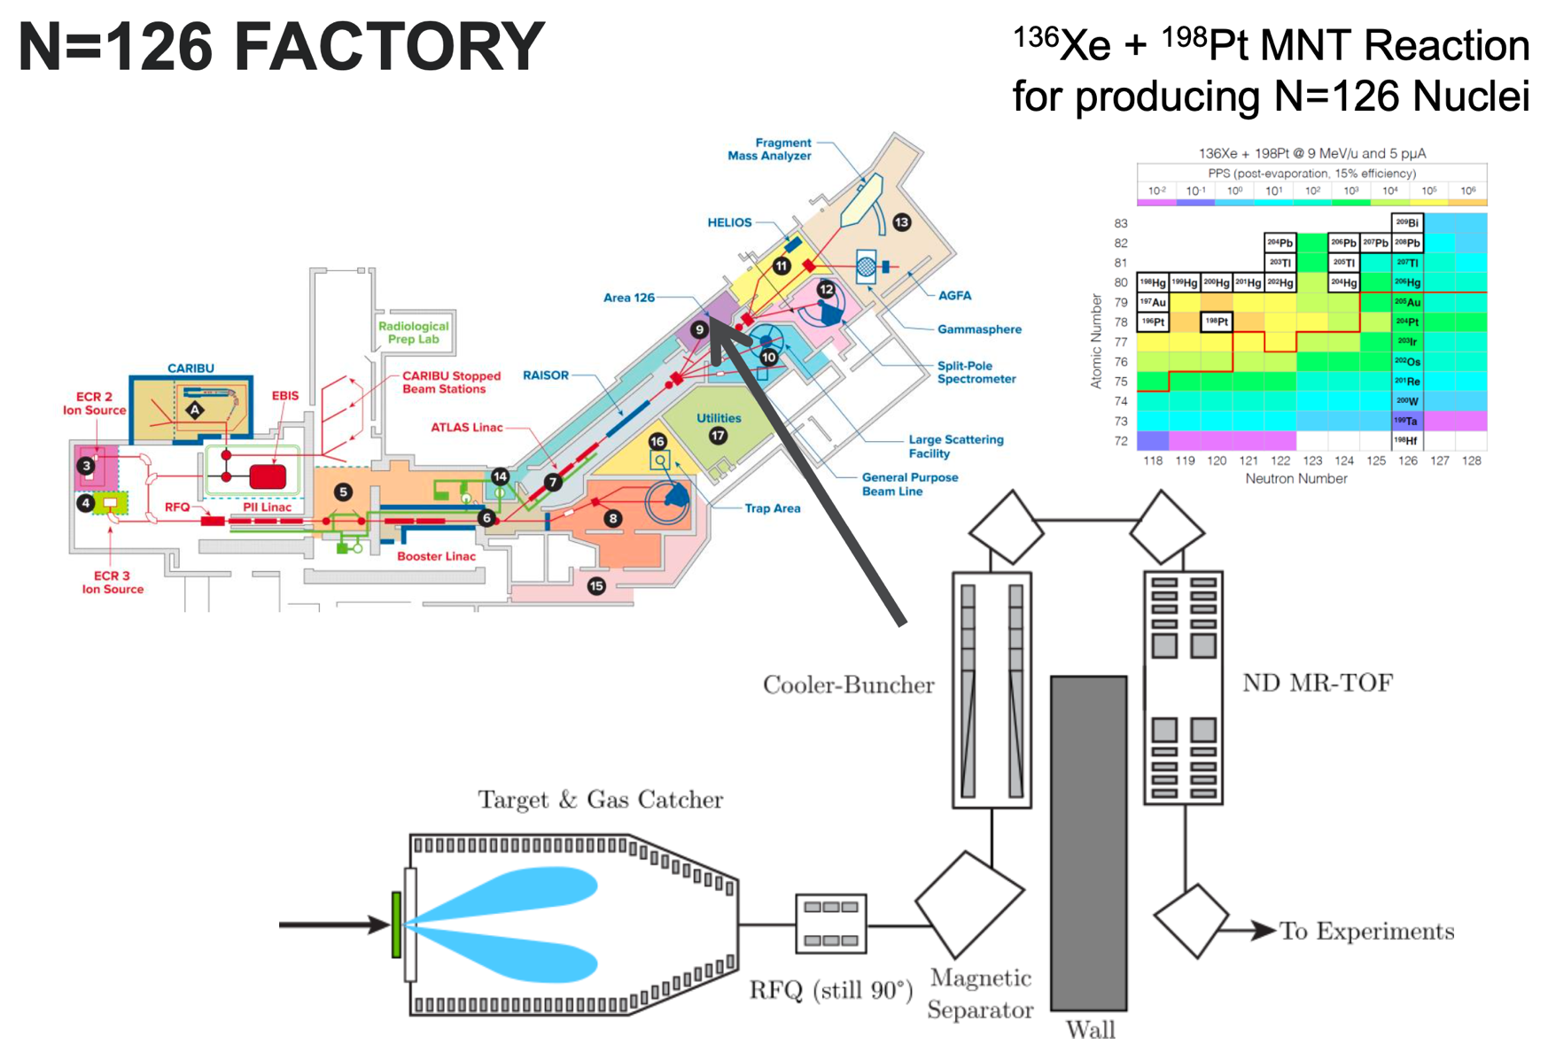

The N = 126 factory
G. Savard et al., NIM B 463, 330 (2020)

Slide 8
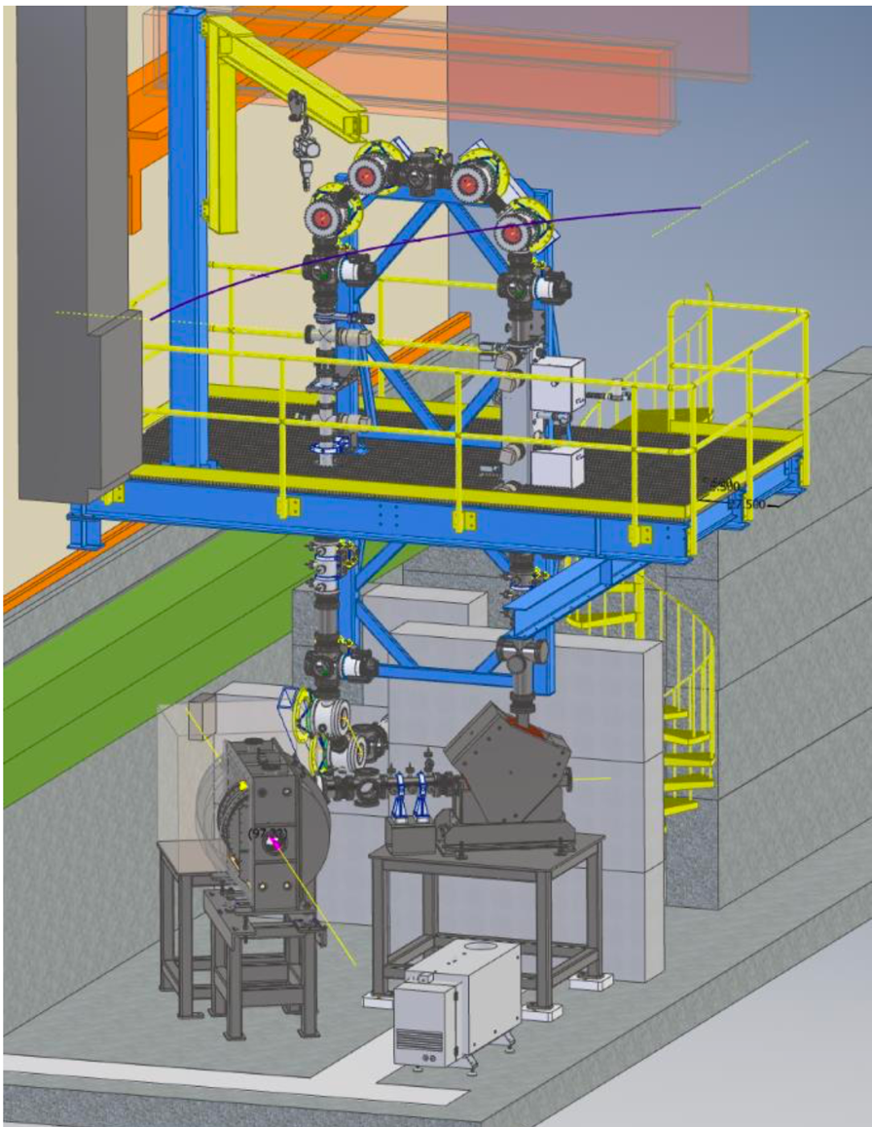
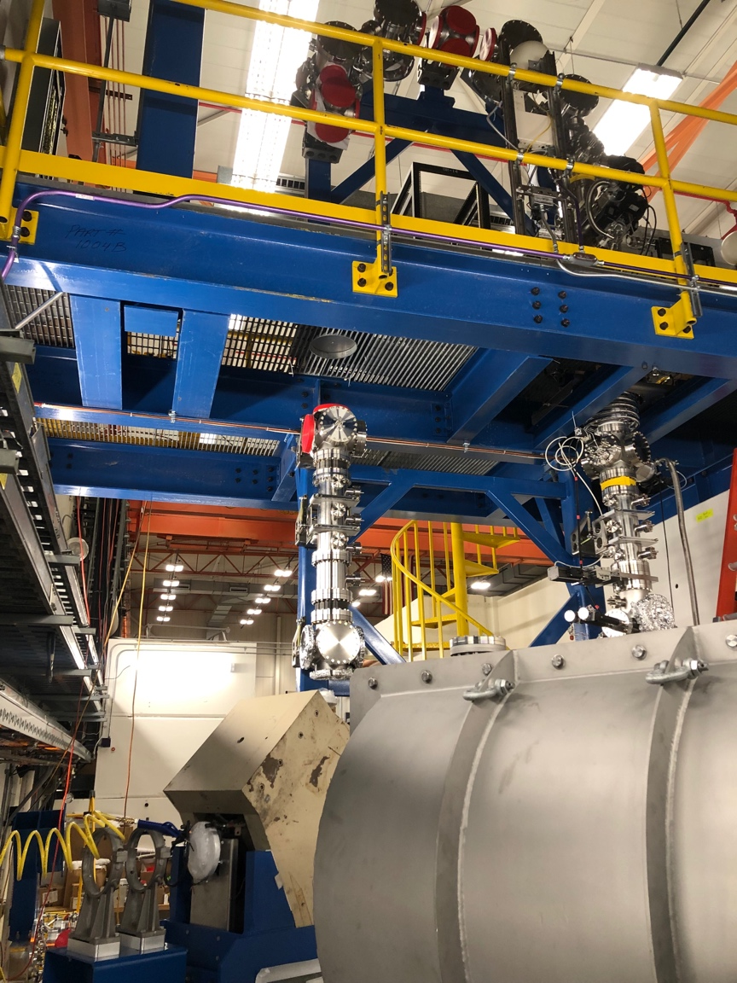
Area 126
RFQ cooler-buncher
Dipole magnet
Gas cell
Gas cell
Gas cell

Slide 9
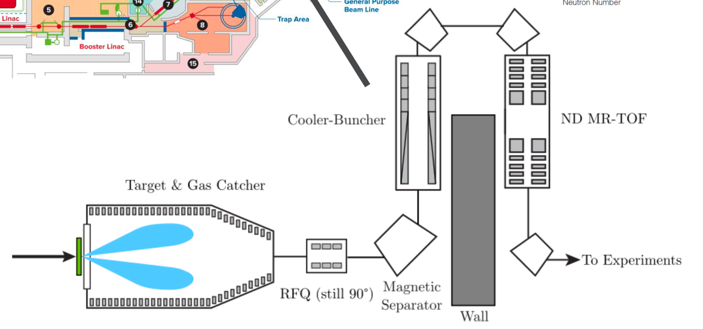
The stubby catcher
Stubby catcher of large angle MNT reaction products
Thermalize in 50-100 mbar helium
Transported with DC + RF and extracted by gas flow
orifice

Slide 10
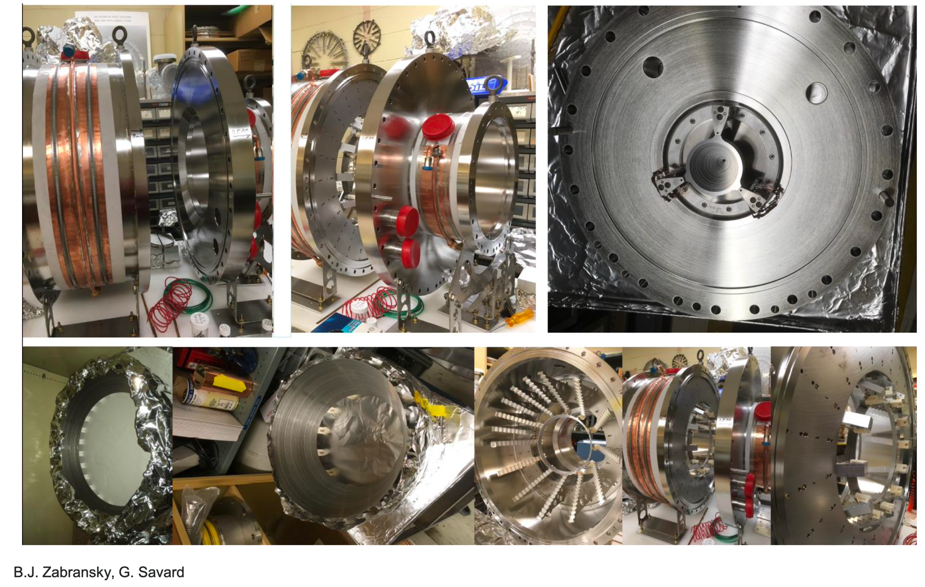
The stubby catcher guts
Thermalize MNT reaction products

Slide 11
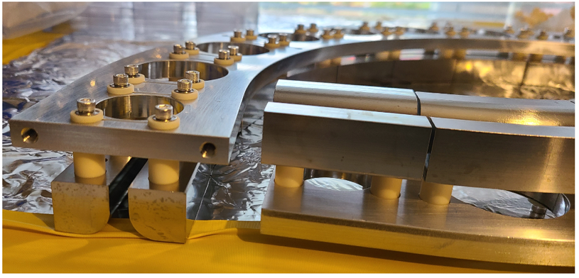
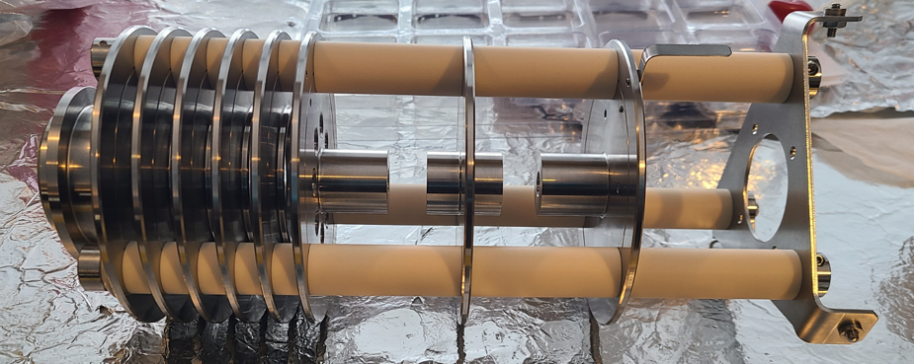
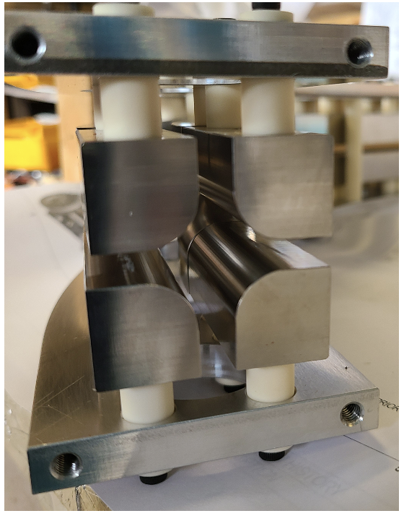
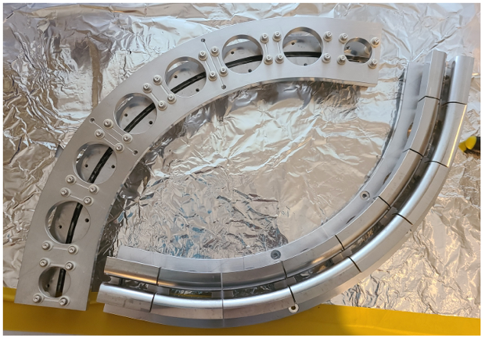
The curved RFQ
90 degrees curved RFQ ion guide.
Accelerating section.

Slide 12
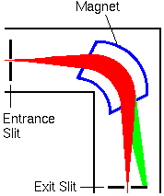
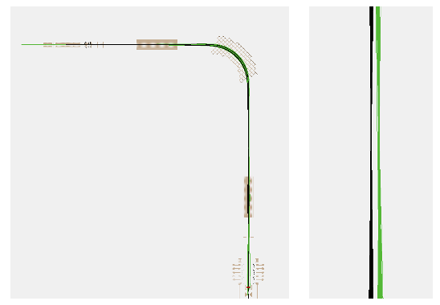
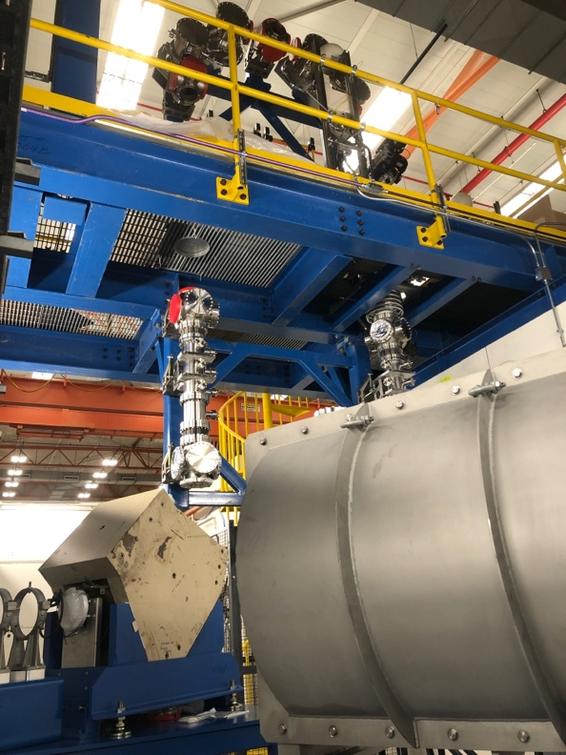
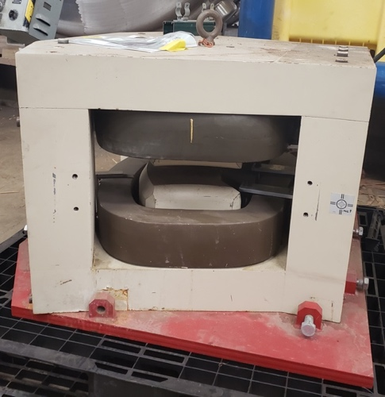
The N = 126 beam factory: Magnet
Dipole magnet with R~1,500 to separate non-isobars

Slide 13
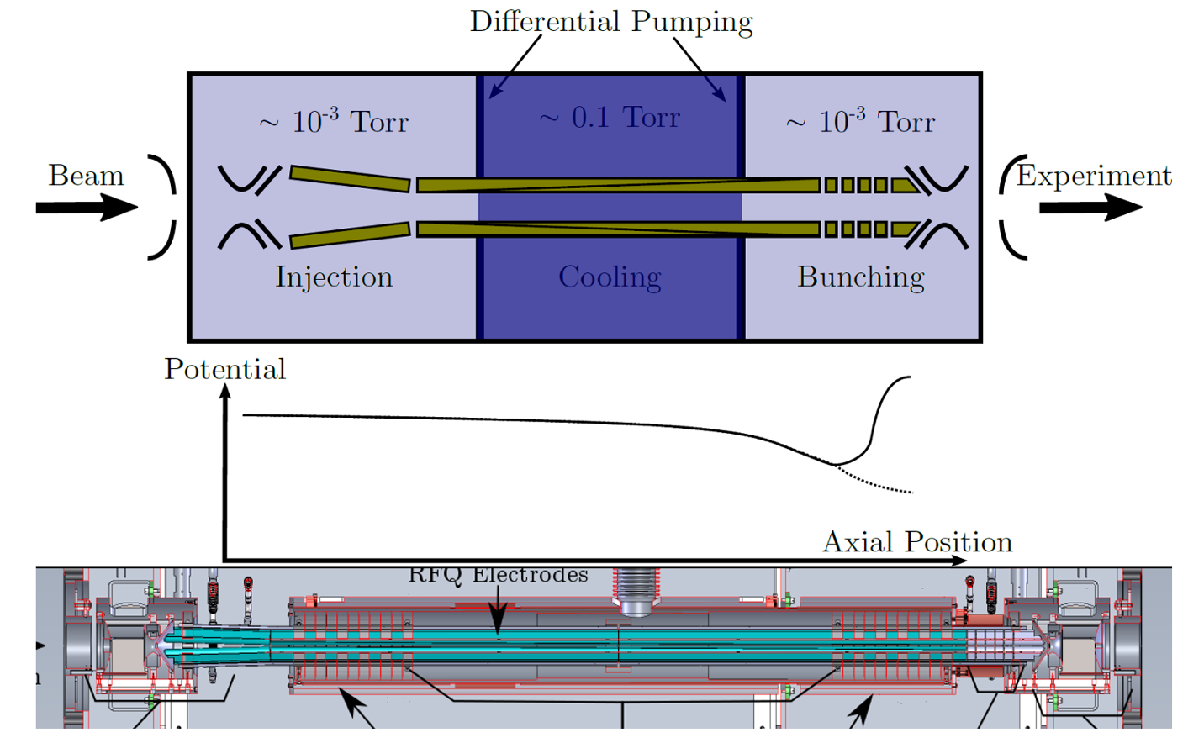
The cooler-buncher
Cool and bunch the RIBs
FRIB EBIT cooler-buncher design. Other copies for BearTrap and St. Benedict at ND (see R. Zite talk)
Separate cooling & bunching sections
A.A Valverde et al., NIM B 463, 330 (2020)

Slide 14
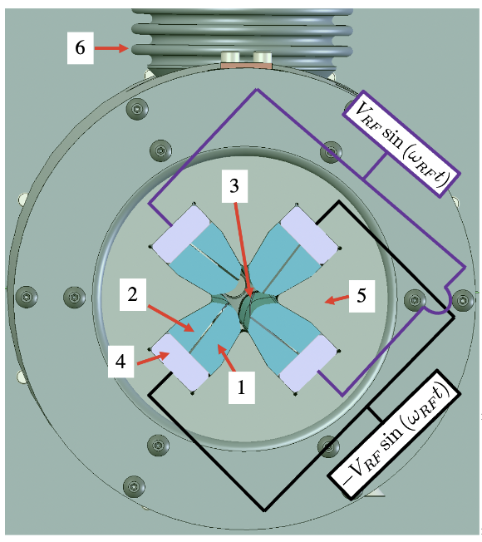
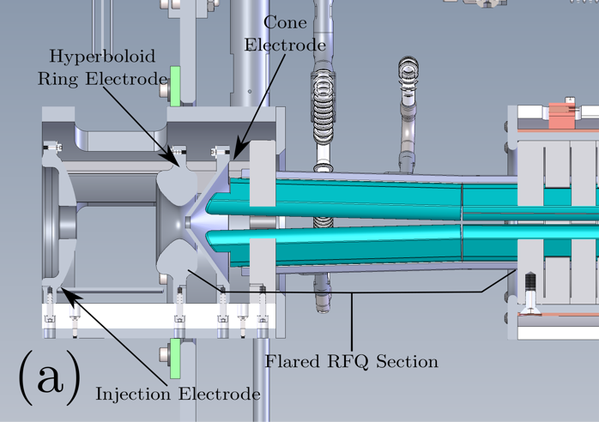
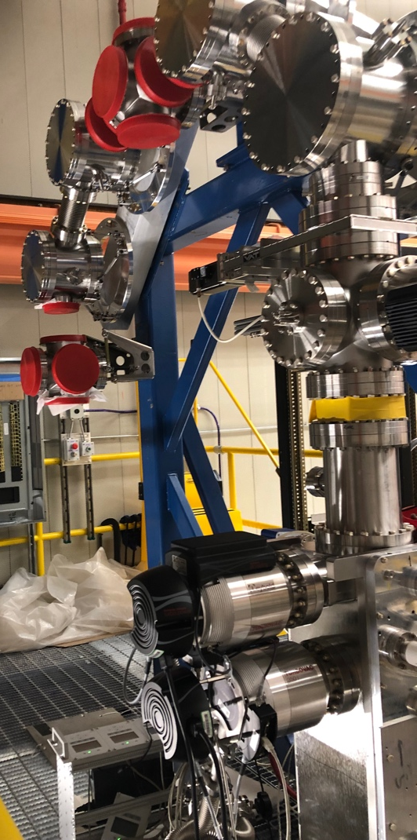
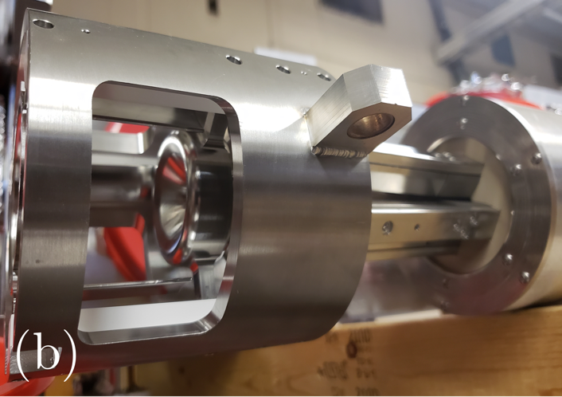
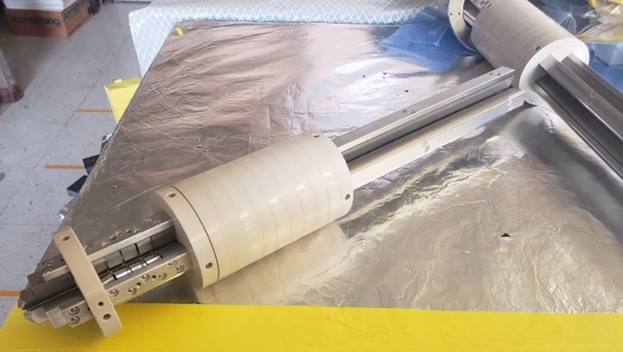
The N = 126 Factory RFQ
Flared entrance section for larger acceptance
High-power RF applied on backbone
Cross-cut DC electrodes

Slide 15
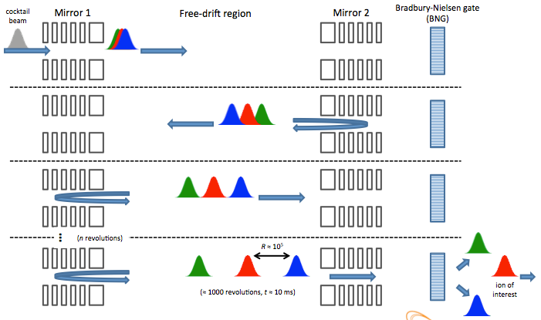
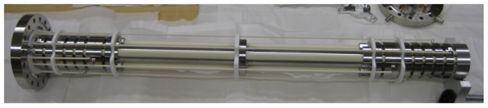
The MRTOF
Separate contaminants by their TOF between electrostatic mirrors
Could also be used for mass measurements

Slide 16
The MRTOF test setup
Assembled and tested at Notre Dame.
B.E. Schultz et al., NIM B 376, 251 (2016)
J. Kelly et al., NIM B 463, 485 (2020)

Slide 17
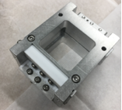
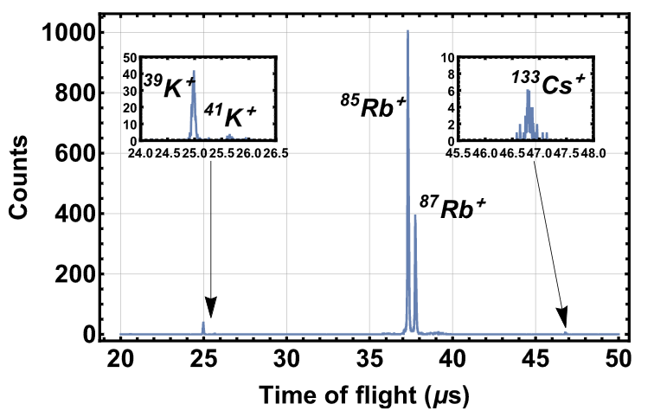
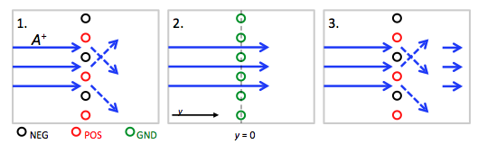
Off-line test setup

Slide 18
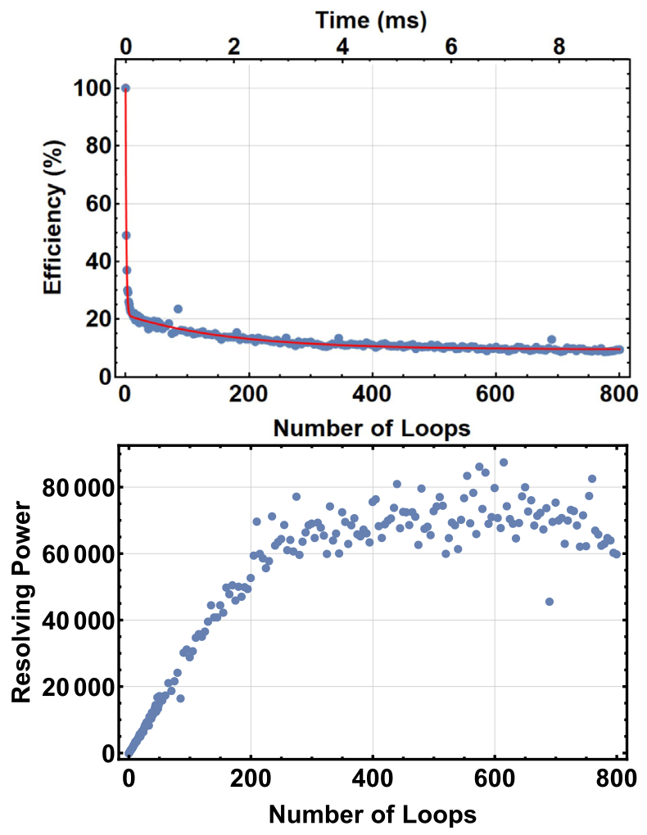
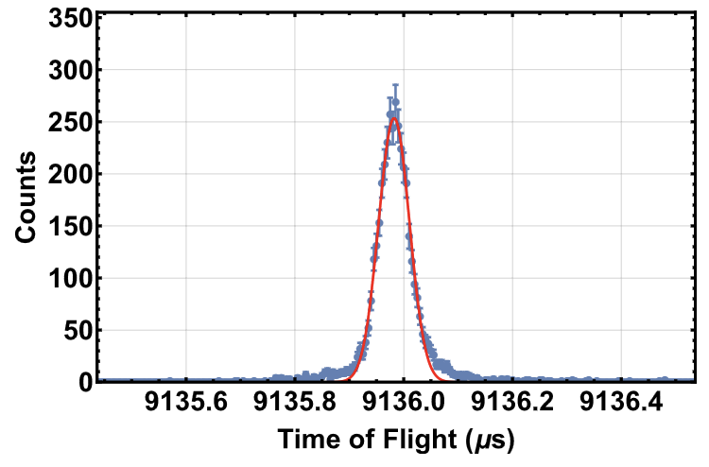
Resolving power and efficiency
400 loops
FWHM = 75 ns
Overlapping ^{85,87}Rb
Most losses occur in the first 5 loops.
Efficiency limited by acceptance of large angular spread BNG-produced bunches.
Resolving power limited by power supply stability and possibly bunch-production method.
B. Liu et al., NIM A 985, 164679 (2021)

Slide 19
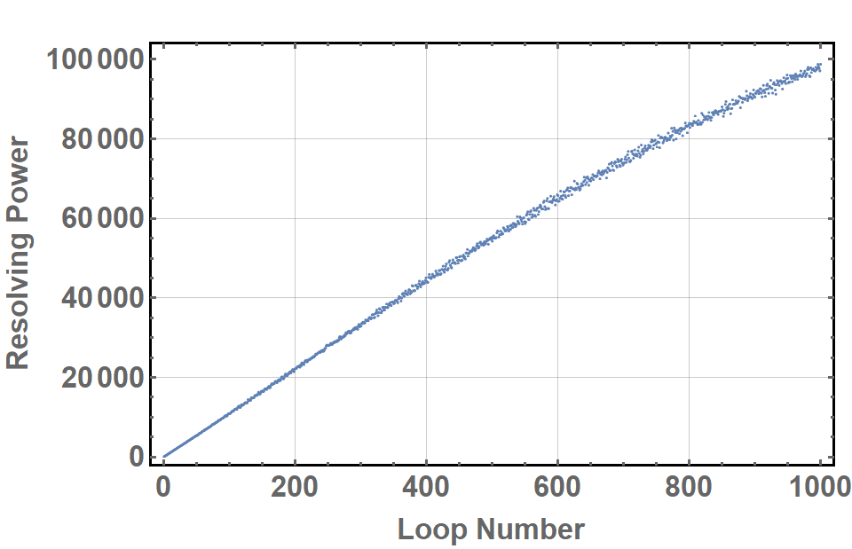
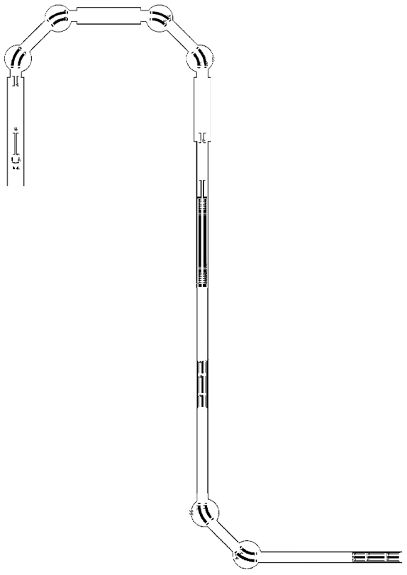
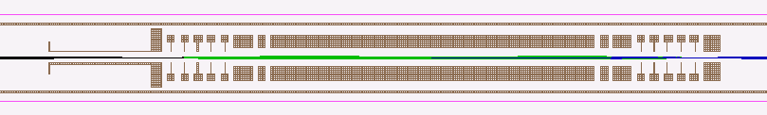
MR-TOF optimization
Optimized ion optics for MR-TOF using beams from cooler buncher at N=126 Factory using a particle swarm code.
Resolving power reaching 100,000 can be obtained.
beam
MRTOF
B. Liu
Cooler-buncher
CPT

Slide 20
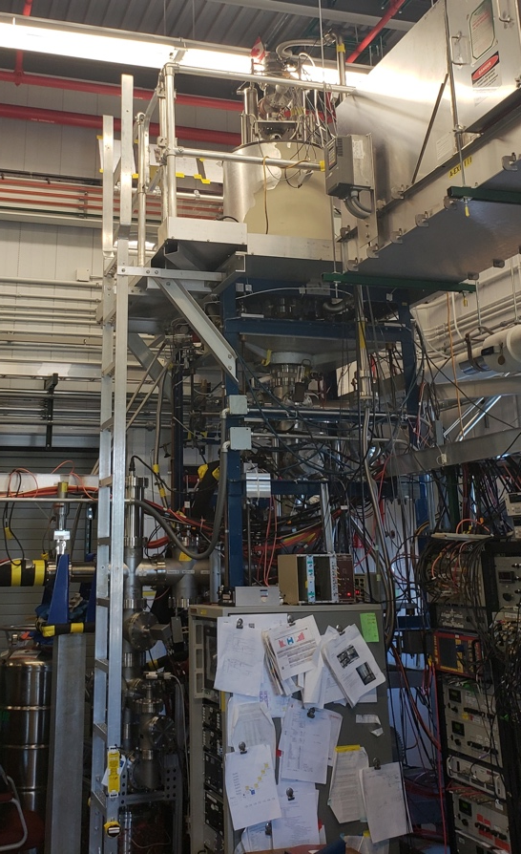
Experiments
CPT will be the 1st experiment to receive N=126 Factory beams
Also plans to have the Xarray decay station coupled to it
Open to suggestions/ideas from the community

Slide 21
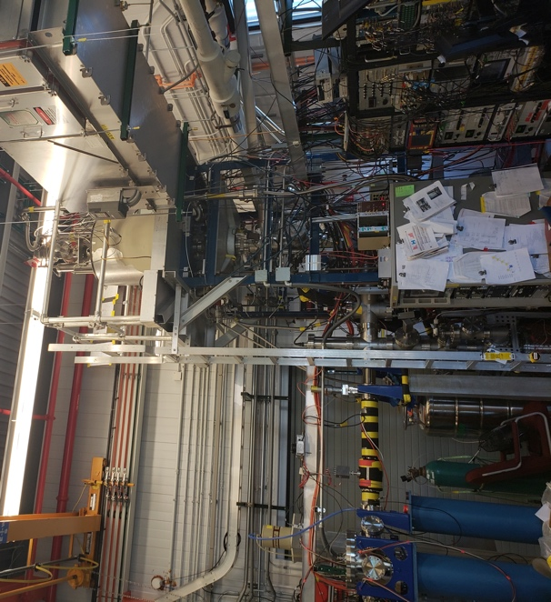
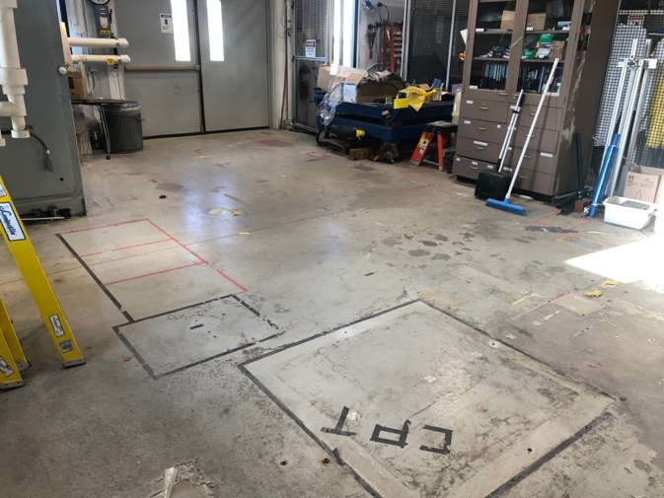
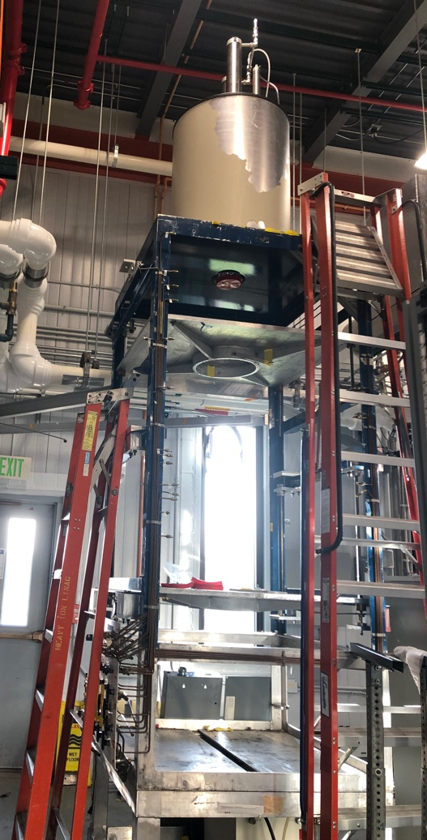
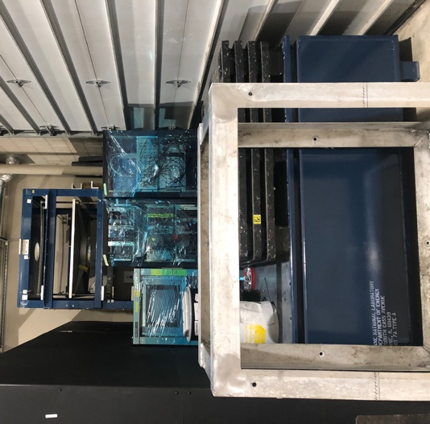
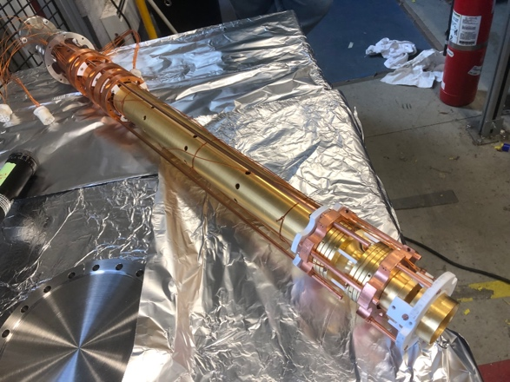
Status of CPT
CPT is undergoing its 3rd move.
To make room for nuCARIBU upgrade (J. Clark talk) and use at N=126 Factory.

Slide 22
Conclusion
The ANL N = 126 Factory aim to produce nuclei of importance for the r-process that are difficult of access: N = 126 shell, after fission peaks, and actinides.
Features a stubby catcher to thermalize large-angle MNT products. Electrodes all assembled. Cask in place in N126 room.
Followed by 90 degrees-curved RFQ ion guide and acceleration section. Electrodes all assembled.
RFQ cooler-buncher based on design from FRIB EBIT cooler-buncher. Installed in the N=126 Factory beam line.
The MR-ToF has been commissioned off-line at Notre Dame and mass resolving powers reaching 70,000 has been observed. Installed in the after BearTrap cooler-buncher for on-line commissioning.
CPT is out of CARIBU room and will be installed in N126 room Fall 2023.
First beams expected late 2023.

Slide 23




Acknowledgements
D.P. Burdette,
J.A. Clark,
R. Knaack,
G. Savard,
L. Varriano,
B.J. Zabransky,
A.A. Valverde
M. Brodeur,
A. Houff,
B. Liu,
S. Porter,
F. Rivero,
R. Zite
K.S. Sharma

