Slide 1
Manipulation of (radioactive) ions for laser spectroscopy
Vladimir Manea
IJCLab, Orsay, France

Slide 2
Outline
Brief overview of laser spectroscopy at accelerator facilities
  Collinear laser spectroscopy
  Hot-cavity and gas-cell laser spectroscopy
Gas-jet laser spectroscopy
  Main concepts
  Improving extraction time and neutralization efficiency
Trap-assisted laser spectroscopy

Slide 3
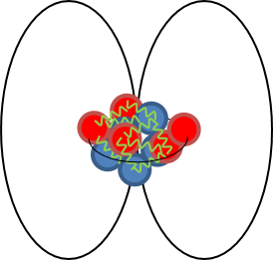
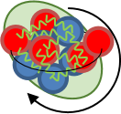

Laser spectroscopy of exotic nuclei
Exploits the hyperfine interaction to extract nuclear observables
I, µ, Q
Wavenumber
F
e–
<r²>
I
λ
J
Ion/photon number
Key parameters when working with rare isotopes:
  Resolution
  Efficiency
  Sensitivity

Slide 4

Laser spectroscopy of exotic nuclei
Collinear laser spectroscopy:
  Resolution:
    > 30 keV acceleration: ~ 10 MHz
  Sensitivity:
    ≈10³ pps for fluorescence
    ≈10 pps for RIS
Accelerator
Thick target
(ISOLDE, ISAC)
>30 keV beam
High resolution separator
He
light projectiles
Thin target in gas cell
(IGISOL)
$$δv= \frac{1}{\sqrt{2mE}}δE$$
heavy projectiles
ions
Neutralization
vapor cell
In-flight separator
He
Cooler-buncher
atoms
Collinear laser spectroscopy (fluorescence, RIS)
ions
MCP
Thin target in flight
(NSCL)
Photomultipliers
X. F. Yang et al., Prog. Part. Nucl. Phys., 129, 104005 (2023)

Slide 5
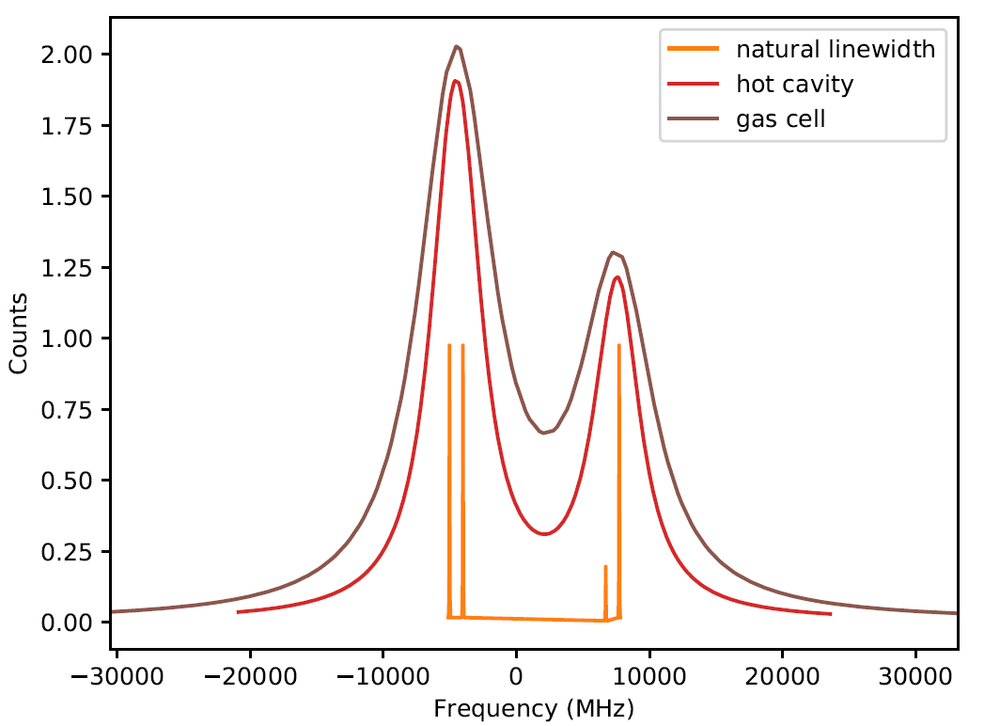
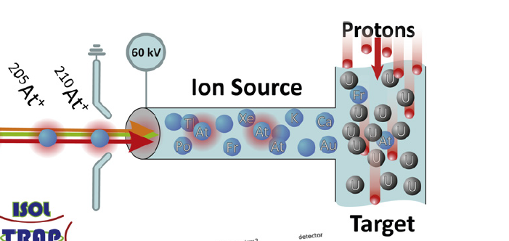
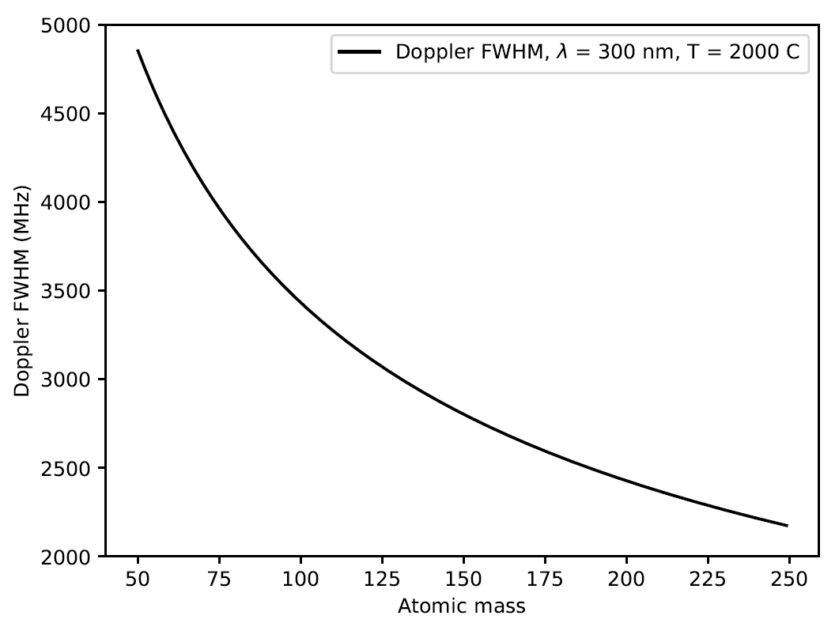
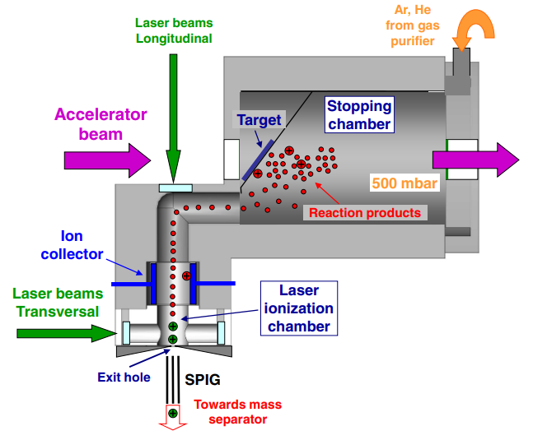
Laser (spectroscopy) ion sources
B. A. Marsh et al., NIM B 317, 550–556 (2013)
Talk by Klaus Wendt
⁶³Cu
Accelerator
Thick target
(ISOLDE, ISAC, IRIS)
λ = 327 nm
>30 keV beam
High resolution separator
He
light projectiles
Thin target in gas cell
(IGISOL, LISOL)
heavy projectiles
The most direct form of laser spectroscopy, but broadening mechanisms:
  Doppler broadening
  Collisional broadening
V. N. Fedosseev et al., Phys. Scr. 85, 058104 (2012)

Slide 6

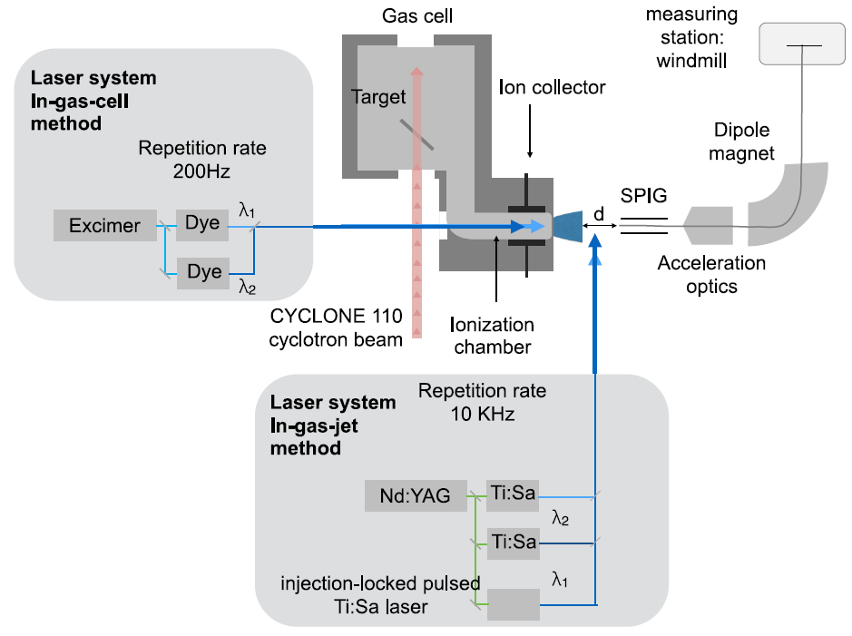
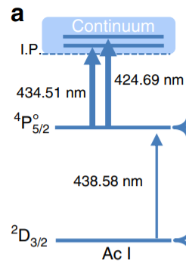
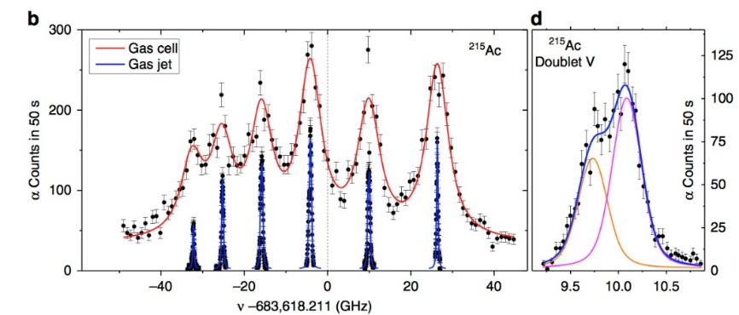



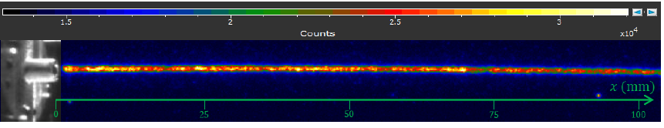
In-gas-jet laser spectroscopy at LISOL
Louvain-la-Neuve facility
Probing in the supersonic gas jet
Low temperature and density
Resolution 400-600 MHz
R. Ferrer, Nature Comm. 8 14520 (2017)
C. Granados et al., Phys. Rev. C 96, 054331 (2017)
A. Zadvornaya et al. Phys. Rev. X 8, 041008 (2018)

Slide 7
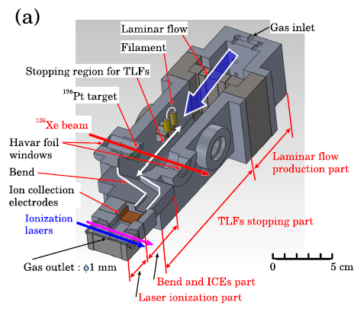
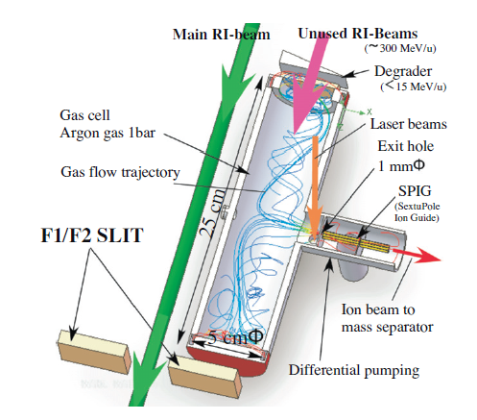
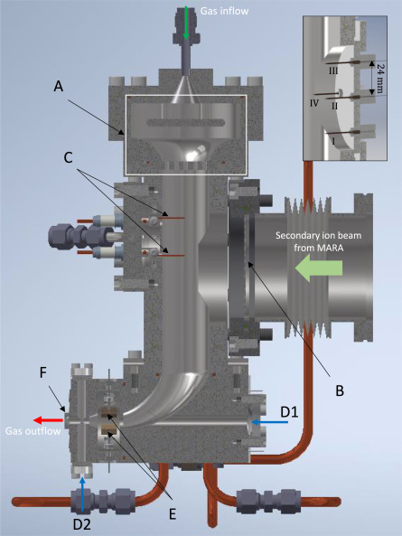
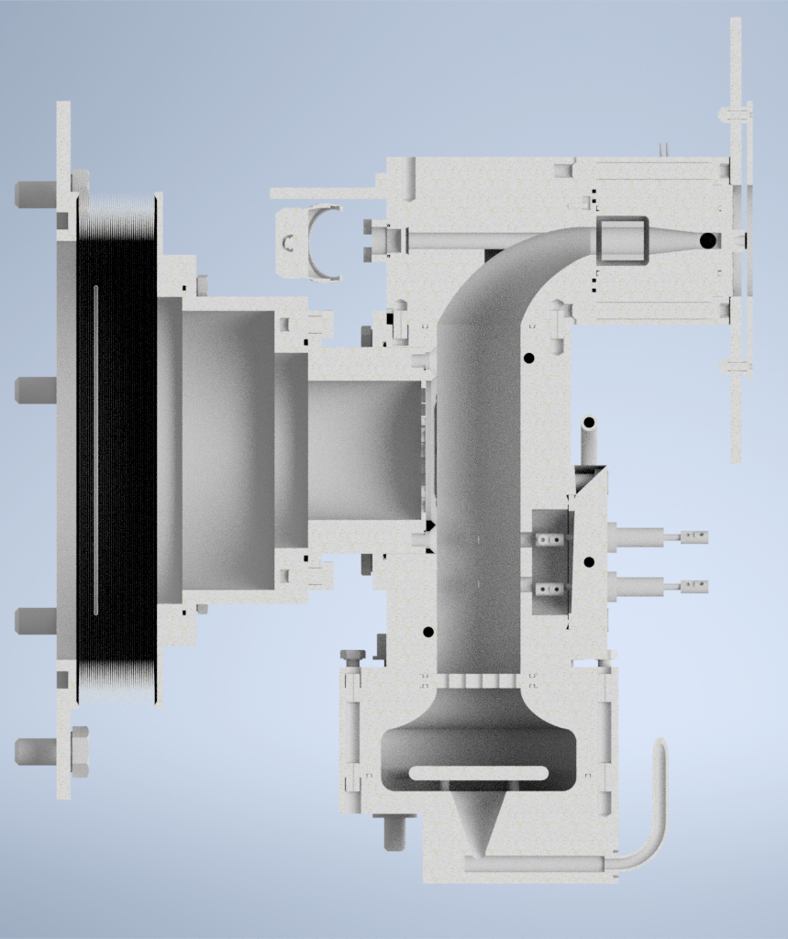
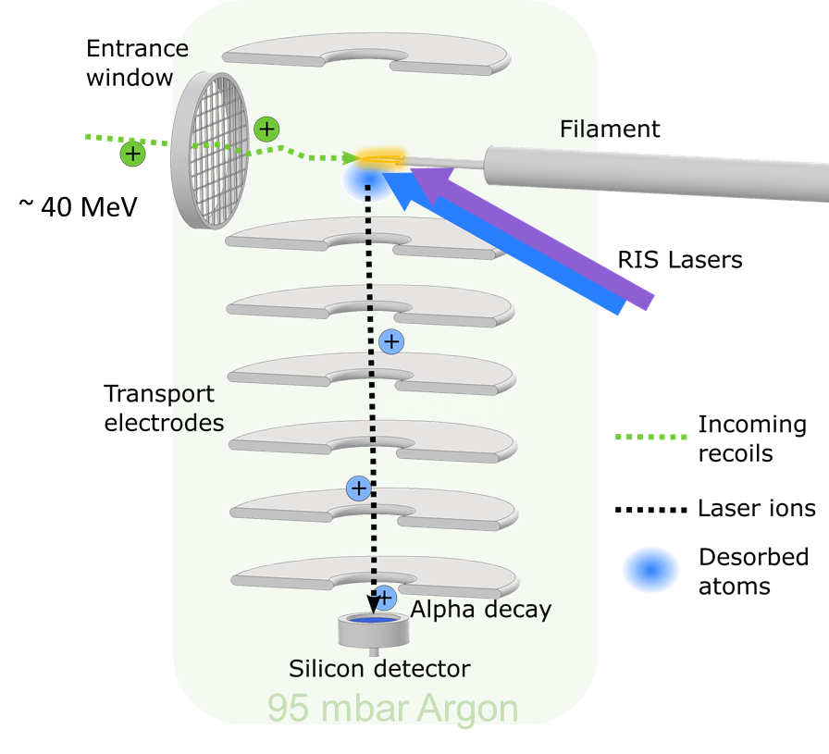
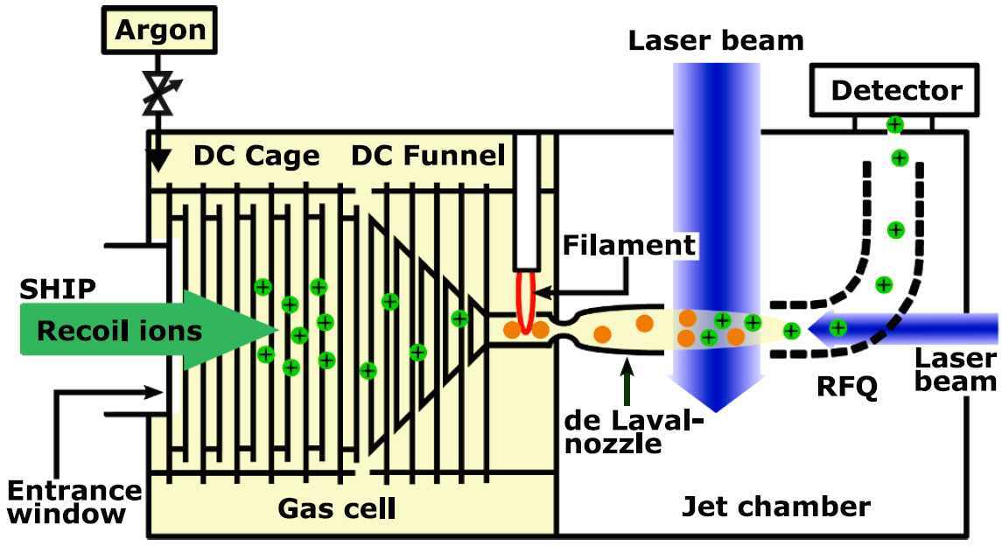
Gas-cell laser spectroscopy setups
KISS
PALIS
MARA-LEB
Y. Hirayama et al., NIMB 412, 11–18 (2017)
T. Sonoda et al., NIMB 295, 1-10 (2013)
A. Zadvornaya et al., NIM B 539, 33-42 (2023)
RADRIS
JETRIS
S³-LEB
S. Raeder et al., NIM B 463, 272-276 (2020)
A. Ajayakumar et al., NIMB 539, 102–107 (2023)
M. Laatiaoui et al., Nature 538, 495–498 (2016)

Slide 8
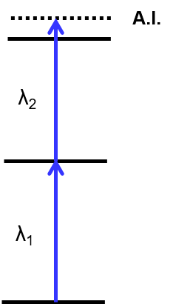
A dedicated design for fusion-evaporation products
Gas jet laser probing
Critical performance criteria :
  Chemical survival/neutralization efficiency
  Stopping efficiency
  Extraction efficiency and time
Gas cell laser probing
Decoupling of laser axis from spectrometer axis
Supersonic jet
Radioactive nuclei
Extraction by gas flow only
E< 1 MeV/u
Stopping, thermalization
and neutralization
Buffer gas at 100-500 mbar
Thin window
Shown is S³-LEB/MARA-LEB geometry
Talks by Jorge Moreno and Nathalie Lecesne

Slide 9
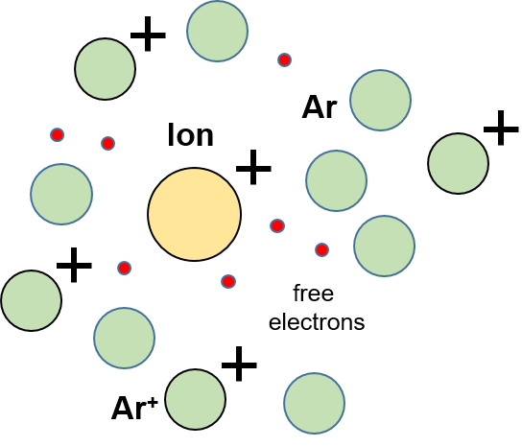
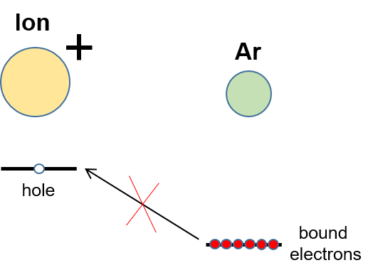
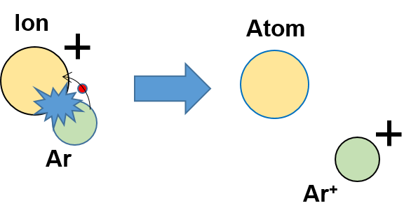
A dedicated design for fusion-evaporation products
Gas jet laser probing
Critical performance criteria :
  Chemical survival/neutralization efficiency
Ion stopping generates plasma
Chemistry is a loss mechanism:
→ ultrapure buffer gas needed
Resonance-ionization spectroscopy:
    neutral atom highly preferable
    use Ar as buffer gas
Supersonic jet
Radioactive nuclei
After thermalization charge exchange not possible
Ar at 100-500 mbar
A fraction of the ions will charge exchange while being slowed down.

Slide 10
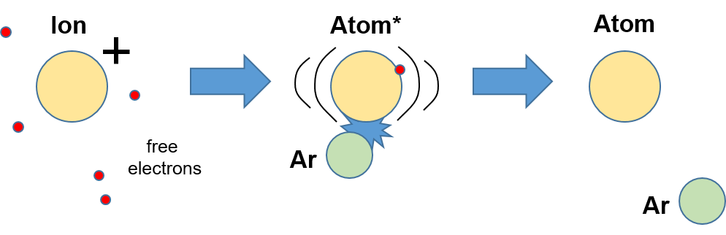
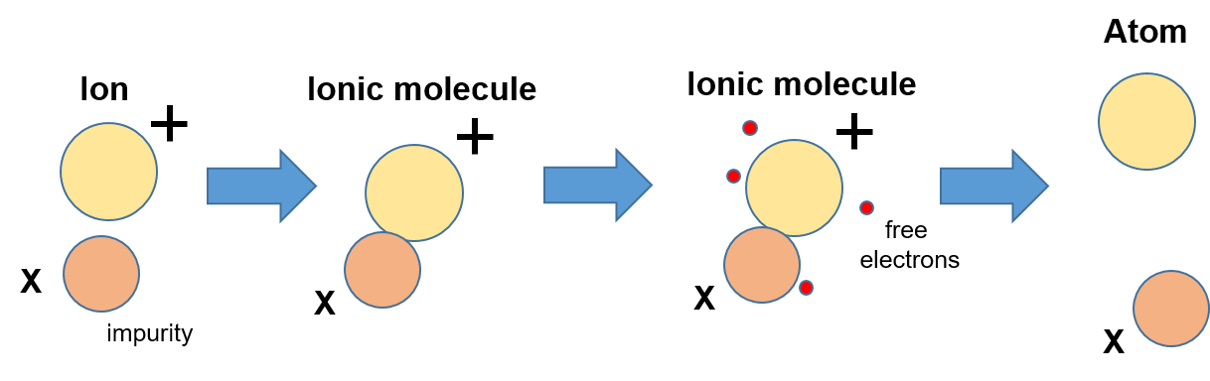
A dedicated design for fusion-evaporation products
Gas jet laser probing
Critical performance criteria :
  Chemical survival/neutralization efficiency
Ion stopping generates plasma
Chemistry is a loss mechanism:
→ ultrapure buffer gas needed
Resonance-ionization spectroscopy:
    neutral atom highly preferable
    use Ar as buffer gas
Supersonic jet
Three-body recombination
Radioactive nuclei
After thermalization charge exchange not possible
Strong dependence on ion beam intensity
No electrical field in neutralization area.
Dissociative recombination
Ar at 100-500 mbar
A fraction of the ions will charge exchange while being slowed down.

Slide 11
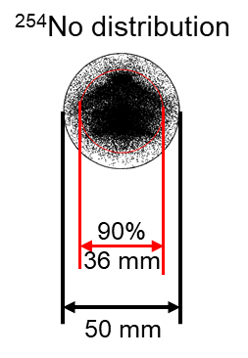
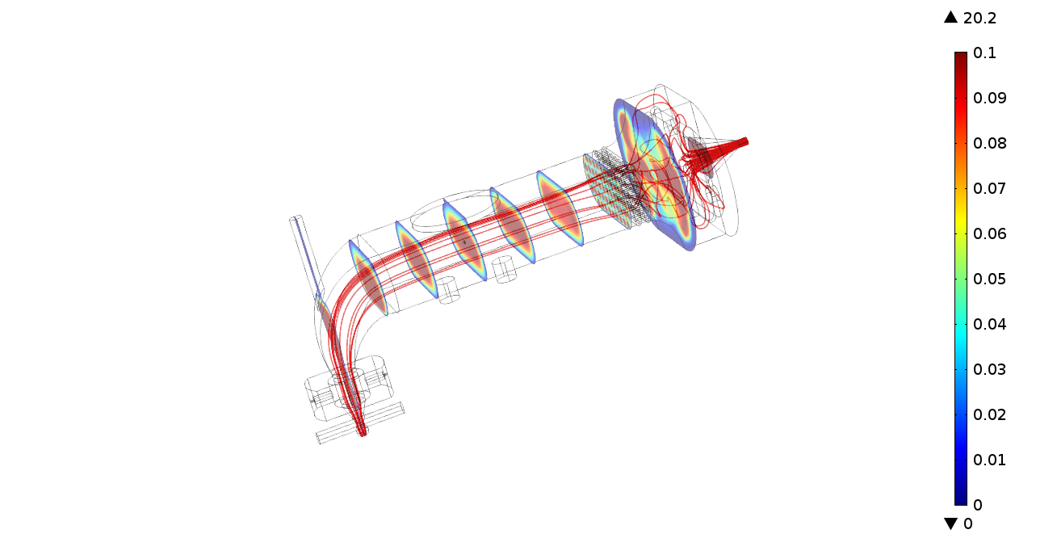
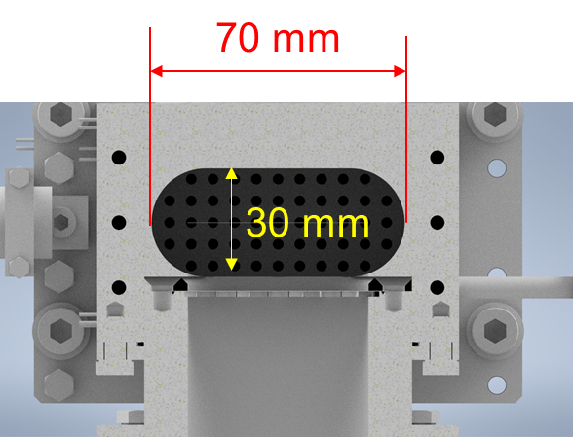

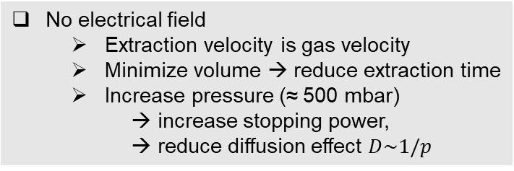
A dedicated design for fusion-evaporation products
Gas jet laser probing
Critical performance criteria :
  Chemical survival/neutralization efficiency
  Stopping efficiency
  Extraction efficiency and time
S³ beam size in convergent mode
No electrical field
  Extraction velocity is gas velocity
  Minimize volume → reduce extraction time
  Increase pressure (≈ 500 mbar)
    → increase stopping power,
    → reduce diffusion effect $D\sim 1/p$
Supersonic jet
Radioactive nuclei
Optimization of the geometry performed in COMSOL (E. Mogilevsky et al., KU Leuven)
Nozzle diameter | Extraction time
d=1 mm | 630 ms
d=1.5 mm | 280 ms
$$T\sim \frac{1}{d^{2}}$$
Ar at 100-500 mbar
Stopping efficiency 100% (for fusion-evaporation products)
Extraction efficiencies > 50 % for 500 mbar pressure (depending on diffusion coefficient)

Slide 12
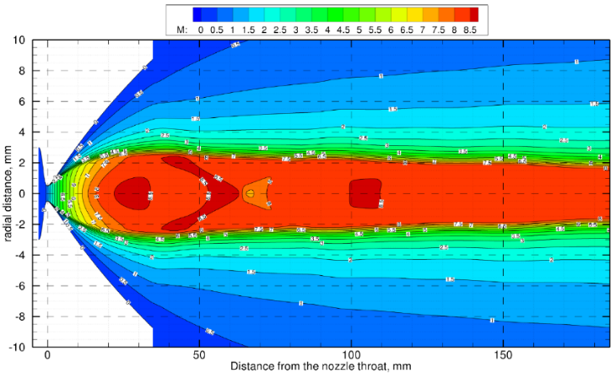
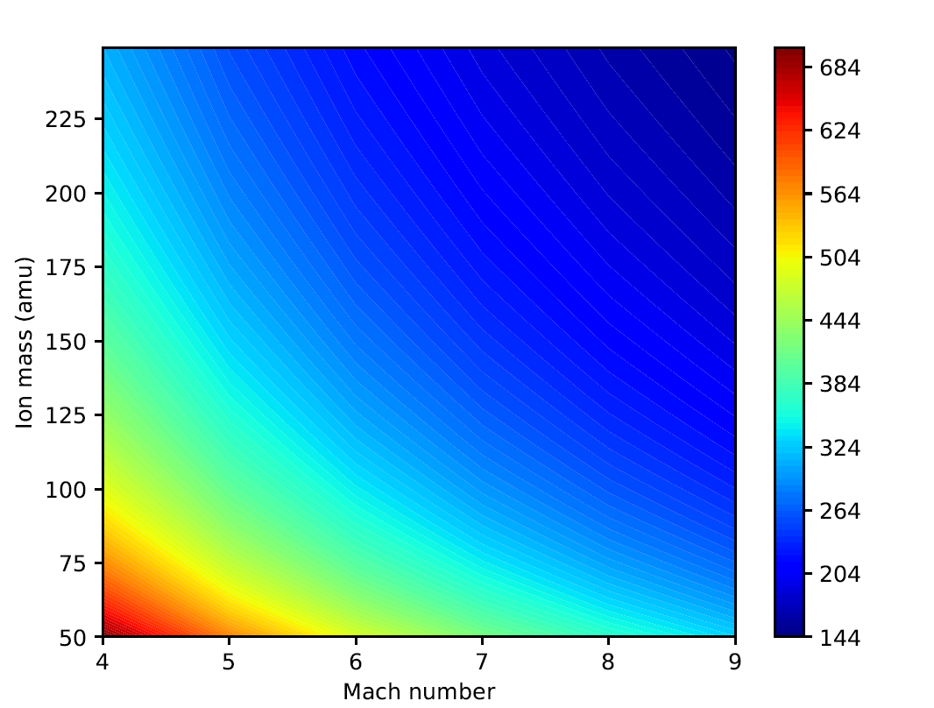
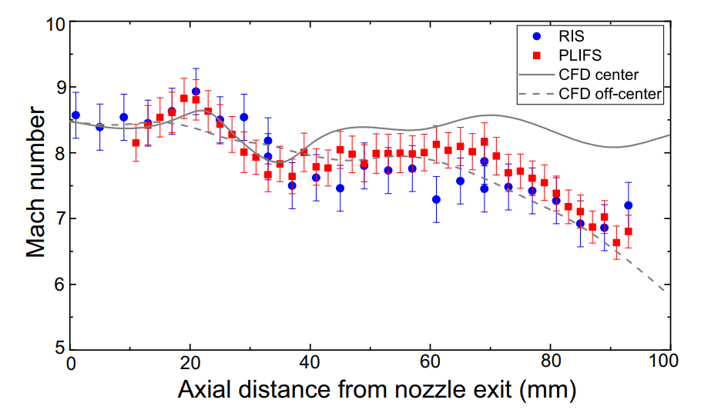
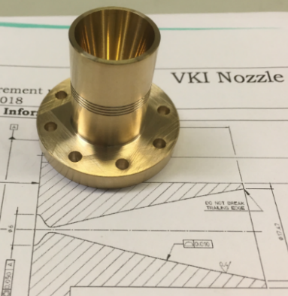
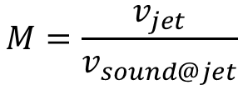
Super/hypersonic gas-jet optimization
$$M=\frac{v_{jet}}{v_{sound@jet}}$$
Mach number:
Super/hypersonic jet = cold jet → low Doppler broadening
Radial distance (mm)
Color code: Doppler FWHM (MHz)
M = 8.1 de Laval nozzle
R. Ferrer et al., Phys. Rev. Res 3, 043041 (2021)

Slide 13
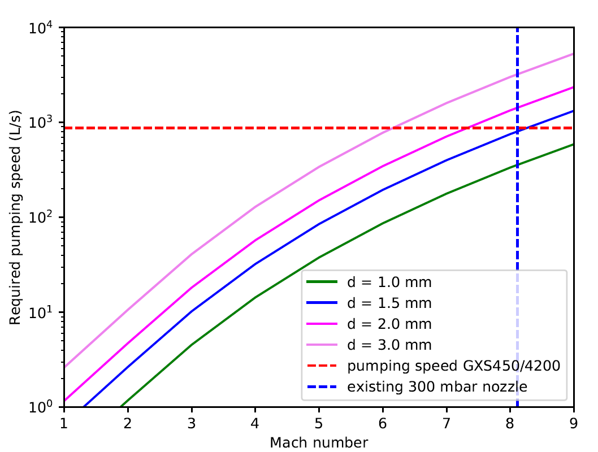
Super/hypersonic gas-jet optimization
$$M=\frac{v_{jet}}{v_{sound@jet}}$$
Mach number:
Super/hypersonic jet = cold jet → low Doppler broadening
Homogeneous jet → no Doppler smearing
But requires pressure matching
Radial distance (mm)
M = 8.1 de Laval nozzle
S³-LEB limited to 1.5 mm for Ar
Yu. Kudryavtsev et al., NIMB 297, 7–22 (2013)

Slide 14
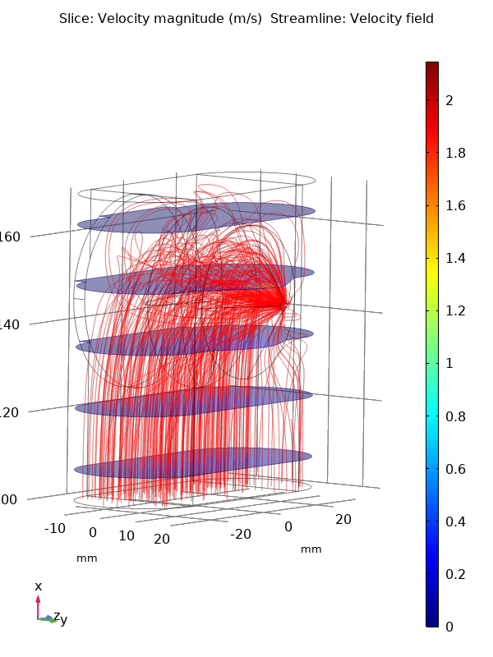
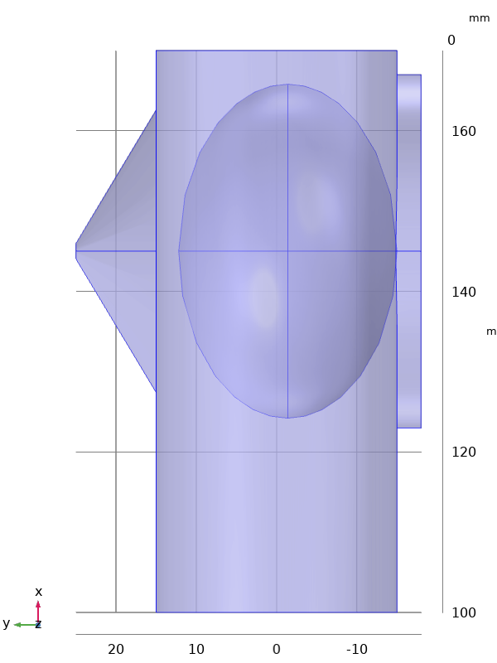
Further reduce gas-cell extraction time
Extraction time is a limitation for short-lived isotopes
Most time is “lost” in the stopping region which is far from the exit
≈ 25 ms
Have exit closer to stopping volume: simulated limit 130 ms for 1 mm exit hole
≈ 250 ms
Ar, 500 mbar
Challenging stopping volume
Gas-cell spectroscopy difficult
High-power probing only transversal
≈ 400 ms
Radioactive nuclei

Slide 15
Further reduce gas-cell extraction time
Extraction time is a limitation for short-lived isotopes
Most time is “lost” in the stopping region which is far from the exit
≈ 25 ms
Have exit closer to stopping volume: simulated limit 130 ms for 1 mm exit hole
≈ 250 ms
Ar, 500 mbar
Challenging stopping volume
Gas-cell spectroscopy difficult
High-power probing only transversal
≈ 400 ms
Radioactive nuclei
Boost extraction from slow volume by electrical field
Neutralization becomes a challenge
E

Slide 16

Further reduce gas-cell extraction time
E
Transfer ions to a region without electrical field
Electrons are removed from stopping volume by electrical field
Extract by gas flow
Fast gas flow
Extract ions quickly from stopping volume by electrical gradient
Neutralize in fast flow near exit
$$T_{extr}=T_{electrical}+T_{flow}$$

Slide 17
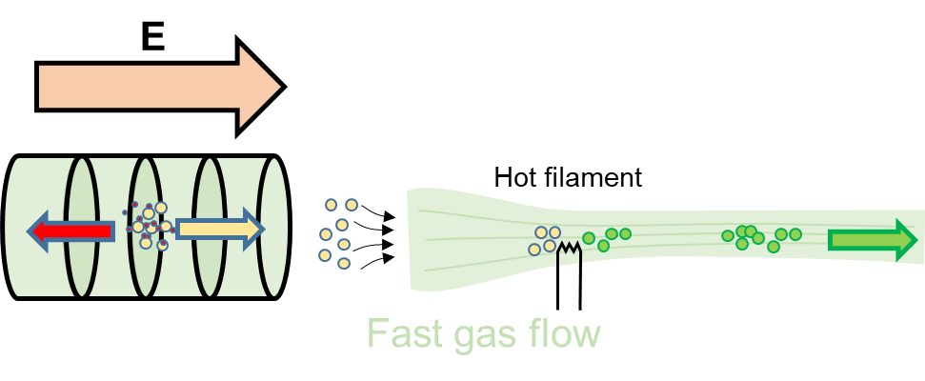
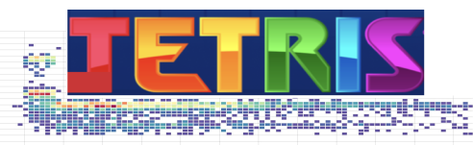
The RADRIS/JETRIS approach
Laser spectroscopy on superheavy elements at GSI/SHIP:
RADRIS: using filament for collection and neutralization in the gas cell, followed by re-evaporation
JETRIS setup: attract beam on filament for neutralization, re-evaporate and extract by flow in gas jet
First on-line in-jet spectroscopy
Talks by Danny Münzberg, Rafael Ferrer and Sebastian Raeder
Critical filament focusing and trade-off of efficiency with extraction time
H. Backe et al., Eur. Phys. J. D 45, 99 (2007)
F. Lautenschläger et al., NIMB 383, 115 (2016)
M. Laatiaoui et al., Nature 538, 495–498 (2016)
J. Warbinek et al., Atoms 10, 41 (2022)
S. Raeder et al., NIM B 463, 272-276 (2020)
Talk by Fedor Ivandikov

Slide 18

Exploring other neutralization approaches
Other approaches can aim to induce neutralization in the free flow, without collection.
Beta source
R. Ferrer et al., Nucl. Instr. Meth. B 317, 570-581 (2013)
E
Impurities
Hot filament
Fast gas flow
Intense electron source
Transfer from electrical region to flow is not trivial
Time scale of neutralization process will limit the total extraction time.
FRIENDS³ project at IJCLab/GANIL: construct a demonstrator for systematically studying the relevant phenomena
Talk by Wenling Dong

Slide 19
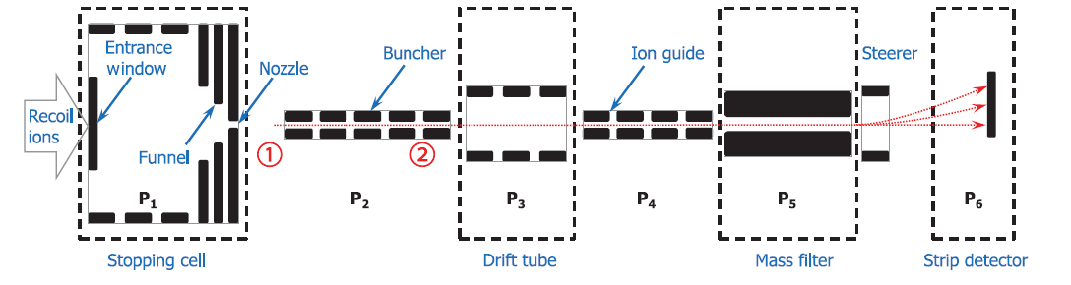
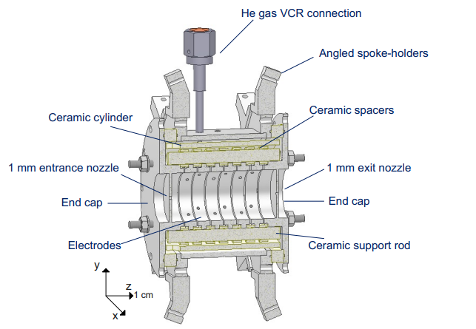
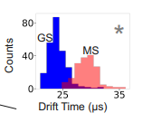
Exploring other approaches: ion chromatography
New project to perform laser resonance chromatography (LRC):
  Optically pump ions into metastable state
  Detect laser resonance via ion chromatography
  (= change in mobility when in metastable state)
  A single laser is required
Sc⁺
M. Laatiaoui et al., PRL 125, 023002 (2020)
E. Romero Romero et al., Atoms 10, 87 (2022)

Slide 20
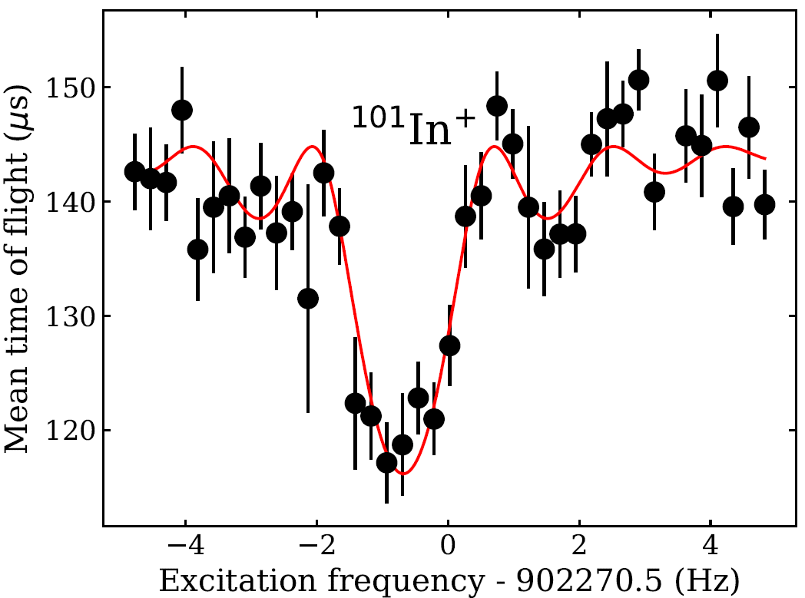
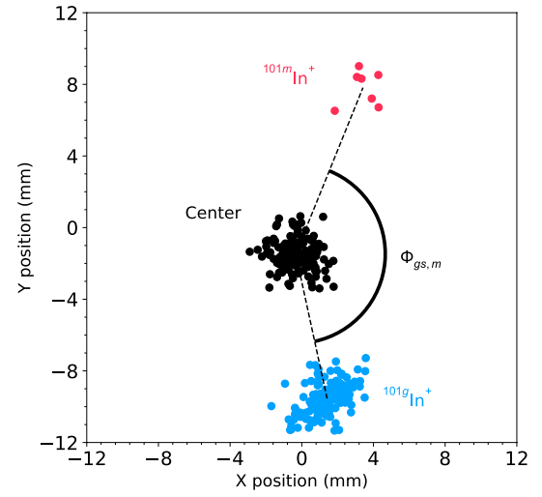
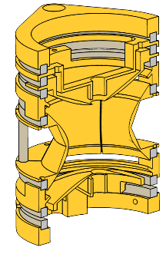
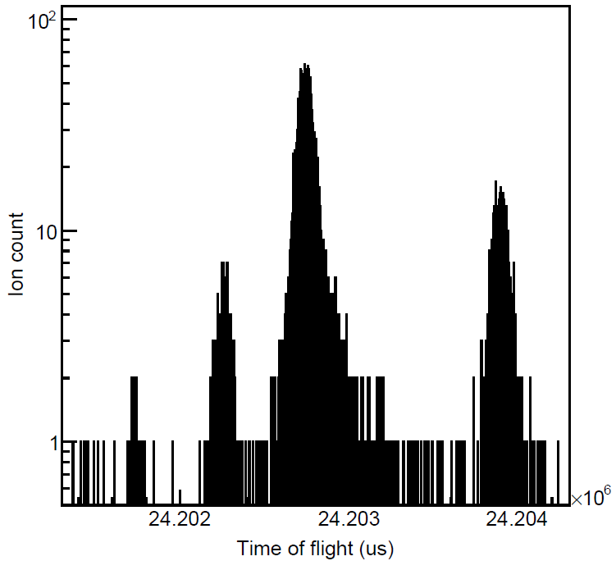
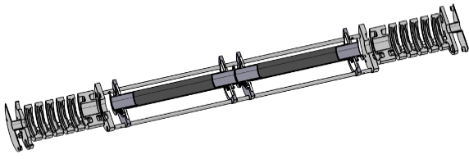


Ion traps for laser spectroscopy
M. Mougeot et al., Nature Physics 17, 1099–1103 (2021)
U
Penning trap
B
$$νc \sim {\left(M_{ion}\right)}^{−1}$$
Time-of-flight ion-cyclotron resonance (TOF-ICR)
Phase-imaging ion-cyclotron resonance (PI-ICR)
S. Eliseev et al., PRL 110, 082501 (2013)
⁸²Sr¹⁹F⁺
$$TOF \sim {\left(M_{ion}\right)}^{1/2}$$
¹⁰¹In⁺
Ion traps can be very useful tools for mass-tagged ion counting
Multi-reflection time-of-flight mass spectrometer

Slide 21



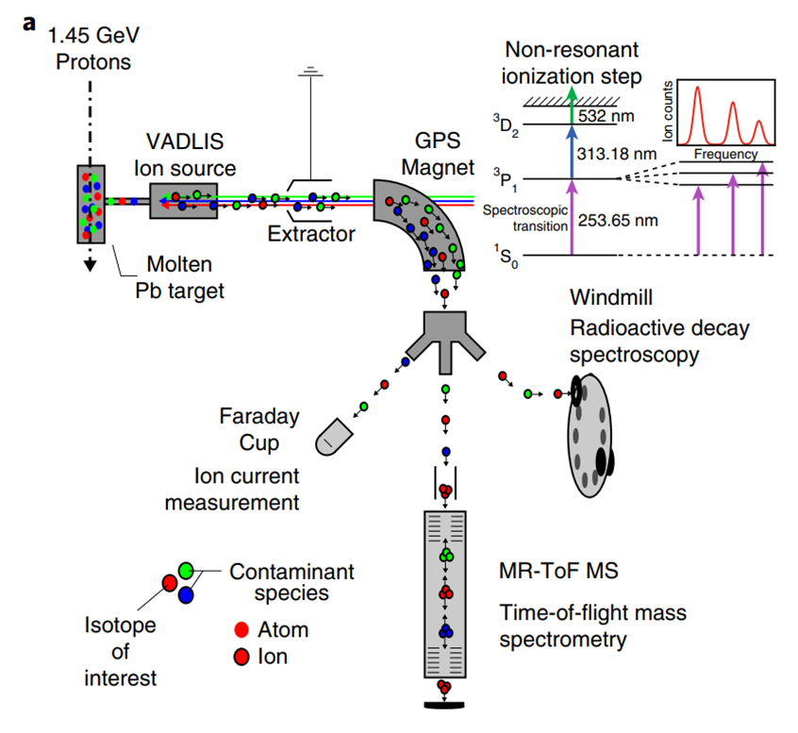
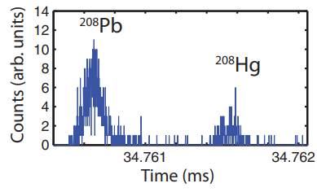
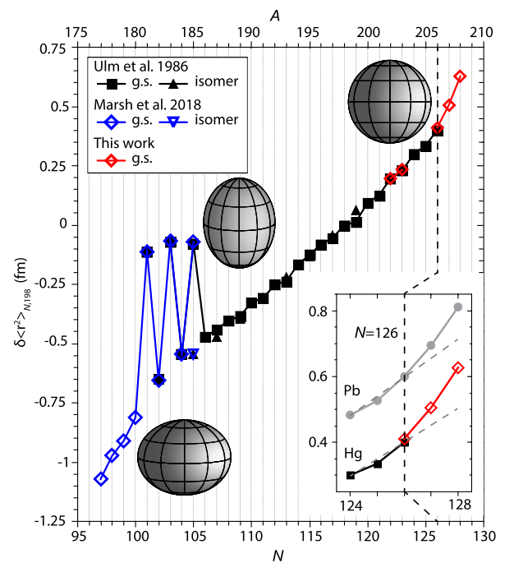
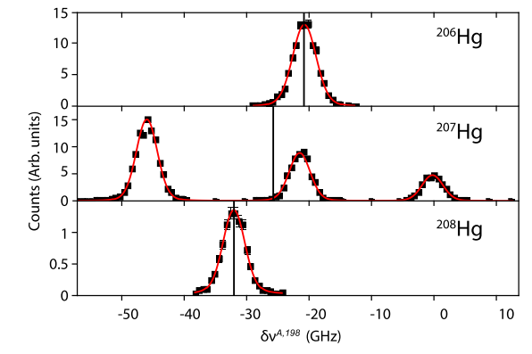
Decay and trap assisted laser spectroscopy
Combination of MR-TOF MS and decay station used at ISOLDE for in-source laser spectroscopy of heavy nuclei
With current resolution of MR-TOF MS, isomeric separation is also be possible
R. N. Wolf et al., Int. J. Mass Spectrom. 349-350, 123-133 (2013)
S. Sels et al., Phys. Rev. C 99, 044306 (2019)
T. Day Goodacre et al., Phys. Rev. Lett. 126, 032502 (2021)
T. Day Goodacre et al., Phys. Rev. C 104, 054322 (2021)

Slide 22
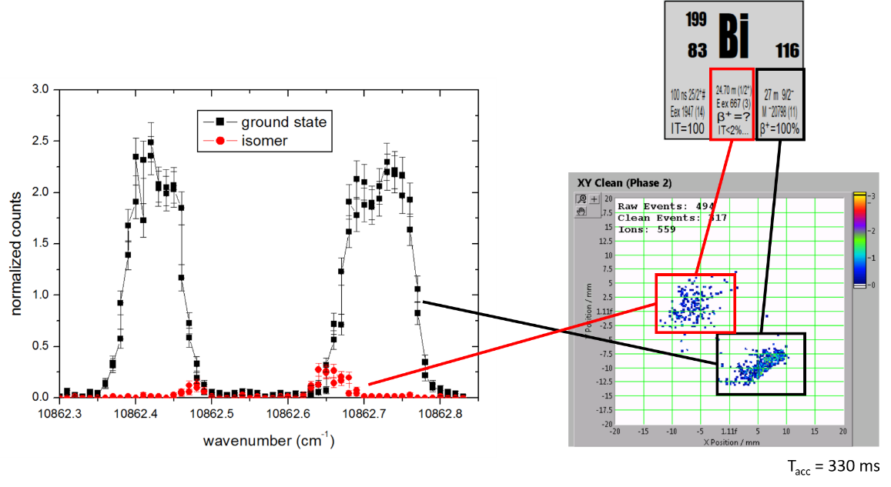
Penning-trap assisted laser spectroscopy
Penning traps can also be used for high-resolution mass tagging either in PI-ICR or TOF-ICR mode.
Early (failed) attempt of in-source laser spectroscopy with PI-ICR detection at ISOLTRAP
The linearity of counting can be a limitation especially in PI-ICR mode (but also high-resolution MR-TOF mode).

Slide 23
Penning-trap assisted laser spectroscopy
Penning traps can also be used for high-resolution mass tagging either in PI-ICR or TOF-ICR mode.
For TOF-ICR, one needs to convert the ICR data in count-rate separation.
Kinetic energy
Ions excited on resonance
Ions excited off resonance

Slide 24
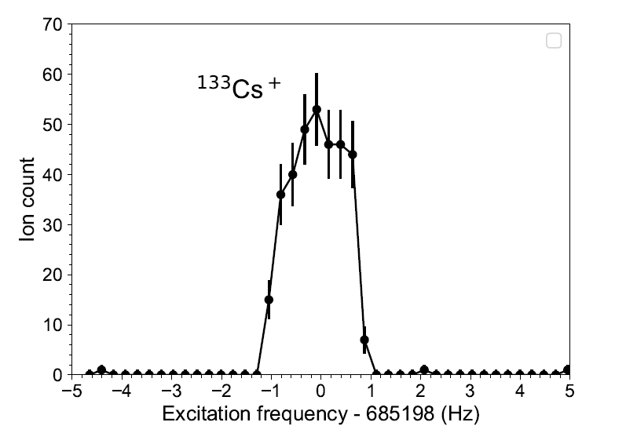
Penning-trap assisted laser spectroscopy
Penning traps can also be used for high-resolution mass tagging either in PI-ICR or TOF-ICR mode.
For TOF-ICR, one needs to convert the ICR data in count-rate separation.
Kinetic energy
Ions excited on resonance
Ions excited off resonance

Slide 25



Penning-trap assisted laser spectroscopy
Penning traps can also be used for high-resolution mass tagging either in PI-ICR or TOF-ICR mode.
For TOF-ICR, one needs to convert the ICR data in count-rate separation.
Kinetic energy
^{201m}Bi
^{201g}Bi
^{201m}Bi
In-source laser spectroscopy of the 1/2⁺ isomer in ²⁰¹Bi while blocking away the ground state (306.8 nm).
Pile-up effect less problematic because of large TOF distribution.
Excite this frequency

Slide 26



PI-ICR assisted laser spectroscopy
Use of the PI-ICR technique for in-source laser spectroscopy of neutron-deficient Ag at IGISOL.
Determining the charge radii of Ag isotopes below the N = 50 shell closure.
Talk by Mikael Reponen
M. Reponen, M., R.P. de Groote, et al. Nat Commun 12, 4596 (2021)

Slide 27


Collinear spectroscopy line at intermediate energy
Buncher
RAPTOR: “RIS And Purification Traps for Optimised spectroscopy”:
  Neutralization in charge-exchange cell
  Collinear laser resonance ionization spectroscopy with few keV beams
  ≈ 100 MHz resolution
Coupling to ion traps for mass tagging
CRIS technique
MR-TOF MS
Penning
Traps
Talk by Mikael Reponen
Slide courtesy of Ruben de Groote

Slide 28
Conclusions
Gas-jet laser spectroscopy is a promising emerging technique at various accelerator facilities.
  Different geometries and approaches are being used, commissioned or developed
  Extraction time and (neutralization) efficiency are important topics of development
Ion traps greatly increase sensitivity of laser spectroscopy across the nuclear chart.
  Several in-source/in-gas laser spectroscopy facilities start exploiting or implementing them
Other approaches being developped (e.g. in-trap laser spectroscopy, ion cooling → MIRACLS project)
Talk by Stephan Ettenauer
S. Sels, F. M. Maier et al., Phys. Rev. Research 4, 033229 (2022)

