Slide 1
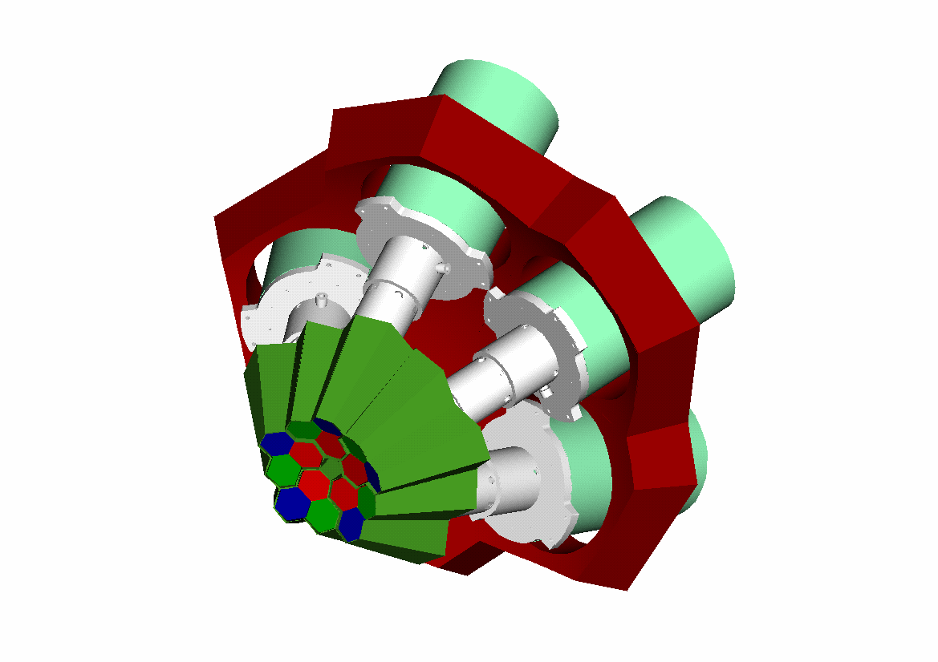


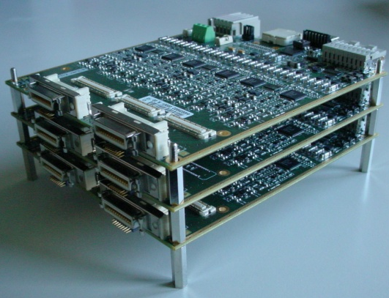
INFN - Milano University of Milano
Department of Physics
“DIGI-OPT12” digitizer for AGATA and GALILEO*
Alberto Pullia
*Technical details in white paper:
“DIGI-OPT12: 12-channel 14/16-bit 100/125-MS/s Digitizer with Optical Output for AGATA/GALILEO” version 1.5
12th AGATA Week
June 11-13, 2012
GSI Germany
June 13, 2012

Slide 2

Mi-Pd group technical meetings from late 2010 to now
Oct. 6, 2010 - Legnaro
Dec. 15, 2010 - Padova
Febr. 1, 2011 - Legnaro
March 1 2011 - Padova
Apr. 21, 2011 - Padova
May 5, 2011 - Legnaro
June 21 2011 - Padova
July 19, 2011 - Legnaro
Oct. 13, 2011 - Legnaro
Dec. 21, 2011 - Legnaro
Jan. 17, 2012 - Legnaro
Apr. 27, 2012 - Legnaro
May 16, 2012 - Padova

Slide 3
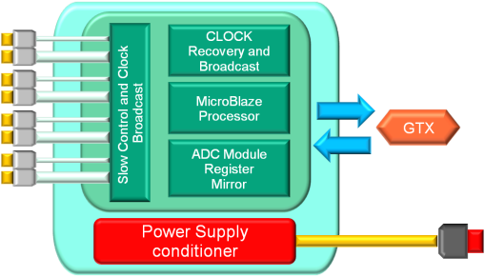
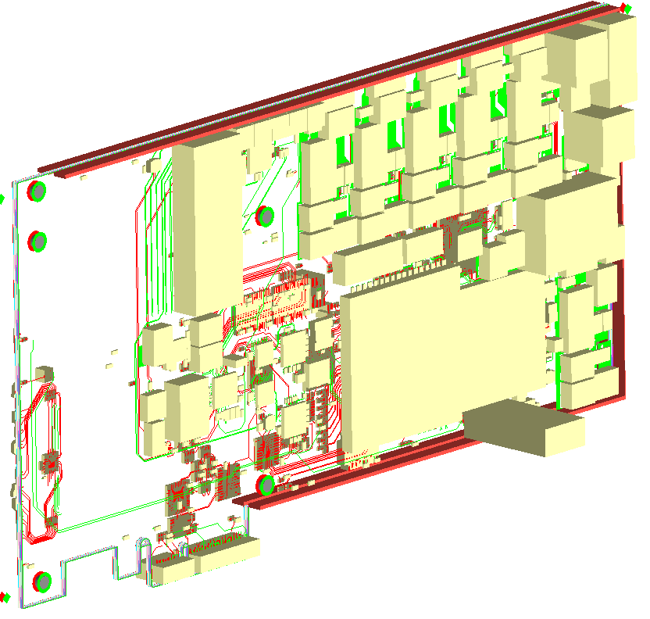
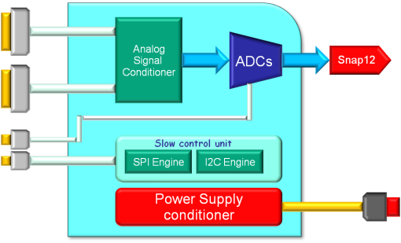
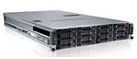
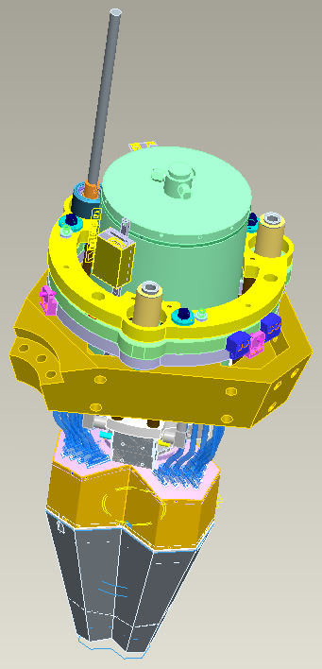


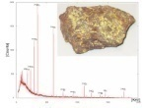
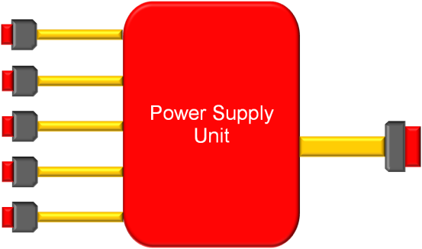
System parts and connections (1 AGATA crystal)
Pre-processing Card
Padova
Clock-Distribution
and Control Unit
Padova
GTS
link
MDR cables
Core ADC
Module
(same HW)
Milano
Spare
fibers
PC + PCIe expansion box
3 Segment ADC Modules
(12 channels each)
Milano

Slide 4
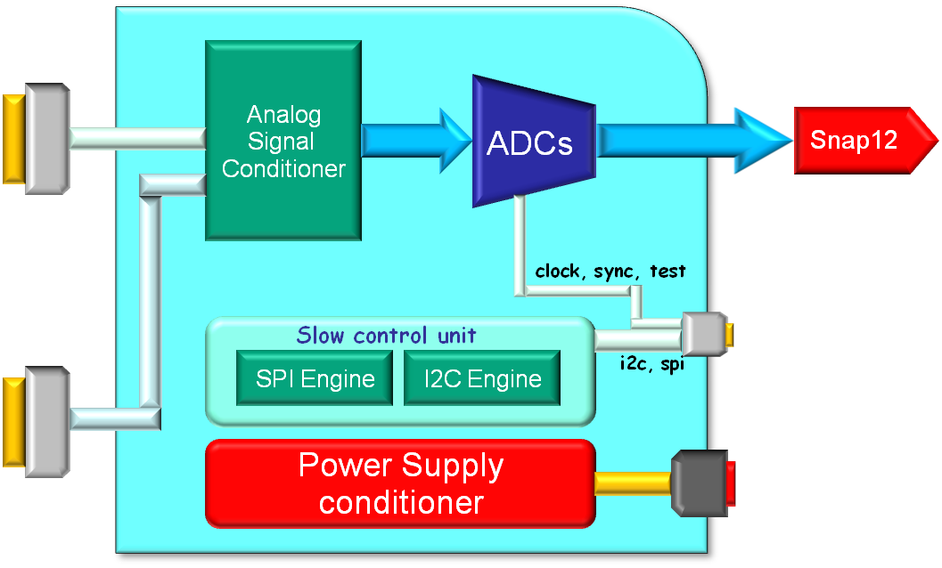
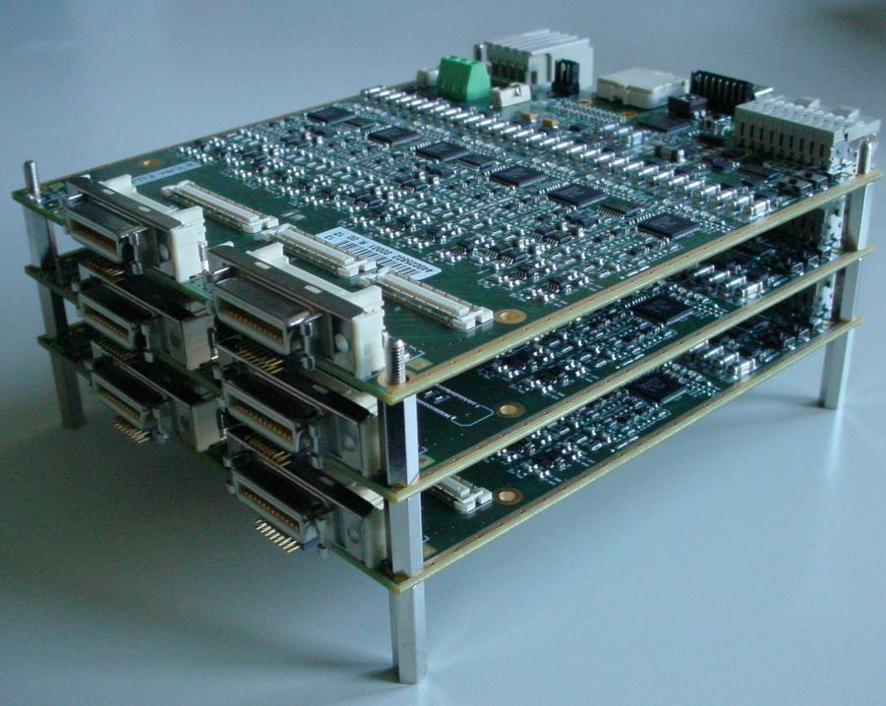
Backplane-ready design
Use of a backplane is foreseen in AGATA, which greatly reduces cable burden
Real thing
Backplane
connectors
Backplane for clock, control signals and PS
MDR connectors
Conceptual design
MDR connectors

Slide 5













ADC card
(this presentation)
Analog
Signal
Conditioner
MDR Connector #1
6 segments or 1 core
ADCs
Snap12
Optical
transmitter
clock, sync, test
clock
TE 6469028-1
and/or
mini-HDMI
Slow control unit
SPI devices
I2C devices
i2c, spi
Slow Control
MDR Connector #2
6 segments or 1 core
Power Supply
conditioner
+2.0V
TE 120955-1
and/or
screw connector
+3.3V
Key words:
Low noise
Minimum power consumption
High integration
High flexibility
ADC with integrated JESD204A encoder/serializer
FPGA-less design!

Slide 6
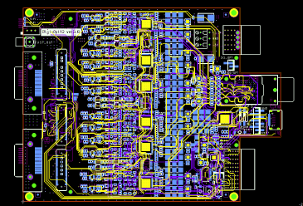
Detailed schematic diagram of ADC card (ver 3.6)
Design completed in July 2011
Layout completed in January 2012

Slide 7
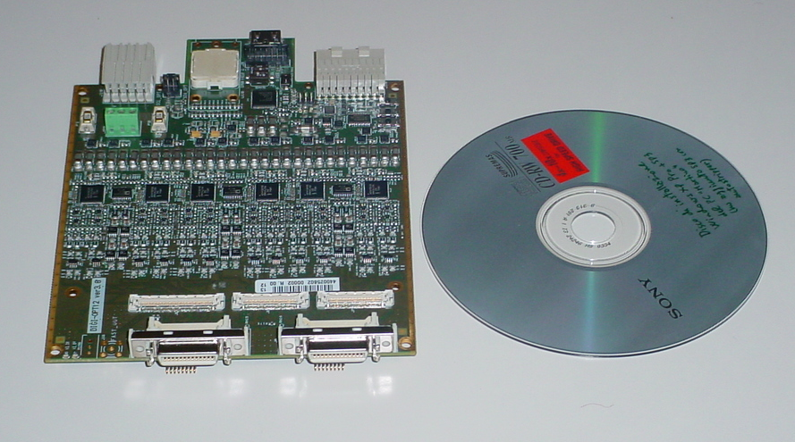
DIGI-OPT12 card - ver 3.6
The first card has been delivered on April 2012
It’s just a little bit larger than a CD-ROM

Slide 8
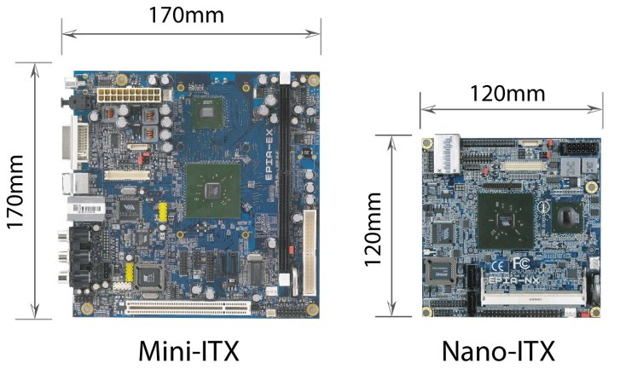
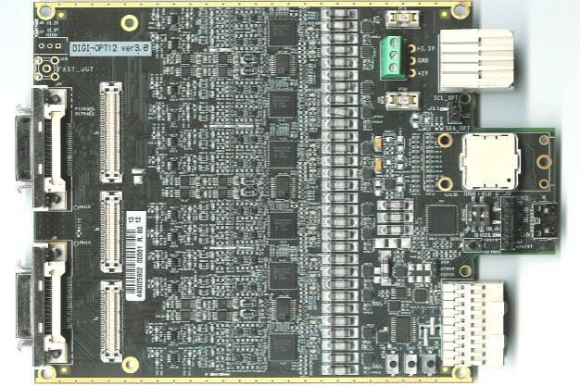
Size of a single ADC card
DIGI-OPT12

Slide 9
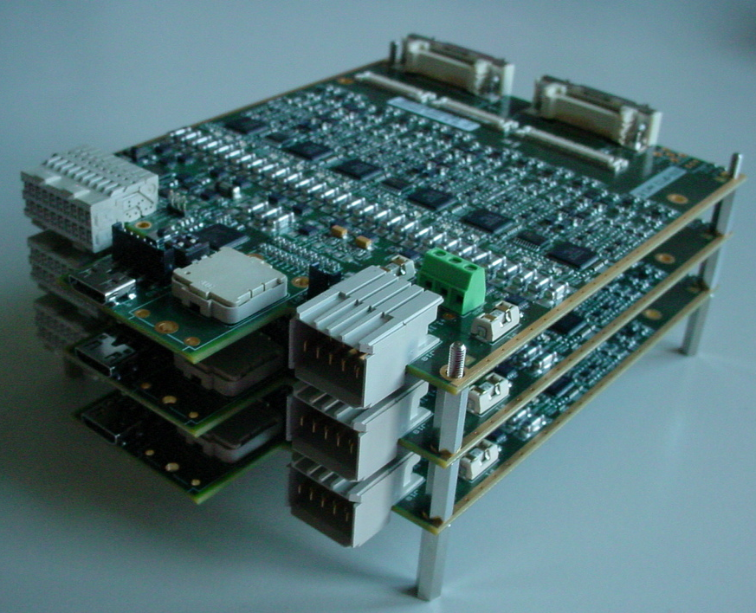
Set of thre piled up cards
Backplane
connectors
MDR connectors
Front view
MDR connectors
Backplane
connectors
Rear view

Slide 10

The card – top view
Power (3.3V, 2V) via screw header
LEDs
Optional fast out with LLD
ADC dual
EMI filters
Power (3.3V, 2V) via backplane
conn’s for core/segm mezzanine
analog front end
SNAP12 TX (not connected)
J5
120 mm
quad digi-pot
clock distr
All signals via mini-HDMI
MDR in
J6
J7
ck, sync, test i2c, spi
via backplane
ADC, CK, TX manual reset
160 mm

Slide 11
Principal properties of DIGI-OPT12 card
14 (or 16) bits, 100MS/s (up to 125) - coding (8b/10b) and SER integrated in ADC chip
Optical output signals (SNAP12, 1 fiber per analog channel)
Compact (120mm x 160mm) and low power (~10W including laser)
Wide choice of factory-set configurations including:
 differential (AGATA) or single-ended input
 segment or core configuration
 AC or DC coupling with or without active input stage (4 setups)
 preset value of common-mode DC voltage
 preset parameters of antialiasing filters
 on-board clock distribution with or without PLL conditioning
End-termination for both differential and common-mode signal components
Remotely-controlled adjustment of DC offset
Remotely-controlled selection of energy range (5 or 20 MeV)
Remotely-controlled setting of ADC and clock-distribution chip parameters
Multiplexed test-pattern input for time synchronization of ADCs
Optional interleaved mode (e.g. 6chs@200MS/s, 4chs@300MS/s, etc)

Slide 12
Clocking the ADCs
Clock jitter is the key parameter to achieving a good SNR/ENOB in the digitized signal
t_{J} = rms jitter on sampling clock
f_{A} = highest analog frequency being digitized
Required clock jitter as a function of f_{A} and ENOB
Use of a high-quality clock distribution chip is the key to get the lowest jitter. Our choice is Analog Devices AD9522-3, with an embedded PLL (on/off options).
f_{A} in AGATA
Noise of on-board clock-distribution chip (AD9522-3 or pin-compatible AD9520-3):
Additive clock jitter: < 260fs
clock distribution only, PLL off
Absolute jitter 1: ~ 300fs
in 12kHz-20MHz BW, with clean clock input. PLL on, with loop BW of 55kHz.
Absolute jitter 2: ~ 400fs
in 12kHz-20MHz BW, with jittery clock input. PLL on, with loop BW of 2kHz.

Slide 13
System architecture: input stage and offset circuit
DC - os
In –
“20 Mev”
range
from preamp
(DC – os) / 2
(DC + os) / 2
“5 Mev”
range
In +
to ADC
DC + os
DC coupling, active input stage - default setup
1.5 V
DC + os
3.0 V
i2c
DC - os
Digipot
256 positions
Offset provided through an i2c digipot and opamps

Slide 14






System architecture: signal path
Detector signal
Divider
Fast
Amplifier
+
Antialias
ADC
Laser
Offset
Regulation
High
spi
High
Test Pattern
i2c
i2c I/O
Signal path for “20 MeV” range measurements (-25% DC offset required to get the full range)

Slide 15
System architecture: signal path
Detector signal
Divider
Fast
Amplifier
+
Antialias
ADC
Laser
Offset
Regulation
Low
spi
High
Test Pattern
i2c
i2c I/O
Signal path for “5 MeV” range measurements

Slide 16
System architecture: signal path
Detector signal
Divider
Fast
Amplifier
+
Antialias
ADC
Laser
Offset
Regulation
Low
spi
Low
Test Pattern
Damiano alg.
i2c
i2c I/O
Signal path for time calibration/synchronization

Slide 17
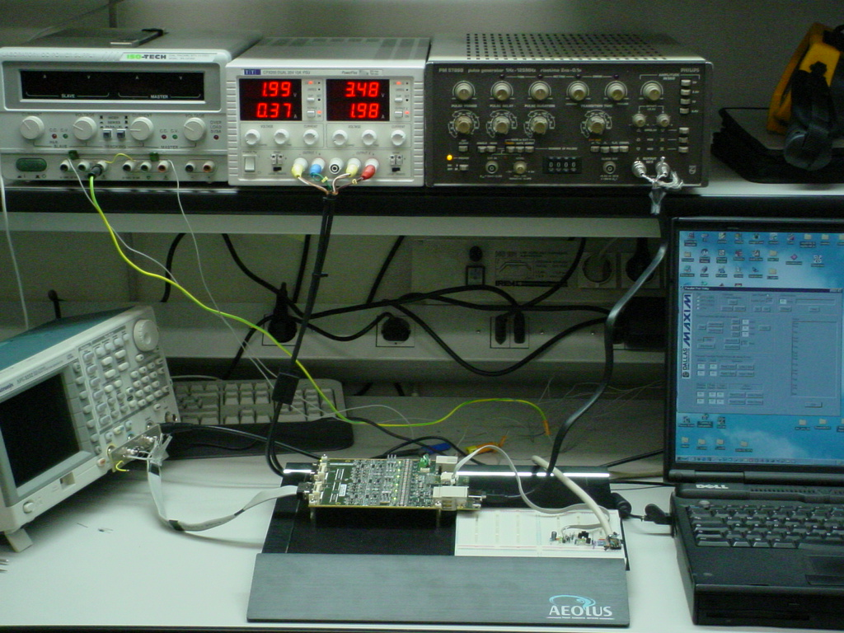
Setup for testing the DIGI-OPT12 card
power
clock
i2c from PC
DIGI-OPT12
Notes:
17

Slide 18
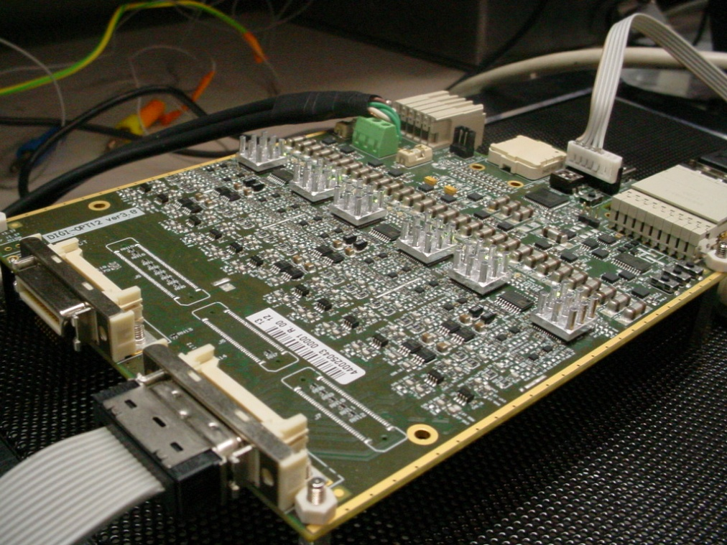
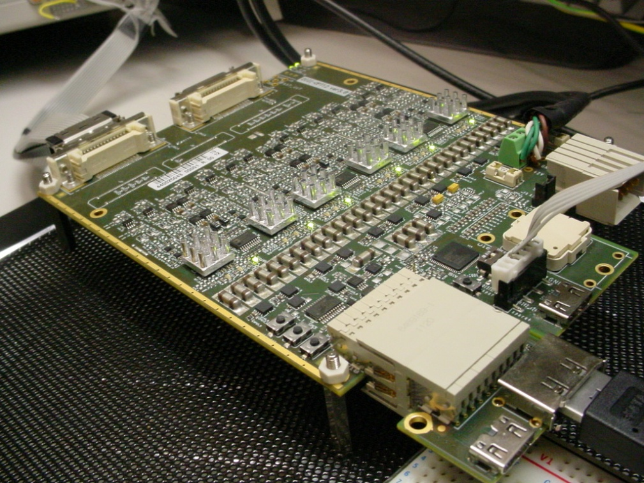
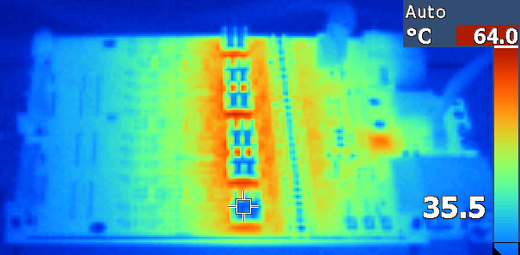
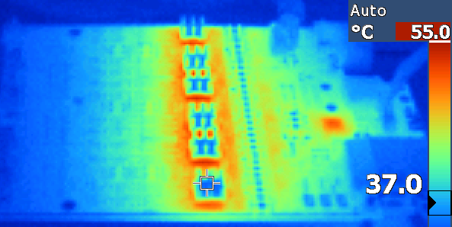
Heat dissipation
2.0V, 3.3V
i2c
IN
CK
Fischer tiny heat sink
PLL lock LEDs
The card on the test bench with tiny heat sinks on the ADCs. Thermographic picture below
Fan-less
With USB powered fan for notebooks
Notes:
18

Slide 19
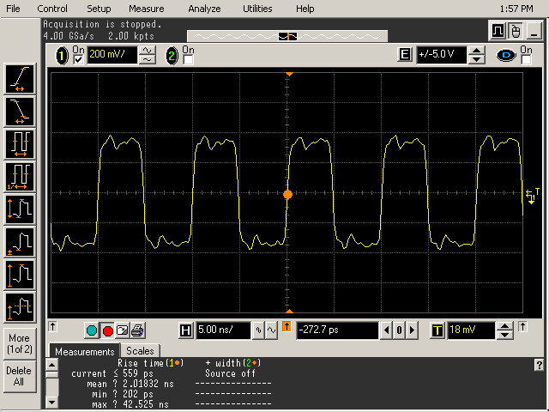
Clock signals captured at the ADC’s input pins
The clock signals are provided to the ADCs through the on board clock-distribution chip
Clock signal @ 100 MHz is clean and symmetric !!
Notes:
19

Slide 20
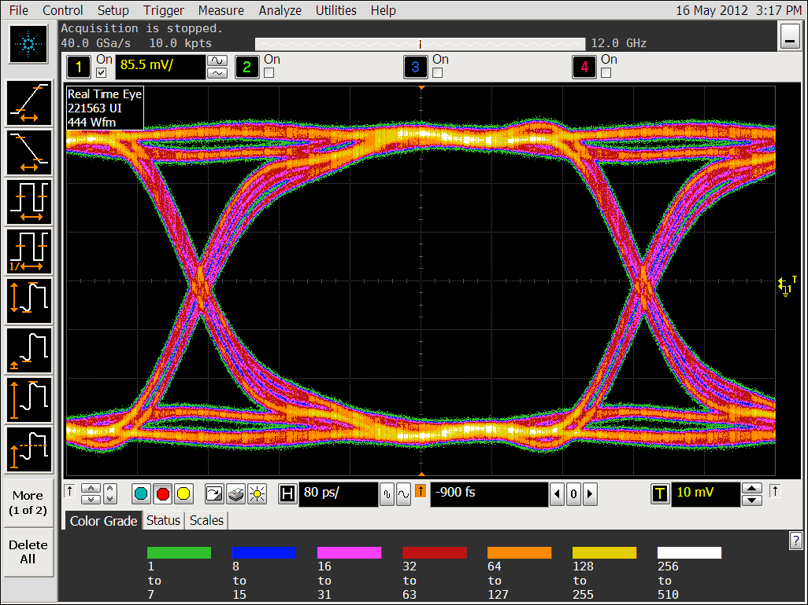
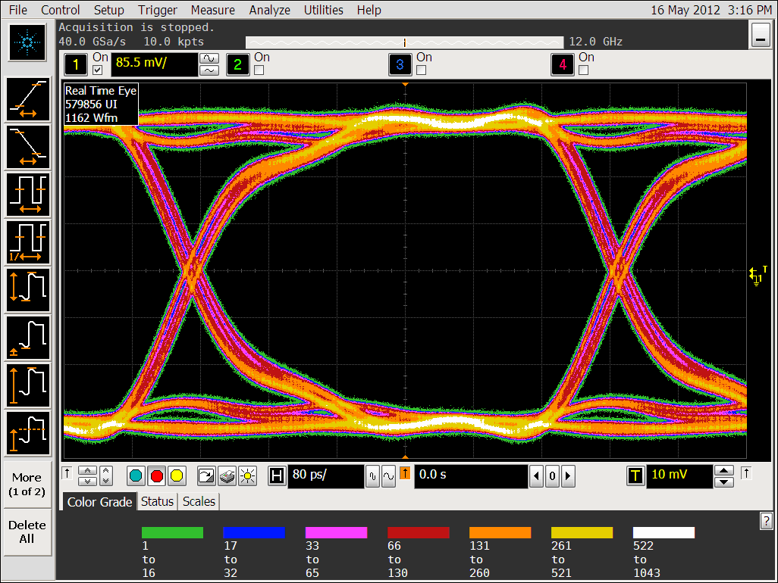
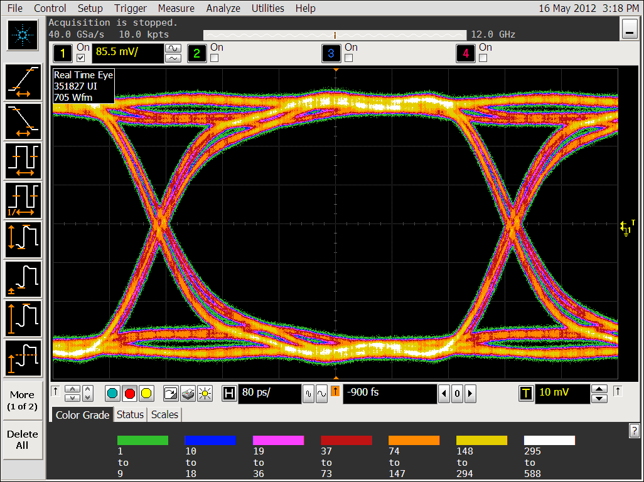
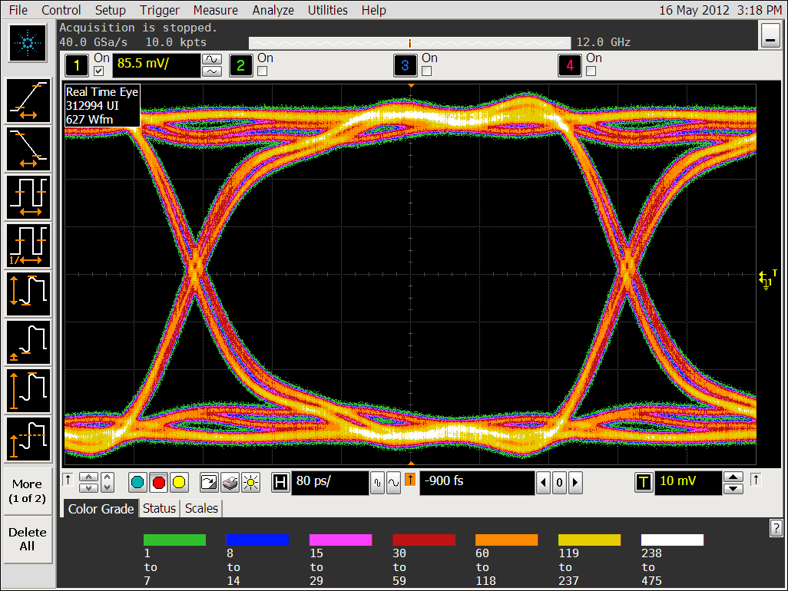
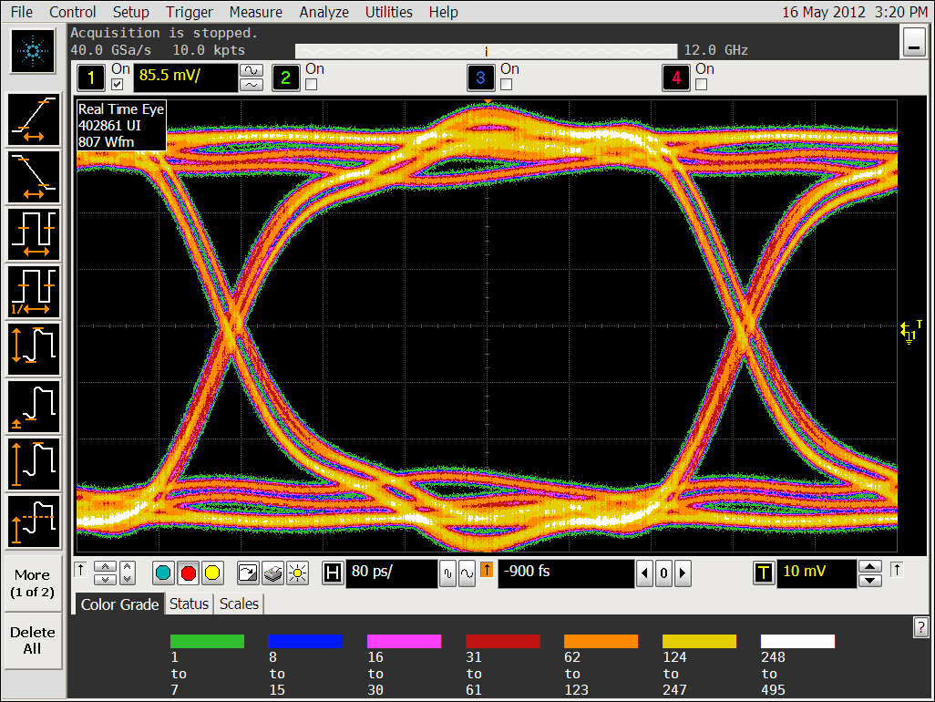
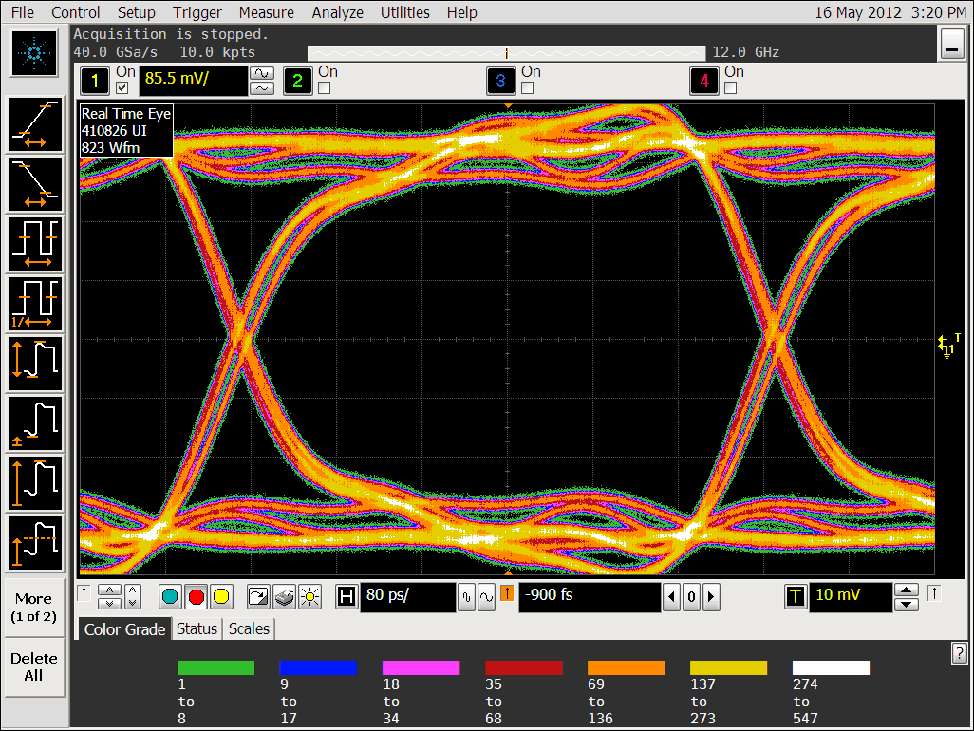
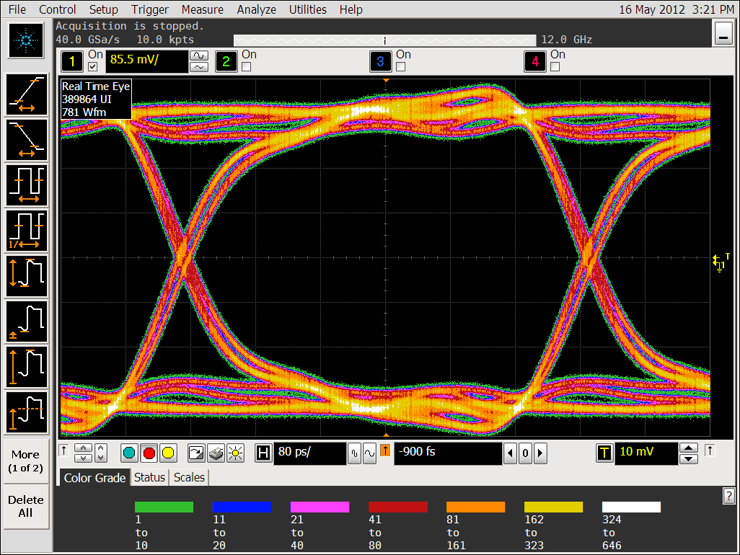
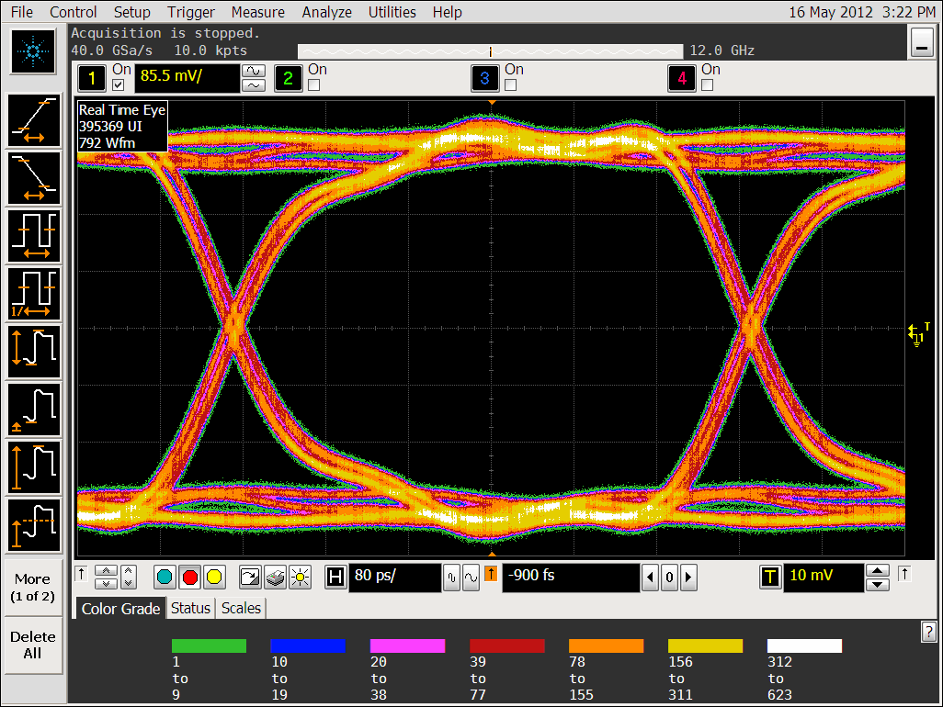
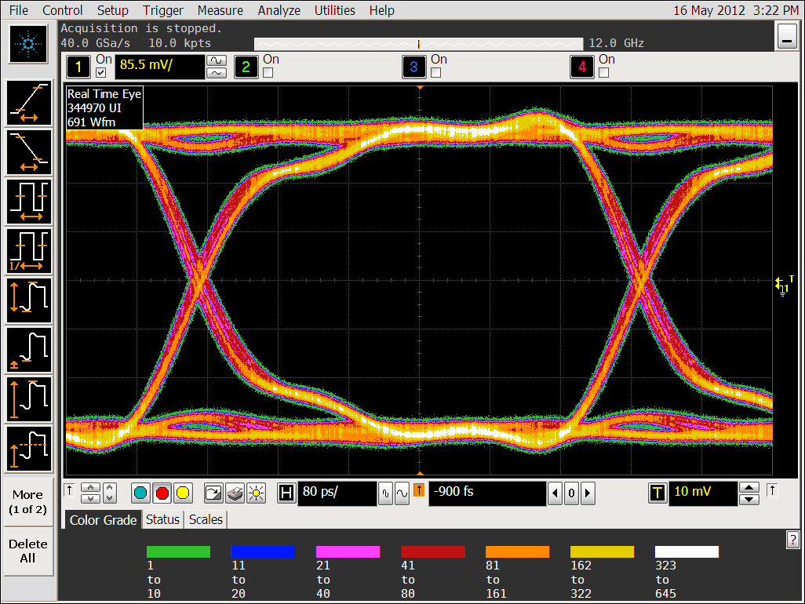
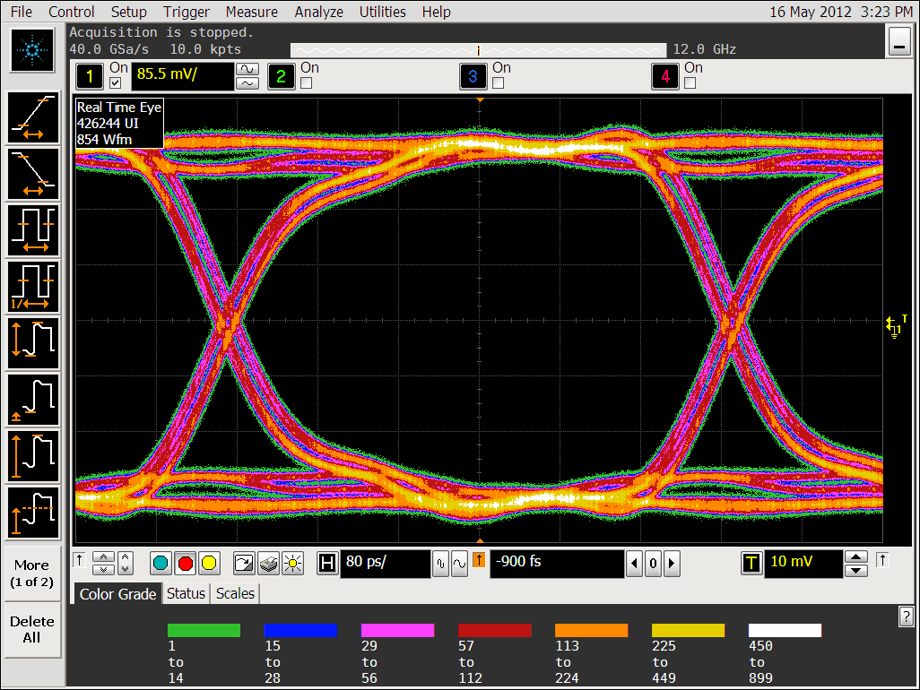
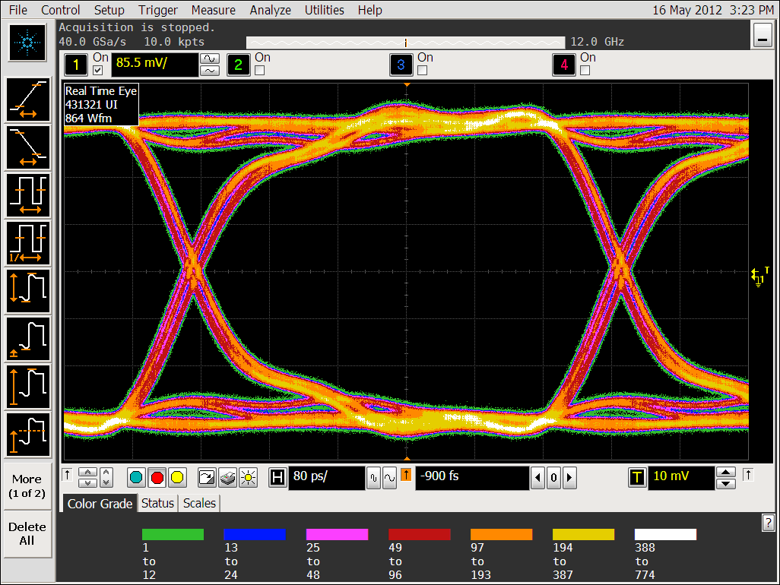
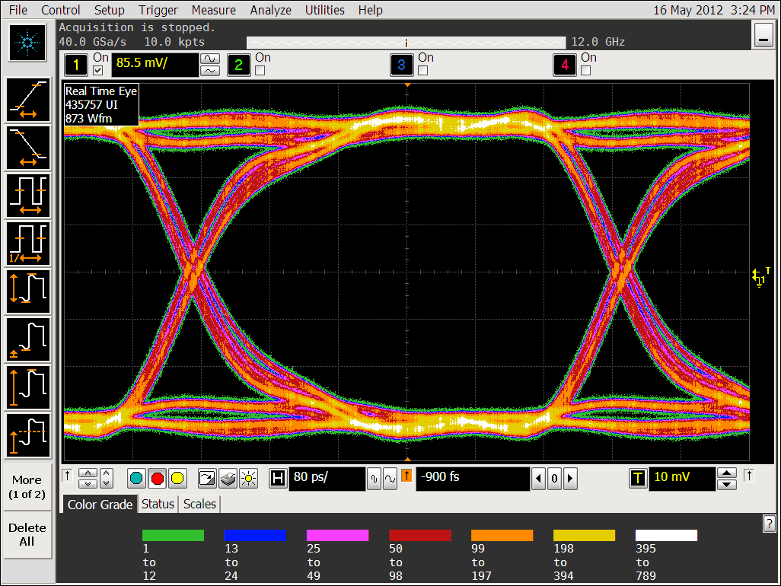
Eye diagrams of the 12 high-frequency digital signals
The 12 encoded/serialized datastreams are provided to the optical TX at high frequency
500 ps
Data stream = 2 Gbps per lane. Eye diagrams are nicely open !!
Notes:
20

Slide 21
Specifications
See also white paper:
“DIGI-OPT12: 12-channel 14/16-bit 100/125-MS/s Digitizer with Optical Output for AGATA/GALILEO” version 1.5 (or later)
ADC | 14 or 16* bit, 100MS/s with JESD204A (8b/10b) and SER interface
Channels | 12 per card
Analog input | Differential, MDR connectors as specified in AGATA preamp white paper v. 3.2
Configurations | “Segment mode” (default, 12 chs) or “Core mode” by insertion of passive piggyback PCB (3 chs + spares)
Clock input | Differential LVPECL through mini-HDMI or backplane
Sync and test pattern input | Single-ended LVCMOS with static toggle through e-SATA connector
Control input | I2C and 3-wire SPI through mini-HDMI (HDMI type C) connector
Output | Optical, 1 fiber each digitized channel (see datasheet of ReflexPhotonics SN-T12-C00601 SNAP12)
Power Supply | 3.3V @ 2.5A and 2.0V @ 0.6A
Power cons | ~ 10W per card
Size of card | 120mm x 160mm
Range control | Remotely controlled range selection: (a) “20 MeV range” (with 25% offset displacement) and (b) “5 MeV range”
Offset control | Remotely controlled within +-30% of full swing
ADC param control | Remotely controlled full set of ADC and JESD204A parameters (see datasheet of NXP ADC1413D)
Clock param control | Remotely controlled full set of clock-distribution parameters, includind switching on the embedded PLL for zero-delay option (see datasheet of AD9522-3)
Pulser param control | Remotely controlled full set of pulser parameters in “Core mode” (see AGATA preamp white paper v. 3.2)
Options | Interleaved mode (e.g. 6 equivalent channels @ 200MS/s), single-ended analog inputs, built-in clock generation
*Pin-to-pin compatible ADC, mod. ADC1613D, is available with a maximum sampling frequency of 125 MHz

Slide 22
Road map and conclusion
April - June 2011
ADC1413D semi-qualified @ Padova
Damiano algorithm for cancellation of random latencies of ADC/state machine
June 2011
Schematic diagram completed (in Orcad Capture)
July - September 2011
Translation of schematics in other CADs (Orcad ConceptHDL, Zuken Cadstar)
September - December 2011
Layout synthesys
Spring 2012
First prototypes ready for testing
Spring-summer-autumn 2012
Tests, qualification, preproduction for GALILEO

Slide 23
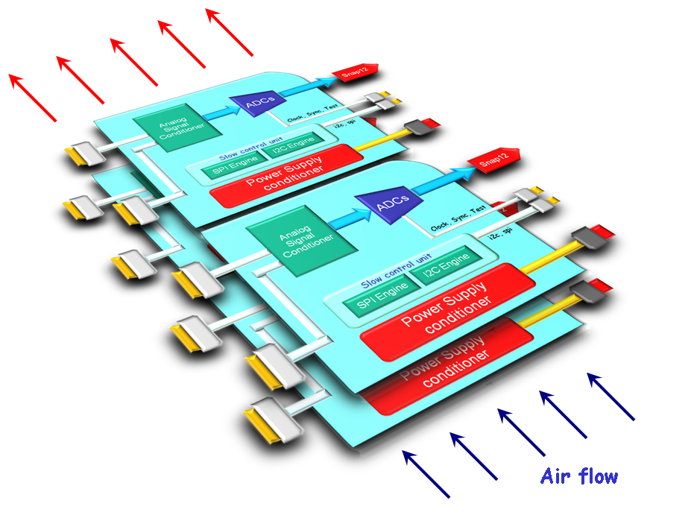
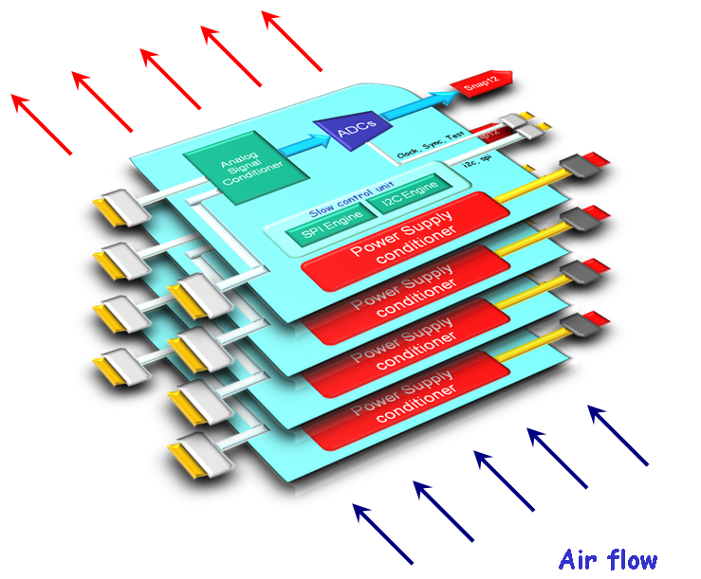
ADC card mounting: fully stacked or paired-and-stacked
Fully stacked
Paired and stacked

Slide 24

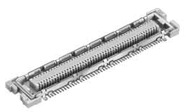
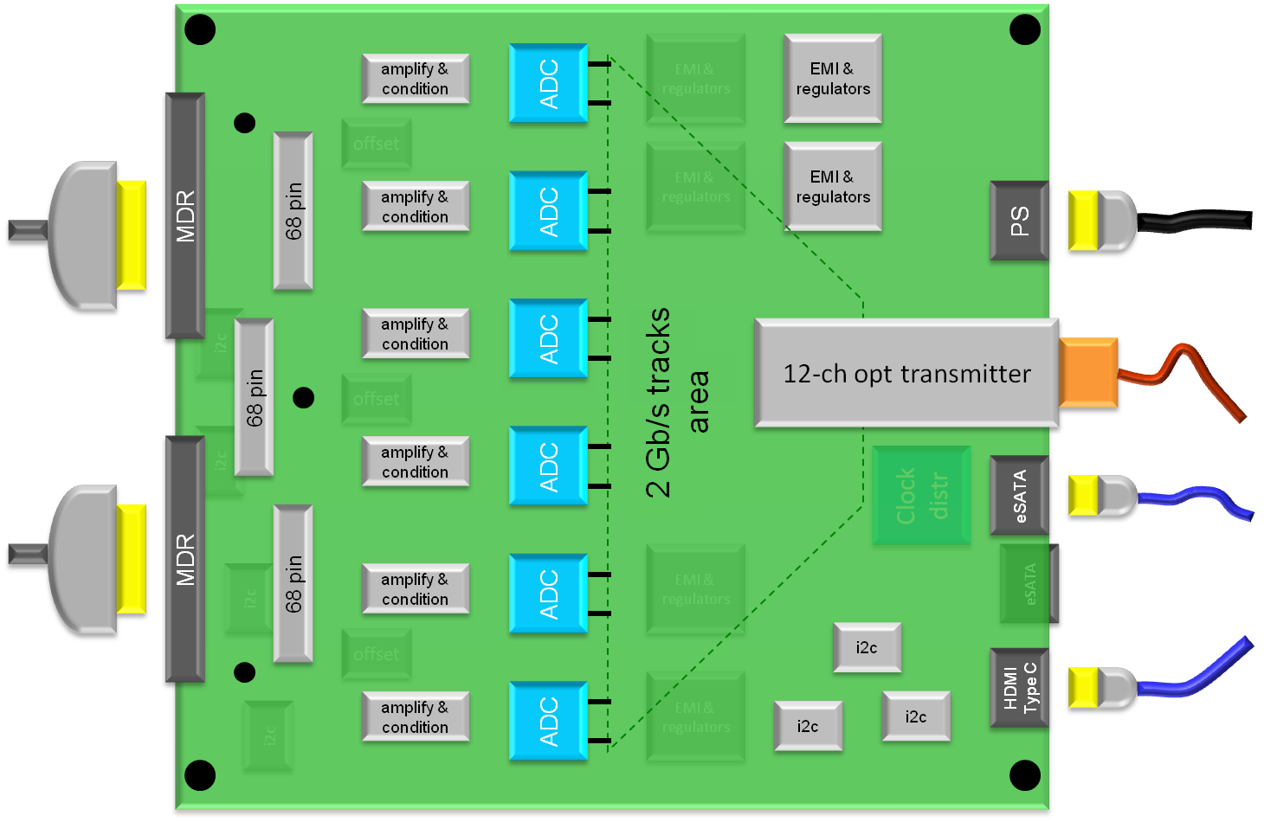
System architecture: the board
Analog in
Analog in
The path from the MDRs to the ADCs goes
through a mezzanine card
→ easy segment or core configuration

Slide 25

System architecture: the board
Analog in
Analog in
The path from the MDRs to the ADCs goes
through a mezzanine card
→ easy segment or core configuration

Slide 26
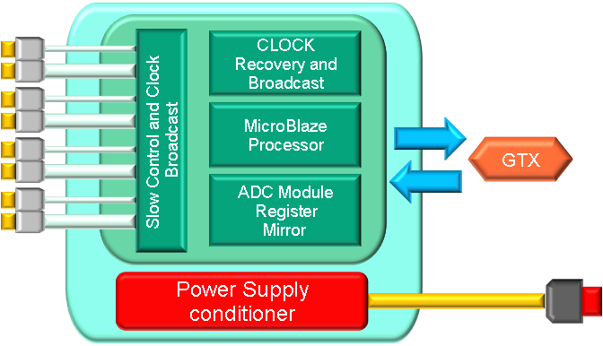
Clock-Distribution and Control Unit
clock,
sync/test,
slow control
ADC Units Clock & Slow Control
Notes:
26

