Slide 1
The FAIR pbar Target
K. Knie

Slide 2
Introduction
Discovery of antiprotons (pbars), secondary beams, p-pbar collider
Challenge 1
Produce pbars at the right place and collect them effciently
(For a beam of sufficient energy and intensity the production of pbars is no challenge at all, it is actually unavoidable)
Challenge 2
Meet Challenge 1 for more than one or two (ideally 10⁶) beam pulses
Challenge 3
Get rid of all the “dirt“ (radiation protection)

Slide 3
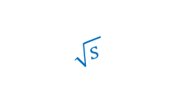
The Berkeley Bevatron (6.3 GeV)
$$\sqrt{s }$$
E_{kin}
E_{kin} [GeV]
p
p
E_{CMS} [GeV]

Slide 4
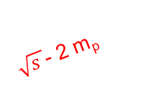
The Berkeley Bevatron (6.3 GeV)
$$\sqrt{s }$$
E_{kin}
E_{kin} [GeV]
p
p
$\sqrt{s }$- 2 m_{p}
E_{CMS} [GeV]

Slide 5
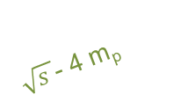
The Berkeley Bevatron (6.3 GeV)
$$\sqrt{s }$$
E_{kin}
p
E_{CMS} [GeV]
p
p
$\sqrt{s }$- 2 m_{p}
p
$\sqrt{s }$- 4 m_{p}
E_{kin} [GeV]

Slide 6
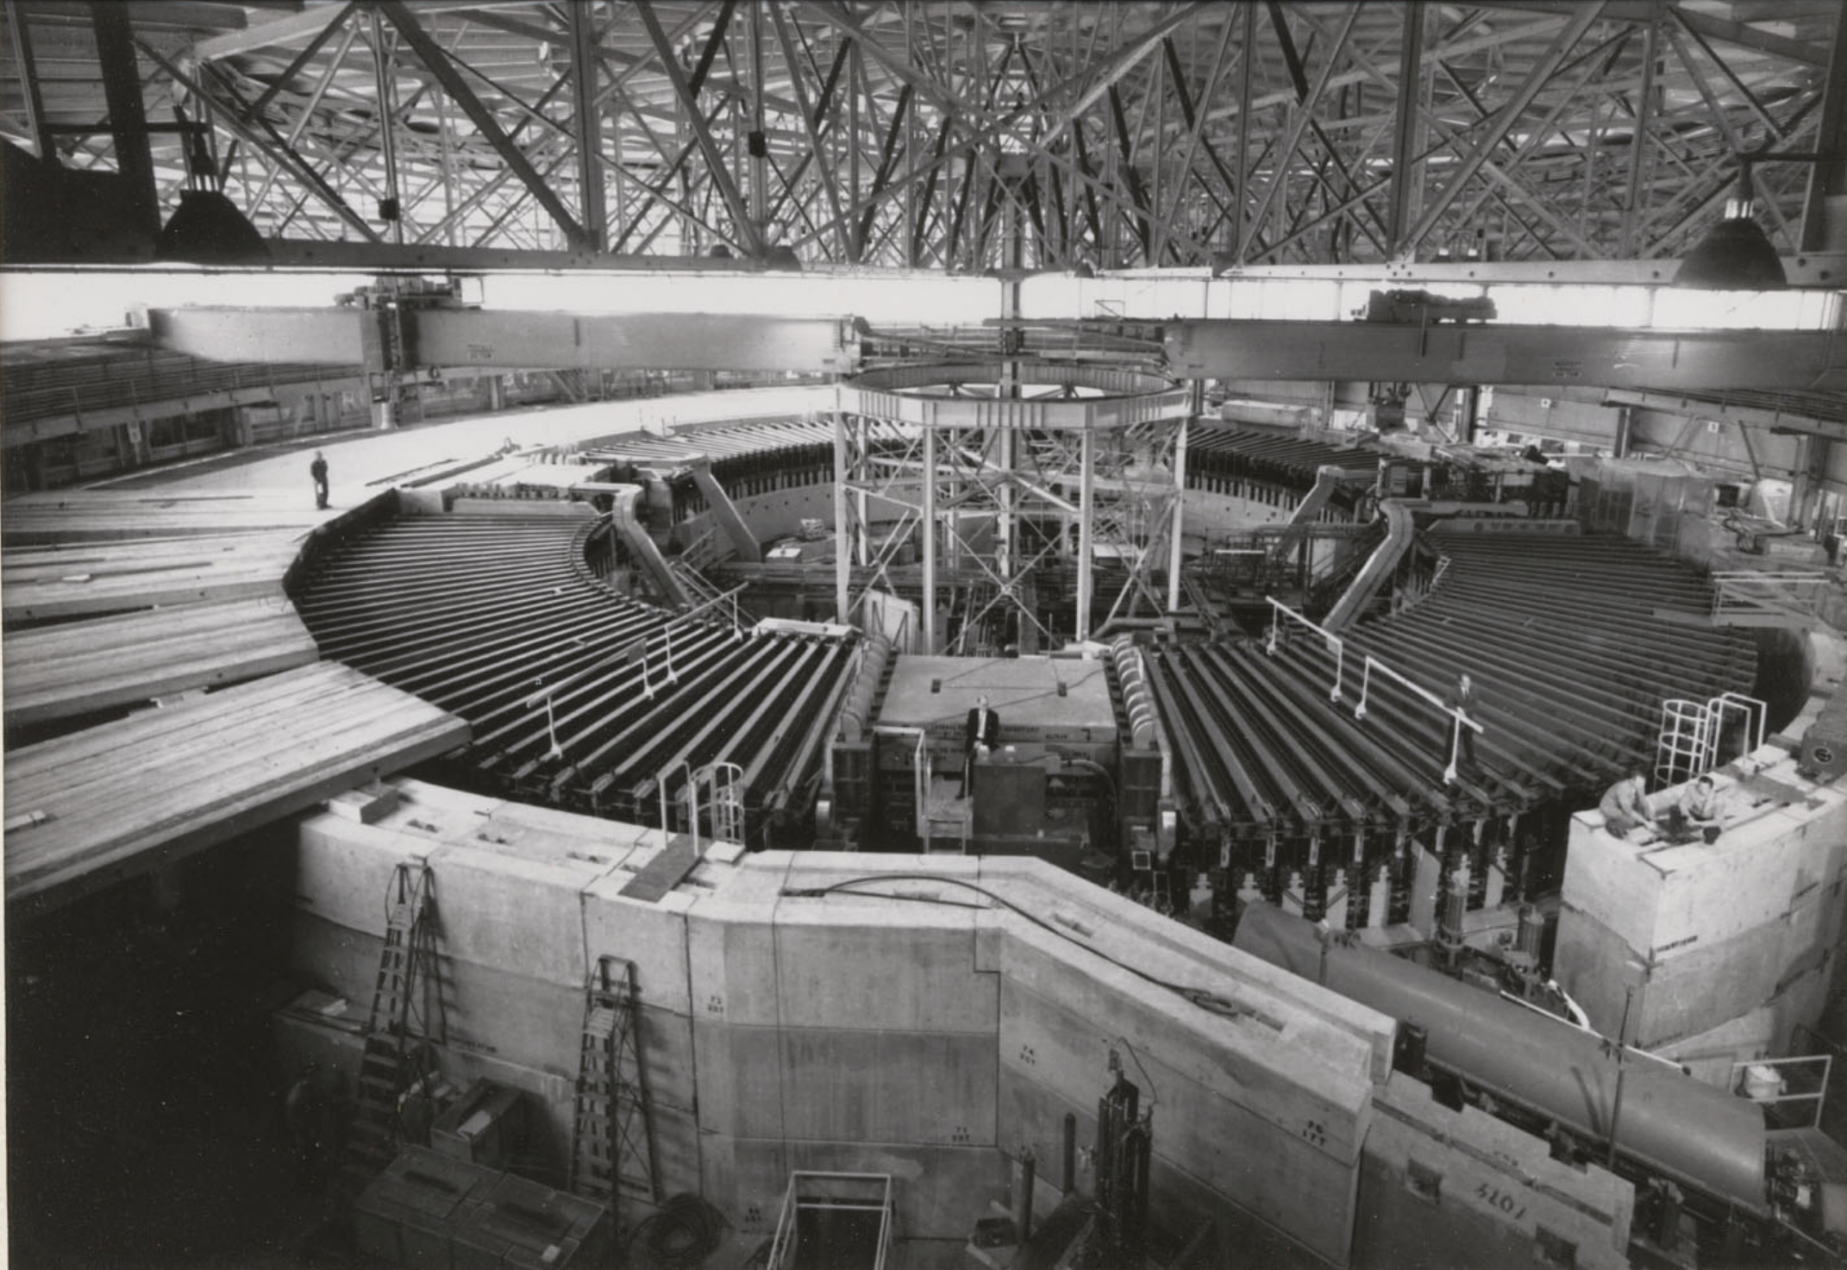
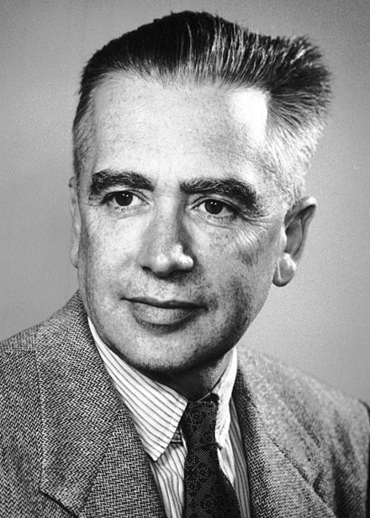
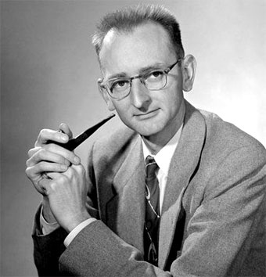
The Berkeley Bevatron (6.3 GeV)
1955: discovery of the antiproton
1956: discovery of the antineutron
1959: Nobel Prize for Emilio Segrè and Owen Chamberlain

Slide 7






p–pbar collider (SPS, Tevatron)
E
$$\sqrt{s}=\sqrt{2Em+2m²}$$
$$\sqrt{s}≈\sqrt{2Em}$$
$$\sqrt{s}=\sqrt{4E^{2}}=2E$$
7

Slide 8
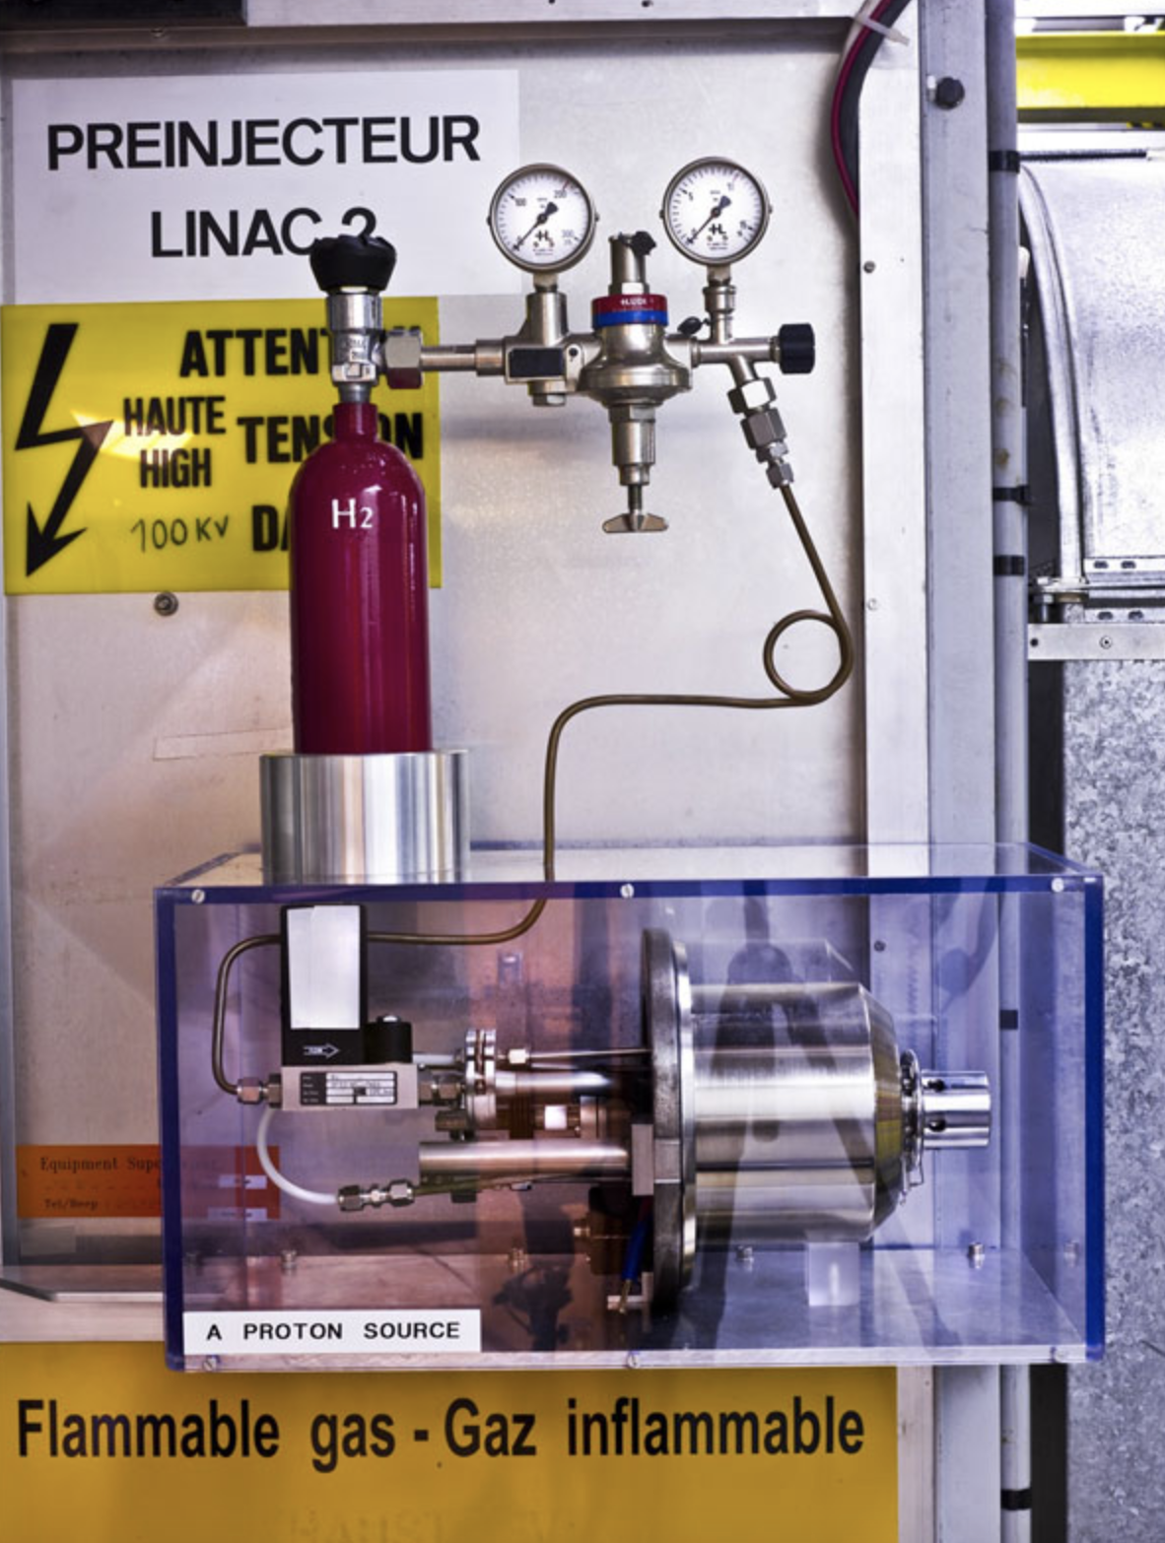
Primary / Secondary Beams
ion
source
accelerator
ion optical system /
separator
stable nuclides or
long loved radionuclides
experiment
8

Slide 9
Primary / Secondary Beams (ISOL)
ion
source
accelerator
ion optical system /
separator
target
ion
source
accelerator
(short lived) radionuclides
experiment
9

Slide 10
Primary / Secondary Beams (In-Flight)
ion
source
accelerator
ion optical system /
separator
target
(very) short lived radionuclides
π, K, pbar, µ
experiment
10

Slide 11
Primary / Secondary Beams (pbar)
ion
source
accelerator(s)
ion optical system /
separator
target
extremely strong
focusing device
detector
(PANDA)
protons
CERN
experiment
(SPS, HESR)
accumulation
(AA, RESR)
collection, pre-cooling
(AC, CR)
FAIR
11

Slide 12
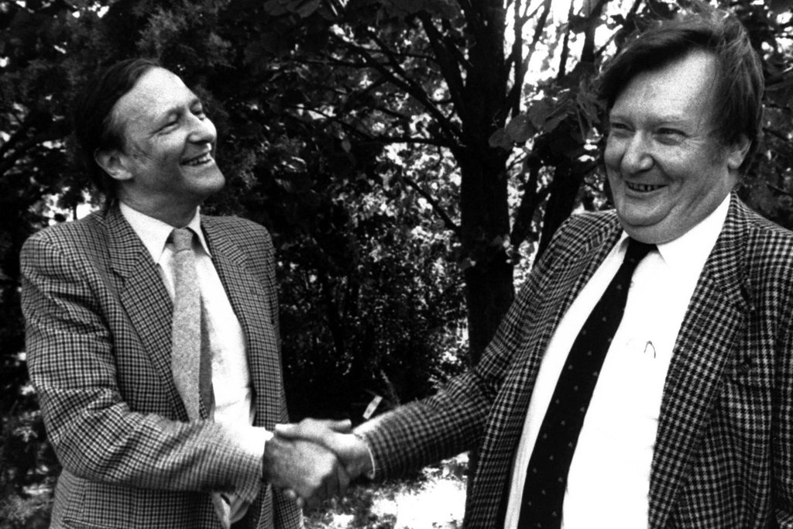
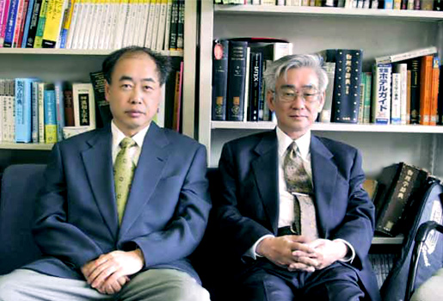
p–pbar collider (SPS, Tevatron)
Detection of W and Z boson at CERN:
Nobel Prize 1984 to Carlo Rubbia (right) and Simon van der Meer (left).
Detection of the top quark at Fermilab (1995)
Nobel Prize 2008 to Makoto Kobayashi (left) and Toshihide Maskawa (right) for its prediction.

Slide 13
Introduction
Discovery of antiprotons (pbars), secondary beams, p-pbar collider
Challenge 1
Produce pbars at the right place and collect them effciently
(For a beam of sufficient energy and intensity the production of pbars is no challenge at all, it is actually unavoidable)
Challenge 2
Meet Challenge 1 for more than one or two (ideally 10⁶) beam pulses
Challenge 3
Get rid of all the “dirt“ (radiation protection)

Slide 14
FAIR / CERN / FNAL pbar Sources
 | FAIR | CERN (AC+AA) | FNAL
E(p), E(pbar) | 27.5 GeV, 3 GeV | 25 GeV, 2.7 GeV | 120 GeV, 8 GeV
acceptance | 240 π mm mrad | 200 π mm mrad | ≈ 30 π mm mrad
protons / pulse | 2 × 10¹³ | 1 - 2 × 10¹³ | ≥ 5 × 10¹²
pulse length | single bunch (50 ns) | 5 bunches in 400 ns | single bunch 1.6 µs
cycle time | 10 s | 4.8 s | 1.5 s

Slide 15
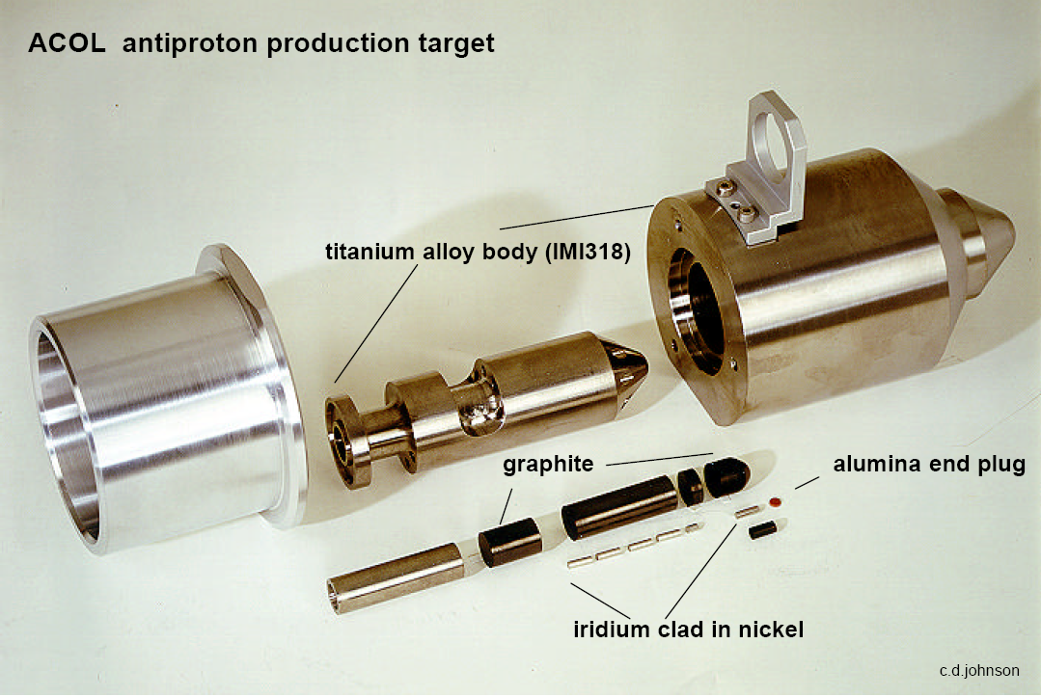
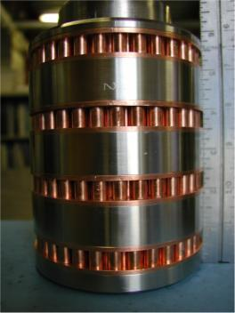
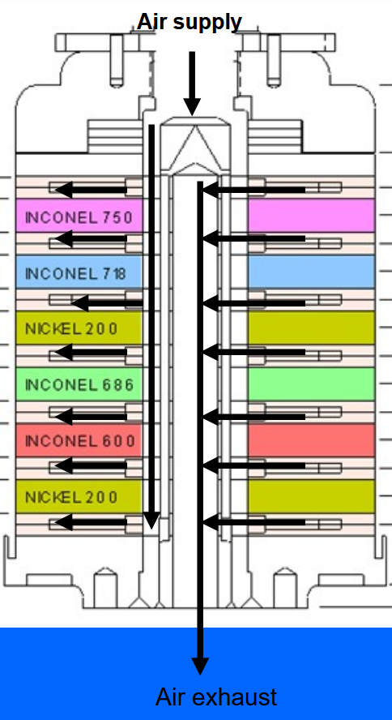
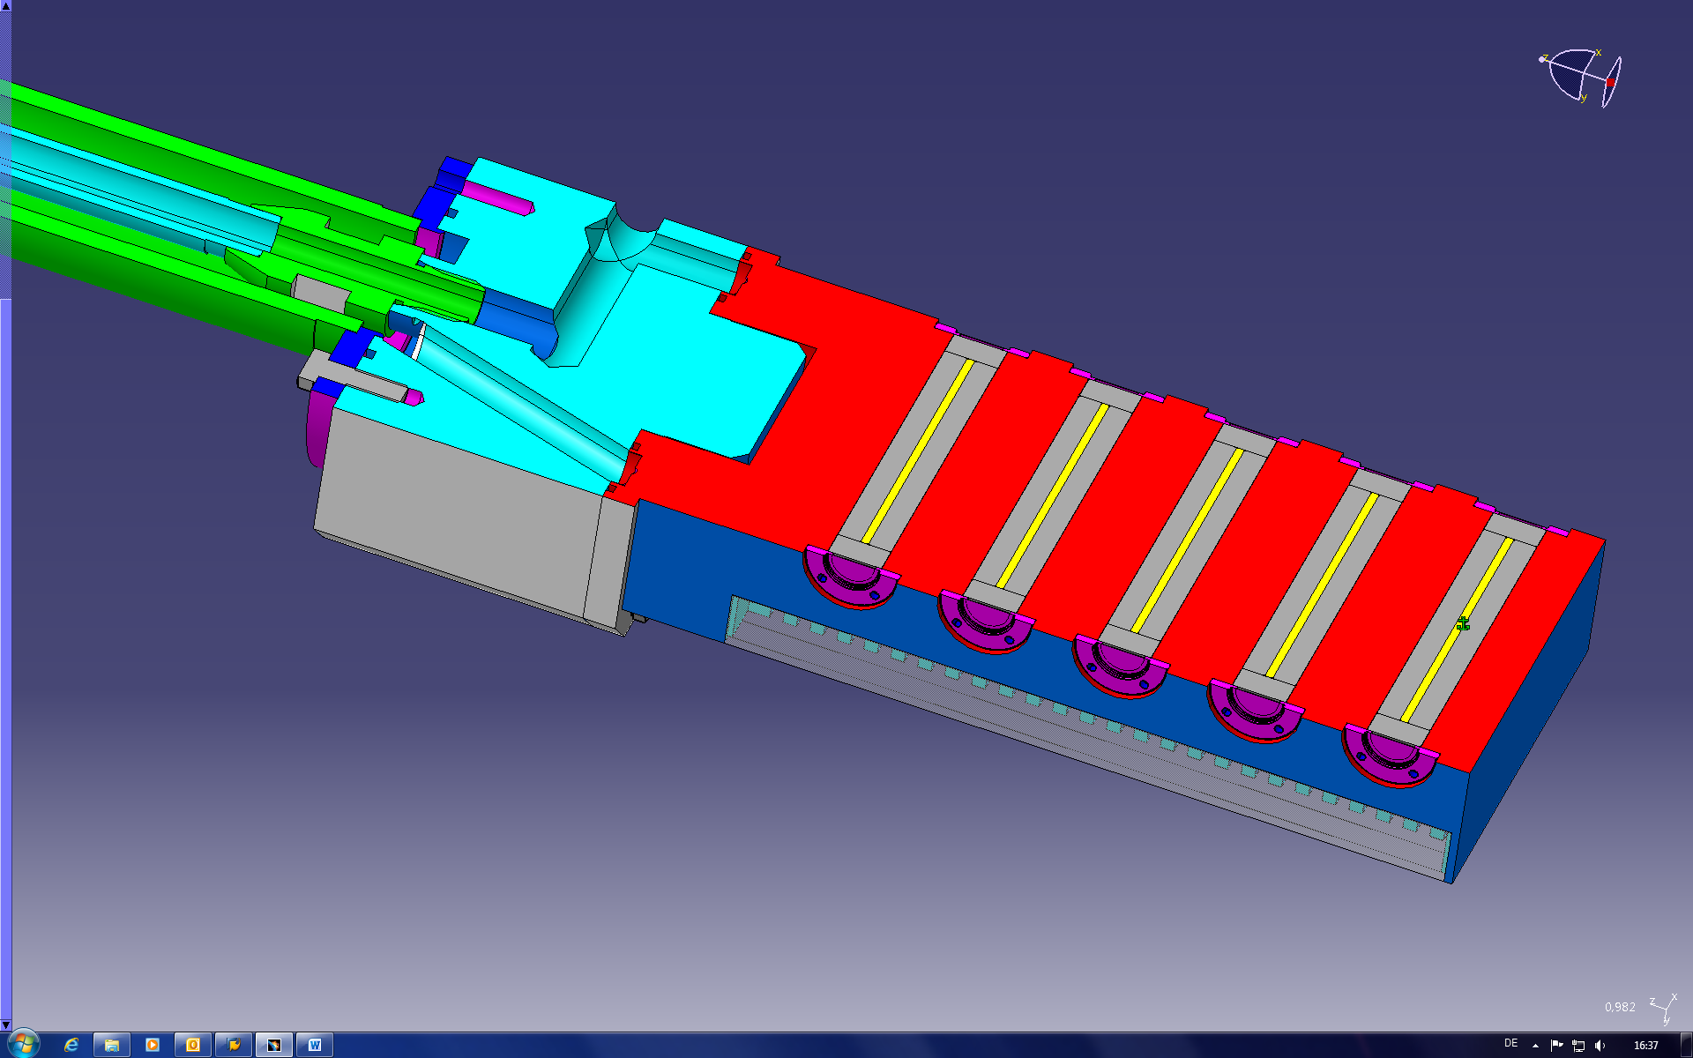
pbar Targets
Fermilab
CERN
FAIR
air-cooled
Al/Ti block
graphite
metal rods,
100 mm, d = 3 mm
FAIR

Slide 16
Creation of Antiprotons
c.m.
p, > 1 GeV
p
p
p, > 1 GeV
p
m = E / c²
m_{p} = m_{pbar} ≈ 1 GeV / c²
pbar
lab
p at rest
p
p
p, > 6 GeV
pbar
p

Slide 17
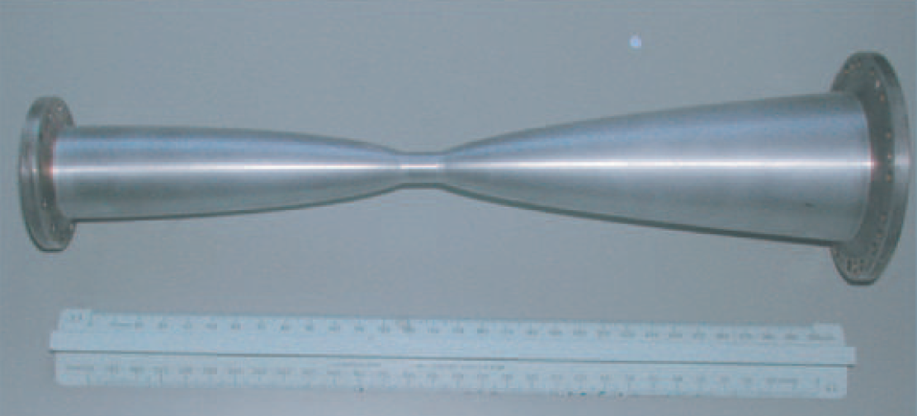
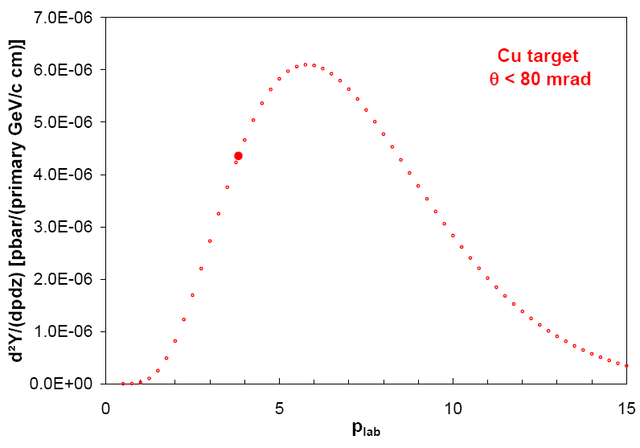
Collectible pbars
Emax SIS 100
y / cm
E_{p} = 29 GeV
magnetic horn
CR max. 13 Tm
z / cm
acceptance separator/CR
p_{pbar} = 3.82 GeV/c ± 3%
0 < p_{pbar} < 80 mrad
From ~ 2.5 × 10⁻⁴ pbar / (p cm target) ~ 5 × 10⁻⁶ (or 2 %) are "collectible"
~ 3 × 10⁻⁵ pbar / (p g/cm² target)

Slide 18
Collecting pbars: Magnetic Horn
B ∼ 1/r
primary beam does not hit the horn
reaction products

Slide 19
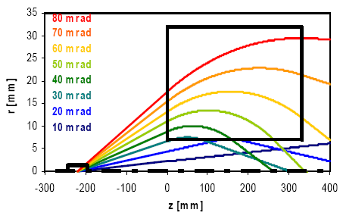
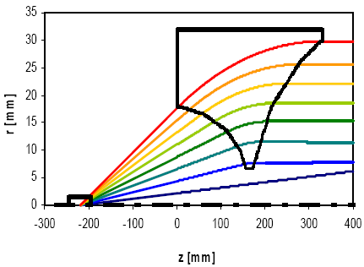
Collecting pbars: Magnetic Horn
target beam axis magnetic field area
CERN ACOL Horn, I = 400 kA

Slide 20
Collectible pbars

Slide 21
Collectible pbars
p
pbar
Cu: σ_{pbar} = 8.8 b

Slide 22
Collectible pbars
p
pbar
Cu: σ_{pbar} = 8.8 b
C: σ_{pbar} = 0.42 b

Slide 23
MARS Simulation of the pbar Yields

Slide 24
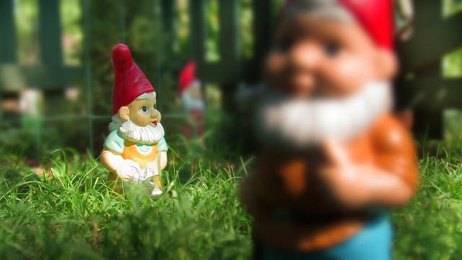
Collection efficiency of the magnetic horn
pbars in the ellipse
yield = = 2 × 10⁻⁵
primary protons

Slide 25
pbar Yield: Comparison to CERN Data
To injection orbit of collector ring:
pbar/p = 2×10⁻⁵ × 0.8 × 0.7 = 1×10⁻⁵
scattering losses/annihilation in air/aluminum losses in separator / during injection
Exp. data from CERN (Baird 1998) to injection orbit:
pbar/p = 0.45×10⁻⁵ × 1.5 = 0.7×10⁻⁵
correction for different energies and emmitances

Slide 26
Introduction
Discovery of antiprotons (pbars), secondary beams, p-pbar collider
Challenge 1
Produce pbars at the right place and collect them effciently
(For a beam of sufficient energy and intensity the production of pbars is no challenge at all, it is actually unavoidable)
Challenge 2
Meet Challenge 1 for more than one or two (ideally 10⁶) beam pulses
Challenge 3
Get rid of all the “dirt“ (radiation protection)

Slide 27
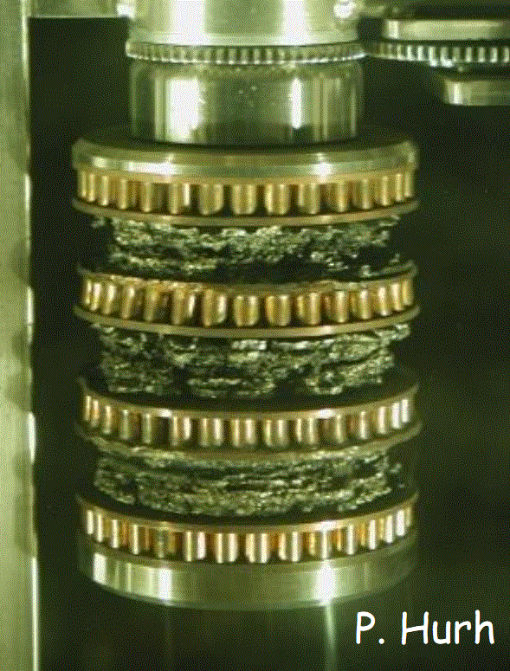
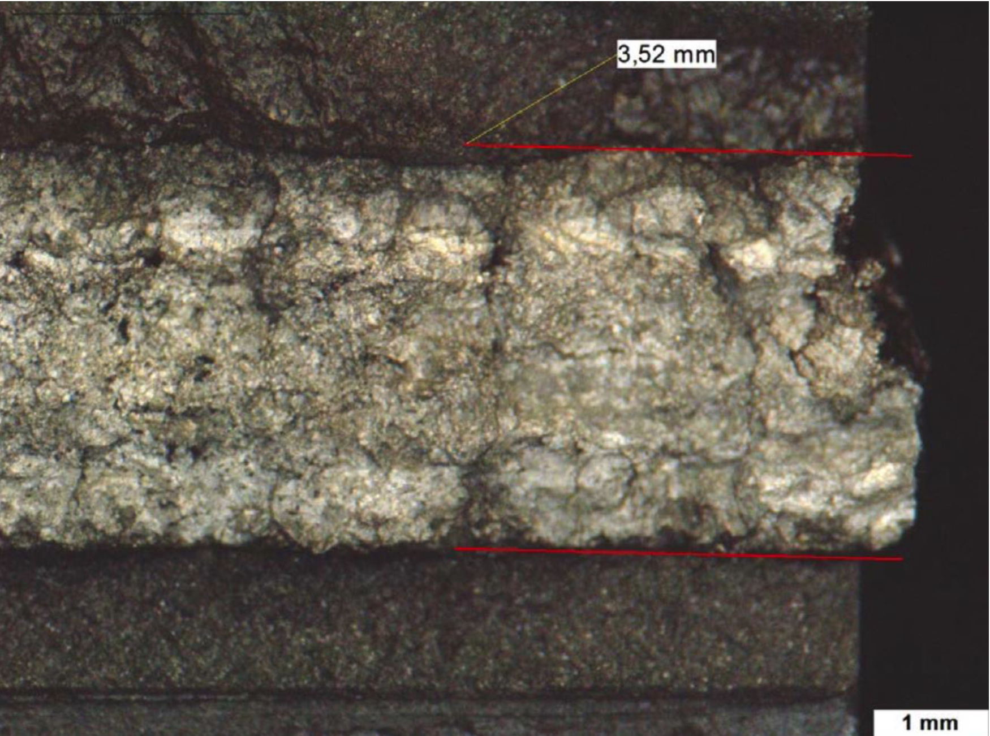
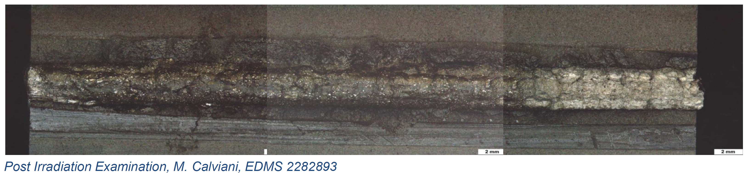
pbar Targets

Slide 28
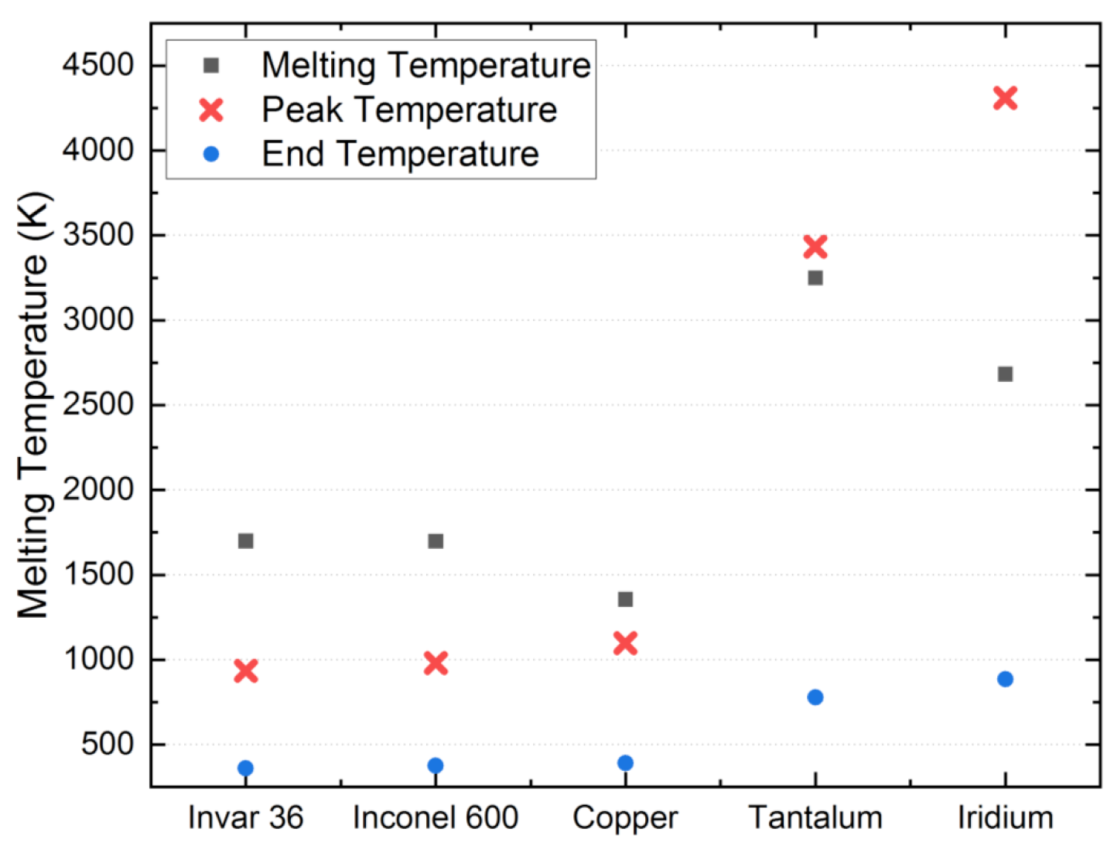
Choice of Target Material
Nuclear physics does not matter
Right density
- too low: deviation from „point-like“ geometry
- too high: secondaries cannot spread out
Coupled Fluka-ANSYS simulations (2.5e13 p)
High thermal stability
Mechanical stability

Slide 29
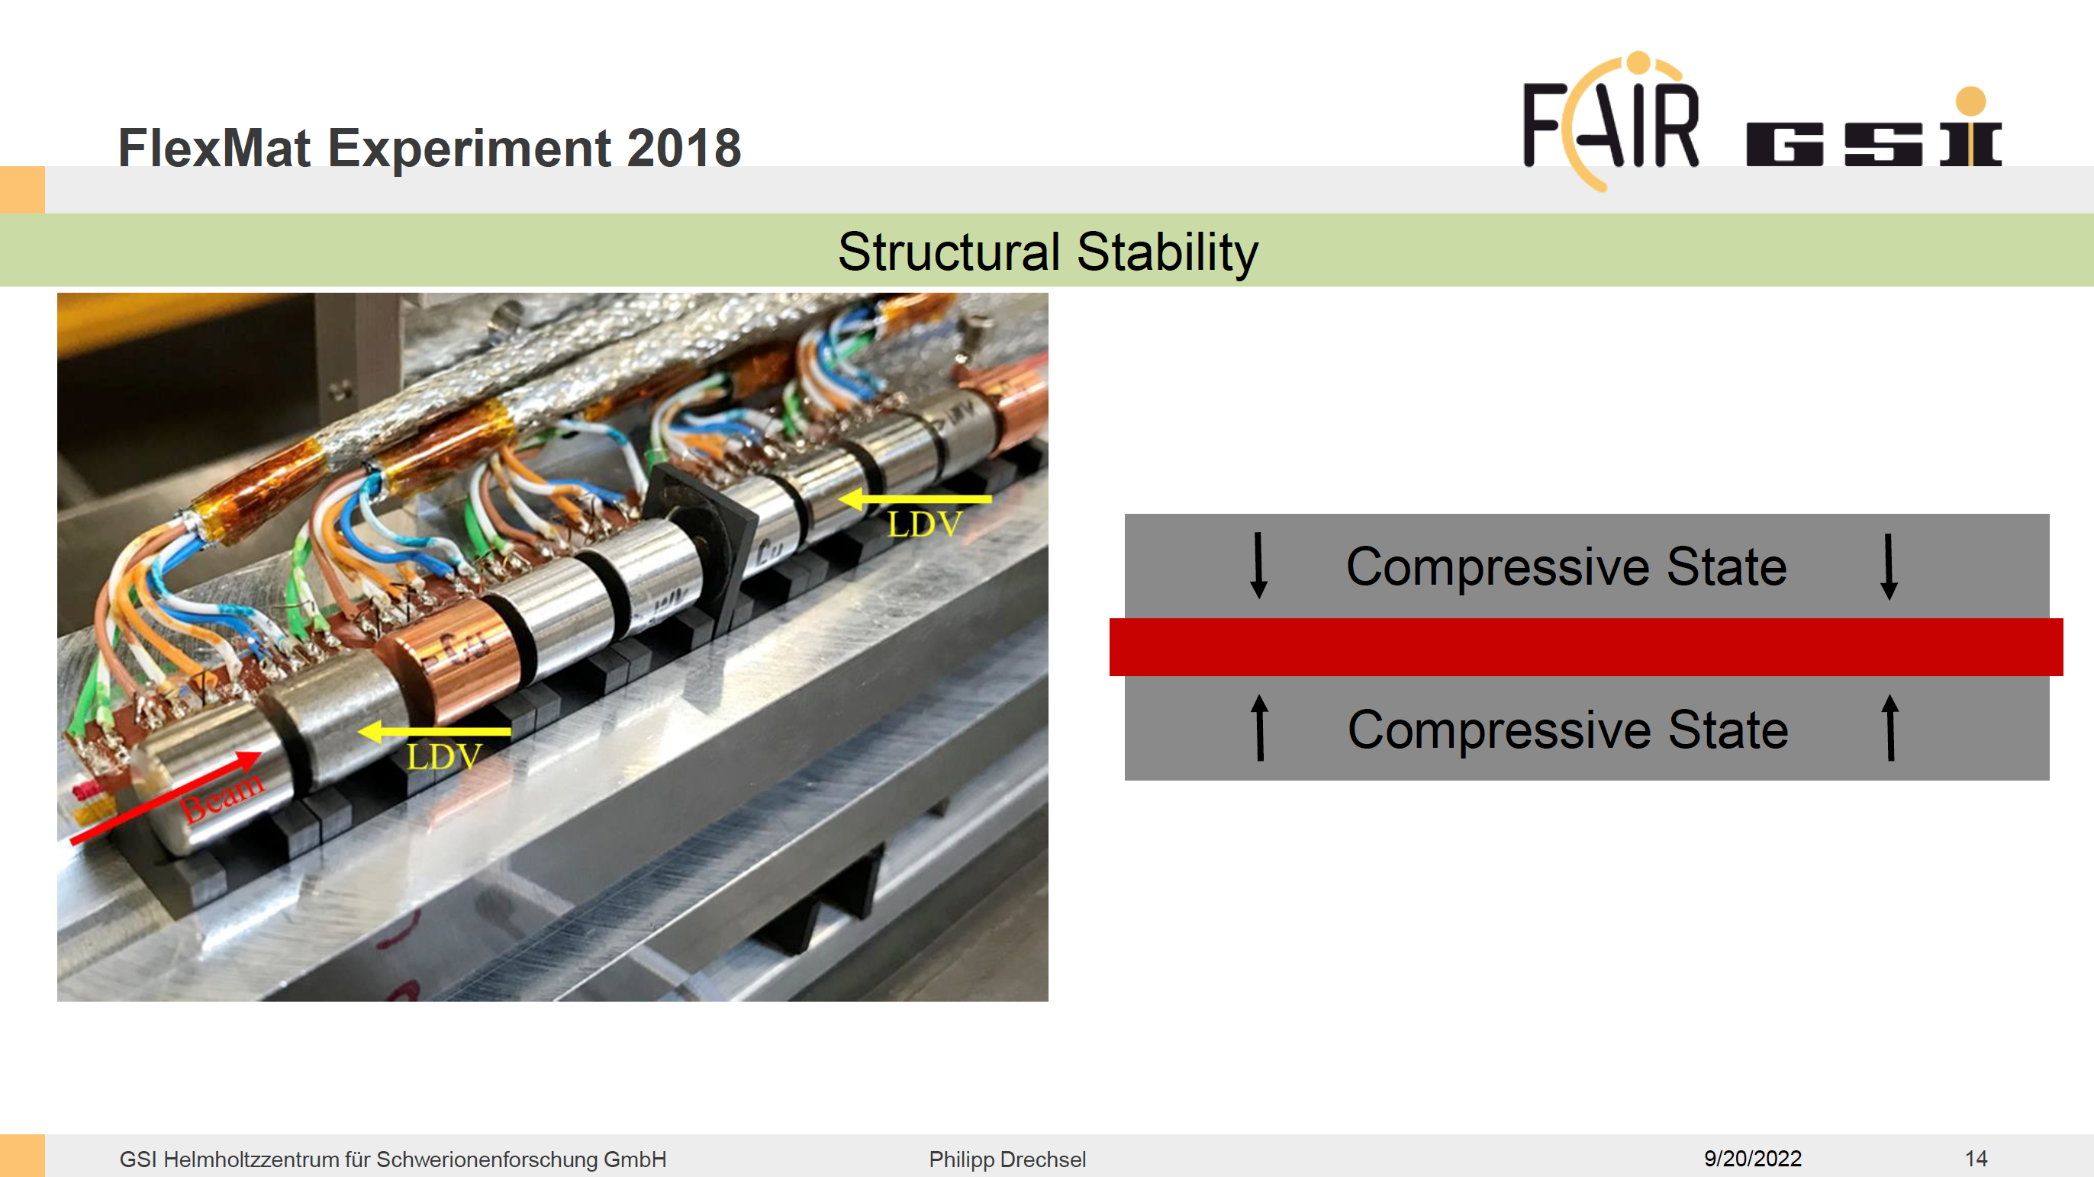

Slide 30
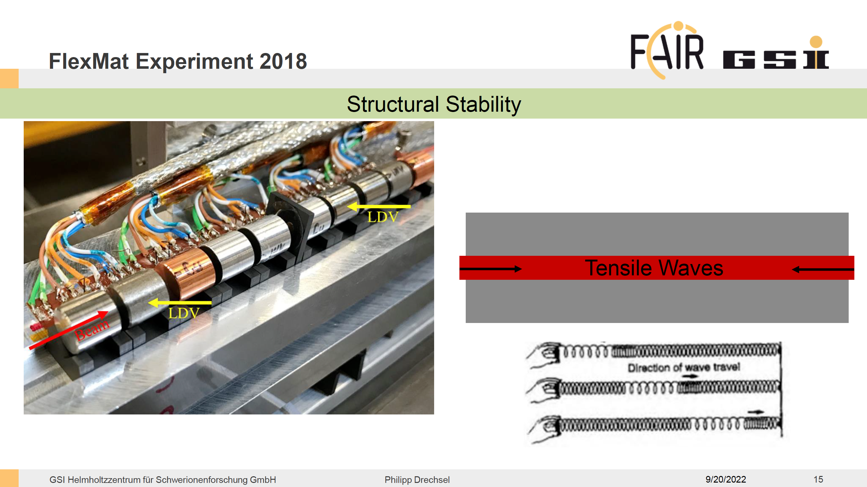

Slide 31
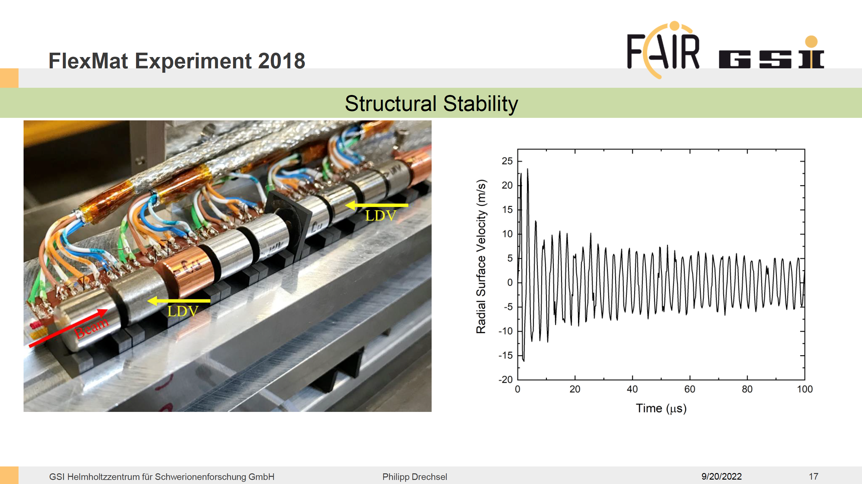

Slide 32
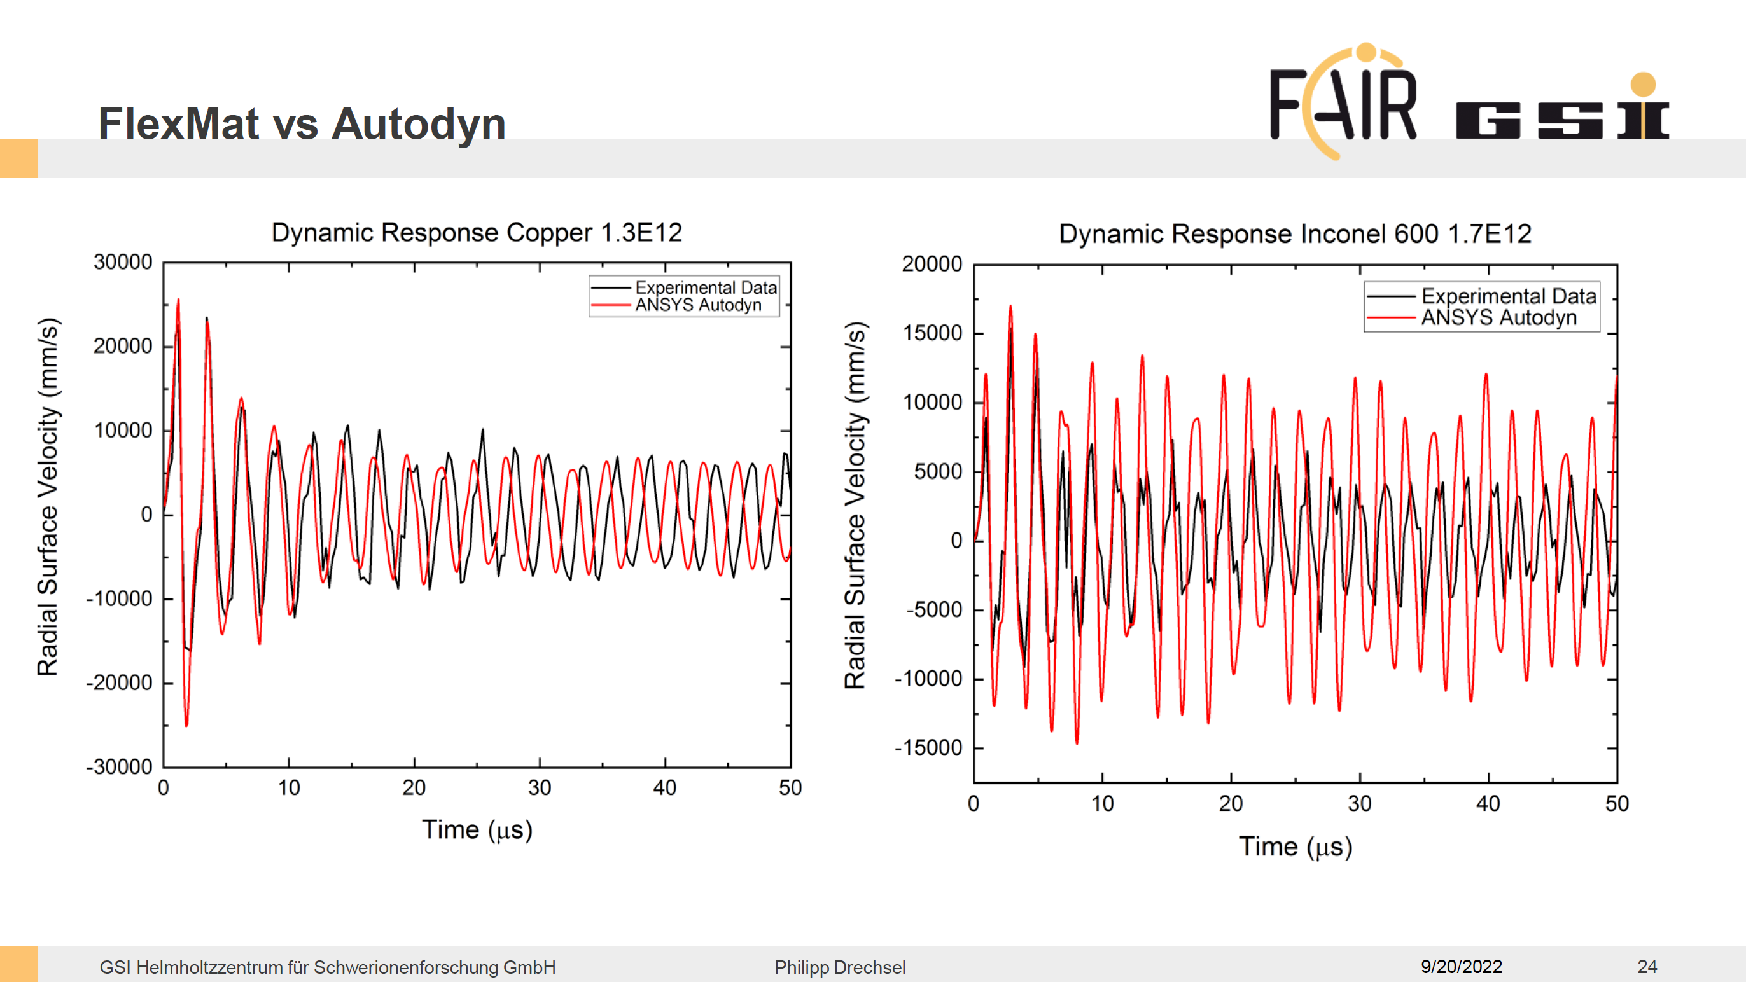

Slide 33
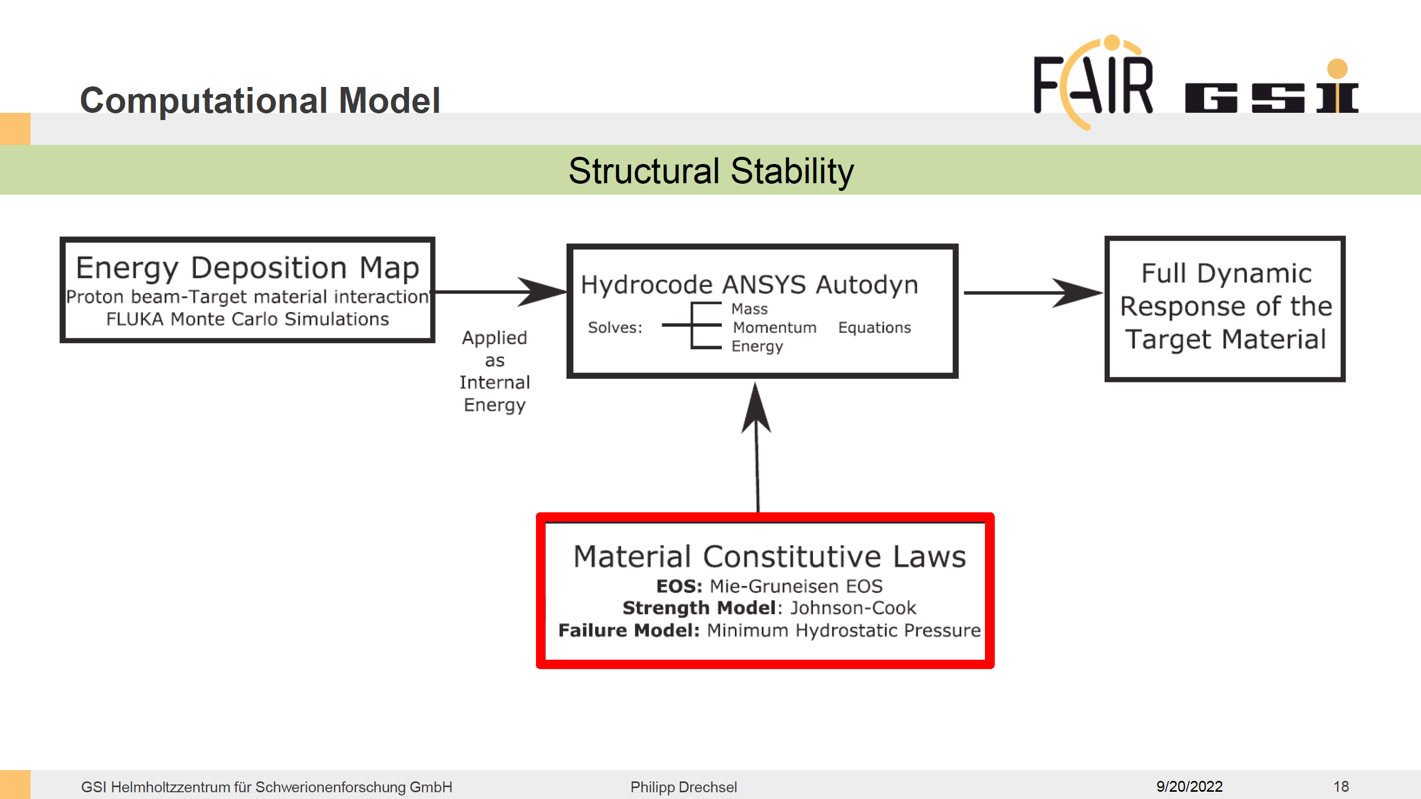

Slide 34
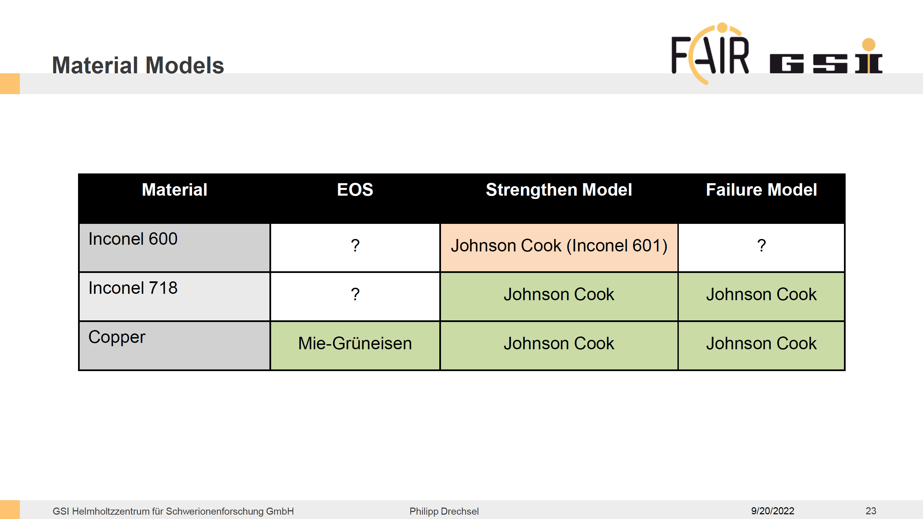

Slide 35
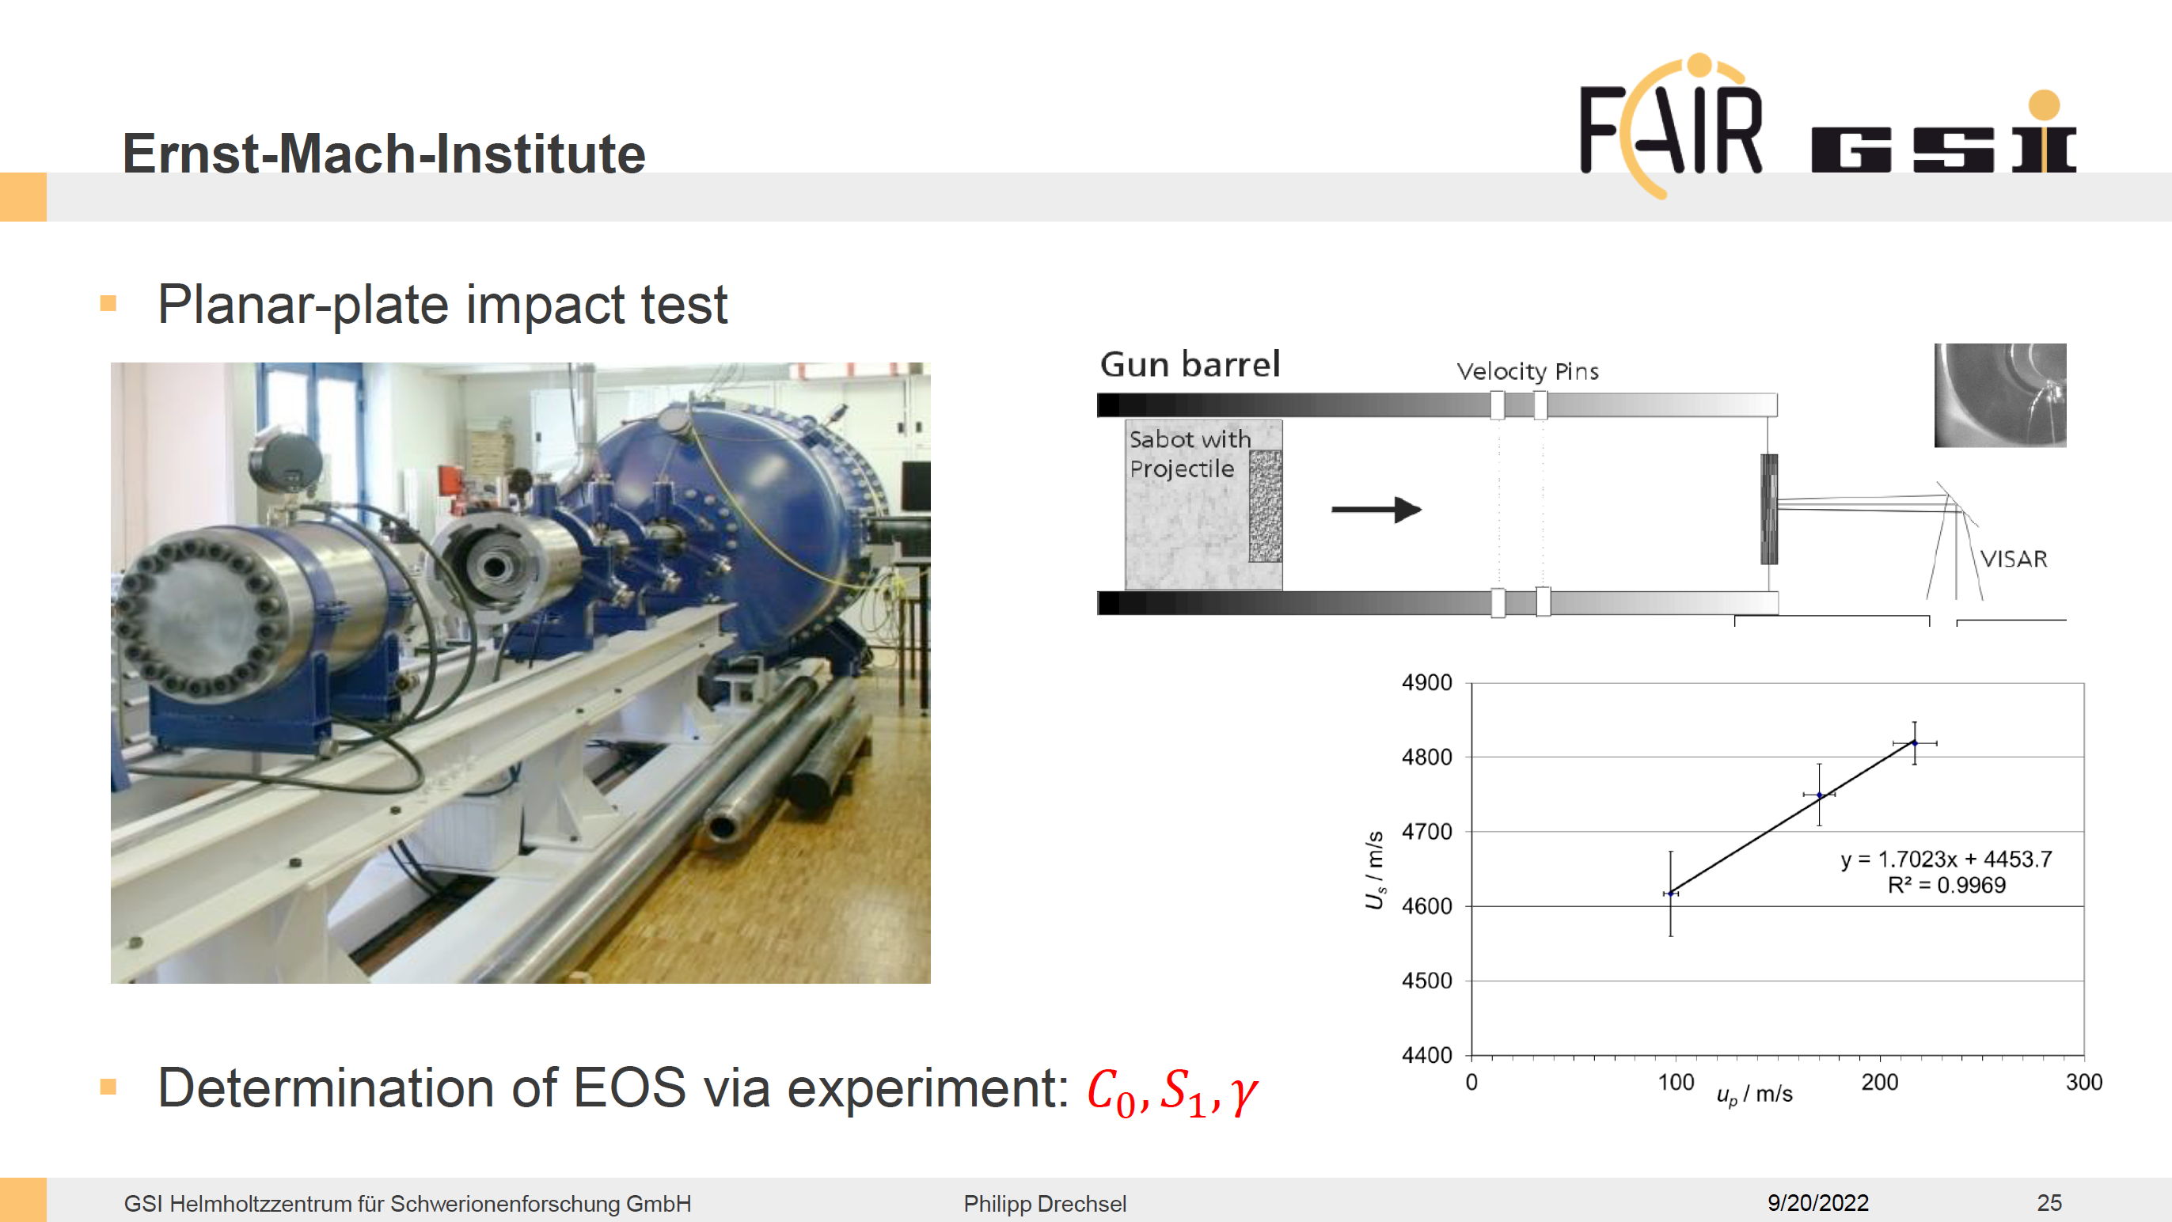

Slide 36
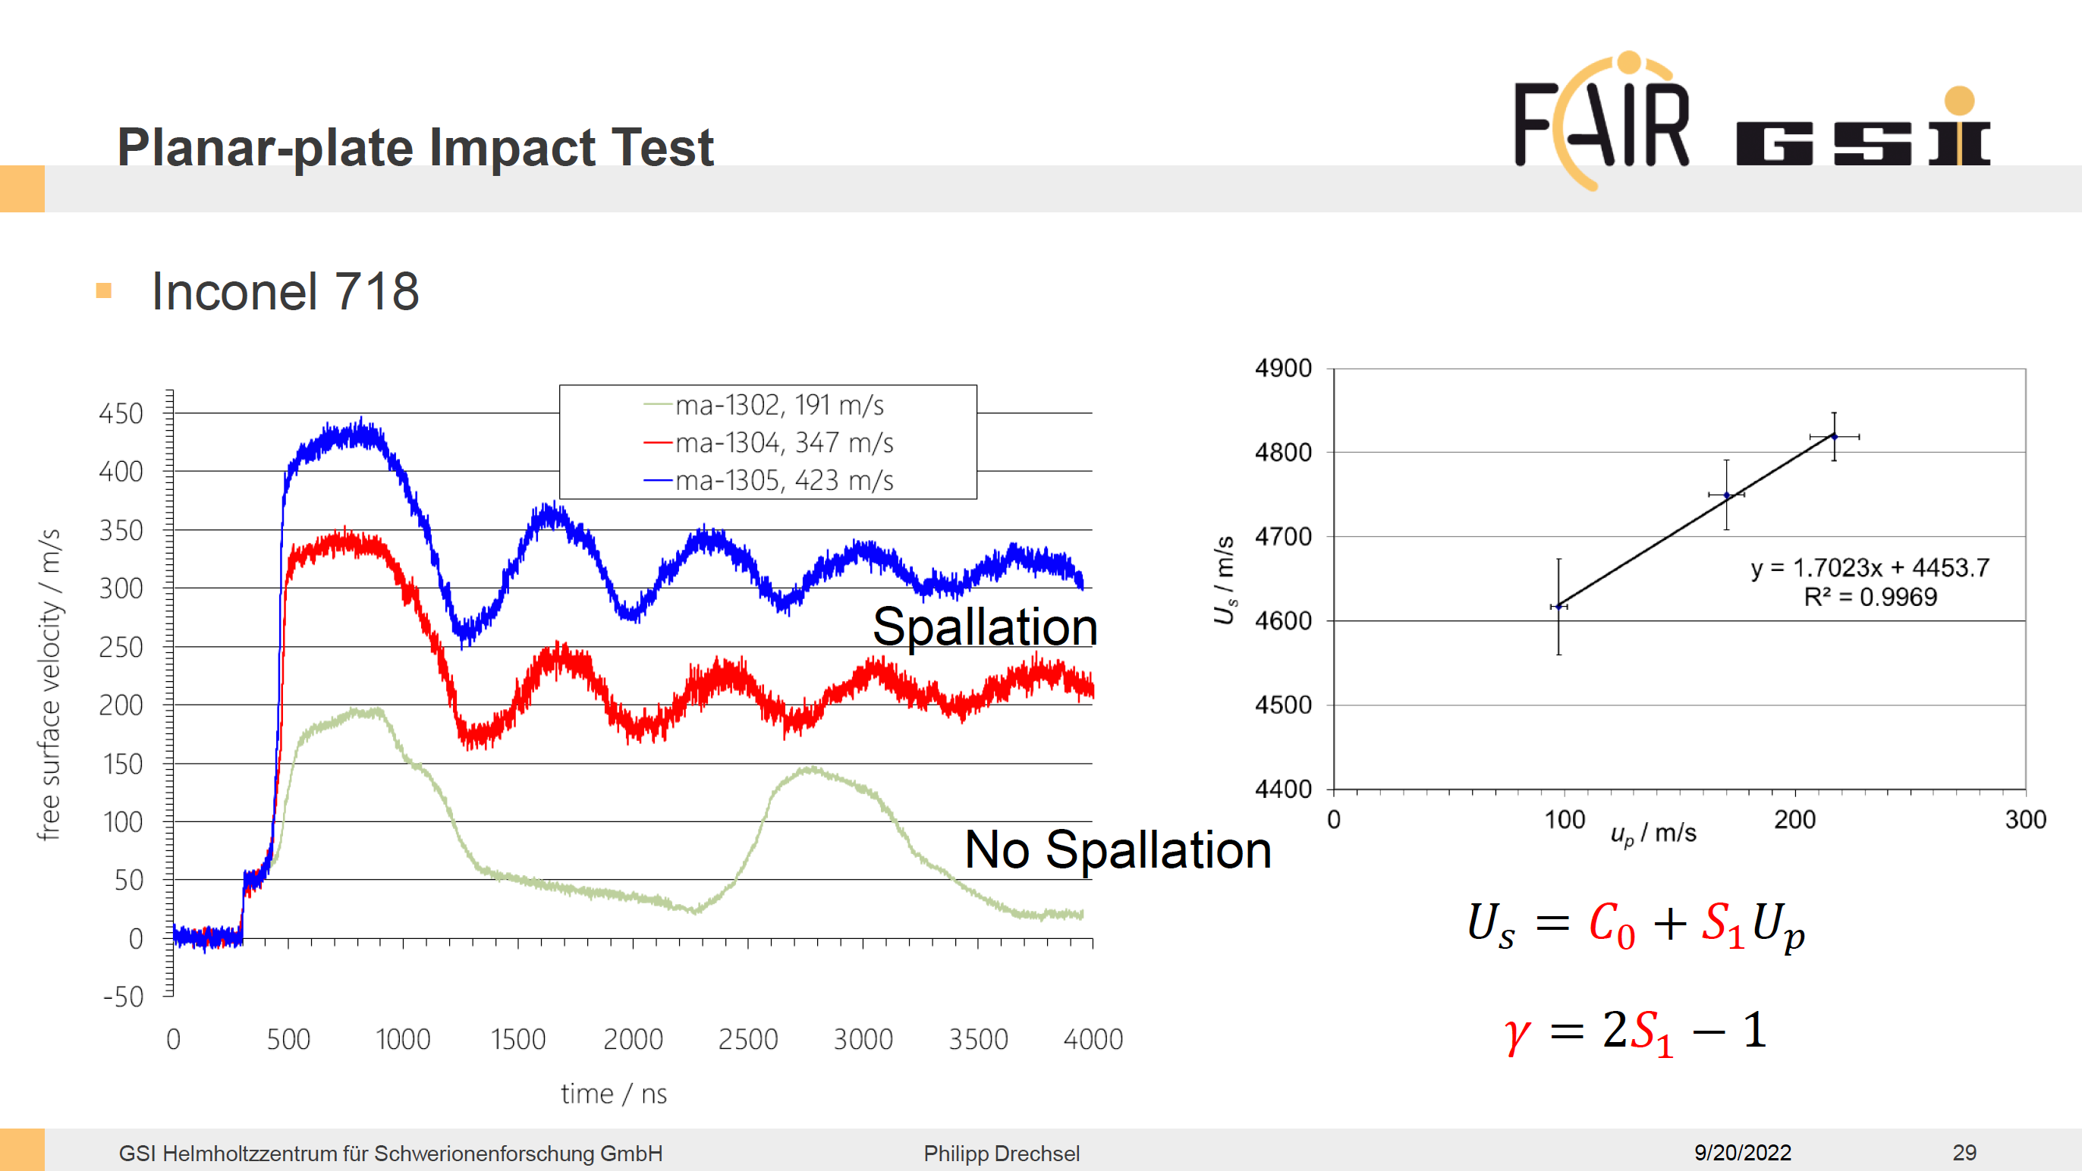

Slide 37
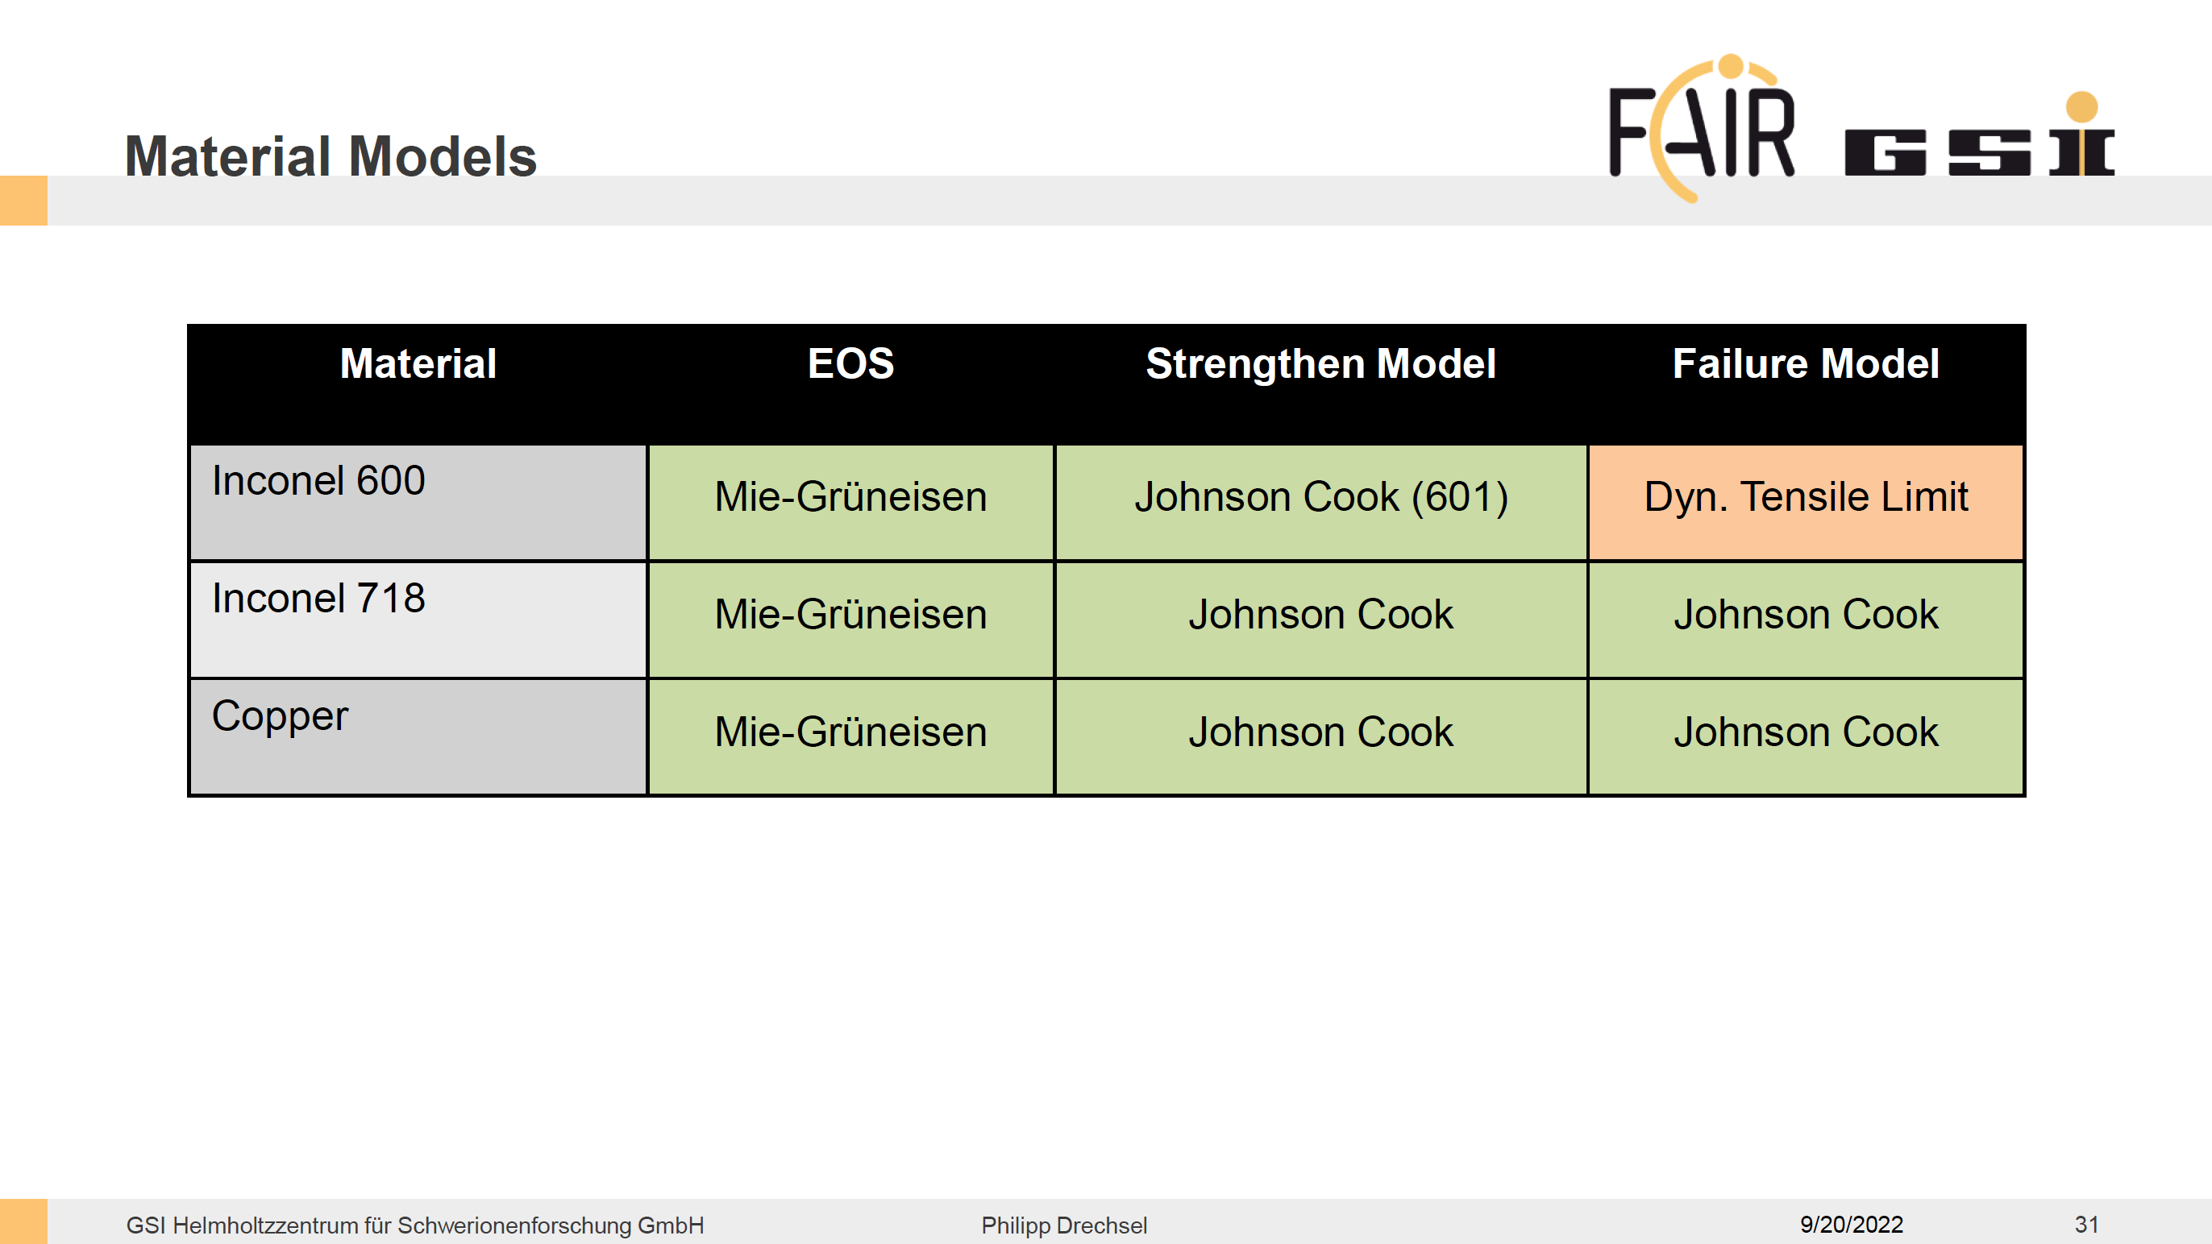

Slide 38
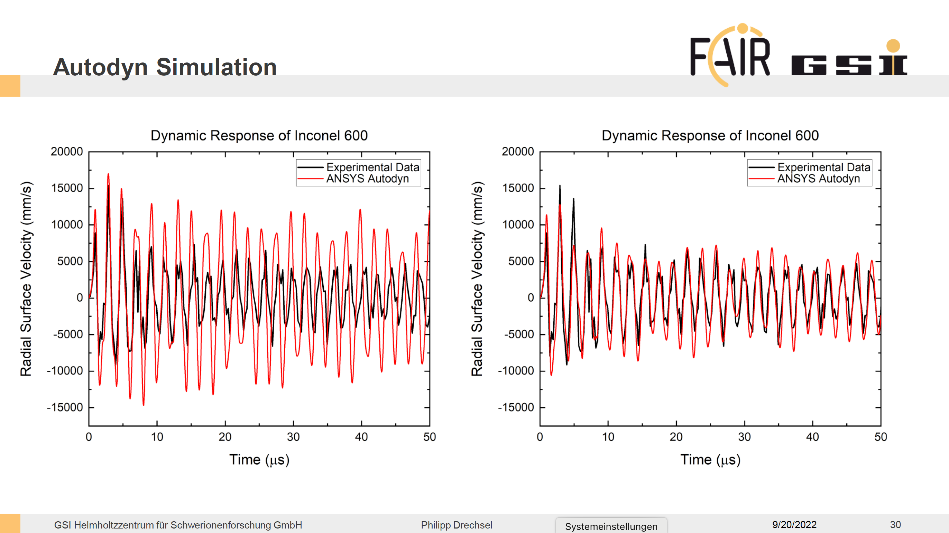

Slide 39
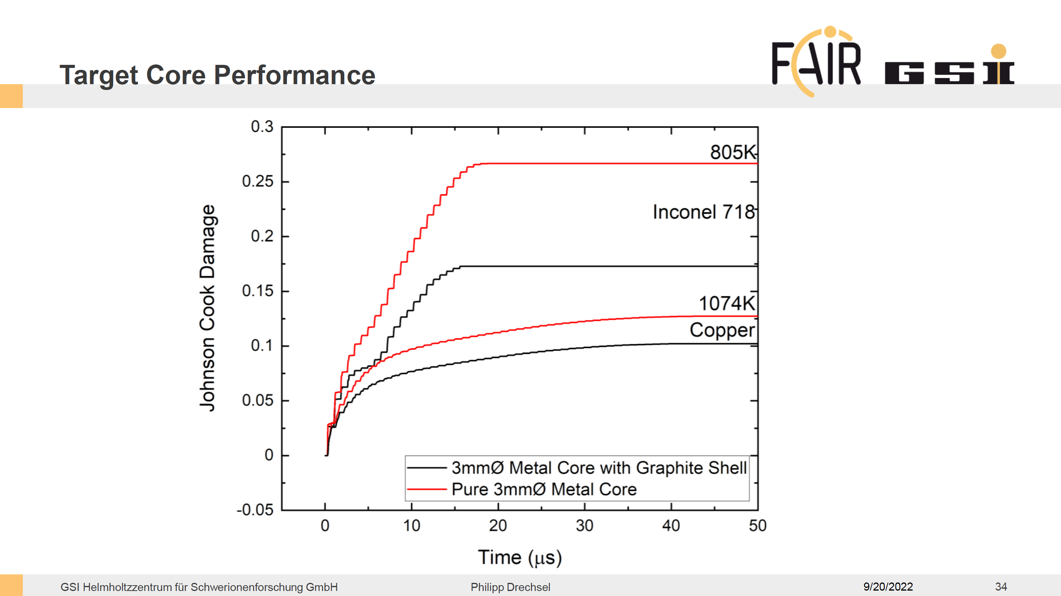
Inconel
Copper

Slide 40
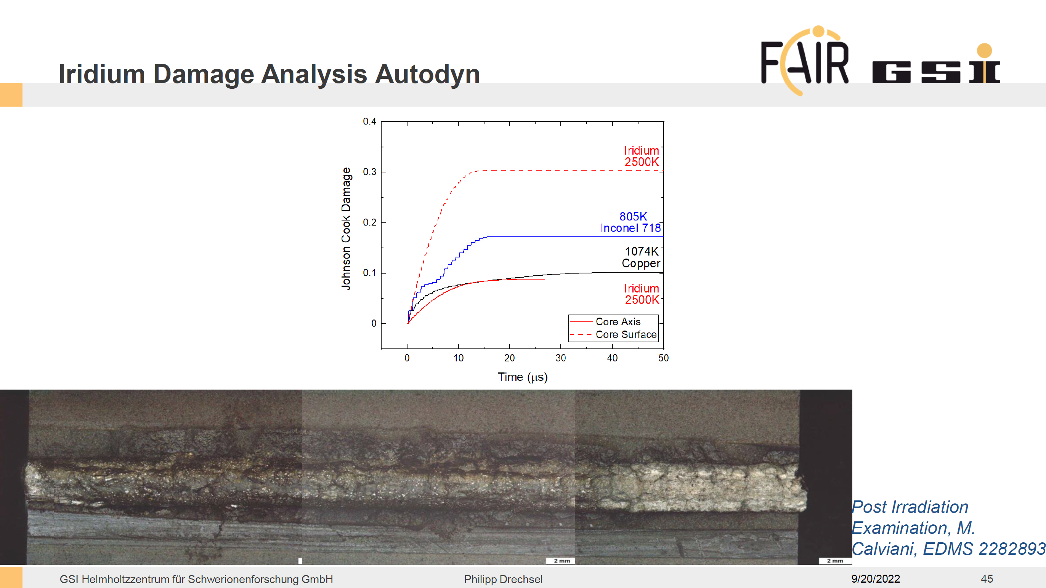

Slide 41
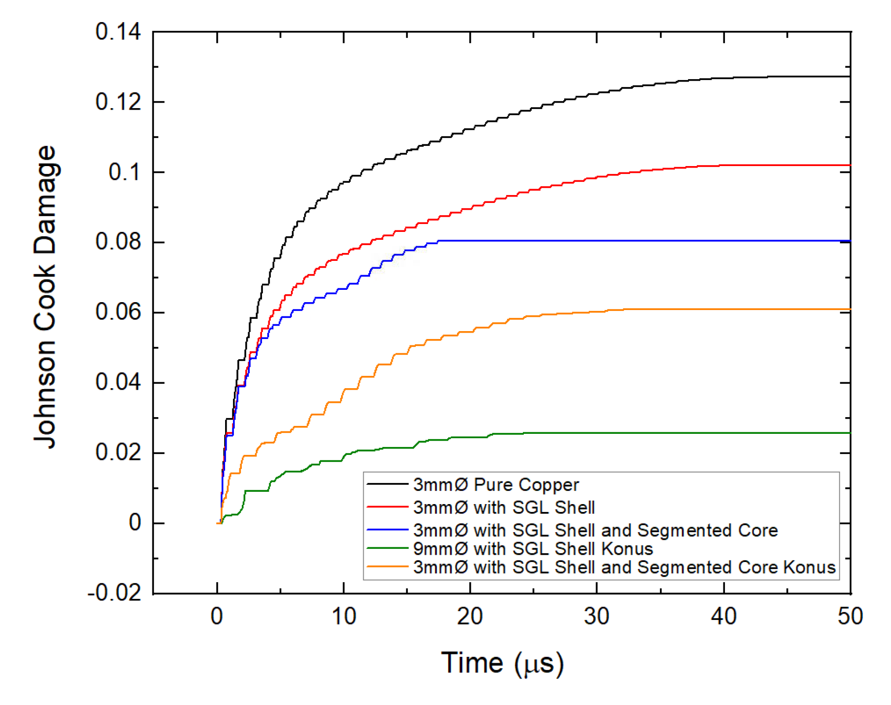
Target Damage after 1st pulse
3 mm Cu
For CERN or FAIR beam parameters the damages after the 1st pulse are already in the order of 10⁻² to 10⁻¹
If the accumulated damage is >1 the material “fails“
This should happen after about 10² pulses
However, the targets at CERN and FNL have seen 10⁶ pulses
“Damaged“ targets have done the job pretty well!
Why not start with an alreay “damaged“ target?
(e.g. metal powder/grafite powder mix)
Simulations might be (too?) complex,
experimental data needed
3 mm Cu in graphite
3 mm Cu in graphite,
segmented
3 mm Cu in graphite,
segmented, conical
9 mm Cu in graphite,
segmented, conical

Slide 42
Introduction
Discovery of antiprotons (pbars), secondary beams, p-pbar collider
Challenge 1
Produce pbars at the right place and collect them effciently
(For a beam of sufficient energy and intensity the production of pbars is no challenge at all, it is actually unavoidable)
Challenge 2
Meet Challenge 1 for more than one or two (ideally 10⁶) beam pulses
Challenge 3
Get rid of all the “dirt“ (radiation protection)
1 primary p → 10⁻³ pbars (10⁻⁵ useable) + 10² n

Slide 43
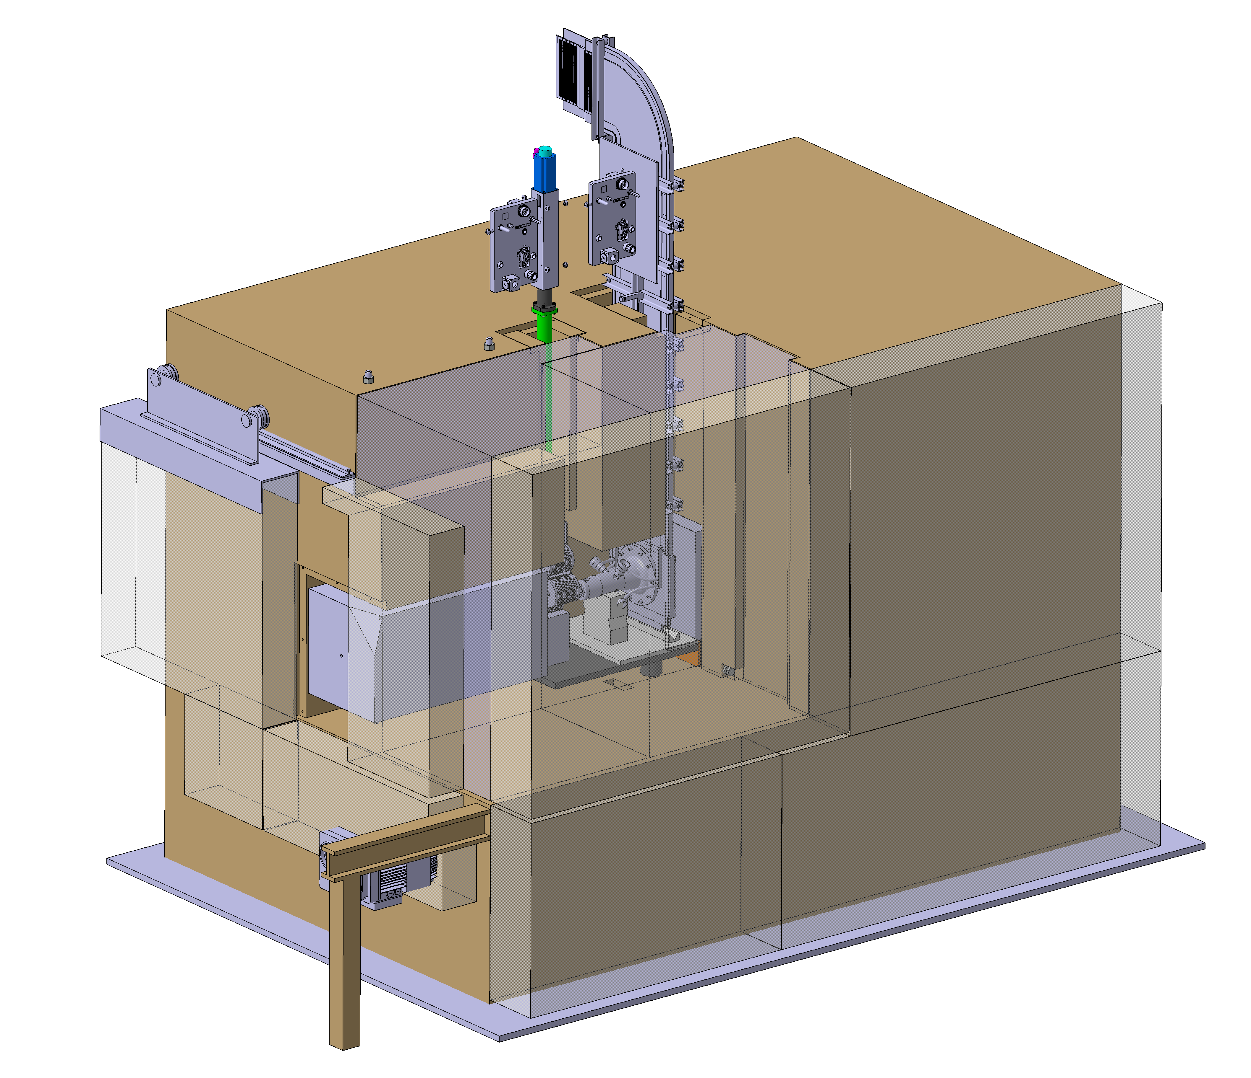
Target Station (200 t of Iron)
Target and magnetic horn assemblies
Shutter mechanism
Main shielding assembly
Exchange door
Entrance collimator
Marble plates
Adjustment table
Exchange doors’ support frame and motor
Grout lining

Slide 44
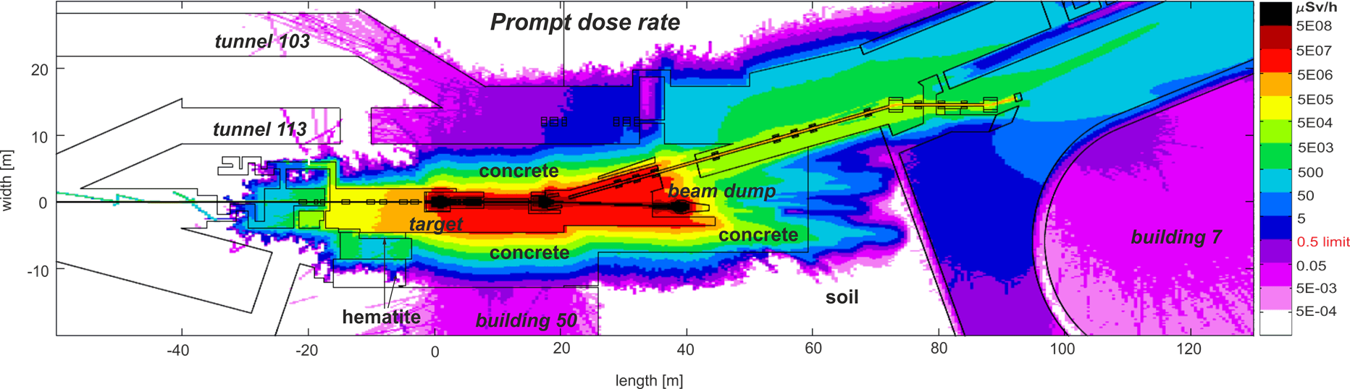
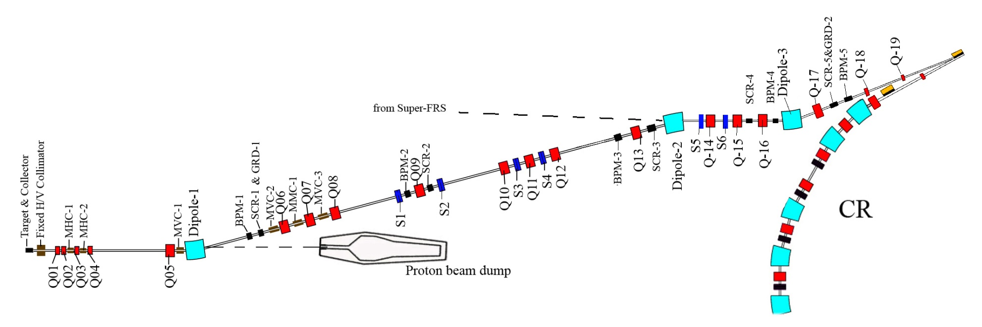
The pbar separator
target &
collector
pbar separator
240 π mm mrad
p = 3.82 GeV/c
Δp/p = ±3%
29 GeV p from SIS 100

Slide 45
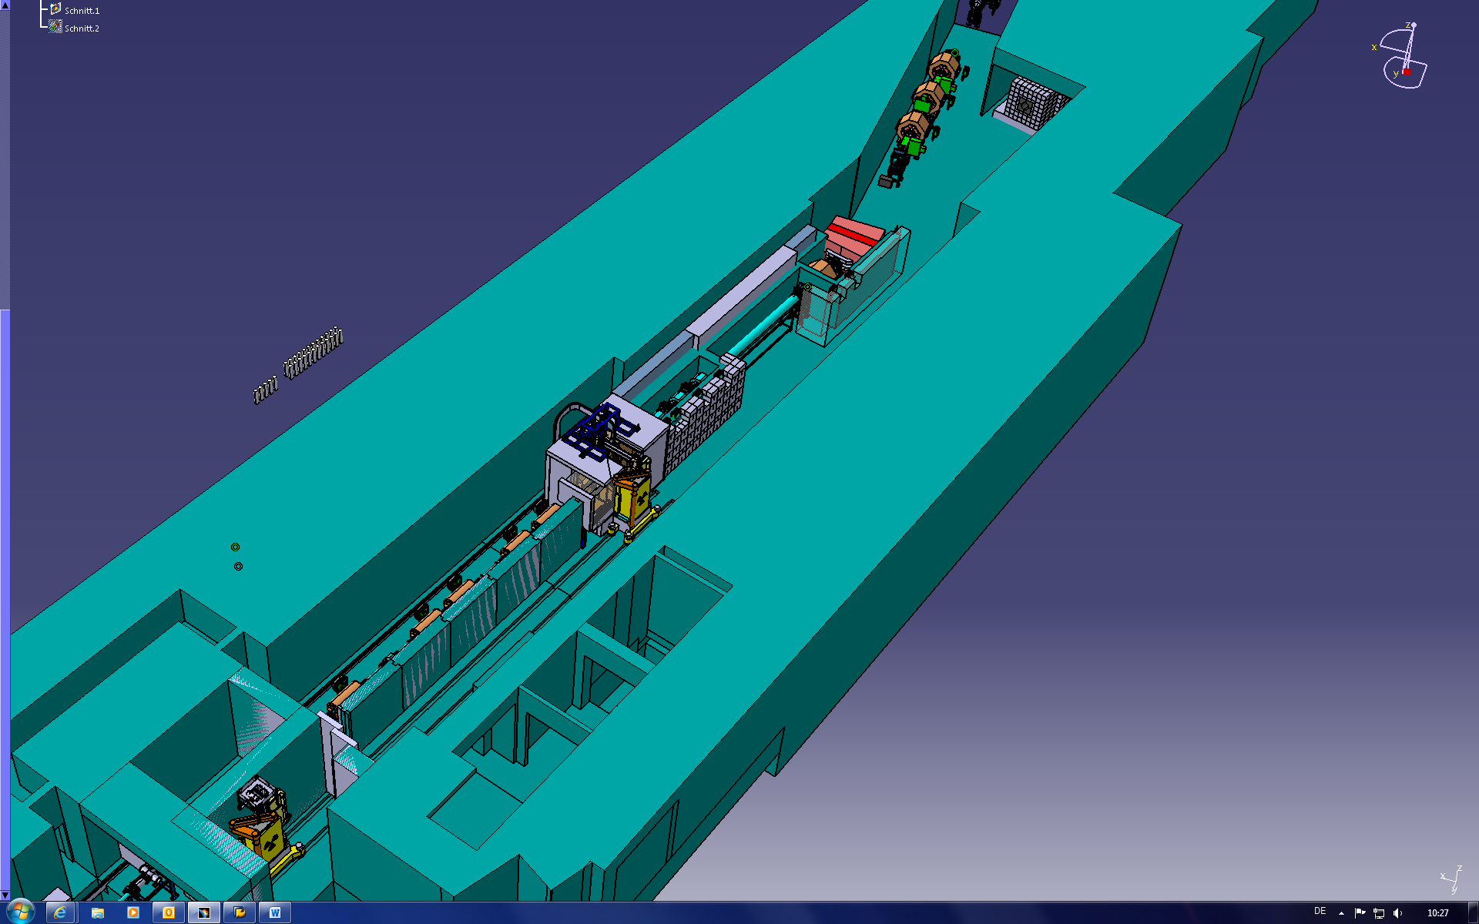
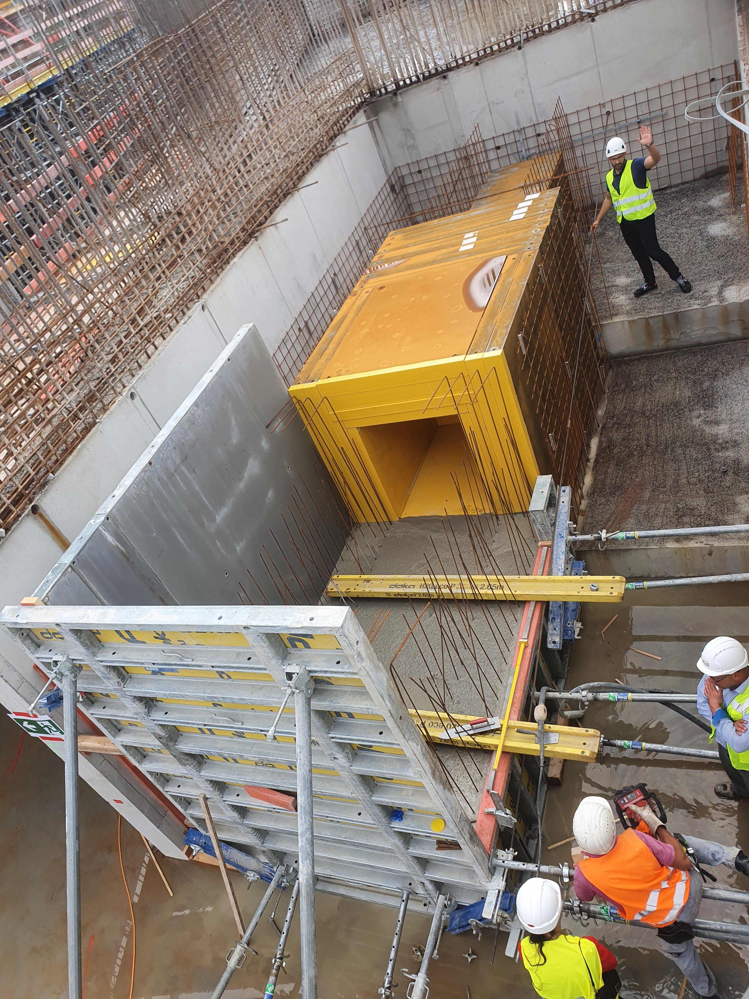
The pbar tunnel
dump
target
7 m concrete walls

Slide 46
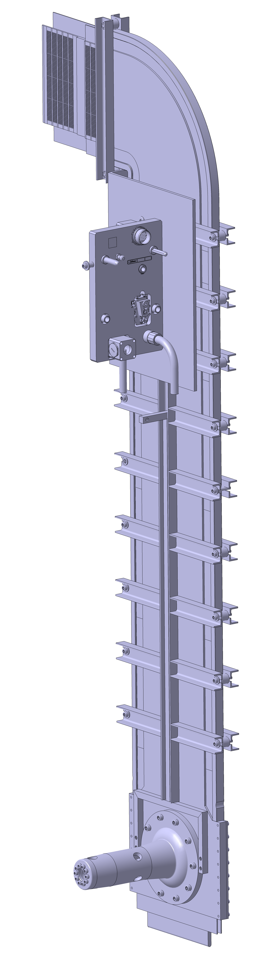
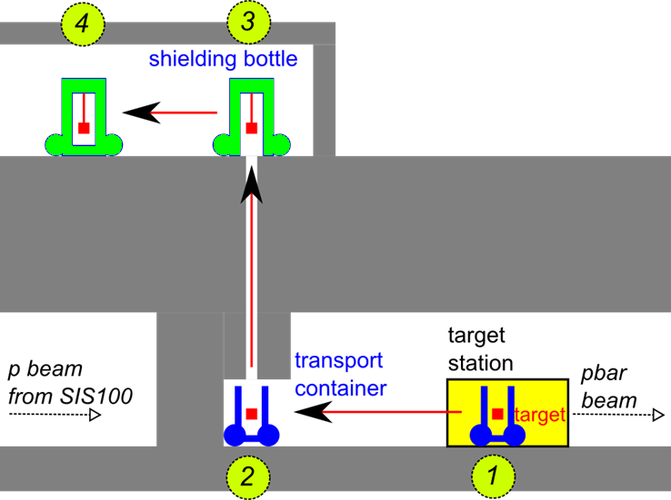
Target/Horn exchange system
shielding flask
Level E20
E10

Slide 47
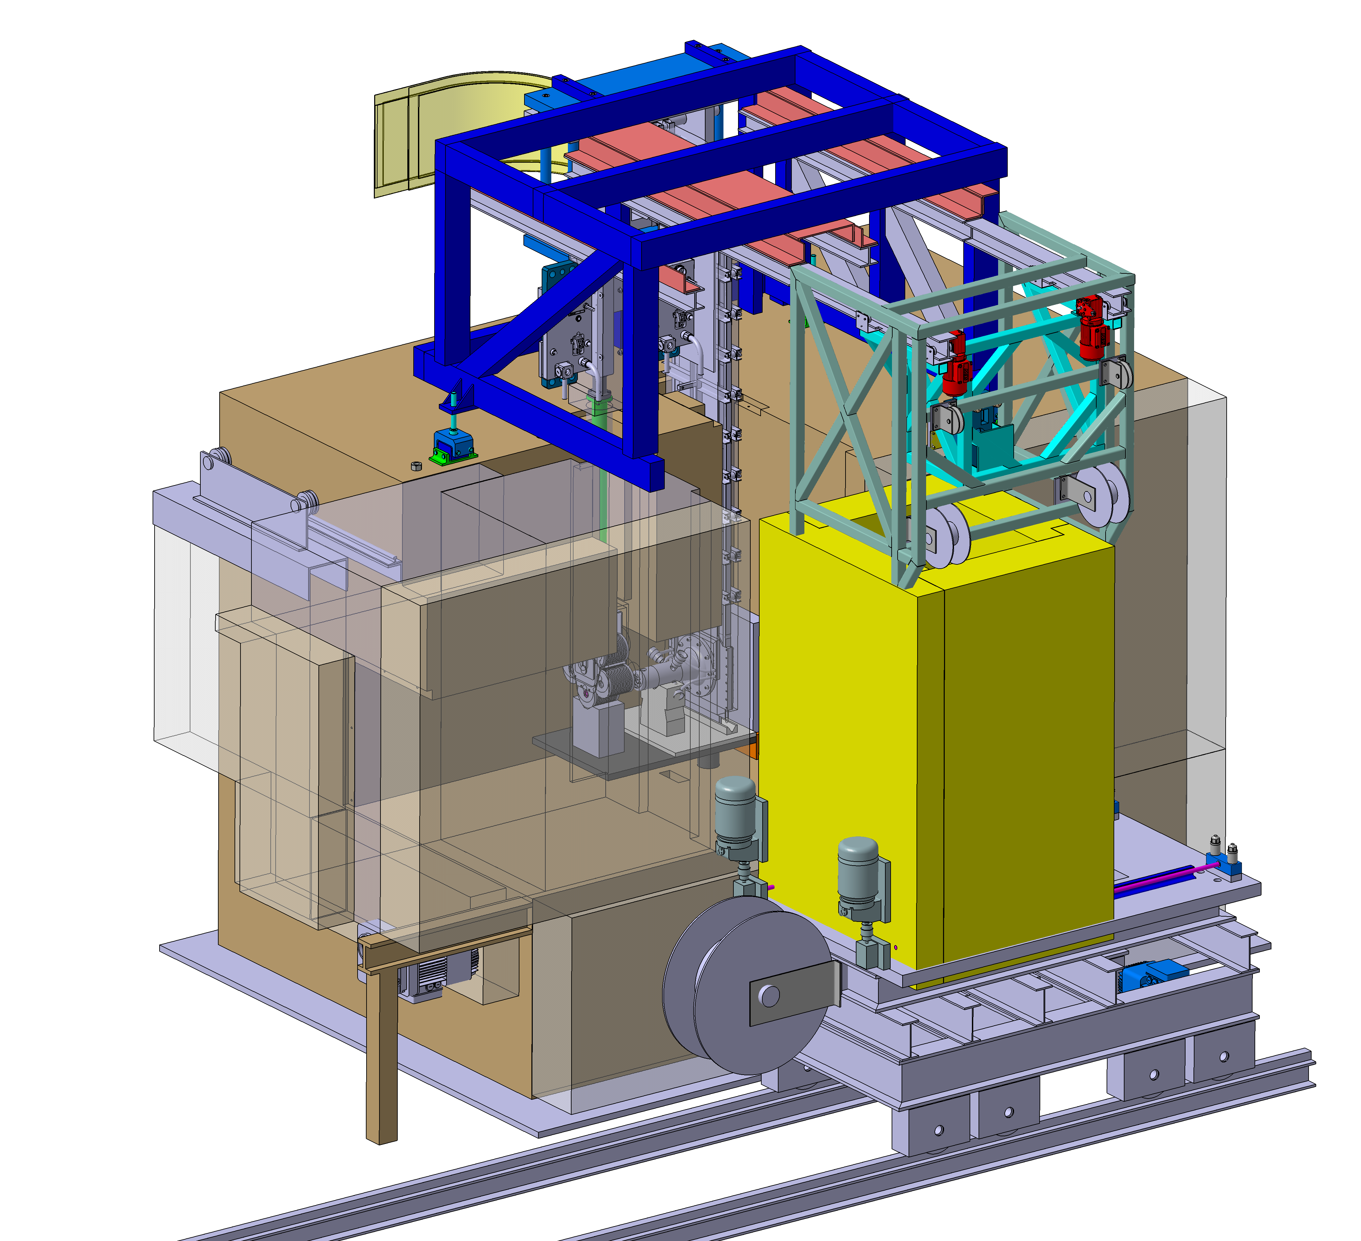
Transport Container
Fixed frame of the top of the Target Station
Exchange rail system
Transport Container
Exchange door

Slide 48
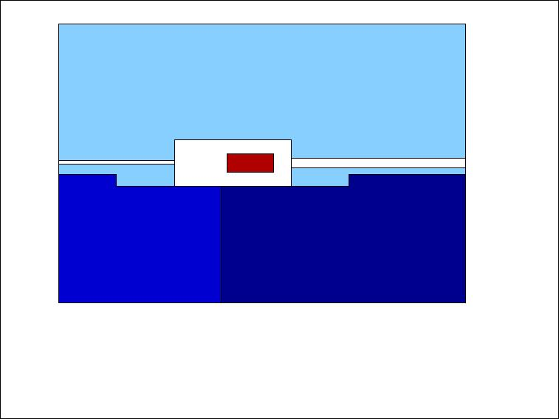
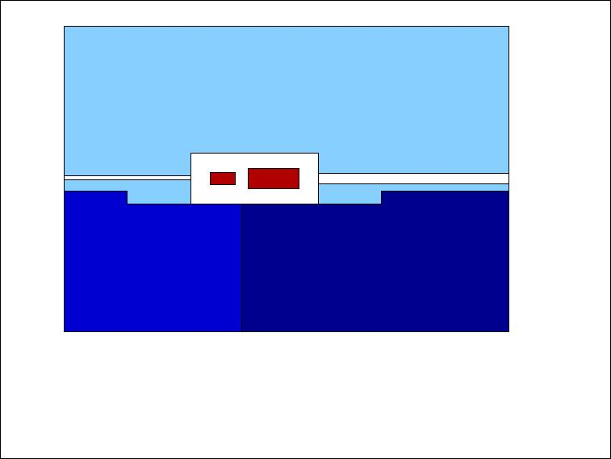
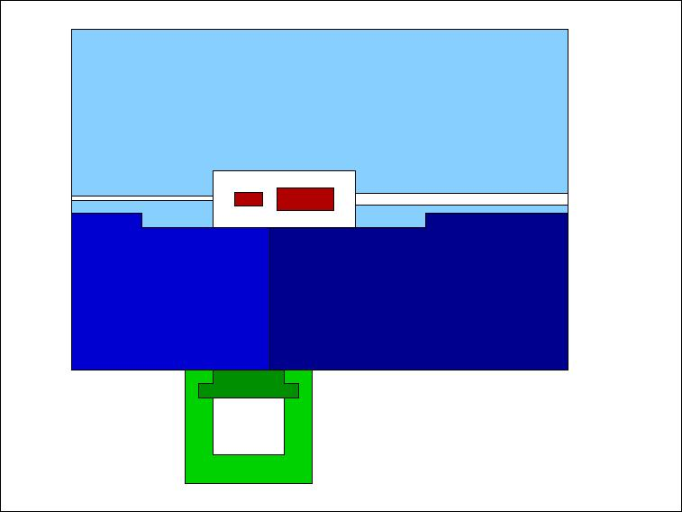
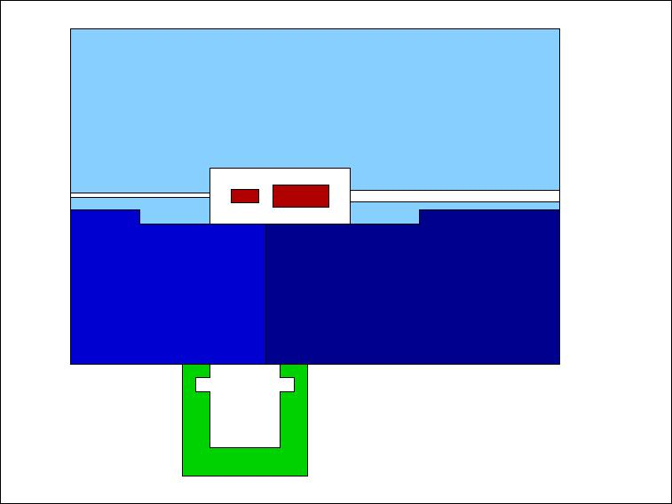
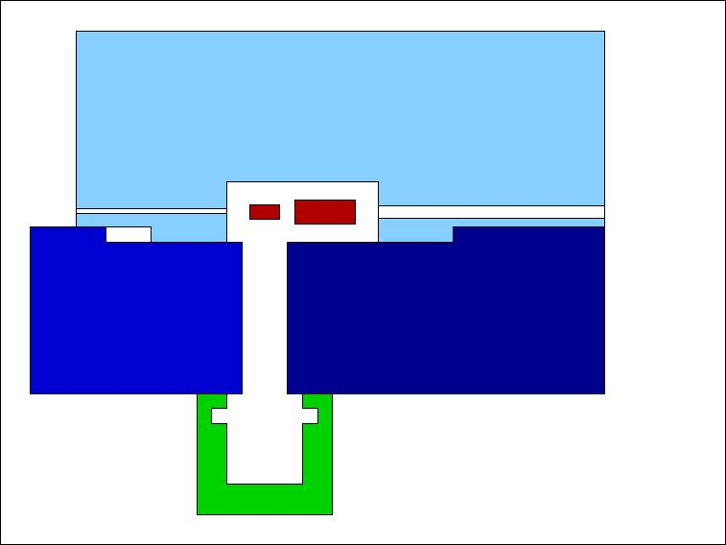
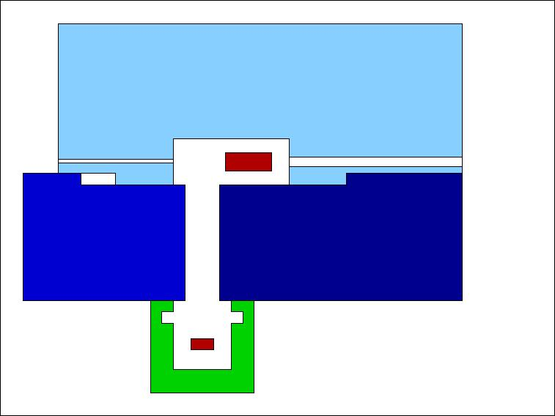

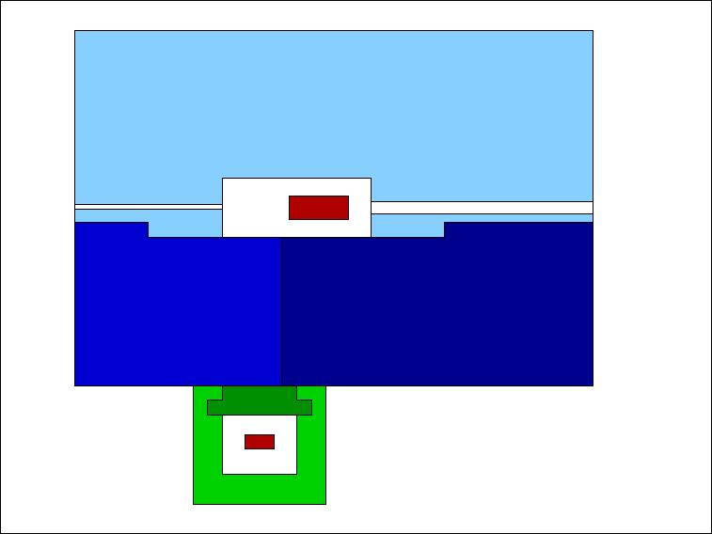

Slide 49





Transport Container: FLUKA

Slide 50
Target/Horn exchange system
shielding flask
Level E20
E10

Slide 51



Transport container/shaft/shielding flask

Slide 52


Shielding Flask (30 t, under production)

Slide 53



Transport to Hot Cell
200 m
flat surface

Slide 54
Thank you for your attention!
Special thanks to:
B. Franzke and P. Sievers for the concept of everything
V. Gostishchev for the countless Fluka simulations
E. Onkels, I. Petzenhauser and S. Mohite for the work on the magnetic horn
M. Rodionova and M. Helmecke for their work on the target station
O. Dolinskiy and S. Udrea for the ion optics calculations
P. Katrik for his work on the dump and on the collimators
P. Drechsel and M. Nowakowski for the ANSYS studies
R. Hettinger and U. Kopf from mechanical engineering
and all Work Package Leaders from the GSI expert groups

