Slide 1
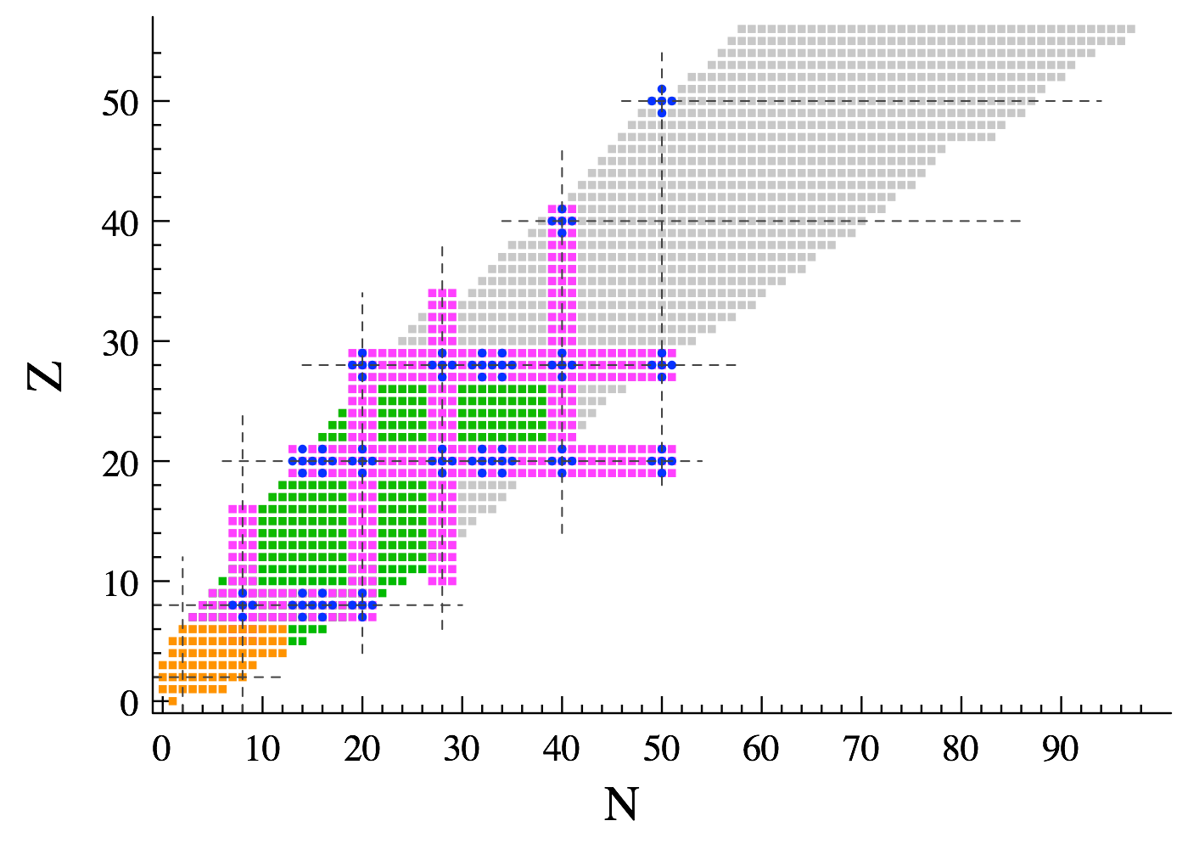



Ab initio description of collective excitations
PGCM-PT (+MR-IMSRG preprocessing of H) for closed and open-shell nuclei
Ab initio methods
Thomas DUGUET
DPhN, CEA-Saclay, France
IKS, KU Leuven, Belgium
PAN@CEA
Effective field theories for nuclei and nuclear matter
January 16-20, Hirschegg, Austria

Slide 2
References
Symmetry-conserving PGCM-based multi-reference perturbation theory
[M. Frosini, T. Duguet, J.-P. Ebran, V. Somà, EPJA 58 (2022) 62]
[M. Frosini, T. Duguet, J.-P. Ebran, B. Bally, T. Mongelli, T. R. Rodriguez, R. Roth, V. Somà, EPJA 58 (2022) 63]
[M. Frosini, T. Duguet, J.-P. Ebran, B. Bally, H. Hergert, T. R. Rodriguez, R. Roth, J. M. Yao, V. Somà, EPJA 58 (2022) 64]
Rooting the nuclear EDF method into the ab initio framework
[T. Duguet, J.-P. Ebran, M. Frosini, H. Hergert, V. Somà, EPJA (2023) in press]

Slide 3









Collaborators on ab initio many-body methods/calculations
B. Bally
J.-P. Ebran
M. Frosini
A. Porro
A. Roux
A. Scalesi
V. Somà
G. Stellin
H. Hergert
P. Navratil
P. Demol
A.Tichai
P. Arthuis
R. Roth
C. Barbieri
T. R. Rodriguez
G. Hagen
T. Papenbrock
J. M. Yao

Slide 4
Contents
⦿ Introduction
⦿ Novel PGCM-PT formalism
⦿ Validation of PGCM-PT(2) against FCI in ²⁰Ne
⦿ Combining MR-IMSRG with PGCM-PT(2) in ²⁰Ne
⦿ Perspectives

Slide 5
Contents
⦿ Introduction
⦿ Novel PGCM-PT formalism
⦿ Validation of PGCM-PT(2) against FCI in ²⁰Ne
⦿ Combining MR-IMSRG with PGCM-PT(2) in ²⁰Ne
⦿ Perspectives

Slide 6
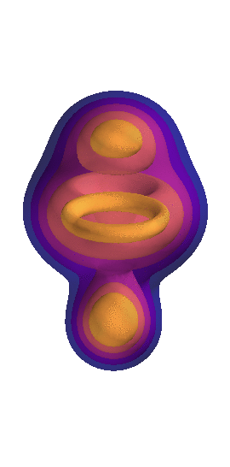

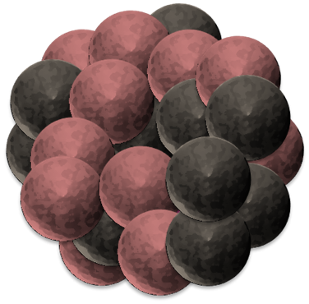
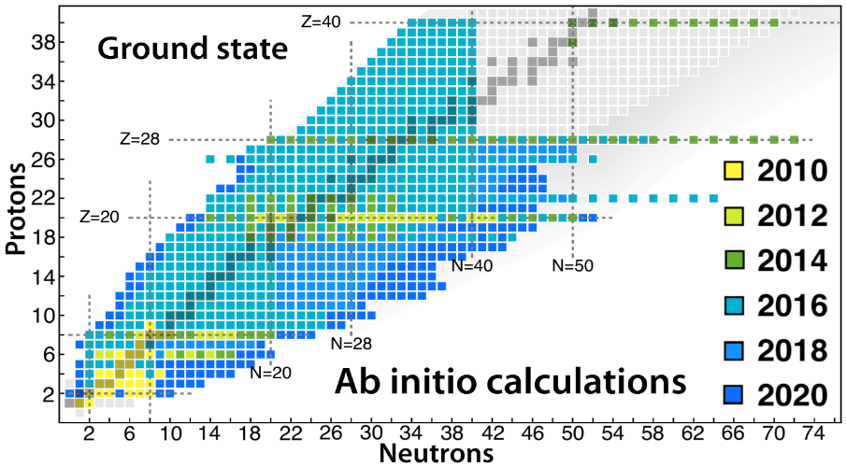
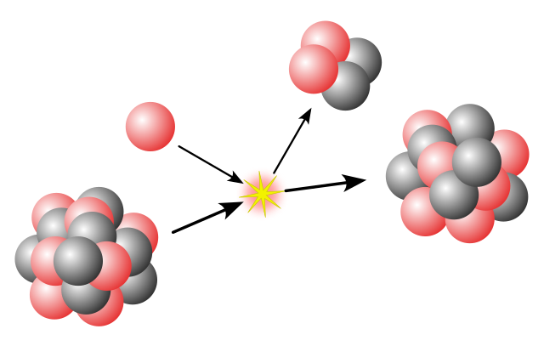
Some of the Ab initio frontiers
SPECTROSCOPY
UNCERTAINTIES
Systematic
Single-particle excitations
Collective excitations
  Hamiltonian
²⁰Ne
[Frosini et al., 2023]
  A-body solution
1⁻/3⁻ vibration (¹⁶O+α ↔ ¹²C + 2α) at 7.2 MeV
OPEN-SHELL
  Basis representation
Novel many-body methods
Memory&CPU ⸕: Ñ^{p} → N^{q} (Ñ<<N)
PAN@CEA
Statistical
[Hergert, 2020]
MANY-BODY
METHODS
fit
ACCURACY
  Algebra cost ⸕
  Difficult manually
  Numerical cost ⸕
    Memory&CPU: N^{p} → N^{q} (q>p)
MASS
Memory&CPU ⸕: N^{p} with N ⸕
Importance of AN forces?
OPERATORS
REACTIONS
[Hu et al, 2022]
  S=0/S≠0 interactions
  Power counting
  Currents
  Fit
  Light nuclei
  Optical potential
  Transition densities

Slide 7
Contents
⦿ Introduction
⦿ Novel PGCM-PT formalism
⦿ Validation of PGCM-PT(2) against FCI in ²⁰Ne
⦿ Combining MR-IMSRG with PGCM-PT(2) in ²⁰Ne
⦿ Perspectives

Slide 8
Many-body expansion methods
Symmetry group
Two issues of interest for today
Degeneracy of SC mean-field state in open-shell nuclei
-Symptom for strong static (collective) correlations
-No single SC mean-field state dominates
-Expansion based on single SC mean-field state ill defined
Consistent access to GS and collective excitations
-Traditional SR expansion methods not well suited
Appropriate partitioning
Static
Correlations
=
Mixing of (nearly) equal/degenerate configurations
Needed properties of unperturbed state for today
Handles degeneracy in open-shell systems
Captures strong static collective correlations
Preserves symmetries
Retains (low) polynomial cost
Requirements for the perturbative expansion
Applicable to ground state and collective excitations
Polynomial cost
« Easy »
to solve
~90%
Typically uncorrelated symmetry-conserving (SC) Hartree-Fock state
Solutions to above issues lie here
Unperturbed state
Key considerations to go beyond the obvious
Unperturbed state
  -what nature for which systems/states?
                -what about symmetries?
                -how « simple »/low-cost can it remain?
Nature of the expansion
-perturbative? non-perturbative?
-formulation depends on unperturbed state?
Dynamical
Correlations
=
Mixing of many small ph/elementary excitations
Expansion series
Typically single-reference (SR) SC MBPT, CC, IMSRG, SCGF
Fully correlated state
Wave operator
Impacts algebraic&numerical complexity

Slide 9
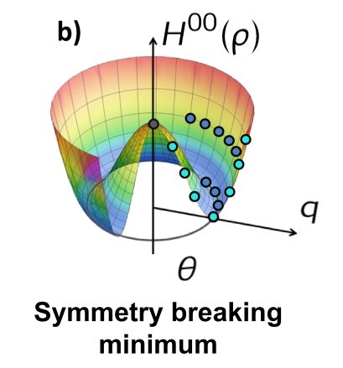
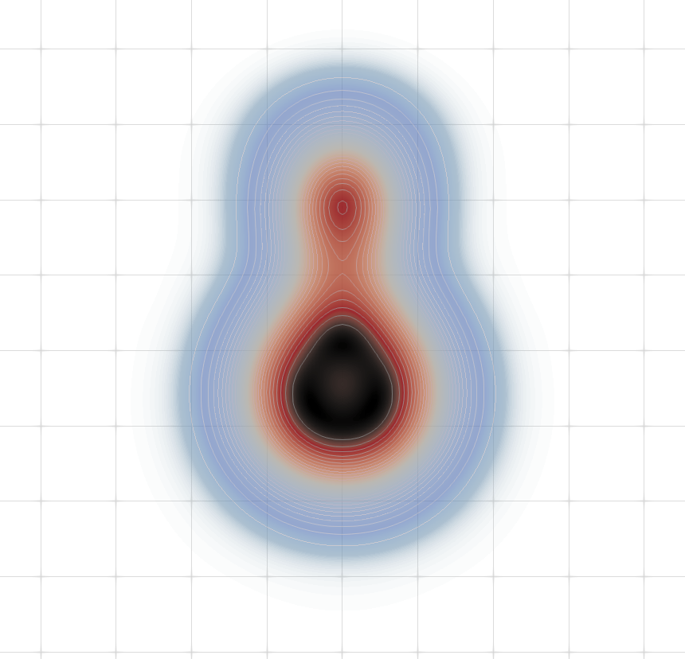
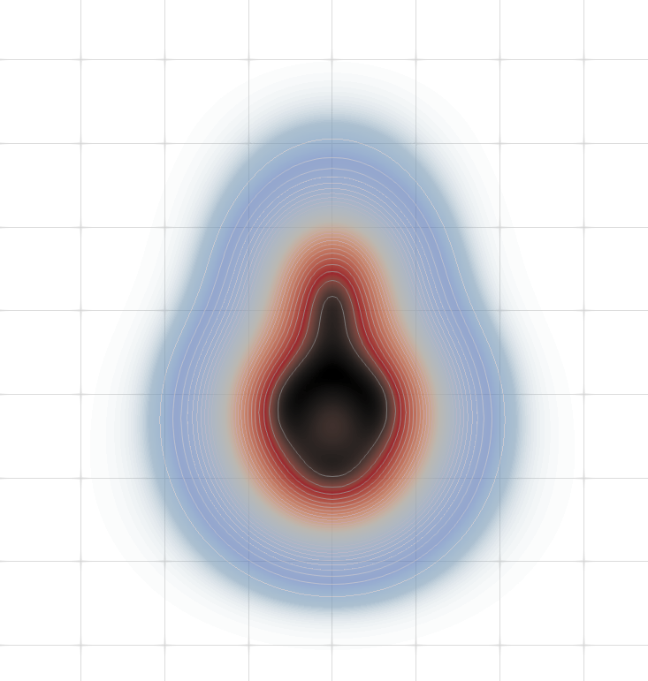
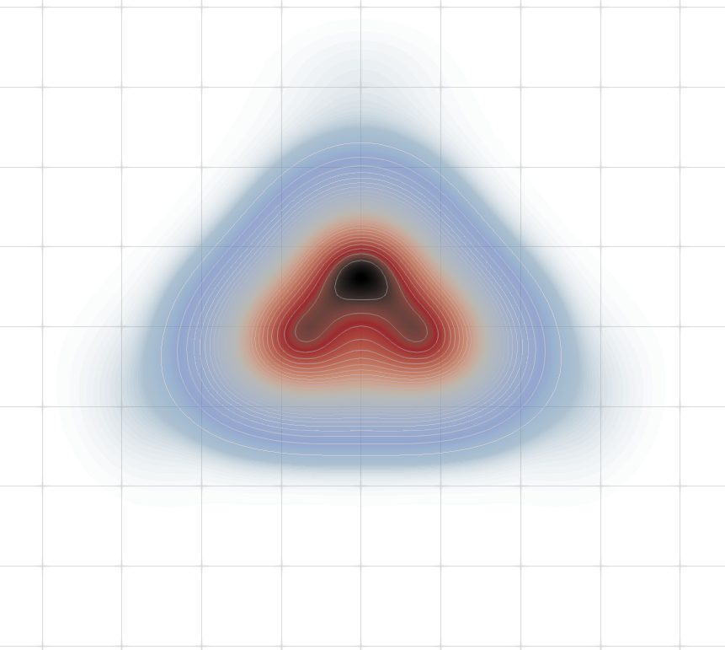







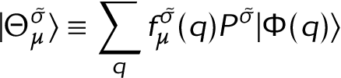
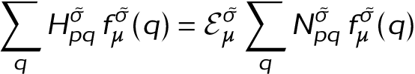
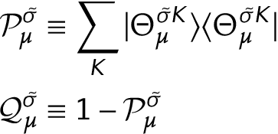



PGCM-PT formalism
[Frosini et al., EPJA58 (2022) 62]
Multi-reference unperturbed state
Symmetry conserving
Low-dimensional (10s to 1000s)
►Scales as N⁴
PGCM state
(J, π, N, Z…)
Constrained symmetry breaking (SB) mean-field (dHFB) states
« Easy »
to solve
Projection
Rotation physics
Shape mixing
Vibration physics
Variational principle HWG equation
Rotational&vibrational collectivity
In real and abstract (e.g. gauge) spaces
Associated static correlations
=J, π
One per IRREP σ
=0, 1, 2…
Hamiltonian kernels
Norm kernels
Rotational&vibrational spectra at once
SC state-specific partitioning: one per (σ,μ)
Only 1 eigenstate of H₀ known
Reduces to SR (B)MBPT if
Projectors
Baranger Hamiltonian
No known basis of Q (in which could be diag.)

Slide 10
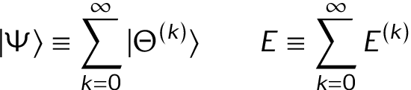
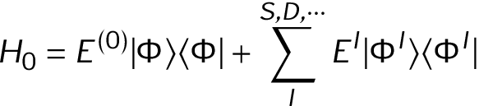

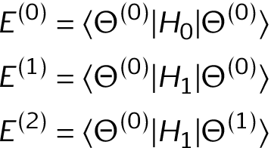
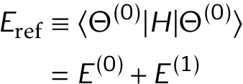
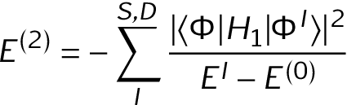

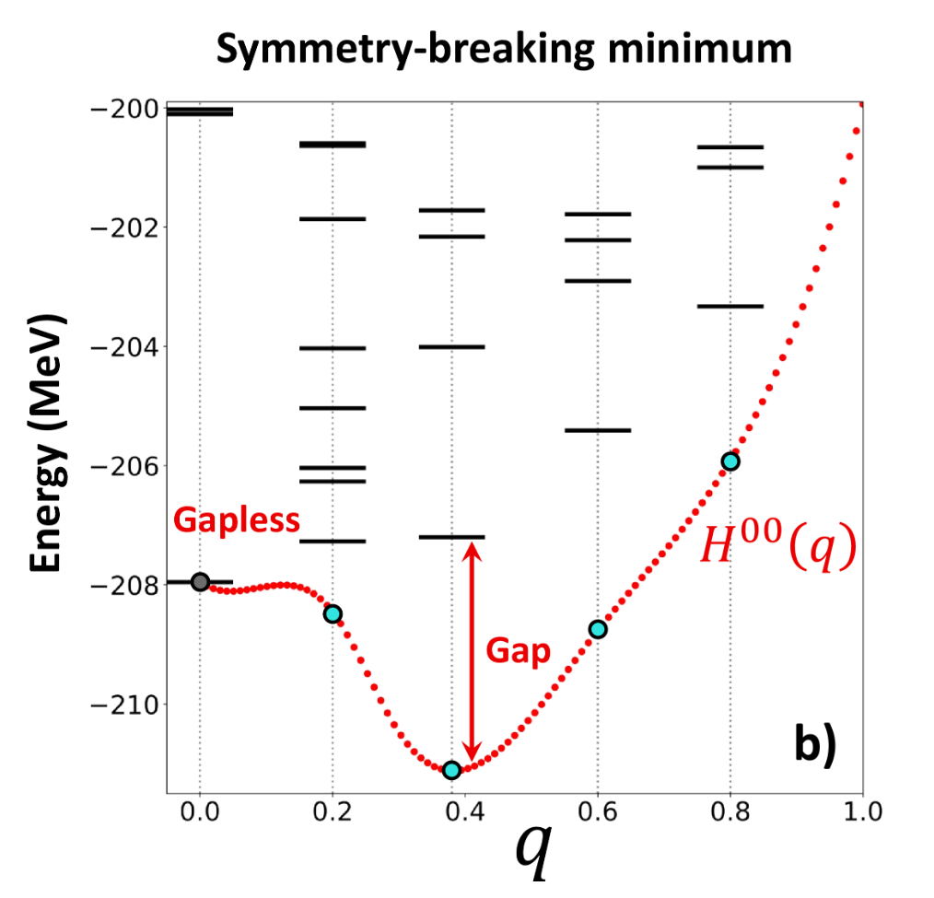
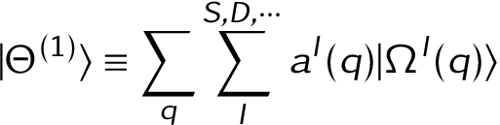


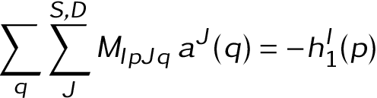
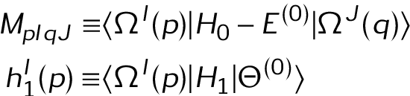
PGCM-PT formalism
[Frosini et al., EPJA58 (2022) 62]
Digression: standard SR (B)MBPT
Formal RS perturbation theory
H₀ diagonal in basis of elementary excitations of HF(B) unperturbed state
Explicit algebraic expression of SR (B)MBPT energy corrections, e.g.
PGCM-PT(2)
►Strong static/collective correlations tackled by PGCM unperturbed state
Low polynomial (N⁴) scaling
►Weak dynamical correlations built perturbatively on top of PGCM state
Recovers standard (B)MBPT for ground state in single-reference limit
►Versatile (but not cheap) symmetry-conserving polynomial method
Doubly closed-shell, singly open-shell, doubly open shell nuclei
Harmonic and non-harmonic vibrators, transitional nuclei, shape coexistence…
Ground state and collective excitations (although an extension needed for non-yrast states)
►Multi copies of A-body Hilbert space = large linear system with redundancies to solve
Approximate resolution with S+D
Numerical methods to handle redundancies, (potential) intruders, large dimension
« Easy »
to solve
Such analytic inversion not possible here
→ Nature of makes expansion more complex/costly
2nd order Master Equation (ME)
→ Convenient representation in Q needed to expand ME
PGCM-PT(2)
Orthogonal to
Elementary excitations of each
with
Symmetry projected
Perturbative expansion
Approximation
with
Expanded ME = linear system of large dimension to solve
N⁸ PGCM-PT(2) cost instead N⁴ of standard (B)MBPT(2)

Slide 11
Contents
⦿ Introduction
⦿ Novel PGCM-PT formalism
⦿ Validation of PGCM-PT(2) against FCI in ²⁰Ne
⦿ Combining MR-IMSRG with PGCM-PT(2) in ²⁰Ne
⦿ Perspectives

Slide 12
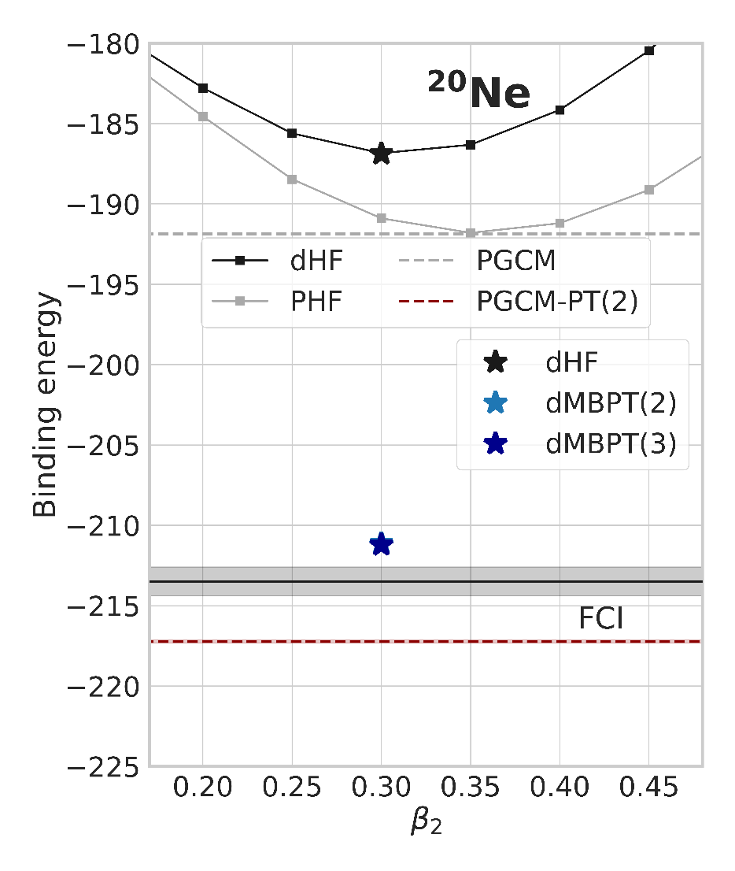
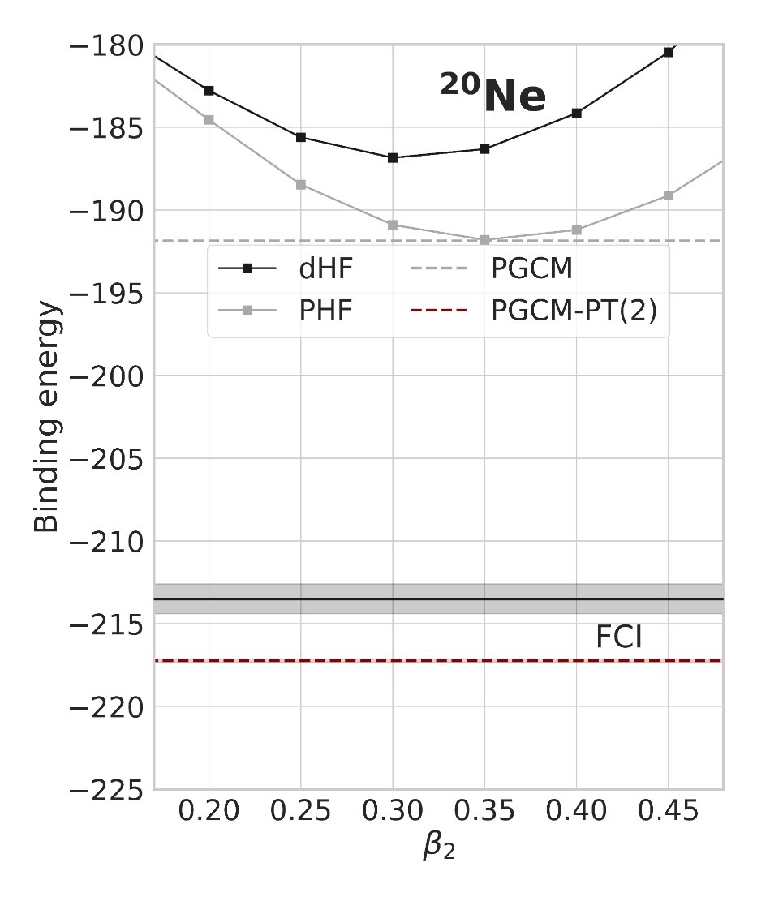
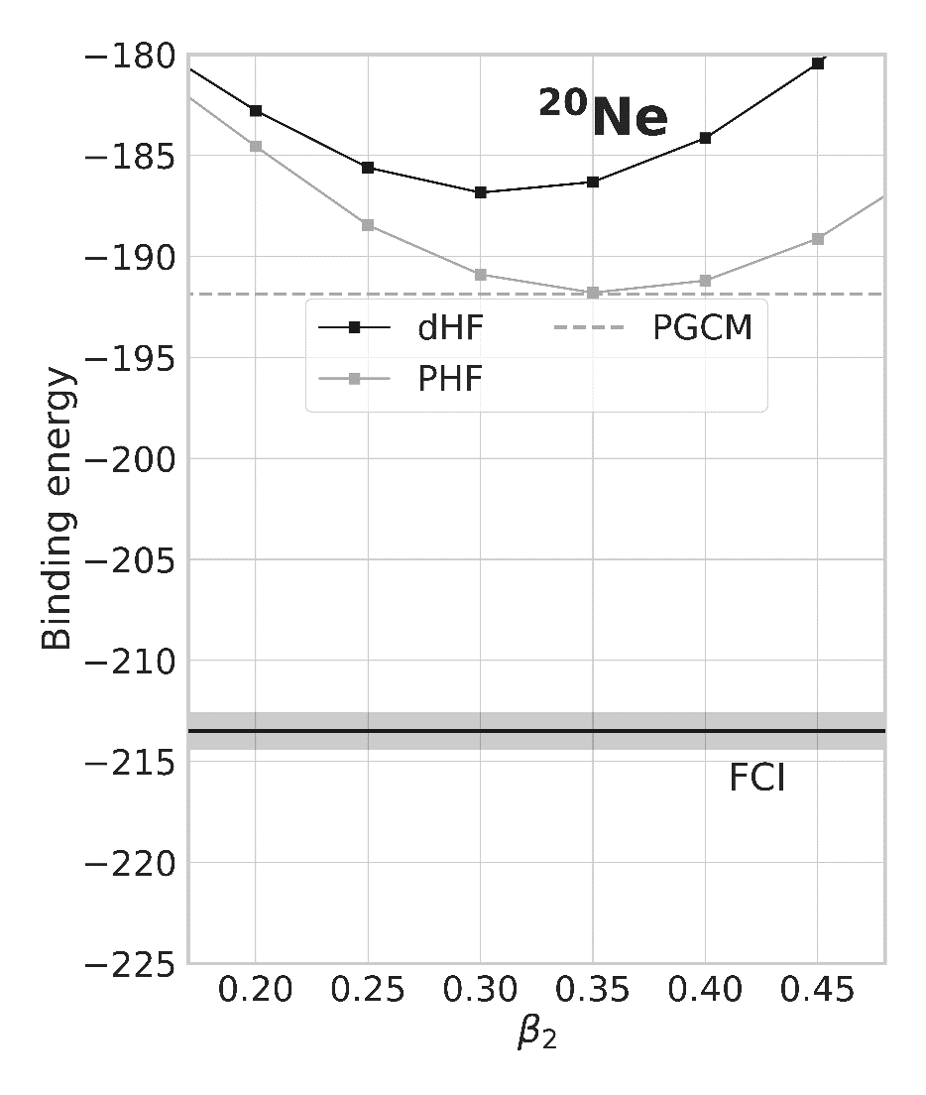
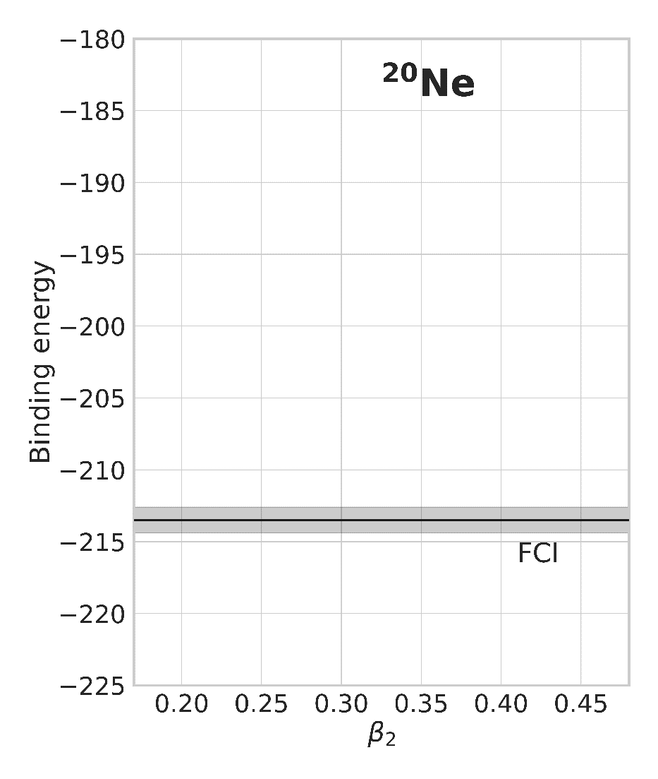
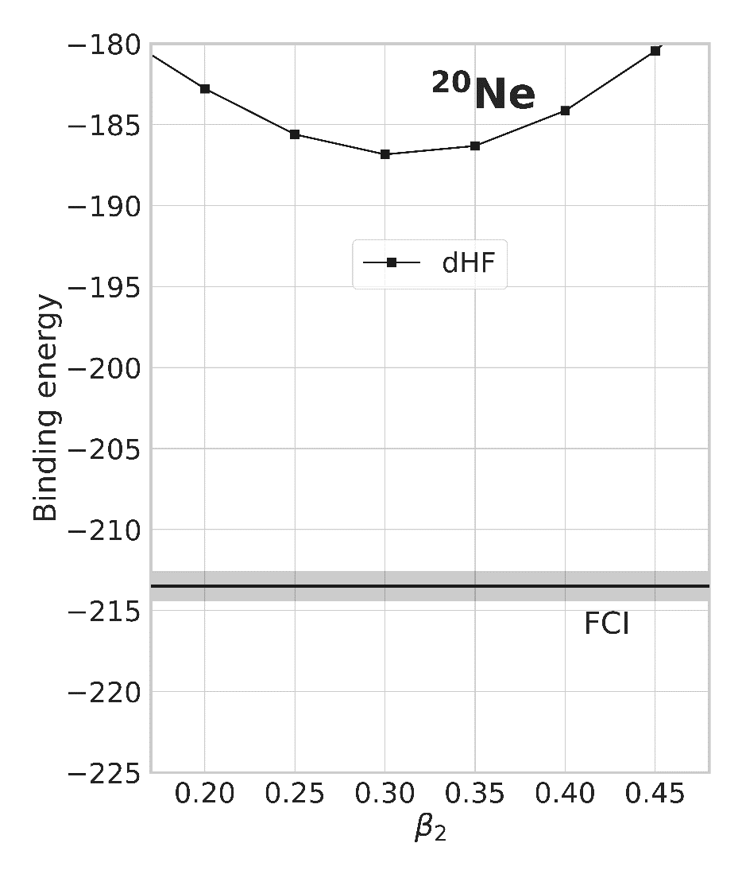
PGCM-PT(2) vs FCI in doubly open-shell ²⁰Ne
Nature of the PGCM unperturbed state
Numerical setting
►e_{max} = 4, hω = 20 MeV
►N³LO NN interaction [Hüther et al 2020]
►λ_{srg} = 1.88 fm-1
No pairing in ²⁰Ne
Axially deformed HFB states
Constraint+mixing on β₂₀
Projection on J²
Euler angles
No trixiality here
Ground-state energy
Static correlations from J² breaking
→ 13 MeV from deformation
Static correlations via PGCM
→ 5 MeV from projection on J=0
→ ~0 from GCM mixing over β₂
PGCM misses dynamical correlations
→ 10 % underbound (21 MeV)
Dynamical correlations via PGCM-PT(2)
→ 1.7% error (3 MeV)
→ Slightly overshooting FCI
Deformed single-reference MBPT(2,3)
→ Underbound (1.2 %)
→ Misses static correl. projection on J
[Frosini et al., EPJA58 (2022) 64]

Slide 13
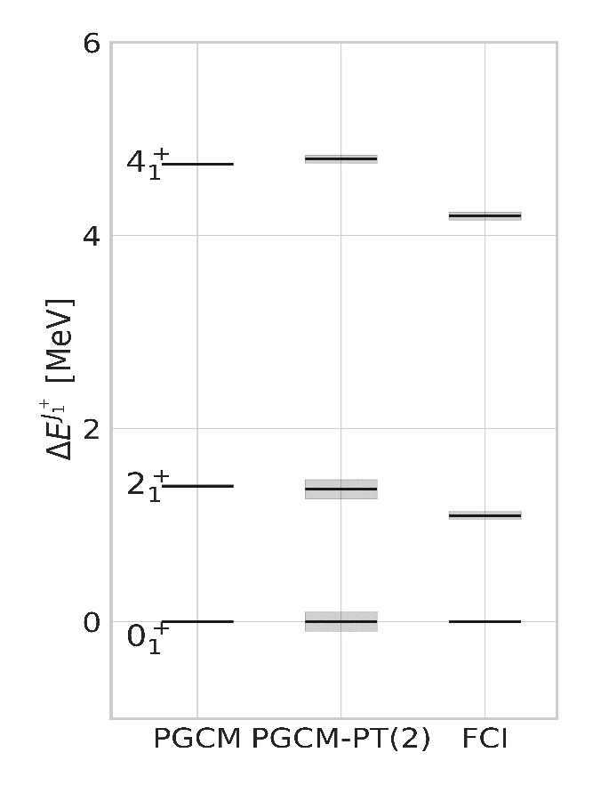
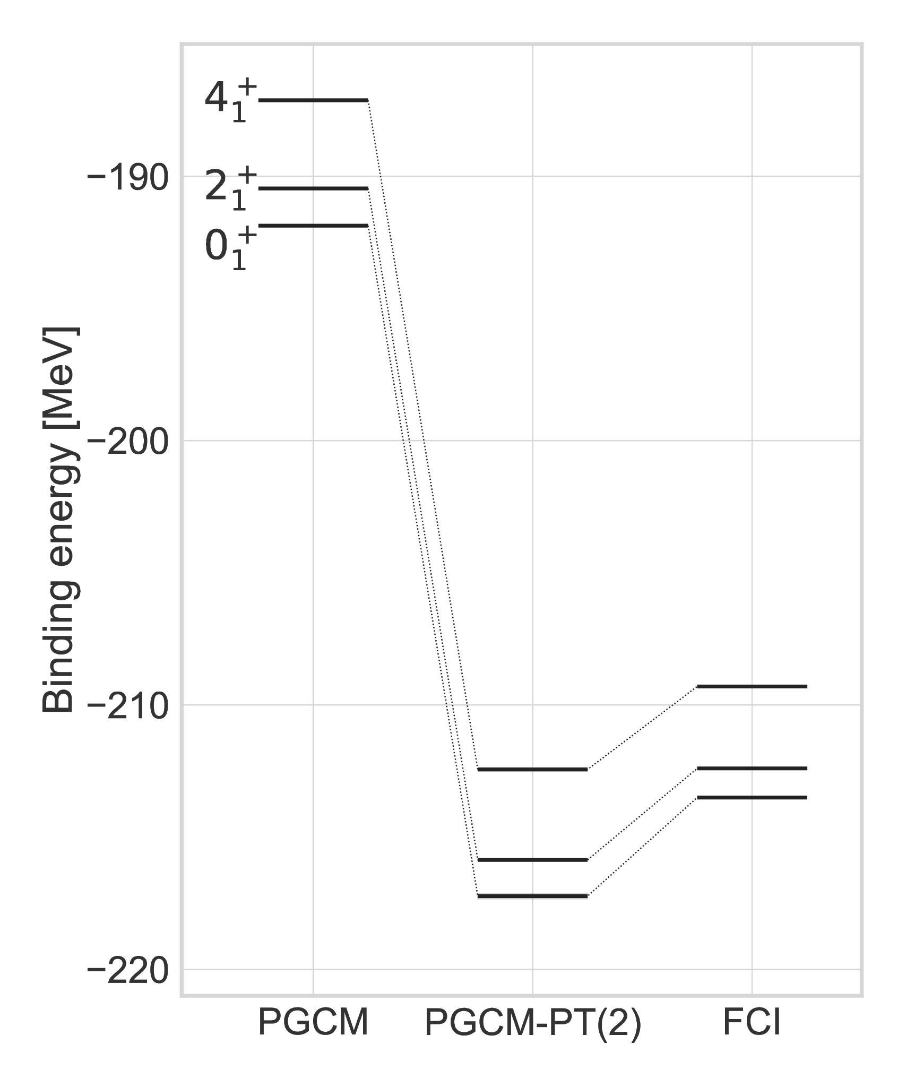
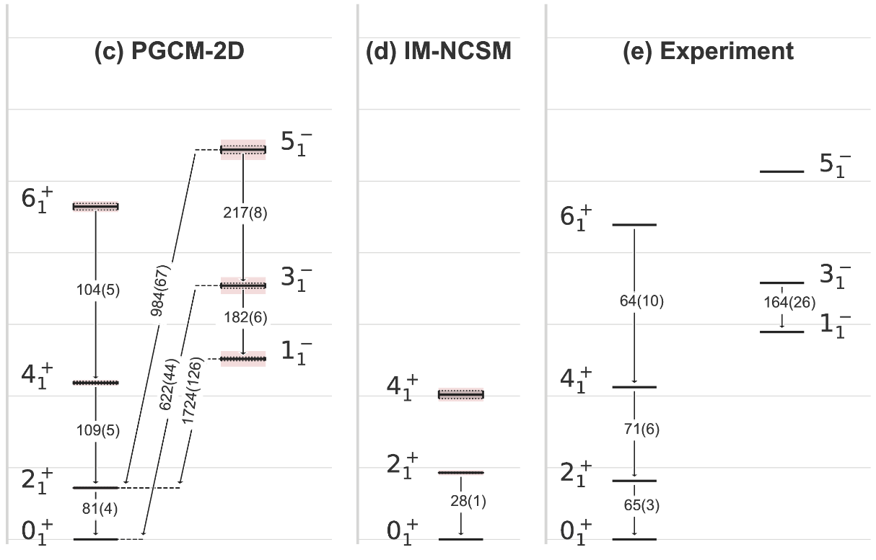
PGCM-PT(2) vs FCI in doubly open-shell ²⁰Ne
Nature of the PGCM unperturbed state
Numerical setting
►e_{max} = 4, hω = 20 MeV
►N³LO NN interaction [Hüther et al 2020]
►λ_{srg} = 1.88 fm-1
No pairing in ²⁰Ne
Axially deformed HFB states
Constraint+mixing on β₂₀
Projection on J²
Ground-state rotational band
Validation of new PGCM-PT(2) many-body method
-Less than 2 % error on absolute binding energies (e_{max} = 4)
Dynamical correlations cancel in rotational spectrum
-PGCM = good approximation to low-lying collective excitations
-To be studied for vibrational excitations
-To be extended to transitional nuclei, shape coexistence…
-Not necessarily true for other observables (r², B(Eλ)…) – See Talk H. Hergert
Rotational spectrum slightly too dilated
-Static correlations: cranking in PGCM to correct?
-Dynamical correlations: unlikely but to be envisioned
Validation of numerical tools
-Preconditioning, complex shift, etc.
Euler angles
β₂, β₃
e_{max} = 10,
e_{3max}= 14
N³LO 2N+3N
λ_{srg} = 1.88 fm⁻¹
No trixiality here
[Hagen et al., PRC105 (2022) 064311]
Ground-state energy
[Frosini et al., EPJA58 (2022) 63]
Static correlations from J² breaking
→ 13 MeV from deformation
Static correlations via PGCM
→ 5 MeV from projection on J=0
→ ~0 from GCM mixing over β₂
PGCM misses dynamical correlations
→ 10 % underbound (21 MeV)
Absolute energies
→ Consistent dynamical correlations for each J
→ 1-2% error vs FCI for all states
Dynamical correlations via PGCM-PT(2)
→ 1.7% error (3 MeV)
→ Slightly overshooting FCI
Excitation energies
→ Good vs FCI (~250keV too dilated)
→ Fine cancellation of PT(2) correlations
Validation of numerics (large numbers cancel)
PGCM good approx. to spectroscopy
Consistent with PCC
Deformed single-reference MBPT(2,3)
→ Underbound (1.2 %)
→ Misses static correl. projection on J
[Frosini et al., EPJA58 (2022) 64]

Slide 14
Contents
⦿ Introduction
⦿ Novel PGCM-PT formalism
⦿ Validation of PGCM-PT(2) against FCI in ²⁰Ne
⦿ Combining MR-IMSRG with PGCM-PT(2) in ²⁰Ne
⦿ Perspectives

Slide 15




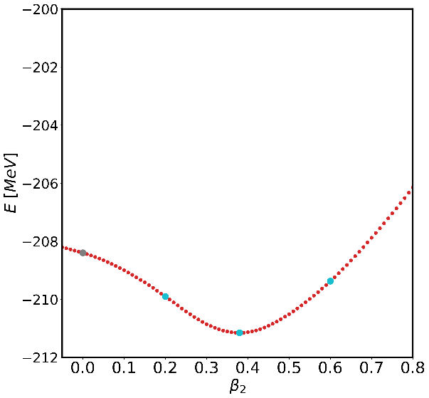



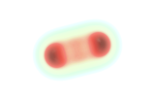
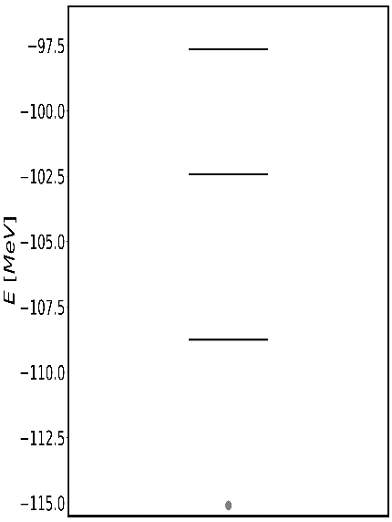
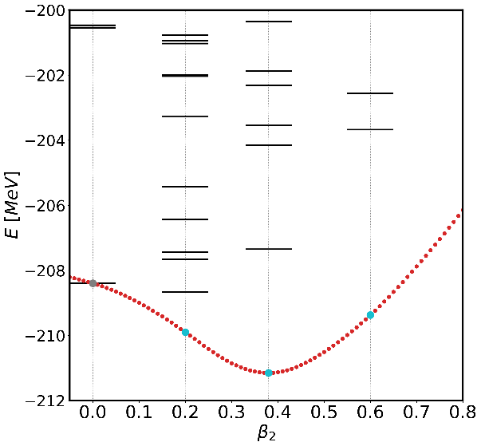


Many-body expansion methods and pre-processing
$$U\left(s\right)HU^{†}(s)$$
Dynamical
Correlations
Pre-processing
Scenario 1
Standard methods
Scenario 2
Double expansion
Scenario 3
Triple expansion
MR-IMSRG+PGCM-PT = Triple expansion for an optimal grasping of correlations
Preprocessing of Hamiltonian via MR-IMSRG with respect to PGCM state
PGCM to capture static correlations at low computational cost
PGCM-PT(2) to bring remaining dynamical correlations
Three non-orthogonal « auto-adapting » (no double counting) processes
Vertical expansion
Static
Correlations
(q₀,ϕ₀ )
(q₀,ϕ₁ )
(q₁,ϕ₀ )
Horizontal expansion
$$μ,σ$$
Pre-processing of H
Horizontal expansion
…
…
Double excitations
Vertical expansion
Dynamical
Correlations
…
Single excitations
Reference vacuum
[Frosini et al., EPJA58 (2022) 64]

Slide 16
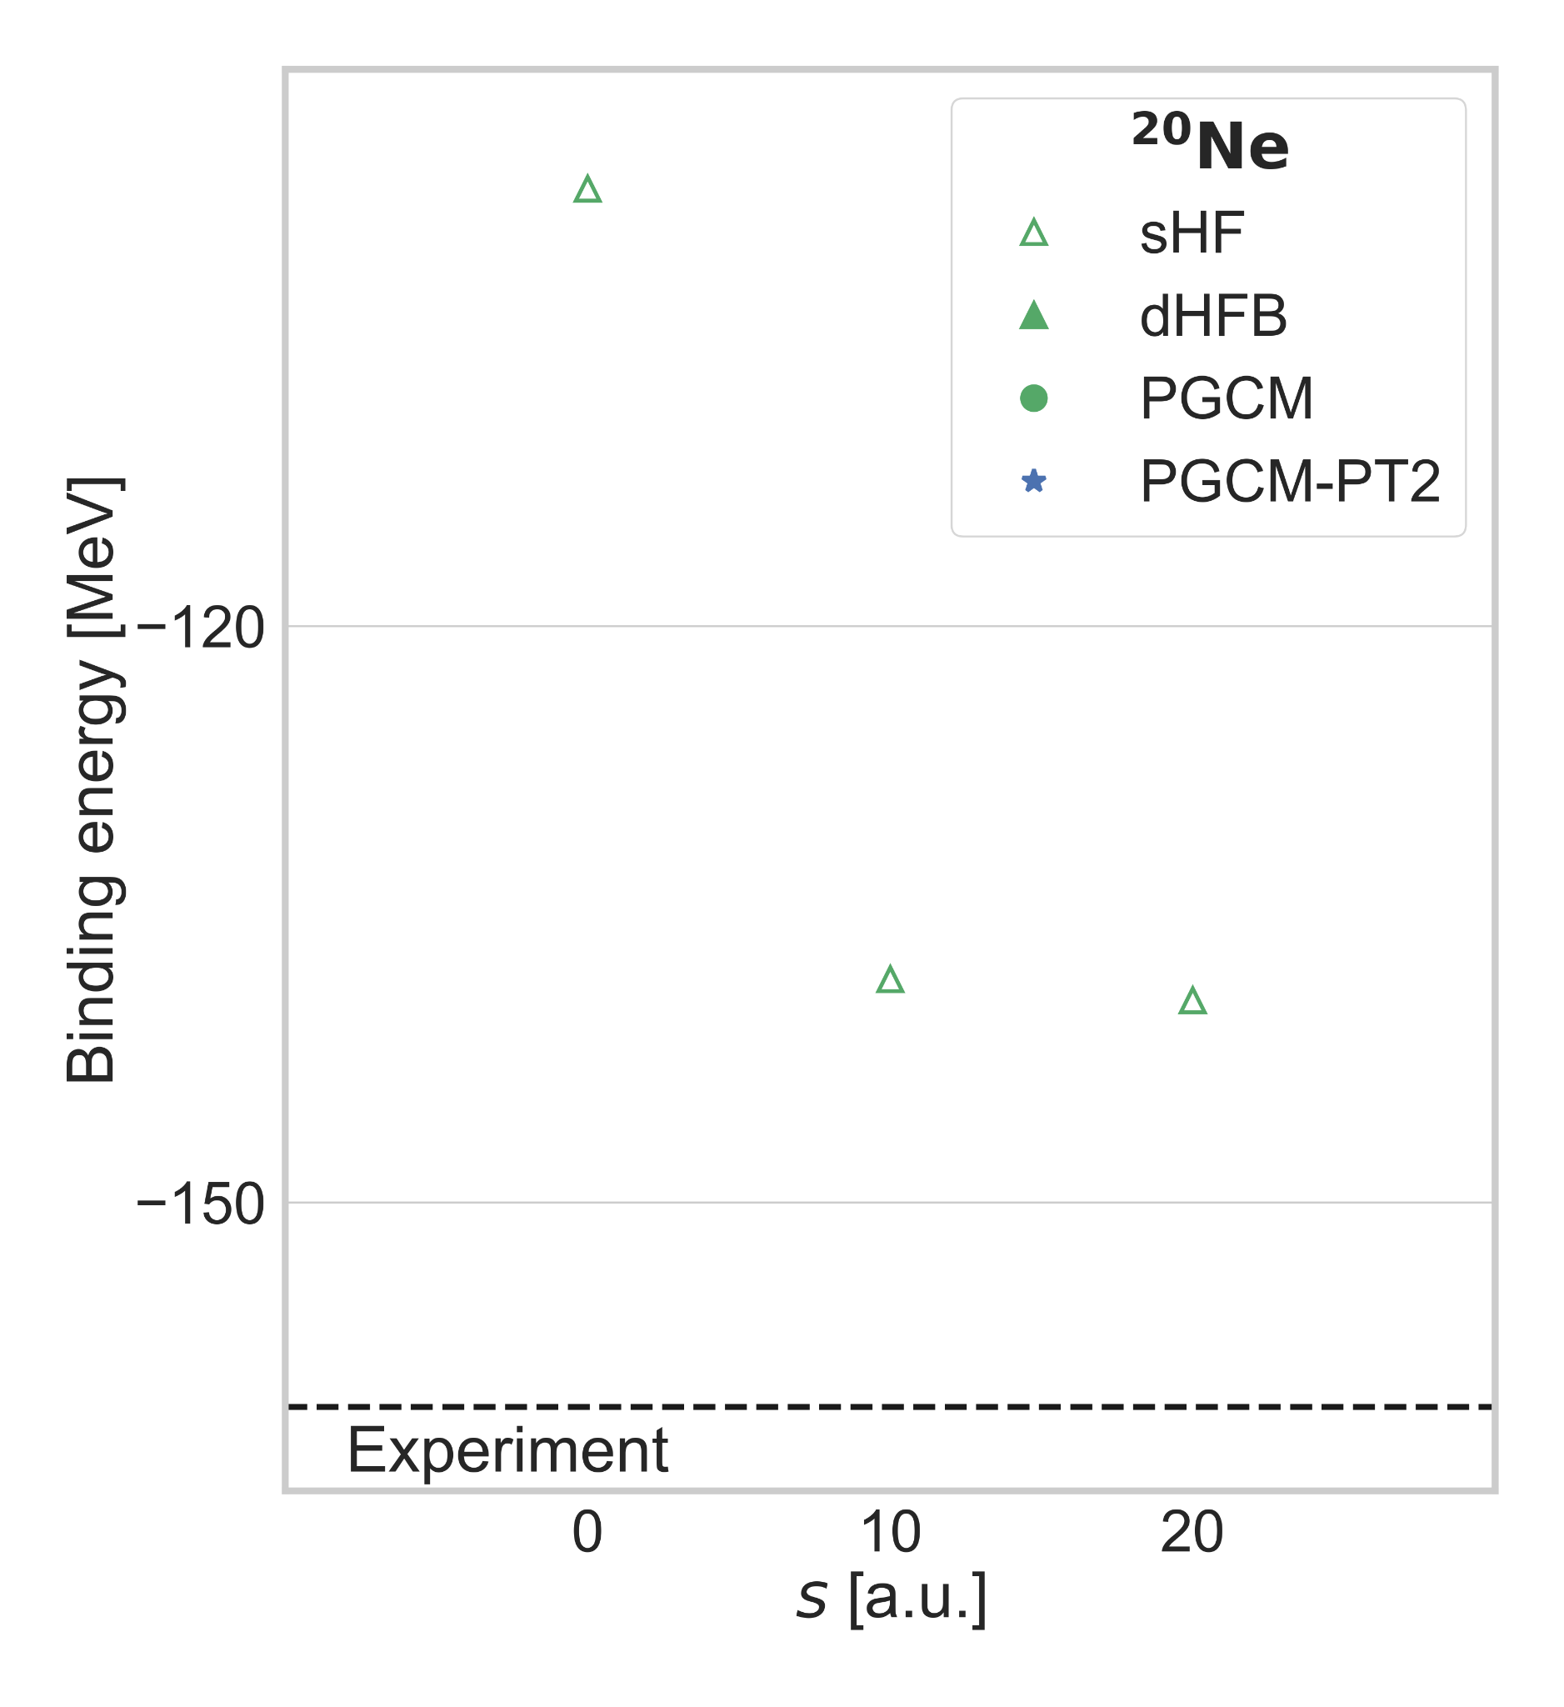
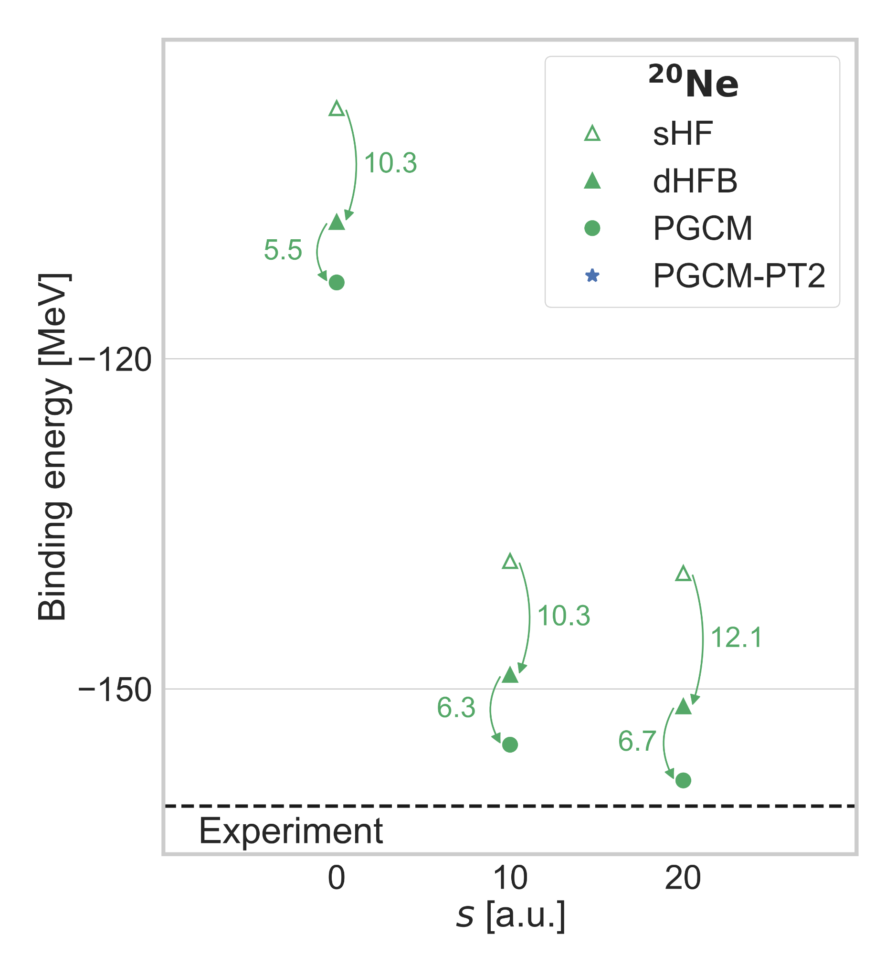
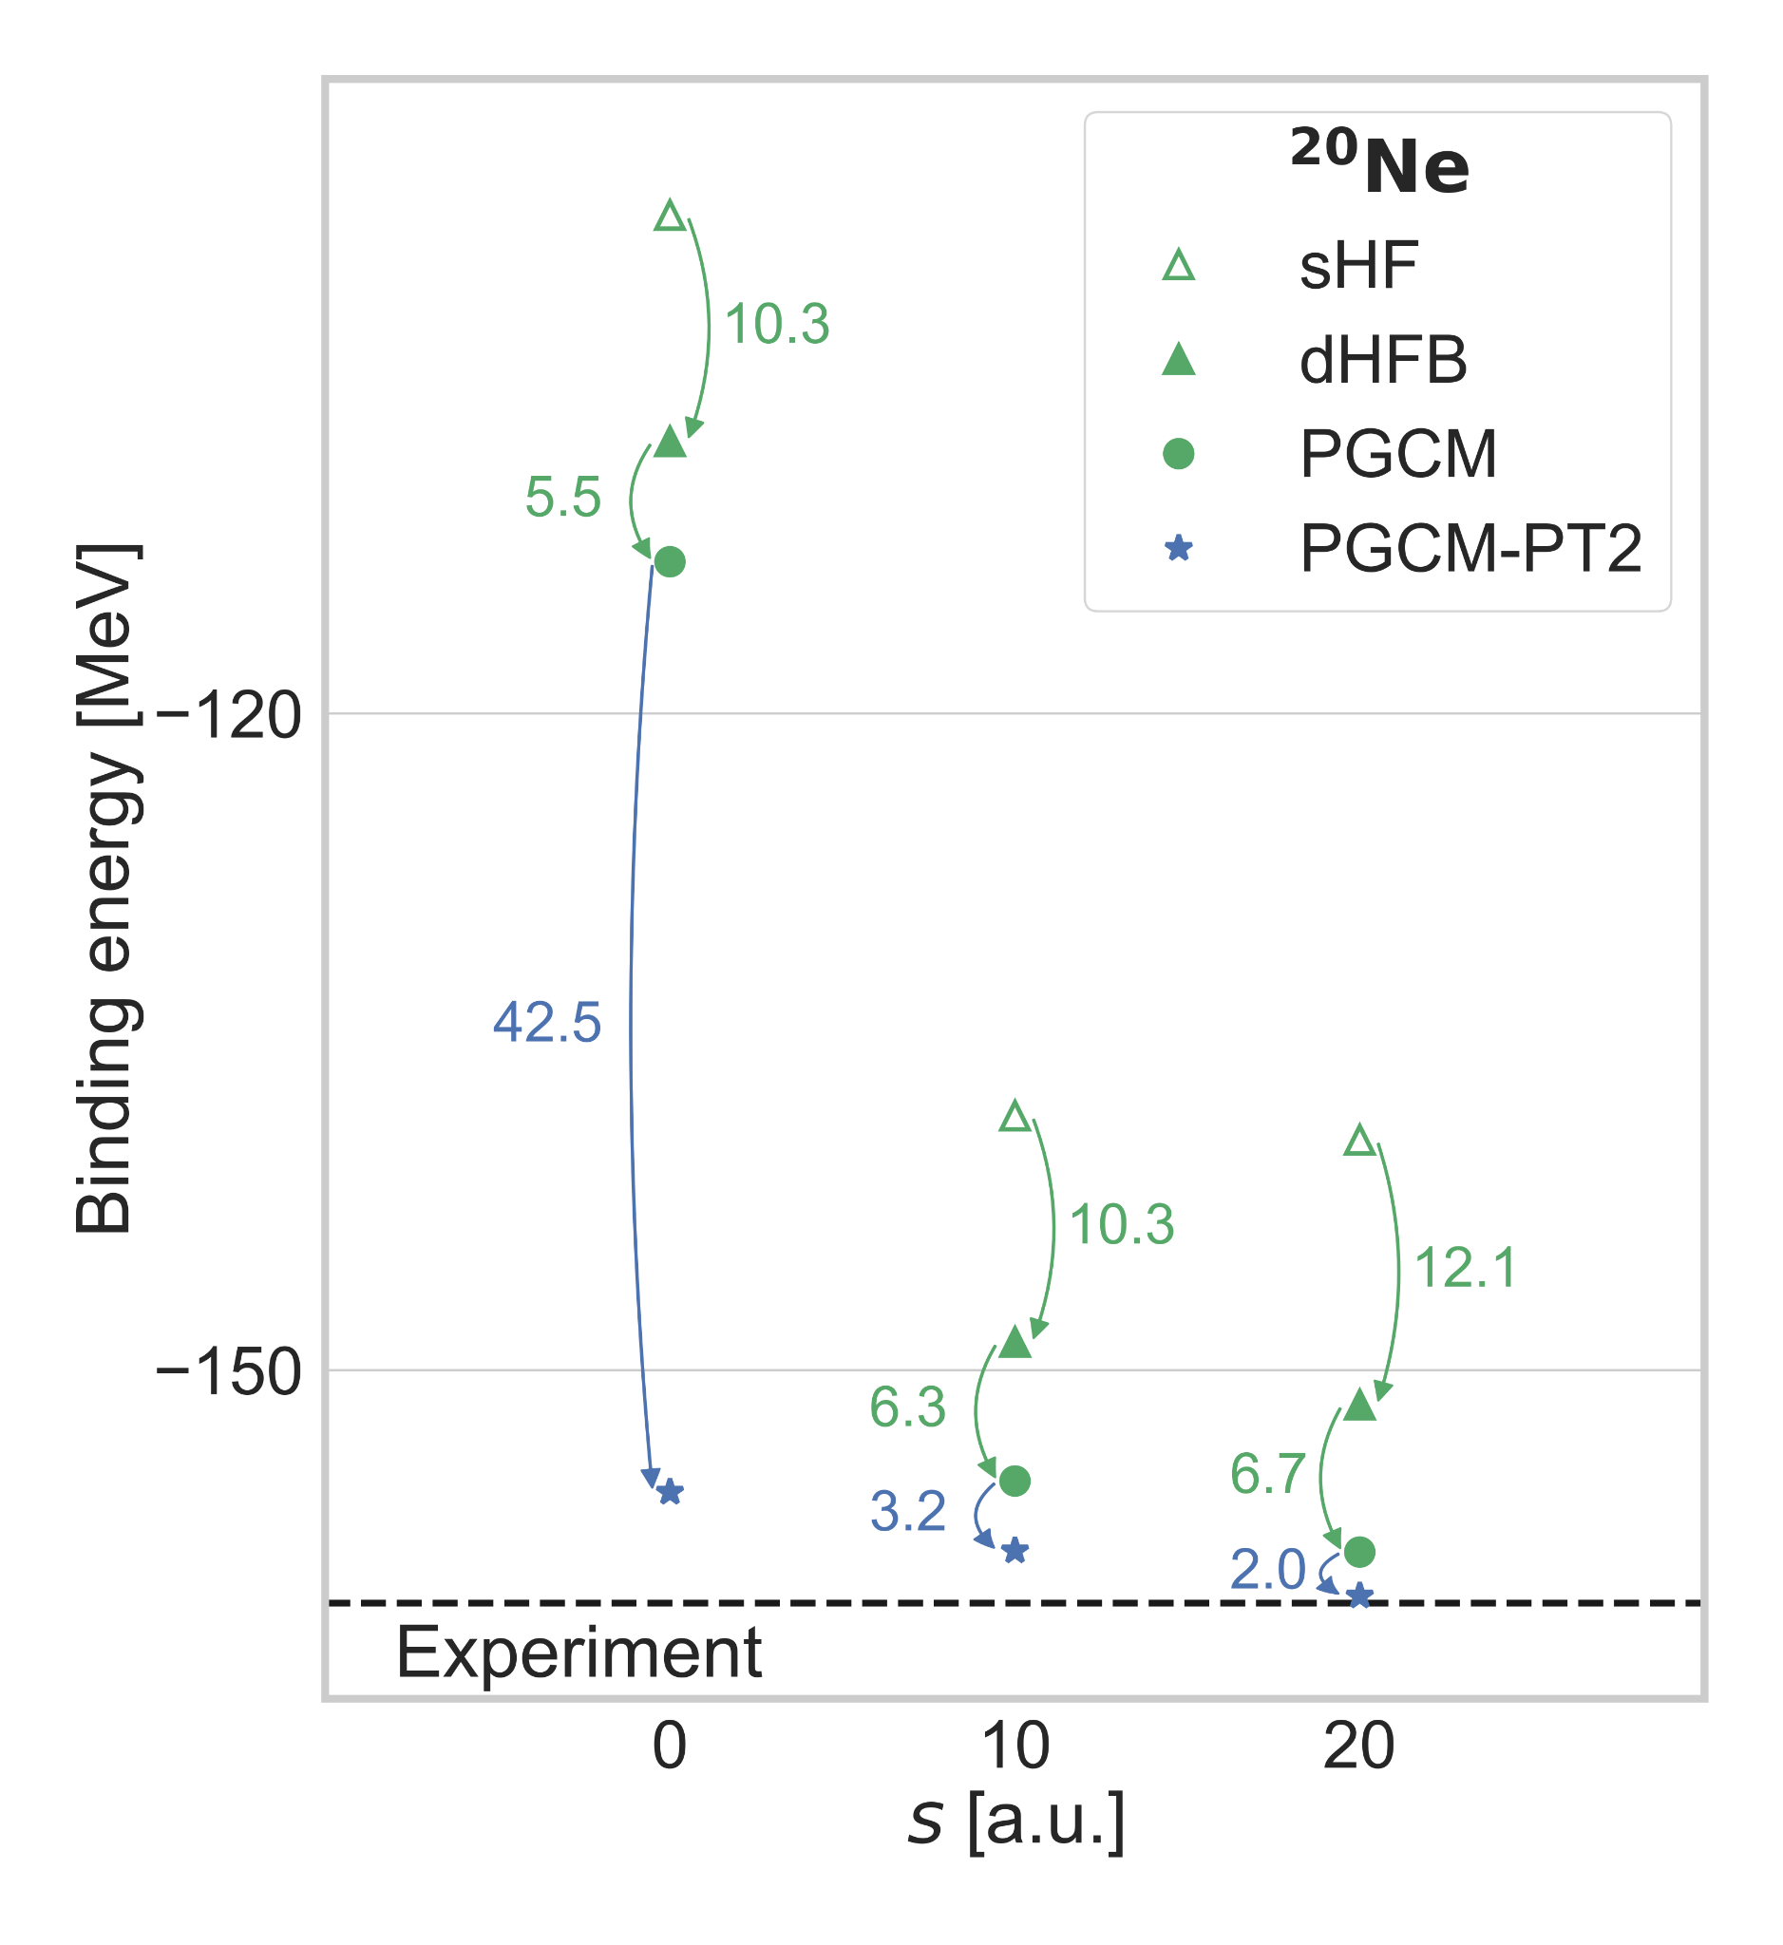
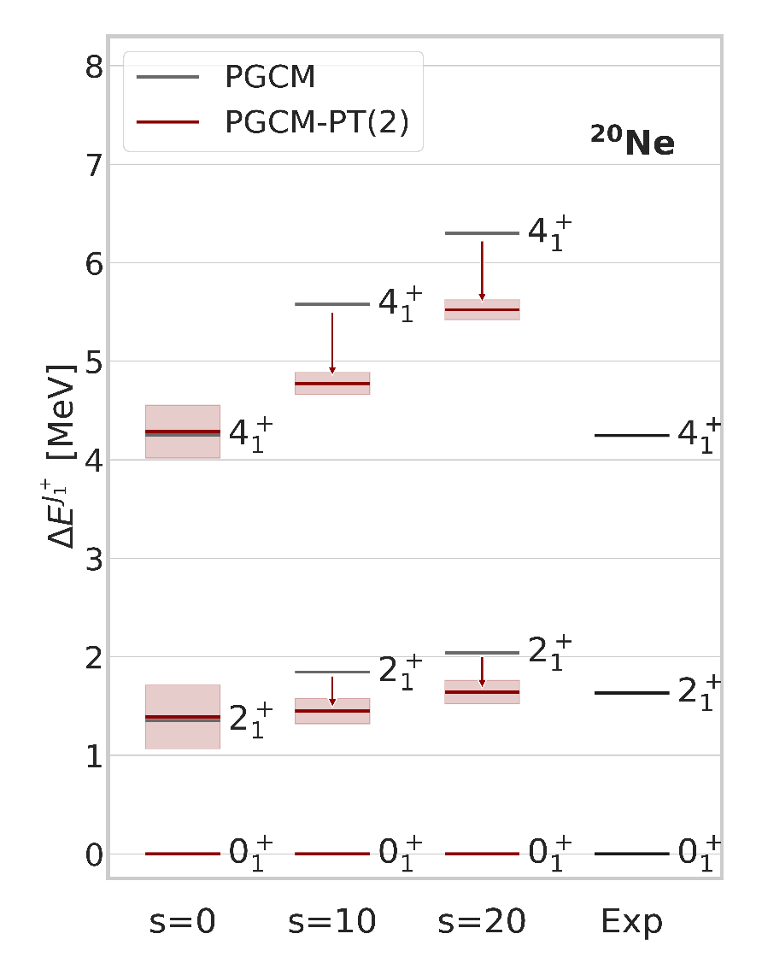
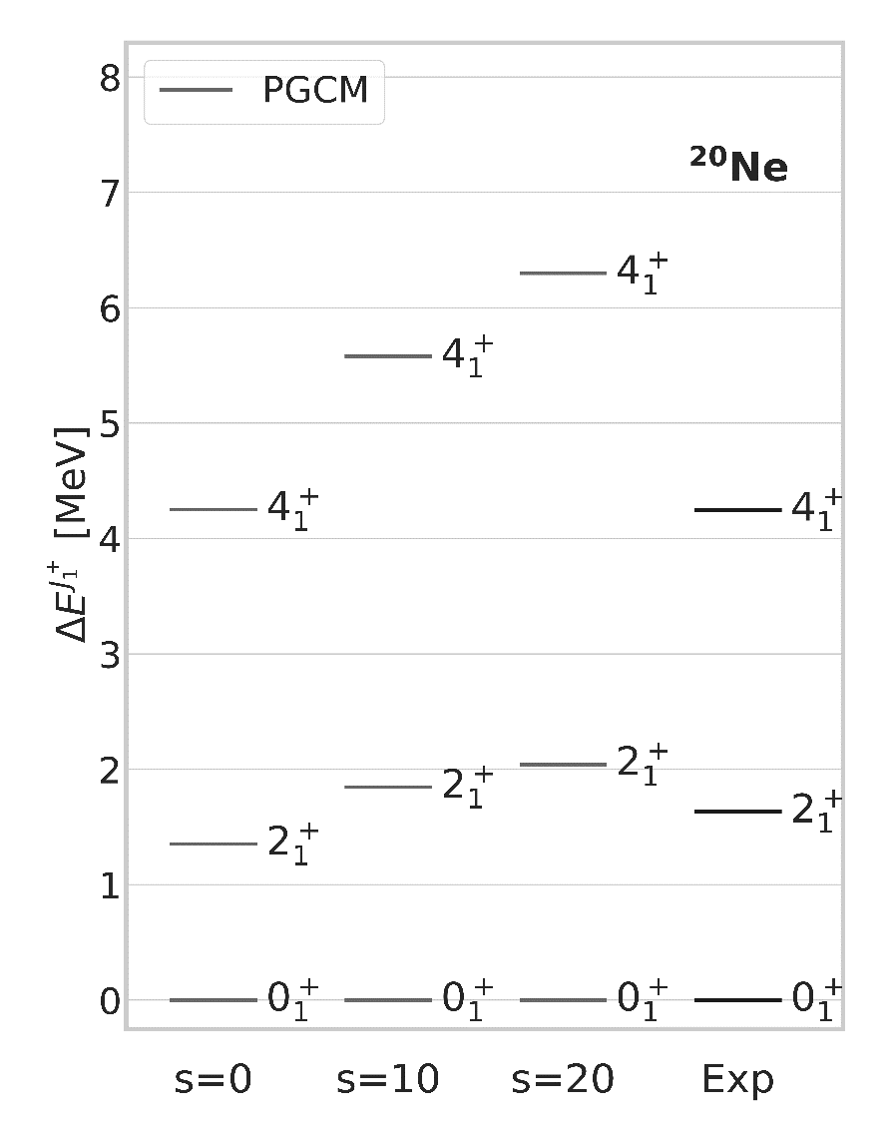
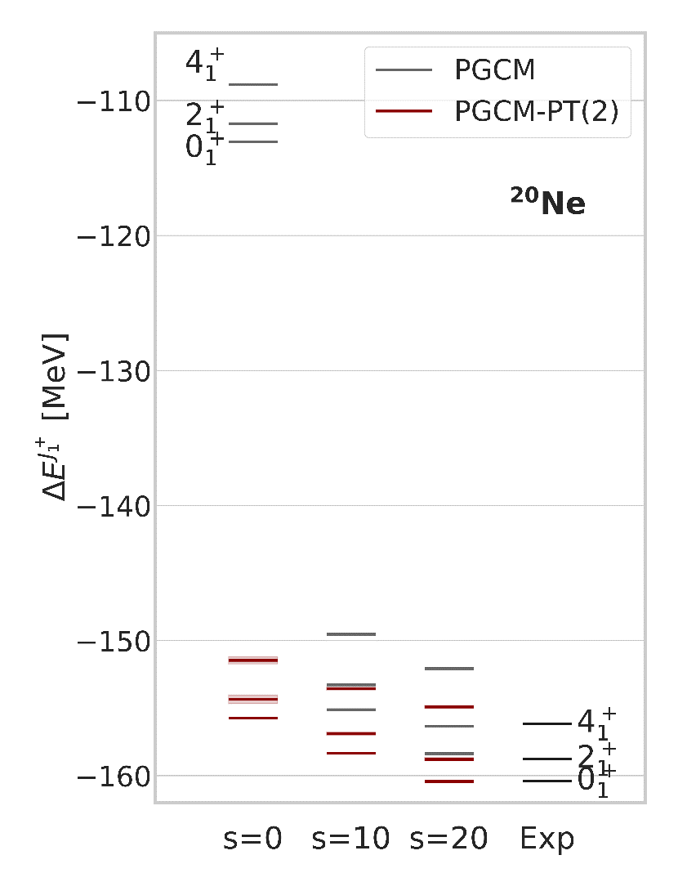
PGCM-PT(2) of ²⁰Ne with MR-IMSRG pre-processing
Pre-processing H via MR-IMSRG with respect to the PGCM state
1
Normal ordering with respect to PGCM state
►Kutzelnigg-Mukherjee generalized Wick Theorem
►Normal-ordered (NO) two-body approximation
Initial condition
2
Flow equation
Truncated up to 2-body NO operators = MR-IMSR(2)
►Unitarity violation as flow parameter s grows
Generator parameterizes the unitary transformation
►Chosen to (quasi) decouple PGCM state from complementary space
►Reshuffles dynamical correlations into H(s)
MR-IMSRG non-perturbative pre-processing of H
►H(s) more perturbative as s grows
►Largely resums dynamical correlations a priori
→PT effects on top of PGCM largely reduced but PGCM state not strictly decoupled
►Solving of PGCM-PT(2) linear system more precise&accurate
►Remaining PT converged in smaller basis?
→Indeed true in IM-NCSM [Gebrerufael et al. 2017]
►PT(2) effects on collective spectrum increased on top of PGCM
→Decouple with respect to ensemble of ground and excited PGCM states
→Improved PGCM, e.g. cranking (see talk H. Hergert), to miminize PT effects on top
►MR-IMSRG(2) improves B(E2) (see talk H. Hergert) but what about PT(2) effects on top?
[H. Hergert et al., PR 621 (2016) 165]
[J. M. Yao et al., PRC98 (2018) 054311]
[J. M. Yao et al., PRL124 (2020) 232501]
Ground-state rotational band
Numerical setting
►e_{max} = 6, hω = 16 MeV
►N³LO NN (λ_{srg} = 1.88 fm⁻¹)
►N²LO 3N (Λ = 2.0 fm⁻¹)
[Hebeler et al. 2011]
Ground-state energy
[Frosini et al., EPJA58 (2022) 64]
Ground-state energy
►Lowers drastically sHF reference point (45 MeV)
►Slightly enhances static correlations (15 MeV → 18 MeV)
►Drastically reduces dynamical PT correlations (42 MeV → 2 MeV)
►Remaining dynamical however non negligible (~1.5%)
Ground-state rotational band
►Consistent evolution of the yrast states
►PGCM spectrum slightly spread by MR-IMSRG preprocessing
►PT effects on spectra consistently increased

Slide 17
Contents
⦿ Introduction
⦿ Novel PGCM-PT formalism
⦿ Validation of PGCM-PT(2) against FCI in ²⁰Ne
⦿ Combining MR-IMSRG with PGCM-PT(2) in ²⁰Ne
⦿ Perspectives

Slide 18
Conclusions
New « universal » PGCM-PT many-body method
MR unperturbed PGCM state
-Low polynomial cost
-Efficiently captures strong static correlations
-Allows access to (collective) excitations
State-specific MR perturbative expansion
Proof-of-principle calculations
  Numerics ok: pre-conditioning, complex shifts
  Absolute energies = 1-2 % accuracy
  Spectra = 20 % accuracy
MR-IMSRG non-perturbative preprocessing of H
-Makes H more perturbative
-Largely resums dynamical correlations
-Remaining PT converged in smaller basis?
Three levers for an accurate / versatile / optimal / consistent nuclear structure description
Preprocessing of Hamiltonian via e.g. MR-IMSRG: further improve decoupling?
PGCM to capture static correlations at low computational cost: further enrich to improve a) and c)?
PGCM-PT(2) to bring remaining dynamical correlations: converged in smaller basis thanks to a)?
Optimal compromise still to be investigated

Slide 19
Looking forward
CALCULATIONS
AB INITIO-BASED EDF
Numerical optimization
  →Algorithmic improvements
  →Importance selections
  →Natural basis
  →Tensor factorization
  Minimize PT corrections
  →Ensemble MR-IMSRG evolution
  →Enriched PGCM ansatz
Non-yrast states
→Orthogonalization
Individual excitations
→Extended PGCM ansatz
Applications
→Pairing vibrations
→Shape coexistence/mixing
⸽
[Duguet et al. EPJA 2023]
H(s)+PGCM «=» MR-EDF
Cancel PT corrections
→Ensemble MR-IMSRG evolution
→Enriched PGCM ansatz
Avoid N^{6|9} building of H(s)
  →Empirical H_{eff} = H(s)?
  →Invent EFT for H(s)?
PGCM-PT
&
MR-IMSRG
Octupole vibration (¹⁶O+α ↔ ¹²C + 2α) at 7.2 MeV
Spectroscopy from PGCM
²⁰Ne
[Beaujeault-Taudière, et al., PRC 2023]
[Frosini et al., unpublished]
Isoscalar Monopole strength
Excellent first account with H(0)
→Low-lying states
→Giant resonances
(P)QRPA = harmonic limit of (P)GCM
  [Jancovici, Schiff, NPA 1964]
  ([Federschmidt, Ring NPA 1985])
  →FT triaxial QRPA (QFAM) with NN+3N code
  Giant resonances with (P)GCM and (P)QRPA
  →Development of «P»QRPA and PQRPA
  →Merits (non-harmonic, shape coexistence)
  →Systematic study up to A~70
  Statistical uncertainties from H
  →Development of PGCM-EC [A. Roux, Ph.D. Thesis]
χ-EFT
EDF-Skyrme
[Porro, Ph.D. Thesis, unpublished]

