Slide 1
MAPS22

Slide 2
Project | HKR-Injector-Upgrade / MAPS22
Project Lead | T. Hoffmann
Status Date | 08.07.2022
Project Description |  | Subprojects / Tasks
Goal is to replace the outdated MAPS system (x86 CPU on MS-Dos, Borland C) and to install a new MAPS-System in LSB (data acquisition and software), use commercial hardware, full FESA integration, digitize all signals in parallel, allow future upgrades and enhancements of the system. Separate the fast beam loss monitor part (SVÜ, to be realized by ACO in the future). Strategy: during start phase of the upgrade signals will be splitted for parallel usage of old and new MAPS (only beam signals, not pre-amp power or I/O), first replace single transformers to allow for parallel testing with old MAPS. Then partially increase the number of transformers in the new MAPS22 up to full amount of devices and full I/O control by MAPS22. |  | Specify the system ✔ Purchase commercial electronics (2U MTCA system AM G64 CPU, TAMC532 32 channel ADC with RTM, 2xSIS8864 I/O modules, FTRN) ✔ plus spare parts -> open Manufacture adaptor box -> in progress Find solution for MAPS oscilloscope -> in progress Installation (LSB) -> open Write FESA and GUI software ✔ Perform beam tests with single transformer -> open (first tests took place) Commissioning of the full system -> open
Project Goals |  | Ressource Profile
Replace the outdated MAPS system with a modern version MAPS22 State of the art hardware components Full FESA / control system integration Be prepared for the move to FCC Separation of the beam-loss monitor part from intensity monitoring „MAPS-Oscilloscope“ function at 10 MHz sampling rate Procurement of relevant spare parts (DAQ main system plus ADC, ~25k€)
Major Milestones |  | Risks, Boundary Conditions and Comments
Q1/2021 | Start procurement | Major Risks: Complex adaptor box not ready MAPS Oscilloscope Lack of manpower LSA not yet ready at Unilac WR Timing model/domains not ready Long delivery times | Concerned departments: BEA ACO (for SVÜ) OPE (user requirements)
Q4/2022 | Procurement of hardware completed (not spares)
Q3/2023 | Commissioning with beam
 |  | Boundary Condition: Must be prepared before move of HKR to FCC | Comments: - Extra costs for MAPS Oszi possible -Trigger issues solved with post trigger -LSA essential for ranges setting. intensity calculation and PG Schutz
Year | Estimated costs [k€] | Personnel [person months]
2022 | 40 | 2.5
2023 | 25 | 2.5
2024 | -- | 1
2025
2026
Sum | 65.000 Euro | 6

Slide 3
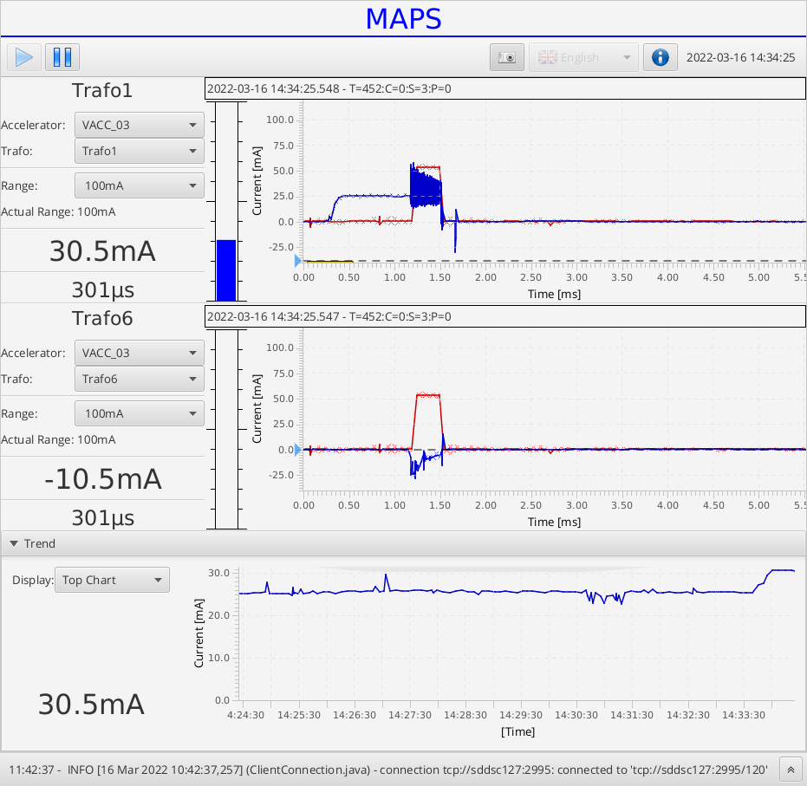

Slide 4
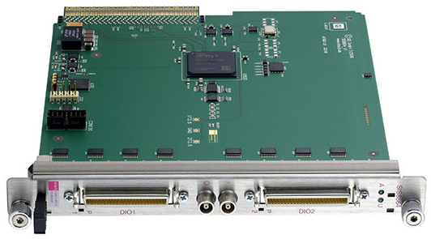
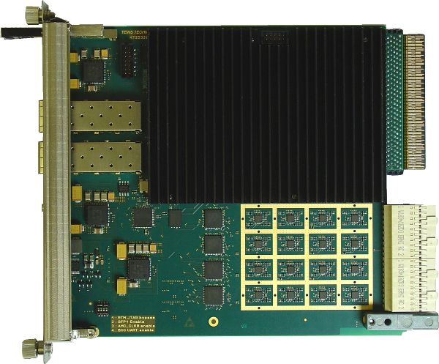
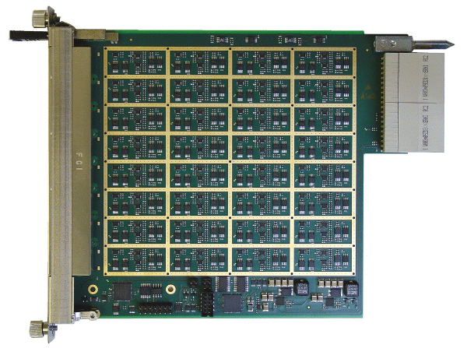
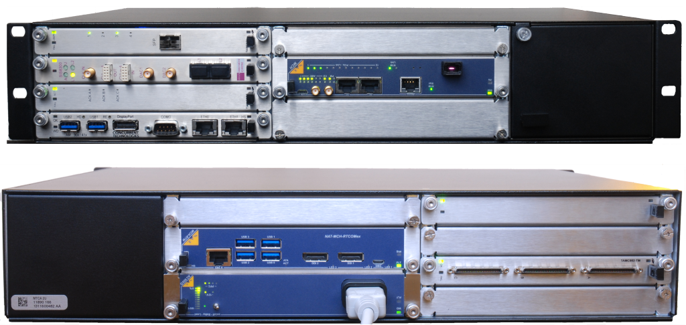
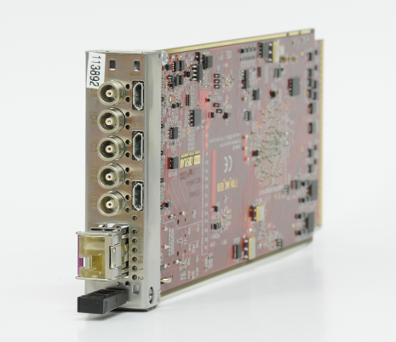
Spare parts
TAMC-532 32 Channel ADC with input RTM
SIS8864 MTCA 64 Channel I/O Register
MTCA.4 6-slot systems incl. CPU (Xeon), MCH und PS
FAIR Timing Receiver Node (AMC)

Slide 5
MAPS - Macro Pulse Selector @ UNILAC 2022
Efforts (estimated):
Task Duration Costs
Preparation of adaptor box: 3 - 6 months 40k€
Installation (step-by-step): 4 weeks 1k€ (cables, adaptors etc)
Programming FESA and GUI: 3 months
Implementation additional features: 6 months
Procurement Spare Parts 18 months 25k€
SVÜ (preparation U/f converter boxes): 6 months unclear
MAPS Oscilloscope 12 months unclear

Slide 6
UNIMON

Slide 7
Project | HKR-Injector-Upgrade / Unimon-Upgrade
Project Lead | T. Hoffmann
Status Date | 08.07.2022
Project Description |  | Subprojects / Tasks
Goal is to replace the outdated Unimon system, i.e. display of chopper, buncher, RFQ, IH, Alv, ER etc., with an updated version using state-of-the art electronic components. The new Unimon shall be fully integrated into the accelerator control system. The complete DAQ system and the signal cables need to be moved from HKR into LSB. There all data is digitized in preparation of usage at FCC. |  | Specify the system ✔ Purchase commercial electronics (MTCA system) ✔ plus spare parts -> open Design and produce adaptor box ✔ Change of display orientation -> in progress (one or two displays?) Use White Rabbit timing -> in progress (final model not available) Write FESA and GUI software (Rocky 8) -> in progress Move hardware from HKR to LSB (new racks, cables, LAN, WR timing etc.) -> open Perform beam tests with single rf channels ?? -> in progress Commissioning of the full system -> open
Project Goals |  | Ressource Profile
Replace the outdated Unimon system with a modern version State of the art hardware components Full FESA / control system integration Be prepared for the move to FCC Move of DAQ hardware and cables from HKR to LSB Procurement of relevant spare parts
Major Milestones |  | Risks, Boundary Conditions and Comments
Q1/2021 | Start procurement | Major Risks: Low priority (compared to FAIR activities), delay No clear WR timing status “cable salad” in false floor (->LSB) and damages | Concerned departments: BEA LRF (move to LSB) OPE (user requirements)
Q2/2022 | Procurement of hardware completed
Q3/2023 | Commissioning with beam
 |  | Boundary Condition: Must be prepared before move of HKR to FCC Decision on date for HKR move | Comments: Installation space in LSB required -> who decides? Responsible persons for move??
Year | Estimated costs [k€] | Personnel [person months]
2022 | 5 | 2.75
2023 | 10 | 1
2024
2025
2026
Sum | 16.000 Euro | 3.75 person months

Slide 9
Efforts (estimated):
Task Duration Costs
Movement to LSB: 3 months 5k€ (rack, cables, adaptors etc)
Programming FESA and GUI: 3 months
Plus programming Timing adaption: 3 months
Procurement Spare Parts 18 months 10k€

