Slide 1
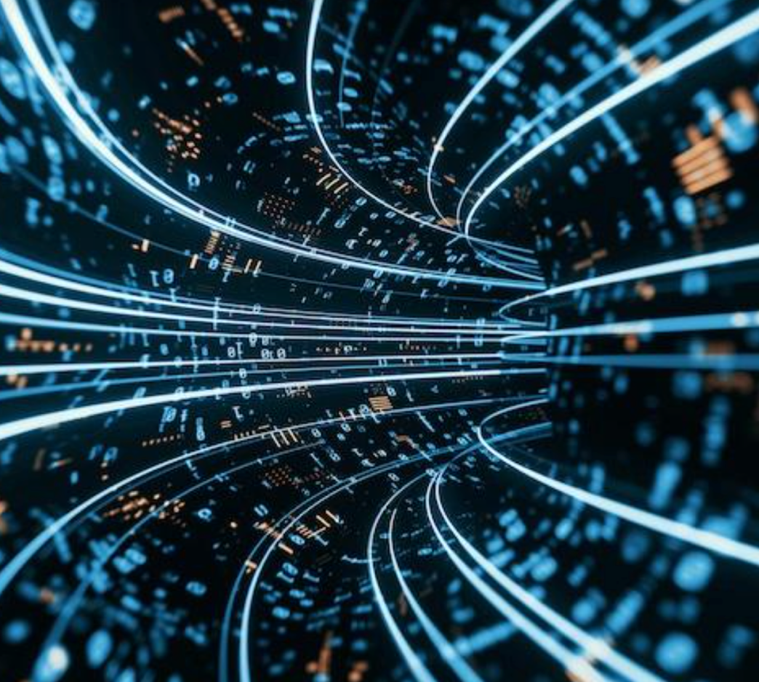
On solid ground
The German Centre for Astrophysics, a centre for research, technology, and digitisation.
  Christian Stegmann
  MU Day, 21.10.2022
A teaser for Marica Branchesi’s keynote “Gravitational Wave Astronomy”
starting at 9:15 here: https://desy.zoom.us/j/68514595879?pwd=ZUhYVWhvU09ZUnhkMHF1Y0FmWmZOQT09
Deutsches Zentrum für Astrophysik

Slide 2
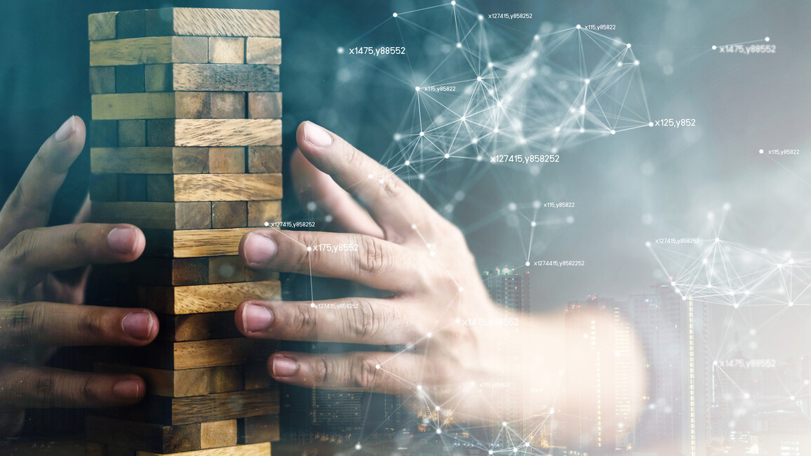
A competition historically unique in Germany
                Structural change
              Knowledge creates perspectives for the region!
      Two new large-scale research centres will be established in Lusatia in Saxony and in the Central German mining region. With "Knowledge creates perspectives for the region!", the BMBF and the Free State of Saxony are launching a competition for the establishment of the centres.
      https://www.bmbf.de/de/wissen-schafft-perspektiven-fuer-die-region-13122.html
              Annual budget after ramp-up phase 170 M€,
              Total volume of the application € 1.4 billion

Slide 3
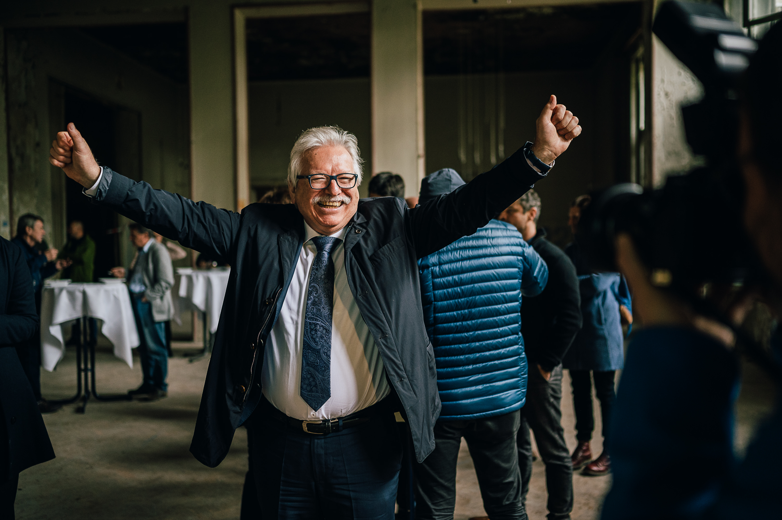
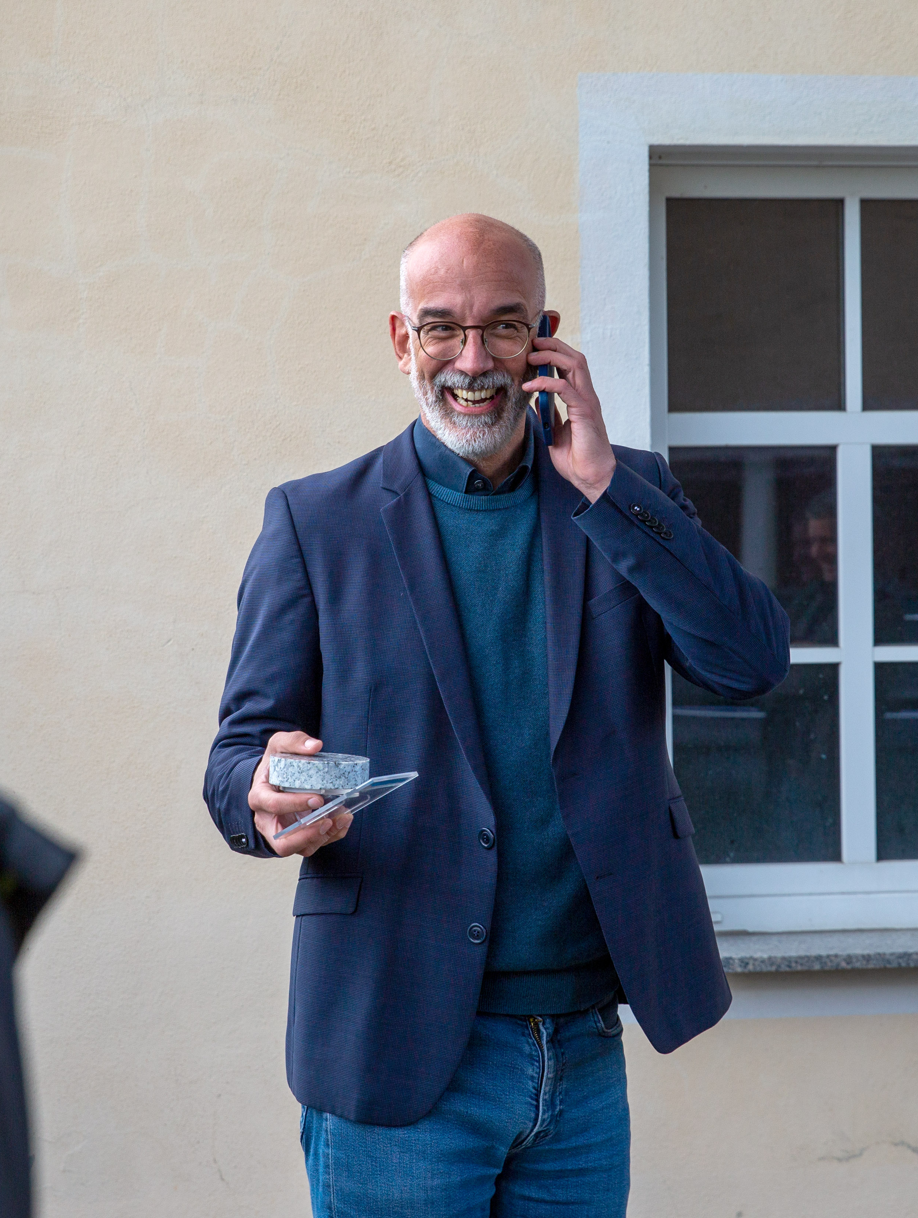
29. September 2022 12:45 Uhr (CEST)
Günther Hasinger, designated founding director of the DZA, in Görlitz
CS in Cunnewitz , Gemeinde Ralbitz-Rosenthal

Slide 4
Who we are
The DZA is a joint initiative of German astronomy and astroparticle physics with the idea of creating a national and also international hub of astrophysics. The idea was born out of the need for cooperation, and it is supported by many research institutions, universities and partners.

Slide 5
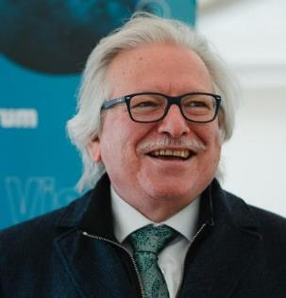
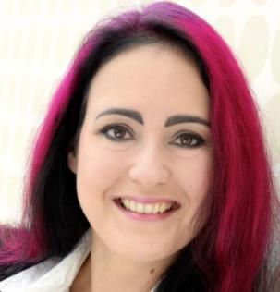
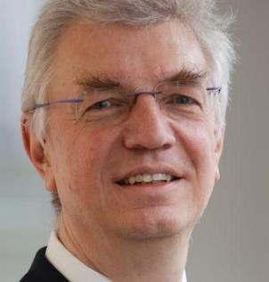




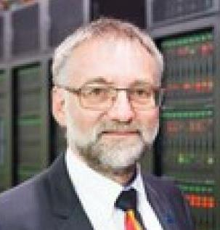
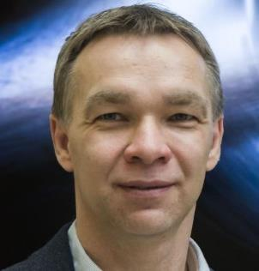
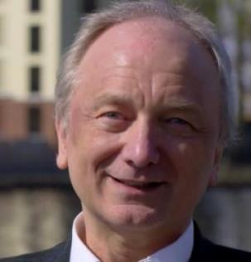



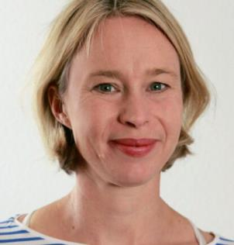
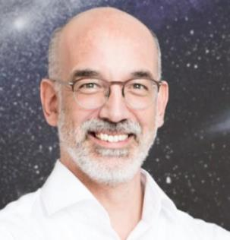
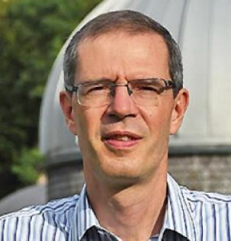














A large team and many partners
              Founding partner
Hasinger
Heurs
Steinmetz
              Part of the Supporter network
Nagel
Kramer
Hessling
Henjes-Kunst
Stegmann
Wagner

Slide 6
DZA concept : the challenges of astrophysics today
Astronomy
Square Kilometre Array Observatory (SKAO)
Einstein Telescope
(Low Seismic Lab)
Instruments
Developments for future astronomical experiments
Strong participation of
Saxon industry
Data Intensive Computing
Processing huge amounts
of astrophysics data from
all over the world
Innovative AI based and
Smart Green Computing
Interlocking of pillars ➔ unique synergies

Slide 7

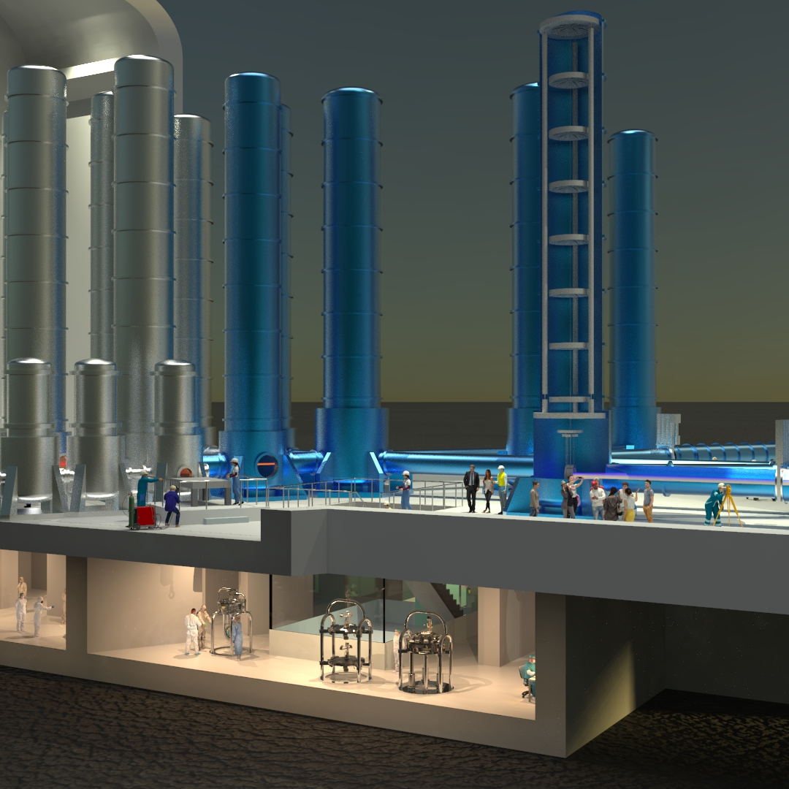
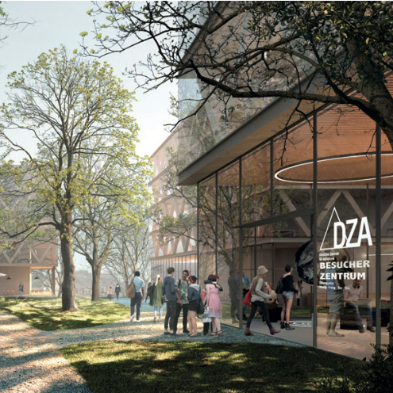
The German Centre for Astrophysics
Cottbus
2 locations for research, technology, digitalisation
Hoyerswerda
Leipzig
Kamenz
Bautzen
Görlitz
Dresden
Zittau
Chemitz
The Low Seismic Lab in the granite of Lusatia
The DZA campus on the Kahlbaum site in Görlitz

Slide 8
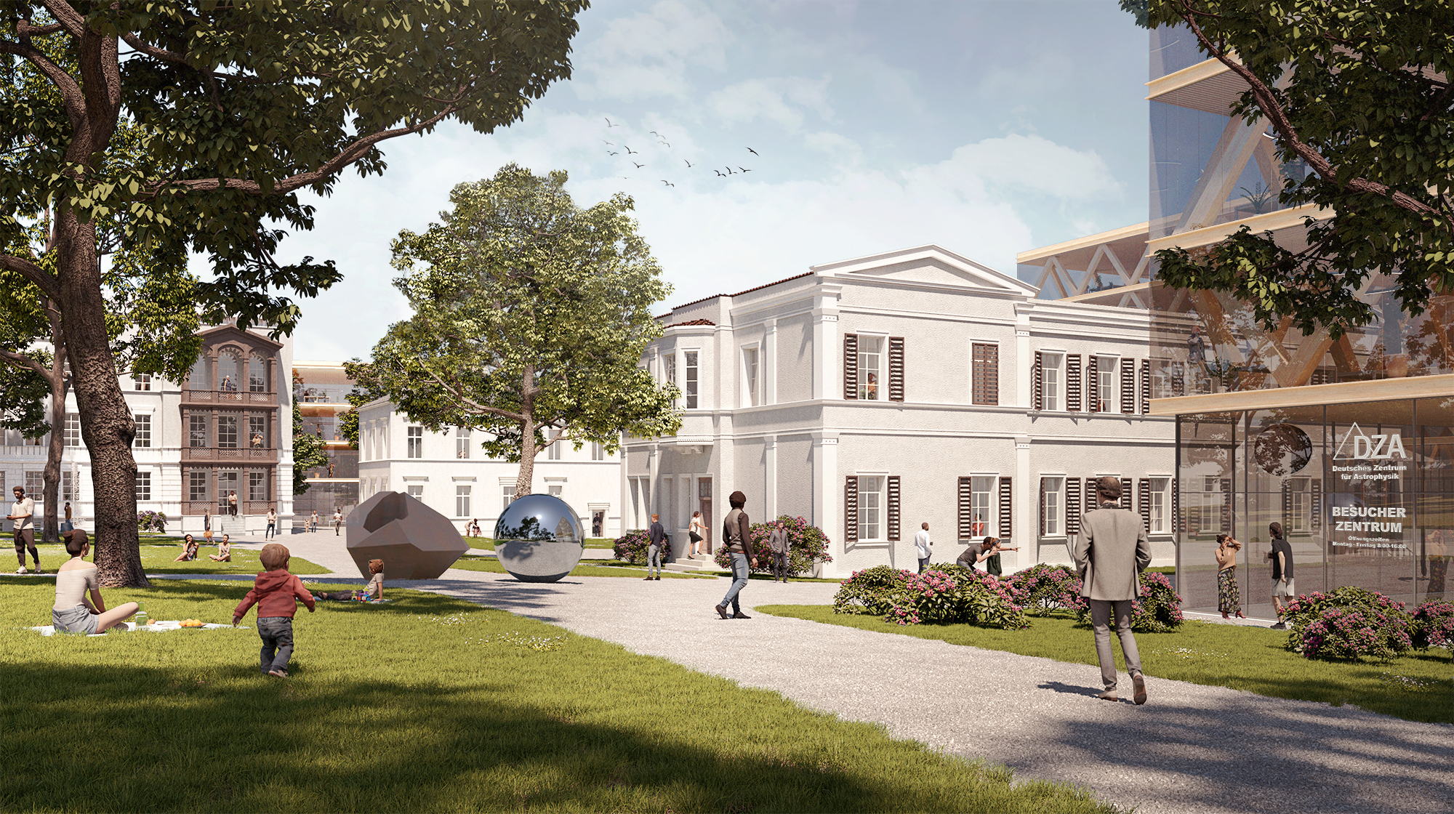

Slide 9
The Structure of the DZA
Institutes
Departments
Astro physics
Data science
Technology development
Transformation research
Administration
Centre for Innovation & Transfer
      Think tanks for key technologies
      Advanced materials (silicon and semiconductor optics, photodetectors), photonics, advanced manufacturing technologies, ...
      Digitisation (hardware, algorithms and software)

Slide 10
The Structure of the DZA
Institutes
Departments
Astro physics
Data science
Technology development
Transformation research
Administration
Centre for Innovation & Transfer
      The Centre for Innovation & Transfer - the innovation engine
      Technology screening
      Promotion of spin-offs and start-ups
      Open Science & Transfer Policy
      Funding, project, network, IP and knowledge management

Slide 11
Research in the treasure of Lusatia
"The Lusatians are proud of their granite treasure, and it is a fascinating approach to let this treasure grow into a large number of long-term stable jobs in the whole range from crafts to science."
Dawid Statnik, Chairman Domowina, Association of Lusatian Sorbs

Slide 12
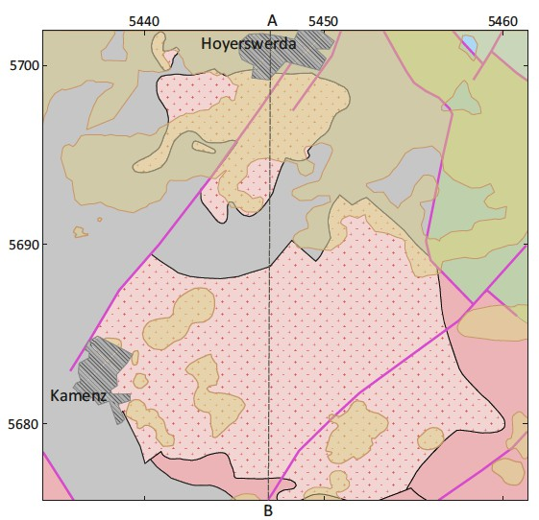
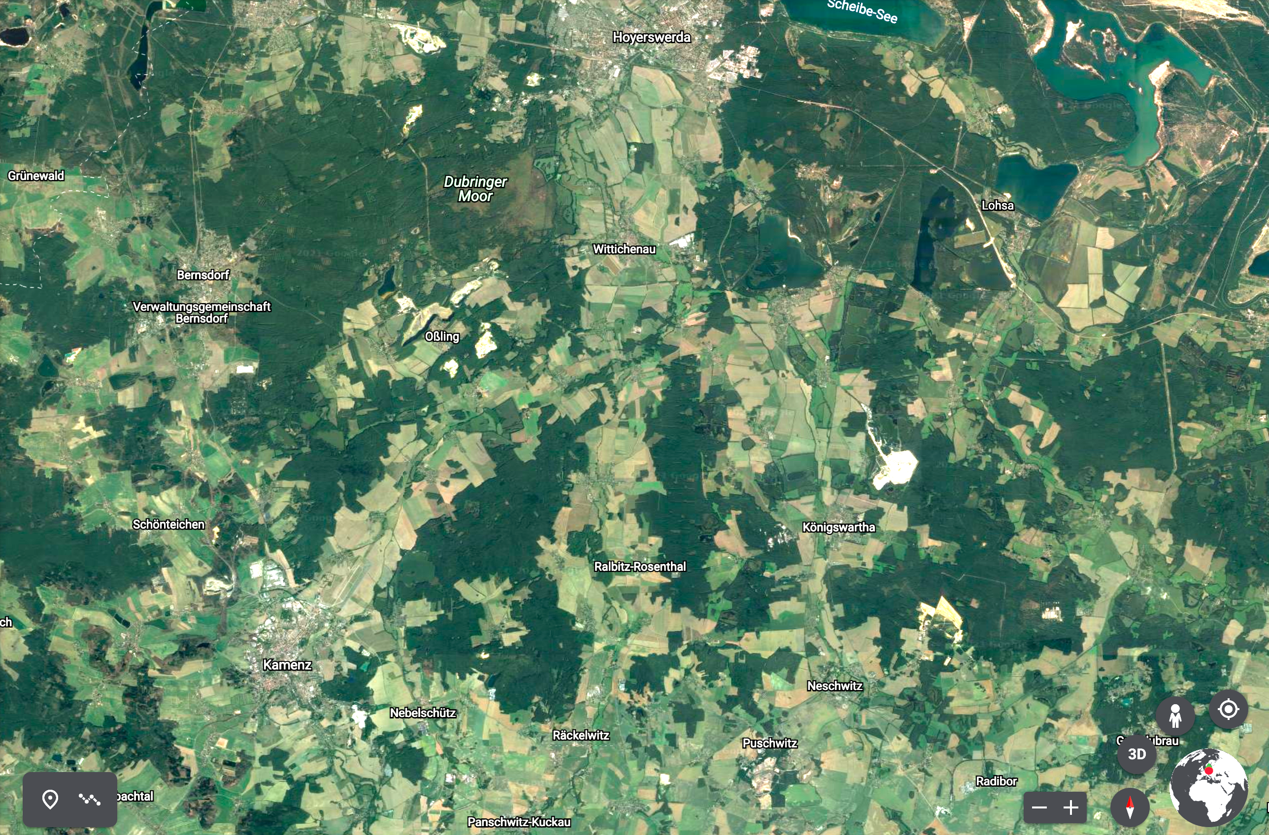
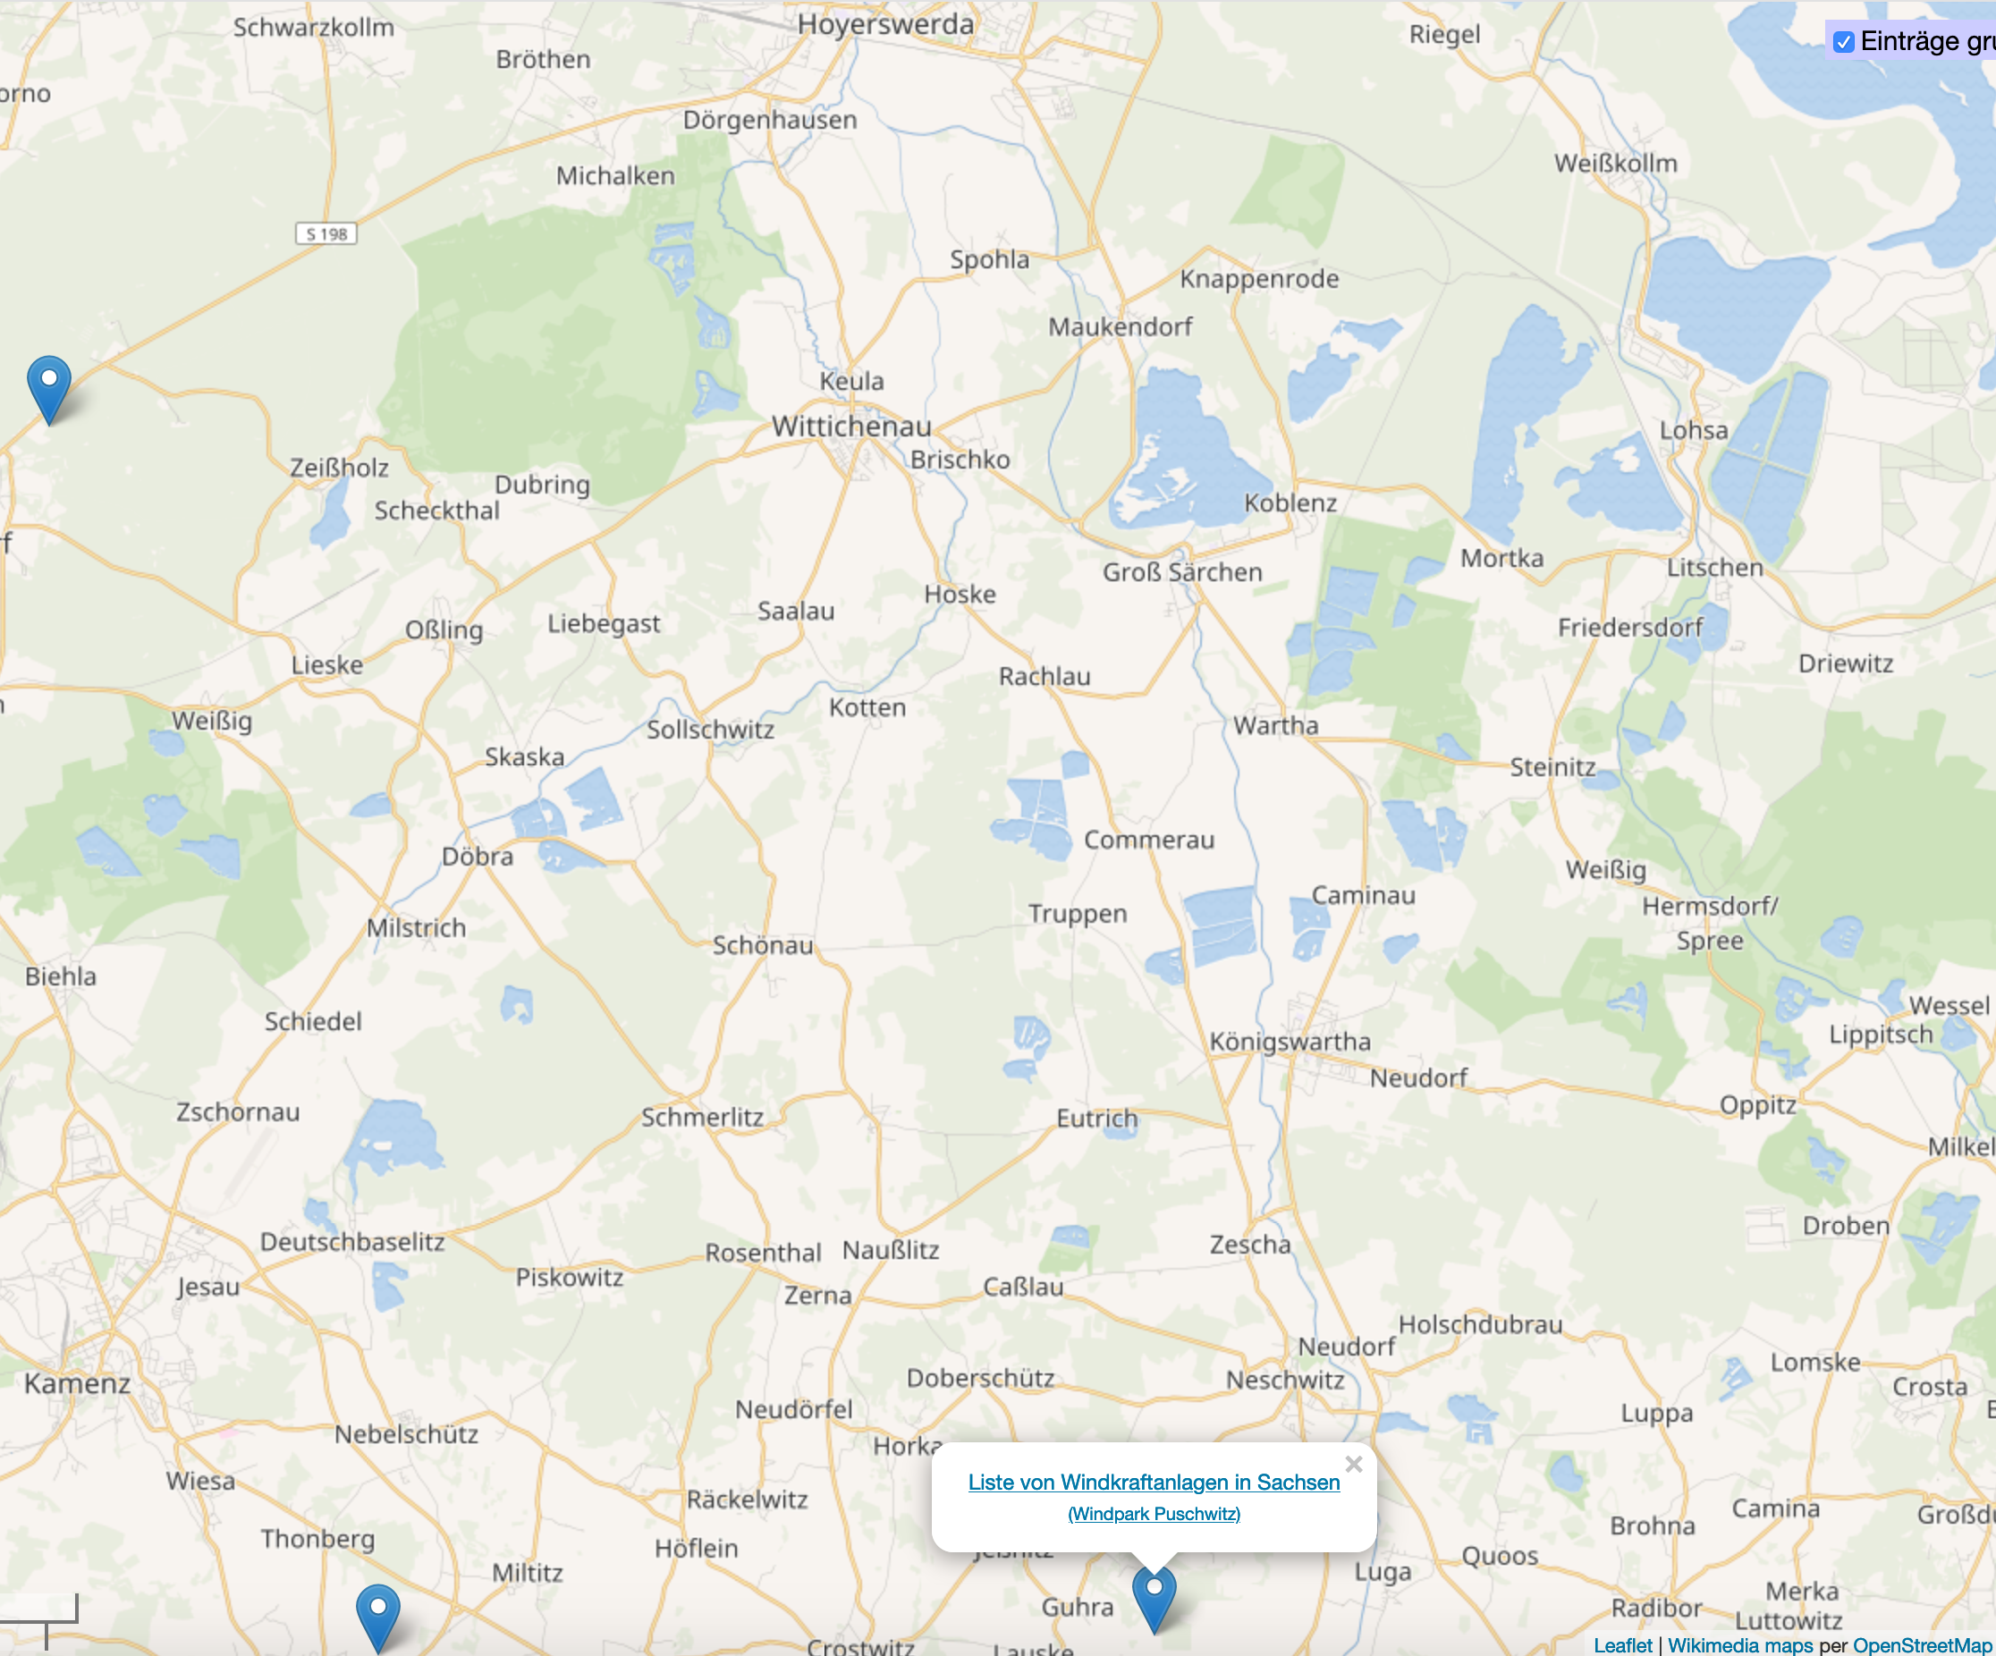

Slide 13
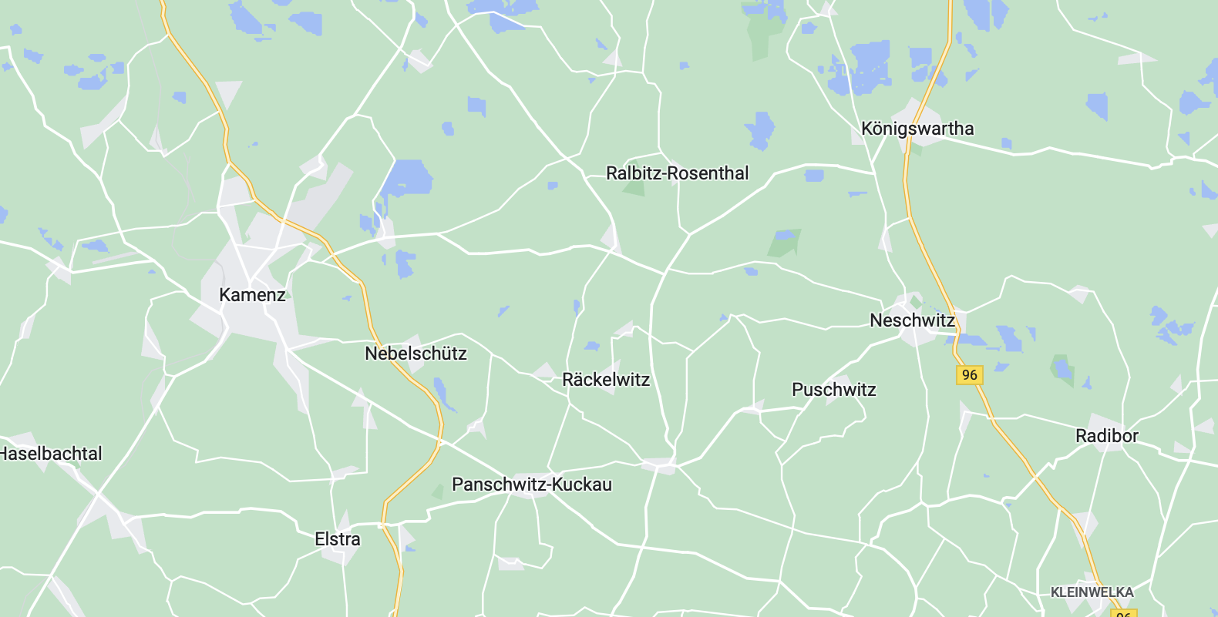
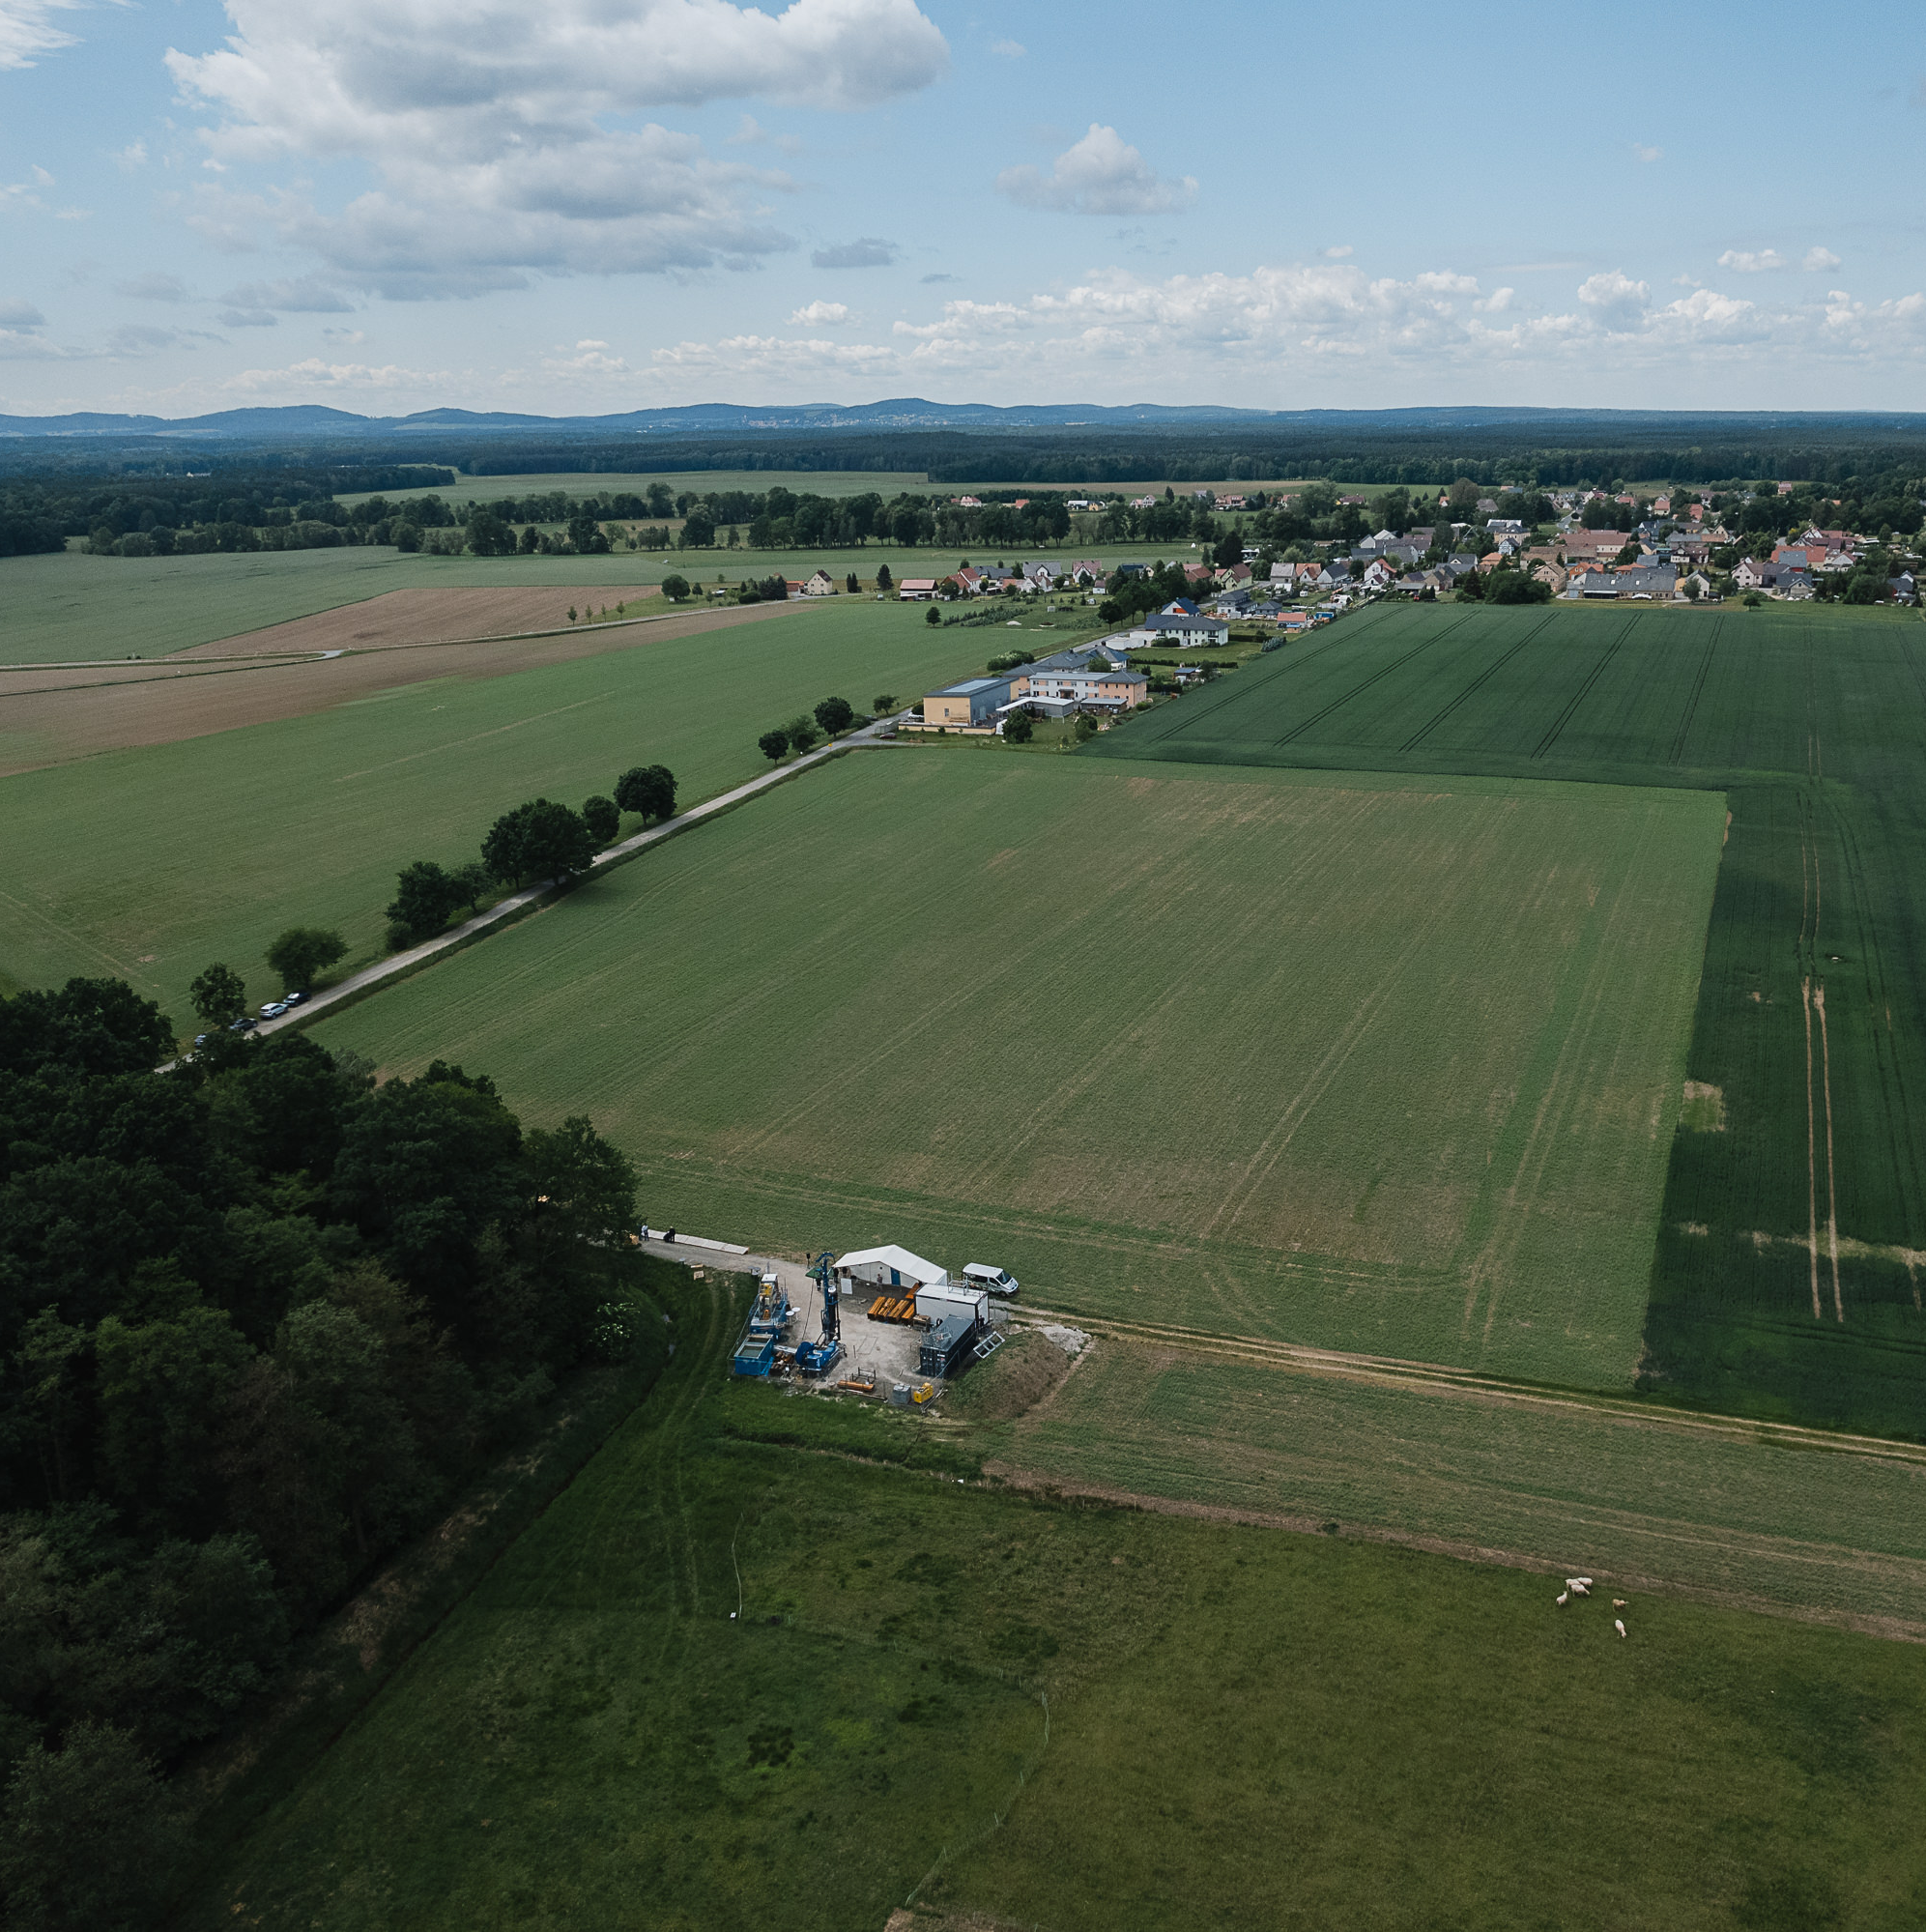
Measurements in the Treasure of Lusatia
Seismometer on
the surface
Test drilling in
Cunnewitz

Slide 14
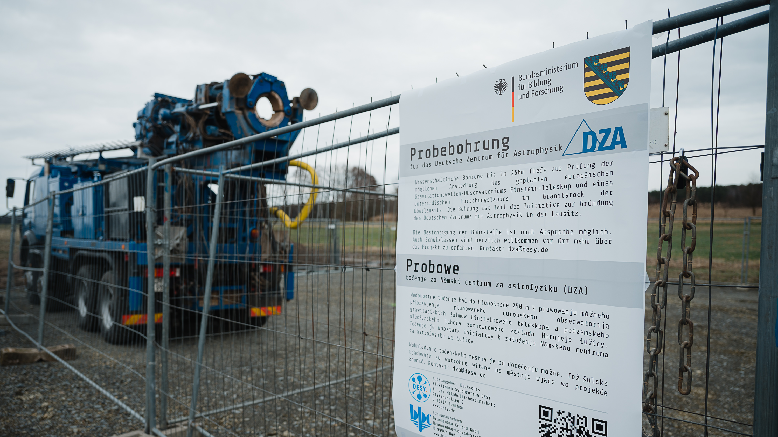

Slide 15
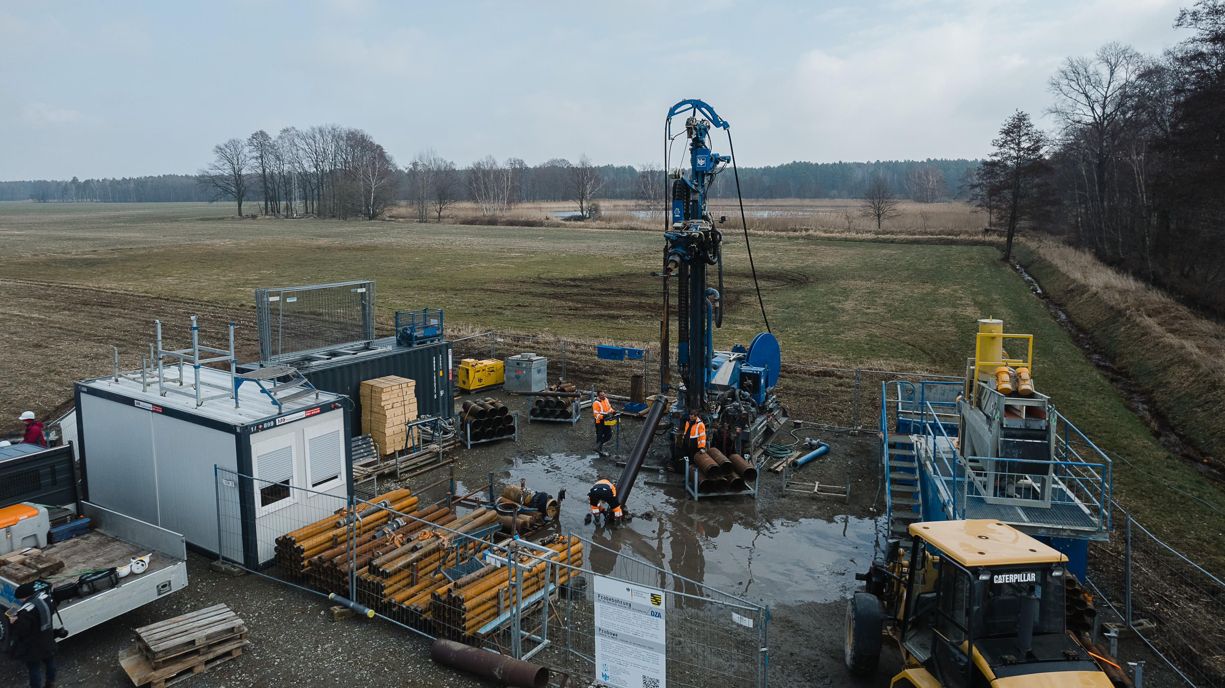

Slide 16
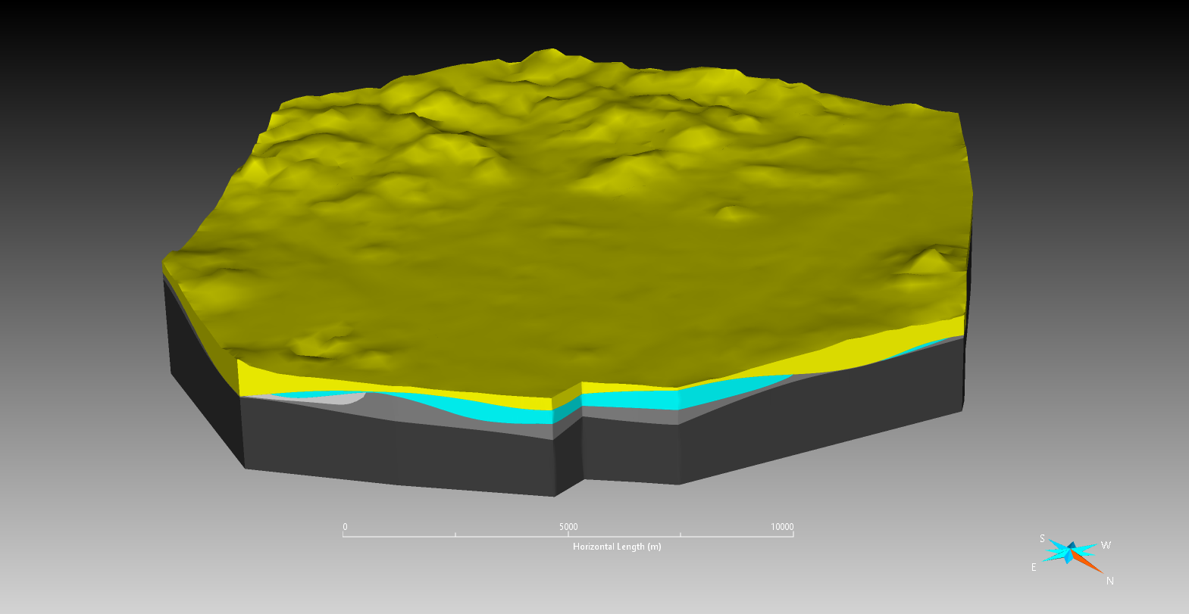
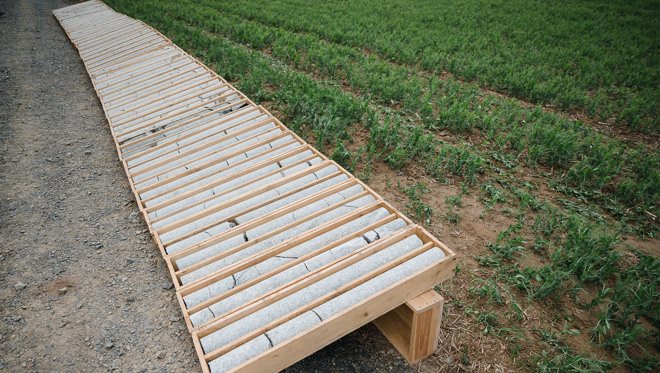

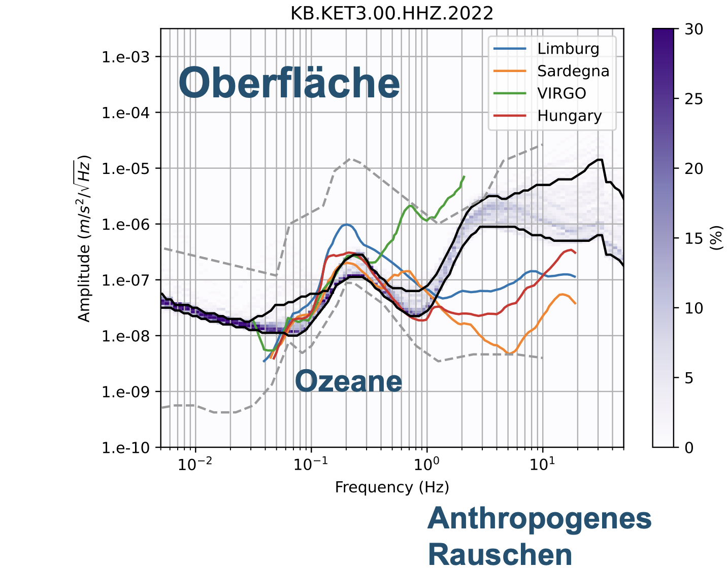
Down to over 250m depth
A unique monolithic and smooth granite block with an extension of at least 20 km with a homogeneous damping and seismic isolation layer!
DZA Master's thesis at the Freiberg Mining Academy
Coming soon
ET requirement
Drill cores
Surface measurement
In 180m depth

Slide 17
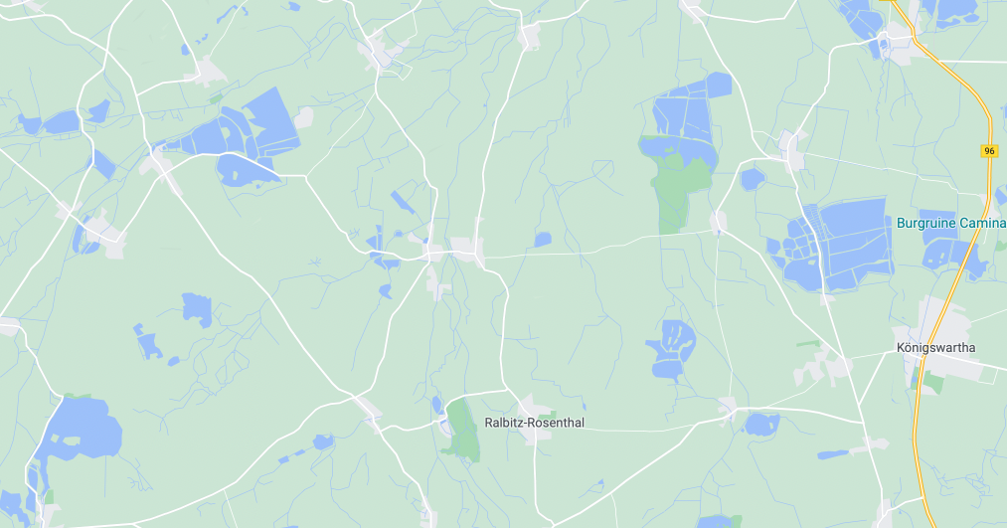
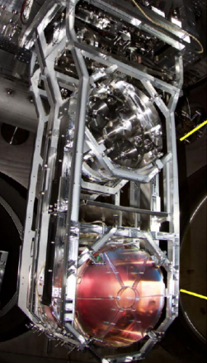
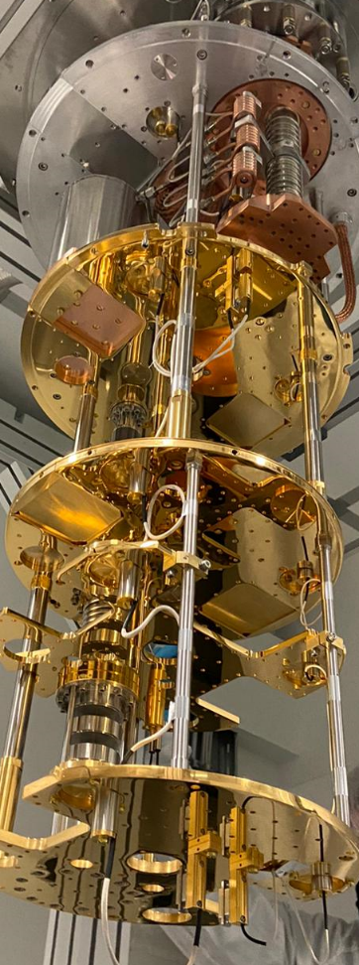

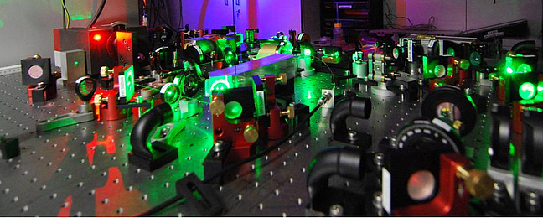
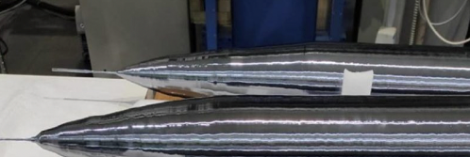
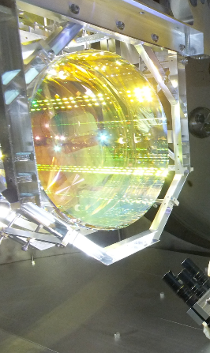
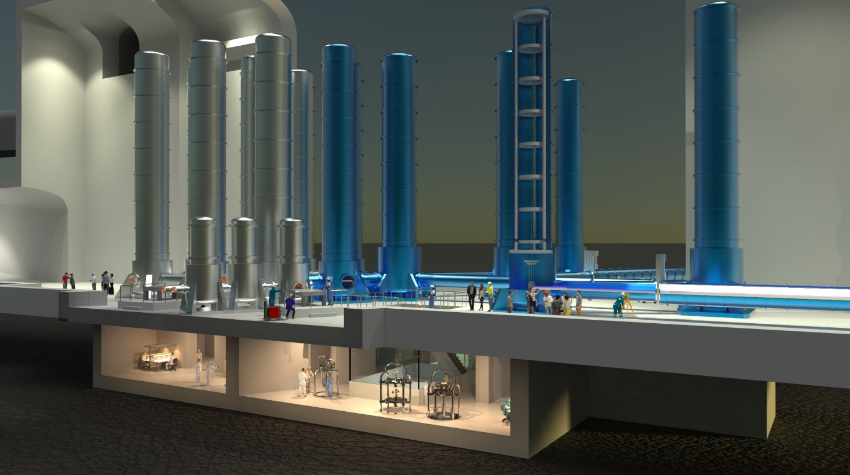
The Low Seismic Lab
Low-Seismic Lab in
einem seismischen Käfig
Innovation platform of approx. (40 x 30 x 30) m³ in 200m depth in the Lusatian granite
With a square kilometre 3D seismometer sensor array.
Metrological validation of advanced seismic isolation concepts on a large scale
              The place for future "deep tech":
  Technology development for gravitational wave astronomy
  Adaptive seismic noise reduction
  Subnanometer microscopy and photolithography
  Quantum computing experiments
  Astrophysics with accelerators
NIKHEF, NL

Slide 18
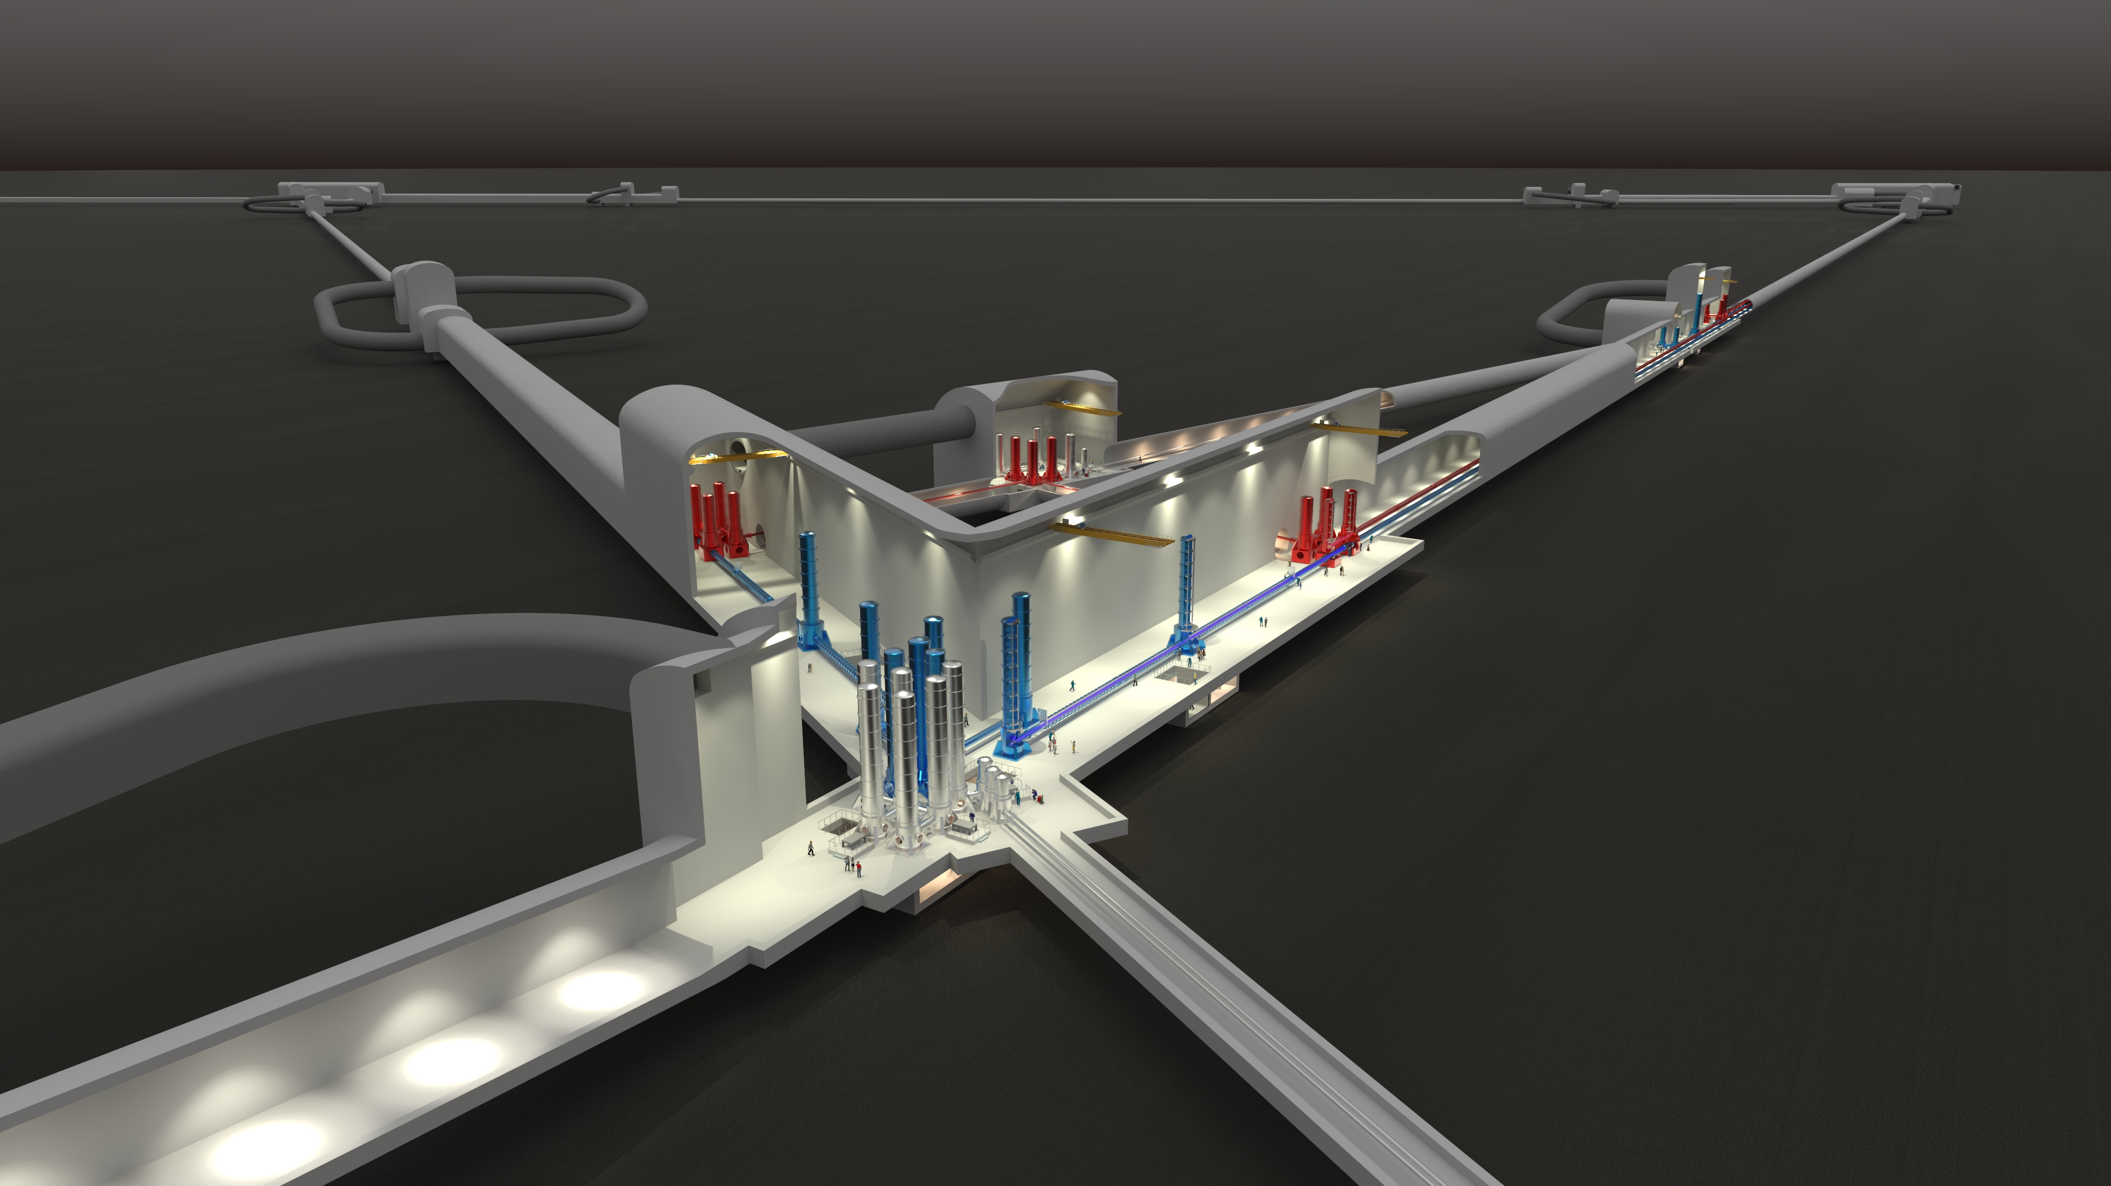
The role of the DZA in the Einstein Telescope
              Three possibilities:
  No ET
  The DZA will participate in other international projects with the Low Seismic Lab (e.g. Cosmic Explorer, Advanced LIGO etc.).
  ET in Sardinia or Holland
  With the Low Seismic Lab, the DZA will make essential contributions to the reduction of seismic noise, among other things.
  ET in Lusatia
  A potentially excellent scientific solution. Strengthening the lighthouse character for the region. Political support for financing is necessary.
Einstein Telescope, NIKHEF, NL
              A European project
  Construction costs:
    First phase € 1.2 billion
    Full scope € 1.7 billion
  Construction time: 8 years
  Lifetime: 50 years
  Location decision: 2025

Slide 19
Knowledge. Creates. Perspectives.
"It is a fascinating idea for our students to get an attractive perspective for the future with the Low Seismic Lab of the DZA in such close proximity to our school. We wish the DZA every success and look forward to many more visits and projects about astronomy and our role in the world."
Milenka Kober, Headmistress, Sorbian Secondary School Ralbitz

Slide 20
Jobs at the DZA
Kostenrechnungswesen
Softwareentwicklung
Rechnungswesen
Projektmitteladministration
Bildungsarbeit
Konstruktionsmechanik
Astronomie
Hardwareentwicklung
Astrophysik
Vermessung
Industrieelektronik
Elektroinstallation
  1000 positions at the DZA
  35%
  scientific positions
  65%
  of posts in the non-scientific area
  3 Job multiplication factor
Systemtechnik
Fremdsprachenassistenz
FacilityManagement
Schweißtechnik
Projektmittelverwaltung
Kommunikationstechnologie
Konstruktion
Versand
Fernmeldeelektronik
Technik
Controlling
Technisches
Logistik
Optik
Informatik
Zeichnen
Fachinformatik
Gesundheitsmanagement
Prozessoptimierung
Holzverarbeitung
Research
Fertigung
Metallbau
Industriemechanik
Elektromechanik
Computing
Administration
Buchhaltung
Steuerwesen
Elektronik
Sachbearbeitung
Feingeräteelektronik
Bauzeichnung
Assistenz
Mechanik
Personalplanung
Produktdesign
Metallverarbeitung
Einkauf
Ingenieure
Anlagenbuchhaltung
Bibliothekswesen
Vertragswesen
Mechatronik
Grafik
Informationstechnologie
Abrechnungswesen
Maschinenbau
Lagerlogistik
Strahlenschutz
Sekretariate
Gerätebau
Wissenschaft
Personalbetreuung
Produktion
Öffentlichkeitsarbeit
Vermessungstechnik
Lasertechnik
Ausbildungsbetreuung
Personalentwicklung

Slide 21
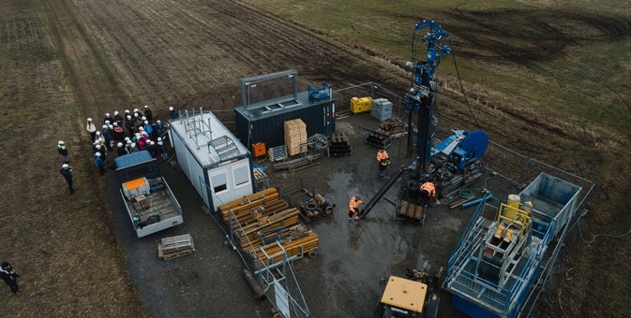
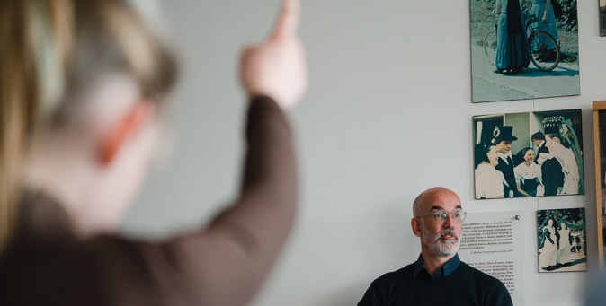
From kindergarten to professor:
All things education
  Fostering enthusiasm in young people about STEM topics at an early stage.
  Cooperation with day care centers, schools, vocational schools and universities.
  Student laboratories, competitions, lectures, internships, training days in our workshops and labs.
  Training opportunities for educators.
  Vocational training. Dual track education.
  Practical training for industry partners.
  Joint professorships. New master courses.
  Exchange programs for students and professors from
  all over Germany and worldwide at the DZA.
                We convey enthusiasm from an early age on and increase the attractiveness of the region!
Notes:
Das Silicon Valley in Kalifornien fängt mit seiner Nachwuchsarbeit in der Kita an. Nicht früh genug können wir junge Menschen für Wissenschaft und Technik begeistern.
Hier nicht alles durchgehen ...
Beispiel DESY Zeuthen Aus- und Weiterbildung für Physiklehrer für das Land Brandenburg.
Bild 1: 2 gute Gründe für die Lausitz: Das Granitgestein unter der Bohstelle und Schüler:innen und Schüler mit weißen Helmen.
Bild 2: Mit ersten Schulbesuchen haben wir bereits begonnen.

Slide 22
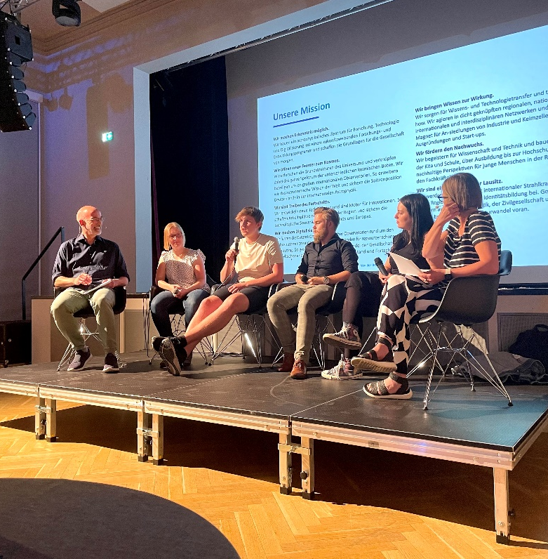
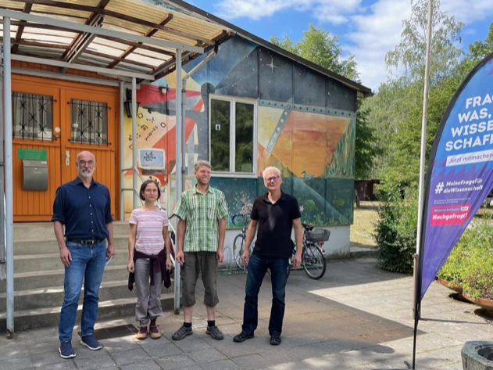
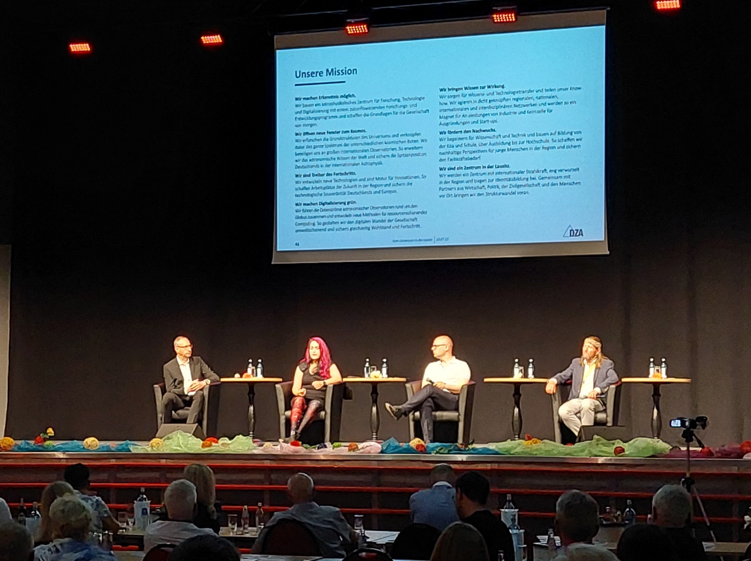
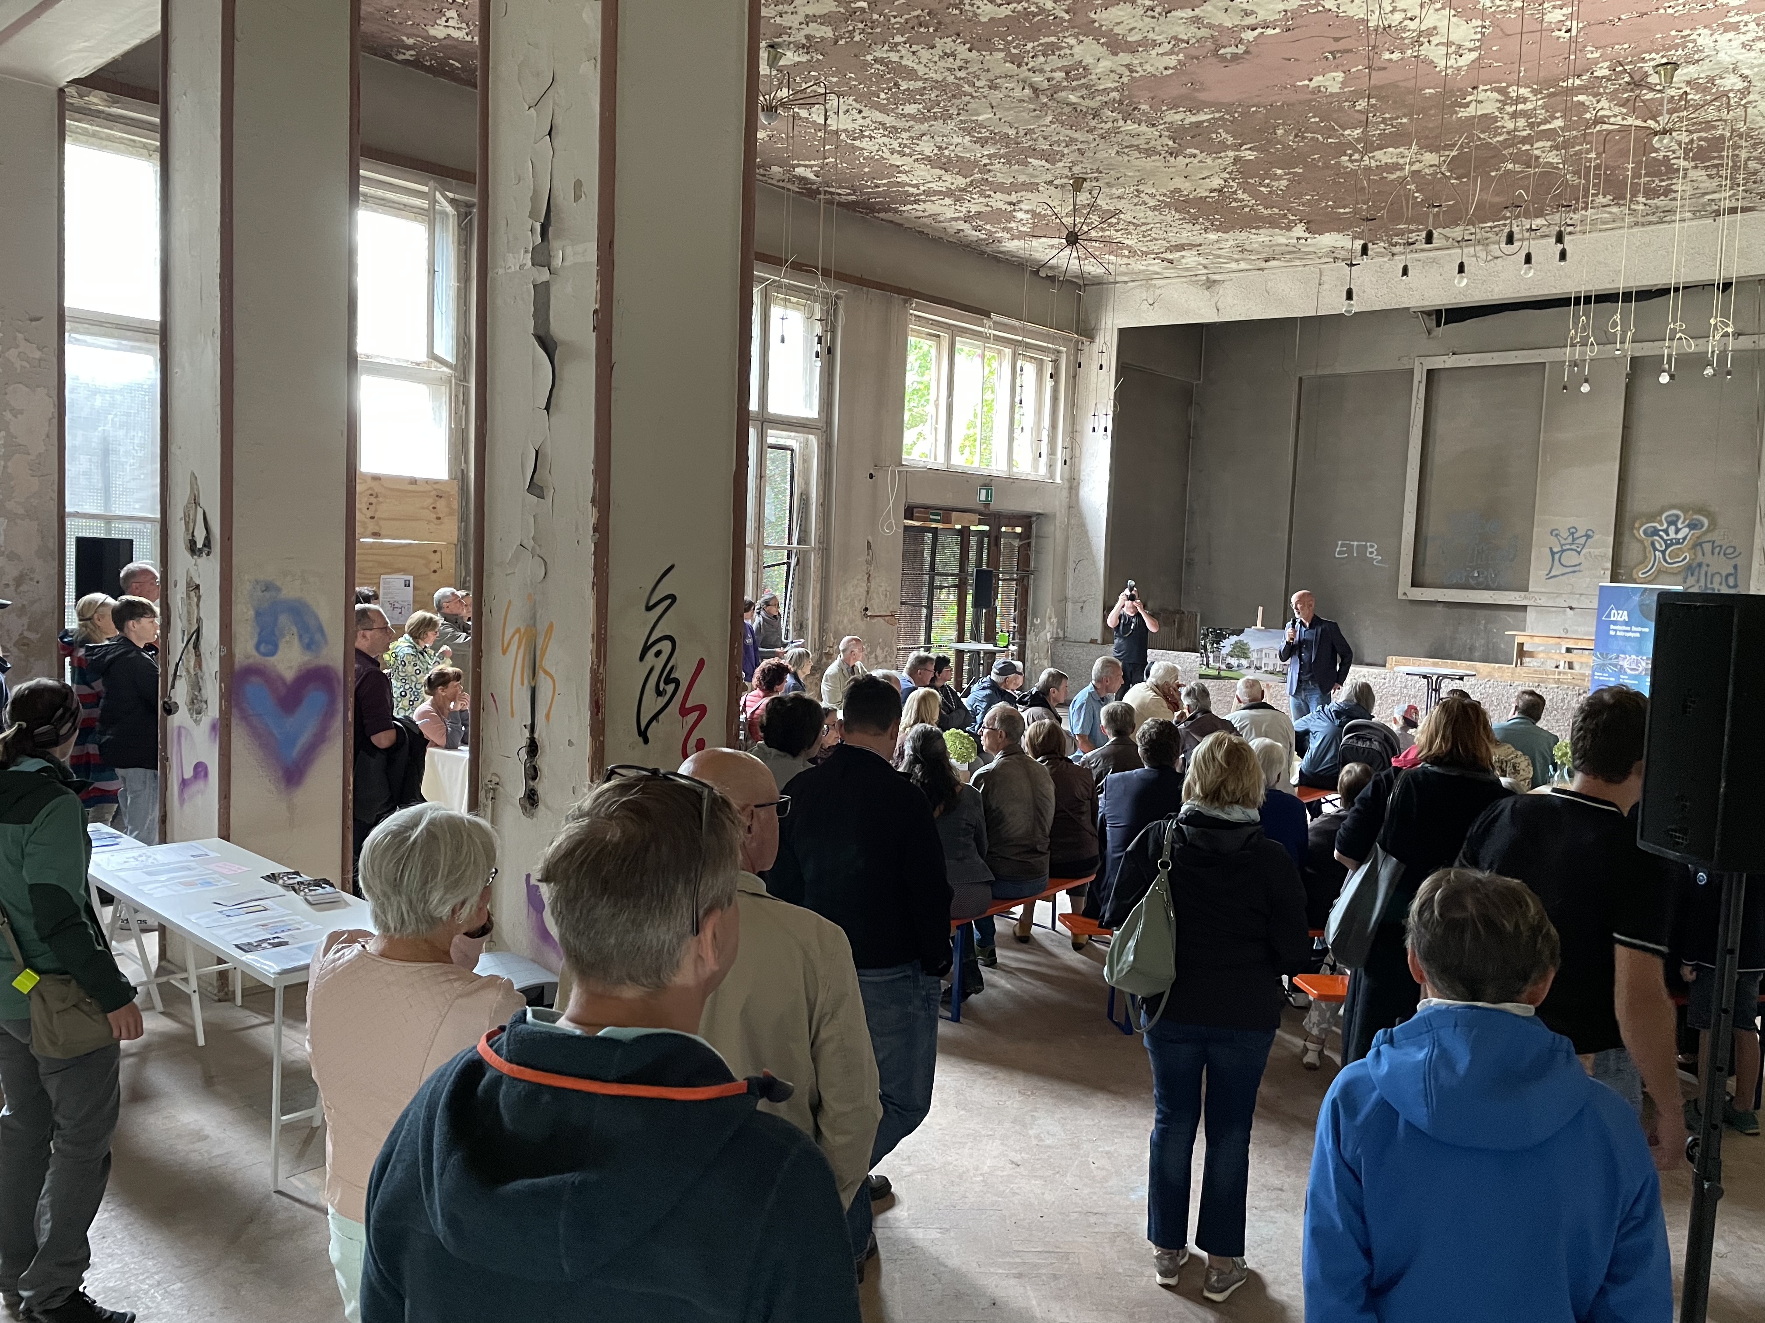
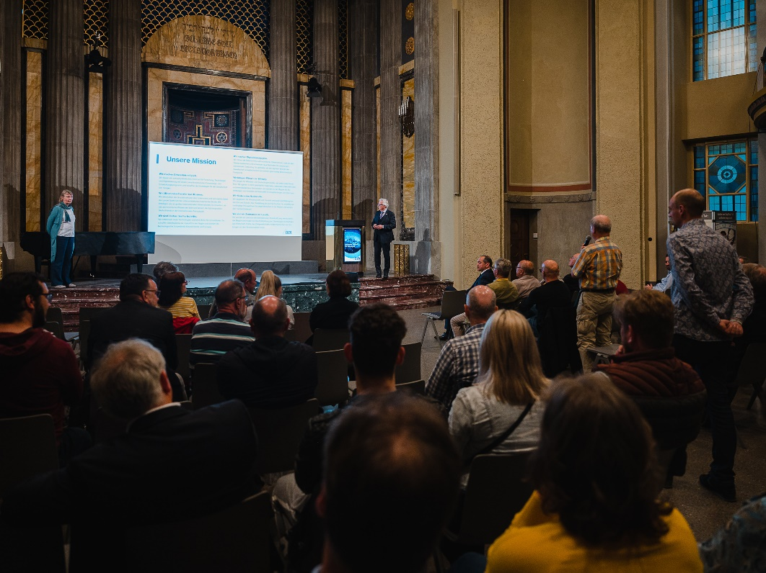
Shaping the future together
Station Weißwasser
Stadthalle Bautzen
KulturFabrik Hoyerswerda
Kahlbaum Areal Görlitz
Synagoge Görlitz

Slide 23
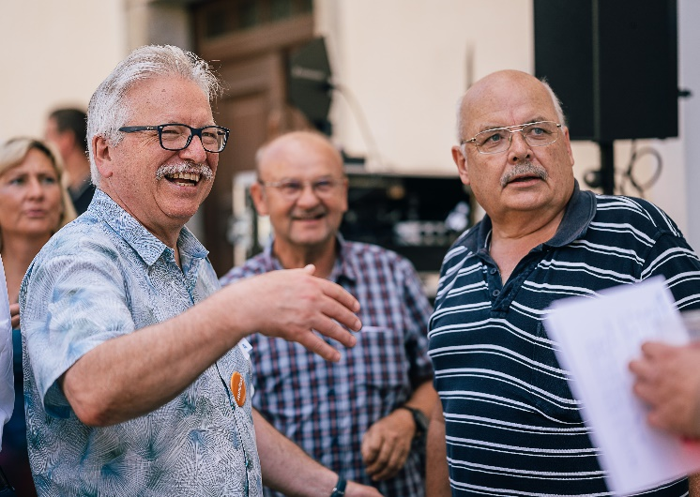
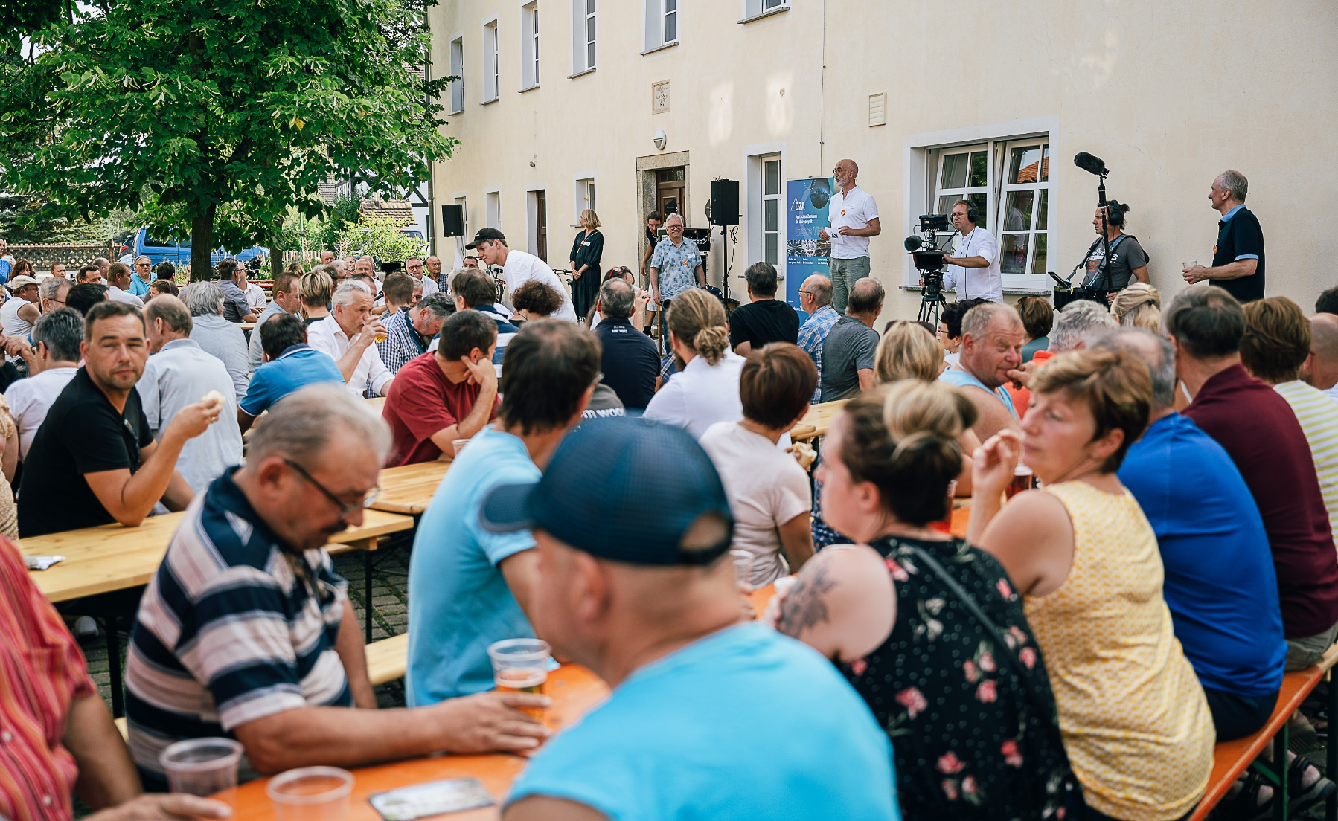
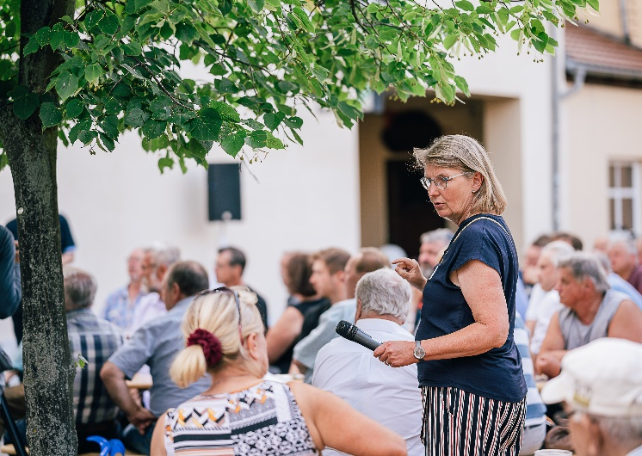
Shaping the future together
Cunnewitz, Gemeinde Ralbitz-Rosenthal

Slide 24
We are ready to go
"Your concept proposal impressively demonstrates that your proposal is a valuable addition to Germany's scientific landscape"
Prof. Otmar Wiestler, President of the Helmholtz Association

Slide 25
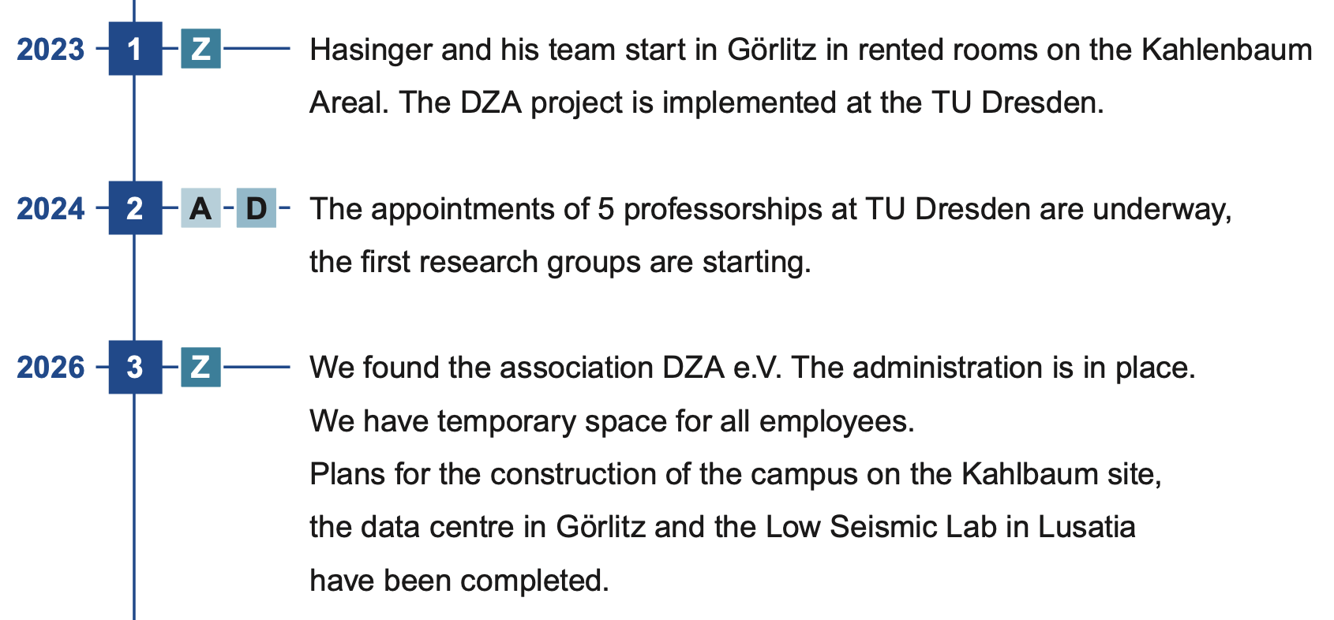
DZA Timeline
From DZA proposal:
For project phase (2023 – 2026):
              In Project phaSE (2023-2026):
„very little“ money flowing in first three years
RIGHT NOW: Further test drills and geological / seismic investigations to determine suitability of granite for LSL & ET
If good, then enter the bid for ET site
If not (but good enough for LSL): Low Seismic Lab for diverse (GW and also EM astronomy related) research
first hires (5 profs, 60 staff and support) + make all plans for:
              In "full funding“ phase (2026 ongoing):
Buildings and underground lab construction, full ramp-up of personnel and research & science
              In any case:
  DZA will conduct technology development for gravitational wave astronomy and in particular for ET

Slide 26
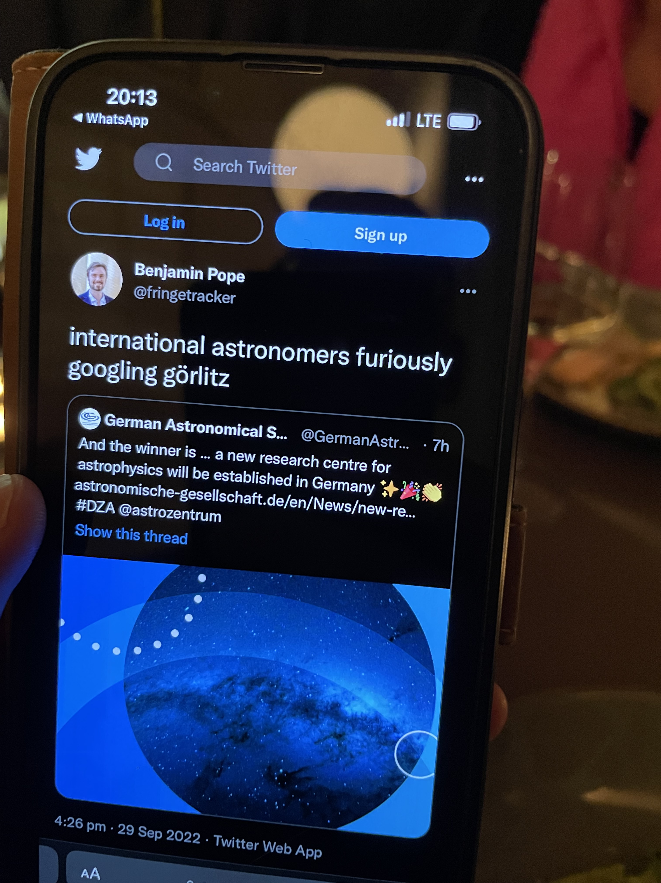
We are ready to start: 2023 start of the given three-year build-up phase. Foundation of the DZA in 2026
National beacon with international visibility.
Unique combination of research and development in digitalisation, sensor technology and materials research.
Jobs with a future in many areas.
Magnet for business and institutions, support for start-ups and spin-offs, transfer of knowledge.
Education from kindergarten to training and university.
Prospects for young people in the region, securing the need for skilled workers.
We attract people and prevent migration.
"This competition opened up new perspectives, for the regions in Saxony and for our society - an important sign for the future in a difficult time." Günther Hasinger

Slide 27
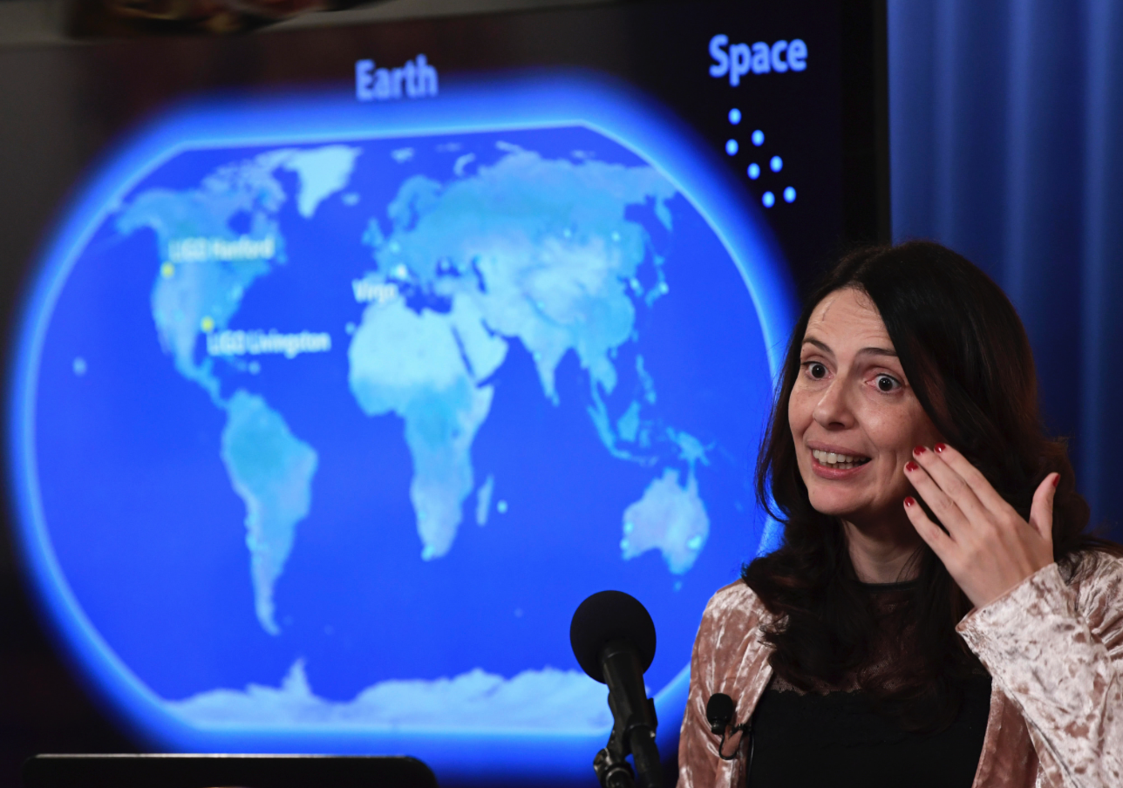
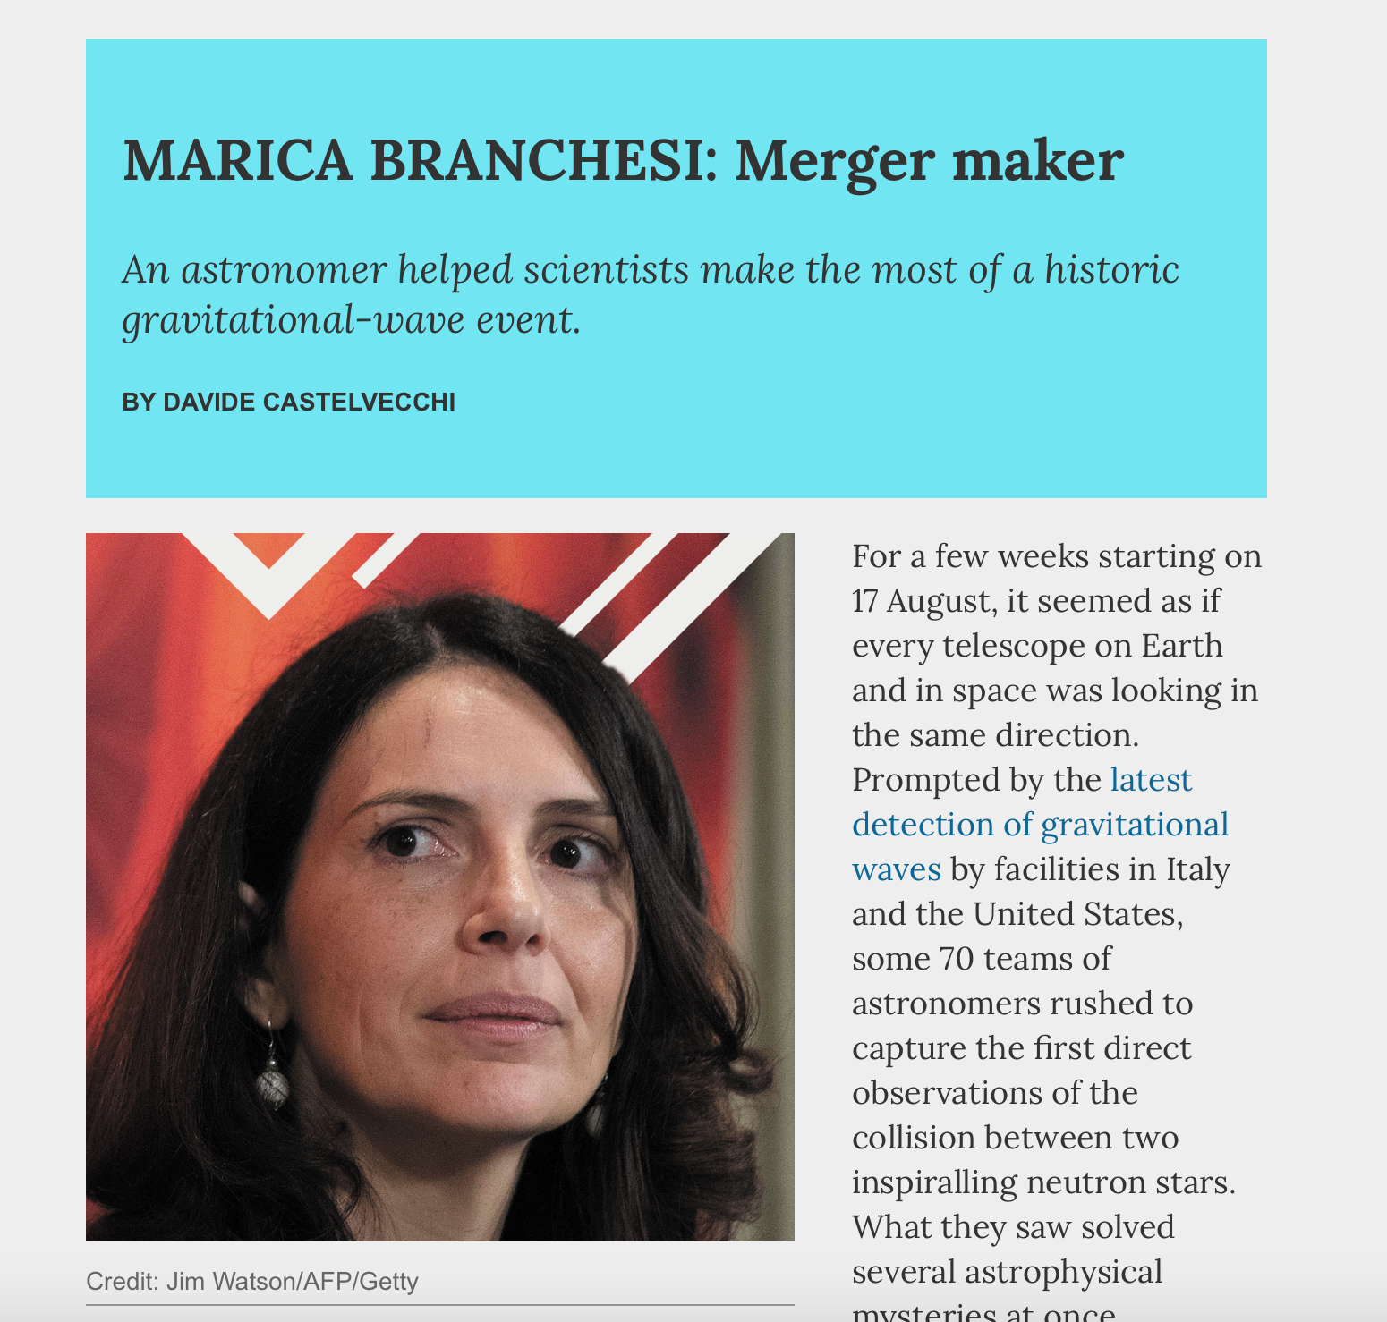
Marica Branchesi “Gravitational Wave Astronomy”
16. October 2017, announcement of the neutron star merger GW170817
Nature’s 10 people who mattered this year
TIME 100 most influential people
Please switch to https://desy.zoom.us/j/68514595879?pwd=ZUhYVWhvU09ZUnhkMHF1Y0FmWmZOQT09

