Slide 1
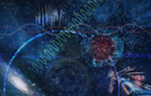
A “charming” view on matter formation in ALICE
Annalena Kalteyer, GSI Darmstadt, Universität Heidelberg
Matter and universe days 2022

Slide 2
From Nature to Experiment
Nature
Big Bang
Quark Gluon Plasma
Proton and neutron formation
Formation of low-mass nuclei
Formation of neutral atoms
Star formation
Dispersion of massive elements
Today
Experiment
Study quantum chromodynamics
Pb-Pb
Investigate fundamental properties of strongly interacting hot matter
Understand the process of hadronization

Slide 3
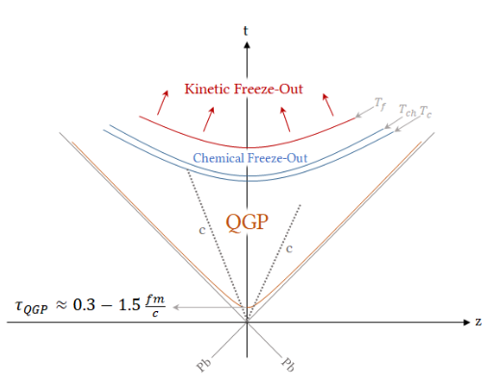
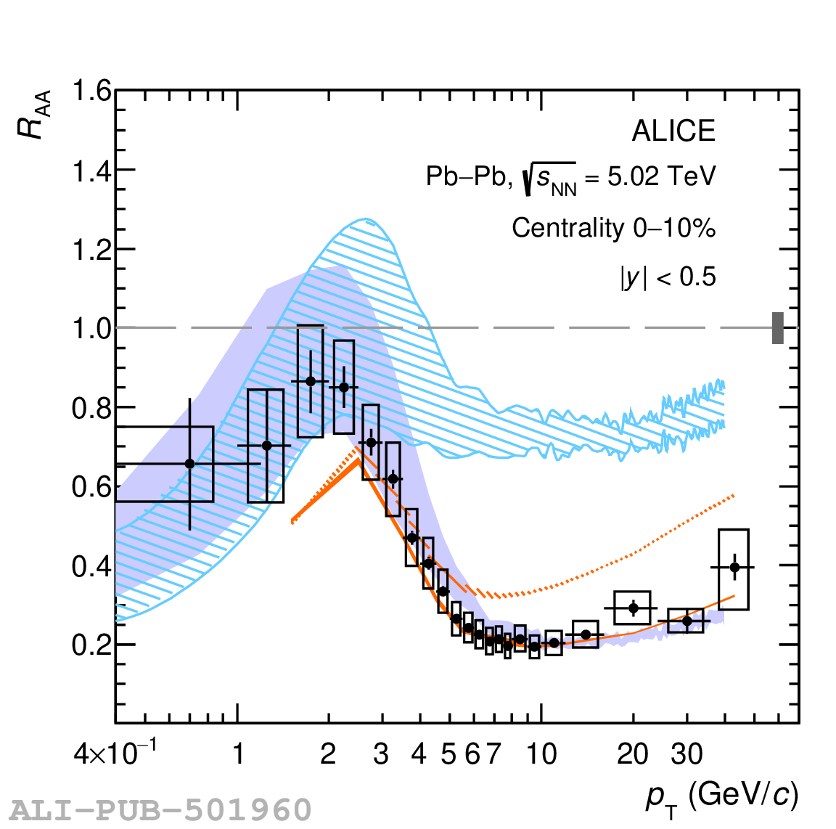
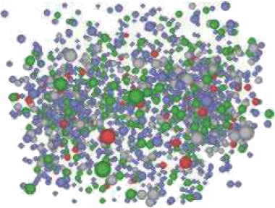
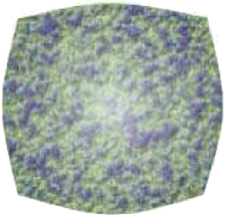
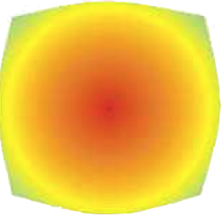
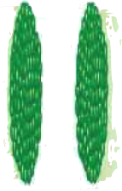
Study QGP with charm hadrons
time
JHEP 01 (2022) 174
$$R_{AA}= \frac{1}{\left\langle T_{AA}\right\rangle }$$
$$D^{0}\left(ūc\right), D^{+}\left(\overline{d}c\right), D_{s}^{+}\left(\overline{s}c\right),D^{∗+}\left(\overline{d}c\right)$$
space
Heavy flavour hadrons
Charm quarks are produced at early times in hard partonic scatterings before the creation of the QGP
Experience the full evolution of the QGP
Large mass of charm allows pQCD calculation of the interaction cross section
From pp to Pb-Pb
$R_{AA}< 1$: modification in Pb-Pb with respect to pp collisions
Interactions between parton and medium
Collisional- and radiative energy loss

Slide 4
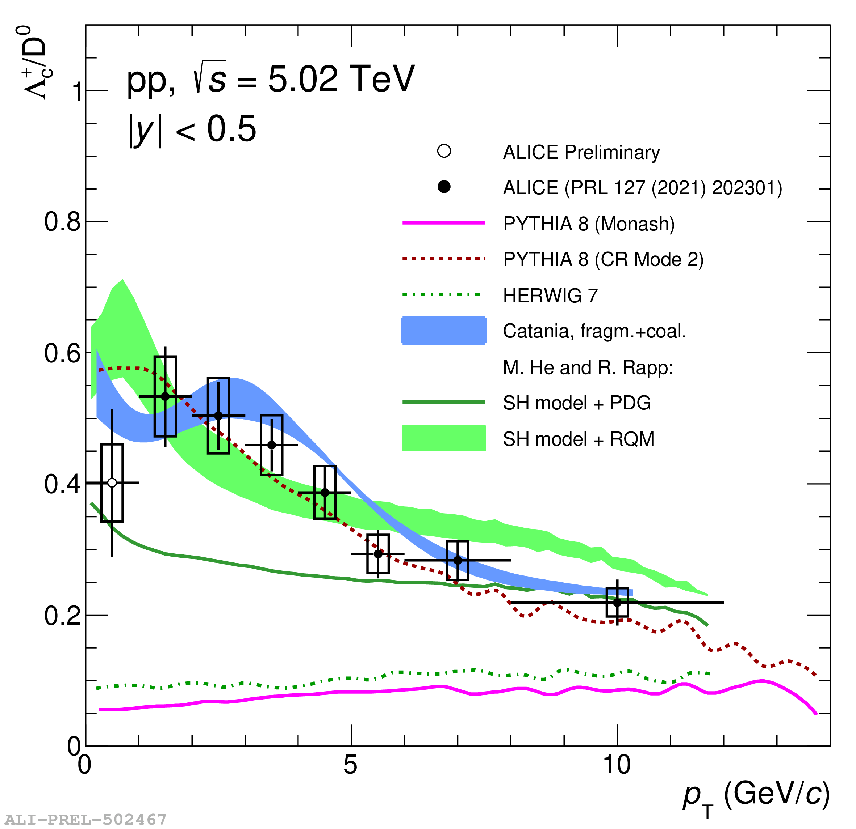
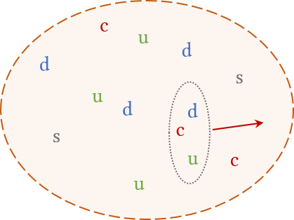
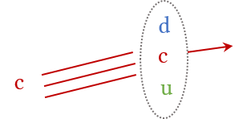
Study hadronization
$$\frac{dσ^{hh→H_{qx}}}{dp_{T}}=fi\left(x1,μ_{f}^{2}\right)fj\left(x2,μ_{f}^{2}\right) ⊗ \frac{dσ^{q}}{dp_{T}}⊗D_{q→H_{q}}(z_{q}=\frac{p_{H_{q}}}{p_{q}},μ_{f}^{2})$$
Parton distribution functions (PDFs)
Hard scattering cross section (pQCD)
Fragmentation function (hadronization)
1
2
Baryon to meson ratios
Yield ratios of hadrons are sensitive to heavy quark hadronization
Investigate various species and compare to model predictions
3
e⁺e⁻
2
Fragmentation + Coalescence
1
Fragmentation
3
Statistical hadronization
Phys. Rev. Lett. 127, 202301

Slide 5
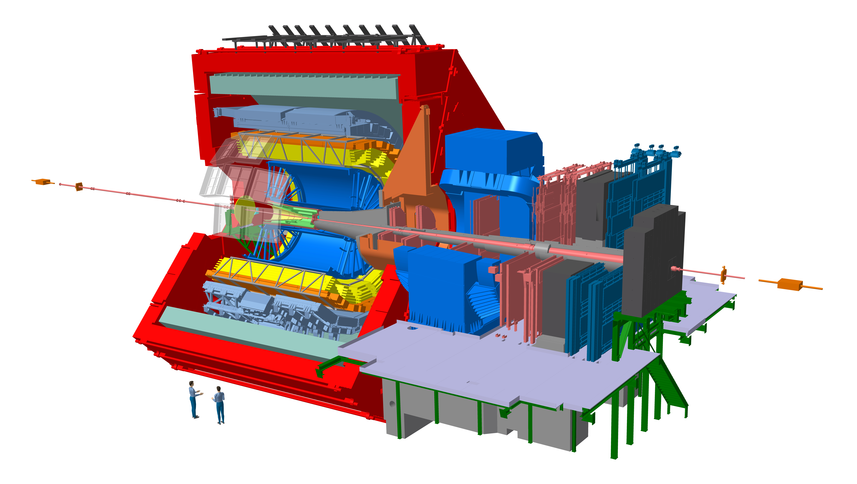
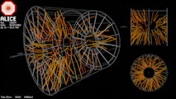
The ALICE detector
LHC Run 3
Higher data taking rate leads to higher statistical precision in the results
Upgraded detectors:
Largest TPC in the world will be run in continuous data taking mode thanks to GEM chambers
Improved vertexing resolution with ITS
Goals:
Direct reconstruction of beauty hadron decays
High precision measurements lead to better constraints to theoretical models of the strongly interacting medium and hadronization
Maurice Donner

