Slide 1
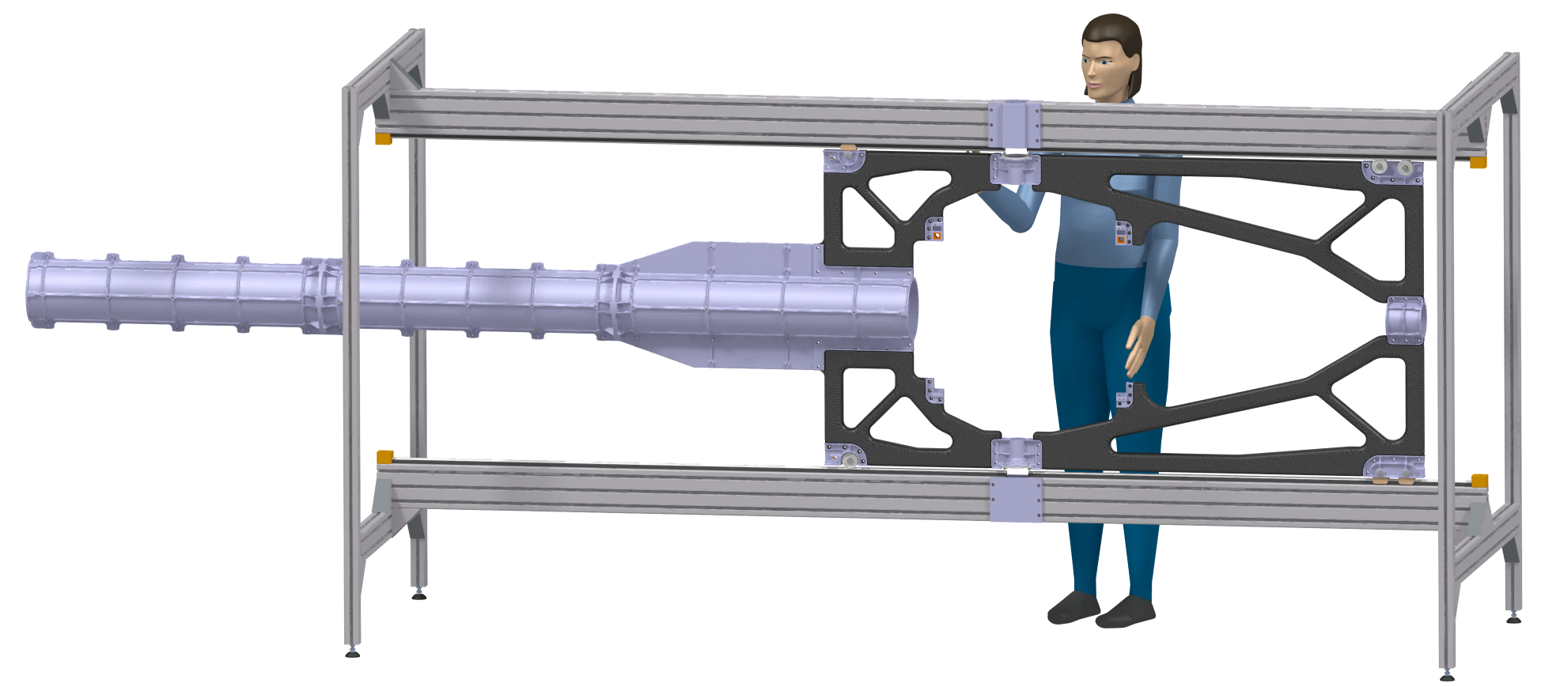
Prototype Central Space Frame (CSF)

Slide 2
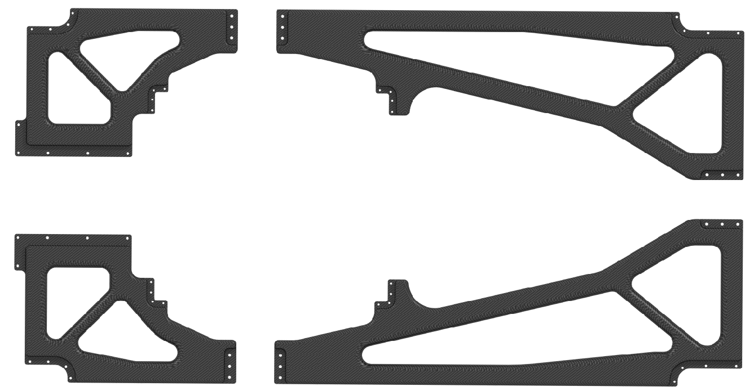
              Prototype Central Space Frame (CSF)
The mainframe is made out of four carbon composite parts, two of which are identical.

Slide 3
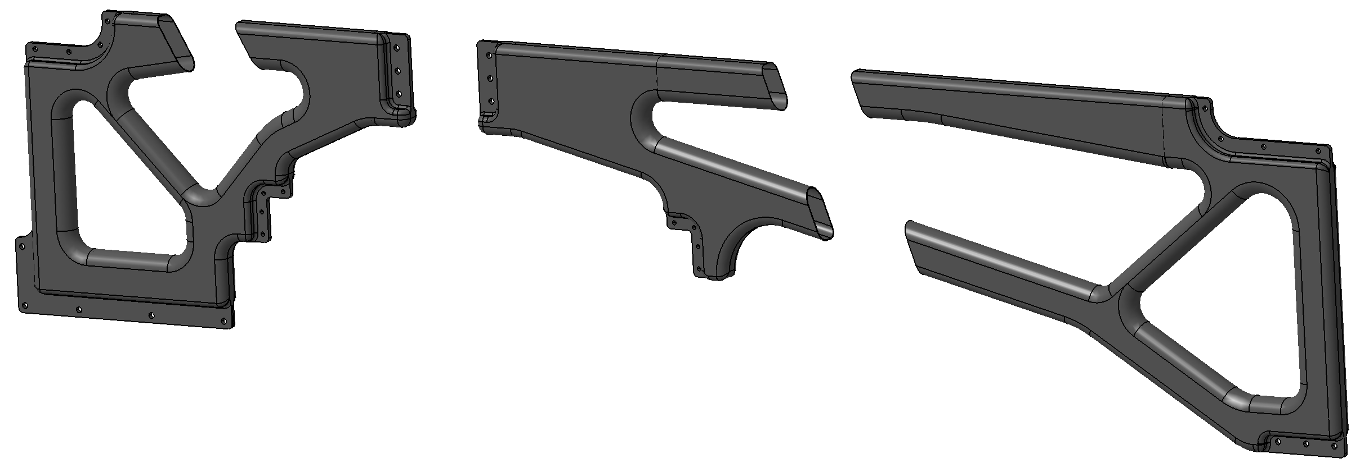
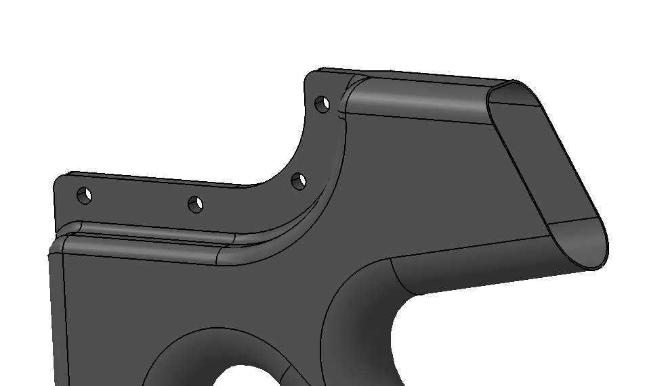
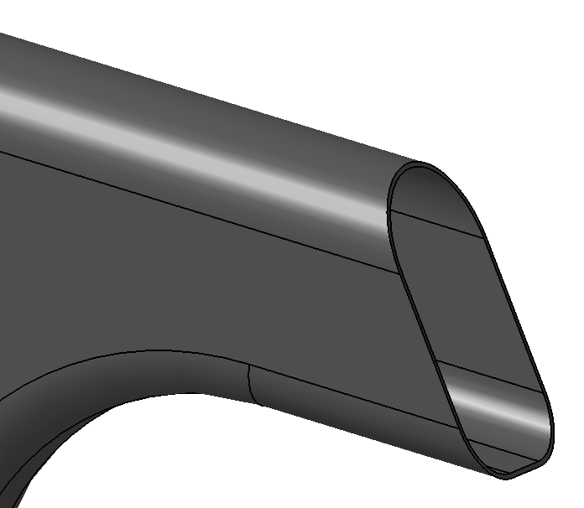
              Prototype Central Space Frame (CSF)
The frames itself are made as tube or hollow profile.
Each of the parts consists of two half-shells, which after lamination are joined together via epoxy-based adhesive .

Slide 4
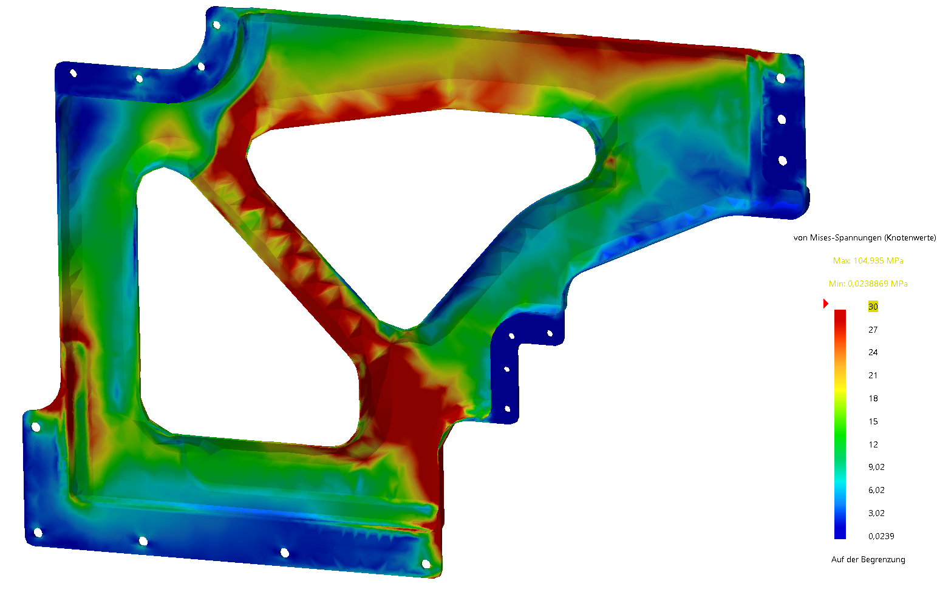
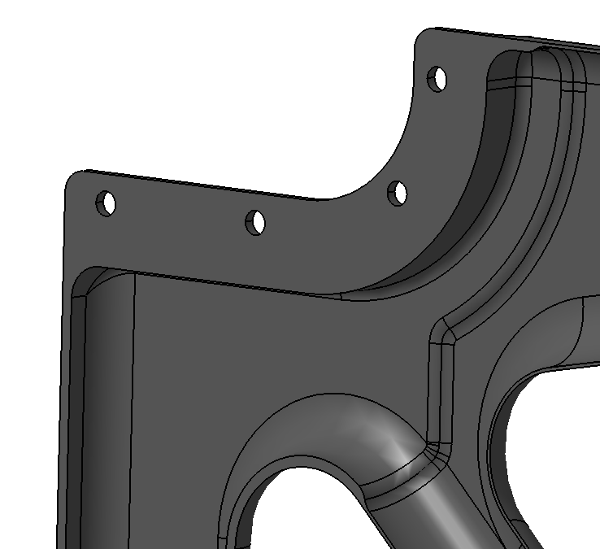
              Prototype Central Space Frame (CSF)
Regarding our FEM calculation, we had foreseen local reinforcements in places of high stress. As a result, the general wall thicknesses and the weight could be kept low. The weight of all 4 carbon parts is about 2 kg.
local reinforcements

Slide 5
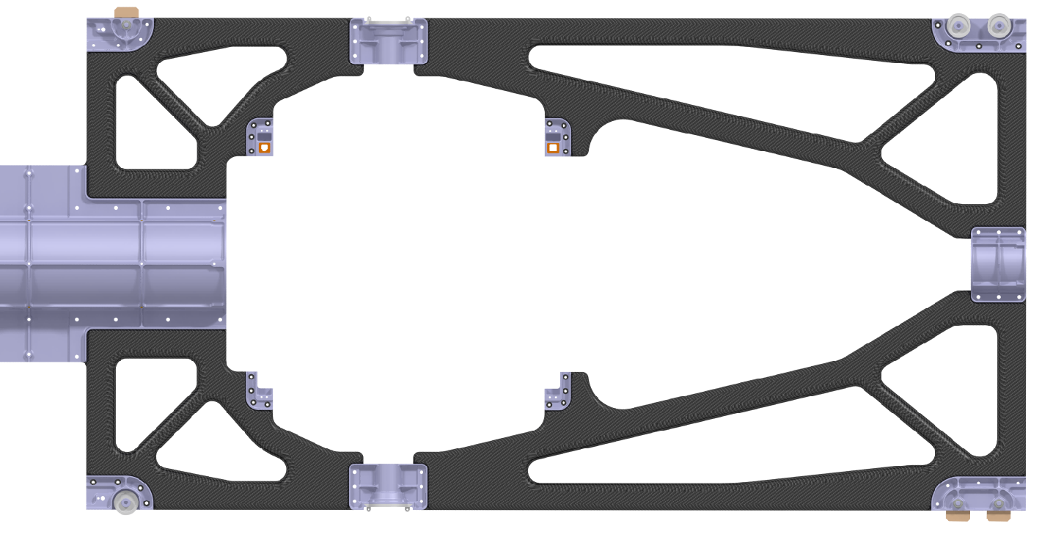
              Prototype Central Space Frame (CSF)
Various brackets and fixings made of aluminum are connected to the mainframe. These parts are all made via 3D printing.

Slide 6
              Prototype Central Space Frame (CSF)
The lower picture shows the 3D model of the Prototype. The following slides will show some photos of this test stand.

Slide 7
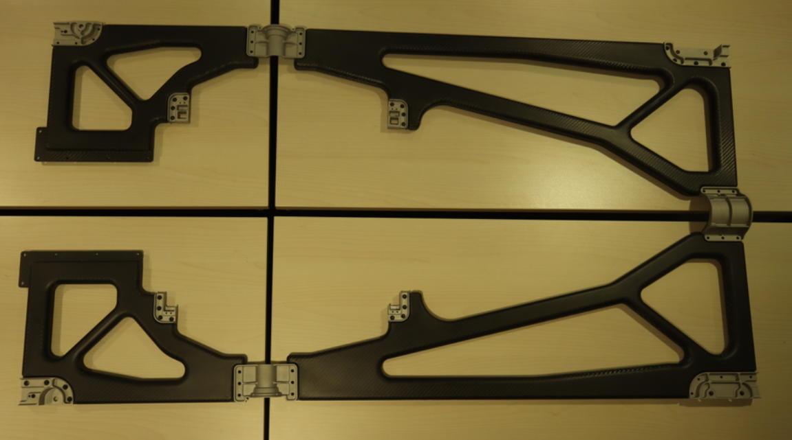
              Prototype Central Space Frame (CSF)
Carbon parts with inner aluminum connectors

Slide 8
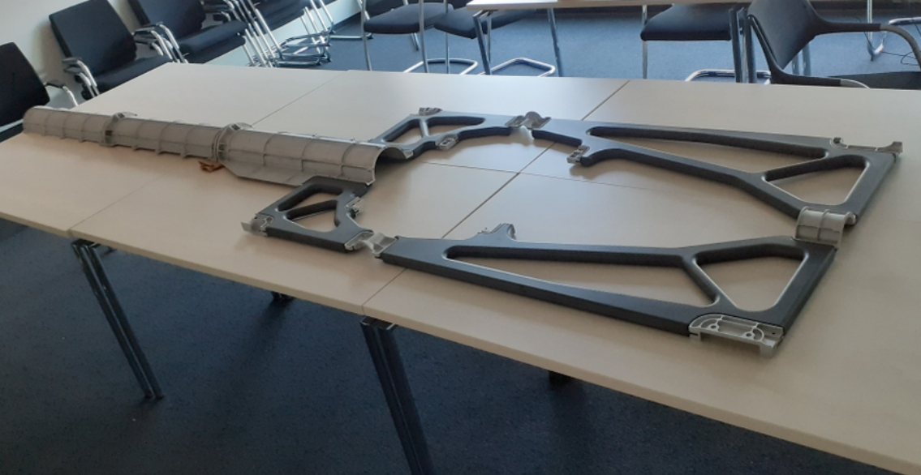
              Prototype Central Space Frame (CSF)
Carbon parts with aluminum connectors and support structure

Slide 9
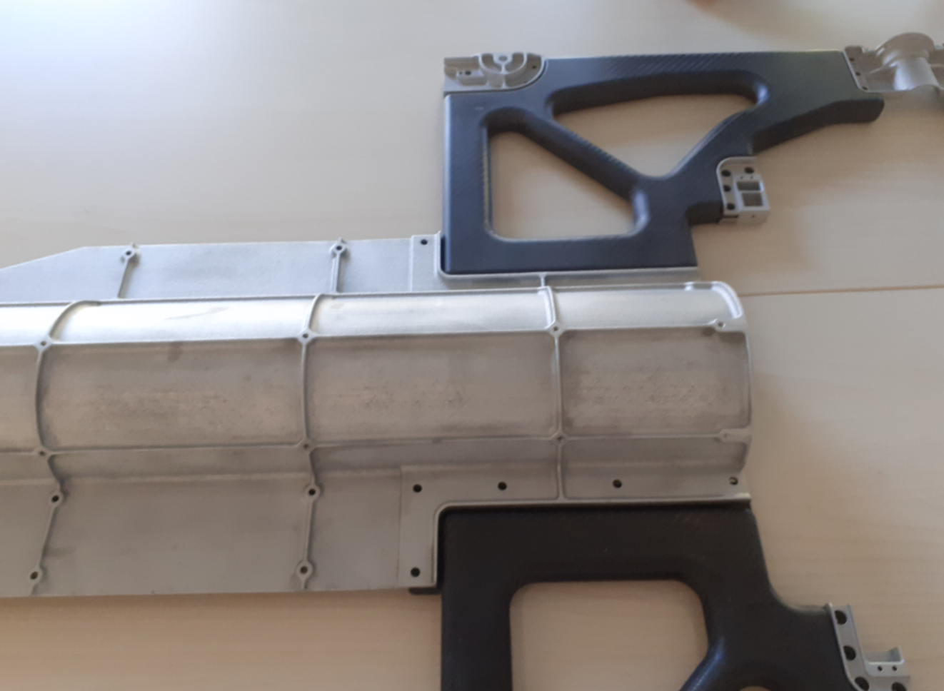
              Prototype Central Space Frame (CSF)
First section of aluminum support structure

Slide 10
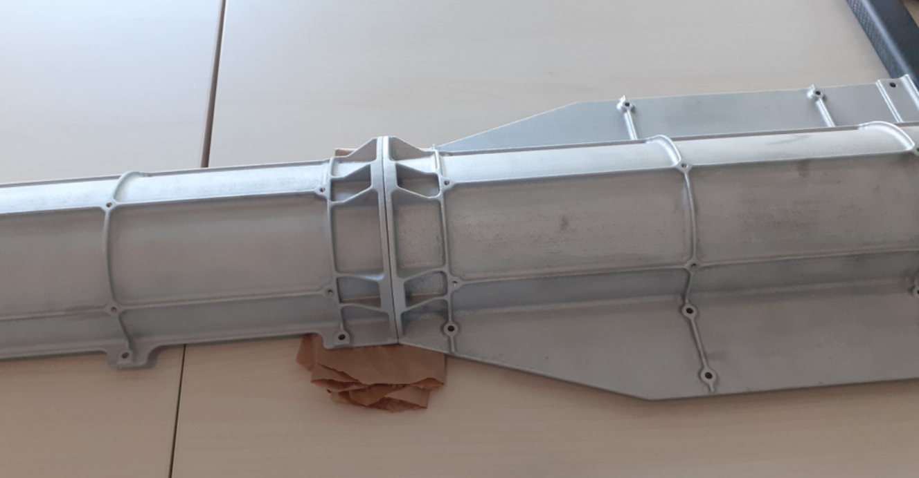
              Prototype Central Space Frame (CSF)
Interfaces between aluminum support structure

Slide 11
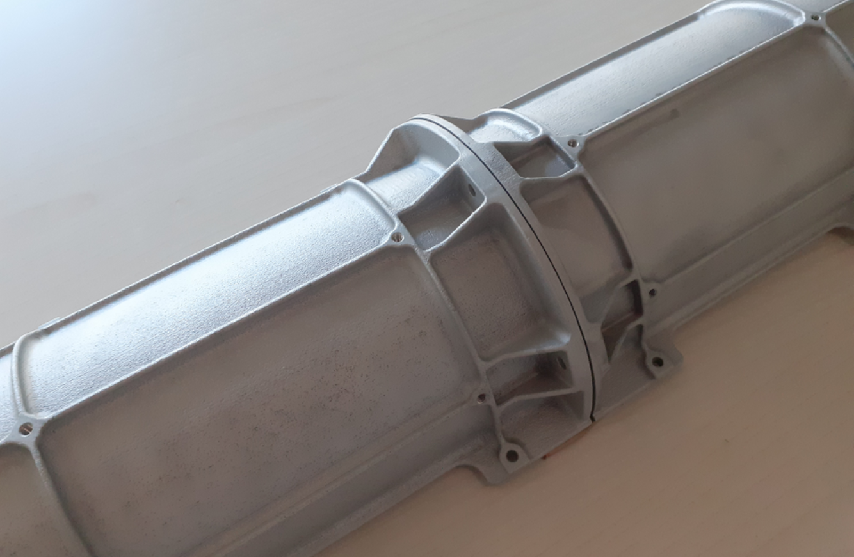
              Prototype Central Space Frame (CSF)
Interfaces between aluminum support structure

Slide 12
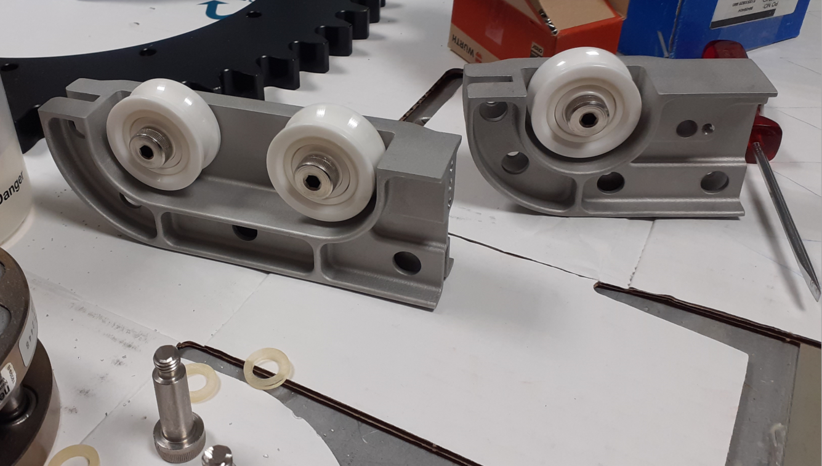
              Prototype Central Space Frame (CSF)
aluminum connectors for roller

Slide 13
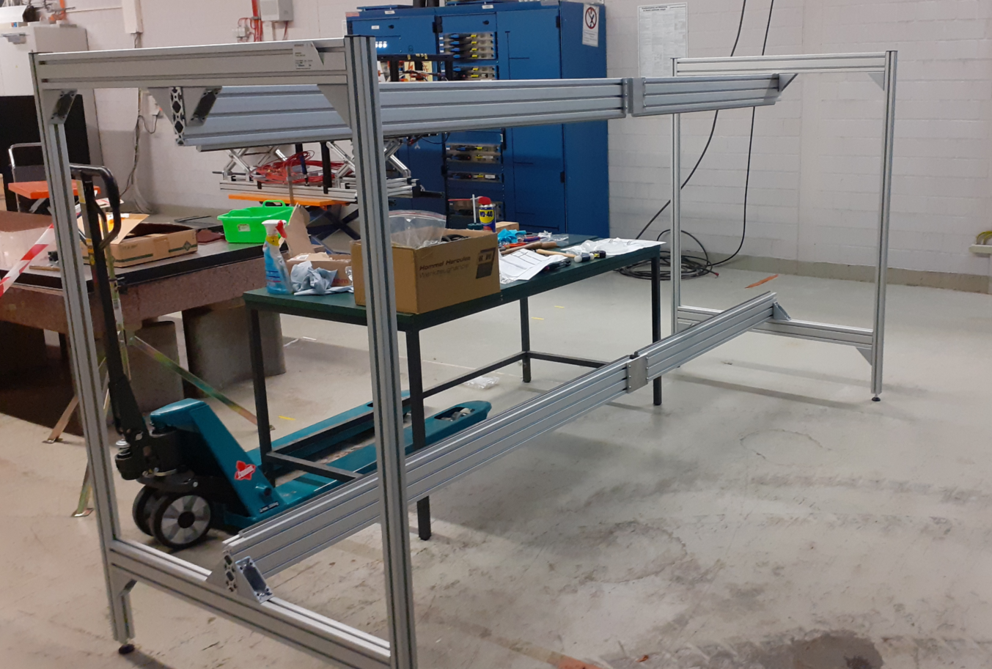
              Prototype Central Space Frame (CSF)
Support frame for prototype

Slide 14
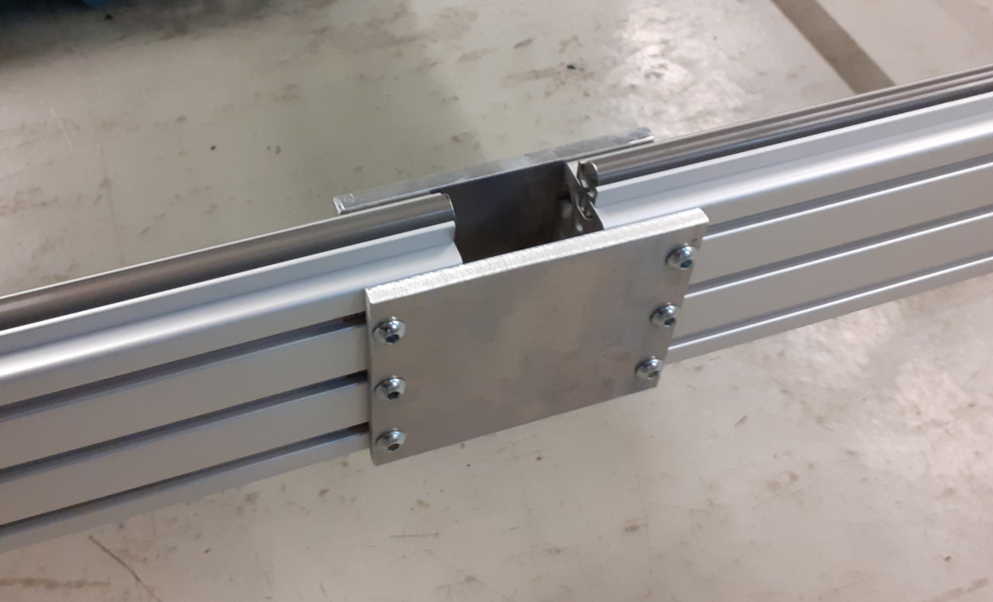
              Prototype Central Space Frame (CSF)
Hard anodized aluminum shaft for movement

Slide 15
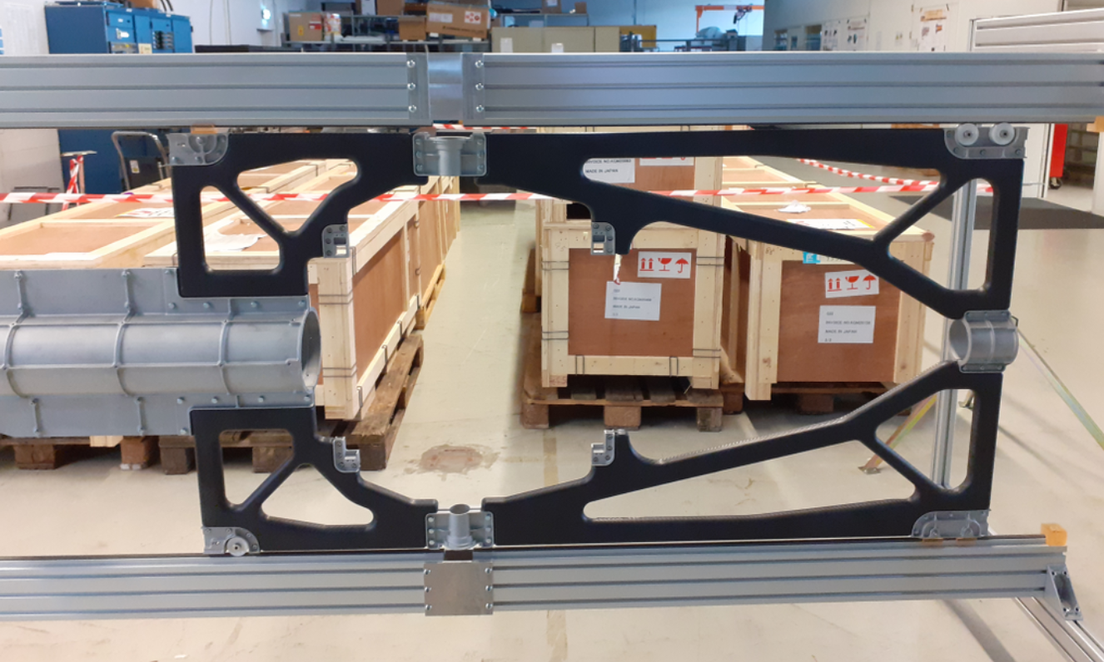
              Prototype Central Space Frame (CSF)
CSF in support frame

Slide 16
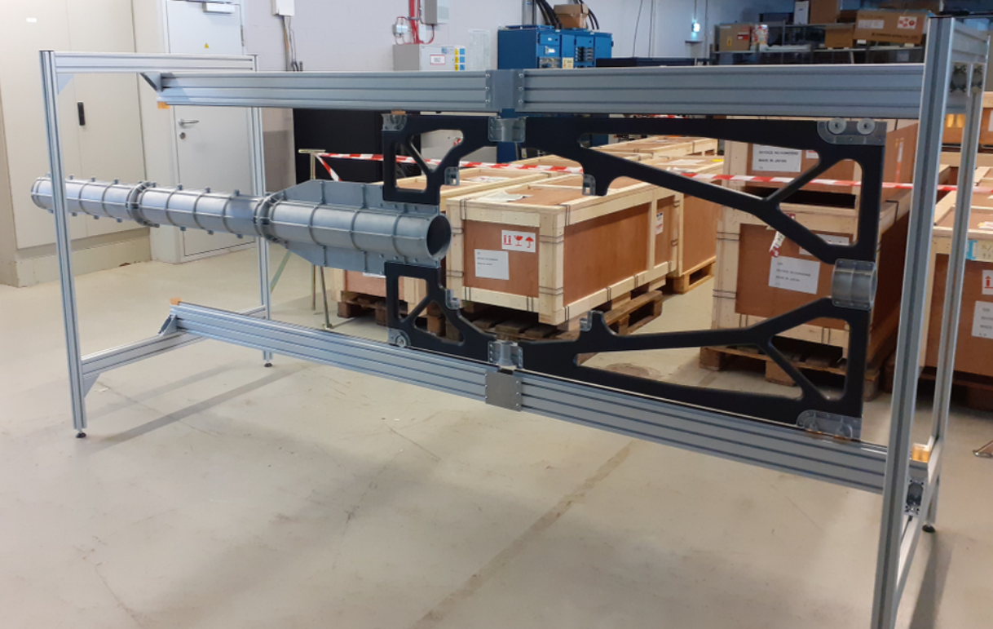
              Prototype Central Space Frame (CSF)
CSF in support frame

Slide 17
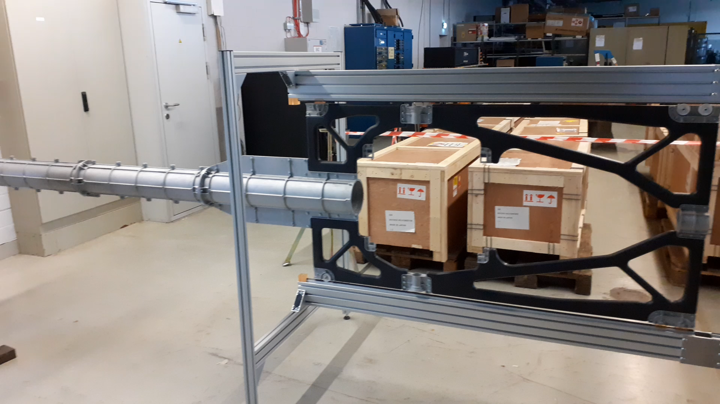
              Prototype Central Space Frame (CSF)
CSF in move

Slide 18
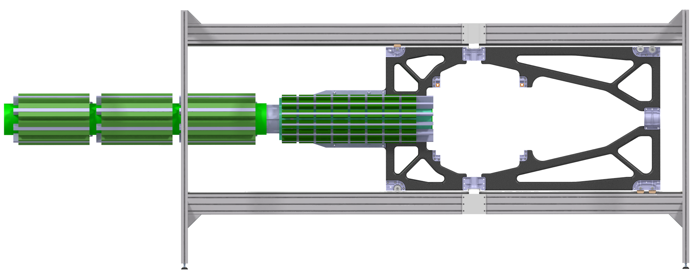
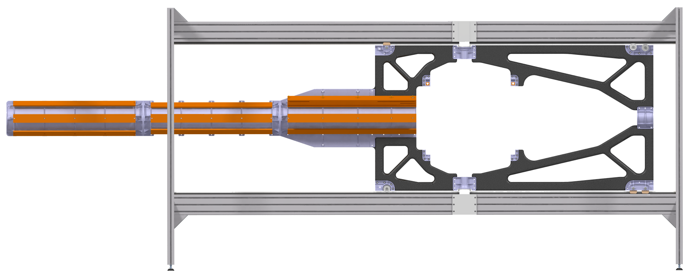
              Prototype Central Space Frame (CSF)
In addition, we made a first load test, to verify that the CSF is can carry the weight of 160 kg MVD electronic and cooling supply. For that, we distributed 72 flat bars(162 kg) in a way, that the mass distribution will be very close to the later electronic and cooling components.
CSF with electronic and cooling supply
CSF with steel bars for load test

Slide 19
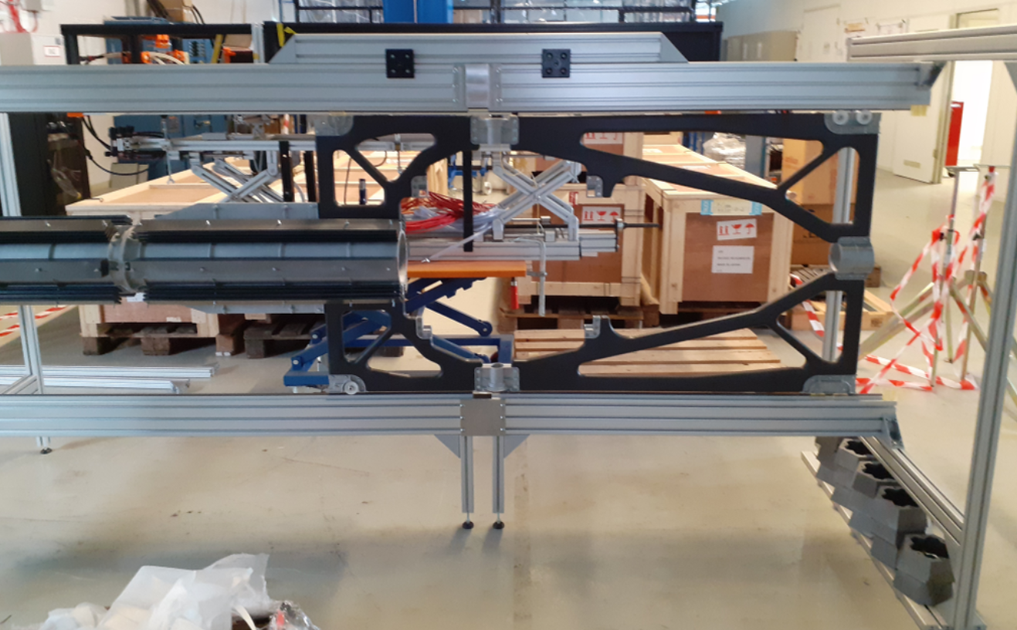
              Prototype Central Space Frame (CSF)
CSF with flat steel bars for load test

Slide 20
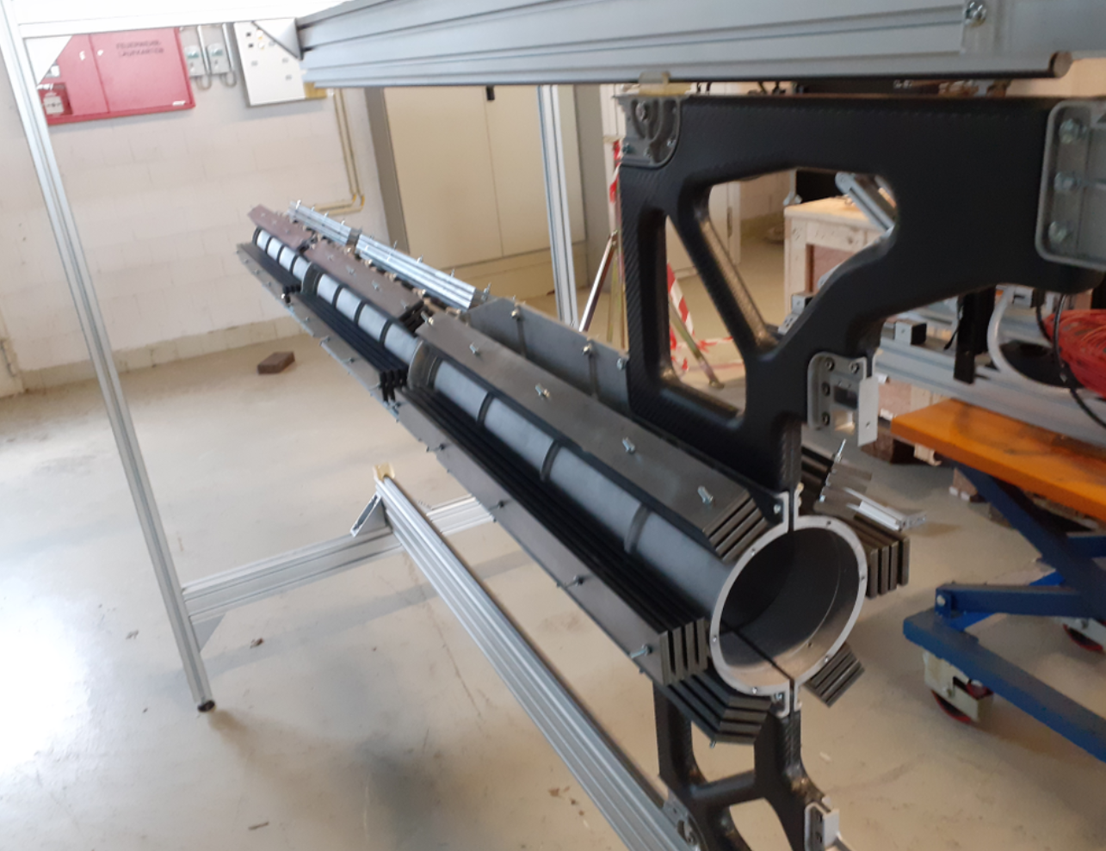
              Prototype Central Space Frame (CSF)
CSF with flat steel bars for load test

Slide 21
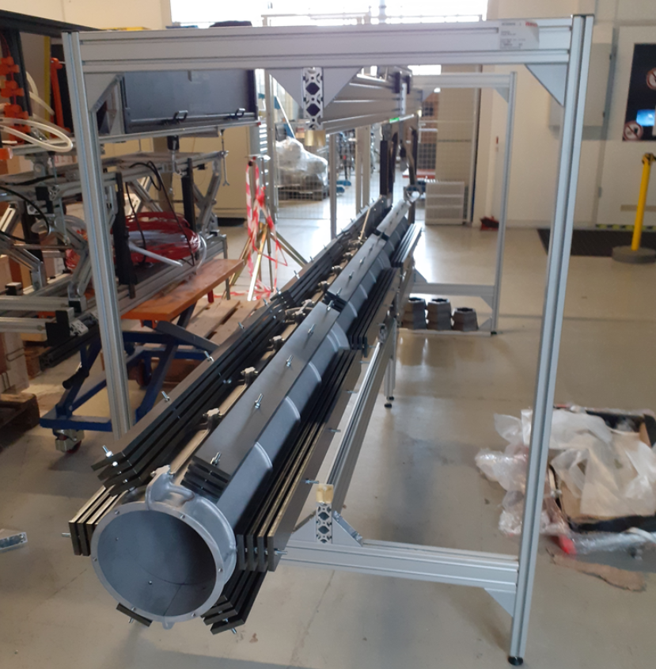
              Prototype Central Space Frame (CSF)
CSF with flat steel bars for load test

Slide 22
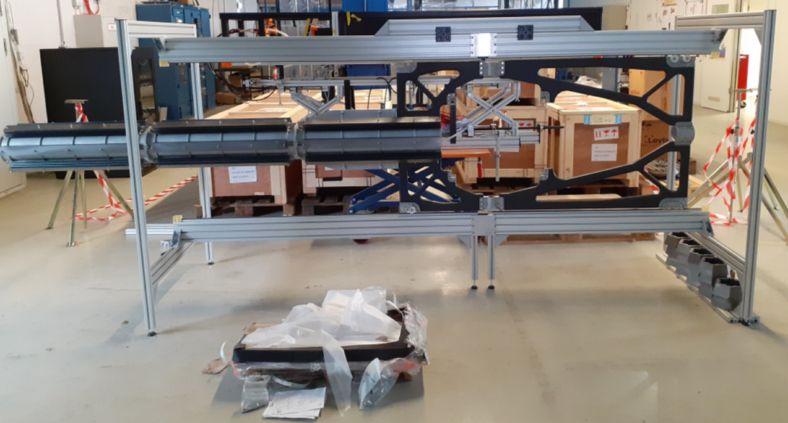
              Prototype Central Space Frame (CSF)
CSF with flat steel bars for load test

Slide 23
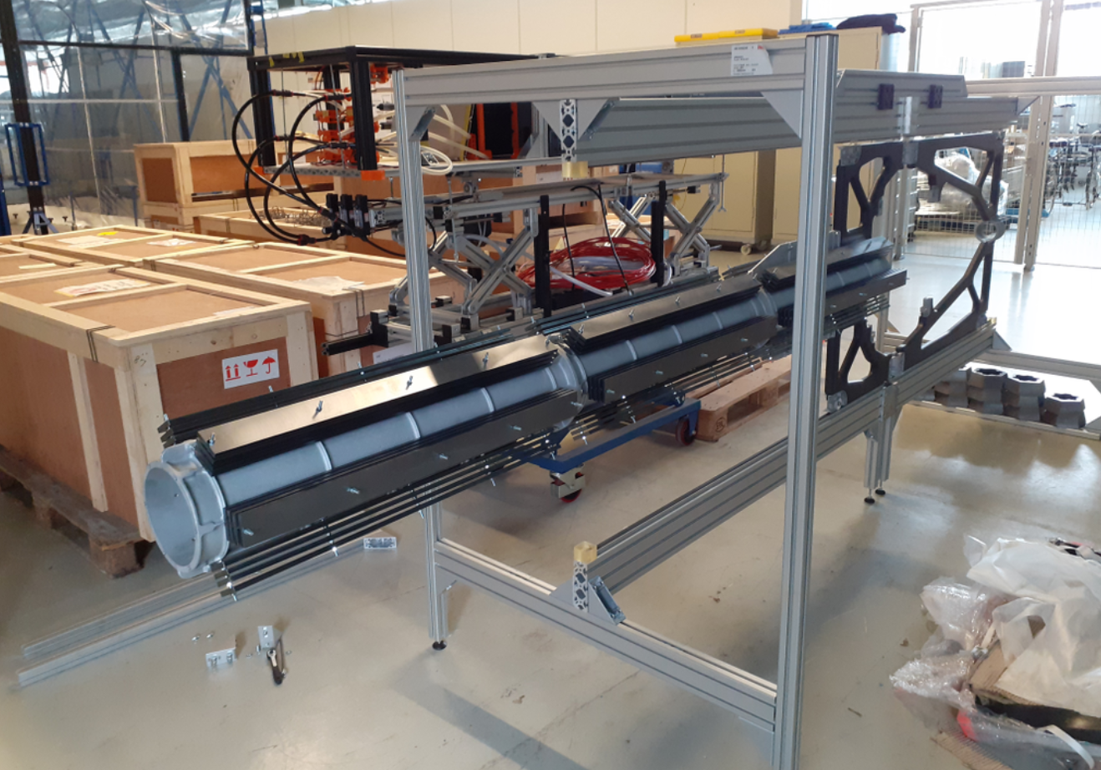
              Prototype Central Space Frame (CSF)
CSF with flat steel bars for load test

Slide 24

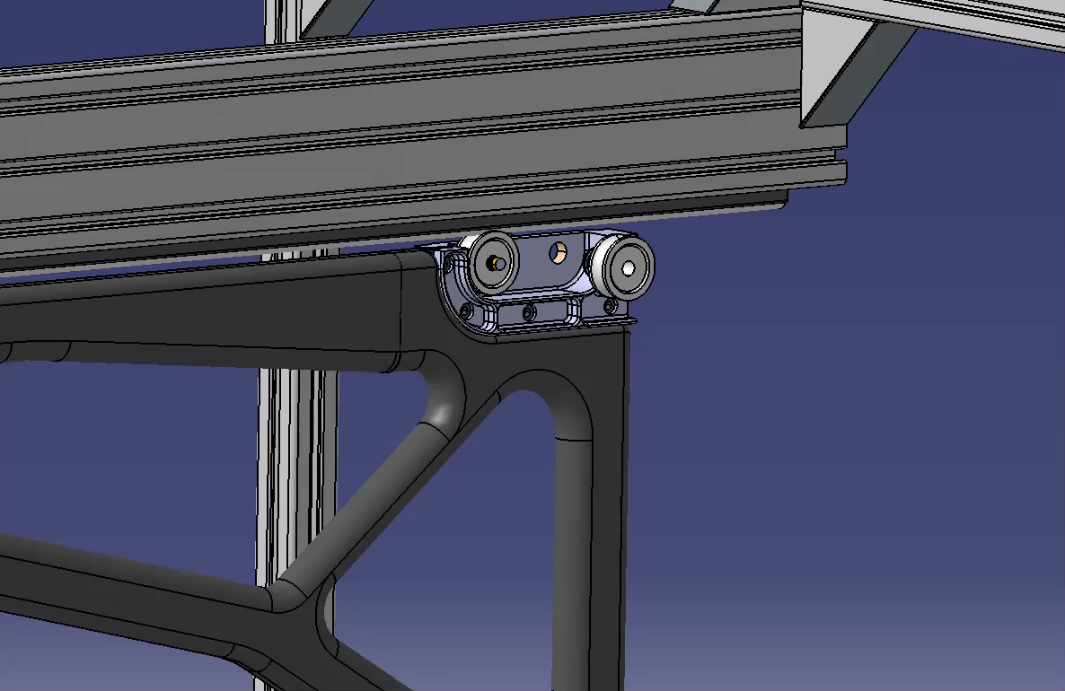
              Prototype Central Space Frame (CSF)
Conclusion:
The load test was successful and showed in principle, that we can built a light weight structure (weight of the carbon structure is just 2 kg) which is able to carry the load of the MVD electronics.
Outlook:
We will continue with various tests and improvements. For example:
Integration of the target pipe
Testing of the bayonet sealing system
integration of the detector frames
Checking of deformation and repeatability regarding to the positioning
using eccentric bolts for the downstream roller to compensate for misalignment and to ensure a smoother moving over the gap reserved for the target cross
Thank you for your attention!

