Slide 1
PANDA muon group meeting, GSI, March 6, 2012 Status of work in Dubna G.Alexeev for Dubna group ___________________________________________________________
Work on Muon System TDR - in progress
Word -> Latex ?
3D model in EDMS – ready/done
Signal to Noise Ratio (SNR) – in progress
Big prototypes studies at CERN – pending travel money !..

Slide 2
Black - Dec.2011 TDR version
Blue - agreed text
Red - candidate text for exclusion
Green – added/proposed items/text

Slide 3
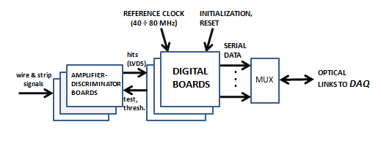
6.8 Digital FE electronics
As the development of the PANDA DAQ system is in process and we have only general ideas of its structure the design of the Muon System digital front-end electronics has not started yet. It is also supposed now that analog data from the Muon System is not required. The complete understanding of this issue will result from R&D works with the Range System prototype at CERN.
To process logic signals from analog electronics we need the relatively simple digital unit which operates as an input register (so called ‘latch mode’) to record the hits from wires and strips. The digital board (Fig.XX) accepts logic (LVDS) signals generated by the amplifier-discriminator card, produces the channel number, adds the time stamp and stores this information in the buffer memory like FIFO. The formatted data from its memory are transferred to the DAQ via optical link. The time stamp is used to tag the data of the individual sub-events belonging to the same event for further processing. The multiplexer is expected to decrease the number of the optical lines to DAQ system. The digital card provides amplifier-discriminator cards with the discriminator threshold and test pulses. The value of threshold is loaded in the digital card during the initialization phase. The logical test pulses generate inside the amplifier-discriminator boards the test current pulses with amplitude comparable with the average signals from detectors, this is about 5 - 10 µA for wires and 0.5 - 1 µA for strips. The design of this unit could be implemented on the basis of FPGA architectures, which is the most-effective solution for these tasks.
Fig.XX. Block diagram of the data stream.
To evaluate (estimate) the expected data rate for Muon System it is necessary to know the number of binary bits to encode any triggered wire/strip, the number of bits for the time stamp as well as the average hit rate. The total number of wires and strips in all 16 modules of the Muon System (8 barrel modules + 2 halves of End Cap + 2 halves of Muon Filter + 4 sub-modules of Forward Range System), according to Table 3.1 is 102839, which corresponds to 17 binary bits. As the MDT detector has a modest time resolution ~ (100 - 200 ns) we may also have the modest resolution for the event time stamp of about 12.5 - 25 ns. For this purpose the reference clock of 40 - 80 MHz is enough. It means that 4 bits will be enough for the time stamp. We may roughly estimate the average bit rate as [number of hits in two projections] x 21 bit x [events rate] MHz. Taking into account that the average hit rate from Muon System is ~ 5 MHz (see section 4.7) it should be equal to ~ 200 Mbit per second (for single hit events only ?!).

Slide 4
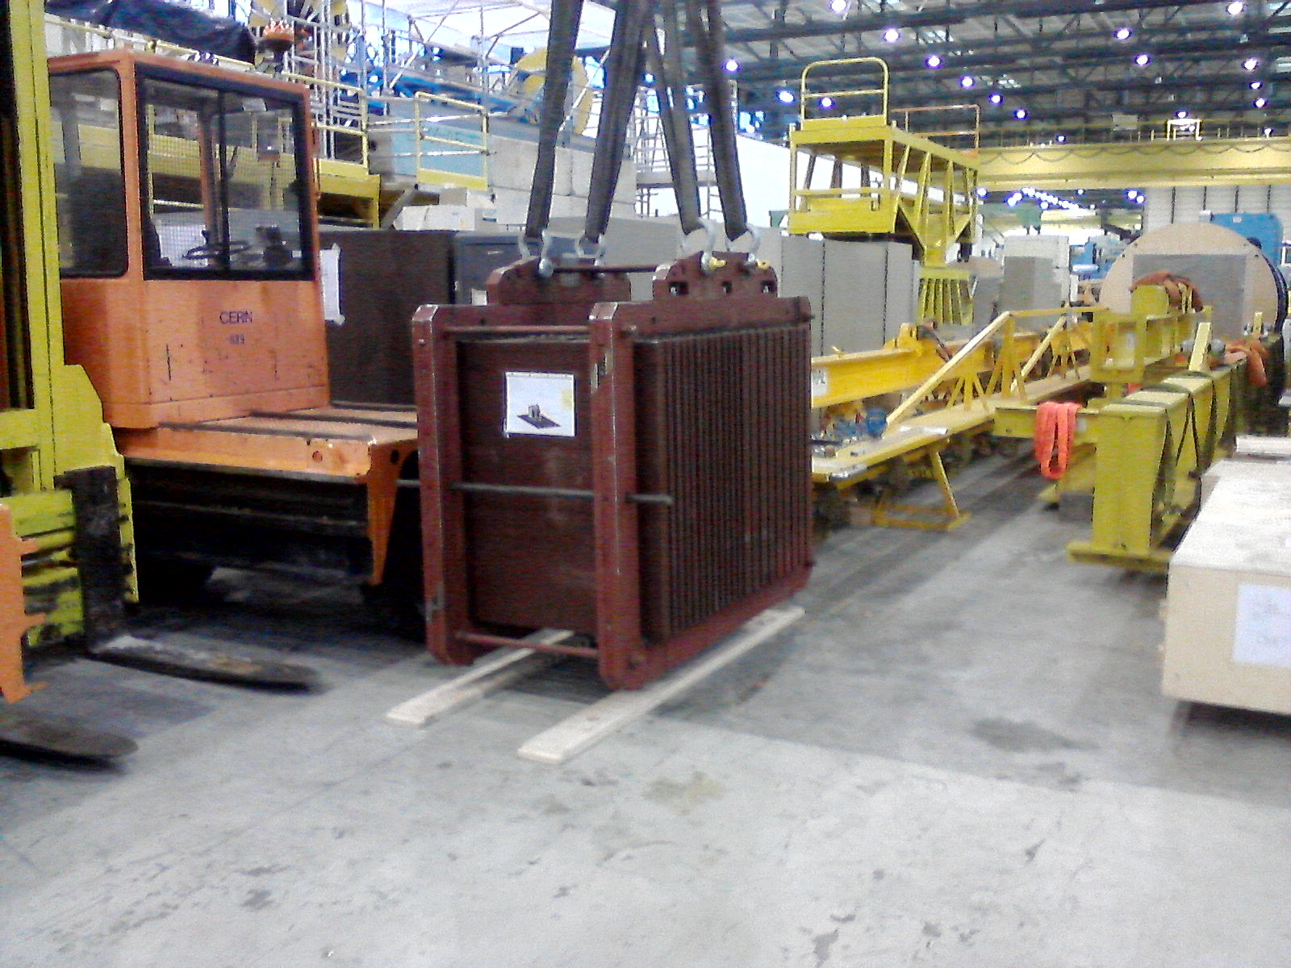
Range System prototype in CERN stock (bld.180)
Range System absorber
Boxes with detectors, electronics and LV power supplies

Slide 5
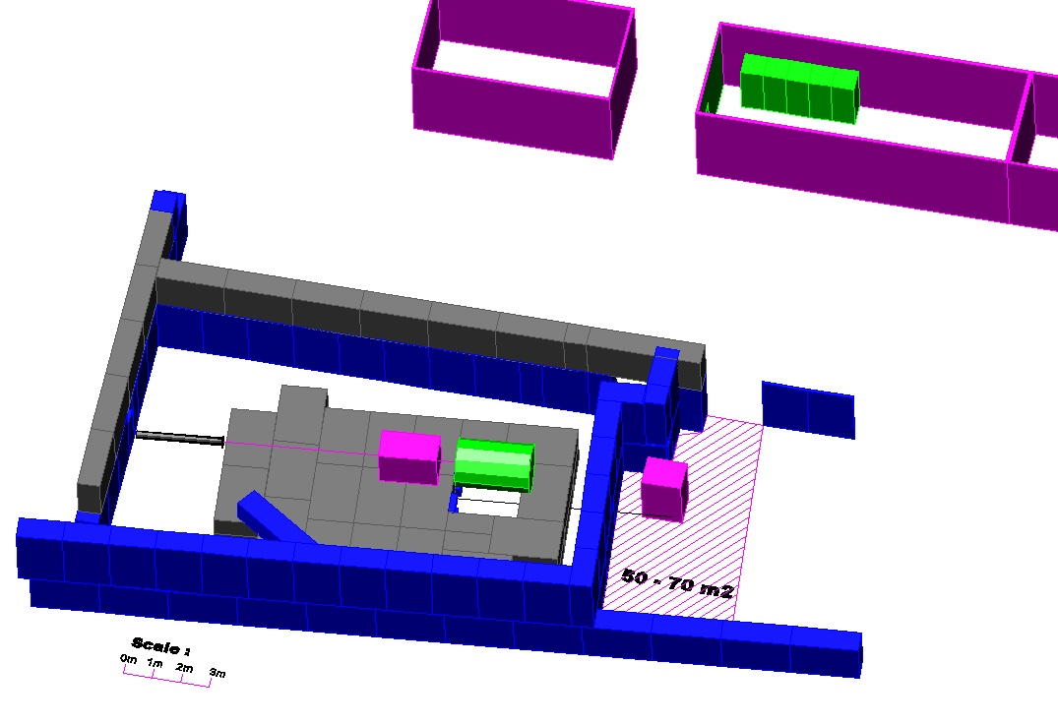
T9 experimental countrol room
PS/T9 beam zone (CERN)
RSProto work position
( on beam )
2 racks
for RSProto
beam
RSProto park and test
( cosmic ) position
magnet

