Slide 1
Glasgow Report
Euan N. Cowie
Nuclear Physics Group
University of Glasgow

Slide 2
Glasgow Hall Layout
Trigger and Detector Positions
Beam
Direction
ToF1
Fast
Detector
ToF2
18.9cm
166cm
448cm
717cm
Distances From downstream edge of MWPC

Slide 3
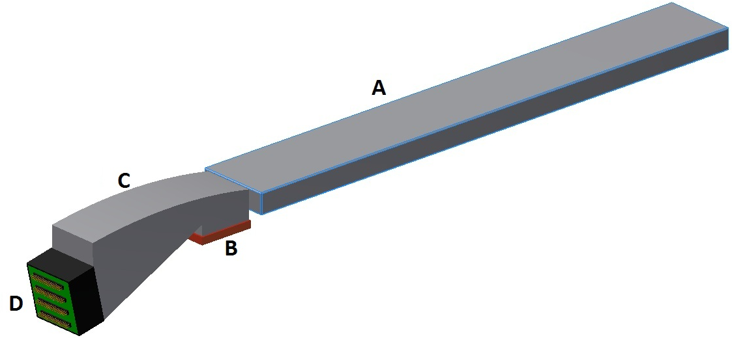
Prototype Layout
Beam
Axis
A: Fused Silica Radiator
B: Lithium Fluoride Plate
C: PMMA Lightguide
D: H9500 MAPMT
Axis of Rotation

Slide 4
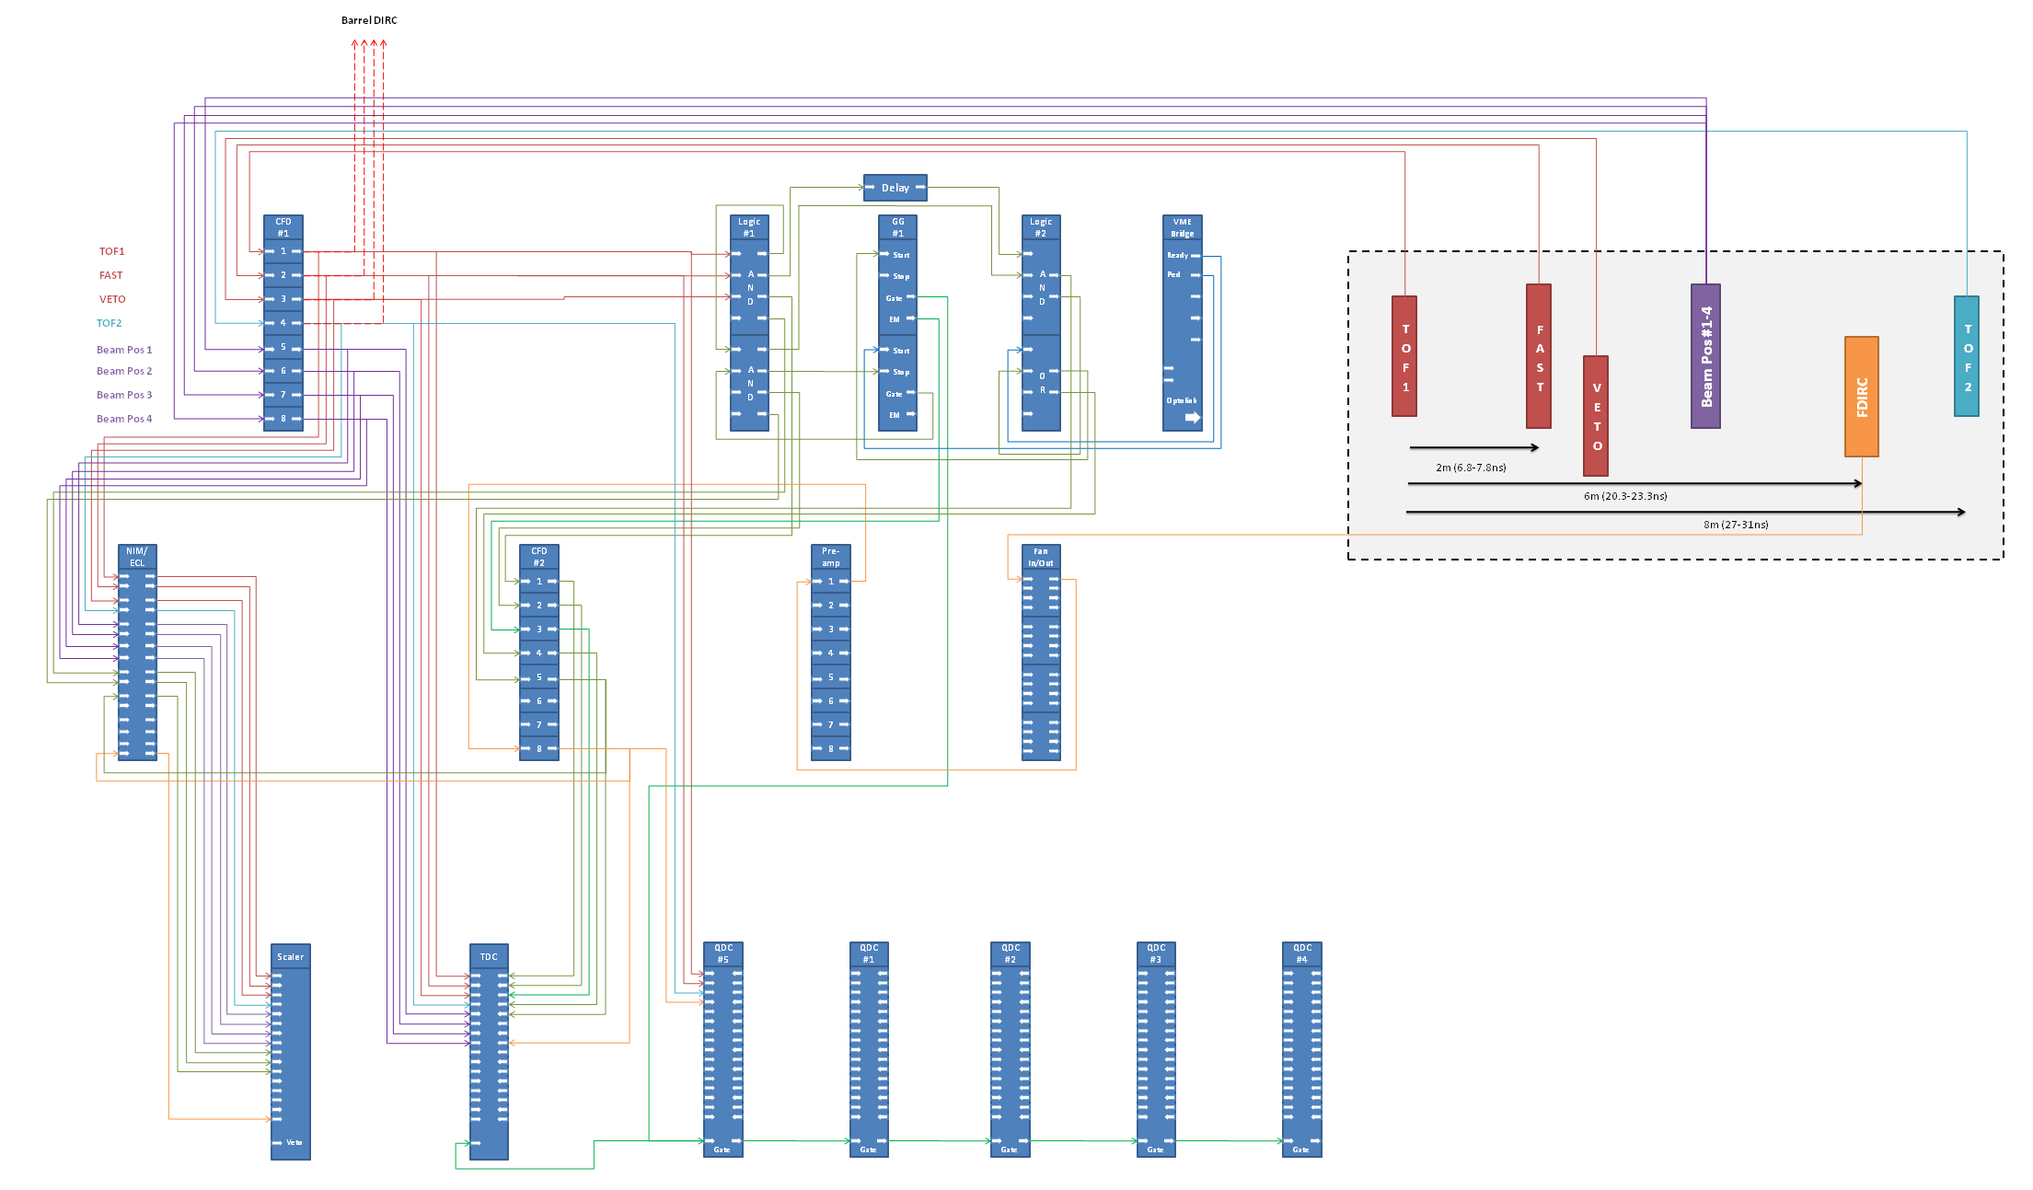
The Source

Slide 5
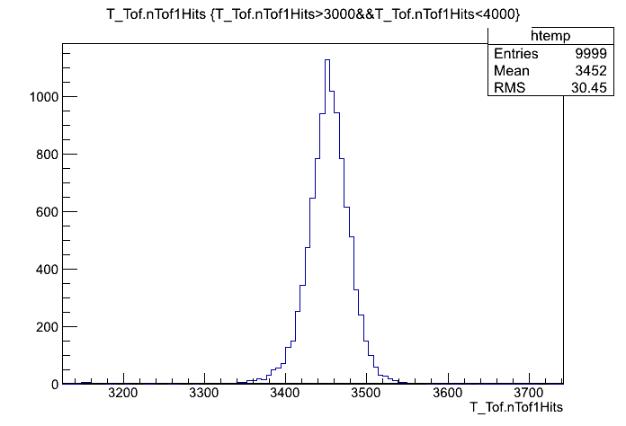
The ToF
The ToF spectrum at for a run at 10GeV

Slide 6
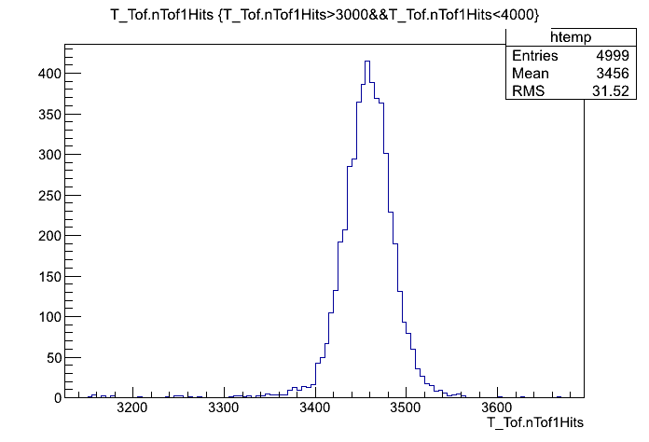
The ToF
The ToF spectrum at for a run at 4GeV

Slide 7
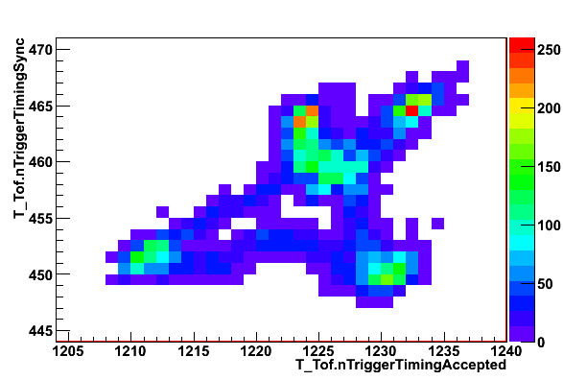
The Timing Hydra
The timing of the output of our synced trigger and our accepted trigger. Note 4 peaks.

Slide 8
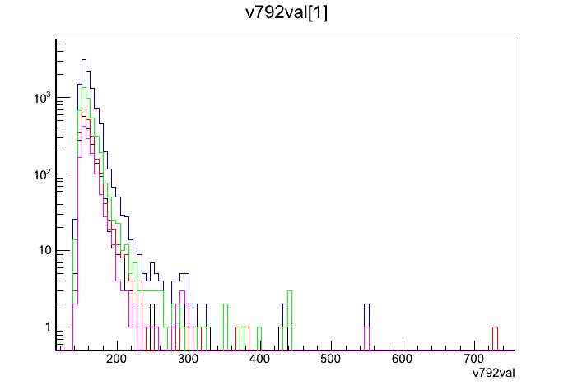
The Resulting Mess
A QDC spectrum example with previous 4 peaks overlay.

Slide 9
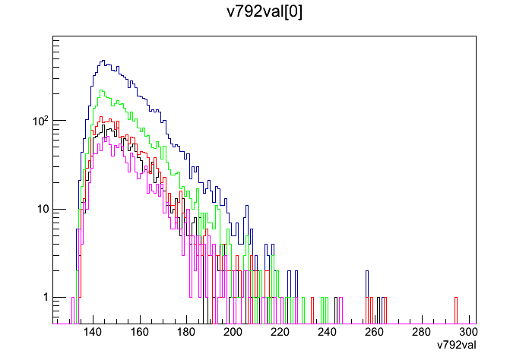
The Resulting Mess
A(nother) QDC spectrum example with previous 4 peaks overlay.

Slide 10
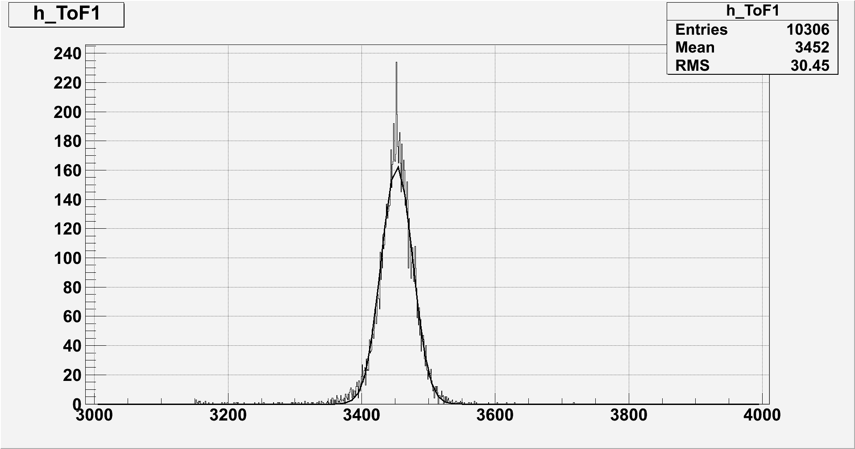
The Fit
Automated ToF fitting example

Slide 11
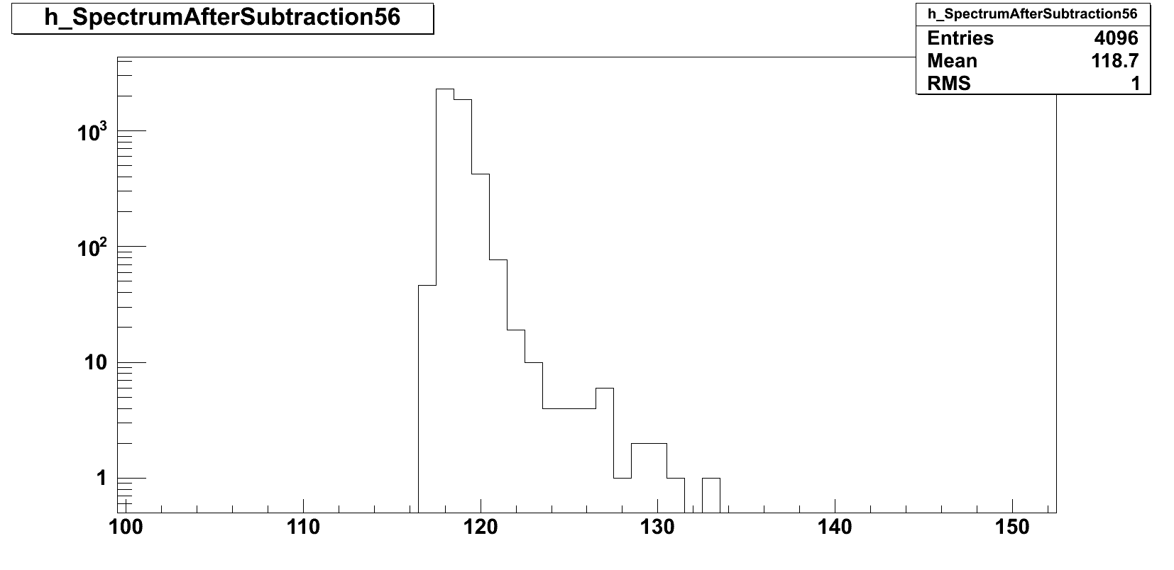
The Background Subtracted

Slide 12
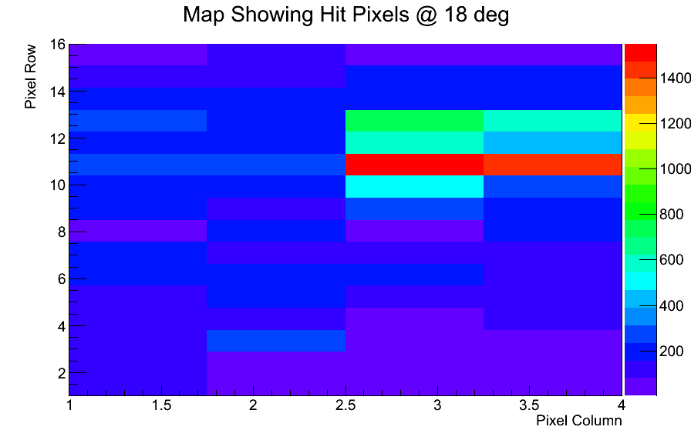
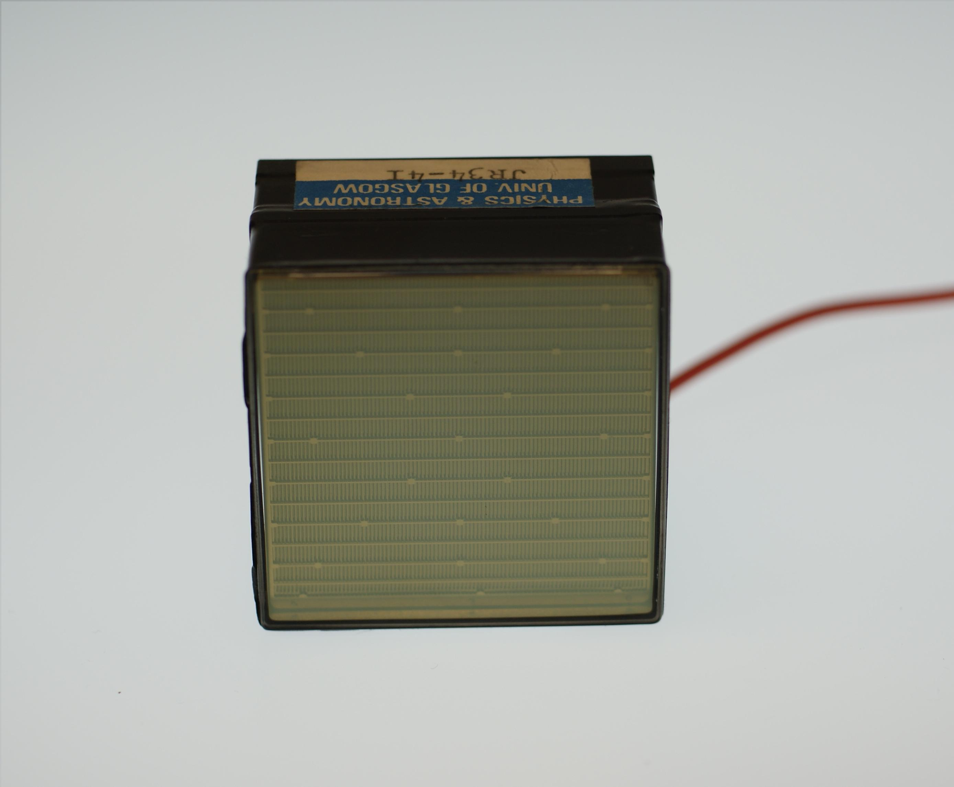
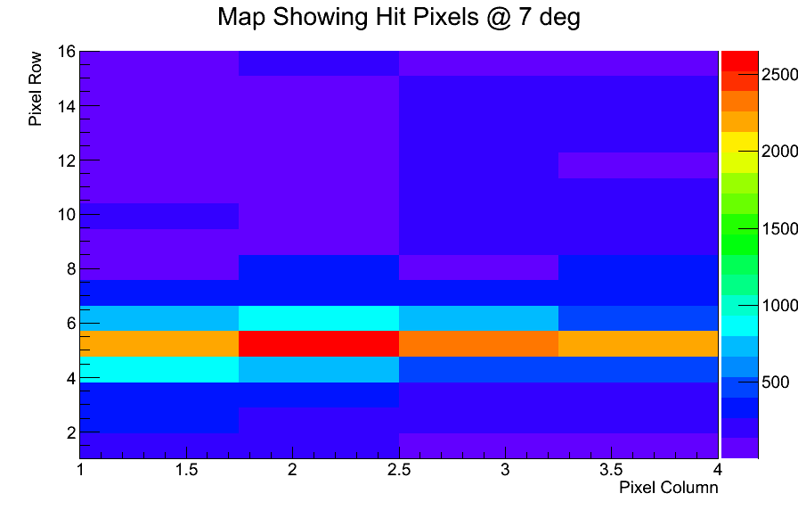
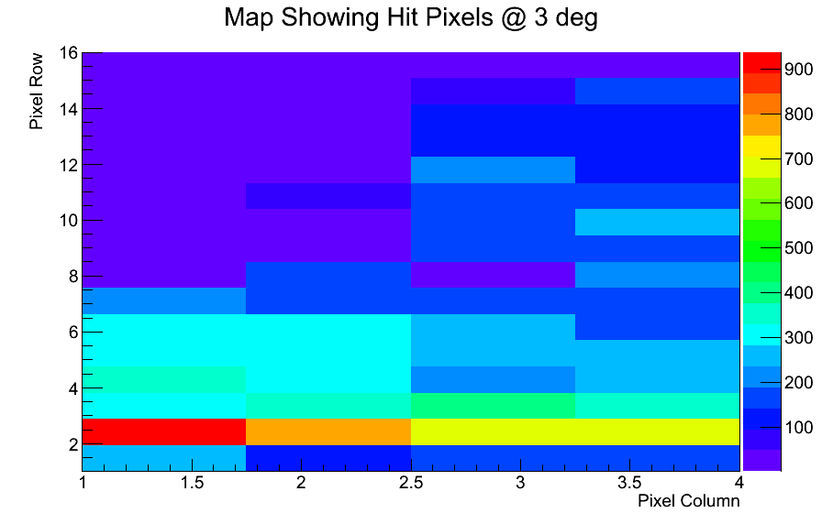
The pretty pictures pt I
Polar Angle
18º
7º
3º
One 4 x 16 pixel section read out

Slide 13
The final countdown
The final countdown
Finalise “Heat Map” diagrams
Finalise results from Chromatic Dispersion measurements
Combine with simulations of both set-ups

Slide 14
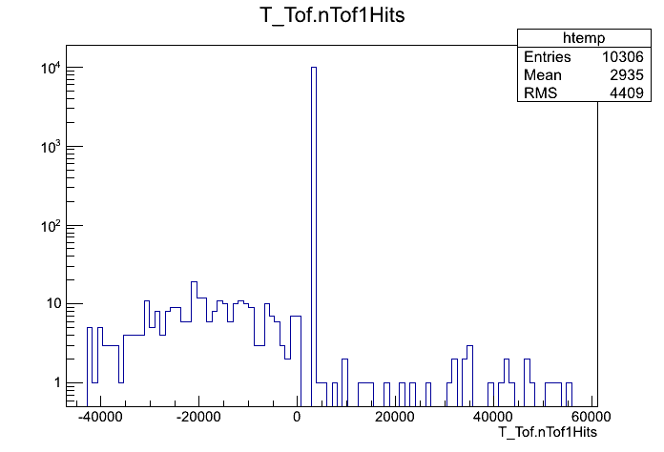
The Backup

Slide 15
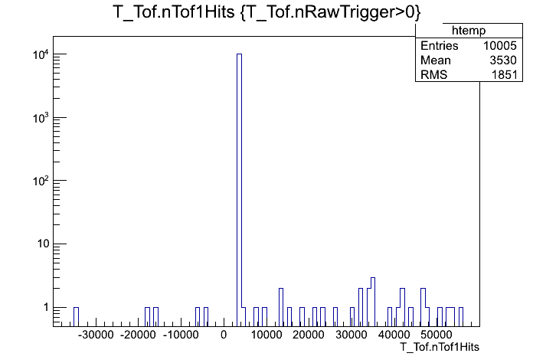
The Backup

Slide 16
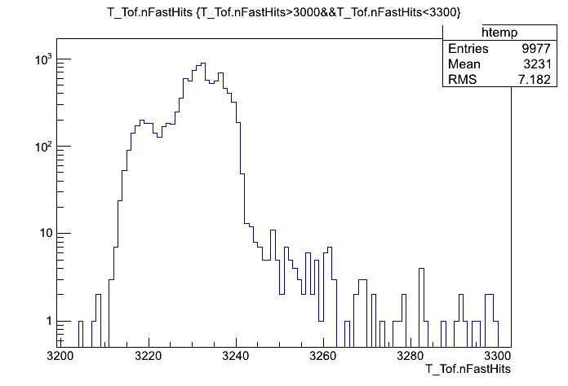
The Backup

Slide 17
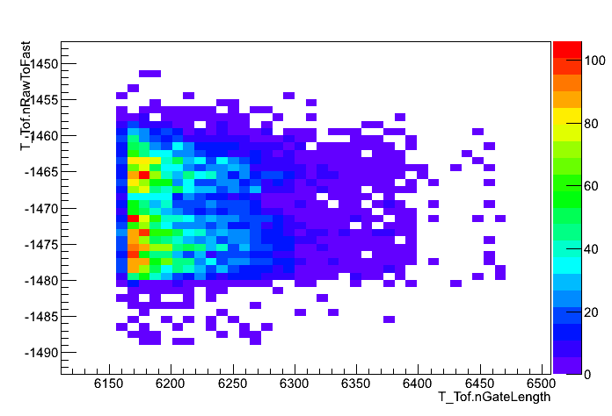
The Backup

Slide 18
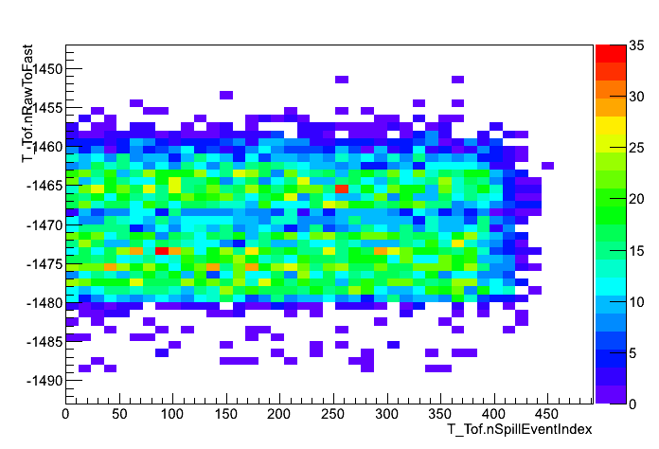
The Backup

Slide 19
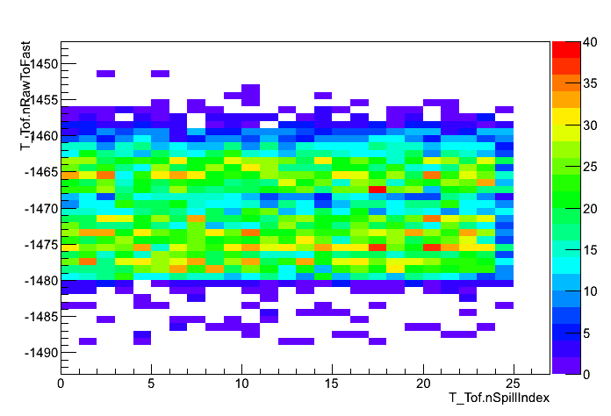
The Backup

