Slide 1
STT Detector risk’s assessment

Slide 2
STT detector work packages
Straw Tubes modules
Straw Tracker mechanics
Front-End Electronics
  Analog electronics
  Digital electronics
Gas system
DAQ
Slow Control
Online tracking
Monitoring and calibration
+ Central Frame shared with MVD and target groups
+ Integration shared with all the neighboring detectors

Slide 3
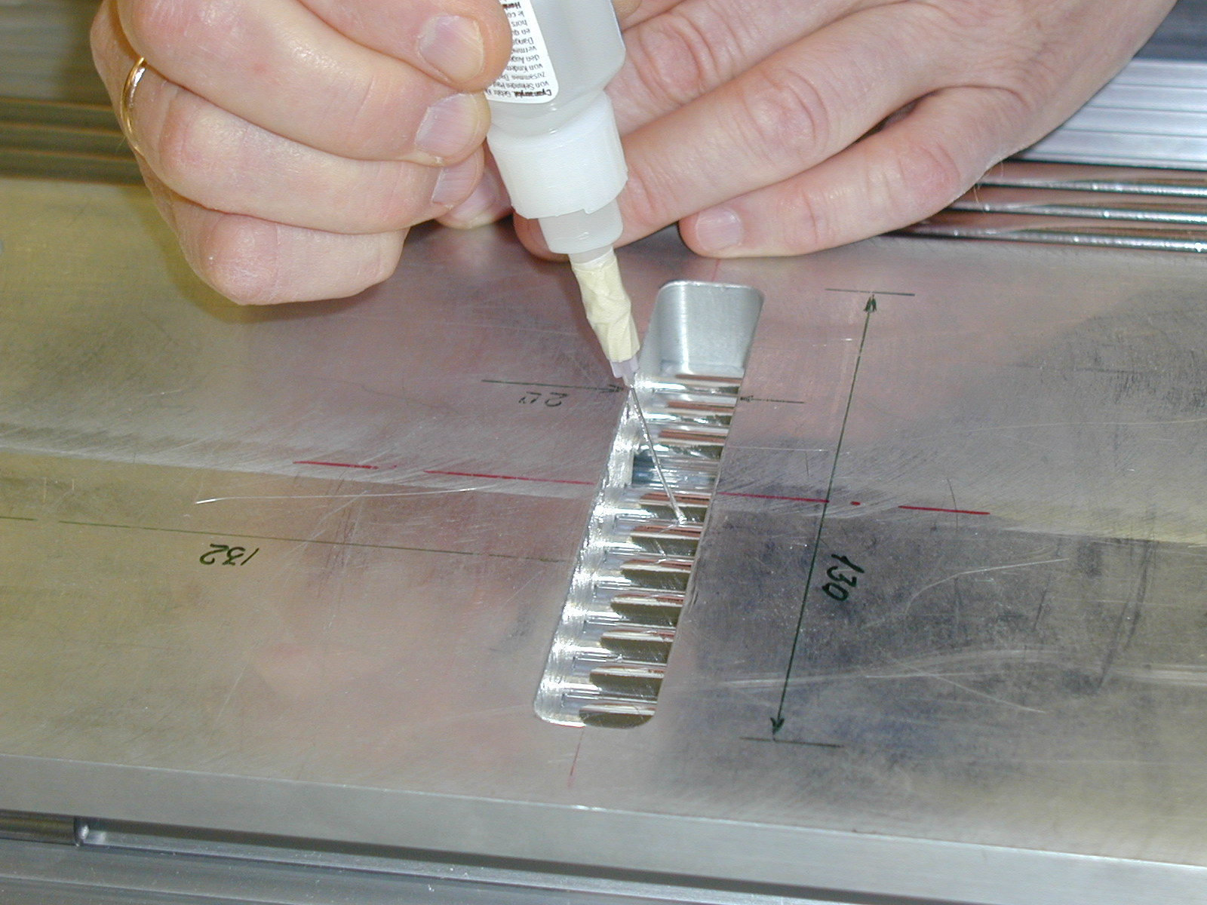
Straw Tube modules
Basic components have been identified and developed.
No major risks.
Two sites (LNF & JFZ) are equipped with the necessary tools to start production.

Slide 4
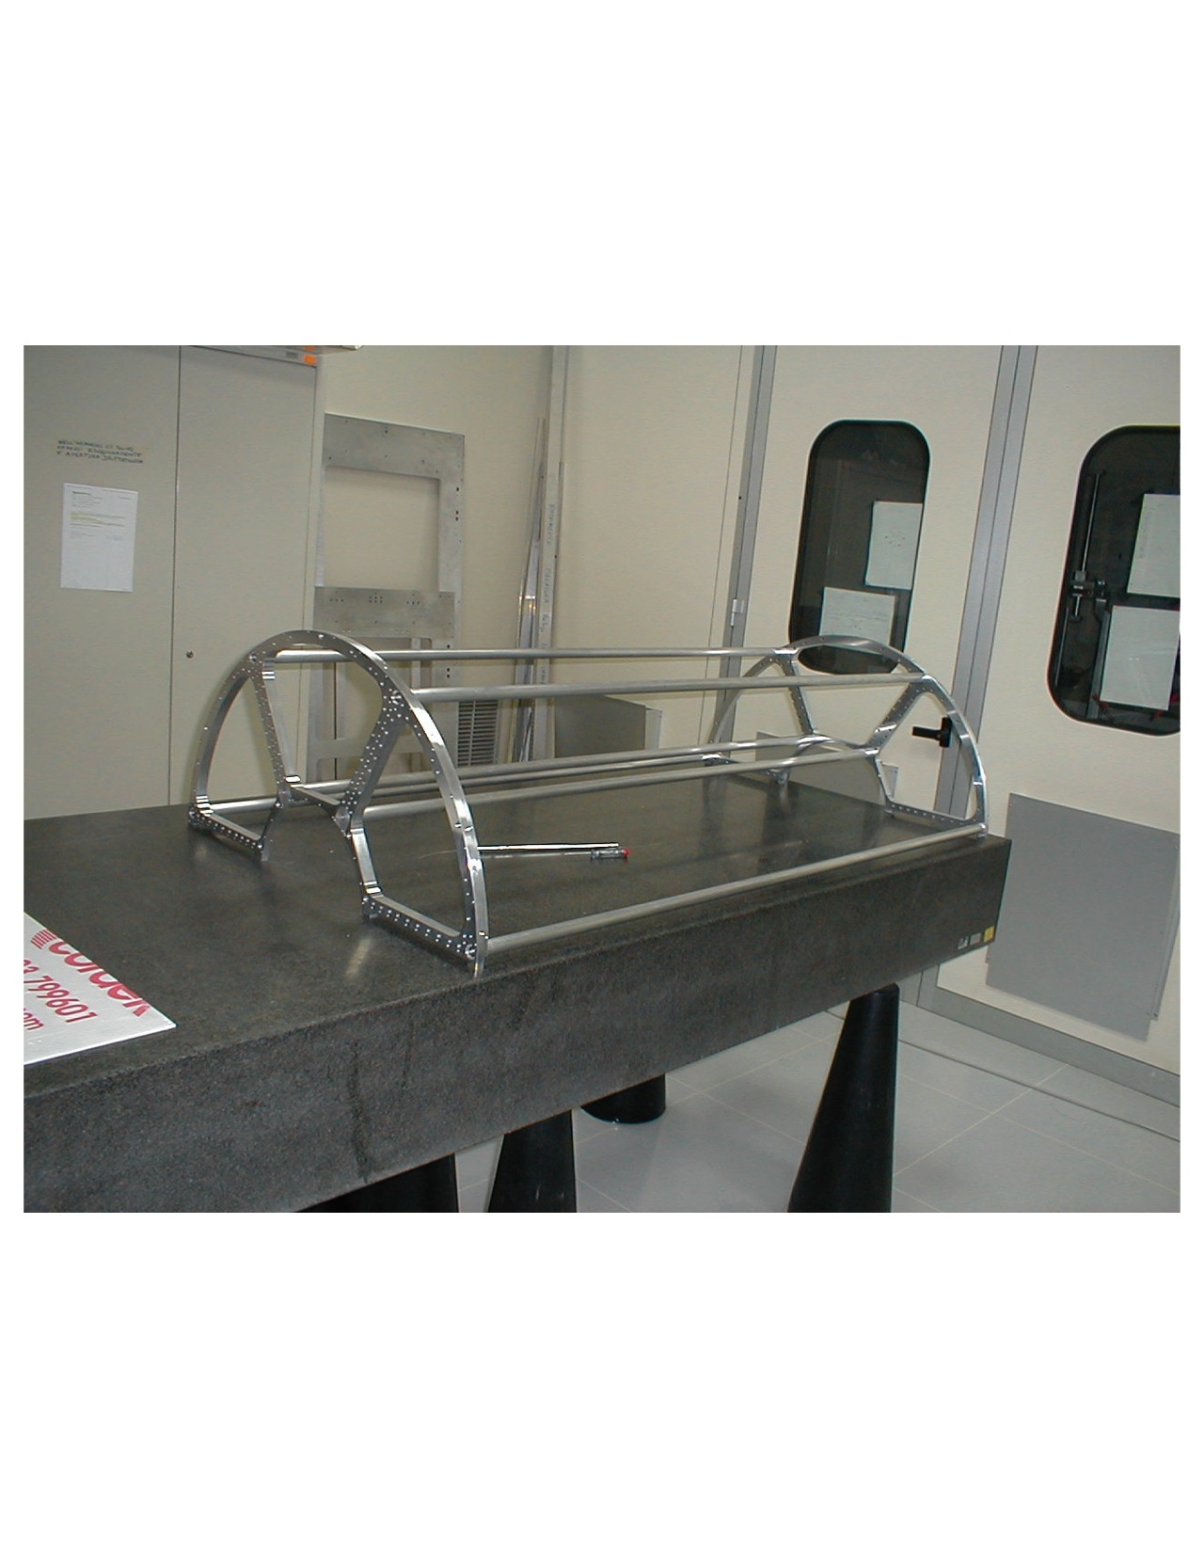
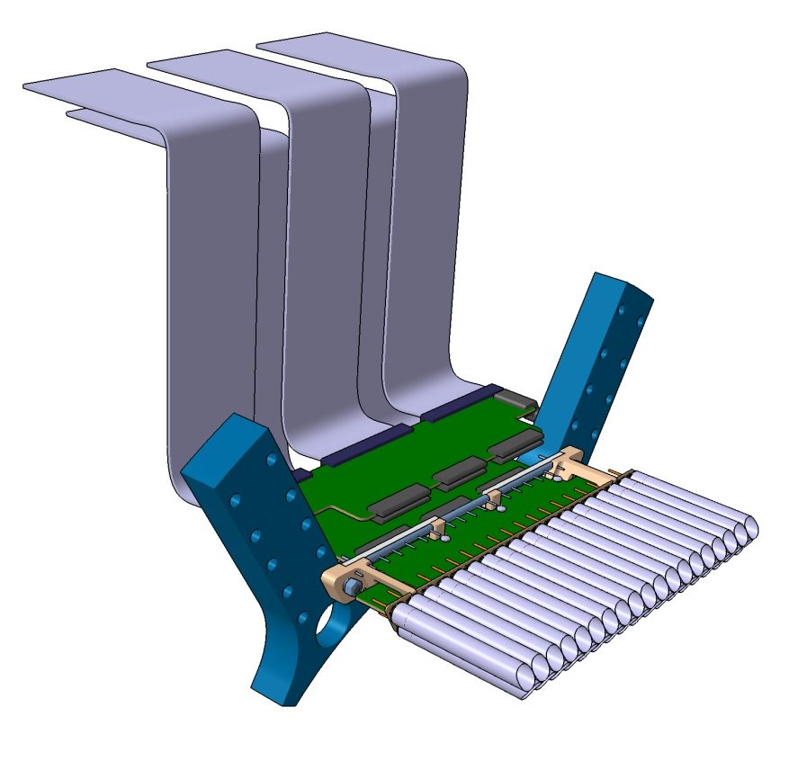
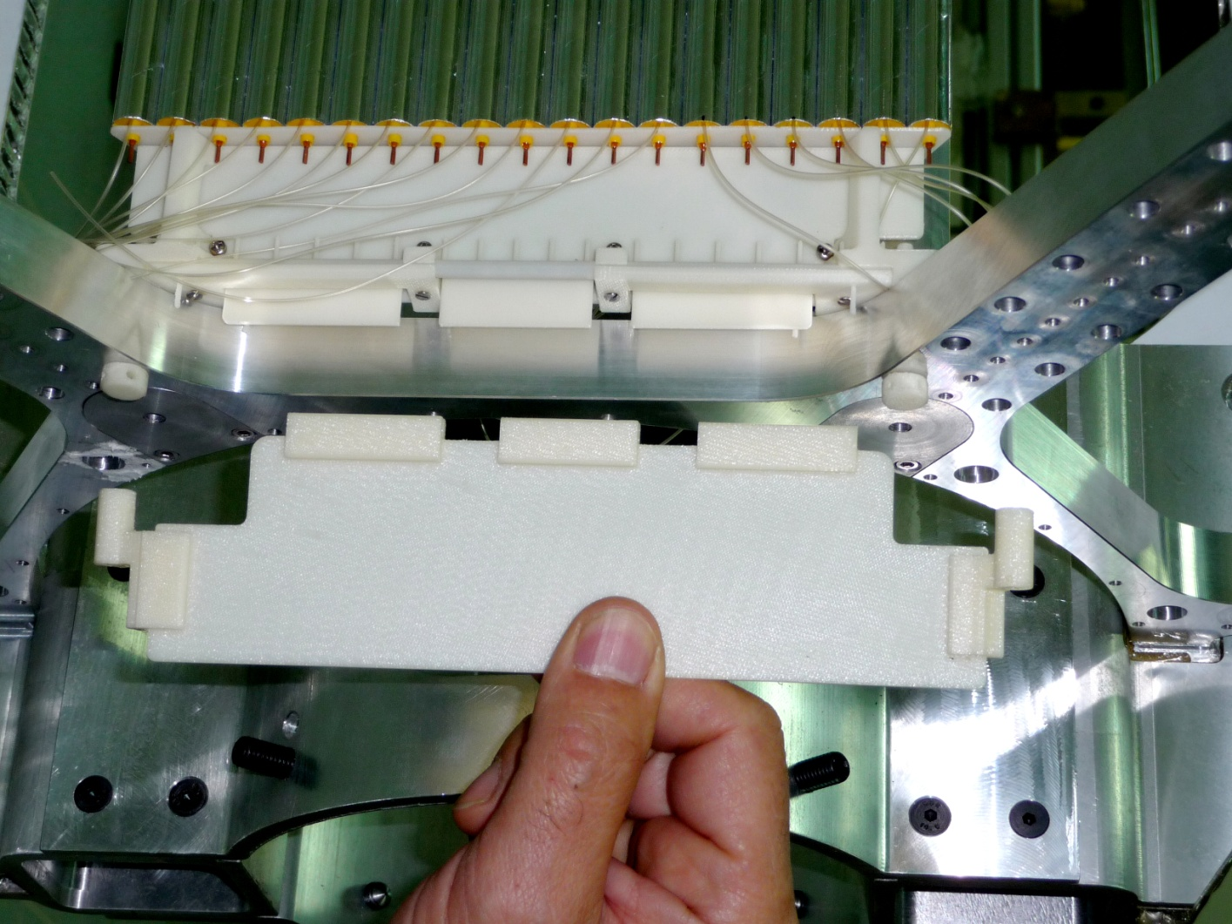
Straw Tracker mechanics
The mechanical layout of the STT is well advanced.
Support structure prototype realized.
Electronics housing and connection worked out: prototypes available.
The proposed solution integrates also the gas distribution.
Open point: electronics design optimization under development
No major risks

Slide 5
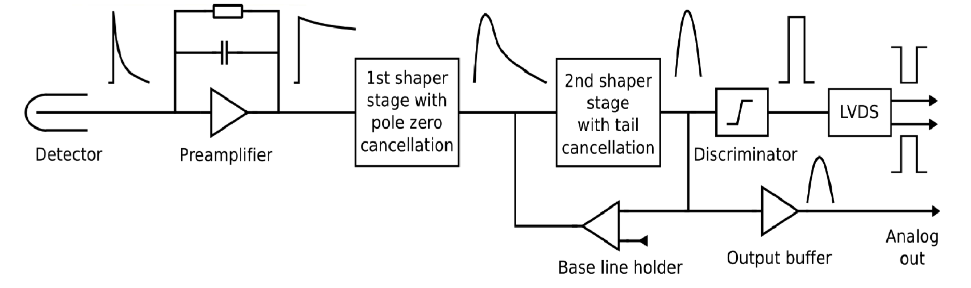
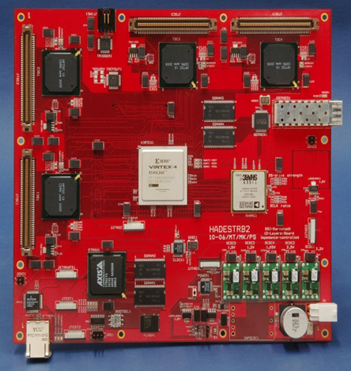
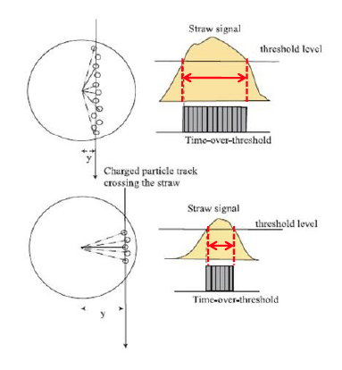
Electronics Development
Basic elements have been identified:
New ASICS for analog readout
New version of TRB (v3) for the Digital part
Two risks have been identified:
TOT will not provide enough resolution;
New ASICS development will take more time
dE/dx using FADC
Delay in STT commissioning

Slide 6
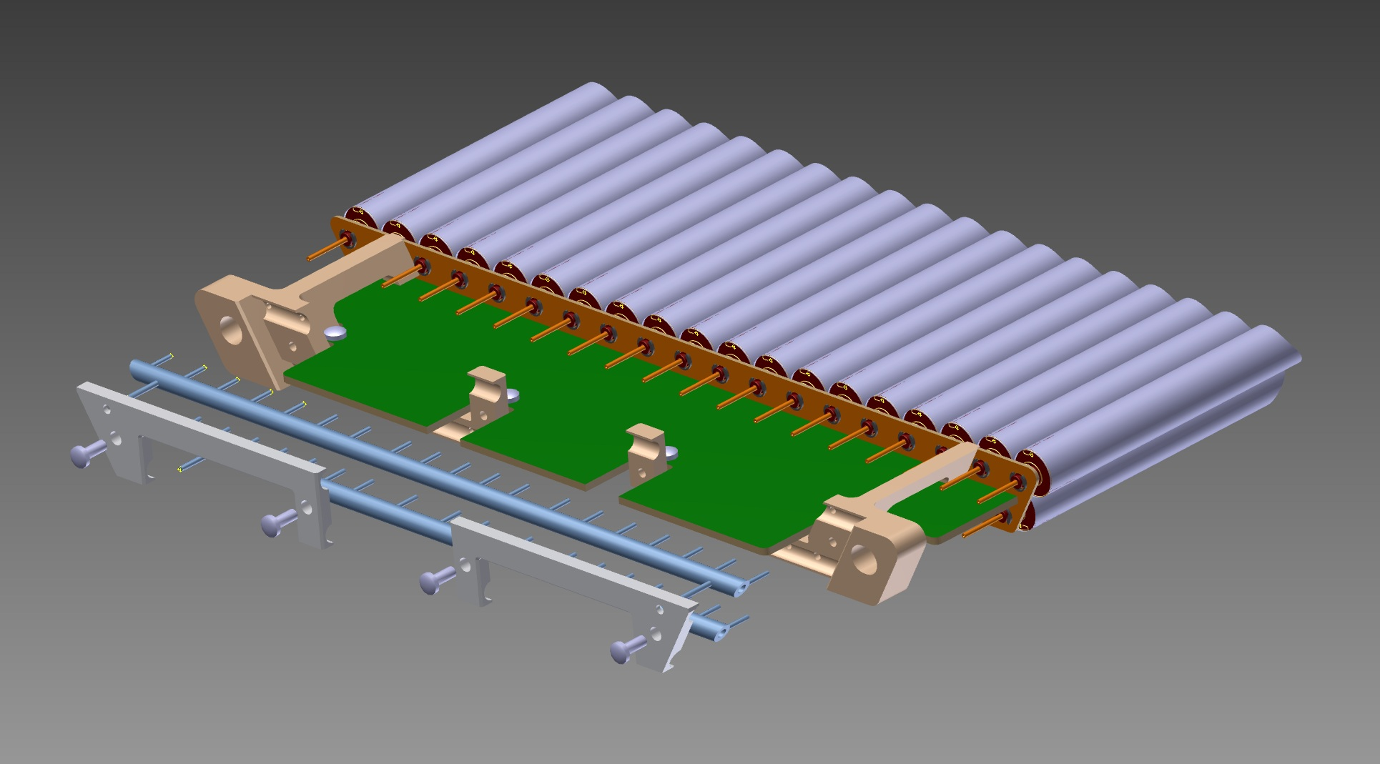
GAS system
A system to automatize and remote control of the gas flow parameters has been designed, with the possibility to switch to manual/local operation.
– setting the ratio of the two components in the gas mixture;
– quantifying the gas flow;
– setting the gas pressure; – controlling the temperature.
Basic elements have been identified. Prototype are under tests
No major risks
Fixing element
up and down gas pipes.
Gas pipes: steel,4mm 

Slide 7
DAQ
Central tracker : 4636 straws
Drift time ~ 200 ns
Time measurement: req. electronics resolution ~ 1 ns
sensitivity (threshold) ~ 2 fC
dE/dx for PID: MIP: signal charge 10⁶⁻10⁸ e⁻
10% resolution in 24 layers
detector capacitance: ~ 10-15 pF (9 pF/m)
Hit rates up to 800 kHz/channel
FE
DB
Common Clock Distribution
(i.e SODA)
Panda DAQ - network
Developments in agreement with the general requirements of the whole PANDA DAQ. No major risks

Slide 8
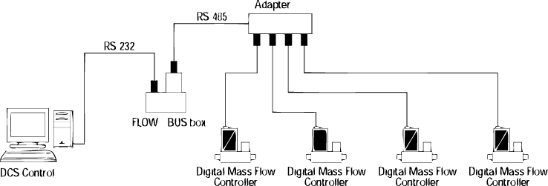
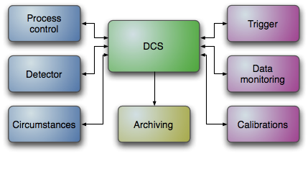
Slow Control
STT parameters to control are:
Gas mixture composition;
Pressure, temperature;
HV, LV
Position monitor
No particular risks have been identified. Everything is under development following PANDA general DCS prescriptions.

