Slide 1
Ionizing Radiation Damage
| Tobias Stockmanns

Slide 2
Simulation of Ionizing Radiation Damage
Ionizing radiation damage causes damage on the boundary between silicon oxide and silicon bulk material
More dangerous for electronics not so much for sensors (depending on the sensor type)
Not simulated up to now
Calculation done via MC dE/dx in the sensors
Results converted into Gray
Simulation done on the pandaGrid to collect enough statistics (about 15 MEvents)

Slide 3
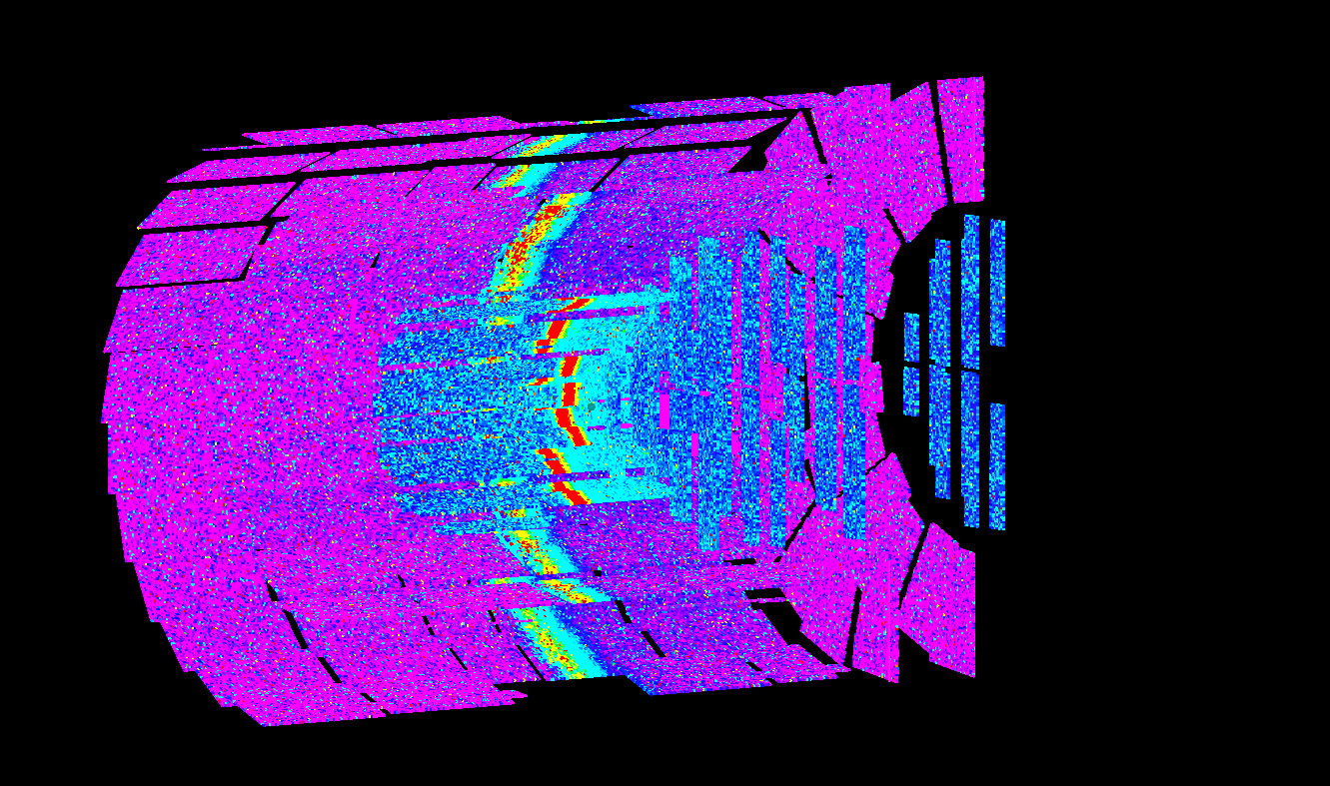
Distribution
Pixel and Strip part have different color scale

Slide 4
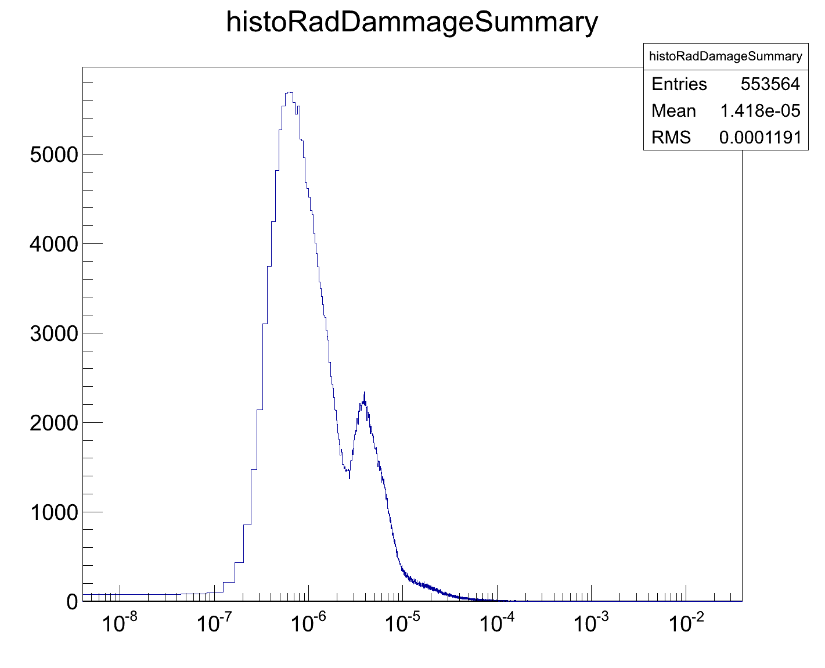
Full MVD
Ionizing Radiation Damage of the Full MVD for the simulated time of 0.75 s
Ionizing radiation damage in 0.75 s [Gray]

Slide 5
Full MVD
Ionizing Radiation Damage of the Full MVD for one year PANDA operation
2⋅10⁻⁴ 2⋅10⁻³ 2⋅10⁻² 2⋅10⁻¹ 2 20 200
Ionizing radiation damage for one year operation [kGray]

Slide 6
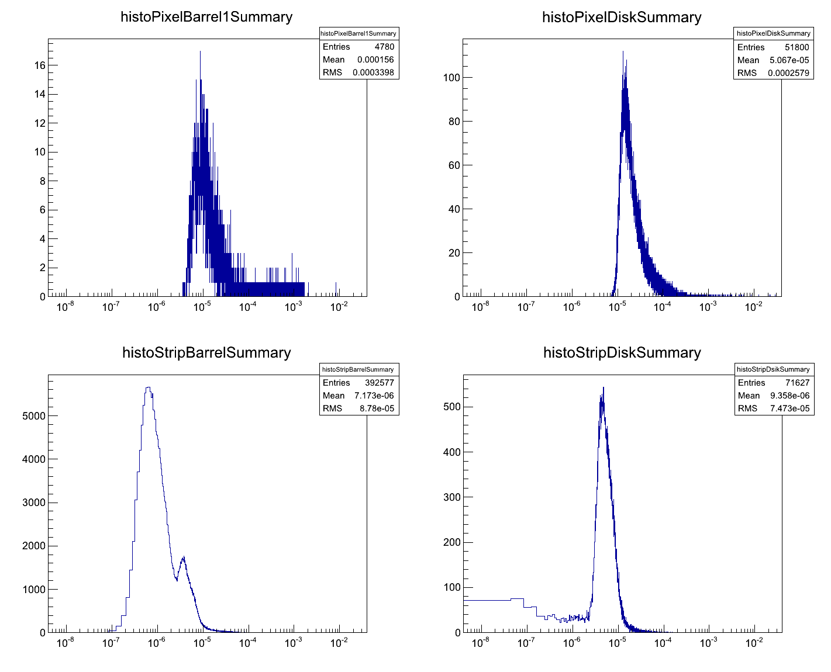
Different subparts
Pixel Barrel
Pixel Disk
2⋅10⁻⁴ 2⋅10⁻³ 2⋅10⁻² 2⋅10⁻¹ 2 20 200
2⋅10⁻⁴ 2⋅10⁻³ 2⋅10⁻² 2⋅10⁻¹ 2 20 200
Strip Barrel
kGray
Strip Disk
kGray
2⋅10⁻⁴ 2⋅10⁻³ 2⋅10⁻² 2⋅10⁻¹ 2 20 200
2⋅10⁻⁴ 2⋅10⁻³ 2⋅10⁻² 2⋅10⁻¹ 2 20 200
kGray
kGray

Slide 7
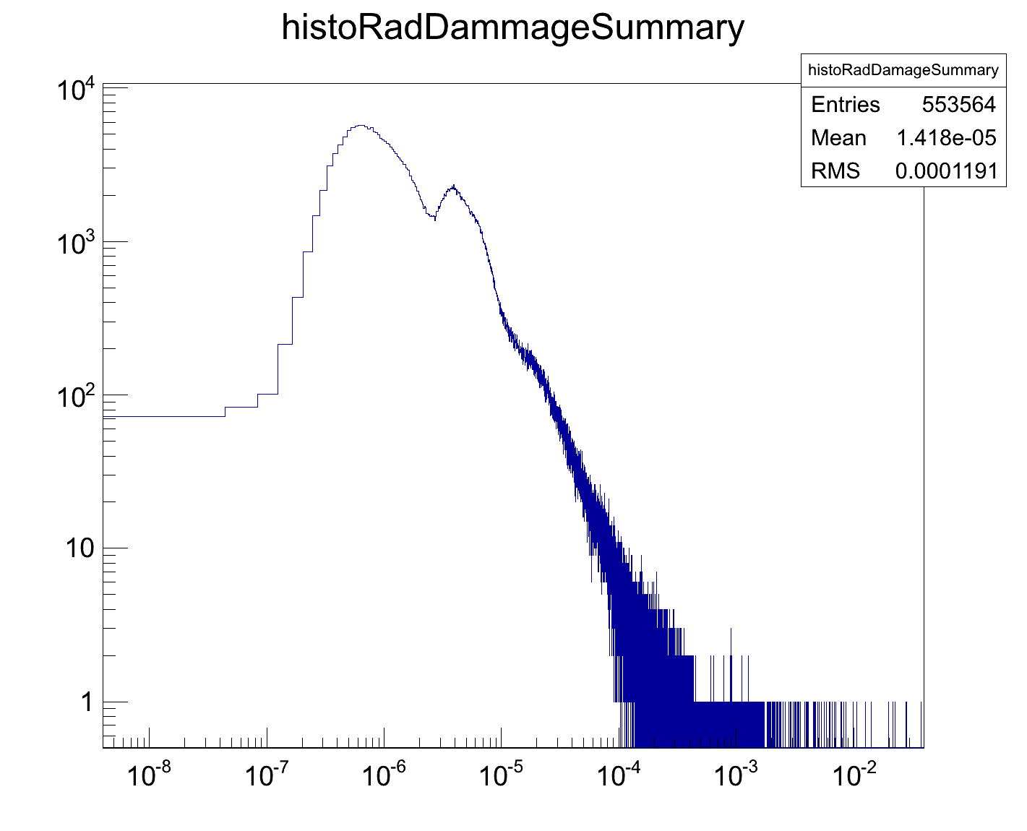
Full MVD double log
2⋅10⁻⁴ 2⋅10⁻³ 2⋅10⁻² 2⋅10⁻¹ 2 20 200
Ionizing radiation damage for one year operation [kGray]

Slide 8
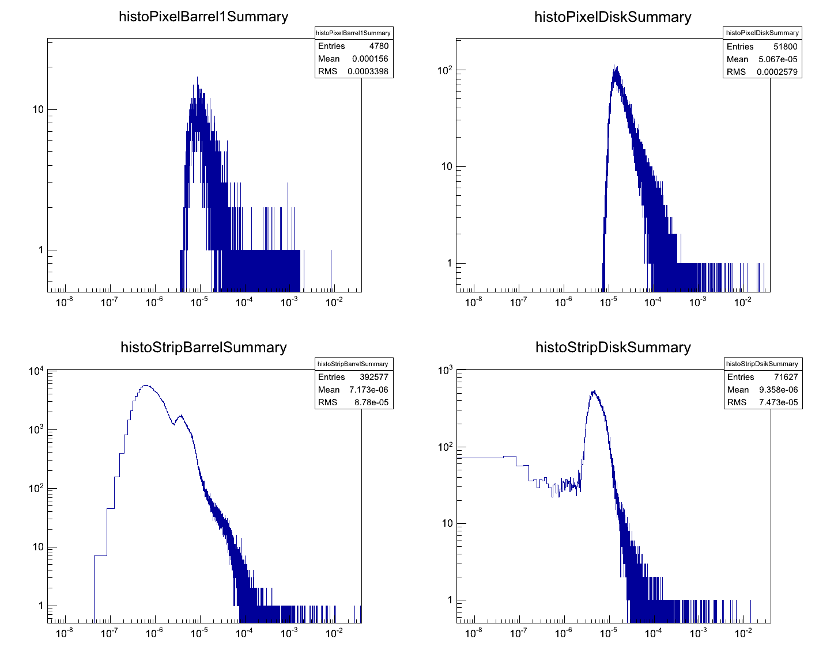
Different subparts double log
Pixel Barrel
Pixel Disk
2⋅10⁻⁴ 2⋅10⁻³ 2⋅10⁻² 2⋅10⁻¹ 2 20 200
2⋅10⁻⁴ 2⋅10⁻³ 2⋅10⁻² 2⋅10⁻¹ 2 20 200
Strip Barrel
kGray
Strip Disk
kGray
2⋅10⁻⁴ 2⋅10⁻³ 2⋅10⁻² 2⋅10⁻¹ 2 20 200
2⋅10⁻⁴ 2⋅10⁻³ 2⋅10⁻² 2⋅10⁻¹ 2 20 200
kGray
kGray

Slide 9
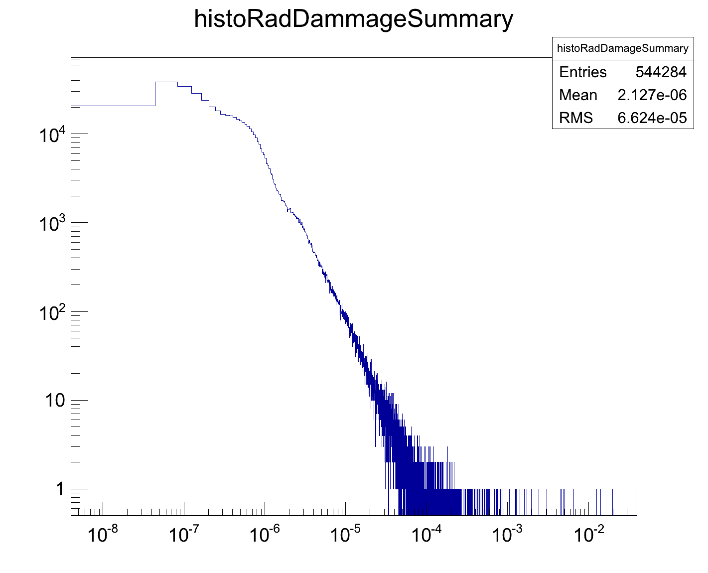
Full MVD 3.2 MEvents
3,198,000 events
2⋅10⁻⁴ 2⋅10⁻³ 2⋅10⁻² 2⋅10⁻¹ 2 20 200
Ionizing radiation damage for one year operation [kGray]

Slide 10
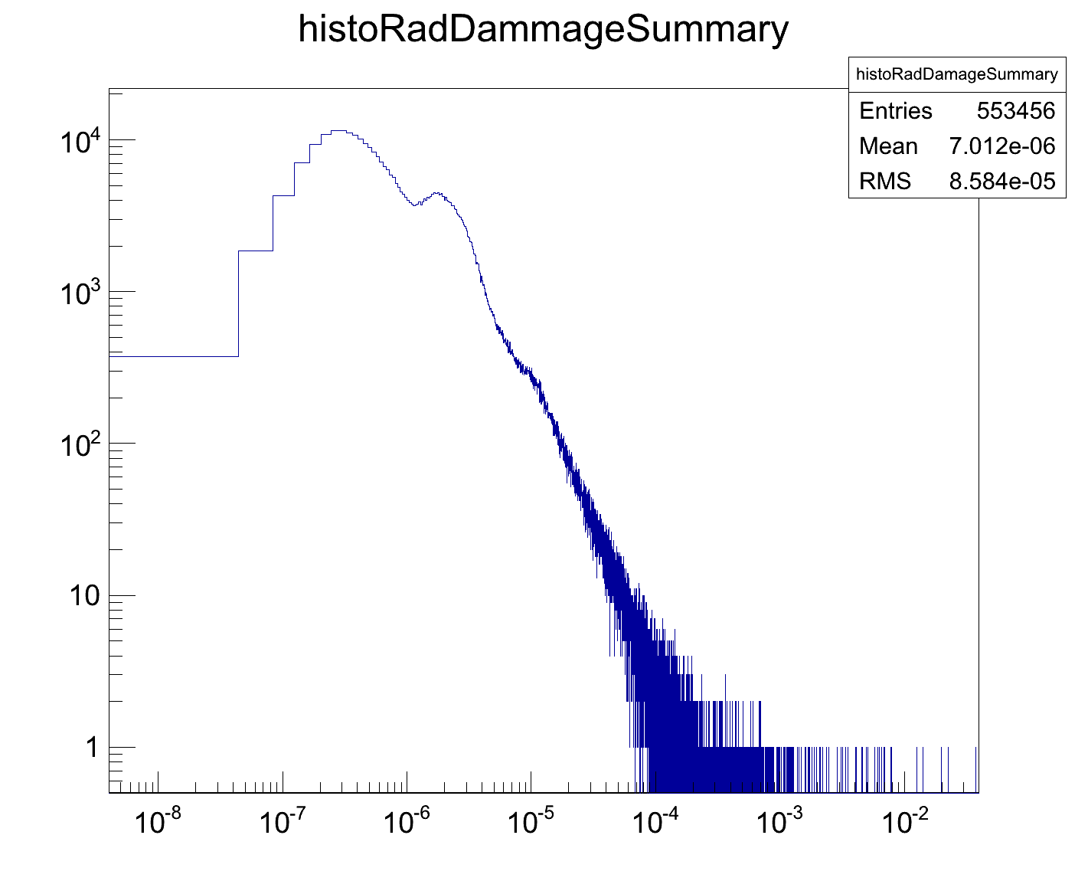
Full MVD 7.2 MEvents
7,116,000 events
2⋅10⁻⁴ 2⋅10⁻³ 2⋅10⁻² 2⋅10⁻¹ 2 20 200
Ionizing radiation damage for one year operation [kGray]

Slide 11

Full MVD 11.0 MEvents
11,040,000 events
2⋅10⁻⁴ 2⋅10⁻³ 2⋅10⁻² 2⋅10⁻¹ 2 20 200
Ionizing radiation damage for one year operation [kGray]

Slide 12
Full MVD 14.9 MEvents
14,930,000 events
2⋅10⁻⁴ 2⋅10⁻³ 2⋅10⁻² 2⋅10⁻¹ 2 20 200
Ionizing radiation damage for one year operation [kGray]

Slide 13
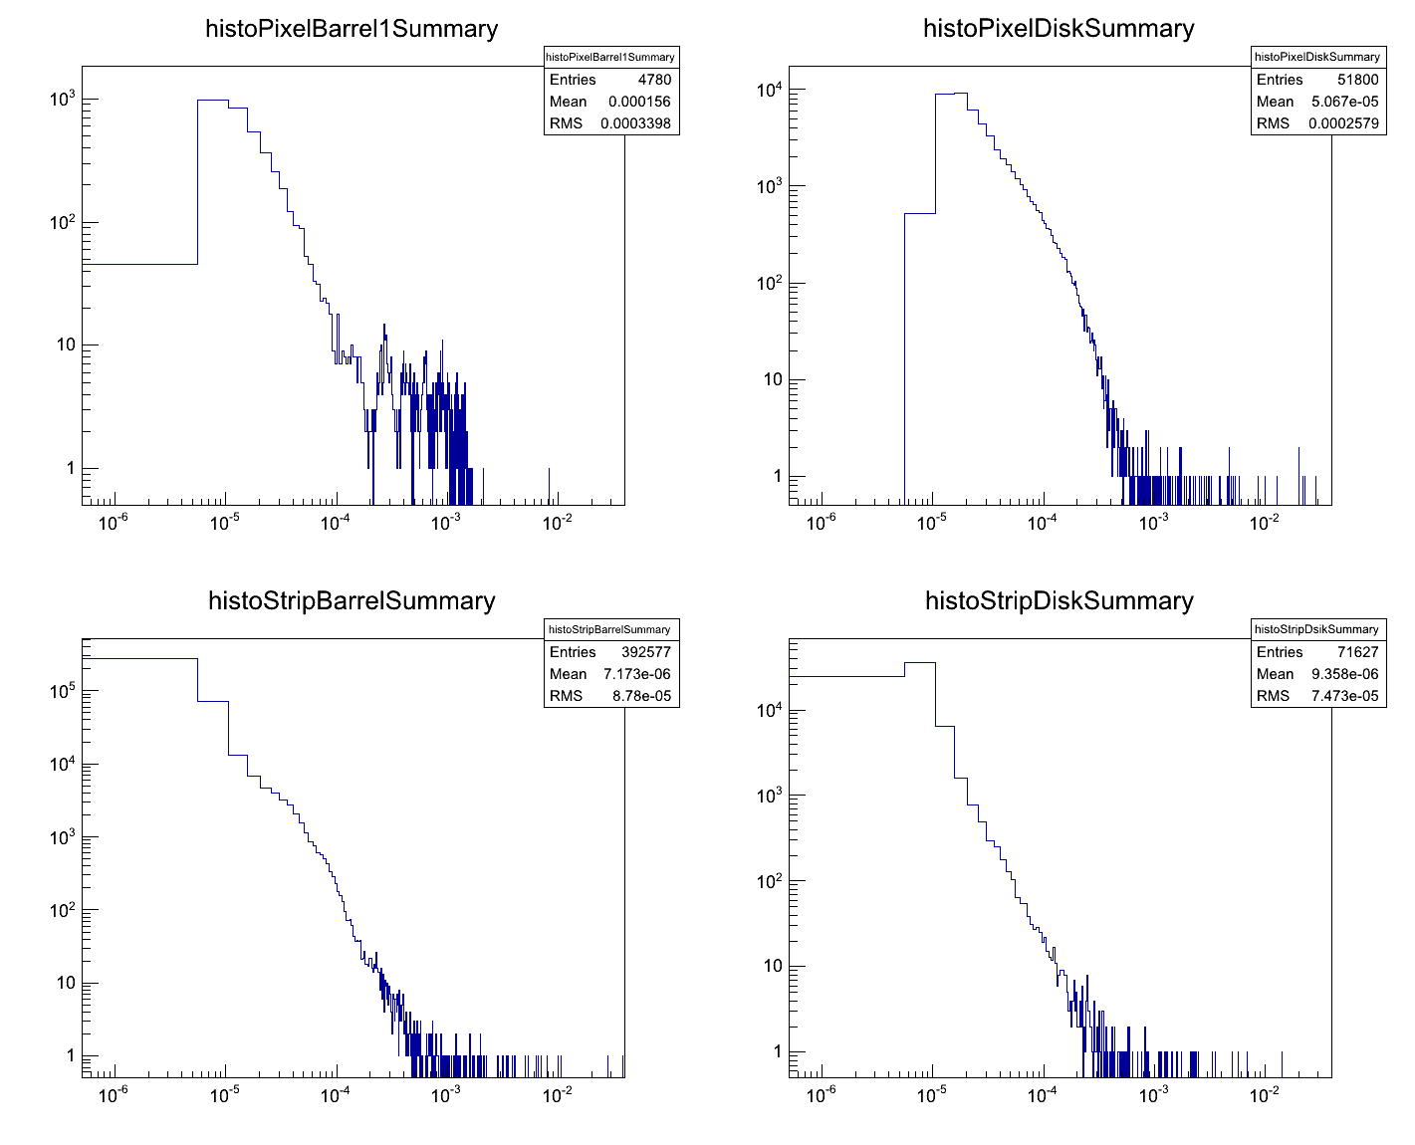
Different subparts double log
Pixel Barrel
Pixel Disk
?
12 kGray
2⋅10⁻² 2⋅10⁻¹ 2 20 200
kGray
2⋅10⁻² 2⋅10⁻¹ 2 20 200
kGray
Strip Barrel
Strip Disk
2⋅10⁻² 2⋅10⁻¹ 2 20 200
kGray
2⋅10⁻² 2⋅10⁻¹ 2 20 200
10 kGray
kGray
6 kGray

Slide 14
Summary
Simulation of ionizing radiation damaged for pbar – p reactions was done for the MVD
A significant contribution of the elastically scattered protons could be seen
The overall radiation dose is about 10 kGray
The radiation dose for the pixel part is twice as much as for the strip part
Structure in the pixel barrel part still needs further studies

