Slide 1
Research Data Management GSI/FAIR Strategy

Slide 2
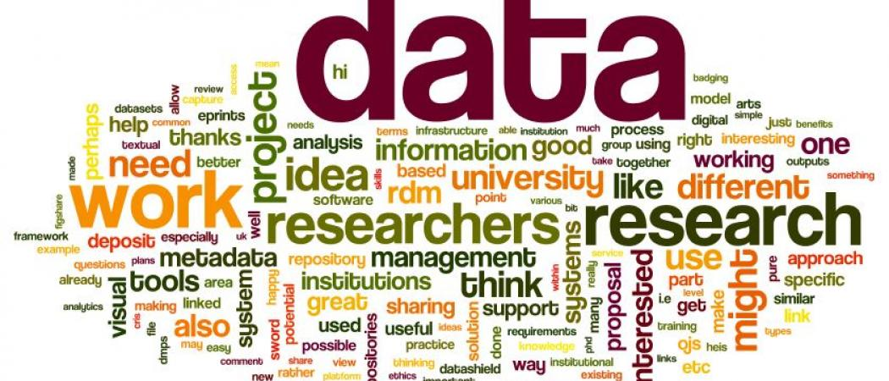
Research Data Management FAQ
What data should I place in a repository? (raw/pre-processed?)
When to publish data to repository?
How long should my data be accessible for?
Who should be able to access my data?
Where should I publish my data?
…

Slide 3
Research Data Management at GSI/FAIR: Strategy
Development of a “concept for RDM” in collaboration with research groups, accelerator division, Library and documentation, and the IT department -> Policies and guidelines
Establish “best practice of RDM” (e.g. data management planning for grants, ease of following the data management life-cycle, repositories …. )
Conduct workshops, training courses and information events on RDM for GSI/FAIR members, collaboration partners and members of associated graduate schools

Slide 4
Development of RDM concept
GSI/FAIR RDM policy Statements:
the research data must be published in a suitable repository with a persistent identifier (i.e. DOI),
a data management plan must be made for each project,
GSI/FAIR will support researchers throughout the data management phases
GSI Open Science working group established
representatives from WTR, IT, Accelerator division, Library, GRO, Technology transfer
GSI/FAIR RDM guidelines (Richtlinien):
Broader policy outlining aspects, details and examples
In preparation

Slide 5
RDM Tools (best practice of RDM)

Slide 6
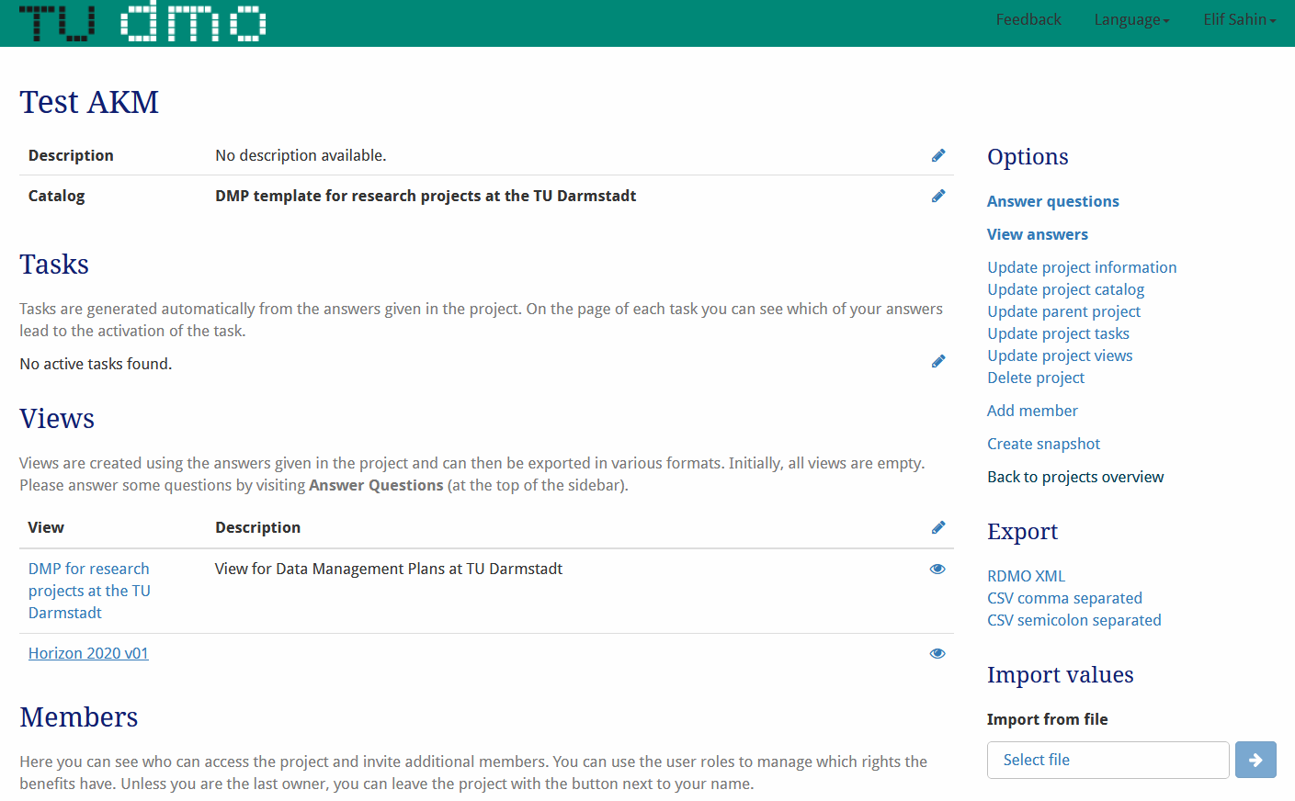
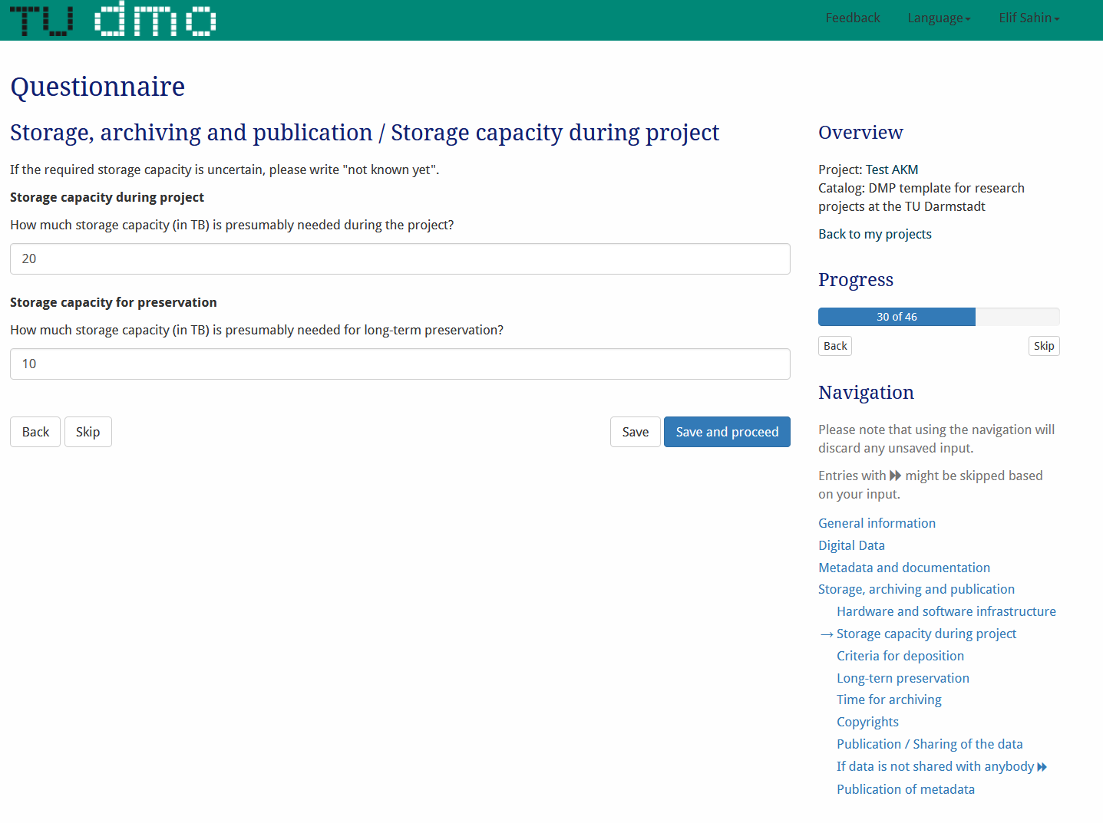
RDM Tools Data Management Planning

Slide 7
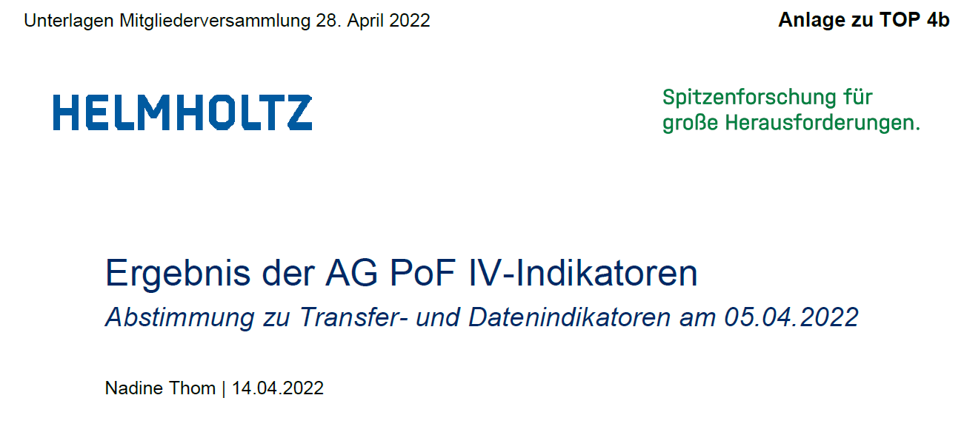
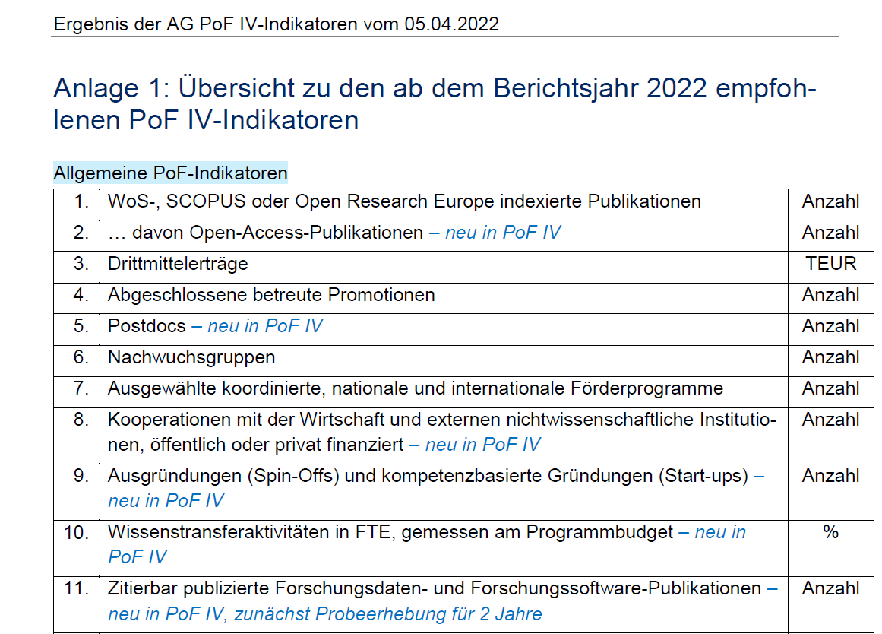

Slide 8
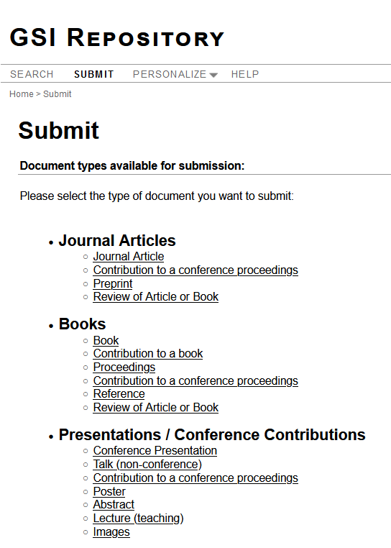
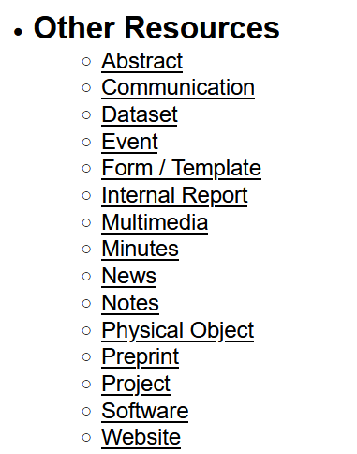

Slide 9
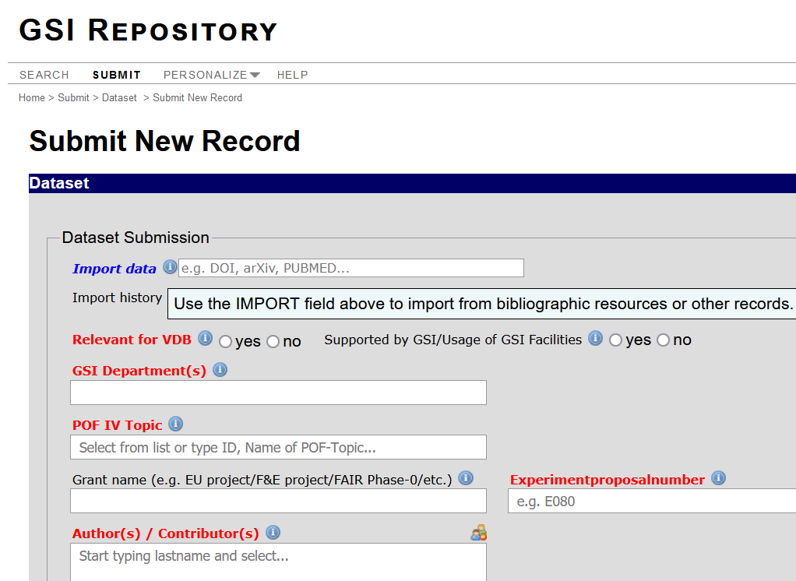
GSI Repository: Research Data
DoIs can be assigned via library
Can also link to data in other repositories (with data assigned Persistent Identifier)
Research data then linked to the published article
Instructions for use in preparation

Slide 10
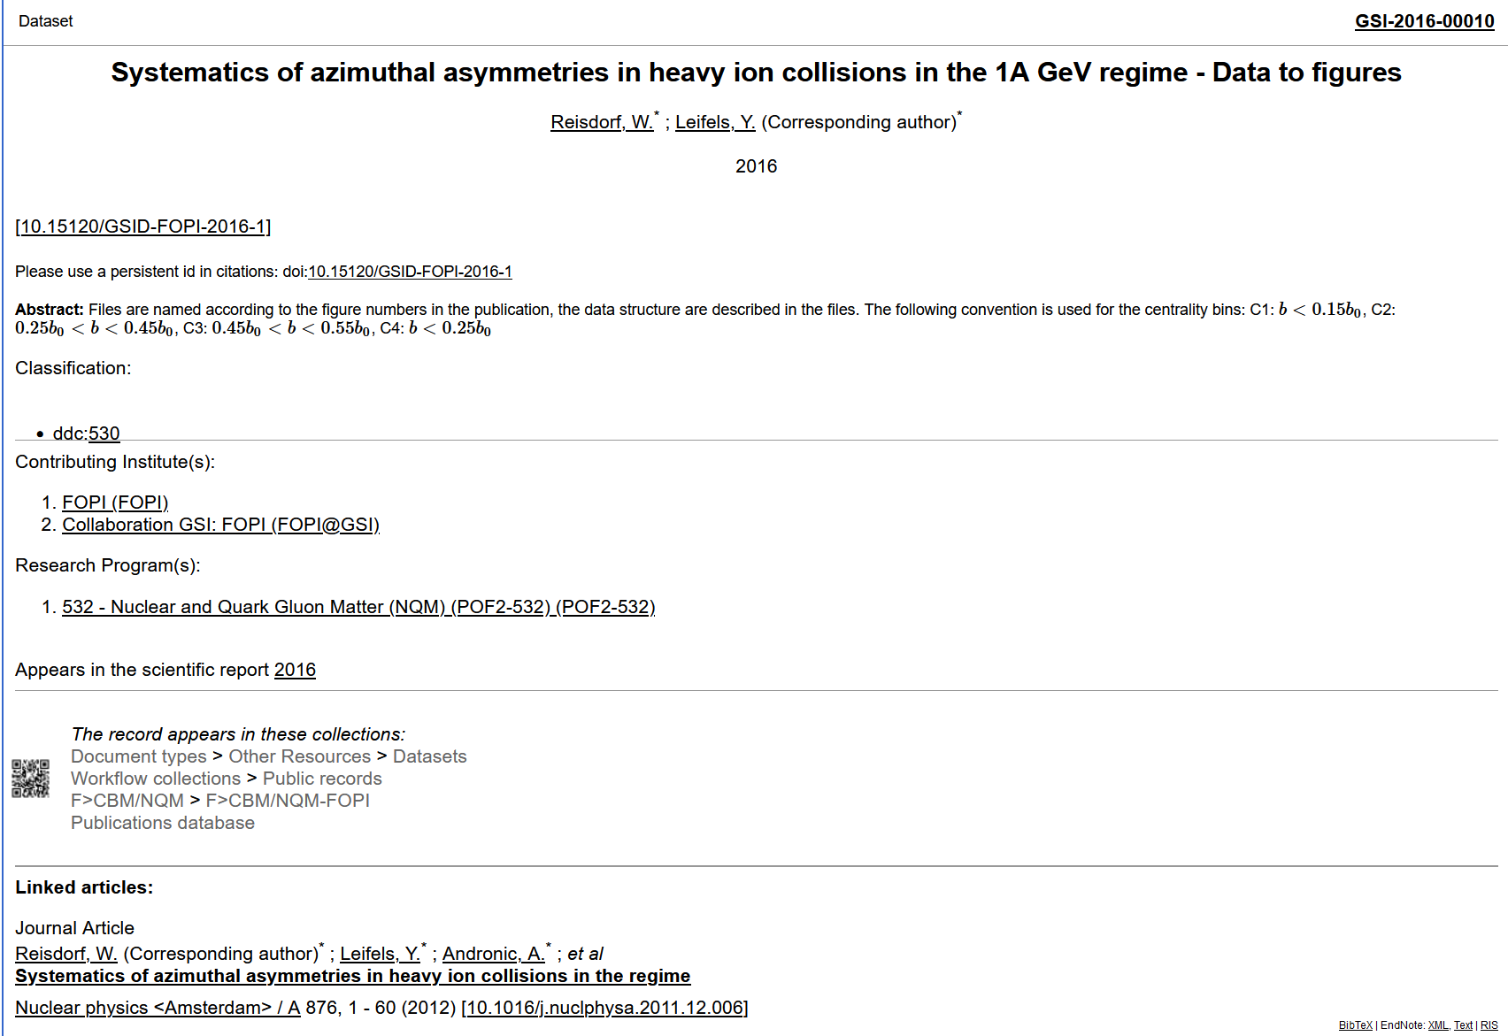
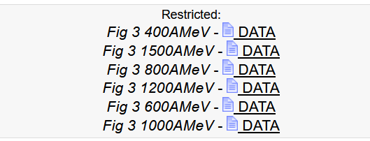
GSI Repository: Research Data Example 1
Persistent Identifier (DoI)
Data Description
Research Program (grant/PoF ID)
Research Data
Published article link (both Journal and GSI repo)

Slide 11
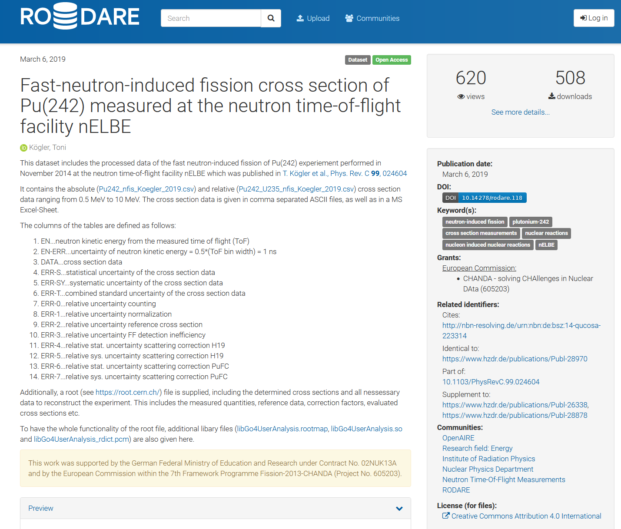
GSI Repository: Research Data Example 2

Slide 12
Next steps…
Current repository needs some adaptions to house data sets
Planned upgrade from current GSI publication (JOIN2) repository to new version (e.g. DSpace-CRIS)
RDM included currently => new repository separate for RDM or combine with publication repository?
Please contact Head of Library and Documentation Katrin Grosse for more information and details about the GSI repository

