Slide 1
GLAD status, upgrade & maintenance
R3B Collaboration Meeting
20220607 GSI Darmstadt
H. Simon ●
GSI Darmstadt

Slide 2
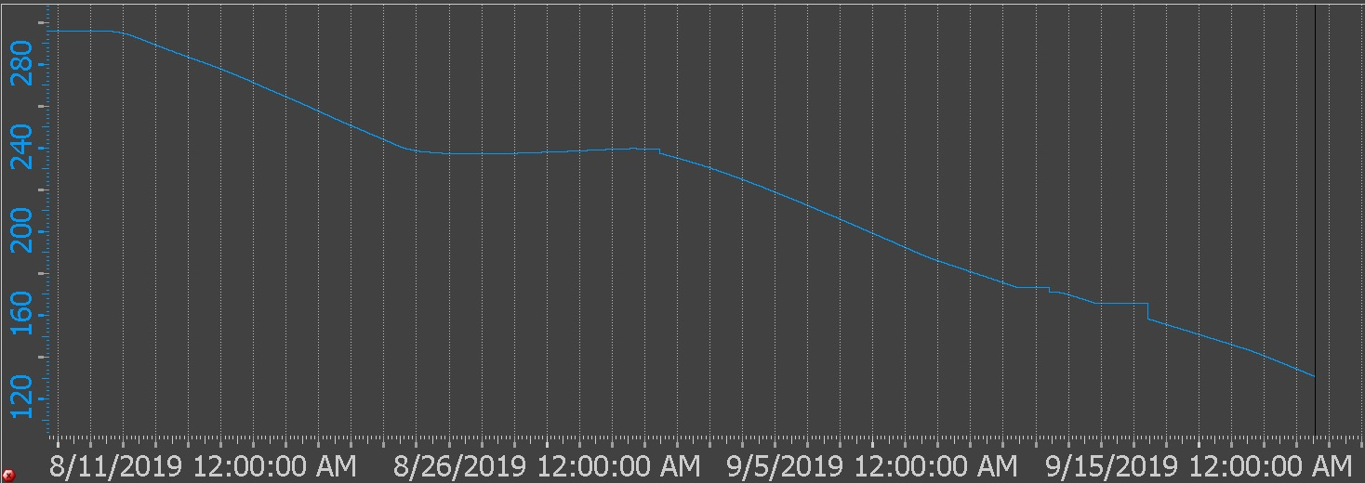
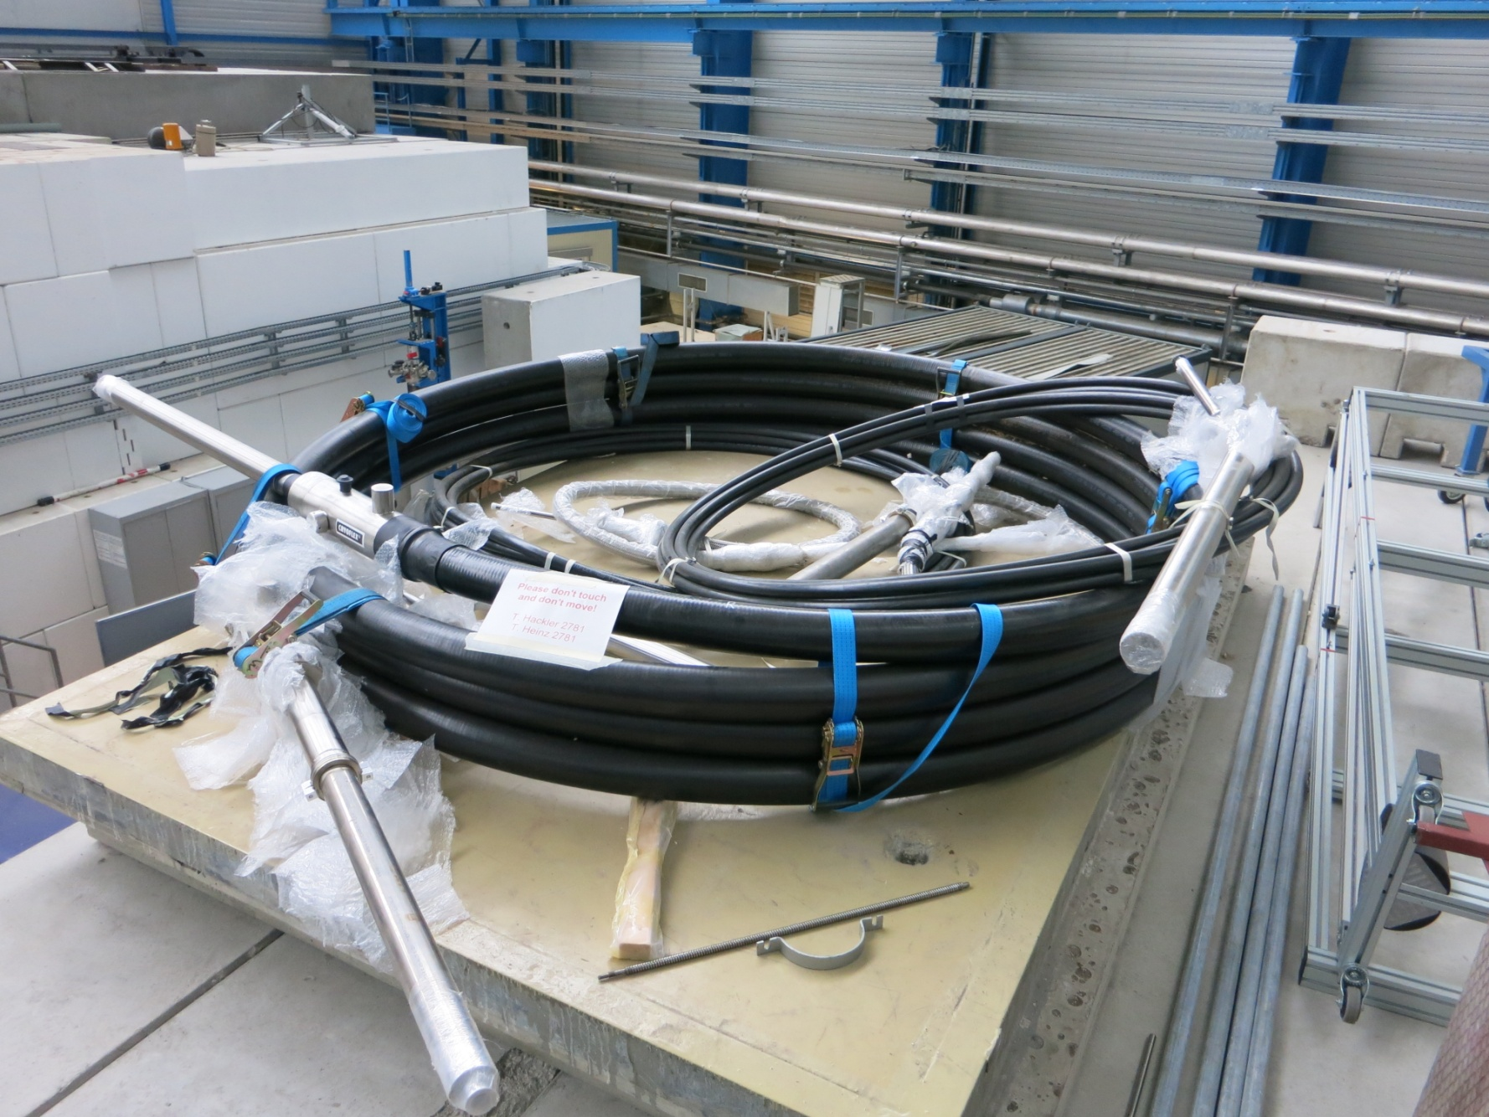
2019: Cool Down limited by coaxial line …
C. Mayri, H.S. T. Hackler et al.
Return flow limited
by return line → flow required through current leads → heater limitation…
Idea (T.Hackler): Create Bypass
Specs: 2012

Slide 3
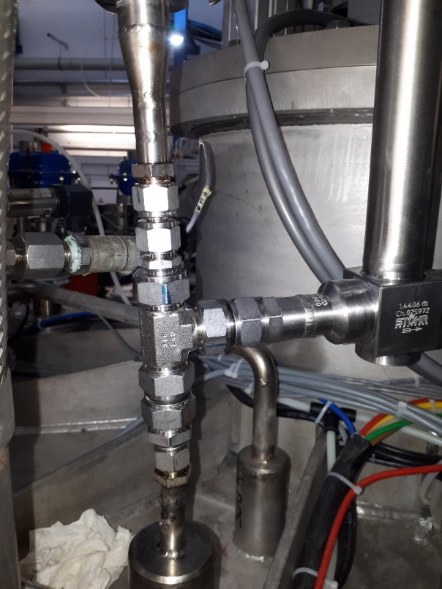
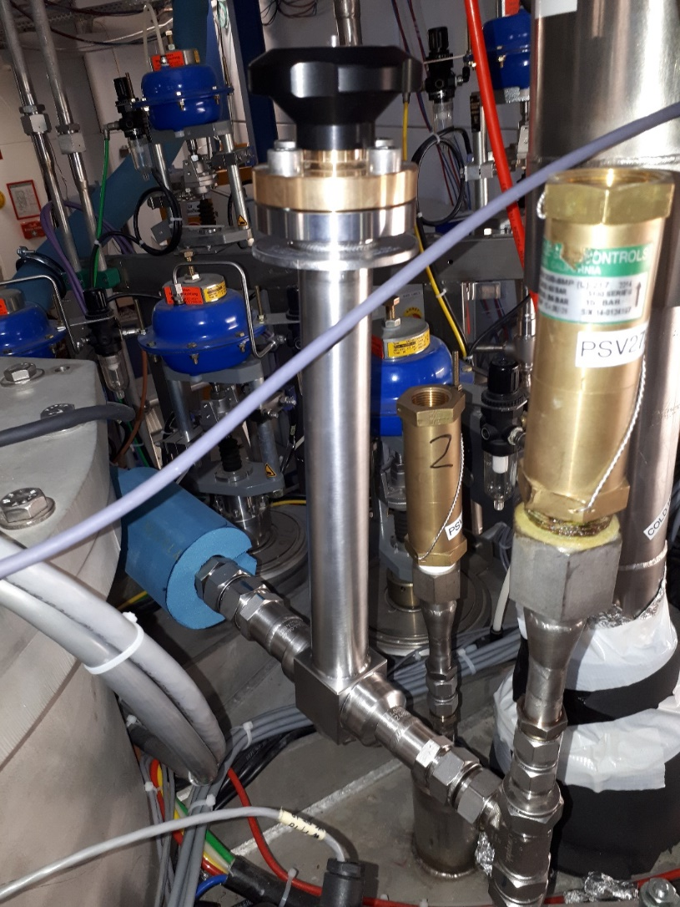
Hardware for additional return line
Additional new cold return valve to adjust return flow and to close new return line
Additional t-piece for removable connection of safety valve and for connection of parallel cooldown return line

Slide 4
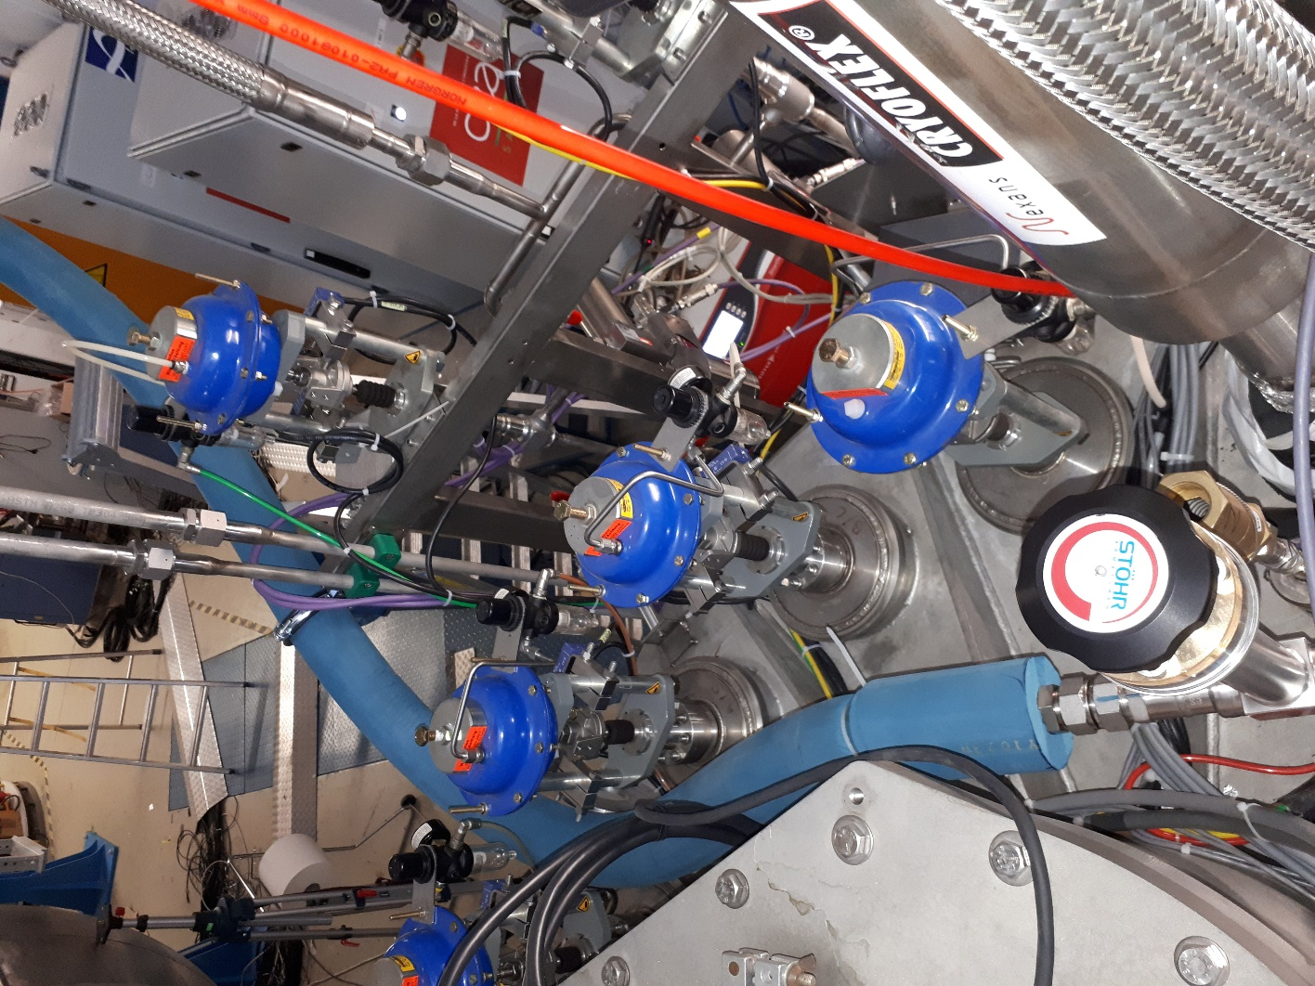
Additional return line
The new cooldown return line is a corrugated tube with a stainless steal wire jacket isolated with special Armaflex LTD isolation for very low temperatures down to -180 °C.
The new line should be used for the cooldown as long as the isolation can avoid water or ice inside Cave C
Special hand valve for extremely low temperatures down to -253 °C
2021 first commissioning in January
2022 Nominal & stable operations achieved in S509/522!

Slide 5
2021: Nominal cool down rate achieved
C. Mayri, H.S. T. Hackler et al.

Slide 6
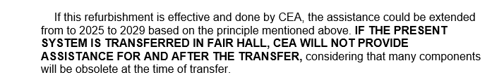
Remaining issues:
Improved field maps → Based on Valeriis field maps inconsistencies with tracker have been found (M . Heil / A Kelic-Heil )
➔ Dedicated mapping foreseen (3t mapping table to be installed after exp. campaign, Measurements until 20220626).
In-kind accepted (France/Germany)
In-kind contracts closed
Maintenance contract closed preventive maintenance and hot-line support (10k€/y)
Documentation received 05/2022 / approval by QA pending
Common funds via NUSTAR → ECE/ECSG (193k€@2005)

Slide 7
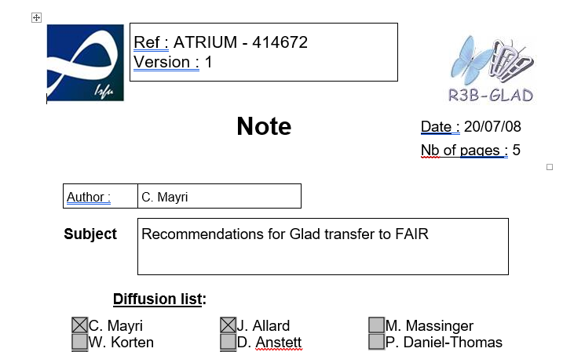
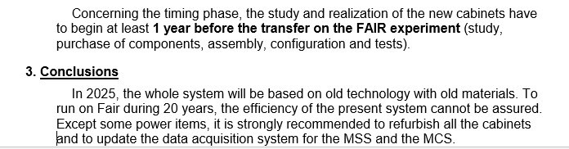
Scope:
Cabling, Magnet Control, Magnet Safety System, Software
Price tag: roughly 200k€ ➔ refined estimate 11/2021.

Slide 8
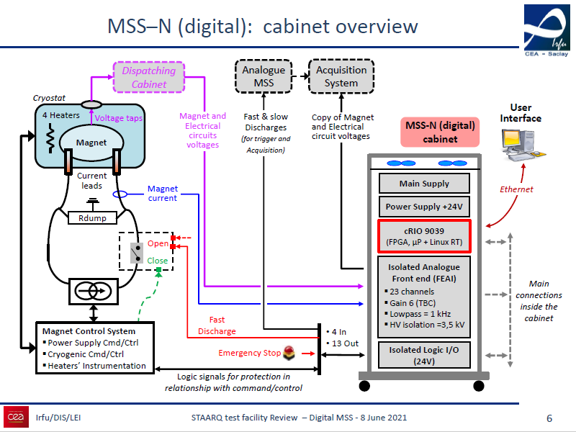
CERN HL-LHC project

Slide 9
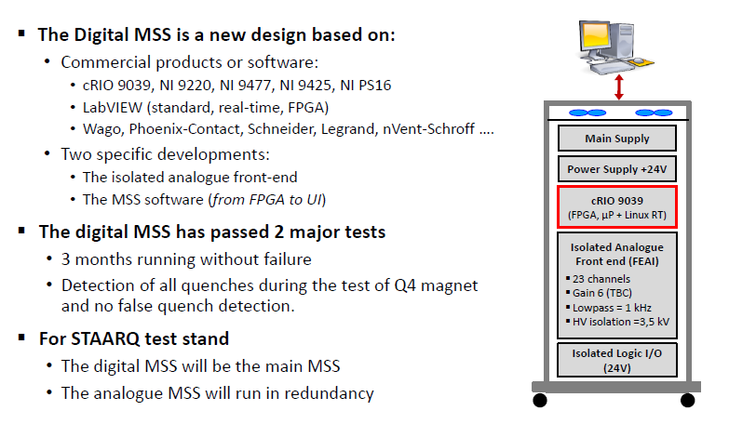
Proposed CEA Design for refurbishment

Slide 10
MCS refurbisment
Some components cannot be maintained after 2025. That includes the PLC and the Muscade software.
The CABTR are operational but cannot be replaced. It is strongly recommended to replace them by CABTF.
The helium box and the ProfiBus could be replaced by more recent and industrial components : LM510 box and ProfiNet. The helium gauges will be replaced.
Other spare components like Sipart, heaters, cabinet equipment may be purchased without replacing the installed ones.
There is a big incertitude on the cable replacement if they are not compatible with Fair safety standards or if they are too short.
Put on hold, can be replaced as part of preventive maintenance (2025-)

Slide 12
Glad CS refurbishment CEA Saclay 2021/11/04

Slide 13
Context
The assistance contract is valid until 2025. It should be extend to 2029 if the magnet control system is refurbished,
The MCS design is dated from 2014 and its building from 2015. Some components are already obsolete.
The MSS design is second generation architecture. We are shifting on numerical safety system (5th generation).

Slide 14
Proposals
CEA-Irfu made a proposal in 2020 for a whole refurbishment of the systems (except the heater cabinets). The estimated cost was 300 k€ of hardware and 300 k€ of manpower (the proposal text indicates 100 k€ by mistake). (internal !)
We studied other scenarios reusing a part of the present cabinets. In this case, it is recommended to purchase some spares. In case of failure, there is a risk to quench the magnet and to loose many experimental days.

Slide 15
MCS refurbisment
Some components cannot be maintained after 2025. That includes the PLC and the Muscade software.
The CABTR are operational but cannot be replaced. It is strongly recommended to replace them by CABTF.
The helium box and the ProfiBus could be replaced by more recent and industrial components : LM510 box and ProfiNet. The helium gauges will be replaced.
Other spare components like Sipart, heaters, cabinet equipment may be purchased without replacing the installed ones.
There is a big incertitude on the cable replacement if they are not compatible with Fair safety standards or if they are too short.
Put on hold, can be replaced as part of preventive maintenance (2025-)

Slide 16
MCS cost
Priority | 1 | 2 | 3 | 4
Hardware | 13 k€ | 35 k€ | 6 k€ | 6 k€
Manpower | 45 Tech.days | 5 Tech.days | 5 Tech.days
There is also all the manpower for the design, the test, the cabinet unwiring and rewiring, and the new system commissioning on Fair.
This work needs 30 days of engineer and 110 days of technician.
We recommend to perform the priority 1 and 2 and to provide the spares (priority 4) for a cost (2021) of :
- hardware 54 k€
- manpower 100 k€
The cable replacement cost is about 40 k€ and 10 k€ of manpower

Slide 17
MSS refurbisment
The present MSS cannot be transferred on Fair and has to be updated in numerical version. Without replacement, the magnet should be damaged in case of main failure.
The As-net (V1) should be maintained by purchasing some spare components. It should be updated in version 2 as soon as it will be operational. The cabinet equipment may be purchased without replacing the installed ones.
There is a big incertitude on the cable replacement if they are not compatible with Fair safety standards or if they are too short.

Slide 18
MSS cost
Priority | 1 | 2
Hardware | 89 k€ | 35 k€
Manpower | 105 Eng.days 90 Tech.days | 5 Tech.days
There is all the manpower for the design, the test, the cabinet unwiring and rewiring, and the new system commissioning on Fair.
This work needs 80 days of engineer and 50 days of technician.
We recommend to perform the priority 1 and the spare procurement for a cost (2021) of :
- hardware 100 k€
- manpower 210 k€
The cable replacement cost is about 30 k€ and 10 k€ of manpower

Slide 19
Conclusion
Some materials have to be replaced and to avoid a long unworked time of the magnet, some spare may be purchased in advance.
The proposal work represents a material cost of about 150 k€ and a global manpower of about 300 k€.
The incertitude on the cables represents a global cost of 90 k€.

