Slide 1



Status of LH2 target
G. Authelet, A. Corsi, A. Lagni, Ch. Mailleret CEA/IRFU
R3B WS, June 8th 2022
GET_INvolved Programme

Slide 2
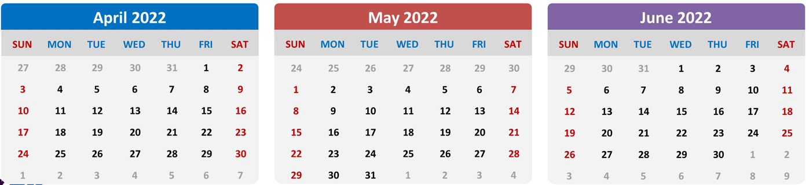
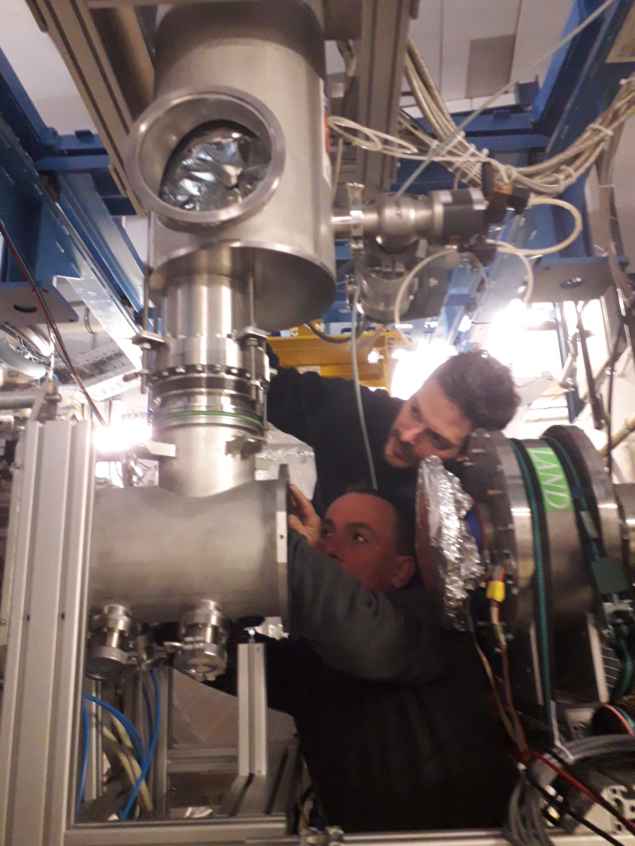
LH2 target in 2022
April 4th-8th: 4th : 5-cm Target installation;
5th : 10-6 mbar vacuum reached in 20h;
6th : PLC and software update;
7th : Cooling.
April 12th-15th: 12th: 5-cm target filling, parameters adjusments;
13th-14th : target stability values fine adjustments;
15th: Target emptying and warming.
May 16th-June 8th: target filled for S522 & S509;
Since today: warm up and vent for the end of the week.
Notes:
Programmable Logic Controller

Slide 3
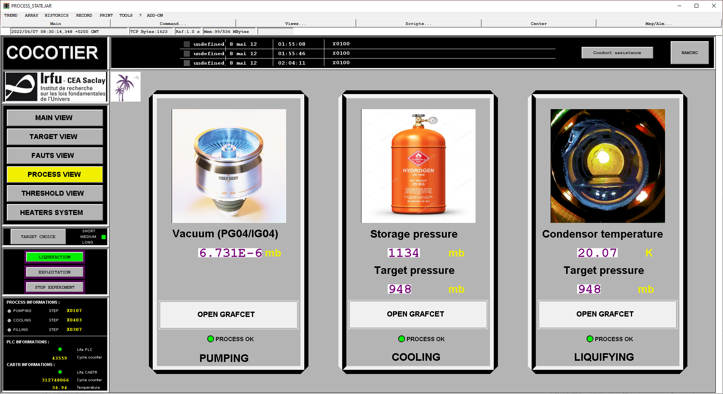
LH2 target in 2022
To be monitored by shifters

Slide 4
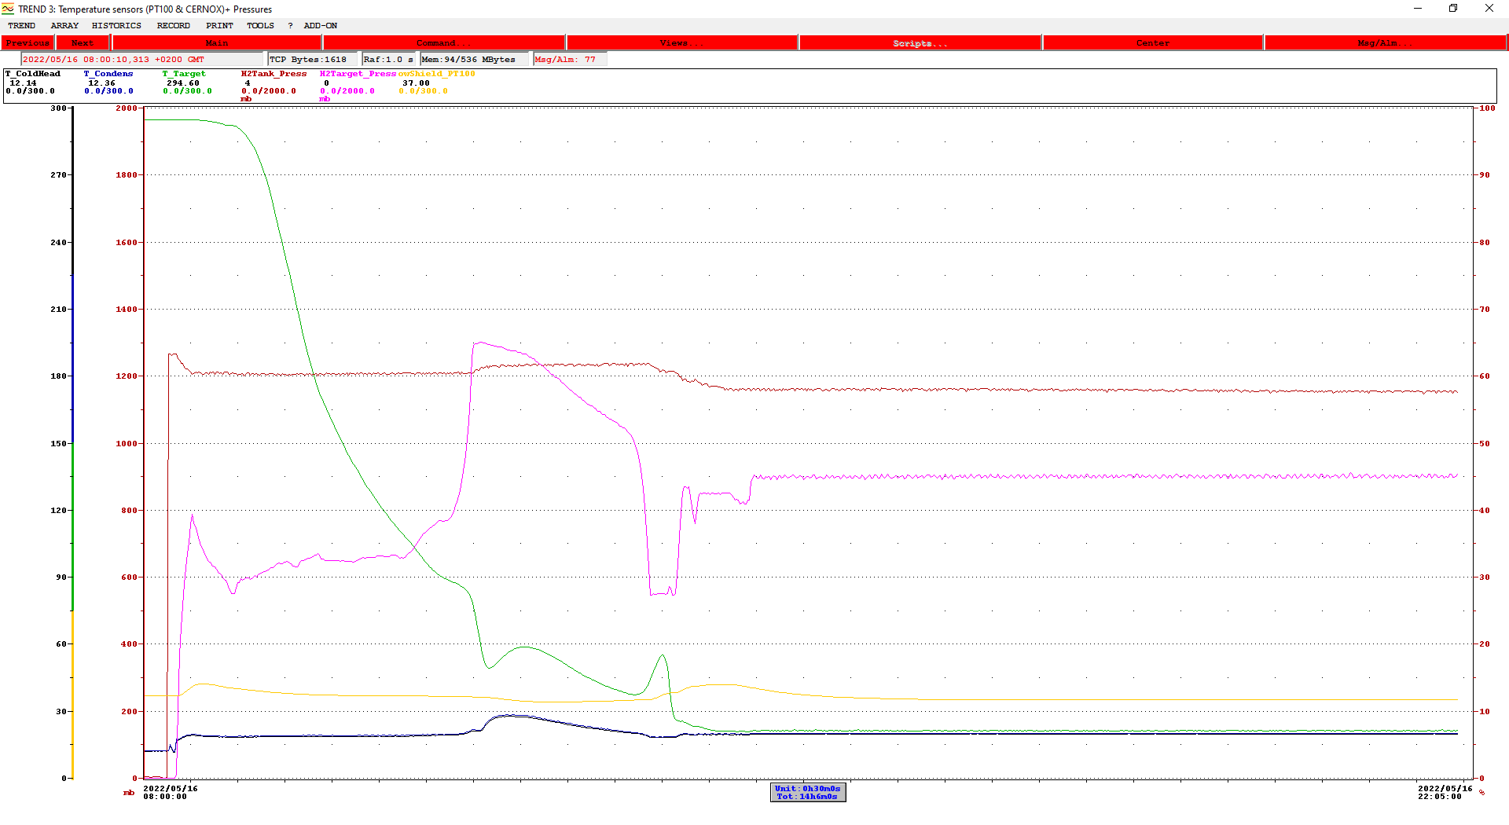
LH2 target in 2022
Target filling April, 16th
8h20: Gas insertion
14h25: Target filled

Slide 5
LH2 target in 2022
Target filling took 6 hours – should always count at least 10 hours since this time, strongly depends on environment.
Target running stable for 23 days!
On Sunday 29th afternoon (tuning of 12C beam): The temperature sensor on the return circuit become unstable, and indicated 1 degree more, target pressure and vacuum increased for half an hour.
A possible explanation is that the top of the target’s body, where is installed the temperature sensor, was hit by intense beam (10⁶ pps).
Decided to not try to fix the sensor issue because too close from beamtime, run S522 part 2 with lower pressure to increase density and stability.
On Tuesday 31th: The probe return to normal after power cycling. Adding H₂ between two beams. Everything is working fine, target is stable for S509.

Slide 6
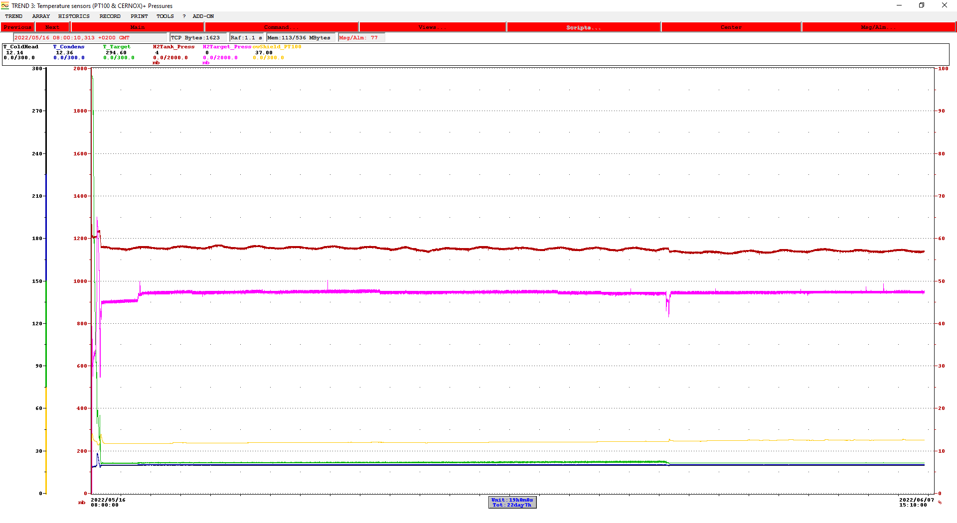
LH2 target in 2022
Target ‘’life’’ on 3 weeks
Working conditions: pressure 943/953 mbar
temperature : 20,05/20,12 K
End of S522 part 1
S522 part 2
Begining S509
Begining of S522 part 1
Gas adding

Slide 7
LH2 target in 2022
Wednesday morning when the beam finishes (8AM):
Pedestal run FOOT;
Bias off FOOT and power off ADC boards;
Warm up the target ( Gilles in remote and me);
Pump the H2;
Target at room temperature and fully secured by Friday.

Slide 8
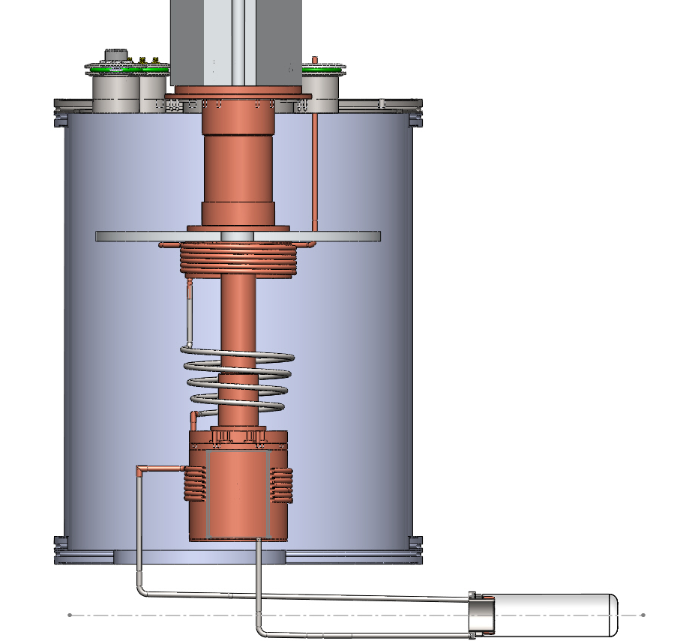
Backup
How it works
Cryostat under vacuum
1st stage (50K)
Cryocooler
2nd stage (4,2K)
Condenser/Liqufier
Target
BEAM

Slide 9
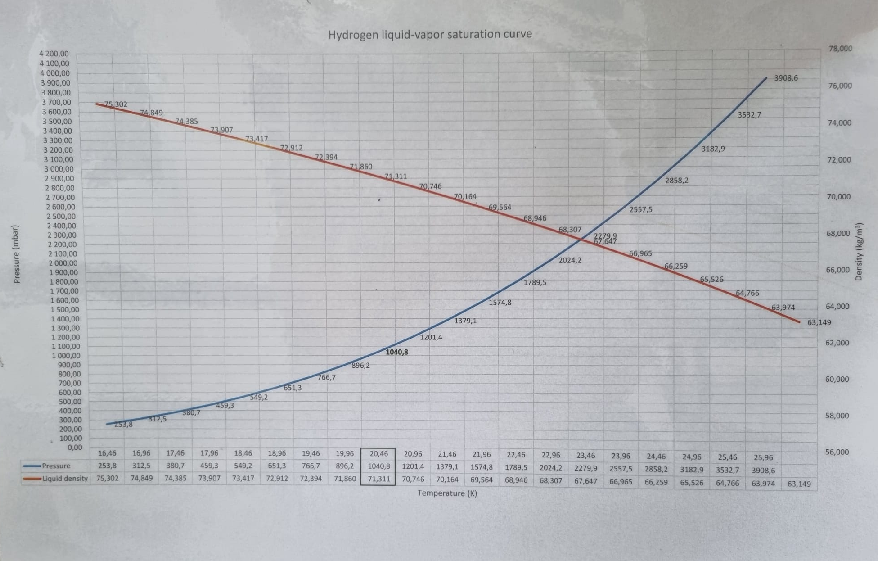
LH2 target in 2022

Slide 10
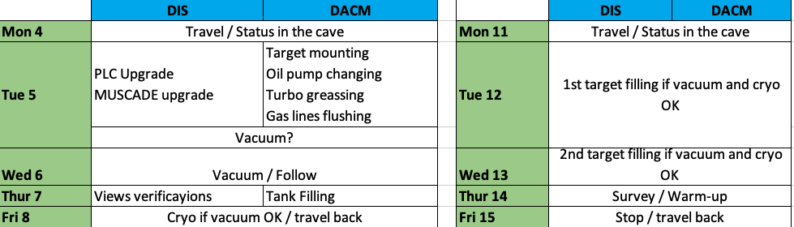
Backup

