Slide 1


Experiment s515 Analysis report
Ivana Lihtar,
Eleonora Kudaibergenova,
Martina Feijoo
R3B Collaboration Meeting
7th-9th June 2022

Slide 2
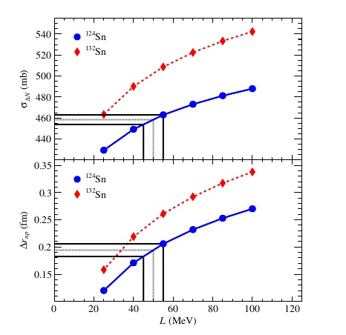
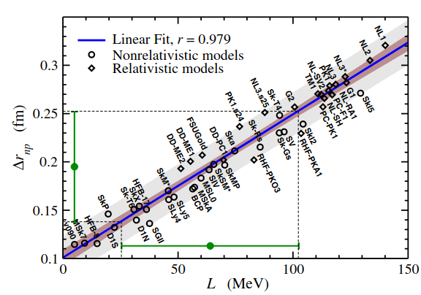
Overview
T.Aumann et al., Physical Review Letters 119 (2017) 262501
Goals
Constrain energy-density functionals and the density-dependence of the symmetry energy using
- Neutron removal (neutron skin thickness)
- Coulomb excitation (dipole polarizability)
Multiknockout reactions (could be sensitive to SRC)
S515 proposal, T.Aumann, A.Horvat
Constraint on L of 10 MeV
± 0.01fm neutron skin thickness (¹²⁴Sn)
2% accuracy in cross section

Slide 3
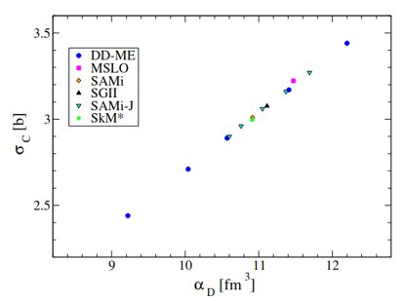
Overview
A precise value in the cross section leads to a constraint in energy-density functionals
Goals
Constrain energy-density functionals and the density-dependence of the symmetry energy using
- Neutron removal (neutron skin)
- Coulomb excitation (dipole polarizability)
S515 proposal, T.Aumann, A.Horvat

Slide 4
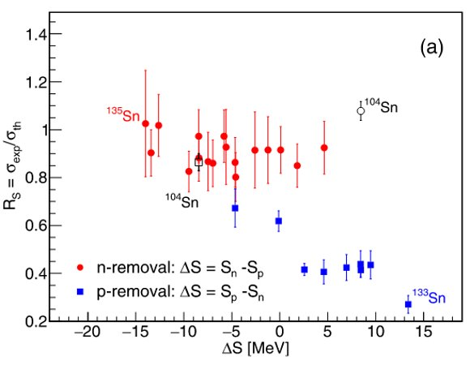
Overview
A precise value in the cross section leads to a constraint in energy-density functionals
Goals
Constrain energy-density functionals and the density-dependence of the symmetry energy using
- Neutron removal (neutron skin)
- Coulomb excitation (dipole polarizability)
Multi-knockout reactions (could be sensitive to SRC)
J. Díaz-Cortés et al., Physics Letters B 811 (2020) 135962
S515 proposal, T.Aumann, A.Horvat
Sistematic trend Rs ⪅ 1 observed, but only single knockout channels were studied

Slide 5
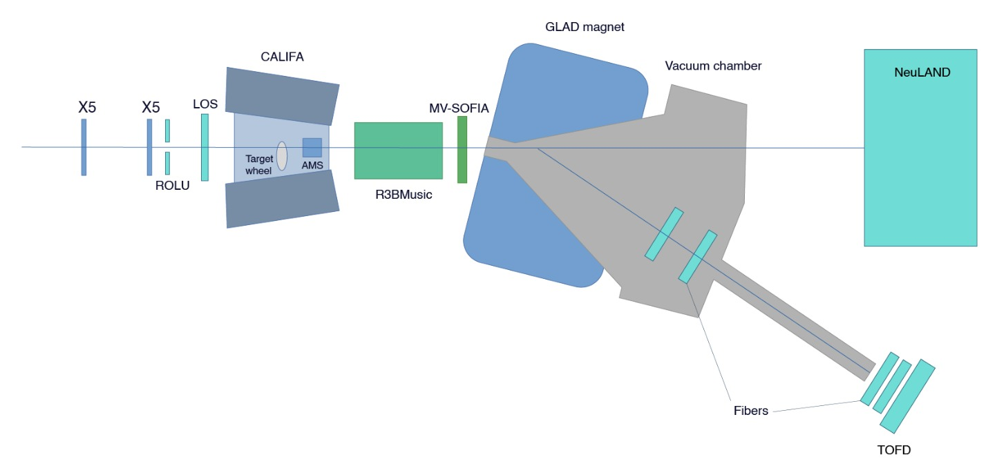
Setup
Targets:
Pb (980mg/cm²)
C (1g/cm², 2g/cm²)
CH₂ (1g/cm² , 2g/cm² )
replaced
Two different secondary beams through FRS:​
Fragmentation 136Xe, Be target 900MeV/u, 405MeV/u​ 124Sn
Fission 238U, Pb targets 900MeV/u 134Sn, 620MeV/u 132Sn

Slide 6
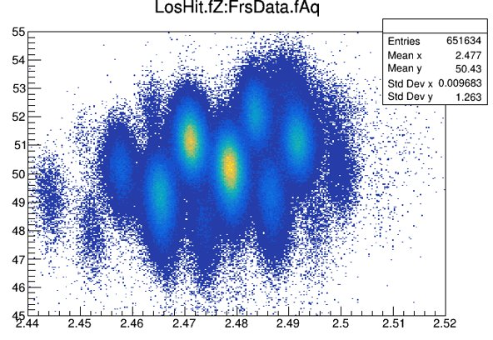
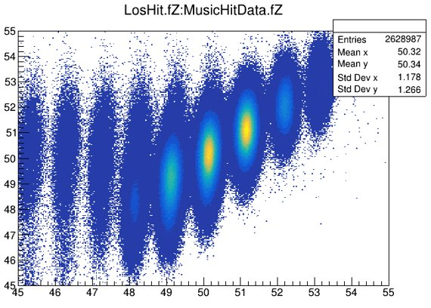
IncomingID
Initial identification with LOS (bad charge resolution) since event mixing in PSPs
Calibration VFTX + Music correlation
124Sn

Slide 7
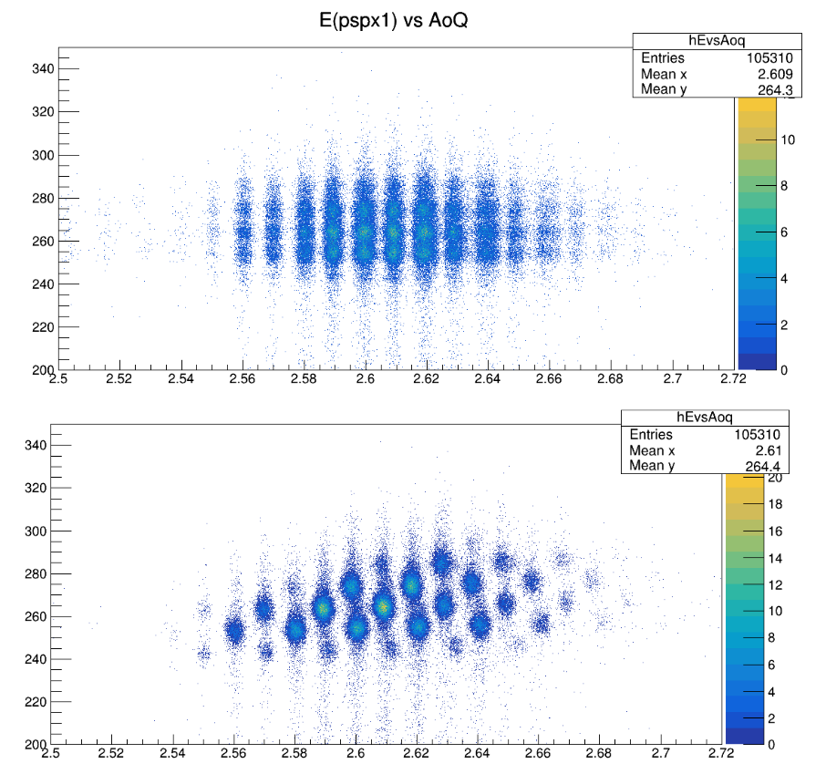
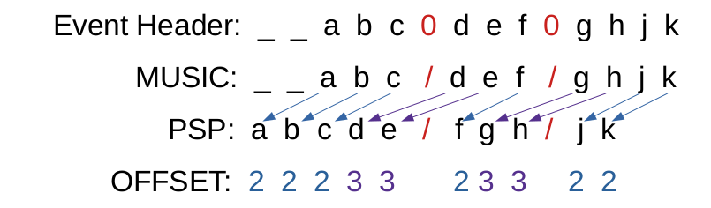
PSP
Position and energy loss measurement
Incoming particle identification
PSP events had “offset” with respect to other detectors in some runs:
Shift = 7

Slide 8
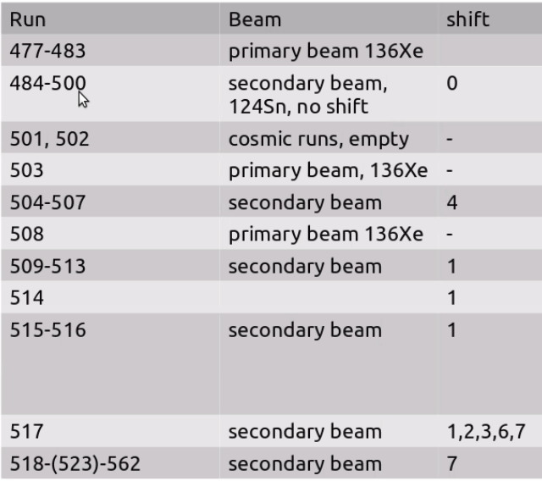
PSP
Solution - for now – standalone macro :
1) skip TPAT == 0 events
2) PSP data and "other" detector data into vectors
3) apply shift between PSP vector and "other" detector vector coordinates

Slide 9

PSP
Solution - for now – standalone macro :
1) skip TPAT == 0 events
2) PSP data and "other" detector data into vectors
3) apply shift between PSP vector and "other" detector vector coordinates
Solution - final – implementation into R3BRoot: special "R3BPspxReaderS515" :
uses parameter file with timestamp (MasterStart) + shift information
buffer of 20 events – skipping TPAT ==0 and applying shift

Slide 10
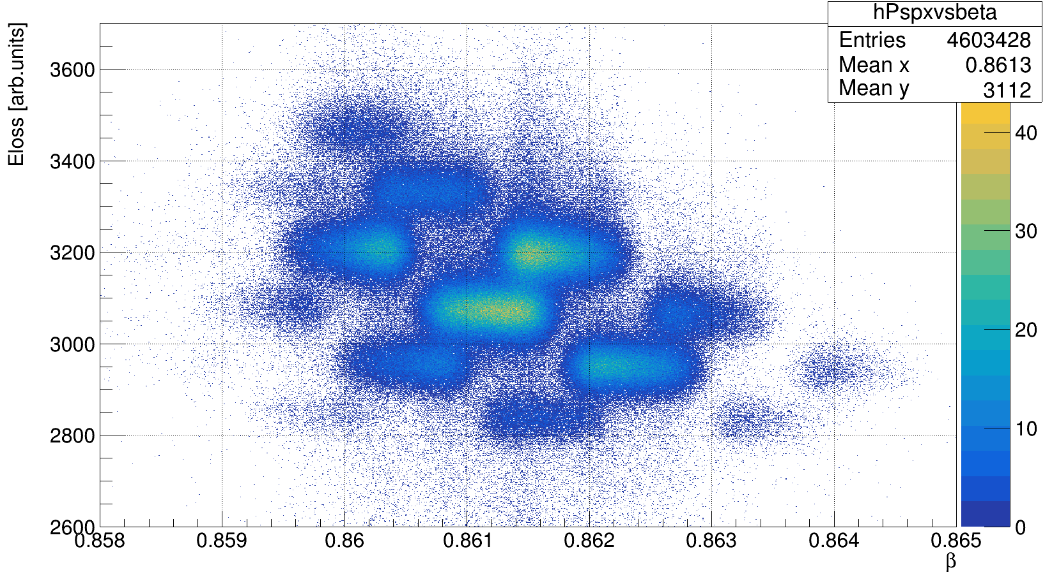
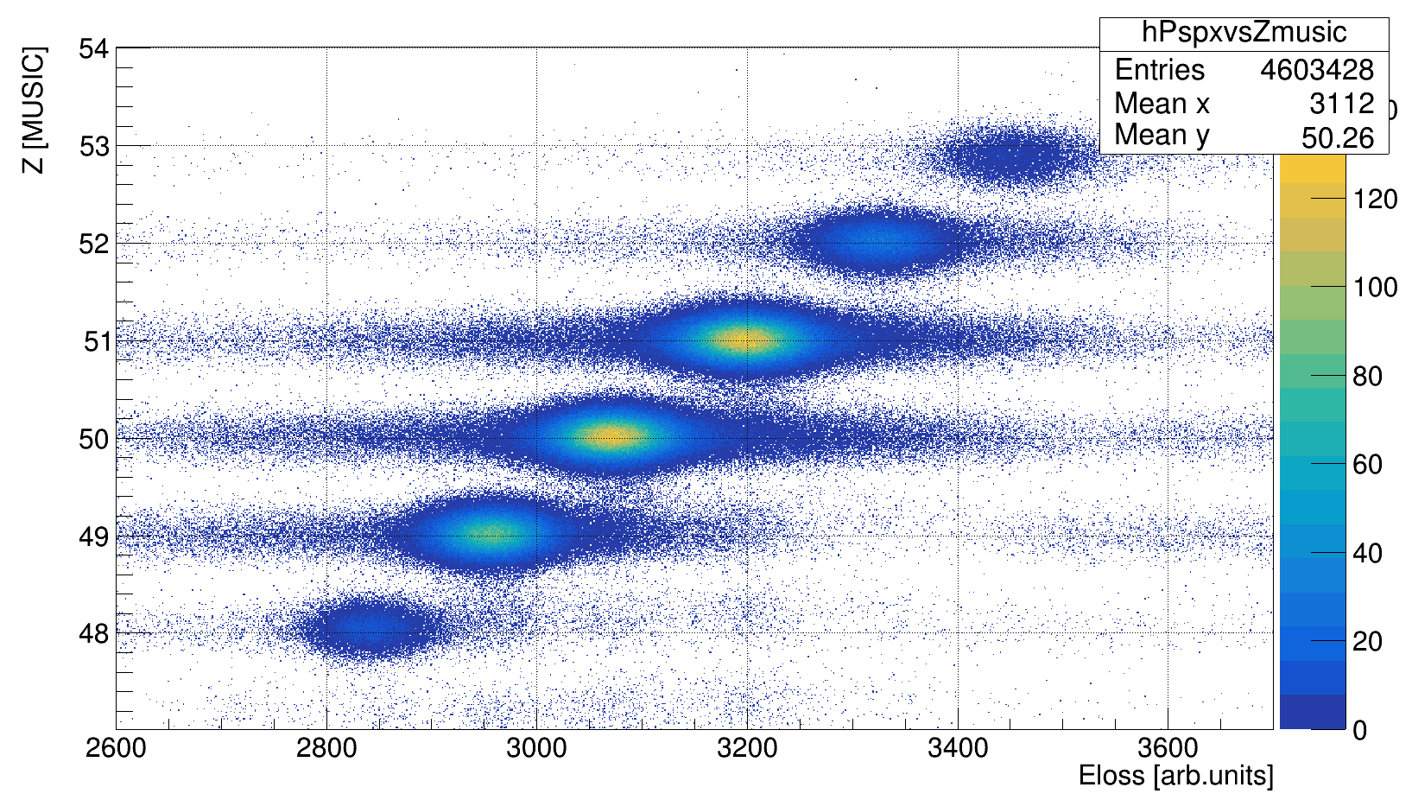
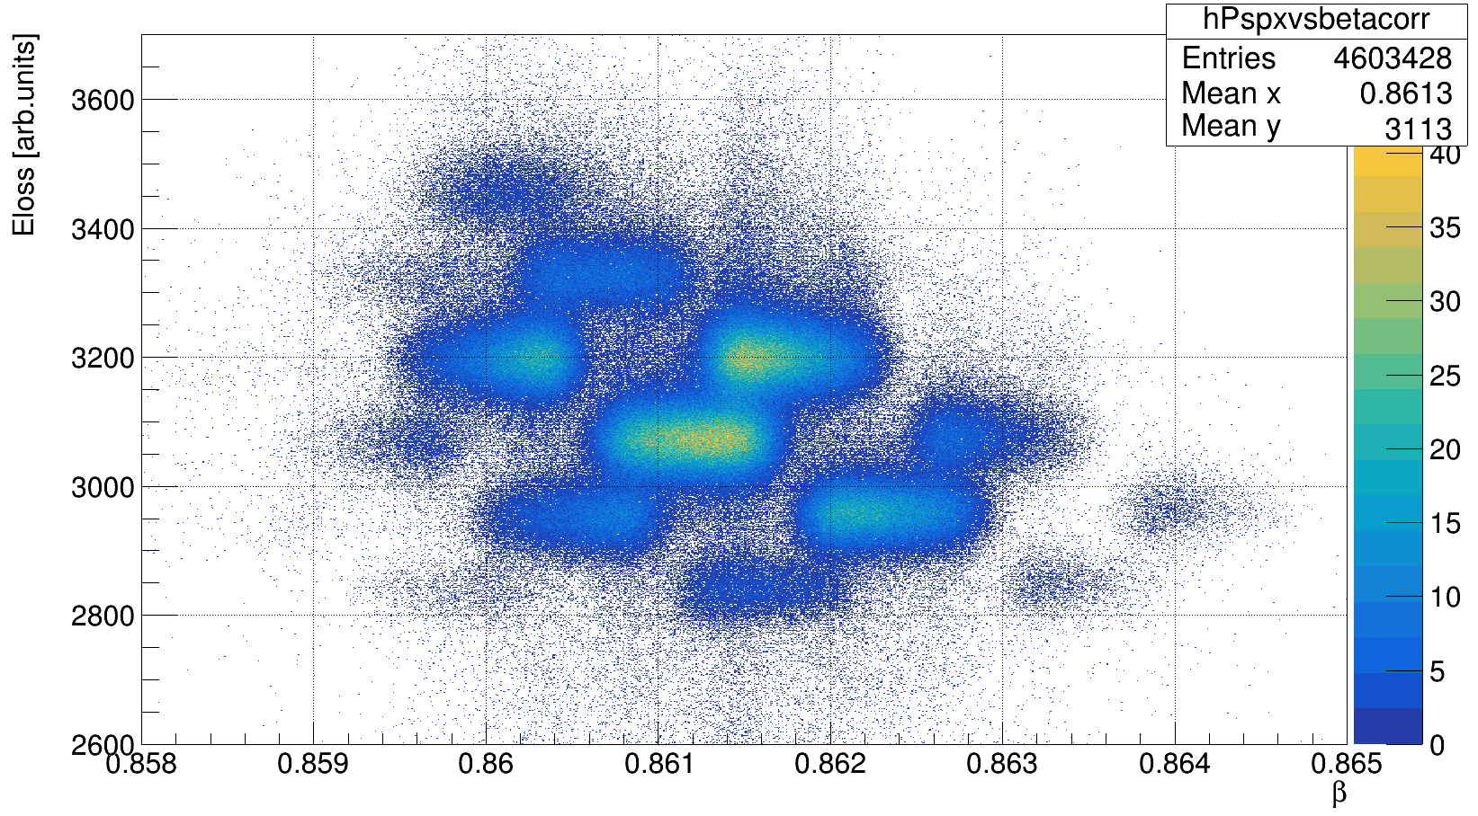
PSP
Correction for β-dependency of energy loss - rotation
Correlation with MUSIC charge – for calibration

Slide 11
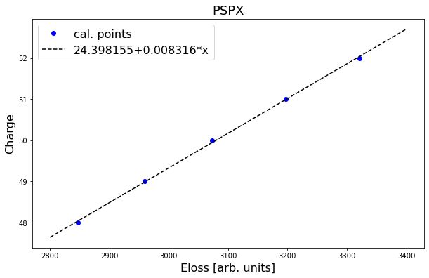
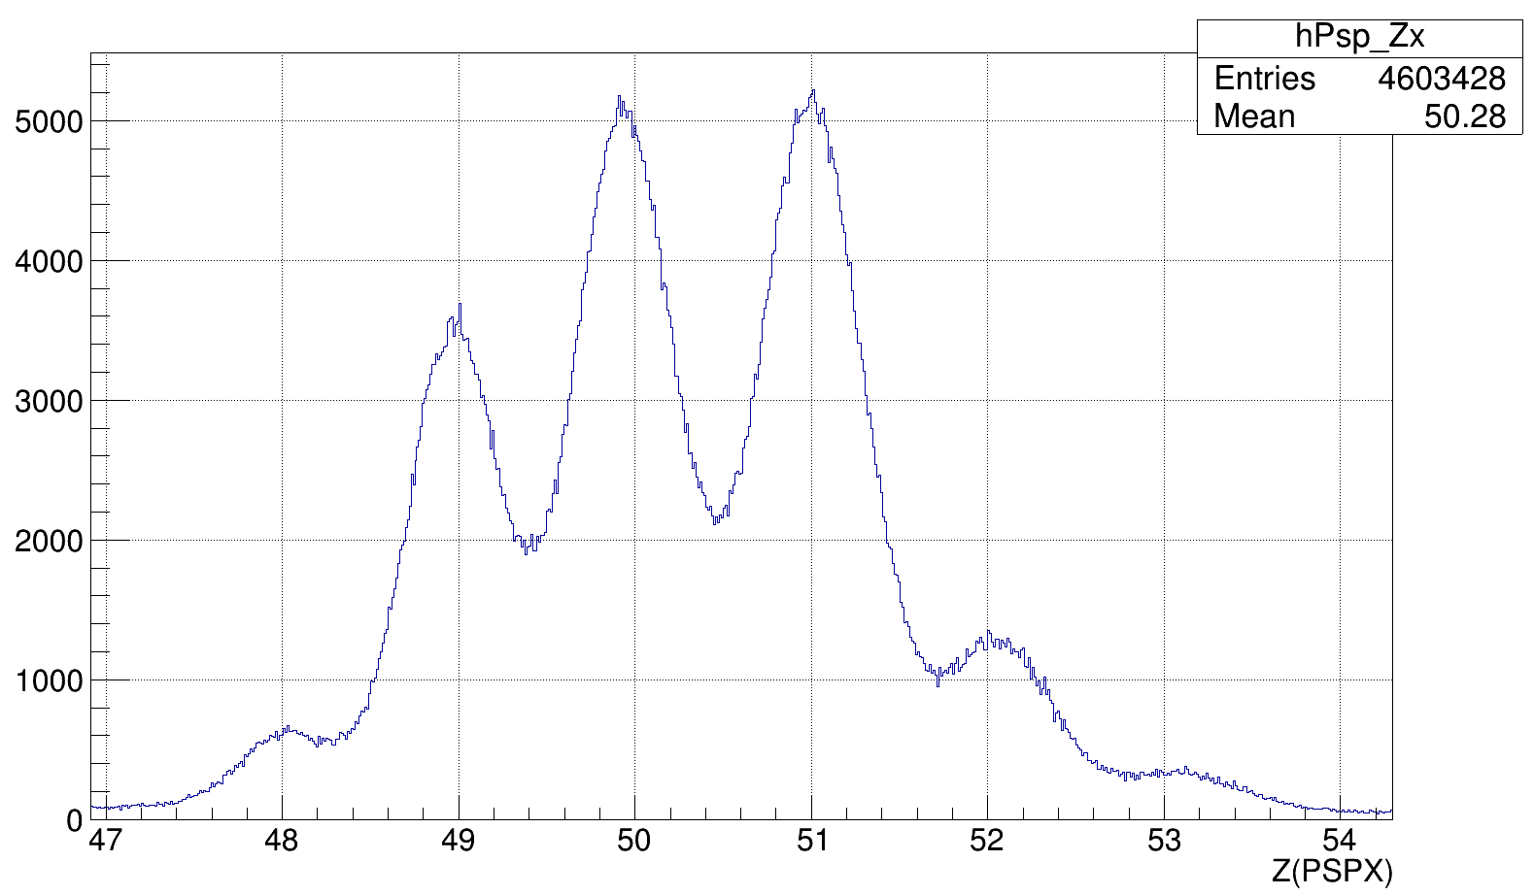
PSP

Slide 12
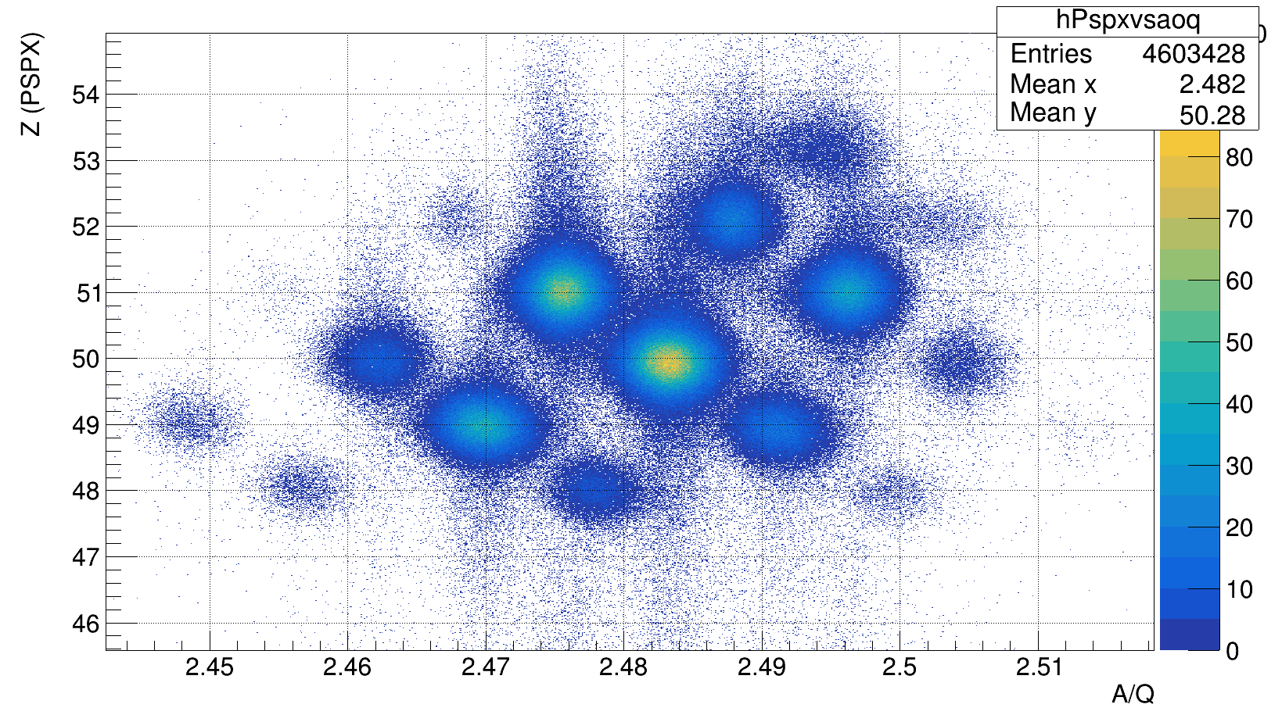
PSP
Incoming identification: ¹²⁴Sn, E = 904 MeV/u

Slide 13
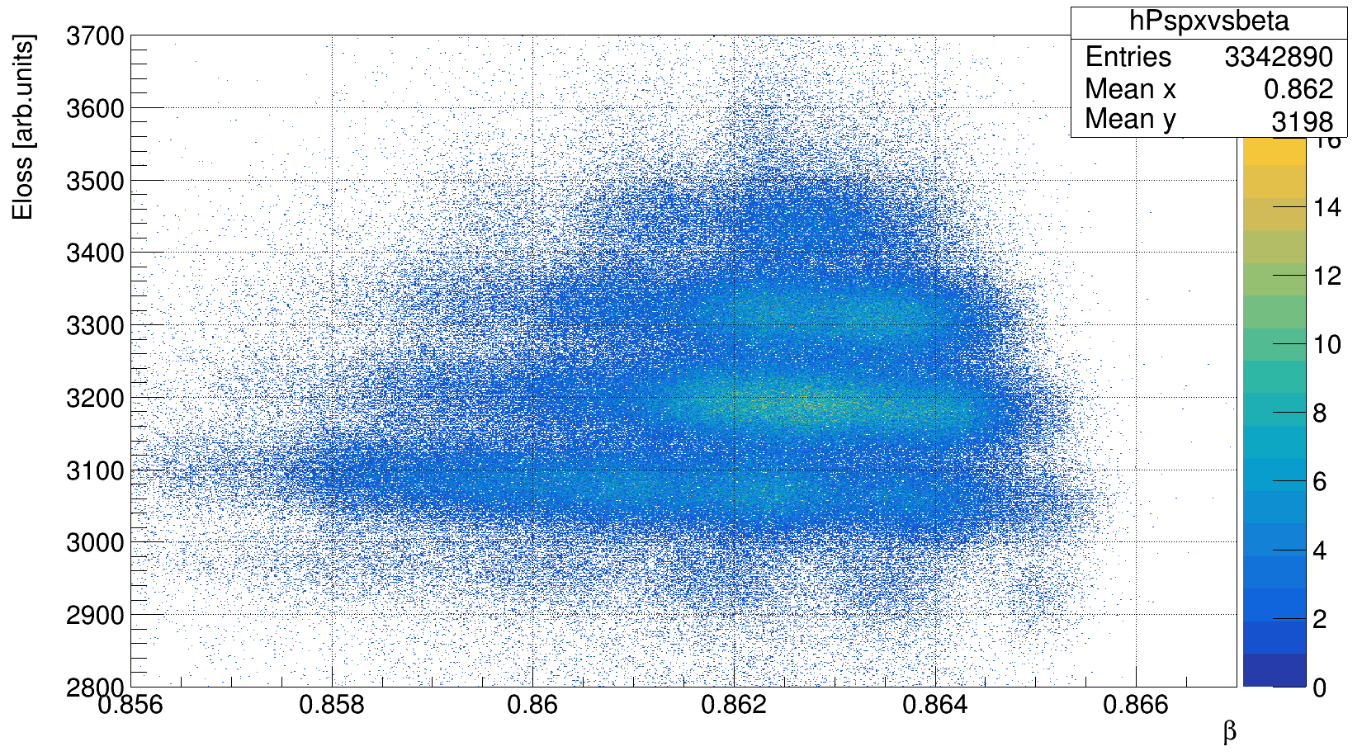
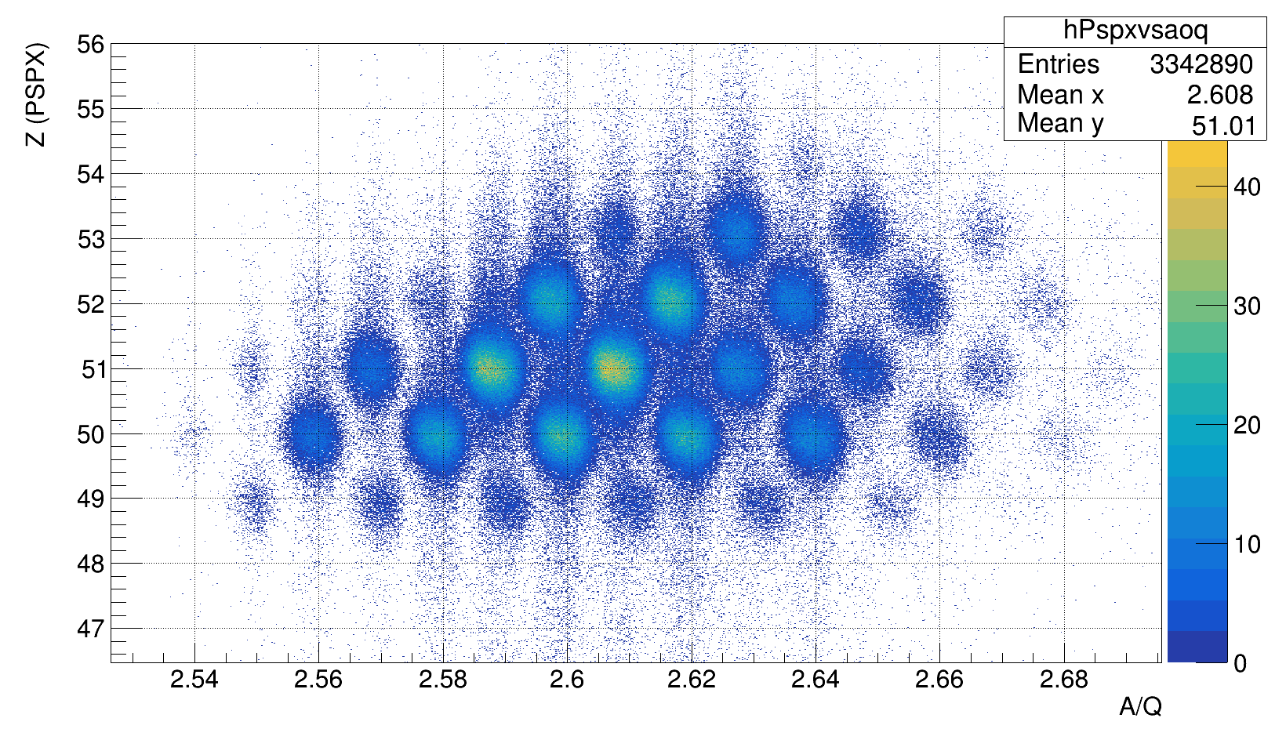
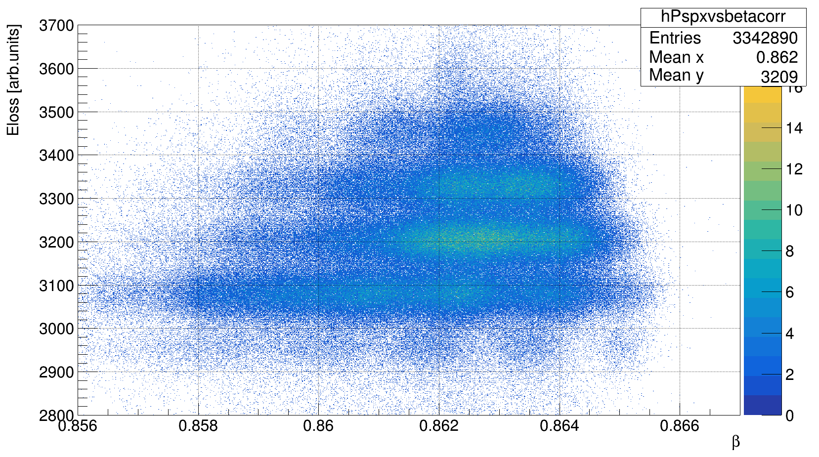
PSP
Incoming identification: ¹³⁴Sn, E = 872 MeV/u

Slide 14
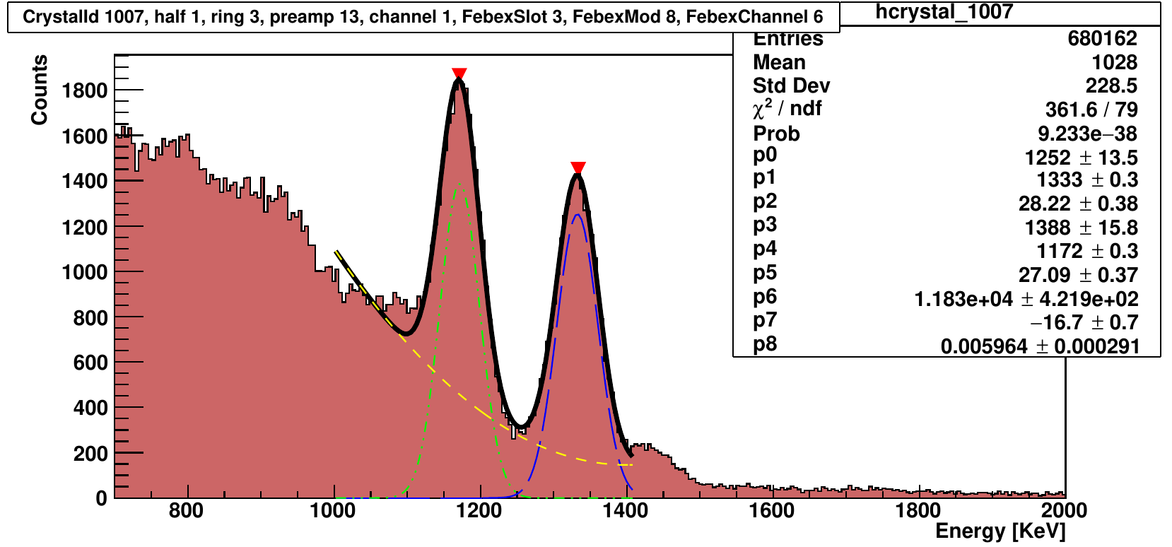
Califa
Only 12 crystals not properly calibrated (out of 1504 -> 0.8%)

Slide 15
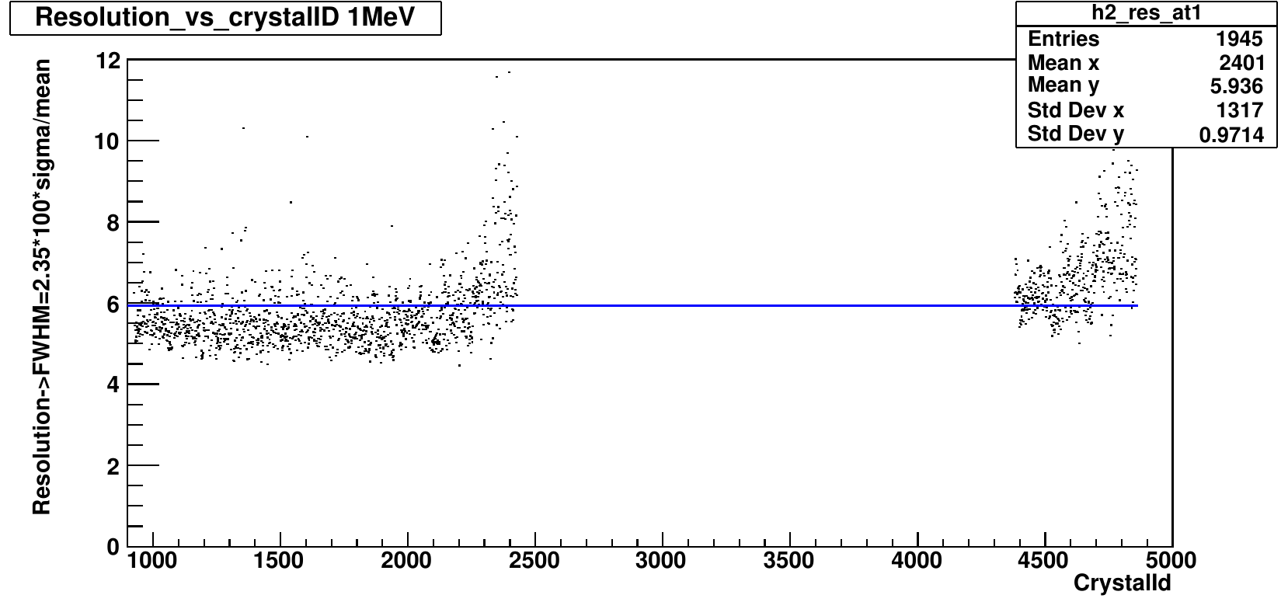
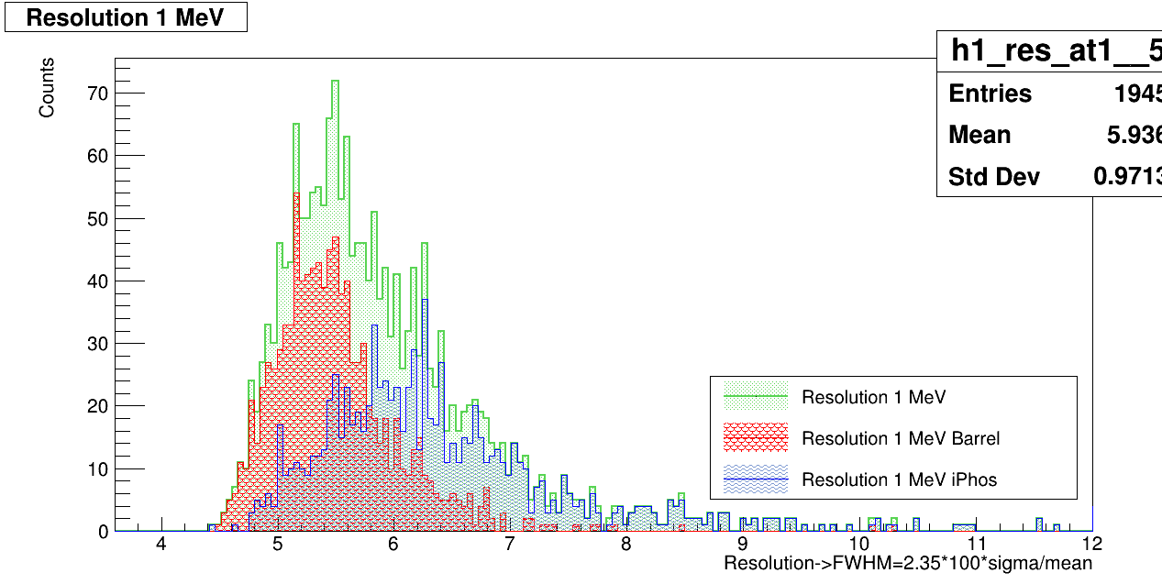
Califa Barrel resolution 5.5% Iphos resolution 6.4%
IPhos
Left gamma range
Right proton range

Slide 16
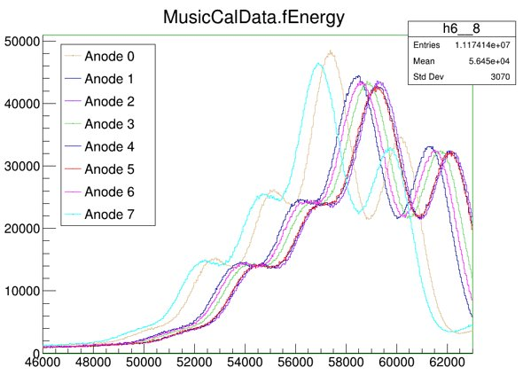
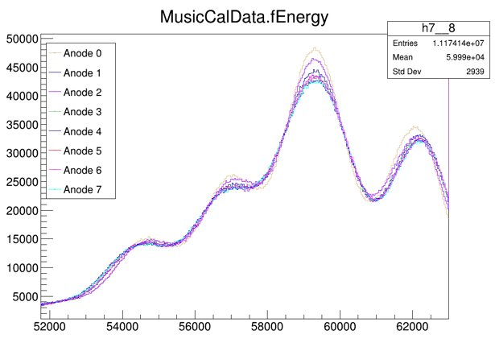
R3B-Music
Anodes alignment (gain matching)
Angle-position calibration (using LOS+MWPC0), no calibration run for the latter so pedestals from s455 are taken)
Z-angle correction (rotation)
Final linear calibration

Slide 17
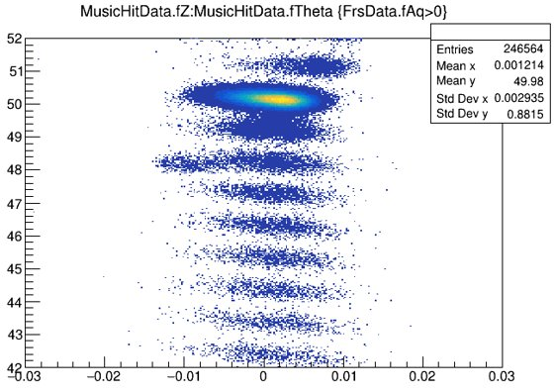
R3B-Music
Anodes alignment (gain matching)
Angle-position calibration (using LOS+MWPC0), no calibration run for the latter so pedestals from s455 are taken)
Z-angle correction (rotation)
Final linear calibration

Slide 18
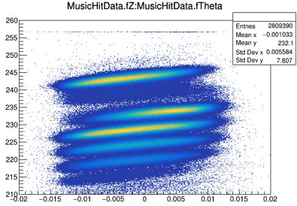
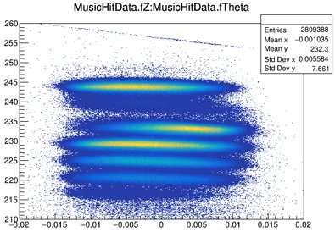
R3B-Music
Anodes alignment (gain matching)
Angle-position calibration (using LOS+MWPC0), no calibration run for the latter so pedestals from s455 are taken)
Z-angle correction (rotation)
Final linear calibration

Slide 19
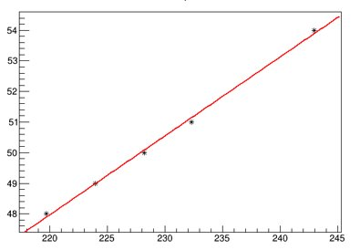
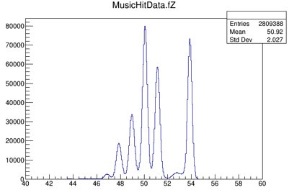
R3B-Music
Z
Anodes alignment (gain matching)
Angle-position calibration (using LOS+MWPC0), no calibration run for the latter so pedestals from s455 are taken)
Z-angle correction (rotation)
Final linear calibration
channel
Z

Slide 20
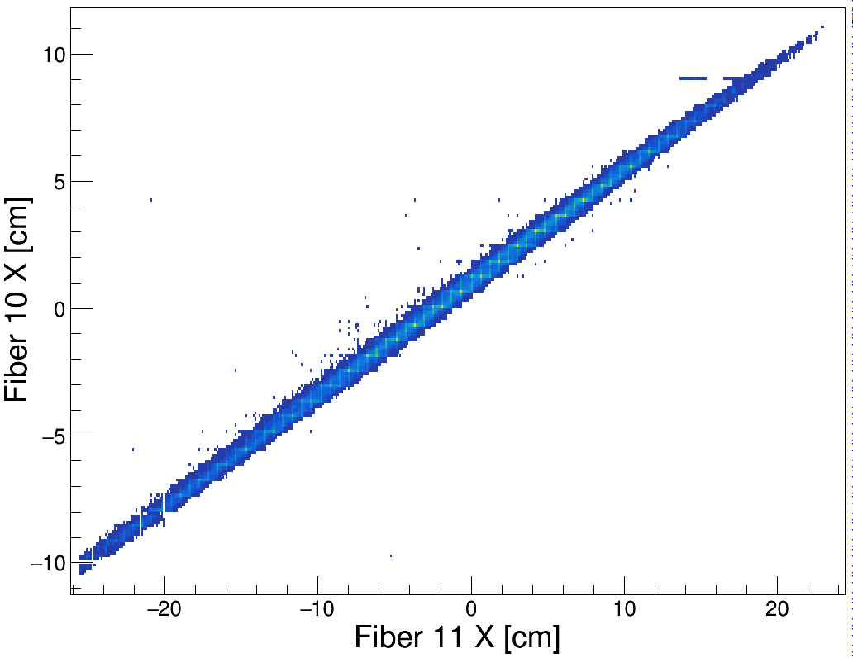
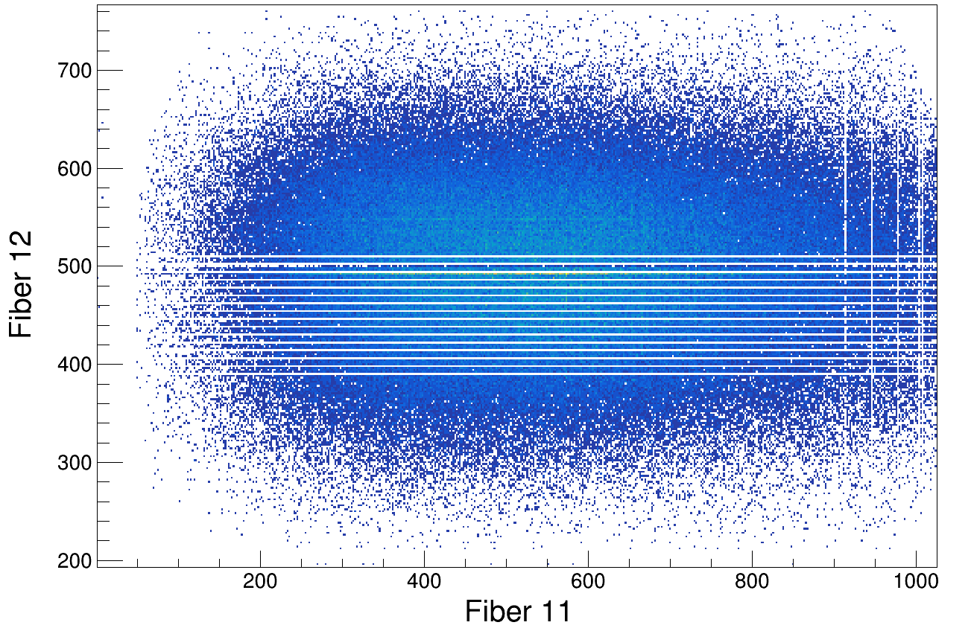
Fibers
Fi13 – not used
Fi10 – needs to be calibrated using MAPMT (1SPMT missing)
Fi11 – calibrated, had SPMT mapping problems – solved!
Fi12 – calibrated, broken PADI board

Slide 21
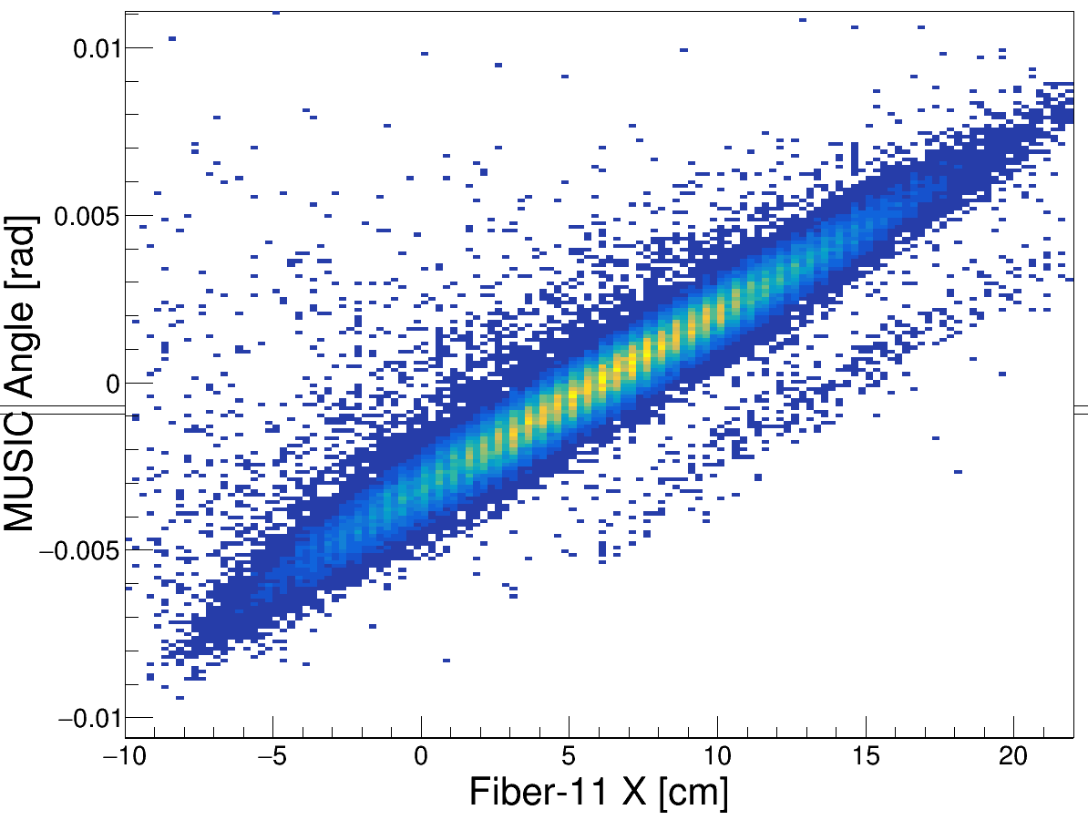
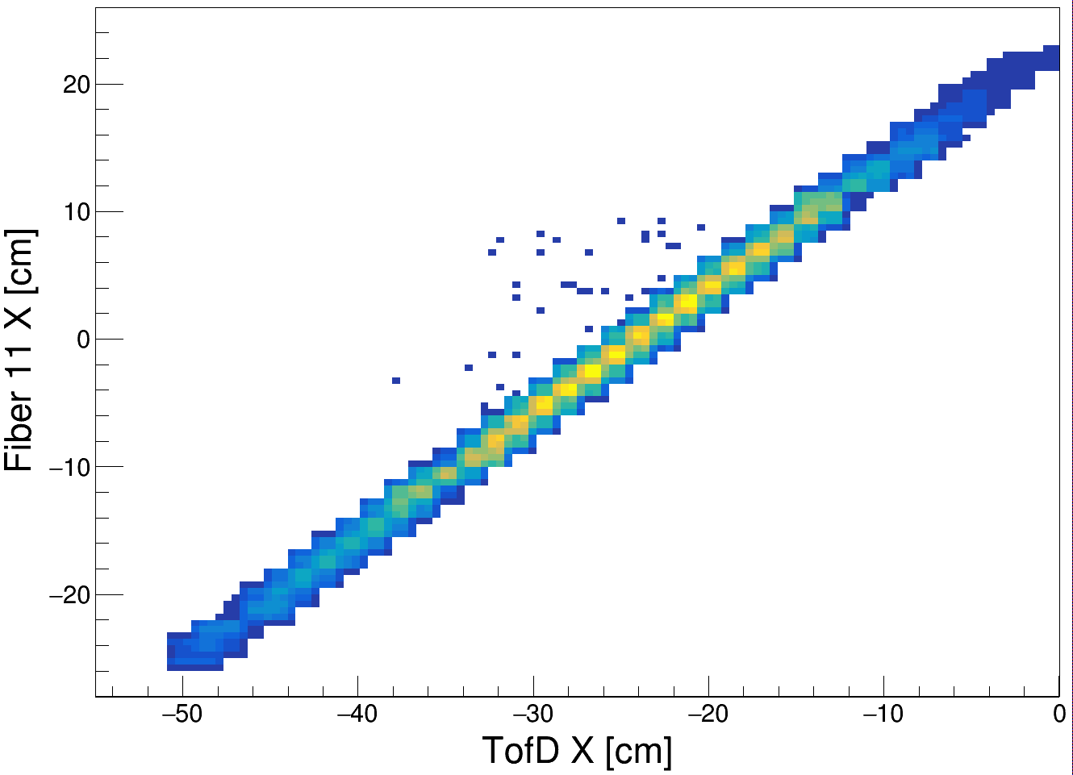
Fibers

Slide 22
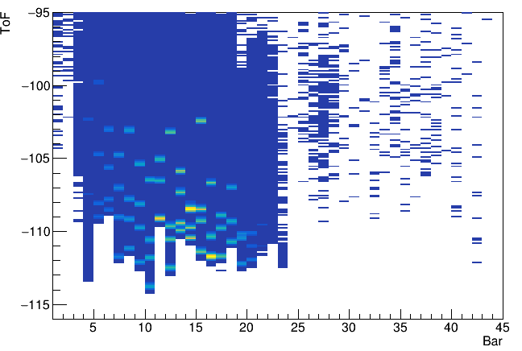
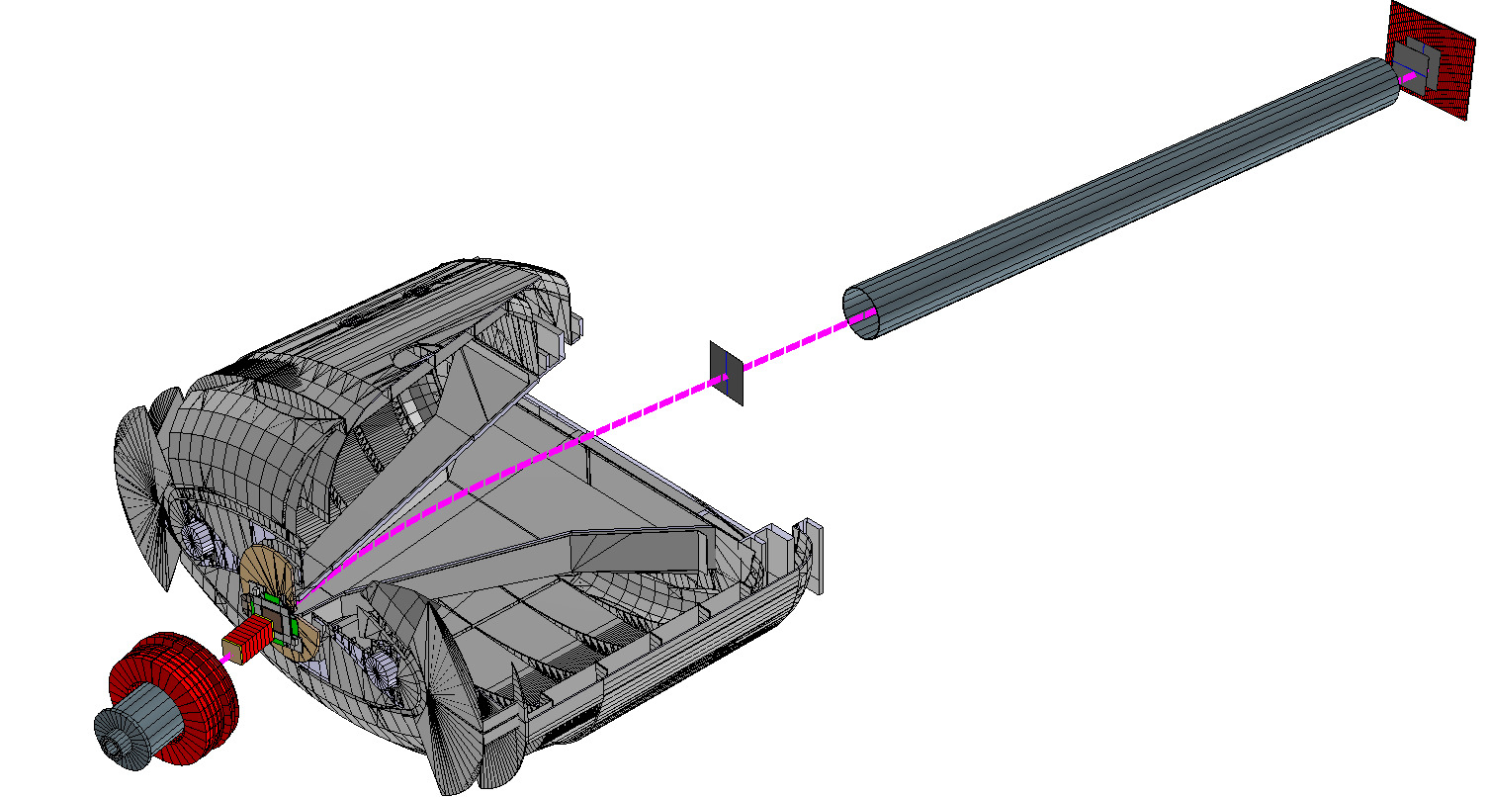
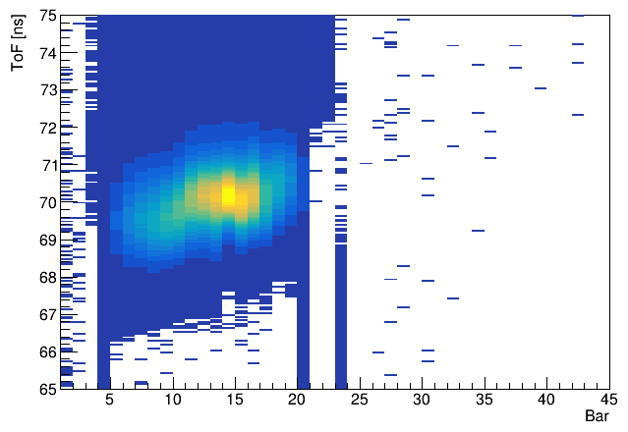
ToFD
Fi11,Fi12(y)
ToFD
MWPC0
R3BMusic
pipe
Fi10
Calibration using sweep runs to align ToF made with primary beam at 2 energies.
Califa
Geometry for simulations implemented
Used for ToF (LOS-ToFD) calibration as reference time

Slide 23
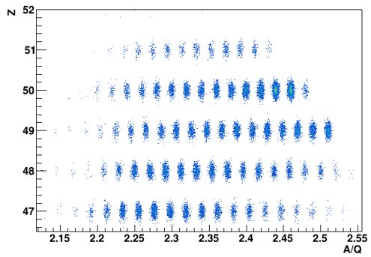
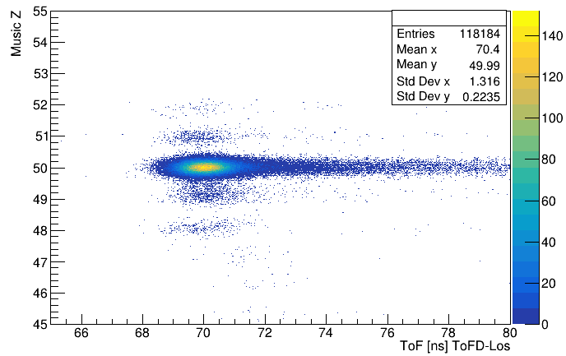
ToFD
Fragments transmission
INCL+ABLA code used as event generator for R3BRoot in the simulation, ideally we should get all this fragments in ToFD
… but real data seems to have poor statistics of reaction fragments

Slide 24

Summary
Incoming PID
- fragmentation settings around 124Sn: Sci2 + LOS
- fission settings around 134Sn: Sci2 + LOS + PSPX
R3B-Music calibrated in charge and angle
Fiber code reviewed and data looks fine, but some PMTs missing
ToFD also calibrated in ToF, but low statistics for outcoming reaction fragments
so far...

Slide 25
Summary
Incoming PID
- fragmentation settings around 124Sn: Sci2 + LOS
- fission settings around 134Sn: Sci2 + LOS + PSPX
R3B-Music calibrated in charge and angle
Fiber code reviewed and data looks fine, but some PMTs missing
ToFD also calibrated in ToF, but low statistics for outcoming reaction fragments
so far...
Fiber calibration needs to be finished
Tracking
- Path length reconstruction with R3B-Music + Fibers
- Velocity calibration using the path length + ToFD
- Reconstruction of masses for PID
NeuLAND calibration
Reconstruction of (p,2p) events in CALIFA
Check if AMS data is useful for (p,2p) tracking
forthcoming
work

Slide 26
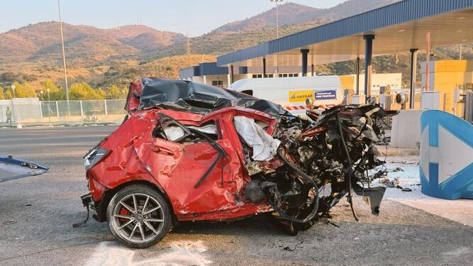

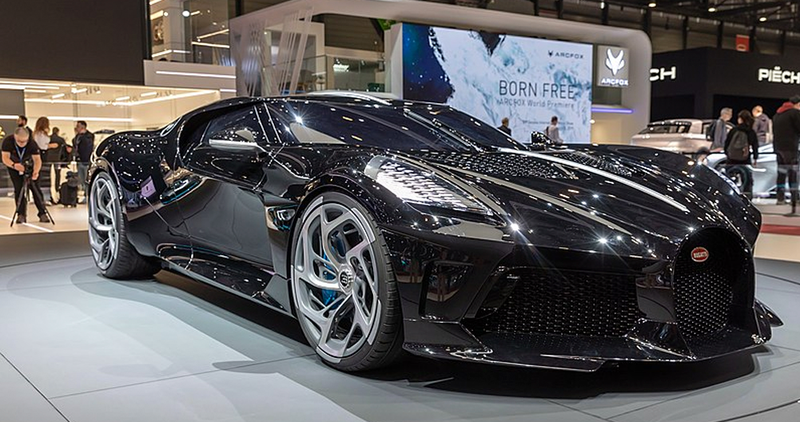
Thanks for your attention! Special thanks to: Andrea Horvat, Dominic Rossi, Hans Toernqvist, Igor Gašparić, Jose Luis Rodríguez, Leandro Fonseca, Valerii Panin
Questions?
Past Present Future?

Slide 27
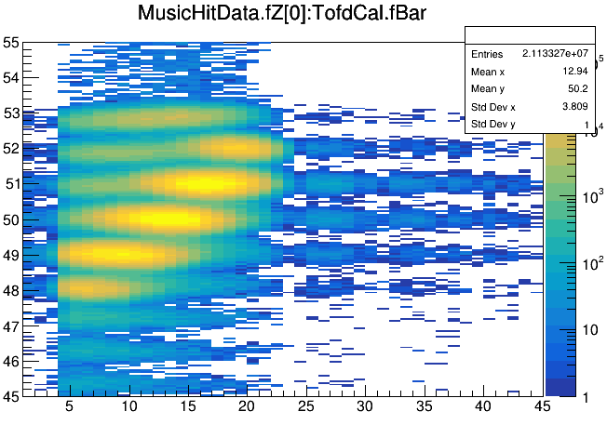
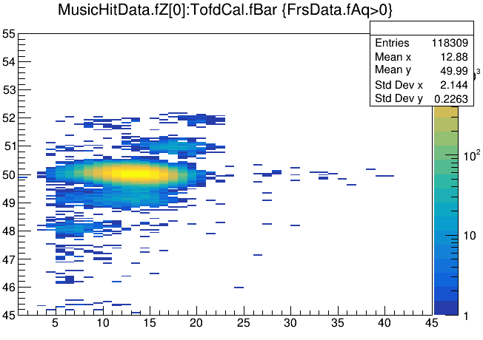
Some useful backup slides
Z (Music) vs ToFD Bar, left plot all cocktail beam and right plot selecting 124Sn

Slide 28
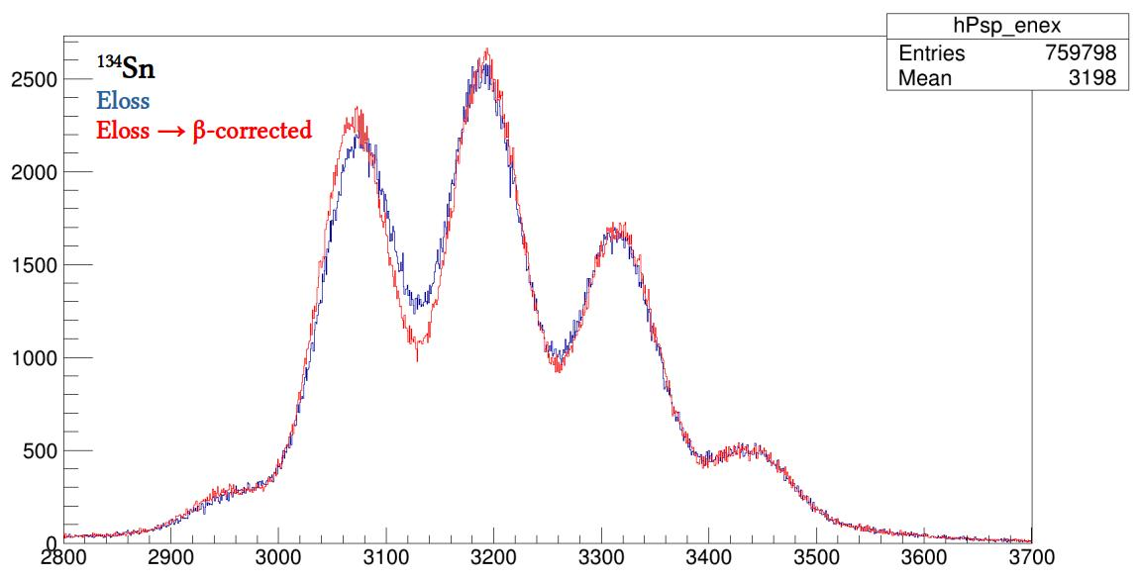
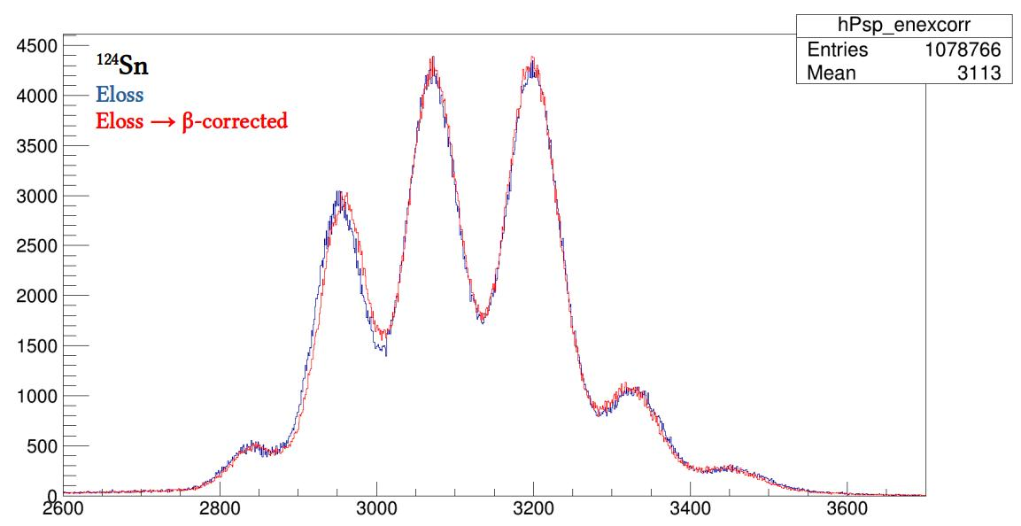
Some useful backup slides

