Slide 1


Results on Hyper-Nuclei Productions
in High-Energy Nuclear Collisions
Nu Xu (LBNL)
Introduction
Lifetime
Rapidity Density and Collectivity

Slide 2
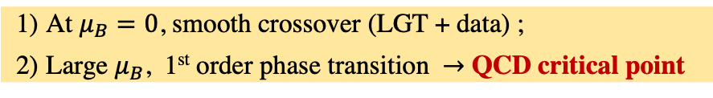
High-Energy Nuclear Collisions and QCD Phase Diagram
LHC
RHIC BES
FAIR, NICA, …
High baryon density:
Inner structure of
compact stars
High temperature:
Early Universe evolution
At $μ_{B}=0$, smooth crossover (LGT + data) ;
Large $μ_{B}$, 1st order phase transition $→$ QCD critical point

Slide 3
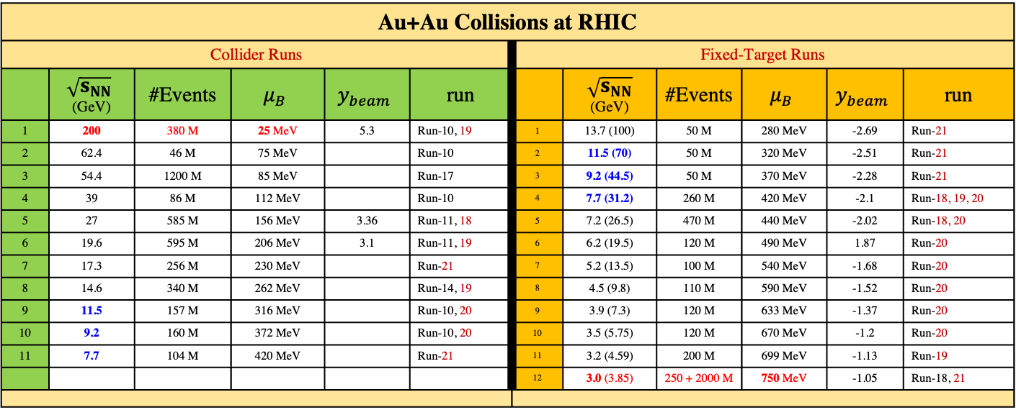

BES-I and BES-II Data Sets
Au+Au Collisions at RHIC
Collider Runs |  |  |  |  |  | Fixed-Target Runs
 | $$\sqrt{s_{NN}}$$ (GeV) | #Events | $$μ_{B}$$ | $$y_{beam}$$ | run |  | $\sqrt{s_{NN}}$ (GeV) | #Events | $$μ_{B}$$ | $$y_{beam}$$ | run
1 | 200 | 380 M | 25 MeV | 5.3 | Run-10, 19 | 1 | 13.7 (100) | 50 M | 280 MeV | -2.69 | Run-21
2 | 62.4 | 46 M | 75 MeV |  | Run-10 | 2 | 11.5 (70) | 50 M | 320 MeV | -2.51 | Run-21
3 | 54.4 | 1200 M | 85 MeV |  | Run-17 | 3 | 9.2 (44.5) | 50 M | 370 MeV | -2.28 | Run-21
4 | 39 | 86 M | 112 MeV |  | Run-10 | 4 | 7.7 (31.2) | 260 M | 420 MeV | -2.1 | Run-18, 19, 20
5 | 27 | 585 M | 156 MeV | 3.36 | Run-11, 18 | 5 | 7.2 (26.5) | 470 M | 440 MeV | -2.02 | Run-18, 20
6 | 19.6 | 595 M | 206 MeV | 3.1 | Run-11, 19 | 6 | 6.2 (19.5) | 120 M | 490 MeV | 1.87 | Run-20
7 | 17.3 | 256 M | 230 MeV |  | Run-21 | 7 | 5.2 (13.5) | 100 M | 540 MeV | -1.68 | Run-20
8 | 14.6 | 340 M | 262 MeV |  | Run-14, 19 | 8 | 4.5 (9.8) | 110 M | 590 MeV | -1.52 | Run-20
9 | 11.5 | 157 M | 316 MeV |  | Run-10, 20 | 9 | 3.9 (7.3) | 120 M | 633 MeV | -1.37 | Run-20
10 | 9.2 | 160 M | 372 MeV |  | Run-10, 20 | 10 | 3.5 (5.75) | 120 M | 670 MeV | -1.2 | Run-20
11 | 7.7 | 104 M | 420 MeV |  | Run-21 | 11 | 3.2 (4.59) | 200 M | 699 MeV | -1.13 | Run-19
 |  |  |  |  |  | 12 | 3.0 (3.85) | 250 + 2000 M | 750 MeV | -1.05 | Run-18, 21
Precision data to map the QCD phase diagram
3 $< \sqrt{s_{NN}}<200 GeV; 760< μ_{B}<25 MeV$

Slide 4
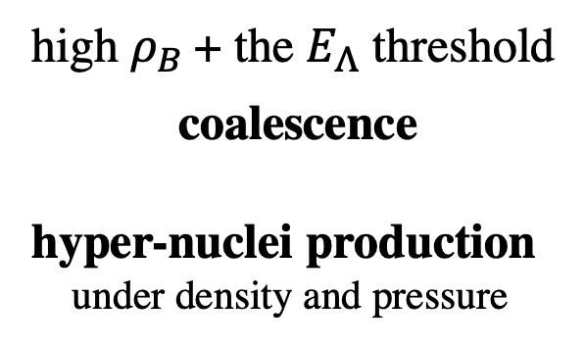
Hyper-Nuclei Production at High Baryon Density
high $ρ_{B}$+ the $E_{Λ}$ threshold
coalescence
hyper-nuclei production
under density and pressure
A. Andronic et al., Phys. Lett. B697, 203(2011)
J. Steinheimer et al., Phys. Lett. B714, 85(2012)
Unlike e- and meson-induced interactions, high-energy nuclear collisions are unique for studying hyper-nuclei collectivity (v₀, v₁, v₂) ;
In-medium EOS parameter under pressure, important for understanding the inner dynamics of compact stars

Slide 5
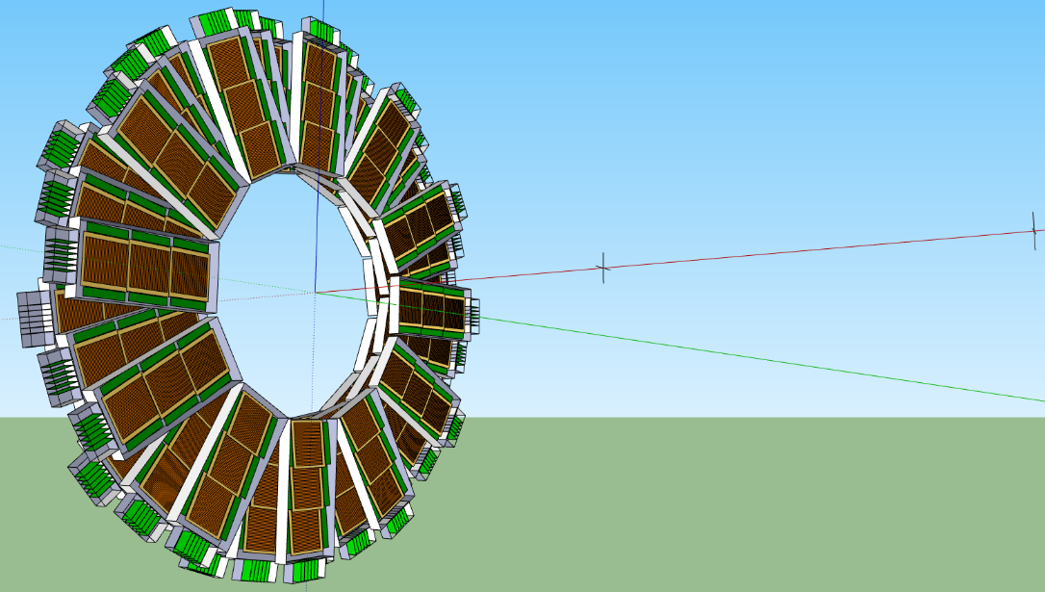
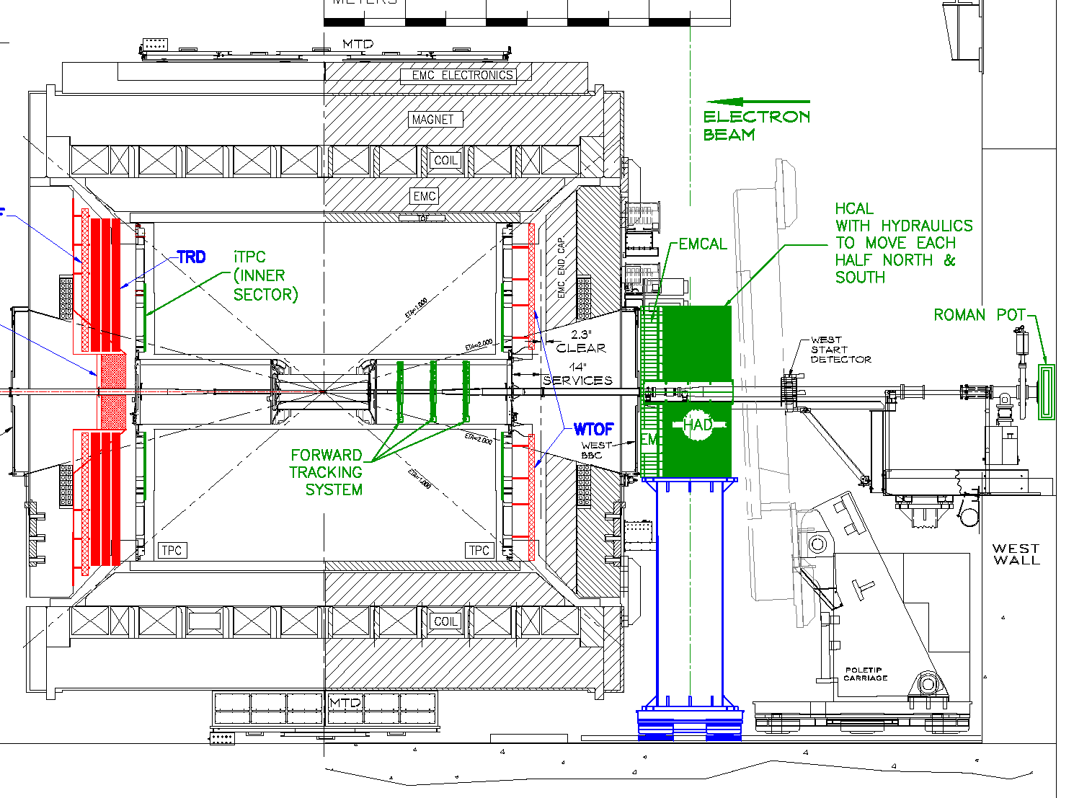
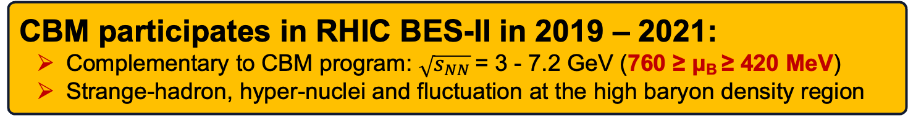
BES-III Started with CBM TOF at STAR
eTOF
Au Target
100 cm
fixed target pos.
(~500 cm)
collider vertex
(~250 cm)
MRPC active area
Read-out electronics
CBM participates in RHIC BES-II in 2019 – 2021:
Complementary to CBM program: $\sqrt{s_{NN}}$ = 3 - 7.2 GeV (760 ≥ μ_{B} ≥ 420 MeV)
Strange-hadron, hyper-nuclei and fluctuation at the high baryon density region

Slide 6
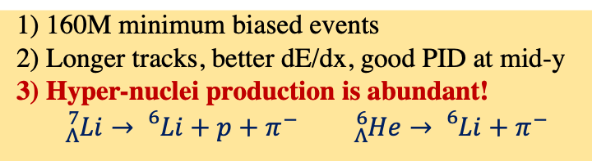
Fixed-Target Collisions: PID and Acceptances
160M minimum biased events
Longer tracks, better dE/dx, good PID at mid-y
Hyper-nuclei production is abundant!
${}_{Λ}^{7}{Li→}$ ${}_{}^{6}{Li+p+}π^{−}$ ${}_{Λ}^{6}{He→}$ ${}_{}^{6}{Li+}π^{−}$

Slide 7
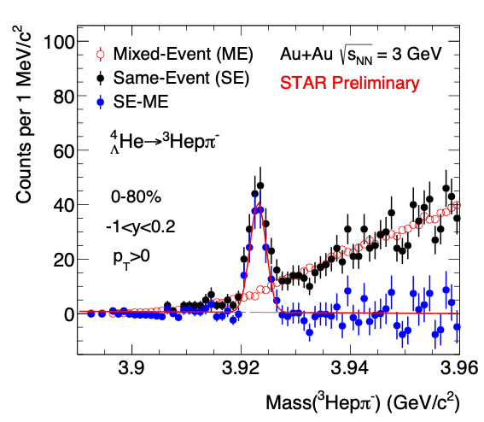
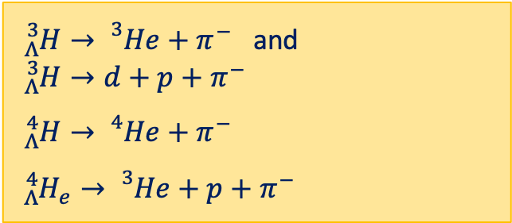
Particle Identifications in Au+Au Collisions at 3 GeV
${}_{Λ}^{3}{H→}$ ${}_{}^{3}{He+}π^{−}$ and
${}_{Λ}^{3}{H→}d+p+π^{−}$
${}_{Λ}^{4}{H→}$ ${}_{}^{4}{He+}π^{−}$
${}_{Λ}^{4}{H_{e}→}$ ${}_{}^{3}{He+}p+π^{−}$

Slide 8
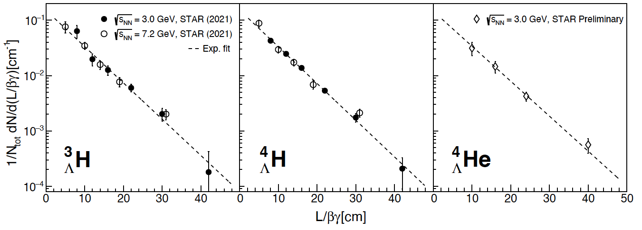

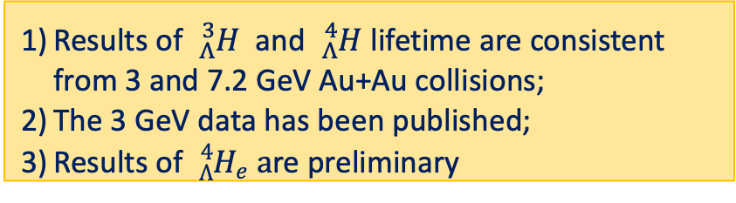
Lifetime Measurements: ${}_{Λ}^{3}H, {}_{Λ}^{4}H,{}_{Λ}^{4}H$e
Results of ${}_{Λ}^{3}H$ and ${}_{Λ}^{4}H$ lifetime are consistent from 3 and 7.2 GeV Au+Au collisions;
The 3 GeV data has been published;
Results of ${}_{Λ}^{4}{H_{e}} a$re preliminary
STAR: Y-H. Leung, HYP2022
Phys.Rev.Lett. 128 (2022) 202301

Slide 9
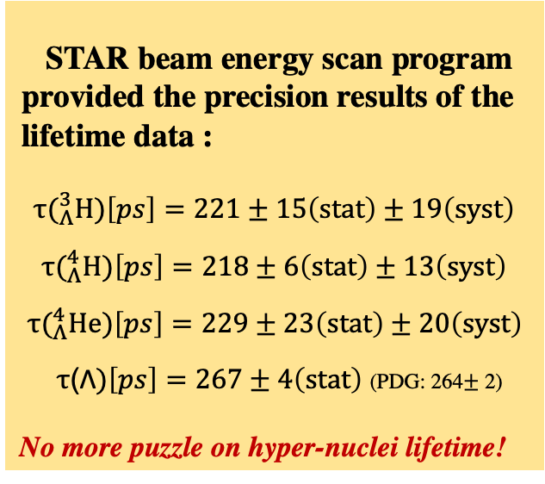
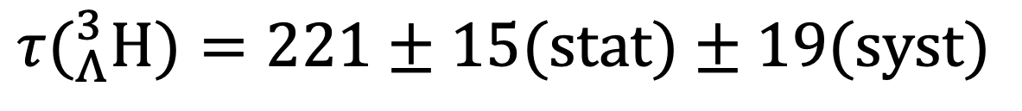
Lifetime Measurements: ${}_{Λ}^{3}H, {}_{Λ}^{4}H,{}_{Λ}^{4}H$e
STAR beam energy scan program provided the precision results of the lifetime data :
$$τ(_{Λ}^{3}H)\left[ps\right]=221±15\left(stat\right)±19\left(syst\right)$$
$$τ(_{Λ}^{4}H)\left[ps\right]=218±6\left(stat\right)±13\left(syst\right)$$
$$τ(_{Λ}^{4}He)\left[ps\right]=229±23\left(stat\right)±20\left(syst\right)$$
$τ$(Λ$)\left[ps\right]=267±4\left(stat\right)$ (PDG: 264$±$ 2)
No more puzzle on hyper-nuclei lifetime!
$$τ(_{Λ}^{3}H)=221±15(stat)±19(syst)$$
STAR: Y-H. Leung, HYP2022
Phys.Rev.Lett. 128 (2022) 202301

Slide 10
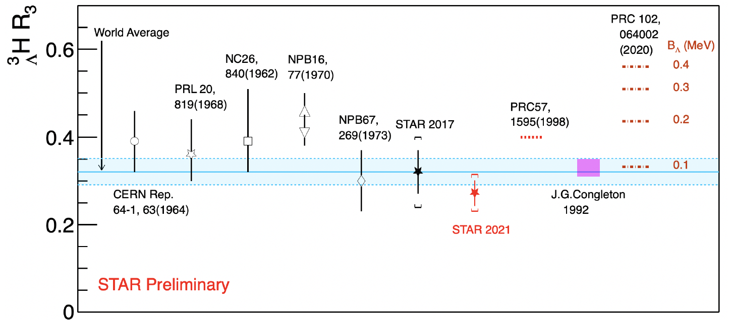

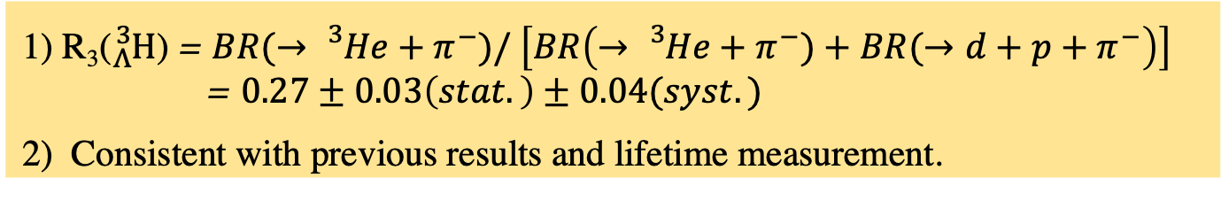
${}_{Λ}^{3}H$Relative Branching Ratio R₃
$$τ(_{Λ}^{3}H)=221±15(stat)±19(syst)$$
STAR: Y-H. Leung, HYP2022
1) R₃(${}_{Λ}^{3}H$) = $BR(→{}_{}^{3}{He+π^{−})/} \left[BR\left(→{}_{}^{3}{He+π^{−})+BR(→d+p+}π^{−}\right)\right]$
= $0.27±0.03\left(stat.\right)±0.04(syst.)$
2) Consistent with previous results and lifetime measurement.

Slide 11
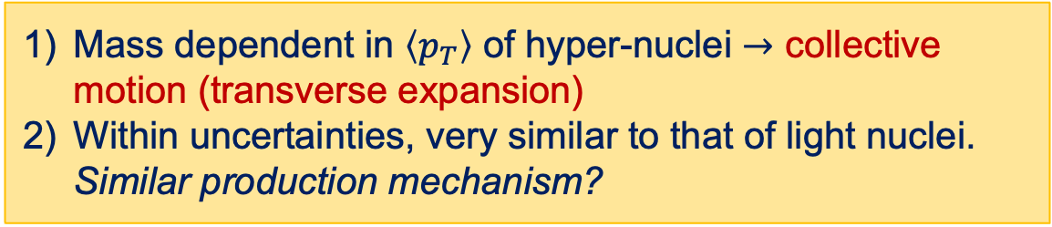
Hyper-Nuclei Transverse Momentum Distributions
Mass dependent in $\left\langle p_{T}\right\rangle$ of hyper-nuclei $→$ collective motion (transverse expansion)
Within uncertainties, very similar to that of light nuclei. Similar production mechanism?
STAR:
Y-H. Leung, HYP2022

Slide 12
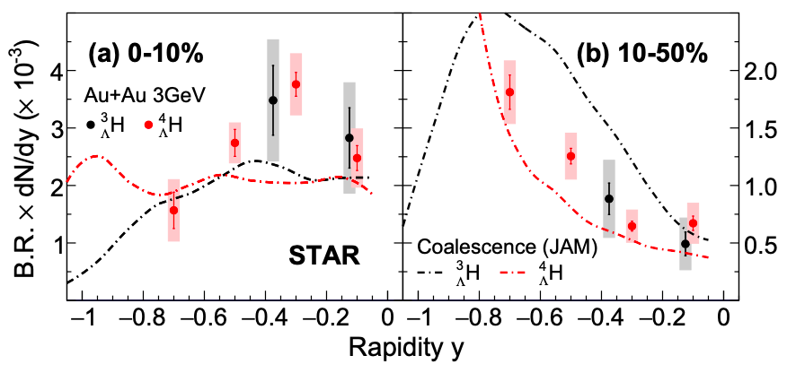
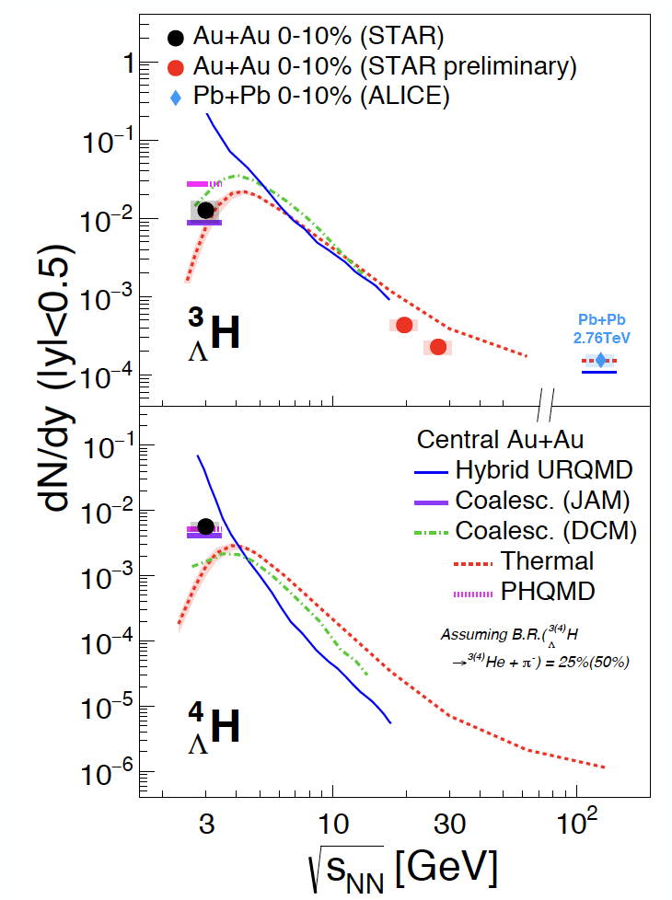
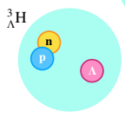
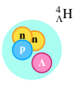
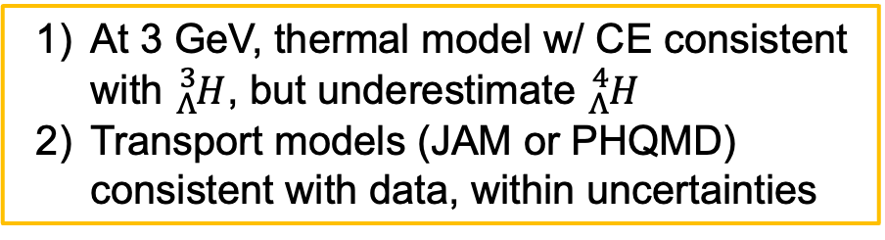
Rapidity Density of Hyper-Nuclei in HIC
Phys. Rev. Lett. 128, 202301(2022)
At 3 GeV, thermal model w/ CE consistent with ${}_{Λ}^{3}H$, but underestimate ${}_{Λ}^{4}H$
Transport models (JAM or PHQMD) consistent with data, within uncertainties

Slide 13
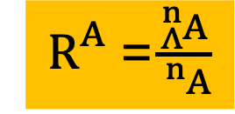
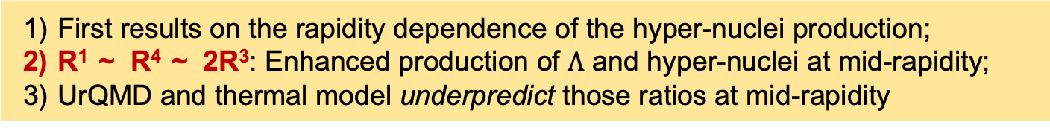
Hyper-Nuclei Production in HIC
$R_{}^{A}$=$\frac{{}_{Λ}^{n}A}{{}_{}^{n}A}$
STAR Preliminary
STAR: Y-H. Leung, HYP2022
Particle Rapidity y
First results on the rapidity dependence of the hyper-nuclei production;
R¹ ~ R⁴ ~ 2R³: Enhanced production of $Λ$ and hyper-nuclei at mid-rapidity;
UrQMD and thermal model underpredict those ratios at mid-rapidity

Slide 14
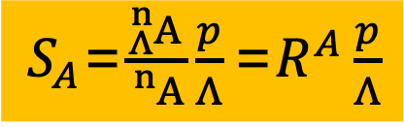


Hyper-Nuclei Production in HIC
$S_{A}$=$\frac{{}_{Λ}^{n}A}{{}_{}^{n}A}\frac{p}{Λ}\text{=}R^{A}\frac{p}{Λ}$
$$S_{4}$$
$$S_{3}$$
STAR: Y-H. Leung, HYP2022
S₃ and S₄: No effects of mass and threshold for strangeness. Constants versus centrality, rapidity and p_{T}; S₄ ~ unity ~ 5 S₃ ?
Theory inputs needed to understand the results.

Slide 15
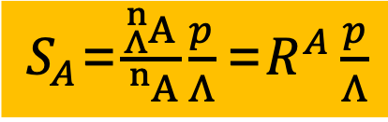
Hyper-Nuclei Production in HIC
$S_{A}$=$\frac{{}_{Λ}^{n}A}{{}_{}^{n}A}\frac{p}{Λ}\text{=}R^{A}\frac{p}{Λ}$
Energy Dependence:
S₃ is suppressed in high baryon density region approaching to thermal production;
At high baryon density, model over predict the ratios

Slide 16
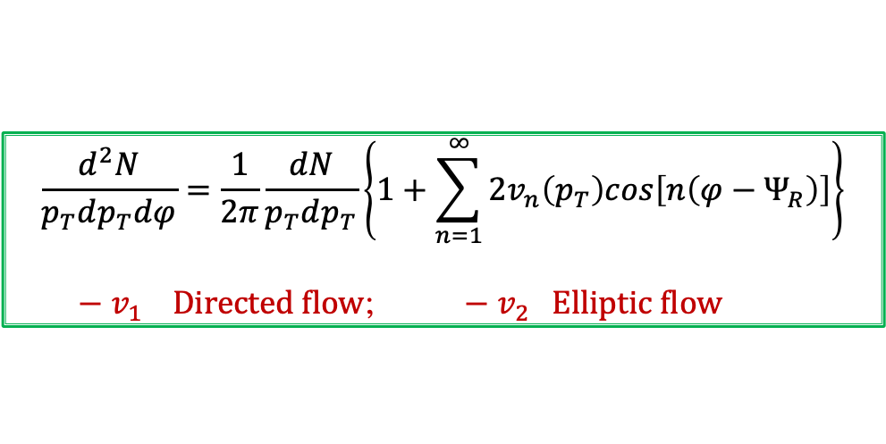
The emergent properties of QCD matter
Collectivity
∂_{μ} [(ε +p)u^{μ} u^{ν} - pg^{μν}] = 0
∂_{μ} [s u^{μ}] = 0
$$\frac{d^{2}N}{p_{T}dp_{T}dφ}=\frac{1}{2π}\frac{dN}{p_{T}dp_{T}}\left\{1+\sum_{n=1}^{∞}{2v_{n}\left(p_{T}\right)cos\left[n\left(φ−Ψ_{R}\right)\right]}\right\}$$
${− v}_{1 } Directed flow$; ${ − v}_{2 }Elliptic flow$

Slide 17
Hyper-Nuclei v₁ Distributions
First measurements on v₁ and clear mass dependent;
Within uncertainties, similar to that of light nuclei and model prediction.

Slide 18
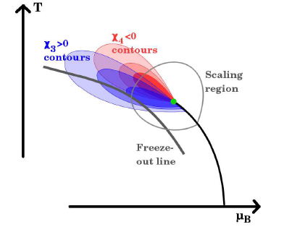
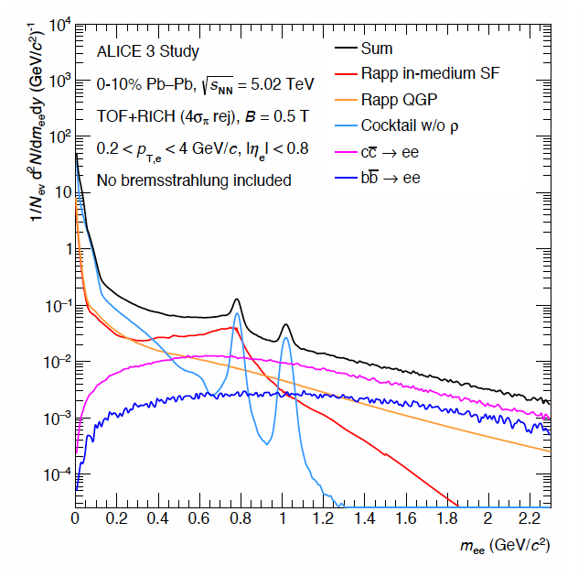
The emergent properties of QCD matter
Future Programs

Slide 19
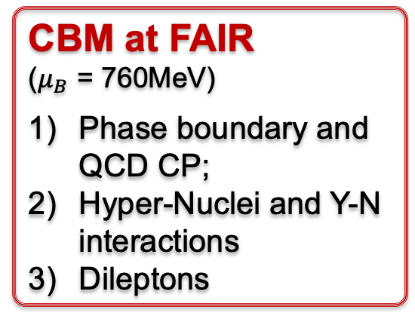
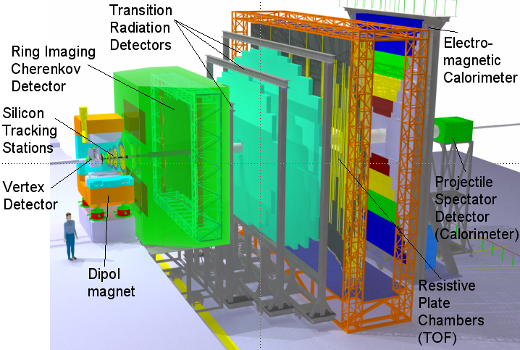
Future Facilities for Heavy-Ion Collisions
800 400 200 20
CBM at FAIR
($μ_{B}$ = 760MeV)
Phase boundary and QCD CP;
Hyper-Nuclei and Y-N interactions
Dileptons

Slide 20
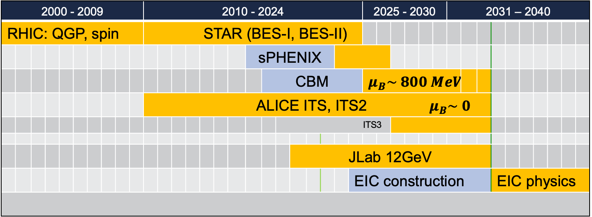
US NSAC Long Range Plan Discussions
Structure of the QCD Matter
Structure of Proton
2000 - 2009 |  |  |  |  |  |  |  |  |  | 2010 - 2024 |  |  |  |  |  |  |  |  |  |  |  |  |  |  | 2025 - 2030 |  |  |  |  |  | 2031 – 2040
RHIC: QGP, spin |  |  |  |  |  |  |  |  |  | STAR (BES-I, BES-II)
 |  |  |  |  |  |  |  |  |  |  |  |  |  |  |  |  | sPHENIX
 |  |  |  |  |  |  |  |  |  |  |  |  |  |  |  |  |  | CBM |  |  |  |  |  |  | $$μ_{B}\sim 800 MeV$$
 |  |  |  |  |  |  |  |  |  | ALICE ITS, ITS2 $μ_{B}\sim 0$
 |  |  |  |  |  |  |  |  |  |  |  |  |  |  |  |  |  |  | ITS3
 |  |  |  |  |  |  |  |  |  |  |  |  |  |  |  |  |  |  |  | JLab 12GeV
 |  |  |  |  |  |  |  |  |  |  |  |  |  |  |  |  |  |  |  |  |  |  |  | EIC construction |  |  |  |  |  |  |  |  |  | EIC physics
Physics!
Community!
arXiv: 2209.05009
US-CBM Whitepaper
Hot@Cold QCD Town Hall Meeting
Sept. 23-25, MIT
~ 2034
《论语·卫灵公》：“子曰: ‘人无远虑，必有近忧’ ”

Slide 21
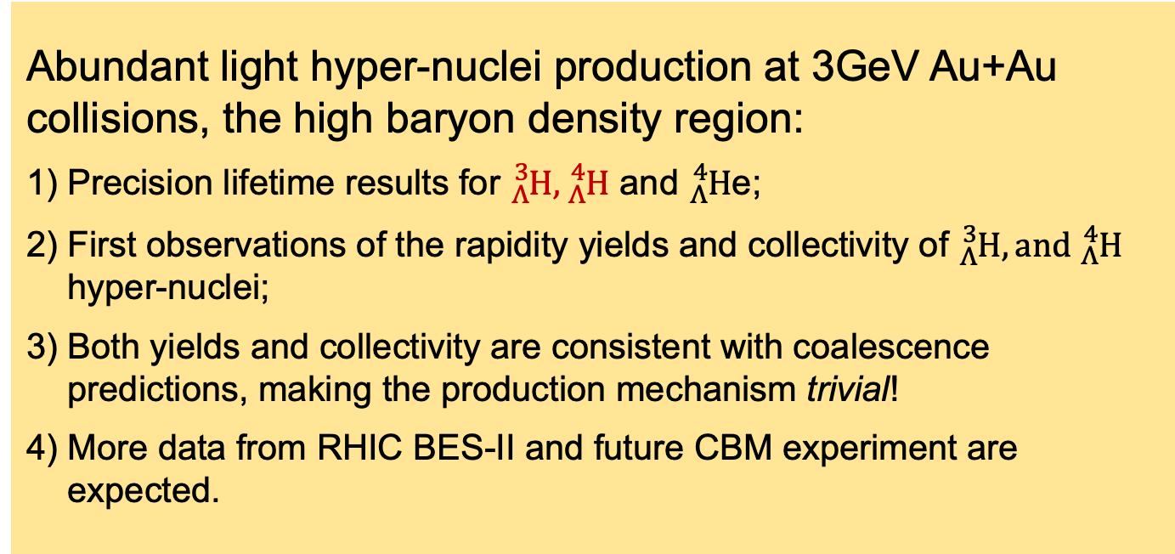
Summary
Abundant light hyper-nuclei production at 3GeV Au+Au collisions, the high baryon density region:
Precision lifetime results for ${}_{Λ}^{3}H, {}_{Λ}^{4}H$ and ${}_{Λ}^{4}H$e;
First observations of the rapidity yields and collectivity of ${}_{Λ}^{3}H, and {}_{Λ}^{4}H$ hyper-nuclei;
Both yields and collectivity are consistent with coalescence predictions, making the production mechanism trivial!
More data from RHIC BES-II and future CBM experiment are expected.

Slide 22
Acknowledgements:
P. Braun-Munzinger, X. Dong, S. Esumi, V. Koch, YH. Leung, XF. Luo, B. Mohanty, T. Nonaka, A. Rustamov, K. Redlich, J. Stachel, M. Stephanov, J. Stroth, V. Vovchenko
// YELLOW: Theory // WHITE: Exp. //
Thanks for Your Attention! Many Thanks to Organizers!

