Slide 1
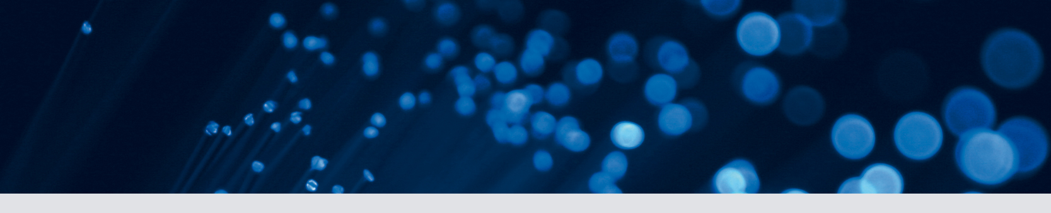




Measurement of time reversal violation in YbF
Ben Sauer

Slide 2
What is interesting for the electron edm?
10⁻²²
10⁻²⁴
MSSM φ ~ 1
YbF experiment (2011)
10⁻²⁶
Multi Higgs
d_{e} < 1 x 10⁻²⁷ e.cm (90% c.l.)
Left -Right
MSSM φ ~ α/π
10⁻²⁸
Predicted values for the electron edm d_{e} (e.cm)
We (and others!) are aiming here!
10⁻³⁰
10⁻³²
10⁻³⁴
10⁻³⁶
Standard Model

Slide 3
Why YbF?
Interaction energy
E
ηd_{e} σ
-ηd_{e} E•σ
Analogous to magnetic dipole interaction -g_{e}μ B.σ but violates P&T
Factor η includes both relativistic interaction ∼Z³, and polarization
system containing
electron
electric field

Slide 4
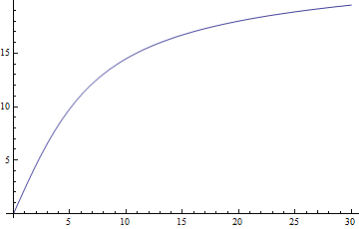
Key advantage of YbF: huge effective field ηE
Parpia
Quiney
Kozlov
Titov
15 GV/cm
15
Effective Field ηE (GV/cm)
10
5
5
10
15
20
25
30
Applied Electric Field (kV/cm)

Slide 5
A rough guide to YbF
A ²Π_{½} (v=0, N=0)
552nm
F = 1
m_{F} = -1
m_{F} = 0
m_{F} = +1
170MHz
X ²Σ⁺ (v=0, N=0)
F = 0
m_{F} = 0

Slide 6
YbF hyperfine levels in an E field
m_{F} = +1
F = 1
m_{F} = -1
m_{F} = 0
Large tensor Stark shift
F = 0
m_{F} = 0

Slide 7
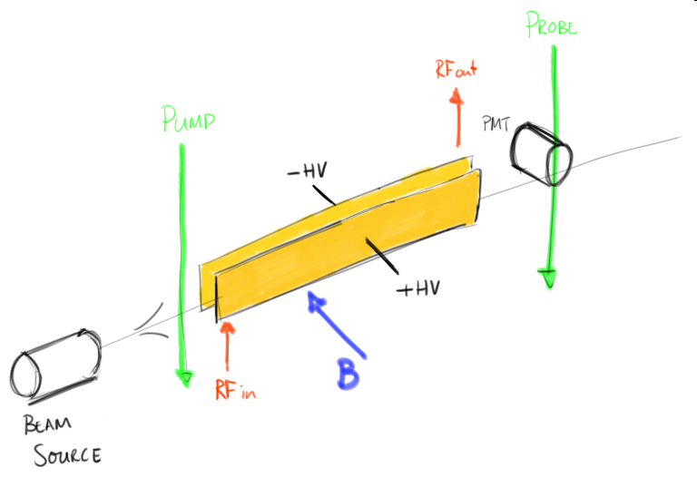

Slide 8
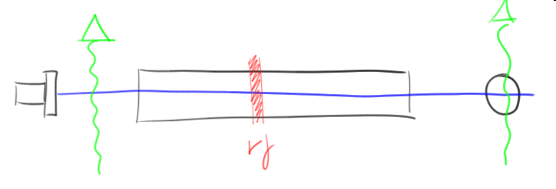
rf transition
F=1
F=1
Pump on, 20μs rf pulse to repopulate.
Scan frequency.
F = 1
F = 0

Slide 9
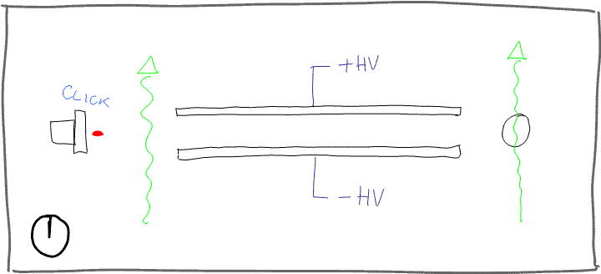
Spin interferometer
F = 1
F = 0

Slide 10
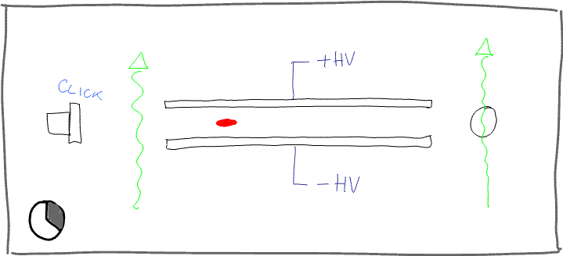
Spin interferometer
F = 1
F = 0

Slide 11
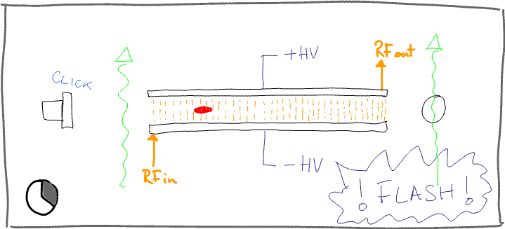
Spin interferometer
F = 1
F = 0

Slide 12
Spin interferometer
F = 1
F = 0

Slide 13
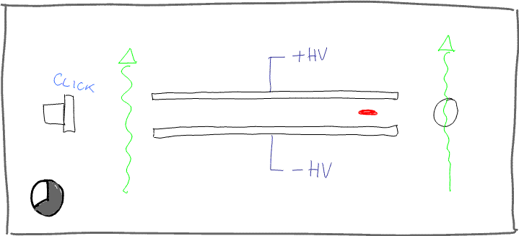
Spin interferometer
F = 1
F = 0

Slide 14
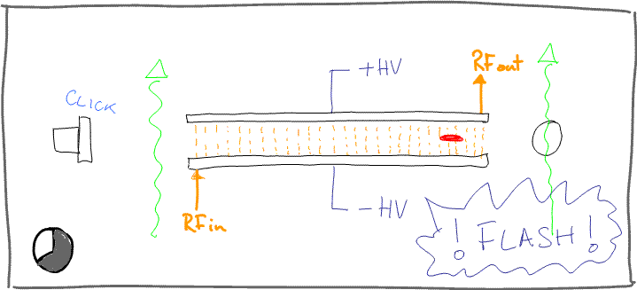
Spin interferometer
F = 1
F = 0

Slide 15
Spin interferometer
F = 1
F = 0

Slide 16
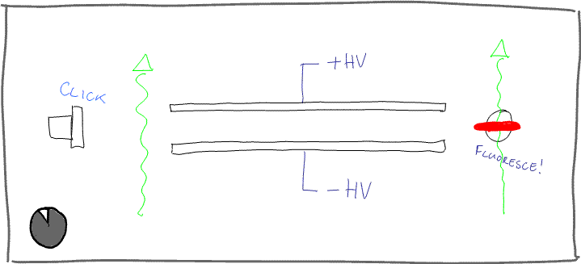
Spin interferometer
F = 1
F = 0

Slide 17
Spin interferometer
Final state is
The detector signal is proportional to
This is a spin precession experiment, but not quite traditional separated oscillatory fields
(there is no local oscillator).

Slide 18
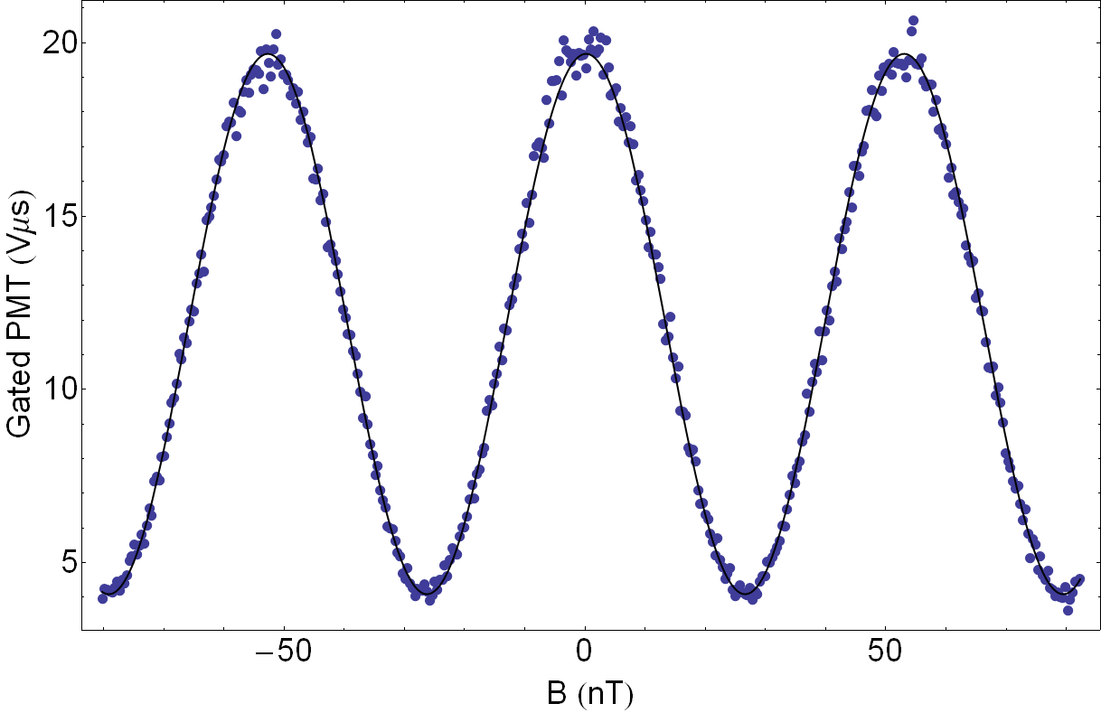
Spin interferometer
F=0 population
F = 1
F = 0

Slide 19
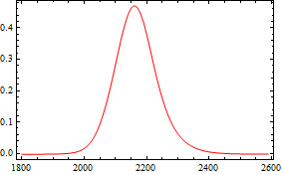
Timing
Time = Position
Vary pulse timings to probe different parts of machine
Slice time-of-flight signal to probe local gradients
Fluorescence signal
Time after valve fires (μs)

Slide 20
Measuring the EDM
+E
-E
δϕ = - 4d_{e}ηET/h
Detector count rate
δϕ = 4d_{e}ηET/h
-B₀
B₀
Applied magnetic field

Slide 21
Measuring the EDM
For each shot of source, set direction of E and B fields, measure transmitted fluorescence.
+E
-E
+B
-B
Time

Slide 22
EDM Data collection and analysis:
We switch 10 parameters over 4096 shots, a “block”. This takes about 6 minutes.
10 parameters give 1024 possible analysis channels, one of which is the EDM.
Other combinations tell us about machine:
e.g. E.ν_{rf1} is the Stark shift in the first rf region under E reversal. A single cluster gave this as 48Hz
(out of 173 MHz).
E field reverses to 0.2V/cm (out of 11kV/cm).

Slide 23
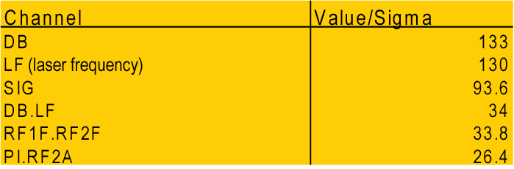
EDM Analysis
Analysis is blind to central value of EDM
see Joshua Klein and Aaron Roodman, Ann. Rev. Nucl. Part. Sci. 55:141–63 (2005).
Examples of other analysis channels:
slope of curve
contrast depends on laser frequency
phase modulator changes rf amplitude

Slide 24
An example: extracting the EDM
-E
δϕ = - 4d_{e}ηET/h
Detector count rate
δϕ = 4d_{e}ηET/h
Signal is
-B₀
B₀
Applied magnetic field

Slide 25
Published results
    Previous result - Tl atoms
    experiment: Regan et al. (PRL 2002)
    theory: Porsev et al. (PRL 2012)
    d_{e} < 1.6 × 10⁻²⁷ e.cm with 90% confidence
    2011 result – YbF – Hudson et al. (Nature 2011)
    d_{e} = (-2.4 ± 5.7 ± 1.5) ×10⁻²⁸ e.cm
    systematic - limited by statistical noise
    68% statistical
    d_{e} < 1 × 10⁻²⁷ e.cm with 90% confidence

Slide 26
Systematics
Many effects which could lead to a false EDM are “trivial”- automatic and manual reversals cancel them.
The rf transitions take place in the electric and magnetic fields. Their transition frequencies shift with the magnitude of the fields. This leads to interesting systematics .
We measure these effects by emphasizing gradients and imperfect reversals. This can lead to a systematic correction with a statistical uncertainty.

Slide 27
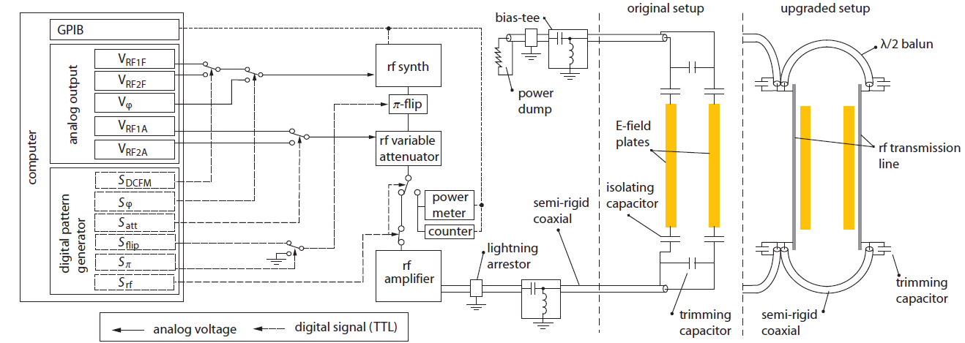
Upgrades since 2011
3rd layer of magnetic shield
(less noise)
Longer inner magnetic shield
(reduce end effects)
Separate rf, high-voltage plates
(reduce end effects, higher voltage, less leakage)
1kW/1μs rf pulses
(reduce gradient effects from both movement and linewidth)
Longer interaction region
In total, a factor of 3 in sensitivity

Slide 28
Current Measurement
Check for laser polarization systematics (pumping inside innermost magnetic shield)
Extensive systematics tests by exaggerating imperfections
Only one is non-zero at 6×10⁻²⁹ e.cm, all others are zero at this statistical sensitivity
Taking data now, goal is 67% c.l. of better than 2×10⁻²⁸ e.cm

Slide 29
Other electron EDM searches
Ferroelectric ceramics
Huge number of electrons!
Yale (Lamoreaux)
Cs atoms
Fountain (LBL),
Trapped (Penn State), Trapped (Texas)
Magnetic field a challenge
Molecules
Metastable PbO in cell (Yale, DeMille)
ThO beam (Harvard/Yale)
PbF beam (Oklahoma)
WC (Michigan)
Trapped HfF⁺ ions (JILA)
Predicting very good sensitivity

Slide 30
The future of YbF?
Factor of 10 increase from a slow beam. We have built a buffer gas source (He carrier gas at 4K).
Another factor of 10 from a YbF fountain. This will require laser cooling of YbF.

Slide 31
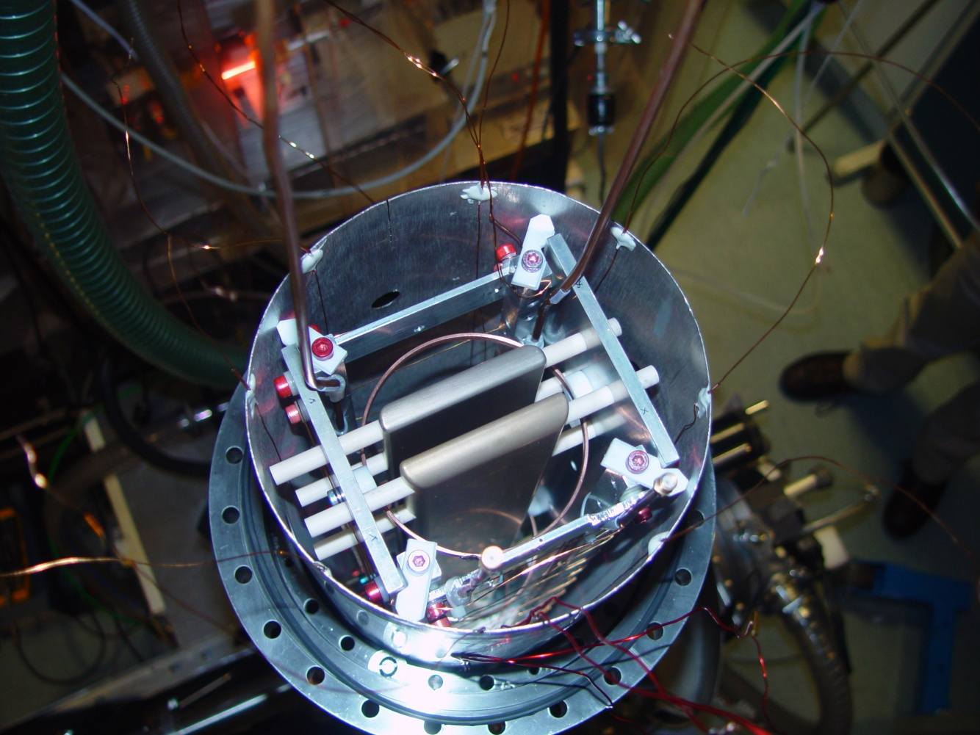
Acknowledgements
Ed Hinds
Jony Hudson
Mike Tarbutt
Dhiren Kara
(now at Cambridge)
Joe Smallman
Jack Devlin

Slide 32
Enhancement in Thallium
Tl is a “3 electron” system. The polarization is linear so E_{eff} = η E_{lab}.
η = -585(60)
Z.W. Liu and H. P. Kelly, Phys. Rev. A 45, R4210 (1992).
linearized relativistic coupled-cluster theory
η = -582(18)
V. A. Dzuba and V.V. Flambaum, Phys. Rev. A 80, 062509 (2009).
hybrid: configuration interaction method and many-body perturbation theory
η = -466(10)
H. S. Nataraj, B. K. Sahoo, B. P. Das, and D. Mukherjee, PRL 106, 200403 (2011).
relativistic coupled-cluster theory
η = -573(20)
S. G. Porsev, M. S. Safronova, and M. G. Kozlov, PRL 108, 173001 (2012).
Possible to compute hyperfine structure of thallium using same wavefunctions

Slide 33
Enhancement in YbF
YbF is a “single-electron” system, but with cylindrical symmetry. There is nonlinear polarization so we express the enhancement as the saturated E_{eff}.
E_{eff} = 30 GV/cm: semiemperical
M. G. Kozlov and V. F. Ezhov, Phys. Rev. A 49, 4502 (1994).
E_{eff} = 18 GV/cm: ab initio relativistic effective core potential
A. V. Titov, N. S. Mosyagin, and V. F. Ezhov, PRL 77, 5346 (1996).
E_{eff} = 25 GV/cm: semiemperical, ground state has 4f hole admixture
M. G. Kozlov, J. Phys. B: At. Mol. Opt. Phys. 30 (1997) L607–L612.
E_{eff} = 24.8 GV/cm: ab initio Dirac-Hartree-Fock
H M Quiney, H Skaane and I P Grant, J. Phys. B: At. Mol. Opt. Phys. 31 (1998) L85.
E_{eff} = 24.8 GV/cm: unrestricted Dirac-Fock
Farid A Parpia, J. Phys. B: At. Mol. Opt. Phys. 31 (1998) 1409.
E_{eff} = 25 GV/cm: ab initio relativistic, core polarization
N S Mosyagin, M G Kozlov and A V Titov, J. Phys B: At. Mol. Opt. Phys. 31 (1998) L763.
Possible to compute hyperfine structure of ¹⁷¹YbF, ¹⁷³YbF using same wavefunctions

Slide 34
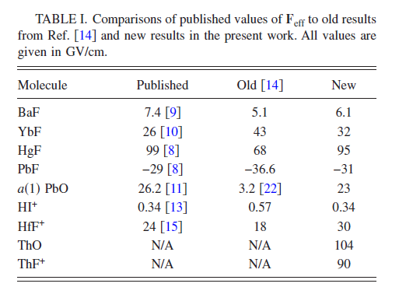
Enhancement in ThO
Experiment takes place in ³Δ metastable state.
Edmund R. Meyer and John L. Bohn, Phys. Rev. A 78, 010502R (2008).
nonrelativistic molecular structure calculations perturbed by the Hamiltonian arising from the eEDM
Not possible to compare to ThO hyperfine structure

Slide 35
A systematic error correction in 2011 data
rf detuning from resonance makes a (small) interferometer phase shift
Measured by the {rf1f.B} and {rf2f.B} correlations
they are both ~ 100 nrad/Hz
Electric field “reversal”
Changes magnitude of E (slightly) causing a Stark shift.
Measured by the {rf1f.E} and {rf2f.E} correlations.
Together ⇒ false EDM
We measure and correct: (+5.5 ± 1.1) ×10⁻²⁸ e.cm.

Slide 36
2011 Systematics
(in units of 10⁻²⁸ e.cm)
Effect Correction Uncertainty
Statistical Systematic
Correlated B field -0.3 1.7 <0.1
rf1 phase 5.0 1.3 <0.1
rf2 phase 0.5 0.7 <0.01
Residual δE effects ̶ ̶ 1.1
Ground plane ( ) ̶ ̶ 0.1
Geometric phase ̶ ̶ 0.03
Leakage currents ̶ ̶ 0.2
B-shield polarisation ̶ ̶ 0.25
effect ̶ ̶ 0.0005
Nature, 473 493 (2011)

Slide 37
Measuring the average of |E|
π/2 pulse
π/2 pulse
F=1
Ramsey pattern, sensitive to
relative Stark shift of levels
π/2
F=0
Signal (arb. u.)
-20
-10
0
10
20
rf frequency f-173565 (kHz)

Slide 38
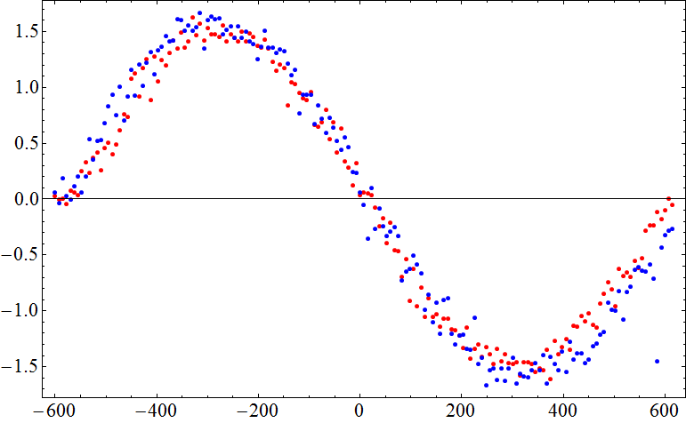
E-field reversal quality
Signal (arb.)
Reversal good to a few mV/cm (out of ~5kV/cm).
Detuning (Hz)
M. R. Tarbutt et al. ArXiv:0803.0967 (2008)

Slide 39
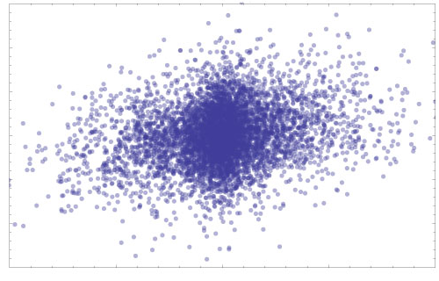
Magnetic field correlation
B fluctuations have some component synchronous with E reversal:
EDM
B synchronous with E reversal
We measure and correct: (-0.3 ± 1.7) ×10⁻²⁸ e.cm.

Slide 40
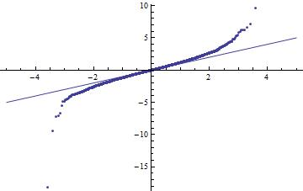
Outliers (Q-Q plot)
Measured deviation
Expected (Gaussian) deviation

