Slide 1
The WITCH Experiment
T. Porobić²,
G. Ban¹, M. Breitenfeldt², V. De LeeBeeck², X. Fléchard¹, P. Friedag³, F. Glück⁵, V. Kozlov⁵, E. Liénard¹, G. Soti², M. Tandecki², S. Van Gorp² , Ch. Weinheimer³, D. Zákoucký⁴, N. Severijns²
¹LPC-Caen, ENSICAEN, Université de Caen, CNRS/IN2P3, Caen, France
²Instituut voor Kern- en Stralingsfysica, KUL, Leuven, Belgium
³Universität Münster, Institut für Kernphysik, Münster, Germany
⁴NPI Rez, Czech Republic
⁵Karlsruhe Institute of Technology, Institut fur Kernphysik, Germany
5th International Symposium on Symmetries in Subatomic Physics
June 18-22, 2012 KVI, Groningen

Slide 2
Outline
Introduction & motivation
Overview of the WITCH setup
Online experiments
Results
Outlook
5th International Symposium on Symmetries in Subatomic Physics
June 18-22, 2012 KVI, Groningen

Slide 3
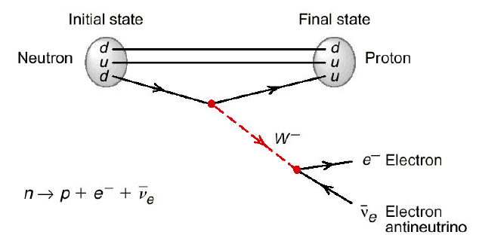
Motivation: New Physics
High energy
Direct production - LHC
Search for physics beyond the standard model
High precision
Low energy – β-decay
Beta decay:
Observables: Energy, angular correlations
Historical: Parity violation on Co
5th International Symposium on Symmetries in Subatomic Physics
June 18-22, 2012 KVI, Groningen

Slide 4
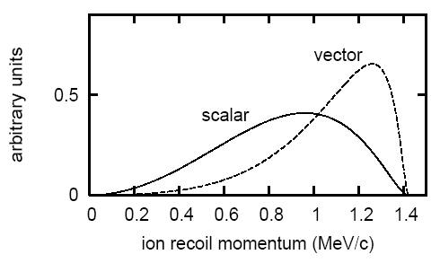
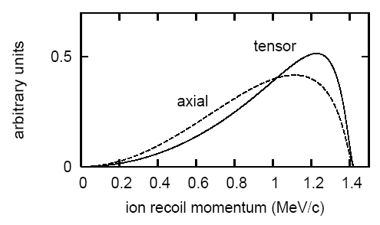
Introduction
Fermi transitions
Gamow-Teller transitions
a
ν
ν
tensor
vector
e⁻
e⁻
recoil
recoil
ν
ν
scalar
axial
e⁻
e⁻
recoil
recoil

Slide 5
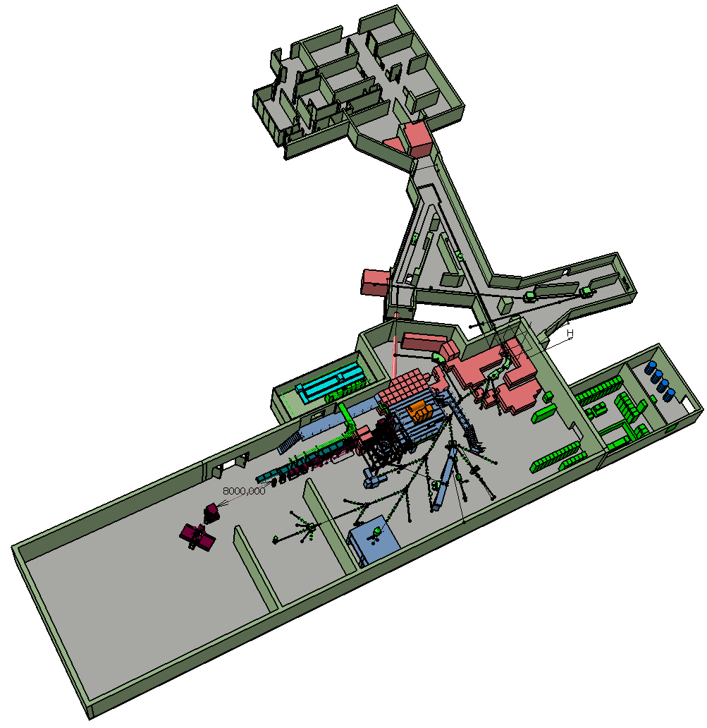
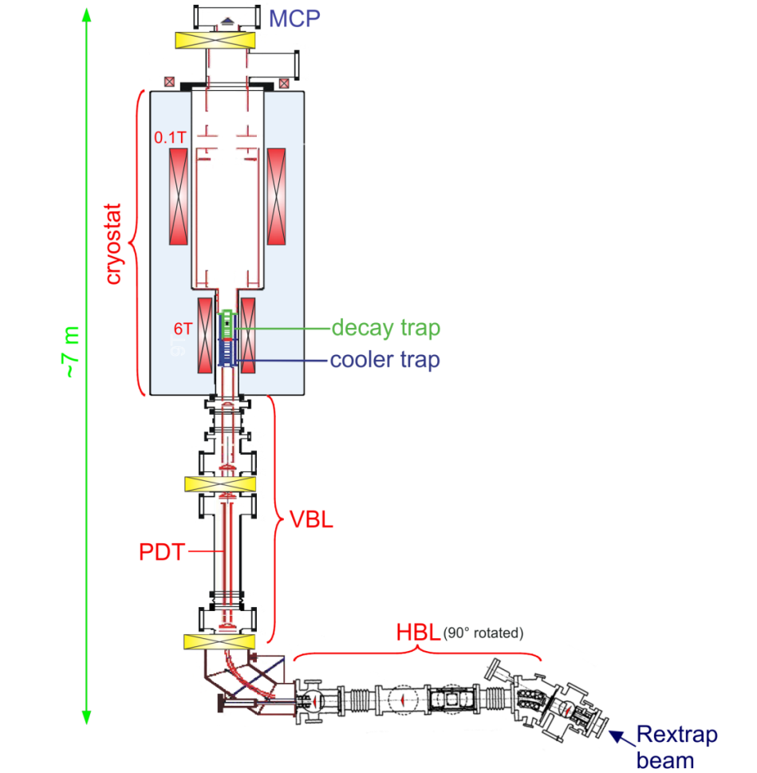
WITCH experiment (CERN/ISOLDE)
Weak Interaction Trap for CHarged particles
Main goal: beta-neutrino correlation
coefficient, a
³⁵Ar – main isotope of interest
5th International Symposium on Symmetries in Subatomic Physics
June 18-22, 2012 KVI, Groningen

Slide 6
Penning traps at WITCH
Scattering-free sources
He buffer gas in the cooler trap
Dipole excitation at magnetron ω₋ frequency – mass independent removal from trap center
Quadrupole excitation at cyclotron frequency ω_{c} – mass selective centering & buffer gas --> cooling of the ion cloud
5th International Symposium on Symmetries in Subatomic Physics
June 18-22, 2012 KVI, Groningen

Slide 7
WITCH: MAC-E filter
9 T magnet
High field (9 T) at the traps, low (0.1 T) in the analyzing plane
Adiabatic approximation: field gradient in a single cyclotron gyration radius is small
E_{cycl} /B is an adiabatic invariant -> if B_{source} >> B_{plane} , then E_{cycl,plane} <<E_{cycl,source}
Combination of electrostatic filter and inhomogenous mag. field => high energy resolution + high statistics
5th International Symposium on Symmetries in Subatomic Physics
June 18-22, 2012 KVI, Groningen

Slide 8
Unwanted Penning-like traps in the spectrometer
Formed at undesirable locations due to the combination of magnetic and electric fields
Two electrodes connected by a magnetic field line
Primary electron emission: by particle collisions (electron and ion sputtering, Compton scattering, photoelectric effect) and by field emission
Typical mechanism of a Penning discharge: electrons from the cathode enter the Penning-like trap and gain kinetic energy -> causing ionisation of the rest gas -> secondary electrons create more ionisation and positive ions travel to the cathode and create more secondary electrons
Solutions: compensating magnet and a wire in the spectrometer
spectrometer
5th International Symposium on Symmetries in Subatomic Physics
June 18-22, 2012 KVI, Groningen

Slide 9
WITCH Results: Proof of principle in 2006¹
Test case: ¹²⁴In
¹M. Beck et al., The European Physical Journal A 47, 9 (2010).
5th International Symposium on Symmetries in Subatomic Physics
June 18-22, 2012 KVI, Groningen

Slide 10
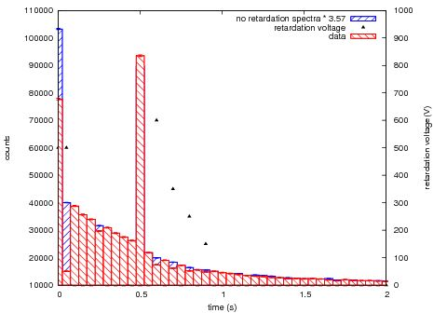
WITCH results: June 2011
Recoil ions observation
- Gaussian shape of the pulse-height
distribution difference indicates
recoil ions
Recoil ion time spectra
500 ms cooling in the cooler trap
Afterwards capture in the decay trap
No retardation (blue) & retardation (red)
5th International Symposium on Symmetries in Subatomic Physics
June 18-22, 2012 KVI, Groningen

Slide 11
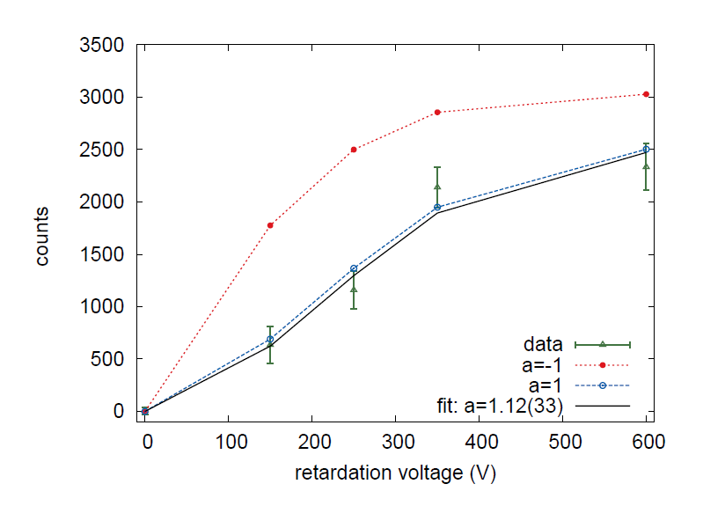
WITCH results: June 2011²
Difference in retardation spectra
and non-retarded spectra
Fit of a to simulated values
a=-1
Result: a = 1.12(33)
SM: a=0.9004(16)
First determination of a with the WITCH setup
²Van Gorp et al, Determination of the Beta-neutrino angular correlation coefficient, a, on ³⁵Ar with the WITCH setup (submitted to PRL)
5th International Symposium on Symmetries in Subatomic Physics
June 18-22, 2012 KVI, Groningen

Slide 12
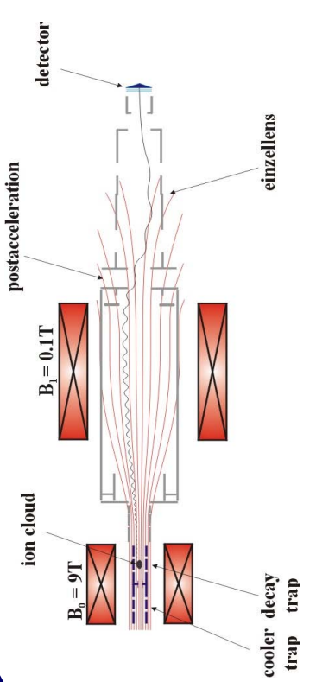
WITCH results: Simulations
Ion cloud in the traps simulations: Simbuca¹
Electric field map calculated with COMSOL
Magnetic field map provided by manufacturer
Ion tracking in the spectrometer: SimWITCH
Ion transport simulated for
various retardation voltages (0 V – 450 V)
Also for all ³⁵Ar charge states (1⁺, 2⁺, 3⁺, 4⁺, 5⁺)
(charge state measurement by LPC trap@GANIL)
¹S. Van Gorp et al. Nucl. Instr. and Meth. A 638 (2011) 192-200.

Slide 13
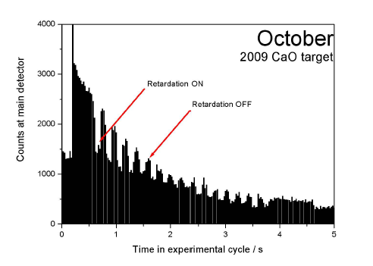
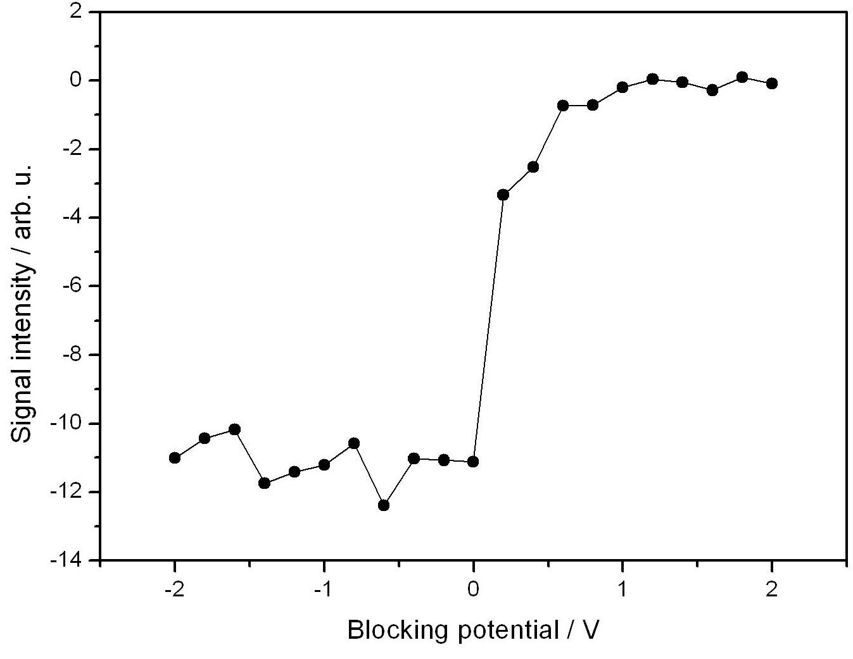
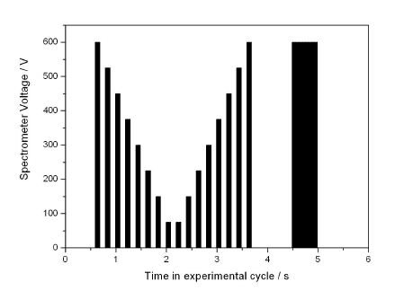
WITCH results: October/November 2011
30 times more data counts,
2-3% stat. error
V-shaped retardation voltage pattern
Energy spread in decay trap
5th International Symposium on Symmetries in Subatomic Physics
June 18-22, 2012 KVI, Groningen
13

Slide 14
WITCH: Outlook
Analysis of October/November data
Systematic effects (misalignment of the traps due to baking)
Misc. upgrades of the system
Next run in Autumn 2012
5th International Symposium on Symmetries in Subatomic Physics
June 18-22, 2012 KVI, Groningen

