Slide 1
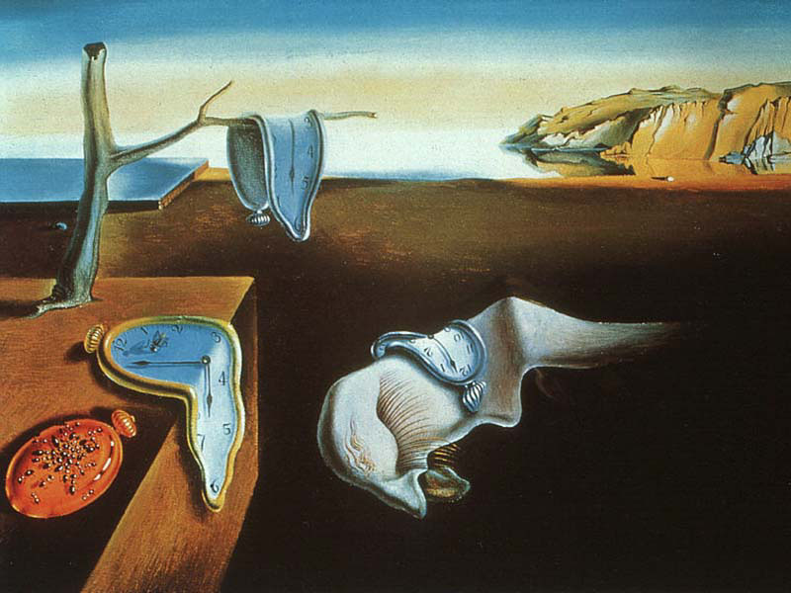
Searches for Lorentz violation
in
³He/¹²⁹Xe clock comparison experiments
W.Heil
Outline:
Features of frequency standards and clocks
³He/¹²⁹Xe „spin“-clock
³He/¹²⁹Xe clock-comparison experiments
Conclusion and outlook
SSP2012, Groningen

Slide 2
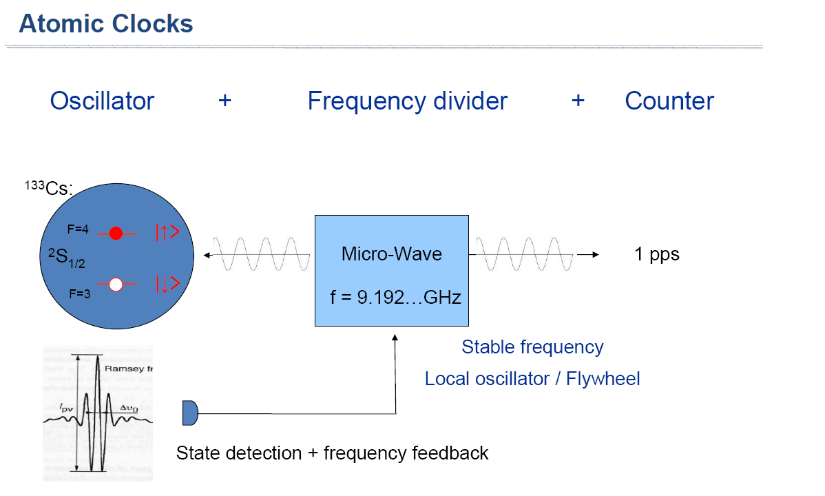


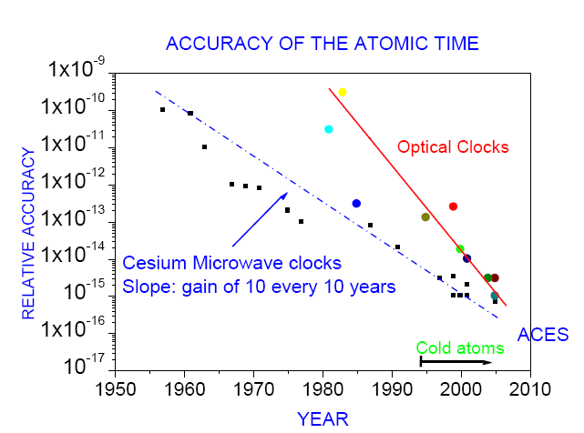
Current accuracy:
Microwave: 6 x 10⁻¹⁶
Optical : 3 x10⁻¹⁷
1 second = 9,192, 631,770 cycles
≈ 1 ns / day
Stable frequency
Local oscillator
sensitivity (absolute scale): δν≈ mHz
better:
reference transition at f ≈ 1 Hz with
δf /f ≈ 10⁻¹⁴
⇒ „nuclear spin -clock“

Slide 3
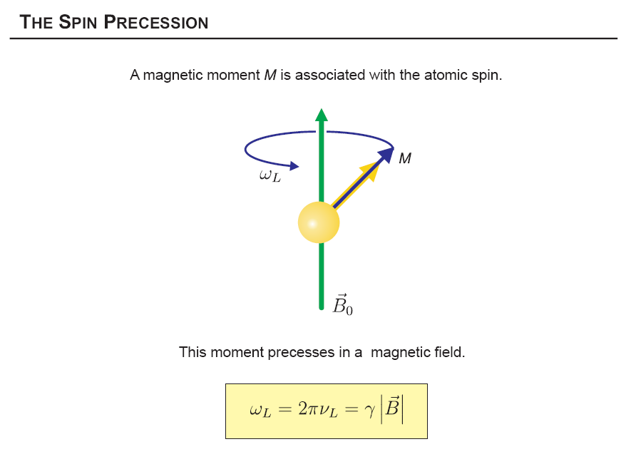

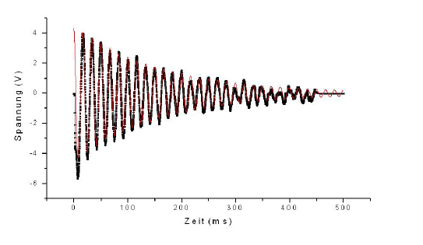
Clock based on nuclear spin precession „ spin-clock“
detector
(G. D. Cates, et al., Phys. Rev. A 37, 2877)
signal (a.u.)
(ms )

Slide 4
Spin-clock: Detection of free spin precession:
long spin coherence times T₂*> 1 day @ Δf/f ~ 10⁻¹⁴
free spin precession: no induced frequency shifts due to
feedback phase error, light shift, etc. (Maser, Cs-M )
use of LT_{c}-SQUIDs to detect the spin precession signal
- intrinsic noise of SQUID: ∼ 1 fT/√Hz
no feedback coupling between detector and spin sample

Slide 5
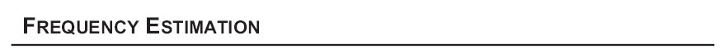
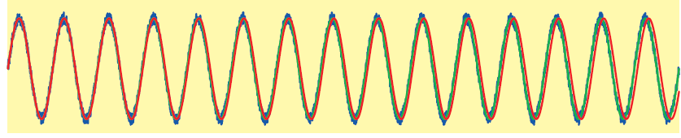
T
Accuracy of frequency determination:
Fourier width
# data points
Δx ≈ 0.1μm /day
If the noise w[n] is Gaussian distributed, the Cramer-Rao Lower Bound (CRLB) sets the lower limit on the variance
<
>
D=10 cm
example: SNR = 10000:1 , = 1 Hz , T= 1 day ⇒

Slide 6
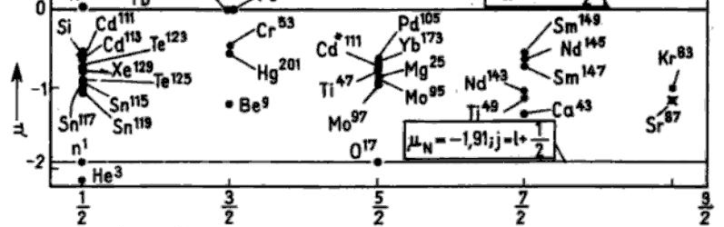
³He/¹²⁹Xe „spin“-clock
μ_{n} = -1.913 μ_{K}
μ_{He} = -2.1276 μ_{K}
OP-techniques:
MEOP
SEOP
μ_{Xe} = -0.7779 μ_{K}
Schmidt-model:
Xe¹²⁹
He³
J →

Slide 7
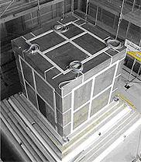
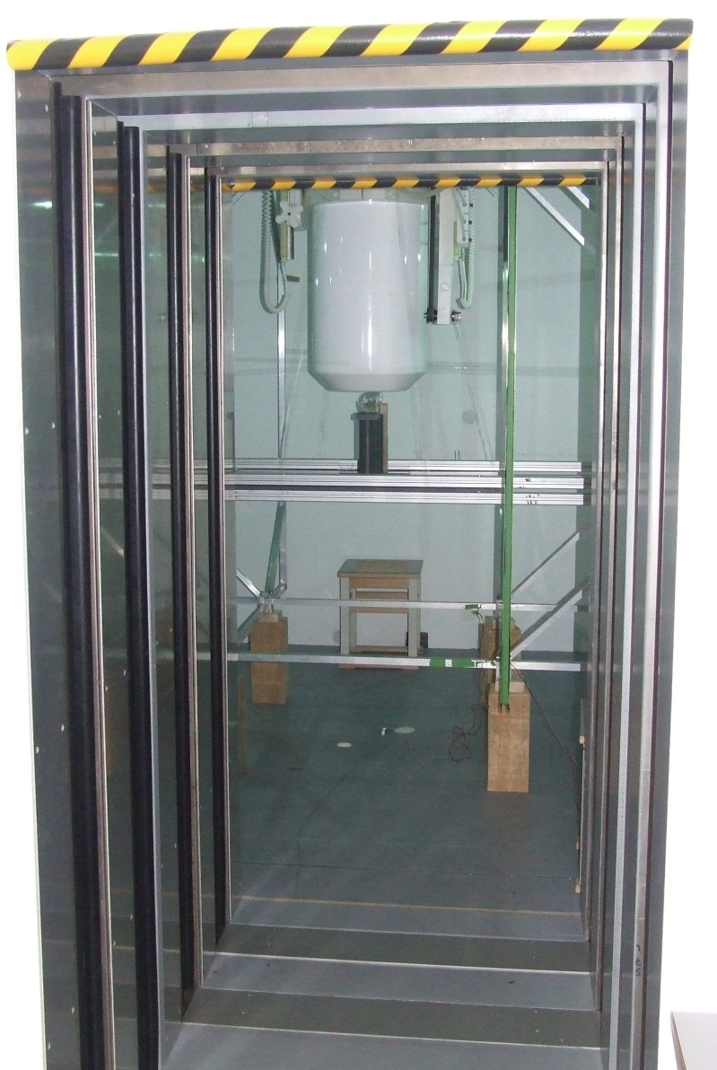
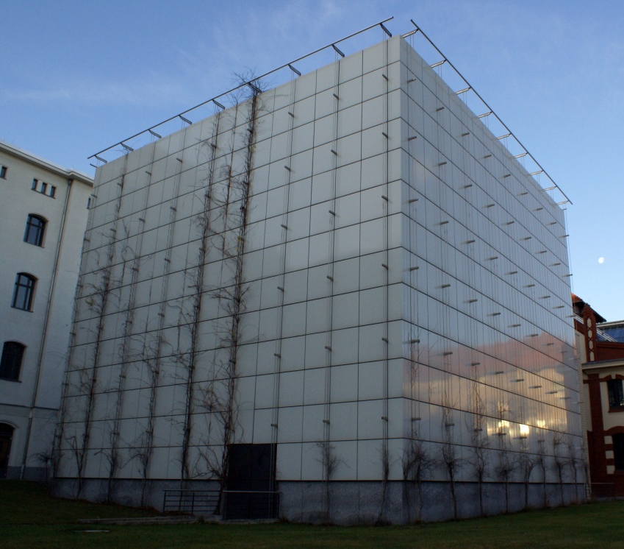
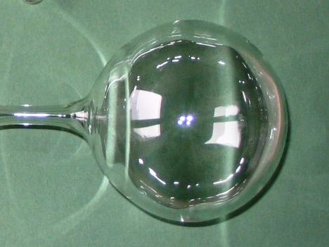
BMSR 2, PTB Berlin
The 7-layered magnetically
shielded room
(residual field < 2 nT)
LT_{c}- SQUID
J. Bork, et al., Proc. Biomag 2000, 970 (2000).
³He (4.5 mbar )
6 cm
magnetic guiding field ≈ 0.4 μT
(Helmholtz-coils)

Slide 8
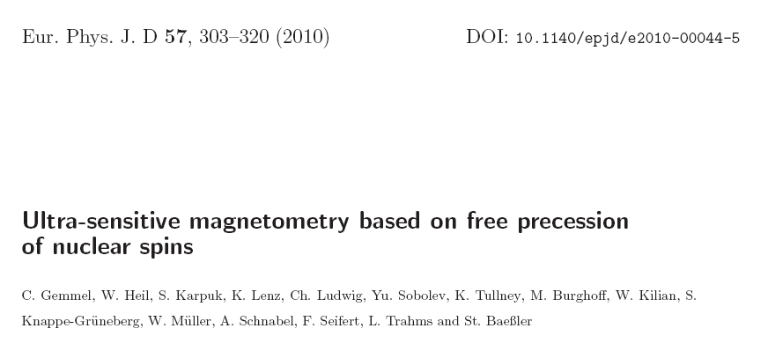
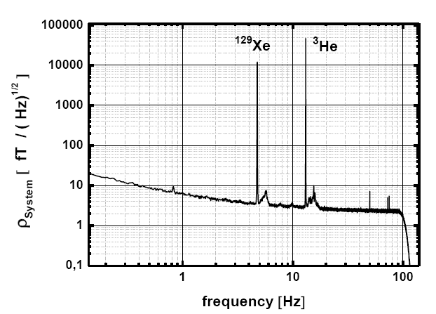
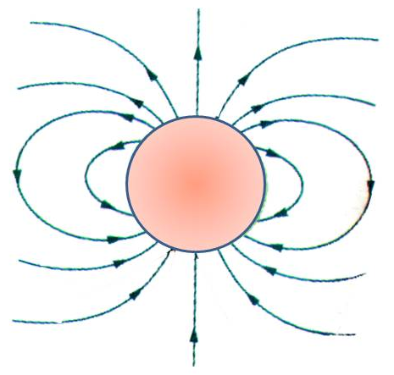

³He free spin-precession signal
SQUID
d
Signal:
parameters:
p_{He}= 1-3 mbar ; P = 10-50%
R =2.9 cm; d = 6cm
→ ΔB = 10-30 pT
R
system noise
inside BMSR-2
~ 2 fT/√Hz
Note:
At present, the Xe spin
coherence time T₂*
is limited to
due to wall relaxation
3 h < T₂*< 4 h

Slide 9
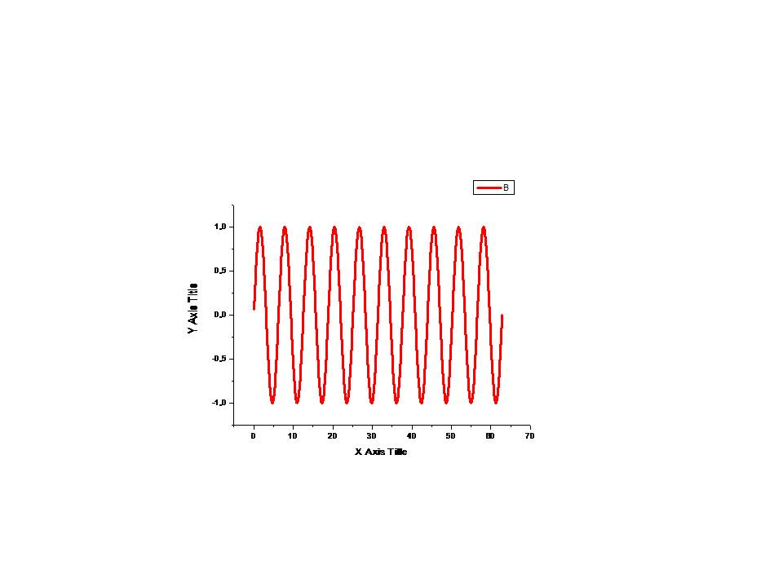
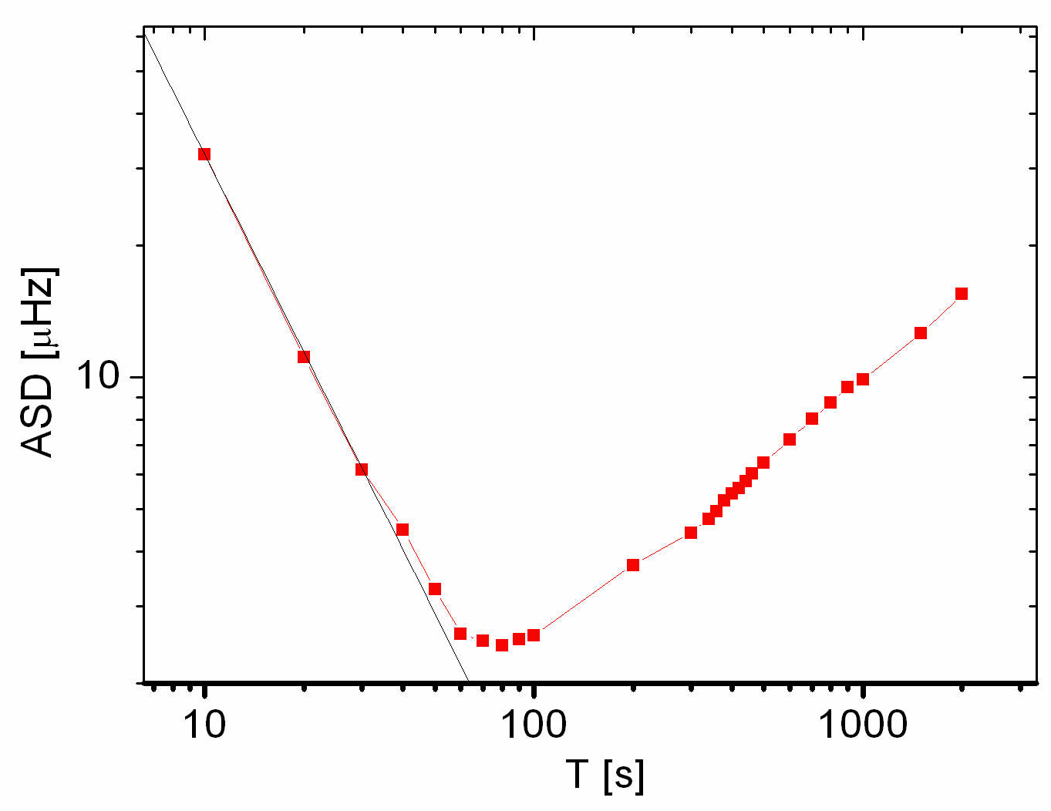
Test of CRLB via Allan Standard Deviation (ASD)
τ
i
i+1
Non-gaussian noise:
magnetic field drifts
intrinsic noise
…
2
τ [s]

Slide 10
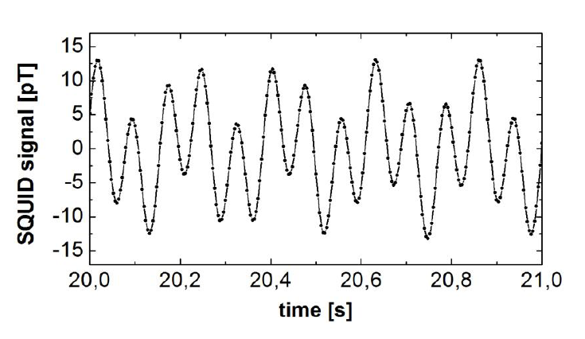
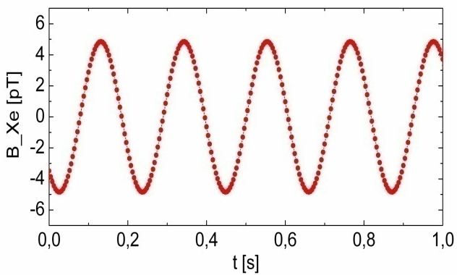
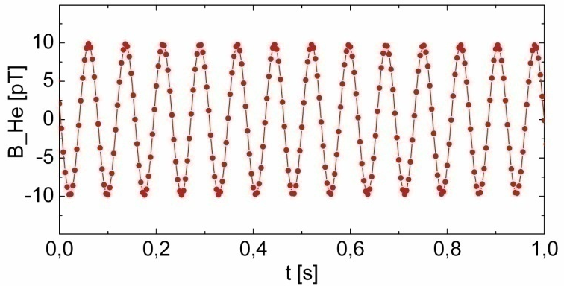
³He / ¹²⁹Xe clock comparison to get rid
of magnetic field drifts
406.68
drift ~ 1pT/h
B [nT]
406.67
δν ∼ 10⁻⁵ Hz/h
406.66
B₀
0
5
1
0
1
5
2
0
t [h]
¹²⁹Xe
³He
(13 Hz)
(4,7 Hz)
!
!

Slide 11
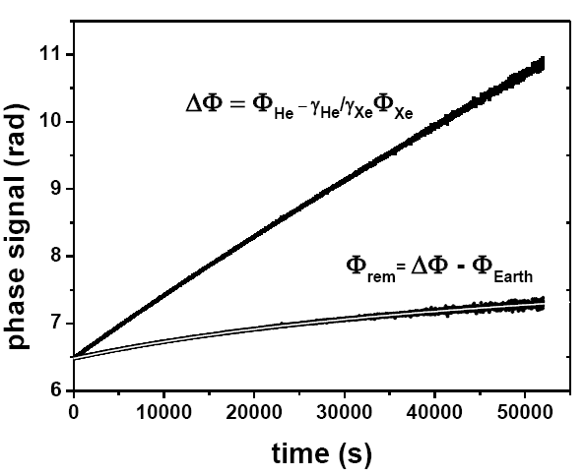
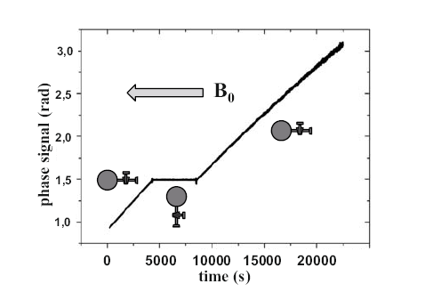
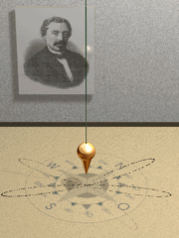
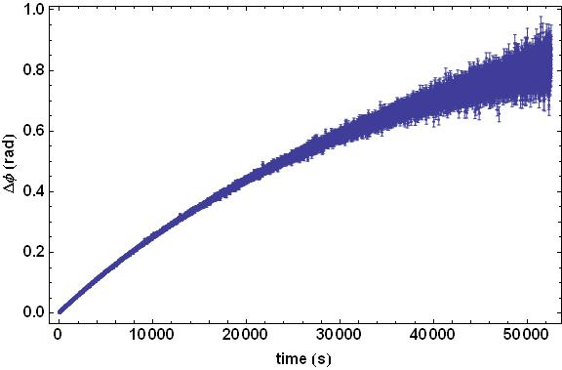
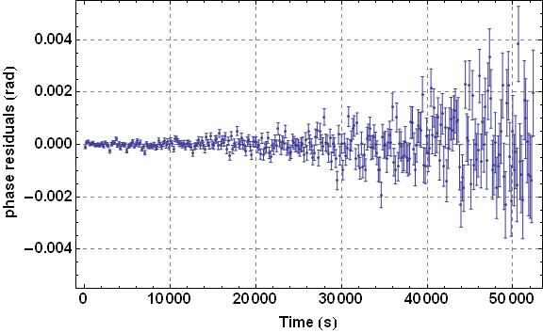

Subtraction of deterministic phase shifts
I. Earth‘s rotation
non-ideal spherical cell:
Ramsey-Bloch-Siegert shift
(self shift)
ΔΦ = Φ_{He}- γ_{He} / γ_{Xe}⋅ Φ_{Xe}
uncertainties in subtraction of Φ_{Earth}
chemical shift:
Φ_{rem} = ΔΦ - Φ_{Earth}
B_{o}
II.
+ Φ (t)_{spin-coupling}
Phase residuals
Φ_{rem}

Slide 12
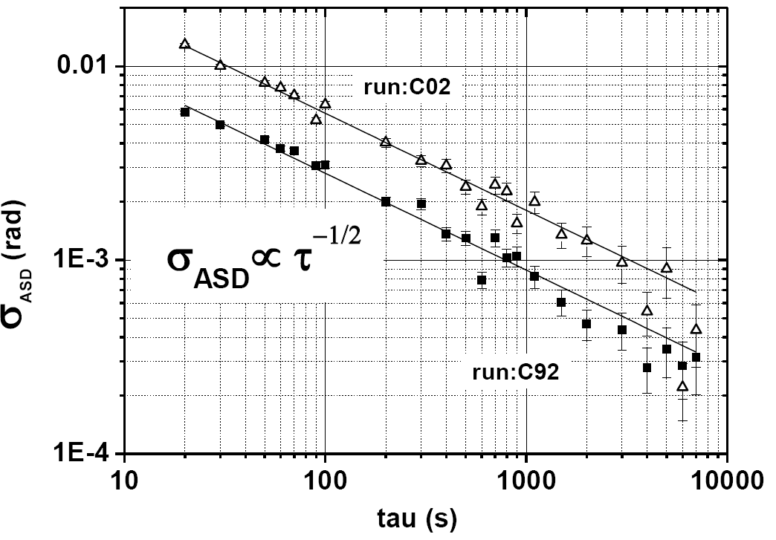
ASD of phase residuals

Slide 13
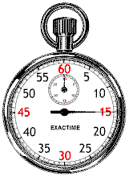
The detection of the free precession of co-located ³He/¹²⁹Xe sample spins can be used as ultra-sensitive probe for
non-magnetic spin interactions of type:
Search for a Lorentz violating sidereal modulation
of the Larmor frequency
Search for spin-dependent short-range interactions
Search for EDM of Xenon
…
Observable:

Slide 14
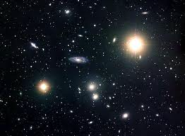
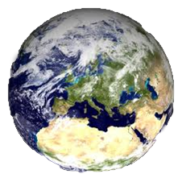
Search for a Lorentz violating sidereal modulation
preferred direction in space-time

Slide 15

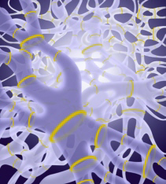
A closer look…
gravitation
Standard Model (SM) of particle physics
General relativity is
a classical theory, i.e.,
non-quantum
SM: relativistic quantum
field theory
strong force
electromagnetic
force
weak
force
Courtesy of C. Lämmerzahl
Unification theories:
string theory, loop quantum gravity,..
Planck scale: energy scale where gravity meets quantum physics
M_{p}~ 10¹⁹ GeV

Slide 16
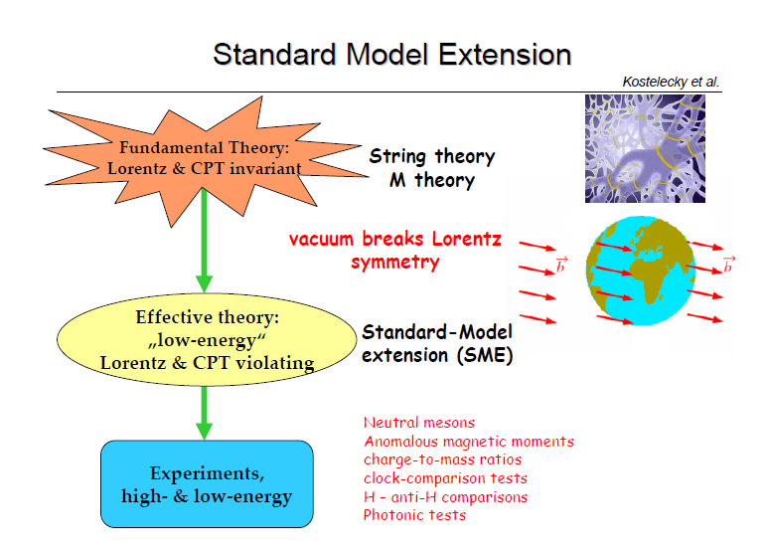



∼
Planck scale
10¹⁹ GeV
Spontaneous Lorentz symmetry
breaking in string theory
e.g. Lorentz vector field makes
non zero vacuum expectation
value
Background fields (tensor fields) give preferred direction
Kostelecký, Perry, Pot, Samuel ’89; ’90; ’91; ’95; '00
e.g. rest frame of CMB
→ talk of Ralf Lehnert
low-energy
world
D. Colladay and V.A. Kostelecky, Phys. Rev. D 55, 6760 (1997); Phys.Rev. D 58, 116002 (1998)

Slide 17
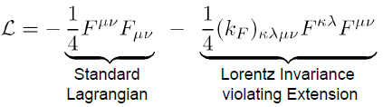

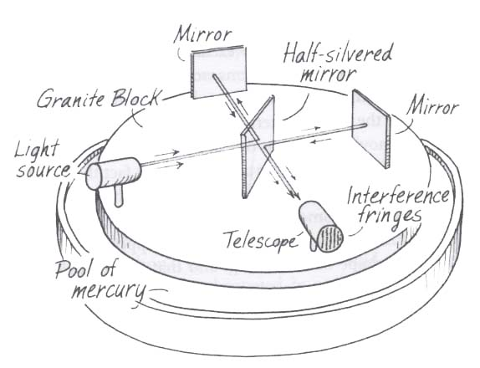
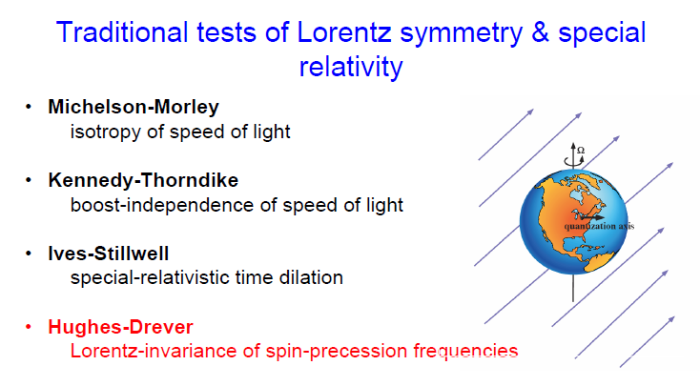
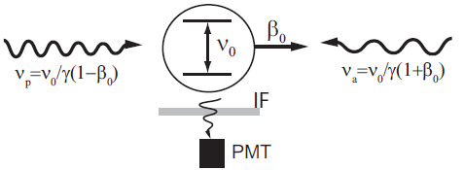
Traditional tests of Lorentz symmetry & special relativity
photon sector:
19 independent
parameters
c(θ) = c
Michelson (1881,Potsdam)
Michelson&Morley (1887,Cleveland)
c(v) = c
Li⁺ - ions
ESR at GSI
relativistic
Doppler effect
C.Novotny et al., PR A 80 (2009) 022107

Slide 18
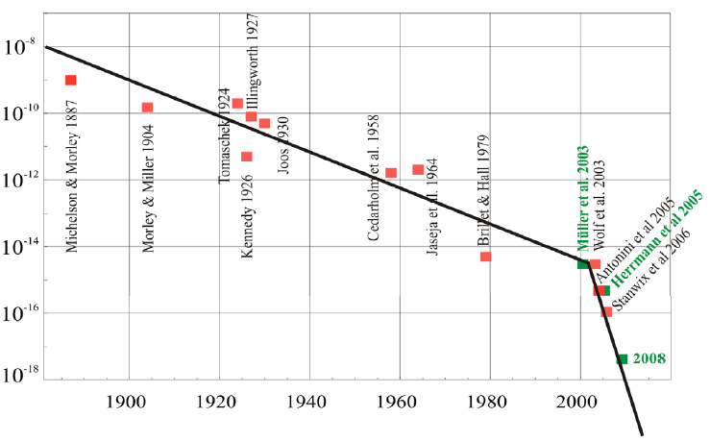
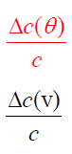
Test of constancy of c
Interferometers
Resonators
Kennedy,Thorndike 1932
Hils,Hall 1990
Braxmaier 2002
Wolf 2004
Herrmann 2009
Year

Slide 19
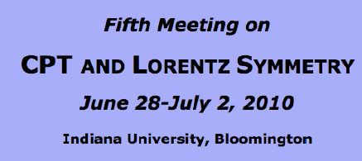
Modern Tests of Lorentz violation
Topics:
searches for CPT and Lorentz violations involving
-birefringence and dispersion from
cosmological sources
-clock-comparison measurements
-CMB polarization
-collider experiments
-electromagnetic resonant cavities
-equivalence principle
-gauge and Higgs particles
-high-energy astrophysical observations
-laboratory and gravimetric tests of gravity
-matter interferometry
-neutrino oscillations
-oscillations and decays of K, B, D mesons
-particle-antiparticle comparisons
-space-based missions
-spectroscopy of hydrogen and
antihydrogen
-spin-polarized matter
* Theoretical studies of CPT and Lorentz biviolation involving
-physical effects at the level of the SM,
General Relativity, and beyond
-origins and mechanisms for violations
classical and quantum issues in field
theory, particle physics, gravity, and strings

Slide 20

Standard-Model Extension
- matter sector -
A. Kostelecky and C. Lane: Phys. Rev. D 60, 116010 (1999)
Modified Dirac equation for a free spin ½ particle (w=e,p,n)
standard DE
CPT violating
CPT preserving terms
Lorentz violating terms
Experimental access:
Cs- fountain
Torsion pendulum
Antihydrogen spectroscopy
Astrophysics
Hg/Cs comparison
UCN/Hg comparison
He/Xe maser
K/He co-magnetometer
Wolf et al.,
B.Heckel et al. PRD 78 (2008) 092006
}
clock
comparison
experiments
coupling strength

Slide 21



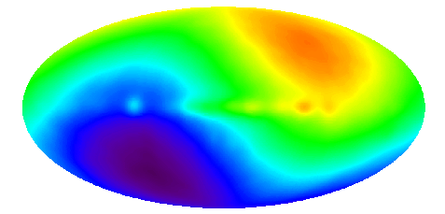
Coupling of spin to background
field:
C
Ω
LAB
cosmic microwave
background
v = 368 km/s
Zeeman
LV
ΔT_{dip} ≈ 3.3 mK

Slide 22
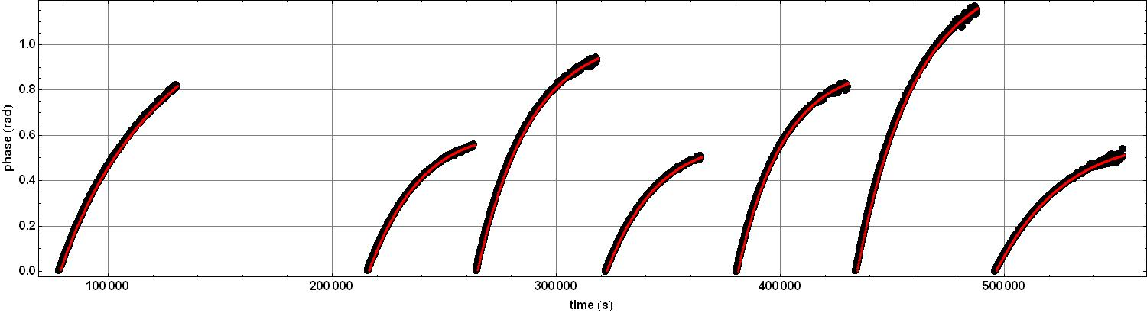
Search for a sidereal modulation of the weighted phase difference
March 2009 run:
Φ_{rem} = Φ_{He} - γ_{He} / γ_{Xe}⋅ Φ_{Xe} - Φ_{Earth}
Φ_{rem}
total data-taking time:≈ 90 h
expect strong correlated error for
Ω_{s}= 2π/T_{SD} = 2π/(23^{h}:56^{m}:4.091^{s}).
Notes:
22

Slide 23
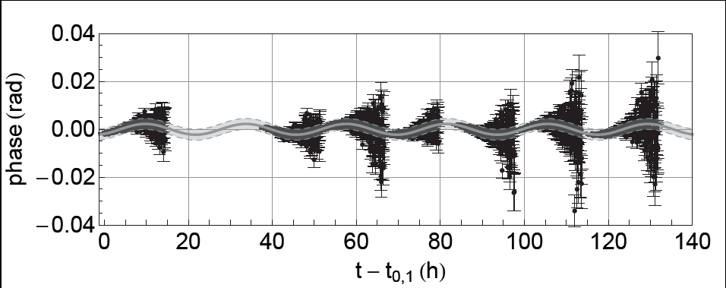
Results of χ²-fit for the sidereal phase amplitudes a_{c} and a_{s} together with their correlated and uncorrelated 1σ-errors .
 | a_{c} mrad |  |  | a_{s} mrad
 | -0.882 | 0.814 | 0.015 | -2.067 | 1.057 | 0.019
To demonstrate the strong dependence of the correlated error on Ω_{s ,} corresponding fit results are shown for multiples of Ω_{s}: Ω’_{s} = g⋅Ω_{s} .
 | -0.048 | 0.120 | 0.016 | -0.149 | 0.112 | 0.017
 | -0.184 | 0.052 | 0.019 | -0.011 | 0.043 | 0.016
 | -0.001 | 0.034 | 0.018 | 0.057 | 0.030 | 0.016
Phaseamplitude of the
sidereal modulation:
Phase residuals with fit-results for

Slide 24

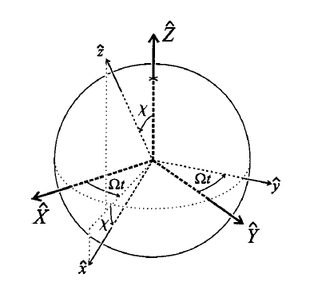

In terms of frequency:
(95% C.L.)
Kostelecky et al. , Phys. Rev. D 60, 116010 (1999)
(X,Y,Z) non-rotating frame
with Z along Earth‘s rotation axis
free neutron:
Lab-frame with
quantization axis z
n : µ = -1.913 µ_{K}
PTB Berlin:
Θ= 52,5164⁰ north
Schmidt-Model
ρ= 28⁰ (north-south)
³He: µ = -2.1276 µ_{K}
¹²⁹Xe: µ = -0.7779 µ_{K}
PRD 82 (2010) 111901

Slide 25
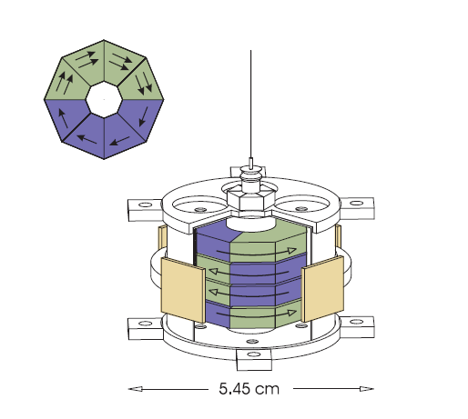
Tightest constrains on SME parameters on neutron sector:
Coefficient Proton Neutron Electron
< 10⁻³¹
< 10⁻³²
< 10⁻³¹
< 10⁻³¹
< 10⁻³²
< 10⁻³¹
< 10⁻³¹
< 10⁻³²
our result:
•Torsion pendulum
B.R.Heckel et al., PRD 78 (2008) 092006
K-³He co-magnetometer
e
=
J. M. Brown et al. Phys. Rev. Lett., 105, 151604 (2010).
Spin maser experiments with ³He and ¹²⁹Xe
( D.Bear et al., PRL 85 (2000) 5038 )
(95% C.L.)

Slide 26
March 2012 run
at
PTB
(1) conventional runs with B-field fixed
(2) active rotation of B-field (2 h / turn)

Slide 27
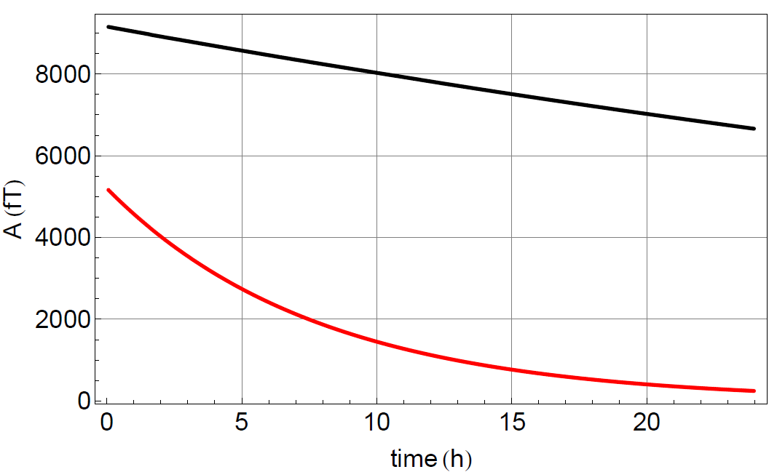
T₂*- improvements:
pure ³He @ p=2.5 mbar :
Gas mixture: p_{He}= 2.7 mbar, p_{Xe}= 4.9 mbar, p_{N2}= 24.8 mbar
FID-Amplitude ( fT )

Slide 28
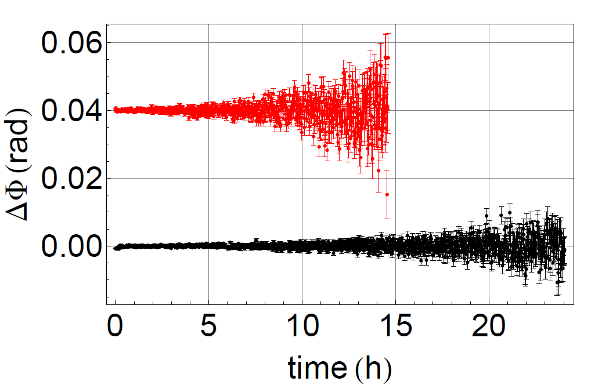
total data taking time: 165 h (90 h March 2009 )
~1.8
Phase residuals:
gain in SNR: 2-3
gain due to CRLB power law (~1/T^{3/2}) : 2.8
reduction of correlated error: ~ 7
March 2009 subrun
for comparison
(shifted by 0.04 rad)
overall gain in sensitivity:
~ 100

Slide 29
(2) rotation of B-field (quantization axis)
BMSR-2
5 subruns (~ 14 h each)
Sequence:
…
field rotation (45⁰) : 2.5 min
measurement (static): 12.5 min
…
S
expected LV-signal:
N

Slide 30
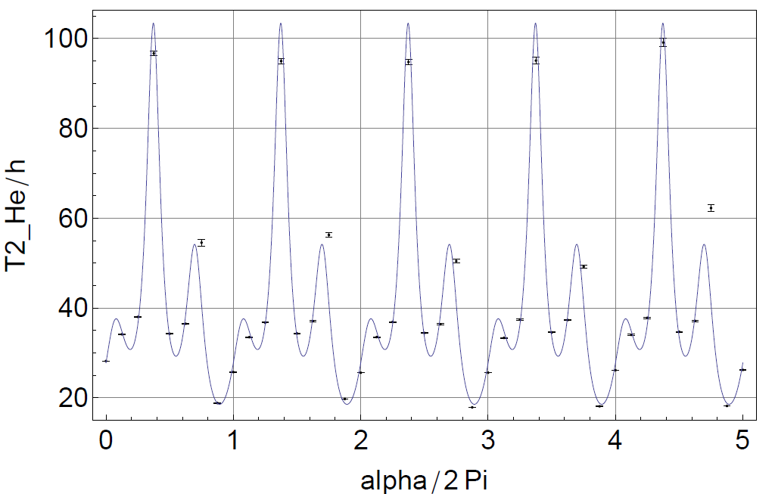
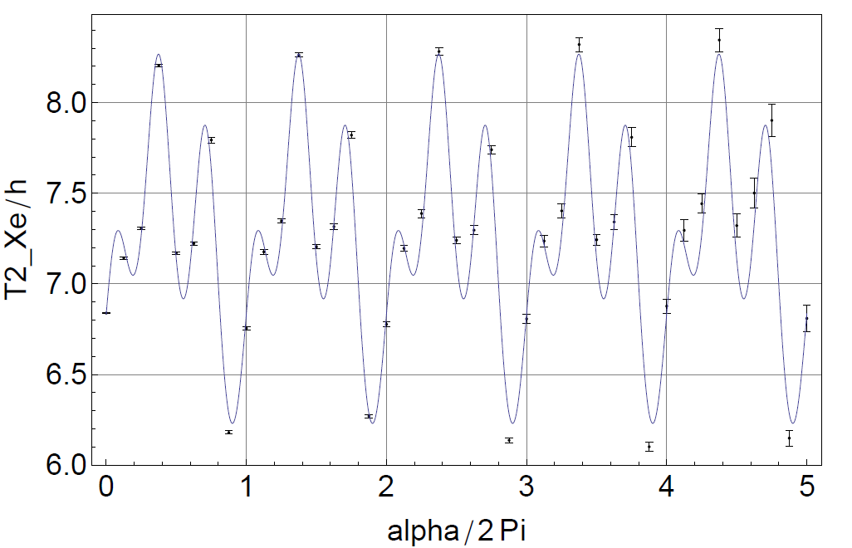
Change of the absolute
field gradient during
rotation and its effect
on T₂*
data analysis ongoing

Slide 31
Conclusion and Outlook
³He , ¹²⁹Xe spin clock based on free spin precession
→ long spin coherence times
(
, March 2012 run )
Search for neutron spin coupling to a Lorentz and CPT-violating background field
K-³He and ³He/¹²⁹Xe co-magnetometer set the tightest limits on SME-parameters
K-³He co-magnetometer :
PRL 105, 151604 (2010)
³He-¹²⁹Xe co-magnetometer :
PRD 82, 111901 (2010)
March 2012 run: expected gain in sensitivity ~ 100 to trace LV interactions

Slide 32
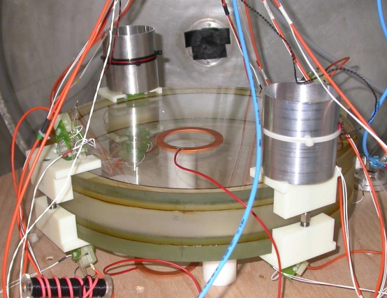
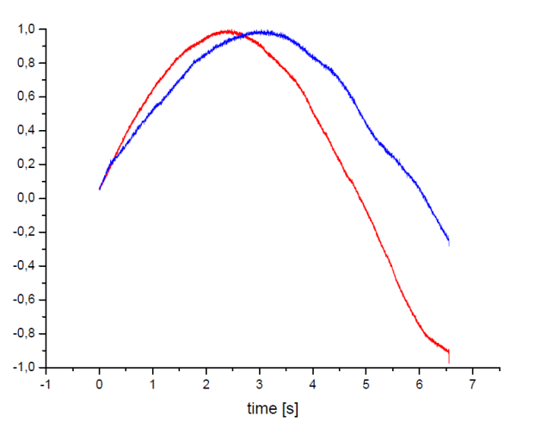
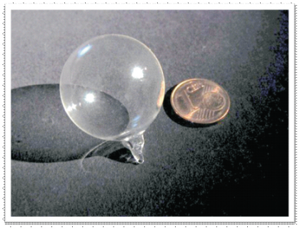
Short range spin-dependent interaction:
J.E.Moody, F.Wilczek
PRD 30 (1984) 130
September 2010 run
¹²⁹Xe electric dipole moment (Groningen-Heidelberg-Mainz collaboration):
Proposal:
ecm
Rosenberry and Chupp, PRL 86,22 (2001)
present sensitivity of ³He/¹²⁹Xe-comagnetometer: < 0.1 nHz per day
Magnetometry (³He)
magnetometer for
nEDM experiment
at PSI
low field : ≈ 1μ Tesla
high field : > 1 Tesla
ultra-high sensitive
magnetometer to monitor
relative field changes of
≈ 10⁻¹²
beat signal (a.u.)
@ 1.5 T
1
3
5
7
time (s)

Slide 33


³He/¹²⁹Xe clock comparison
probing fundamental symmetries
Institut für Physik, Universität Mainz:
  C. Gemmel, W. Heil, H.Hofsetz, S. Karpuk, Y. Sobolev,
  K. T.
Physikalisch-Technische-Bundesanstalt, Berlin:
  M. Burghoff, W. Kilian, S. Knappe-Grüneberg,
  W. Müller, A. Schnabel, F. Seifert, L. Trahms
Physikalisches Institut, Ruprecht-Karls-Universität Heidelberg:
F. Allendinger, U. Schmidt
K.Tullney
Thank you for your attention

Slide 35


Slide 36



Search for a new pseudoscalar boson
(Axion-like particle)
Gerardus 't Hooft,: QCD has a non-trivial vacuum structure that in
principle permits CP-violation
from neutron EDM we get:
Original proposal for Axion ( R. Peccei, H.Quinn PRL 38(1977),1440)
as possible solution to the „Strong CP Problem“ that cancels the CP violating term
in the QCD Lagrangian
Modern interest: Dark Matter candidate. All couplings to matter are weak
Axions, if they exist, will be very light and will mediate a macroscopic CP- force
energy scale P.Q.-symmetry
is spontaneously broken
Notes:
It is known that QCD has a non trivial vacuum structure that in principle permits CP violation. The corresponding term in the QCD Lagrangian is shown here. Alpha s is the strong coupling constant. Gaμν is the gluon field strength tensor with its dual and θ is the phase parameter. This term is CP violating. We should expect a strong CP violation for θ in the order of 1. However, from nEDM experiments, on ecan derive that θ is less than 10⁻¹⁰ . The proposal by PQ to propose a global U1 symmetry (extension to the SM) to the standard model that becomes spontaneously broken in the early universe and keeps θ dynamically small. Once this new global symmetry breaks, a new particle resultsThis hypothesized new particle is called the axion. (On a more technical note, the axion is the would-be Nambu-Goldstone boson that results from the spontaneously broken Peccei-Quinn symmetry. However, the non-trivial QCD vacuum effects (instantons) spoil the Peccei-Quinn symmetry explicitly and provide a small mass for the axion. Hence, the axion is actually a pseudo-Nambu-Goldstone boson.)
To solve this fine-tuning problem, Peccei and
Quinn proposed a new symmetry [5] that spontaneously
broke in the very early Universe, dynamically minimized
QCD and generated the axion. Today, these axions would
compose at least some of the cold dark matter [6].

Slide 37






Axions generated in the sun
Laboratory axions
Polarised laser through vacuum in a strong magnetic field (PVLAS)
E_{a} ≈ 4 KeV
AXION SEARCHES
using the
Primakoff Effect
Galactic axions
Tunable resonant cavity in magnetic field coupled to a ultra low noise microwave receiver
“Light shines through the wall”
ADMX, CARRACK
γ*
γ*
8 Tesla
1GHz: 4 μeV
Notes:
The study of the Primakoff effect [1] in the coherent
photoproduction of pseudo-scalar mesons on nuclear targets: p(γ,π₀)p
Solar hidden photon search (SHIPS)_ sub eV range
Dark photon search MAMI (100 MeV range) : γ’→ e⁺e⁻

Slide 38


If axions are dark matter, they are a relic of the early universe. A particular scenario coupled with the requirement that the axion mass density not severely overclose the universe results in a lower bound to the axion mass.
Current Axion Search Experiments
Solar Axion Telescope – „CAST“
Dark Matter Axion Search – „ADMX“
Vacuum Optical Properties –“PVLAS“ etc.
Photon Disappearance Experiments
New Force Search – Torsion Pendulums, etc.
CAST
Notes:
Estimations of stellar and
supernova energy loss rates impose an upper bound of
about 10 meV [8] Heavier axions that couple so strongly
that they do not escape from stars or supernovae are
precluded by laboratory-based particle physics experiments
[9] and by limits on hot dark matter [10]. Nevertheless, the axion mass bounds define an
‘‘axion window’’ where most axion and pseudoscalar
search efforts are focused.
The strength of the axion’s couplin~ to normal matter and radiation are given by effective coupling constants gm, g~, g-, etc., for the axion coupling to
photons, electrons and protons. Since the elementary sxion coupliqp are model dependent, these effective couplings are model dependent as well. For instance,
the effective two photon coupling constant is g_aγγ=(α/2π)/f_a*(E/N - 2(4 + z)/3(1 + Z) ,
If axions are dark matter, they area relic of the early universe. We know of several scenarios by which a substantial amount
of relic axions can be created. A particular scenario coupled with the requirement that the axion mass density not severely overclose the universe results in a lower
bound to the axion mass. With these assumptions and typical values for the Hubble and QCD scales, axions with mass near 10-s eV form closure density and much lower axion masses would severely overclose the universe. This misalignment mechanism therefore provides a lower limit to the axion mass.
Stars are usually completely opaque to radiation produced in their interior, so
stellar cooling is determined by radiation from a photosphere near the surface. (In the case of the SN1987a, the same
argument applies to neutrino radiation.) On the other hand, a very weakly-coupled exotic particle, even if only rarely
produced, can eciently transport energy directly out of the stellar interior.
The supernova SN1987A released 1053 ergs of energy, virtually all of it in neutrinos with a characteristic
temperature of 10 MeV. The Kamiokande and IMB detectors together recorded 19 neutrinos spread over about
10 seconds, a result consistent with our understanding of supernovae dynamics and the number of light neutrino
avors. Early analyses demonstrated that axion radiation by nucleon-nucleon bremsstrahlung NN ! NNA would
have noticeably foreshortened the neutrino pulse for axion masses between 10􀀀3 eV, and around 2 eV.

Slide 39
Short range interaction of the axion
Yukawa-type potential with monopole-dipole coupling:
(Moody and Wilczek PRD 30 130 (1984))
polarized matter
unpolarized matter N
N
σ_{n}
N
n
g_{s}
g_{p}
Faxion
axion
σ_{n}
N
Faxion
Notes:
39
However, any
ALP that couples with both scalar and pseudoscalar vertices
to fundamental fermions would also mediate a parity
and time-reversal symmetry-violating (PTV) force [14]
between a polarized electron and an unpolarized atom,
described by the potentialthey are sensitive to ALPs that do not couple to photons,
and most importantly, they can simultaneously probe the
entire axion window
Axions mediate a P- and T-reversal violating monopole-dipole interaction potential between spin
and matter (polarized and unpolarized nucleons) where gs and gp are dimensionless coupling constants of the scalar and pseudoscalar vertices (unpolarized
and polarized particles), mn the nucleon mass at the polarized vertex, the nucleon spin
s = h=2, r is the distance between the nucleons, = h=(mac) is the range of the force, ma - the
axion mass, and n = r/r is the unitary vector.

Slide 40
How to measure?
unpolarized
matter
(Pb-glass, BGO)
³He
Position: Close
³He
Position: Far
Requirement:
Notes:
40
40

Slide 41

Dewar housing the LT_{c}-SQUIDs
Pb-glass (2009 run)
BGO crystal (2010 run)
³He/¹²⁹Xe cell

Slide 42
Data processing for extraction of short-range interaction effect:
To cancel magnetic field influence we calculate the weighted phase difference:
2. Temporal dependence can be described by:
f(t)= c+(a_{ER}+a_{CS}+a_{SR})⋅t+a_{He}⋅e^{-t/T2,He}+a_{Xe}⋅e^{-t/T2,Xe}
Ramsey-Bloch-Siegert-Shift
Earth rotation
chemical shift
short range !
(
γ_{He}
)
-1
Δω_{SR} =(a_{SR,close} - a_{SR,far})⋅
1 -
γ_{Xe}
Close
Far
t0
Notes:
42
42

Slide 43

Results
B₀
L
R
 | Δν_{SR} [nHz] | δ(Δν)_{corr.} [nHz] | δ(Δν)_{uncorr.} [nHz]
C53-R | 25.17 | 6.19 | 0.68
C54-R | -7.39 | 4.28 | 0.56
C55-L | -1.87 | 4.63 | 0.52
C60-L | 15.19 | 5.19 | 0.57
C63-L | 2.34 | 3.40 | 0.44
C65-L | 1.10 | 4.26 | 0.54
C67-R | -3.82 | 4.09 | 0.53
C68-R | -7.46 | 3.39 | 0.43
C71-R | 8.04 | 3.09 | 0.40
C80-L | 18.35 | 3.95 | 0.51
C82-L | -22.00 | 4.43 | 0.56
September 2010:
11 measurements (~9 hours)
gap = 2.2 mm
Mass sample: BGO crystal with density ρ=7.13 g/cm³
=> Δν_{SR} = (-0.78 ± 1.22 ± 0.15) nHz
Analysis:
Average potential <V*(λ)> was calculated numerically for our cells (Ø= 6 cm, l = 6 cm), a gap of 2.2 mm between cell inner volume and BGO crystal (Ø= 57 mm, l = 81 mm). Due to the inequation <V*(λ)>/h < Δ(δν) the sensitivity level of g_{S}g_{P} can be determined by:
g_{S} g_{P} < 4 (2π)² m_{n} δ(Δν )_{corr} / (NV ħ <V*(λ)>)
Notes:
43
43

Slide 44

Exclusion Plot for new spin-dependent forces
Hammond 1993
Ni 1999
Youdin 1996
Adelberger 2011
gap of 0.5 mm
our result 2010
our result 2009
Notes:
Youdin: Hg,Cs magnetometer
Ni: paramagnetic salt (Terbiumfluorid)
Hammond: ähnlich Adelberger
Adelberger: A PTV force between the polarized electrons in
the electromagnet and the unpolarized silicon atoms
in the pendulum generates a magnetic-field-dependent
(MFD) torque on the pendulum
electromagnetic production of a light U(1) gauge boson γ′ decaying to e+e− (dark photon)
A light U(1) boson in the mass range below 1GeV/c2 might explain e.g. the
observed anomaly of the muon magnetic moment

Slide 45


Search for
a
Xe EDM
short range int.
Xe EDM search
P,T transformation
of spin and EDM
I
¹²⁹Xe
I
¹²⁹Xe
Standard-model:
CKM-C̷P too small to produce
observed baryon asymmetry
¹²⁹Xe
I

Slide 46

10⁻²⁴
observable
EDM
atomic
EDM
nuclear
EDM
hadron
EDM
particle
EDM
Notes:
Radium atoms ,radon, enhancement >500 Paramagnetic like 205Tl are primarily sensitive to de
Diamagnetic atoms (e.g. 199Hg) and the free neutron
are primarily sensitive to Θ_{QCD}, d_{q} (quark EDM) , d~_{q} (quark chromo EDM)
Interplay between theory and experiment

Slide 47

3×10⁻²⁶
•
1.0×10⁻²⁷

Slide 48
E_{ext}
++
Atomic EDM‘s
E_{int}
E_{ext} +E_{int}=0
L.I.Schiff (PR 132 2194,1963):
- -
System of non-relativistic charged point particles that interact electrostatically
can not have an EDM
Heavy atoms (relativistic treatment):
d_{e} ≠ 0 → d_{atom} ≠ 0 ~ Z³α²d_{e}
P,T-odd eN interaction
Tensor-Pseudotensor ~Z²G_{F}C_{T}
Scalar- Pseudoscalar ~Z³G_{F}C_{S}
Nuclear EDM – finite size
Schiff moment induced by P,T-odd N-N interaction ~10⁻²⁵ η [ecm]
PRL 102, 101601 (2009)
Parameter | ¹⁹⁹Hg | Best alternate limit
d_{e} (e cm) | 3.0×10⁻²⁷ | YbF:1.0×10⁻²⁷
d_{n} (e cm) | 5.8×10⁻²⁶ | n: 2.9×10⁻²⁶
C_{S} | 5.2×10⁻⁸ | Tl:2.4×10⁻⁷
C_{T} | 1.5×10⁻⁹ | TlF:4.5×10⁻⁷
C_{PS} | 5.1×10⁻⁷ | TiF: 3×10⁻⁴
η | 8.0×10⁻⁵ | Xe: 5×10⁻²
Diamagnetic atoms:
Ginges & Flambaum, Phys. Rep. 397 (04) 63.
Dzuba, Flambaum, Ginges, Phys. Rev. A 66 (02) 012111.
[ecm]
6× less sensitive to CP violating interactions
Notes:
The nuclear edm causes the electrons to rearrange themselves so that they
develop a dipole moment exactly opposite to that of nucleus; this cancelation
is complete for a point nucleus, non-relativistic electrons and em interactions
pseudoscalar-scalar interactions (CPS). Second, electron-nucleon interactions that are T-odd and P-odd can generate an EDM.
Three relativistically invariant forms for these interactions exist: tensor-pseudotensor
interactions (CT is a dimensionless parameter measuring the strength of the tensorpseudotensor
interaction), scalar-pseudoscalar interactions (CS is the analogous parameter for
the scalar-pseudoscalar interaction), and pseudoscalar-scalar interactions (CPS). In the
approximation that the nucleus is infinitely massive, the pseudoscalar-scalar interaction does
not contribute. Third, the finite size of the nucleus means that the spatial charge and EDM
distribution of the nucleus may not be the same. Thus the EDM of a neutron or proton, or T-odd and P-odd nucleon-nucleon interactions, could give rise to an atomic EDM. The difference in the two distributions is measured by the Schiff moment S
In the
approximation that the nucleus is infinitely massive, the pseudoscalar-scalar interaction does
not contribute
choice of nucleus mostly dictated by simplicity of atomic physics
atomic enhancement Z3 Most e
orts for 199Hg (electr (...6s2))
up of point, charged particles which interact electrostatically with each other and with
an arbitrary external field, the shielding is complete [1] Neutral atomic system of point particles
in Electric field readjusts itself to give
zero E field at all charges

Slide 49
Measurement sensitivity: ¹²⁹Xe electric dipole moment
B_{o}
E
E
Rosenberry and Chupp, PRL 86,22 (2001)
ΔE_{o}
ΔE↑↑
ΔE↑↓
ecm
Observable:
weighted frequency difference
sensitivity limit:
from 2010 run: δν = 0.2 nHz @ 1 day
assume : E=2 kV/cm
Then we will reach
… after 100 days of data taking:

Slide 50
Proposed setup
3D field compensation
Collaboration:
80
University of Mainz
KVI Groningen
University of Heidelberg
PTB Berlin
Dewar with SQUIDs
5 layer μ-metal shield
eddy current shield
396
There is room for improvements:
• Increase of SNR of Xe
(P_{xe}: 10% ⇒ 70%)
• Increase of T_{2,Xe}
5h (at present) ⇒ 10-20 h
δd_{Xe} < 10⁻³¹ ecm
…new sensitivity levels for
129Xe/3He polarizer
Lorentz-invariance tests
short range interations
80

Slide 52
Optical Pumping
B_{o}
…reemission of
fluorescence light
absorption …
LASER
…transfer of
angular momentum
Rb-pumping
5 p_{1/2}
σ₊
2/3
1/3
5 s_{1/2}
m = -1/2
m = +1/2
T₁
N(1/2) – N(-1/2)
P =
N(1/2) + N(-1/2)
rate equation:
= 1 – (2/3)^{n}

Slide 53
Optical Pumping of ³He
history :
●Spin exchange with optically pumped Rb-vapour ( SEOP )
( Bouchiat et al., Phys. Rev. Lett. 5 (1960) 373 )
p_{He} ≈ 1-10 bar
Rb
³He
●Optical pumping of metastable ³He*-atoms ( MEOP )
( Colegrove et al., Phys. Rev. 132 (1963) 2561 )
³He*
³He
p_{He} ≈ 1 mbar
³He
³He*

Slide 54



MEOP: Metastabilty Exchange Optical Pumping
L.D. Schearer
³He : 1 mbar
³He* ≈1ppm

Slide 55
In terms of frequency:
(95% C.L.)
Kostelecky et al. , Phys. Rev. D 60, 116010 (1999)
(X,Y,Z) non-rotating frame
with Z along Earth‘s rotation axis
free neutron:
Lab-frame with
quantization axis z
n : µ = -1.913 µ_{K}
PTB Berlin:
Θ= 52,5164⁰ north
Schmidt-Model
ρ= 28⁰ (north-south)
³He: µ = -2.1276 µ_{K}
¹²⁹Xe: µ = -0.7779 µ_{K}

Slide 56


Feedback loop to get long coherence times …
( Cs-Magnetometer, Maser, … )
but …
frequency shifts due to
feedback phase error
light shift
…

Slide 57


Slide 58





β
(moving clock)
metastable ⁷Li⁺ - ions
Laser P
Laser A
Lamb dip
TSR (HD) : ß = 0.064
ESR(GSI) : ß = 0.34
Ch.D.Lane, PRD 72 (2005) 016005

Slide 59

Kostelecky et al., arXiv:0801.0287v2
Clock-comparison experiments

Slide 60



spin-coupled interactions
Torsion pendulum
B.R.Heckel et al., PRD 78 (2008) 092006
Antihydrogen Spectroscopy (→ J. Walz )

Slide 61



Fundamental physics tests using Rb and Cs fountains
Wolf et al.,
Observable free of 1st order Zeeman-effect

Slide 62

Ω⊕
Ω⊕
Ω⊕
Ω⊕
Ω⊕ : Earth‘s orbital motion
ω⊗ : Earth‘s rotation frequency

Slide 63

Relaxation of ¹²⁹Xe
(measured)

Slide 64

Magnetic field (measured via the He spin precession signal )
in presence of a conductor
( aluminium cylinder : diameter 56 mm, length 70 mm)
removal of aluminium block
paramagnetic effects
Johnson noise

Slide 65

CMB dipole
v = 368 km/s
ΔT_{dip} ≈ 3.3 mK
galactic coordinate system
(l, b) = (264º.31±0º.04±0º.16, +48º.05±0º.02±0º.09)
measurement on 01.10.2007 at
PTB-Berlin (52° 31´ north, 13° 25´ east)
horizon coordinate system
(observer's local horizon)

Slide 66




Prototype of cylindrical μ-metal shield
no elevated system noise
inside inner shield made out
of metglas (amorphous metal alloy ribbon)

Slide 67

Ø 57 mm
H = 81 mm
Density = 3.9 g/cm³
Lead glass samples

Slide 68




MEOP Polarizer Mainz:
³He
1083 nm
SEOP Polarizer PTB: Xe
He
Xe
N₂

Slide 69

Detection of magnetic field produced by oriented nuclei
(Cohen-Tannoudji et al., PRL 22 (1969),758)
Results:
³He spin precession: T₂* = 2h 20min
sensitivity of Rb-magnetometer:
100fT@ BW 0.3 Hz
P_{He} ≈ 5% @ 4 mbar
10⁻¹¹ tesla
Improvement of measurement sensitivity:
SQUID-detectors@2 fT/√Hz
laser for OP of ³He @ P> 70%
longer T₂*-times (needed !!!)
10⁻¹³ tesla
Notes:
NACHLESEN!

Slide 70


False effects :
Barometric formula :
h
S_{He}
B₀
x
x
S_{Xe}
assume:
drops out in
δν = ½ (Δν_{right sample} - Δν_{left sample} ) = (4.8 ± 7.0 ± 0.4) nHz
From the measured value of δν we get:
g_{S}g_{P} < 4 (2π)² m_{3He} δν / (NV ħ <V*(λ)>)

Slide 71

Gain in sensitivity compared to measurements with short coherence times:
arbitrary phase
1 day
Example „short spin coherence time“:
ΔT = 5 min → ≈ 300 × less sensitive !
Notes:
71

