Slide 1
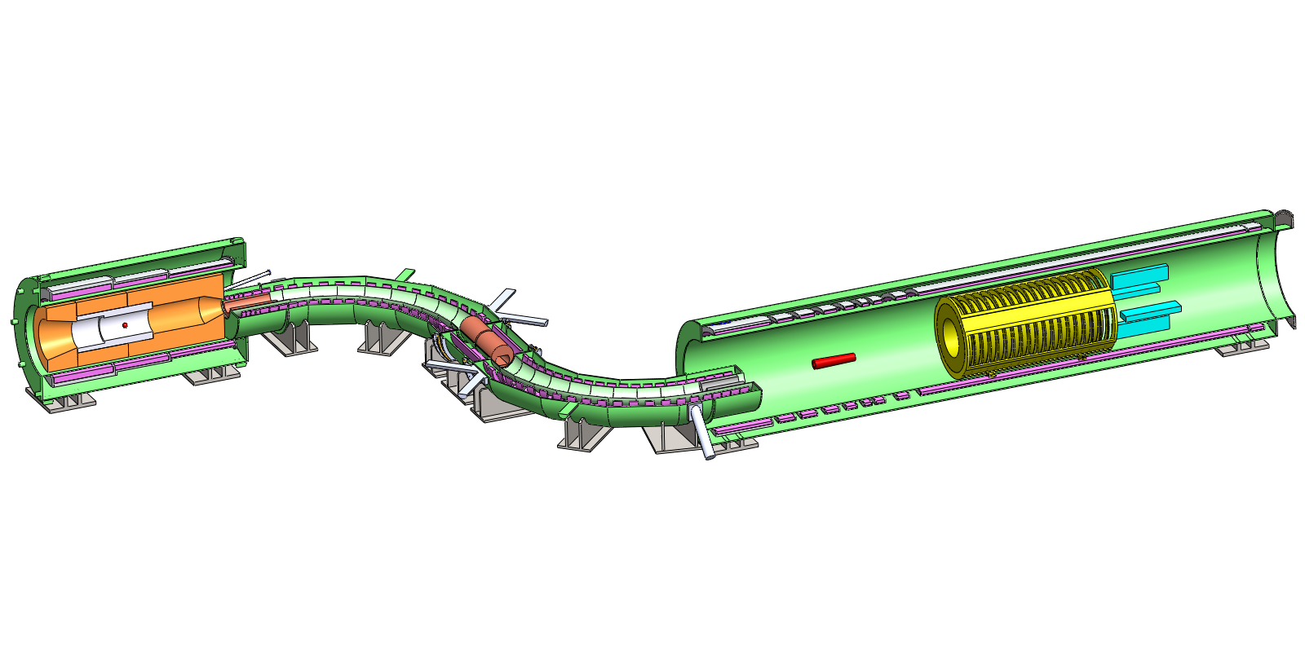
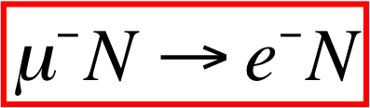
The Mu2e Experiment at Fermilab:
A Search for Charged Lepton Flavor Violation
Proton Beam
Production Solenoid
Detector Solenoid
Transport Solenoid
Production Target
Calorimeter
Tracker
Jim Miller, Boston University
SSP2012 Groningen
June, 2012
  http://mu2e.fnal.gov
Notes:
I’m going to describe Mu2e, a muon to electron conversion experiment being
developed at Fermilab

Slide 2
Outline
Quick introduction to μ to e conversion
Current status of μ to e conversion
Details of the Mu2e experiment
Conclusions
Notes:
I’ll start off with a description of what mu2e is and then a very general outline of the idea of the experimental method . Then I’ll give a brief theoretical motivation followed by a description of the experimental method in some detail.

Slide 3
Mu2e in a Nutshell
Neutrinoless conversion of a muon into an electron in the field of a nucleus (nucleus required for E and p conservation)
Make lots of very low energy negative muons
Stop muons in a suitable thin target material (Mu2e choice is aluminum)
Muonic atoms are spontaneously produced (1S atomic state)
  Look for the conversion of a muon to a monoenergetic electron with no accompanying neutrinos (E_{e} =105 MeV in Al):
  Usual decay mode conserves lepton flavor:
  μ to e conversion does not conserve lepton flavor:
Notes:
Usual decay mode conserves lepton flavor, without the neutrinos conservation of individual muon and lepton flavors is violated. That means that both electron and muon flavors are conserved.

Slide 4
Muon to Electron Conversion: Present and Future Precision
four orders of magnitude improvement over current limit!
Notes:
What is quoted is the rate of mu to e conversion divided by the rate of ordinary muon capture.

Slide 5

LFV Status and Plans
Reaction | Current Limit | Future limit | Who/where?
μ→eγ | 2.4x10⁻¹² | <10⁻¹³ | MEG at PSI
μ→eee | 1.0x10⁻¹² | <10⁻¹⁵-10⁻¹⁶? | PSI, Osaka ?
μN→eN (Au) | 7x10⁻¹³ | <10⁻¹⁸ | PRISM/ Mu2eX
μN→eN (Al) | ----- | <10⁻¹⁶ /10⁻¹⁸ | Mu2e, COMET/ upgrades
μN→eN (Ti) | 4.3x10⁻¹² | <10⁻¹⁸ | PRISM/ Mu2eX
μ⁺e⁻◊μ⁻e⁺ | 8.3x10⁻¹¹
τ◊μγ | 4.5x10⁻⁸ | <10⁻⁹-10⁻¹⁰ | Flavor factory
τ◊eγ | 1.1x10⁻⁷ | <10⁻⁹-10⁻¹⁰ | Flavor factory
τ◊μμμ | 3.2x10⁻⁸ | <10⁻⁹-10⁻¹⁰ | Flavor factory
τ◊eee | 3.6x10⁻⁸ | <10⁻⁹-10⁻¹⁰ | Flavor factory
Current and Planned
Experiments
Neutrino Oscillations!
τ decays at Babar,
Belle.
Future τ decays:
Super B factories
MEG at PSI: μ→eγ
μe conversion:
  Mu2e at FNAL
  COMET at JPARC
Notes:
There are a number of cLFV reactions that are either current or planned.

Slide 6
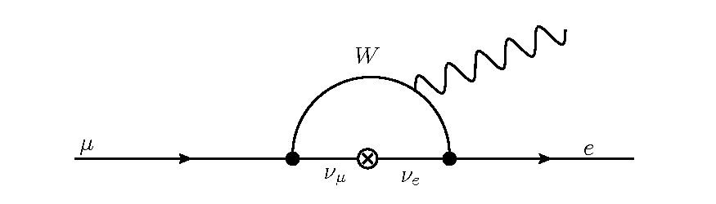
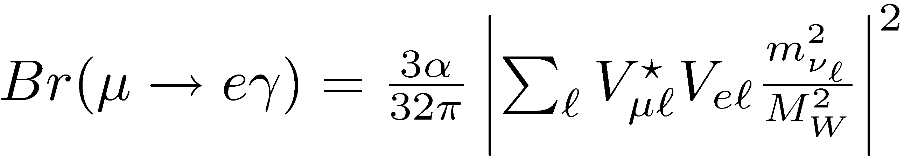
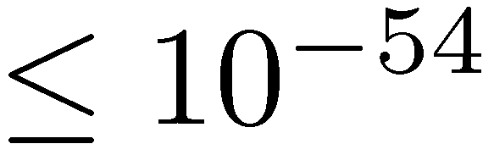
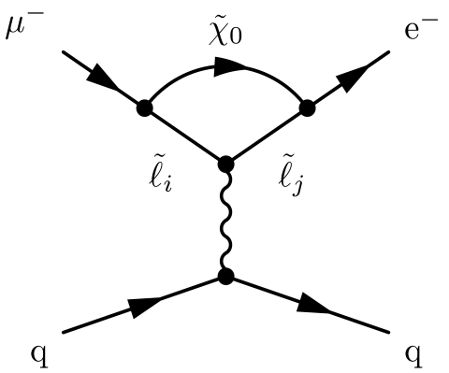
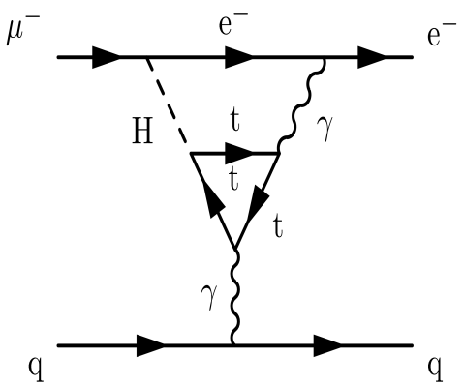
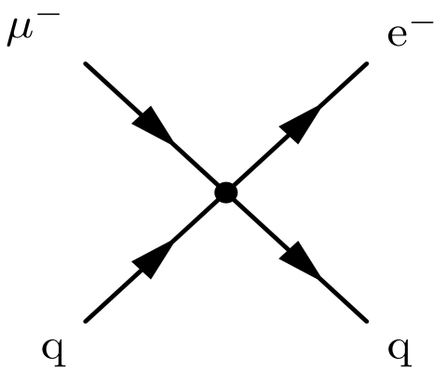
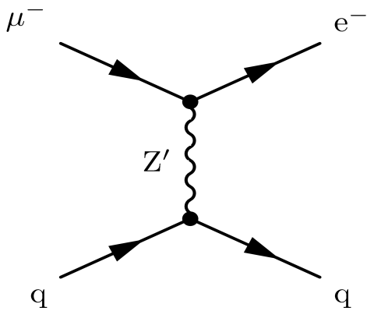
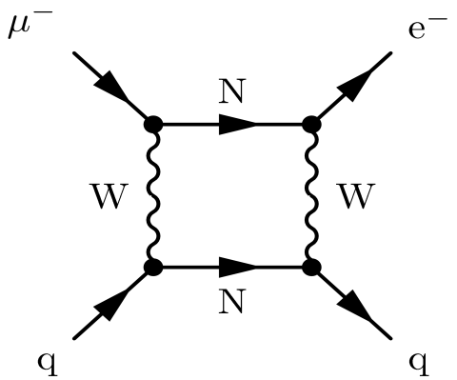
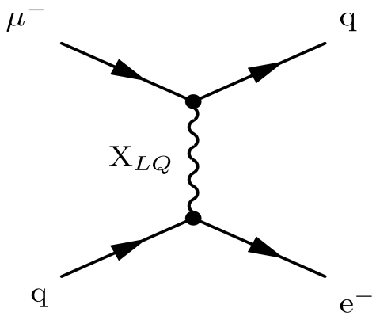
Muon Conversion Arises in Many New Physics Scenarios
In SM:
SUSY
Second Higgs Doublet
Compositeness
Heavy Gauge Bosons
Heavy Neutrinos
Leptoquarks
The discovery of Weak scale SUSY at LHC would imply observable cLFV rates
(From W. Marciano)
Notes:
Here are some physics diagrams that could produce mu2e. Neutrino oscillations have been observed and this is an example of LFV. Then it is possible to estimate the rate of Mu2e or mu to e gamma in the SM. The predicted rates are extremely small, far below any conceivable experimental sensitivity. Therefore we can say that measurements of mu to e gamma or mu to e conversion are free of SM background and any detection would be a sign of new physics. Below the title are diagrams for mu to e conversion that can come from new physics. The upper left diagram is a SUSY contribution, basically a (mu to e gamma) diagram with a quark line attached. Attaching the quark line reduces the mu to e conversion relative to mu to e gamma by a factor of a couple hundred, however Mu2e has a mu to e conversion sensitivity goal that is a thousand times smaller than MEG’s goal for mu to e gamma, which should more than make up for it. Contributions to mu to e conversion can also come from the exchange of new heavy particles with a quark, for example a Leptoquark or a Heavy Gauge boson. The effects of heavy particle exchanges are far less for mu to e gamma because of the absence of quarks, so in the case of a signal mu to e is complementary to the mu to e gamma measurement and they together will help sort out the type of physics that is causing the LFV. Similar arguments can be used to show the need for mu to 3e and tau decay data.

Slide 7
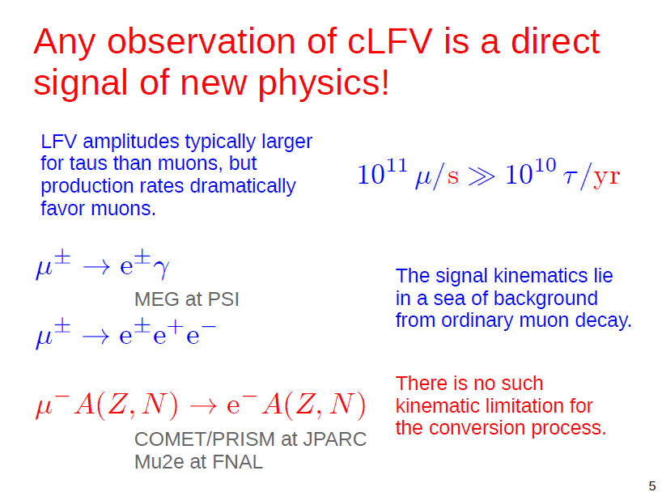
Experimental Advantages of Muon to Electron Conversion
10¹⁰
Notes:
There are certain experimental advantages to mu2e that suggest that it may be the channel that can be explored with the greatest sensitivity. In some models of new physics, the magnitude of cLFV in tau’s can be much higher than for the muon. However, taus are much harder to make than mu’s, there will be as many muons made per second as there are tau’s made in a year. However, some models predict very large amplitudes it is important to pursue tau decays for their complementary information, and these will be a prominent feature in future flavor factories.

Slide 8
The Measurement Method
Stop negative muons in an aluminum target
The stopped muons form muonic atoms
  207x smaller radius than inner e⁻ in Al−>
  well inside electron orbits ◊
  muon forms a hydrogen-like atom, unaffected by e’s
  hydrogenic 1S : Bohr radius ~20 fm, BE~500 keV
  Nuclear radius ~ 4 fm →
  muon and nuclear wavefunctions overlap significantly
Three main things can happen (numbers for case of Al):
  Muon decays (40%):
  Muon captures on the nucleus (60%):
  (capture is roughly sum of reactions with protons in nucleus: )
  Muon to electron conversion:
Muon lifetime in 1S orbit of aluminum ~864 ns
  (40% decay, 60% nuclear capture), compared to 2.2 μsec in vacuum
Look for 105 MeV conversion electron signal

Slide 9
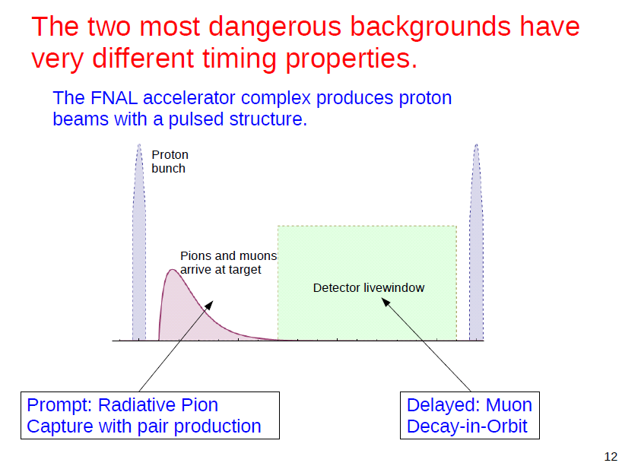
Extinction=10⁻¹⁰
t=0
t=670 ns
t=1695 ns
Also low energy backgrounds from muon captures In stopping target. Per capture we get ~1.2 neutrons, ~0.1 protons, ~2 gammas
Notes:
A lot of the design of the experiment depends on the need to control backgrounds. Two of the most dangerous backgrounds behave quite differently with time.
One of these backgrounds is due to pions stopping in the stopping target, giving a background almost instantly when it stops. The other is due to electrons produced by muons decaying in orbit, which are delayed according to the lifetime of the muonic atom.
To get rid of the pion background, we have gone to a pulsed proton beam. Protons make pions, pions decay to muons- so generally there are pions mixed in with the muons in the beam, and they arrive at the stopping target after a couple hundred nanoseconconds. Then we wait about 700 ns after the proton pulse before beginning the search for conversion electrons, after most of the pions in the beam have decayed or interacted. We need to select a target that has a large enough lifetime that a significant fraction remain in the live window. If we have a high-Z target, the lifetimes can be under 100 ns and not many are left after 670 ns. Muonic Aluminum is about right with a lifetime of 864 ns. The pulsed beam is one of the keys to why we can go to so much higher sensitivity than previous experiments. Previous experiments used a continuous beam of muons and pions; pion background was suppressed by vetoing on electron conversion candidates in time coincidence with an arriving beam particle. The veto requirement limited the maximum allowable beam intensity and the ultimate sensitivity of previous experiments. I’ll say more about these backgrounds in the next two slides.

Slide 10
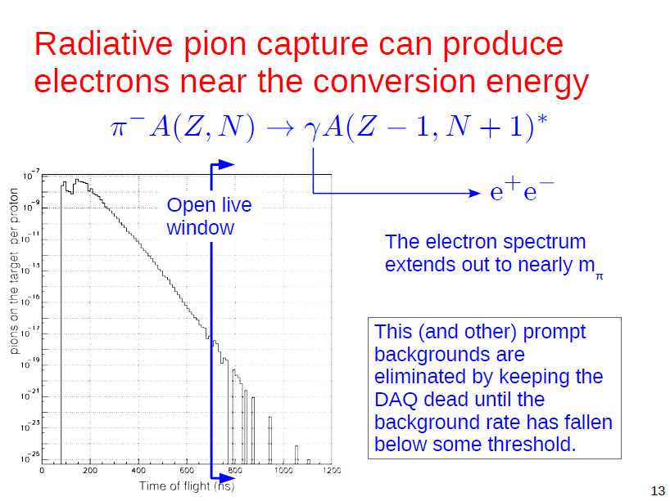
=139.6 MeV
Notes:
The pions produce background through radiative pion capture. Pions come down the beamline, stop in the stopping target, form atoms, but unlike muons, quickly annihilate on the nucleus. About 2% of the time, a high energy photon is produced. The photon can pair produce in the target, possibly producing a 105 MeV electron that looks exactly like a conversion electron. This is a plot of the simulated pion stopping rate as a function of time after the proton pulse. Note that, we must suppress the proton rate on the primary target by ten orders of magnitude between proton pulses to avoid producing pions that arrive during the measurement period. We call this the extinction requirement.

Slide 11
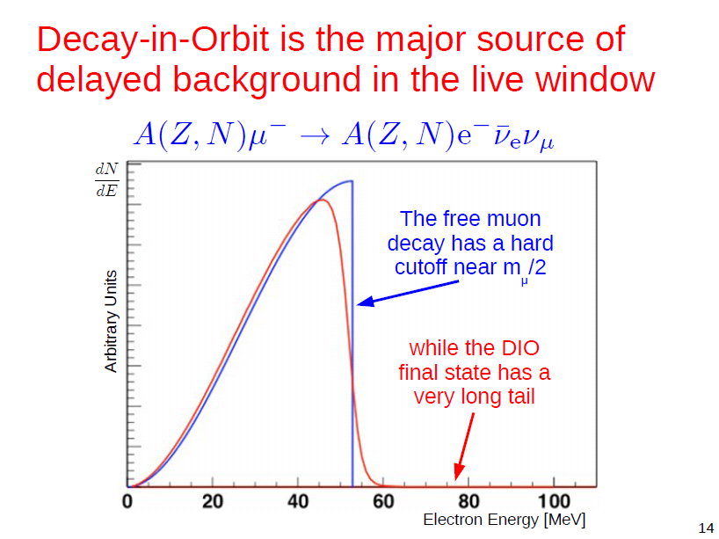
Conversion electron
energy
Czarnecki, Tormo, Marciano
Note, the background flux of e⁺ and γ from is what
makes experimentally so difficult compared to

Slide 12
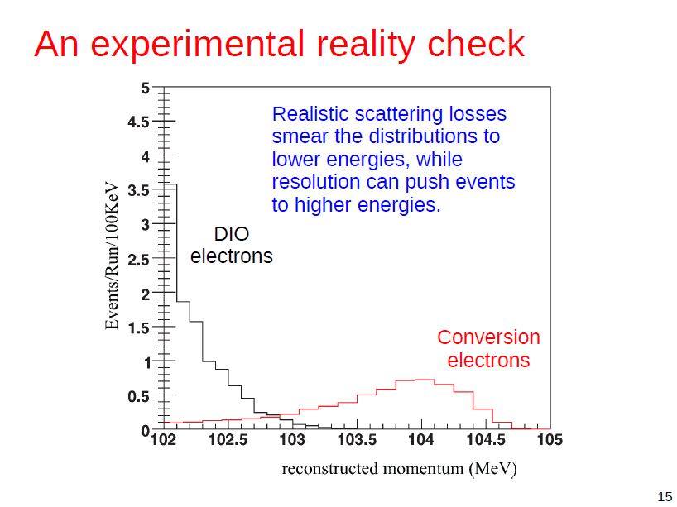
(Assuming R_{μe}=10⁻¹⁶
FWHM ~ 1 MeV, ~ 4 events
In 103.5 MeV<E< 104.7 MeV)
Notes:
If we assume a BR close to our goal of 1e-16 and a FWHM energy resolution of about 1 MeV, then simulations show that we can get a good energy separation between the conversion and the high energy tail from muon decays in orbit.

Slide 13
Outline
Quick introduction to μ to e conversion
Current status of μ to e conversion
Details of the Mu2e experiment
Conclusions
Notes:
I’ll start off with a description of what mu2e is and then a very general outline of the method so as to orient you to an experimental method you are probaly not so familiar with. Then I’ll give a bief theoretical motivation followed by a description of the experimental method in some detail.

Slide 14
Mu2e Muon Beamline Goals
  Pulsed muon beam from pulsed proton beam, 200 ns wide
  Deliver high flux μ⁻ beam to stopping target
    High proton flux. At FNAL ~6x10¹² Hz, 8 GeV
    High efficiency muon beamline. Mu2e will use solenoidal muon collection and transfer scheme
    Stopped muons ~10¹⁰ Hz , 5x10¹⁷ total needed
  Muon properties
    Low momentum and/or narrow momentum spread
      Stop max # muons in thin target
      Avoid ~105 MeV e⁻ from in-flight μ⁻ decay (keep p_{μ}<75 MeV/c) or down the beam line
    Background particles from beam line must be minimized
  during measurement period.
    Especially pions: Beam Extinction: (in-time protons)/(out-of-time protons)=10⁻¹⁰

Slide 15
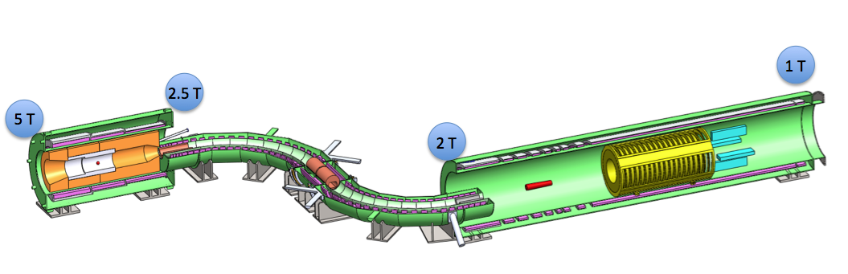
Mu2e Solenoidal Muon Beam Line
Three superconducting solenoids in series
  Production Solenoid (PS), 4m long
  Transport Solenoid (TS), 13 m long
  Detector Solenoid (DS), 11 m long
  Warm bore, evacuated to 10⁻⁴ Torr
Delivers ~0.002 stopped
muons per 8 GeV proton
Production Solenoid
protons
Detector Solenoid
Transport Solenoid
Notes:
This beam line is much more efficient than ordinary beam lines at capturing low energy muons

Slide 16
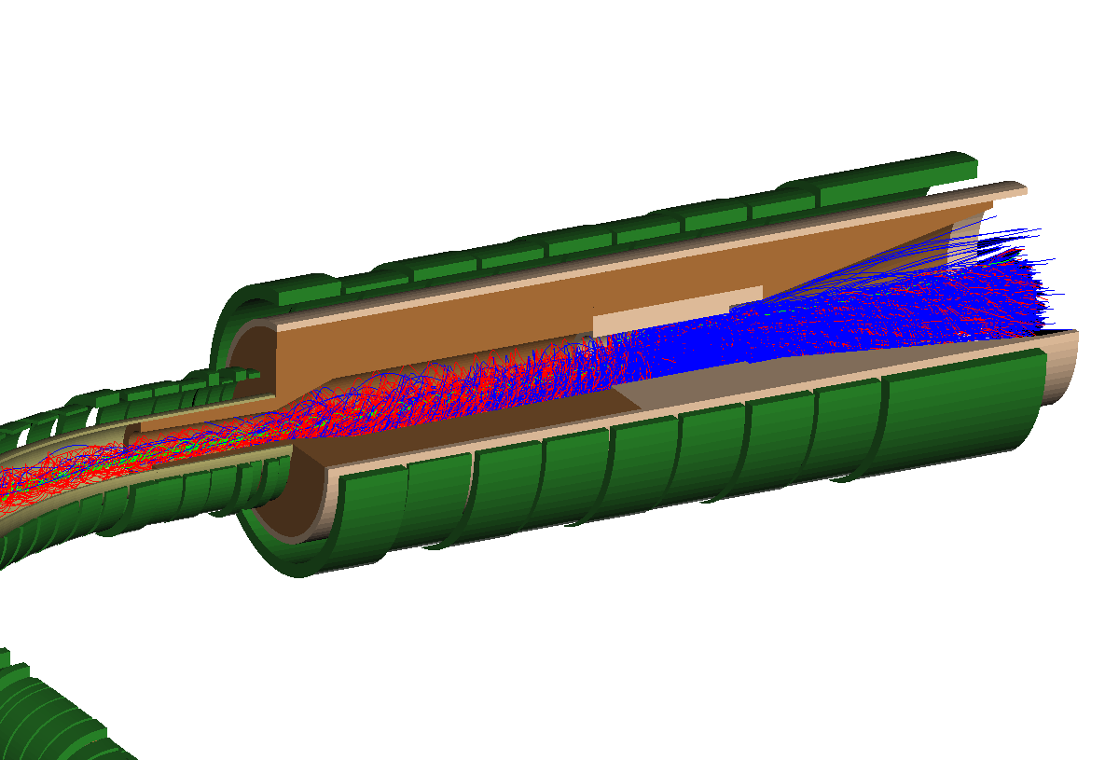
Production Solenoid
Magnetic
Mirror Effect
8 GeV Incident Proton Flux
3×10⁷ p/pulse (200 ns width)
5T
Gradient Solenoid Field
p
2.5T
Primary π production
off gold target
μ
π
π
¹
π decays to μ
μ is captured into the transport solenoid and proceeds to the stopping targets

Slide 17

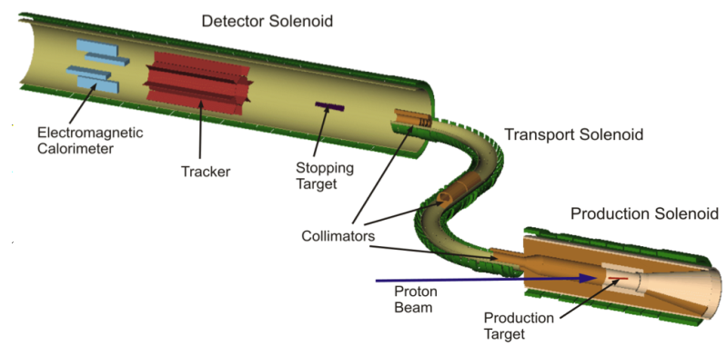
The Transport Solenoid (TS)
S-shaped to reduce any line-of-sight photons and neutrons from PS to DS
Stopping Target and
Mu2e Detector
1 m long straight section into DS
It consists of a set of superconducting solenoids and toroids that form a
magnetic channel that transmits low
energy negatively charged muons from
the PS to the DS
90° turn
High energy negatively charged particles, positively charged particles will nearly all be eliminated by the two 90° bends combined with a series of collimators.
~2 m long straight section
μ beam
2nd Collimator with pbar absorber
1 m long straight section from PS
90° turn
17
Notes:
The major radius of the two curved sections is about 3 m and the resulting total magnetic length of the Transport Solenoid along its axis is about 13 m. The inner warm bore of the Transport Solenoid cryostat has a diameter of about 0.5 m. A relatively tight specification exists on the fields in the three straight sections where negative field gradients must be maintained at all places to eliminate backgrounds from late arriving particles. High energy negatively charged particles, positively charged particles and line-of-sight neutral particles will nearly all be eliminated by the two 90° bends combined with a series of absorbers and collimators.

Slide 18

The Detector Solenoid (DS)
Signal events pass through tracker and produce hits, then stop in calorimeter
~11 m
The Cosmic Ray Veto
Tracker
Graded field (2 -1 Telsa)
Calorimeter
~2 m
Al Stopping target
Calorimeter: energy, position, and timing information on tracks that have been reconstructed by the tracker.
1952 LYSO crystals arranged in four vanes
17 Al disks, 0.2 mm thick, spaced 5.0 cm apart. Radii decreases from 8.3 cm upstream to 6.53 cm downstream.
Proton absorber : Thin polyethylene absorber to attenuate the proton rate.
18
Notes:
The solenoids are the cost and schedule driver for the project. The Production and Detector Solenoids will be designed and constructed in industry, likely by different vendors. The relatively unique Transport Solenoid will be designed and fabricated at Fermilab, though many of the components (superconducting cable, cryostats, etc.) will be procured from industry. The make-buy decisions are based on the similarity of the Production and Detector Solenoids to other solenoids fabricated in industry and to the limited availability of resources at Fermilab. The superconducting cable and the tooling required for fabricating the solenoids are long-lead items that must be procured early.
Cosmic ray veto
The Cosmic Ray Veto for Mu2e will be constructed from three layers of extruded scintillator bars with embedded wavelength shifting fibers that are read out with Silicon photomultipliers (SiPMs). The CRV surrounds the Detector Solenoid on 3 sides (Figure 4.15) and extends up to the midpoint of the Transport Solenoid.
Significant infrastructure is required to support the operation of the solenoids. This includes power, quench protection, cryogens (liquid nitrogen and liquid helium), control and safety systems as well as mechanical supports to resist the significant magnetic forces on the magnets.
Proton absorber
he largest potential contribution to the tracker rate during the measurement period is from protons that originate from muon capture. The protons are very slow moving and highly ionizing, so they can be easily identified in the tracking detector using pulse height information. The large pulse height associated with protons traversing the tracker will shadow hits from low energy electrons. This could lead to reconstruction errors that might create background. However, conversion electrons also pass through the proton absorber and the associated energy loss and straggling can contribute to the momentum resolution function, so the geometry and material budget of the proton absorber must be precisely optimized before fabrication

Slide 19
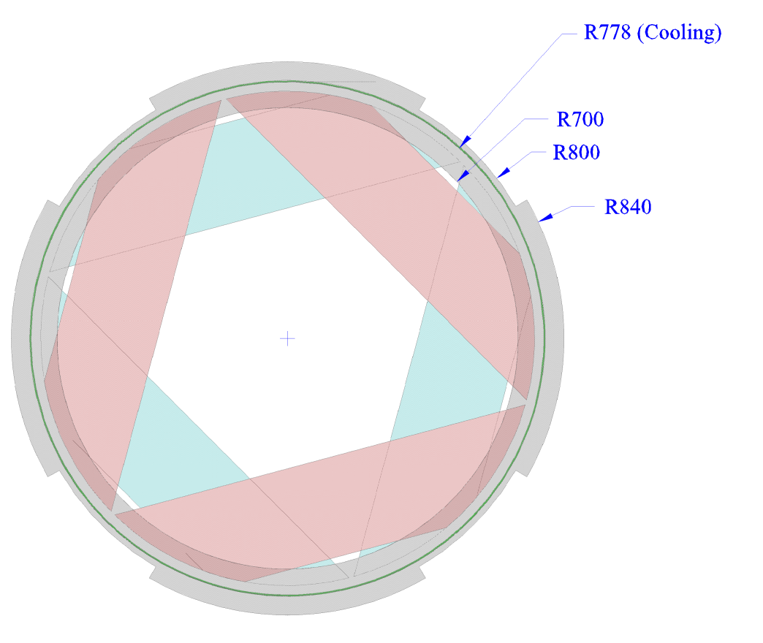
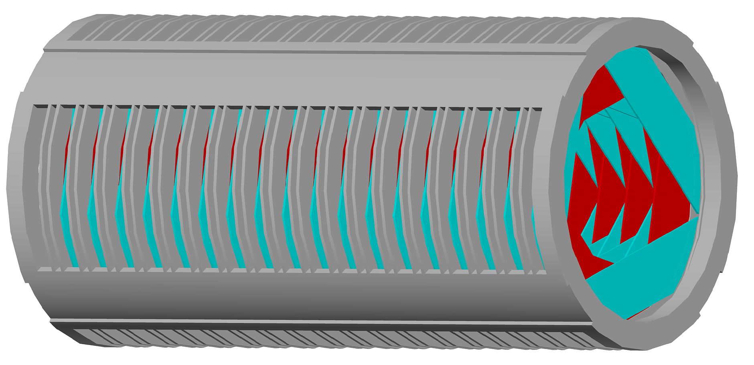
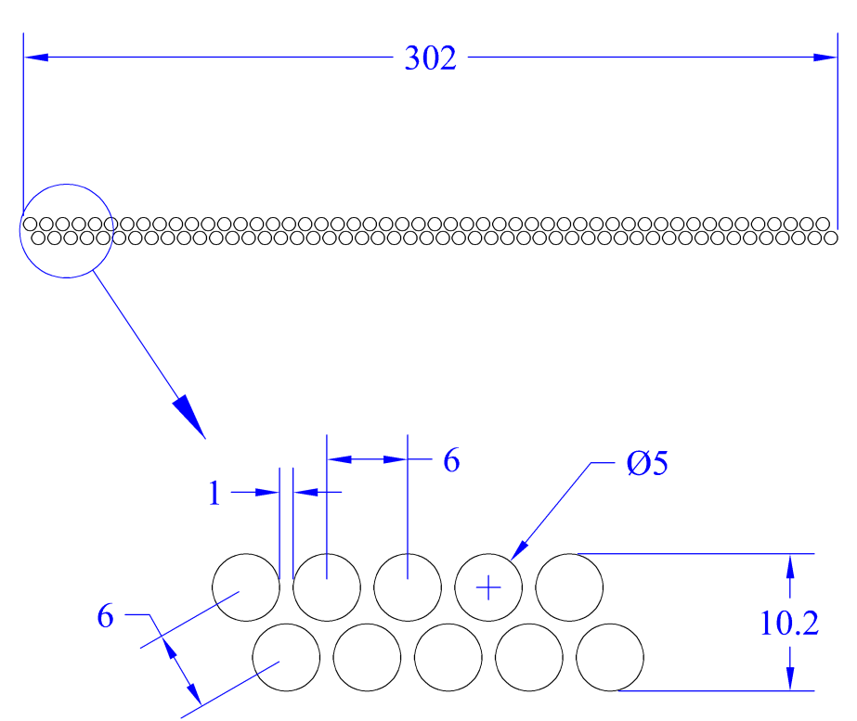
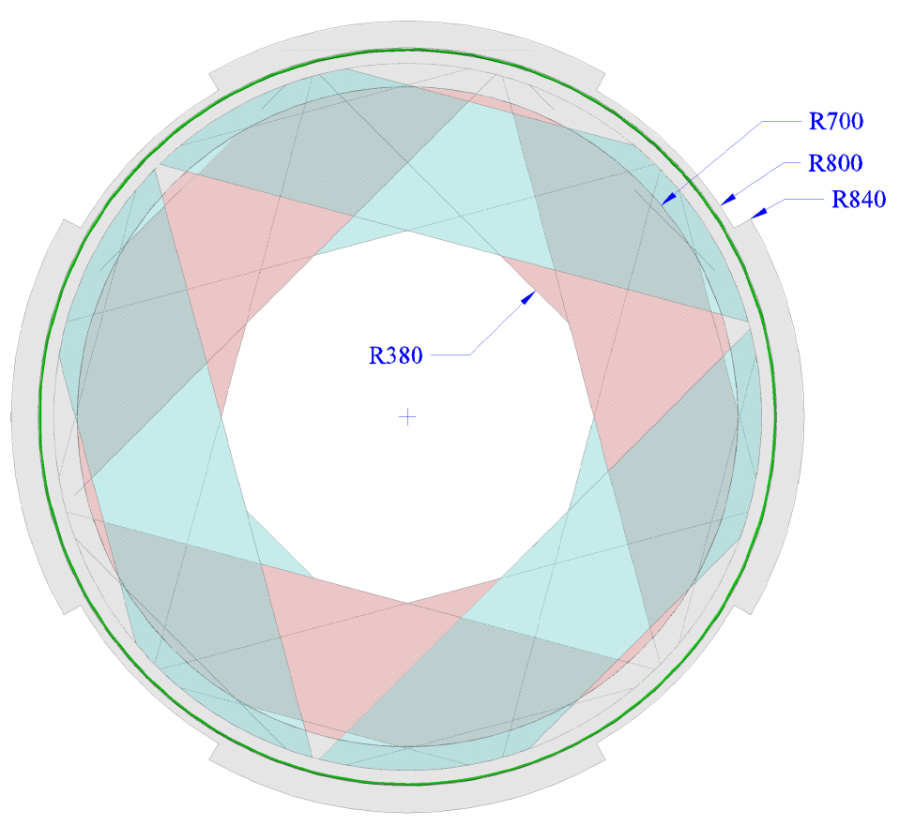
T-Tracker
Plane
Max. straw rates-
Flash: 3 MHz/cm
During Measurement Period: 3 kHz/cm²
Time division on each straw
First version ASIC prototype nearly ready
Station
170 mm between
←Stations
18 | Stations
2 | 2 planes per station
6 | 6 panels per plane
2 | layers per panel
50 | straws per layer
21,600 | straws

Slide 20
Simulated Pattern Recognition and Track Fitting
Hit-based simulation of straw tracker response
Kalman filters adapted from Babar
Conversion electrons + Backgrounds: DIO + realistic noise hits
transported in GEANT4 model
Successively tighter cuts shown (assuming R_{μe}=10⁻¹⁵)

Slide 21
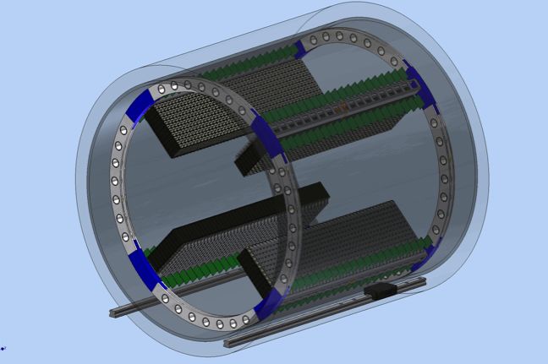
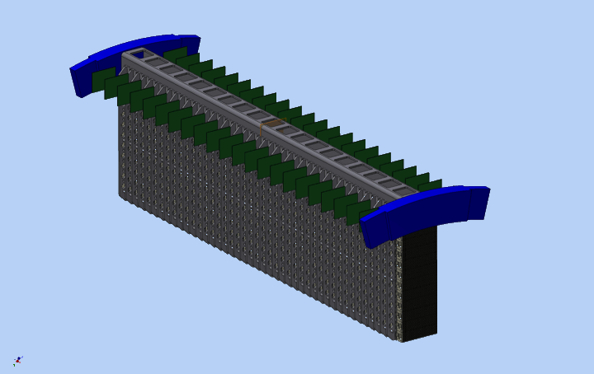
Calorimeter
4 vanes, 1936 LYSO xtals, 1.3 m long
12x44 in each vane
3x3x11 cm elements, x10 X₀
~ 2-3 MeV, σ(x)~1 cm, σ(t)<1 ns
Can serve as trigger
Helps confirm particle ID
Confirms tracker prediction
on energy and position
Left FEE digitizers
Right FEE digitizers

Slide 22
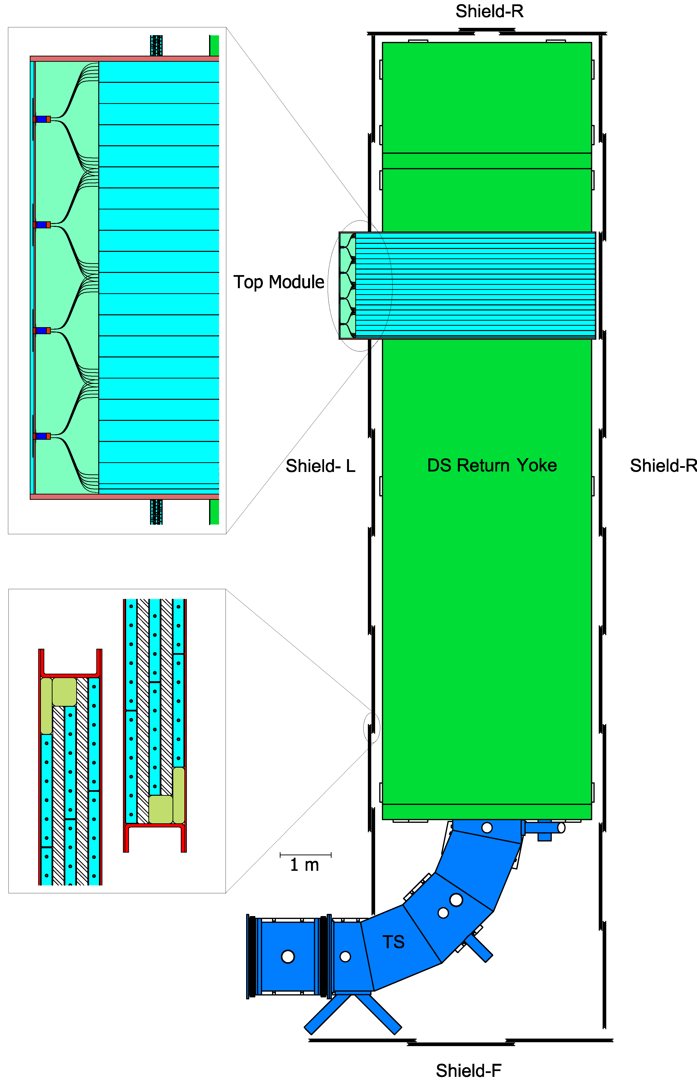
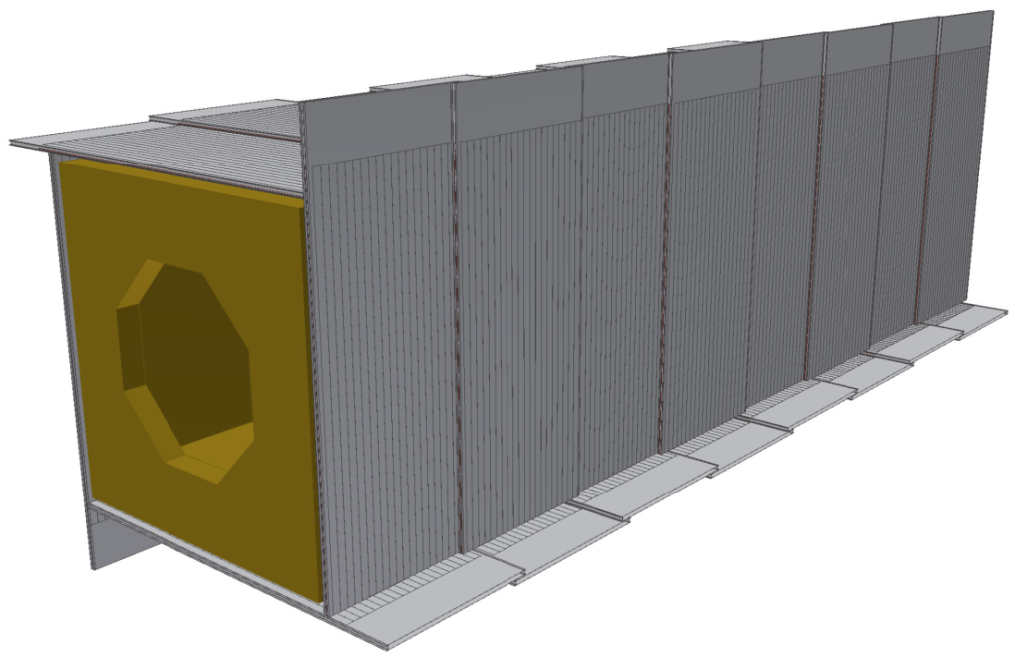
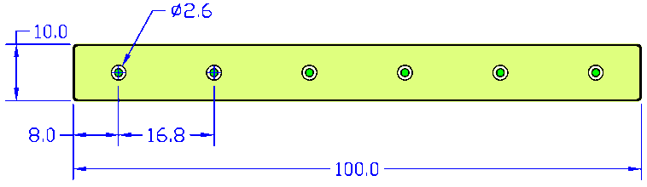
Cosmic Ray Veto
Surrounding Detector Solenoid
99.99% efficiency: Require 2 out of 3 layers
16000 x 5m long waveshifter fiber
End view of extruded scintillator with
embedded 1.4 mm diameter waveshifting
fibers

Slide 23
Background Estimates
 | back | uncert
pbar background/RPC at stop target | 0.08 | 0.04
pbar background/pbar stops in stop target | 0.02 | 0.01
RPC | 0.03 | 0.01
DIO | 0.22 | 0.05
pi decay inflight | 0.003 | 0.0015
mu decay inflight | 0.01 | 0.003
cosmic background | 0.05 | 0.025
beam electrons | 0.0006 | 0.0006
Reconstruction errors | 0.002 | 0.002
Totals | 0.41 | 0.08

Slide 24
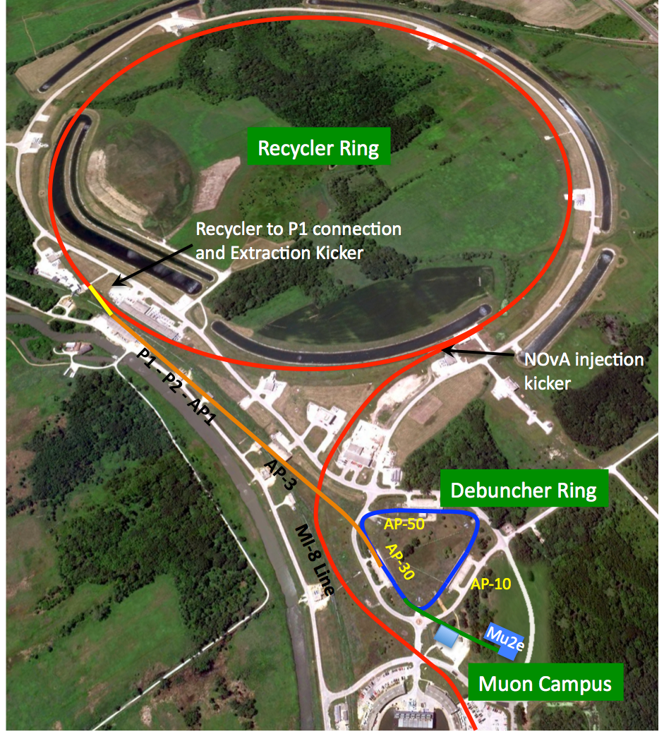
Proton Delivery and Economics
Reuse existing Fermilab facilities with modifications.
Send 8 GeV proton Booster
batch (4x10¹²) into Recycler
Form 4 bunches in Recycler (same as g-2)
Extract 1 bunch at a time to Debuncher
Slow-extract from one bunch in
Debuncher (period=1695 ns)
Sharing p’s with NOVA:
  NOVA 12/20 booster cycles.
  Mu2e will use 2/20 cycles.
6x10¹² protons/s gives 1x10¹⁰ Hz stopped muons
Need 5x10¹⁷ stopped muons to
reach sensitivity goal. 10¹⁰ Hz stopping muon rate → 3 years assuming 2x10⁷ s running/year.

Slide 25
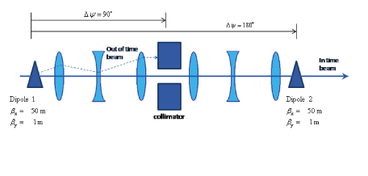
Extinction Scheme
Sweep protons out of beam between proton pulses
  Between-pulse protons / Main pulse protons less than 10⁻¹⁰
  Get >10⁻⁵ from clean extraction from ring, another >10⁻⁵ -10⁻⁶ from AC dipole sweeper:
Continuous Extinction monitoring techniques under study
  Telescope to measure secondary proton production
Under development

Slide 26
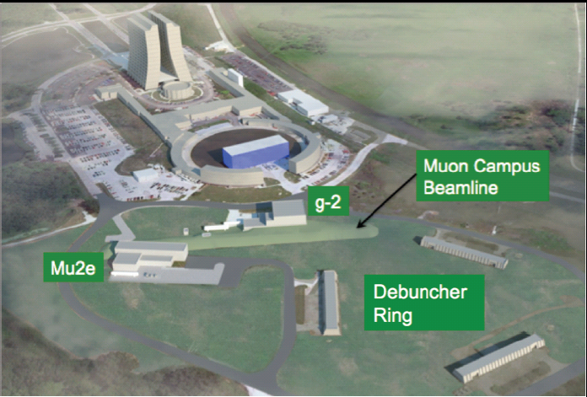
The Muon Campus
Notes:
Mu2e is part of a new larger muon program being developed at Fermilab that includes the Muon g-2 experiment. There are many shared components which result in a significant savings for each project. Examples are shared rings, kickers, and utilities such as helium refrigeration equipment.

Slide 27
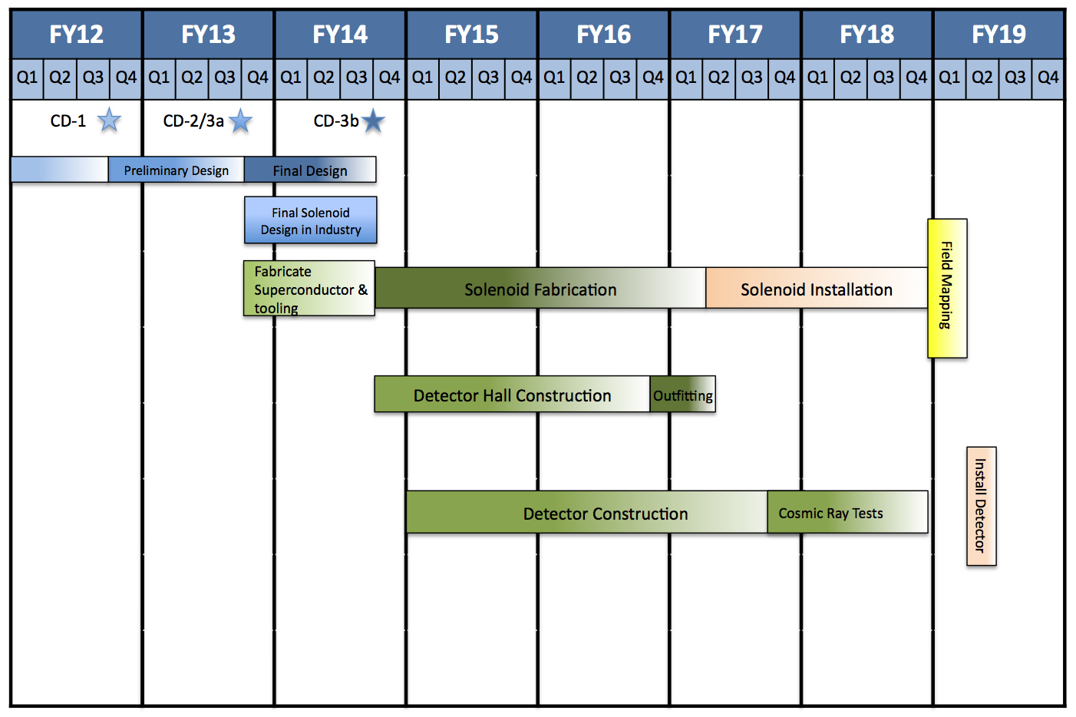
Estimated Schedule
Mu2e has Stage I approval and CD0 now
Just had a successful CD1 review, anticipate official CD1 very soon
Critical path: solenoids lead to technically limited schedule
  Have preliminary design of solenoids: coils, cryostats, support, etc
  Have conceptual design of all subsystems
R&D going on now or soon.
  PSI/TRIUMF: products of μ capture on Al.
  FNAL: Extinction tests; straw, calorimeter CRV, accelerator design, magnet design...

Slide 28
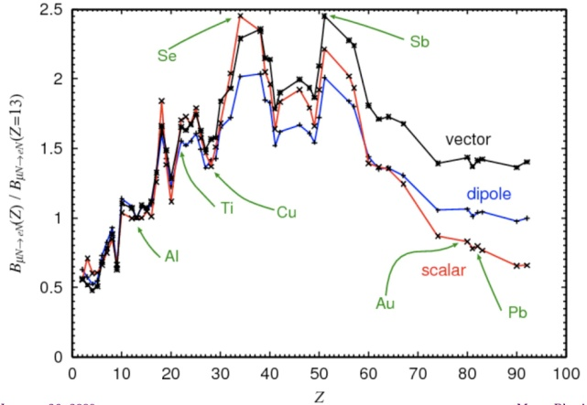
Muon to e Conversion: Future Upgrade to 10⁻¹⁸
Project X at FNAL → 100x more proton beam
  Beam pulse structure tailored to Mu2e
  Improved muon beams: FFAG(Fixed Field,
  Alternating Gradient ring), cooled beam,…?
Plan: mu-to-e will be muon flagship of Project X
Path of upgrade → results of “Round 1” of Mu2e:
  Lessons learned from 10⁻¹⁶ measurement
  If signal seen
    If signal small, establish signal with high statistics
    Go to high Z targets: structure of interaction will affect BR vs Z
      Need to start Meas. Period much sooner: eliminate beam pions, electrons…
  If no signal seen
    Go to x100 higher statistics on Al or Ti- need lower relative backgrounds
      Eliminating DIO requires higher detector resolution
      go to narrower muon momentum distribution to get a thinner target, less multiple scattering.
      Requires detector configuration capable of handling much higher low energy background rates.
      May require improved cosmic ray rejection

Slide 29
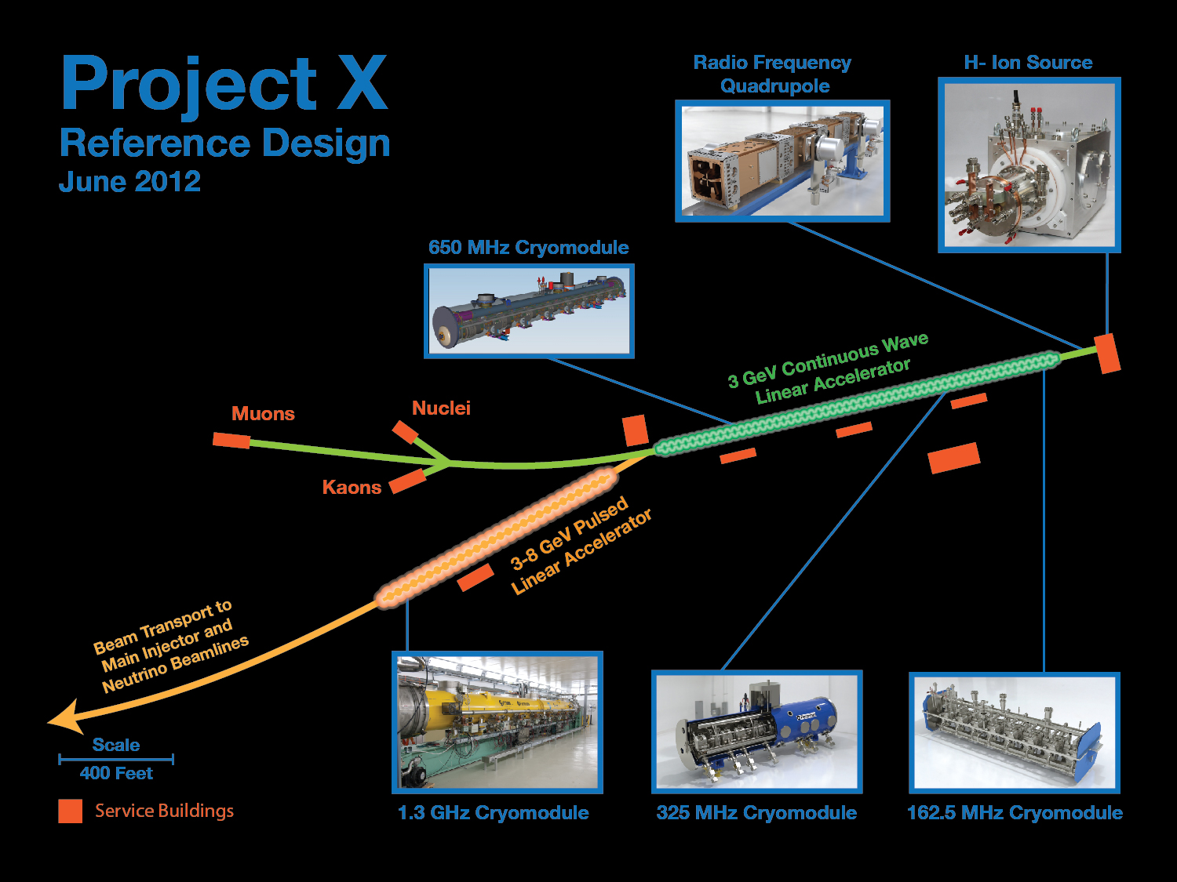
      as;lkjfda;lskdjf;salkjfd
Argonne National Laboratory • Brookhaven National Laboratory • Fermi National Accelerator Laboratory • Lawrence Berkeley National Laboratory
Pacific Northwest National Laboratory • Oak Ridge National Laboratory / SNS • SLAC National Accelerator Laboratory
Thomas Jefferson National Accelerator Facility • Cornell University • Michigan State University • ILC/Americas Regional Team
Bhaba Atomic Research Center • Raja Ramanna Center of Advanced Technology • Variable Energy Cyclotron Center • Inter University Accelerator Center

Slide 30
Reference Design Capabilities
3 GeV CW superconducting H- linac with 1 mA average beam current
  Variable beam structures to multiple experiments
  Drives rare processes program at 3 GeV
  Allows extraction at 1 GeV for nuclear energy program
3-8 GeV pulsed linac delivering 300 kW
  Support for neutrino short baseline & precision neutrino program
  Establishes path toward high intensity muon facility
Upgrades to Main Injector and Recycler complexes to provide 2+ MW at 60-120 GeV
  Support for long baseline neutrino program
CW linac creates a facility with performance & flexibility that can not be matched in a synchrotron-based facility

Slide 31
Conclusions
  A wide-ranging program of measurements is planned or under way to search for LFV: neutrino oscillations, tau decays, mu decays
  A positive cLFV signal is a definite indicator of new physics
  cLFV can be large in most extensions to the SM, ‘just around the corner’
  Complementary to LHC- LHC has new particle discovery potential, but is not well-adapted to study muon lepton flavor violation- in some scenarios reach of Mu2e can far exceed LHC
  τ decay data have been reported by Babar and Belle, perhaps x10-100 better at super flavor factories- signal also ‘just around the corner’?
  MEG μ→eγ is under way now.
  Two experiments are currently being developed to study μΝ→eN.
    Mu2e has Stage 1 approval at FNAL, CD0 Doe approval, just completed CD1 Review, anticipate CD1 approval, to measure x10000 better than the current limit.
    COMET has a similar goal and Stage 1 approval at JPARC.
  μΝ→eN may be the channel best suited to the highest precision tests of cLFV (x10000 improvement in currently planned expt, another x100 at future facilities?), and will be an important part of the Project X upgrade at FNAL. Study group has been formed to develop Project X version of μ→e conversion

Slide 32
Summary
Mu2e: Start data in 2019. Sensitivity for 3 years of running:
  Discover new physics or Rμe < 1 x10⁻¹⁶
  Mass scales to O(1,000’s TeV) are within reach.
  ~4 orders magnitude better than previous best limit, extraordinary physics reach
Many SUSY@LHC scenarios predict Rμe ≈ 10⁻¹⁵,
  Expect 40 events with < 0.5 events BG.
Critical path is the solenoid system:
  Technically limited schedule: startup in 2019.
Project X era:
  If a signal, we can study N(A,Z) dependence.
  If no signal, improve sensitivity up to x100 giving Rμe < O(10⁻¹⁸) .

Slide 33
End of talk
Beginning of extra slides

Slide 34
For Further Information
Mu2e home page: http://mu2e.fnal.gov
Mu2e Document Database:
  http://mu2e-docdb.fnal.gov/cgi-bin/DocumentDatabase
  Mu2e Proposal: Mu2e-doc-388
  Mu2e Conference presentations
  My email miller@bu.edu

Slide 35
Motion in a Solenoid with a Linear Gradient Field
Low momentum charged particles follow helical paths along the field lines.
  Magnetic moment associated with the helical motion is approximately constant. For a relativistic particle, p_{t}²/B=constant,
  p_{l} is continuously increasing in the direction of decreasing field
  Particles are ‘pushed’ in the direction of lower field
  Mirror: Particles with initial polar pitch angle >90⁰ (spiraling upstream) can be reflected back downstream if B=B_{max} is large enough:
p_{t}
Idealized linear gradient field:
B_{r}
B_{r}
p_{t}

Slide 36
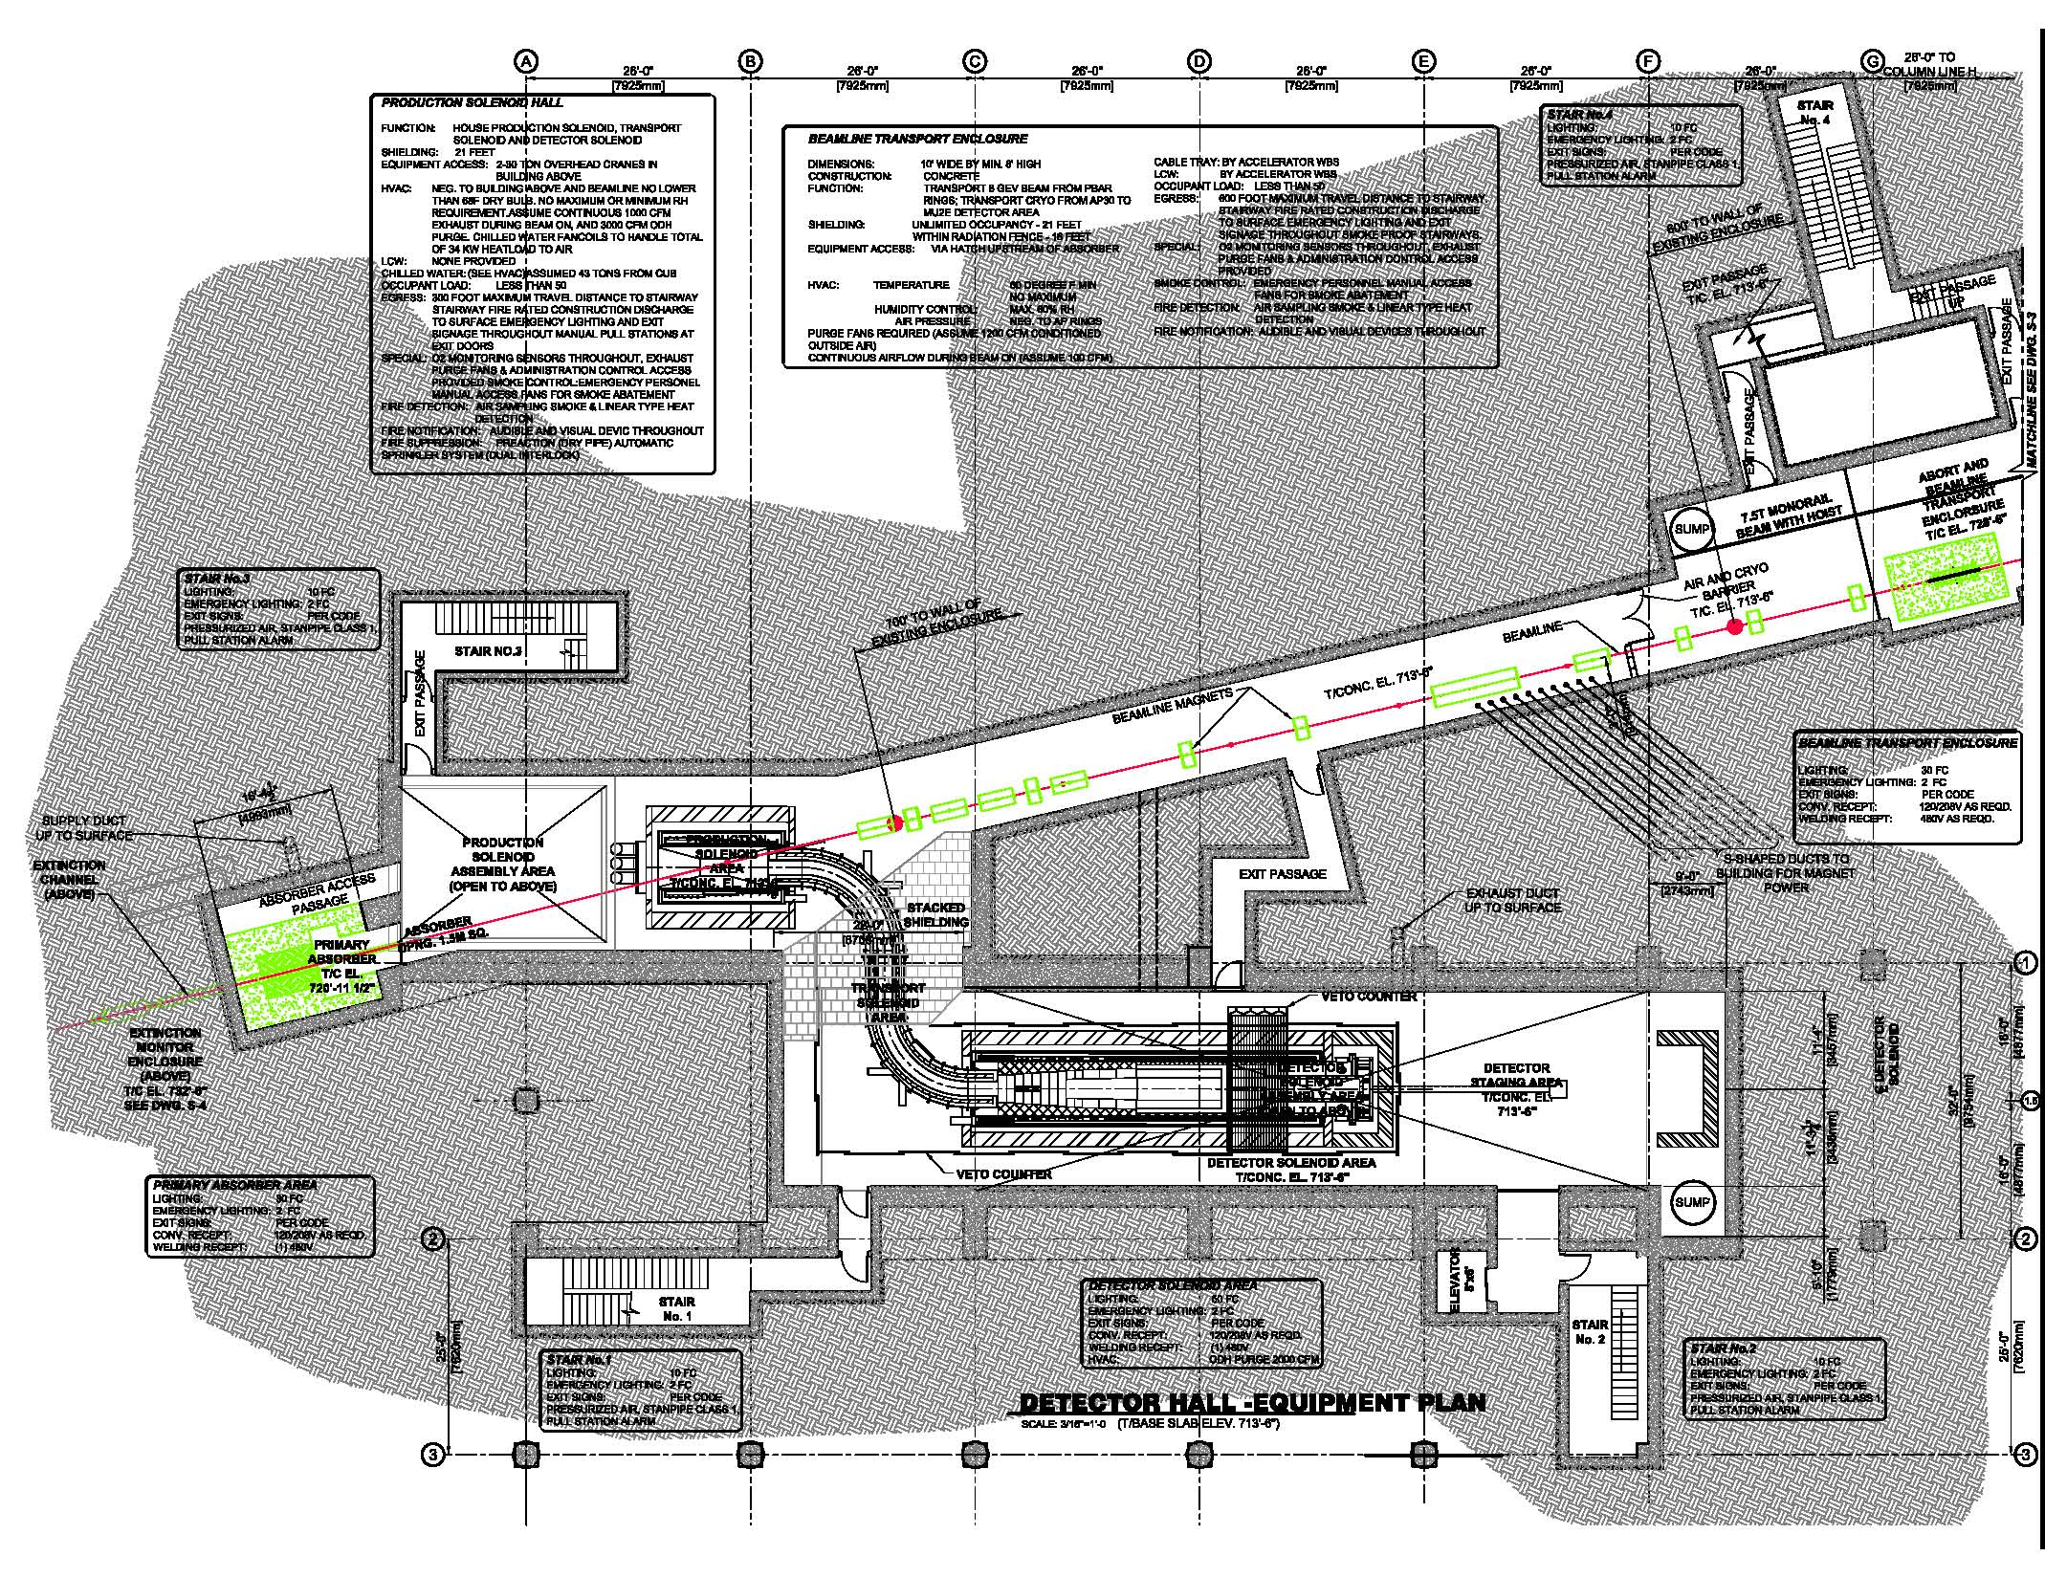

Slide 37
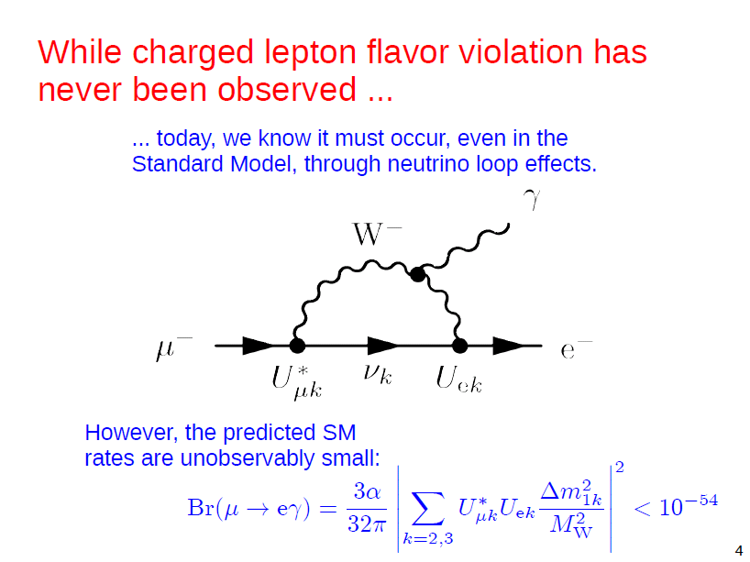

Slide 38
What LFV has been seen/not seen?
Examples of observed reactions:
Examples of un-observed reactions: Charged Lepton Flavor Violation: (cLFV,) mostly
New physics contributions: Advantage τ
Number of particle: Advantage

Slide 39
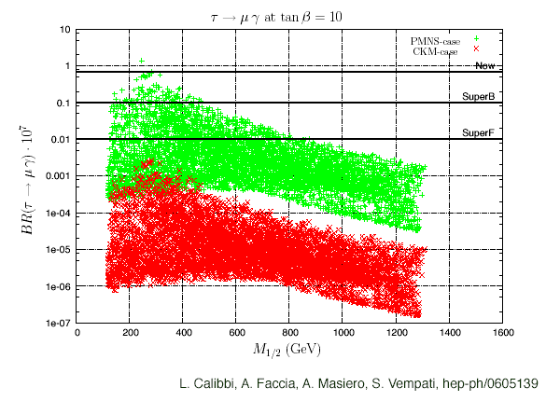
Supersymmetry in Tau LFV
Neutrino-Matrix Like (PMNS)
Minimal Flavor Violation (CKM)
Neutrino Mass via the see-saw mechanism, analysis performed
in an SO(10) framework

Slide 40
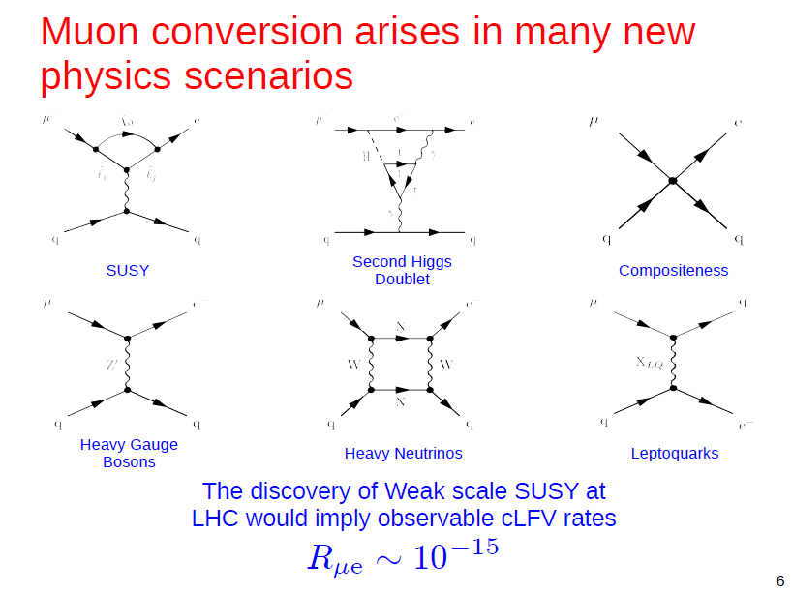

Slide 41
A Word of Caution
The MEG Collaboration is doing that experiment.
See their web site:
Or check SPIRES for publications by the MEGA Collaboration.
http://meg.web.psi.ch

Slide 42
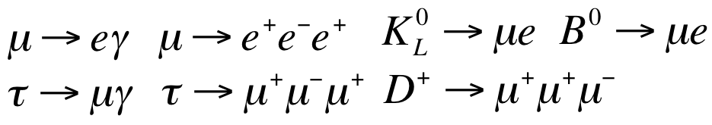
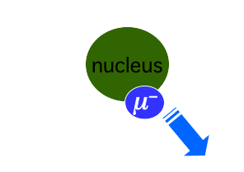
Single mono-energetic electron.
  Energy O(M_{μ}).
  Depends on Z of target.
Recoiling nucleus (not observed).
  Coherent: nucleus stays intact.
Charged Lepton Flavor Violation (CLFV)
Related decays:

Slide 43
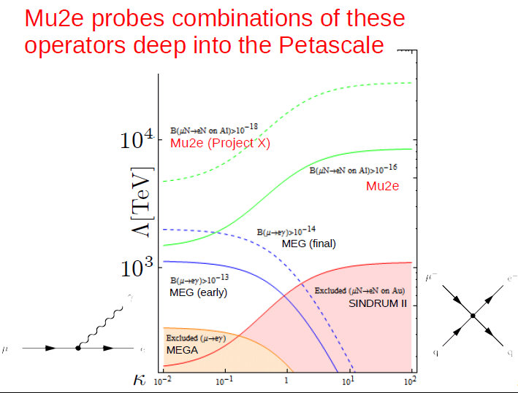

Slide 44
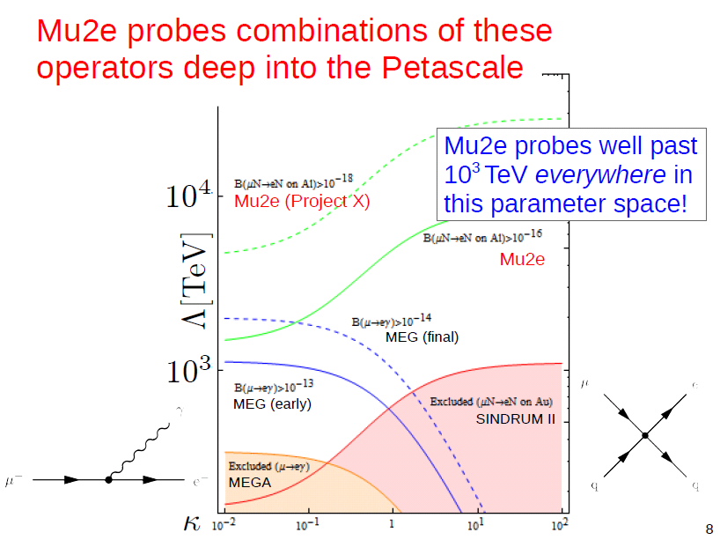

Slide 45
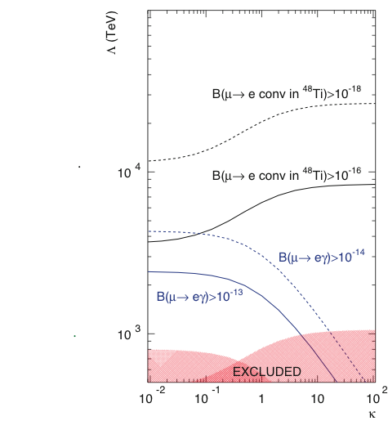
Physics Reach of μ→eγ and μ→e Conversion
κ small: dipole interaction
κ large: contact term
1) Scale extends to several x 10³ TeV
2) Μu2e/COMET ~2 times more sensitive than MEG to dipole interaction terms
3) μΝ−>eΝ has much greater sensitivity to contact terms compared to μ−>eγ
André de Gouvêa, Project X Workshop Golden Book
Μu2e/COMET probe well past 10³ TeV everywhere in this parameter space!
Complementary to MEG measurement.
Λ (TeV)
Project X Mu2e
Mu2e/COMET
higher mass scale
MEG
MEGA(μ−>eγ)
SINDRUM(μe)
κ
Notes:
generally acknowledge for experimental reasons mu e gamma will not get much better -- this improvement is only a factor of 5 --point to MEG/MEGA, but mu-e conversion can improve by 10,000 --SINDRUM to Mu2e. Independent of model! If supersymmetry, great -- but if not, can reach to 10^4 TeV for new physics. This is a unique contribution made by mu-e conversion. You know about COMET/PRISM proposed here in Japan: different design, similar sensitivities.

Slide 46
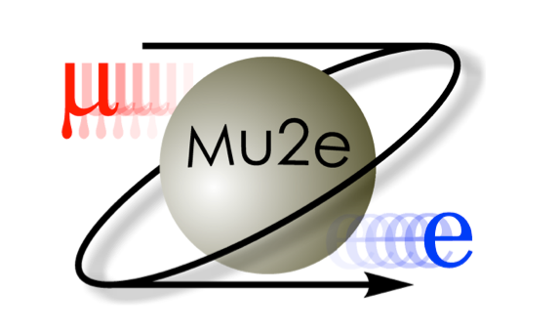
The Mu2e Collaboration
Boston University
Brookhaven National Laboratory
City University of New York
College of William & Mary
Fermi National Accelerator Laboratory
Idaho State University
Instituto Nazionale di Fisica Nucleare, Lecce
Instituto Nazionale di Fisica Nucleare, Pisa
Institute for Nuclear Research, Moscow
Joint Institute for Nuclear Research, Dubna
Laboratori Nazionali di Frascati
Lawrence Berkeley National Laboratory
Muons Inc.
Northwestern University
Rice University
Syracuse University
University of California, Berkeley
University of California, Irvine
University of Houston
University of Illinois
University of Massachusetts, Amherst
University of Virginia
University of Washington
23 Institutes
120 Collaborators
Both HEP and Nuclear Physics groups.

Slide 47
Experimental Advantage: Muon to Electron Conversion
The signals lie in a sea of
backgrounds from ordinary decays
There is no such limitation for the conversion process
Notes:
Mention PSI running mu2egamma, planned mu 3e

Slide 48
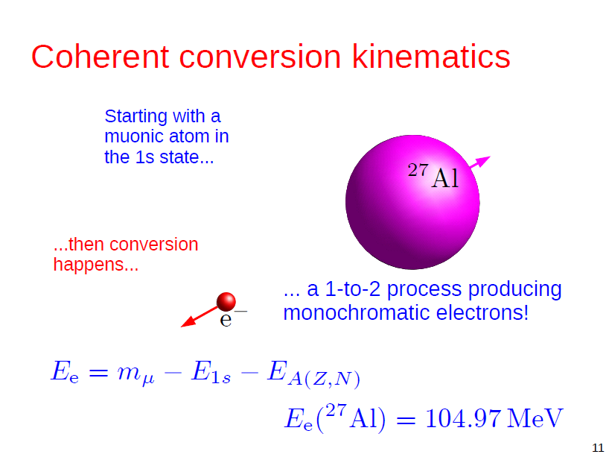

Slide 49
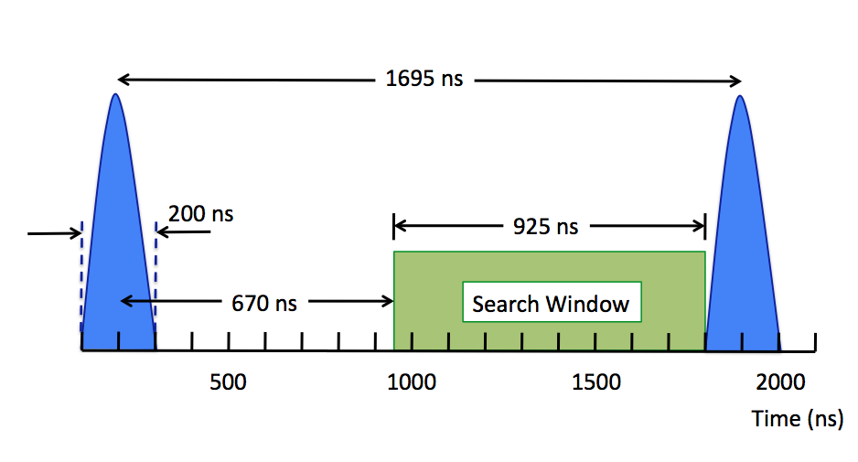
The two most dangerous backgrounds have very different time structures
The FNAL accelerator complex produces a
proton beam with a pulsed structure.

Slide 50
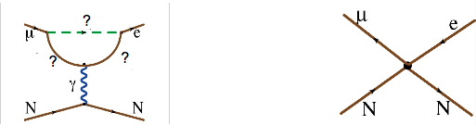
Can get muon to electron conversion by attaching quarks to the photon from
Because of overlap between muon wavefunction and the nucleus in a
muonic atom, can get in addition direct exchange of heavy particles with
the quarks

Slide 51
The backgrounds and resolutions constrain the design and reach of the experiment
Spectrometer design:
track momentum resolution O(200 keV)
handle high hit rates during flash and to a
lesser extent during measurement period
Beam transport
Out-of-time particle suppression 10⁻¹⁰
3.6x10²⁰ Protons On Target
1x10¹⁸ Stopped Muons
R_{μe}<6x10⁻¹⁷ (90% c.l.)
This is a factor 10⁴ improvement on the current limit!
(Single event sensitivity=2.5x10⁻¹⁷)

Slide 52
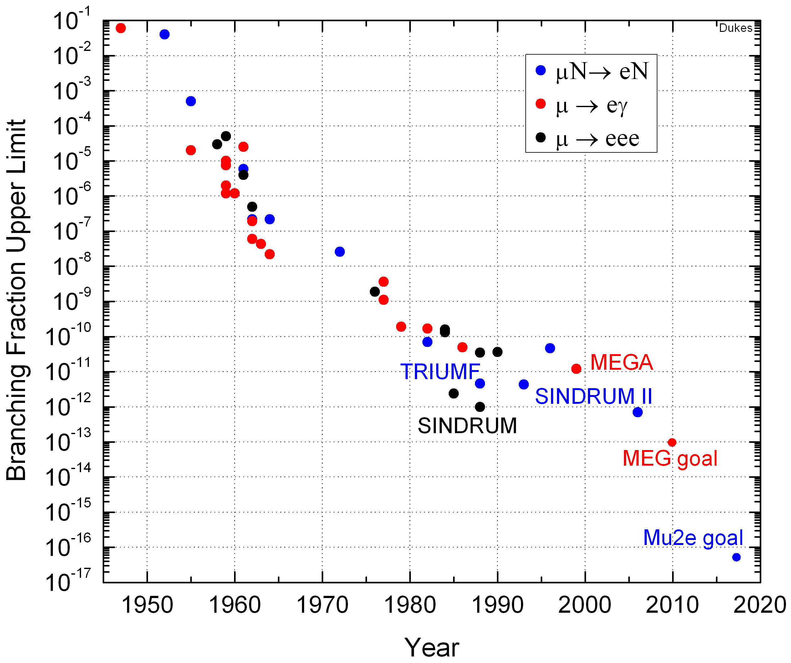
Time Line for Experimental Limits in cLFV in Muon Decays
Pontecorvo, 6x10⁻² in 1948
Notes:
Here we show a time history of the experimental limits in the decay of the muon. Pontecorvo showed in 1948 that the muon was not just an excited state of the muon because of the failure for it to decay to e gamma. Later it was demonstrated that the muon and electron neutrinos were distinct, and it was apparent that lepton flavor was converved. Mu2e gamma has a new limit of 2.4e-12 from MEG at PSI, 5 x better than MEGA at Los Alamos. SINDRUM II has the best current limit on Mu2e, with plans by Mu2e at Fermilab (the subject of this talk) and a competing experiment at Fermilab to take this limit to

Slide 53
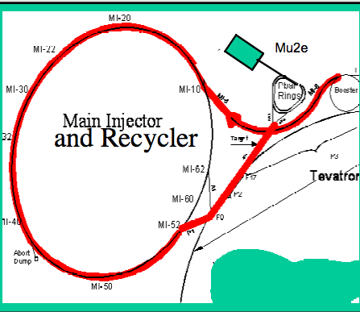
Proton Delivery and Economics
Reuse existing Fermilab facilities with modest modifications.
Send 8 GeV proton Booster
batch (4x10¹²) into Recycler
Form 4 bunches (same as for g-2)
Extract 1 at a time to debuncher
Slow-extract one bunch from
Debuncher (period=1695 ns) in pbar complex
Sharing p’s with NOVA:
  NOVA 12/20 booster cycles.
  Mu2e will use 2/20 cycles.
6x10¹² protons/s gives 1.2-1.5x10¹⁰ Hz stopped muons
Need 1x10¹⁸ stopped muons to
reach goal→ 3-4 years assuming 2x10⁷ s running/year.
Making a stable, slow spill with a very intense proton beam is a challenge.

Slide 54
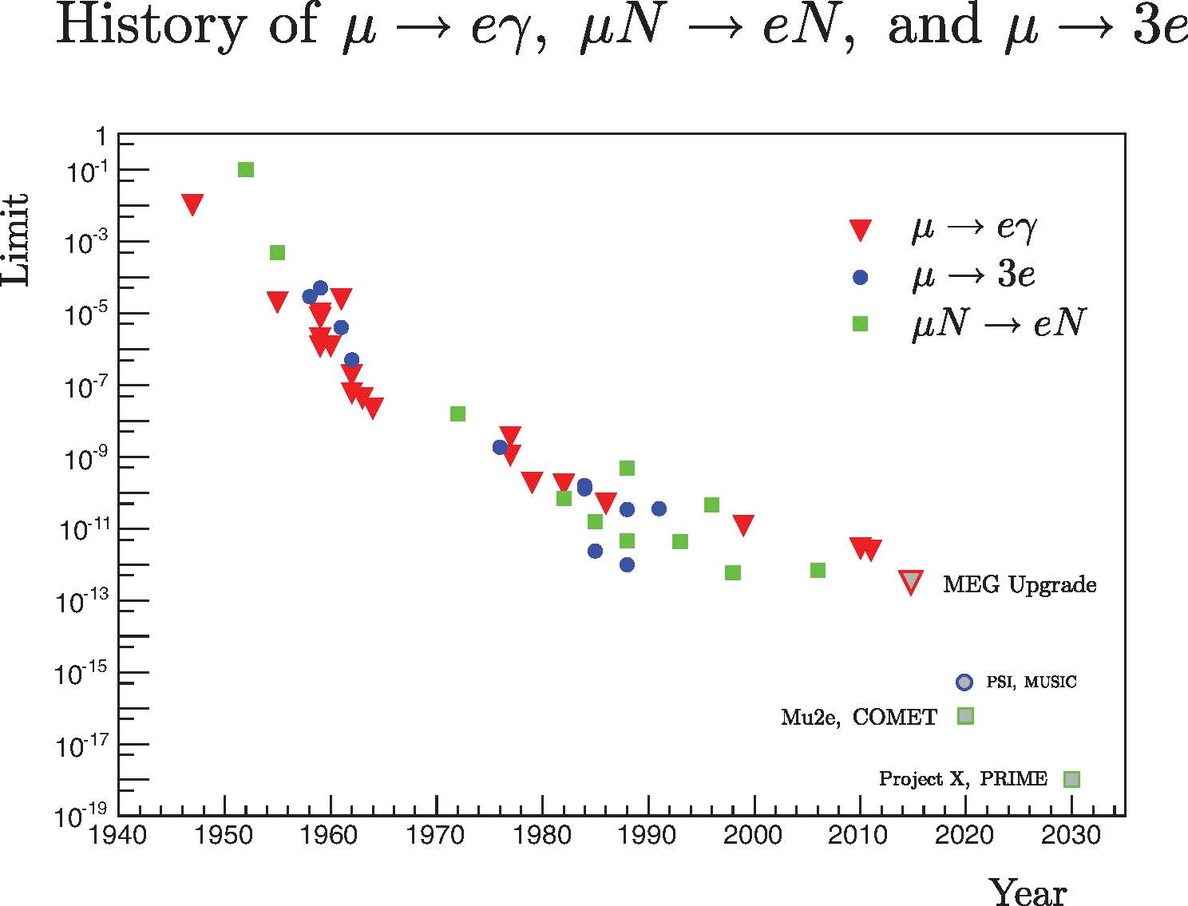
Time Line for Experimental Limits in cLFV in Muon Decays

Slide 55

We can parameterize most of these models
in terms two effective interactions

Slide 56



Comparing Sensitivities of μ→e and μ→ e γ to cLFV
Model
independent
effective cLFV
Lagrangian
κ>>1
Contact
interaction
μN→eN rate many
orders of magnitude
greater than
μ→eγ rate
κ<<1
magnetic moment type
operator
μ→eγ rate ~300X
μN→eN rate
Notes:
Here we see a plot of the energy scale probed as a function of the relative mixture of the two types of interactions, for mu to egamma and for mu2e. The energy scale exclusion areas for the old mu2egamma and mu2e experiments are shown. This is the exclusion region for MEG if they get to 1e-13, but it is likely they will get to only to a few e-13 so the exclusion region is maybe not quite this good. The mu2e exclusion region is a few times better than MEG for kappa small but is vastly more sensitive to the contact terms. This emphassizes the complementarity of these two measurements, and the fact that the mass reach is in the thousands of TeV.

Slide 57

Muon-Electron Conversion in SUSY
Neutrino-Matrix Like (PMNS)
Minimal Flavor Violation (CKM)
tan(β)=10
Measurement
Can distinguish
between PMNS
And MFV
Mu2e
BR(μΝ→eΝ) x10¹² vs M_{1/2} for tanβ=10
L. Calibbi, A. Faccia, A. Masiero, S. Vempati, hep-ph/0605139: neutrino mass via the see--saw mechanism,analysis in SO(10) SUSY-GUT framework

Slide 58


Similar Plots for τ→μγ and μ→eγ
BR(τ→μγ) x10⁷ vs M_{1/2} for tanβ=10
L. Calibbi, A. Faccia, A. Masiero, S. Vempati hep-ph/0605139: neutrino mass via the see--saw mechanism,analysis in SO(10) framework
BR(μ→eγ) x10¹¹vs M_{1/2} for tanβ=10

Slide 59

μ→e Conversion versus μ→eγ
MEG
Little Higgs Model w/T parity
M. Blanke, A. J. Buras, B. Duling, A. Poschenrieder and C. Tarantino, JHEP 0705, 013 (2007).
Mu2e
MEG
BR(μΤι→eΤι)
BR(μ→eγ)
Constrained Minimal
SUSY SO(10) models
C. Albright and M. Chen, arXiv:0802.4228, PRD D77:113010, 2008.
MEGA
Mu2e

Slide 60
SUSY: Minimal SU(5)
μ>0
μ<0
J. Hisano, T. Moroi, K. Tobe and M. Yamaguchi, Phys. Lett. B 391, 341 (1997). [Erratum-ibid. B397, 357 (1997).]
Notes:
In an older minimal SUSY paper, the old mu to e experimental limit did not put much of a constraint on parameters, but with the new planned limit will constrict a large portion of the parameter space, depending on the value of tan(beta).

Slide 61
Reminder: The Bohr Atom
Conversion electron energy for Aluminum:
Conversion electron energy for Gold:
For muonic 1S state in aluminum, r~20 fm, E~500 keV
E_{e}=m_{μ}c²(105.67 MeV)-BE(0.47 MeV)-Recoil(0.22 MeV)=104.97 MeV
E_{e}=m_{μ}c²(105.67 MeV)-BE(10.08MeV)-Recoil(0.025 MeV)=95.56MeV
Note: Bohr formula does not work for Au because muon wf sustantially inside nucleus!
Notes:
2500x, 35000x

Slide 62
Muonic Atom Formation and Nuclear Capture
Hydrogenic Radial wavefunction at small r: R(r) r^{l} Z^{3/2} , 1S~ Z^{3/2}
Ordinary Muon Capture Rate, μ⁻ + A(N,Z) ◊Β(N+1,Z-1) + ν_{μ} : proportional to the probability of overlap between nucleus and muon times number of protons −>l=0 capture rate by far largest. Proportional to: (# protons) x (Prob. muon overlap w/ nucleus) ~ Z⁴
Conversion rate is coherent −> Proportional to
(# protons)² x (Prob. nuclear overlap) ~Z⁵
R_{μe}=(conversion)/(capture)~Ζ⁵/Ζ⁴∼Ζ
High Z preferred for sensitivity. Max is
at Z~50-60, slowly decreases after that.
(But…we will see on the next slide that we
don’t want the muonic atom to die away too
fast, and Mu2e is likely limited to Al and Ti)
μ⁻
Nucleus
Notes:
Remember we are interested in the ratio of these rates

Slide 63


Slide 64
Mu2e Muon Beam Line
Transport Solenoid (TS)

Slide 65
Mu2e Muon Beam Line
Detector Solenoid (TS)

Slide 66

Transport solenoid
The curved transport solenoid separates charged particles in the non-bend plane,eliminates straight-line from production target to detectors. Second
reverse bend
recombines.
Collimators in the central straight section reject most wrong sign particles, and can be rotated to change
sign for calibration runs.

Slide 67

Detector Solenoid
Solenoid, 1m radius, B=2 T→1T from 0 to 4 m, B=1 T from 4 to 10 m
Negative field gradient at target creates mirror increasing detector acceptance.
Stopping target: thin to reduce loss of energy resolution due to energy straggling
Calorimeter
Stopping
Target
Tracker
Muon Beam Line
B=1T
Uniform field
B=1T
Muons
Field gradient<0
Large flux of electrons from
low energy portion of muons
decaying in target (DIO) mostly
spiral harmlessly through
the centers of the detectors
B=2T
Notes:
67

Slide 68

Detector
Useful tracks make 2 or 3 turns inside the tracker.
3 candidate trackers:
  L-Tracker (shown)
  T-Tracker
  I-Tracker

Slide 69

The Mu2e Collaboration
120 Collaborators
Both HEP and Nuclear Physics groups.
Boston University
Brookhaven National Laboratory
University of California, Berkeley
University of California, Irvine
Caltech
Duke
City University of New York
Fermilab
Idaho State University
University of Illinois, Urbana-Champaign
University of Houston
Institute for Nuclear Research, Moscow, Russia
JINR, Dubna, Russia
Lewis University
Los Alamos National Laboratory
Muons Inc.
Northwestern University
INFN Frascati
INFN Pisa,
Università di Pisa, Pisa, Italy
INFN Lecce, Università del Salento, Italy
Universita di Udini
U. Of Washington
U. Mass. Amherst
Rice University
Syracuse University
University of Virginia
College of William and Mary
More opportunities for University groups.

Slide 70
Accelerator/Experiment Interface
Proton Beam
Production Solenoid
Detector Solenoid
Transport Solenoid
Production Target
Calorimeter
Tracker
Notes:
The interface between the Mu2e experiment and the proton beam is in the Production solenoid.

Slide 71
Accelerator/Experiment Interface
Proton Beam
Production Solenoid
Detector Solenoid
Transport Solenoid
Production Target
Calorimeter
Tracker
Notes:
The interface between the Mu2e experiment and the proton beam is in the Production solenoid.

Slide 72
Future Upgrade to 10⁻¹⁸
Project X → 100x more proton beam
Improved muon beams: FFAG(Fixed Field
Alternating Gradient ring), cooled beam,…?
Plan: mu-to-e will be muon flagship of Project X
Path of upgrade → results of “Round 1” of Mu2e:
  Lessons learned from 10⁻¹⁶ measurement
  If signal seen
    If signal small, establish signal with high statistics
    Go to high Z targets where structure of interaction will make noticeable changes in the BR.
      Need to start Meas. Period much sooner: eliminate beam pions, electrons…
  If no signal seen
    Go to x100 higher statistics on Al or Ti- need lower relative backgrounds
      Eliminating DIO requires higher detector resolution, go to narrower muon momentum distribution to get a thinner target.
      Requires detector configuration capable of handling much higher low energy background rates.
      May require improved cosmic ray rejection

Slide 73

To get to R_{μe}~10⁻¹⁸: PRISM (Phase Rotated Intense Slow Muon Source) Beam Line?
FFAG=Fixed Field Alternating Gradient

Slide 74

Lepton Flavor Violation Only Observed in Neutrino Oscillations…
Neutrinos can oscillate to different lepton flavors, for example:
This implies that muons and taus should violate lepton flavor in their decays, but the predicted Standard Model BR is too tiny to see it experimentally.
  No cLFV has been seen yet
  BR<10⁻⁵⁴ for μ→eγ! (similar for ) Way below any experimental capability!
Any detection of cLFV is a definite sign of new physics
Notes:
Free of backgrounds

Slide 75
Time Line for Experimental Limits in cLFV in Muon Decays
Pontecorvo, 6x10⁻² in 1948
MEG
MEG goal
Mu2e goal
Notes:
Here is a plot of the time history showing the steadily improving experimental limits on cLFV in the decay of the muon. In 1948, Pontecorvo set a limit on the rate of mu to e gamma, suggesting that the muon was not just an excited state of the muon. Later it was demonstrated that the muon and electron neutrinos were distinct, and it was apparent that lepton flavor was conserved. MEG, a mu to e gamma experiment now running at PSI, has recently set a new limit of 2.4e-12, not shown in the plot, 5 x better than the MEGA experiment at Los Alamos more than a decade ago. Their ultimate goal is a few x 1e-13. As I’ve already mentioned, SINDRUM II has the best current limit on Mu2e, with plans by Mu2e at Fermilab (the subject of this talk) and a competing experiment at Fermilab to take this limit to 1e-16

Slide 76
LFV Status and Plans
Reaction | Current Limit | Future limit | Who/where?
μ→eγ | 2.4x10⁻¹² | <10⁻¹³ | MEG at PSI
μ→eee | 1.0x10⁻¹² | <10⁻¹⁵-10⁻¹⁶? | PSI, Osaka ?
μN→eN (Au) | 7x10⁻¹³ | <10⁻¹⁸ | PRISM/ Mu2eX
μN→eN (Al) | ----- | <10⁻¹⁵/10⁻¹⁶ /10⁻¹⁸ | Mu2e, COMET/ upgrades
μN→eN (Ti) | 4.3x10⁻¹² | <10⁻¹⁸ | PRISM/ Mu2eX
μ⁺e⁻◊μ⁻e⁺ | 8.3x10⁻¹¹
τ◊μγ | 4.5x10⁻⁸ | <10⁻⁹-10⁻¹⁰ | Flavor factory
τ◊eγ | 1.1x10⁻⁷ | <10⁻⁹-10⁻¹⁰ | Flavor factory
τ◊μμμ | 3.2x10⁻⁸ | <10⁻⁹-10⁻¹⁰ | Flavor factory
τ◊eee | 3.6x10⁻⁸ | <10⁻⁹-10⁻¹⁰ | Flavor factory
Current and Planned
Experiments
Neutrino Oscillations!
τ decays at Babar,
Belle.
Future τ decays:
Super B factories
MEG at PSI: μ→eγ
μe conversion:
  Mu2e at FNAL
  COMET at JPARC
Notes:
There are a number of cLFV reactions that are either current or planned.

Slide 77
Comparing Sensitivities of μ→e and μ→ e γ to cLFV
Model
independent
effective cLFV
Lagrangian
κ>>1
Contact
interaction
μN→eN rate many
orders of magnitude
greater than
μ→eγ rate
κ<<1
magnetic moment type
operator
μ→eγ rate ~300X
μN→eN rate
Notes:
Here we see a plot of the energy scale probed as a function of the relative mixture of the two types of interactions, for mu to egamma and for mu2e. The energy scale exclusion areas for the old mu2egamma and mu2e experiments are shown. This is the exclusion region for MEG if they get to 1e-13, but it is likely they will get to only to a few e-13 so the exclusion region is maybe not quite this good. The mu2e exclusion region is a few times better than MEG for kappa small but is vastly more sensitive to the contact terms. This emphassizes the complementarity of these two measurements, and the fact that the mass reach is in the thousands of TeV.

