Slide 1

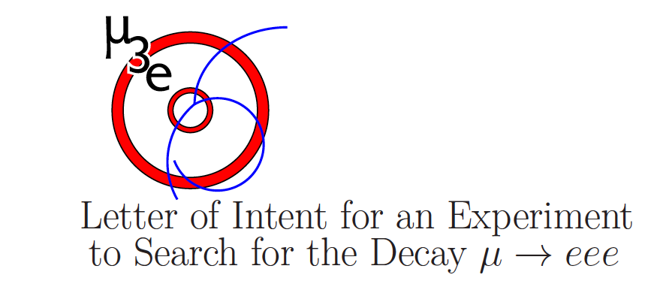
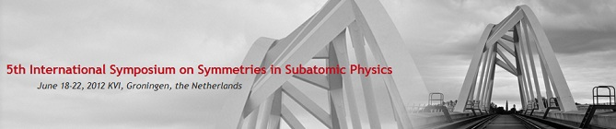

The “Golden” cLFV Channels µ→eγ & µ→3e
-the High-intensity Frontier
Peter-Raymond Kettle
Paul Scherrer Institut PSI

Slide 2
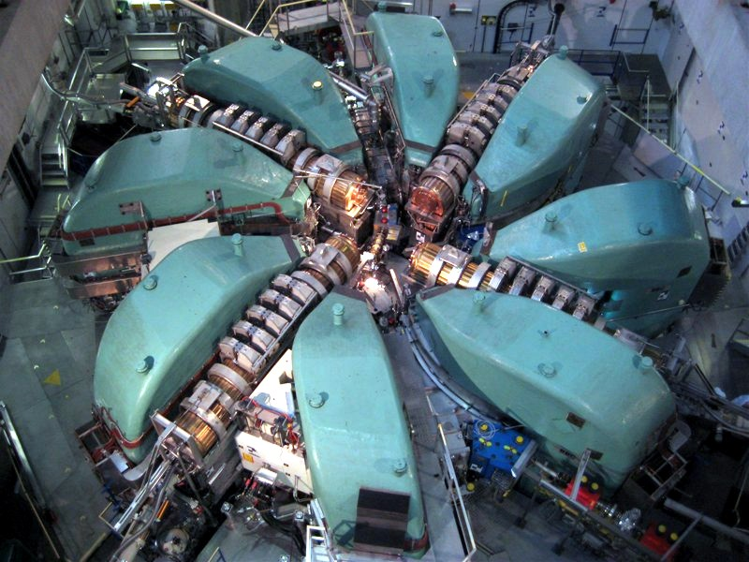
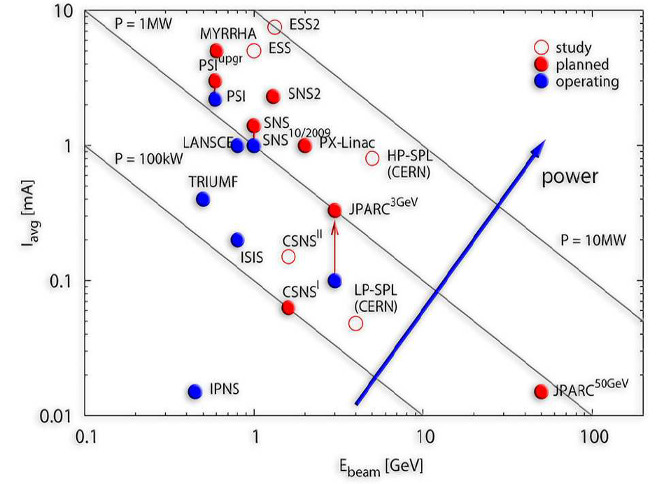
PSI a Benchmark for the High-Intensity
Precision Frontier
The unique high-intensity proton cyclotron complex HIPA
at PSI is at the “Intensity Frontier”
& Enables:
the World’d highest intensity DC
Surface Muon Beams > 10⁸µ⁺s⁻¹
Optimal machine duty-cycle for coincidence
experiments (100% macro duty-cycle)
Routine 1.3 MW
Beam Power
‘FUTURE’
Can explore the Predicted realm of
‘New Physics’
through precision experiments,
allowing insight into mediating particle mass scales
even beyond
the
reach of the
‘High-Energy Frontier’
machines
‘NOW’

Slide 3
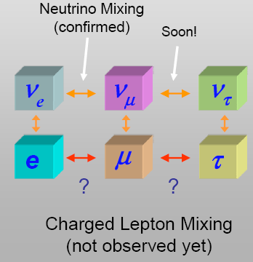
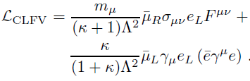
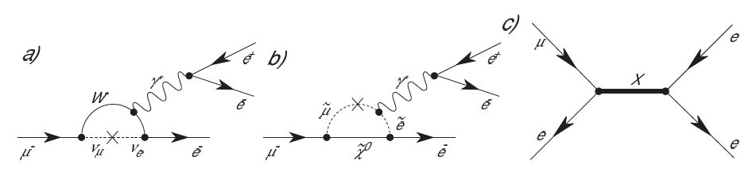
Motivation for cLF-Physics
LF violated in
the neutral
sector
To unravel the puzzle of FLAVOUR MIXING & CP-VIOLATION
& the connection between the 3 generations of Fermions
in the quark & lepton sectors
one needs the complementarity of
the High-energy & High-intensity frontiers
LHC, PSI, Super-B
A. de Gouvêa
Nucl. Phys. B 188 (2009) 303-308
Sensitivity to new BSM mediating mass-scales Λ
Muons seem to provide the most sensitive limits
(copious source, small mass, long life)
“GOLDEN CHANNEL”
in the Charged Lepton Sector:
μ→ eγ μN→ eN μ→3e
All 3 channels are needed since
subject to different couplings
Λ = mediating
mass scale
κ = dimensionless
parameter giving
relative contribution
of dipole κ< 1
or 4-fermion κ>>1
contribution
e.g. μ→3e (also μN→ eN + μ→ eγ not 4-fermion)
SM BSM (SUSY) BSM (Exotic)
neutrinos sleptons new heavy particles

Slide 4
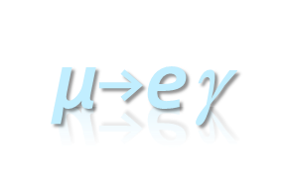
MEG – Benchmark for next Generation cLFV
Experiments
Standard Model (SM) Prediction
Beyond the Standard Model (BSM) Prediction
ν-mixing
slepton-mixing
γ
·
γ
·
W⁻
·
·
·
·
μ⁻
e⁻
μ⁻
ν_{μ}
ν_{e}
e⁻
SUSY/SUSY-GUT
Model Ranges
≈ O(10⁻¹¹ – 10⁻¹⁵)
Theory: B(μ→eγ) ~ 200x B(μ→e)
B(μ→eγ) ~ 150x B(μ→3e)
If Sensitivity (MEG) O(10⁻¹³)
Then to be competitive with MEG
Sensitivity(μ→3e or μ→e)
SHOULD BE BETTER than 7•10⁻¹⁶
Radiative
Coupling
only κ<1
- Very Highly Suppressed!
- Predictions Far Beyond
Experimental Reach!
∴ SM processes are
non-contaminating!
μeγ Signal is Clear Evidence
for “New Physics”

Slide 5
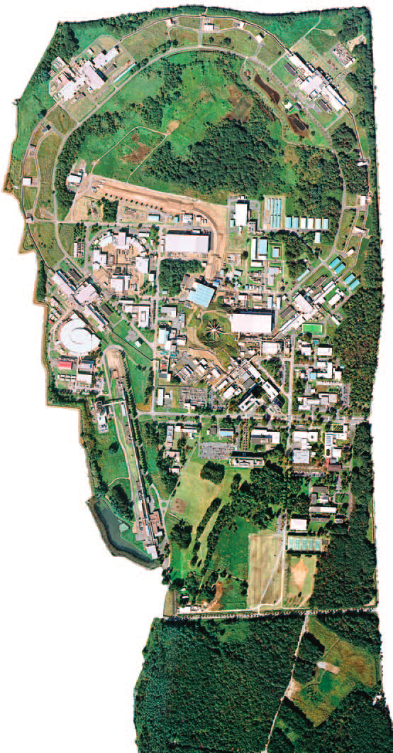
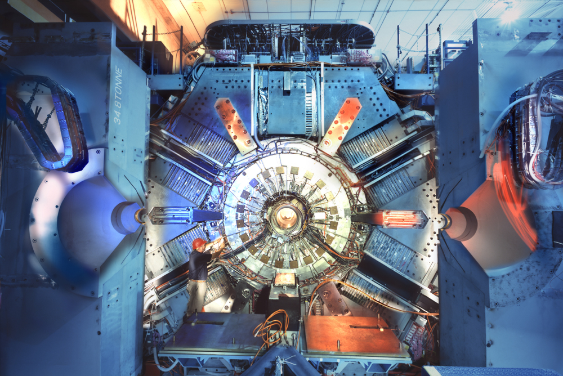
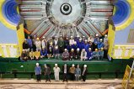
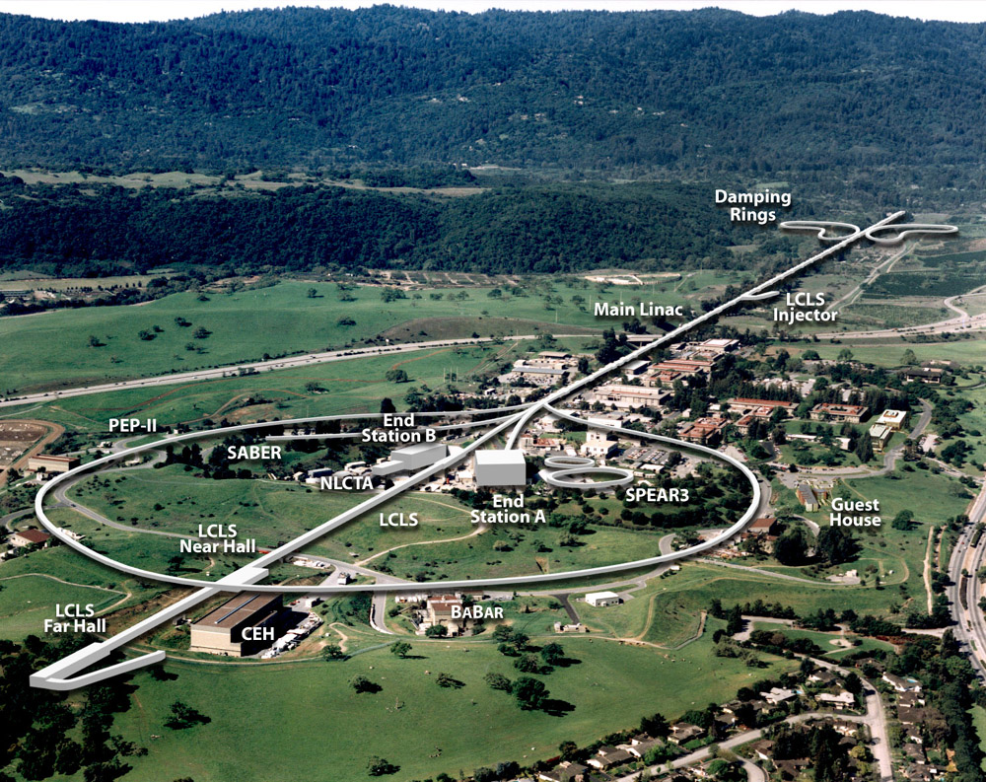
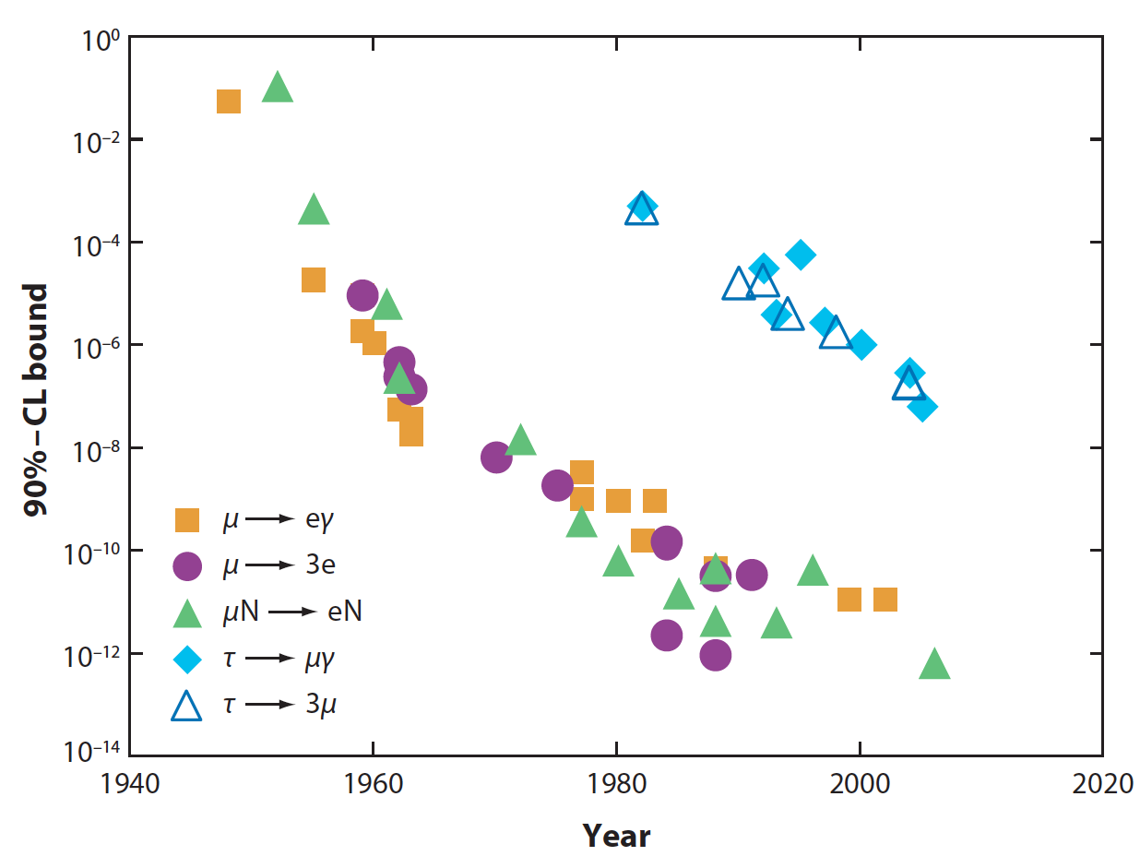
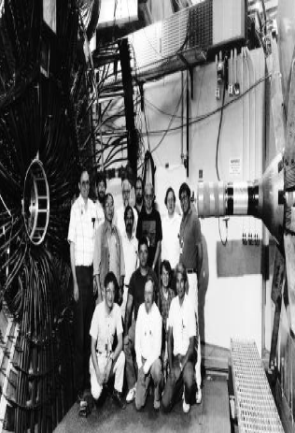
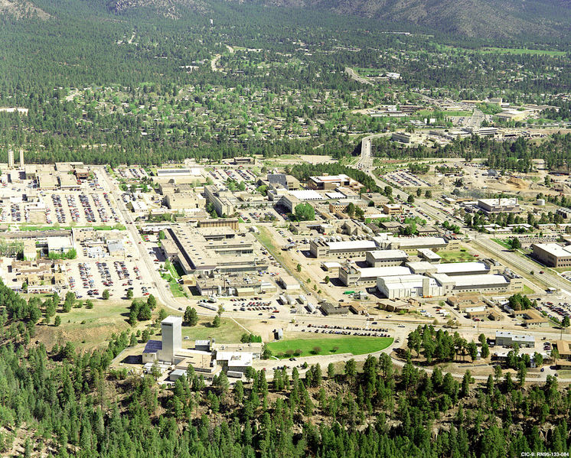
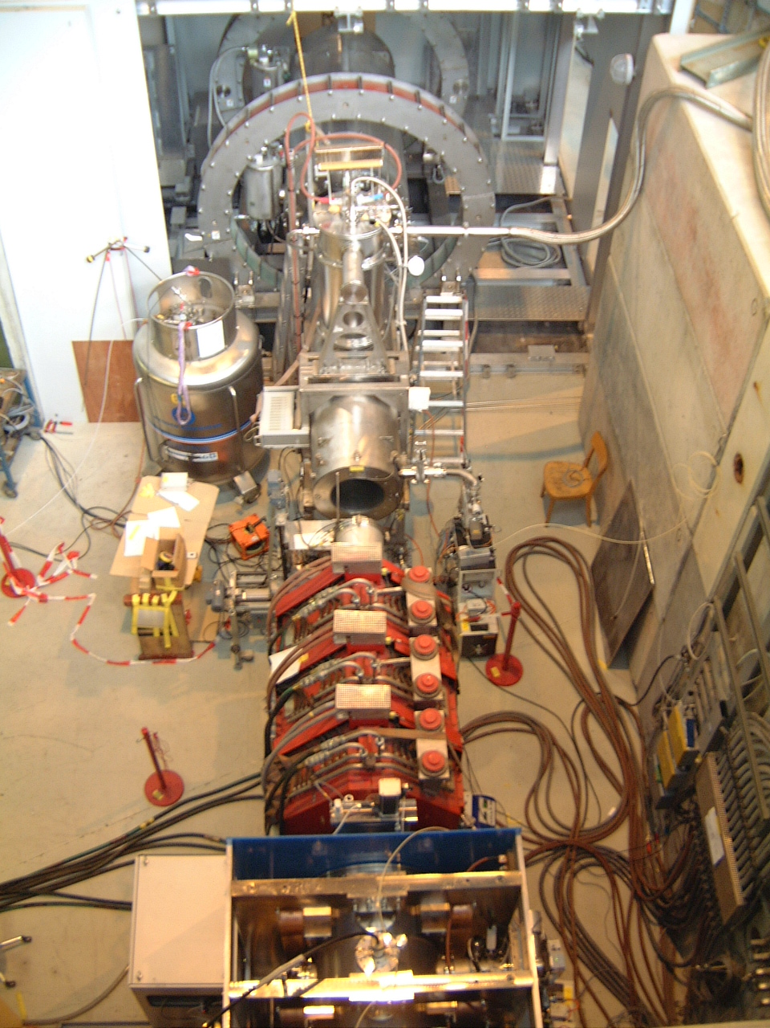
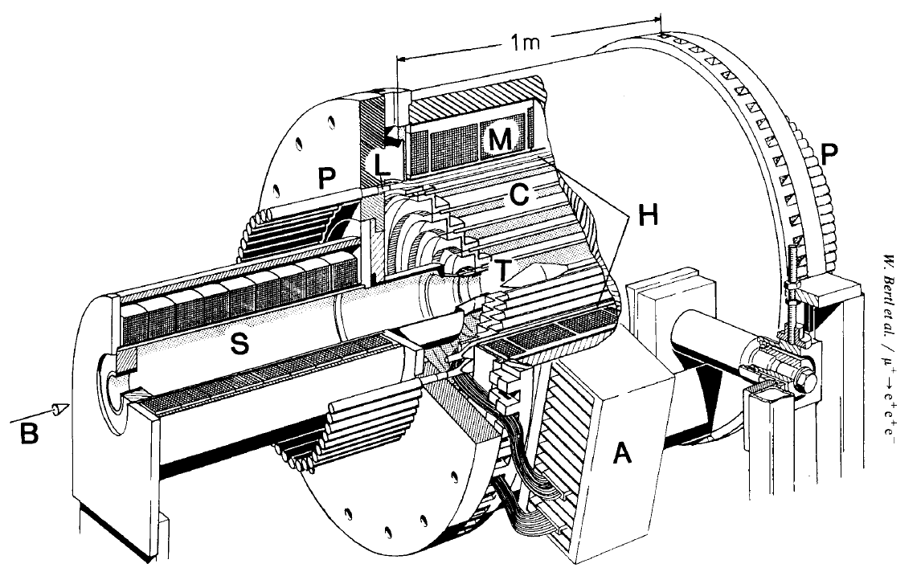
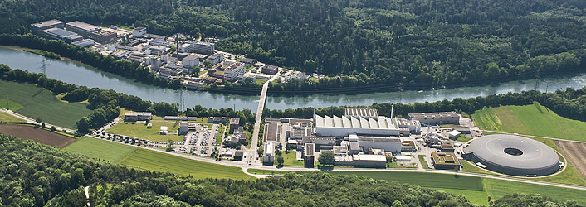
cLFV-Experimental Chronology
BaBar
(SLAC)
τ → μγ
< 4.4⋅ 10⁻⁸
Belle
(KEKB)
τ → 3μ (3e)
< 2.1⋅10⁻⁸ (2.7⋅10⁻⁸ )
FUTURE cLFV Experiments
𝜇 → eγ: MEG II (PSI) ~ 5⋅10⁻¹⁴
𝜇 → 3e : Mu3e (PSI) ~ 10⁻¹⁶
MuSIC (Osaka) ~ 10⁻¹⁵ Kuno-san Talk
𝜇N→ eN: DeeMee (J-PARC) 10⁻¹⁴
COMET (J-PARC) 6⋅10⁻¹⁷ Kuno-san Talk
PRIME/PRISM (J-PARC) < 10⁻¹⁸
Mu2e (Fermilab) 6⋅10⁻¹⁷ James Miller Talk
ProjectX Mu2e < 10⁻¹⁸
Original: Marciano, Mori & Roney,
Annu. Rev. Nucl. Part. Sci. 2008 58:315–41
MEG (PSI)
𝜇 → eγ
< 2.4⋅ 10⁻¹²
SINDRUM (PSI)
𝜇 → 3e
< 1.0⋅ 10⁻¹²
SINDRUM II (PSI)
𝜇 Au→ eAu
< 7⋅ 10⁻¹³
𝜏-Channels
𝜇-Channels
MEGA
( LAMPF)
μ → eγ
< 1.2 ⋅10⁻¹¹
I
H
J
A
H
D
C
D
G
F
E
B

Slide 6
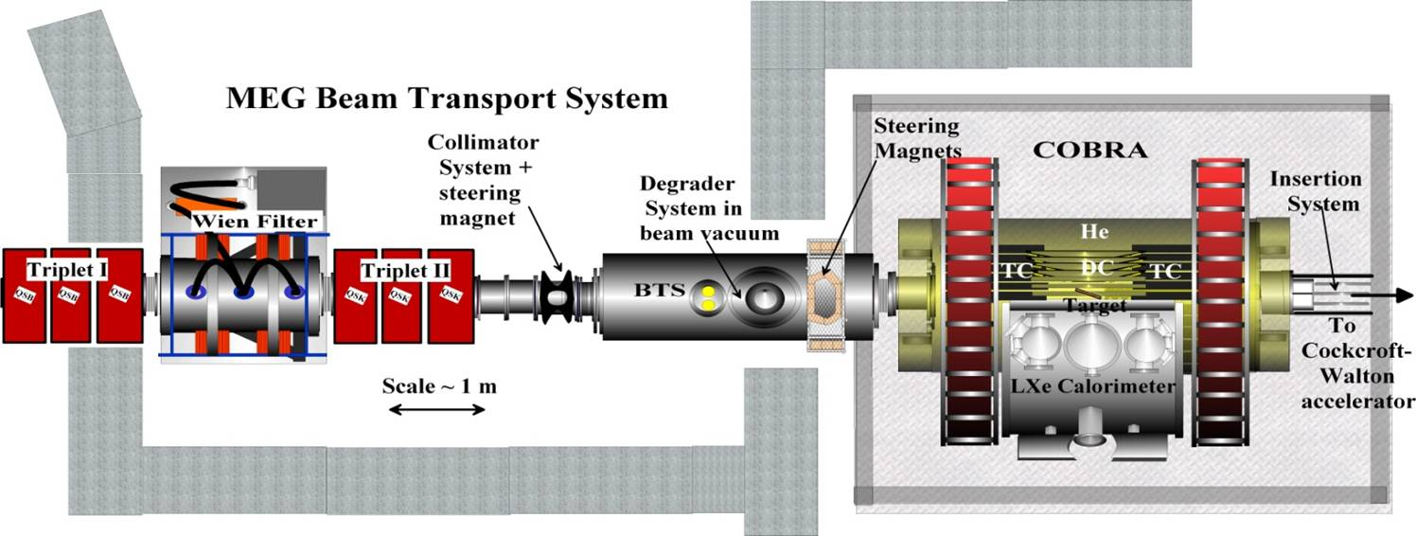
μ→e𝛄
The MEG Experiment

Slide 7


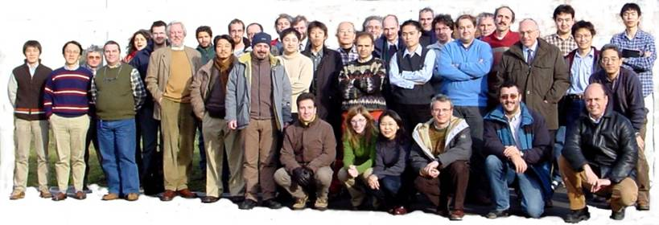
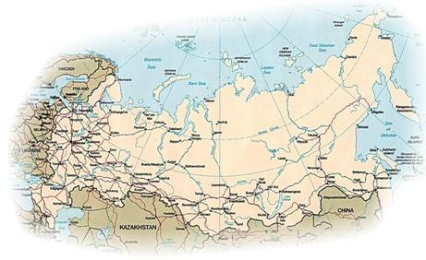
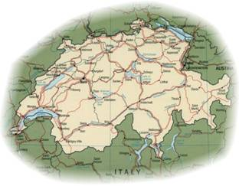





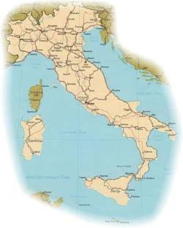

MEG Home
Paul Scherrer Institute
PSI
Russia
BINP Novosibirsk,
Dubna
Switzerland
PSI, ETH-Z
MEG Collaboration
some 65 Physicists
5 Countries, 14 Institutes
Japan
Univ.Tokyo, KEK
Waseda Univ., Kyushu Univ.
Italy
INFN + Univ. :
Pisa, Genova,
Pavia, Roma I
& Lecce
USA
University of California Irvine
UCI

Slide 8
Experimental Signature & Backgrounds
Signal:
mono-energetic
e⁺ & γ
Signal & Background
μ ⁺
98.6% “Michel decay”
e ⁺
γ
~ 1.4% “RMD”
(i) back-to-back (measure angle θ_{eγ} )
(ii) coincident in time (measure time t_{eγ} )
(iii) Energy = ½(M_{μ}) (measure P_{e} & E_{γ} )
< 10 ⁻⁹ %
Two Main Backgrounds – “Prompt” & “Accidental”
“Prompt” Background
Radiative muon decay RMD
“Accidental” Background
e⁺ from Normal Michel decay + γ
from Radiative muon decay
or Annihilation–in-flight
or Bremsstrahlung
RMD
Proportional
to R_{μ}
Accidental
Proportional
To R_{μ}²
μ ⁺
γ
e ⁺
μ ⁺
ν
e ⁺
−
ν
ν
−
dangerous when νs
carry off little energy
∴Detector
Resolutions
Crutial
e ⁺
ν
γ
Dominant Background x10

Slide 9
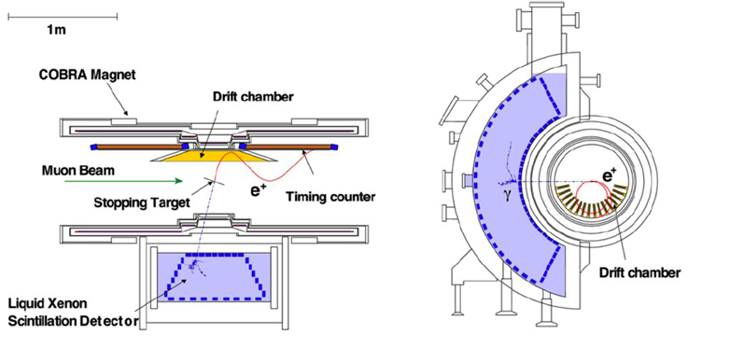
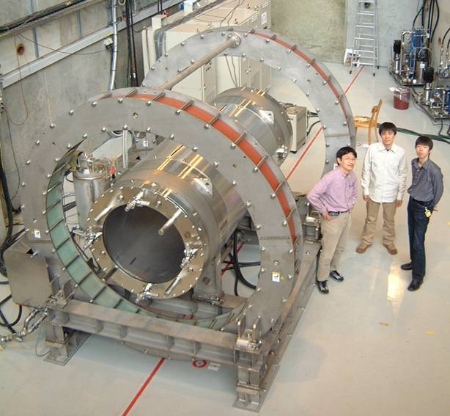
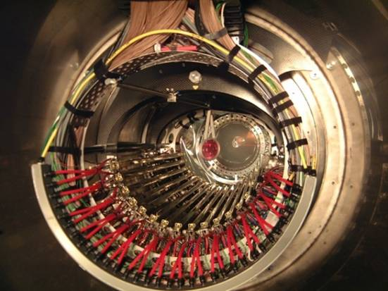
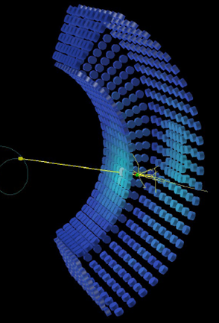
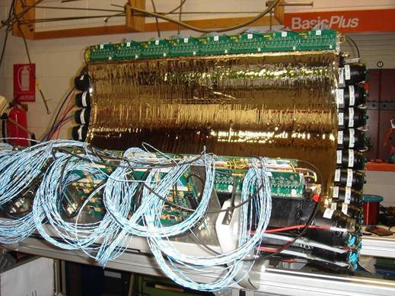
MEG Detector
Top View
e⁺ Spectrometer
σ(E/E) 6‰
σ(X/Y) 2/1 mm
φ ~7 mr
θ~ 11 mr
Front View
Combined σ(eγ) σ(T_{eγ}) 122 ps, φ ~14.0 mr, θ~ 17.1 mr
Photon Detector
<σE/E> < 2%
<σ_{T}> = 67 ps
σ(X,Y) 5 mm,
σ(depth) 6 mm
εγ 59% (ε_{Detect} x ε_{Anal})
Drift Chambers
Highest Intensity Muon Beam in the world
> 10⁸ Muons/s at 28 MeV/c
Largest LXe calorimeter in the world
900 litres, ΔΩ/4π = 10%, 846 PMs on walls inside LXe
16 radial, staggered ultra-thin double-layered DCs
Gradient-field superconducting solenoid (1.27-0.5 T)
2-scintillator arrays with orthogonal fibres, each of
15 axial bars and 256 transverse fibres
intrinsic σ_{t} ≈ 70ps over 90 cm
Smart trigger & FE-electronics + DAQ
all 3000 channels digitized 1.6 GHz, 0.8 GHz
Arsenal of calibration & monitoring tools
C-W, π⁻ CEX, RMD, Mott e⁺, n-generator....
Timing Counters
LXe Detector

Slide 10
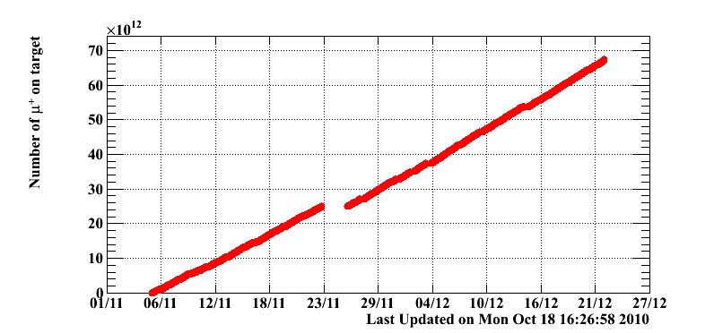
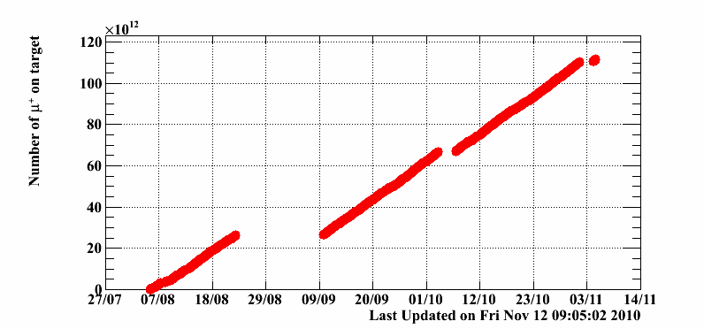
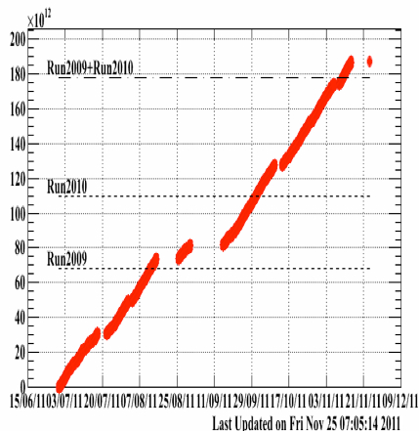
Chronology & Statistics
Accumalated muons 2009
6.5·10¹³ muons
MEG
Chronology
: Proposal submitted to PSI
: Detector R&D and construction
: Engineering run
: Physics run I
Detector performance not optimal
: Physics run II
  Total physics DAQ time: 43
: Physics run III
  Total physics DAQ time: 67
: Physics run IV
  Total physics DAQ time: 113
: Physics run V
Expected 1.1 x 2011 121D
1998
‘99 - ‘06
2007
2008
2009
2010
2011
2012
Constant
Progress
Accumalated muons 2010
1.1·10¹⁴muons
2011 =
1.1 x (2009 + 2010)
Accumalated muons 2011
1.8·10¹⁴muons
expect 2012 =
1.1 x (2011)

Slide 11
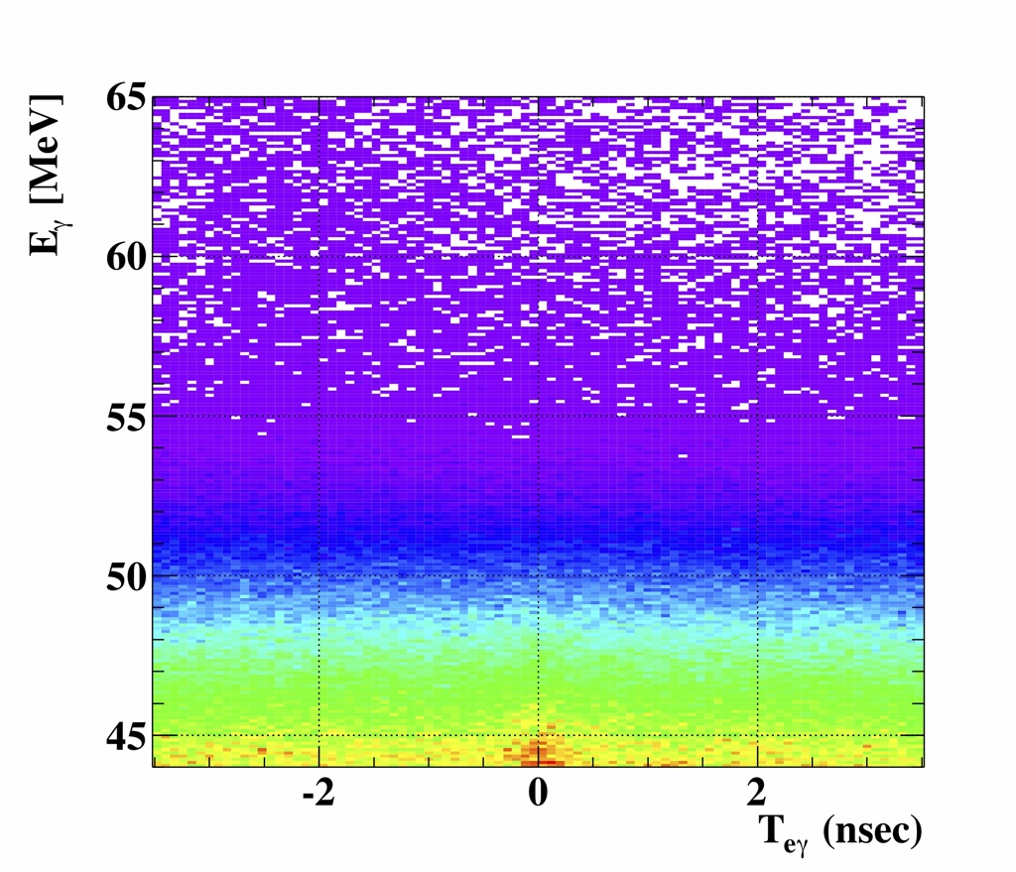
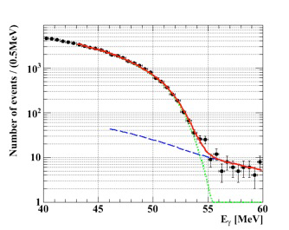
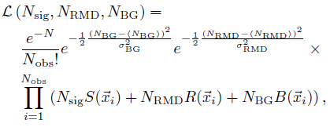
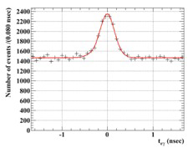
Analysis Principle & Data Sample
Blind likelihood Analysis:
Data Sample defined by 5 Observables:
E_{e}⁺, E_{γ} ,θ_{eγ},φ_{eγ}, T_{eγ}
Analysis-box for Likelihood fit
defined in 5D-space and
Analysis Region shown in 2D
(No Selection)
Fully frequentist approach (Feldman-Cousins) with
Profile likelihood ratio ordering
BG E_{γ} spect.
Left
Time
Sideband
Right
Time
Sideband
Blinding &
Analysis-box
“Blinded” in the
E_{γ} vs T_{eγ} plane during calibration and
optimization of physics analysis
E_{γ}-Sideband
sidebands
T_{eγ} resolution
!!! Timing & E_{γ} sidebands & angular sidebands used to
estimate the background in the signal region
check of experimental sensitivity
measure the timing resolution (RMD in the E_{γ}-SB)
Since our background is dominated by “accidentals”
µeγ signal
Rad. µ-decay
Accidental BG
3 event types + 2 nuisance parameters
to constrain background PDF mainly → SB data
SSP2012 Groningen

Slide 12
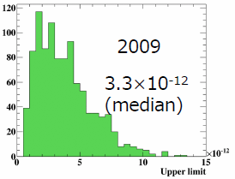
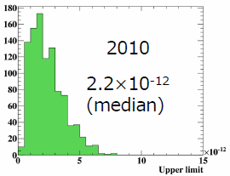
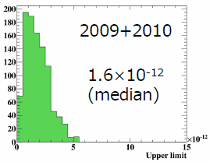
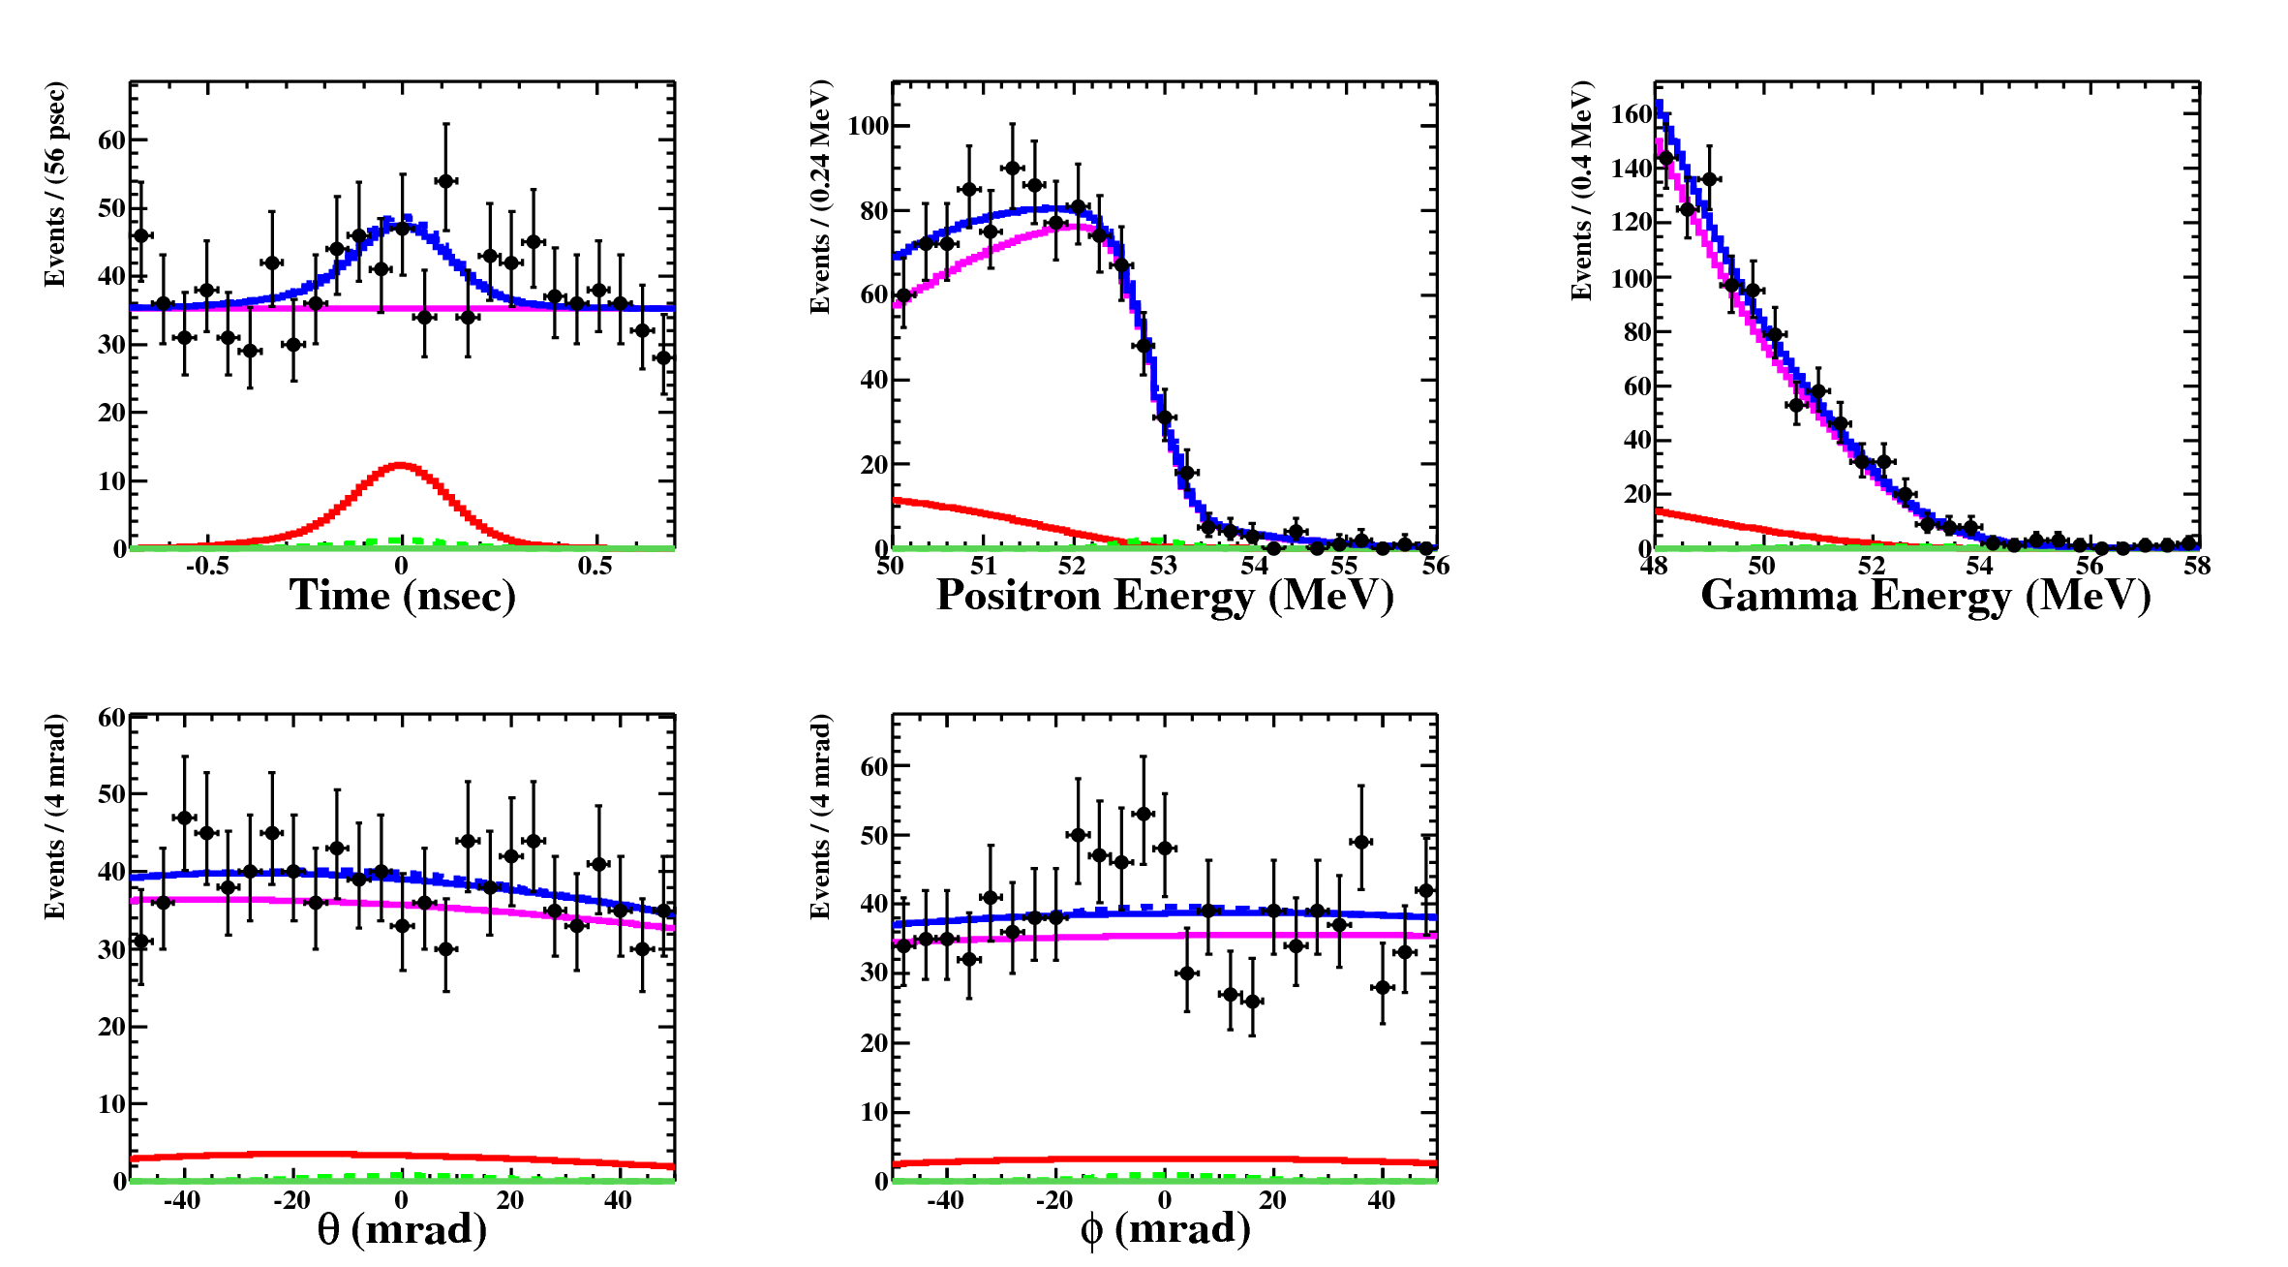

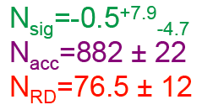
Likelihood Fit Results & Sensitivities
Expected 90% C.L. Upper Limit
Likelihood Fit Results to Combined Data
Sensitivity definition
Median* of 90% C.L. Upper Limit
distribution on BR.
- taken from a toy MC
Experiment Ensemble
assuming “Null hypothesis”
Combined 2009-2010
Sensitivity 1.6⋅10⁻¹²
Expected (Side Bands)
Background = 961 ± 17.6
Sensitivity 8 x better than previous
Best U.L. MEGA B ≤ 1.2⋅10⁻¹¹ 90% C.L.
SSP2012 Groningen

Slide 13
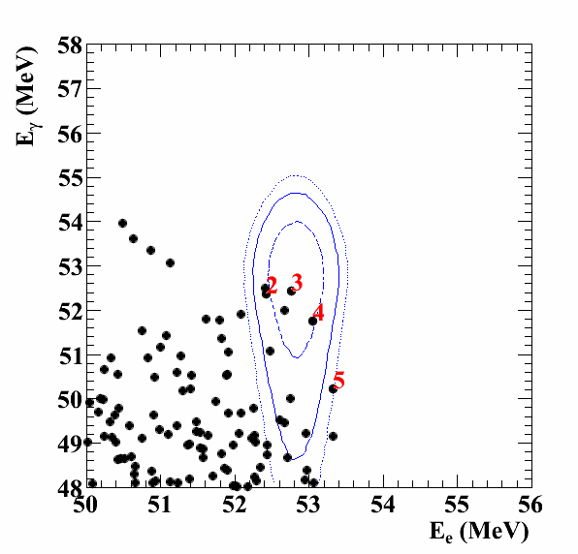
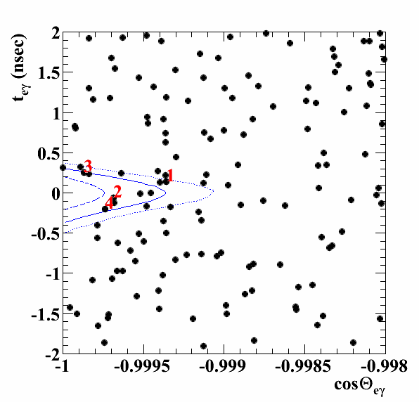
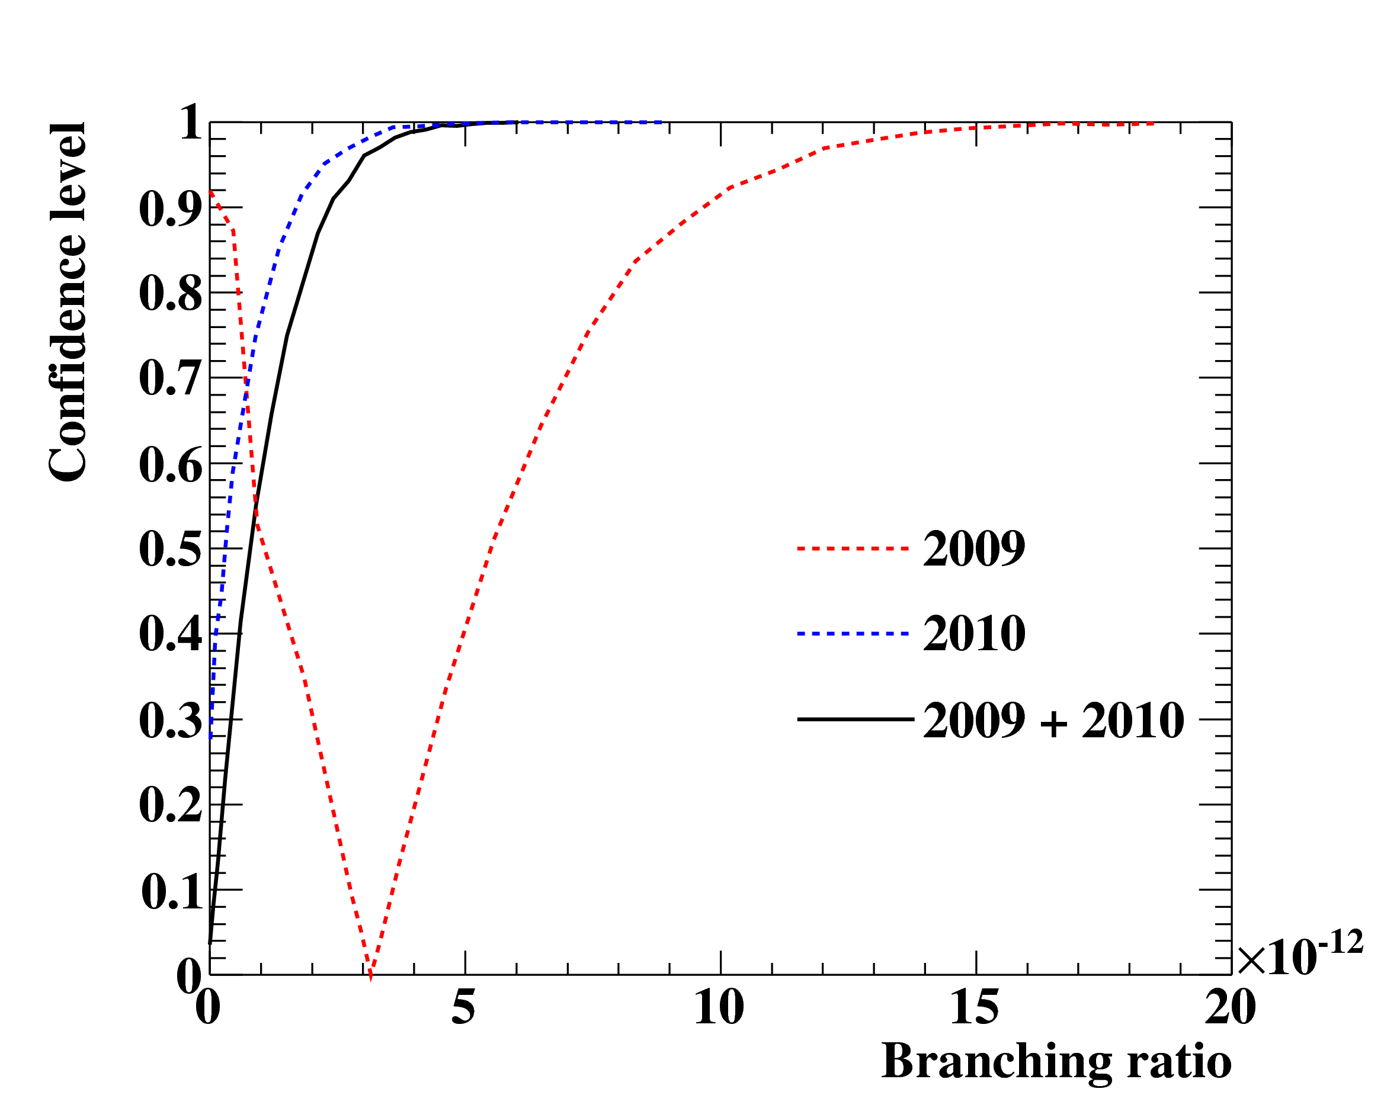
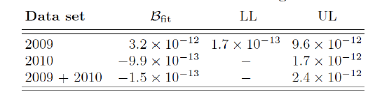
Combined Analysis 2009 + 2010
2009 + 2010
Events ranked according to their
Relative Signal Likelihoods
“signal/noise”
Ranking = S / (0.1R+0.9B)
Signal PDf Contours:
1, 1.64, 2 σ
2009 + 2010
Each plot, cut on
other variables ~
to contain 90%
of signal region
Likelihood fitting on “combined” data-set done in one go
Taking into account different resolutions, conditions etc.via
event-by-event method signal & background calculated
for combined data-set
Combined Fit Results give:
B ≤ 2.4⋅10⁻¹² (90% C.L.)
Sensitivity : 1.6⋅10⁻¹²
⇒ Phys. Rev. Lett 107 (2011) 171801
Factor 5 improvement on MEGA- Limit
Systematic Uncertainty (in total) 2% UL
SSP2012 Groningen

Slide 14
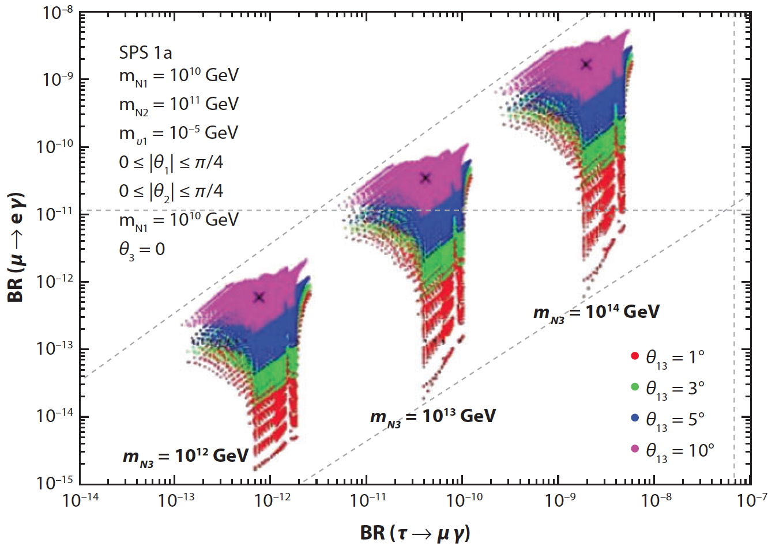
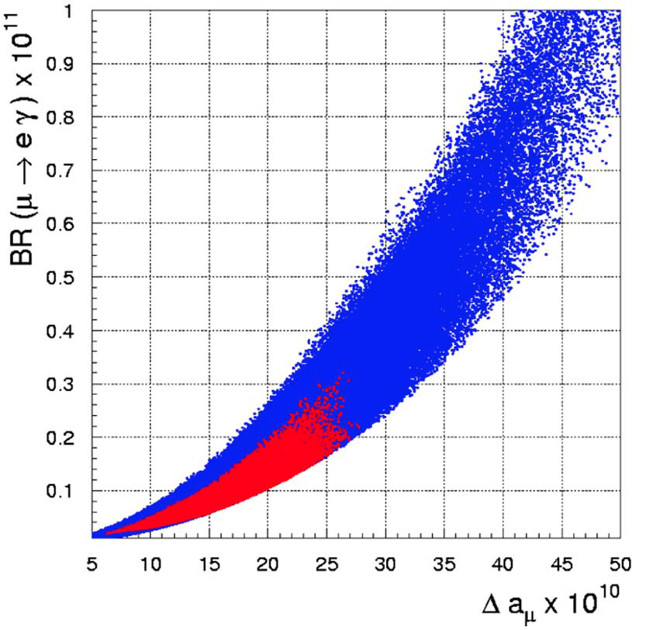




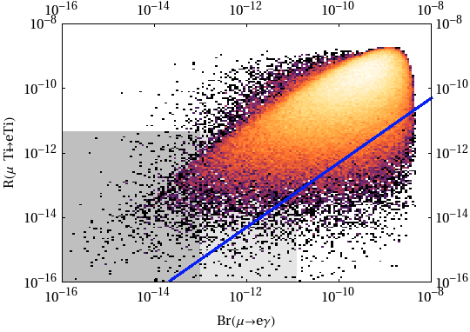
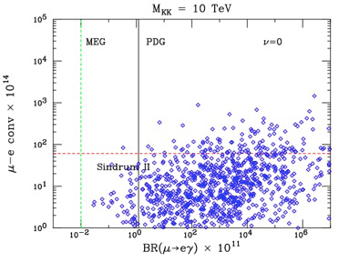


Model Constraints
SUSY –
GUT
SUSY –
Seesaw
S. Antusch et al., JHEP 11 (2006) 090
G.Isidori et al., PRD 75 (2007) 115019
MEG
MEG
MEG
g-2
g-2
g-2
g-2
BaBar, Belle
b-physics
MEG Goal
Θ₁₃~ 10°
(Daya Bay, RENO, Double Chooz,T2K, MINOS)
Little
Higgs
M.Blanke et al., Acta Phys. Polon. B41 (2010) 657
Extra
dimensions
K.Agashe et al., PRD 74 (2006) 053011
SINDRUM II
SINDRUM II
MEG
MEG

Slide 15

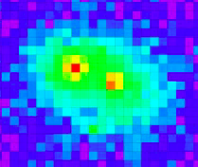
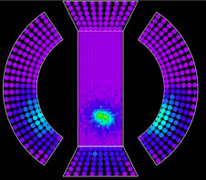


Status & Perpectives
MEG Data statistics
2011 Run Very Successful doubled 2009+ 2010 Stats.
2011 Data analysis on-going ready to “unblind” soon
2012 Run about to start > beam intensity increase
expect some improved resolutions + efficiencies
Expect to explore Branching Ratio Region O (10⁻¹³)
with 2011 + 2012 data-sets
Still 3σ discovery possible if B> 10⁻¹²
though Sensitivity reach slowing down due to background and detector resolutions
Upgrade ➔ MEG II in the planning:
?
2008 2009 2010 2011 2012(exp) 2013(?)
Published
B ≤ 2.4⋅10⁻¹² (90% C.L.)
Phys. Rev. Lett 107 (2011) 171801
New single volume e⁺ tracker stereo wires
Active target Si or fibres
MPPCs for inner-face LXe detector
(higher granularity)
Tile-structured TC
MEG II Sensitivity Reach
O (10 ⁻¹⁴) 3yrs Data-taking

Slide 16
μ→3e
The Mu3e Experiment at PSI

Slide 17







Mu3e Proto-Collaboration
University of Heidelberg
University of Genève
ETH Zürich
University of Zürich
Paul Scherrer Institut PSI
Currently 18 persons from 6 Institutes
LoI submitted to PSI PAC January 2012
Test Beam 2012
Proposal envisaged to PSI PAC Jan 2013
AIM 4-orders of magnitude improvement over current best limit SINDRUM B ≤ 1.0 ⋅10⁻¹² 1988
Staged approach – Stage I PSI πE5 Area O(10⁻¹⁵) Sensitivity Experiment ~2014-2017
Stage II planning PSI SINQ beam O(10⁻¹⁶) Sensitivity Experiment post 2017

Slide 18




Experimental Signature & Backgrounds
Signal:
3 charged Particles: 2e⁺ & e⁻
μ ⁺
(i) coincident in time (measure time t_{eee} )
(ii) Coplanar + same vertex
(iii) ΣEnergy = M_{μ} (measure E_{e} )
(iv) Σ p_{i} = 0 (measure P_{e} )
(v) Track curvature in Bfield
“Combinatorial” Background
A ) 2 x Michel + Fake e⁻
2x
+ e⁻
“Physics” Background
Radiative muon decay RMD
With Internal or External
Conversion
Good Energy
&
Momentum
Resolution
μ ⁺
Fake e⁻ from wrong charge reconstruction
or Bhabha or Back-curl
B) RMD (IC) + Michel (Fake e⁺)
Pion Decays:
negligible
+ Michel
Precise
Vertexing,
TOF,
Kinematics

Slide 19


Experimental Considerations
1)
is one of the most serious
considerations !
need precise momentum measurement &
excellent energy resolution for missing P_{ν} & E_{ν}
To reach B (μ→3e) ≤ 10⁻¹⁶ need σE < 1 MeV
2)
High-rate, high-precision tracking ➯ Si
Granularity of tracker is high then momentum
resolution σ_{p}/p dominated only by Multiple Scattering
σ_{p}/p ∝ √N_{LAYERS} use FEW but THIN Layers!
Good momentum resolution NEED
- large lever-arm
- best precision as with 180∘ spectrometer
½-turn ➯ Re-curl stations

Slide 20

Mu3e Detector Concept
Side View
Front View
He
He
High-intensity Muon Beam: Phase I 2⋅10⁸ Hz, Phase II 2 GHz
Large geometrical coverage 70% & background suppression, low material budget (MS) + He
Tracking: 2 central double layers Si pixel + double layer forward/backward Si Re-curl Stations
total 250 M channels precise energy, momentum, topology (vertex), > acceptance
Central scintillating-fibre hodoscope 4000 chs, track timing + Re-curl scintillating tile hodos.
for re-curl track precision timing 6000 chs, both for accidental background reduction!
Hollow, thin, double-cone target, high stopping efficiency – spread vertices Vertex res. 150μm
possibly active target?
Homogeneous solenoidal spectrometer magnet 1 – 1.2 T

Slide 21





Tracker Design
CMOS HV-MAPS
With integrated
readout
Si HV-MAPS – High Voltage Monolithic Active Pixel Sensors
Integrated sensor + readout functionality in same device
High precision pixels 80 x 80 µm²
‘’thinned’’ down to 30 µm thickness (0.0004 X₀)
Low cost (standard HV-CMOS process 60v)
Triggerless fast readout (time-frames 50 ns)
Total 250 M channels
50 ns timing resolution
Occupacy: inner layer highest – max. 3kHz/channel at 2GHz µ⁺/s
Pixel timing info used to ease track reconstruction & reduce
combinatorial background – to keep to reconstruction of < 100 decay
electrons per readout frame a hit resolution of ≤ 50 ns is required:
for 2GHz µ⁺/s:
Inner double-layer Support structure
25 µm+ flex print mock-up
With TOF
< 1ns
Only Si
< 50 ns
Sensor tested:
Low noise
Radiation tolerant
High efficiency

Slide 22





Hodoscope Design
Central SciFI Hodoscope:
4000 chs
5 layers 250μm fibres
σ_{t} ~ few hundred ps
Use SiPM arrays both ends
Waveform digitizing DRS5
5Gs/s 12-bit
Re-curl Tile Stations:
US & DS each 3000 Tiles
σ_{t} ~ 50 ps
(10x10x5) mm³ with light-guides
Use SiPMs
Waveform digitizing DRS5 (PSI)
Re-curl
Tile Station
Central SciFi Hodoscope
250 μm Fibres

Slide 23







Beam Line – High Intensity Possibilities
Mu3e Stage I Solutions:
Require ~ 2⋅10⁸ µ⁺/s
Only πE5 Area PSI feasible,
one of most intense DC µ⁺ beams in the
world
Share with MEG II Experiment
Schematic
only
Mu3e
Mu3e
U-Branch
Z-Branch
Mu3e Stage II Solution:
Require ~ 2⋅10⁹ µ⁺/s
New Concept (Kettle) ⇒ use SINQ
Spallation Neutron Source window
as a target
Use solenoidal extraction channel +
coventional beam line
π-suppression ~ 10⁻¹² level
Proposal for feasibility study submitted
Intensity > 10¹⁰ µ⁺/s seems possible

Slide 24


Expectation
Fully digitized, zero-suppressed channel readout
Continuous FE read-out (no trigger)
FPGAs & GPUs
Raw data-rate 150 (15) Gbyte/s at 2 (0.2) GHz muon stops < LHC
On-line track reconstruction
Data reduction factor 1000 ⇒ on tape 100Mbyte/s

Slide 25
On with the
Next Generation
Experiments!
Thank You!

Slide 26

A wonderful
Opportunity to
Both
Learn/Discuss Physics
and enjoy
the atmosphere
in the famous
Private School
“Lyceum Alpinum”
in Zuoz
at 1750 m in
the Swiss Alps!
Please VISIT
for full details
http://ltpth.web.psi.ch/zuoz2012/index.htm

Slide 27



Data 2009 & 2010
Preliminary 2009 Results presented at ICHEP 2010
Impovements untertaken post ICHEP – leading to a better understanding of the detector:
  New alignment technique
  Improved magnetic field map using measured field
  Implementation of correlation amongst e⁺-observables (reduction of systematics)
Improved Likelihood analysis technique
  Constrained background from sidebands (nuisance parameters)
  Profile-likelihood interval calculated with Feldman-Cousins method
Decided on combined Analysis 2009 + 2010 (statistics x2₎
consisent analysis methods used for both data-sets
149±10 ps
143±7 ps
124±5 ps
SSP2012 Groningen

Slide 28



2009 Event-distributions + Results
Each plot, cut on
other variables ~
to contain 90%
of signal region
Signal PDf Contours:
1, 1.64, 2 σ
Events ranked according to their
Relative Signal Likelihoods
“signal/noise”
Ranking = S / (0.1R+0.9B)
N_{sig} Best Fit: 3.0 (preliminary ICHEP)  3.4
No Significant change RESULT ROBUST!!!
Confidence Interval – ’’Frequenist ‘’
Approach Feldmann-Cousins
With profile likelihood ordering
2009 Result 90% C:L.
1.7⋅10⁻¹³ ≤ B ≤ 9.6⋅10⁻¹²
Sensitivity : 3.3⋅10⁻¹²
P-value for ‘’Null-signal’’ – 8%
0.2<Nsig< 10.4
@ 90% C.L.
SSP2012 Groningen

Slide 29







2010 Results (Blind-box ‘’OPENED’’ 5th July 2011)
Likelihood Fit 2010 DATA
Signal PDf Contours:
1, 1.64, 2 σ
Entries 645
Each plot, cut on
other variables ~
to contain 90%
of signal region
Nsig < 3.8
@ 90% C.L.
2010 Result 90% C:L.
B ≤ 1.7⋅10⁻¹²
Sensitivity : 2.2⋅10⁻¹²
2009 effect NOT
Reproduced
SSP2012 Groningen

Slide 30

Normalization of Signal Events
Normalization – 2 methods employed as cross-check:
(Method 1): Normailize relative to “Michel” e⁺ decays (BR ~ 100%) - measured using
unbiased Michel trigger data mixed in the physics data using high pre-scaled trigger
k is the normalization factor & contains ratios of
acceptances & efficiencies
trigger
spectrometer
calorimeter
Normalization of N_{Sig}
with respect to N_{eνν}
(Method 2): Normalize relative to Radiative Muon Decays (RMD) - count RMD events in
the E_{γ}-sideband
Combined
2009 + 2010
SSP2012 Groningen

