Slide 1
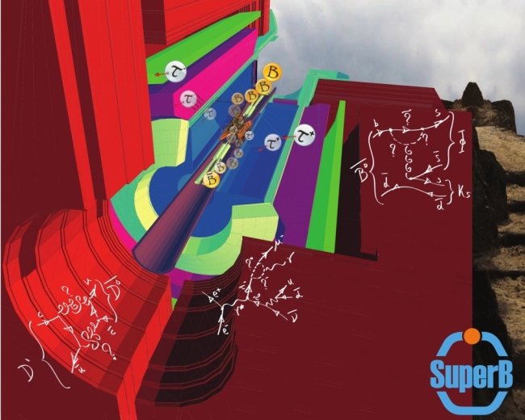
Physics Prospects
for the SuperB Factory
Kevin Flood
California Institute of Technology
SSP 2012
KVI – Gronigen, the Netherlands

Slide 2
Overview
SuperB at a Glance
Physics Prospects
Accelerator, Detector
Timeline, Funding
Further Reading
SSP 2012 – KVI
KEVIN FLOOD

Slide 3
SuperB at a Glance
Asymmetric e⁺e⁻ collider
E_{e-} ∼7 GeV, E_{e+} ∼4 GeV
Clean e⁺e⁻ initial state
>90% 4π acceptance in CMS
∼80% polarized electrons
Data-taking starting ∼2017
E_{CMS}: psi(3770) up to Y(5S)
psi(3770): coherent ccbar
Y(4S): coherent bb (B_{u} , B_{d})
Y(5S): coherent bb (B_{s})
all E_{CMS} : τ⁺τ⁻, continuum light quark (udsc) production
Luminosity ∼10³⁶ cm⁻² s⁻¹
Synchrotron light source?
psi(3770): ∼1 ab⁻¹ (few months)
Y(4S): ∼75 ab⁻¹ (∼6 years)
Y(5S): ∼1 ab⁻¹ (few months)
SSP 2012 – KVI
KEVIN FLOOD

Slide 4
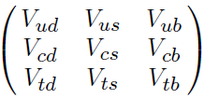
CKM Unitarity Triangle
*
**
*
**
SSP 2012 – KVI
KEVIN FLOOD

Slide 5
CKM Unitarity Triangle
SSP 2012 – KVI
KEVIN FLOOD

Slide 6
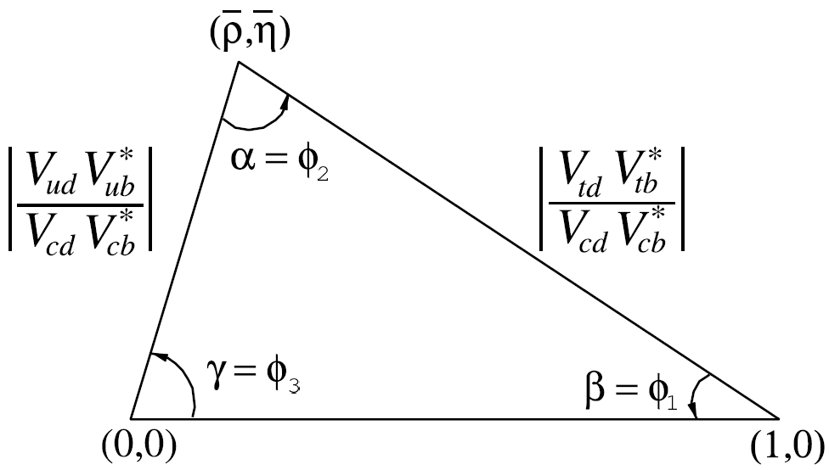
CKM Unitarity Triangle
SSP 2012 – KVI
KEVIN FLOOD

Slide 7
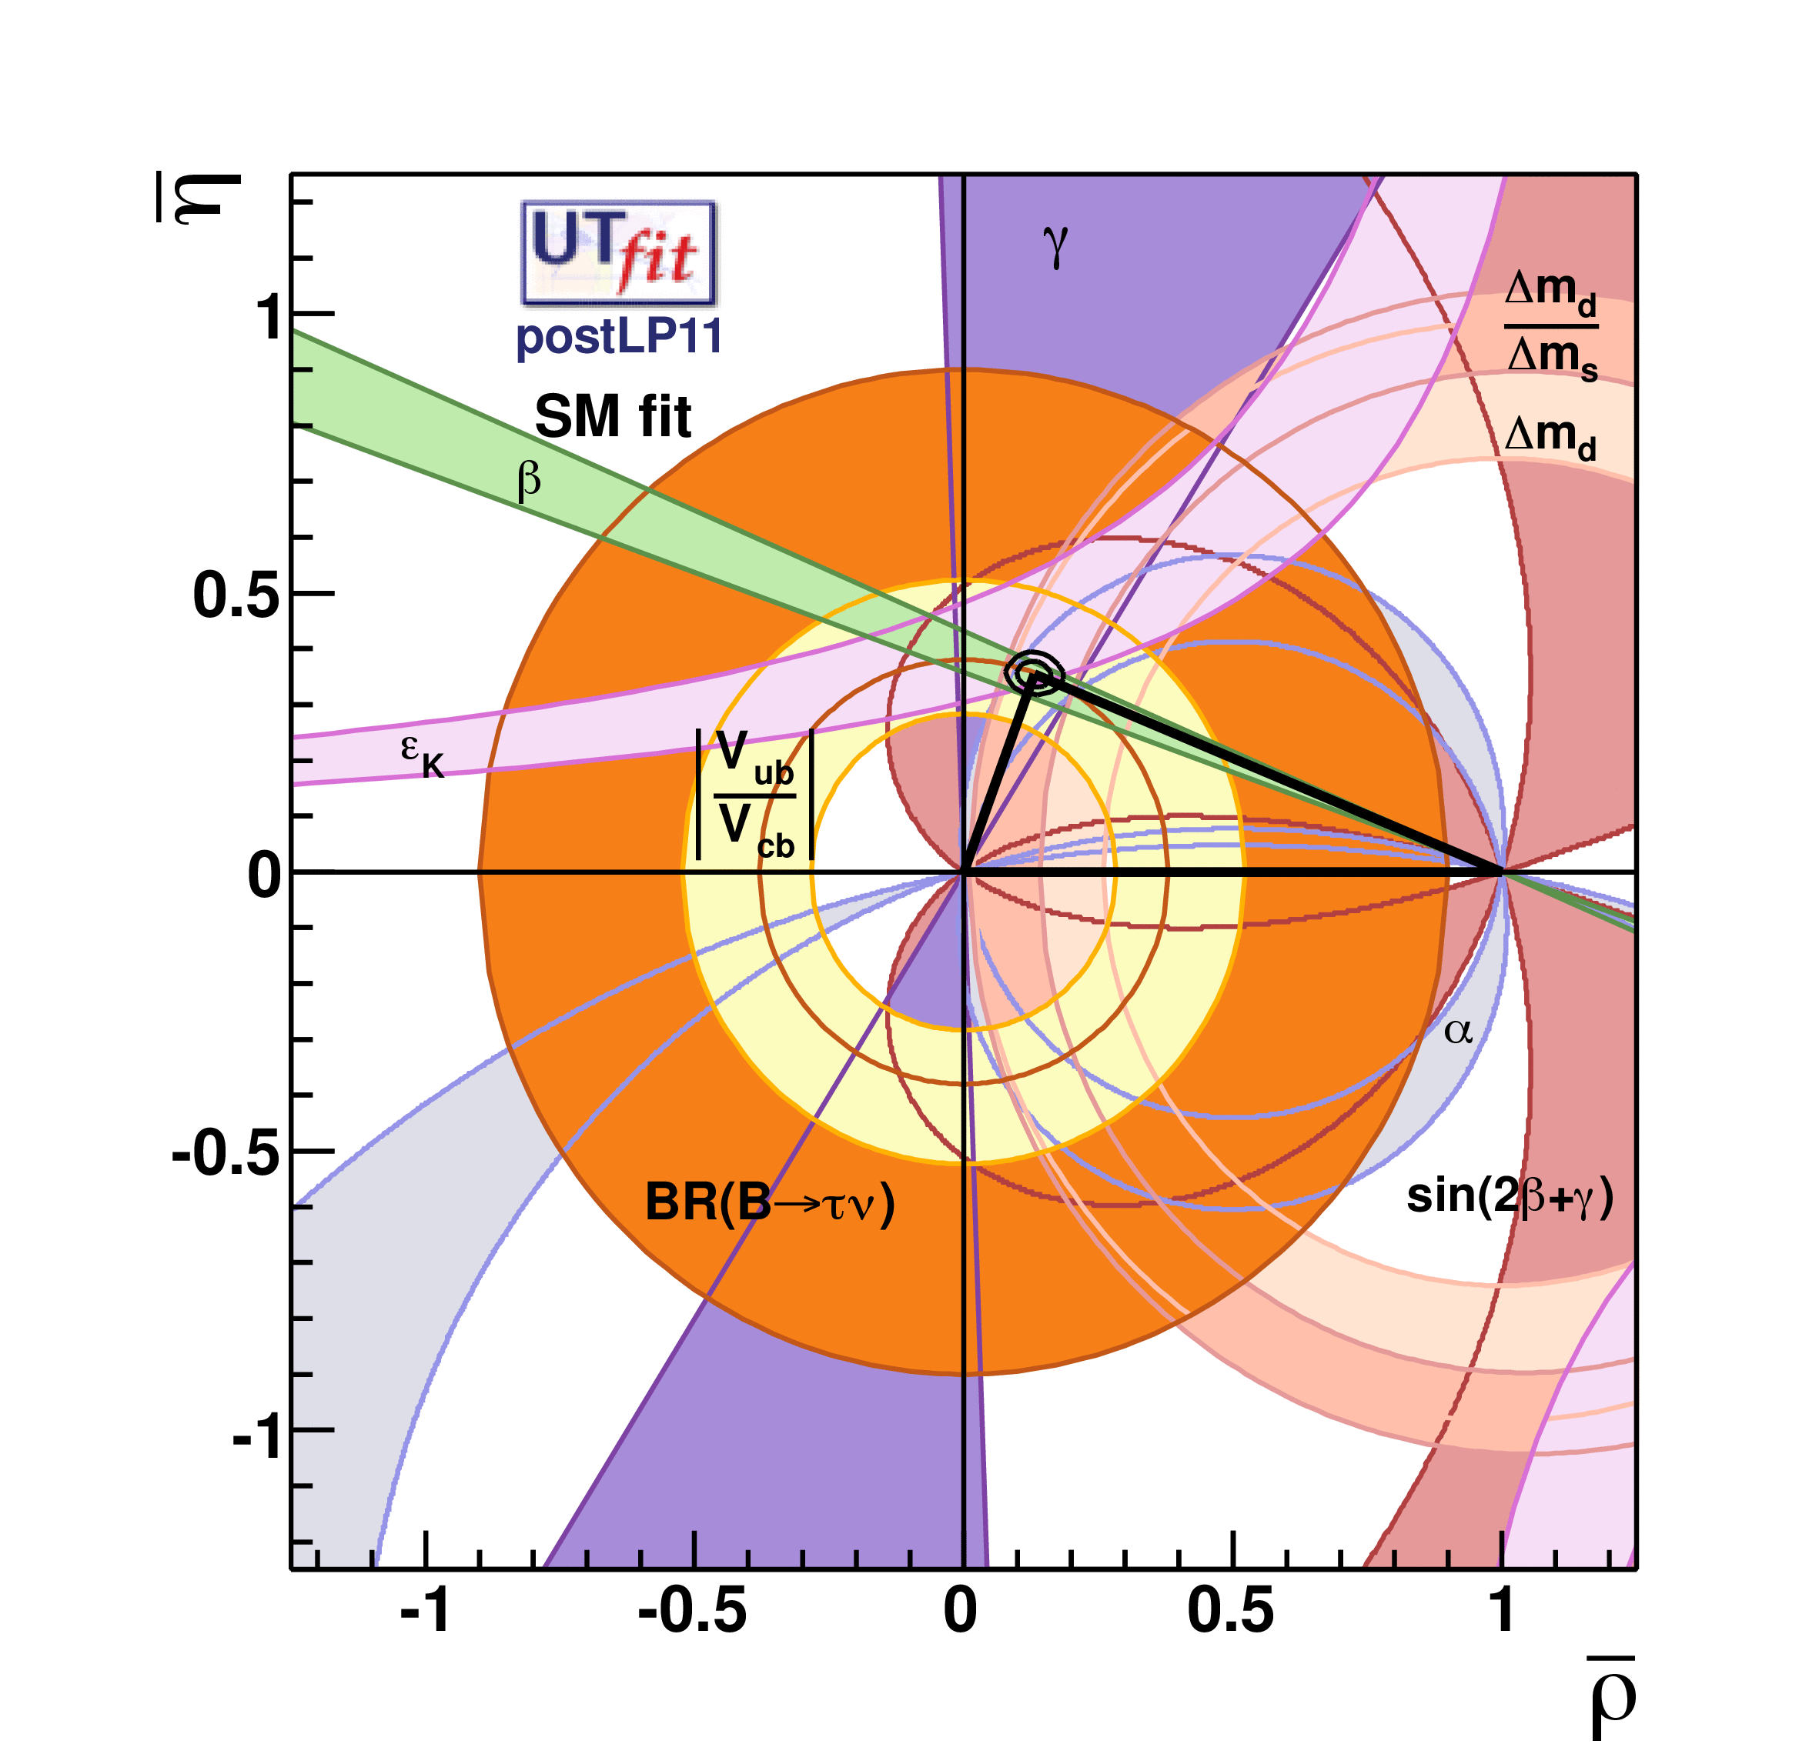
CKM Unitarity Triangle Experimental Constraints
Status of the UT after LP2011 from the combination of all results
The game is to over-constrain the UT by finding disagreement on the triangle’s closure by using independent measurements of the UT sides and angles
The Babar/Belle physics program resulted in confirmation of the KM mechanism as the source of CPV in the SM
2008 Nobel Prize to KM
http://www.utfit.org/UTfit/ResultsSummer2011PostLP
SSP 2012 – KVI
KEVIN FLOOD

Slide 8
Physics Prospects: CKM Unitarity Triangle After SuperB
Zoom in on the LP2011 UT first quadrant
NB: Super B plots based on older UT results
SuperB w/NP:
no global
overlap region
LP 2011
SuperB w/SM only: high precision overlap
SSP 2012 – KVI
KEVIN FLOOD

Slide 9
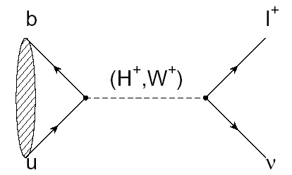
Physics Prospects: Rare Decays, B⁺ → τ⁺ ν
B_{τν}
r_{H}
B_{SM+NP}
lattice,
CKM inputs
B_{SM}
B⁺ → τ⁺ ν @ Babar (~0.5 ab⁻¹)
B⁺ → τ⁺ ν @ 75 ab⁻¹
Final Babar B⁺ → τ⁺ ν result using full
dataset will be released in 1-2 weeks!
2σ Excluded
3σ Excluded
Inclusive
V_{ub}
SuperB
Atlas exclusion limit computed using arXiv:0901.0512
SSP 2012 – KVI
KEVIN FLOOD

Slide 10
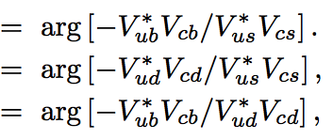
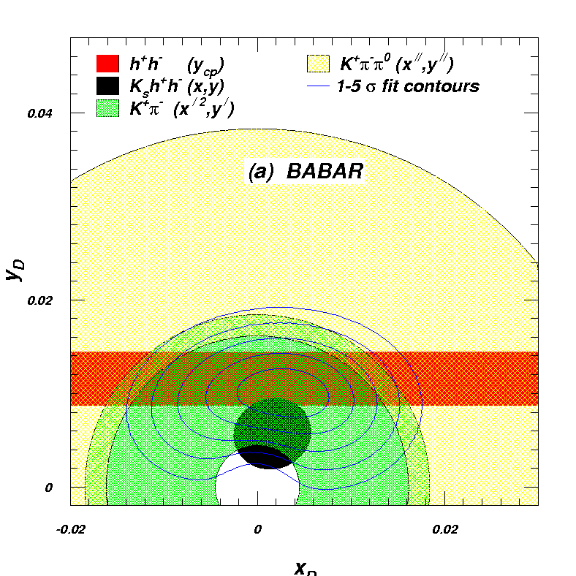
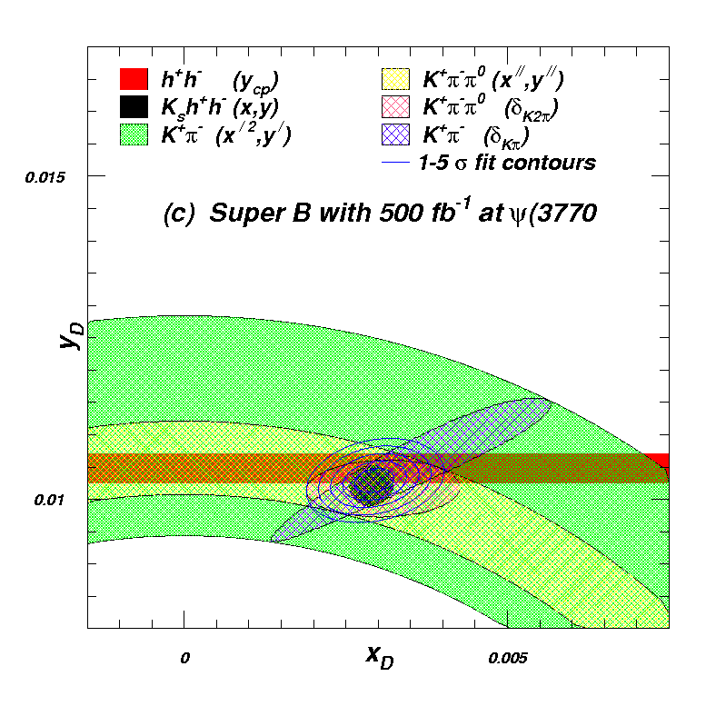
Physics Prospects: Charm Physics
SuperB will measure charm UT,
SM:
Coherent production at charm threshold will allow precision measurements of mixing parameters (x,y) and strong phases (δ)
0.04
0.015
Babar
)
y = ΔΓ / 2Γ
0.02
0.01
0
-0.02
0
0.02
0
x = ΔΜ / Γ
0.005
x = ΔΜ / Γ
SSP 2012 – KVI
KEVIN FLOOD

Slide 11
Physics Prospects: Tau Physics
Courtesy of A. Lusiani, Pisa, as shown at the most recent SuperB Collaboration Meeting (Elba, 1-4 June 2012)
SSP 2012 – KVI
KEVIN FLOOD

Slide 12
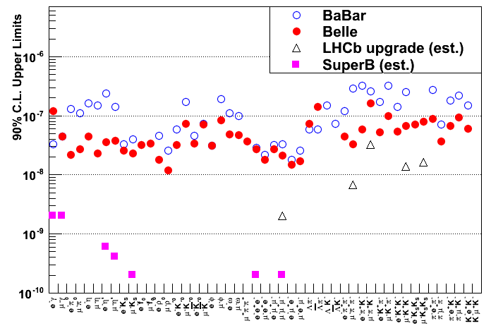
Physics Prospects: Tau Physics
SuperB will search for transitions and
e⁻ polarization can help in suppressing backgrounds in some modes
Searches in final states with little-to-no back-ground can improve by more than two orders of magnitude over Babar
Can hadron machines compete?
No! according to LHCb upgrade projections
Yes! according to W. Marciano’s talk yesterday (10⁻¹⁰ – 10⁻¹¹) ?
e,μγ
e,μη’
μK_{S}
eee
μμμ
SSP 2012 – KVI
KEVIN FLOOD

Slide 13
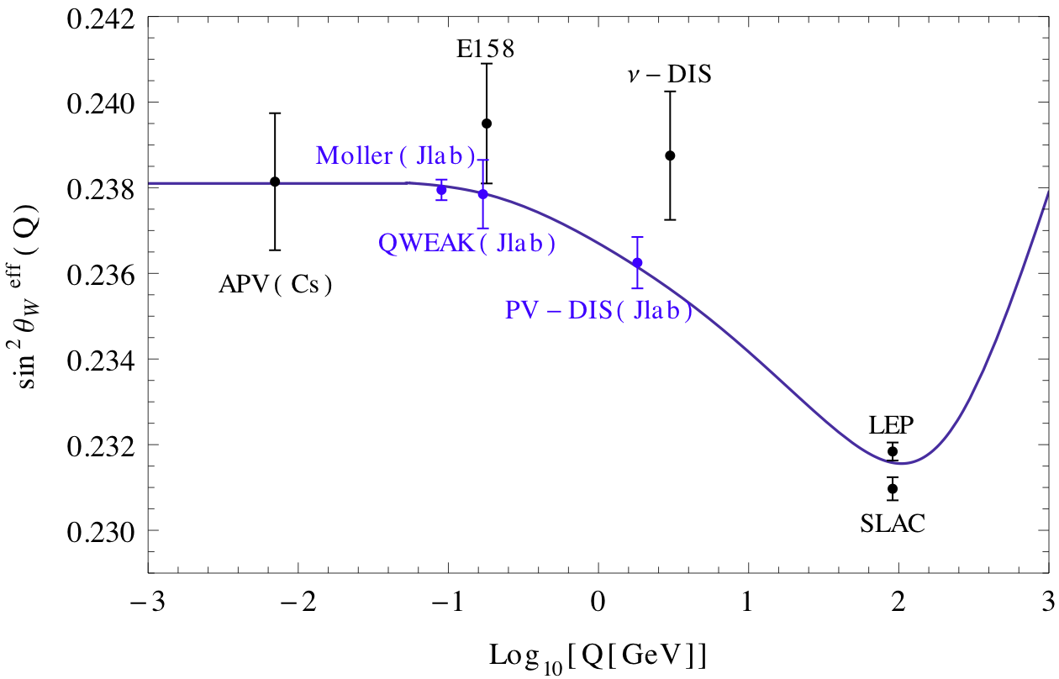
Physics Prospects: Precision Electroweak Physics
sin²θ_{W} can be measured with polarised e⁻ beam
√s=ϒ(4S) is theoretically clean, c.f. Z pole b-fragmentation at LEP/SLC
Simply need to measure event rates for left and right polarized beams
Measure LR asymmetry in
Done at the ϒ(4S) to the same precision as LEP/SLC at the Z-pole, also can have point at charm threshold
Precision is driven by the polarization measurement
Complements lower energy measurements
SuperB
Plot adapted from W. Marciano’s talk yesterday
SSP 2012 – KVI
KEVIN FLOOD

Slide 14
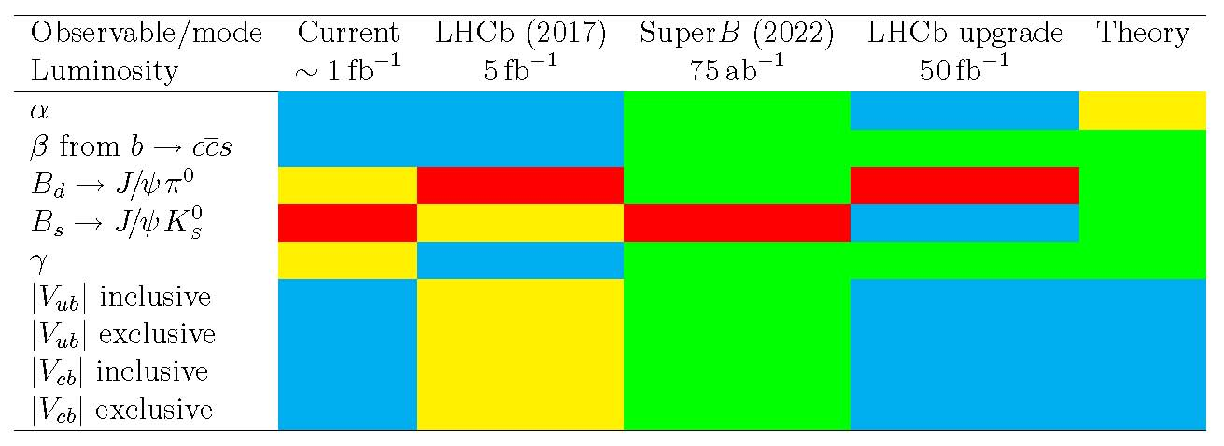
Complementarity: CKM Golden Modes, SuperB vs LHCb
Can make a straightforward comparison of the relative precision of CKM observables measured at SuperB (75 ab⁻¹) versus existing measurements, along with expectations from near-future LHCb (5 fb⁻¹) and after the LHCb upgrade (50 fb⁻¹)
ab⁻¹
(2028) 50 fb⁻¹
LHCb can only use ρπ
β theory error B_{d}
β theory error B_{s}
Need e⁺e⁻ environment to do high-precision measurements with semileptonic B decays
SSP 2012 – KVI
KEVIN FLOOD

Slide 15
Complementarity: Golden Modes in General, SuperB vs LHCb
A selection of other interesting modes/observables
(2028) 50 fb⁻¹
SuperB benefits from polarised e⁻ beam
Very precise with improved detector
Stat. limited, angular obs. OK @ 75ab⁻¹
Right handed currents
SuperB measures many more modes
Tagged analyses, low systematics
Inclusive analyses only possible @ e⁺e⁻
LHCb limited to μμ only
SuperB exploits coherent production
Theoretically clean
b fragmentation limits interpretation
SSP 2012 – KVI
KEVIN FLOOD

Slide 16
The Accelerator Scheme
General strategy:
Very small emittance (ILC-DR)
Small β* at IP
Crab waist technique
Large crossing angle
Currents similar to present accelerators
Advantages:
Small collision area
No parasitic crossings
No synchro-betatron resonances
Moderate backgrounds
Possible to reuse many components from PEP-II
LER
arc
HER
arc
HER Energy:
6.7 GeV
RF
FF
Polarization
80% for e⁻
l *~ 0.5m
I.P.
LER Energy:
4.2 GeV
e+
FF
e-
LER
arc
HER
arc
SSP 2012 – KVI
KEVIN FLOOD

Slide 17
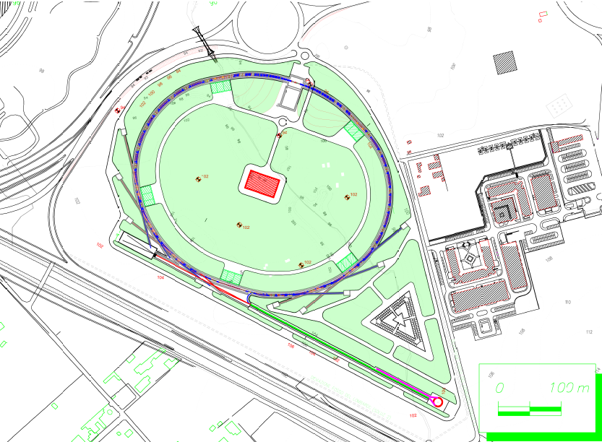
The Accelerator Complex at the Tor Vergata Campus (near Rome)
IR, Detector
SR Beamlines
SR Beamlines
Linac
0 100m
|---|---|
SSP 2012 – KVI
KEVIN FLOOD

Slide 18
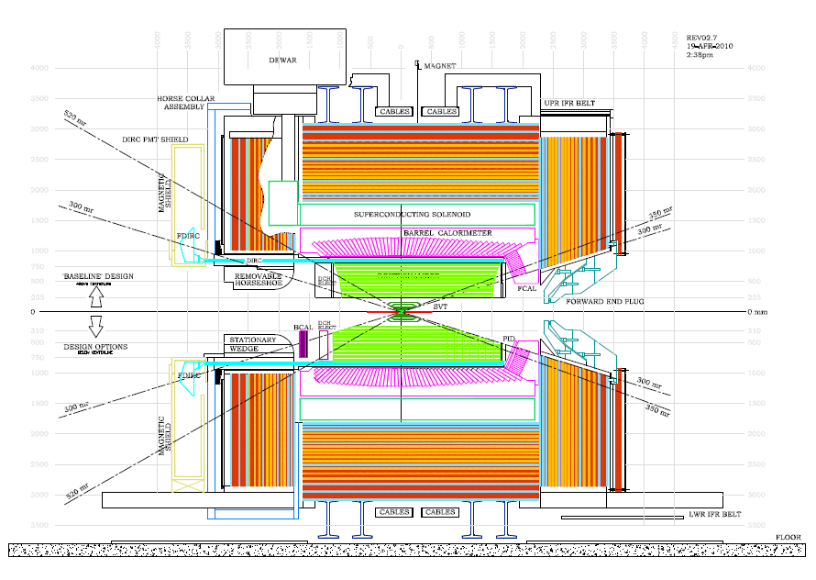
The SuperB Detector
Large pieces of BaBar will be reused in the SuperB detector:
Barrel, FWD ECAL
Solenoid
Flux Return
Muon System
Baseline
New backward ECAL
improves Xνν sensitivity
ECAL
e-
DCH
e+
SVT
Proposed
Improvements
New focusing RICH
detector provides PID
SSP 2012 – KVI
KEVIN FLOOD

Slide 19
The SuperB Timeline
SSP 2012 – KVI
KEVIN FLOOD

Slide 20
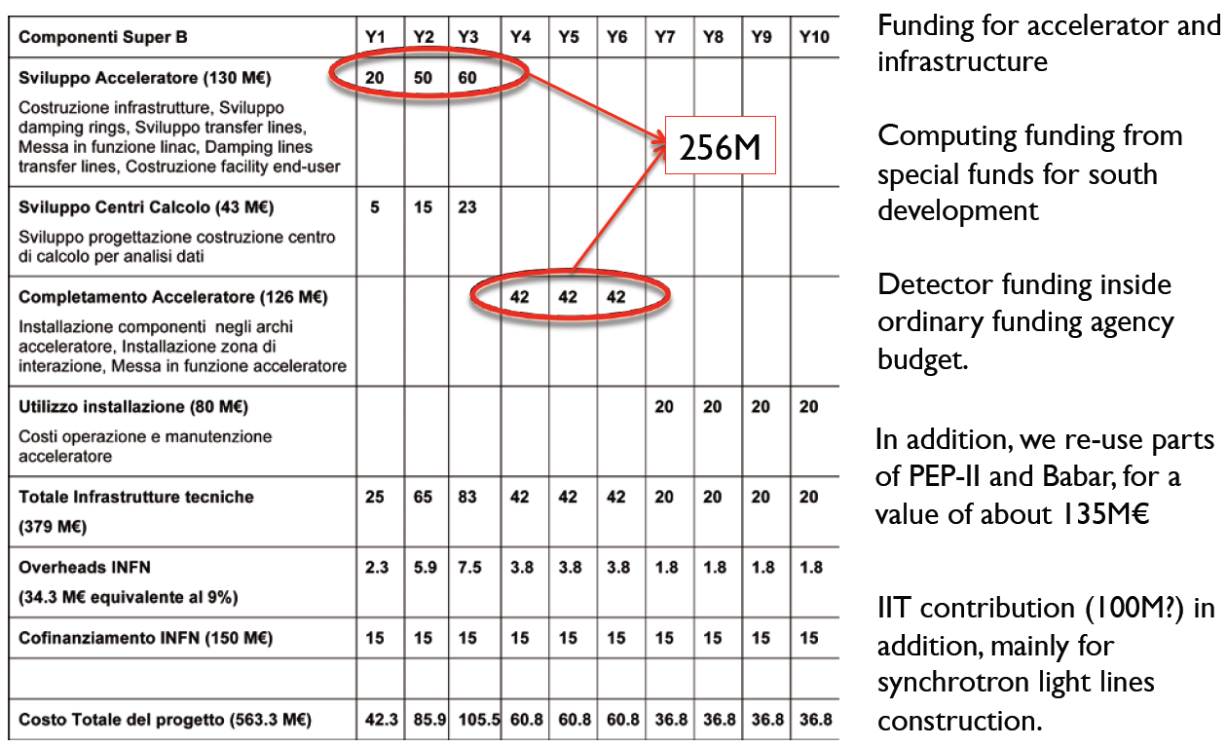
Funding in the INFN Multi-year Plan
Fully allocated
22M€ allocated
SSP 2012 – KVI
KEVIN FLOOD

Slide 21
Further Reading
Conceptual Design Report:
arXiv:0709.0451
Valencia Physics Workshop Report:
arXiv:0810.1312
Detector White Paper:
arXiv:1007.4241
Accelerator White Paper:
arXiv:1009.6178
Physics White Paper:
arXiv:1008.1541
Impact Document:
arXiv:1109.5028
Recent Review:
arXiv:1110.3901
Technical Design Report on target
for completion in Sept-Oct 2012
SSP 2012 – KVI
KEVIN FLOOD

Slide 22
BACKUP SLIDES
La Thuile 2012
Kevin Flood

Slide 23
The Projected SuperB Dataset
Physics dictates 75 ab⁻¹ at the ϒ(4S) + 0.5-1 ab⁻¹ at/near ψ(3770)
At ϒ(4S): ~75 x10⁹ B, D and τ pairs
Will also run at the ϒ(5S) and above, as well as off-resonance running
~80% e- polarization will improve S:B in studies of LFV in the tau sector
At ψ(3770): few x 10⁹ D pairs
Also will run at nearby resonances
Total 0.5 ab⁻¹ collected in several months running
SSP 2012 – KVI
KEVIN FLOOD

Slide 35
The quest for the final angle of the CKM matrix: β_{c}
The charm cu triangle has one unique element: β_{c}
Precision measurement of mixing phase in many channels (<2°)
Constrain β_{c,eff} using a Isospin analysis
Search for NP and constrain β_{c,eff} ~ 1°.
Can only fully explore in an e⁺e⁻ environment.
Data from the charm threshold region completes the set of 5 |V_{ij}| to measure: needs SuperB to perform an indirect test of the triangle.
Bevan, Inguglia, Meadows, PRD 84 114009 (2011)

Slide 36
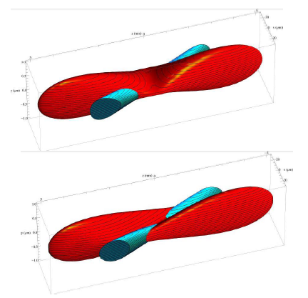
A SuperB Innovation: The Crab Waist Final Focus
Raimondi, Shatilov, Zobov http://arxiv.org/abs/physics/0702033
Make the final focus so that only a small fraction of one bunch collides with the other bunch
Large crossing angle
Long bunch length
No parasitic crossings
Due to the large crossing angle the effective bunch length (the colliding part) is now very short so we can lower β_{y}* by a factor of 50
The beams must have very low emittance, like present day light sources
The x size at the IP now sets the effective bunch length
In addition, by crabbing the magnetic waist of the colliding beams we greatly reduce the tune plane resonances enabling greater tune shifts and better tune plane flexibility
Crab‐sextupoles off: waist line is orthogonal to the axis of the beam
Crab‐sextupoles on: waist moves parallel to the axis of other beam: maximum particle density in the overlap between bunches
SSP 2012 – KVI
KEVIN FLOOD

Slide 37
Luminosity Profile: SuperB vs. Super-Belle
SuperB design and max instantaneous luminosity will exceed Belle-II
SuperB: >10³⁶
Belle-II: ~0.810³⁶
Both machines expect turn- on about 2016-2017
By 2022-2023:
SuperB: 75 ab⁻¹
Belle-II: 50 ab⁻¹
Belle-II uses up-date of current KEK machine, polarized beam, charm threshold running are not possible
SuperB
Belle-II
SSP 2012 – KVI
KEVIN FLOOD

