Slide 1


CP Violation at LHCb
Marcel Merk
5-th International Symposium on
Symmetries in Subatomic Physics (SSP2012)
June 18 - 22, Groningen

Slide 2
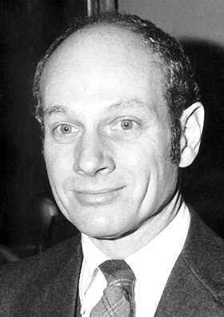
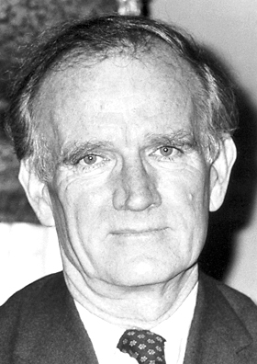
A slide of History
Charge Parity Violation in particle physics
  1964 (CCFT): Discovered in neutral Kaon beam “indirect CP violation”
    Also called: CPV in mixing
    Prob(K⁰→K⁰) ≠ Prob (K⁰→K⁰)
    |ε|= (2.228 ± 0.011 ) x 10⁻³ (PDG)
  1999 (NA48 & KTeV): Seen in Kaon decays
  “direct CP violation”
    Also called: CPV in decay
    Decay rates Γ(K⁰→π⁺π⁻) ≠ Γ(K⁰→π⁺π⁻)
    Re(ε’/ε) = (1.65 ± 0.26) x 10⁻³ (PDG)
  2001 (Belle & Babar): Observed in B mesons decays “CP violation in interference”
    Also called: mixing induced CPV
    Sin2β = 0.673 ± 0.023 (PDG)
James Watson Cronin
Val Logsdon Fitch
➔ Nobel prize 1980

Slide 3
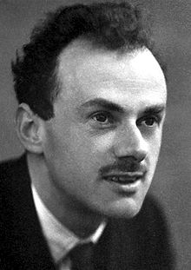
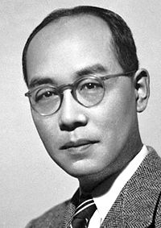
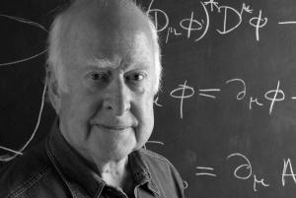
CP Violation in the Standard Model
Paul Dirac
Peter Higgs
Hideki Yukawa
The Yukawa flavour couplings Y_{ij} make the theory CP violating if they are complex.
After Spontaneous Symmetry Breaking the Yukawa terms give rise to quark masses.
Expressing the quark flavour eigenstates in mass eigenstates leads to CP violating flavour changing charged currents.
The origin of CP violation is related to the origin of mass and requires the existence of at least 3 generations

Slide 4
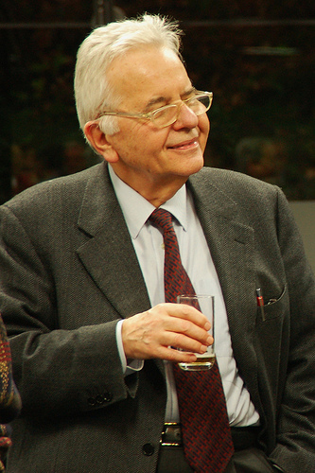
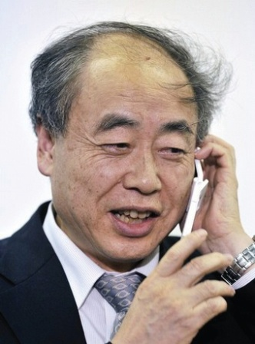
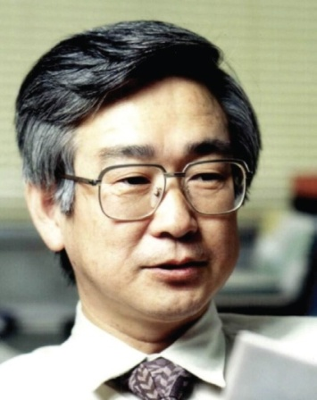


Interactions between Quarks
Cabibbo described “V-A” quark interactions with flavour changing charged currents:
➔ quark mixing
u , c , t
W
J^{μ+}
g_{weak}
d , s , b
Particle →Antiparticle
g_{weak}→g*_{weak}
Nicola
Cabibbo
Makoto
Kobayashi
Toshihide
Maskawa
Kobayashi and Maskawa predicted in 1972 the 3rd quark generation to explain CP-Violation within the Standard Model
➔ Nobel Prize 2008 (shared with Nambu)
9 Coupling constants:
g_{weak} → g ∙ V_{CKM}

Slide 5
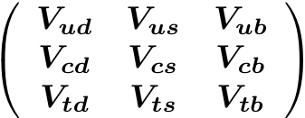
The CKM Matrix V_{CKM}
d s b
u
c
t
Notes:
This is the three by three matrix. It represents the strength with which the different quark flavours couple to the W boson.

Slide 6
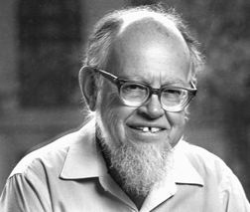
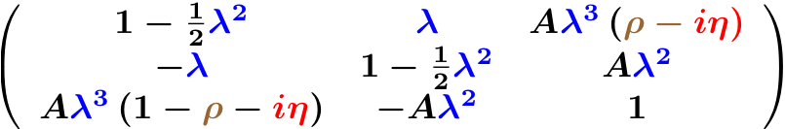
The CKM Matrix V_{CKM}
d s b
u
c
t
Wolfenstein parametrization: V_{CKM}
From unitarity (V_{CKM} V†_{CKM}=1)
CKM has four free parameters:
3 real: λ (≈0.22) , A (≈ 1), ρ
1 imaginary: iη
Particle → Antiparticle: V_{ij} → V_{ij}*
=> 1 CP Violating phase
Notes:
This is the three by three matrix. It represents the strength with which the different quark flavours couple to the W boson.

Slide 7
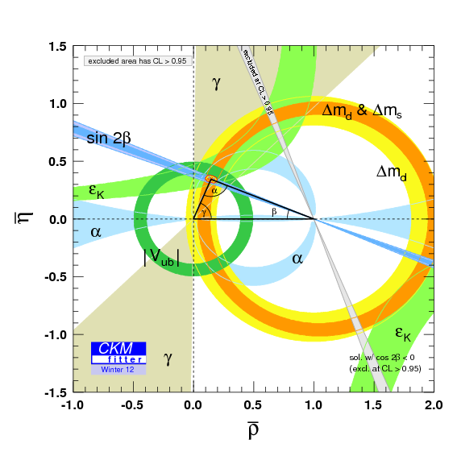
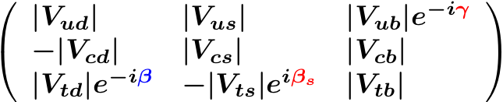
The CKM Matrix V_{CKM}
d s b
u
c
t
Wolfenstein parametrization: V_{CKM}
Notes:
This is the three by three matrix. It represents the strength with which the different quark flavours couple to the W boson.

Slide 8
Observing CP Violation in B decays
CP Violation occurs in interference of two quantum amplitudes that have a different CP odd (as well as CP even) phase
  Use the phenomenon of B-B mixing:
  Interference of direct decay and decay via mixing leads to CP violation.
  Standard Model:
    B⁰-B⁰ phase ϕ_{d} = arg(V_{td}) = 2β
    B_{s}-B_{s} phase ϕ_{s} = arg(V_{ts}) = 2β_{s}
Notes:
Here is a Feynman diagram indicating why Bs->Ds K is sensitive to angle gamma, due to the fact that there is a Vub coupling involved.

Slide 9
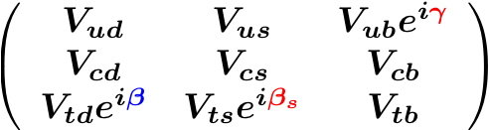
Observing CP Violation in B decays
CP Violation occurs in interference of two quantum amplitudes that have a different CP odd (as well as CP even) phase
  Use the phenomenon of B-B mixing:
  Interference of direct decay and decay via mixing leads to CP violation.
  Standard Model:
    B⁰-B⁰ phase ϕ_{d} = arg(V_{td}) = 2β
    B_{s}-B_{s} phase ϕ_{s} = arg(V_{ts}) = 2β_{s}
B⁰
f_{CP}
iϕ_{d}
e
B⁰
B_{s}
f_{CP}
iϕ_{s}
e
B_{s}
Notes:
Here is a Feynman diagram indicating why Bs->Ds K is sensitive to angle gamma, due to the fact that there is a Vub coupling involved.

Slide 10
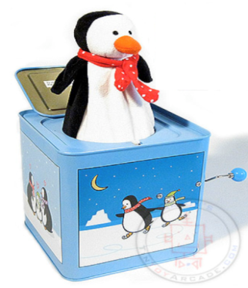

Probing new physics
Flavour Physics: indirect search for new particles or interactions
  Measure CP violation in many B, D decay modes
    All observations should be consistent with a single CP phase
  Measure branching rates of decays that are suppressed in SM
Look for interference of CKM physics with New Physics
  Expect sensitivity for new physics where SM amplitudes are suppressed: loop diagrams
  Measure CP phases “with tree decays” and “with loops”
“Box” diagram: ΔB=2
“Penguin” diagram: ΔB=1
b
s
b
s
s
b
μ
μ

Slide 11
Classification of CP Violation Methods @ LHCb
Many methods have been developed for B decays
The classification direct and indirect is no longer sufficient
  E.g.: methods with intermediate Charm states
We use also experimental classifications
  “Time dependent” vs “Time independent” methods
    Observe CP Violation as function of B-decay time vs integrated over time
  “Tagged” vs “Untagged” methods
    Require knowledge of b-flavour at production or not
I can’t give a complete overview
  Examples of several prominent ongoing analyses

Slide 12
CP Violation Measurements @ LHCb
Time Integrated measurements:
  (1) Direct CP Violation in charmless decay B_{(s)}→Kπ
    Interference of trees with penguins
  (2) CP Violation in charmed B decays: B⁻→D⁰K⁻ and B⁻→D⁰π⁻
    Measurement of “ γ with trees” using ADS/GLW method
Time dependent measurements (interference of mixing and decay):
  (3) CP violation in charmless B_{(s)} decays B_{s}→K⁺K⁻ and B→π⁺π⁻
    Measurement of “ γ with loops”
  (4) CP Violation in charmed B_{s} Decays B_{s}→D_{s}K
    Measurement of “γ with trees”
  (5) CP Violation in B_{s} decays to CP eigenstate B_{s}→J/ψ ϕ
    Measurement of B_{s} mixing phase Φ_{s} (β_{s})
A charming surprise: CP Violation in charm
  (6) CP Violation in two-prong hadronic D⁰ decays
    Measurement of ΔA_{CP}, difference of CP violation in D⁰→K⁺K⁻ and D⁰→π⁺π⁻

Slide 13
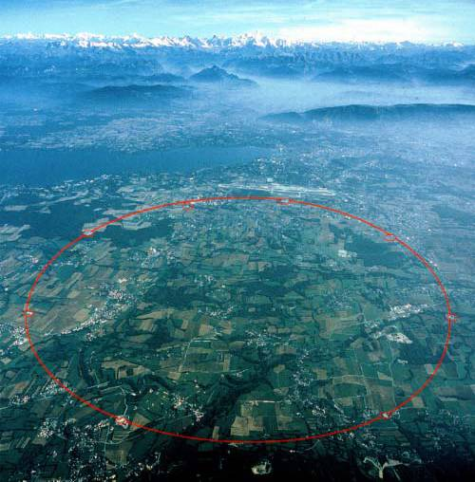
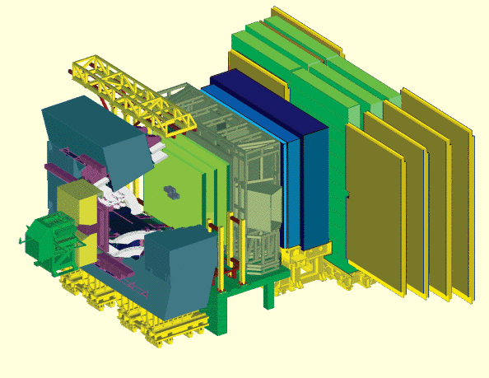
LHCb @ LHC
CERN
LHCb
ATLAS
CMS
ALICE

Slide 14
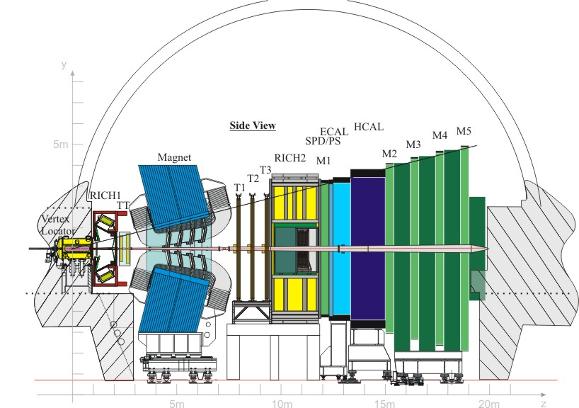

B Physics @ LHCb
K⁺
B_{s}
Background Suppression
Flavour tagging
Decay time measurement
K⁺
D_{s}
K⁻
Primary vertex
π⁻
b^{tag}
~1 cm
Vertex and momenta reconstruction
Particle identification (π, К, μ, е, γ)
Trigger
Design:
LHCb event rate: ~30 MHz
1 in 160 is a b-b event
10¹² b-b events per year

Slide 15
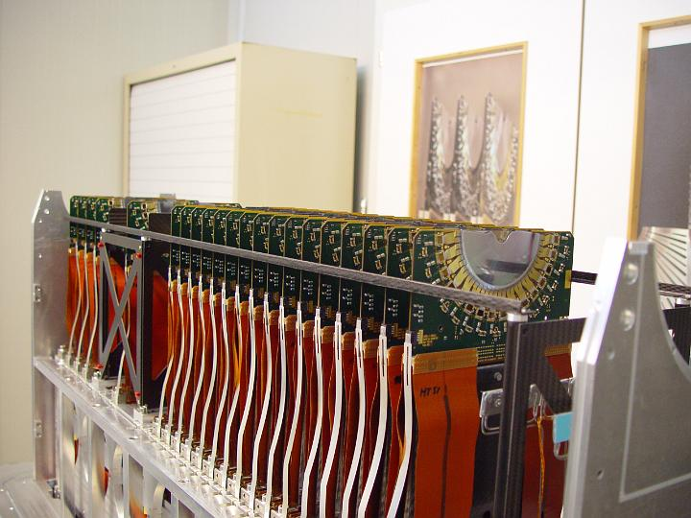
Vertex Topology
Vertex Locator

Slide 16
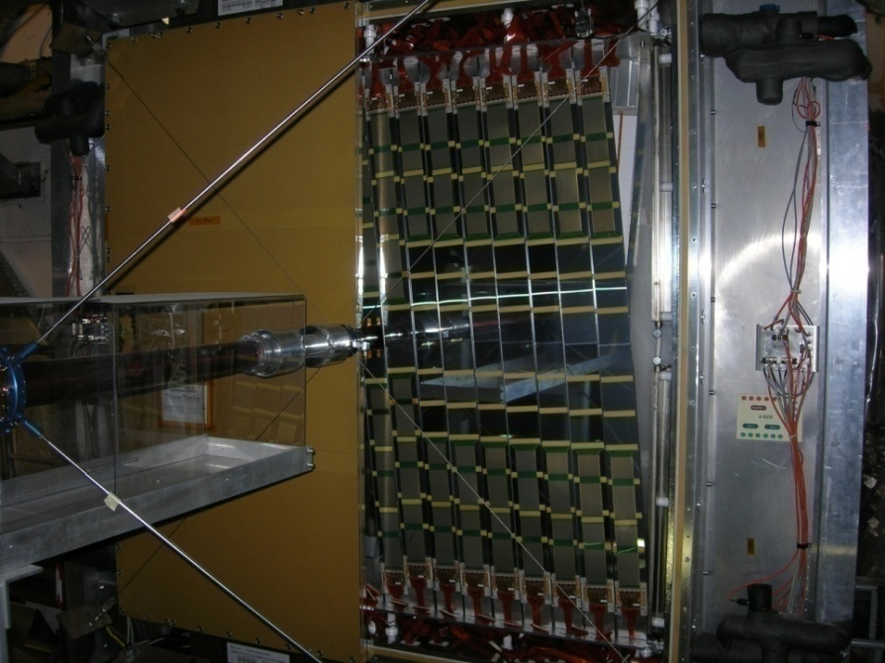
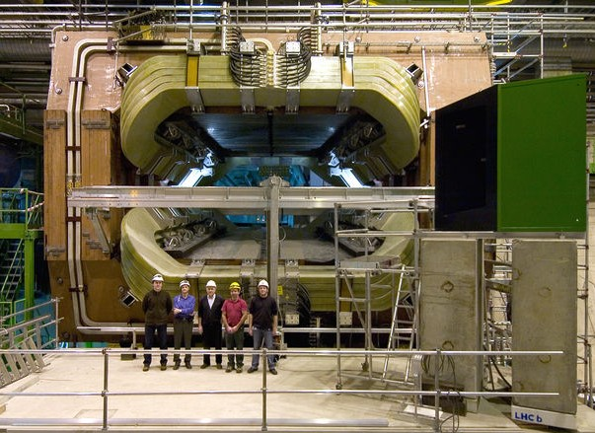
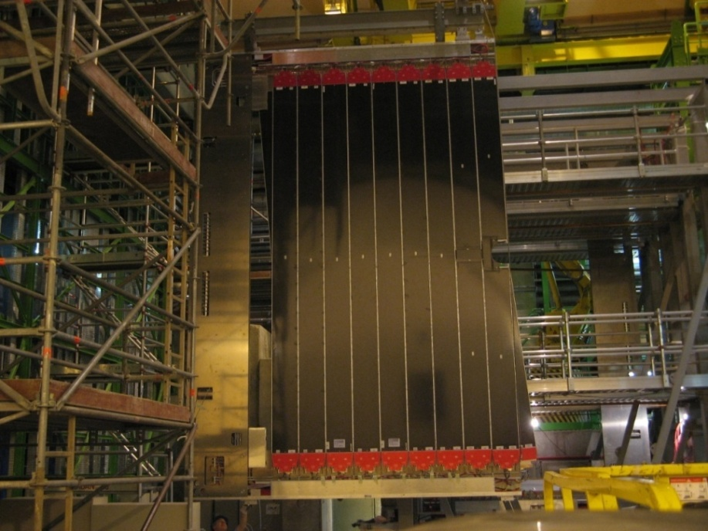
Momentum and Mass Reconstruction
Trigger Tracker
Magnet
Outer Tracker

Slide 17
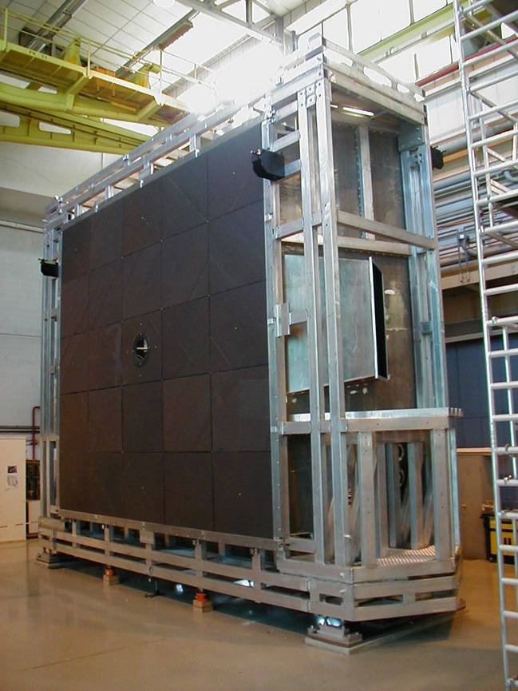
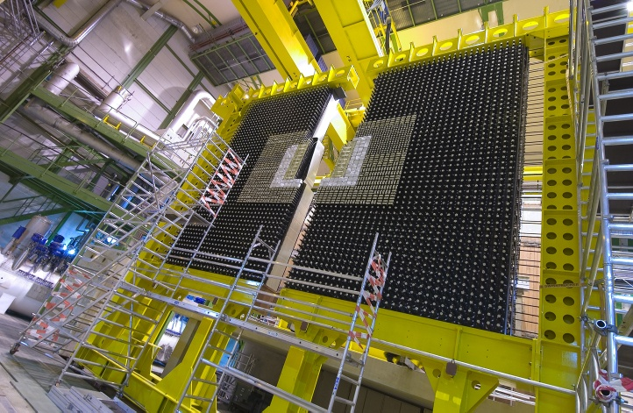
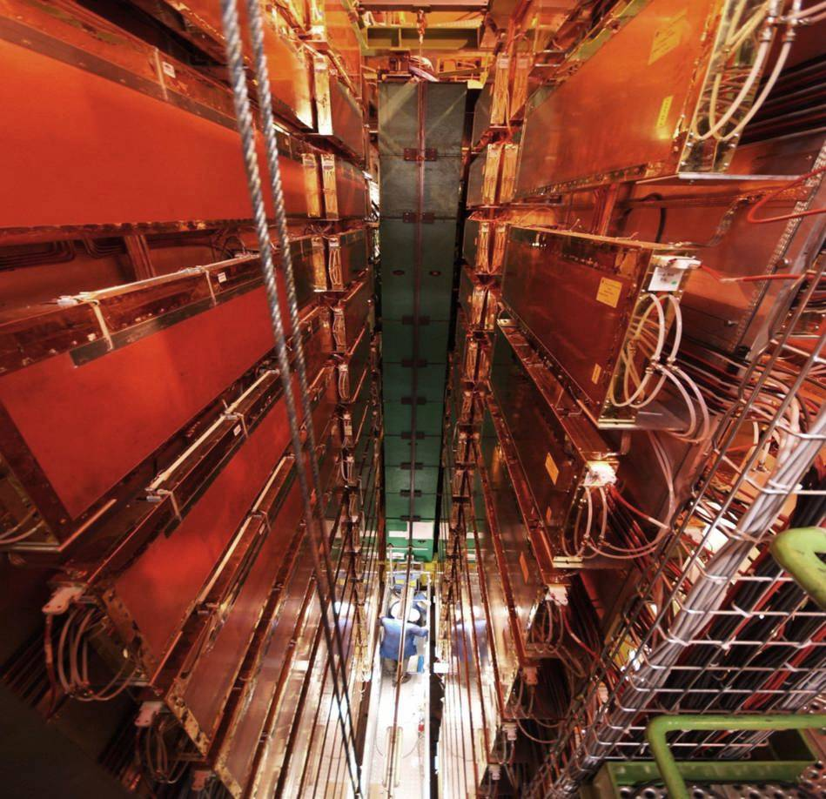
Particle Identification: π, K, μ, γ, e
RICH
Calorimeter
Muon

Slide 18



The LHCb Detector
23 sep 2010 19:49:24
Run 79646 Event 143858637
18

Slide 19
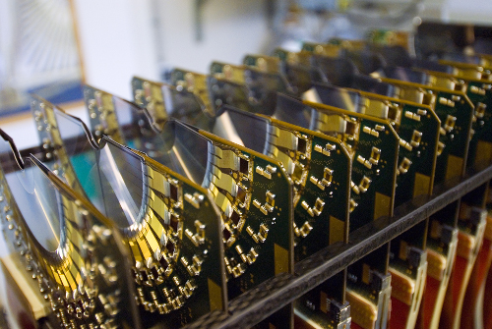

The LHCb Detector
23 sep 2010 19:49:24
Run 79646 Event 143858637
19

Slide 20
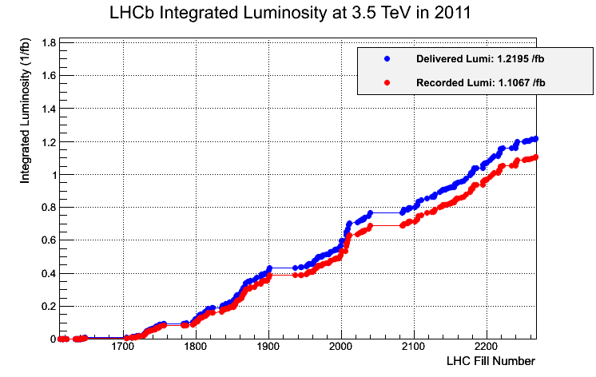
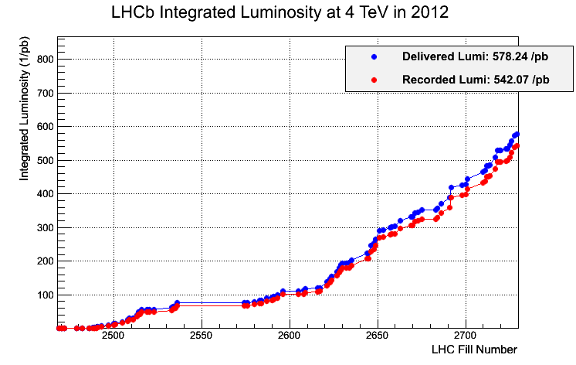
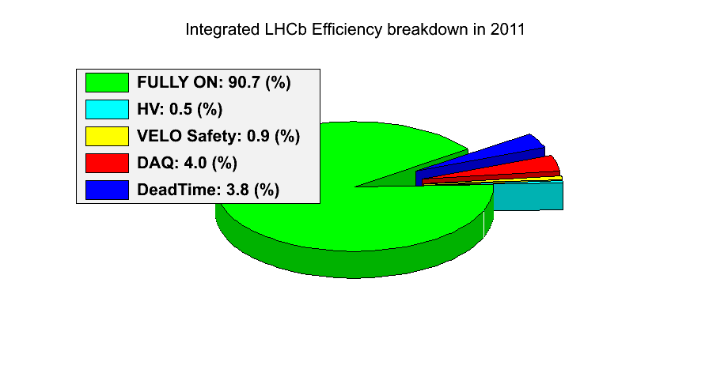
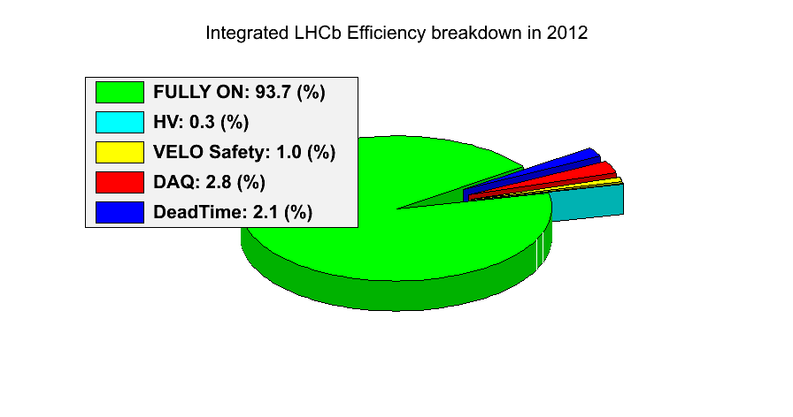
LHCb Running
2011
2012
1.1 fb⁻¹
0.5 fb⁻¹
(Expect 1.5 fb⁻¹)

Slide 21
CP Violation Measurements @ LHCb
Time Integrated measurements:
  (1) Direct CP Violation in charmless decays B_{(s)}->Kπ.
  (2) CP Violation in charmed decays B⁻→D⁰K⁻ and B⁻→D⁰π⁻
Time dependent measurements (interference of mixing and decay):
  (3) CP violation in charmless B_{(s)} decays B_{s}→KK and B→ππ
  (4) CP Violation in charmed B_{s} decays B_{s}→D_{s} K
  (5) CP Violation in B_{s} decays to CP eigenstate B_{s}→J/ψ φ
CP Violation in mixing
  (6) A charming surprise

Slide 22
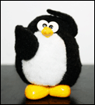
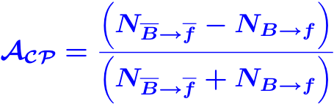

(1) Direct CP Violation with B_{(s)}→ Kπ
+
γ
Interference of trees and penguins
  New physics can contribute to penguin loop
Sensitive to V_{ub} phase: CKM angle γ
Measure the untagged CP asymmetry for B⁰ and B_{s} decays:
(The correction factor is ~1%,
measured from data)
Instrumental
asymmetry
Mixing dilution times
production asymmetry
Notes:
The instrumental asymmetry is controlled using charm decays and magnet polarity reversion. The production asymmetry is measured using B->J/psi K* times the mixing dilutions using world averages.

Slide 23
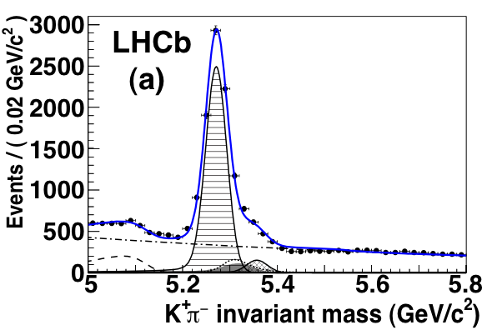
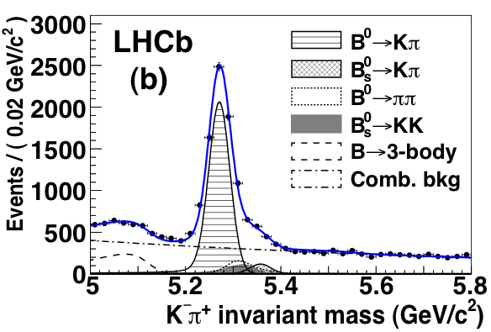
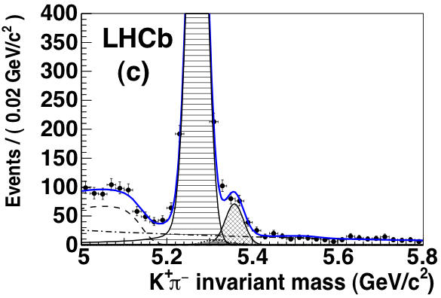
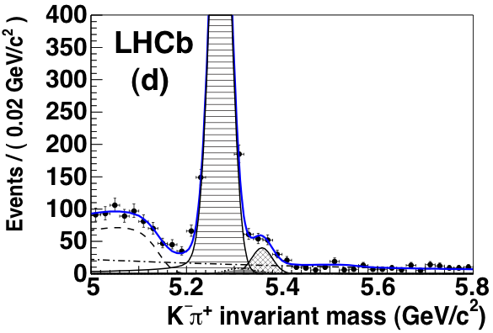
(1) Direct CP Violation with B_{(s)}→ Kπ
+
γ
B⁰ → K π
PRL 108.201601
A_{CP} = -0.088 ± 0.011 ± 0.008
0.35 fb⁻¹
Most precise and first 5σ
observation of CP violation
in a hadronic machine
B⁰ → K⁺ π⁻
B⁰ → K⁻ π⁺
B_{s} → π K
PRL 108.201601
0.35 fb⁻¹
A_{CP} = 0.27 ± 0.08 ± 0.02
B_{s}⁰ → K⁺ π⁻
B_{s}⁰ → K⁻ π⁺
First 3σ evidence for
CP asymmetry in B_{s} decays
Notes:
Direct CP Violation

Slide 24
CP Violation Measurements @ LHCb
Time Integrated measurements:
  (1) Direct CP Violation in charmless decays B_{(s)}->Kπ.
  (2) CP Violation in charmed decays B⁻→D⁰K⁻ and B⁻→D⁰π⁻
Time dependent measurements (interference of mixing and decay):
  (3) CP violation in charmless B_{(s)} decays B_{s}→KK and B→ππ
  (4) CP Violation in charmed B_{s} decays B_{s}→D_{s} K
  (5) CP Violation in B_{s} decays to CP eigenstate B_{s}→J/ψ φ
CP Violation in mixing
  (6) A charming surprise

Slide 25
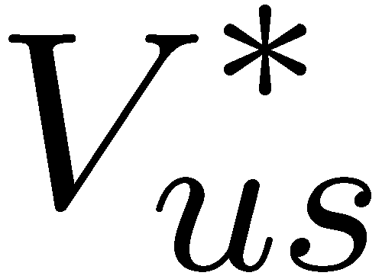
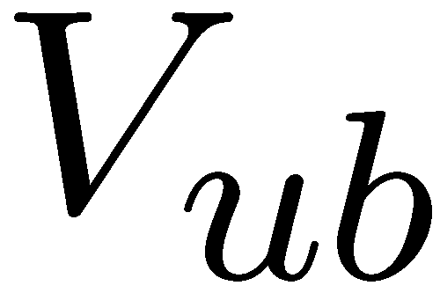



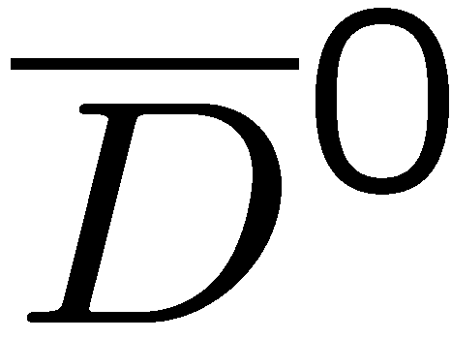



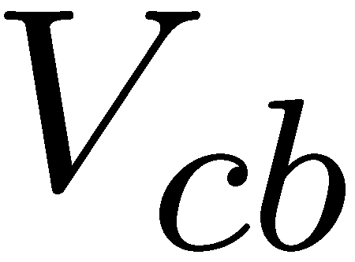



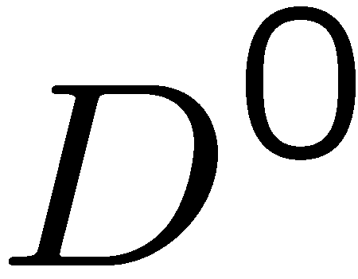
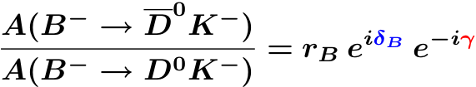
(2) The GLW/ADS method with B→DK and B→Dπ
Interfere decays b→c with b→u
to final states common to D⁰ and D⁰
color
suppression
Notes:
Self tagging modes from kaon charge: B-→K-, B+→K+, B0→K*(K+pi-)
Gronau London Wyler – triangle relations difficulty: rB? Semileptonic decay with huge background.
Atwood Dunietz Soni

Slide 26



(2) The GLW/ADS method with B→DK and B→Dπ
Interfere decays b→c with b→u
to final states common to D⁰ and D⁰
color
suppression
GLW method:
f_{D} is a CP eigenstate common to
D⁰ and D⁰: f_{D}= K⁺K⁻, π⁺π⁻,…
Measure: B→D⁰K, B → D⁰K, B→ D₁K
Large event rate; small interference
b→c favoured
D⁰K–
B–
f_{D}K–
Gronau, London, Wyler:
Phys. Lett. B 265, 172 (1991)
D⁰K–
Observables:
b→u suppressed
Unknown phases:
Weak phase γ
Strong phase δ_{B}
Notes:
Self tagging modes from kaon charge: B-→K-, B+→K+, B0→K*(K+pi-)
Gronau London Wyler – triangle relations difficulty: rB? Semileptonic decay with huge background.
Atwood Dunietz Soni

Slide 27

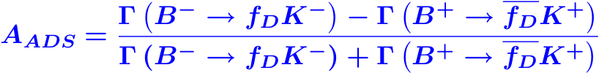
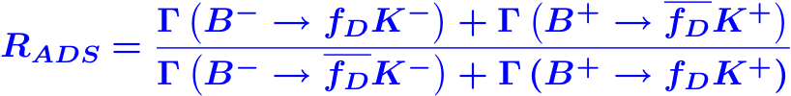
(2) The GLW/ADS method with B→DK and B→Dπ
Interfere decays b→c with b→u
to final states common to D⁰ and D⁰
color
suppression
ADS method:
Use common flavour state f_{D}=(K⁺ π –) Note: decay D⁰→K⁺π– is double Cabibbo suppressed
Lower event rate; large interference
b→c favoured
Cabibbo supp.
D⁰K–
B–
f_{D}K–
Atwood, Dunietz, Soni:
Phys Rev Lett 78, 3257 (1997)
Phys Rev D 63, 036005 (2001)
D⁰K–
Observables:
b→u suppressed
Cabibbo allowed.
Unknown phases:
Weak phase γ
Strong phase δ_{B} , δ_{D}
Notes:
Self tagging modes from kaon charge: B-→K-, B+→K+, B0→K*(K+pi-). Gronau London Wyler – triangle relations difficulty: rB? Semileptonic decay with huge background.
Atwood Dunietz Soni. It leads to a future extraction of gamma from combined analyses.

Slide 28
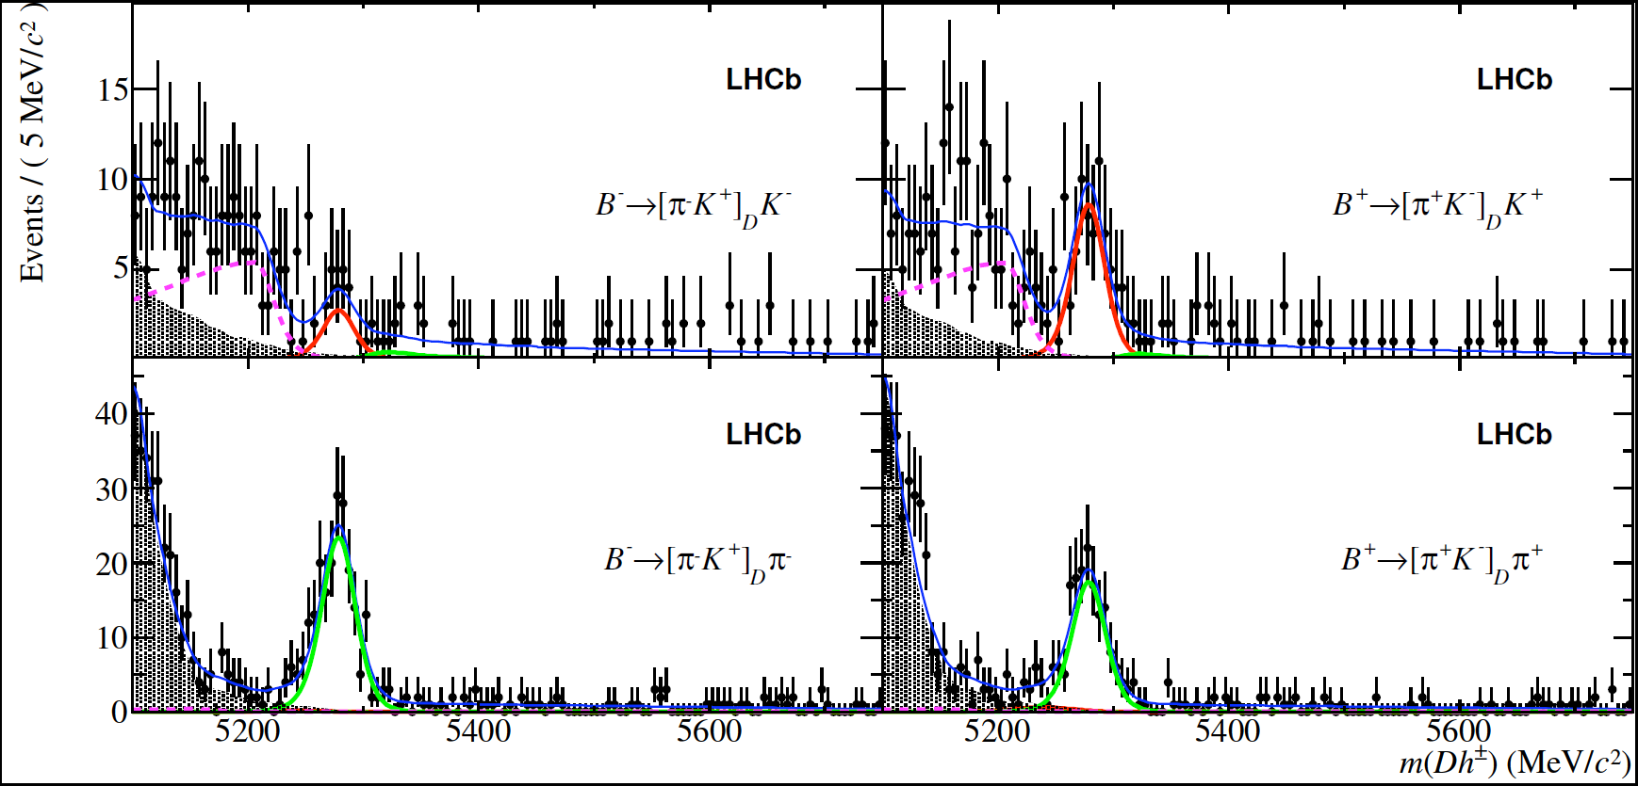
(2) The GLW/ADS method with B→DK and B→Dπ
Observe ADS mode B⁻→[π⁻K⁺]_{D} K⁻ with 10 σ significance
arXiv:1203:3662
LHCb: 1.0 fb⁻¹
B⁻→[π⁻K⁺]_{D} K⁻
B⁺→[π⁺K⁻]_{D} K⁺
B→DK
B⁻→[π⁻K⁺]_{D} π⁻
B⁺→[π⁺K⁻]_{D} π⁺
B→Dπ
B→DK shows 4.0 σ evidence of CPV:
B→Dπ shows 2.4σ hint of possible asym:
A_{ADS}(K) = -0.52 +- 0.15 +- 0.02
R_{ADS}(K) = 0.015 +- 0.002 +- 0.000
A_{ADS}(π) = 0.14 +- 0.06 +- 0.01
R_{ADS}(π) = 0.0041 +- 0.0003 +- 0.0001
Notes:
Production asymmetry and detection effects are below the 1% level each and included in the systematic error.
A_CP+ (GLW) gives a 4.5 sigma asymmetry. In total 5.8 sigma CP violation observed.

Slide 29
CP Violation Measurements @ LHCb
Time Integrated measurements:
  (1) Direct CP Violation in charmless decays B_{(s)}->Kπ.
  (2) CP Violation in charmed decays B⁻→D⁰K⁻ and B⁻→D⁰π⁻
Time dependent measurements (interference of mixing and decay):
  (3) CP violation in charmless B_{(s)} decays B_{s}→KK and B→ππ
  (4) CP Violation in charmed B_{s} decays B_{s}→D_{s} K
  (5) CP Violation in B_{s} decays to CP eigenstate B_{s}→J/ψ φ
CP Violation in mixing
  (6) A charming surprise

Slide 30




Time Dependent CP Violation
B
f_{CP}
B_{s}
f_{CP}
B
B_{s}
Extraction of and require flavour tagging: knowing the flavour of the B-meson at production

Slide 31





(3) Charmless B_{(s)} decays B→π⁺π⁻ and B_{s}→K⁺K⁻
+
+
β_{(s)}
γ
A measurement of “γ with loops”
Sensitivity to new physics enters via the penguin loop
Combined analysis of B→KK, B→ππ with B→Kπ
  Make use of U-spin flavour symmetry to extract common hadronic factors
(Fleisher: Phys.Lett.B459:306-320,1999)

Slide 32
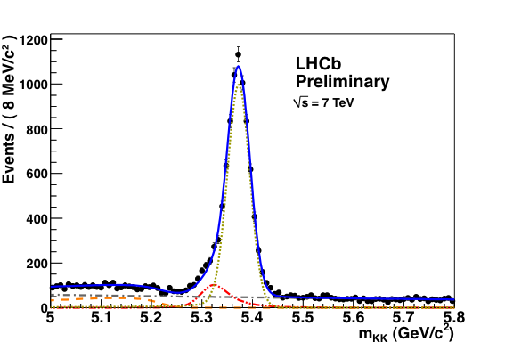
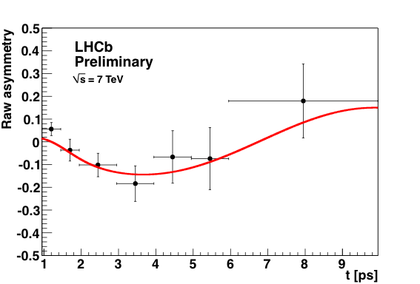
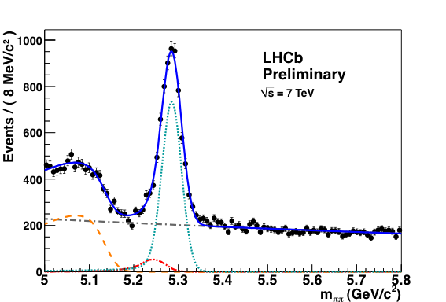
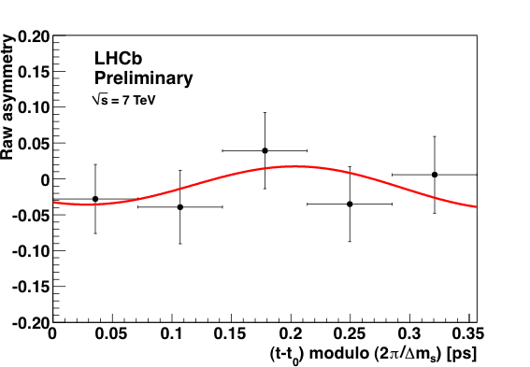
(3) Charmless B_{(s)} decays B→π⁺π⁻ and B_{s}→K⁺K⁻
LHCb-CONF-2012-007
B→ππ
B_{s}→KK
First (preliminary) evidence of mixing induced CP violation seen at hadron collider (3.2σ)

Slide 33
CP Violation Measurements @ LHCb
Time Integrated measurements:
  (1) Direct CP Violation in charmless decays B_{(s)}->Kπ.
  (2) CP Violation in charmed decays B⁻→D⁰K⁻ and B⁻→D⁰π⁻
Time dependent measurements (interference of mixing and decay):
  (3) CP violation in charmless B_{(s)} decays B_{s}→KK and B→ππ
  (4) CP Violation in charmed B_{s} decays B_{s}→D_{s} K
  (5) CP Violation in B_{s} decays to CP eigenstate B_{s}→J/ψ φ
CP Violation in mixing
  (6) A charming surprise

Slide 34
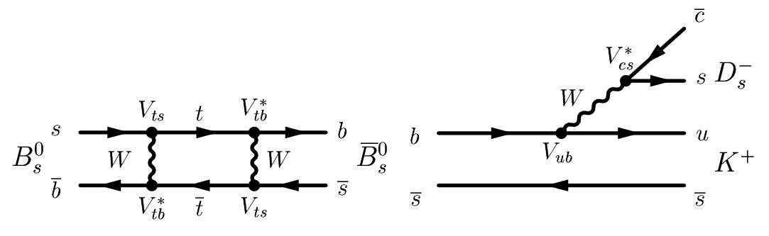
(4) Charmed B_{s} decays: B_{s}→D_{s}K
Two decay amplitudes to the same final state:
via mixing B_{s}→B_{s}→D_{s}⁻K⁺:
direct: B_{s}→D_{s}⁻K⁺:
γ
β_{s}
:
+
:
Golden mode for a time dependent measurement of “γ with trees”
  Hadronic uncertainties small
Sensitivity to new physics enters via the mixing loop: expected to be small
Combined analysis of B→D_{s}K with B_{s}→D_{s}π:
  For B_{s}→D_{s}π only decay amplitude 2) is possible (no CP violation)
  Use B_{s}→D_{s}π decay as a calibration process for B mixing

Slide 35



(4) Charmed B_{s} decays: B_{s}→D_{s}K
arXiv:1204.1237
LHCb-CONF-2011-050
B_{s}→D_{s}π
0.37 fb⁻¹
arXiv:1204.1237
B_{s}→D_{s}π
  Flavour tagging:
Opposite side: εD² = 3.2 ± 0.8 %
Same side: additional power
  Measurement of B_{s} mixing:
Δm_{s} = 17.63 ± 0.11 ± 0.02 ps⁻¹
B_{s}→D_{s}K
  Branching ratio:
BR = (1.90 ± 0.12 ± 0.18) x 10⁻⁴
LHCb-CONF-2011-050 and arXiv:1112.4311
B_{s}→D_{s}K
0.37 fb⁻¹
arXiv:1204.1237
Notes:
Actual BR =1.9 +- 0.12 +- 0.13 (+0.12 – 0.14) , where the last error is f_s/f_d

Slide 36
CP Violation Measurements @ LHCb
Time Integrated measurements:
  (1) Direct CP Violation in charmless decays B_{(s)}->Kπ.
  (2) CP Violation in charmed decays B⁻→D⁰K⁻ and B⁻→D⁰π⁻
Time dependent measurements (interference of mixing and decay):
  (3) CP violation in charmless B_{(s)} decays B_{s}→KK and B→ππ
  (4) CP Violation in charmed B_{s} decays B_{s}→D_{s} K
  (5) CP Violation in B_{s} decays to CP eigenstate B_{s}→J/ψ φ
CP Violation in mixing
  (6) A charming surprise

Slide 37
(5) B_{s} decays to a CP eigenstate: B_{s}→J/ψϕ
Two decay amplitudes to the same CP eigenstate final state.
via mixing B_{s}→B_{s}→J/ψϕ:
direct: B_{s}→J/ψϕ:
β_{s}
:
+
:
Golden mode for a time dependent measurement of “β_{s} via mixing diagram”
  Hadronic uncertainties small
High sensitivity to new physics that enters via the mixing loop
B_{s} is a speudoscalar (s=0) while J/ψ and ϕ are vector particles (s=1)
  Final state is superposition of CP even (L=0 and L=2) CP odd (L=1)
  Requires angular analysis to disentangle
Alternative analysis in pure CP odd eigenstate B_{s}→J/ψ f₀(980)

Slide 38






(5) B_{s} decays to a CP eigenstate: B_{s}→J/ψϕ
1fb⁻¹
ψ
θ
B_{s}→J/ψϕ
ϕ
CP-even
CP-odd
LHCb-CONF-2012-002
Preliminary:
ϕ_{s} = -0.001 ± 0.101 ± 0.027 rad
ΔΓ_{s} = 0.116 ± 0.018 ± 0.006 ps⁻¹
ϕ_{s}=2β_{s}
Consistent with no CP violation as predicted in SM

Slide 39
CP Violation Measurements @ LHCb
Time Integrated measurements:
  (1) Direct CP Violation in charmless decays B_{(s)}->Kπ.
  (2) CP Violation in charmed decays B⁻→D⁰K⁻ and B⁻→D⁰π⁻
Time dependent measurements (interference of mixing and decay):
  (3) CP violation in charmless B_{(s)} decays B_{s}→KK and B→ππ
  (4) CP Violation in charmed B_{s} decays B_{s}→D_{s} K
  (5) CP Violation in B_{s} decays to CP eigenstate B_{s}→J/ψ φ
CP Violation in mixing
  (6) A charming surprise

Slide 40
(6) CP Violation in mixing: A Charming Surprise
CP Violation in charm:
  The mixing amplitude is small.
    Expect no significant interference between mixing and decay
    Difference D→D and D->D expected to be very small → O(10⁻⁴)
  Direct CP violation (in decay)
    Expected negligible in Cabibbo favoured modes (“Trees”)
    In Cabibbo suppressed mode “plausible” up to O(10⁻³ - 10⁻⁴)
  Expectation: observation of any CP asymmetry in charm is a sign of New Physics…

Slide 41



(6) CP Violation in mixing: A Charming Surprise
CP asymmetry from charm decays:
Measure time integrated CP asymmetries in D→π⁺π⁻ and D→K⁺K⁻
  Use decays D*±→D π_{s}± to tag the flavour of the D (D or D) using the charge of the slow pion π_{s}
Observed asymmetry includes detector effects and possible production asymmetry of D*
Cancel these to first order by measuring difference between D→π⁺π⁻ and D→K⁺K:
Contribution from possible indirect CP violation term small
M.Gersabeck et. al.,
J.Phys. G39 (2012) 045005

Slide 42



Signal Yields
1.4 M tagged D⁰→K⁺K⁻ and
0.4M tagged D⁰→π⁺π⁻
LHCb, 0.6 fb⁻¹, PRL 108, 111602 (2012)
D⁰→K⁺K⁻
D^{*+} →
D⁰(K⁺K⁻)π
D⁰→π⁺π⁻
D^{*+} →
D⁰(π⁺π⁻)π
ΔA_{CP} =(-0.82±0.21(stat)±0.11(sys) )%
3.5 σ deviation from zero.
Value is larger than was expected from SM before measurement was available
Postdiction: general agreement that we cannot yet exclude that it is caused by hadronic uncertainties…
  Currently hot activity in experiment and in theory.

Slide 43
Summary & Conclusions
CP Violation:
  1964 CP Violation with K⁰
  2001 CP Violation with B⁰
  2011 Evidence for CP Violation with B_{s} and CP Violation with D⁰
LHCb carrying out full physics program
  Collected 1.5 fb⁻¹ by now
  Backgrounds well under control
  Expect to collect 5 fb⁻¹ before upgrade
Time dependent and time integrated CP observables for B decays
  Towards measurements of CKM angle “γ with trees”
  Towards measurements of CKM angle “γ with loops”
  World best measurement of B_{s} mixing phase ϕ_{s} (consistent with SM β_{s})
CP violation in charm
  Evidence for CP violation in ΔA_{CP}.
  Hadronic effects to be clarified.
LHCb upgrade in 2018
  Higher luminosity: expect to collect 50 fb⁻¹ in the upgrade
  New 40 MHz Trigger
    Extend the physics program

