Slide 1


The electric dipole moment of the neutron
Peter Fierlinger

Slide 2
Outline
State of the art
Next generation approaches (selected)
The approach at TUM
2
P. Fierlinger – SPP Groningen 22.6.2012

Slide 3
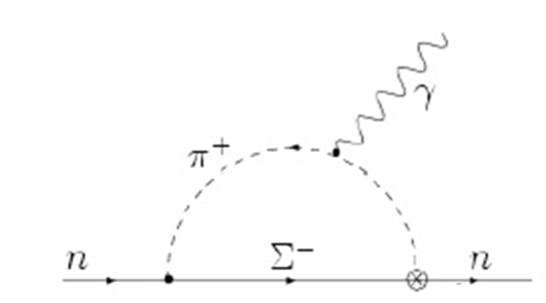
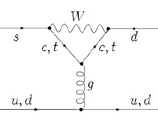
Neutron EDM and the SM
CP violation from CKM
Strong Interaction
CP-odd term in Lagrangian:
Pospelov, Ritz, Ann. Phys. 318(2005)119
Khriplovich, Zhitnitsky (1982),
McKellar et al., (1987)
Really small neutron EDM:
d_{n} ≈ 10⁻³² e cm
Strong CP problem
(d_{q} ≈ 10⁻³⁴ e cm)
P. Fierlinger – SPP Groningen 22.6.2012

Slide 4
Baryon asymmetry
Observed: n_{B} / n_{γ}
6.7-9.2 x 10⁻¹⁰ (BBN)
8.4-9.3 x 10⁻¹⁰ (CMB)
Expected:
n_{B} / n_{γ} ~ 10⁻¹⁸
e.g. astro-ph/0603451
JETP Lett. 5 (1967) 24
Mainstream: Sakharov conditions
Remarks:
Beyond-SM physics usually requires large EDMs
EDMs and Baryogenesis via Leptogenesis?
Also other options w/o new CP violation possible (Kostelecky, CPT)
What do we learn from an EDM?
different measurements needed!
e.g. Cirigliano, Profumo, Ramsey-Musolf JHEP 0607:002 (2006)
P. Fierlinger – SPP Groningen 22.6.2012

Slide 5
Physics behind EDMs
Fundamental theories: TeV scale physics
d_{q}
d_{q}
θ
C_{qe}
d_{e}
d_{μ}
d_{τ}
~
C_{qq}
g_{πNN}
See also Pospelov, Ritz, Ann. Phys. 318(2005)119
Neutron, proton
C_{S,P, T}
Leptons
Ions
Schiff-Moment ∝ Z²
Schiff-Moment ∝ Z³
Diamagnetic
atoms
Paramagnetic atoms,
polar molecules
5
P. Fierlinger – SPP Groningen 22.6.2012

Slide 6
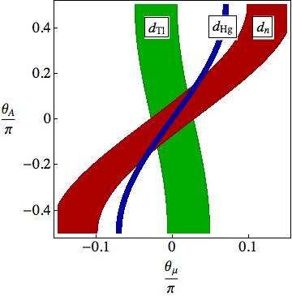
Supersymmetry
More sources of CP violation...
~ EDMs at 1 loop level
MSSM example:
MSSM for
M = 1 TeV,
tan β=3
Hg EDM ~ exp. Limit!
Consequences
small phases:
problem for baryogenesis
cancellations: requires tuning
heavy masses
Pospelov, Ritz, Ann. Phys. 318(2005)119
P. Fierlinger – SPP Groningen 22.6.2012

Slide 7
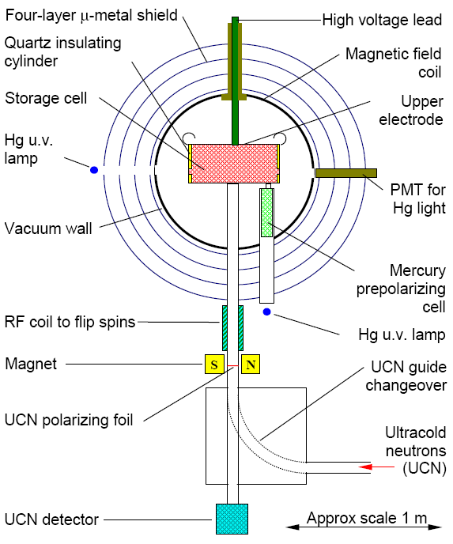
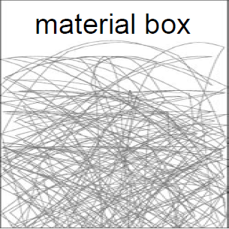
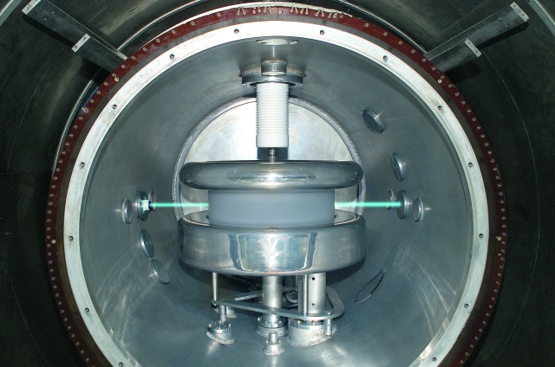
State of the art
(RAL/SUSSEX/ILL experiment)
Ultra-cold neutrons (UCN)
trapped at 300 K in vacuum
E_{kin} < 250 neV
λ > 50 nm
T ~mK
storage ~ 880 s
B₀
7
P. Fierlinger – SPP Groningen 22.6.2012

Slide 8
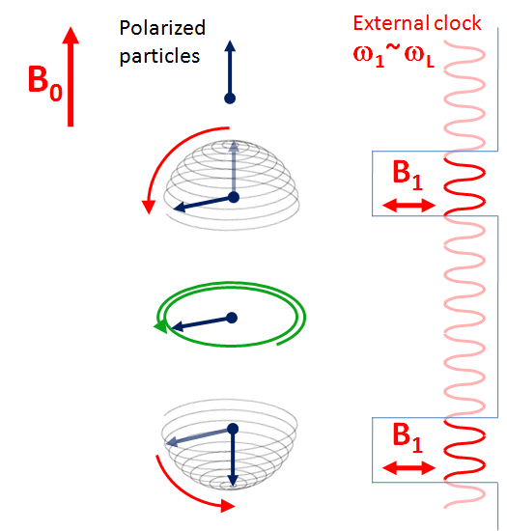
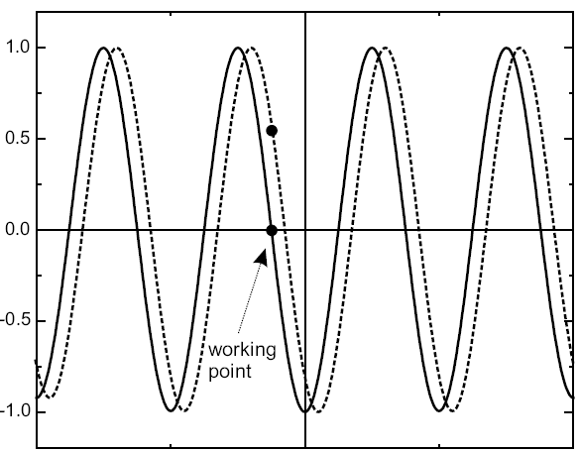
Separated oscillatory fields
Particle beam or trapped particles
Polarization
10² s
ω₁-ω_{L} („detuning“)
EDM changes Larmor precession:
8
P. Fierlinger – SPP Groningen 22.6.2012

Slide 9
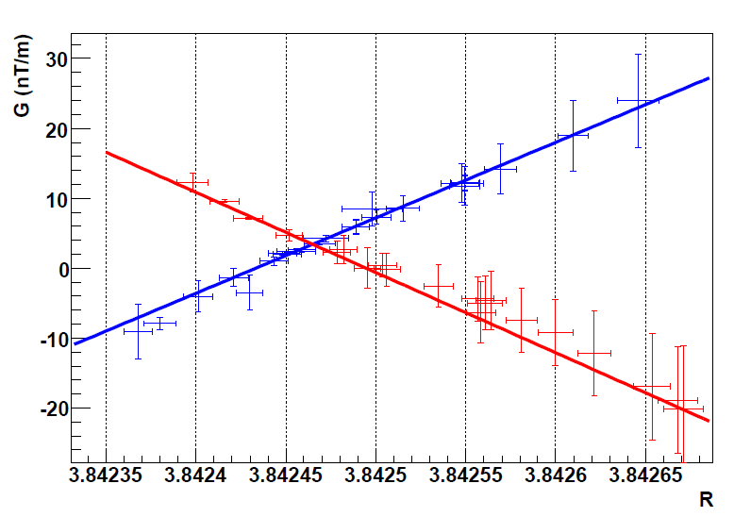
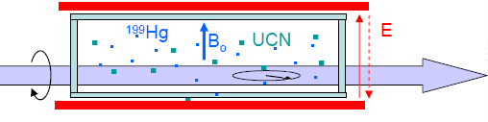
Clock comparison experiment
Neutrons and ¹⁹⁹Hg stored
in the same chamber.
Systematic effect: gravity!
Illustration (2008 ILL data)
B₀ down
B₀ up
Physical Review Letters 97 (2006) 131801.
Applied Gradient
~ ‚false‘ EDM
Frequency ratio
d_{n} < 2.9 x 10⁻²⁶ e cm (90%)
- The ‚co-magnetometer‘ is a very successful concept...
- Many side products: e.g. CPT, axion-like coupling - tests
9
P. Fierlinger – SPP Groningen 22.6.2012

Slide 10
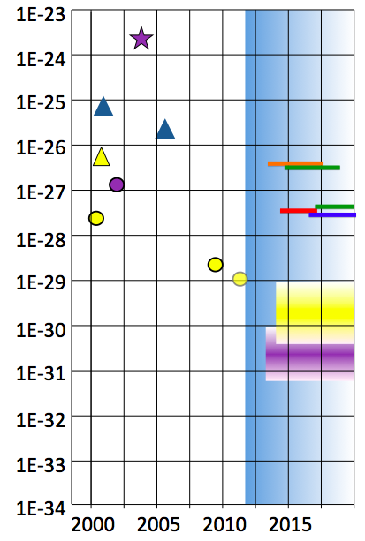
New approaches
Status: NEUTRON EDM with UCN + ¹⁹⁹Hg
p
‚Near‘ neutron EDM limits:
~ 5.10⁻²⁷ ecm,
2-3 years from now (ILL, PNPI, PSI)
BUT: requires strong UCN sources!
n
n+Hg
Xe
n ‚near‘
EDM limits [ecm]
e⁻(Tl)
n ‚far‘
Hg `01
‚Far‘ nEDM limits:
~ few.10⁻²⁸ ecm,
CryoEDM@ILL, Crystal EDM,
J-PARC, PNPI/ILL, PSI,
RCNP/TRIUMF, SNS, TUM
Hg `09
Nuclei
e⁻
10
P. Fierlinger – SPP Groningen 22.6.2012

Slide 11
New approaches
Status: NEUTRON EDM with UCN + ¹⁹⁹Hg
p
‚Near‘ neutron EDM limits:
~ 5.10⁻²⁷ ecm,
2-3 years from now (ILL, PNPI, PSI)
BUT: requires strong UCN sources!
n
n+Hg
Xe
n ‚near‘
EDM limits [ecm]
e⁻(Tl)
n ‚far‘
Hg `01
‚Far‘ nEDM limits:
~ few.10⁻²⁸ ecm,
CryoEDM@ILL, Crystal EDM,
J-PARC, PNPI/ILL, PSI,
RCNP/TRIUMF, SNS, TUM
Hg `09
Nuclei
e⁻
Strategy:
New UCN sources with 10³ times more neutrons
Improved magnetic field control
Stronger electric fields
New tools to control systematic effects
11
P. Fierlinger – SPP Groningen 22.6.2012

Slide 12

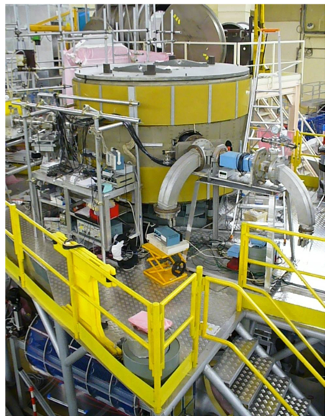
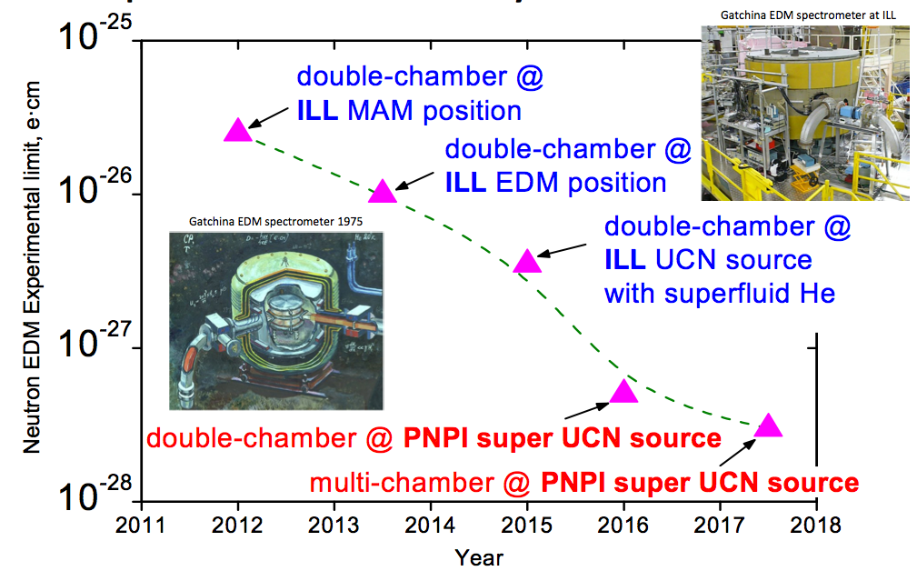
‚Conventional‘ approaches
PNPI/ILL/PTI
Features:
Double chamber
No co-magnetometer
It is currently operating (with state-of-the-art UCN density)
12
P. Fierlinger – SPP Groningen 22.6.2012

Slide 13
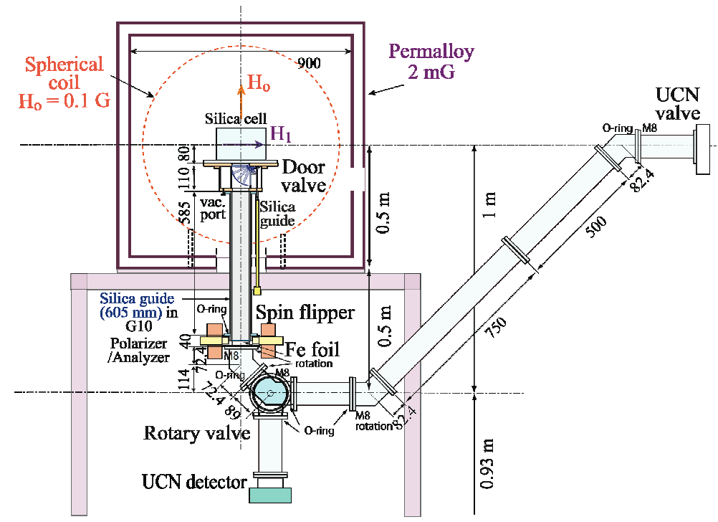
‚Conventional‘ approaches
RCNP/TRIUMF
Features:
High UCN density from 4He source (but experiment is in vacuum at room-temperature)
¹²⁹Xe co-magnetometer
with buffergas:
good breakdown stength
controls geometric phases
Small size:
small geometric phases
Prototypes of source and
EDM built
Larger source requires horizontal UCN extraction: challenging
13
P. Fierlinger – SPP Groningen 22.6.2012

Slide 14
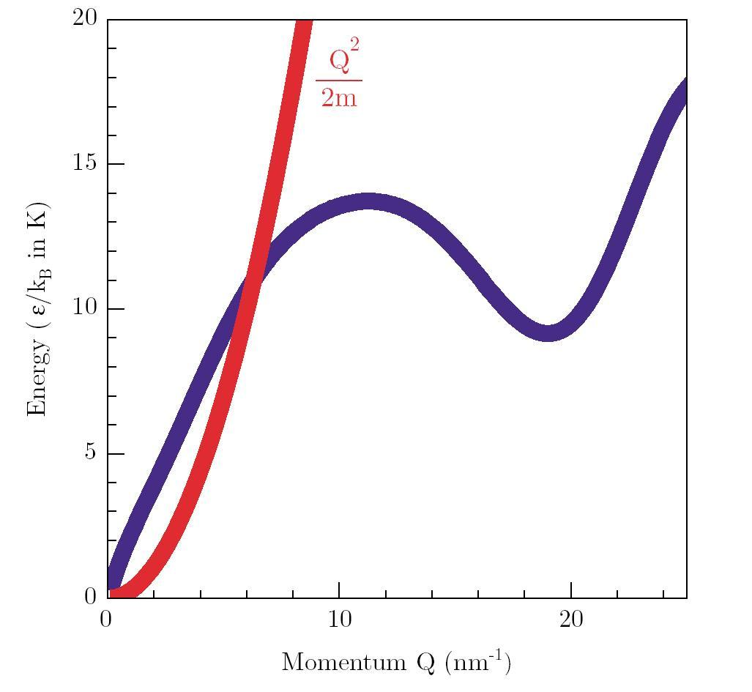
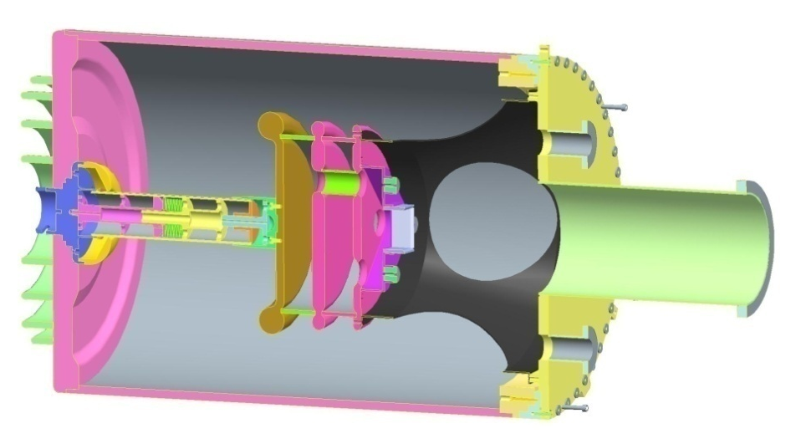
Cryogenic approaches
RAL-Sussex-ILL-Oxford-Kure experiment
Features:
High UCN density from 4He source
Experiment in 4He
High electric breakdown
strength of He
Long coherence times
High polarization
Apparatus is built
Intermediate result planned
UCN production
Landau- Feynman dispersion curve for ⁴He excitations
EDM cell:
400 kV
Reference cell (no HV)
High voltage
UCN entrance
250l He-II 0.5K
Figures: M.G.D van der Grinten
P. Fierlinger – SPP Groningen 22.6.2012

Slide 15
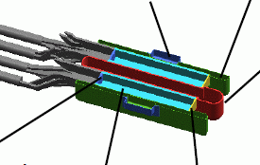
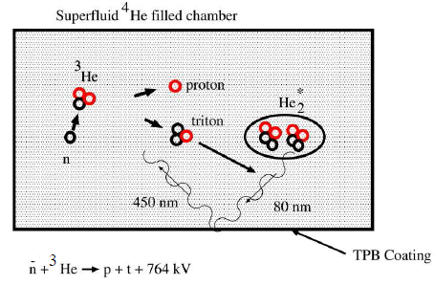
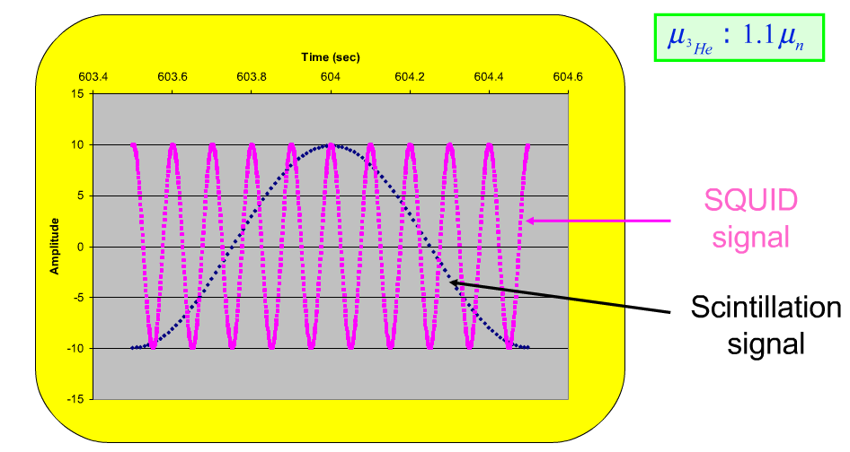
Cryogenic approaches
Light guides
SQUID enclosure
SNS experiment
Ground
Features: (selected)
High UCN density from 4He source
= EDM chambers
3He co-magnetometer:
spin-dependent neutron absorption
SQUIDs
High electric breakdown strength
Very innovative but extremely challenging
HV
Beam stop/ window
EDM chamber
Deuterated acrylic entrance
500 UCN/cm³
UCN and ³He in superfluid He
Pictures: B. Filippone
15
P. Fierlinger – SPP Groningen 22.6.2012

Slide 16

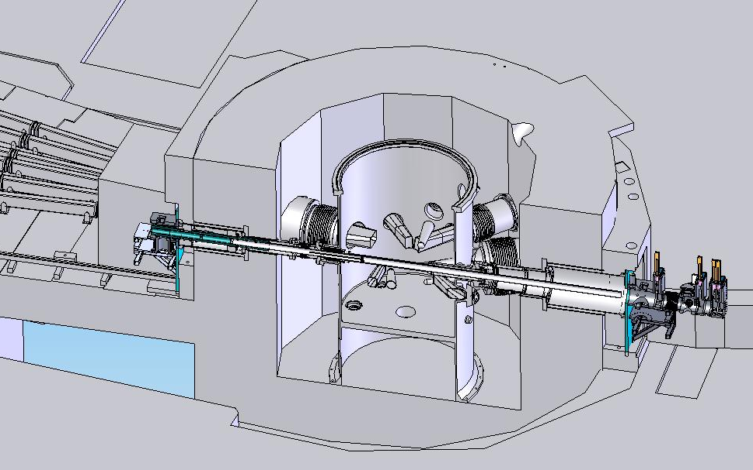
New sources of UCN
E.g. superthermal solid D₂, at the FRM-2 reactor, TU München Molceular excitations used to cool neutrons to zero energy -
similar: LANL, Mainz, NCSU, PNPI, PSI, …
~10¹⁵ n/s on source
Goal: 10³ UCN/cm³
in the experiment (2013)
Other sources use superfluid He-II (via phonons): ILL, KEK, SNS, TRIUMF(?), …

Slide 17
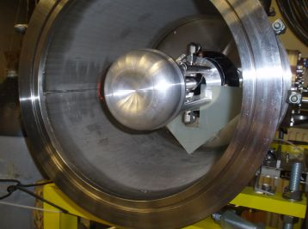
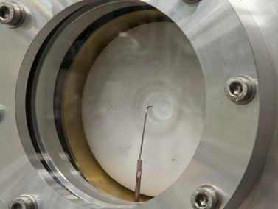
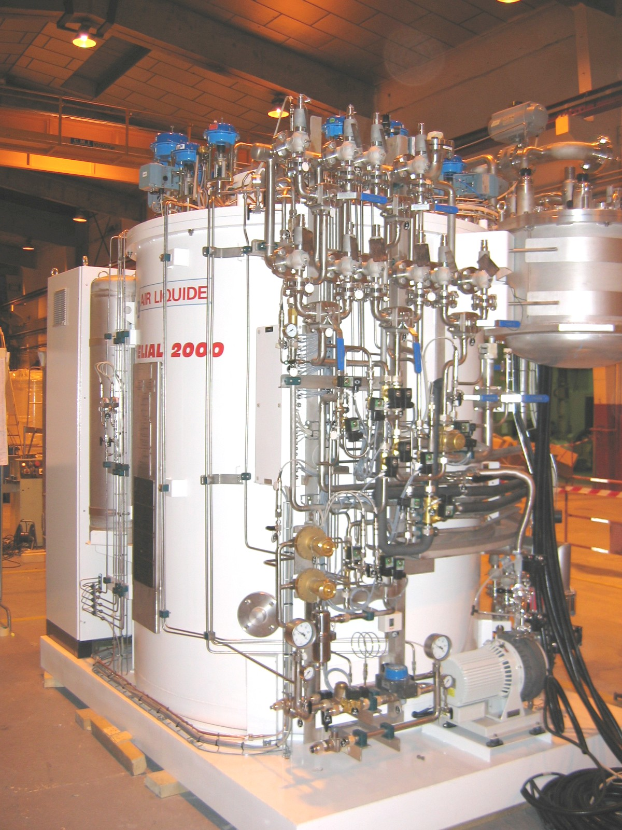
UCN source at FRM-2
Status:
-Hydrogen freezeout successful
-UCN production investigated
-Most components on site / ordered
-Regular operation end of 2013
1 kW at 4 K cooling power
D₂ layer frozen on inpile part
17
P. Fierlinger – SPP Groningen 22.6.2012

Slide 18
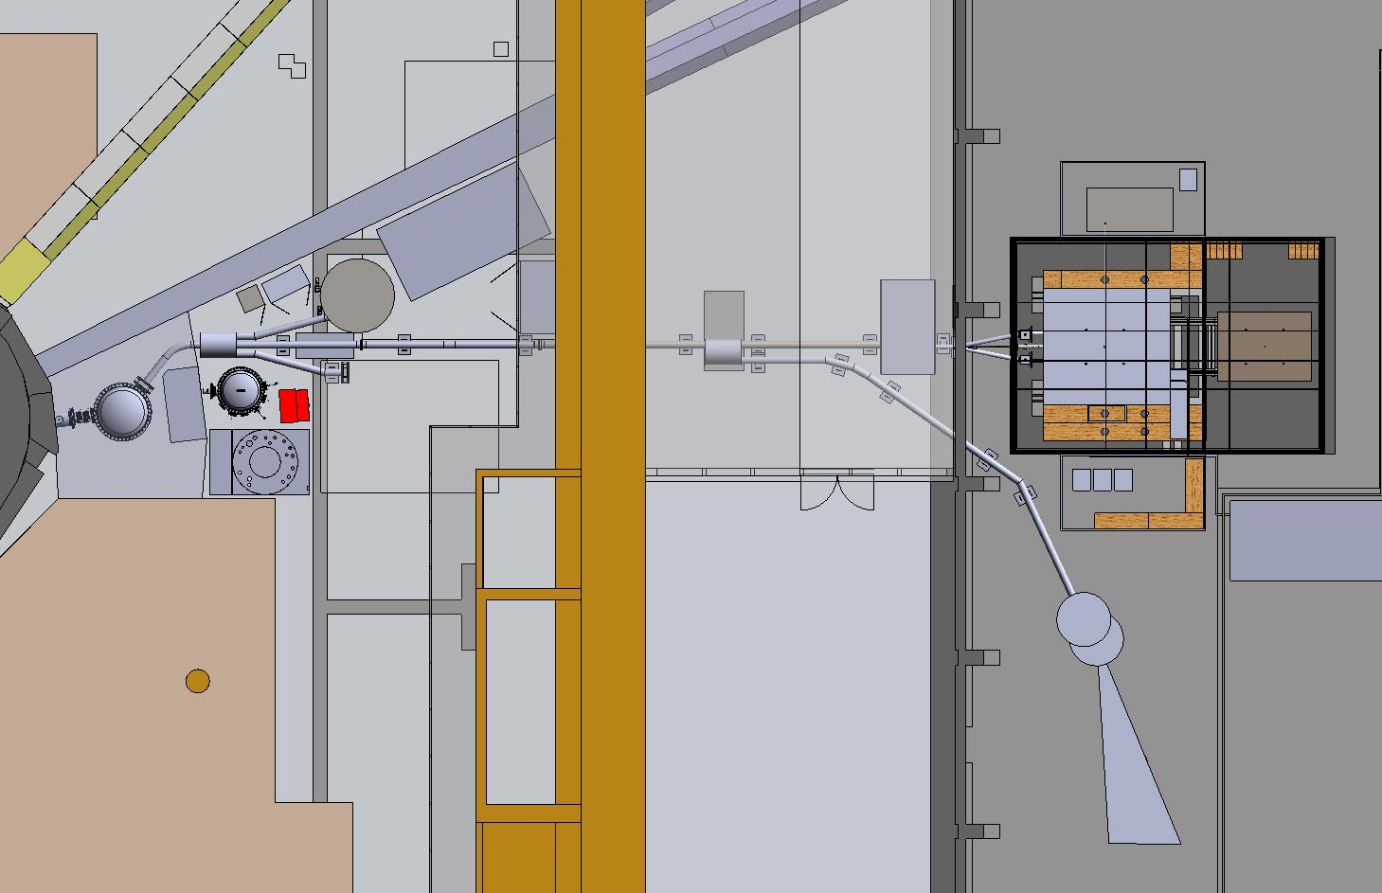
UCN facility a FRM-2
EDM
SR6 exit
UCN source
Biological shield
Reactor wall
27 m
18
P. Fierlinger – SPP Groningen 22.6.2012

Slide 19
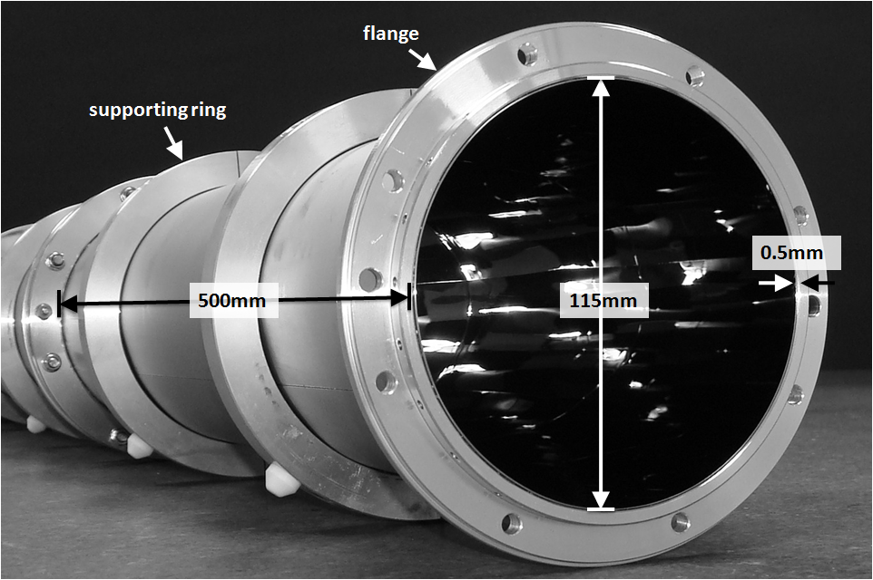
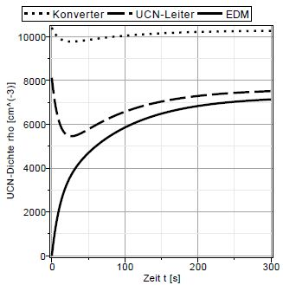
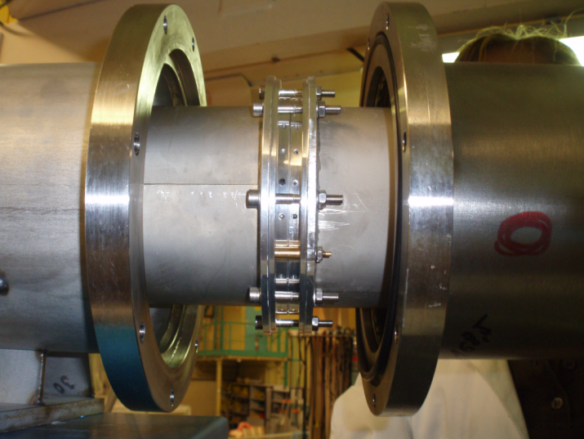
High transmission neutron guides
Cooperation TUM & SDH Heidelberg:
Welded replica foils, 0.5 m pieces
‚perfect‘ connections
-
6 m guides tested with 99% transm./meter: world record
10³ polarized UCN /cm³ inside EDM chambers
A. Frei
19
P. Fierlinger – SPP Groningen 22.6.2012

Slide 20
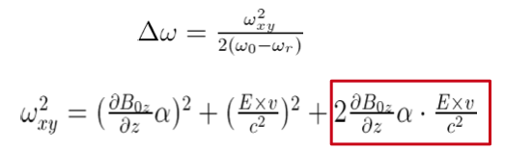
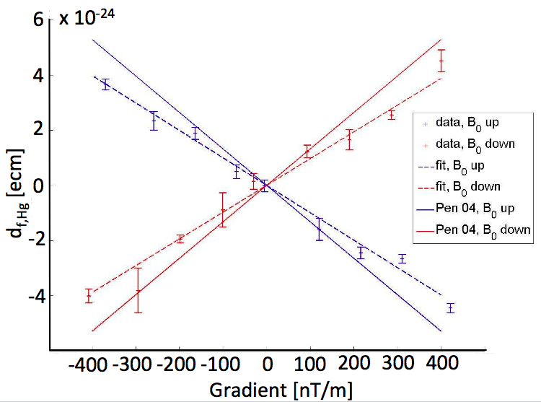
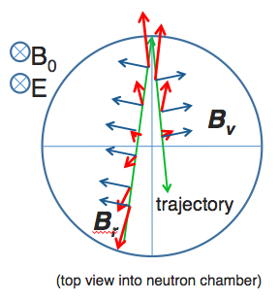
Systematic effects
Critical for all next generation experiments: ‚geometric phases‘
‘Ramsey Bloch Siegert shift’:
linear with
B-gradient,
chamber size,
E
(M. Horras, I. Altarev et al., 2011)
20
P. Fierlinger – SPP Groningen 22.6.2012

Slide 21
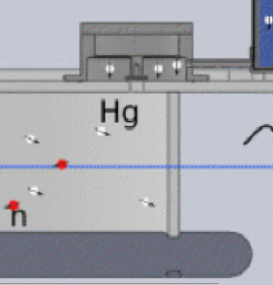
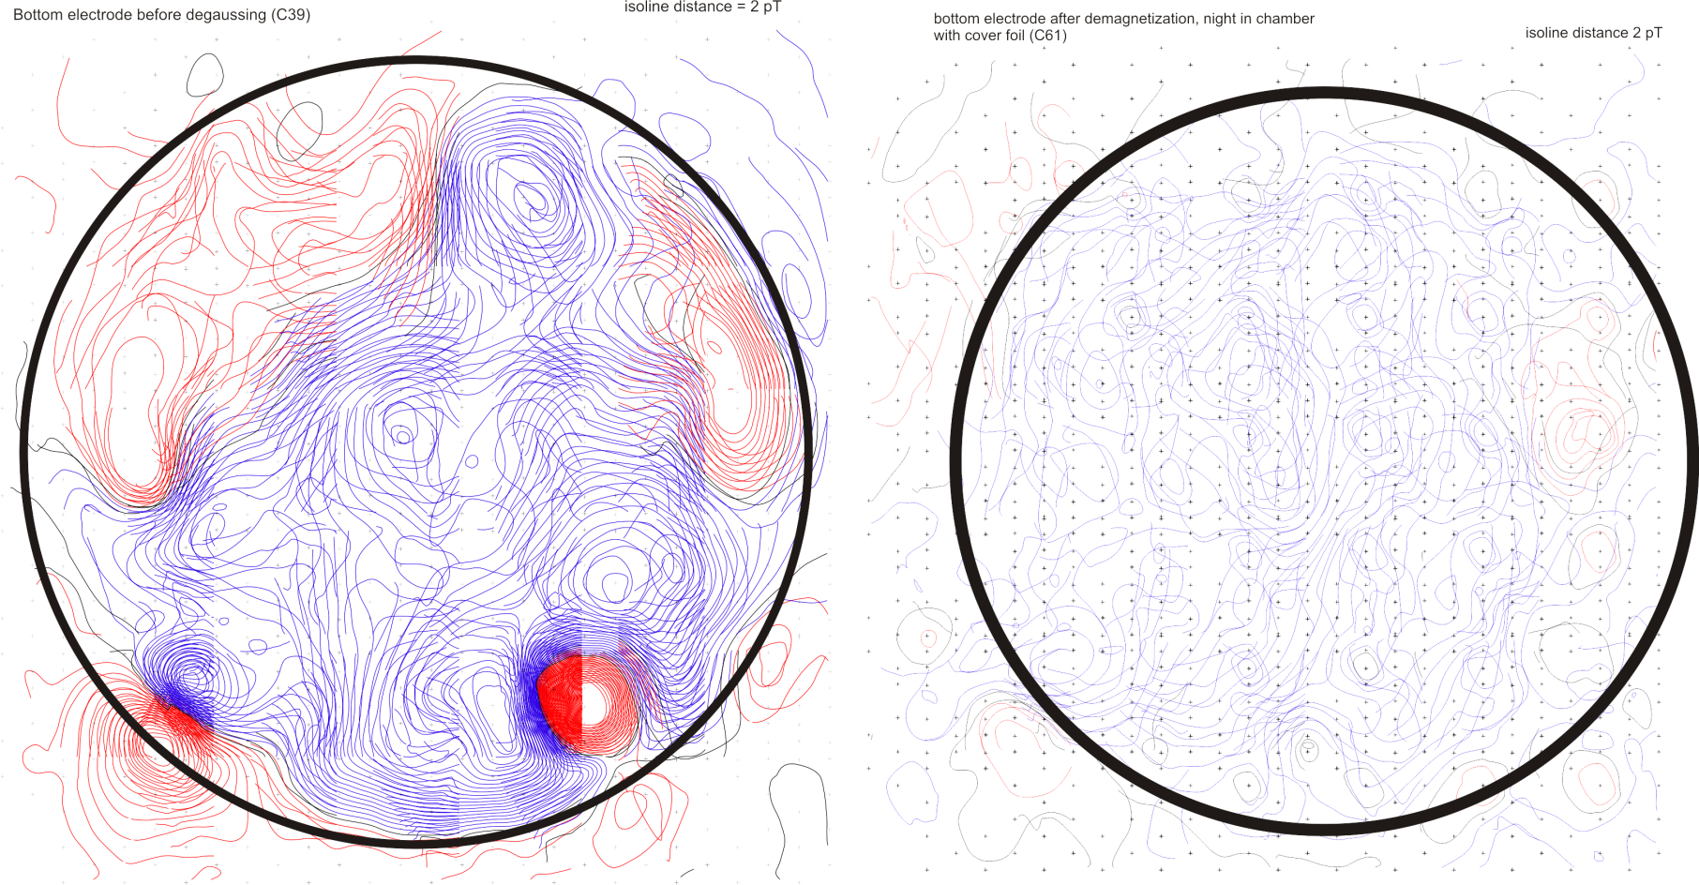
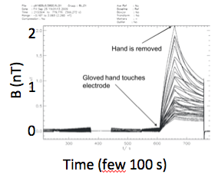
Systematic effects
Where can additional geometric phases come from?
e.g. E-field deformations...
Residual fields in electrodes
Thermally induced
currents in metals
SQUID measurements
of aluminium electrodes @ PTB Berlin
200 pT pp
demagnetized:
20 pT pp
[Illustration only]
Residual B-fields
~ 1 pT in 2 cm distance =error budget
Issues with HV techniques...
21
P. Fierlinger – SPP Groningen 22.6.2012

Slide 22
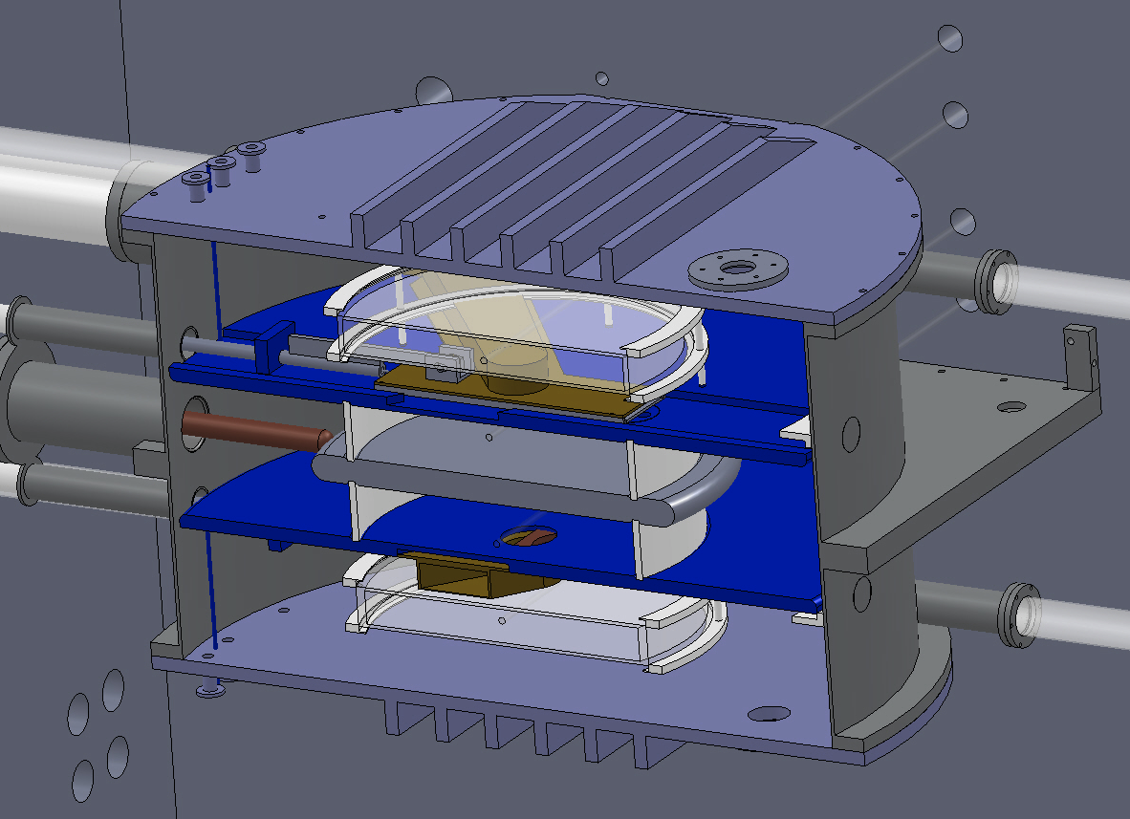
The nEDM project at FRM-2
Double chamber Ramsey experiment with UCN stored at room temperature
1 m
199Hg magnetometer
Online access:
Cs, SQUIDs
UCN
+199Hg chambers
High voltage electrode 200 kV
B₀
199Hg magnetometer
Limit of the concept: d_{n} < 5.10⁻²⁸ ecm (3σ), stat. + syst.
22
P. Fierlinger – SPP Groningen 22.6.2012

Slide 23
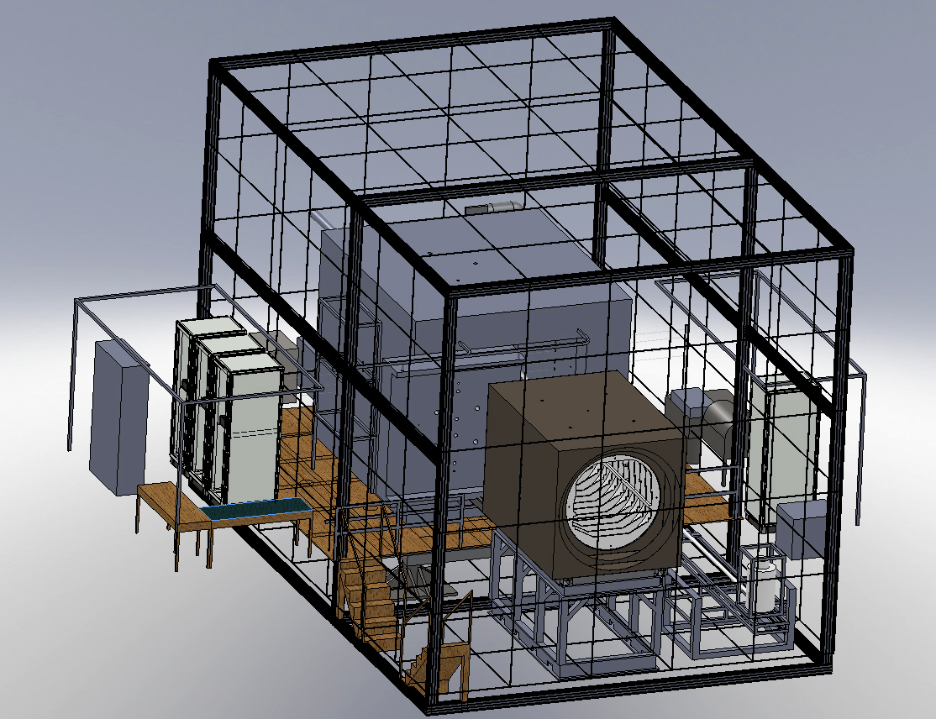
Magnetic field requirements
10⁻²⁸ ecm – level sensitivity:
Drifts: 10 fT/Ramsey-cycle error for 1 year data (statistical!),
0.1 fT in case of correlated errors: difficult...
Gradients: < 0.3 nT/m,
ΔB₀/B₀ ~ < 3.10⁻⁴
(< 0.3 nT in 1 μT field over 1 m³) =
d_{f} ~ 4.10⁻²⁷ ecm (¹⁹⁹Hg geom. phases),
d_{f} ~ 2.10⁻²⁸ ecm (n geom. phases)
23
P. Fierlinger – SPP Groningen 22.6.2012

Slide 24
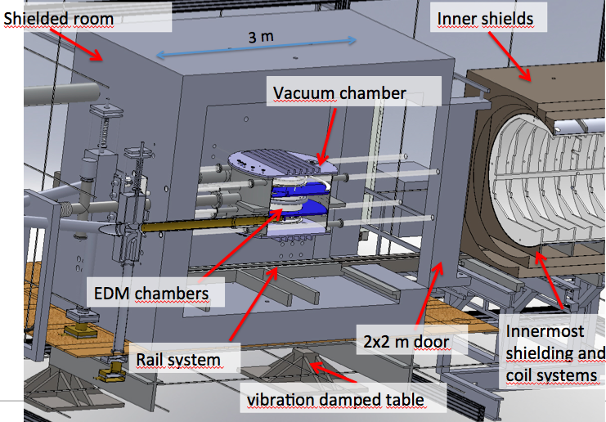
Magnetic fields
Multi-stage approach:
Environment with small
magnetic disturbances
Active compensation of
fields and vibrations
Walk-in shielded room with
retractable inner shield
Innermost shield with field coils
Many ways to measure magnetic fields online and offline
Only non-metallic components inside inner shields: e.g. vacuum chamber, electrodes, magnetometers...
24
P. Fierlinger – SPP Groningen 22.6.2012

Slide 25
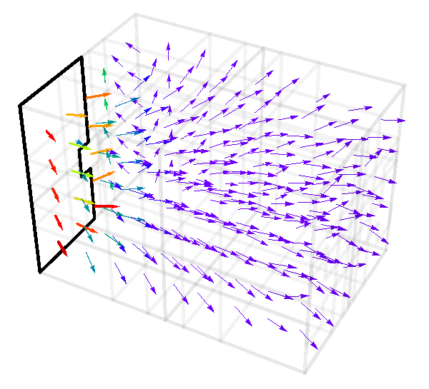
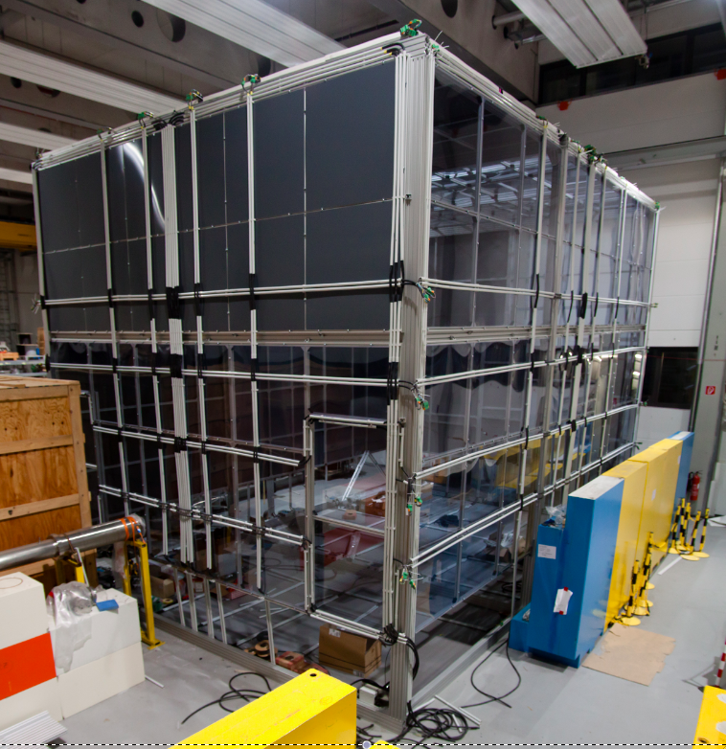
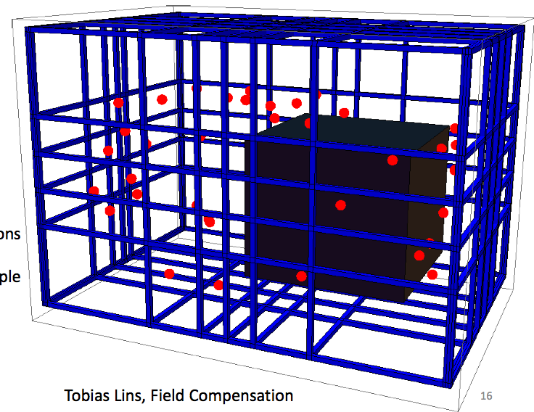

Magnetic environment
Nonmagnetic concrete floor
6 x 6 x 9 m field coil cage, 24 coil pairs, 180 magnetometers
Environmental parameters controlled:
e.g. electric potentials of building structure
Mu-shields ready for installation on site (10⁵ DC shielding)
Various new developments in passive DC shielding
Measured fields (Background corrected)
25
P. Fierlinger – SPP Groningen 22.6.2012

Slide 26
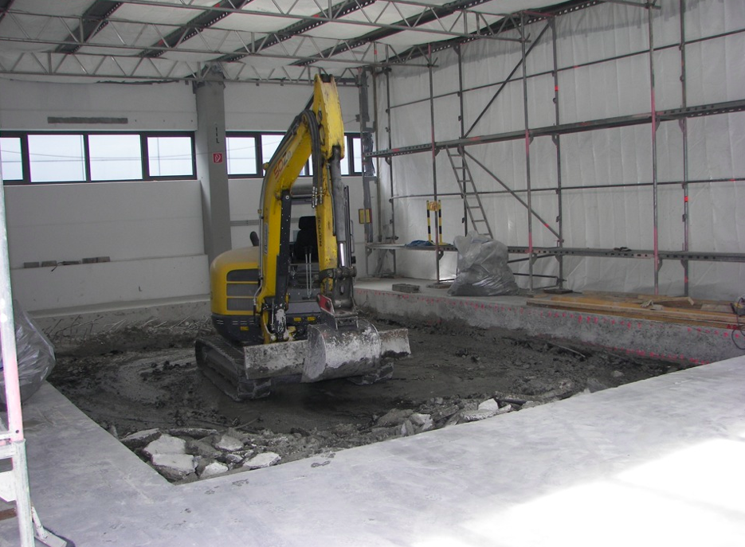
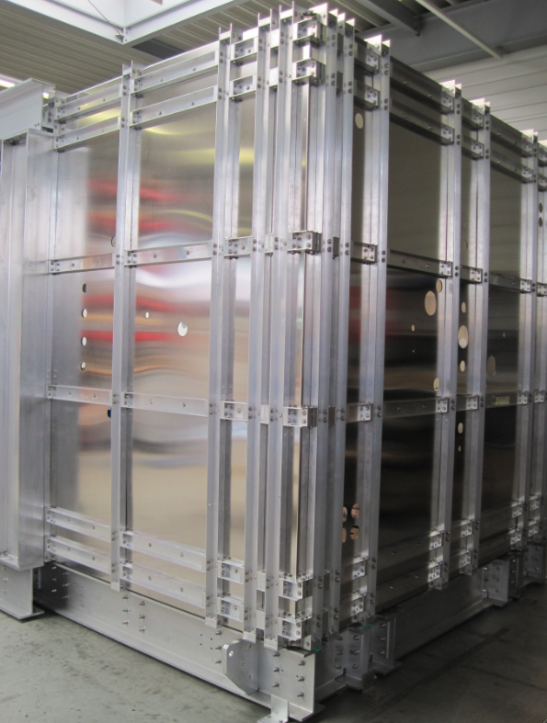
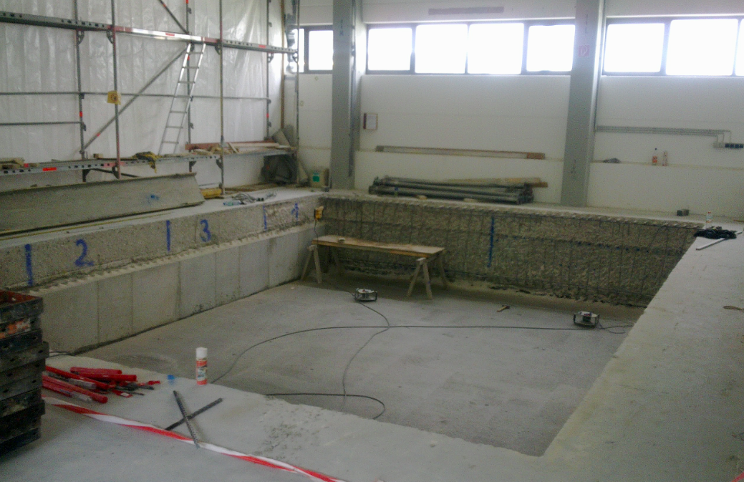
Magnetic environment
110 m³ of concrete floor removed!
Measured fields (Background corrected)
26
P. Fierlinger – SPP Groningen 22.6.2012

Slide 27
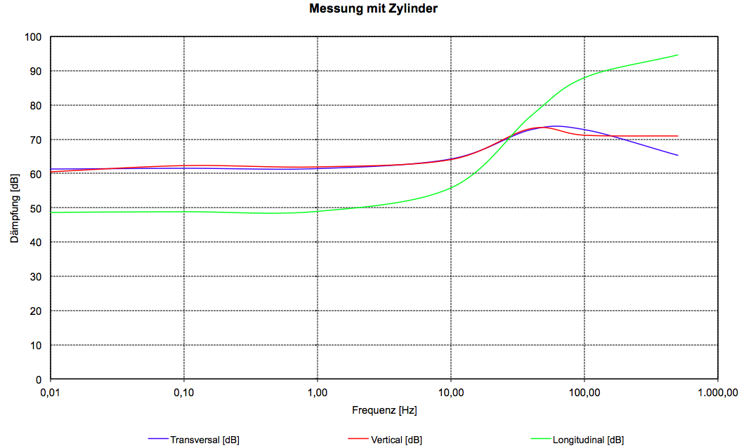
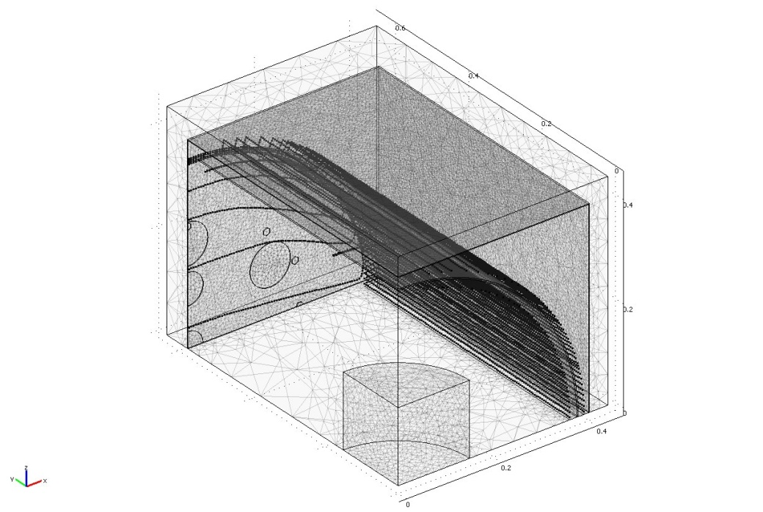
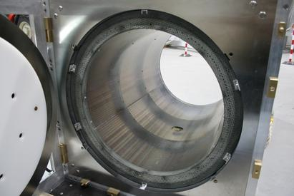
Innermost shield
100
- Fields are generated by coil system
in combination with Mu-metal
- 5x10⁻⁵ homogeneity possible
- Stability: 60 low noise current sources
- Measured residual fields < 1 nT
- Non-metallic vacuum chamber realized
-
60
Shielding [dB]
0,01
1
100
Frequency [Hz]
0.6 m
Most inner layer of the shield
Coils
Holes in the door
8
7
6
Cylindrical mu-metal shell
5
4
3
2
1:2.5 scaled prototype (DC SF ~1000)
nEDM spectrometer position
1
8 probe points
27
P. Fierlinger – SPP Groningen 22.6.2012

Slide 28
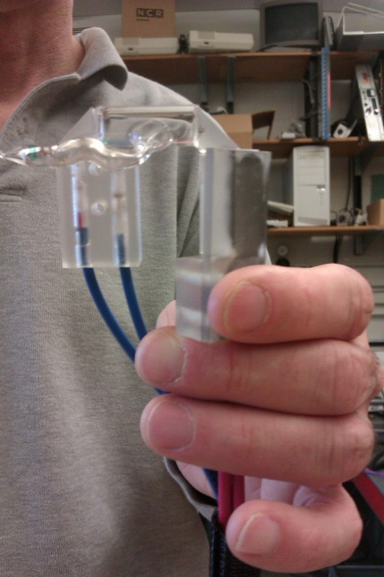
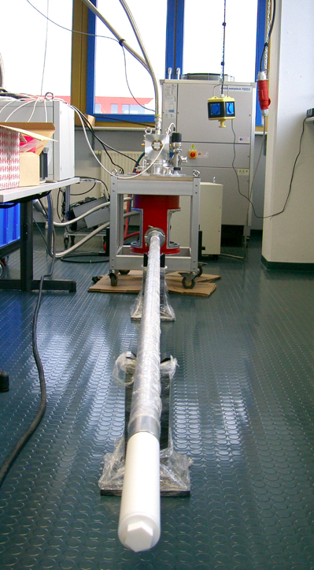
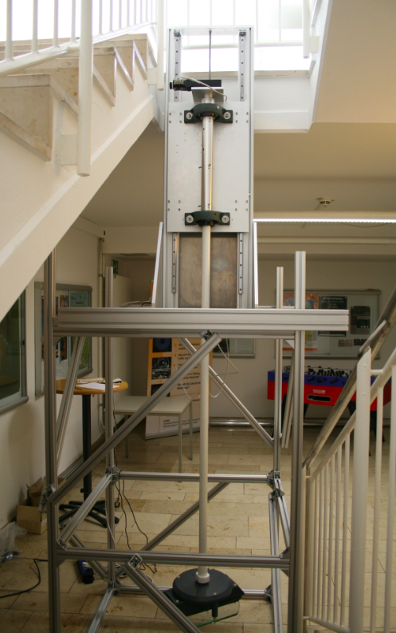
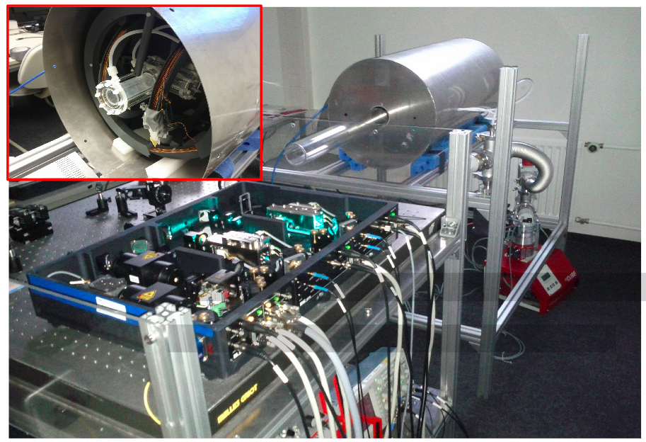
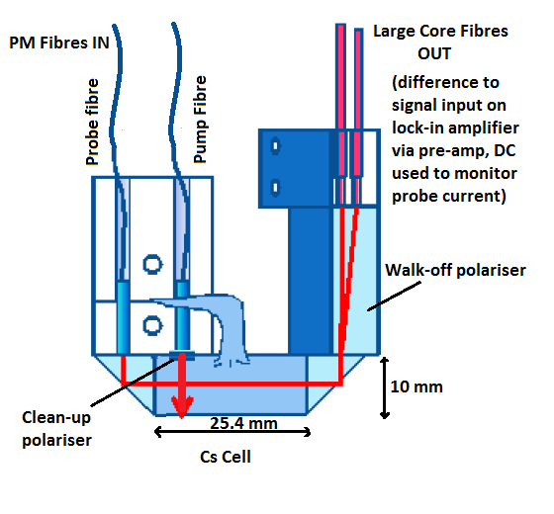

Measuring magnetic fields
Magnetometry:
Fully optical Cs atomic vapor magnetometers (Berkeley, UIUC)
Multi-cell Hg magnetometry, variable Hg temperature
SQUIDs
¹²⁹Xe SEOP + transport system (as backup)
B-field
28
P. Fierlinger – SPP Groningen 22.6.2012

Slide 29

UCN geometric phases
Problematic: ... also for ‚slow‘ UCNs!
Possibility: treatment of velocity dependent effects with adjustable UCN energy spectrum
1 T SC magnet at beam line
+ RF spin flipper as polarizer:
e.g. H. Weinfurter et al,. Z. Phys. B72 (1988) 195
Maximum stored energy in EDM chambers
29
P. Fierlinger – SPP Groningen 22.6.2012
Notes:
stray fields

Slide 30

Summary
New neutron EDM experiments will be highly sensitive probes for new physics at (or beyond) LHC energies.
Although there is a lot of progress with other systems, the neutron is still a very interesting option
So far no source delivers enough UCN
New projects should be portable to the best suitable neutron source:
1000 or more per cm³ are necessary!
The TU München approach will be ready for UCN in 2 years
I. Altarev, V. Andreev, D. Beck, S. Chesnevskaya, T. Chupp, M. Daimer, P. Fierlinger, A. Frei, E. Gutsmiedl, A. Himpsl, F. Kuchler, T. Lauer, P. Link, T. Lins, M. Marino, J. McAndrew, S. Paul, G. Petzoldt, A. Pichlmaier, J. Rothe, C. Schneider, R. Schönberger, S. Seidel, M. Steinmaßl, R. Stoepler, T. Stolz, S. Stuiber, M. Sturm, B. Taubenheim, R. Thiele, J. Weber, D. Wurm
30
P. Fierlinger – SPP Groningen 22.6.2012

