Slide 1


Status of Finnish in-kind components for accelerators (Super-FRS)
Tuomas Grahn
Helsinki Institute of Physics &
University of Jyväskylä
Super-FRS Experiment Collaboration meeting
Walldorf, 27 April 2023

Slide 2


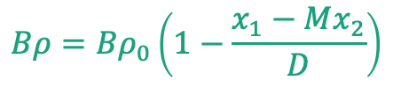
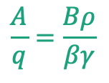
Beam indentification at Super-FRS
Measurements in the B𝜌-TOF-𝛥E method:
$$ΔE⟹Z$$
$$\frac{A}{q}=\frac{Bρ}{βγ}$$
Measured quantities
A and Z
$$Bρ=Bρ_{0}\left(1−\frac{x_{1}−Mx_{2}}{D}\right)$$
D is despersion, M is magnification and B𝜌₀ is reference magnetic rigidity

Slide 3
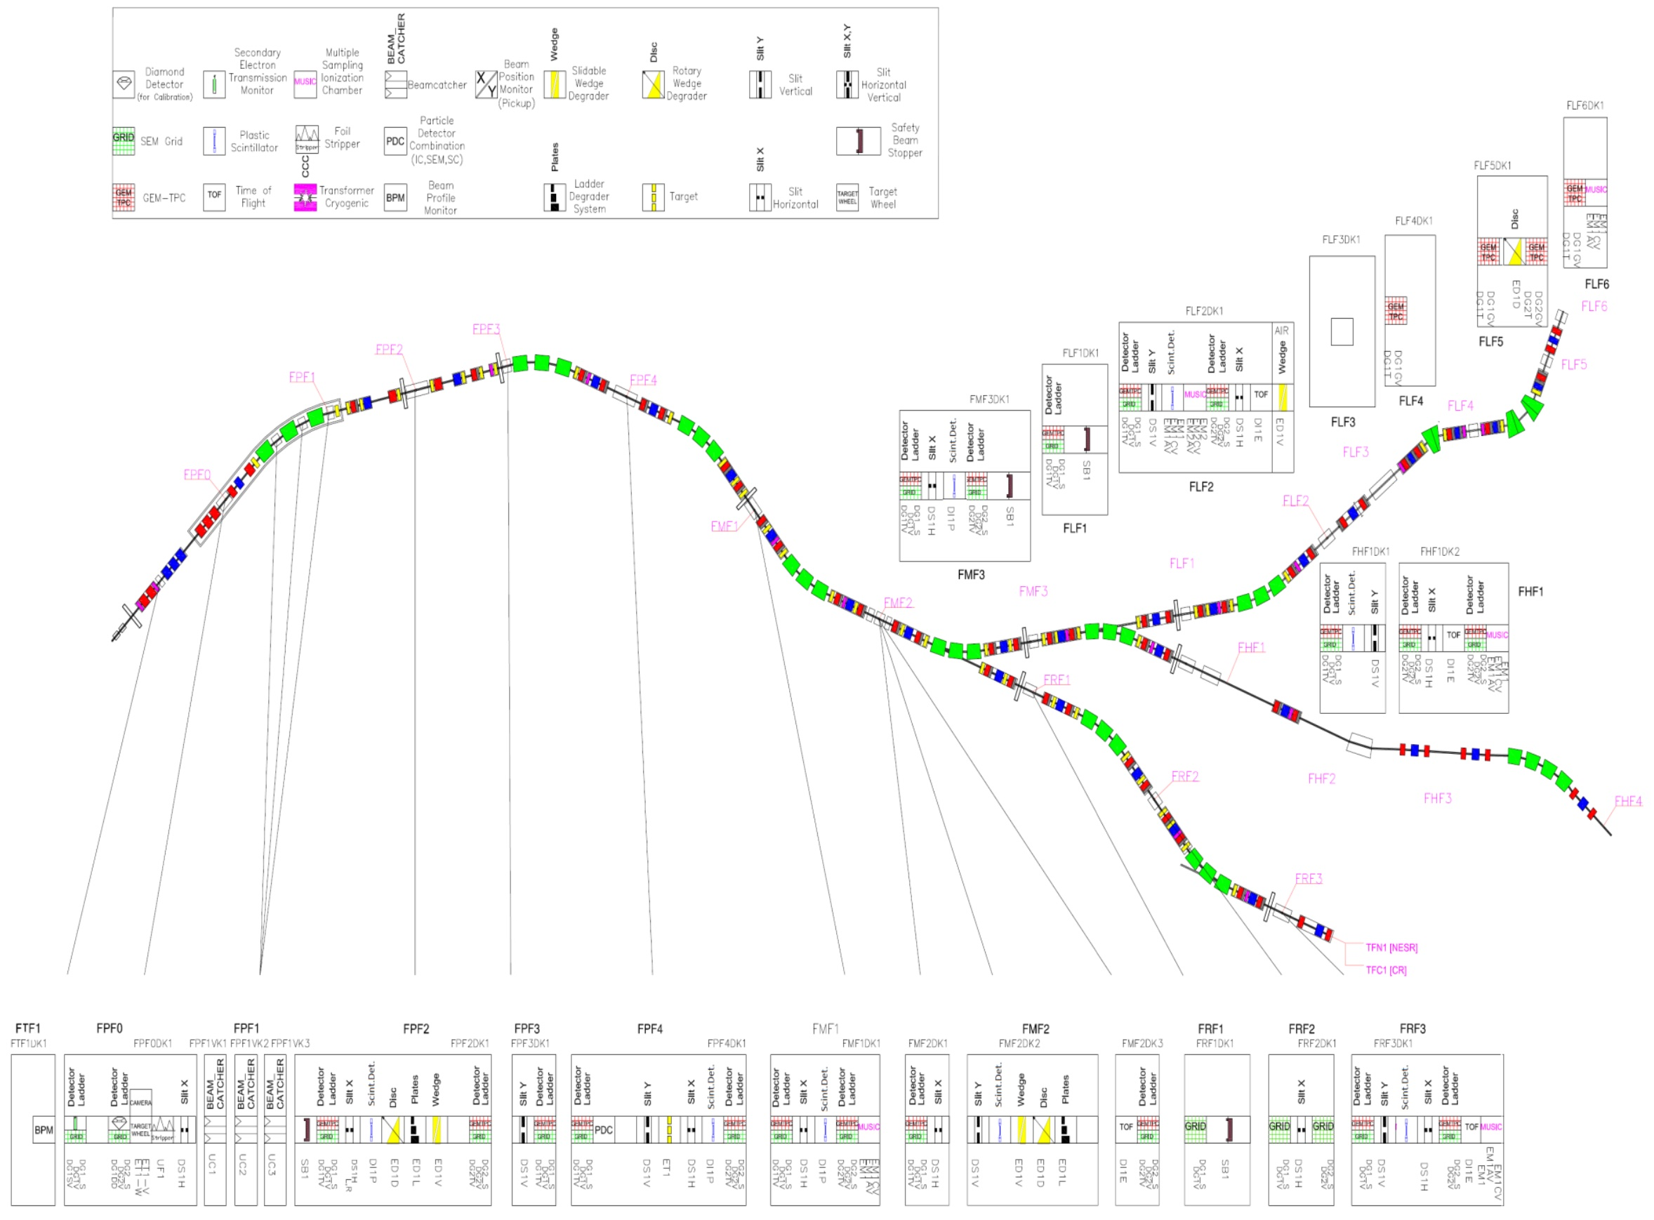
Finland will provide detectors…
…that measure
Enegy loss 𝛥E ⇒ Z (MUSIC detectors)
Particle position in the xy plane ⇒ B𝜌 (GEM-TPC detectors)
In addition, beam profile (SEM-grid) detectors are needed

Slide 4
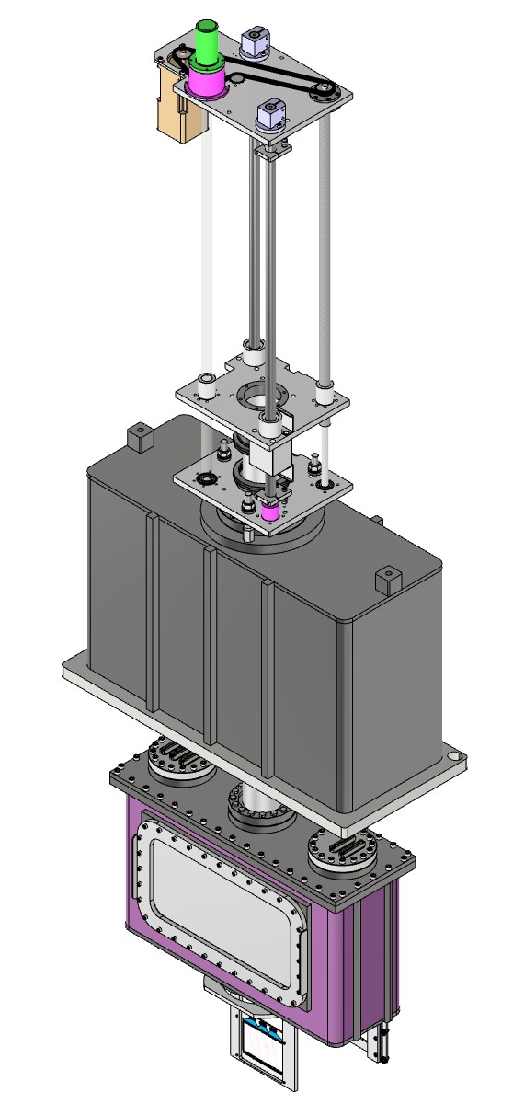
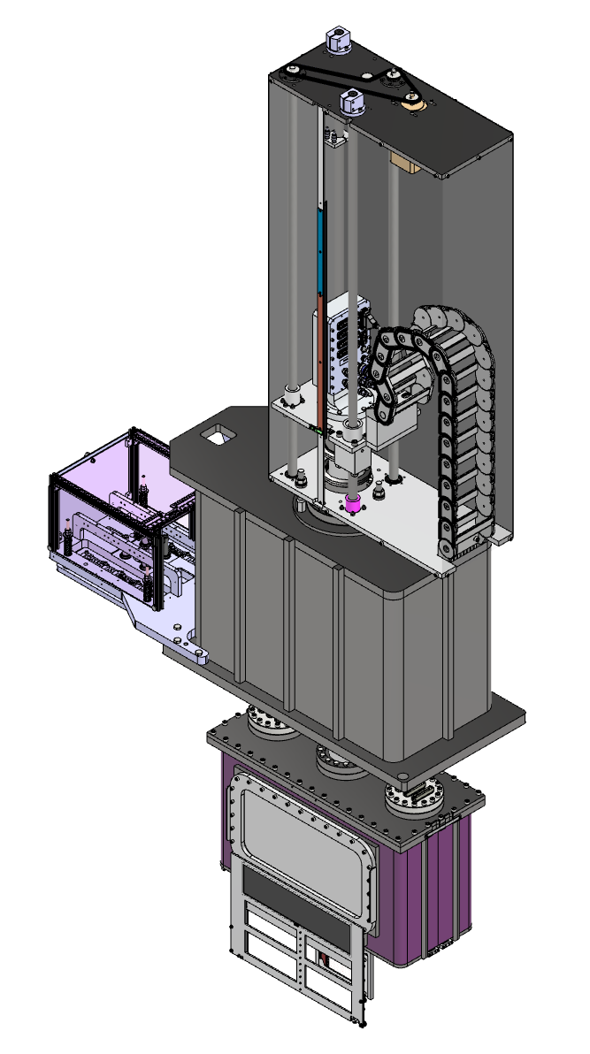
Beam insertion device seven different variants
xy
TOF
xy
MUSIC
Media board
slit
GEM-TPC
SEM-grid
Conceptual design report conditionally accepted.
Mechanical design at University of Jyväskylä (J. Tuunanen)
Calibration tool holder

Slide 5
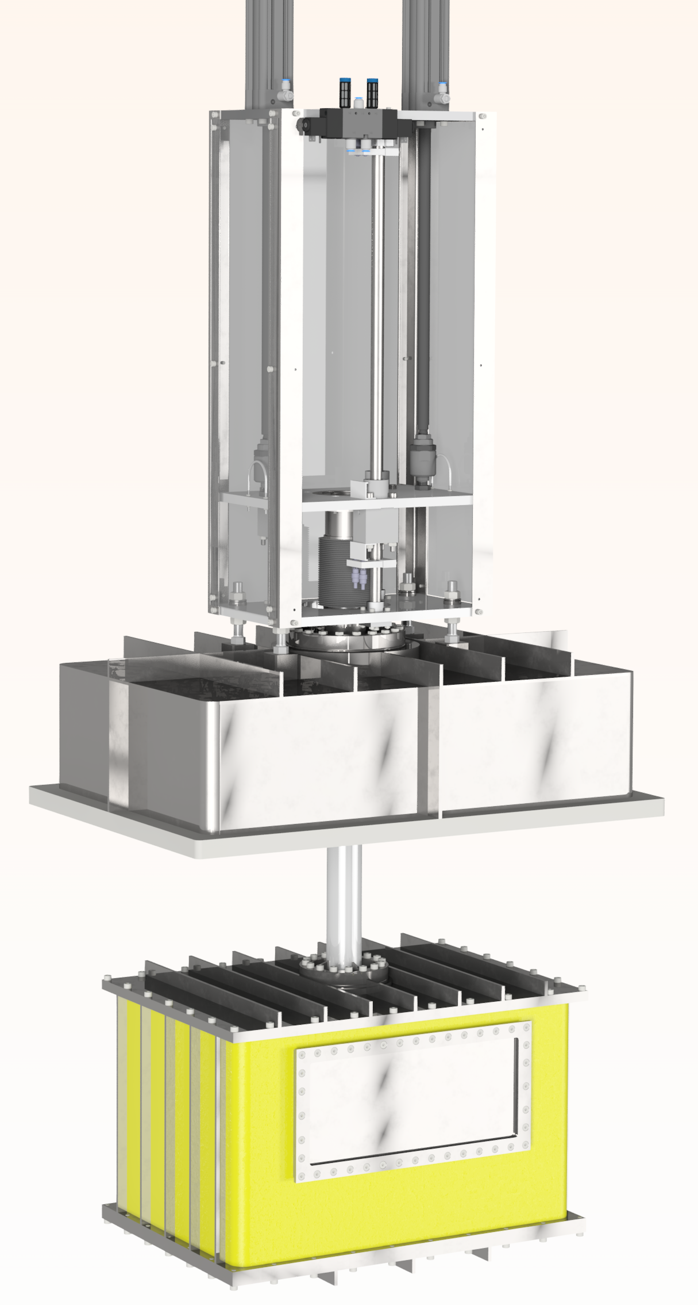
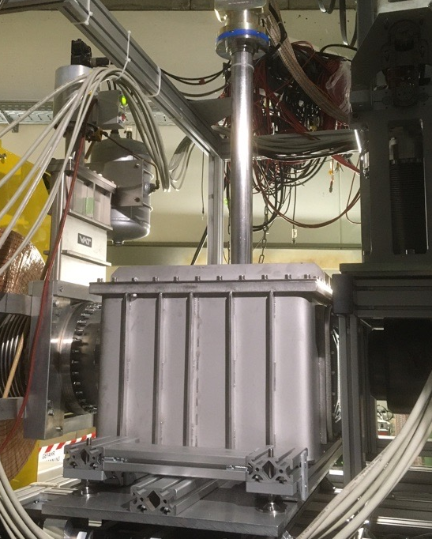
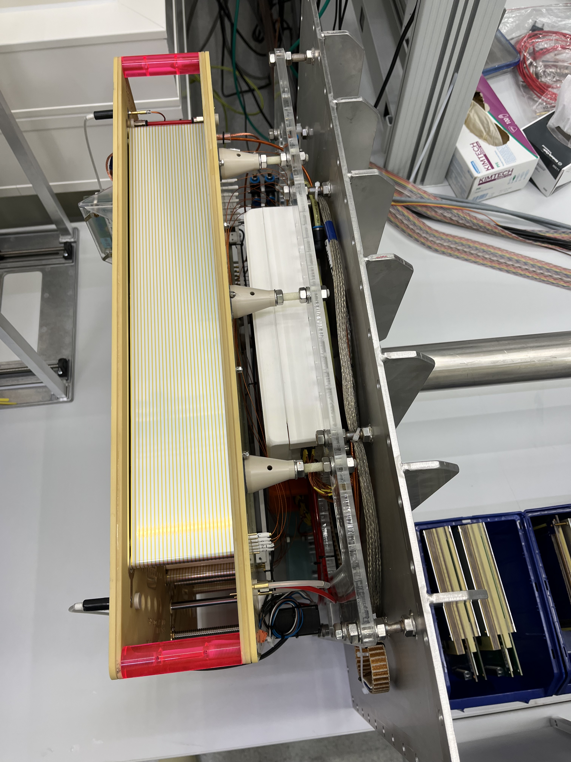
MUSIC 𝛥E detector
Pneumatic drive
The MUSIC detector is in final desing phase
Mitigations to problems observed in summer 2022 beam time ongoing
Design by GSI DL (B. Voss et al.)
Field cage

Slide 6
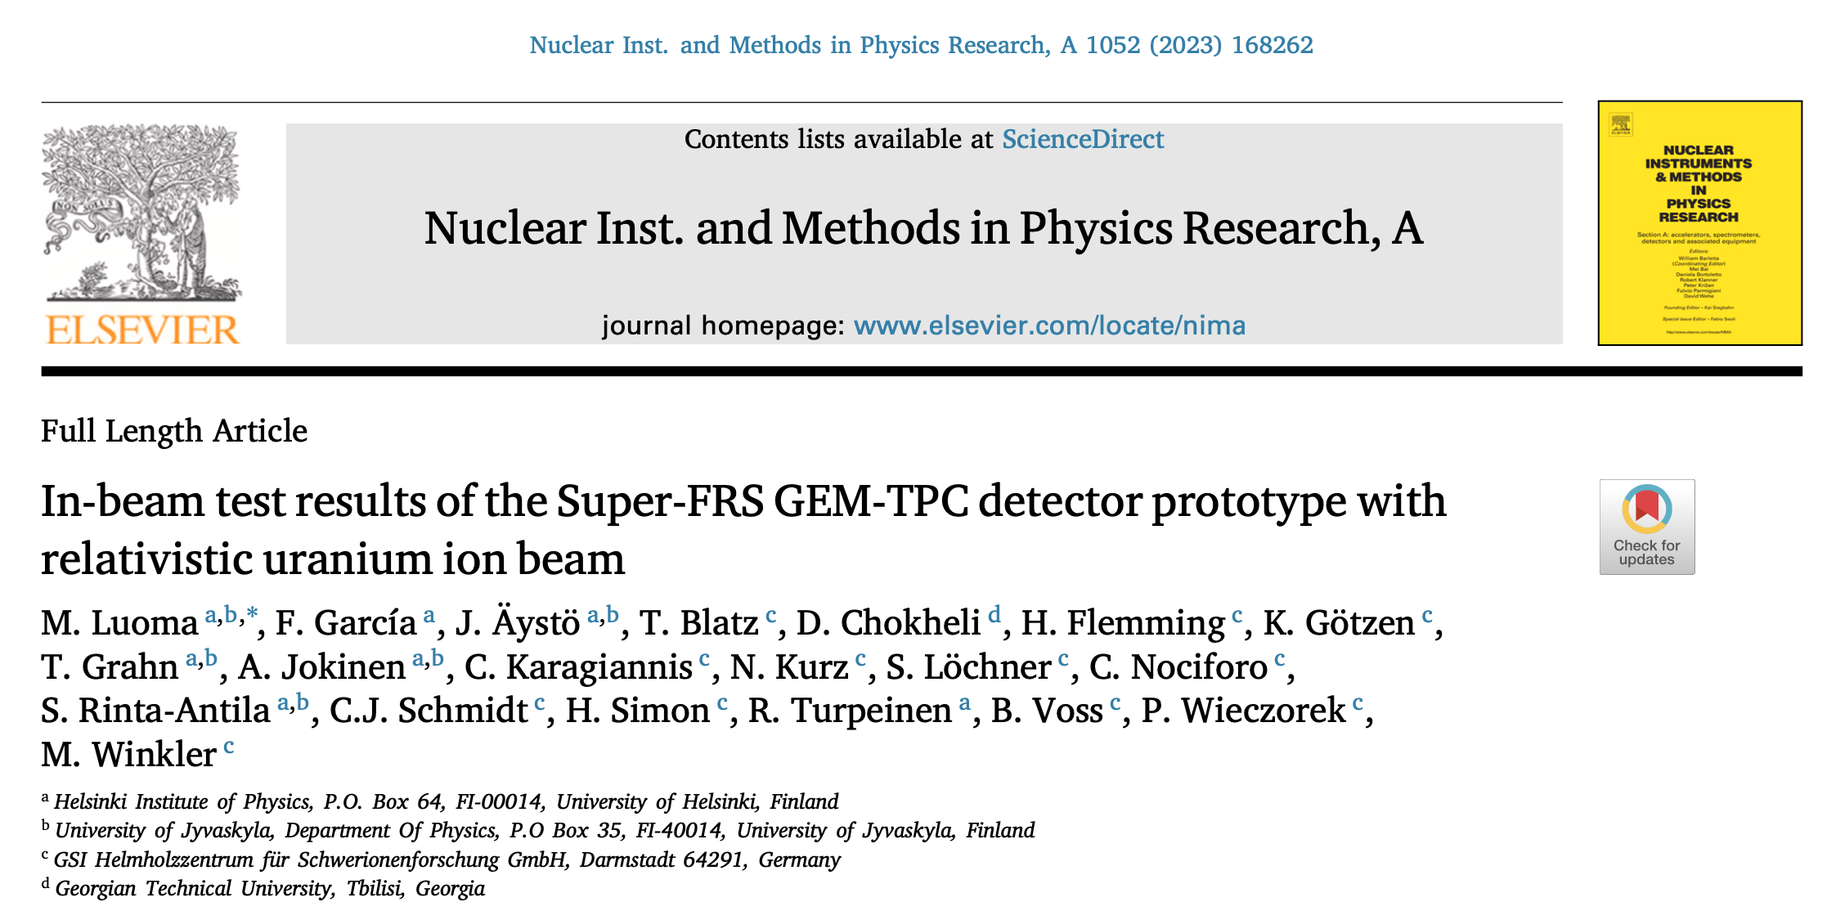
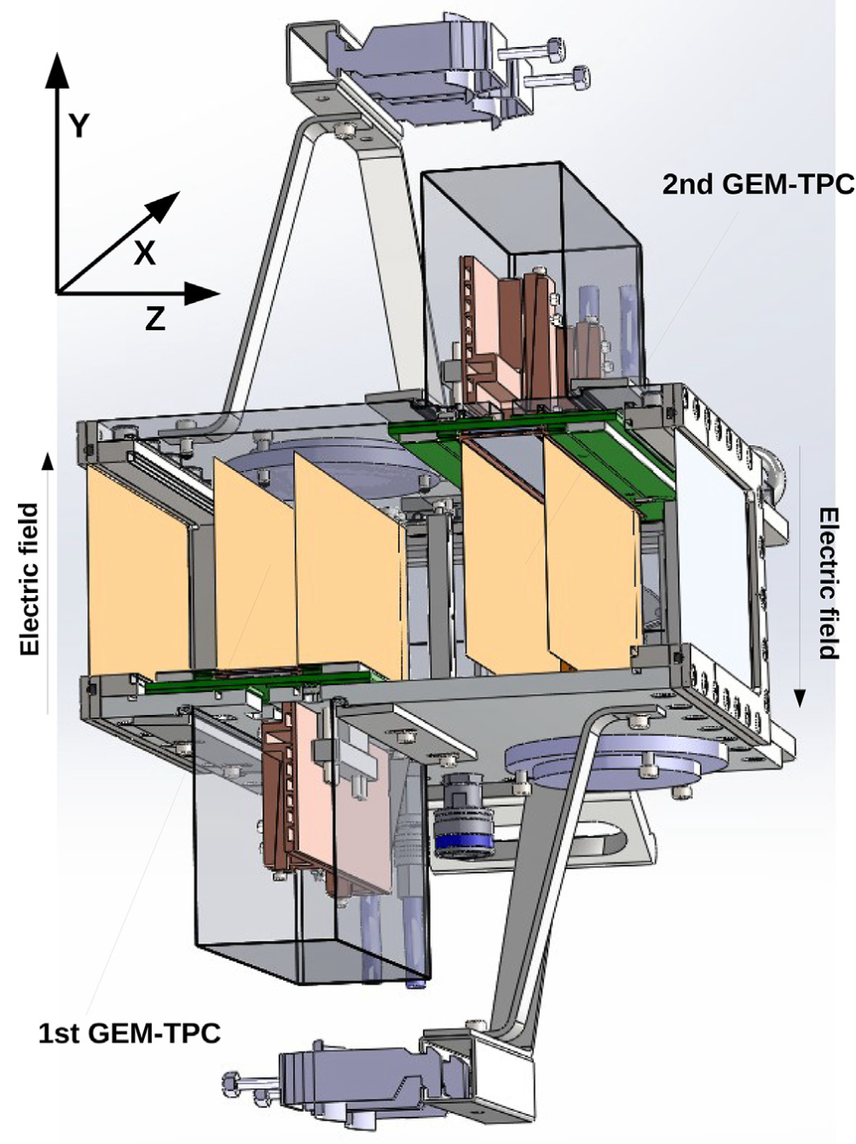
GEM-TPC position detector
The project is in conceptual design phase
In collaboration between HIP (F. Garcia) and GSI DL (B. Voss et al.)
So far the readout electronics have been a problem, new test results just published (by M. Luoma et al.)

Slide 7
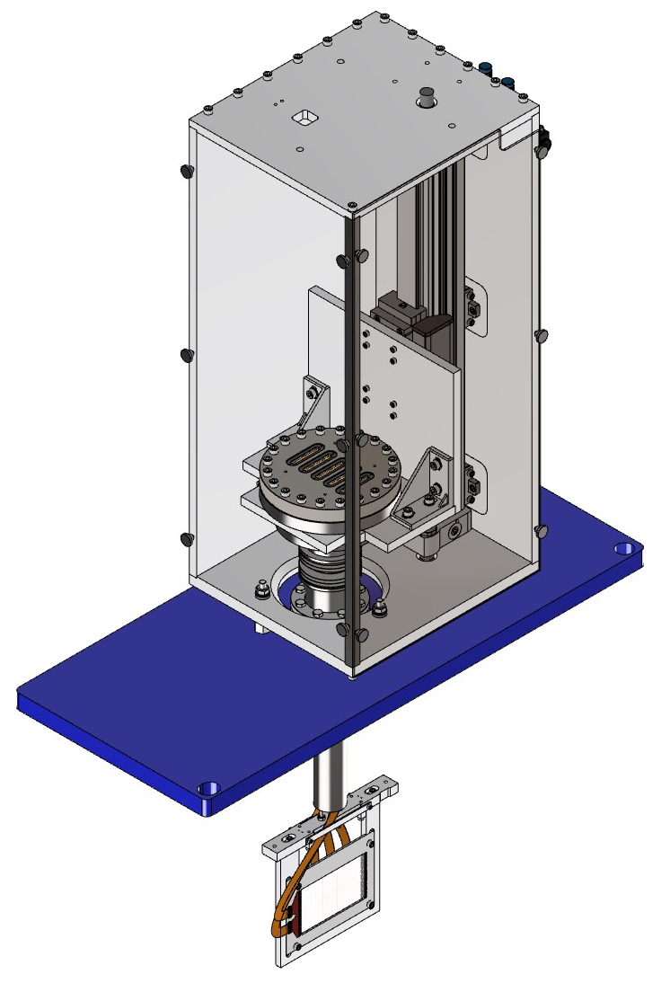
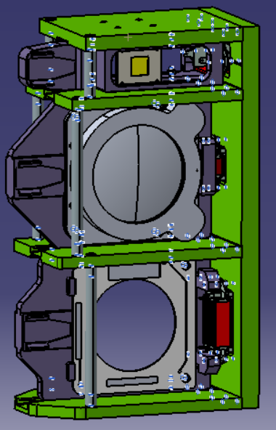
SEM-grid beam profile
Based on the Fermilab design, produced by Hbar Technologies, LLC
Holding structure designed by University of Jyväskylä (J. Tuunanen)
50-75 𝜇m Au-plated W wires in x and y
Signal readout through POLAND digitisers
SEM-grid on a pneumatic drive
Target SEM-grid

Slide 8
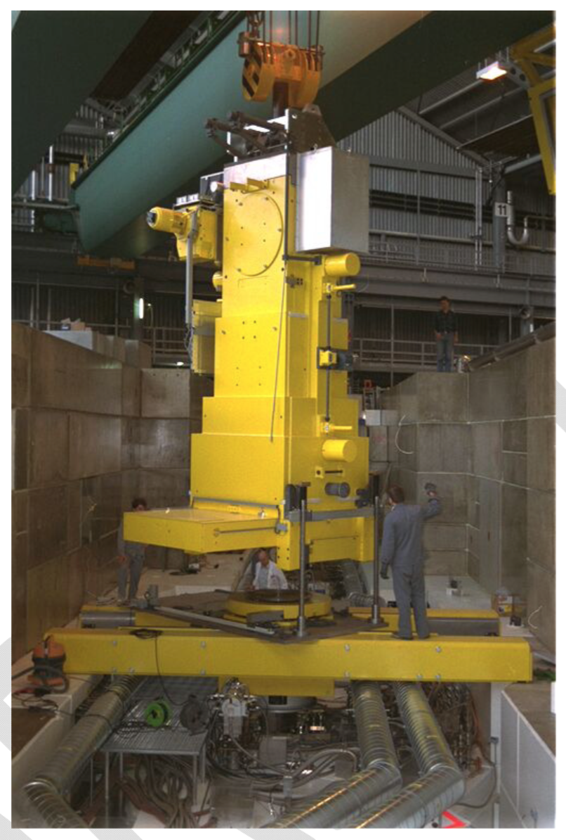
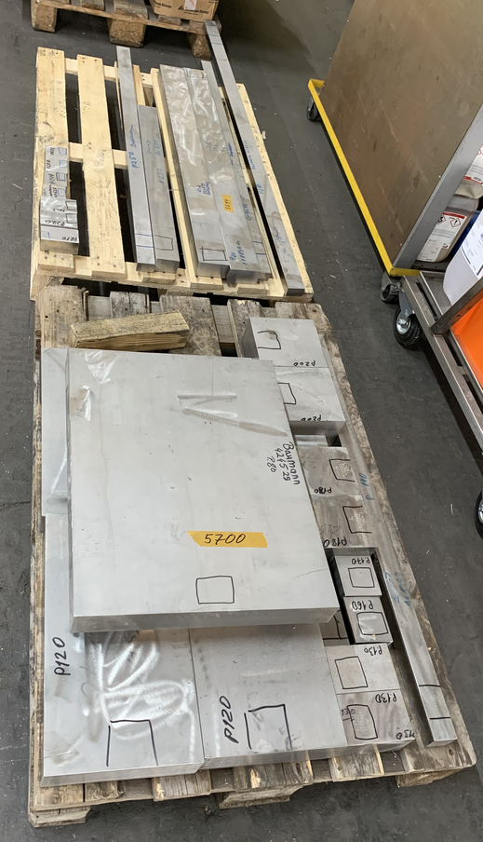
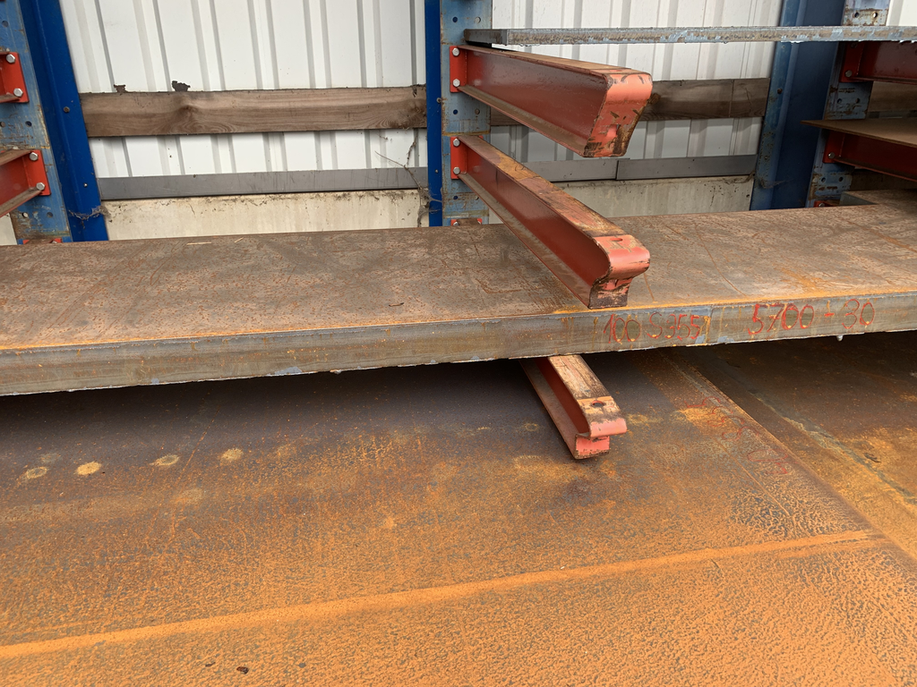
Super-FRS flask
The Super-FRS flask (Finland) and PANDA (Sweden) pbar flask were tendered together by FAIR. The contract was awarded to Billfinger Noell GmbH.
We are now entering the production phase
Status at the moment
PSI flask

Slide 9


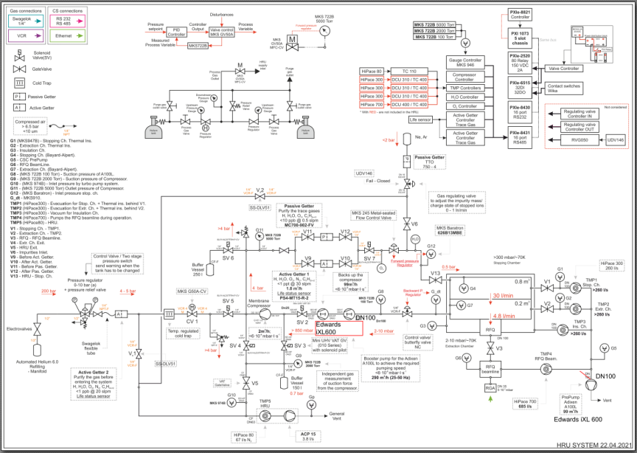

Helium Recovery Unit
Developed in collaboration with GSI and ELI-NP
Recovers >98% of (precious!) buffer gas He 6.0
Purifies buffer gas at each cycle
Final design report accepted
Purchasing underway. Test and Assembly of first components starts in the coming weeks.
Applied for beamtime in the GSI engineering run 2023
Notes:
Essential unit for the CSC operation.
For reference a standard gas bundle – 12 gas cylinders 50l each will last only 2.5 days without HRU. With HRU it is ~1 year of continuous operation.
And much more

