Slide 1



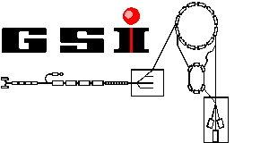

TRIGA-SPEC:
Developement platform for MATS and LaSpec at FAIR
Double-beta transition Q-value measurements with TRIGA-TRAP
NUSTAR Meeting 29.02.12
Christian Smorra
T. Beyer, K.Blaum, M. Block, Ch. E. Düllmann, K. Eberhardt,
M. Eibach, S. Eliseev, Sz. Nagy, W. Nörtershäuser, D. Renisch,
and the TRIGA-SPEC collaboration
Outline:
TRIGA-SPEC experiment
Mass measurements with Penning traps
Resonant enhancement of double-electron capture
Experimental results
Conclusions and Outlook

Slide 2
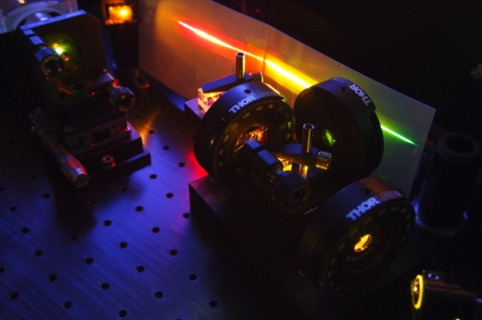
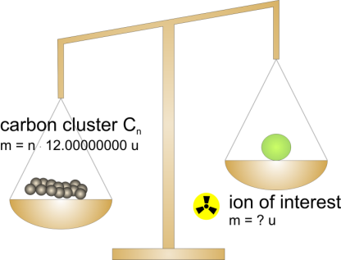
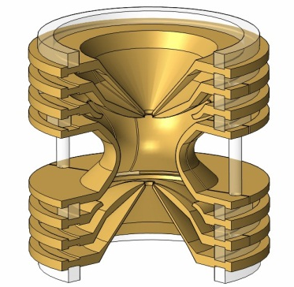


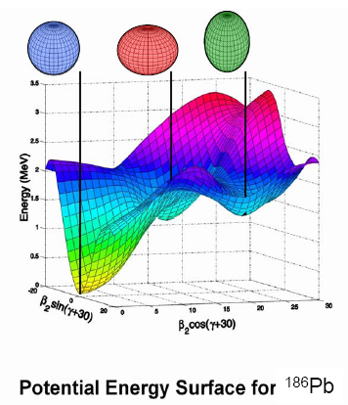
Ground-state properties of exotic nuclei
Mass Spectrometry
Laser Spectroscopy
MATS
LaSpec
nuclear nuclear
spin radius
magnetic spectroscopic
moment quadrupole moment
nuclear
binding
energy
?
=
mass differences, e.g.
separation energies
reaction Q values

Slide 3
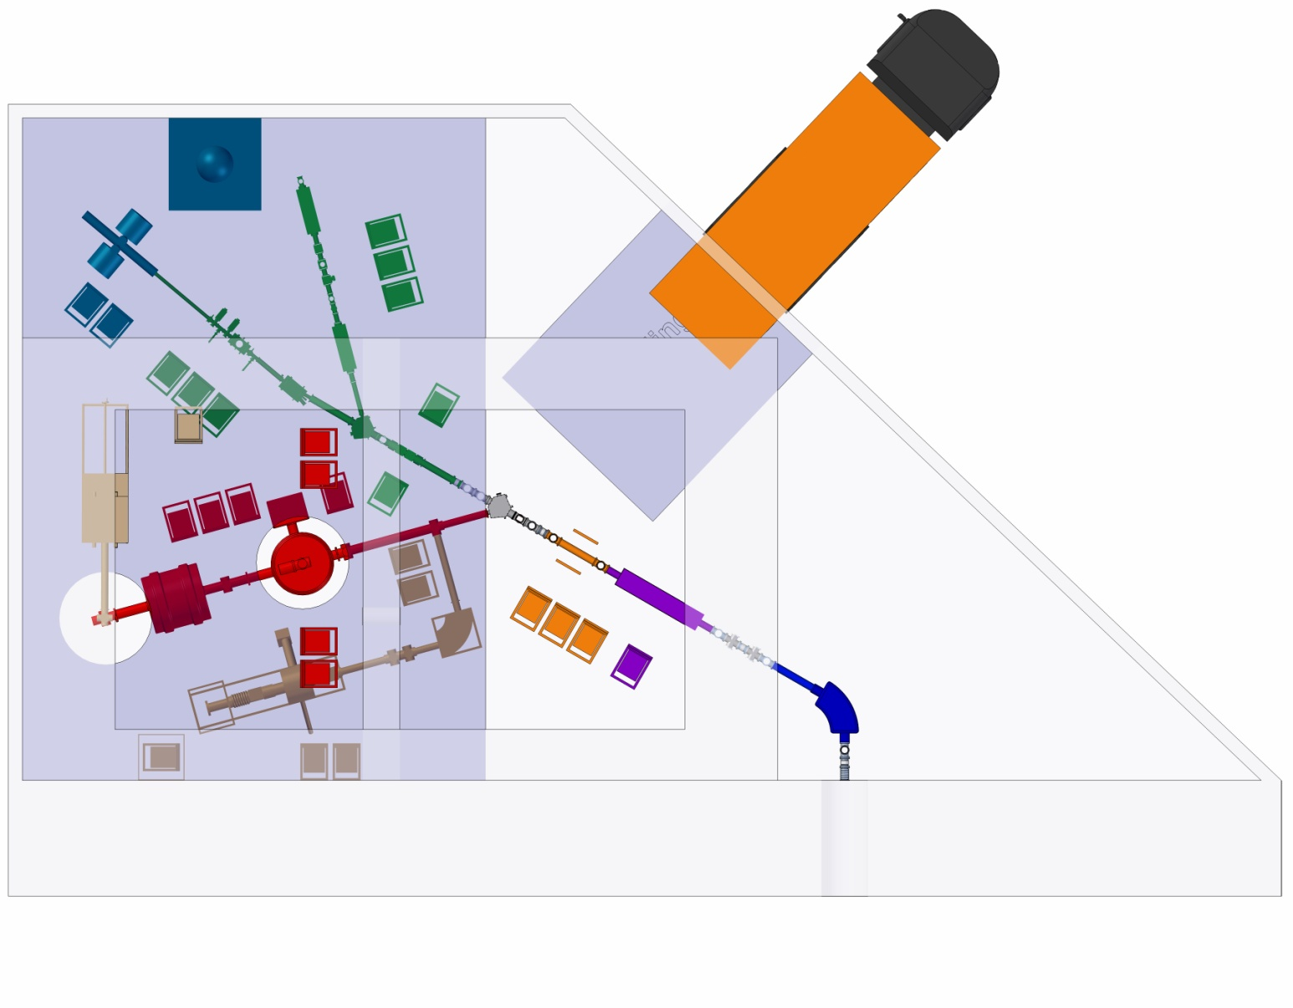
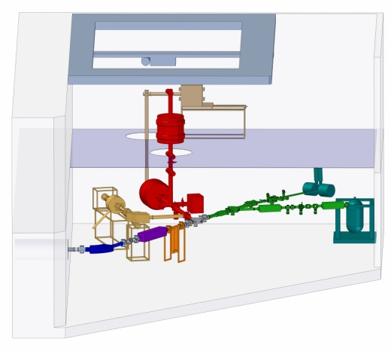
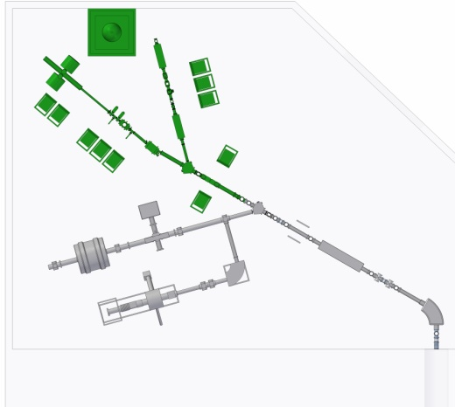
Future Facility MATS & LaSpec at FAIR
Laser Spectroscopy
T > 2017 A.D.
MR-TOF
RFQ cooler & buncher
MATS
EBIT
Dipole magnet
Gas cell
Low-energy branch behind the Super-FRS
for more information see:
Technical Design Report of MATS & LaSpec:
D. Rodriguez, EPJ Special Topics 183 (2010) 1-123
Notes:
MOTIVATION slide for TRIGA-SPEC: operation at MATS & LASPEC
as this LEB branch will not be finished before 2017 (or later), we were locking for alternatives were to build and develop a prototype under realistic conditions, e.g. with access to radioactive isotopes.
Solution (literally) very close to us….(see next slide)

Slide 4
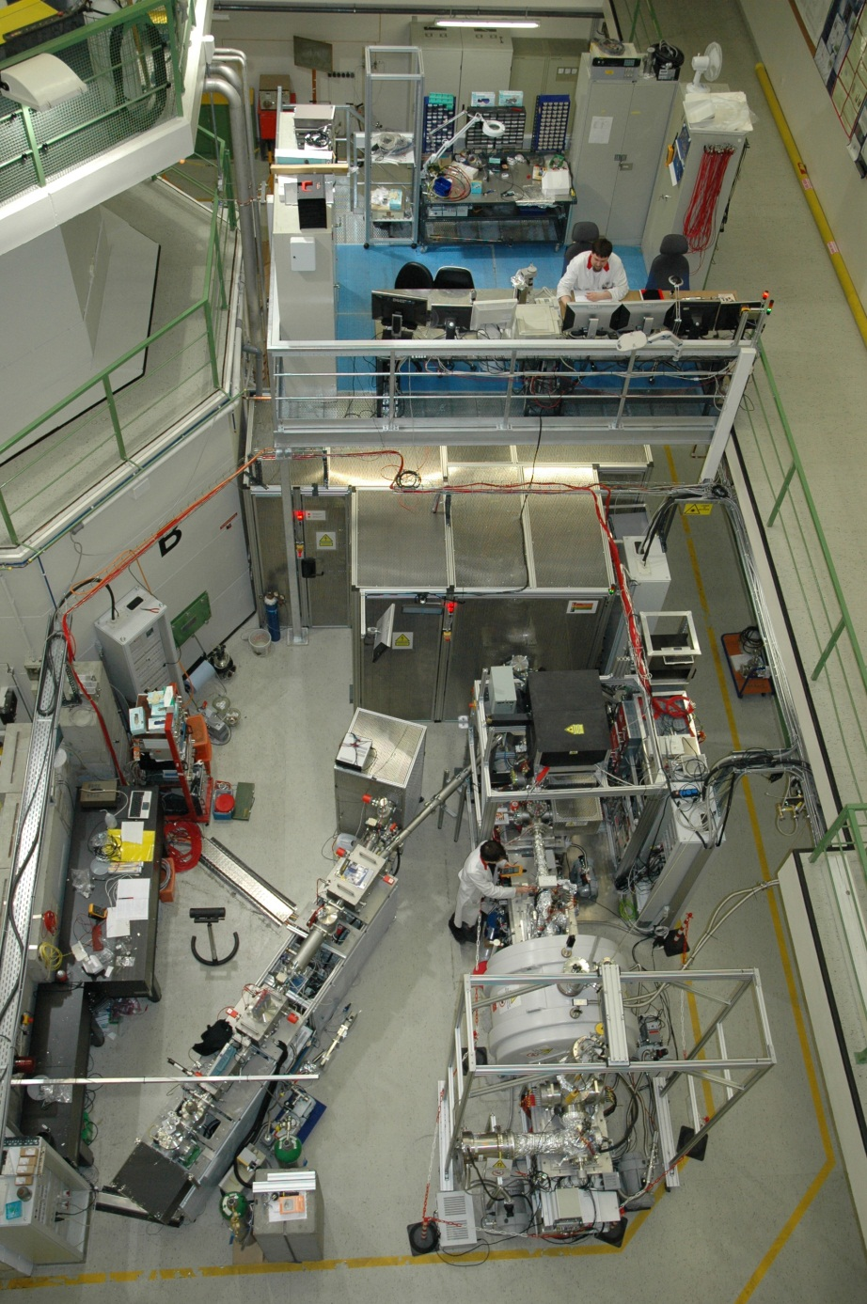
TRIGA-SPEC:
Development platform for MATS and LaSpec
project start @ TRIGA: 01/08
online ion source
Mass separator
RFQ
TRIGA-LASER
W. Nörtershäuser
TRIGA-TRAP
Nucl. Instrum. Meth. A 594, 162 (2008)

Slide 5
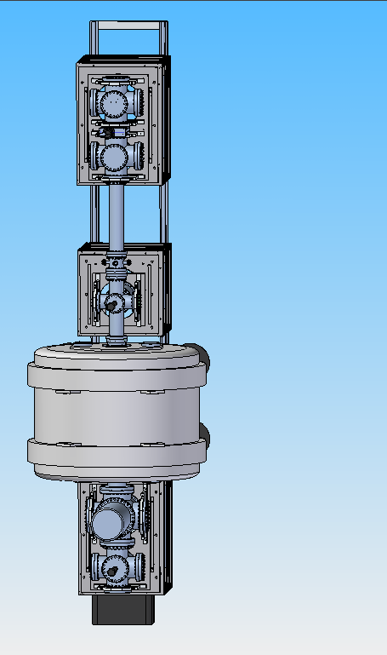
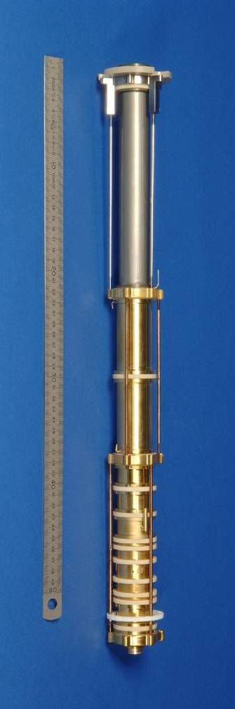
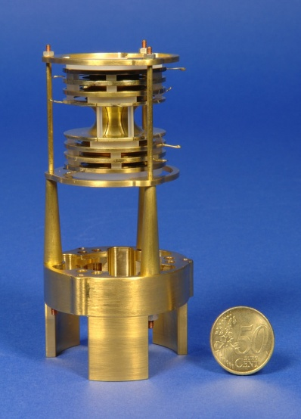
The TRIGA-TRAP experiment
top view
Purification trap:
Cleaning of unwanted ion species by buffer-gas cooling
Preparation of a mono-isotopic ion bunch
Precision trap:
High-precision mass measurements with single ions
Laser ablation ion source
Surface ion source
Beam analysis MCP
7 T magnet
Cryostat / 4K Electronics
TOF-ICR Detectors
1 m

Slide 6
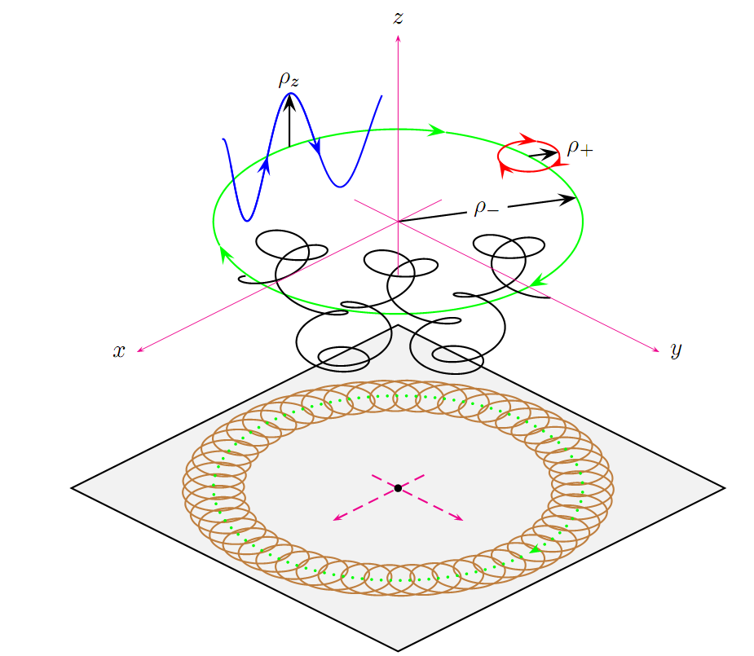
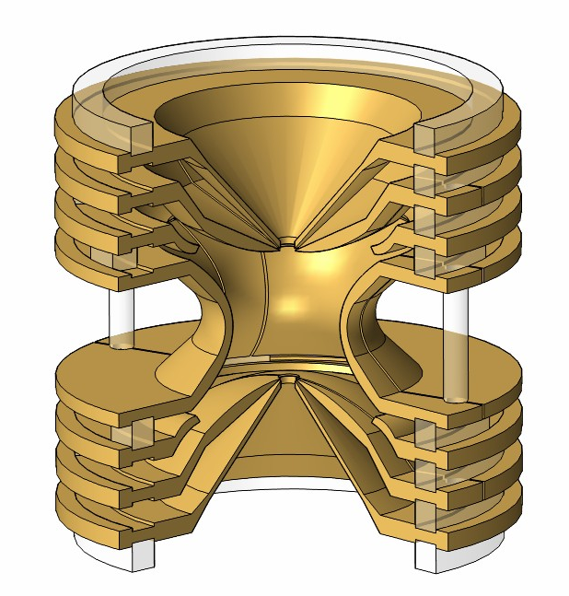
Principle of Penning trap mass spectrometry
B
Cyclotron frequency:
PENNING trap
Strong homogen.
magnetic field
Weak electric 3D
quadrupole field
q/m
ν_{z}
B
ν₊
ν₋

Slide 7
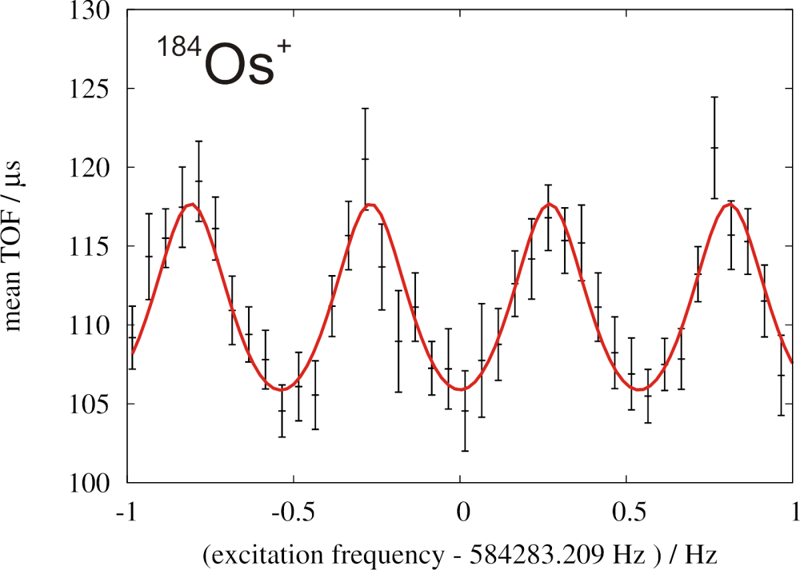
Time-of-flight ion-cyclotron-resonance
(TOF-ICR) method
3) Detection
MCP
Detector
2) Adiabatic conversion of
radial energy to axial energy
1) Ion excitation in the trap

Slide 8
Mass and Q-value determination
Reference ion
Ion of interest
Mother nuclide
Daughter nuclide
Required precision for double-beta Q values: ~ 100eV – 1 keV
Relative uncertainty of the frequency ratio: ~10⁻⁹ – 10⁻⁸

Slide 9
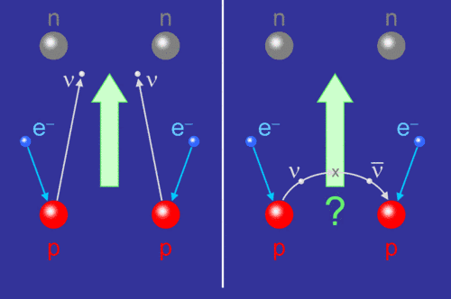
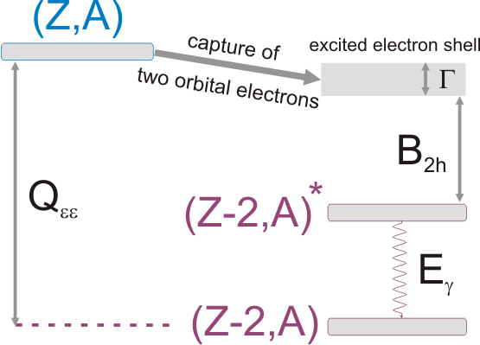
Neutrinoless double-electron capture (0νεε)
Is the neutrino a Majorana or Dirac particle?
2νββ (T_{1/2}~10²⁰y)
0νββ (T_{1/2}>10²⁵y)
2νεε (T_{1/2}>10²⁴y)
0νεε (T_{1/2}>10³⁰y)
Search for nuclides with Δ=(Q_{εε}−B_{2h}-E_{γ}) < 1 keV by measurements of Q_{εε} –values

Slide 10
Resonance enhancement factors
S. Eliseev, Phys. Rev. Lett. 106, 052504 (2011)

Slide 11
TRIGA-TRAP Q-value measurement results
/ keV / keV / keV / keV
2748.2 (0.4) (2,3)⁻ 2770 (7) 2775.01 (0.56) -0.73(0.69)
SHIPTRAP: 2775.39 (0.10) -0.33(0.41)
0.0 (0) 0⁺ 272 (6) 272.04 (0.55) > 200
433.938 (0.005) 2⁺
1322 .152 (0.022) 0⁺ 1451.2(1.6) 11.3 (1.6)
2004 (11) 2017.8 (1.2)
ISOLTRAP: 2017.85 (0.64)
C.S. et al., Phys. Rev. C 85, 027601 (2012)
M. Goncharov et al., Phys. Rev. C 84, 028501 (2011)
D. Fink et al., Phys. Rev. Lett. 108, 062502 (2012)

Slide 12
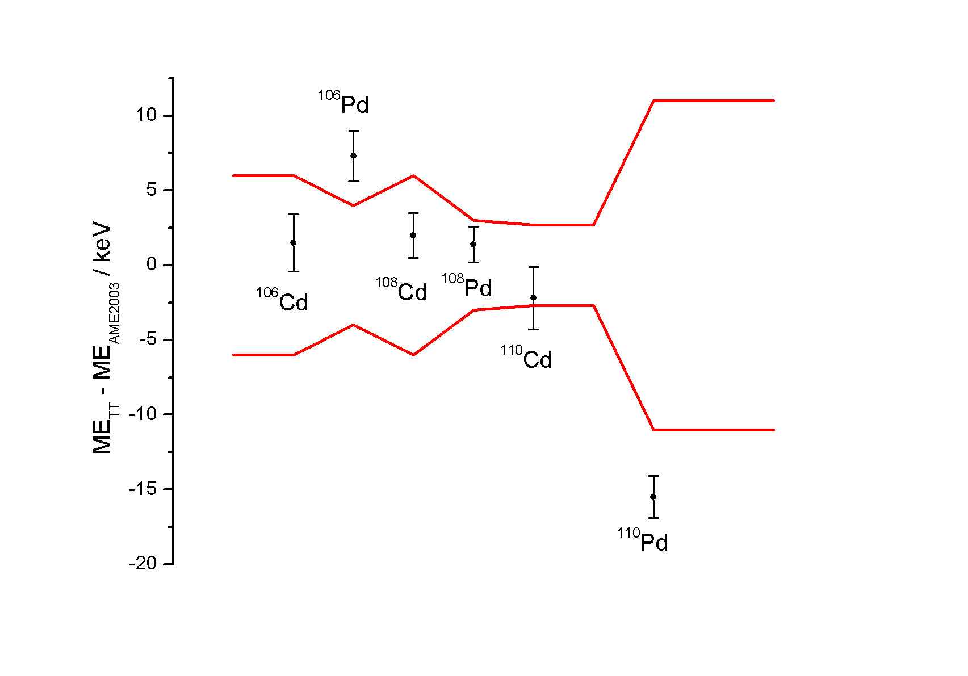
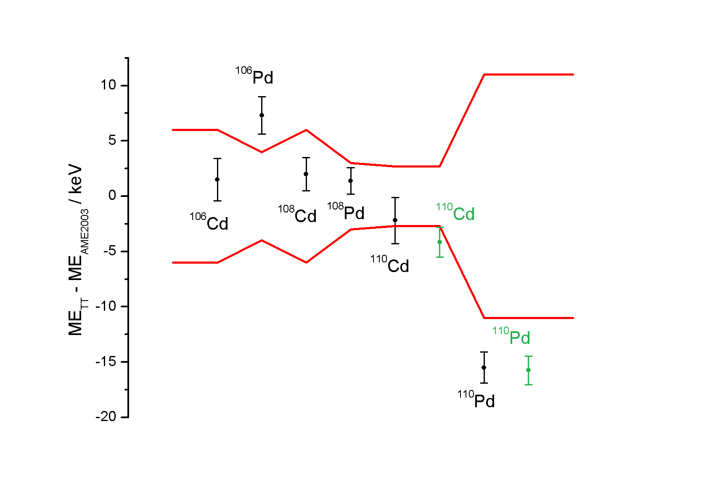
Results: Cadmium and palladium masses
AME 2003

Slide 13
Conclusions and Outlook
Q-value measurements of double-beta transitions of ¹⁰⁶Cd, ¹⁰⁸Cd, ¹¹⁰Pd and ¹⁸⁴Os with TRIGA-TRAP
  Uncertainties of the Q-values and mass values were improved
  Resonance condition of ¹⁰⁶Cd, ¹⁰⁸Cd and ¹⁸⁴Os were investigated
TRIGA-SPEC serves as a development platform for MATS and LaSpec at FAIR
  FT-ICR detection system for MATS
  Online coupling to the TRIGA reactor
  (Ion sources, RFQ Buncher, etc.)
Thank you for your attention!

