Slide 1

Progress Report

Slide 2
FAIR GmbH OrgChart
FAIR Council
AFC
Scientific Council
IKRB
MAC
Management
Board
Staff Office
Legal
Advisor
Council
Issues
Secretariat
BFC
Internal Auditing
Research
Technical
Division
Site &
Buildings
Admin.
Expert C‘ttee Experiments
Project Office
Experiments
Project Office Techn. Division
Reporting
Project Office
Site & Buildings
Internal Services
APPA
Technical
Services
M&E Advisor
Civil Eng. Advisor
Controlling
CBM
In-Kind Coordination
M&E Eng. Automation, IT
Finance
NuSTAR
Technical
Follow-up
M&E Eng.
Power, Mat.
Purchasing
PANDA
M&E Eng. Thermo, Refrig.
Personnel
M&E Eng.
Liqu., Gases
Constr. Eng.
Building, Geo.
Constr. Managem. Eng.

Slide 3
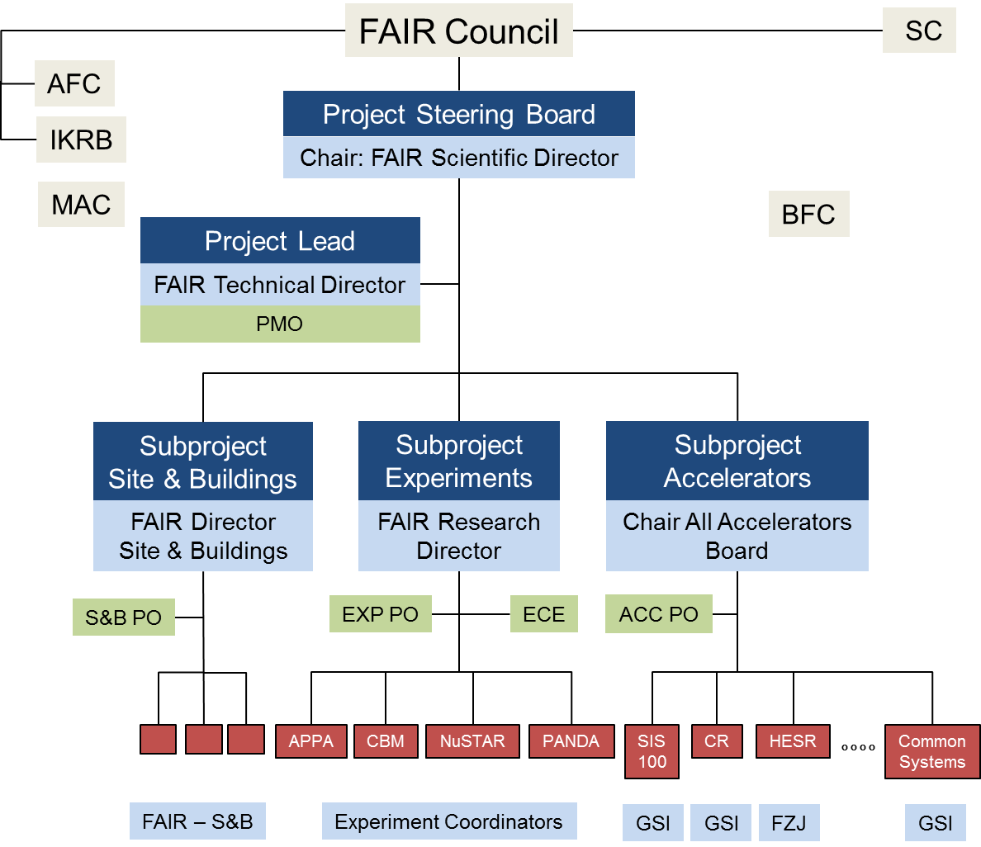
OrgChart FAIR-GSI Collaboration

Slide 4
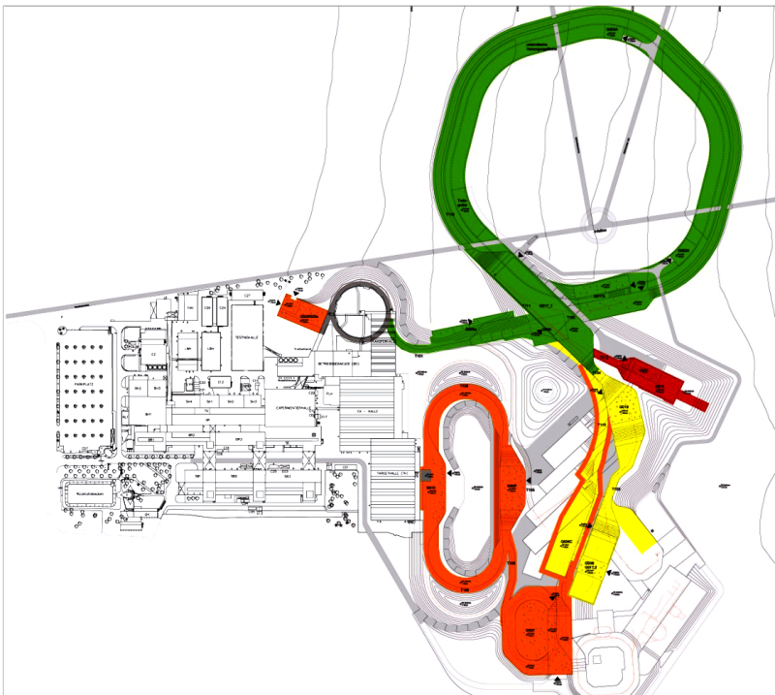
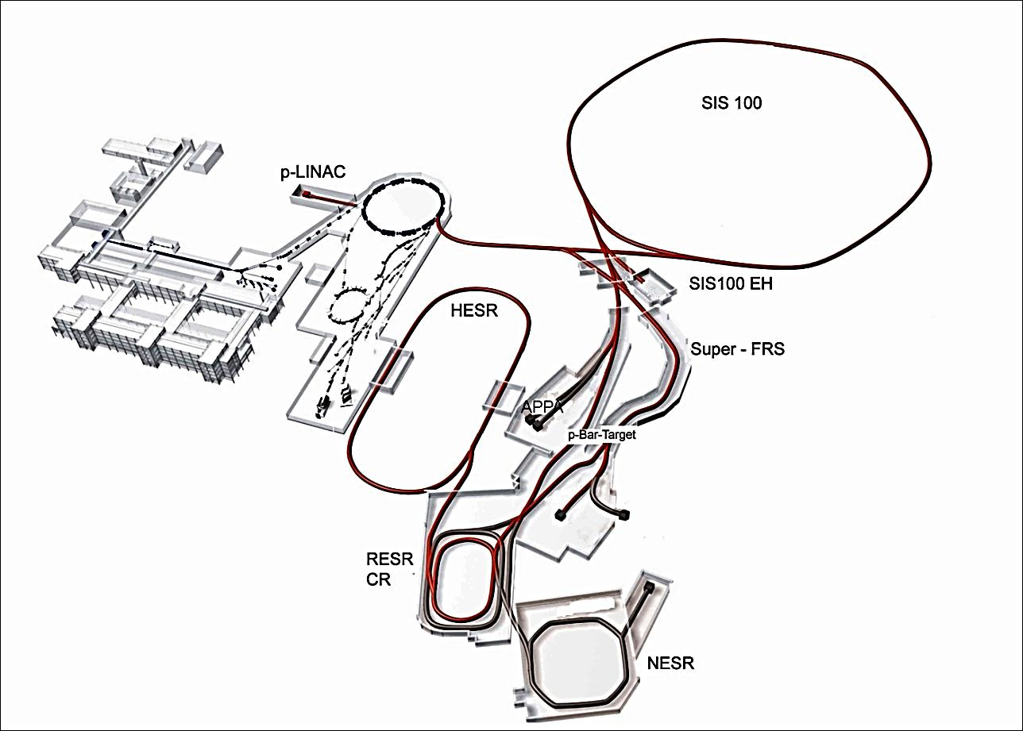
Modularised Start Version
M0
M3
M1
CBM/HADES
M3
M2
APPA
Experiments
M1: APPA
M1: CBM/HADES
M2: NuSTAR
M3: PANDA
PANDA
NuSTAR

Slide 5
Timeline
2011
2012
2013
2014
2015
2016
2017
2018
2019
6
7
8
9
10
11
12
6
Building permits
Site preparation
Civil construction contracts
Building of accelerator & detector components
Completion of civil construction work
Installation & commissioning of accelerators and detectors
Start Data taking
7
8
9
10
11
12

Slide 6
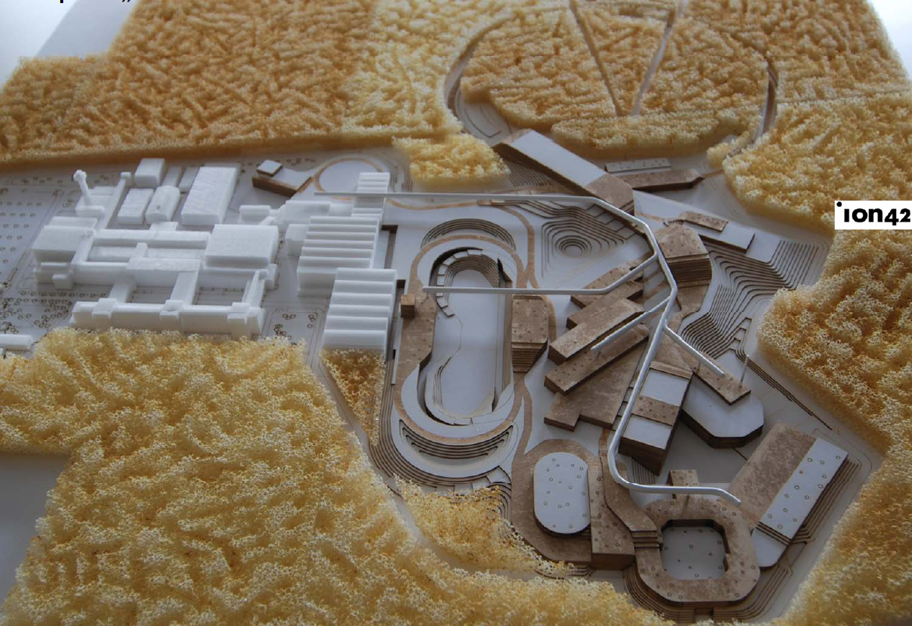
Civil Construction

Slide 7
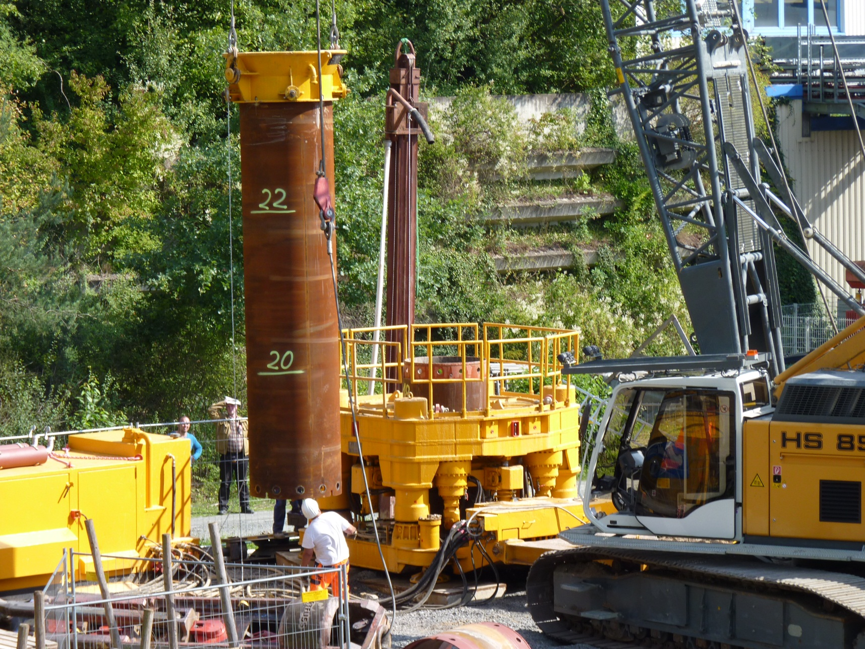
First Post Drilling 31/8/2011

Slide 8
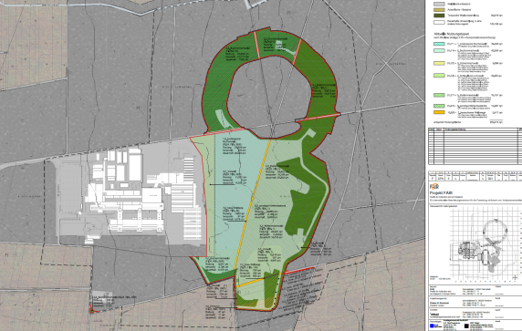
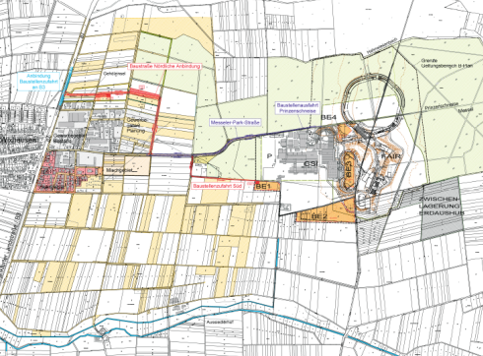
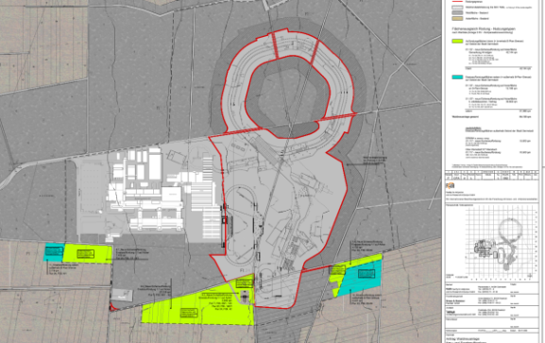
Permits
 | 09 / 11 | 10 / 11 | 11 / 11 | 12 / 11 | 01 / 12
Clearing permit
Building application
Application for afforestation
Permit for site roads
Application for water rights
11.11.11
31.08.11
19.01.12
20.01.12
21./23.11

Slide 9
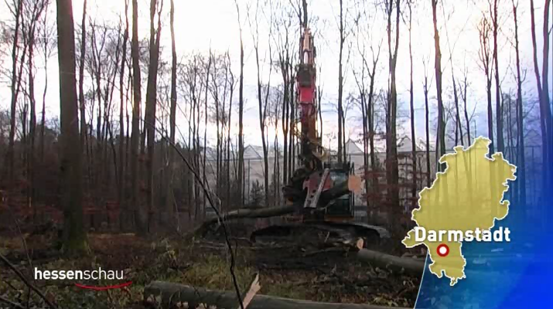
Clearing Construction Site 6/12/2011

Slide 10
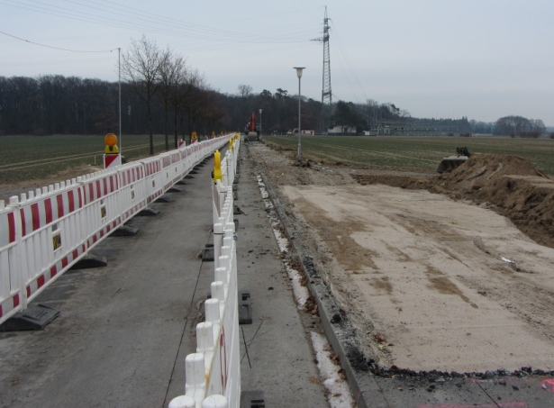
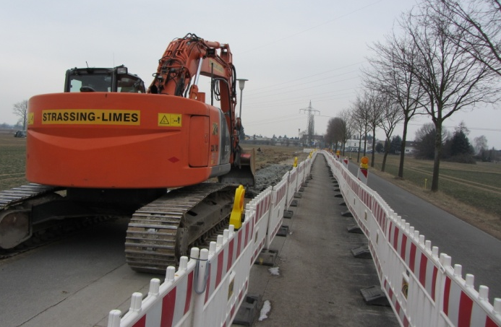
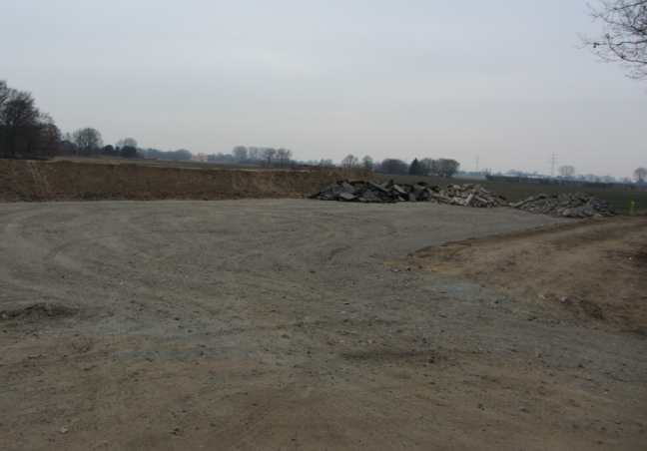
Further Preparatory Work
 | 01 / 12 | 02 / 12 | 03 / 12 | 04 / 12
Stripping of topsoil (area tree felling)
Site roads (Messeler Parkstr.)
Site roads (southern traffic link)
Site roads (northern traffic link)

Slide 11
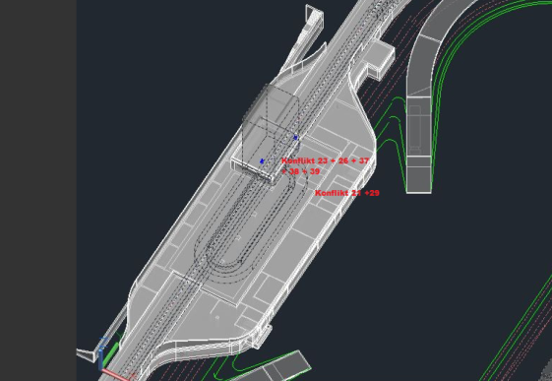
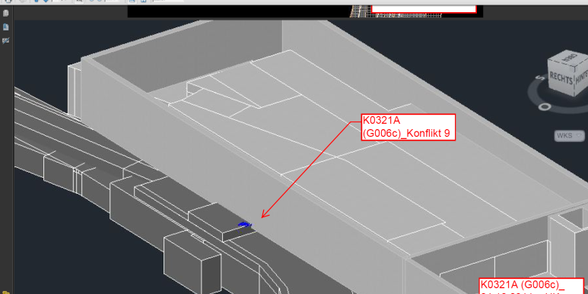
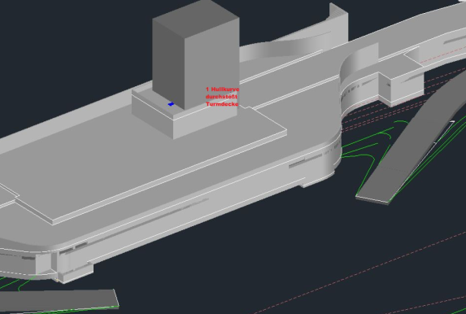
Planning Activities
 | 01 / 12 | 02 / 12 | 03 / 12 | 04 / 12
Checking and approval of Lph 3
Checking of cost calculations (analysis of differences to ZBau)
Technical route planning (Lph 5)
Statics / layout drawings (Lph 5)
Announcement of logistics

Slide 12
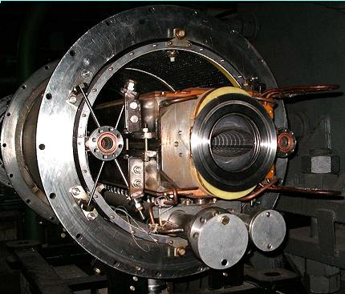
Accelerators
Ordered for SIS100 from Babcock Noell in Jan. 2012 (German in-kind contribution, BMBF grant to GSI)
Many other parts of SIS100 and CR in preparation (in-kind or tender)
HESR ready to go out for tender (BMBF grant offered to FZJ)
IKRB meeting at FAIR on 28/3/12
MAC meeting at FZJ on 2/4/12
Compact & cost effective
Fast cycling superconducting magnets
dB/dt ~ 4T/s

Slide 13
MSV Experiments
APPA
CBM
NuSTAR
PANDA
SPARC
HEDgeHOB
WDM
BIOMAT
LEB
Super-FRS
HISPEC/
DESPEC
MATS
LASPEC
R³B
ILIMA
HADES

Slide 14
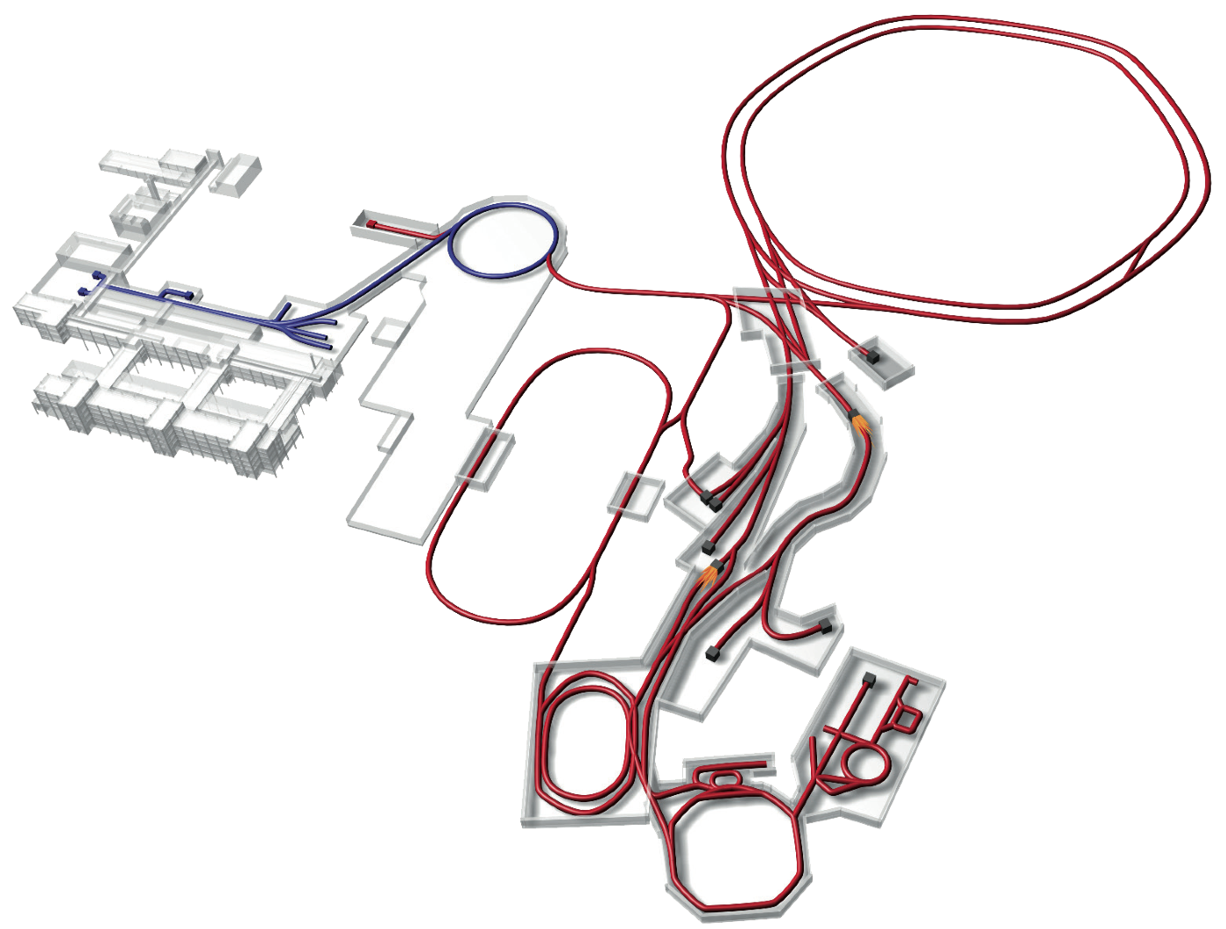
APPA
Board of APPA Collaborations established
Spokesman and Deputy elected
Layout of APPA hall finalised
Options explored for experiments at
  HESR
  Cryring @ ESR
APPA

Slide 15
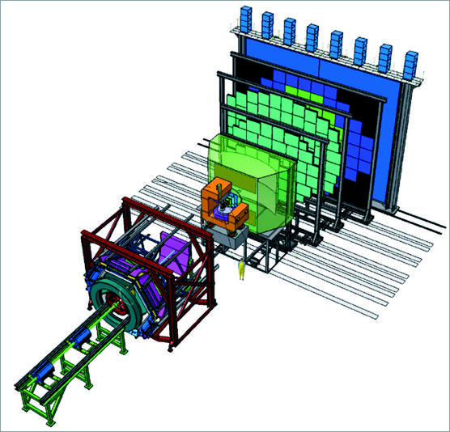
CBM
HADES detector upgraded
Collaboration with Dubna (Nica) being considered
Finishing R&D work
CBM

Slide 16
NuSTAR
Cf. this meeting
Hall LEB being considered by Collaboration
  caveat: no funds available in MSV budget
Exp. @ HESR being considered
Super-FRS
NuSTAR

Slide 17
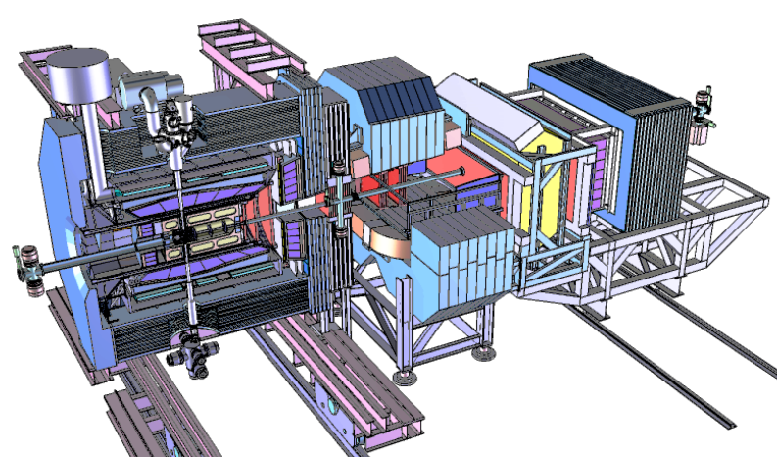
PANDA
R&D being finished
Remaining TDRs being finalised
Premounting @ FZJ being prepared
PANDA

Slide 18
Costs MSV
Accelerators and personnel (including Super-FRS) | 502 M€
Civil construction (excluding site related costs) | 400 M€
FAIR contribution to experimental end stations * | 78 M€
FAIR GmbH personnel & running until 2018 (>8 years) | 47 M€
Grand Total MSV, Modules 0 - 3 | 1027 M€
in 2005 €
(inflation escalation until 2018: ca. +50%)
* Total experimental end stations (excluding Super-FRS):
ca. 210 M€ (2005) = 315 M€ (2018)

Slide 19
Tasks 2012/13
Collaborations finish R&D phase
  Deliver prototypes of essential parts of detectors
Collaborations submit TDRs
  Take decisions on alternative technical solutions
FAIR Research Division initiates and monitors procedures through
  Project Office
  Technical and Resource Co-ordinators
FAIR establishes Expert Committee Experiments, ECE
  Nominations by Collaborations
  Co-ordination with FAIR Council Chair
  Negotiations with nominees
  Approval by FAIR Council
FAIR establishes TDR Review Panels: ECE members (+ external experts)
FAIR organises/monitors the co-ordination of experiments with
  Civil construction
  Accelerators/storage rings
Collaborations identify, in collaboration with FAIR, critical pathways regarding
  Timelines, milestones, deliverables
Collaborations submit risk management plans
  To be assessed by FAIR and
  integrated into Risk Reports to AFC and Council
Funding Issues
  FAIR organises Resource Review Boards in collaboration with each Collaborations, which report to participating funding agencies
Each Collaboration, their Funding Agencies and FAIR negotiate Construction MoU

Slide 20
Thank you very much

