Slide 1











NUSTAR financial status 11th FAIR-NUSTAR Resources Review Board FAIR/GSI, Darmstadt, Germany
Alexander Herlert
NUSTAR Resource Coordinator
FAIR
Finland
France
Germany
India
Poland
Romania
Russia
Slovenia
Sweden
UK
Czech Republic

Slide 2

Outline
NUSTAR funding
Recent main changes (since 10th meeting)
Status of secured funding and intended funding (MSV and Day one)
NUSTAR Construction Common Fund items (finalized)
NUSTAR Construction MoU
Status of Construction MoU
Details on C-MoU structure (main text and annexes)
Cost-sharing for Construction Common Fund

Slide 3
Recent main changes
LEB infrastructure
TDR for LEB infrastructure submitted to ECE/ECSG, cost-matrix values updated
Additional funding for cryogenic stopping cell received (BMBF-VF/Germany and Israel)
HISPEC/DESPEC
Funding for slowed down beam setup received (BMBF-VF/Germany)
MATS
Second superconducting magnet funded and to be sent soon (Univ. Granada, Spain)
MATS layout adapted: two beam lines – Penning trap system 1 and 2
Additional funding for FT-ICR detection system (BMBF-VF/Germany)
EoI from HIM (Mainz, Germany) for control system -> toward full funding of Day-one configuration

Slide 4
Recent main changes
R³B
TDR of infrastructure approved
Overhaul of GLAD magnet safety system (infrastructure) to be covered by Common Fund (needs to be done before move to new cave)
Additional funding for CALIFA (BMBF-VF/Germany)
ILIMA
EoI from Univ. Saitama (Japan) for remaining Day-one items.
Super-FRS EC
Secured funding for additional components of the EXPERT system (JINR Dubna/Russia)

Slide 5
Evolution of NUSTAR project funding (MSV)
Note:
GLAD with final cost
UK included in FAIR

Slide 6
NUSTAR MSV – funding status
46.6 MEUR
core funding (secured and expected) from:
(FAIR funding in bold face)
Australia
Belgium
Bulgaria
Canada
Czech Republic
Finland
France
Germany
Hungary
India
Israel
Japan
Netherlands
Poland
Romania
Russia
Slovenia
Spain
Sweden
Turkey
United Kingdom
Status: February, 2022

Slide 7
NUSTAR experiment-funding overview (MSV)
Experiment | Prices, K Euro
 | 2005 prices |  |  | 2022 prices
 | Secured* | EoI | to be assigned | EoI | to be assigned
LEB infrastructure | 1226.8 | 638.8 | 1189.6 | 1017.5 | 1894.9
HISPEC/DESPEC | 11071.8 | 2509.1 | 600.8 | 3996.7 | 957.0
MATS | 1596.3 | 651.9 | 684.5 | 1038.4 | 1090.3
LaSpec | 335.2 | 158.3 | 133.8 | 252.2 | 213.1
R³B | 17278.8 | 2690.1 | 1805.9 | 4285.1 | 2876.6
ILIMA | 820.0 | 281.4 | 690.2 | 448.2 | 1099.4
Super-FRS EC | 559.0 | 1451.5 | 214.8 | 2312.1 | 342.2
Total | 32887.9 | 8381.1 | 5319.6 | 13350.2 | 8473.5
(*including expected from FAIR budget)
Status: February, 2022

Slide 8
Status of TDRs (MSV)
Sub-system | TDR # | name | status
NUSTAR | 2_01 | LEB infrastructure | submitted
LEB infrastructure | 2_02 | Cryogenic Stopping cell | approved
HISPEC/DESPEC | 2_04 | HISPEC/DESPEC infrastructure | approved
NUSTAR | 2_05 | NUSTAR DAQ | approved
HISPEC/DESPEC | 2_07 | Active target (India) | expected
HISPEC/DESPEC | 2_08 | HYDE | expected
HISPEC/DESPEC | 2_09 | LYCCA | approved
HISPEC/DESPEC | 2_10 | Plunger | approved
HISPEC/DESPEC | 2_11 | AIDA | approved
HISPEC/DESPEC | 2_12 | DEGAS | approved
HISPEC/DESPEC | 2_13 | FATIMA | approved
HISPEC/DESPEC | 2_14 | BELEN | approved
HISPEC/DESPEC | 2_15 | MONSTER | approved
HISPEC/DESPEC | 2_16 | NEDA | approved
HISPEC/DESPEC | 2_17 | DTAS | approved
HISPEC/DESPEC | 2_18 | gSPEC | expected
NUSTAR | 2_19 | MATS/LaSpec | approved
R3B | 2_21 | GLAD | approved
R3B | 2_22 | R3B tracking | approved
R3B | 2_24 | CALIFA barrel | approved
R3B | 2_25 | CALIFA fwd endcap | approved
R3B | 2_26 | Si tracker | expected
R3B | 2_27 | NeuLAND | approved
R3B | 2_28 | R3B vacuum | approved
R3B | 2_29 | R3B infrastructure | approved
R3B | 2_30 | R3B spectrometer | expected
R3B | 2_32 | ACTAF | approved
ILIMA | 2_33 | ILIMA Schottky | approved
ILIMA | 2_34 | ILIMA TOF detectors | approved
ILIMA | 2_35 | ILIMA Heavy ion detector | approved
HISPEC/DESPEC | 2_37 | Slowed down beam setup | expected
Super-FRS Experiment | 2_38 | EXPERT | approved
Super-FRS Experiment | 2_39 | Super-FRS Exp infrastructure | approved
Super-FRS Experiment | 2_40 | Liquid hydrogen target | expected
Super-FRS Experiment | 2_41 | (Ice target and tensor force) | expected
Super-FRS Experiment | 2_42 | (future WASA) | expected
R3B | 2_43 | HYDRA | expected
26 | approved
1 | submitted
2 | expected*
8 | beyond “Day one”
*funding available/secured

Slide 9
NUSTAR MSV – funding status
46.6 MEUR
core funding (secured and expected) from:
(FAIR funding in bold face)
Australia
Belgium
Bulgaria
Canada
Czech Republic
Finland
France
Germany
Hungary
India
Israel
Japan
Netherlands
Poland
Romania
Russia
Slovenia
Spain
Sweden
Turkey
United Kingdom
Status: February, 2022

Slide 10
Day-one configuration – funding status
33.8 MEUR
core funding (secured and expected) from:
(FAIR funding in bold face)
Bulgaria
Canada
Czech Republic
Finland
France
Germany
Hungary
India
Israel
Japan
Netherlands
Poland
Romania
Russia
Slovenia
Spain
Sweden
United Kingdom
Status: February, 2022

Slide 11
Day-one configuration – funding status
33.8 MEUR
core funding (secured and expected) from:
(FAIR funding in bold face)
Bulgaria
Canada
Czech Republic
Finland
France
Germany
Hungary
India
Israel
Japan
Netherlands
Poland
Romania
Russia
Slovenia
Spain
Sweden
United Kingdom
+ Common Fund (all member institutions)
final list of items
Status: February, 2022

Slide 12
NUSTAR experiment funding (Day one)
Experiment | Prices, K Euro
 | 2005 prices |  |  | 2018 prices
 | Secured* | EoI | to be assigned | EoI | to be assigned
LEB infrastructure | 1226.8 | 638.8 | 89.6 | 1017.5 | 142.7
HISPEC/DESPEC | 10539.6 | 241.7 | 0.0 | 385.0 | 0.0
MATS | 1132.9 | 40.0 | 0.0 | 63.7 | 0.0
LaSpec | 252.6 | 0.0 | 0.0 | 0.0 | 0.0
R³B | 17259.4 | 677.1 | 56.9 | 1078.6 | 90.6
ILIMA | 820.0 | 281.4 | 0.0 | 448.2 | 0.0
Super-FRS EC | 398.1 | 170.1 | 0.0 | 271.0 | 0.0
Total | 31629.4 | 2049.1 | 146.5 | 3264 | 233.3
(*including expected from FAIR budget)
Status: February, 2022

Slide 13
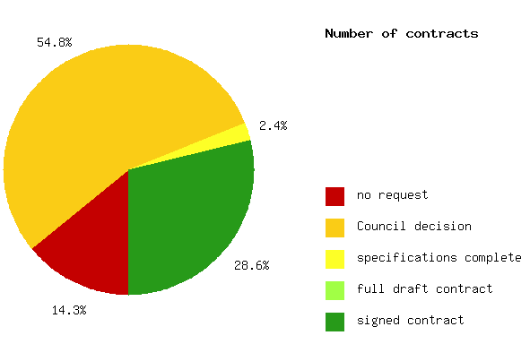
In-kind and Collaboration Contracts
42 contracts
New assignments at FAIR Council meetings
Specifications for several contracts in preparation
contract phase | number of contracts | in-kind value (kEUR)
signed | 12 | 9411.1
full draft contract | 0 | 0
specs completed | 1 | 343.5
Council decision | 23 | 7625.4
not yet requested | 6 | 3721.1
total | 42 | 21101.1

Slide 14
In-kind and Collaboration Contracts
Final acceptance completed for three contracts
CALIFA barrel crystals – Lund University (Sweden)
CALIFA forward endcap crystals – JINR Dubna (Russia)
GLAD magnet – CEA Saclay (France) and GSI (Germany)

Slide 15
Construction Common Fund items (final)
PSP-Code | Description | data from approved TDR | cost (2005) kEUR | comment
1.2.1.2.4 | Detectors and slit system for FLF6 | yes | 135.7
1.2.1.2.5 | Beam line to MATS-LaSpec hall | yes | 154.0
1.2.1.7 | Beam line to MATS RFQ | yes | 198.4
1.2.1.8 | Media supplies | no | 80.5 | TDR submitted
1.2.1.9 | Safety | no | 25.7 | TDR submitted
1.2.1.10 | IT infrastructure | no | 16.1 | TDR submitted
1.2.1.11 | Mechanics and alignment | no | 28.4 | TDR submitted
1.2.2.1.8 | Scintillators at FLF2 in vacuum | yes | 28.6
1.2.2.5 | Safety | yes | 59.2
1.2.5.1.1.3.3 | GLAD feedbox | yes | 135.7
1.2.5.1.1.3.4 | GLAD warm piping | yes | 6.8
1.2.5.1.1.3.5 | GLAD infrastructure | no | 193.3 | technical assistance contract
1.2.5.1.3.4 | Vacuum systems (4th share) | yes | 114.9
1.2.5.1.5.1 | Mechanics and alignment | yes | 112.0
1.2.6.4.4 | ToF detectors - infrastructure CR | yes | 63.8
1.2.6.6.4 | DAQ - common infrastructure | yes | 24.4
1.2.10.1.1.2 | DAQ infrastructure (share 2) | yes | 74.3
1.2.10.1.2.1.1 | Pendulum valves (share 1) | yes | 66.0
1.2.10.1.2.3 | 60L dewar | yes | 24.8
1.2.10.1.2.4 | LN2 piping | yes | 5.0
 |  | Total | 1547.6

Slide 16
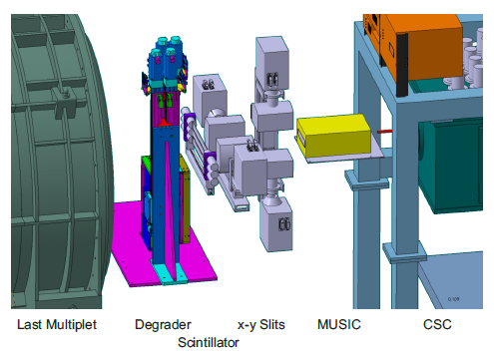
LEB – FLF6 infrastructure
PSP-Code | Description | data from approved TDR | cost (2005) kEUR
1.2.1.2.4 | Detectors and slit system for FLF6 | yes | 135.7
1.2.1.2.5 | Beam line to MATS-LaSpec hall | yes | 154.0
1.2.1.7 | Beam line to MATS RFQ | yes | 198.4

Slide 17
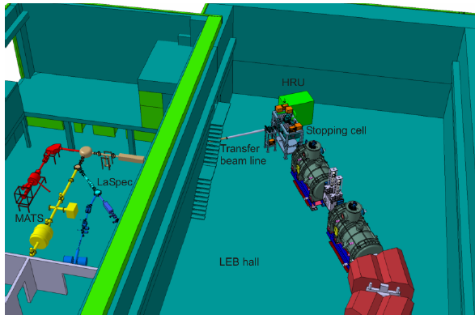
LEB – beam line to MATS RFQ
PSP-Code | Description | data from approved TDR | cost (2005) kEUR
1.2.1.2.4 | Detectors and slit system for FLF6 | yes | 135.7
1.2.1.2.5 | Beam line to MATS-LaSpec hall | yes | 154.0
1.2.1.7 | Beam line to MATS RFQ | yes | 198.4

Slide 18
LEB – common infrastructure
PSP-Code | Description | data from approved TDR | cost (2005) kEUR
1.2.1.8 | Media supplies | no | 80.5
1.2.1.9 | Safety | no | 25.7
1.2.1.10 | IT infrastructure | no | 16.1
1.2.1.11 | Mechanics and alignment | no | 28.4

Slide 19
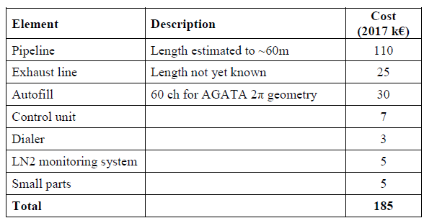
HISPEC/DESPEC – common infrastructure
PSP-Code | Description | data from approved TDR | cost (2005) kEUR
1.2.2.1.8 | Scintillators at FLF2 in vacuum | yes | 28.6
1.2.2.5 | Safety | yes | 59.2
8
main contribution to pipeline from GSI in-kind

Slide 20
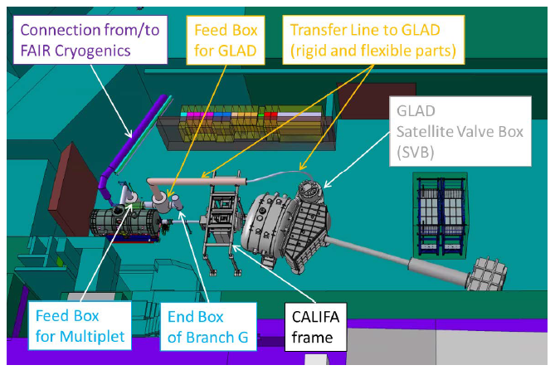
R³B – GLAD cryogenics
PSP-Code | Description | data from approved TDR | cost (2005) kEUR
1.2.5.1.1.3.3 | GLAD feedbox | yes | 135.7
1.2.5.1.1.3.4 | GLAD warm piping | yes | 6.8
1.2.5.1.1.3.5 | GLAD infrastructure | no | 193.3

Slide 21
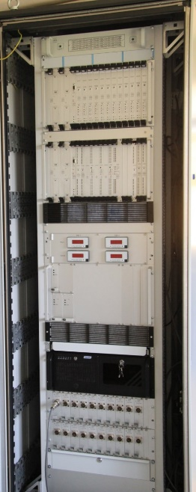
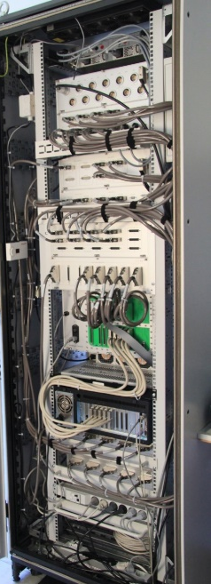
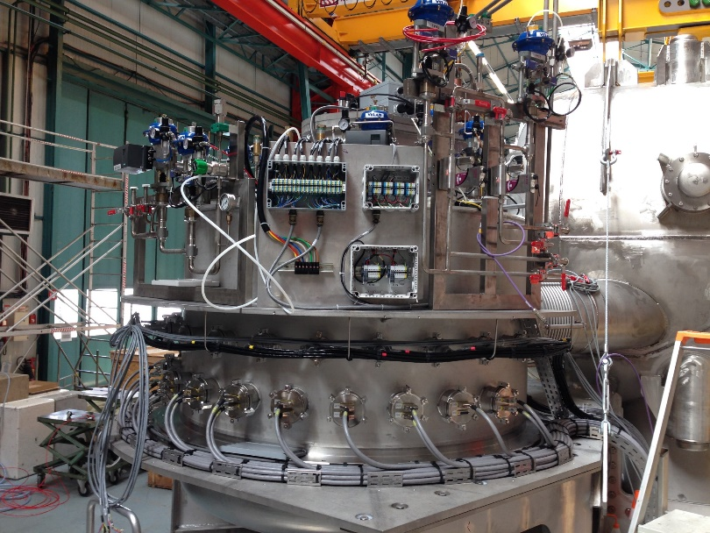
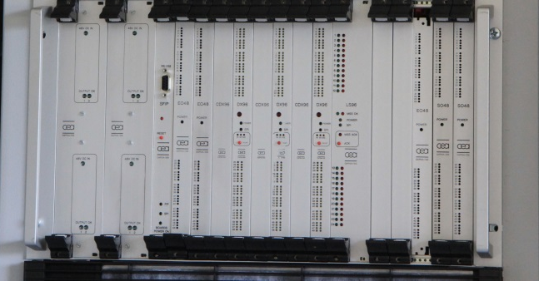
R³B – GLAD infrastructure
PSP-Code | Description | data from approved TDR | cost (2005) kEUR
1.2.5.1.1.3.3 | GLAD feedbox | yes | 135.7
1.2.5.1.1.3.4 | GLAD warm piping | yes | 6.8
1.2.5.1.1.3.5 | GLAD infrastructure | no | 193.3
MSS cabinet
(magnet safety system)
cabling
controls
initial infrastructure to be upgraded
(technical assistance contract)
GLAD satellite
front view
rear view

Slide 22
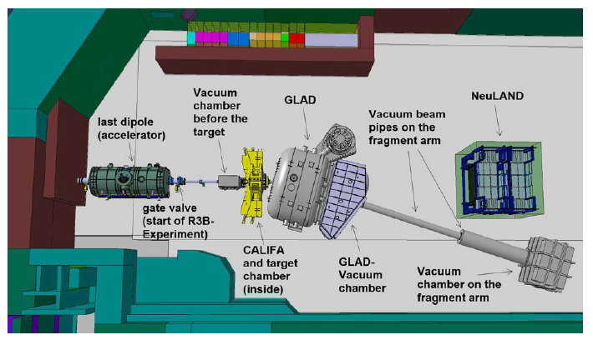
R³B – vacuum
PSP-Code | Description | data from approved TDR | cost (2005) kEUR
1.2.5.1.3.4 | Vacuum systems (4th share) | yes | 114.9
ToF chamber will be
co-financed with GSI
project funds

Slide 23
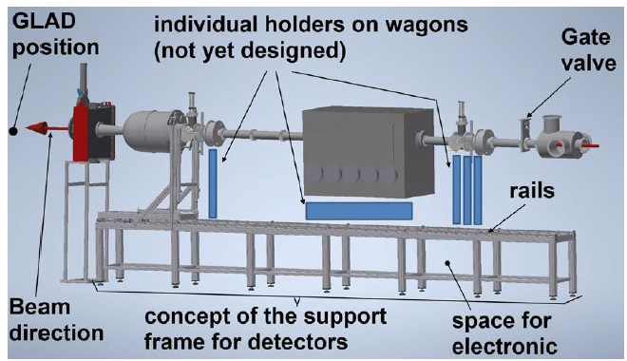
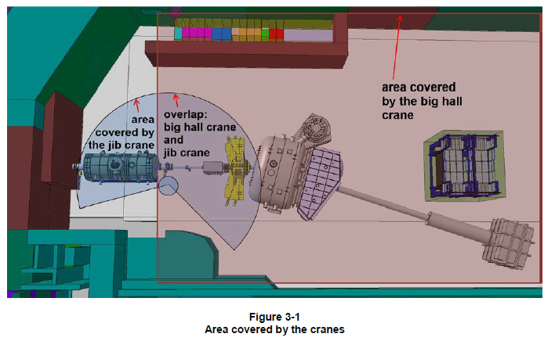
R³B – mechanical infrastructure
PSP-Code | Description | data from approved TDR | cost (2005) kEUR
1.2.5.1.5.1 | Mechanics and alignment | yes | 112.0

Slide 24
ILIMA – common infrastructure
PSP-Code | Description | data from approved TDR | cost (2005) kEUR
1.2.6.4.4 | ToF detectors - infrastructure CR | yes | 63.8
1.2.6.6.4 | DAQ - common infrastructure | yes | 24.4

Slide 25
Super-FRS EC – common infrastructure
PSP-Code | Description | data from approved TDR | cost (2005) kEUR
1.2.10.1.1.2 | DAQ infrastructure (share 2) | yes | 74.3
1.2.10.1.2.1.1 | Pendulum valves (share 1) | yes | 66.0
1.2.10.1.2.3 | 60L dewar | yes | 24.8
1.2.10.1.2.4 | LN2 piping | yes | 5.0

Slide 26
Expenditures per year (C-MoU V7.2.2022)
PSP-Code | Description | 2005 | 2022 | 2023 | 2024 | 2025 | 2026 | total
1.2.1.2.4 | Detectors and slit system for FLF6 | 135.7 |  |  |  | 233.6 |  | 233.6
1.2.1.2.5 | Beam line to MATS-LaSpec hall | 154.0 |  |  |  | 265.1 |  | 265.1
1.2.1.7 | Beam line to MATS RFQ | 198.4 |  |  |  |  | 350.5 | 350.5
1.2.1.8 | Media supplies | 80.5 |  |  | 135.0 |  |  | 135.0
1.2.1.9 | Safety | 25.7 |  | 42.0 |  |  |  | 42.0
1.2.1.10 | IT infrastructure | 16.1 |  |  | 27.0 |  |  | 27.0
1.2.1.11 | Mechanics and alignment | 28.4 |  |  | 47.6 |  |  | 47.6
1.2.2.1.8 | Scintillators at FLF2 in vacuum | 28.6 |  |  | 48.0 |  |  | 48.0
1.2.2.5 | Safety | 59.2 |  |  | 99.3 |  |  | 99.3
1.2.5.1.1.3.3 | GLAD feedbox | 135.7 |  | 221.8 |  |  |  | 221.8
1.2.5.1.1.3.4 | GLAD warm piping | 6.8 |  | 11.1 |  |  |  | 11.1
1.2.5.1.1.3.5 | GLAD infrastructure | 193.3 | 31.9 | 283.3 |  |  |  | 315.2
1.2.5.1.3.4 | Vacuum systems (4th share) | 114.9 |  |  | 192.7 |  |  | 192.7
1.2.5.1.5.1 | Mechanics and alignment | 112.0 |  |  | 187.9 |  |  | 187.9
1.2.6.4.4 | ToF detectors - infrastructure CR | 63.8 |  |  |  | 109.8 |  | 109.8
1.2.6.6.4 | DAQ - common infrastructure | 24.4 |  |  |  | 42.0 |  | 42.0
1.2.10.1.1.2 | DAQ infrastructure (share 2) | 74.3 |  |  | 124.6 |  |  | 124.6
1.2.10.1.2.1.1 | Pendulum valves (share 1) | 66.0 |  |  | 110.7 |  |  | 110.7
1.2.10.1.2.3 | 60L dewar | 24.8 |  |  | 41.6 |  |  | 41.6
1.2.10.1.2.4 | LN2 piping | 5.0 |  |  | 8.4 |  |  | 8.4
 |  | 1547.6 | 31.9 | 558.2 | 1022.8 | 650.5 | 350.5 | 2613.9

Slide 27
NUSTAR – status of Day-one configuration
Update of construction and test/commissioning status in progress
(values from September 2021 score card)

Slide 28
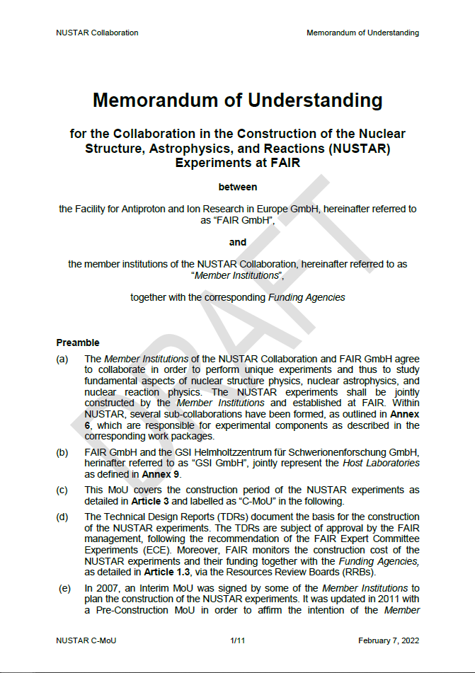
NUSTAR Construction MoU
NUSTAR Construction MoU
NUSTAR C-MoU adapted to the one from CBM
Version from December 17, 2021
endorsed by NUSTAR Council (Collaboration Board)
submitted to ECSG and comments received and changes implemented in new version
submitted to all Member Institutions to get first feedback – minor modifications to main text and annexes for new version
Version from February 7, 2022
submitted to FAIR-RRB

Slide 29
NUSTAR Construction MoU - structure
Main text
adapted from CBM C-MoU (markup provided)
Annexes
Annex 1: List of Member Institutions
For information only
Annex 2: List of Funding Agencies
For information only
Annex 3: Organisation rules of the NUSTAR Collaboration
Internal regulations - for information only
Annex 4a: Responsibilities of the Member Institutions for the work packages
List of main components and relation to work packages (PSP codes) and contributing Member Institutions - for information only
Annex 4b: Summary tables on construction cost and funding
Cost matrix and data from RRB11
Annex 5: Status of Technical Design Reports
Present TDR status - for information only

Slide 30
NUSTAR Construction MoU - structure
Annexes (continued)
Annex 6: NUSTAR sub-collaborations
Overview on all NUSTAR sub-collaborations and their internal organizational structure as well as involvement of Member Institutions in work packages - for information only
Annex 7: Construction schedule
Level 2 plan of NUSTAR (MS Project) – for information only
Annex 8: Procedures for the Construction Common Fund
Common Fund item list and cost – endorsed by NUSTAR Collaboration – RRB to take note
Procedure for Construction Common Fund – RRB to take note
Minor adjustments for cost-sharing (feedback concerning number of senior members per institute/country) – to be finalized end of April 2022
Annex 9: General conditions applicable to experiments performed at FAIR
Document approved by FAIR committees
Annex 10: The Day-one configuration of NUSTAR
Overview of Day-one work packages (as given in cost-matrix) and work packages of sub-sequent phases of the MSV – for information only

Slide 31
NUSTAR members
NUSTAR members
>700
(incl. students,
engineers)
R³B
EXL
23
ELISe
18
HISPEC/ DESPEC
Super-FRS
EC
246
MATS
ILIMA
233
53
223
LaSpec
SHE
63
79
42
status: February 18, 2022
Notes:
=RUNDEN(WURZEL(B5/PI());2)

Slide 32
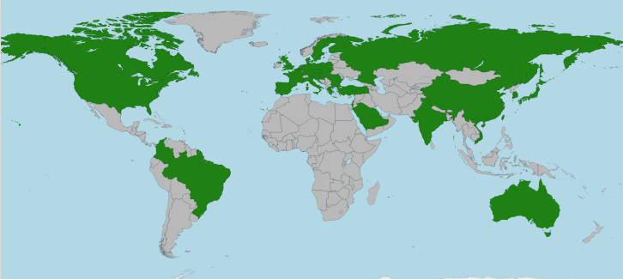
NUSTAR Collaboration senior members
For Construction
Common Fund:
HISPEC/DESPEC
MATS
LaSpec
R³B
ILIMA
Super-FRS EC
448 senior
members
(PhD holders)
status: February 7, 2022

Slide 33
Common Fund cost-sharing
Total expected cost (cash)
2613.9 kEUR
Present number of senior members
448 senior members (PhD holders)
Not taking into account „emeritus“ members and theoreticians with PhD
Contribution per senior member
One-time payment (sum as given in the C-MoU)
Possibility to pay in several rates
Possibility to provide components instead of cash
contribution per senior member: ~5.8 kEUR (C-MoU version Feb 7)

Slide 34
Latest updates on CF contributions (examples)
France
Additional senior members (compared to Feb 7 version)
Poland
Additional senior members for several institutes (compared to Feb 7 version)
Grant application for a contribution of 100 kEUR as Polish share of NUSTAR Construction Common Fund planned
Further minor adjustments during negotiation phase possible …
To be completed end of April 2022

Slide 35
Conclusion
NUSTAR funding
93.5% of Day-one-configuration funding secured
4.6% (infrastructure) expected via Construction Common Fund
NUSTAR Construction MoU
Construction Common Fund item list and procedure endorsed by NUSTAR Collaboration
Minor adjustments for cost-sharing (feedback concerning number of senior members per institute/country) – to be finalized end of April 2022
RRB asked to start review process for main text and annexes
Feedback expected until end of April 2022 in order to prepare a final version to be submitted in May 2022 for a final check

Slide 36
Additional material

Slide 37
NUSTAR MSV: Funding distribution (by country)
 | LEB infra- structure | HISPEC/ DESPEC | MATS | LaSpec | R³B | ILIMA | Super-FRS EC | total | secured | EoI
Australia |  | 50.0 |  |  |  |  |  | 50.0 |  | 50.0
Belgium |  |  |  | 153.8 |  |  |  | 153.8 | 82.6 | 71.2
Bulgaria |  | 16.3 |  |  |  |  |  | 16.3 | 16.3
Canada |  |  |  |  |  | 80.0 | 120.4 | 200.4 | 80.0 | 120.4
Common Fund | 638.8 | 87.8 |  |  | 562.7 | 88.2 | 170.1 | 1547.6 |  | 1547.6
Czech Republic |  |  |  |  |  |  | 305.5 | 305.5 | 160.0 | 145.5
Finland |  | 387.9 | 215.2 | 106.4 |  |  | 36.3 | 745.8 | 745.8
France |  | 220.0 |  |  | 2935.0 |  |  | 3155.0 | 2935.0 | 220.0
Germany | 1168.3 | 1699.3 | 1675.9 | 146.2 | 8077.2 | 740.0 | 11.8 | 13518.7 | 12935.6 | 583.1
Hungary |  |  |  |  | 12.1 |  |  | 12.1 | 12.1
India |  | 2514.0 | 40.0 |  |  |  |  | 2554.0 | 2052.9 | 501.1
Israel | 58.5 |  |  |  |  |  | 13.6 | 72.1 | 58.5 | 13.6
Japan |  |  |  |  |  | 193.2 | 196.8 | 390.0 | 196.8 | 193.2
Netherlands |  |  |  |  | 104.0 |  |  | 104.0 | 104.0
Poland |  | 500.0 |  |  |  |  |  | 500.0 | 500.0
Romania |  | 1822.5 |  |  |  |  |  | 1822.5 | 1822.5
Russia |  |  |  |  | 2994.3 |  | 1156.0 | 4150.3 | 1577.2 | 2573.1
Slovenia |  | 21.4 |  |  | 75.0 |  |  | 96.4 | 96.4
Spain |  | 2332.2 | 317.1 |  | 1195.2 |  |  | 3844.5 | 2139.2 | 1705.3
Sweden |  | 1027.9 |  |  | 1800.0 |  |  | 2827.9 | 2817.9 | 10.0
Turkey |  | 88.5 |  |  |  |  |  | 88.5 |  | 88.5
United Kingdom |  | 2813.1 |  | 87.1 | 2213.4 |  |  | 5113.6 | 4555.1 | 558.5
to be assigned | 1189.6 | 600.8 | 684.5 | 133.8 | 1805.9 | 690.2 | 214.8 | 5319.6
total | 3055.2 | 14181.7 | 2932.7 | 627.3 | 21774.8 | 1791.6 | 2225.3 | 46588.6 | 32887.9 | 8381.1

Slide 38
NUSTAR MSV: Funding distribution (by country)
 | total | secured FAIR | secured external | EoI
Australia | 50.0 |  |  | 50.0
Belgium | 153.8 |  | 82.6 | 71.2
Bulgaria | 16.3 |  | 16.3
Canada | 200.4 |  | 80.0 | 120.4
Common Fund | 1547.6 |  |  | 1547.6
Czech Republic | 305.5 |  | 160.0 | 145.5
Finland | 745.8 | 709.5 | 36.3
France | 3155.0 | 2530.0 | 405.0 | 220.0
Germany | 13518.7 | 6020.0 | 6915.6 | 583.1
Hungary | 12.1 |  | 12.1
India | 2554.0 | 2010.0 | 42.9 | 501.1
Israel | 72.1 |  | 58.5 | 13.6
Japan | 390.0 |  | 196.8 | 193.2
Netherlands | 104.0 |  | 104.0
Poland | 500.0 | 500.0
Romania | 1822.5 | 1822.5
Russia | 4150.3 | 1379.0 | 198.2 | 2573.1
Slovenia | 96.4 |  | 96.4
Spain | 3844.5 |  | 2139.2 | 1705.3
Sweden | 2827.9 | 1575.0 | 1242.9 | 10.0
Turkey | 88.5 |  |  | 88.5
United Kingdom | 5113.6 | 4555.1 |  | 558.5
to be assigned | 5319.6
total | 46588.6 | 21101.1 | 11786.8 | 8381.1

Slide 39
Day-one: EoIs and to-be-assigned
Sub-system | PSP code | Description | Cost (kEUR) | Institute | Country | Status
LEB infrastructure | 1.2.1.2.7 | RF carpets and electrode system (3rd share) | 89.6 |  |  | tba
HISPEC/DESPEC | 1.2.2.1.1 | Beam tracking and identification detectors (1st share) | 33.2 | IUAC Delhi | India | EoI
HISPEC/DESPEC | 1.2.2.2.3 | HISPEC/DESPEC Beamline (3rd share) | 10.0 | Lund Univ. | Sweden | EoI
HISPEC/DESPEC | 1.2.2.3.3 | Mechanics (rails, support, etc) + installation (3rd share) | 71.4 | STFC Daresbury | United Kingdom | EoI
HISPEC/DESPEC | 1.2.2.3.4 | Mechanics (rails, support, etc) + installation (4th share) | 39.3 | TIFR Mumbai | India | EoI
MATS | 1.2.3.9.1 | Control system (1st share) | 40.0 | HIM | Germany | EoI
R3B | 1.2.5.1.2.3.2.8 | CALIFA forward endcap (8th share) | 114.4 | Univ. Vigo | Spain | EoI
R3B | 1.2.5.1.4.3 | DAQ electronics (3rd share) | 56.9 |  |  | tba
ILIMA | 1.2.6.4.3 | Time-of-flight detectors (3rd share) | 10.8 | Univ. Saitama | Japan | EoI
ILIMA | 1.2.6.6.1.2 | Data acquisition systems - Schottky (2nd share) | 146.4 | Univ. Saitama | Japan | EoI
ILIMA | 1.2.6.6.2 | Data acquisition systems - ToF detector | 36.0 | Univ. Saitama | Japan | EoI
EoI | 501.5 kEUR
tba | 146.5 kEUR

Slide 40
Day-one: EoIs and to-be-assigned
Sub-system | PSP code | Description | Cost (kEUR) | Institute | Country | Status
LEB infrastructure | 1.2.1.2.7 | RF carpets and electrode system (3rd share) | 89.6 |  |  | tba
HISPEC/DESPEC | 1.2.2.1.1 | Beam tracking and identification detectors (1st share) | 33.2 | IUAC Delhi | India | EoI
HISPEC/DESPEC | 1.2.2.2.3 | HISPEC/DESPEC Beamline (3rd share) | 10.0 | Lund Univ. | Sweden | EoI
HISPEC/DESPEC | 1.2.2.3.3 | Mechanics (rails, support, etc) + installation (3rd share) | 71.4 | STFC Daresbury | United Kingdom | EoI
HISPEC/DESPEC | 1.2.2.3.4 | Mechanics (rails, support, etc) + installation (4th share) | 39.3 | TIFR Mumbai | India | EoI
MATS | 1.2.3.9.1 | Control system (1st share) | 40.0 | HIM | Germany | EoI
R3B | 1.2.5.1.2.3.2.8 | CALIFA forward endcap (8th share) | 114.4 | Univ. Vigo | Spain | EoI
R3B | 1.2.5.1.4.3 | DAQ electronics (3rd share) | 56.9 |  |  | tba
ILIMA | 1.2.6.4.3 | Time-of-flight detectors (3rd share) | 10.8 | Univ. Saitama | Japan | EoI
ILIMA | 1.2.6.6.1.2 | Data acquisition systems - Schottky (2nd share) | 146.4 | Univ. Saitama | Japan | EoI
ILIMA | 1.2.6.6.2 | Data acquisition systems - ToF detector | 36.0 | Univ. Saitama | Japan | EoI
JLU Gießen: to be requested from BMBF-VF (funding period 2024-2027)

Slide 41
Day-one: EoIs and to-be-assigned
Sub-system | PSP code | Description | Cost (kEUR) | Institute | Country | Status
LEB infrastructure | 1.2.1.2.7 | RF carpets and electrode system (3rd share) | 89.6 |  |  | tba
HISPEC/DESPEC | 1.2.2.1.1 | Beam tracking and identification detectors (1st share) | 33.2 | IUAC Delhi | India | EoI
HISPEC/DESPEC | 1.2.2.2.3 | HISPEC/DESPEC Beamline (3rd share) | 10.0 | Lund Univ. | Sweden | EoI
HISPEC/DESPEC | 1.2.2.3.3 | Mechanics (rails, support, etc) + installation (3rd share) | 71.4 | STFC Daresbury | United Kingdom | EoI
HISPEC/DESPEC | 1.2.2.3.4 | Mechanics (rails, support, etc) + installation (4th share) | 39.3 | TIFR Mumbai | India | EoI
MATS | 1.2.3.9.1 | Control system (1st share) | 40.0 | HIM | Germany | EoI
R3B | 1.2.5.1.2.3.2.8 | CALIFA forward endcap (8th share) | 114.4 | Univ. Vigo | Spain | EoI
R3B | 1.2.5.1.4.3 | DAQ electronics (3rd share) | 56.9 |  |  | tba
ILIMA | 1.2.6.4.3 | Time-of-flight detectors (3rd share) | 10.8 | Univ. Saitama | Japan | EoI
ILIMA | 1.2.6.6.1.2 | Data acquisition systems - Schottky (2nd share) | 146.4 | Univ. Saitama | Japan | EoI
ILIMA | 1.2.6.6.2 | Data acquisition systems - ToF detector | 36.0 | Univ. Saitama | Japan | EoI
STFC Daresbury: to be requested in 2024
Lund Univ.: clarification in progress
IUAC Delhi: clarification in progress
TIFR Mumbai: clarification in progress

Slide 42
Day-one: EoIs and to-be-assigned
Sub-system | PSP code | Description | Cost (kEUR) | Institute | Country | Status
LEB infrastructure | 1.2.1.2.7 | RF carpets and electrode system (3rd share) | 89.6 |  |  | tba
HISPEC/DESPEC | 1.2.2.1.1 | Beam tracking and identification detectors (1st share) | 33.2 | IUAC Delhi | India | EoI
HISPEC/DESPEC | 1.2.2.2.3 | HISPEC/DESPEC Beamline (3rd share) | 10.0 | Lund Univ. | Sweden | EoI
HISPEC/DESPEC | 1.2.2.3.3 | Mechanics (rails, support, etc) + installation (3rd share) | 71.4 | STFC Daresbury | United Kingdom | EoI
HISPEC/DESPEC | 1.2.2.3.4 | Mechanics (rails, support, etc) + installation (4th share) | 39.3 | TIFR Mumbai | India | EoI
MATS | 1.2.3.9.1 | Control system (1st share) | 40.0 | HIM | Germany | EoI
R3B | 1.2.5.1.2.3.2.8 | CALIFA forward endcap (8th share) | 114.4 | Univ. Vigo | Spain | EoI
R3B | 1.2.5.1.4.3 | DAQ electronics (3rd share) | 56.9 |  |  | tba
ILIMA | 1.2.6.4.3 | Time-of-flight detectors (3rd share) | 10.8 | Univ. Saitama | Japan | EoI
ILIMA | 1.2.6.6.1.2 | Data acquisition systems - Schottky (2nd share) | 146.4 | Univ. Saitama | Japan | EoI
ILIMA | 1.2.6.6.2 | Data acquisition systems - ToF detector | 36.0 | Univ. Saitama | Japan | EoI
To be funded via HIM budget

Slide 43
Day-one: EoIs and to-be-assigned
Sub-system | PSP code | Description | Cost (kEUR) | Institute | Country | Status
LEB infrastructure | 1.2.1.2.7 | RF carpets and electrode system (3rd share) | 89.6 |  |  | tba
HISPEC/DESPEC | 1.2.2.1.1 | Beam tracking and identification detectors (1st share) | 33.2 | IUAC Delhi | India | EoI
HISPEC/DESPEC | 1.2.2.2.3 | HISPEC/DESPEC Beamline (3rd share) | 10.0 | Lund Univ. | Sweden | EoI
HISPEC/DESPEC | 1.2.2.3.3 | Mechanics (rails, support, etc) + installation (3rd share) | 71.4 | STFC Daresbury | United Kingdom | EoI
HISPEC/DESPEC | 1.2.2.3.4 | Mechanics (rails, support, etc) + installation (4th share) | 39.3 | TIFR Mumbai | India | EoI
MATS | 1.2.3.9.1 | Control system (1st share) | 40.0 | HIM | Germany | EoI
R3B | 1.2.5.1.2.3.2.8 | CALIFA forward endcap (8th share) | 114.4 | Univ. Vigo | Spain | EoI
R3B | 1.2.5.1.4.3 | DAQ electronics (3rd share) | 56.9 |  |  | tba
ILIMA | 1.2.6.4.3 | Time-of-flight detectors (3rd share) | 10.8 | Univ. Saitama | Japan | EoI
ILIMA | 1.2.6.6.1.2 | Data acquisition systems - Schottky (2nd share) | 146.4 | Univ. Saitama | Japan | EoI
ILIMA | 1.2.6.6.2 | Data acquisition systems - ToF detector | 36.0 | Univ. Saitama | Japan | EoI
Univ. Vigo: waiting for clarification
DAQ: review DAQ WP in progress

Slide 44
Day-one: EoIs and to-be-assigned
Sub-system | PSP code | Description | Cost (kEUR) | Institute | Country | Status
LEB infrastructure | 1.2.1.2.7 | RF carpets and electrode system (3rd share) | 89.6 |  |  | tba
HISPEC/DESPEC | 1.2.2.1.1 | Beam tracking and identification detectors (1st share) | 33.2 | IUAC Delhi | India | EoI
HISPEC/DESPEC | 1.2.2.2.3 | HISPEC/DESPEC Beamline (3rd share) | 10.0 | Lund Univ. | Sweden | EoI
HISPEC/DESPEC | 1.2.2.3.3 | Mechanics (rails, support, etc) + installation (3rd share) | 71.4 | STFC Daresbury | United Kingdom | EoI
HISPEC/DESPEC | 1.2.2.3.4 | Mechanics (rails, support, etc) + installation (4th share) | 39.3 | TIFR Mumbai | India | EoI
MATS | 1.2.3.9.1 | Control system (1st share) | 40.0 | HIM | Germany | EoI
R3B | 1.2.5.1.2.3.2.8 | CALIFA forward endcap (8th share) | 114.4 | Univ. Vigo | Spain | EoI
R3B | 1.2.5.1.4.3 | DAQ electronics (3rd share) | 56.9 |  |  | tba
ILIMA | 1.2.6.4.3 | Time-of-flight detectors (3rd share) | 10.8 | Univ. Saitama | Japan | EoI
ILIMA | 1.2.6.6.1.2 | Data acquisition systems - Schottky (2nd share) | 146.4 | Univ. Saitama | Japan | EoI
ILIMA | 1.2.6.6.2 | Data acquisition systems - ToF detector | 36.0 | Univ. Saitama | Japan | EoI
Grant request from Univ. Saitama planned

